Slide 1
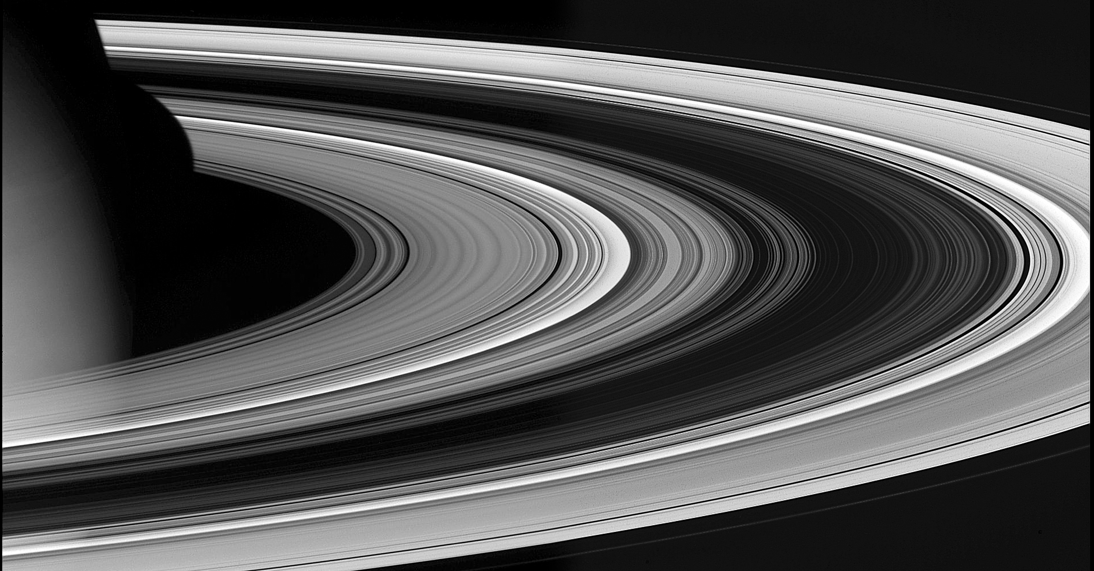
What has Cassini taught us about Saturn’s Rings?
A whirlwind tour
Context; the fluid rings
Moonlets and structure
Composition and pollution
Origin and age
Second half: more detail and unsolved problems – join me at my poster

Slide 2
The Dark Side
G, E
D
C
B
CD
A
F

Slide 3
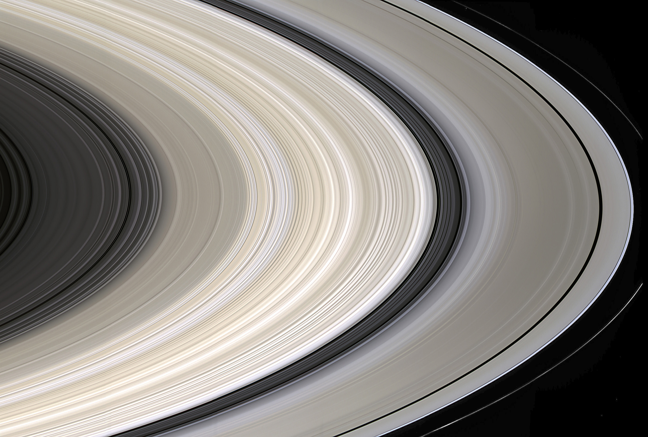
C
B
C D
A
F
Notes:
NOTE IRREGULAR STRUCTURE, FAINT HUES. NOTE C RING REGULAR PLATEAUS
NOTE CASSINI DIVISION BANDS. NOTE COLOR OF TRANS-KEELER REGION.

Slide 4
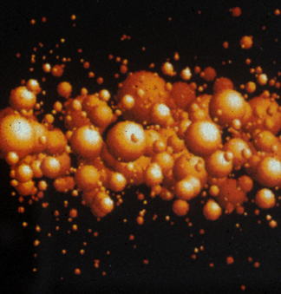
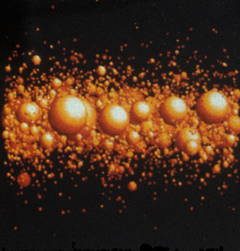
Few particles thick
30m
H. Salo
Current ring model
Self Gravity “wakes”
15km/s
Gentle collisions & weak gravity between particles
give the rings the quality of a viscous fluid
(pressure, viscosity, etc) but gravity is also important
Notes:
CLOSEUP OLD CONCEPT; RELATIVE VELOCITIES AND COLLISIONS
NOW THINK THEY ARE EVEN FLATTER AND DENSER; COMPLICATES OUR MODELING

Slide 5
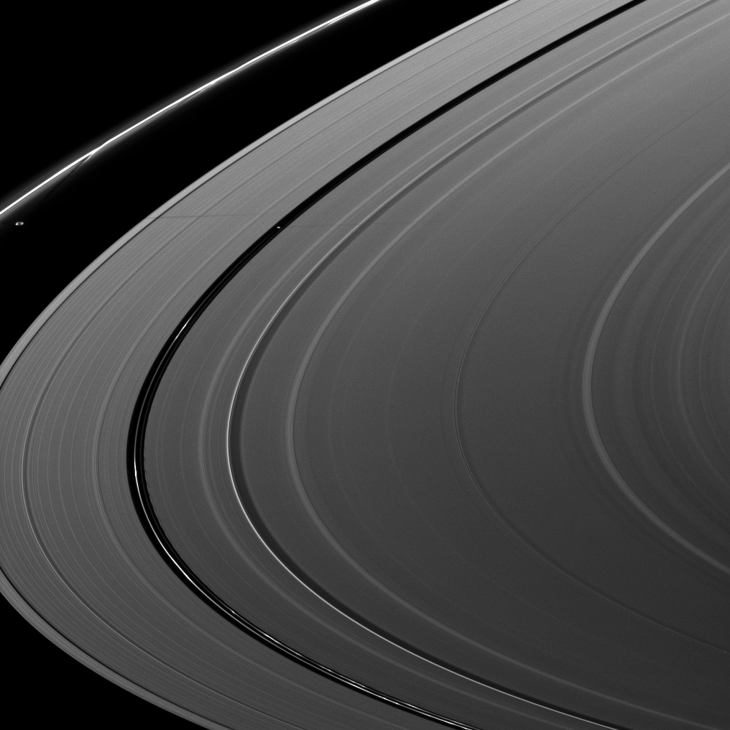
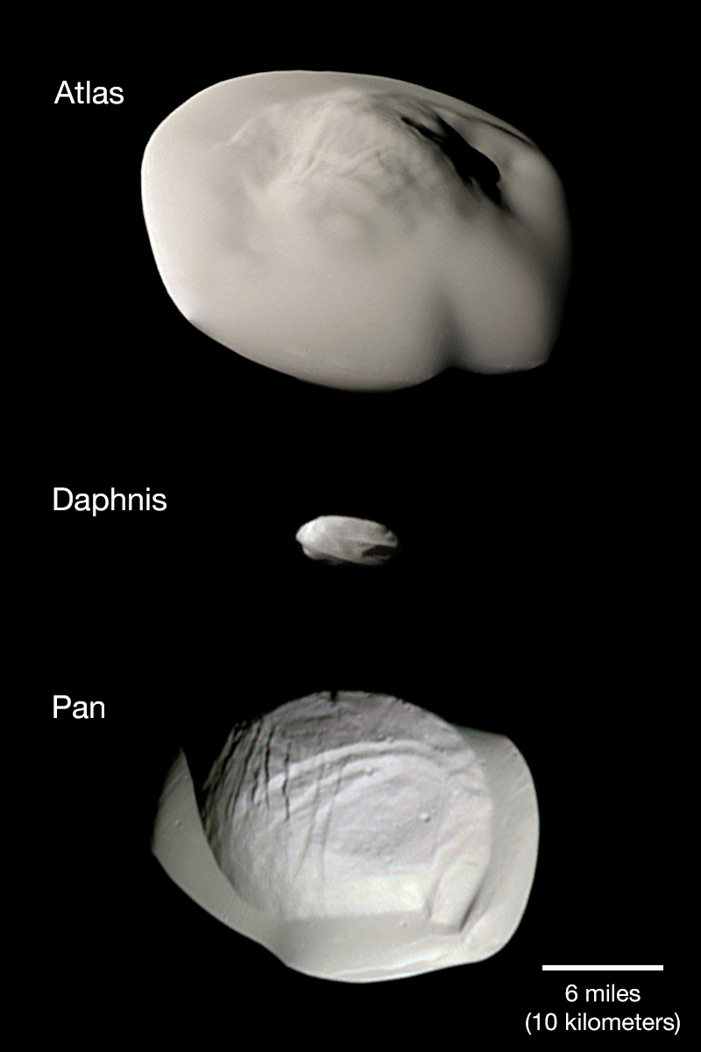
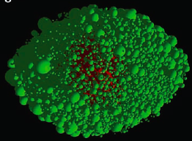
Atlas
Rubble Piles
Porco+ 2005
Pan
(Encke)
10km
Notes:
F ring and prometheus I will discuss in a minute

Slide 6
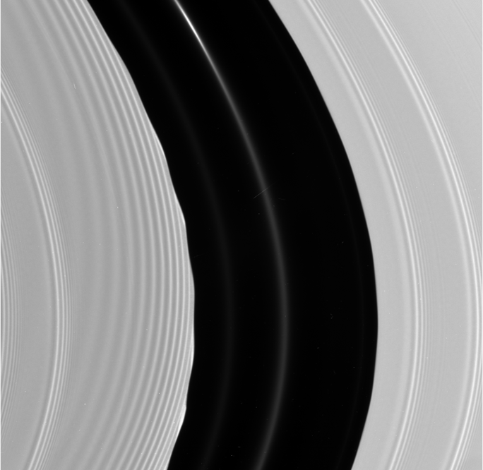
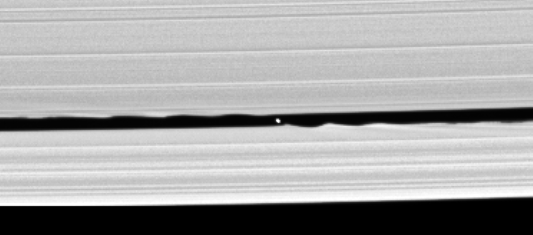
Moonlets within the rings: protoplanetary disk analogs
But! Expected moonlets NOT found in Cassini Division and C Ring gaps!
Pan (r=15km) in Encke gap,
Daphnis (r=3.5km) in Keeler gap;
300 km wide
30 km wide
360º of inner edge structure - complex!
Simulation: Lewis and Stewart
Notes:
PAN itself (20 km across) in 320km encke gap. . Cuzzi, Scargle, Showalter, others..
Wavy edge on left like ripple in a stream, Pan upstream off to the top.
Cassini discovered Keeler gap in outer A. Same effect! Smaller moon (few km across)
Grav pert’s cause waves = eccentric orbits stimulated in material that has just passed the moon,
like the ripple in the stream. This effect also lead to repulsion of ring material by the moon (gap clearing).
Movie file is called Lewis_unclipped.gif

Slide 7
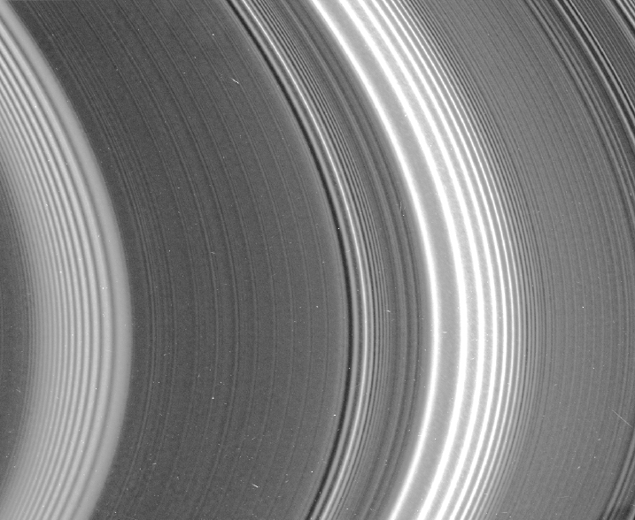
Spiral density & bending waves
(images and occultations)
transfer orbital momentum
between rings and moons
(Goldreich & Tremaine, Shu et al)
.. and let us measure:
moon masses (rubble piles),
and
ring surface mass density
(mostly for the A and C Rings)
.. But ..
B ring mass
not well constrained this way;
recently found by RSS gravity
Notes:
Density & Bending waves tell us several VERY important things!
TORQUE!
Small moons moving away - first short lifetime constraint

Slide 8
Spiral density & bending waves
(images and occultations)
transfer orbital momentum
between rings and moons
(Goldreich & Tremaine, Shu et al)
.. and let us measure:
moon masses (rubble piles),
and
ring surface mass density
(mostly for the A and C Rings)
.. But ..
B ring mass
not well constrained this way;
recently found by RSS gravity
Modes in the planet can drive spiral density
and bending waves
(Marley & Porco 93)
(Hedman, Mankovich T.M.)
Notes:
Density & Bending waves tell us several VERY important things!
TORQUE!
Small moons moving away - first short lifetime constraint

Slide 9
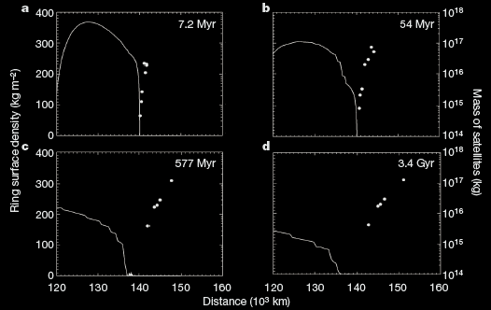
Close-in ringmoons:
Born in the rings or shards of the ring parent?
(1st young ring argument)
Murray et al 2014
“Peggy”
Charnoz et al 2010
Notes:
DW torque spin the ringmoos out and drive the A ring in
Note 577Myr already too far AND the moons are too small. That is, the real situation has created LARGER moons than their 577Myr simulation, but they have not MIGRATED as far. Does this support a younger ring with more mass in its outer periphery? Surely there is SOMETHING to this model but my guess is, it’s not quantitatively correct.
Peggy - A birth experience - emerging from the coccoon of the ring, into the emptiness of life beyond.

Slide 10
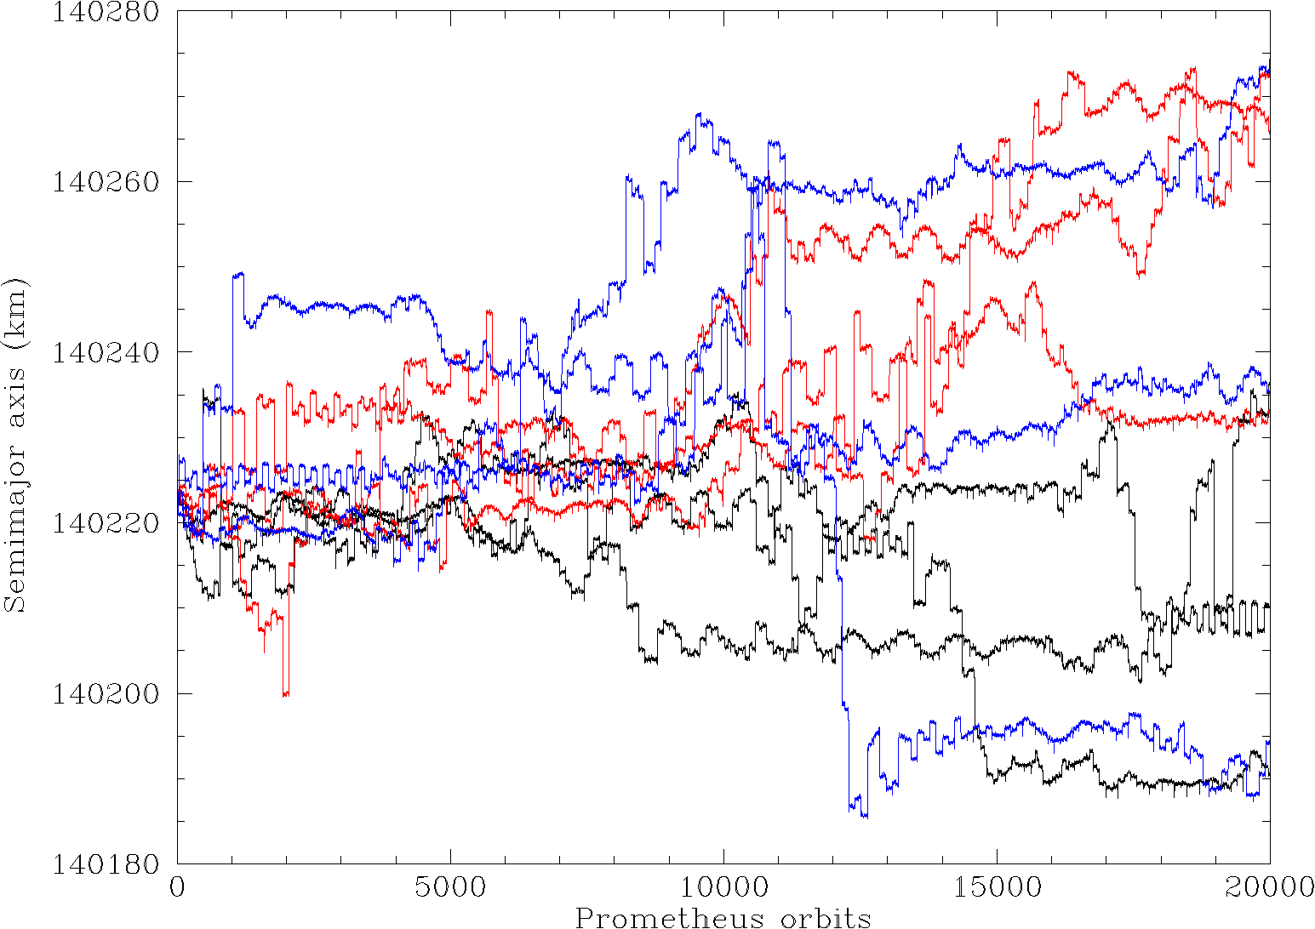
Prometheus and the F ring (Murray, T.M.)
Collision with a rampaging moonlet
on a chaotic orbit
F Ring true core (RSS) remains stable
in this sea of chaos –
unique resonance combination –
it’s in the only place it could be
Cuzzi et al 2014 and in review
N. Cooper and C. Murray
Local orbits are chaotic due to Prometheus;
Moonlets are discovered and lost again,
In months
80km
(35 yr)
Notes:
Cooper movie. F Ring ITSELF is not moving in and out. ALL the local particles are just executing their epicycles, just like Prometheus is. It is AT a geometry when the apses are anti-aligned, giving close intrusions.
SLIDE 46 (SKIP SLIDE 45))
F ring first glimpsed by Pioneer 11
Voayer - strands and straddling mmoons - dubbed “shepherding satt’s” because .. Yadda yadda
However since then we have realized (a) moons are massive & eccentric enough that orbits
Between them are “chaotic” - prone to sudden glitches in ecc, period, etc.. Thus not stable - things
In that region more likely to be banging into each other than nicely “confined”. Furthermore HST
Results - P & P - chaotic.. What we have is a dynamically rich, everchanging system. Cass results -
L and R lower panels - P&P. Elongate, porous (low density). Rubble piles..
Details of ring structure - Some, but not all, beginning to be understood. “folds” or warps -
Due to Prometheus - actually enters the region of faint material. Many of the larger kinks in the bright f ring core also caused this way. BUT as seen in top center panel, VERY fine scale str also seen, prob need small, unseen objects even closer to ring. ISS has seen several of these, some have been lost!! Transient clumps? Possibly! Even the numerous outrigger strands are new since voyager; cover a wider region.
Movie file is called cooper_fmovie1_153276_30dec16 copy

Slide 11
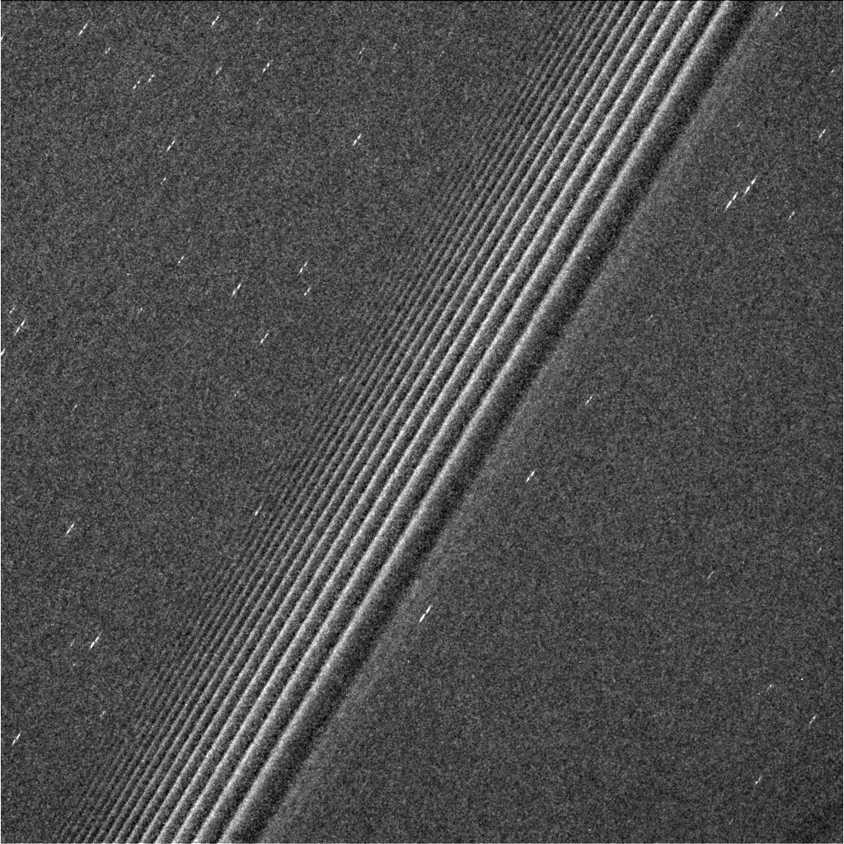
“Propellers”- 100m-R chunks
Leftover shards from formation?
Locally grown?
Esposito, T.M.
Spahn & Sremcevic 2000;
Tiscareno et al 2006, 07, 10, 18
Notes:
Unpublished picture. Prometheus 9:8 DW is shown. Detailed stdies show that props are not seen within DW’s. maybe disrupted, maybe clearing is frustrated.
Tisc 2008 shows wider regions of avoidance associated with stronger DWs (Janus 5:4) or combinations.

Slide 12
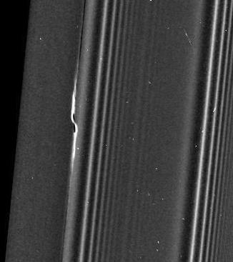
“Propellers”- 100m-R chunks
Leftover shards from formation?
Locally grown?
km-R
“giant propellers”
meandering in
semimajor axis
+/- 1km
Esposito, T.M.
Tiscareno 2010, Pan & Chiang 2010,
Crida et al 2010, Rein & Papaloizou 2010
H. Rein, pers. comm
(Hoffmann, Seiler T.M.)
Notes:
Image N1871322544, showing propellers in the Propeller Belts of the mid-A ring on the unlit side of the rings at 0.39 km/px
Belt image is 385m/pxl. Say 385km arcross. A portion of image N1868838859, showing the propeller Earhart on the lit side of the rings at 0.67 km/px

Slide 13
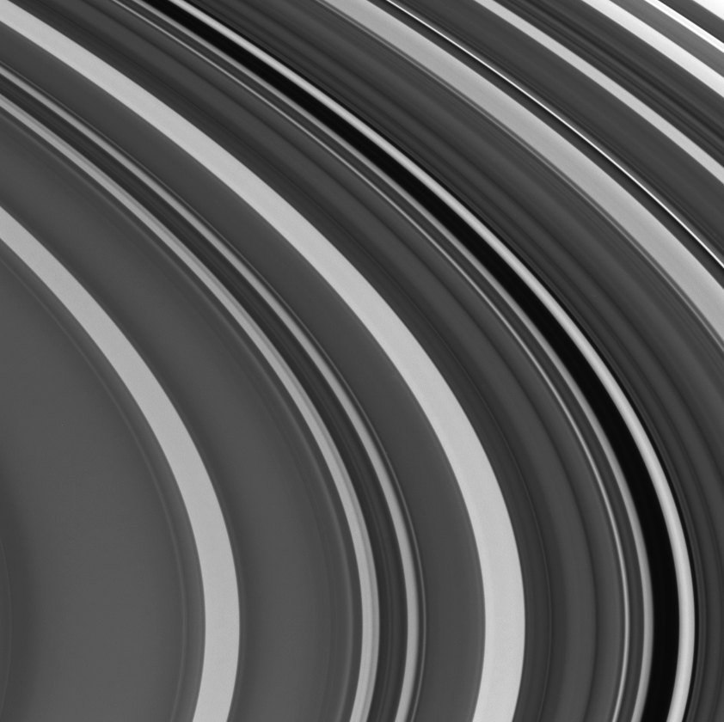
C Ring “plateaus”:
Sharp boundaries defined by particle size differences
Seemingly regular pattern centered on Saturn 2:1
Jerousek, Colwell,
Becker, Green T.M.
Tiscareno, Aye T.M.
200km
Krono-Seismology:
2:1 resonance;
This and others constrain
Saturn’s internal structure;
A diffuse core boundary?
Hedman & Nicholson 2013, 2014,
Fuller 2014, French et al 2016)
But sadly,
do not explain
the plateaus!
Hedman, T.M.
Mankovich, T.M.

Slide 14
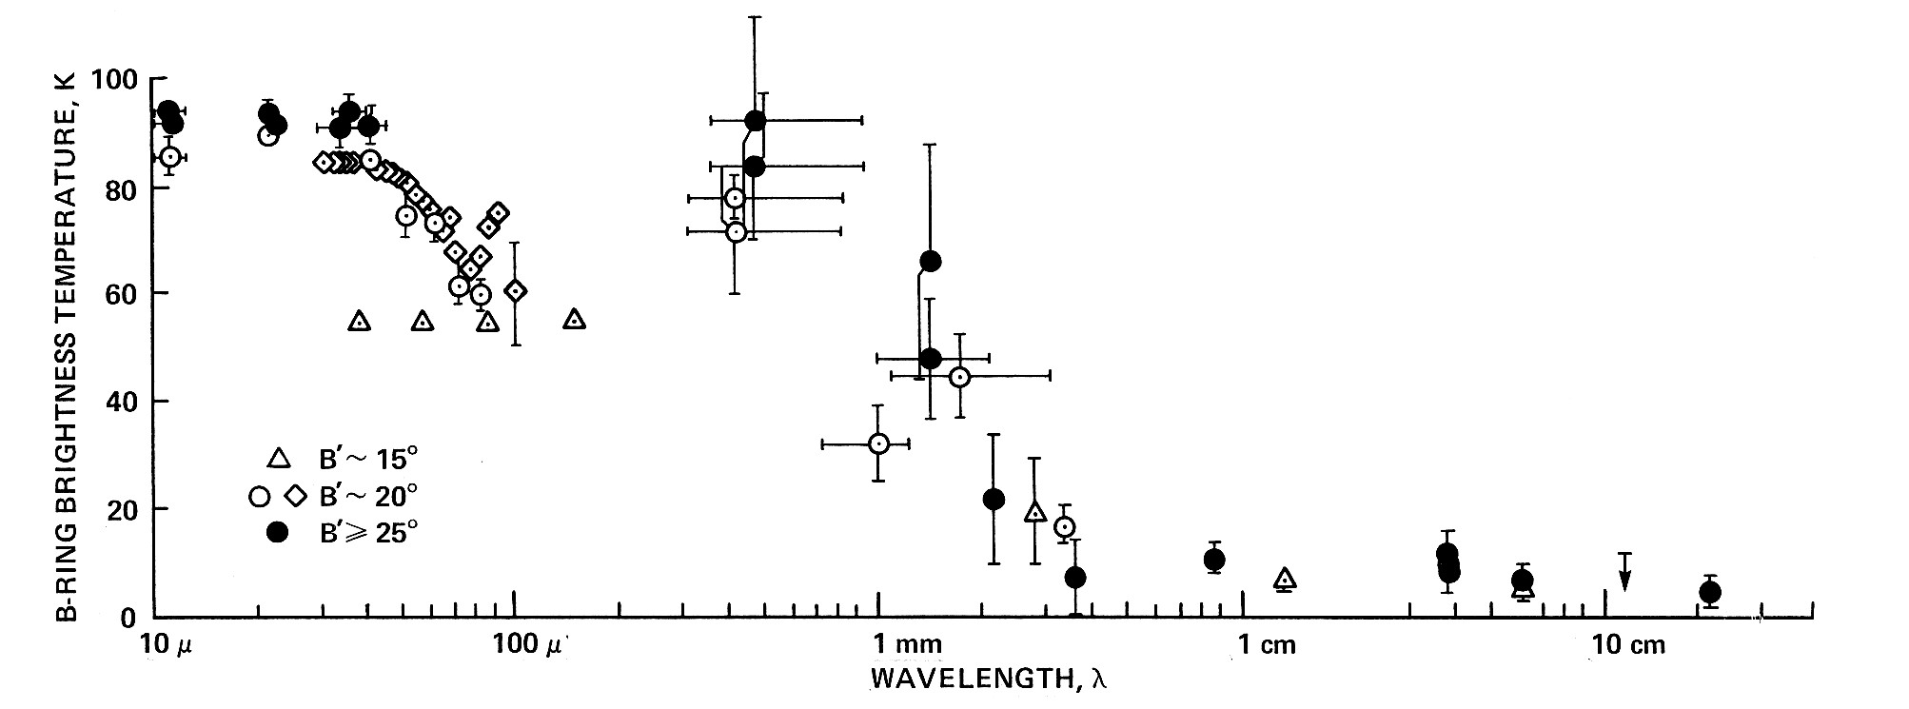
Ring particles cm’s-m’s in size; A,B rings >95% water ice
Cassini CIRS
Spilker et 2005
Van der Tak et al 1999
Deau, Pilorz, Brooks T.M.
Vahidinia, T.M.
λ 3.6cm
Adapted from:
Esposito et al 1984
Cassini 2.2cm radiometry: Zhang et al 2016,17
< 1% nonicy material in A,B
B
B
B
10μ
100μ
1mm
1cm
A
A
A
10cm
Wavelength
Vast improvements from Cassini RSS (E. Marouf; TM) ; also UVIS (Colwell, Jerousek)
See also Cuzzi et al 2009

Slide 15
C Ring may contain a buried silicate rubble belt; core of ring parent or ?
8
Regolith % nonicy material (Zhang +2017)
6
4
2
τ
Surface mass density
UVIS variance max Radius
(Colwell et al 2018 & T.M.)
(Hedman &
Nicholson
2014)
75
80
85
90
RSS differential τ
10x change in surface mass density,
with small changes in R or τ, imply
large change in internal density of particles

Slide 16
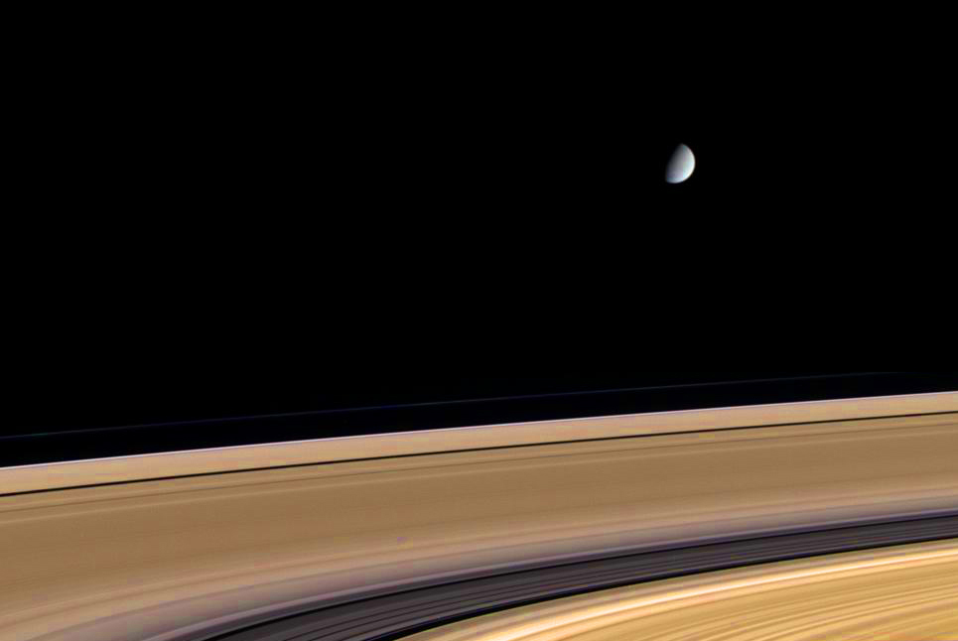
Main rings are not pure water ice !
Color enhanced
A
B

Slide 17
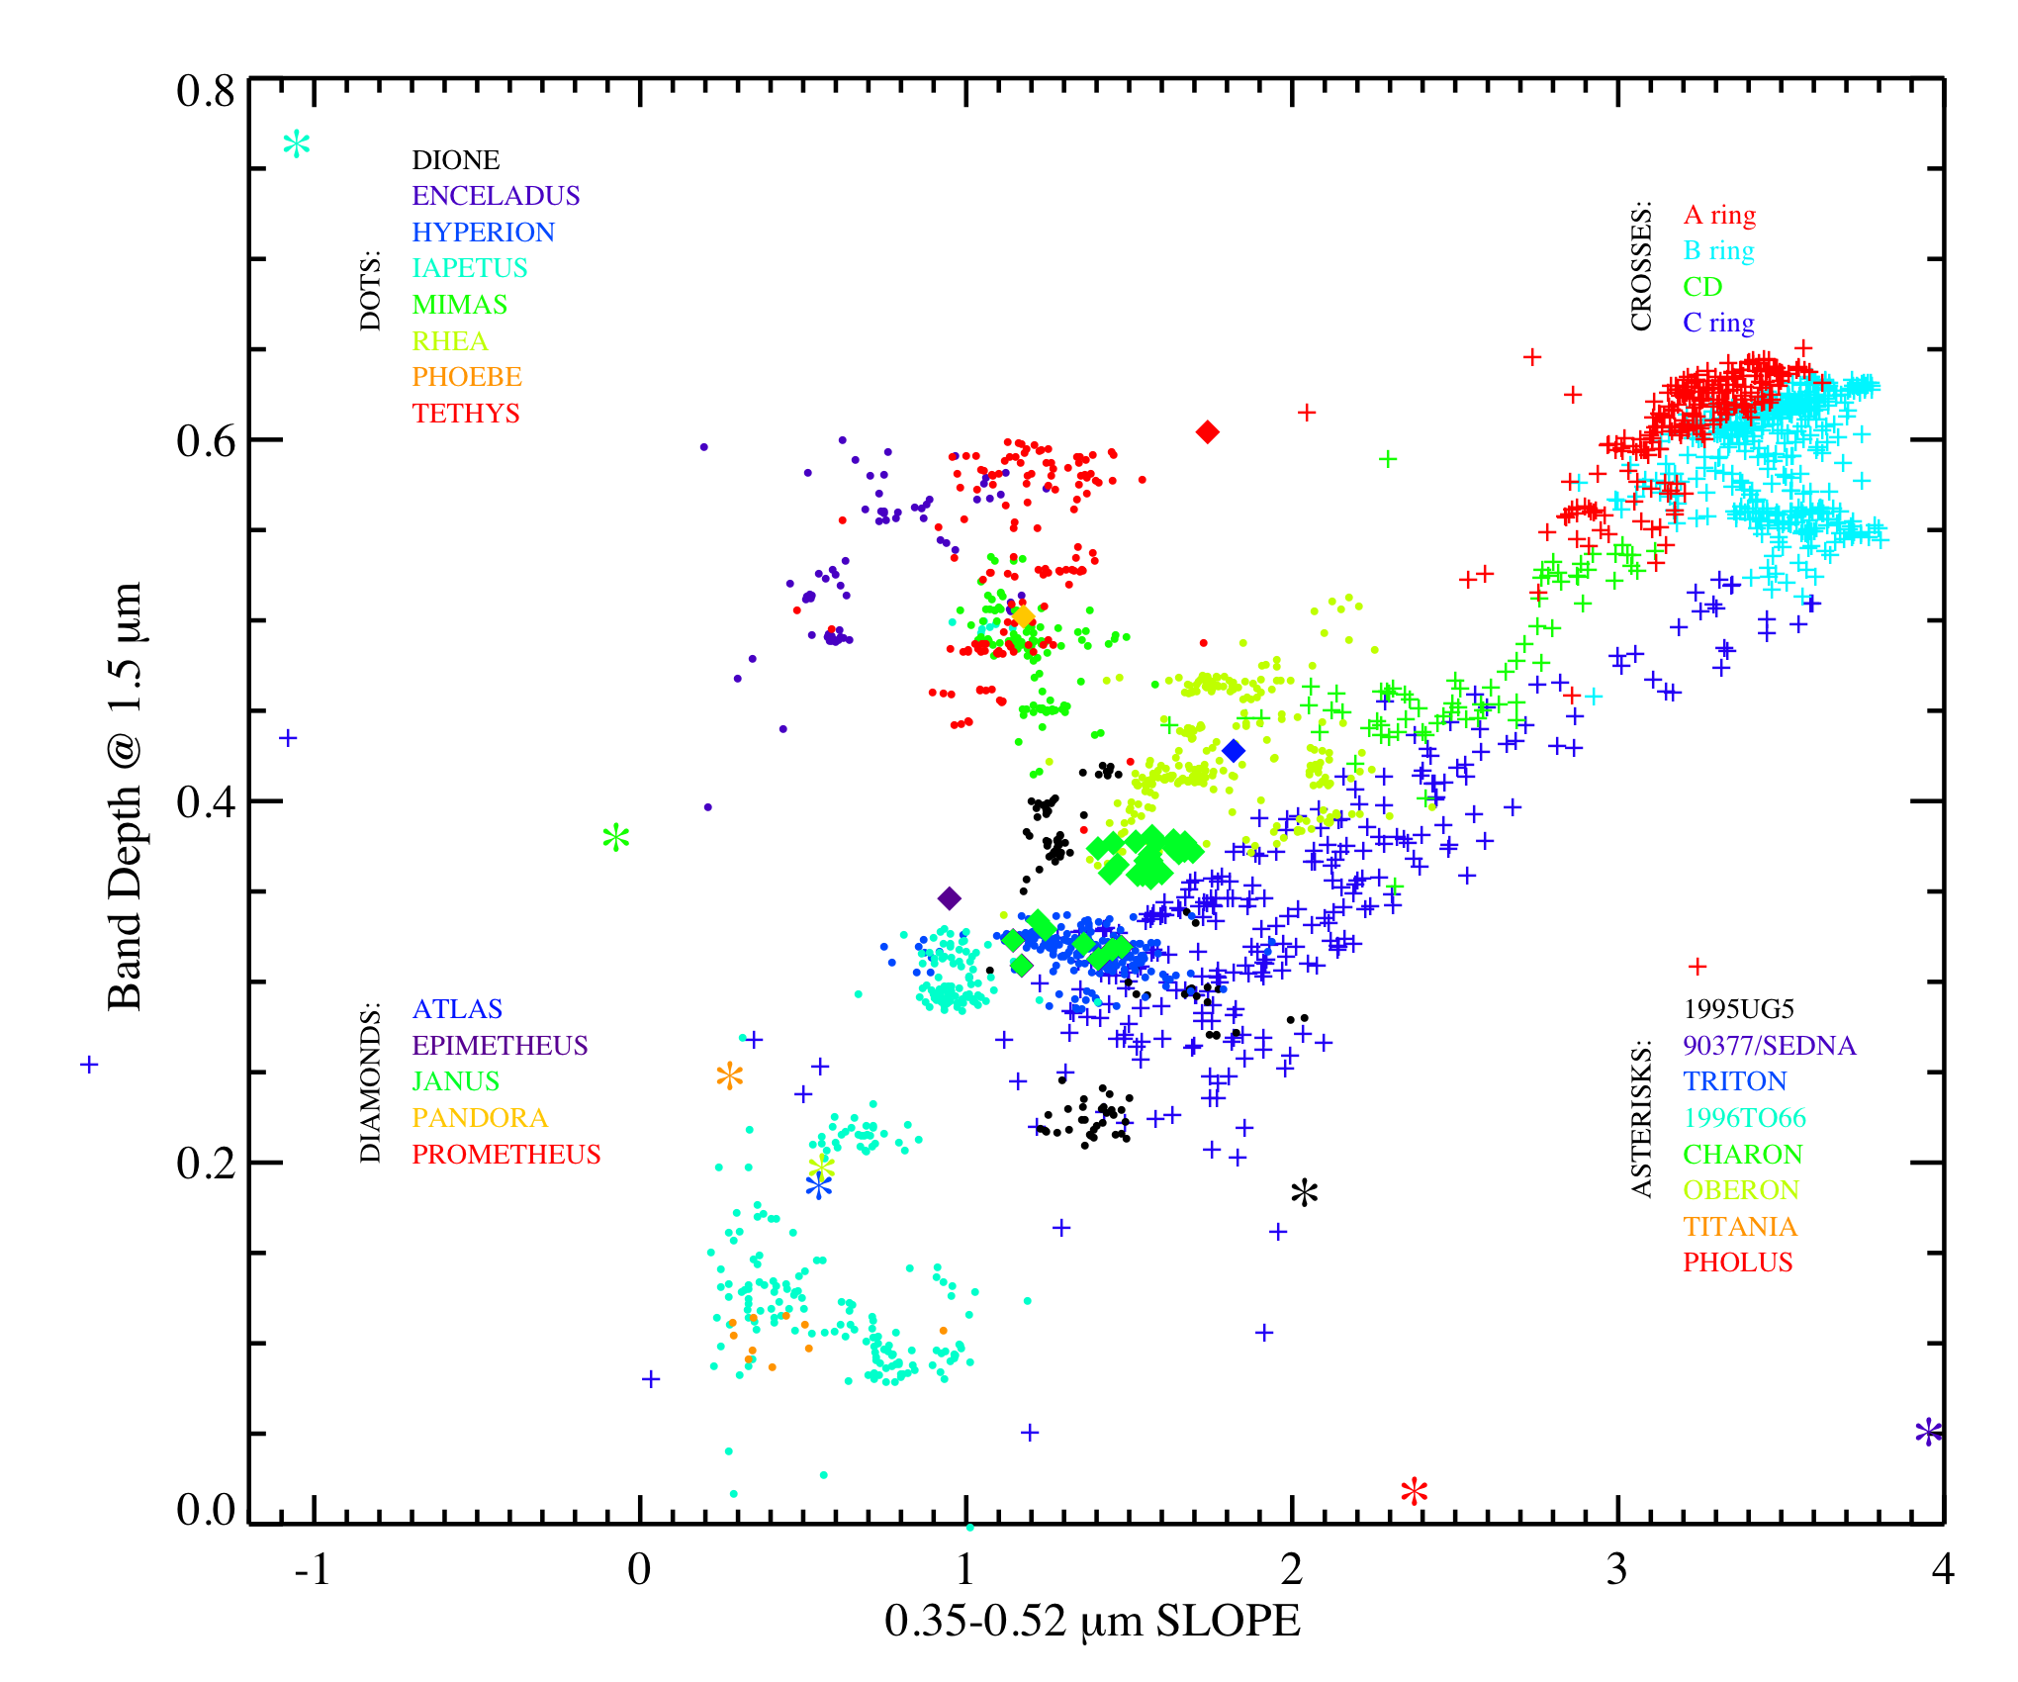
Filacchione et al 2012
A,B
TNOs
Most Classical Icy Moons
CD
1.5μm water ice band depth
C
Dione
H,I
Iapetus Dark
Visual redness (350-520nm spectral slope)

Slide 18
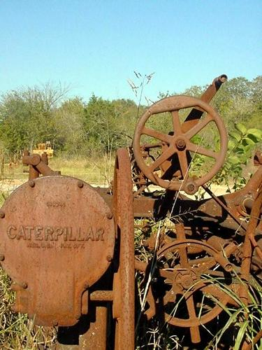
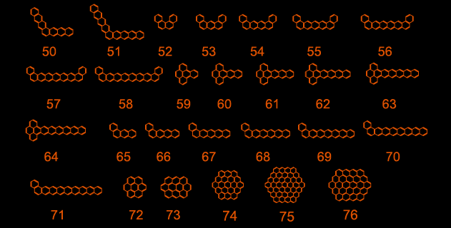
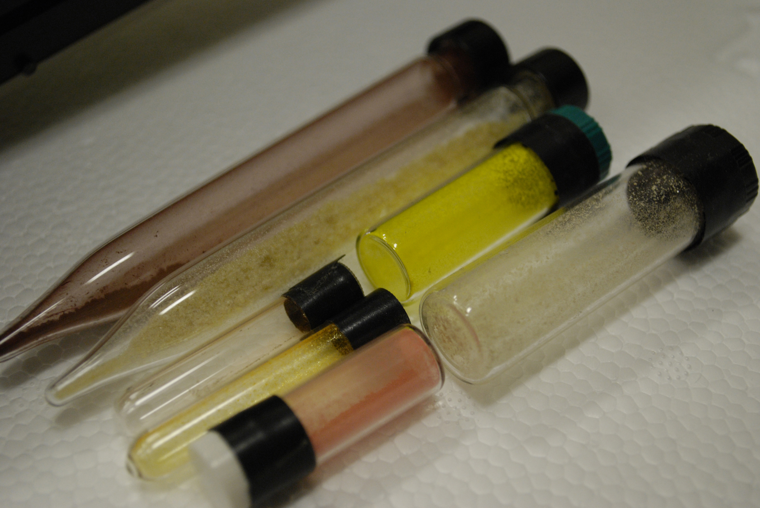
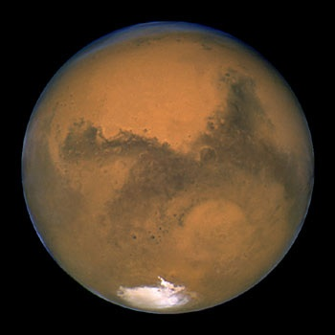
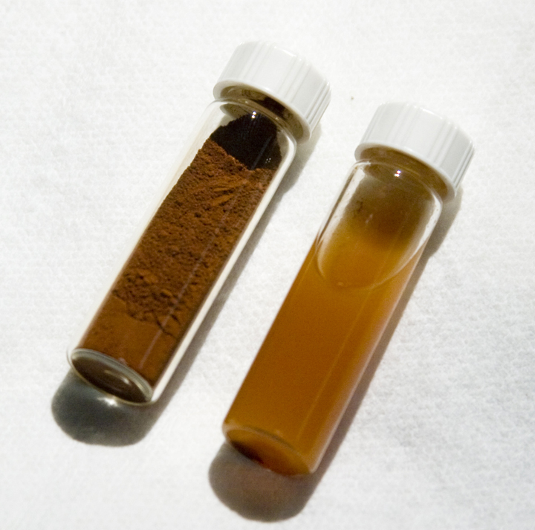
Why are the rings reddish? organic or inorganic material?
PAHs?
(nano-)-Fe?
Cuzzi et al 2009
Notes:
ALLAMANDOLA - SALAMA

Slide 19
in-situ determination
of ring particle composition (and flux)
(and Ring mass
from gravity)
Mitchell et al MIMI,
Science
Perry, T.M.
nm-size particle layer
+/- 1 deg latitude
Fe-poor silicates and
heavy organics, with dominant H2O ice in rings
apparently sputtered away
Hsu et al CDA,
Science, & T.M.
Organics
Silicate
example
Waite et al INMS; Science;
Miller et al T.M. Is CH4 special?

Slide 20
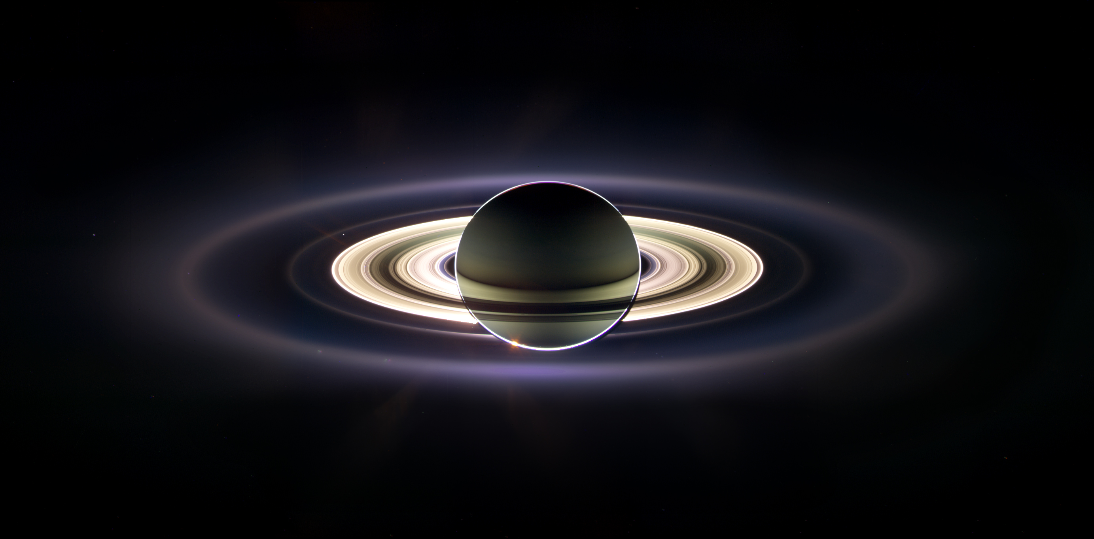
Changing before our eyes:
one example of many
(Chancia T.M.)
Hedman et al 2007
Hedman & Stark ApJ 2015
D
F
G
E

Slide 21
Ring Atmosphere
(and ionosphere)
O₂, O⁺ (SOI)
But CO? CH₄?
Not in spectra
1
Tseng et al 2010;
Cuzzi et al 2009
2
i=24º
14º
4º
2º
3
Tseng, Hsu, Hamilton, Sulaiman T. M.
4
5

Slide 22
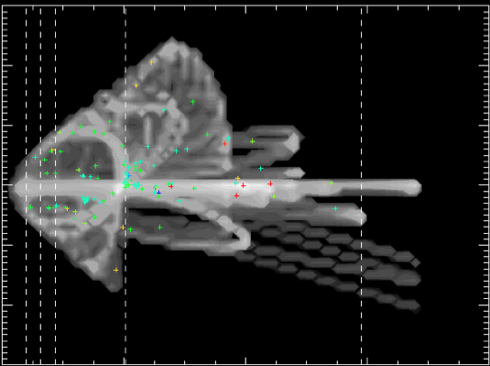
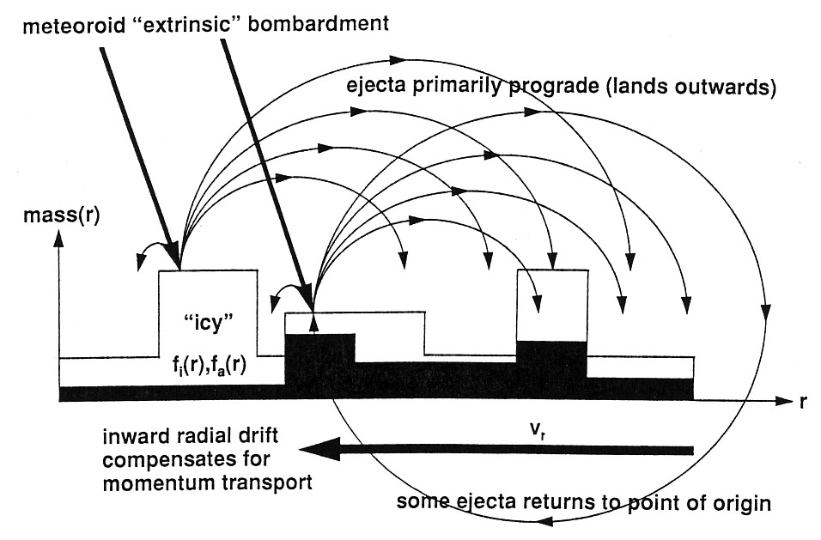
Age of the Rings: Meteoroid Pollution and Ring Mass
30
Mission-long
detections by CDA
(Kempf et al 2018,
Altobelli T.M.)
Infalling “cometary” material darkens the icy rings
(2nd young ring argument)
20
10
Current nonicy pollution %,
+ mass infall rate (CDA)
+ ring mass (RSS: Iess T.M.) ..
allow us to AGE-DATE the rings:
< few hundred Myr
0
-10
-20
-30
0
20
40
60
(Estrada, Elliott, T.M.)
Radial Distance (Rs)
“Ballistic Transport” of
extrinsic and intrinsic material
can provide constraints from ring
structure/composition profiles
(Estrada, T.M.)
Mostly prograde ejecta
Kempf et al, 2017
and in prep
Dots:
Model of drifting KBOs
Material compensates
by drifting inward
20
40
Durisen, Estrada, and others
Semi-major Axis (AU)
Notes:
Model by Poppe & Horanyi

Slide 23
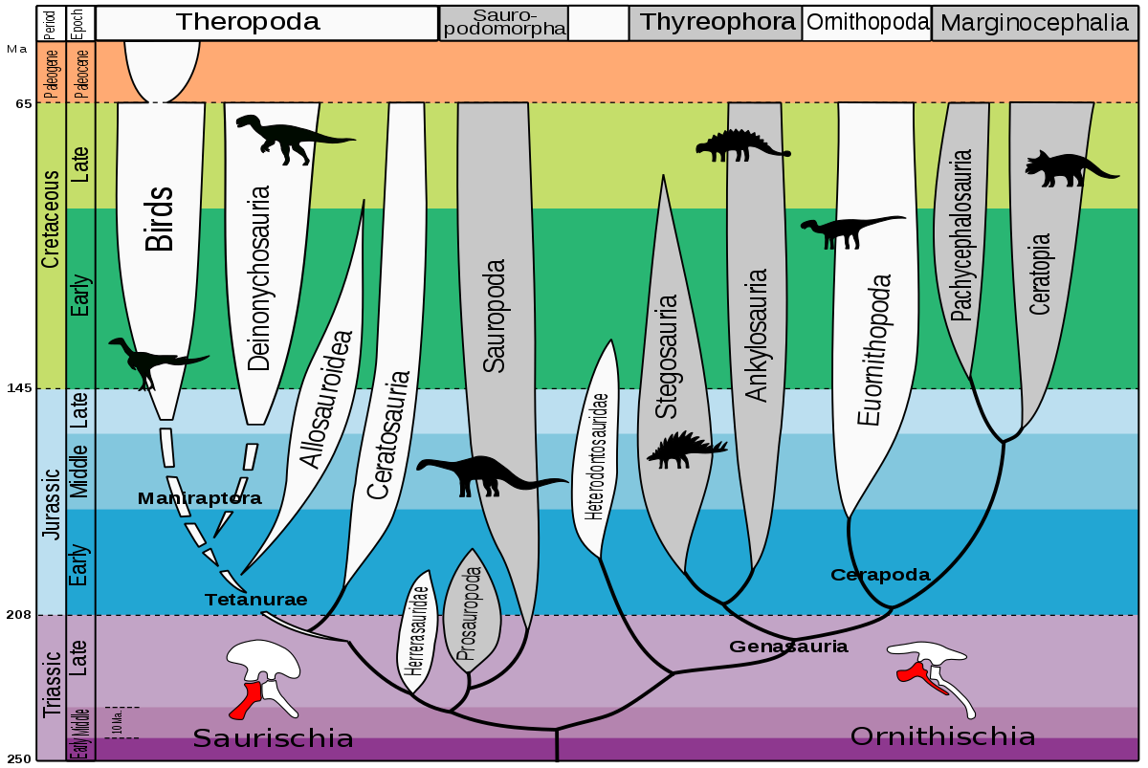
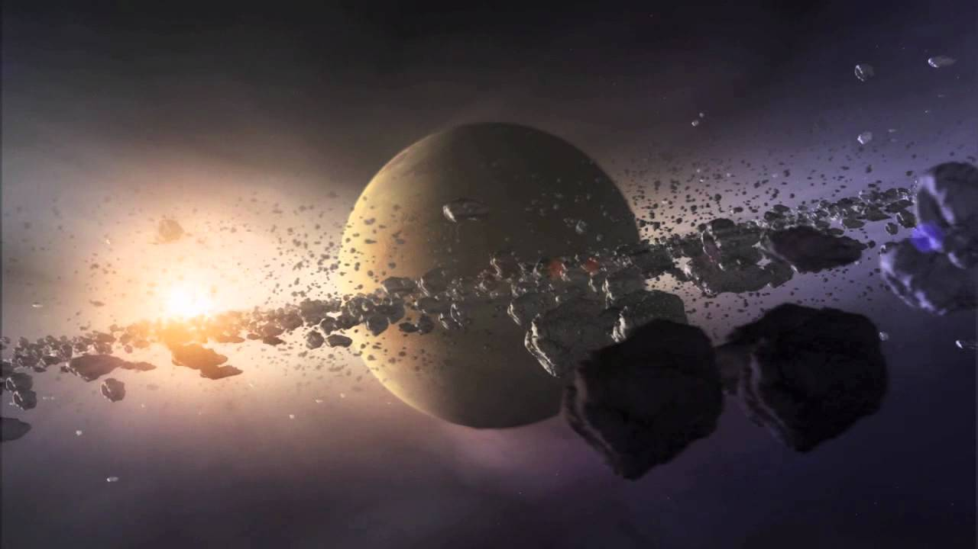
Born with the dinosaurs?
Myr
65
K-T boundary
145
208
250
Evolution_of_dinosaurs_by_Zureks.svg

Slide 24
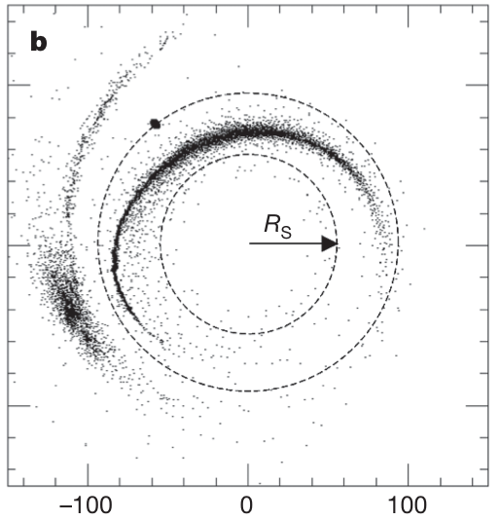
OLD rings? . . or . . YOUNG rings?
Ancient impact: Roche,Dones: Statistically plausible but pollution is a problem
Current mass
Recent impact: Dones,Dubinsky TM:
Pollution OK, but
Statistically implausible
High-mass; Tidal Disruption
Cratering
constraints on satellite ages?
Kirchoff, Schenk, Stephan, Zahnle T.M.
Low-mass: Recent
evection resonance instability
“Titanic”
a
Rs
Rhea, Dione
Can any scenario account for C ring rubble belt
(old core)?
e
C’uk et al 2016
Canup 2010
t(Myr)
Asphaug & Reufer 2013
Viscous evolution
Collisional evolution
Salmon & Charnoz 2010
and T. M.
M_{M}
Loose ends in recent formation “models”
RSS
Teodoro et al
T. M.
0 1 2 3 4 5 Gyr
Notes:
One recent scenario (Canup 2009) involves tidal migration and disruption of Titan-sized ring “grandparent” to create a Rhea-sized ring “parent”, which evolves in later and is again disrupted. Mosqueira/Estrada (2003 etc) scenarios grow the Rhea-sized parent directly. Saturn system has other examples of large, nearly pure ice bodies (Iapetus, Tethys). Such an object could be destroyed by impact during the LHB (Charnoz et al 2008). Many questions remain regarding satellite and ring formation.
A LOW current meteoroid mass flux would not require and may preclude a young ring age. However, much larger fluxes are expected during LHB and primordial era, so primordial ring would need to be much more massive than current ring.
Present locations of “ringmoons” are still a puzzle but resonant interactions, collisions, disruption, etc might slow their outward torque-based evolution.
At least the A and B Ring parent(s) must be nearly pure ice. Disruption of a differentiated body has long been advocated to explain this. Recent RADAR results on C Ring may point to a disrupted silicate/carbon core.

Slide 25
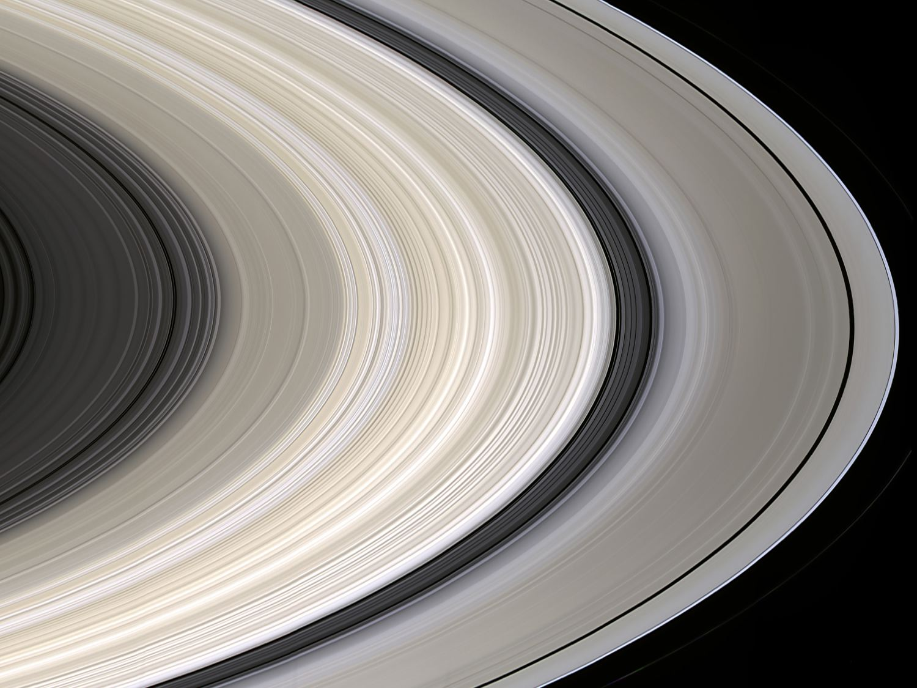
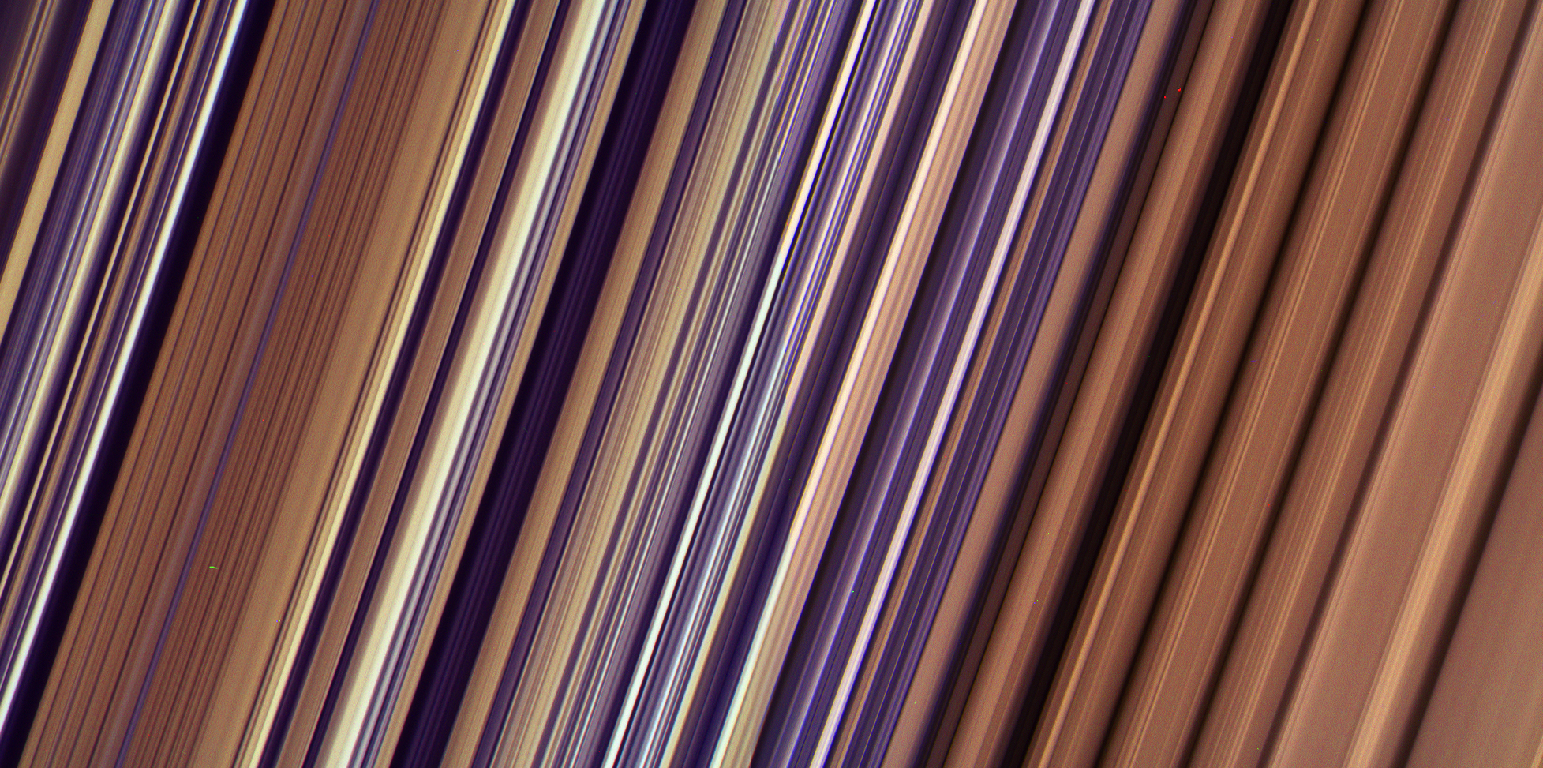
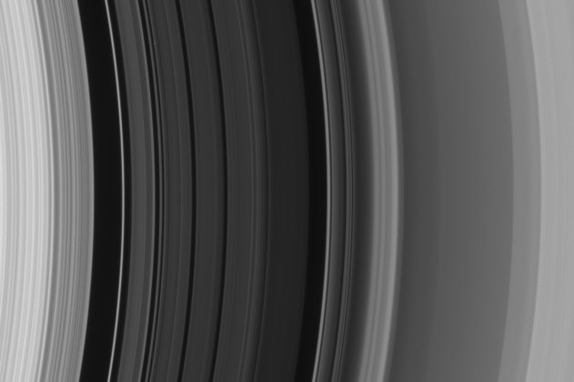
C ring “plateaus”
B ring “irregular structure”
B ring irreg here
5000km
4000km
Many puzzles and
a treasure-trove
of data remain
(see my poster tomorrow)
5000km
Compositional
variation?
Cassini Division;
moonlet-free gaps?
Notes:
Upper right - irregular structure in inner B ring. 99000km “red bands” start at right. So, just at the boundary between moderate tau and higher tau where RSS sees “channel structure”. Original Image is 4900 km across; structure typical scale is roughly the ~80km seen by Horn & Cuzzi but smoother in the lower tau regions. Crop shown here is only 4100km across.
Upper left: C ring plateau structure surrounding Maxwell gap. Broad plateaus are about 300km wide. Image covers about 5100km radial width.

Slide 27
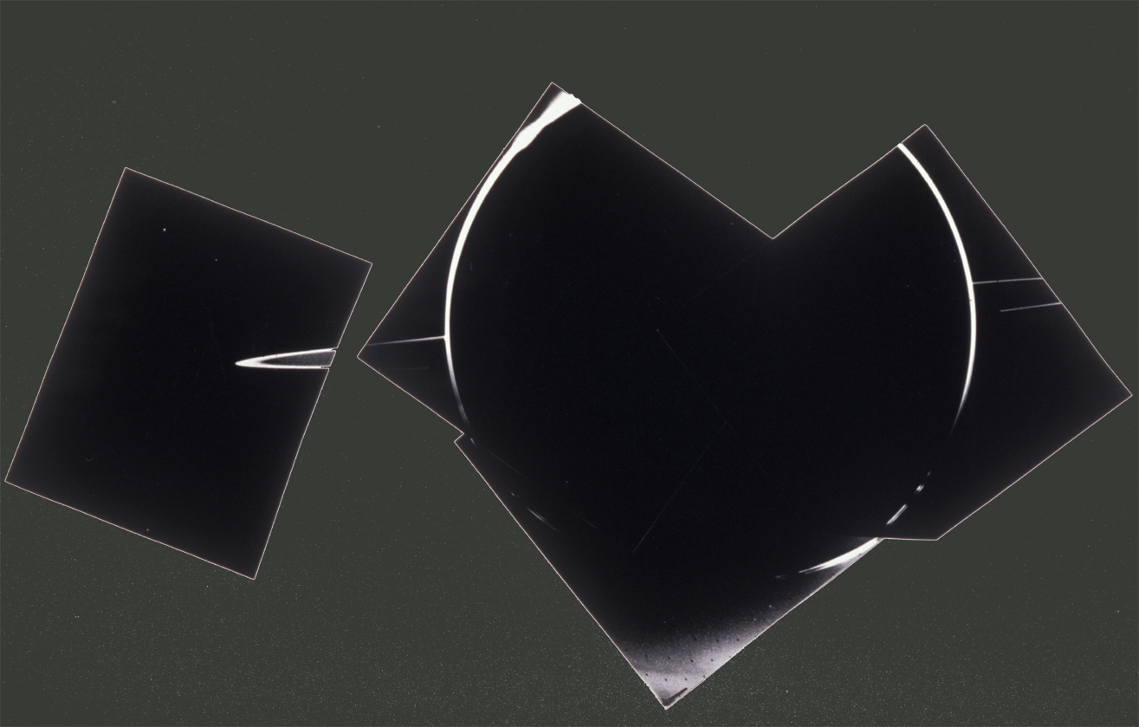
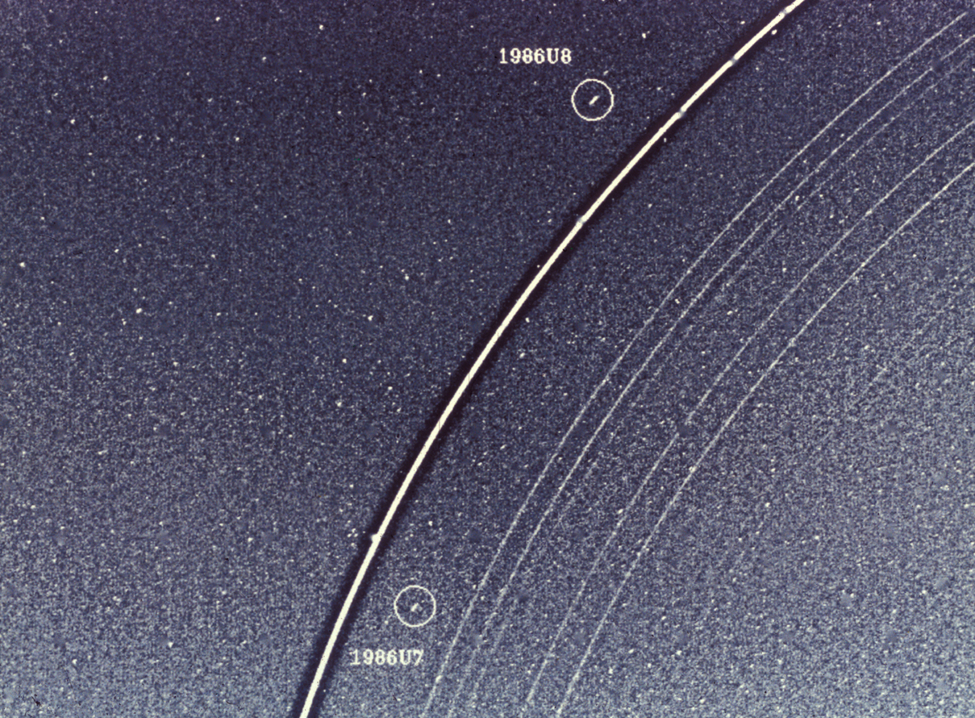
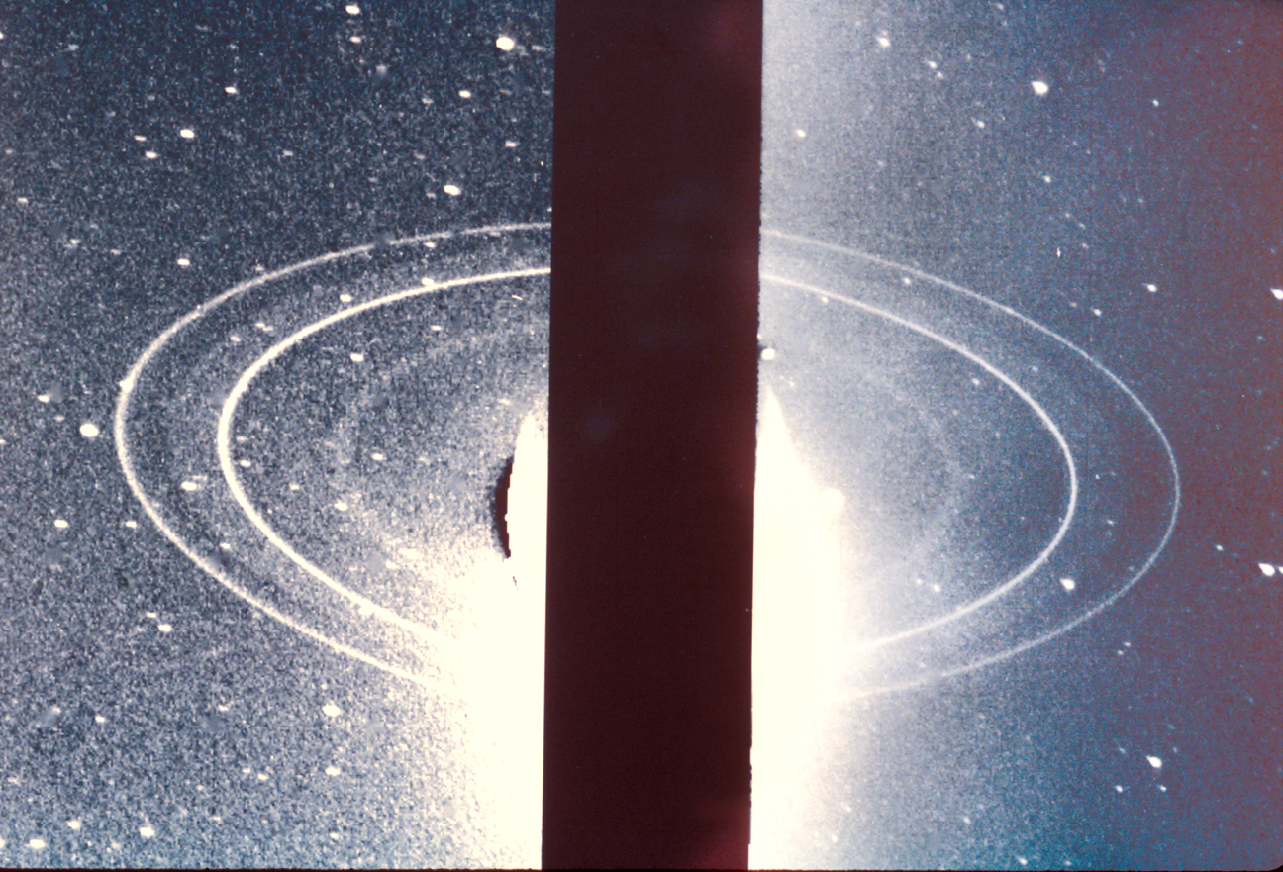
Jupiter (1979)
Saturn (1980-81)
Why is Saturn the only giant planet with (young) massive icy rings?
Uranus (1986)
Neptune (1989)
Notes:
6 min to complete this

Slide 28
Evection resonance instability never encountered at Jupiter or Uranus ?
P. Estrada
3-body Laplace
Resonance
halts evolution?
Small
observed “Q”
(Lainey et al;
Fuller et al)
Evection Resonance
Large “Q”
(planet is all core)

Slide 29
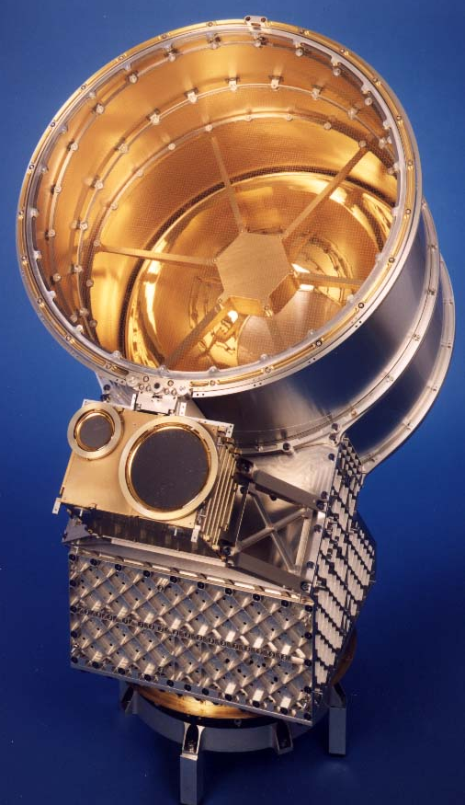
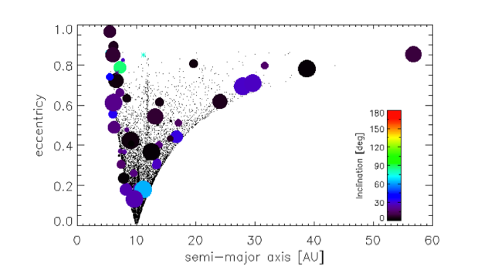
Age of the Rings: Meteoroid Pollution and Ring Mass
30
CDA: “Dust telescope” Infalling material contains silicates and carbon, quickly darkens the nearly pure-ice ring material
(2nd young ring argument)
20
10
0
-10
-20
Sensitive area
-30
0
20
40
60
Detections (mass, i, e, a)
Radial Distance (Rs)
Pollution allows us to AGE-DATE the rings, using both the mass infall rate (CDA; Altobelli et al T.M.) and the ring mass (from RSS gravity; Iess et al T.M.):
< few hundred Myr
0.8
0.6
Eccentricity
0.4
Kempf et al, 2017
and in prep
Dots:
Model of drifting KBOs
0.2
0
20
40
60
Semi-major Axis (AU)
Notes:
Model by Poppe & Horanyi

Slide 30
Prometheus and the F ring
Collision with a rampaging moonlet
on a chaotic orbit
N. Cooper and C. Murray
Orbits are chaotic due to Prometheus;
Moonlets are discovered and lost again,
In months
80km
(35 yr)
Notes:
SLIDE 46 (SKIP SLIDE 45))
F ring first glimpsed by Pioneer 11
Voayer - strands and straddling mmoons - dubbed “shepherding satt’s” because .. Yadda yadda
However since then we have realized (a) moons are massive & eccentric enough that orbits
Between them are “chaotic” - prone to sudden glitches in ecc, period, etc.. Thus not stable - things
In that region more likely to be banging into each other than nicely “confined”. Furthermore HST
Results - P & P - chaotic.. What we have is a dynamically rich, everchanging system. Cass results -
L and R lower panels - P&P. Elongate, porous (low density). Rubble piles..
Details of ring structure - Some, but not all, beginning to be understood. “folds” or warps -
Due to Prometheus - actually enters the region of faint material. Many of the larger kinks in the bright f ring core also caused this way. BUT as seen in top center panel, VERY fine scale str also seen, prob need small, unseen objects even closer to ring. ISS has seen several of these, some have been lost!! Transient clumps? Possibly! Even the numerous outrigger strands are new since voyager; cover a wider region.

Slide 31
Prometheus and the F ring
Collision with a rampaging moonlet
on a chaotic orbit
N. Cooper and C. Murray
Orbits are chaotic due to Prometheus;
Moonlets are discovered and lost again,
In months
80km
(35 yr)
Notes:
SLIDE 46 (SKIP SLIDE 45))
F ring first glimpsed by Pioneer 11
Voayer - strands and straddling mmoons - dubbed “shepherding satt’s” because .. Yadda yadda
However since then we have realized (a) moons are massive & eccentric enough that orbits
Between them are “chaotic” - prone to sudden glitches in ecc, period, etc.. Thus not stable - things
In that region more likely to be banging into each other than nicely “confined”. Furthermore HST
Results - P & P - chaotic.. What we have is a dynamically rich, everchanging system. Cass results -
L and R lower panels - P&P. Elongate, porous (low density). Rubble piles..
Details of ring structure - Some, but not all, beginning to be understood. “folds” or warps -
Due to Prometheus - actually enters the region of faint material. Many of the larger kinks in the bright f ring core also caused this way. BUT as seen in top center panel, VERY fine scale str also seen, prob need small, unseen objects even closer to ring. ISS has seen several of these, some have been lost!! Transient clumps? Possibly! Even the numerous outrigger strands are new since voyager; cover a wider region.

Slide 32
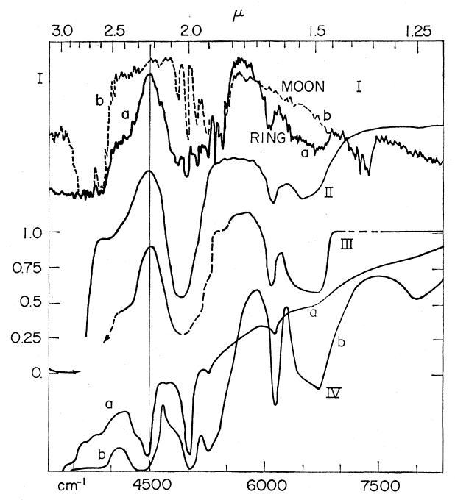
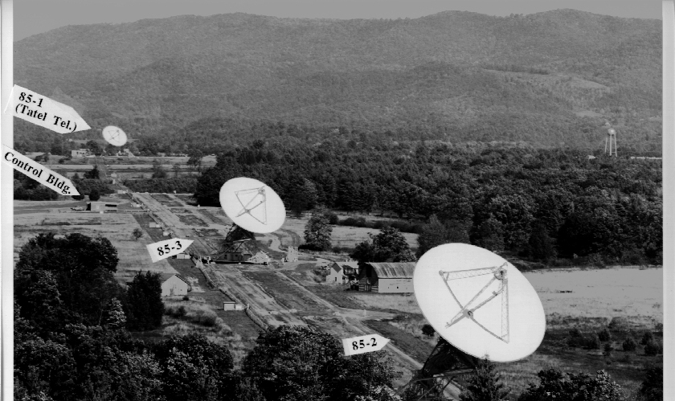
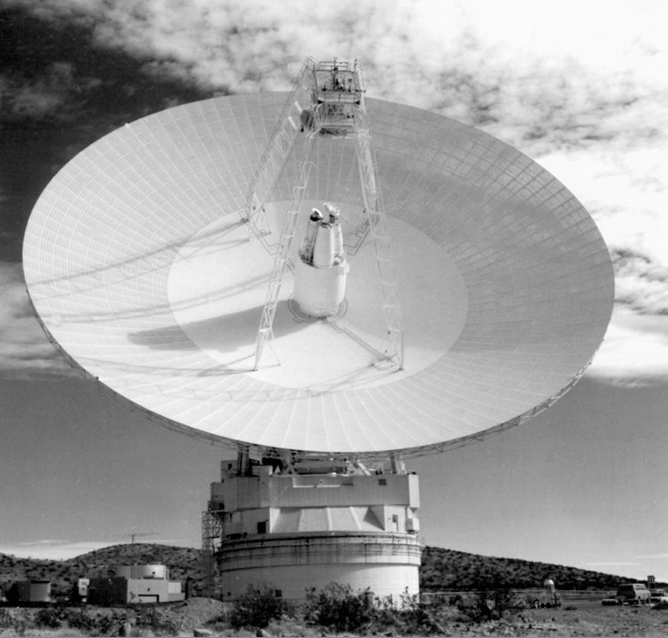
Ring particles: cm-m’s in size, dominantly (>90%) water ice
RSS (E. Marouf);
in Cuzzi et al 2009
lab H₂O
Ring/Moon
(Marouf, TM)
lab NH₃
Pilcher et al 1970; Kuiper et al1970
Various 1974 - 1984
Spilker et al
Cassini CIRS
Spilker et 2005
Van der Tak et al 1999
(Showalter&Nicholson1990)
Showalter & Nicholson 1990
Independent technique:
Stellar Occultation
Variance
Larger
particles
λ 3.6cm
Variance in signal
Cassini 2.2cm radiometry: Zhang et al 2016,17
.. and active radar scans now being reduced!
Technique has been extended to constrain gaps as well as clumps (Green, Colwell posters)
Compilation:
Esposito et al 1984
B
B
B
Poisson statistics
(small particles)
1cm
A
A
A
10μ
100μ
1mm
10cm
Wavelength
Average Occ signal counts/s

Slide 33
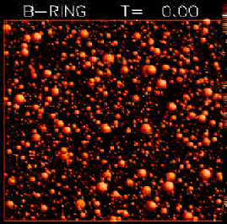
Few (large) particles thick
30m
Current ring model
H. Salo
Self Gravity “wakes”
Constant gentle collisions between particles
flatten the rings to a dense layer, and give them
the nature of a viscous fluid (pressure, viscosity, etc) but gravity and tidal shear is important
(Nicholson, Stewart, T.M.)
15km/s
Notes:
CLOSEUP OLD CONCEPT; RELATIVE VELOCITIES AND COLLISIONS
NOW THINK THEY ARE EVEN FLATTER AND DENSER; COMPLICATES OUR MODELING
Movie file is called bring_all.mpg

