Slide 1
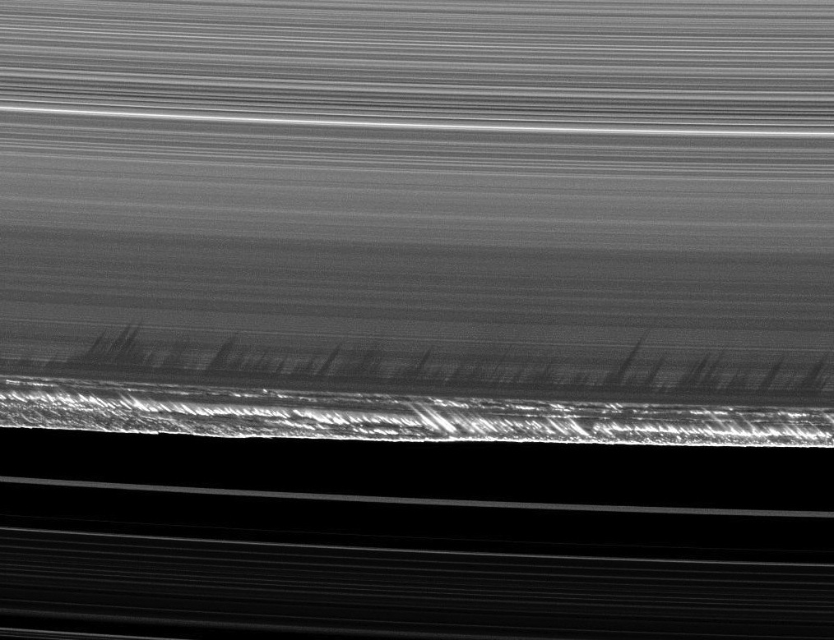
Saturn’s outer B ring
P.D. Nicholson, M.M. Hedman & R.G. French
Boulder CO, Aug 2018

Slide 2
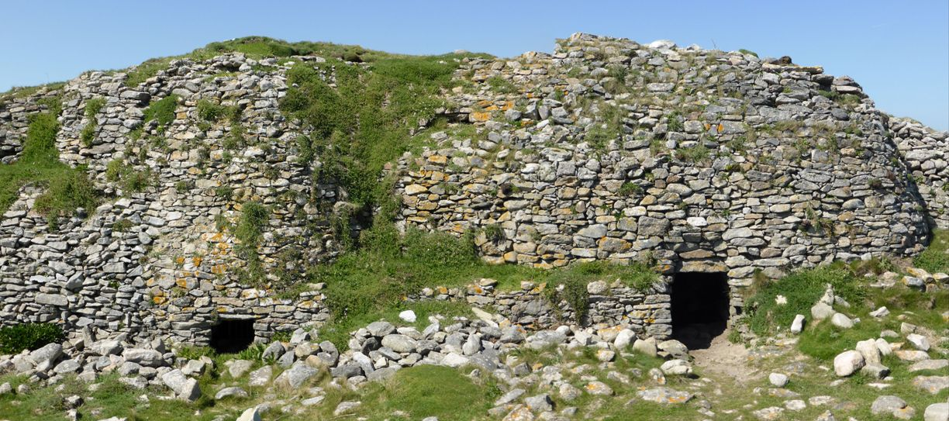

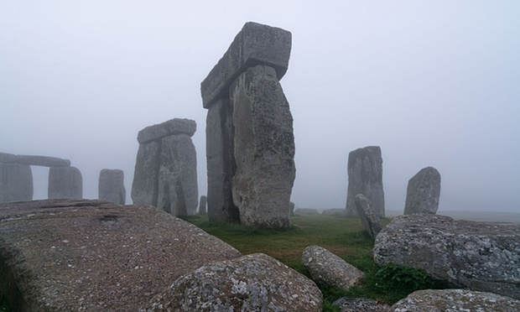
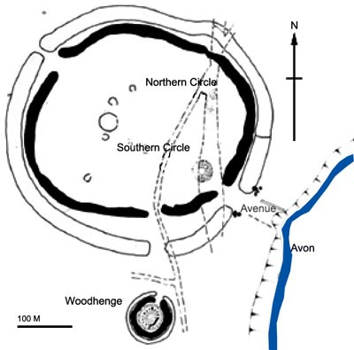
Isle Carn, Brittany
Nurage San Antine, Sardinia
Stonehenge, UK
Historical background:
1978: Goldreich & Tremaine propose that the outer edge of the B ring (& the inner edge of the Cassini Division) is confined by the torque exerted by the Mimas 2:1 inner Lindblad resonance.
1984: Porco et al. examine Voyager images and occultation data, and find that the B ring edge has the expected m=2 perturbation, rotating at Mimas’ mean motion, with a radial amplitude of ~50 km. One minimum is aligned with Mimas.

Slide 3
Early Cassini results:
Fits to Cassini imaging data show perturbations with m=1, m=2 (Mimas), m=2 (free), & m=3.
Red, green & blue colors show anomalous regions, omitted from the fits.
Spitale & Porco (2010) A.J. 140, 1747-1757.

Slide 4
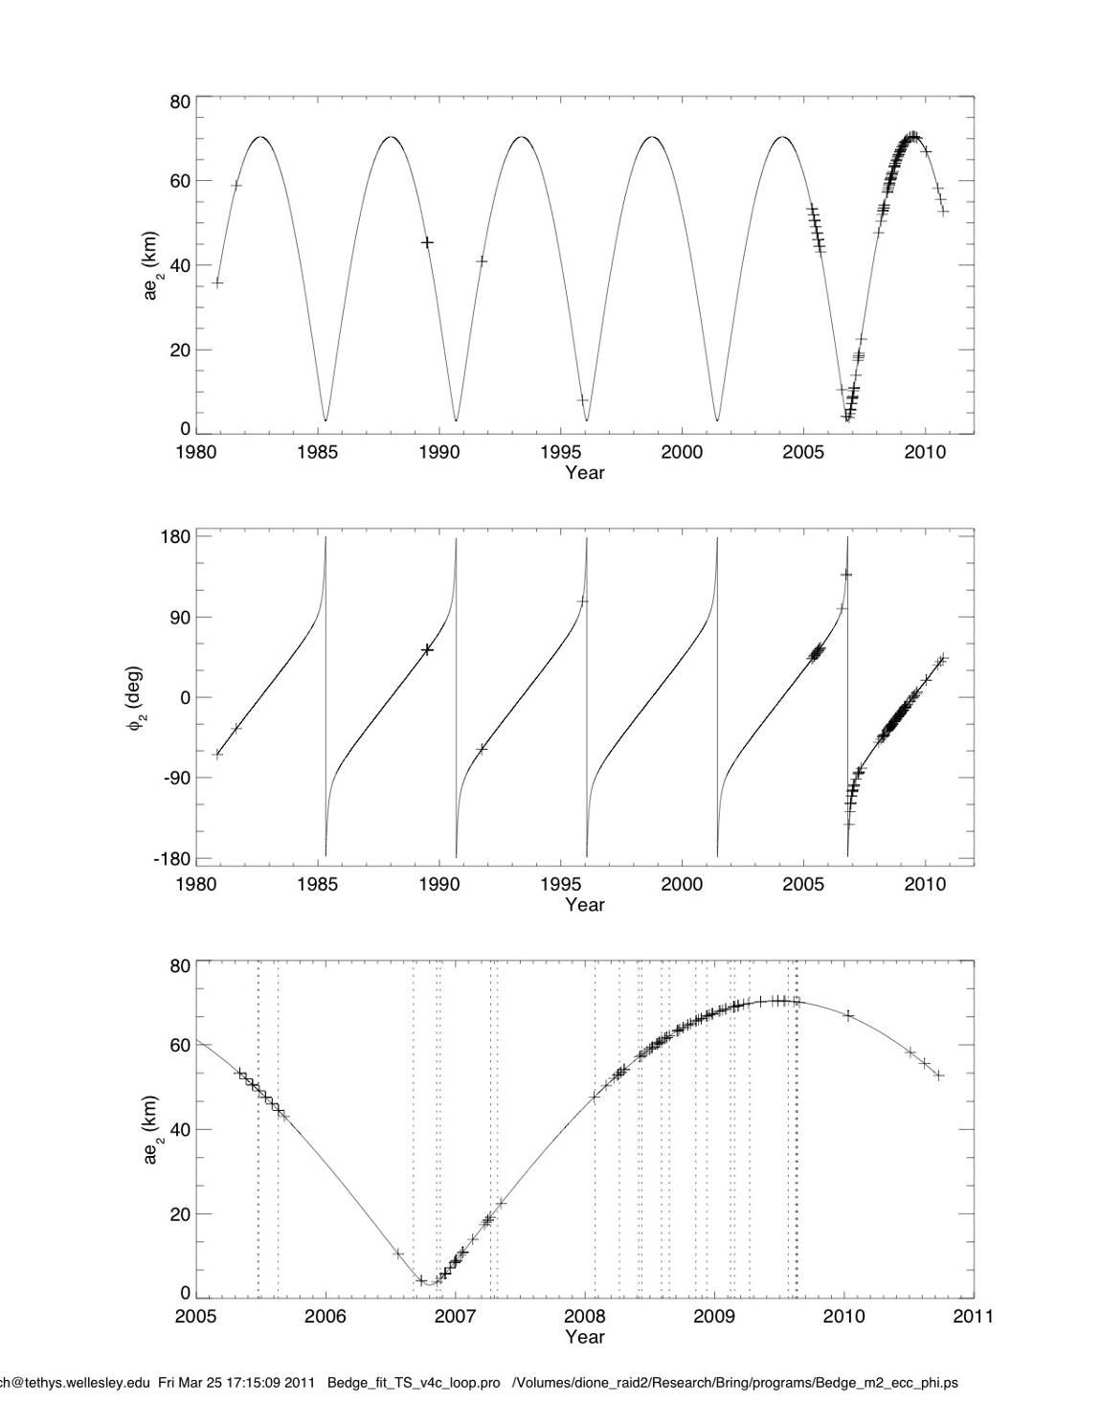
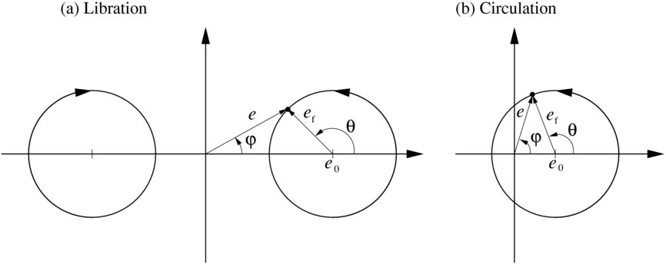
Cassini, HST & Voyager occultation data confirm that the phase of the best-fitting m=2 model circulates with a period of 5.42 yrs (0.181 deg/d).
ae (km)
φ (deg)
Both the m=2 amplitude and phase vary substantially with time, because the free eccentricity (ae = 37 km) is only slightly greater than the resonantly-forced eccentricity (33 km).
ae (km)
Nicholson et al. (2014) Icarus 227, 152-175.

Slide 5
B ring edge predicted libration: 2000 - 2020
B ring edge occultation data: 2005 - 2017
m=1
m=2
Since the previous work in 2010/11 there has been one more complete libration cycle of the m=2 pattern, though no new fits have been published.

Slide 6
Summary of B ring edge perturbations, as of Dec 2017 (R. French, unpubl. data.)
m=2 (free mode) ae = 38.0 km, 382.07 deg/d
m=2 (forced by Mimas 2:1 ILR) ae = 33.0 km
m=1 (free mode) ae = 22.3 km, 5.083 deg/d
m=3 (free mode) ae = 9.7 km, 507.72 deg/d
m=4 (free mode) ) ae = 7.7 km, 570.53 deg/d
m=5 (free mode) ) ae = 6.6 km, 608.21 deg/d
m=6 (free mode) ) ae = 3.7 km, 633.33 deg/d
Even with all 7 modes, the rms residuals for the best fits to the occultation data are σ = 7.6 km, or ~40 times greater than for most sharp-edged, non-circular features.

Slide 7
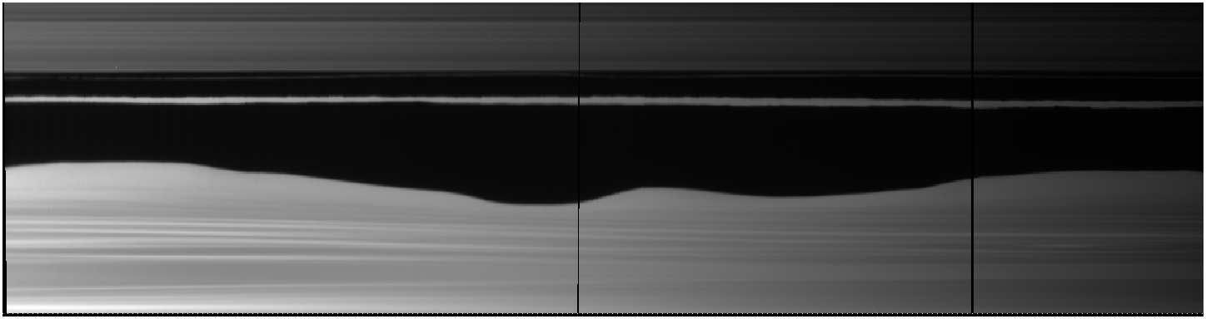
The radial residuals of 7-10 km may indicate additional normal modes, but appear to be largely due to local, small-scale irregularities on the ring edge that are unexplained. Some of these move at the keplerian rate & may indicate embedded objects (Spitale & Porco 2010).
Cassini imaging mosaic, covering 330 deg of longitude
Spitale & Porco (2010) A.J. 140, 1747-1757.

Slide 8
Multiple occultation profiles from 2008/9 show that complex perturbations extend at least 500 km interior to the B-ring edge, with little obvious correlation between profiles obtained over a period of ~6 months:

Slide 9
Searches for propagating waves:
A search for m = 2 wave patterns in the outer B ring at the predicted pattern speed of 383.5º/d does not show anything significant or consistent over the 12 year period of Cassini observations.
Similar searches for wavelike patterns with m between +4 and -4 also yield null results, with the exception of m = 1 and (perhaps) m = 0.

Slide 10
A blind search for wavelike structures in the 2008/9 data, using a phase-coherent wavelet algorithm and m=1.
Note peak at 117,150 km, with <k> = 0.055 km⁻¹ or λ ~ 110 km.

Slide 11
The m=1 structure at at ~117,150 km appears to be a “wave packet” with a trailing spiral pattern that extends over ~1.5 rotations.
32 VIMS profiles sorted by phase and assuming m=1 and Ω_{p} = dω/dt.
VIMS occultation data, 2008 – 2013.

Slide 12
The structure in the outer 500 km of the B ring seems to have changed qualitatively between 2009 and 2015.
In 2016 occultations we see a pronounced “toothy region” of 10-12 cycles over ~150 km. These show systematic changes in morphology with m=1 phase.
However, this pattern is NOT periodic in any strict sense.
VIMS α Sco data, 2016

Slide 13
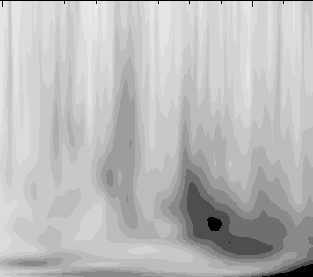
Is the strongly-perturbed B ring edge somehow responsible for all of this variable structure?
The most plausible inward-propagating wave would be m=0 (for which the group velocity is negative & the phase velocity is positive). A search for such a wave using all available occultation data shows a possible signature, corresponding to a plausible surface density of Σ = 30-40 g/cm².
However, the wave does not seem to be phase-coherent over any significant period.

Slide 14
Because of confusion due to the strong m=1 perturbations extending inwards from the ring edge by 200 km or more, the best opportunity to see an m=0 wave is provided by ISS B-ring MOVIEs. These sample the ring at a fixed longitude over ~1 orbital period (~11 hr), during which the m=1 pattern moves by <3 deg.
We see a wavelike pattern with λ = 15-20 km moving outwards at 1 cycle/orbit → a trailing wave with m=2 or a propagating wave with m=0.
Rev 206: 2014-198

Slide 15
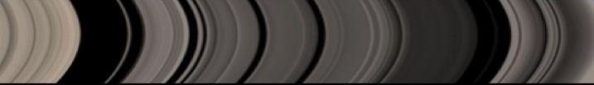
An m=0 disturbance can propagate through the rings as an axisymmetric density wave:

Slide 16
Other m = 0 signatures:
We know of at least two other instances in which an m=0 normal mode or wave seems to be generated at an edge which is resonantly forced:
-- the inner edge of the Barnard gap in the Cassini Division is perturbed by the Prometheus 5:4 ILR (French et al. 2016), and we find an m=0 wave propagating inward from the gap
(Hedman et al. 2018, in prep.).
-- the uranian γ ring is perturbed by both m=1 and
m=0 modes, and its inner edge is located very near the 6:5 IER with Ophelia (Porco & Goldreich 1987).

Slide 17
Backup slides.

Slide 18
B ring outer edge:
Fits to Cassini RSS, UVIS & VIMS occultation data, showing the dominant m=2 perturbation in 2005, 2006/7 & 2008/9.
Note the varying amplitude and phase wrt Mimas.
Nicholson, et al. (2014) Icarus 227, 152-175.

Slide 19
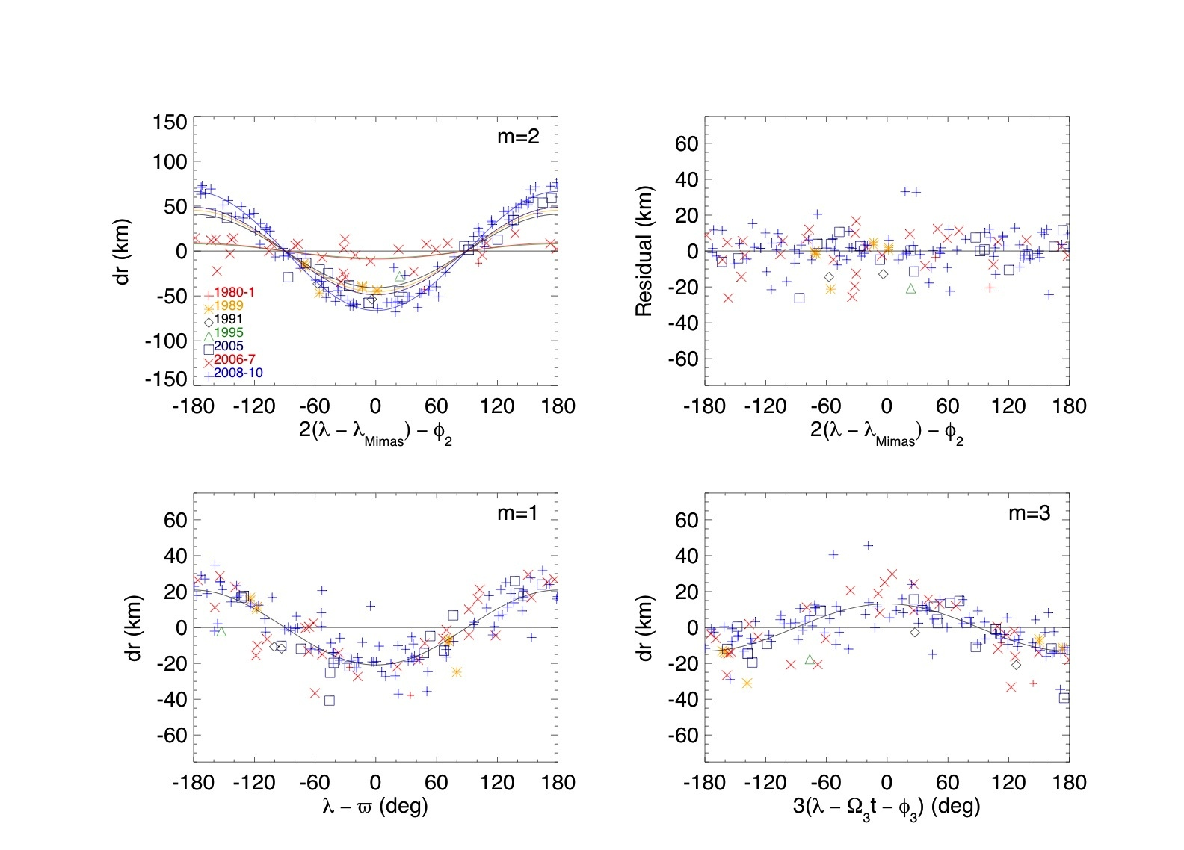
Major components & residuals of the B ring edge model:
Nicholson et al. (2014) Icarus 227, 152-175.

Slide 20
A similar B-ring MOVIE taken on rev 42, in 2007. Duration = 9.5 hrs. Note that the outward-propagating pattern is restricted here to outside ~117,380 km.
There appear to be 2 cycles per orbit here → m=3 or m=-1?
Rev 42: 2007-105

Slide 21
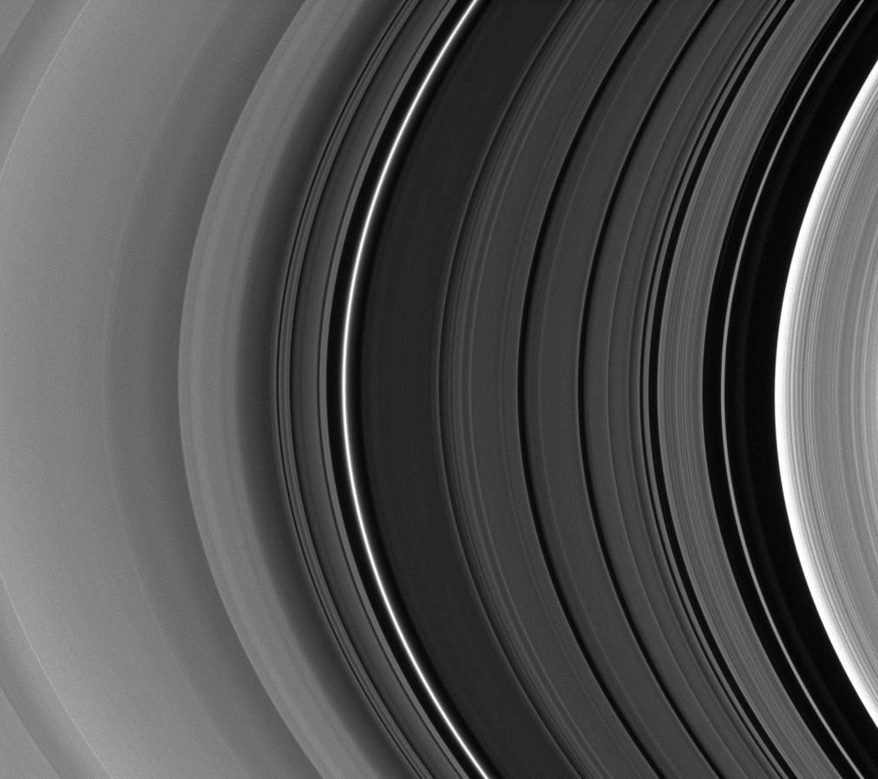
The Cassini Division
Huygens ringlet
Russell gap
Barnard gap
B ring edge
Jeffreys gap
Bessel gap
Kuiper gap
1000 km
Herschel gap & ringlet
Laplace gap & ringlet

Slide 22
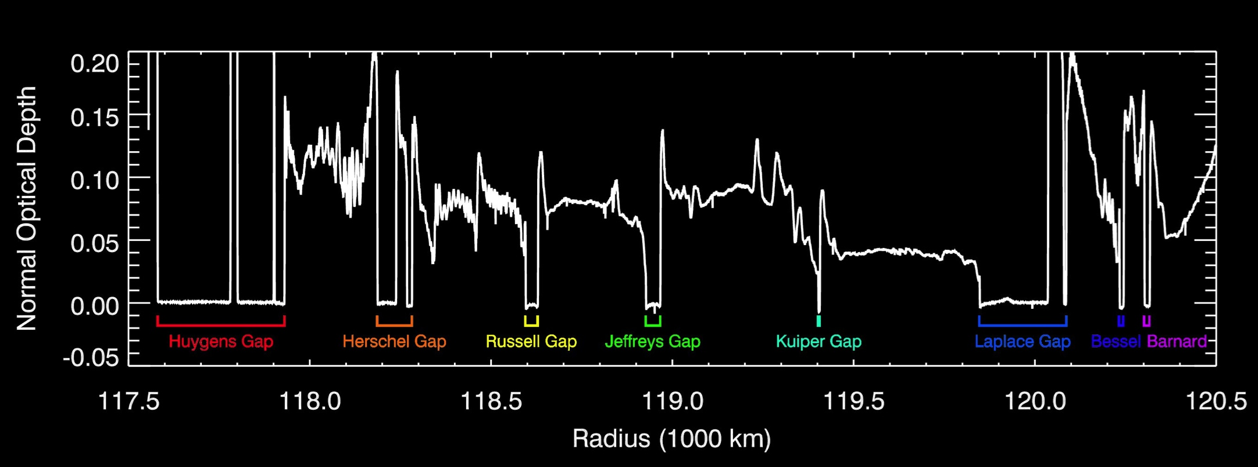
.
.
The eccentric edges in the Cassini Division appear to occur where
ϖ = ϖ_{B} – jL
L ~ 0.06⁰/day ~
1/3 of libration frequency of m=2 component at the B ring edge
Pattern speed of eccentric edge
Pattern speed of m=1 component in the B-ring edge (~5.08⁰/day)
Pattern Speeds of eccentric edges (in degrees/day)
Pattern Speed differences (in degrees/day)
5.06
5.08
5.02
5.03
4.96
4.97
4.90
4.93
4.85
4.87
4.79
4.79
4.72
4.73
4.67
4.68
0.04
0.05
0.06
0.06
0.06
0.04
0.05
0.06
0.06
0.08
0.07
0.06
0.05
0.05
Resonant edges
Unmodeled edges
Eccentric edges
Circular edges

