Slide 1

Radial distribution of textures in Saturn’s rings
Matthew S. Tiscareno, SETI Institute
Jesse Modesto, Cal Poly Pomona
Cassini Science Symposium
Boulder CO, 13 August 2018

Slide 2
Ring Textures
C
B
CD
A
Lit Side
100 km
No texture
Clumpy “straw”
Streaky texture
Azimuthally symmetric structure removed
Plateau P1
Notes:
2
277/HRRADSCNL

Slide 3
Optical Depth ≠ Surface Mass Density
Ring photometry is complex!
Some sharply-bounded optical depth features do not correlate with any sharp change in surface mass density
  Inner edge of the A ring (Iapetus –1:0 BW)
  Plateaux in the C ring
Implies sharply-bounded changes in one or more of:
  Composition
  Particle size
  Regolith character
Texture belts likely provide another window
Tiscareno et al. (2013, Icarus)
Hedman and Nicholson (2013, AJ)
Colwell et al. (2018, Icarus)
Déau et al. (2018, Icarus)
Notes:
3

Slide 4
“Straw” in Spiral Density Waves
C
B
CD
A
We knew about this kind
100 km
Porco et al. (2005, Science)
Clumpy “straw”
Azimuthally symmetric structure removed
Janus/Epimetheus 6:5 DW
Lit Side
Notes:
4
268 HRRADSCNL

Slide 5
“Straw” in Spiral Density Waves
C
B
CD
A
100 km
Prometheus 25:24 DW
Clumpy “straw”
Azimuthally symmetric structure removed
Prometheus 26:25 DW
Mimas 8:5 BW
Prometheus 27:26 DW
Pandora 16:15 DW
Prometheus 28:27 DW
Pandora 17:16 DW
Lit Side
Notes:
5
268 HRRADSCNL

Slide 6
“Straw” in Unexpected Places
C
B
CD
A
Lit Side
100 km
Azimuthally symmetric structure removed
No clear correlation with DWs
Pandora 11:9 DW
Atlas 7:6 DW
Notes:
6
263/SUPRHRESL
Inner A ring (124,230 km)
Clumpy belts do not correlative (positively or negatively) with density waves

Slide 7
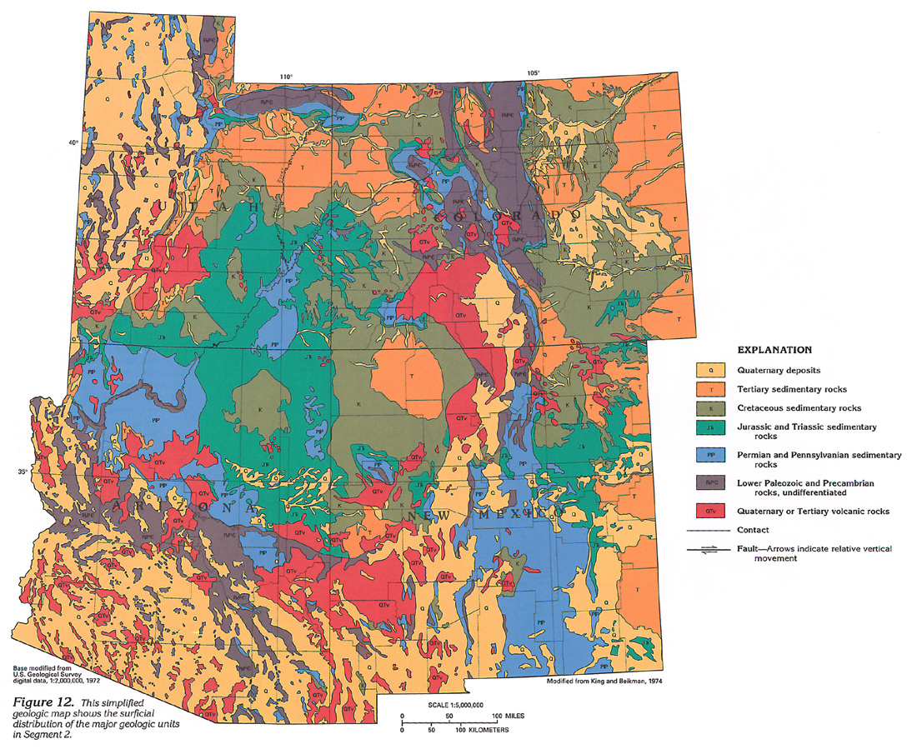
A “Geologic Map” of the Rings
A geologic map shows layout of terrain types
Notes:
7

Slide 8
A “Geologic Map” of the Rings
A geologic map shows layout of terrain types
We are systematically mapping ring textures
Gap
No Texture
Spiral Structure, No Straw
Spiral Structure With Straw
Strong Straw/Clumpy Texture
Weak Straw/Clumpy Texture
Strong Streaky/Feathery Texture
Weak Streaky/Feathery Texture
Spiral Structure With Streaks
Notes:
8

Slide 9


Mapping Ring Textures
C
B
CD
A
100 km
Spiral,
No Straw
No Texture
Spiral
w/Straw
Notes:
9

Slide 10

Mapping Ring Textures
C
B
CD
A
100 km
No Texture
Weak Straw
Notes:
10

Slide 11

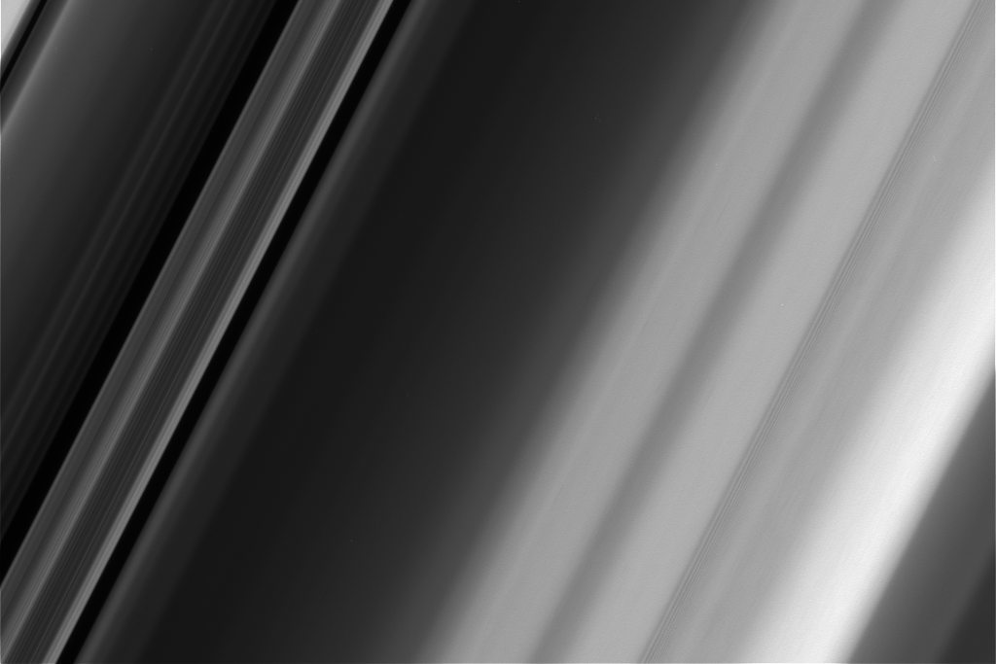
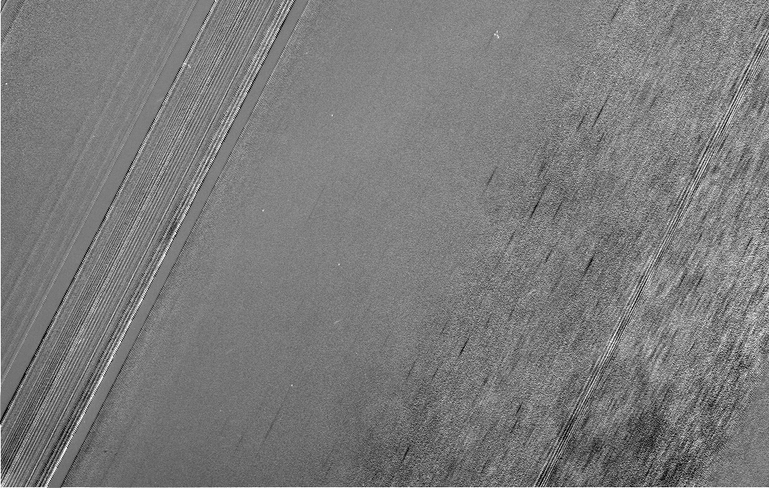
Mapping Ring Textures
C
B
CD
A
100 km
No Texture
Spiral,
No Straw
Spiral
w/Straw
Gap
Weak Streaky
Strong Streaky
Spiral w/Streak
Weak
Straw
Notes:
11

Slide 12

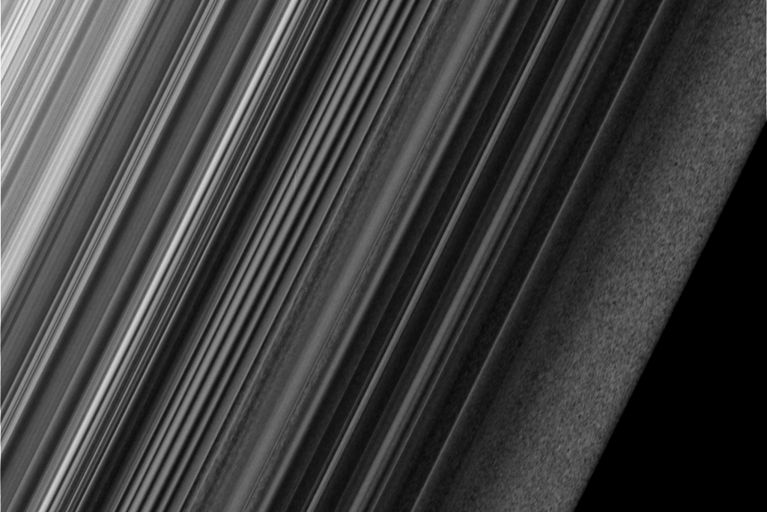
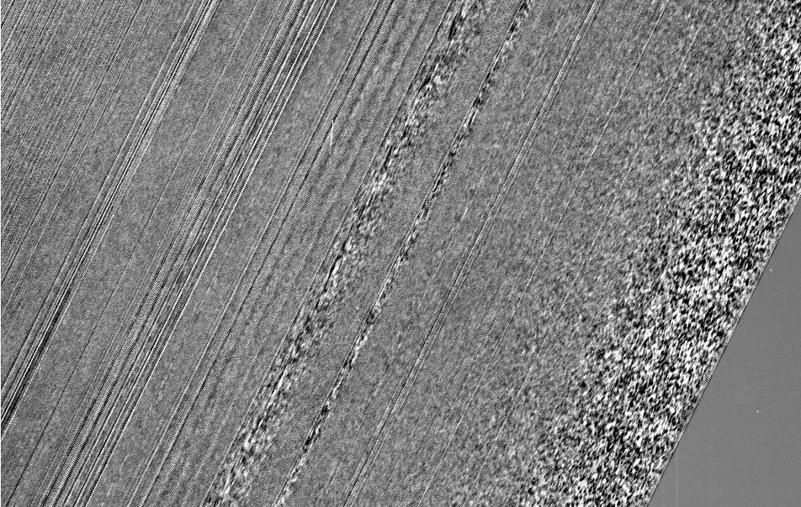
Mapping Ring Textures
C
B
CD
A
100 km
No Texture
Weak Straw
Strong Straw
Gap
Notes:
12

Slide 13

Mapping Ring Textures
C
B
CD
A
100 km
Strong Straw
No Texture
Strong Streaky
Notes:
13

Slide 14
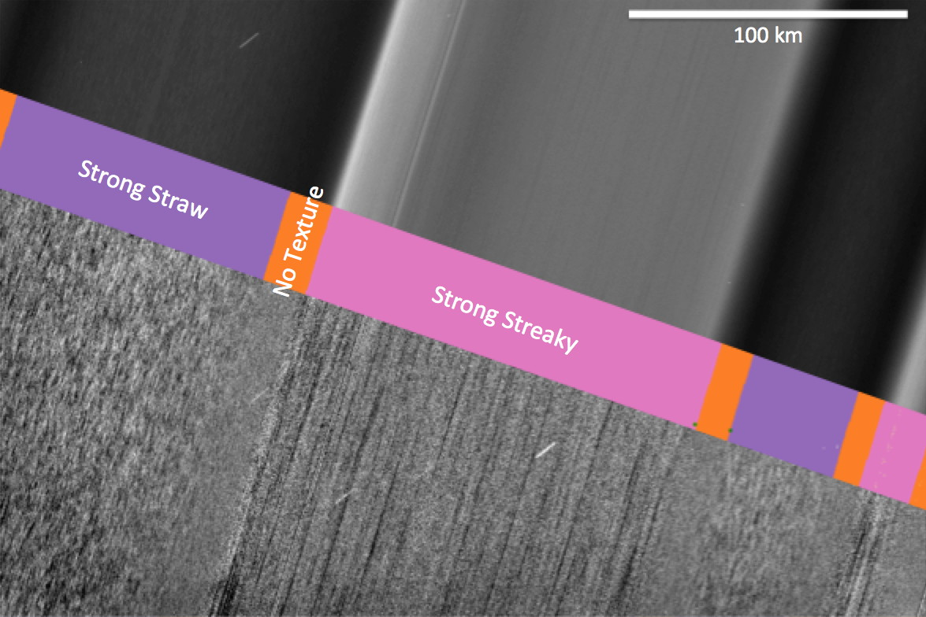
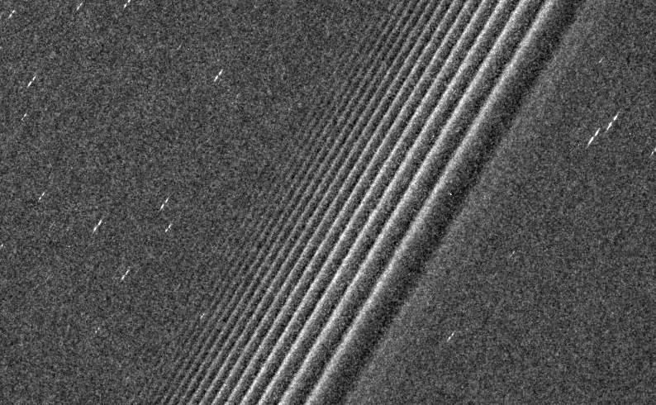
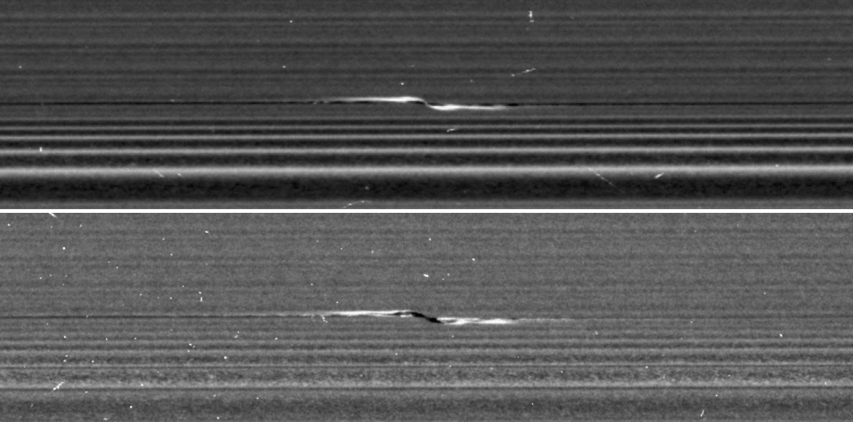
See Us at DPS!
Radial Distribution of Textures in Saturn’s rings
J. Modesto and M. Tiscareno (poster)
Radial Stratification of Propeller Size Distributions
M. Tiscareno and J. Modesto
Comparing Lit- and Unlit-Side Photometry of Propeller “S-D” from Close-Up Images
J. Robinson and M. Tiscareno (poster)
J. Modesto participation funded by NSF REU. J. Robinson participation funded by Cassini Project.
Notes:
14

