Slide 1
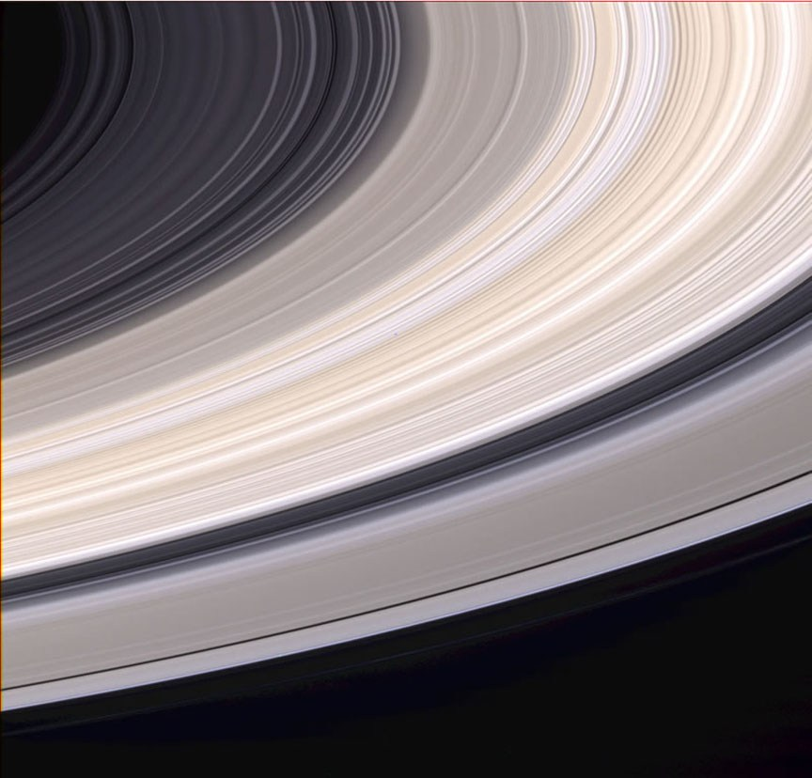
Synergy between Density Waves
and Viscous Overstability
in Saturn’s Rings
Glen Stewart
Univ. of Colorado
Cassini Science Symposium
Boulder, Colorado 2018

Slide 2
How to measure the mass of Saturn’s B ring?
Spiral density waves observed in the optically thick B ring seem to imply low surface mass density and very porous ice particles (Hedman and Nicholson 2016).
UVIS and VIMS observations of stellar occultations by Saturn’s B ring and HST observations of the azimuthal brightness asymmetry of the B ring both imply that particles clump up into opaque self-gravity wakes. (Colwell et al. 2007, French et al. 2007, Nicholson & Hedman 2010).
But self-gravity wakes cannot form if the particles are so porous that they fill their Hill spheres (Salo et al. 2018 in Planetary Ring Systems).
The accepted theoretical interpretations of these two kinds of observations therefore lead to conflicting conclusions about the mass of the B ring. One of these theories must be in error!
Cassini radio science measurements of the the total ring mass have rather large error bars due to longitudinal variations in Saturn’s gravity field (Iess et al. (2018) AOGS abstract PS16-D1-PM1-323B-002). They favor porous ring particles.

Slide 3
Quadrupole Brightness Asymmetry Explained by Self-gravity Wakes
Pitch angle of wakes is sensitive to internal particle density!

Slide 4
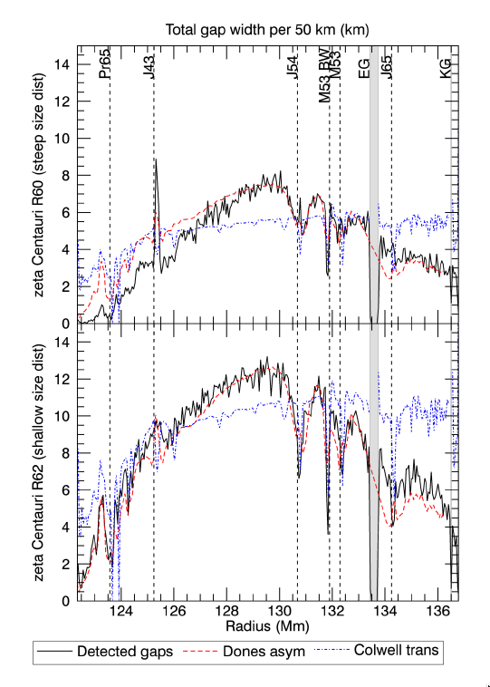
Radial distribution of gap
widths measured by UVIS
stellar occultations
tracks radial dependence of
azimuthal brightness
asymmetry in A ring
(Rehnberg et al. 2017 Icarus)
This is strong evidence that
ring particles are dense
enough to allow the formation
of self-gravity wakes!

Slide 5
High optical depth and high particle porosity suppress particle clustering and support viscous overstability.
porosity
Optical depth

Slide 6
Stellar Occultations → Self-Gravity Wakes
UVIS observations of stellar occultations by B ring show strong variations of optical depth with viewing geometry. This is explained by opaque self-gravity wakes separated by low density gaps with a particular orientation. HST observations of azimuthal brightness asymmetry of Saturn’s B ring are also explained by this model.
Colwell et al. (2009) in Saturn from Cassini Huygens

Slide 7
Self-Gravity Wakes → Large B Ring Mass
N-body simulations show that self-gravity wakes cannot form if ring particles fill their Hill spheres. Therefore, ring particles in B ring must not be too porous, which implies larger surface density to achieve observed large optical depths.
Particle density
Salo et al. (2018) in Planetary Ring Systems

Slide 8
Robbins et al. (2010) found that particle clustering of low-porosity particles reduces final optical depth.

Slide 9
Using density waves, Hedman and Nicholson (2016) find surface density to be weak function of optical depth in B ring. This implies that particle clustering observed in A ring does not occur in the B ring. But this is in conflict with UVIS observations of self-gravity wakes in the B ring! Is there something missing in the standard theory of density waves?

Slide 10
Density Waves in Saturn’s Rings
Wavelength ~ 10 km

Slide 11
Viscous Overstable Waves Wavelength ~ 200m
N-body Simulation by Salo (2018)

Slide 12
Overstable waves in inner A ring

Slide 13
10 km
Density Wave
200 m
Overstable Wave

Slide 14
Hydrodynamic simulations show strong nonlinear interaction between viscous over stable waves and spiral density waves
Figure from Lehmann, Schmidt, Salo (2018) arXive: 1806.01211

Slide 15
Theoretical Approach
Replace collisionless orbits with viscous overstable oscillations as the primary free oscillation in the rings using fluid model. (Note that the oscillation frequency is nearly the same.)
Model the spiral density wave as a forced, large-scale modulation of the small-scale viscous overstable waves. (Inspired by Latter and Ogilvie’s 2009 study of unforced modulations.)
Project dynamics onto linear eigenvectors that separate the long-scale dynamics from the short-scale dynamics with nonlinear coupling between the two scales.

Slide 16
Primary Assumptions
The overstable waves have the same doppler-shifted angular frequency as the the forced density wave, so that they are stationary in the rotating frame of the perturbing satellite’s orbit.
This assumption is motived by the observation of forced self-gravity wakes in N-body simulations of Pan wakes on the edge of the Encke gap that are stationary in the rotating frame of Pan’s orbit (Lewis and Stewart 2005).
Model the rings as a viscous, isothermal fluid. Future work should include a non-isothermal fluid, which does a better job of matching N-body simulations of overstable waves (Lehmann, Schmidt, & Salo 2017).

Slide 17
No viscous overstability
Change in wavelength
With viscous overstability

Slide 18
Conclusions
The viscous overstability can have a significant effect on the wavelength of a density wave.
Changes from the linear theory depend sensitively on the assumed parameters of the fluid model.
We should not assume that the usual linear dispersion relation for density waves yields accurate surface densities in the B ring just because it yields consistent results in the A ring!
A satisfactory theory must be consistent with both the self-gravity wakes and the density waves observed in the B ring.
More work needs to be done to accurately model density waves in Saturn’s B ring.

