Slide 1
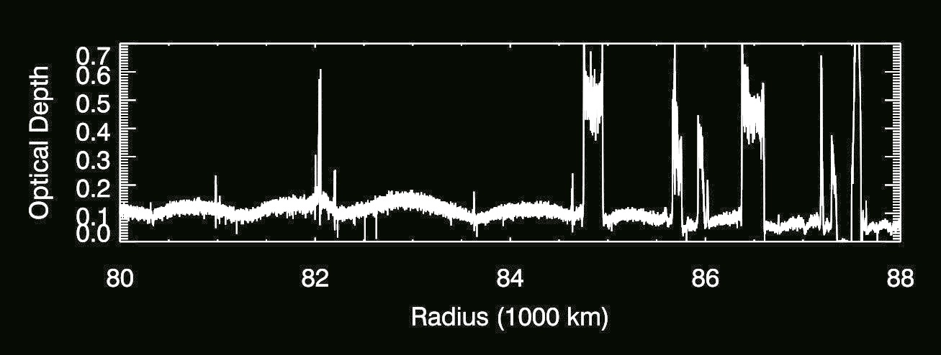
Still more Kronoseismology with Saturn’s rings
M.M. Hedman, P.D. Nicholson, R.G. French, M. El Moutamid
C
B
A

Slide 2
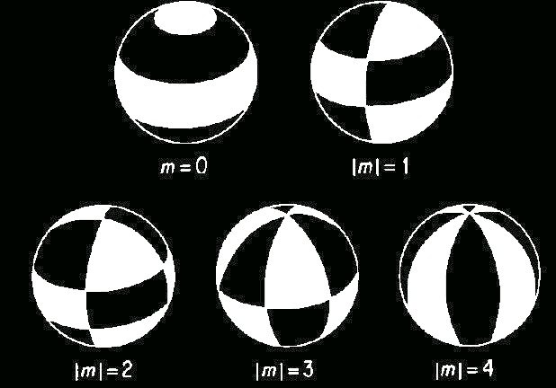
Giant planets have a well-defined series of normal modes
All 𝓁=4
Marley & Porco (1993)

Slide 3
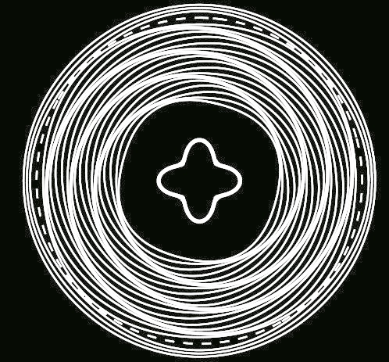
Oscillations in the planet produce spiral patterns in the rings.
Spiral wave with 4 arms
Planetary mode with m=4
The number of spiral arms in the ring → azimuthal wavenumber of oscillation
The pattern speed of the wave → frequency of the planetary oscillation

Slide 4
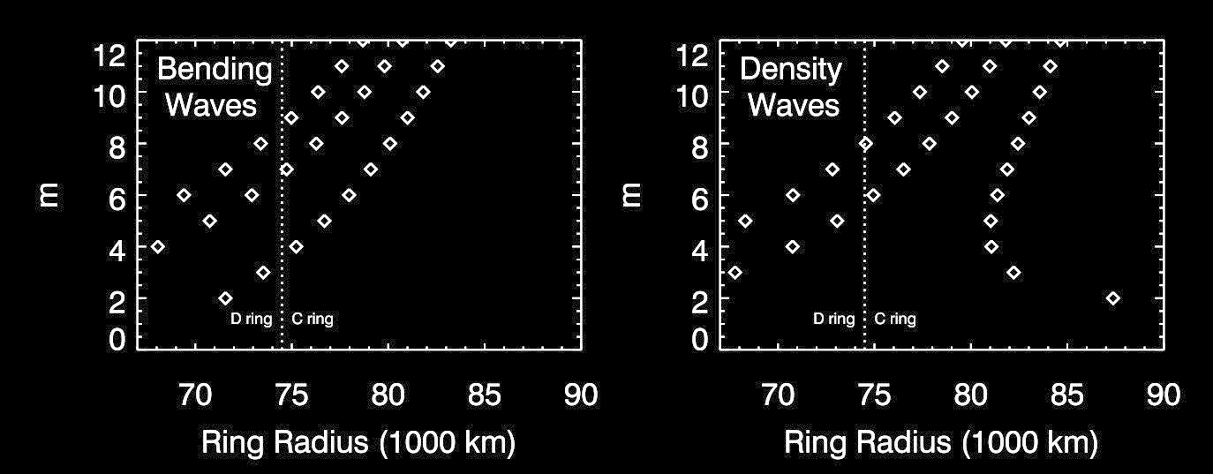
For a given planetary interior model, the locations of the resonances with specific normal modes can be predicted.
𝓁=m+5
𝓁=m+4
𝓁=m+3
𝓁=m+1
𝓁=m+2
𝓁=m
Normal modes with 𝓁=m, m+2… generate density waves
Normal modes with 𝓁=m+1, m+3… generate bending waves
Predictions from C. Mankovich

Slide 5
Oscillations in the planet produce spiral patterns in the rings.
Spiral wave with 4 arms
Planetary mode with m=4
The number of spiral arms in the ring → azimuthal wavenumber of oscillation
The pattern speed of the wave → frequency of the planetary oscillation

Slide 6
Prior work had identified eight strong density waves in the middle C ring.
𝓁=m+4
𝓁=m+2
𝓁=m
m=2
m=3
m=2
m=3
m=3
m=4
m=10
m=2

Slide 7
These waves fall close to where models predicted the
sectoral mode resonances should be.
𝓁=m+4
𝓁=m+2
𝓁=m
m=2
m=3
m=2
m=3
m=3
m=4
m=10
m=2

Slide 8
Most non-sectoral waves should fall in the inner C ring.
Identifying waves here requires very precise geometric navigation
French et al. (submitted)
𝓁=m+4
𝓁=m+2
𝓁=m
74
76
78
80

Slide 9
Most non-sectoral waves should fall in the inner C ring.
3 density waves have been identified in this region, two appear to be fundamental normal modes, but one appears to be something else.
𝓁=m+4
𝓁=m+2
𝓁=m
9
density
2
7
74
76
78
80

Slide 10
Most non-sectoral waves should fall in the inner C ring.
𝓁=m+5
𝓁=m+4
𝓁=m+3
𝓁=m+1
𝓁=m+2
𝓁=m
bending
8
density
7
4
9
2
9
7
74
76
78
80

Slide 11
What about the rest of the sectoral normal modes?
𝓁=m+4
𝓁=m+2
𝓁=m
m=2
m=3
m=2
m=3
m=3
m=4
m=10
m=2

Slide 12
Detangling waves with wavelets
Average profile of 23 occultations
Average wavelet signal
Fraction of signal consistent with a
5-armed spiral rotating at 1593.6⁰/day
Fraction of signal consistent with a
5-armed spiral rotating at rates close to 1593.6⁰/day
Reconstructed wave signal.
m=5

Slide 13
Detangling waves with wavelets
This particular region contains both an m=5 and a m=11 wave
m=5
m=11

Slide 14
The m=5 wave is probably from a sectoral normal mode
with 𝓁=m=5,
The m=11 wave is probably from a mode with 𝓁=13, m=11.
𝓁=m+4
𝓁=m+2
𝓁=m
2
2
3
3
3
4
5
10
2
11

Slide 15
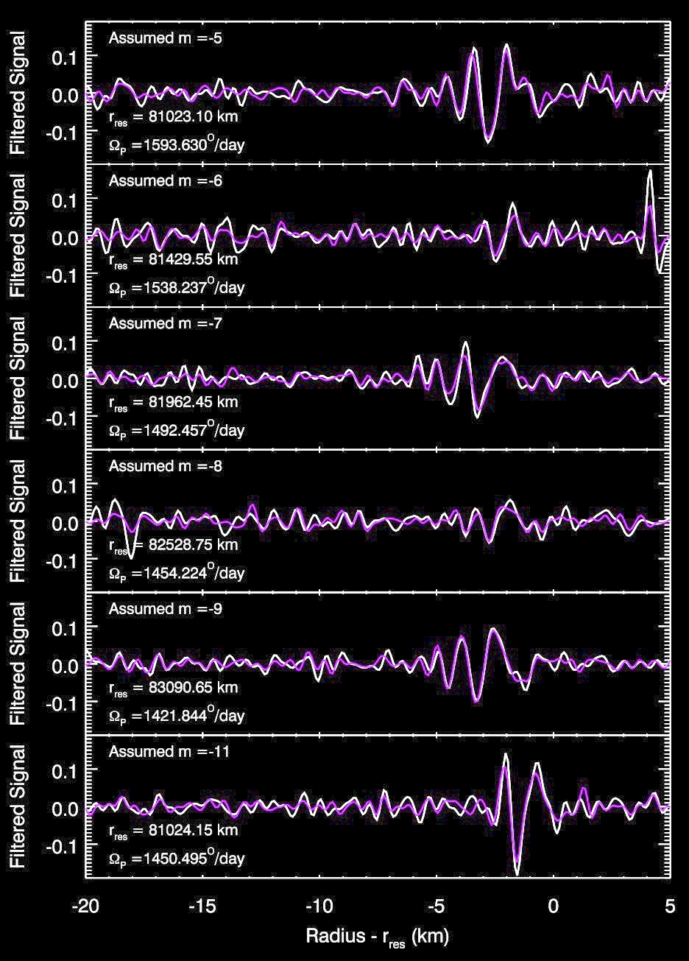
m = 5
More general searches also found weak signals with m=6,7,8 and 9
The reconstructed profiles of these weaker waves are consistent across the course of the Cassini mission.
Data before 2010
Data after 2010
m = 6
m = 7
m = 8
m = 9
m = 11

Slide 16
These additional waves appear to fill out the sequence of sectoral normal modes.
𝓁=m+4
𝓁=m+2
𝓁=m
2
2
3
3
3
4
5
10
2
11
6
7
8
9

Slide 17
Current state of knowledge about Saturn’s normal modes
𝓁=m+5
𝓁=m+4
𝓁=m+3
𝓁=m+1
𝓁=m+2
𝓁=m
See talks by E. Dederick and C. Mankovich on what these mean for the planet!
Previously published (HN 2013, 2014;
French et al. 2016)
French et al. 2018 (submitted)
Hedman et al. 2018 (submitted)

Slide 18
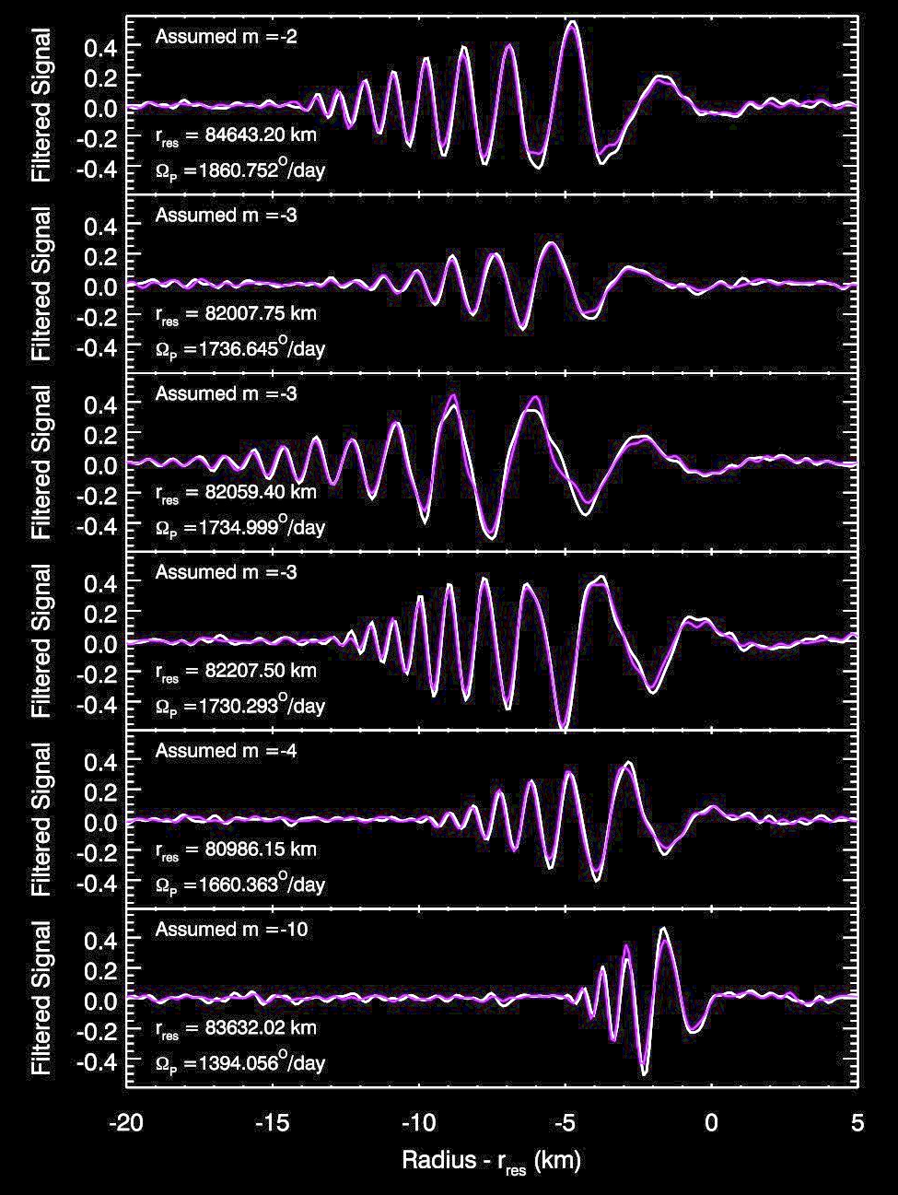
Why are the amplitudes of the sectoral waves so variable?
m = 2
m = 5
m = 3
m = 6
m = 3
m = 7
m = 3
m = 8
m = 4
m = 9
m = 10
m = 11

Slide 19
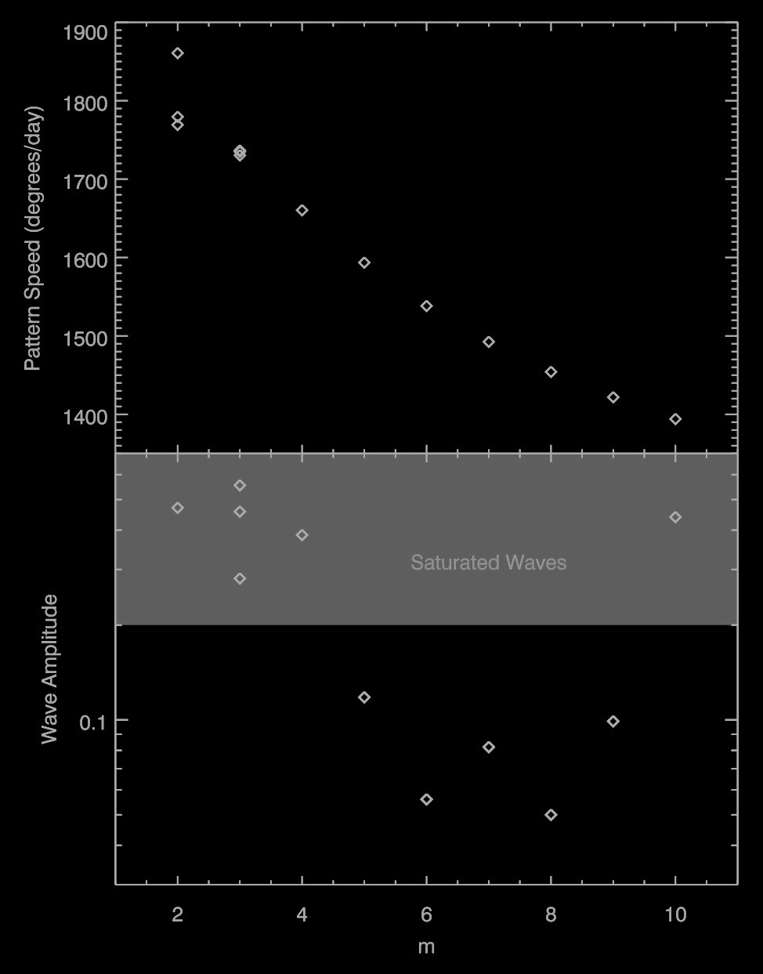
What determines the strength of the normal mode amplitudes inside the planet?

Slide 20
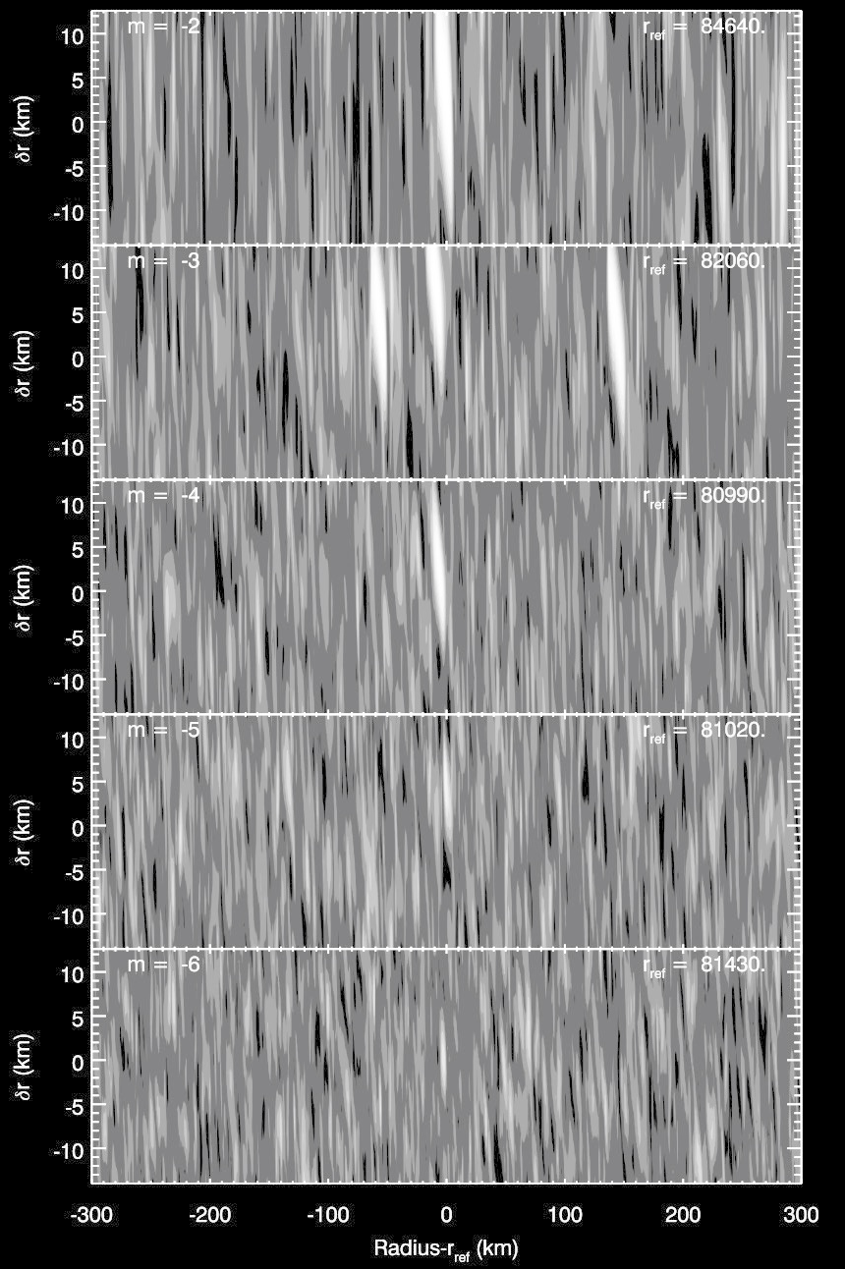
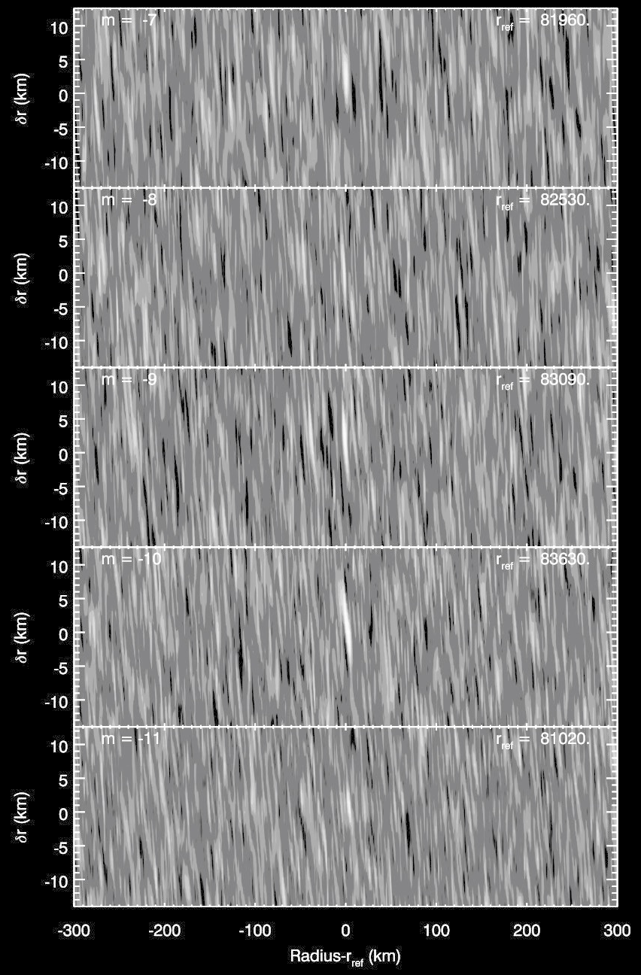
Similar techniques allowed us to find other waves
m = 2
m = 7
m = 3
m = 8
m = 4
m = 9
m = 5
m = 10
m = 6
m = 11
(non-sectoral)

Slide 21
Previously, we had identified 8 strong waves associated with fundamental planetary normal modes
m=2
m=3
m=2
m=3
m=3
m=4
m=10
m=2

Slide 22
Normal modes with 𝓁=m, m+2… generate density waves
Normal modes with 𝓁=m+1, m+3… generate bending waves
All 𝓁=4
Marley & Porco (1993)

