Slide 1
Non-Temperature Results from CIRS
Stu Pilorz¹, Scott Edgington², Shawn Brooks²,
Nicolas Altobelli³, Joshua Colwell⁴, Mark Showalter^{1,}
Linda Spilker²
1 SETI Institute
2 JPL
3 ESA, Madrid
4 UCF Dept. of Physics
Cassini Final Symposium, Boulder, CO 13 August, 2018

Slide 2
Brief Rings & CIRS overview (for Tamas!)
Occultation Results
IR Emissivity Results

Slide 3
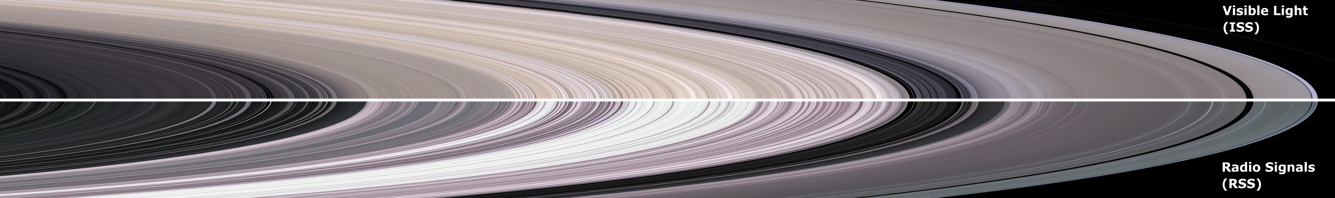
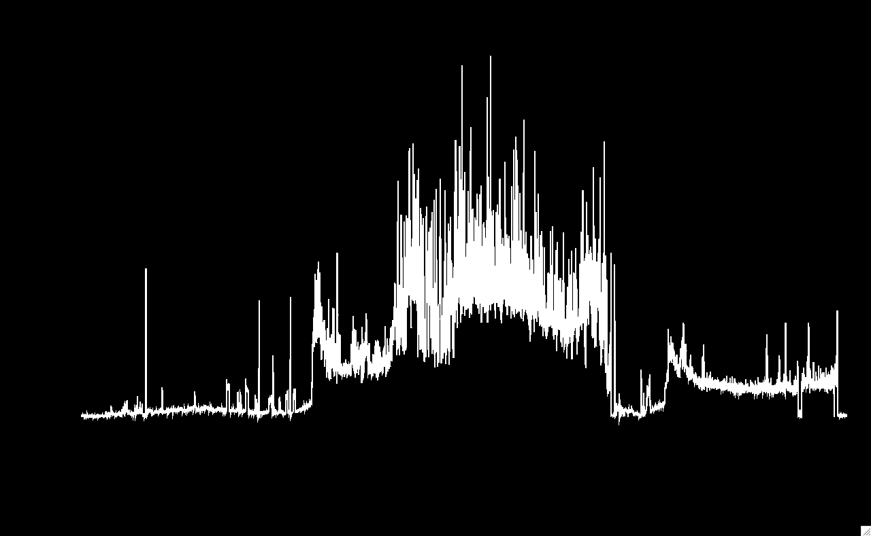
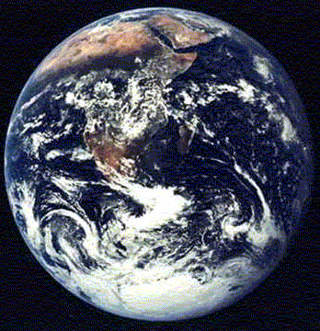
[Very] Brief Overview:

Slide 4
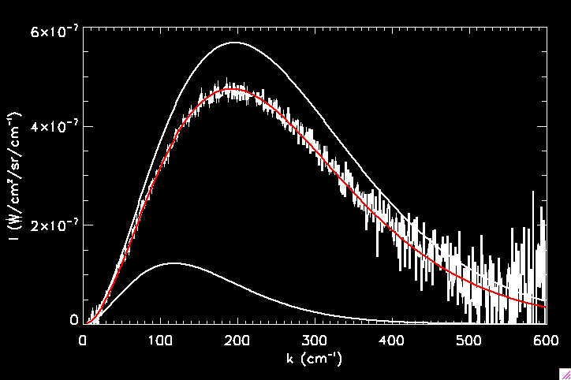
The rings are observed to be Planck emitters in the
20-500um region:
I(k) = beta * B(k,T)
beta
T

Slide 5
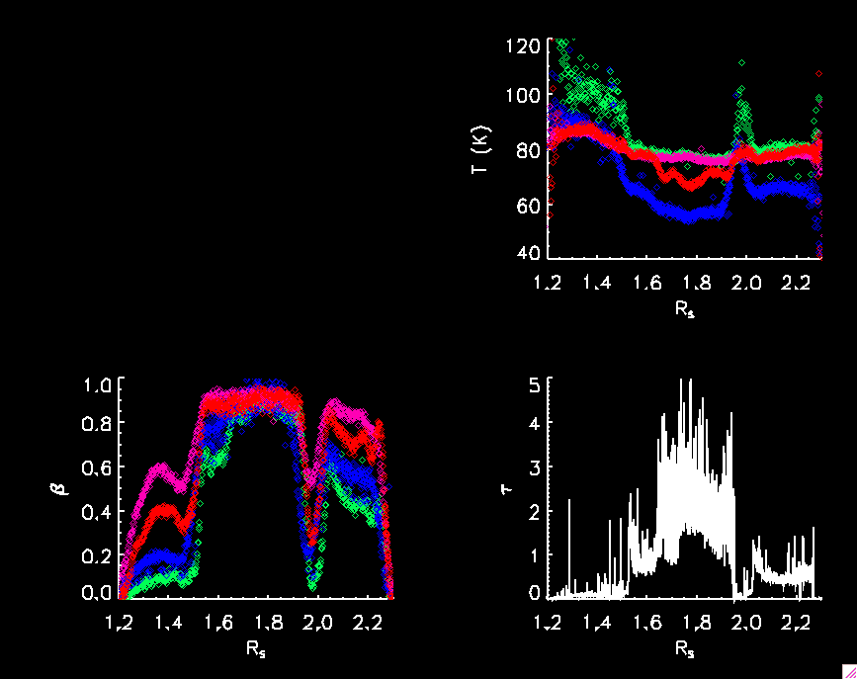
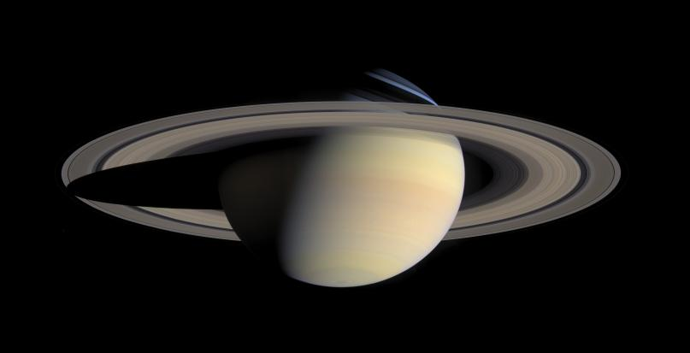
We observe (T,beta) from all different geometries

Slide 6
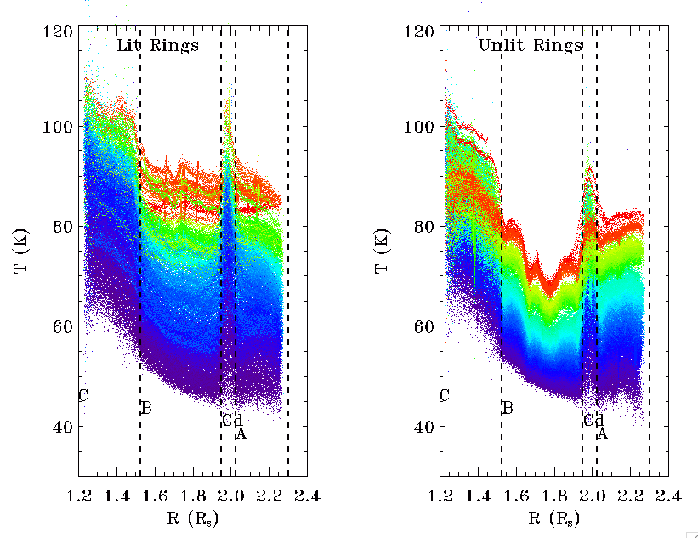
Every CIRS spectrum taken during the mission has a fitted (T,beta) pair:
T vs radius
Colored by
solar elevation
(purple = low,
red = high)

Slide 7
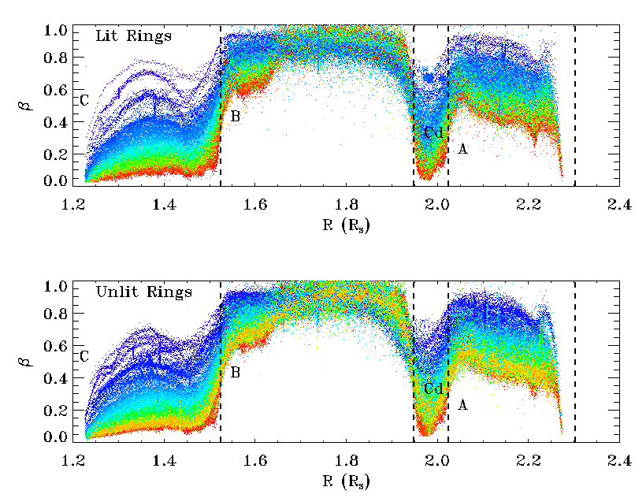
Beta vs radius, colored by viewing elevation angle (purple=low, red=high)

Slide 8
40 < T < 120 : tells a characteristic physical temperature
0 < beta < 1: If the observed flux is from a collection
of blackbody emitters in the FOV,
then beta is expressed as the product of
beta = filling factor x emissivity x f(T)
where f(T) depends on the distribution of
temperatures in the FOV

Slide 9
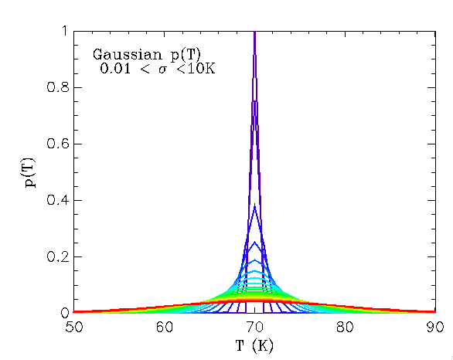
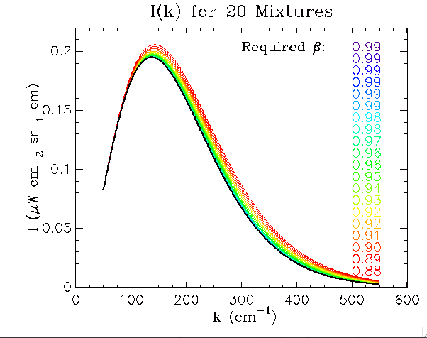
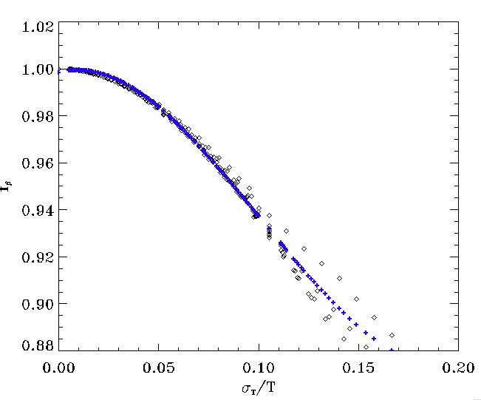
More about f(T):
f(T) decreases
as sub-FOV
T variance
Increases:
This curve has been fit
with temperatures
from 50-110K

Slide 10
Part II: Overview of observations/analyses:
Occultation observations
Analysis of the beta factor

Slide 11
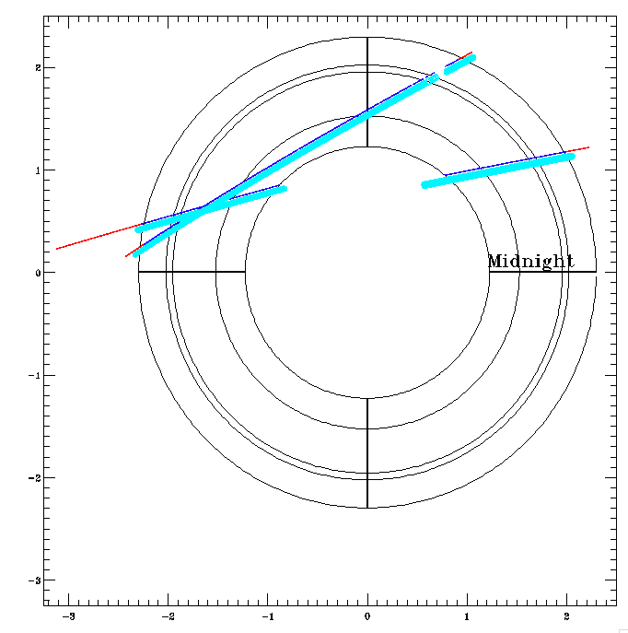
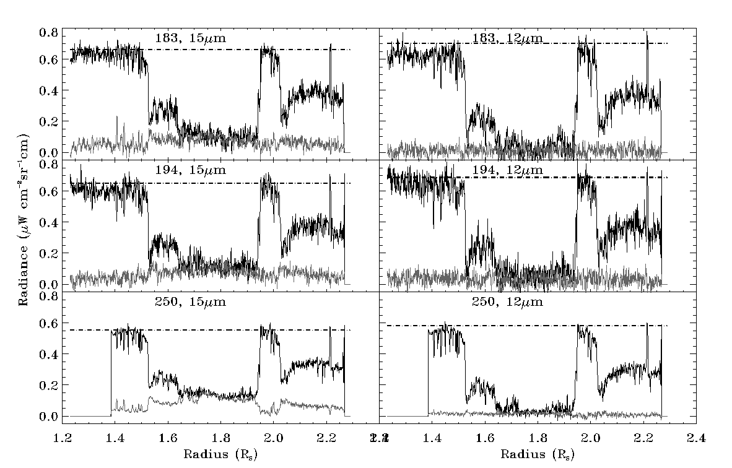
a) Occultation observations: plugged & designed by Scott Edgington
CIRS observed eta Carinae
at 11-18um as it transited the
rings.
In the usual manner, we
derived an optical filling
factor as the difference
of occulted stellar signal and
a null signal, divided by the
unocculted stellar signal.

Slide 12
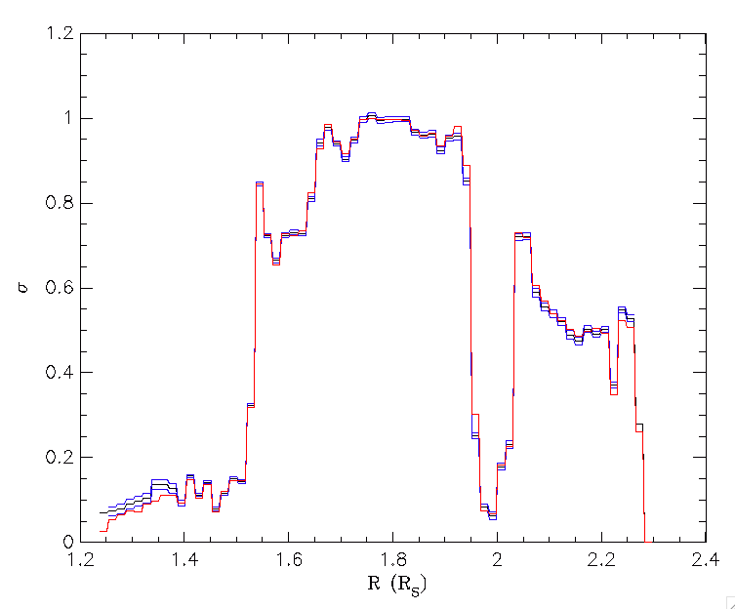
Filling factor: CIRS sees [almost] what UVIS sees
Blue: UVIS at 500km
Red: CIRS FP3 at 500km
B:
A:
C:
Cd:

Slide 13
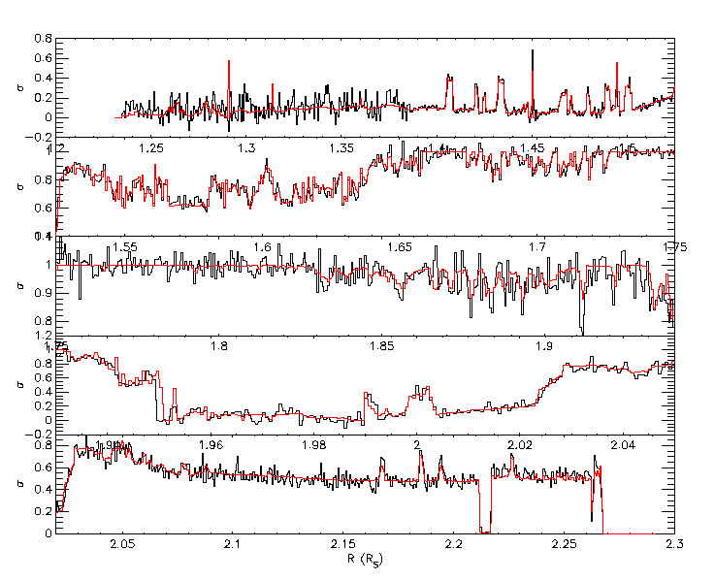
UVIS (red) and CIRS FP3 filling factors at 40km Resolution:

Slide 14
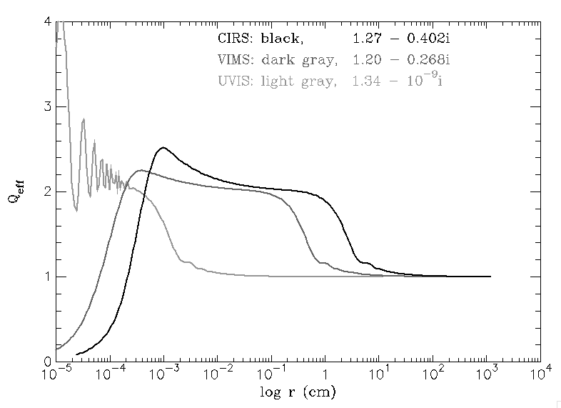
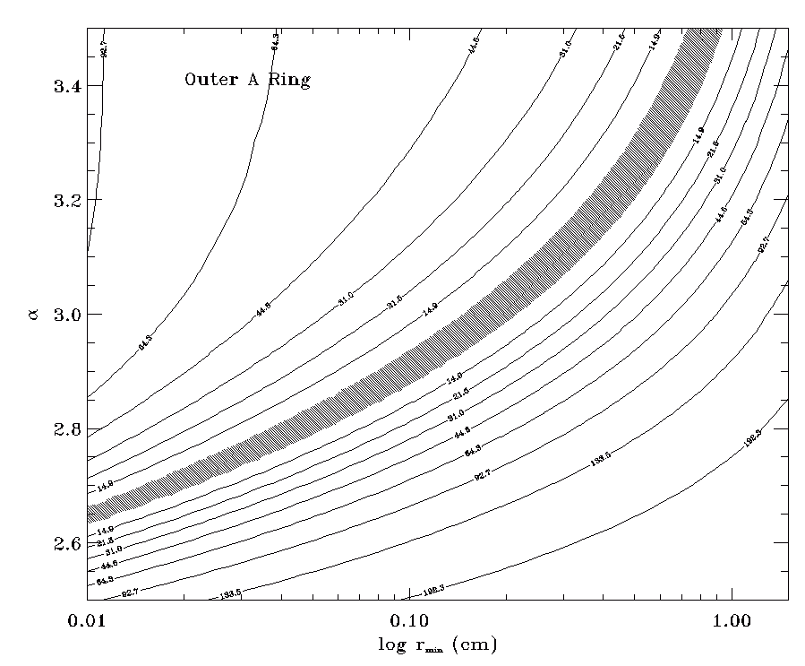
CIRS occultation results:
Effective cross section seen by an
instrument depends on sensor size
relative to diffraction lobe width.
UVIS
CIRS
VIMS
Diffraction lobe width depends upon size distri-
bution in optically thin rings.
OUR RESULTS:
Confirm particles ~5mm in outer A gaps
Consistent with 10um size particles in outer
B ring gaps

Slide 15
b) Analysis of information in beta:

Slide 16
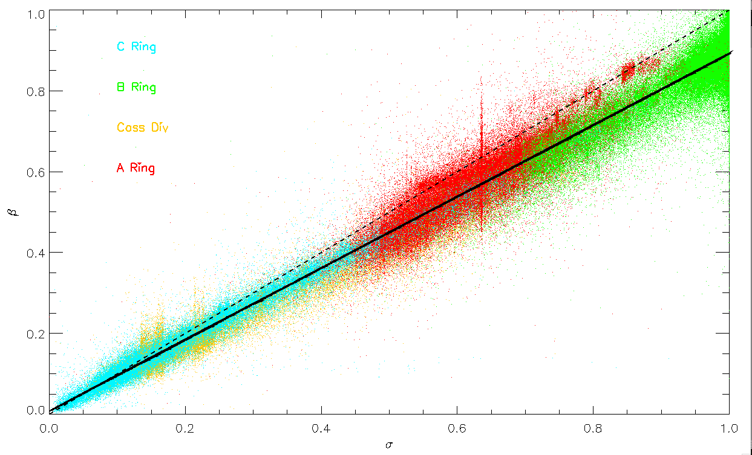
Line fit: beta = (epsilon f ) sigma ~ 0.9 sigma
Line fit: beta = 0.9 sigma
= (epsilon f) sigma
So epsilon*f(varT) ~ 0.9

Slide 17
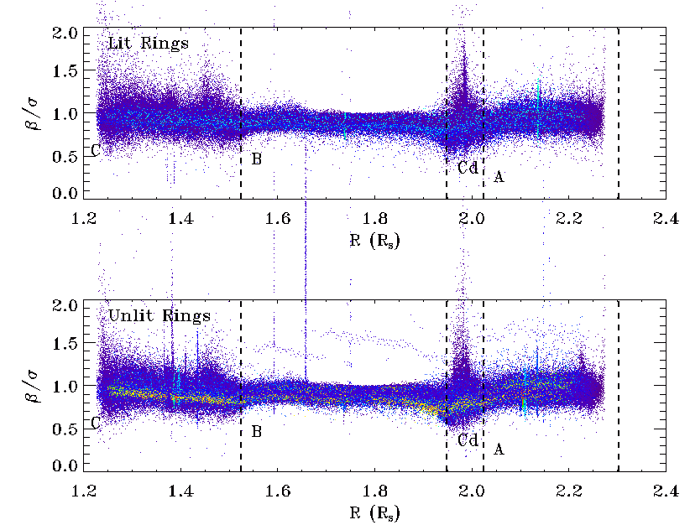
Radial variation of beta/sigma [~ emissivity * f(T)] :

Slide 18
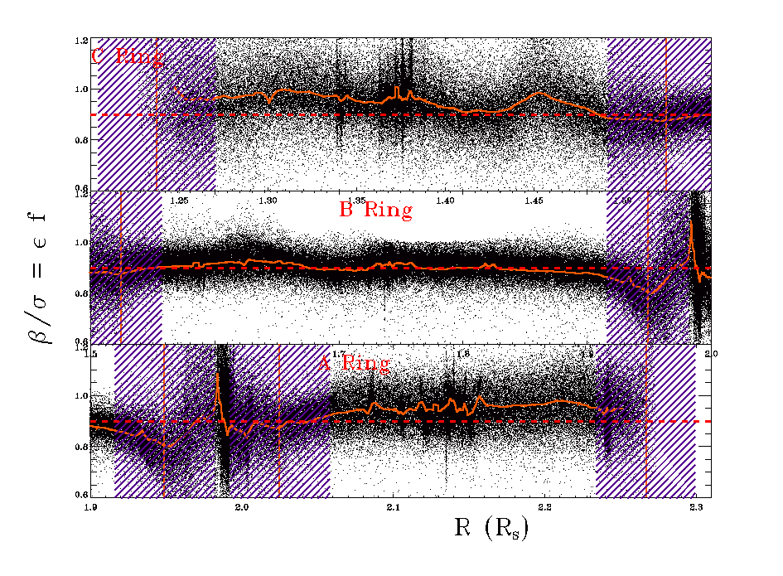
Radial Variation in epsilon * f:

Slide 19
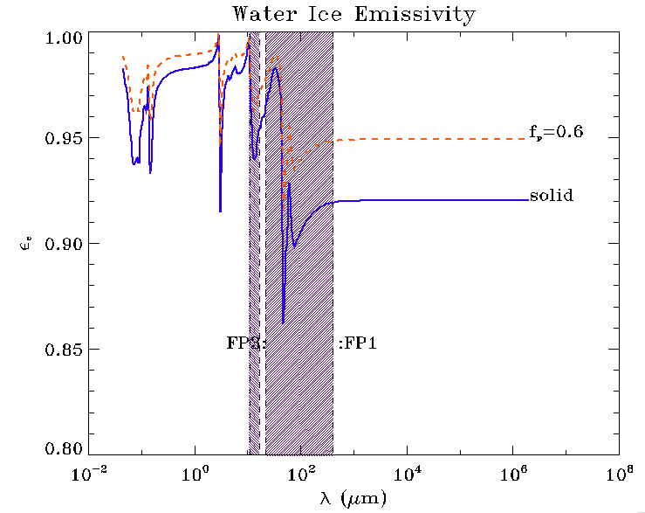
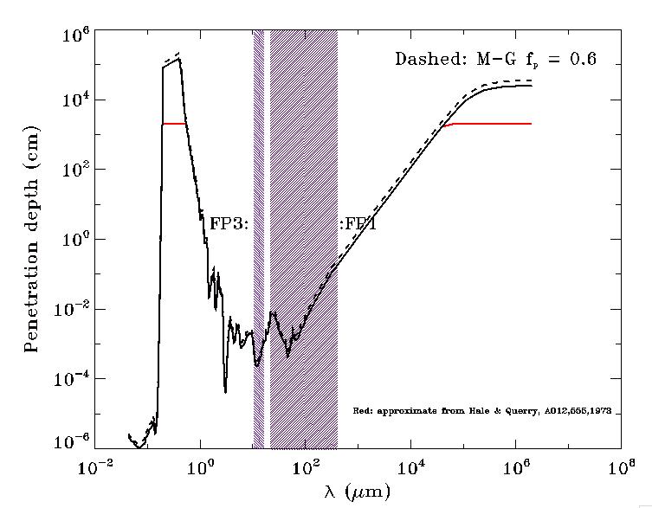
Emissivity could be anywhere
between .91 and 1 for icy surface,
Depending on porosity, contaminants
Penetration depth for FP1
is 10um -1mm:
So for large particles, assume
we’re seeing surface effects:

Slide 20
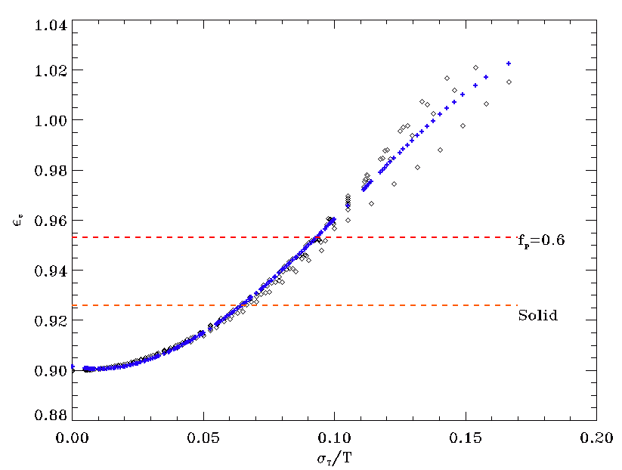
Recall our fit for f (sigma_T)
epsilon(sigma_T/T)
assuming R=0.9
Epsilon = R_observed / f(sigma_T)

Slide 21
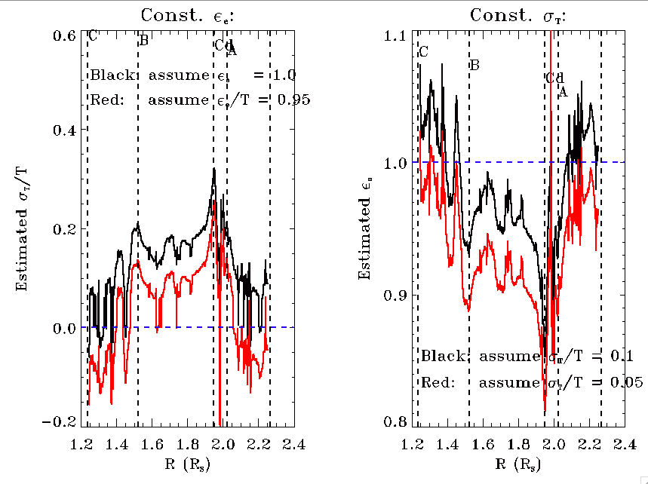

Slide 22
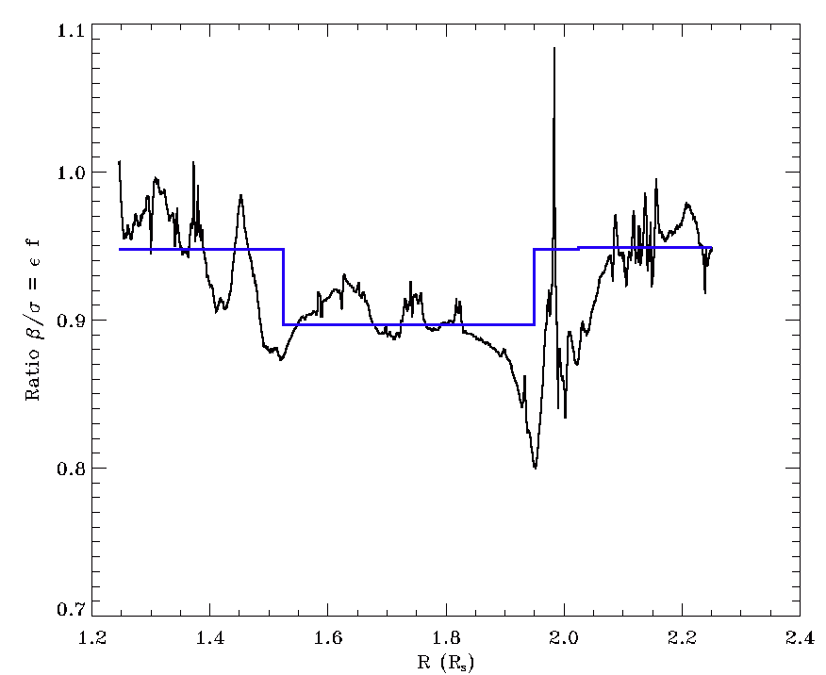
Simplify the fit to R(r):
R ~ 0.95 in C, Cd and A ring
R ~ 0.89 in B ring

Slide 23
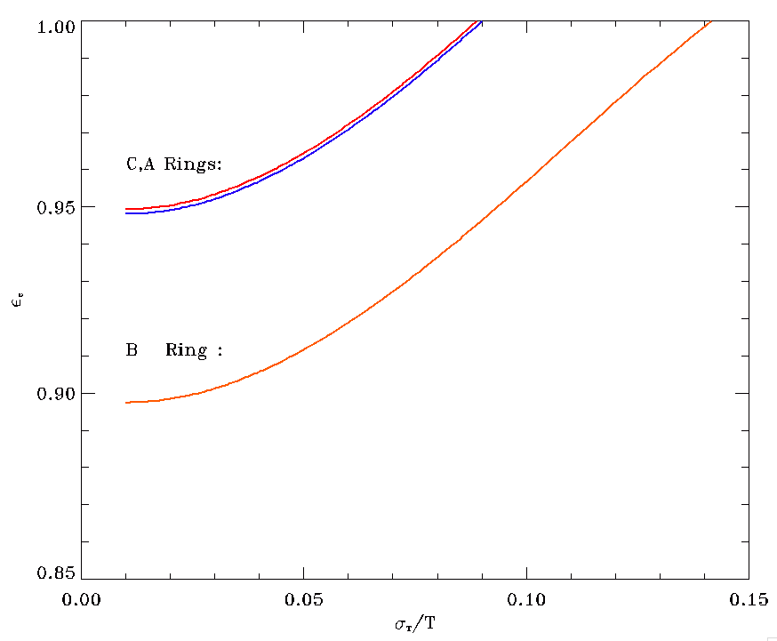
R_observed~0.95
R_observed ~0.89

Slide 24
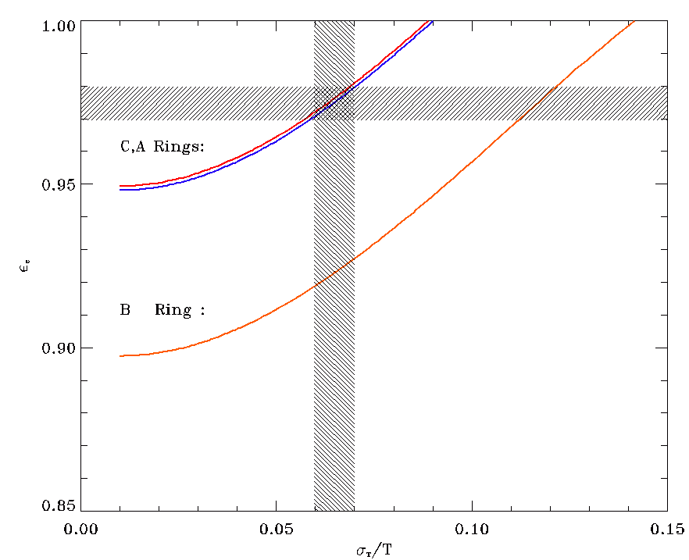
IF emissivity is the same everywhere, it must be > 0.95 AND the
temperature variance in the B ring must be larger than in the C ring—
but it’s likely to be _smaller_.
IF temperature variance is the same everywhere, then the C and A rings
have a higher emissivity than the B ring.

Slide 25
From Shawn Brooks last week: a plot of his COMPLIT
observations. These have good enough S/N to investigate
multi-temperature effects!!

Slide 26
Summary:
1: Occultations with CIRS FP3 add 12um and 15um
to the armory. Q_eff(r) allows detection of
particles with .1mm < 1cm, and could allow
detection of particles ~ 10um.
2. Observations of the fitted “ring emissivity” during
the whole mission imply that either the small scale
temperature variance or the emissivity– and
probably both– are different in the B ring from the
other main ring regions.

Slide 27
Backups:

Slide 28
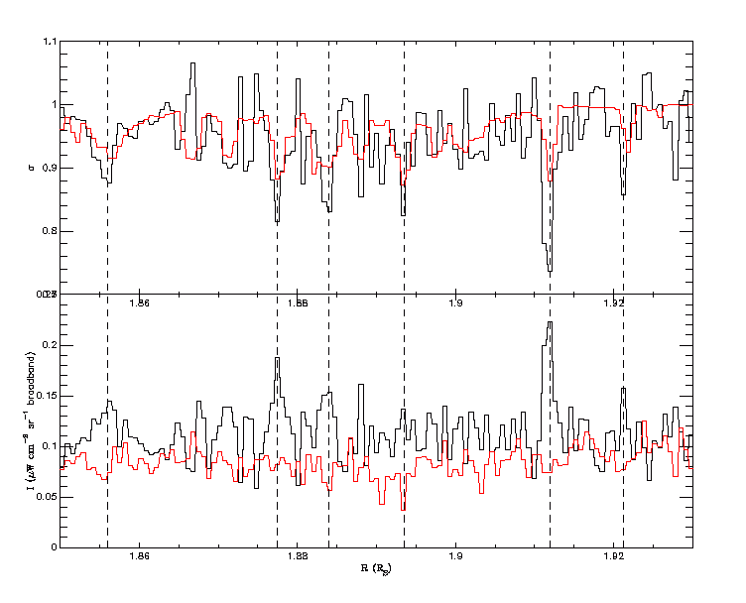

Slide 29
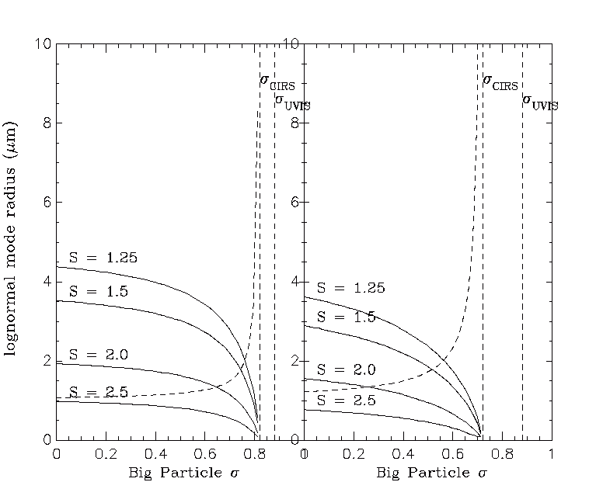

Slide 30
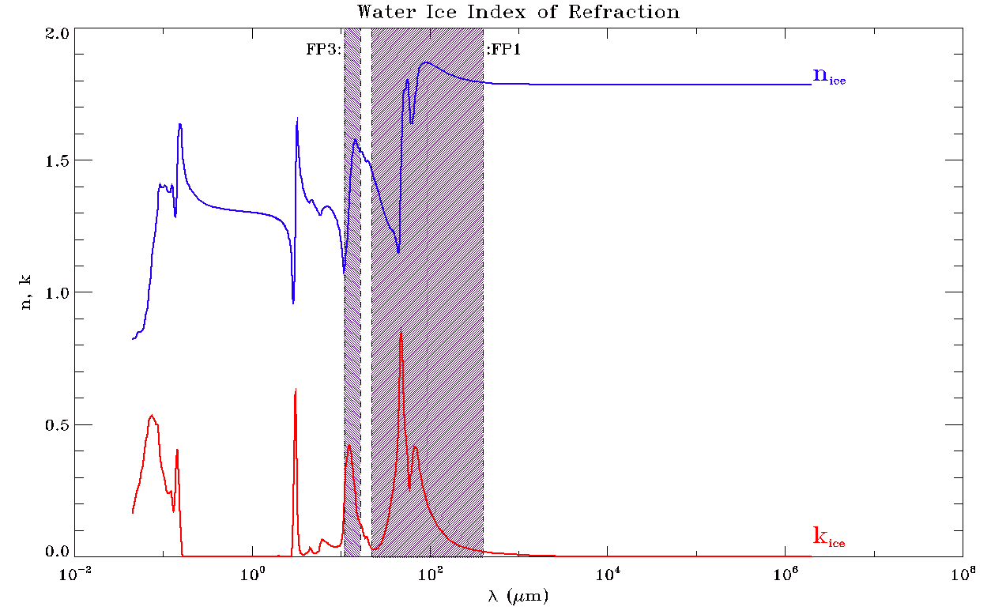
We already examined f(T)’s behavior.
Emissivity effects: depends on geometry and n-ik

Slide 31
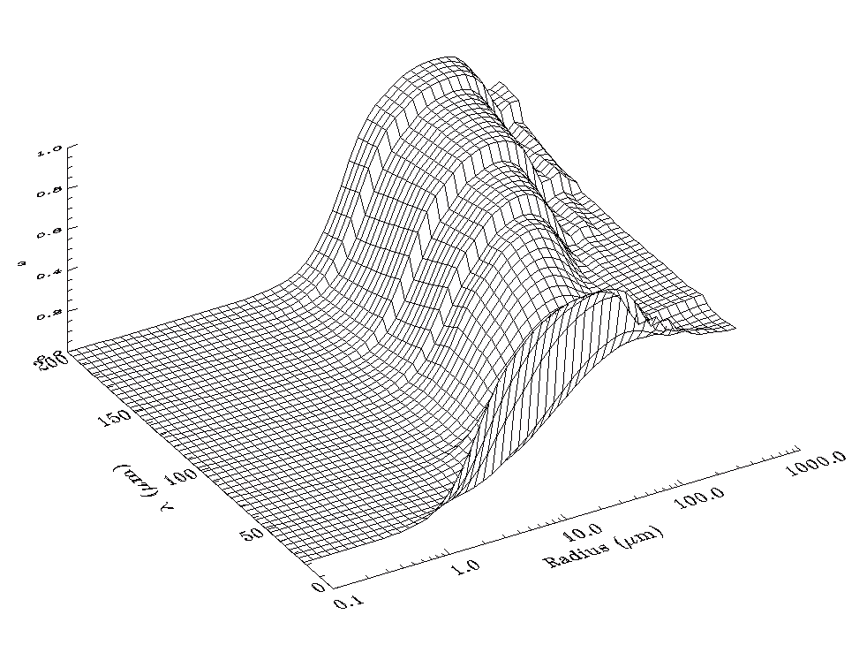
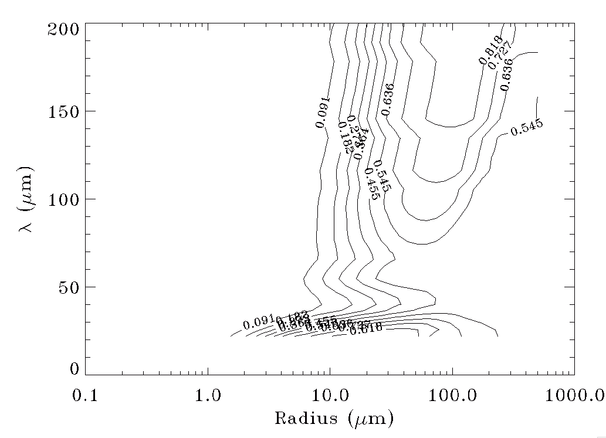
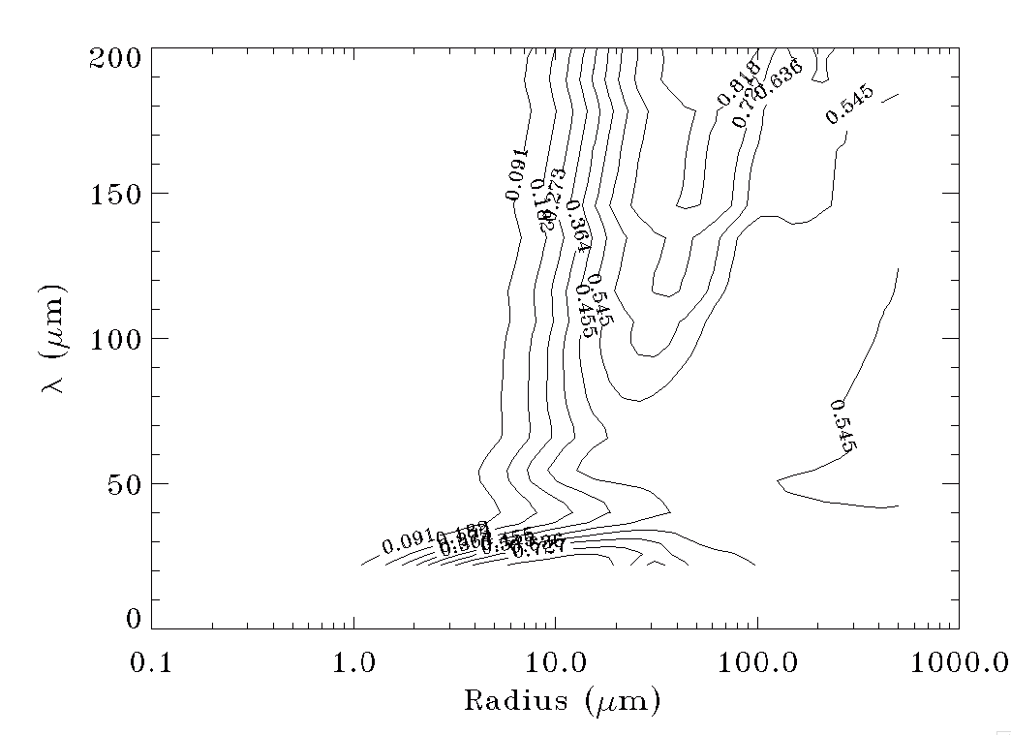
Q_sca/Q_ext:
f_p = 0.6
Mie simulations of solid, porous, and
layered particles, using Qsca/Qext as
albedo relevant to entire particle.
Regardless of porosity, particles <10um
have emissivity nearly 1,
For particles larger than 1cm, we’re seeing
a surface (because the penetration depth
is small).
f_p = 0

Slide 32
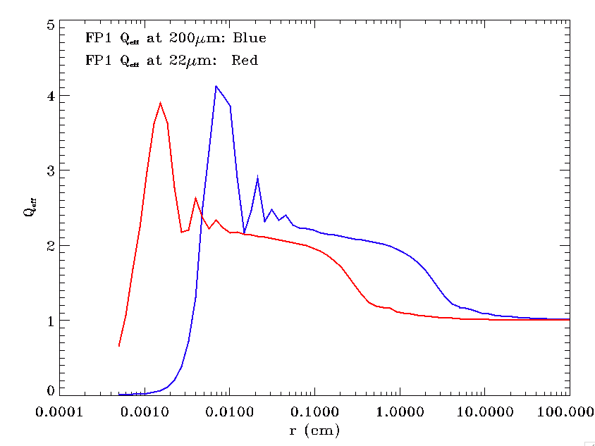

Slide 33
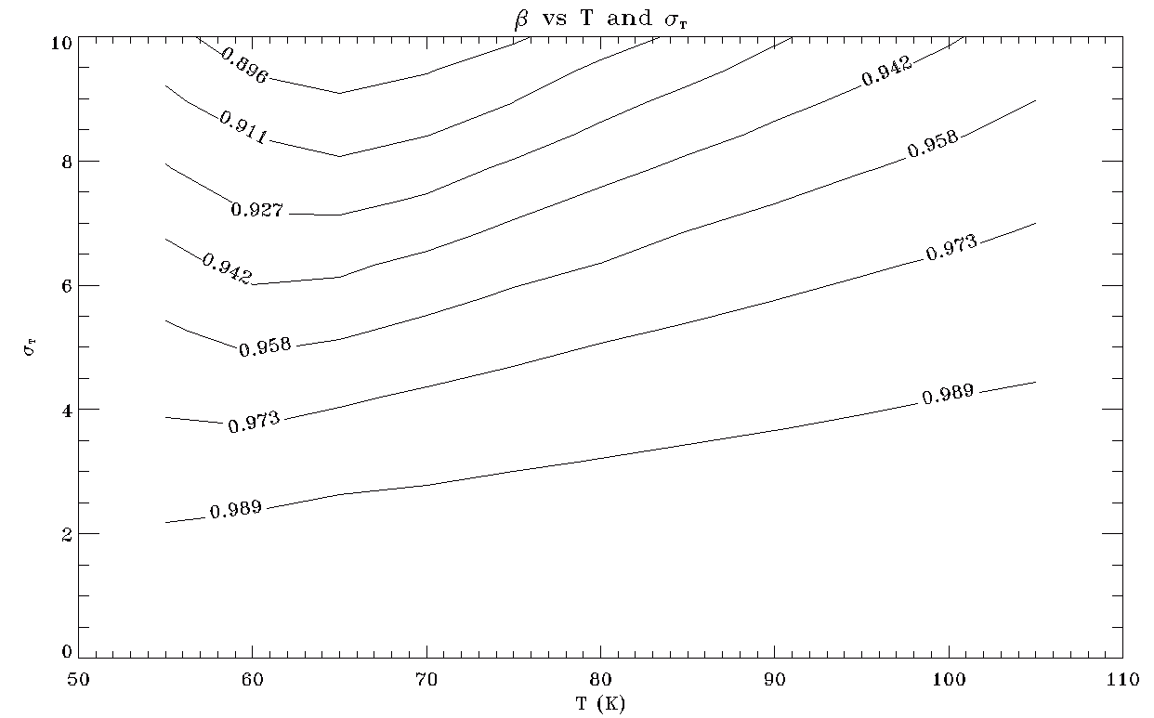

Slide 34
b) Beta:

