Slide 1
Properties of aggregates and particle sizes in the C ring plateaus
Richard G. Jerousek¹, Joshua E. Colwell¹, Matthew M. Hedman², Richard G. French³, Essam A. Marouf ⁴, Larry W. Esposito⁵, Philip D. Nicholson⁶
1. Department of Physics and Florida Space Institute, University of Central Florida, Orlando FL 32816, physics.cos.ucf.edu 2. Department of Physics, Univ. of Idaho, Moscow ID 83844 3. Department of Astronomy, Wellesley College, Wellesley, MA 02481 4. Department of Electrical Engineering, San Jose State University, San José, CA 95192-0080 5. Laboratory for Atmospheric and Space Physics, Univ. of Colorado, Boulder CO 80309 6. Department of Astronomy, Cornell University, Ithaca NY 14853

Slide 2
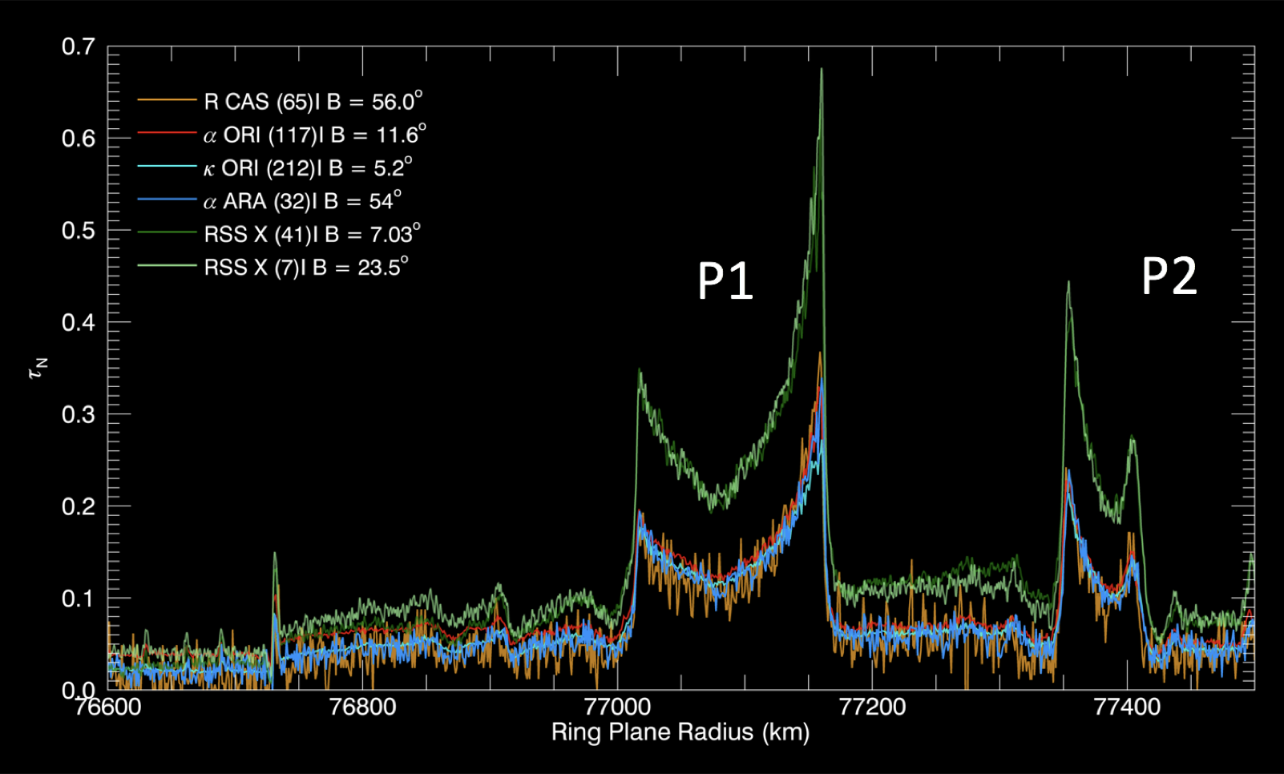
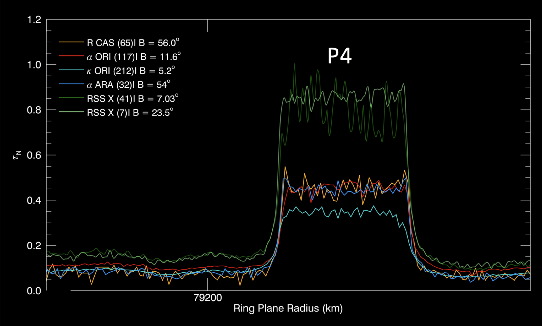
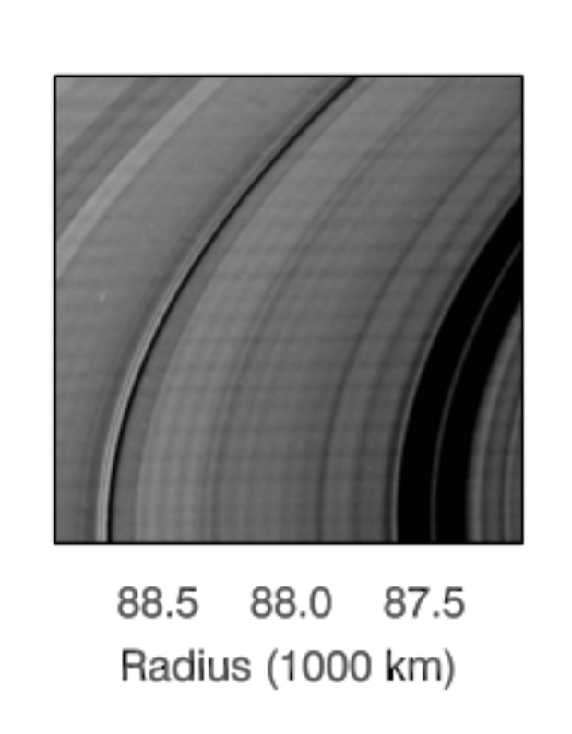
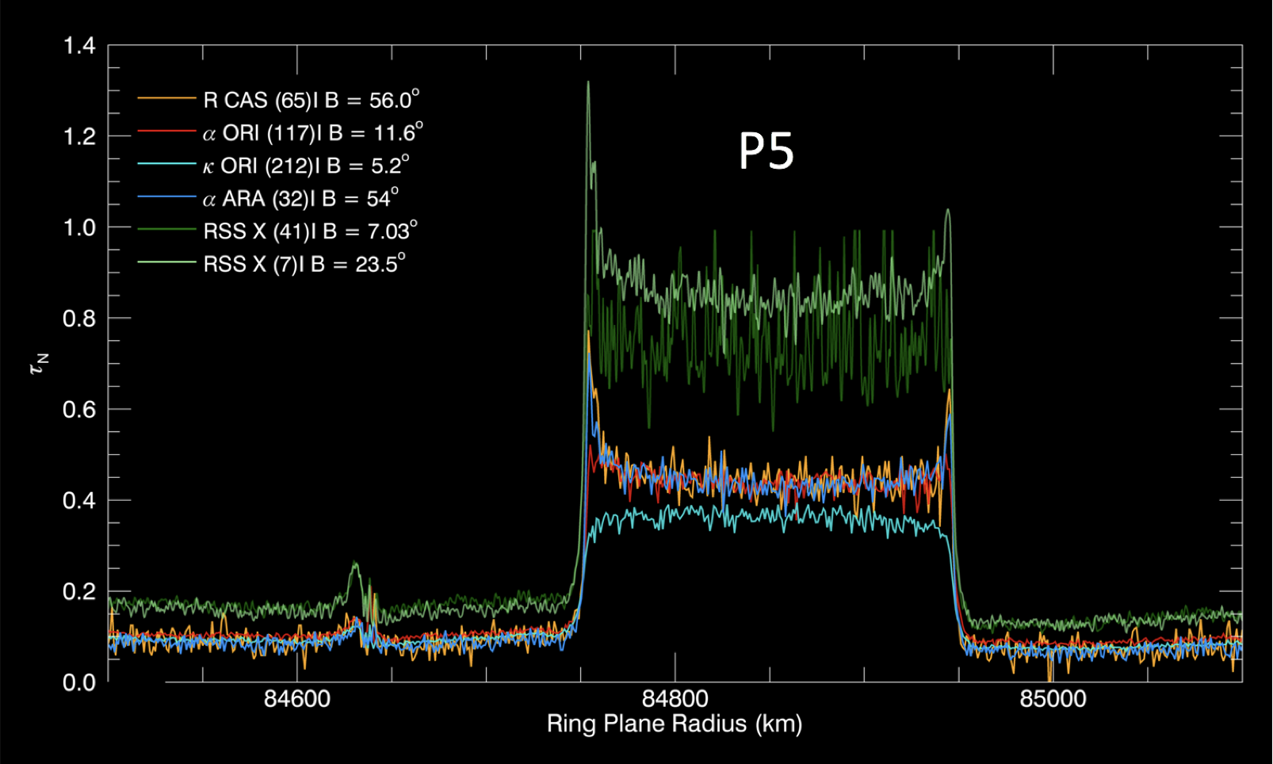
C ring plateaus: some optical depth profiles at a glance
Named for their optical depth profiles, rising above the background C ring in τ over edges spanning several km.
Characteristic U-shaped profile turns upside down at very low incidence angles.
Larger vertical extent of ring near plateau edges.
Hedman et al. (2011)
P8 shadow?
Corrugation shadows
Notes:
The 11 C ring plateaus are named for their appearance in optical depth profiles, The plateaus also have a characteristic U-shape, which in some plateaus is more prominent than in others. I’ve chosen to show just a few of the plateaus in optical depth from RSS X-band, VIMS, and UVIS. The roughly factor of 2 difference between X-band and V/U optical depth is due to the fact that phase information is unknown for V/U and collect diffracted ligh

Slide 3
Texture seen in ring grazing orbits
P1
Dark “streaks” appear dark when viewed from both lit and unlit faces of the rings. Tiscareno et al. (submitted 2018)
Streaks appear to be aligned to the direction of orbital motion.
Pixel scale: ~ 300 - 400 m
50 km
P5
50 km
Notes:
Tiscareno et al. (2018)

Slide 4
UVIS occs resolve many streaks (a.k.a. ghosts)
P5 dr = 31 m, rdθ = 16 m, B = 17.2º
Streaks are < ~ 60 m across and spaced by ~ 0.5 - 1 km.
Some of these are the “ghosts” reported by Baillie et al. (2013), others where not included in their study since they are not completely transparent.
Ghosts are not seen at the same radial location in occultations at different longitudes.

Slide 5
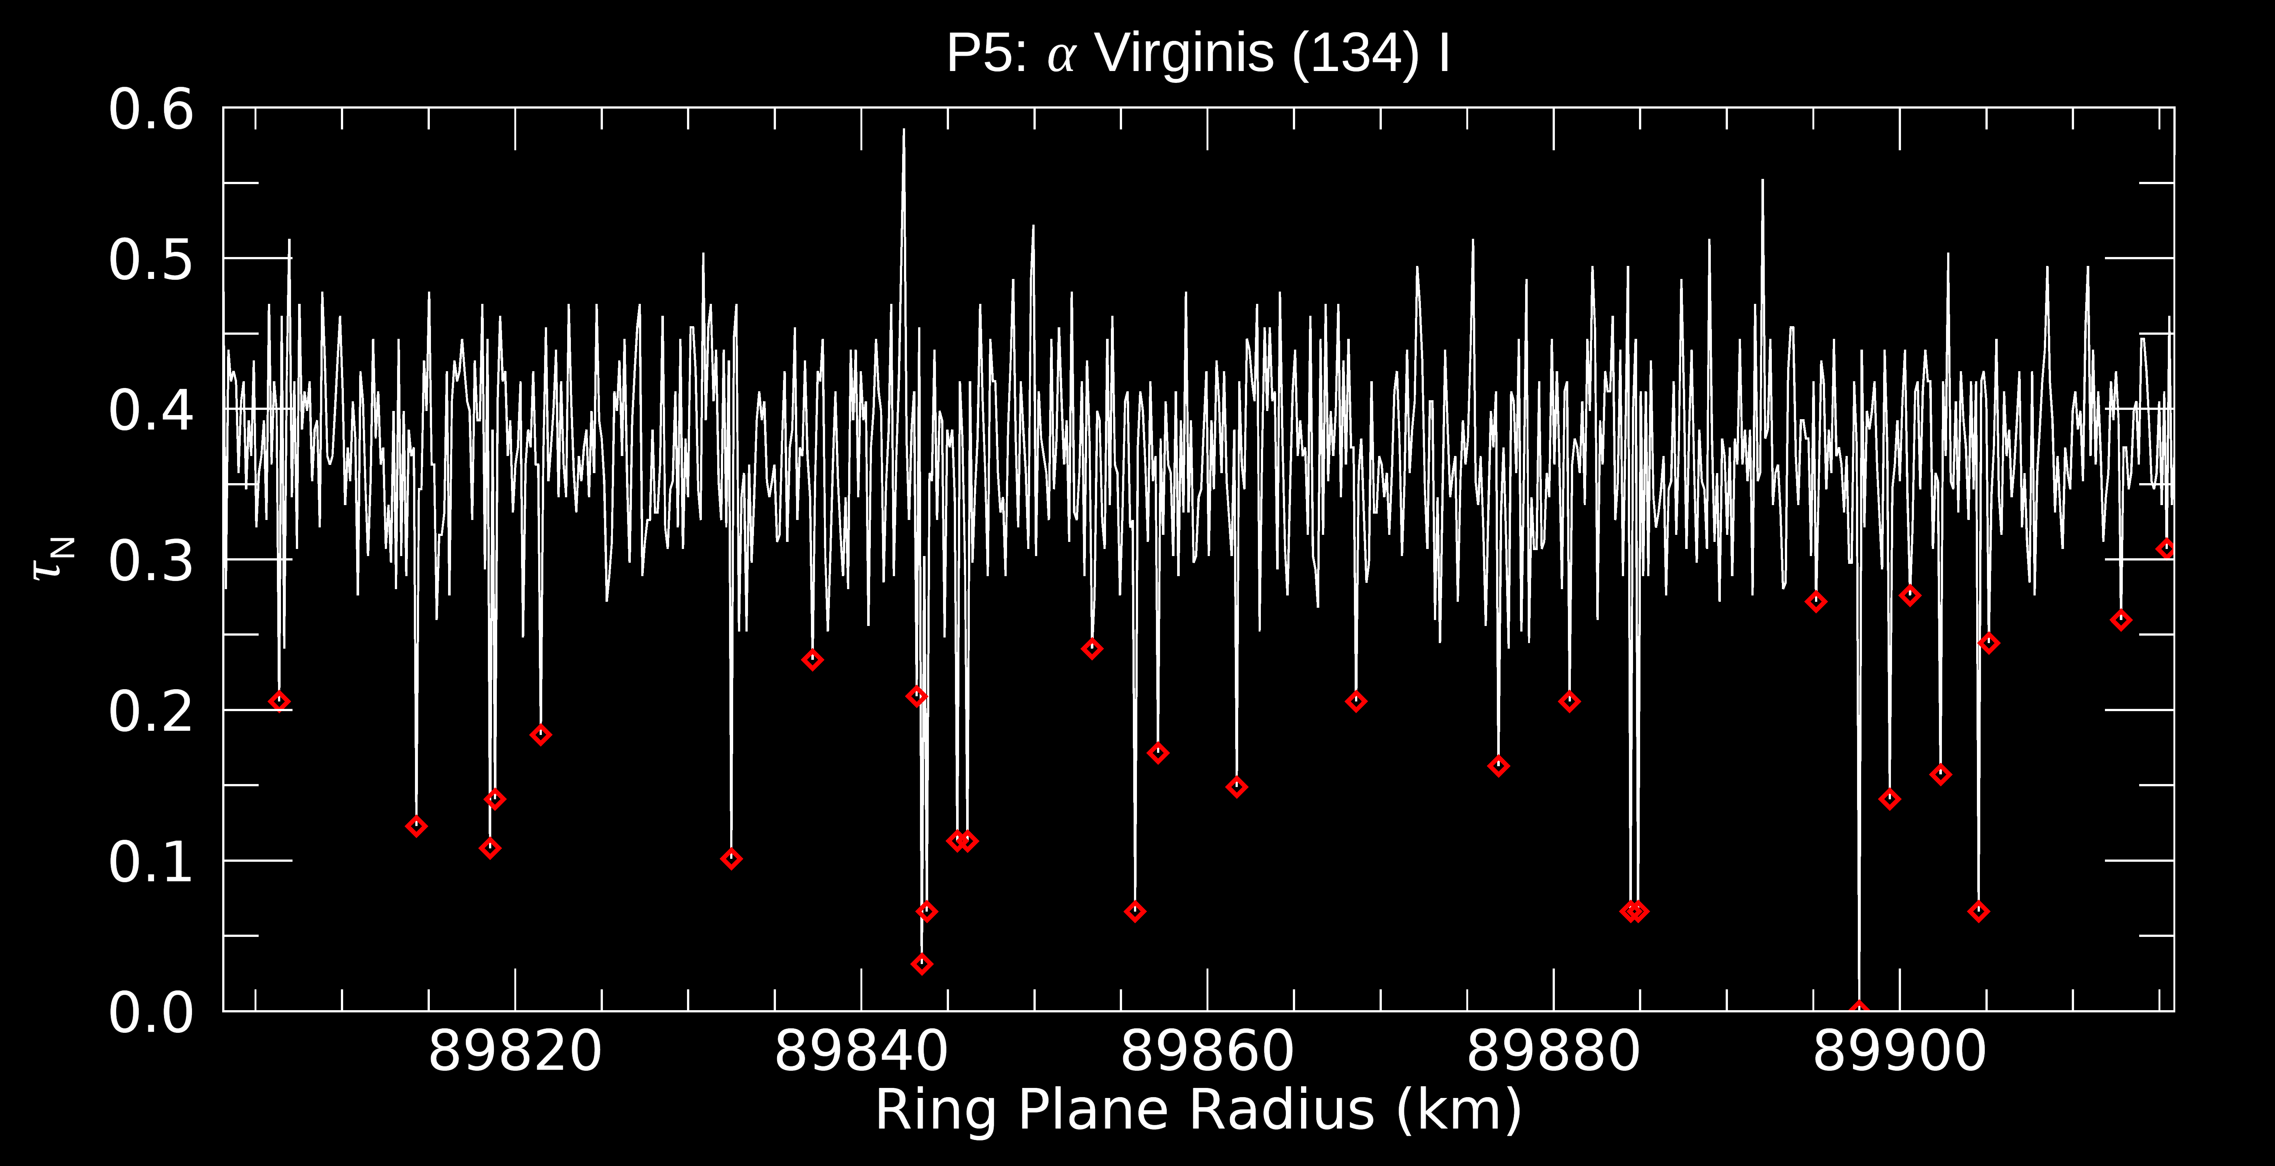
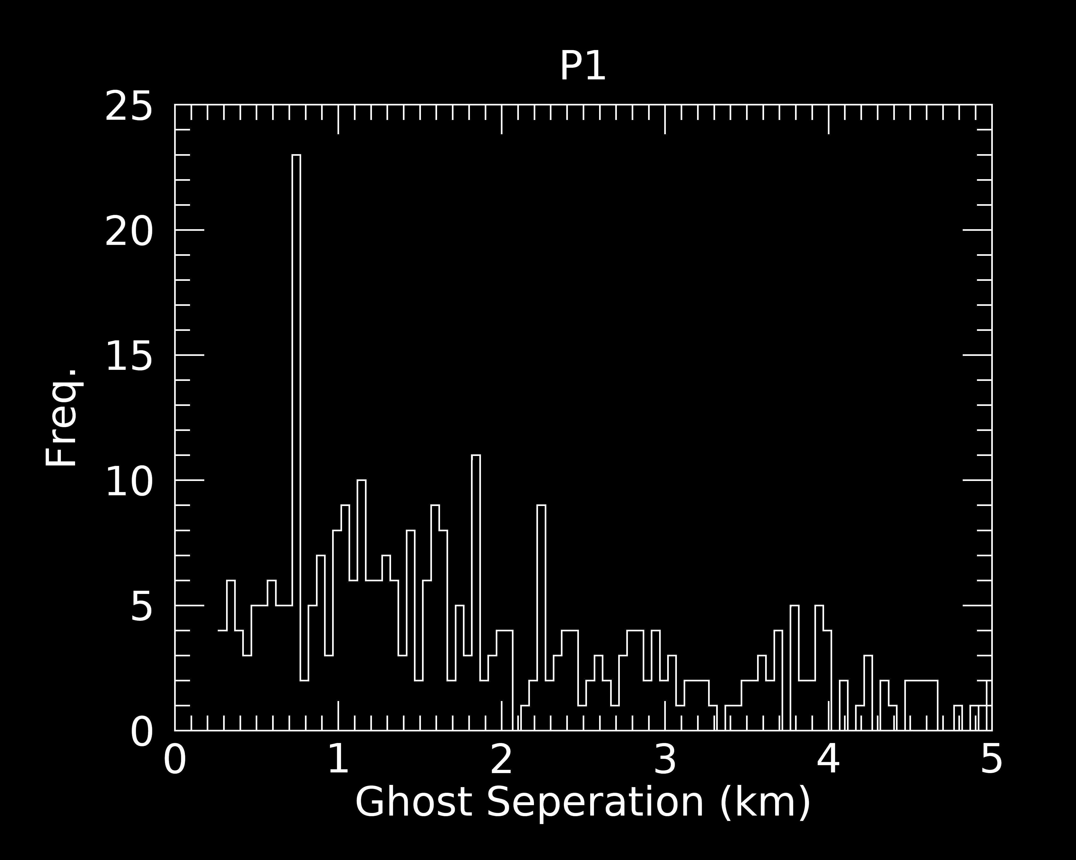
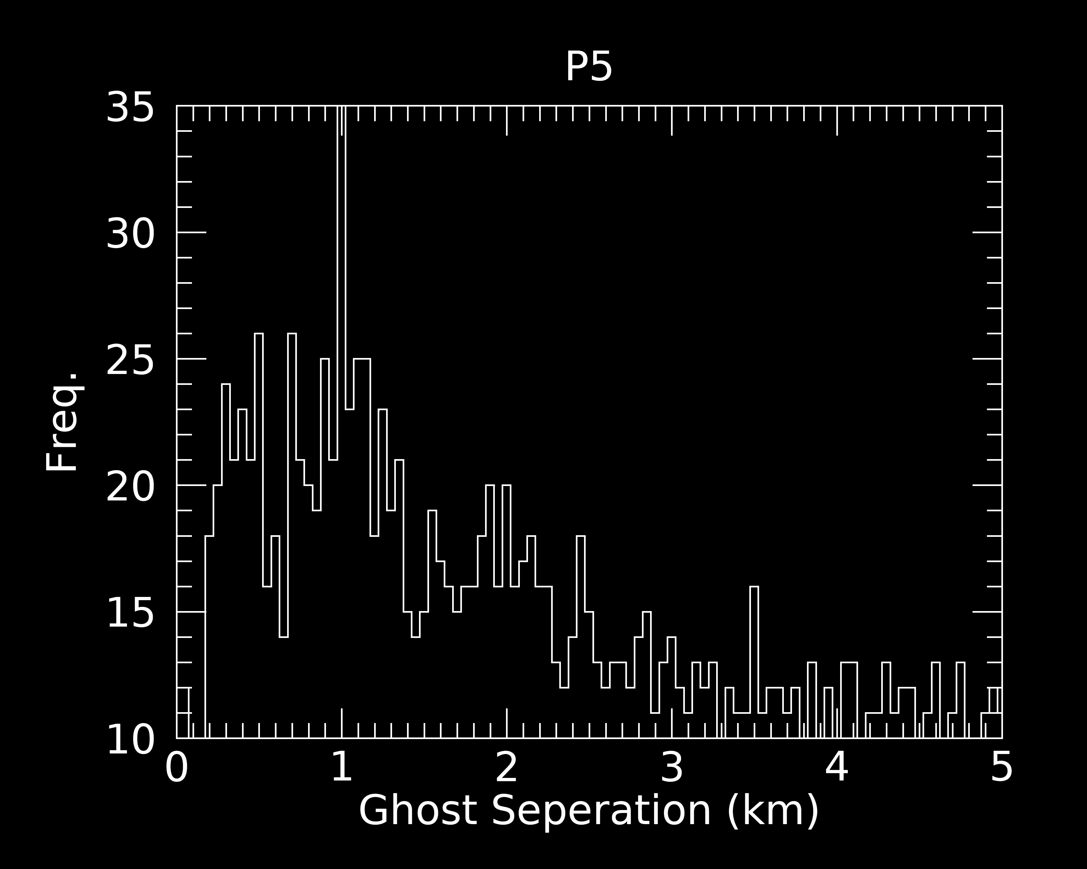
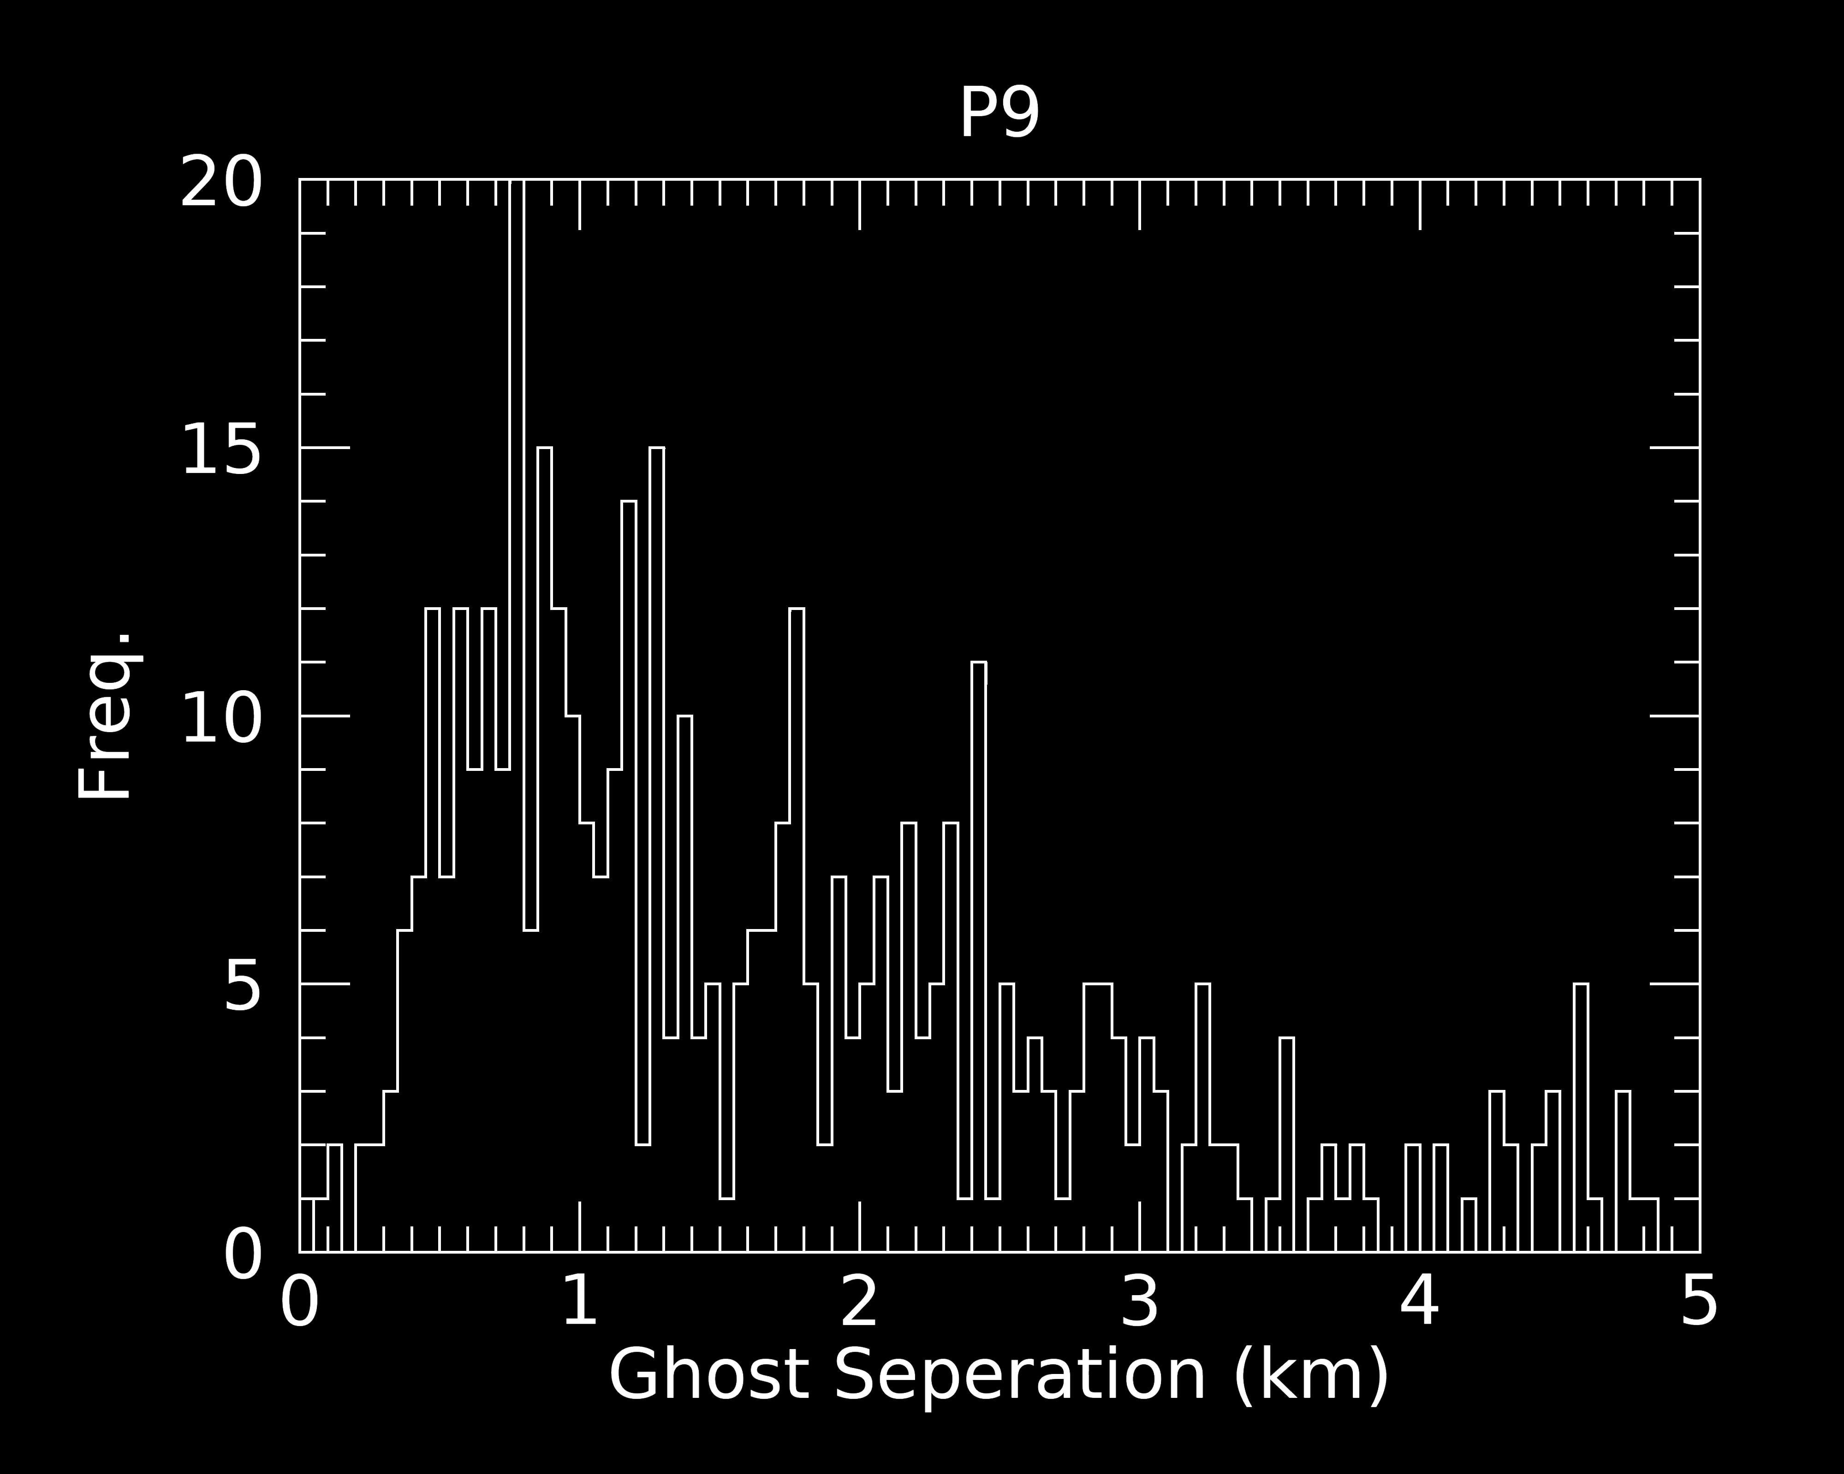
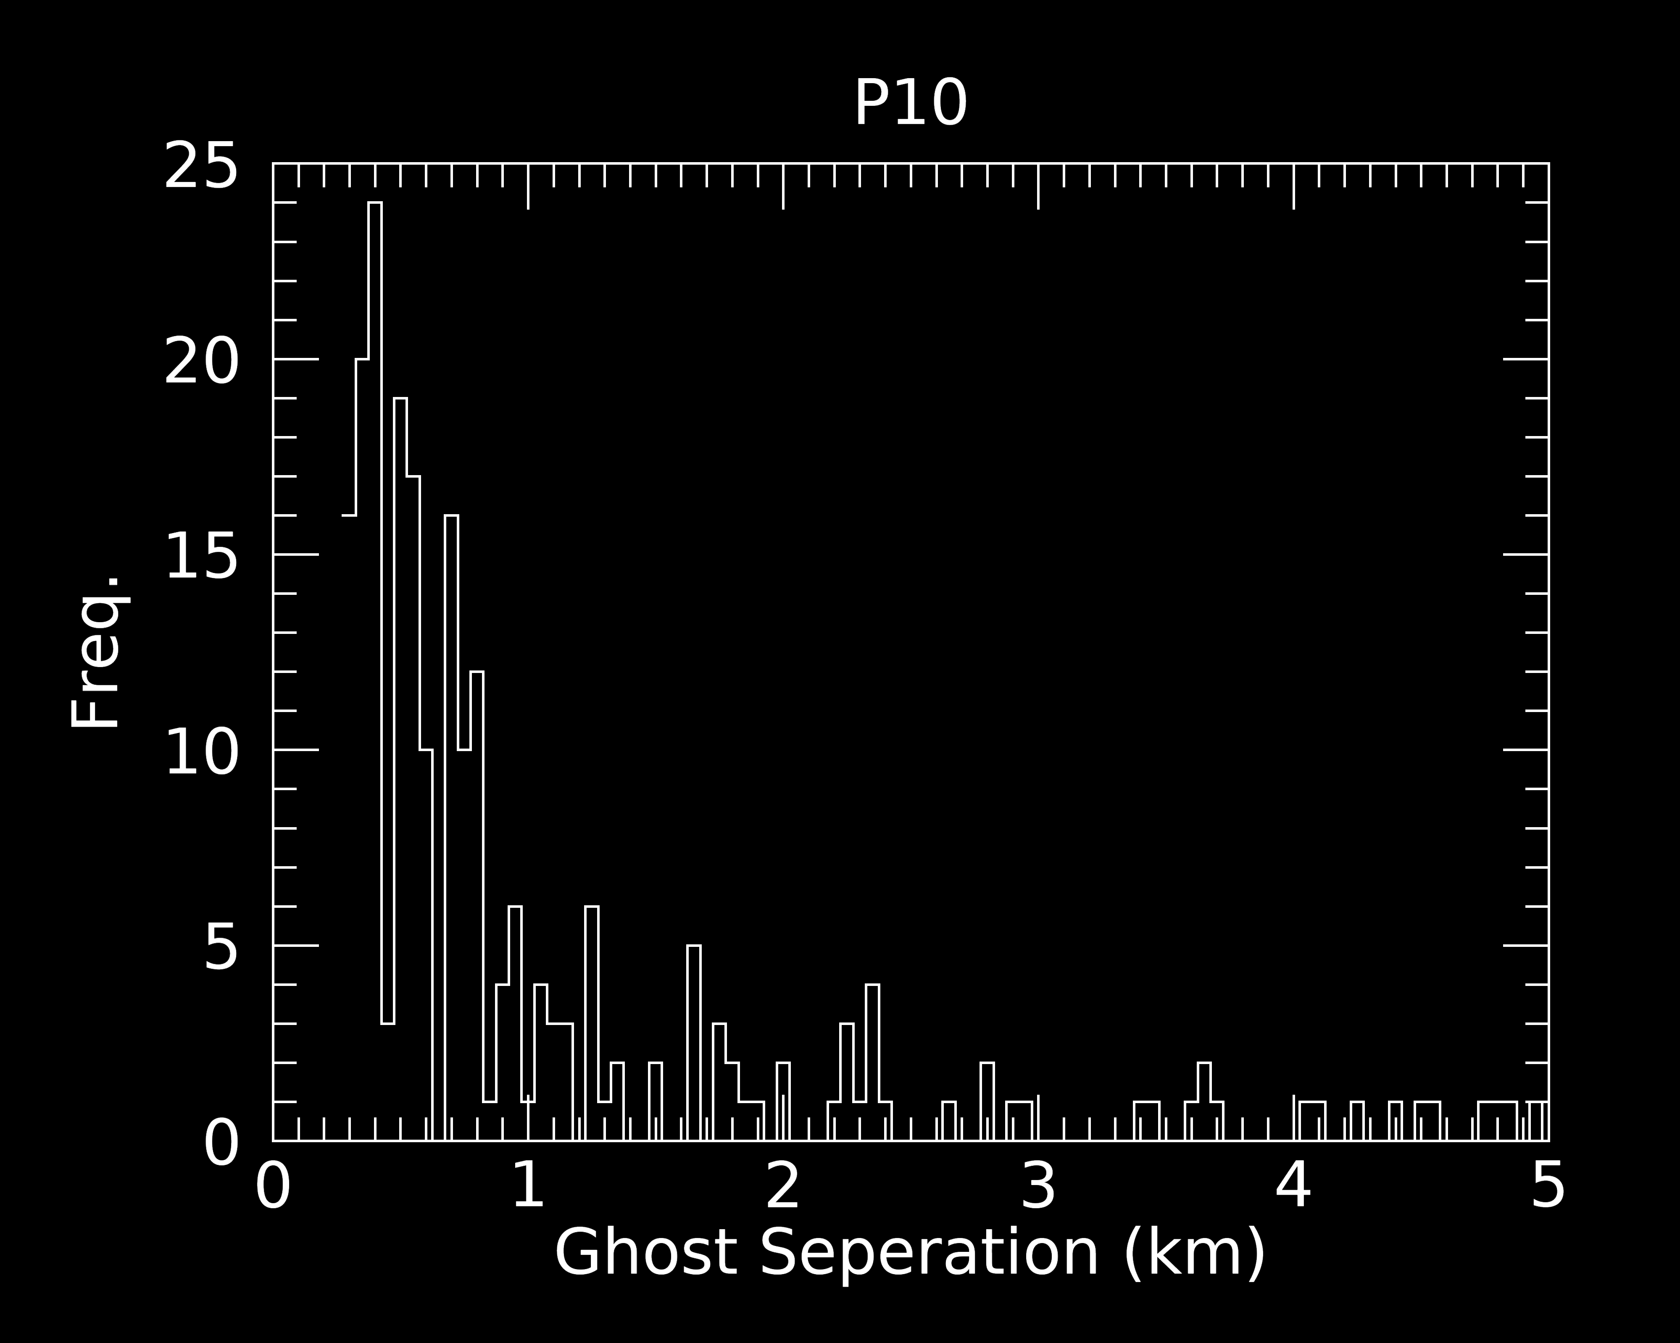
Distributions of ghost separations
700 m
950 m
Ghosts from Baillie et al. (2013) all have τ_{N} within 1-σ_{τ} of zero, but all ghosts may not be transparent.
We chose to include any point with $τ_{N}<{\overline{τ}}_{N}−4σ_{τ}$.
Distributions of ghost spacing in some plateaus are sharply peaked between 0.5 and 1.5 km.
750 m
350 m

Slide 6
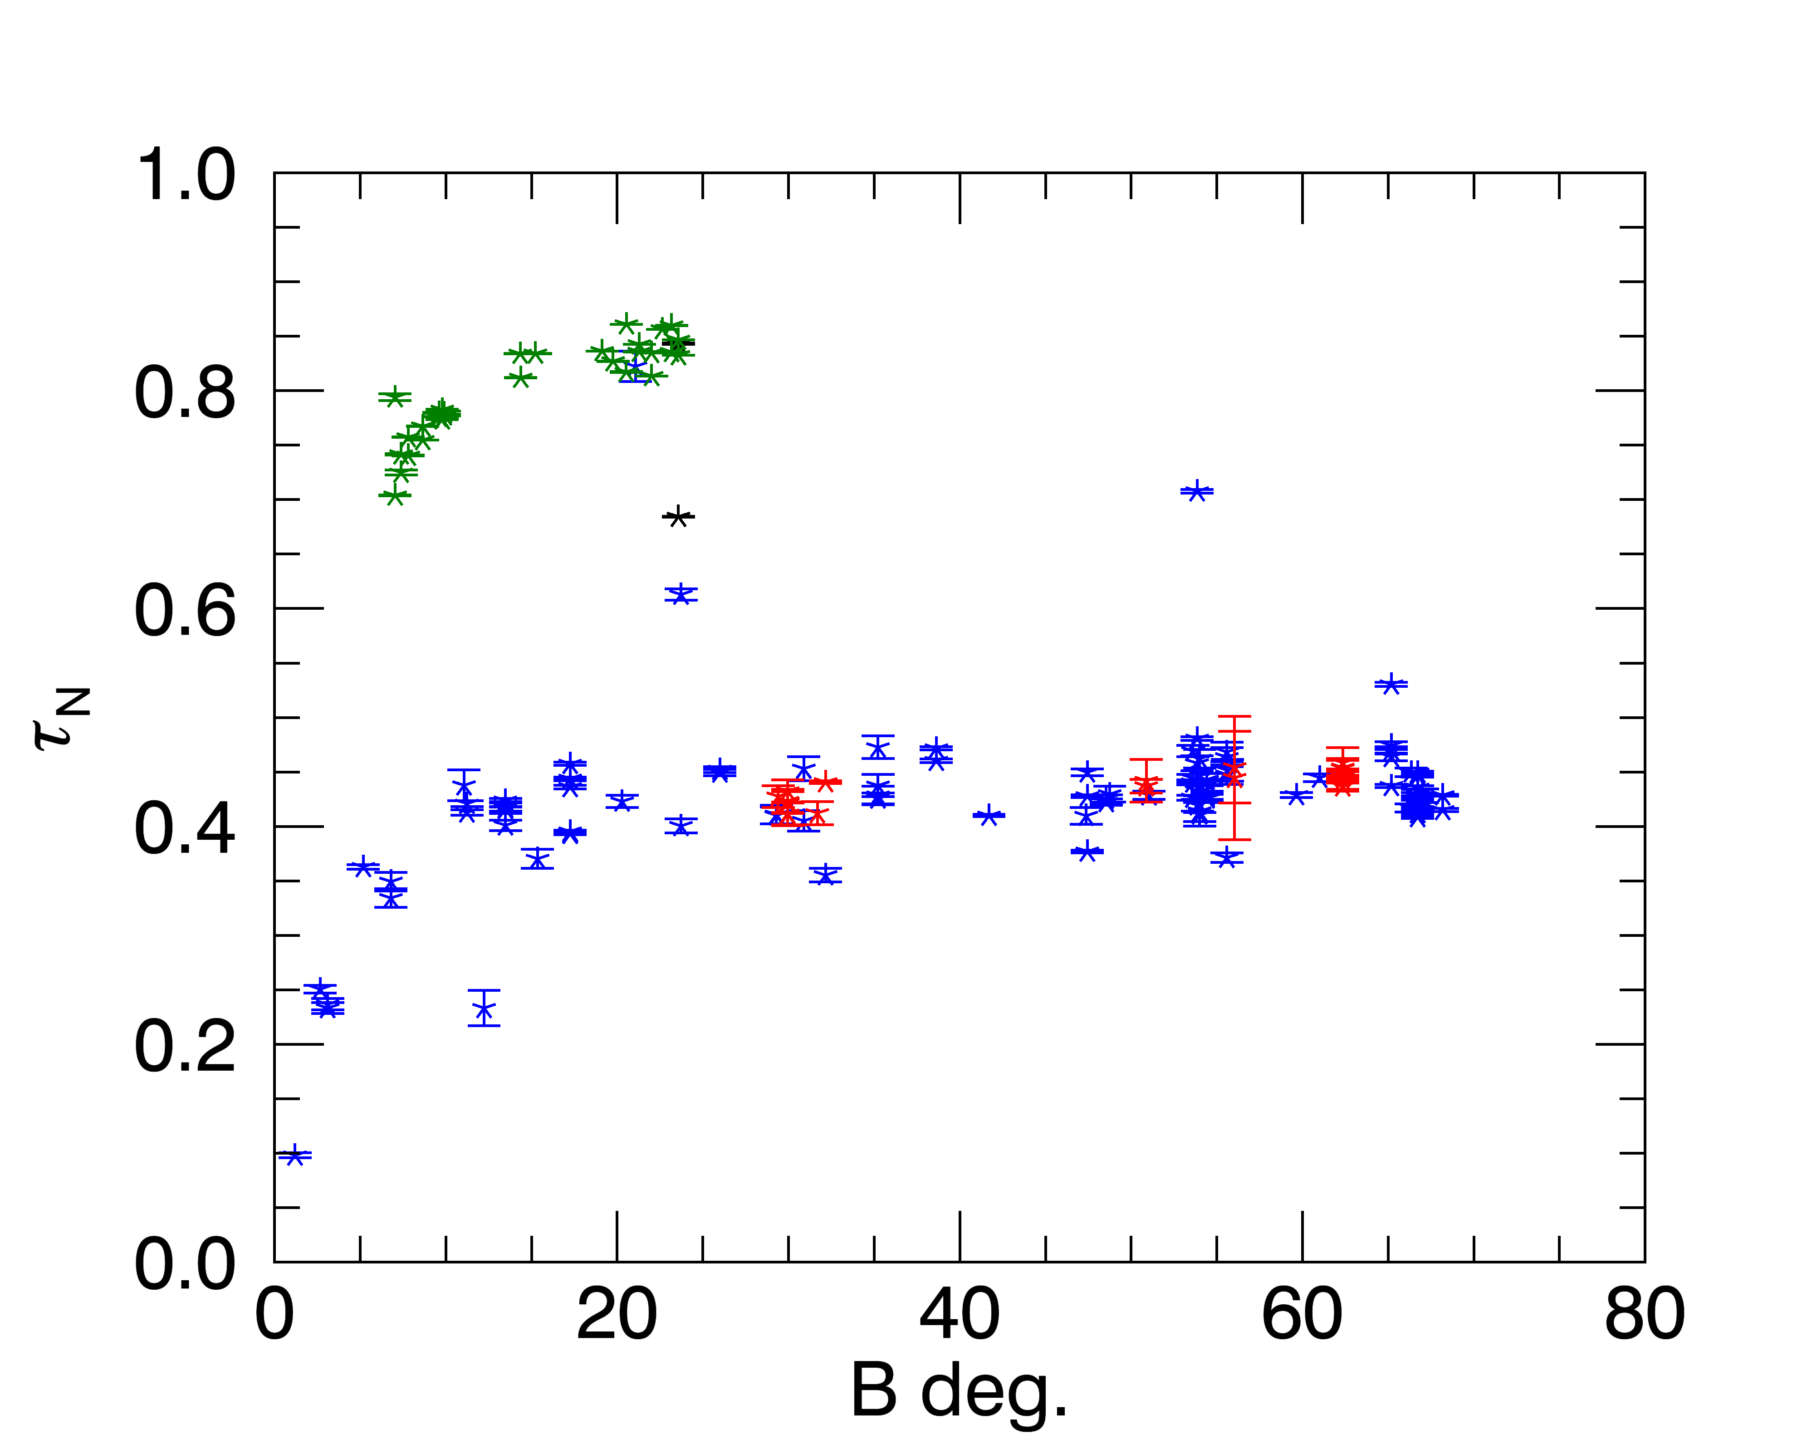
Modeling ghosts as ”missing” granola bars
P5: r = 84,850 km
Optical depth profiles of plateaus are viewing-geometry dependent (like the A ring due to self-gravity wakes)
We fit 19 UVIS optical depth profiles with 2.7º < B < 35º to a bimodal transparency distribution with rectangular cross-sections (similar to the self-gravity wake model of Colwell et al. (2006, 2007)
RSS
UVIS VIMS
S
Direction of orbital motion (𝜙 = 90º)
W_{Ghost}: τ ≤ 0.01
τ_{P}
In P5, we find W_{Ghost}/S ~ 0.017, τ_{Ghost} ~ 0.010, and H/S ~ 0.013.
If λ ~ 1 km:
L. W. Esposito finds similar results using excess variance of star signal beyond Poisson counting statistics from Colwell et al. (2018) – See poster session tomorrow (T15)
H
𝜙
$${\overline{W}}_{Ghost} \sim 17 m, \overline{H} \sim 13 m$$
λ

Slide 7
Particle Size Distribution Parameters
We fit UVIS, VIMS, and RSS (X-band, Ka-band, S-band) normal optical depths to determine the number of monolayers (N) and the power-law size distribution parameters:
$$n\left(a\right)da= n_{0}{\left(\frac{a}{a_{0}}\right)}^{−q},a_{min}≤a≤a_{max}$$
Fitting measured optical depths to the thin-layers ring model of Zebker et al. (1985):
$$τ_{N}\left(λ\right)=−2μ_{0}N ln\left[1−\frac{1}{2μ_{0}N}\int_{0}^{∞}{Q_{ext}\left(a,λ\right)}πa^{2}n\left(a\right)da\right]$$
toward Saturn’s equator
a thin ring composed of N = 5 monolayers with multiple particle scattering between the layers:
Multiple particle scattering between adjacent layers but not between particles in the same layer.
As N → ∞, the classical optical depth formula (single-scattering, many-particle-thick ring) is recovered.
B
B
ring plane
Notes:
Another model, which takes into acount multiple scattering between N particles monolayers was developed by Zebker et al. (1985). In this model, the ring is divided into a series of thin layers. Multiple scattering can occur between particles in adjacent layers, but scattering between particles in the same layer is not taken into acount. This model reproduces the classical optical depth expression in the limit that N goes to infinity.

Slide 8
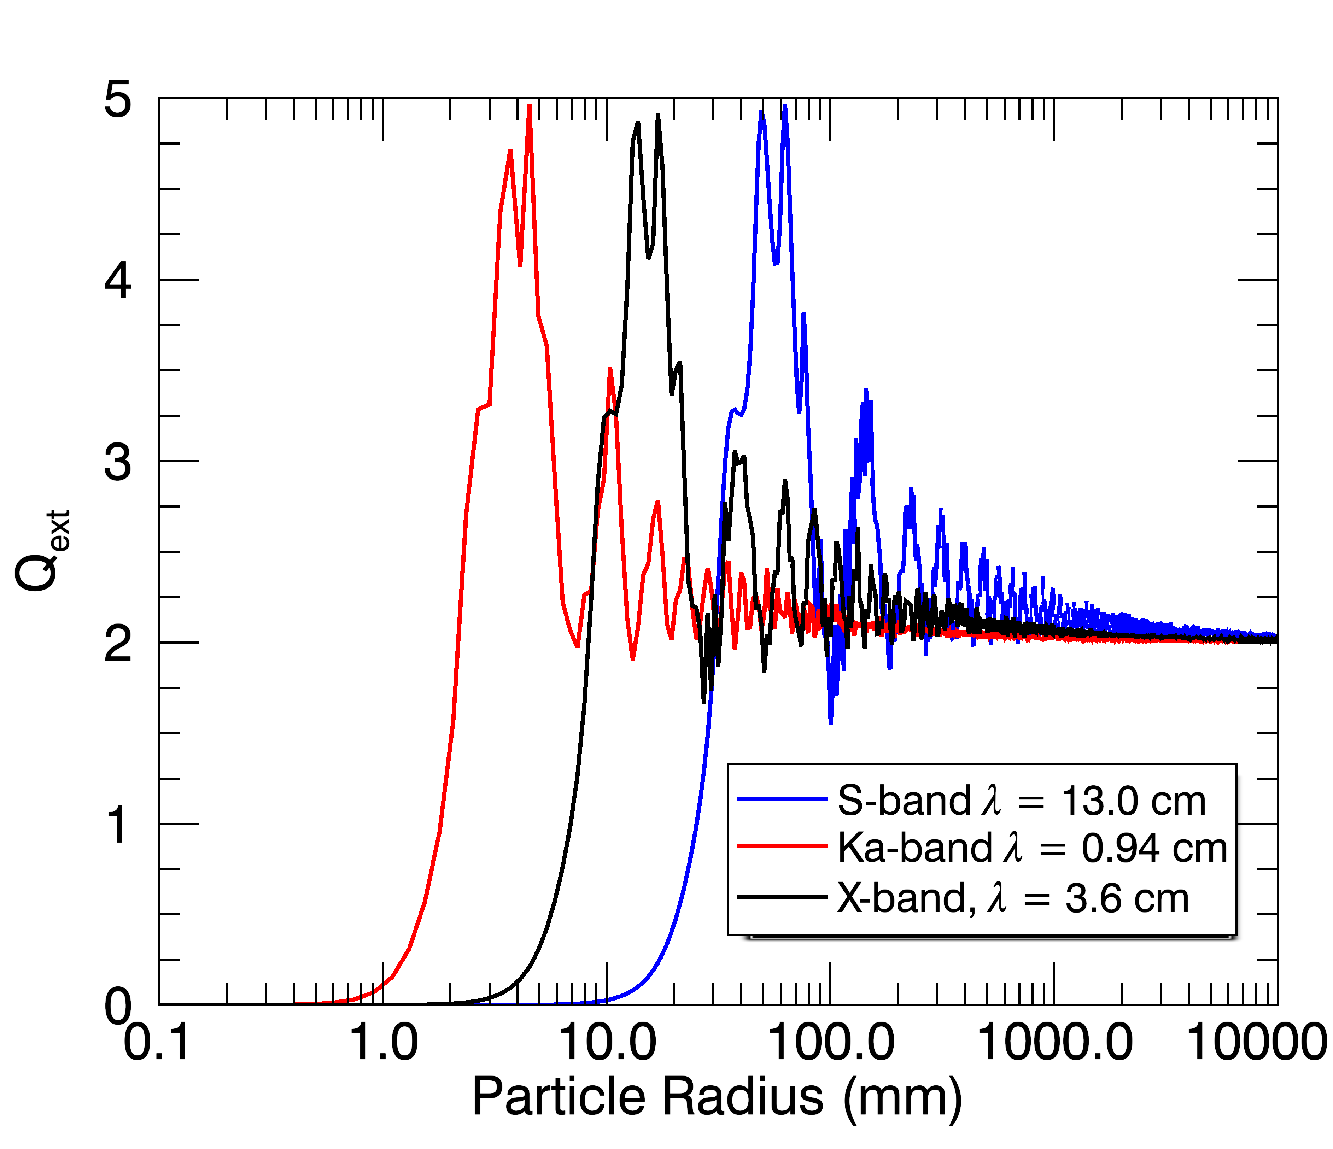
Extinction Efficiency Considering the FOV filling factor
Q_{UVIS} = 2 – f
(f = fraction of FOV filled with particles)
Q_{VIMS} = 2× [1 – θ(a – a_{crit}) × f ] ; a_{crit} ~ 8.9 mm
Q_{RSS} = Q(a,λ) Determined from Mie model
f_{VIMS} ~ 0.75
f_{UVIS} ~ 0.5
Notes:
VIMS measures starlight at an effective wavelength of 2.92 um and UVIS at 0.15 um. There are no particles this small in Saturn’s main rings since these particles adhere to the surfaces of the larger ones. So how do optical depth profiles measured at these two wavelengths tell us about particle sizes? It has to do with the sizes of the UVIS and VIMS instruments FOV. If the ring fills the FOV of both instruments, particles smaller than acrit will diffract light out of the FOV of VIMS which will not be replaced by light diffracted by neighboring particles UVIS, however, captures this diffracted light in its wider FOV

Slide 9
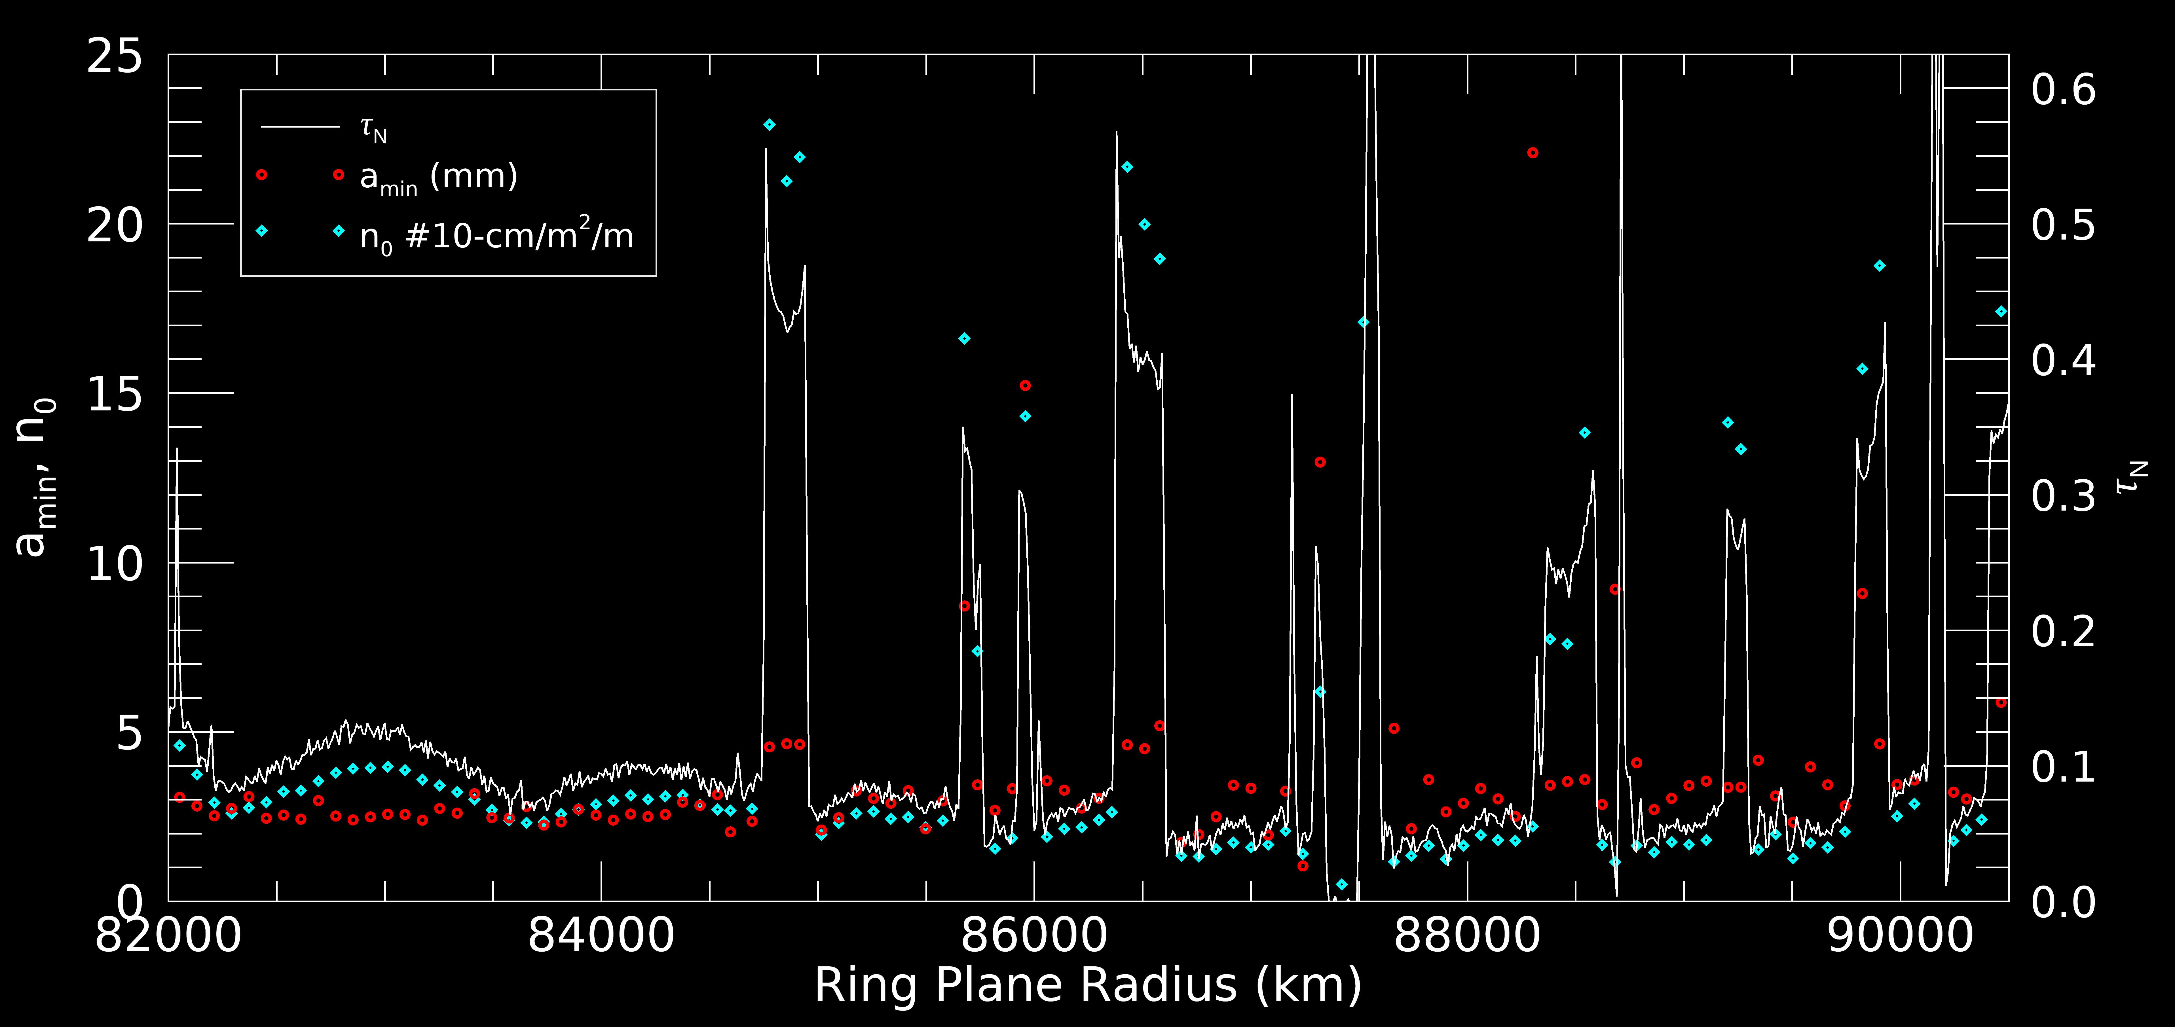
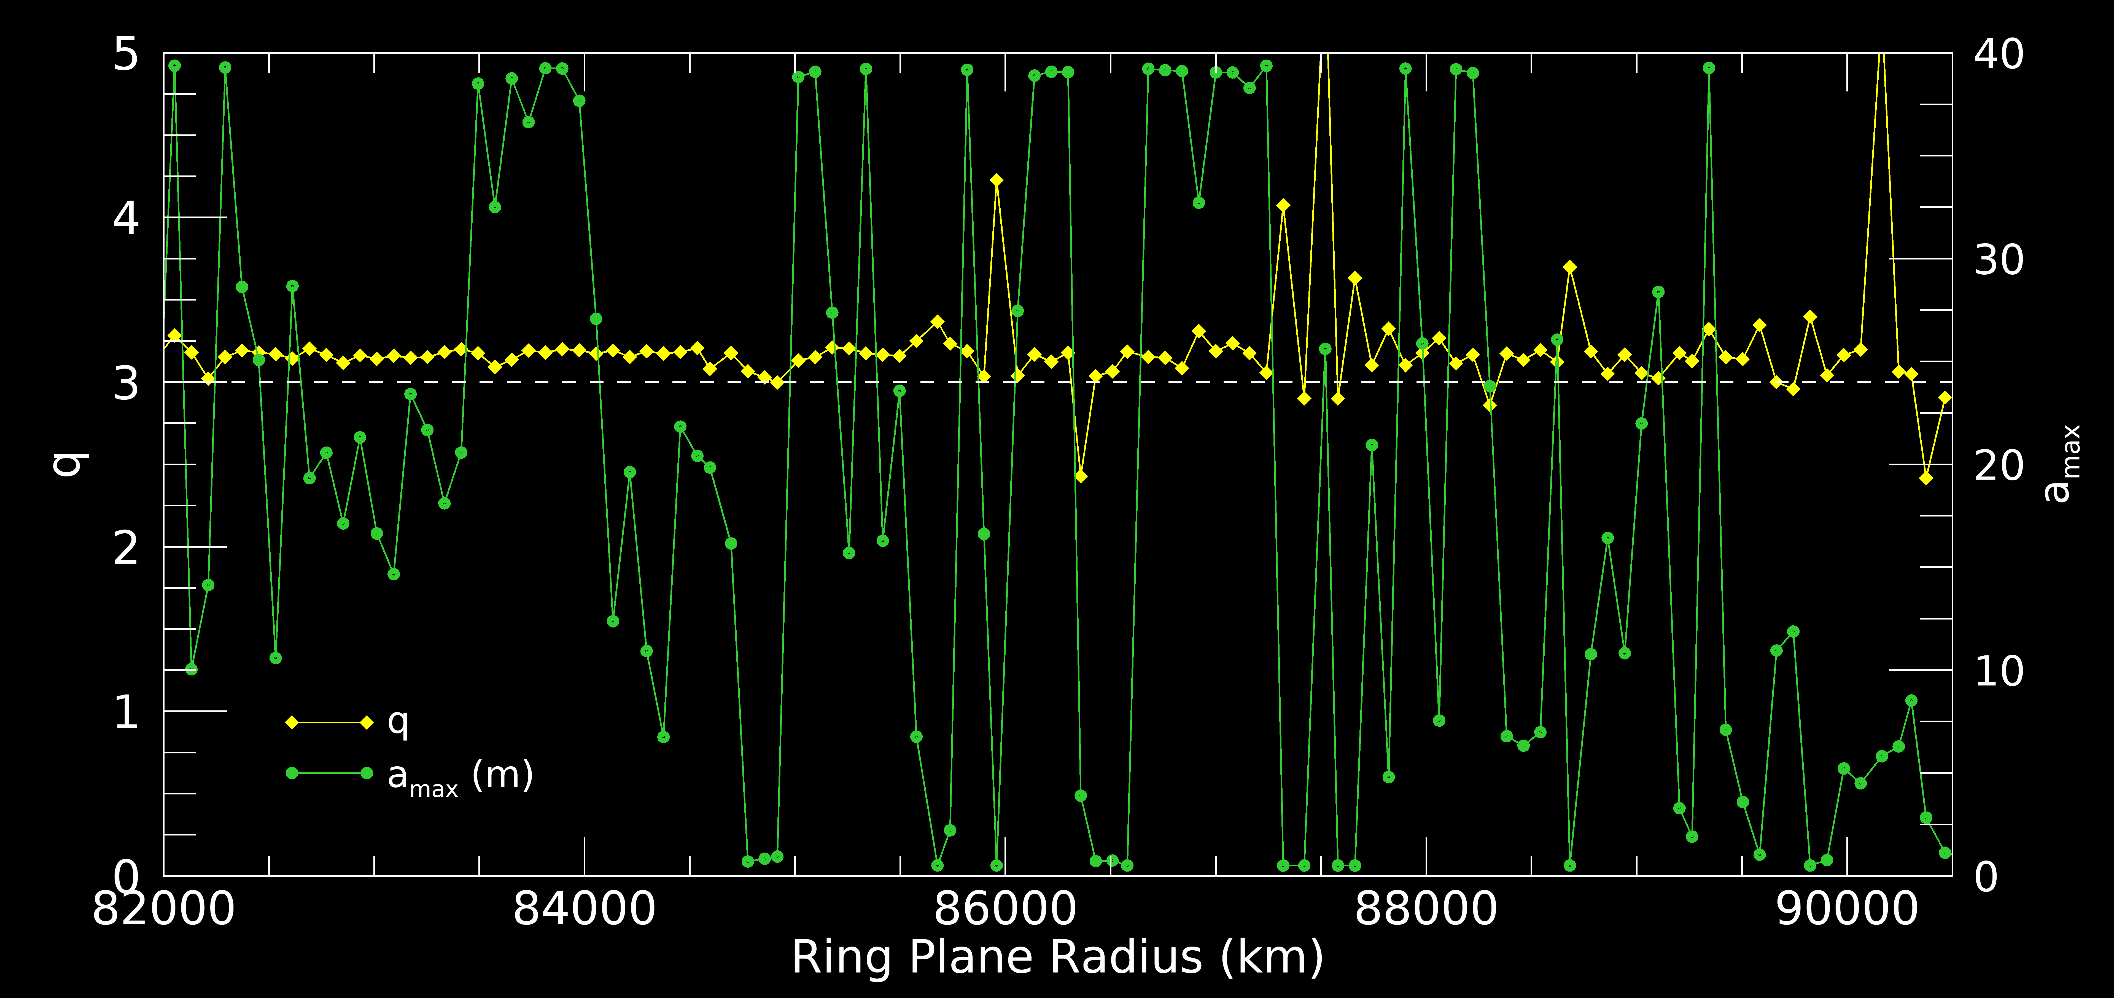
Particle Size Distribution Parameters
Larger smallest particles and smaller largest particles in the C ring plateaus:
(a_{min} ~ 4 – 5 mm, a_{max} ~ 0.5 – 3 m)
q smaller in plateaus than in the background C ring by ~ 5%.
Best-fits a single monolayer with χ² ~ 1–3.
P5 P6 P7 P8 P9 P10
P5 P6 P7 P8 P9 P10

Slide 10
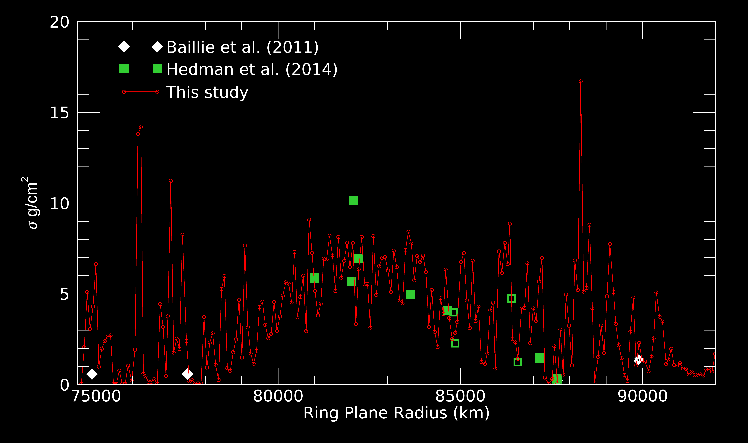
Surface mass densities from size distribution
Surface mass densities from integrating over the size distribution (with ρ = 0.4 g/cm³ ) agree with estimates from density wave dispersion by Hedman et al. (2013, 2014) and Baillie et al. (2011)
σ is NOT larger in plateaus!

Slide 11
Conclusions
Large boulders or aggregates (~ 20 m) are ubiquitous in the background C ring. But objects this size can only sparsely populate the C ring plateaus.
These boulders create the ghosts seen in UVIS occultation data and as the streaky texture in ISS images. (Like propeller moonlets which open similar, but larger features in the A ring.)

Slide 12
Thank you
References
Baillié, K., Colwell, J.E., Esposito, L.W., Lewis, M.C. 2013. Meter-sized moonlet population in Saturn’s C ring and Cassini division. Astron. J. 145:171. doi:10.1088/0004-6256/145/6/171
Baillié, K., Colwell, J. E. , Lissauer, J. J., Esposito, L. W., Sremcevic, M. (2011) Waves in Cassini UVIS Stellar Occultations 2. The C Ring. Icarus, 216, 292-308. doi:10.1016/j.icarus.2011.05.019.
Colwell, J. E., Esposito, L. W., Sremčević, M. (2006) Gravitational wakes in Saturn’s A ring measured by stellar occultations from Cassini. Geophys. Res. Lett., 33, L07201, doi:10.1029/2005GL025163.
Colwell, J. E., Esposito, L. W., Sremčević, M., Stewart, G. R., McClintock, W. E. (2007) Self- gravity wakes and radial structure of Saturn’s B ring. Icarus, 190, 127-144, doi:10.1016/j.icarus.2007.03.018.
Hedman, M. M., Nicholson, P. D. (2014) More Kronoseismology with Saturn’s Rings. Mon. Not. Roy. Astron. Soc., 444, 1369-1388.
Tiscareno et al. Close-range remote sensing of Saturn’s rings during Cassini’s ring grazing orbits and grand finale (submitted to Science, 2018)
Zebker, H. A., Marouf E. A, Tyler, G. L. (1985) Saturn’s rings: Particle size distributions for thin layer model. Icarus, 64, 531-548.

