Slide 1
PALEO NON-SYNCHRONOUS ROTATION (NSR)
AND TRUE POLAR WANDER (TPW)
ON ENCELADUS
Paul Helfenstein¹, Radwan Tajeddine¹, Peter C. Thomas¹
Bernd Giese², Thomas Roatsch²
Tilmann Denk³
¹Cornell University (CCAPS) ²German Aerospace Center (DLR) ³Freie Universität Berlin
Presentation IS11
Cassini Science Symposium
Boulder, Colorado
August 13, 2018

Slide 2
OBJECTIVE
Follow-up Study of Tajeddine et al.’s (2017) TPW Work:
Examine how the placement and orientations of tectonic features and classified terrain units on Enceladus may have changed over time due to True Polar Wander as predicted by Tajeddine et al. (2017)
Especially interested in features that may have passed over the south pole of Enceladus in the past and which may bear some resemblance to modern South Polar Terrain (SPT) features.
Especially interested in the nature of terrain materials on which these plausible “fossil” SPT features are emplaced.

Slide 3
SPOILER ALERT
PRELIMINARY RESULT: We identify an ancient system of quasi-parallel fractures that appear to be relic Tiger Stripe rifts which likely originated near the geographic location now occupied by the active Baghdad Sulcus tiger stipe.
CONCLUSIONS:
[1] TPW hypothesis is supported
[2] NSR has played a role

Slide 4
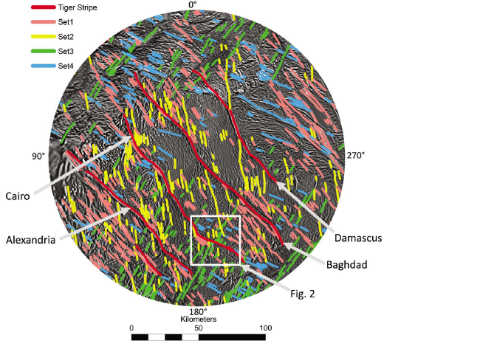
Patthoff and Kattenhorn (2011):
Fracture history consistent
with NSR.
2) NSR requires a global subsurface ocean.

Slide 5
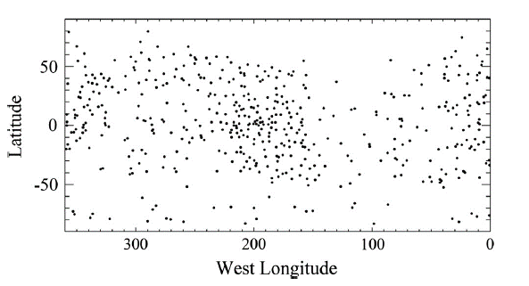
Thomas et al. (2016):
determine the satellite’s precise rotation state
Found forced physical libration
Used control points accumulated over seven years of spacecraft observations to of 0.120 ± 0.014
Value is too large to be consistent with core rigidly connected to the surface
Implies a global ocean rather than a localized polar sea.

Slide 6
Tajeddine et al. 2017

Slide 8
55° Rotation about (0°N, -11°W)

Slide 9
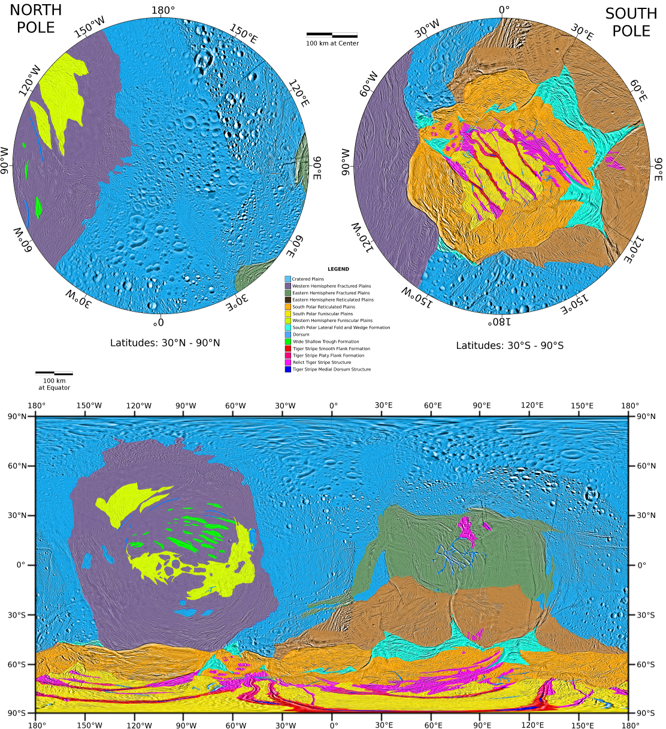
Global Terrain Map:
Original:
Spencer et al. 2009
Revised:
Remapped on new USGS Basemap
Western Hemisphere terrains from Helfenstein et al. (2010,2013)
Presented in Patterson et al. (2018) chapter in new Enceladus book.

Slide 10
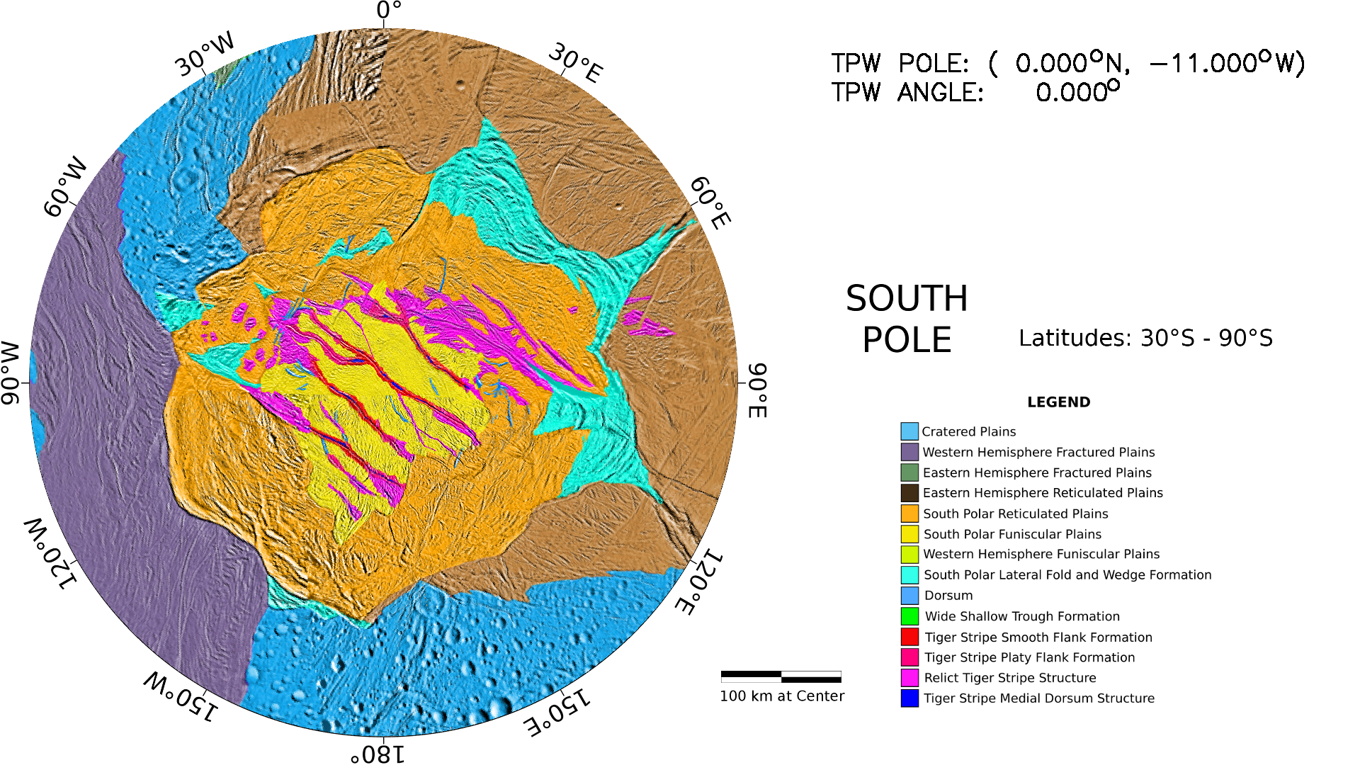

Slide 11
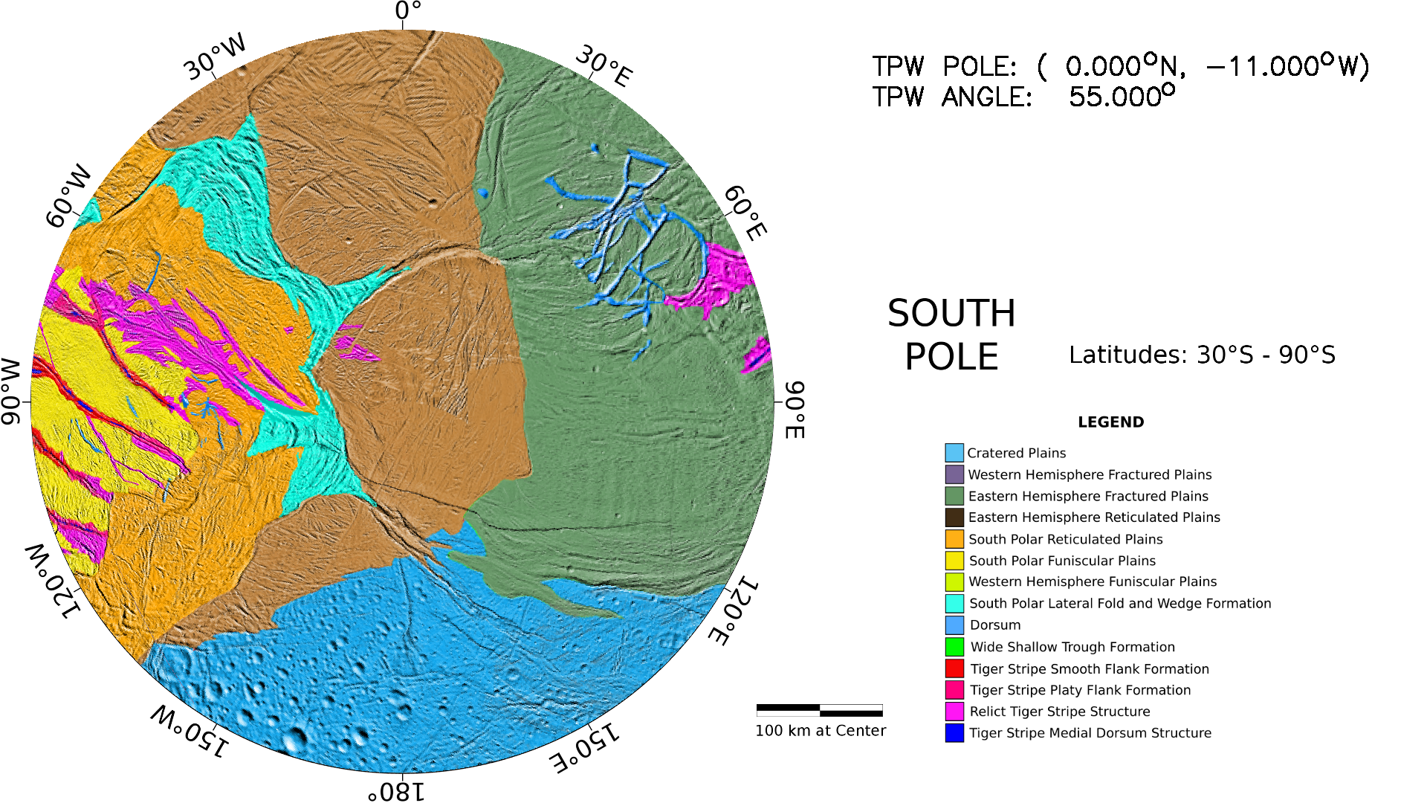

Slide 12
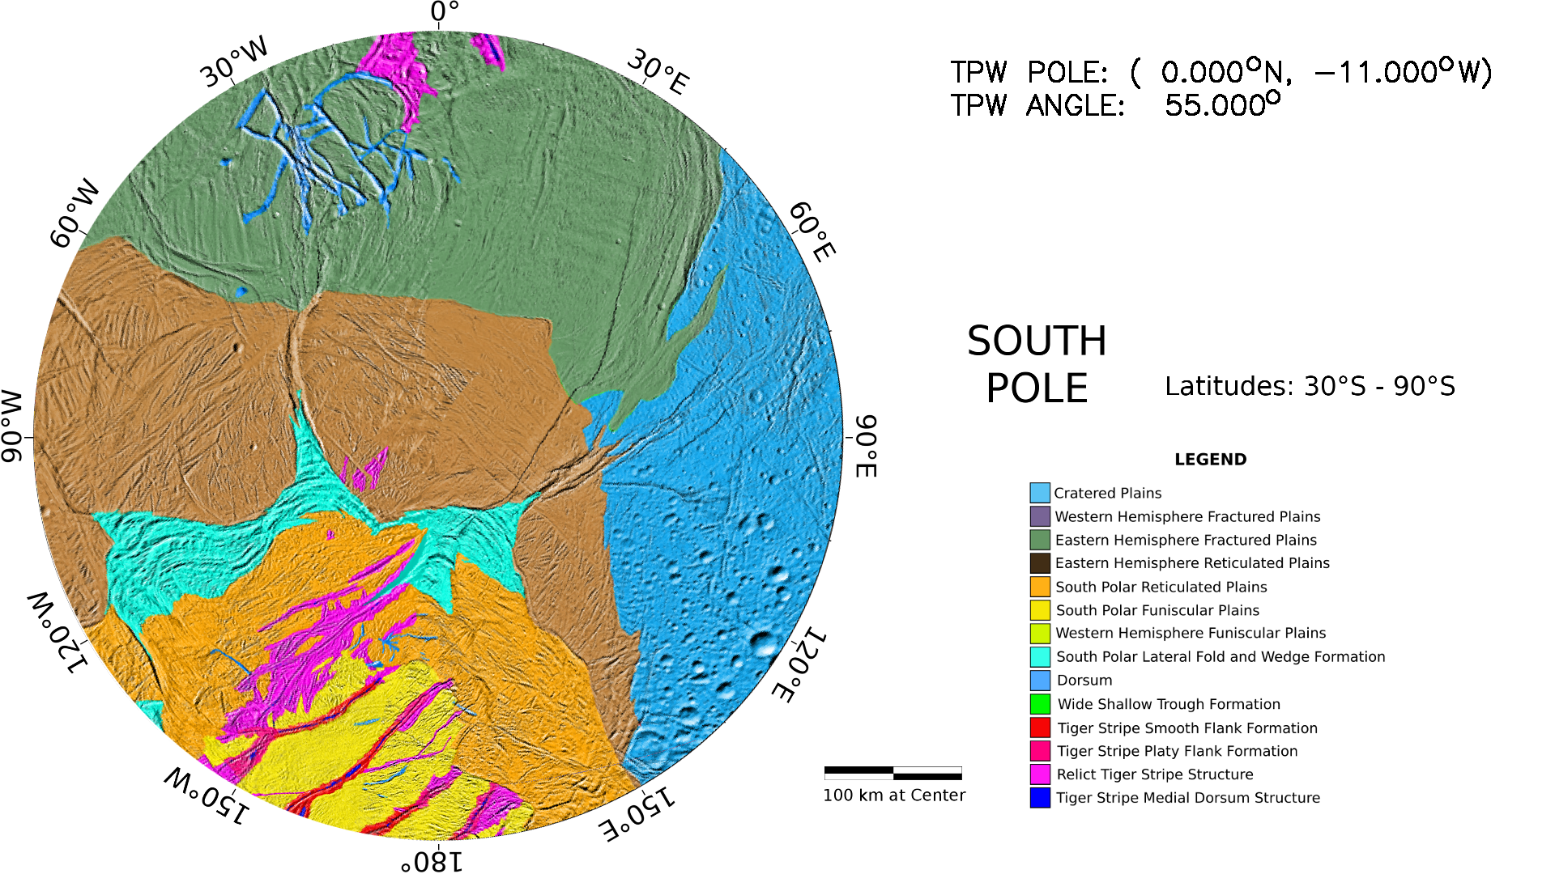

Slide 13
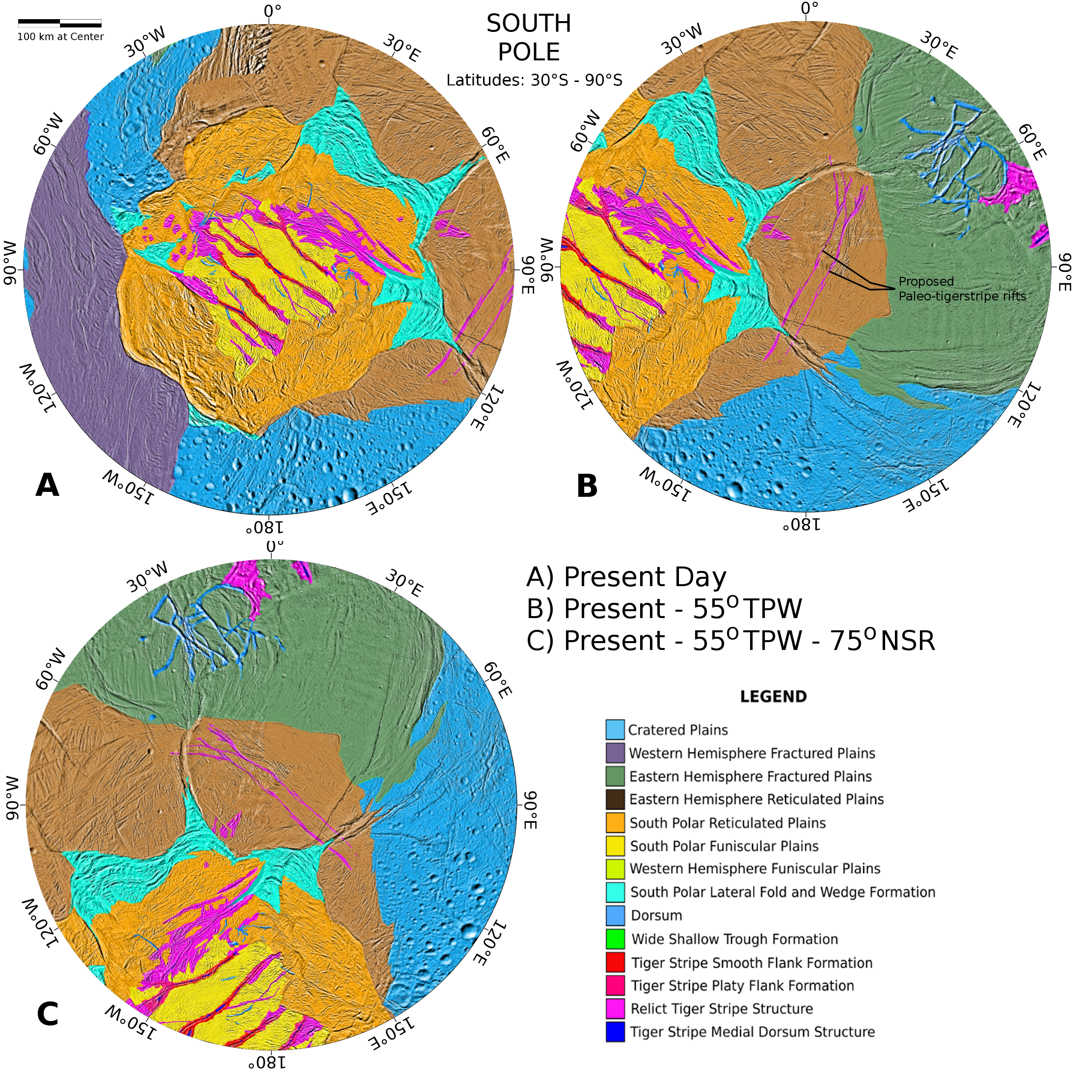

Slide 14
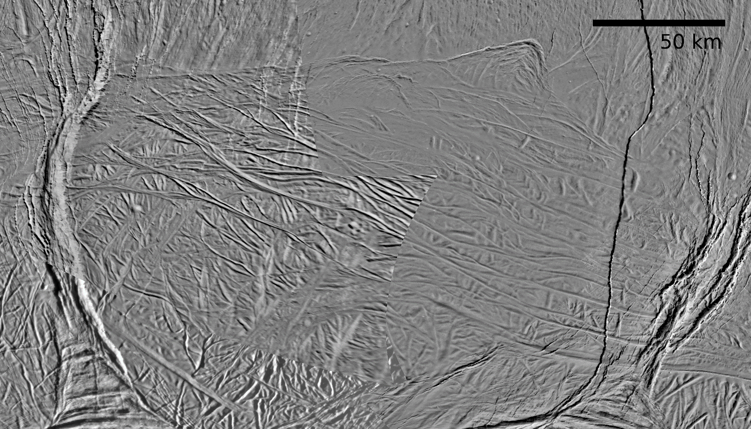

Slide 15
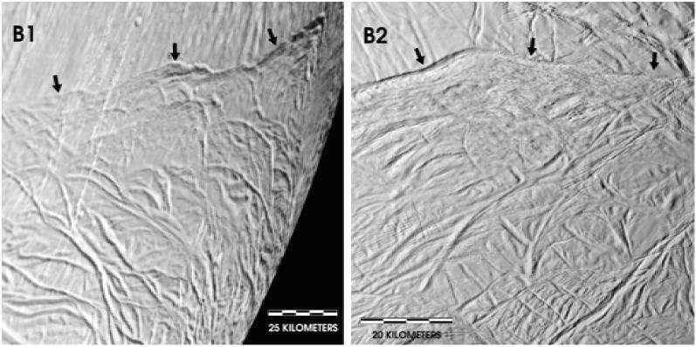
Eastern Hemisphere
Reticulated Terrain
South Polar
Reticulated Terrain

Slide 16
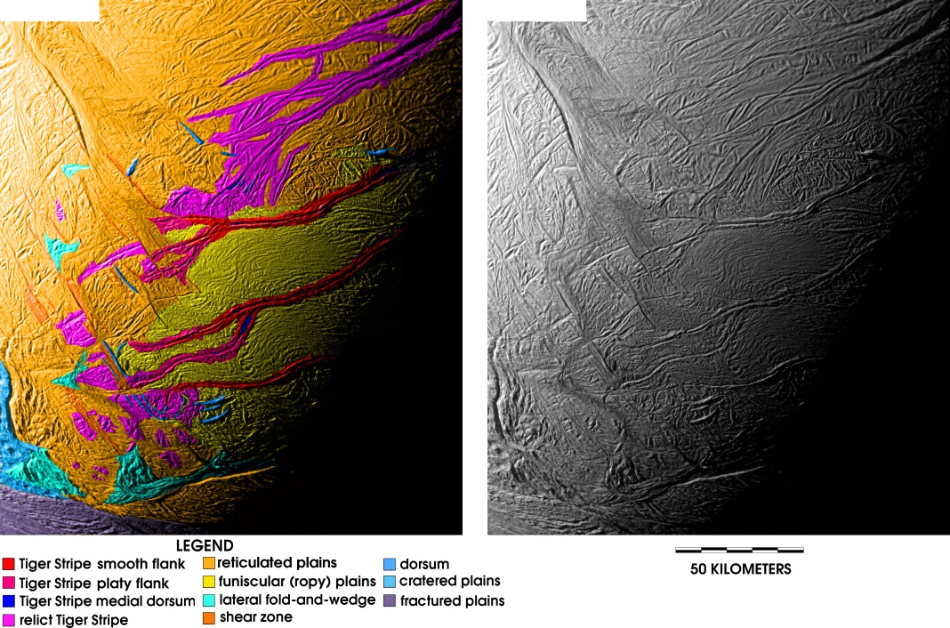
Helfenstein et al. 2011

Slide 17
OBSERVATIONS AND INTERPRETATIONS
The proposed paleo tiger stripe rifts are geometrically similar to Baghdad Sulcus, including their bifurcations
The proposed rifts and modern tiger stripes formed in response to a similar system of global or regional stresses
Funiscular plains terrain is absent between the paleo rifts, but separates tiger stripes in the active SPT
The mechanism that produces funiscular plains was not operative in the paleo rift region at the time they were near the South Pole or
Funiscular plains material existed there at one time but have been tectonically overprinted and erased since then.
The NSR and TPW reorientations were treated sequentially rather than as a simultaneous process.
The time scale over which TPW occurred may have been very short compared to the time scale of NSR.

Slide 18
CONCLUSIONS
Our results:
Support the TPW hypothesis
Imply that NSR has persisted much longer though Enceladus’s history than revealed from present stratigraphic patterns
of SPT fractures
Suggest that the mechanism that produced funiscular plains in the SPT region may not have been operating near the south pole at the time that the paleo rifts formed there

