Slide 1
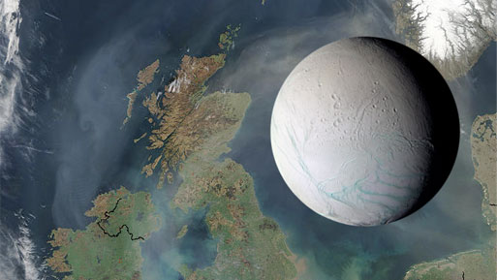
Evolving Enceladus
What Cassini Taught Me about
Saturn’s Surprising Satellite
James Roberts
Cassini Science Symposium
13 August 2018

Slide 2
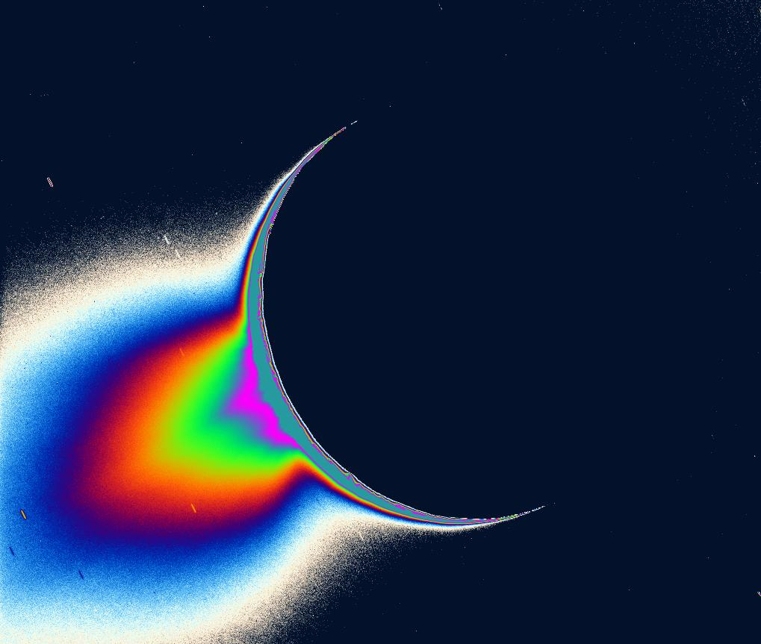
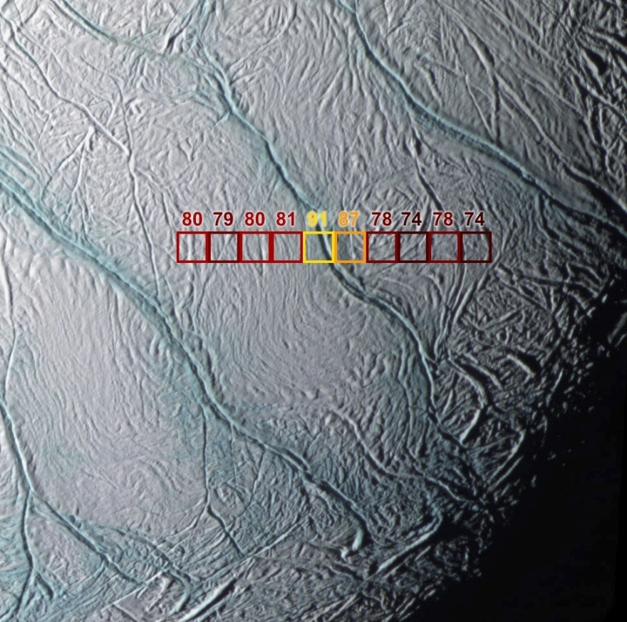
The south polar region
Plumes
Tiger Stripes
Ice and vapor
(false color)
South
~10 GW Heat Flow
Porco et al. Science 2006
Spencer et al. Science 2006
Notes:
Plumes of ice and vapor emanating from tidally-controlled fractures in the south polar region
5-16 GW heat flow in south polar region (Howett et al. 2011; 2013)
Much of it focused in the Tiger Stripes
Roughly 10X long-term sustainable level (Meyer and Wisdom, 2007)
There is no corresponding thermal anomaly in the north polar region
Asymmetry implies a non-tidal mechanism(70 - 200 mW m⁻²)

Slide 3
Diapir-induced reorientation
Buoyant plume acts as gravity low
Causes reorientation of Enceladus to place the plume at the pole if it does not start there.
Timescale and magnitude of reorientation depend on density contrasts (thermal and chemical)
Convection modeling needed
This got me my first job!
Nimmo and Pappalardo, 2006

Slide 4
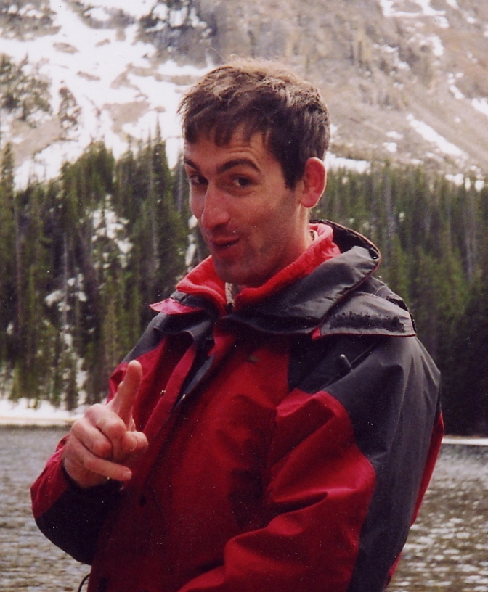
What I was hired to do
Figure out how to get a plume at Enceladus
Put that plume at the south pole.
Calculate tidal heating in Enceladus’s interior
Get that heat out.
Do all the above in a 5’ by 8’ space.
Nimmo, 2006q

Slide 5
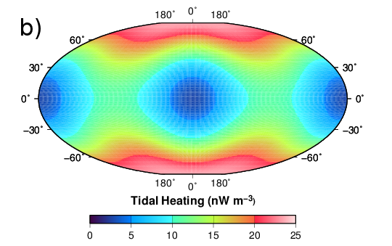
Polar heating is normal
Maximum dissipation expected at the poles
Why is the south pole special and not the north?
Need some way to break the symmetry
Roberts and Nimmo, 2008
Figure 1: Example pattern of tidal dissipation in the ice shell of Enceladus. Other patterns are possible [9], but all are symmetric about the equator.
Figure 1: Example pattern of tidal dissipation in the ice shell of Enceladus. Other patterns are possible [9], but all are symmetric about the equator.
Notes:
But why is there nothing in the north?
We’ll come back to that.

Slide 6
Degree-1 convection
Needs small core (< 100 km radius) and high heat dissipation (> 3 GW)
Implies incomplete differentiation and high heating
Hard to get degree-1 in a thinner ice shell.
Roberts and Nimmo, 2008
Grott et al., 2007

Slide 7
Too much heat?
  Spencer et al., (2006)
Meyer and Wisdom, 2007
Observed: 6 GW ± bunches
Available: 1 GW ± not enough

Slide 8
Not all at once
Zhang and Nimmo, 2010
O’Neill and Nimmo, 2010

Slide 9
Not enough heat!
T_{s} = 80 K f(θ)
Ice Shell
Tidal
Heating
d
F_{b}
T_{b} = 273 K
Ocean
F_{c}
Silicate Core
Temperature
(Nondimensional)
Heating Rate
(10⁻⁹ W m⁻³)
In thermal equilibrium, F_{b} = F_{c}
What combination of d and η₀ satisfies this?

Slide 10
We’re doomed!
No combination of d and η is consistent with an ocean in thermal equilibrium with either a convective or a conductive ice shell given present-day eccentricity
If the ocean freezes, tidal heating drops dramatically.
  Can never get out of frozen state
  Hard to explain observations without ocean
A transient ocean today as the remnant of an earlier time?
  Freezes in 10s of Ma.
Conductive
Radiogenic Core Heat Flow

Slide 11
A way out!
Thin oceans may be resonantly forced
Dramatic increase in tidal dissipation in ocean at certain thicknesses
Prevents total freezing of ocean
Makes it easier to recover.
Tyler, 2014

Slide 12
Which you may not need…
Notes:
Significant dissipation in core if porosity > 20 %
At 30% porosity, dissipate 1.7 GW
Mostly in core!
Factor of 20 change in heating between end-member models

Slide 13
Astrometry to the rescue!
Saturn looks to be WAY more dissipative than expected from theory
  Like by 10x
Equilibrium heating is totally fine!
But we learned a lot trying to solve this problem.
Lainey et al., 2012, ApJ

Slide 14
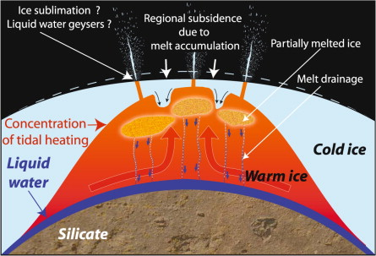
Back to this…
  Collins and Goodman (2007), Icarus
Narrow range of sea sizes that would work
And why is there exactly one polar sea?
  Tobie et al. (2008), Icarus
Figure 1: Example pattern of tidal dissipation in the ice shell of Enceladus. Other patterns are possible [9], but all are symmetric about the equator.
Figure 1: Example pattern of tidal dissipation in the ice shell of Enceladus. Other patterns are possible [9], but all are symmetric about the equator.

Slide 15
Last refuge of the scoundrel…

Slide 16
Answers and Questions
We learned:
Polar wander unnecessary
  Patterns of tidal dissipation show the maximum heating is expected at the poles.
Ocean not strictly necessary
  A rubble core can dissipate plenty of heat
Clever ways to get high heat flux recently
  Tidal evolution
  Episodic overturn
  Impact heating
But…
Why is there not also activity at the north pole?
It’s a lot easier to maintain.
  Resonances in ocean prevent total freezing
Heat flux can be high all the time!
  Saturn may be dissipative.

Slide 17
Concluding Remarks
Enceladus is really cool.
Sometimes, being wrong is great. We explored paths we wouldn’t have considered otherwise, and we learned a lot in the process. It’s boring to be right the first time.
But seriously, how do you break the tidal symmetry?
There once was a moon called Enceladus
Whose tiger-stripes have cast a spell at us.
The south polar plume
Like an ice-vapor ‘shroom
Has poked its way through the ice shell at us.

