Slide 1
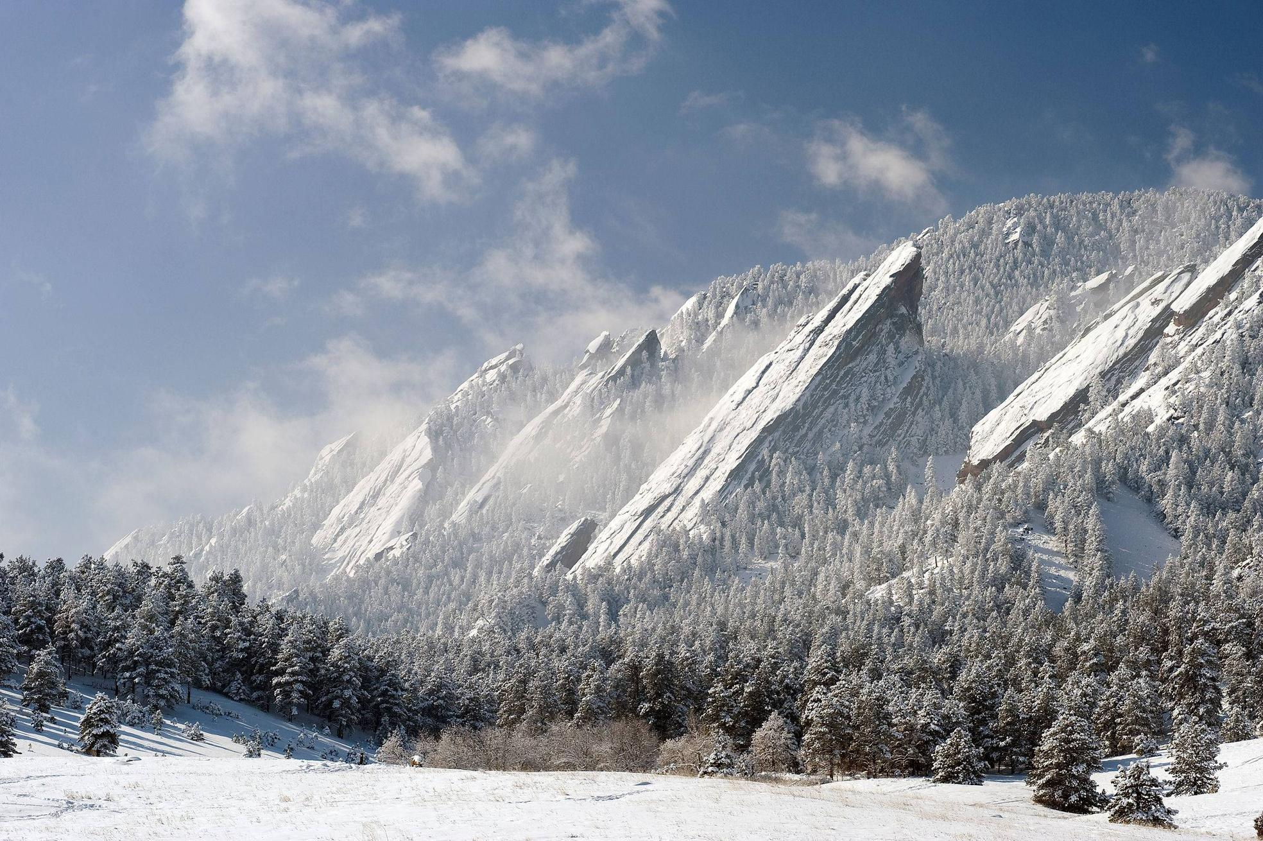
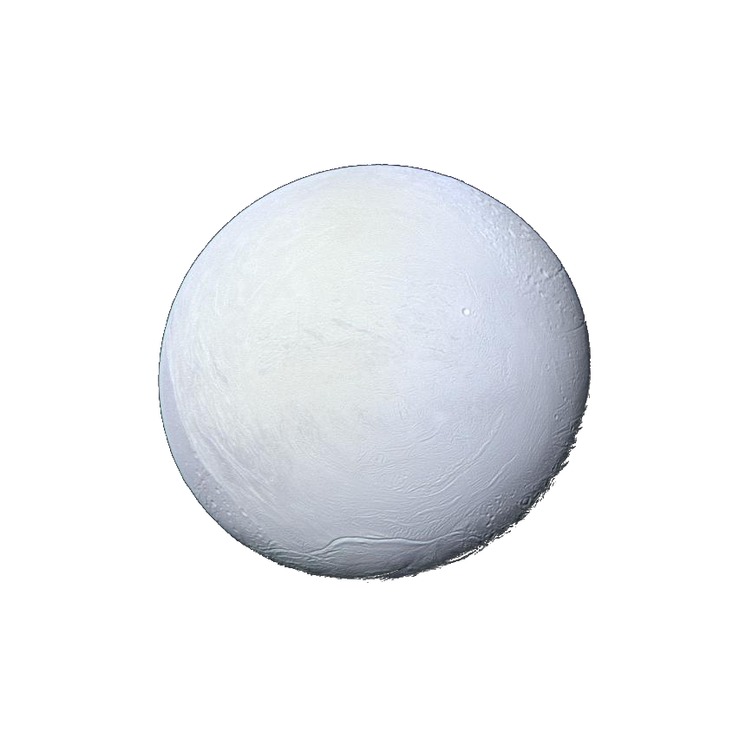
Cassini ISS Photometry of Enceladus’ Surface and Major Terrains Anne J. Verbiscer U. Virginia Paul Helfenstein Cornell U. Andrew Annex Johns Hopkins U.
Cassini Science Symposium
University of Colorado, Boulder
13 August 2018

Slide 2
Objectives of Photometric Analysis
Goals:
Determine physical surface properties from the manner in which radiation
is scattered from it.
Can be performed at multiple wavelengths
These Surface Properties include:
Albedo – reflectance
Surface Roughness, texture
Particle Opacity
Porosity
Grain Sizes
Directional scattering (backward or forward) – describes mechanical
structure of grains
Physical surface characteristics then are related to environment –
ring-magnetosphere/moon interactions

Slide 3
How Do We Measure Surface Properties from Photometry?
Photometric studies are best accomplished through the application of photometric models
(Hapke, Shkuratov) to observations that span the full range of observing geometries:
Phase Angles α 0°-180°
Incidence Angles i, Emission Angles e 0°-90°
For Enceladus, Earth-based studies limited to phase angles between 0°-6.4°
only whole-disk, no spatial resolution
Fortunately, Cassini enables the full range of viewing geometry and enable
disk-resolved analyses
Disk-Integrated Solar Phase Curves
Disk-Resolved Limb Profiles
usually studied independently, but best studied simultaneously

Slide 4
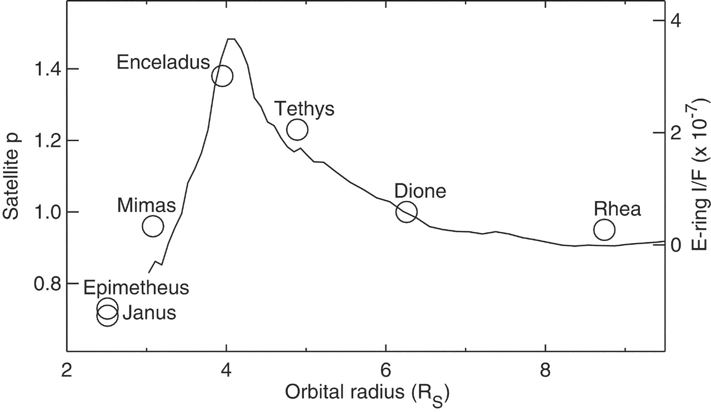
Saturn’s E-ring embedded satellites are highly reflective
Verbiscer et al. 2007
All Saturn satellites interior to Titan are highly reflective
Exception: Aegaeon (p ~ 0.15) – in the G ring!

Slide 5
Disk Integrated Solar Phase Curves
Geometric Albedo p
reflectance at zero phase relative to a diffuse disk of same size,
same distance from Sun
can be an awkward quantity because of the Opposition Effect
Phase Integral q
area under the normalized phase curve
Spherical Albedo, Bond Albedo
A=pq
related to the energy balance of the surface

Slide 6
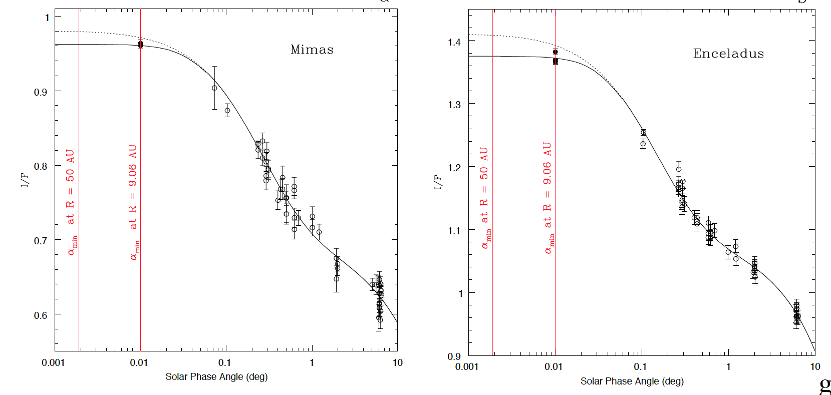
Disk-Integrated Phase Curves of Mimas and Enceladus
HST 550nm (2005)
Gave first opportunity to measure, not extrapolate, geometric albedo
Constrain opposition surge parameters well

Slide 7
Photometric Parameters
Single scattering albedo w
measures efficiency of regolith grains to scatter and absorb light
related to composition, optical constants, size, and mechanical structure of grains
Macroscopic roughness θ
average topographic slope angle of sub-resolution scale surface relief
constrained at moderate phase angles, broad range of i and e
Problem for (bright) saturnian satellites: photons in shadow are lost
Opposition Effect
dramatic, non-linear increase in reflectance near zero phase
zero phase only attainable for a point source!
angular size of solar disk limits phase angles at Saturn to ~α=0.01°
Shadow Hiding Opposition Effect (SHOE) α = 0°-20°
h_{SH} angular half-width (radians) depends on regolith porosity and grain size
distribution
B_{SH} amplitude, measures grain transparency
Coherent Backscatter Opposition Effect (CBOE) α = 0°-2°
h_{CB} angular half-width (radians), B_{CB} amplitude
depend on density and size of small (sub-grain) scatterers and transparency
of medium (mean optical path length of photon) and porosity

Slide 8
Enceladus Phase Curve (NAC CL1-CL2)
Helfenstein et al. 2012

Slide 9
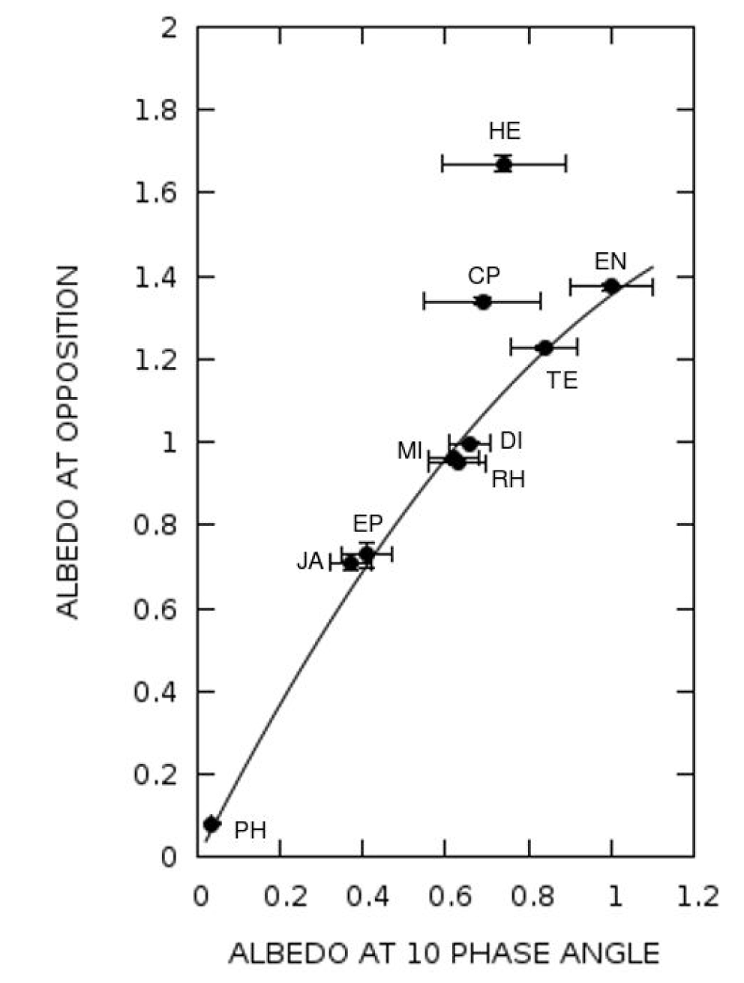
Albedos of Saturn’s Major Satellites
Verbiscer et al. 2018

Slide 10
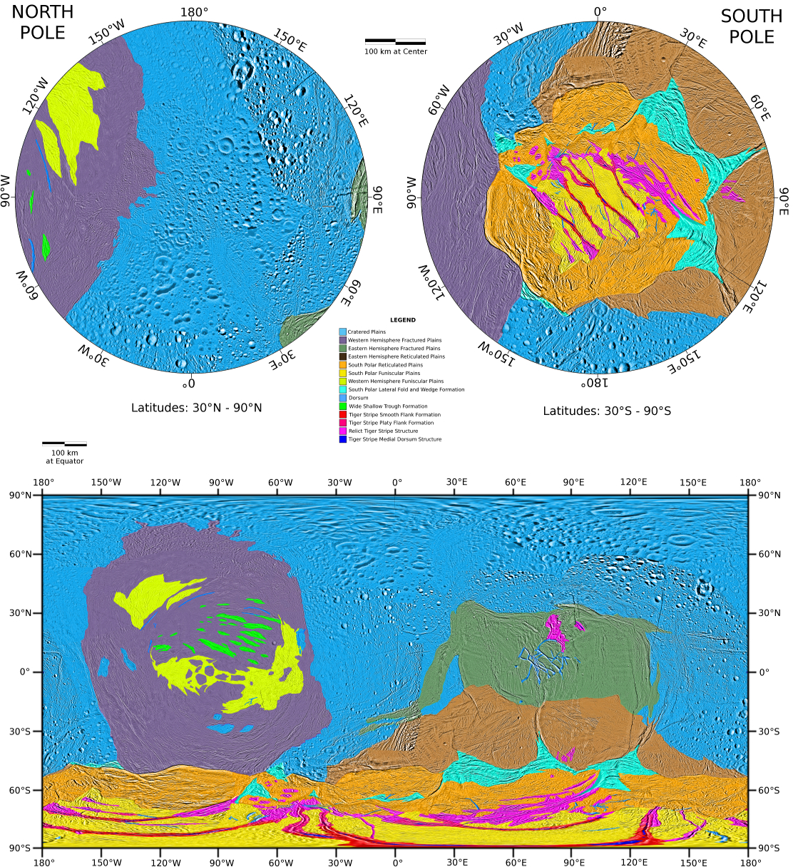
Global Terrain Map:
Original:
Spencer et al. 2009
Revised:
Remapped on new USGS Basemap
Western Hemisphere terrains from Helfenstein et al. (2010,2013)
Presented in Patterson et al. (2018) chapter in new Enceladus book.

Slide 11
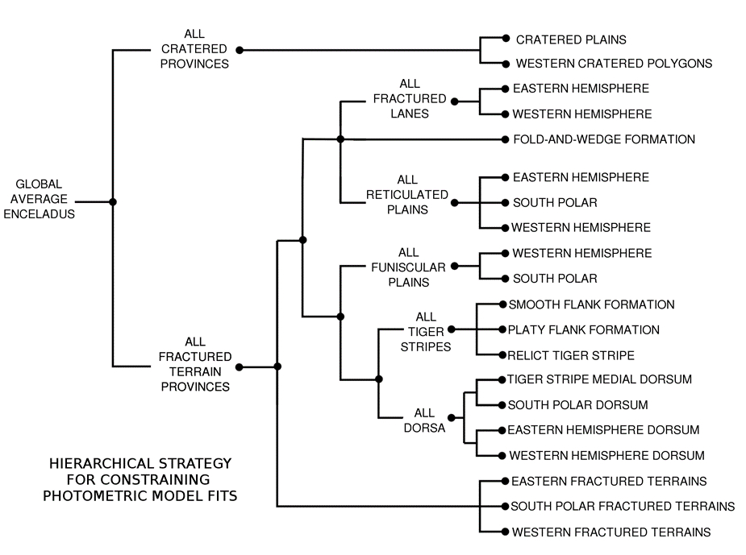
Top two-tiers of the dendrogram provides strong constraints on all parameters.
Lower tiers: Fix the values of poorly constrained parameters at higher-tier values and fit only the remaining parameters that are sensitive to the limited coverage

Slide 12
Objectives
STAGE 1: Survey and classify distinct terrain features that exhibit contrasting
photometric behavior (especially with phase angle).
STAGE 2: Measure, model, and interpret to the extent that is sensibly allowed by
modern radiative transfer theory regolith optical and possibly other
physical properties that distinguish different terrain photometric units.
STAGE 3: Perform realistic error analysis and establish confidence limits

Slide 13
Stage 1: Method(s)
Derive Global Average Photometric model that accurately
describes both average disk-resolved and whole-disk
brightness.
2) Create albedo images: Apply photometric model to
perform shading corrections across ISS images that
show the same features at different photometric
geometries but similar spatial resolution.
3) Re-project albedo images to common spatial resolution
and viewing perspective for comparison.
4) Option: Create “phase ratio” images to accentuate and
classify albedo contrast differences.

Slide 14
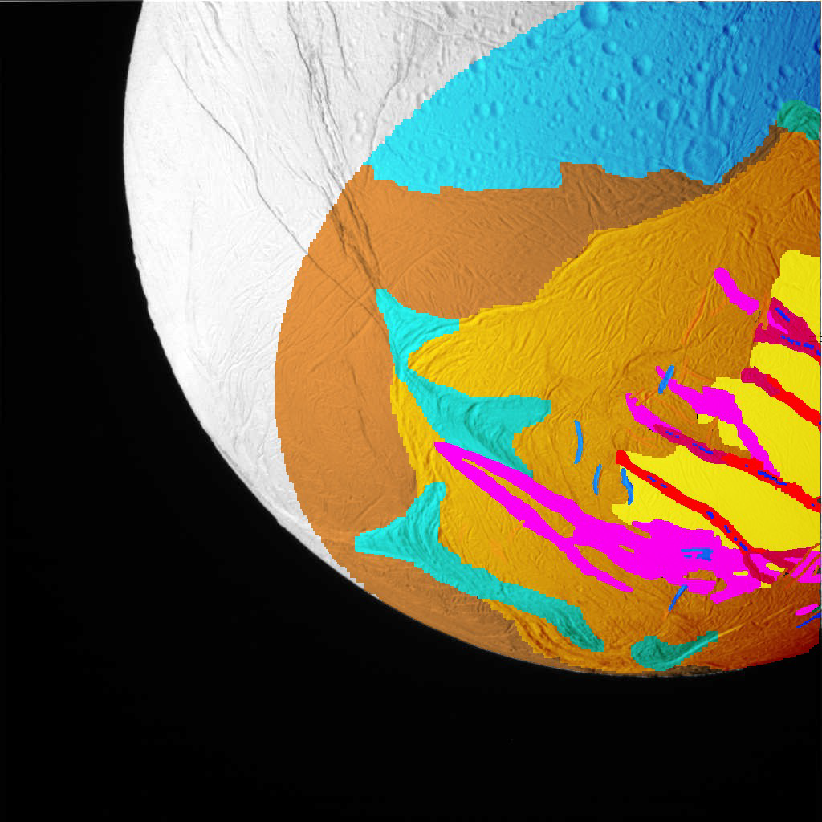
Disk Resolved
Photometry of
Enceladus
From Cassini
ISS
Limitation:
South Polar Terrain
is never seen at low
incidence angles
Sample CLR filter image N1500056057 with
regions of interest color coded to match those
on the Spencer et al. (2009) South
Polar Terrain Unit Map
Annex et al. 2012

Slide 15
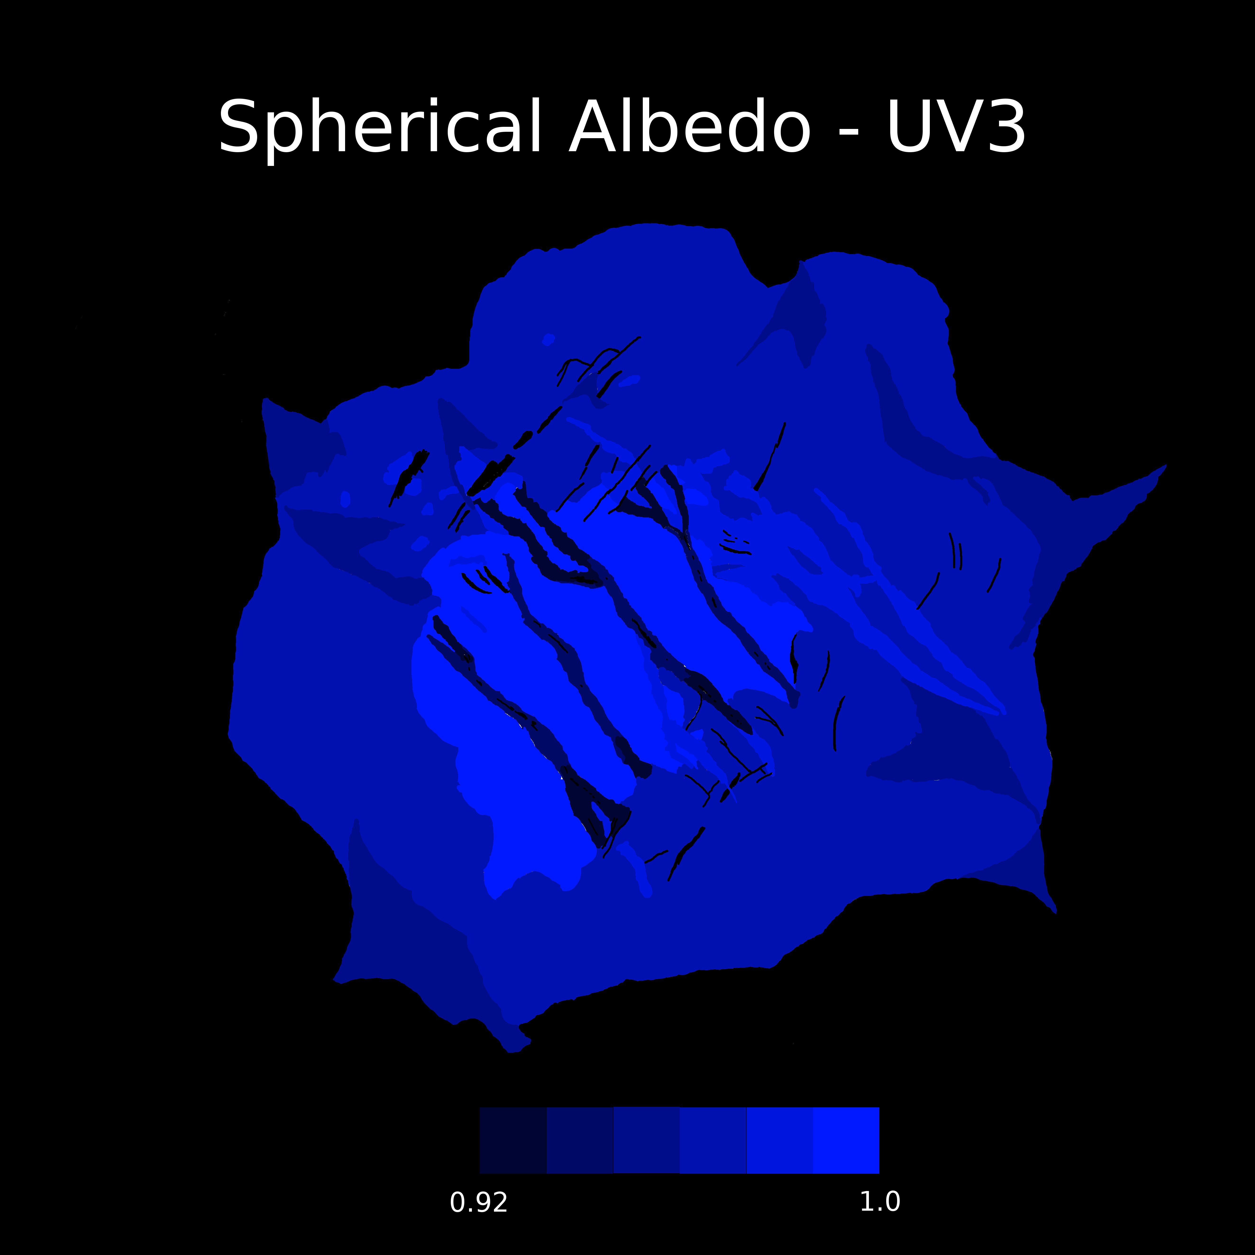
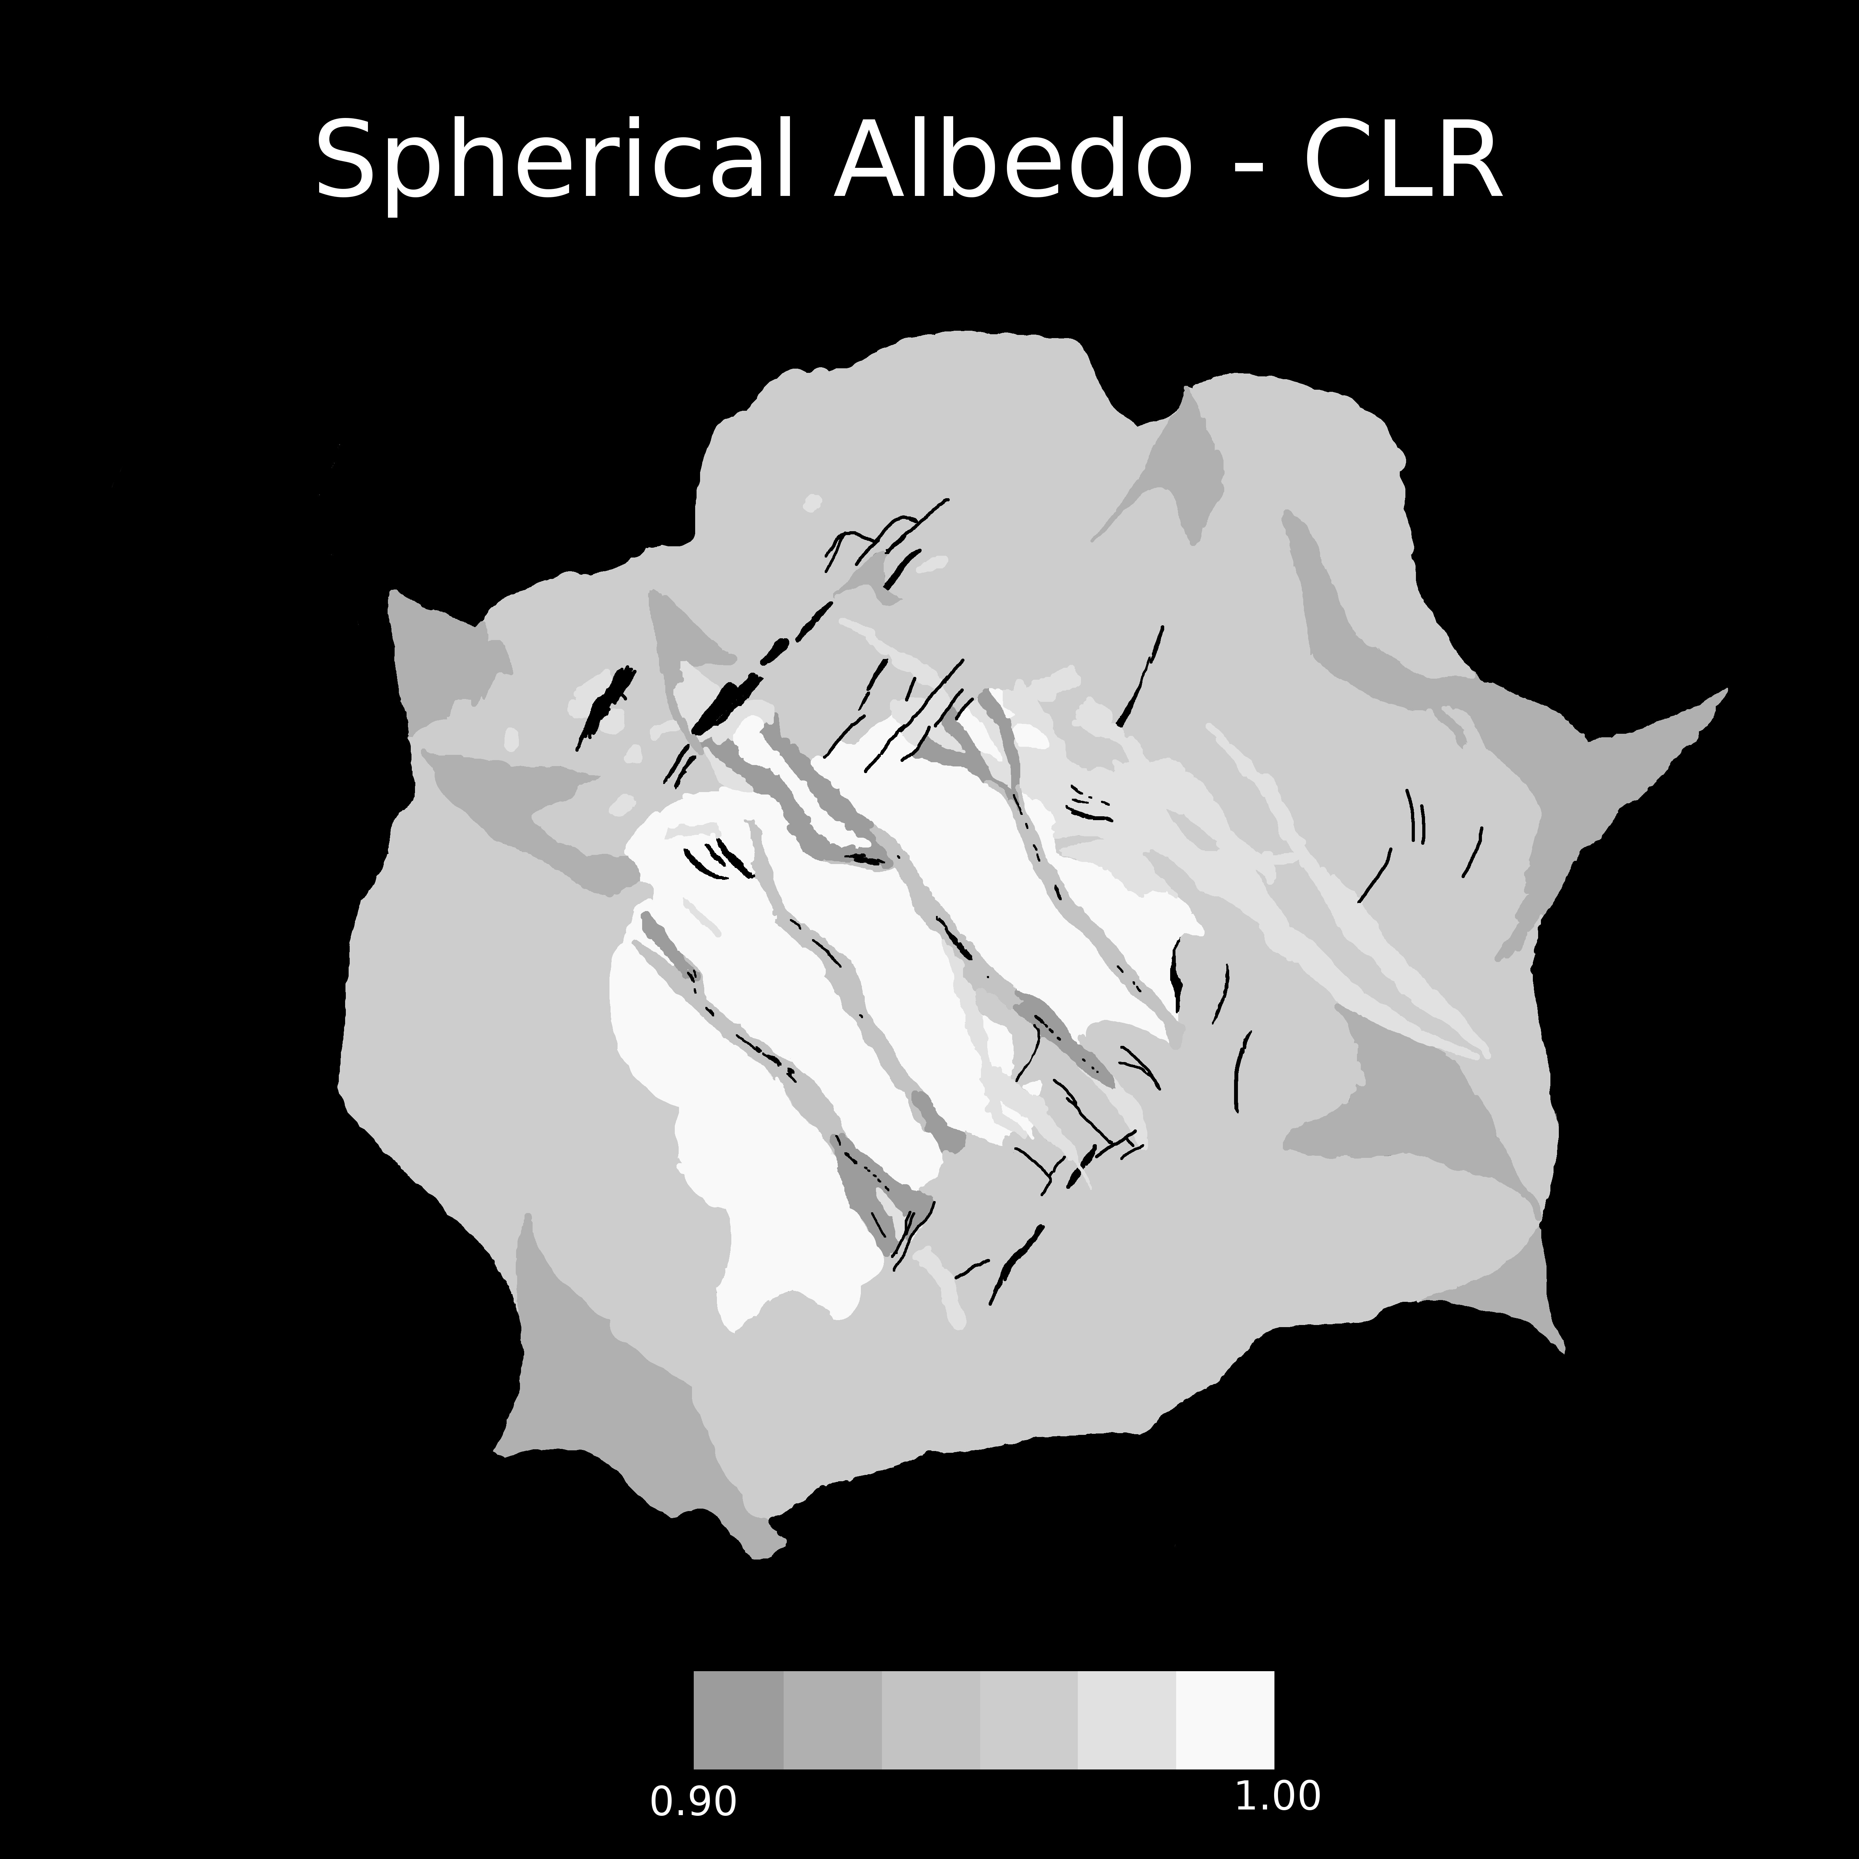
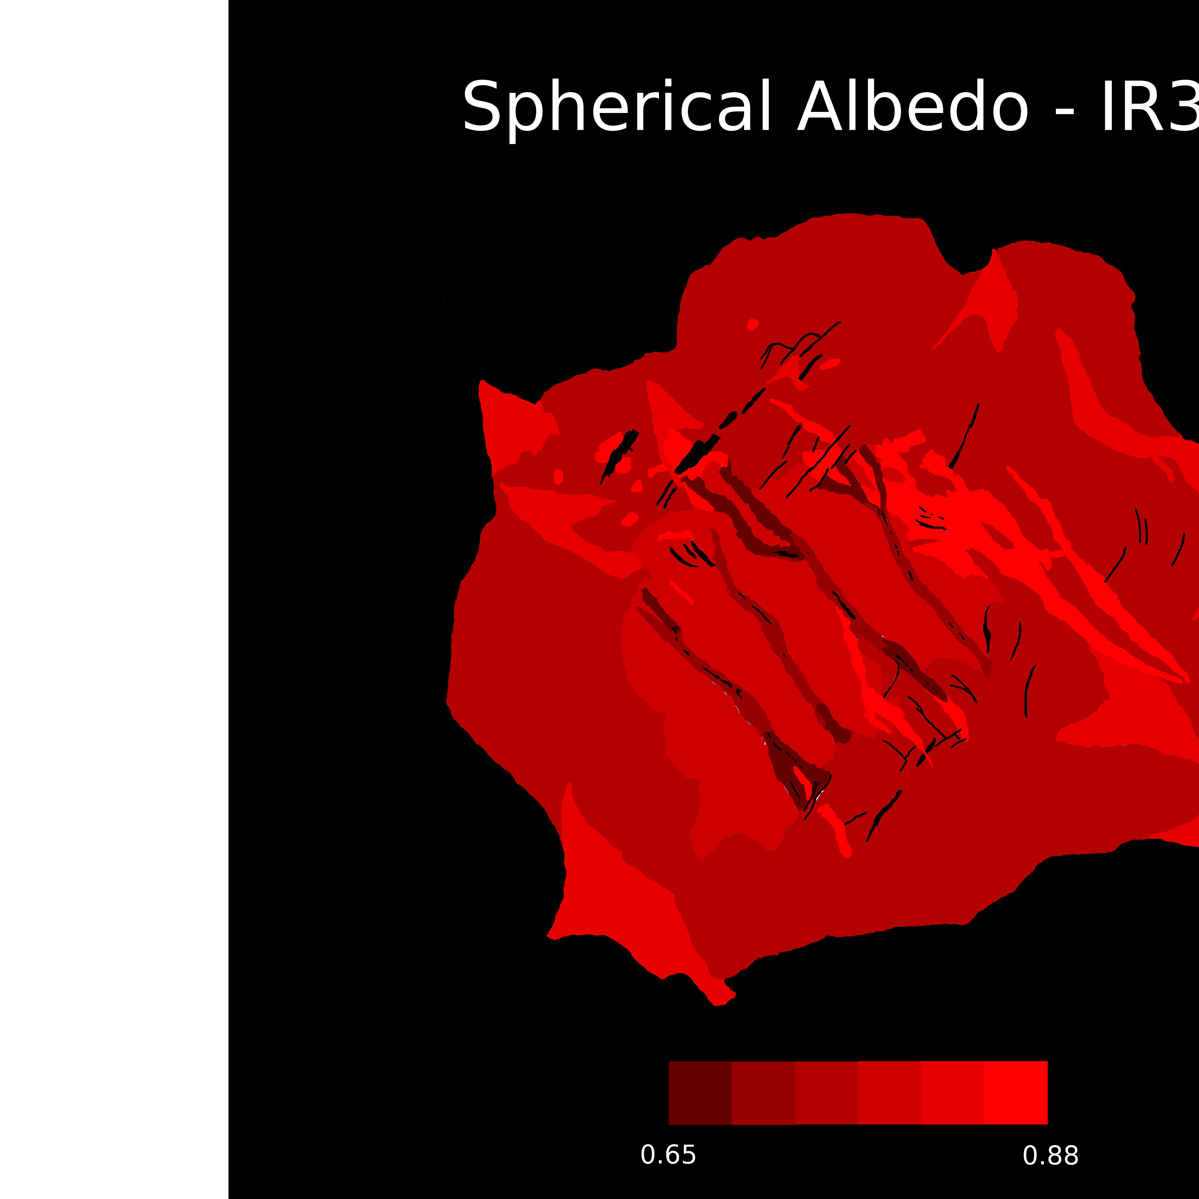
Spherical Albedos in
Enceladus’ South Polar Terrain

Slide 16
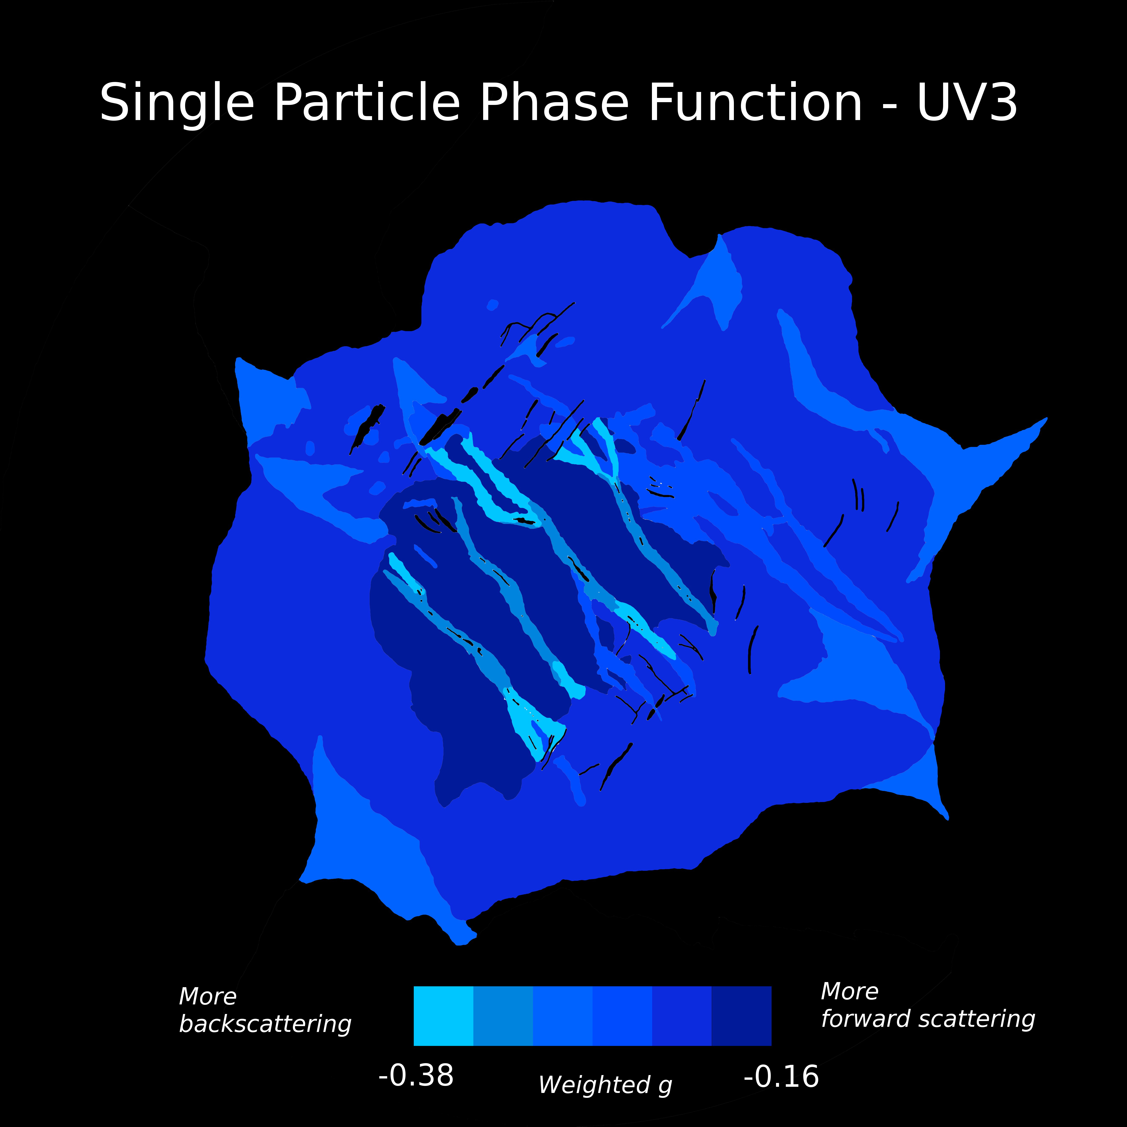
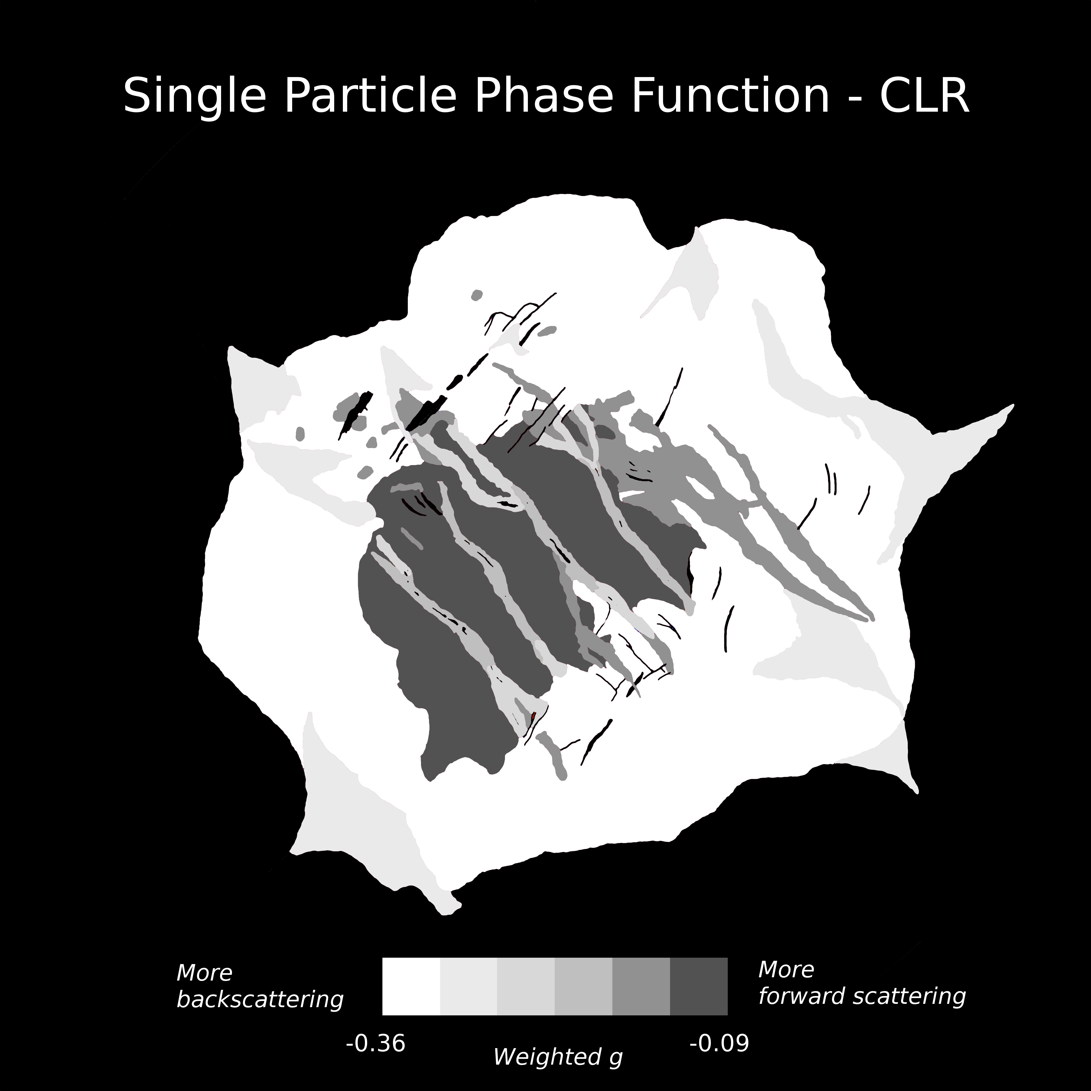
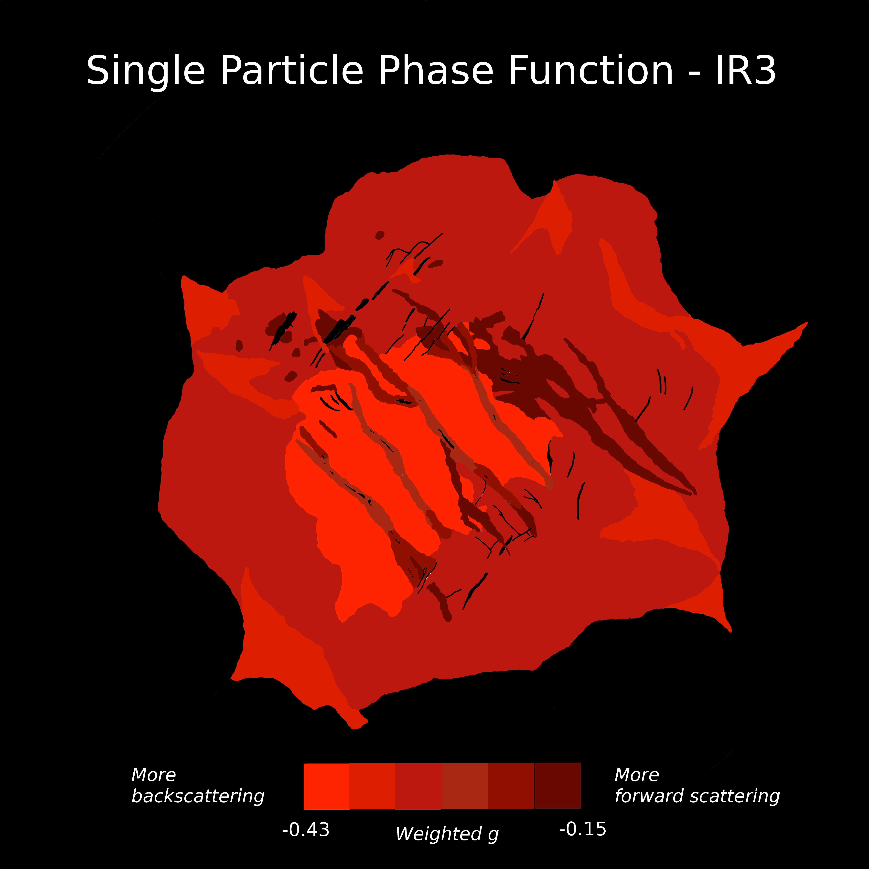
Single Particle Phase Function in Enceladus’
South Polar Terrain
In UV3 and CLR filters,
funiscular terrains are
more forward scattering than
tiger stripes and surrounding
terrains (but still backscattering overall)
In IR3, funiscular terrains are more back scattering
Characteristic of plume fallout?

Slide 17
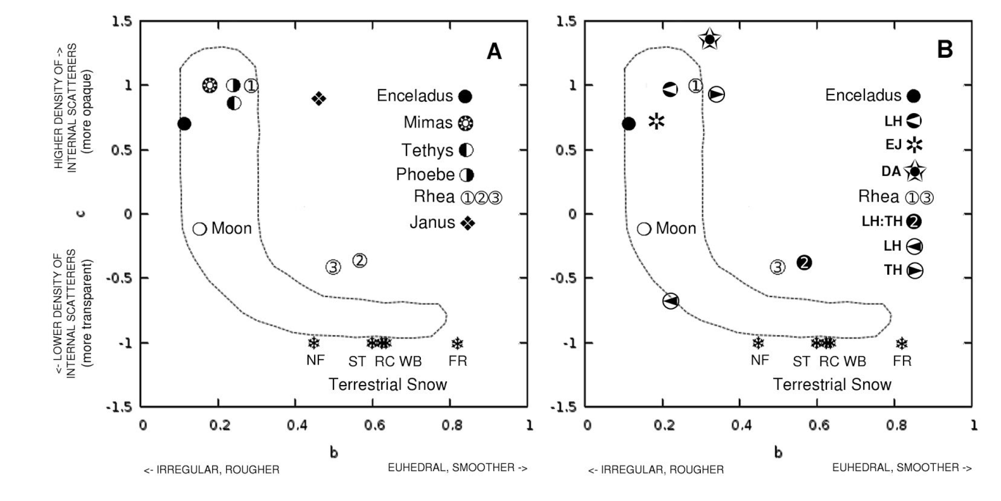
Two-Term Henyey-Greenstein Phase Function
P(α) = (1+c)/2 (1-b²)/(1 – 2b cos (α) + b²)^{1.5}
+ (1-c)/2 (1+b²)/(1 + 2b cos (α) +b²)^{1.5}
where α = phase angle, b = cos Θ and Θ = π – α
b describes assumed equal narrowness of backscattering and forward scattering lobes
c determines relative amplitude of each lobe. Each constrained by large and small α

Slide 18
Leading Side Test Region
Helfenstein et al. 2012

Slide 19
Test Region (near 15°S, 75°W)
Near center leading-hemisphere
Schenk et al. (2010) predicts plume fallout to be relatively thin in this region
At relatively large phase angles, circular “albedo” features are visible –
possibly highly-relaxed ancient impact craters, palimpsests or surface
expressions of subsurface diapirs.
Relatively dark feature “P1” and a brighter feature “P2” (see next slide).

Slide 20
CHANGE OF ALBEDO CONTRAST WITH PHASE a) Key b) α=124° c) α= 94° d) α= 76° e) α= 41° f) α= 31°
Helfenstein et al. 2012

Slide 21
Preliminary Results
Circular “low” albedo feature (P1) nearly vanishes at small phase angles
leaving small set of quasi-parallel lineaments
Small bright diffuse spot in P2 (bright ejecta from a small crater) becomes
more prominent at small phase – probably due to changes in background terrain
Hint of possible equatorial band at small phase angles (related to leading-side
bands on Tethys and Mimas?)
Contrast Ratio P1:P2 decreases from
27±3% at α=124° to
1.3±0.2 at α=31°

Slide 22
Next Steps for Test Region
Examine phase dependence of terrains albedo contrast as a
function of wavelength
Requires global average photometric model for CL1-UV3,
CL1-GRN, CL1-IR3
Classify units and separately model (Hapke 2008/Helfenstein
and Shepard 2011)
Apply 2-layer radiative transfer model (Hillier 1997) to investigate
frost cover.

Slide 23
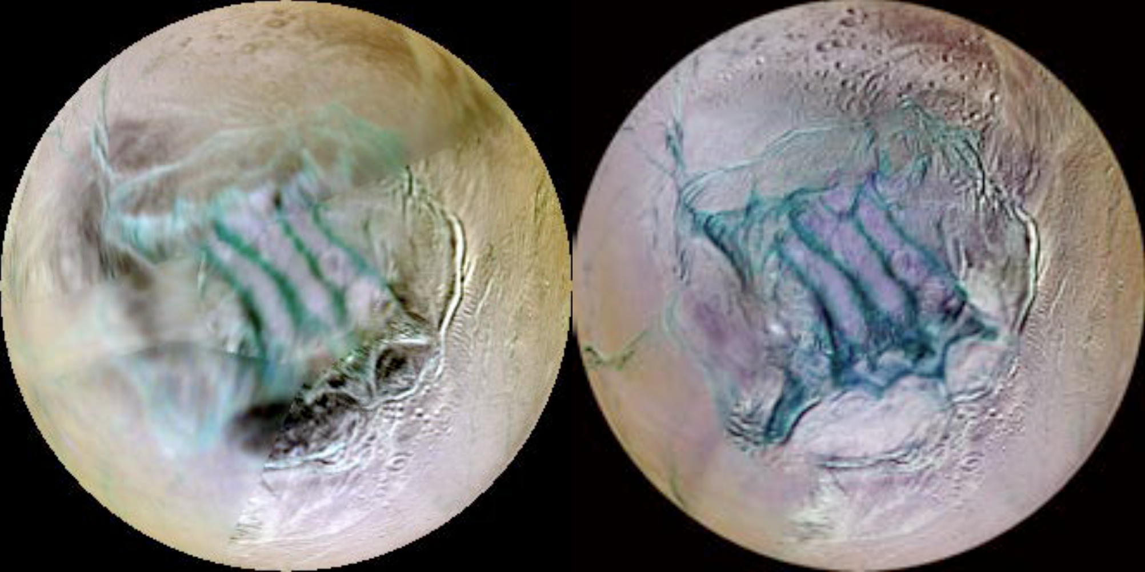
Enceladus South Polar Terrain
Phase Angle Dependent Albedo Changes
IR3-GRN-UV3 Color Maps of Enceladus SPT
α < 25°
α = 40 - 75°
Schenk et al. 2017

Slide 24
Summary and Future Work
Despite the nearly ubiquitous coating of Enceladus by plume material, differences in the
photometric properties of regions on Enceladus can be discerned.
We now have the most complete photometric data set for Enceladus that we will have for
quite some time and we now have the tools available to complete the photometric analysis.
Hapke (2012) model has addressed shortcomings present in previous versions,
recent studies reproduce laboratory results,
Corrected for grain packing in regolith, etc.
Can address non-uniqueness issues with broad viewing geometry coverage
Additionally, Cassini has polarization observations that have not yet been studied.
Cassini has provided a rich dataset of photometric observations of Enceladus
over a wide range of viewing geometries and wavelengths, from UV to IR

