Slide 1
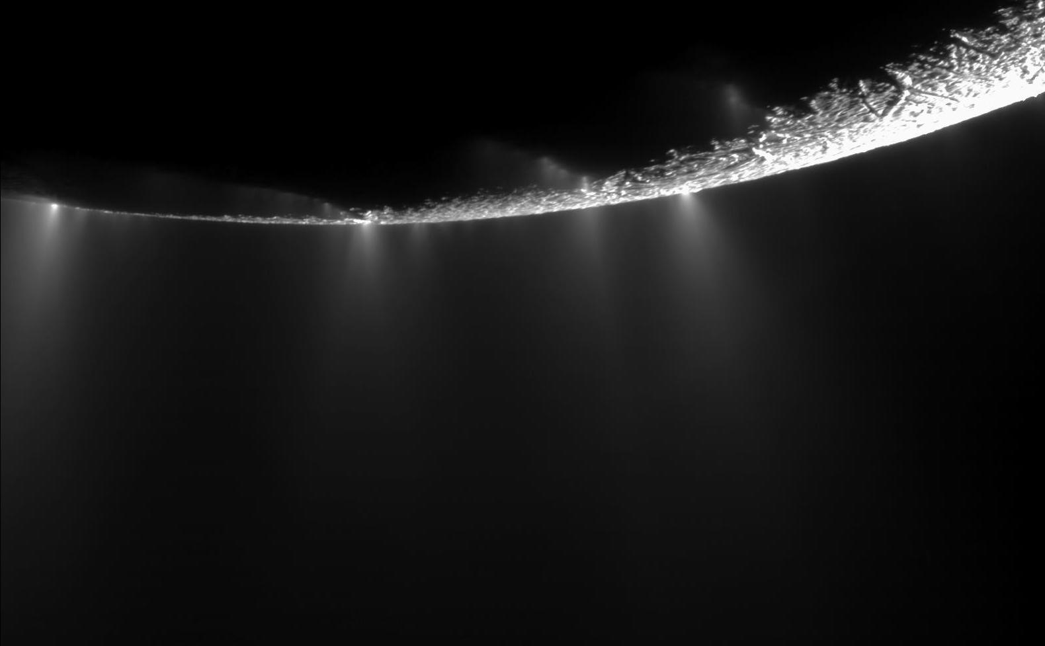
Exploring the Oxidation Chemistry of Enceladus’ Ocean
Christine Ray^{1,2}, Christopher Glein²,
J. Hunter Waite^{2,1}, Ben Teolis², Julie Huber³
1
2
3

Slide 2
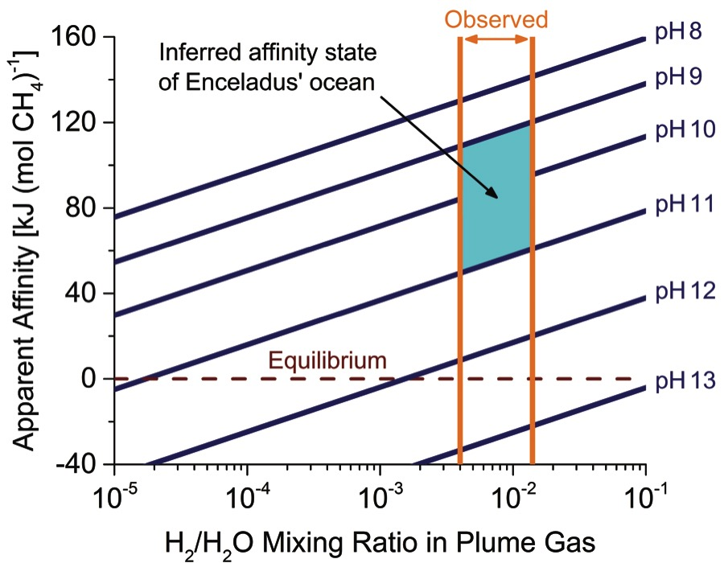
Chemical Affinity for Methanogenesis in Enceladus’ Ocean
Methanogenesis
4H₂+CO₂→CH₄+2H₂O
Affinity = 50 – 120 kJ/mol
Species | Molar Percentage
H₂O | 96 to 99
CO₂ | 0.3 to 0.8
CH₄ | 0.1 to 0.3
NH₃ | 0.4 to 1.3
H₂ | 0.4 to 1.4
Waite et al., 2017

Slide 3
Possible Metabolisms:
1. Methanogenesis:
4H₂ + CO₂→ CH₄ + 2H₂O
2. Methane Oxidation:
CH₄ + 2O₂→ CO₂ + 2H₂O
3. Hydrogen Oxidation:
2H₂ + O₂→ 2H₂O
4. Sulfide Oxidation:
H₂S + 2O₂ → SO₄²⁻ + 2H⁺
5. Iron Sulfide Oxidation:
FeS₂ + 3.5O₂ + H₂O → 2SO₄ + Fe²⁺ + 2H⁺
6. Sulfate Reduction:
4H₂ + SO₄²⁻ + 2H⁺→ H₂S + 4H₂O
7. Anaerobic Oxidation of Methane:
CH₄ + SO₄²⁻ + 2H⁺ → CO₂ + H₂S + 2H₂O
8. Iron Reduction:
H₂ + 2FeOOH + 4H⁺ → 2Fe²⁺ + 4H₂O
Modified from Amend et al. (2011), Zolotov and Shock (2004)
The common ingredient: oxidants!

Slide 4
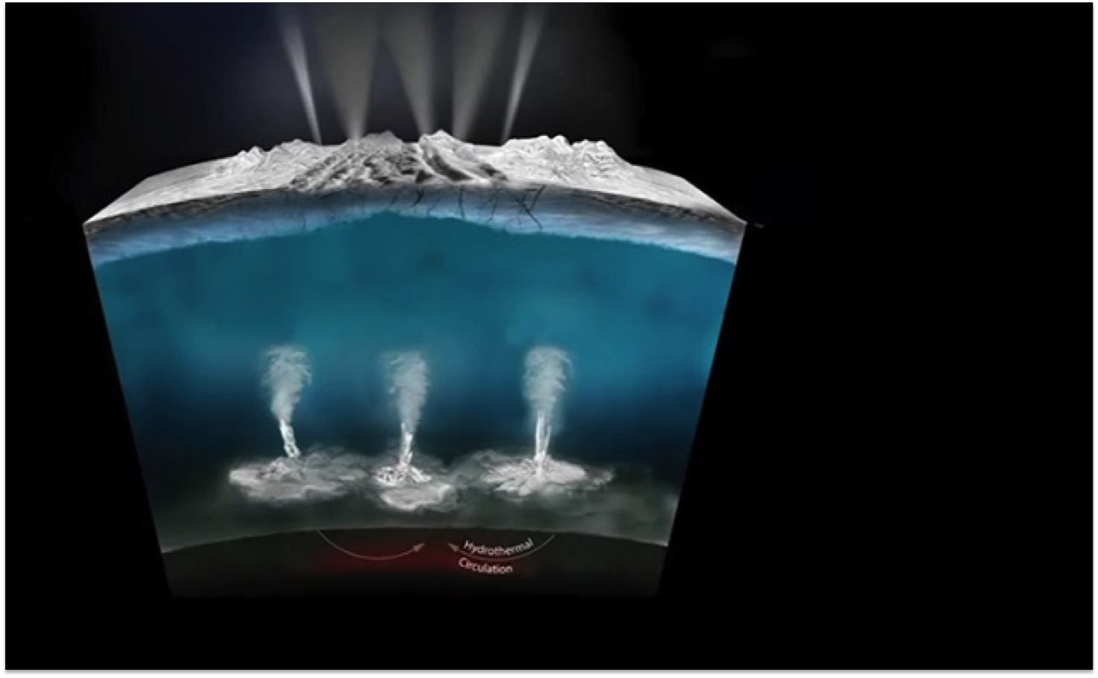
Where could these other oxidants come from?
Radiation
Radiation
1. Radiolysis creates O₂ and H₂O₂ in surface ice
2H₂O ➔ 2H₂ + O_{2,} H₂O₂
2H₂O ➔ 2H₂ + O_{2,} H₂O₂
Ice Shell
Ocean
Rocky Core

Slide 5
Where could these other oxidants come from?
1. Radiolysis creates O₂ and H₂O₂ in surface ice
O₂, H₂O₂ Trapped in Ice
2. Snowfall from plume transfers surface ice down to ocean
Ice Shell
Dissolved O_{2,} H₂O₂
Ocean
Rocky Core

Slide 6
Where could these other oxidants come from?
1. Radiolysis creates O₂ and H₂O₂ in surface ice
2. Snowfall from plume transfers surface ice down to ocean
Ice Shell
⁴⁰K decay
3. O₂ and H₂O₂ are also produced from decay of ⁴⁰K atoms dissolved in the ocean
2H₂0
2H₂ + O_{2,} H₂O₂
Ocean
Rocky Core

Slide 7
What about sulfate and ferric iron?
1. Radiolysis creates O₂ and H₂O₂ in surface ice
2. Snowfall from plume transfers surface ice down to ocean
Ice Shell
3. O₂ and H₂O₂ are also produced from decay of ⁴⁰K atoms dissolved in the ocean
Dissolved O_{2,} H₂O₂
Fe²⁺
H₂S, HS⁻
Ocean
4. O₂ and H₂O₂ could react with Fe²⁺ and H₂S/HS⁻ in ocean to produce new oxidants – but it depends what’s going on in the core
FeOOH
SO₄²⁻
Rocky Core

Slide 8
Our first limiting case: O₂ and H₂O₂ build up in the ocean
Radiation
Radiation
1. Radiolysis creates O₂ and H₂O₂ in surface ice
O₂, H₂O₂ Trapped in Ice
2. Snowfall from plume transfers surface ice down to ocean
Ice Shell
Dissolved O_{2,} H₂O₂
Ocean
Rocky Core

Slide 9
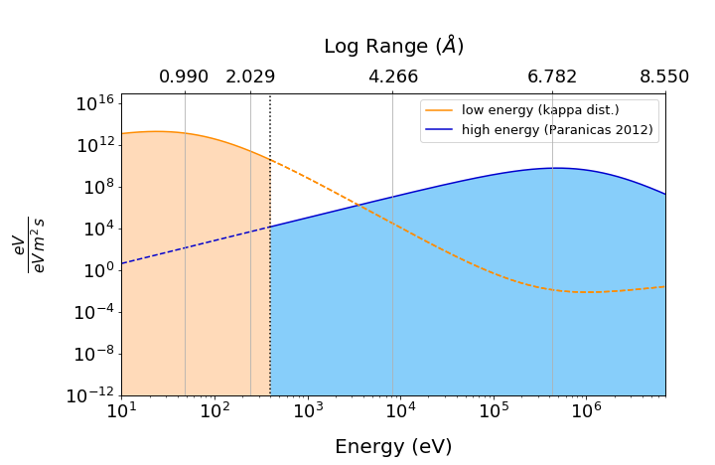
Our first limiting case: O₂ and H₂O₂ build up in the ocean
Start with the incident energy spectrum at Enceladus
High energy electrons will produce H₂O₂, while lower energies produce O₂
Integrated high energy distribution is ~6x higher than the integrated low energy distribution, so we should get more peroxide than oxygen

Slide 10
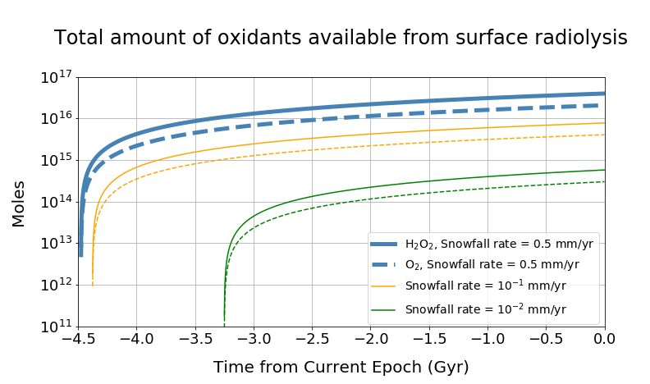
Our first limiting case: O₂ and H₂O₂ build up in the ocean
Plume burial rates from Kempf et al.(2010) are much faster than surface sputtering rate (Teolis et al., 2017)
With a ~10 km-thick ice shell and transport over the south polar region, it takes ~10⁷ years to reach the ocean
Assuming constant delivery rate, we can calculate how much O₂ and H₂O₂ are sent to the ocean over time
Over 10¹⁶ moles O₂ and H₂O₂ could be available from this process

Slide 11
Where could these other oxidants come from?
1. Radiolysis creates O₂ and H₂O₂ in surface ice
2. Snowfall from plume transfers surface ice down to ocean
Ice Shell
⁴⁰K decay
3. O₂ and H₂O₂ are also produced from decay of ⁴⁰K atoms dissolved in the ocean
2H₂0
2H₂ + O_{2,} H₂O₂
Ocean
Rocky Core

Slide 12
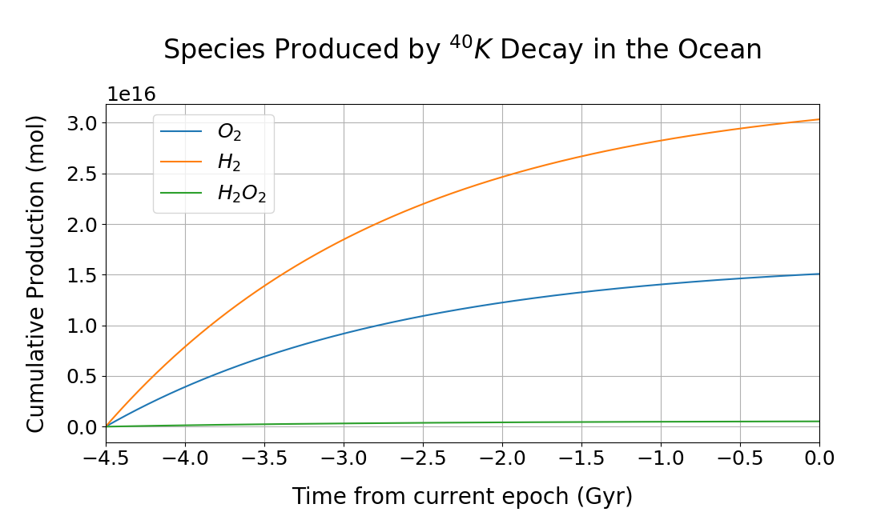
Our first limiting case: O₂ and H₂O₂ build up in the ocean
Draganic et al. (1991) calculated rates of O_{2,} H₂ and H₂O₂ production from ⁴⁰K decay in seawater
Can use this with ⁴⁰K concentration in Enceladus’ ocean, derived from K concentration (Postberg et al., 2009) and solar system ⁴⁰K abundance (Lodders, 2003)
Another ~10¹⁶ moles O₂ are available
from this process

Slide 13
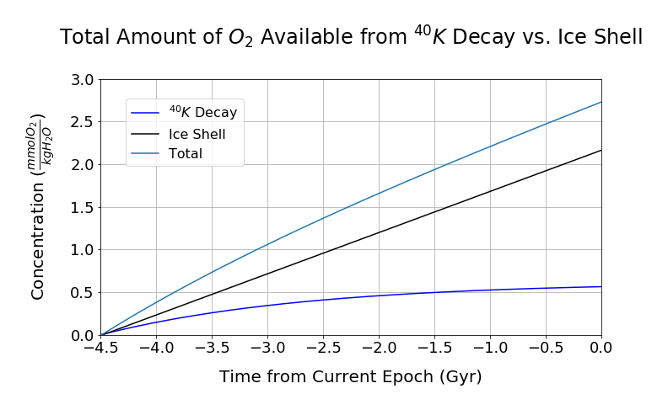
Our first limiting case: O₂ and H₂O₂ build up in the ocean
Assumptions:
All H₂O₂ dissociates into O₂ when it enters the ocean
O₂ builds up in the ocean over 4.5 Gyr without reacting with any reductants
Maximum possible O₂ concentration: 3 mmol/kg H₂O

Slide 14
Our first limiting case: O₂ and H₂O₂ build up in the ocean
2. CH₄ + 2O₂→ CO₂ + 2H₂O
Affinity = 830 kJ/mol
3. 2H₂ + O₂→ 2H₂O
Affinity = 440 - 470 kJ/mol
*Recall methanogenesis was 50-120 kJ/mol
In this case, O₂-consuming reactions provide a lot of energy!

Slide 15
Our second limiting case: a reductant-rich ocean
Ice Shell
Dissolved O_{2,} H₂O₂
Fe²⁺
H₂S, HS⁻
Ocean
4. O₂ and H₂O₂ could react with Fe²⁺ and H₂S/HS⁻ in ocean to produce new oxidants – but it depends what’s going on in the core
FeOOH
SO₄²⁻
Rocky Core

Slide 16
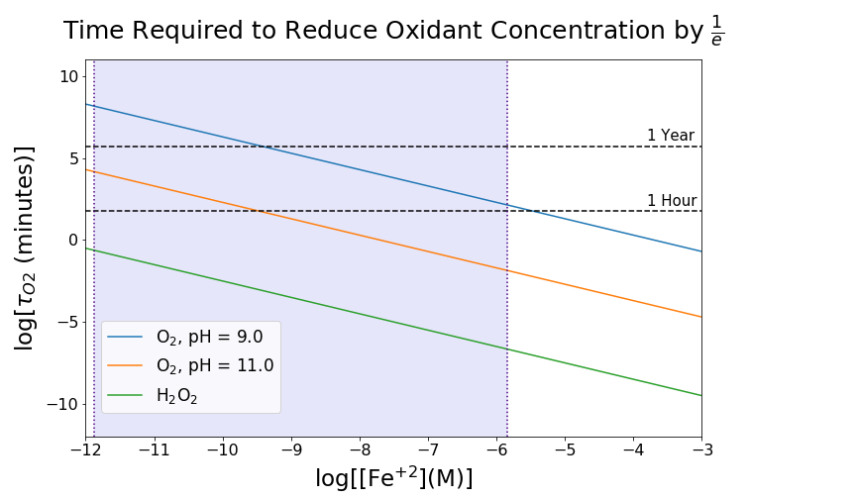
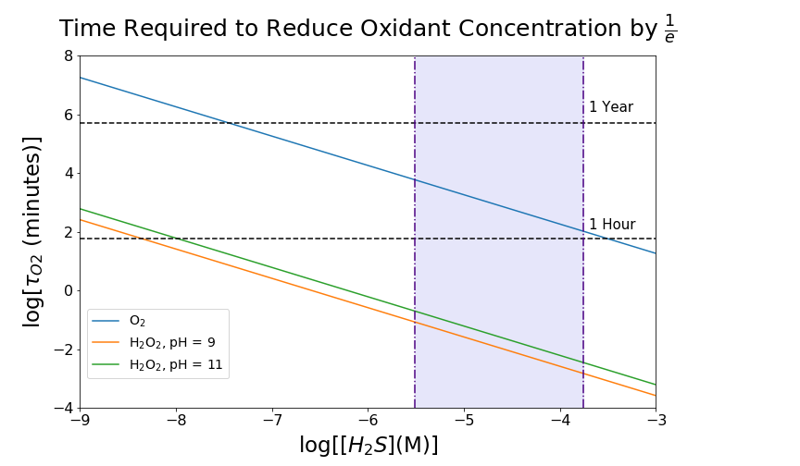
Our second limiting case: a reductant-rich ocean
H₂S + 2O₂ → SO₄ + 2H⁺
4Fe²⁺ + O₂ + 6H₂O→ 4FeOOH + 2H⁺
Reaction rates from Millero et al. (1986) and Millero et al. (1987)
Reductant concentrations, constrained by equilibrium solubilities of ocean floor minerals, are abundant enough in the ocean to drive O₂ to steady-state

Slide 17
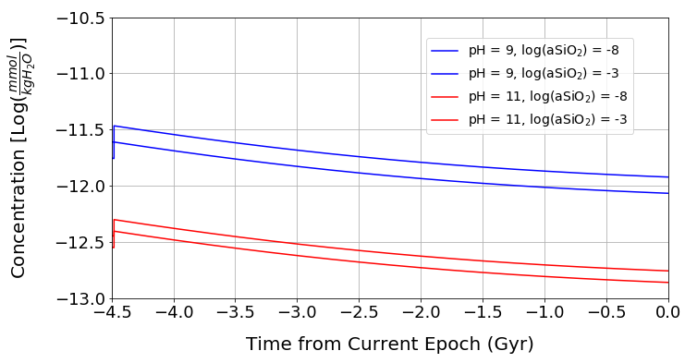
Our second limiting case: a reductant-rich ocean
Steady-State O₂ Concentration
Assumptions:
Reductants are far more abundant in the ocean than oxidants (from water-rock reactions, hydrothermal vents)
The resupply rate of reductants is greater than the production rate of O₂
The O₂ concentration is driven very low…

Slide 18
Our second limiting case: a reductant-rich ocean
Steady-State O₂ Concentration
2. CH₄ + 2O₂→ CO₂ + 2H₂O
Affinity = 690 – 710 kJ/mol
3. 2H₂ + O₂→ 2H₂O
Affinity = 370 - 410 kJ/mol
4. H₂S + 2O₂ → SO₄²⁻ + 2H⁺
Affinity = 670 - 690 kJ/mol
5. FeS₂ + 3.5O₂ + H₂O → 2SO₄²⁻ + Fe²⁺ + 2H⁺
Affinity = 1140 – 1180 kJ/mol
…but O₂ is still a powerful oxidant!

Slide 19
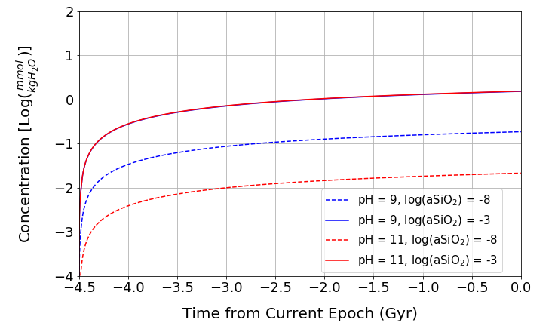
Sulfate and Geothite are not as Powerful, but their Concentrations are Much Higher
Steady-State SO₄²⁻ Concentration
6. 4H₂ + SO₄²⁻ + 2H⁺→ H₂S + 4H₂O
Affinity = 50 – 120 kJ/mol
7. CH₄ + SO₄²⁻ + 2H⁺ → CO₂ + H₂S + 2H₂O
Affinity = 50 – 70 kJ/mol
Up to ~2 mmol/(kg H₂O) of SO₄²⁻ are available at present day

Slide 20
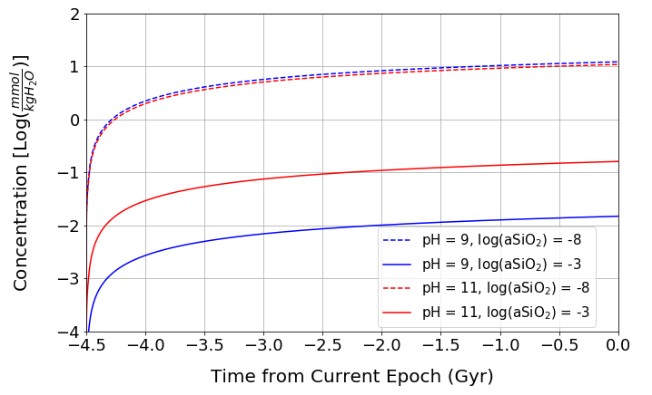
Sulfate and Geothite are not as Powerful, but their Concentrations are Much Higher
Steady-State FeOOH Concentration
8. Iron Reduction: :
H₂ + 2FeOOH + 4H⁺ → 2Fe²⁺ + 4H₂O
Affinity = 0 - 50 kJ/mol
Up to ~10 mmol/(kg H₂O) of FeOOH are available at present day

Slide 21
Possible Metabolisms:
1. Methanogenesis:
4H₂ + CO₂→ CH₄ + 2H₂O
Affinity = 50 – 120 kJ/mol
2. Methane Oxidation:
CH₄ + 2O₂→ CO₂ + 2H₂O
Affinity = 690 – 830 kJ/mol
3. Hydrogen Oxidation:
2H₂ + O₂→ 2H₂O
Affinity = 370 - 470 kJ/mol
4. Sulfide Oxidation:
H₂S + 2O₂ → SO₄²⁻ + 2H⁺
Affinity = 670 - 690 kJ/mol
5. Iron Sulfide Oxidation:
FeS₂ + 3.5O₂ + H₂O → 2SO₄²⁻ + Fe²⁺ + 2H⁺
Affinity = 1140 – 1180 kJ/mol
6. Sulfate Reduction:
4H₂ + SO₄²⁻ + 2H⁺→ H₂S + 4H₂O
Affinity = 50 – 120 kJ/mol
7. Anaerobic Oxidation of Methane:
CH₄ + SO₄²⁻ + 2H⁺ → CO₂ + H₂S + 2H₂O
Affinity = 50-70 kJ/mol
8. Iron Reduction:
H₂ + 2FeOOH + 4H⁺ → 2Fe²⁺ + 4H₂O
Affinity = 0 - 50 kJ/mol
Most affinities are comparable, or larger than, those for methanogenesis

Slide 22
Possible Metabolisms:
1. Methanogenesis:
4H₂ + CO₂→ CH₄ + 2H₂O
Power = 5800 – 11,400 kW
2. Methane Oxidation:
CH₄ + 2O₂→ CO₂ + 2H₂O
Power = 232 – 235 kW
3. Hydrogen Oxidation:
2H₂ + O₂→ 2H₂O
Power = 126 - 136 kW
4. Sulfide Oxidation:
H₂S + 2O₂ → SO₄²⁻ + 2H⁺
Power = 227 - 229 kW
5. Iron Sulfide Oxidation:
FeS₂ + 3.5O₂ + H₂O → 2SO₄²⁻ + Fe²⁺ + 2H⁺
Power = 382 – 393 kW
6. Sulfate Reduction:
4H₂ + SO₄²⁻ + 2H⁺→ H₂S + 4H₂O
Power = 0.05 – 8 kW
7. Anaerobic Oxidation of Methane:
CH₄ + SO₄²⁻ + 2H⁺ → CO₂ + H₂S + 2H₂O
Power = 0.05 – 4 kW
8. Iron Reduction:
H₂ + 2FeOOH + 4H⁺ → 2Fe²⁺ + 4H₂O
Power = 0.02 - 13 kW
Methanogenesis dominates, but we’re ignoring the core!

Slide 23
What Has Cassini Already Detected?
INMS, Without Ambiguity:
Species | Molar Percentage
H₂O | 96 to 99
CO₂ | 0.3 to 0.8
CH₄ | 0.1 to 0.3
NH₃ | 0.4 to 1.3
H₂ | 0.4 to 1.4
Constraints already applied to this model

Slide 24
What Has Cassini Already Detected?
INMS, With Ambiguity:
Species | Molar Percentage (Upper Limit)
H₂S | 0.001
O₂ | 0.004
The concentration used in our model falls under this, but it could be higher…
Even our limiting case, O₂ is less than this
CDA, With Ambiguity:
Species | Molarity (Upper Limit)
SO₄²⁻ | 0.001
We are slightly over this number!

Slide 25
What Can We Accomplish with a Future Enceladus Mission?
Clear detections of H₂S, SO₄²⁻, O₂

Slide 26
What Can We Accomplish with a Future Enceladus Mission?
Clear detections of H₂S, SO₄²⁻, O₂
Comparison of detections with model predictions – our current predictions fall within (or are close to) observational constraints, but we are ignoring a lot of the core

Slide 27
What Can We Accomplish with a Future Enceladus Mission?
Clear detections of H₂S, SO₄²⁻, O₂
Comparison of detections with model predictions – our current predictions fall within (or are close to) observational constraints, but we are ignoring a lot of the core
Detections of new oxidants like nitrates

Slide 28
What Can We Accomplish with a Future Enceladus Mission?
Clear detections of H₂S, SO₄²⁻, O₂
Comparison of detections with model predictions – our current predictions fall within (or are close to) observational constraints, but we are ignoring a lot of the core
Detections of new oxidants like nitrates
How much energy is there in the ocean, and what might the diversity of metabolisms look like?

Slide 29
Questions?
Email: christine.ray@swri.org
Twitter: @ItsChristineRay

Slide 30
Backup Slides

Slide 31
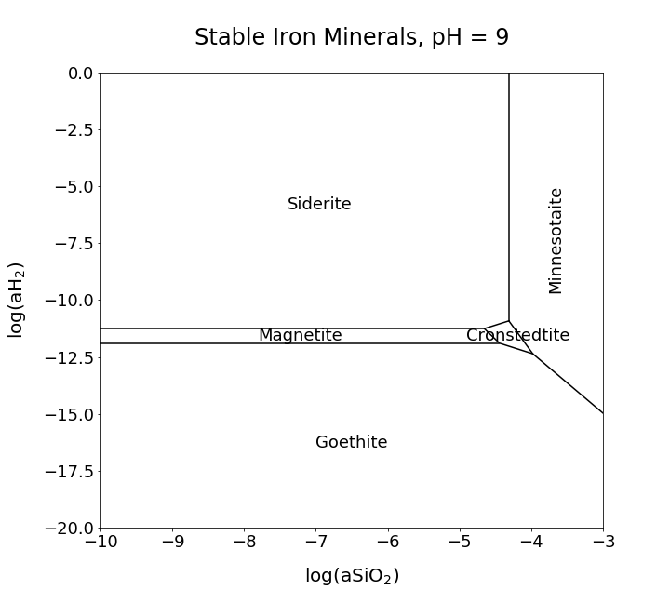
4. What Happens to O₂ and H₂O₂ in the Ocean?
We can calculate the concentration of Fe²⁺ if we know which mineral is controlling it

Slide 32
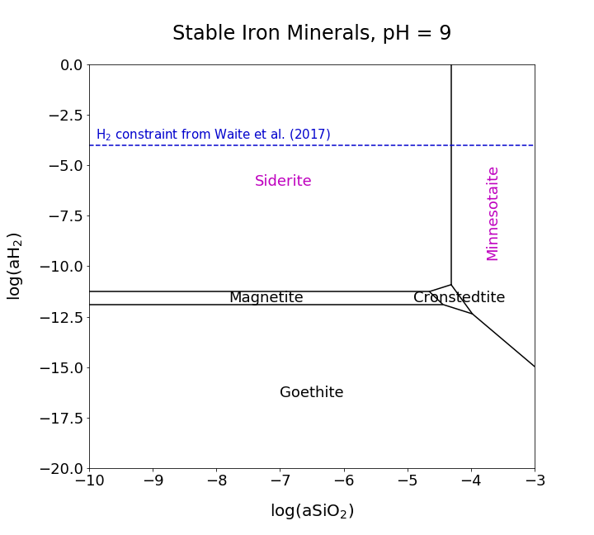
4. What Happens to O₂ and H₂O₂ in the Ocean?
We can calculate the concentration of Fe²⁺ if we know which mineral is controlling it
Based on the H₂ constraint from Waite et al (2017), it will either be siderite or minnesotaite at pH 9

Slide 33
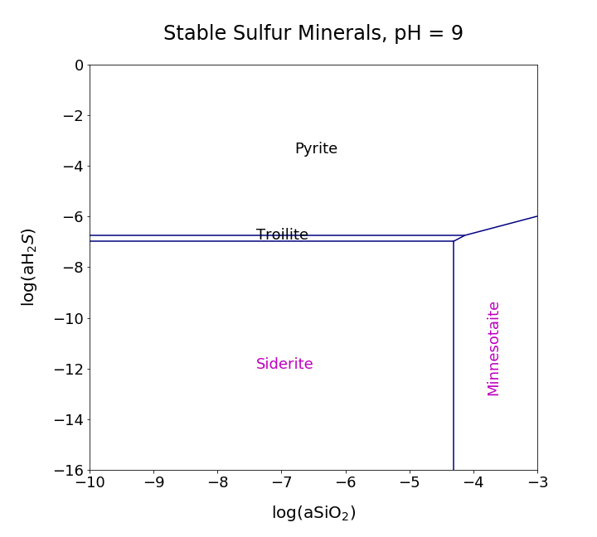
4. What Happens to O₂ and H₂O₂ in the Ocean?
We can then use these iron-bearing minerals to figure out which sulfur-bearing minerals could control the ocean’s H₂S/HS⁻ concentration (troilite or pyrite at pH 9)

Slide 34
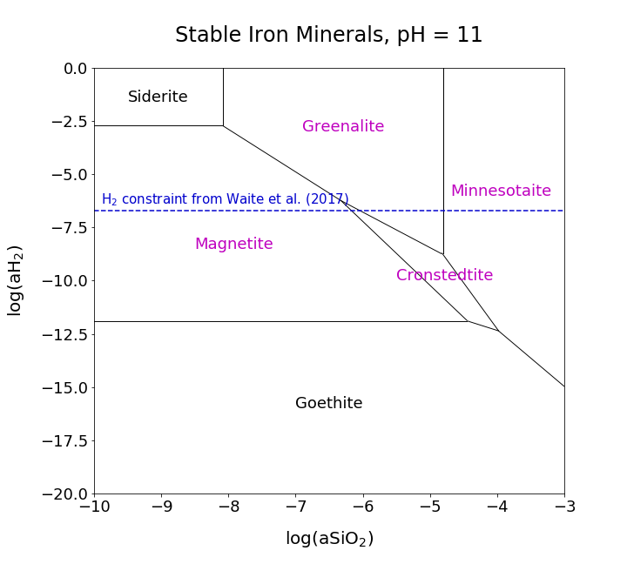
4. What Happens to O₂ and H₂O₂ in the Ocean?
At pH 11, magnetite, cronstedtite, greenalite or minnesotaite will control the Fe²⁺ concentration…

Slide 35
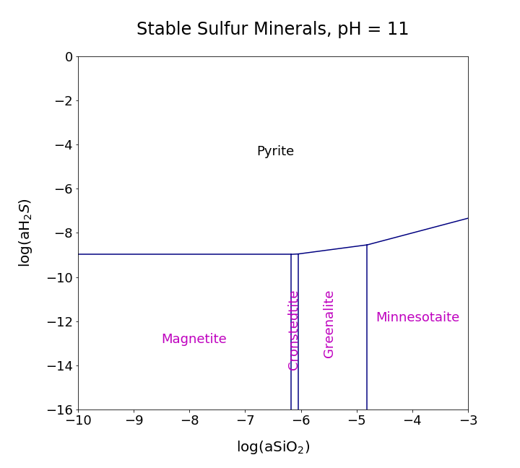
4. What Happens to O₂ and H₂O₂ in the Ocean?
…which means pyrite will control the H₂S/HS⁻ concentration

Slide 36
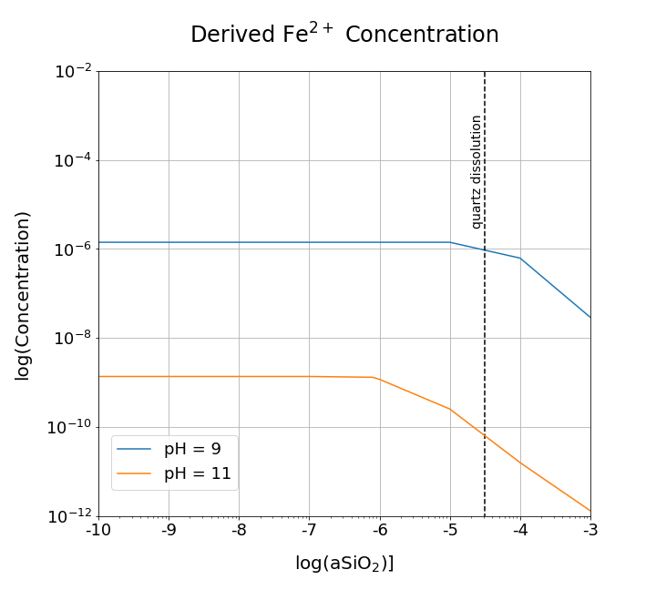
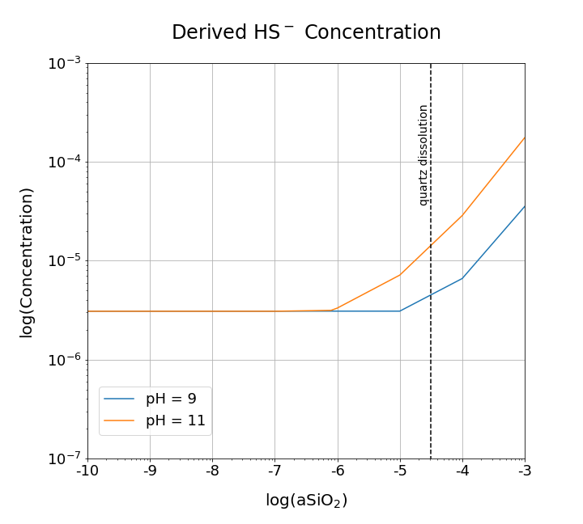
4. What Happens to O₂ and H₂O₂ in the Ocean?
Speciation calculations using these minerals, along with current ocean chemistry models, yield the appropriate concentration ranges for Fe²⁺ and H₂S/HS⁻

