Slide 1
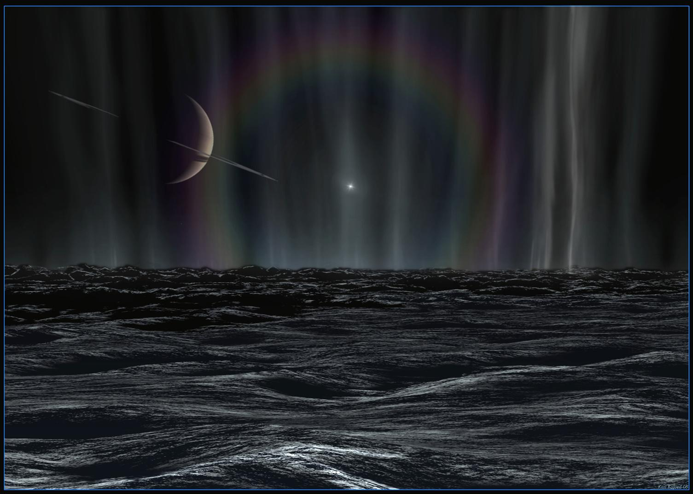
The Structure and Composition of Enceladus’ Plume – Results from Cassini’s Ultraviolet Imaging Spectrograph (UVIS)
C. J. Hansen, L. W. Esposito, A. Hendrix, A. Portyankina, J. Colwell
August 2018
Notes:
1
I will be talking today about some recent UVIS data and new findings, in the context of the complete collections

Slide 2
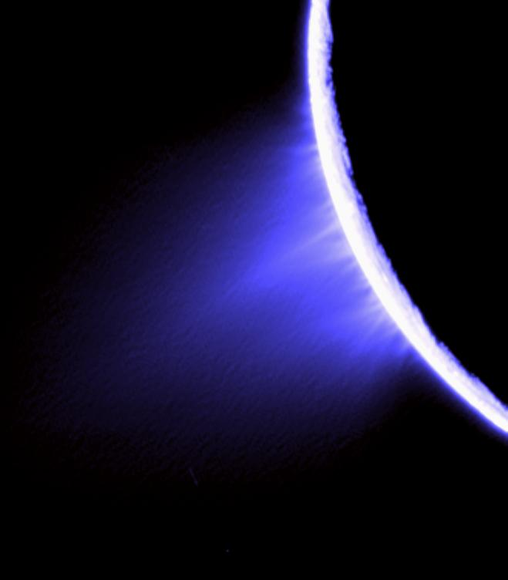
Cassini’s Ultraviolet Imaging Spectrograph (UVIS) observes occultations of stars and the sun to probe Enceladus’ plume
Composition, source rate, and plume and jet structure
Introduction
In the span from 2005 to 2017 we’ve observed a total of 9 occultations
Diagonal
Horizontal
Mid-latitude
This talk will review findings from the occultations, and place in context new results from the latest / last occultation observations
Plume
Jets
Shown in this Cassini ISS image are small particles – UVIS detects gas
Composition
Jets
Variability
Notes:
2

Slide 3
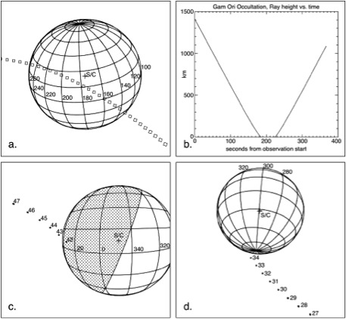
The Occultation Collection (1)
Plume Discovery
In 2005 we discovered a plume of water vapor coming from Enceladus’ south polar region
2005 – lambda Sco Occultation
Gas absorption was only detected by the gamma Ori ingress, not egress or at all in lambda Sco occ -> the plume is localized
Water vapor is the primary constituent
Mass flux adequate to explain water products (O, OH) previously detected in the Saturn system
2005 - gamma Orionis Occultation
Notes:
3
We observed two occultations in 2005. No one remembers the February lambda Sco occ because the plume was not detected, however, combined with the July occultation we could establish that we were seeing a localized phenomena, not a global exosphere

Slide 4
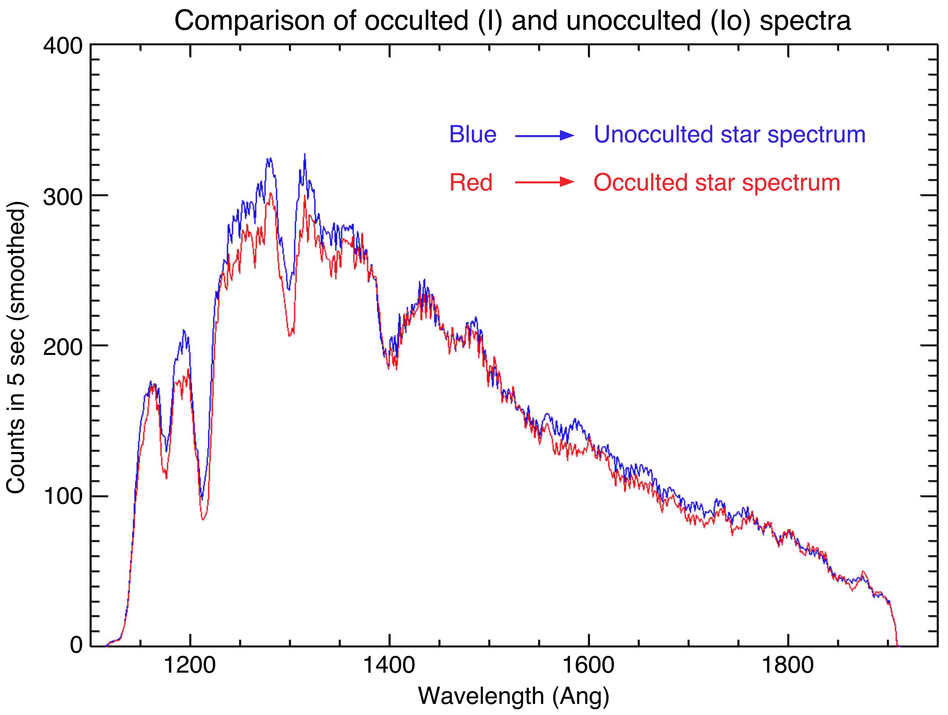
2005 Gamma Orionis Occ, FUV data
UVIS spectra, occulted and unocculted
5 sec integration, good snr
Plot I/I₀ to see absorption features
I=I₀ exp (-n*)
Compare I/I₀ to water absorption spectrum
Water vapor: uses Mota absorption cross-sections
Best fit column density = 1.6 x 10¹⁶ cm⁻²
Used this data to look for other species
Notes:
This is what FUV data looks like.

Slide 5
Ammonia, Methanol Anti-Freeze
Checked for NH₃ and CH₃OH because either could lower the freezing point of the water internal to Enceladus
NH₃ not identified (at INMS level)
CH₃OH provides a better fit, but there are no unambiguous features to be sure
CO < 0.9%, N₂ < 0.5%

Slide 6
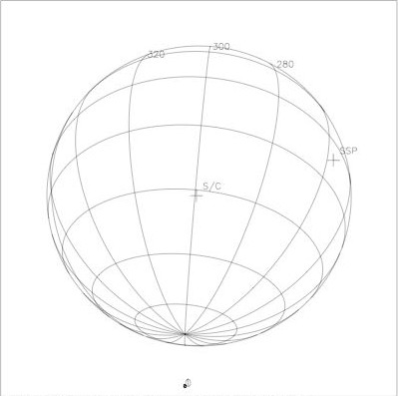
Plume Mass Flux Estimation
Simple
S = flux (source rate)
= N * x * y * v_{th}
= (n/x) * x * y * v_{th}
= n * y * v_{th}
Where
N = number density / cm³
x * y = area
y = v_{los} * t at FWHM
v_{th} = thermal velocity = 45,000 cm/sec for T = 170K
(note that escape velocity = 24,000 cm/sec)
n = column density measured by UVIS
New recommended estimate:
300 kg/sec
y
x
v
More accurate
There is another way to compute mass flux: sum the HSP data across the entire occultation
Need to use the FUV spectrum for the calculation
I/I₀ = Σ I₀(λ)e^{-nσ} dλ / Σ I₀(λ) dλ
Create a look-up table for I/I₀ to retrieve column density at each time interval
Calculate distance traversed in each time interval
Use same formula to calculate molecules / sec detected in that time interval (typically 1 sec)
Sum
Doing it this way gives a consistently larger value
Notes:
6
6
Important message – flux has not changed much in 5 years. (Deviation is only 15%, not factors of 2)
Width (y) is at FWHM
Vlos is the line-of-sight velocity of the star across the plane of the sky
Given uncertainties our best estimate of water flux from Enceladus is 200 kg/sec

Slide 7
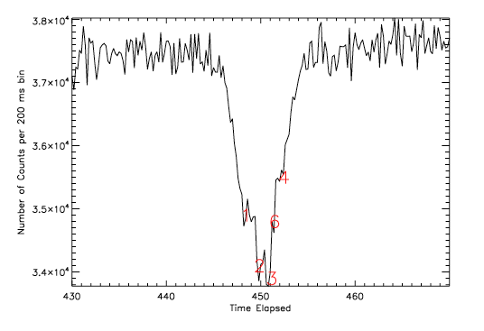
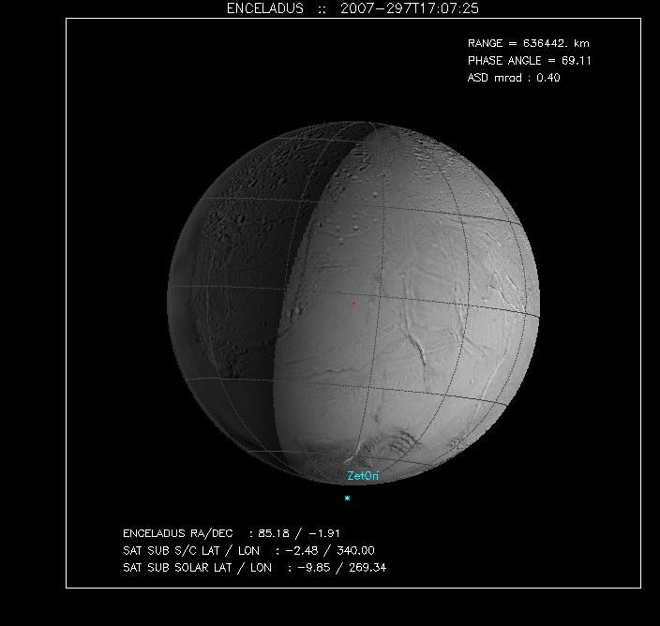
The Occultation Collection (2)
Horizontal Cuts show Jets
Supersonic Jets are imbedded in the bulk plume
Collimated gas jets were identified in the HSP data from the 2007 zeta Ori horizontal cut through the plume
2007 - zeta Orionis Occultation
Numbers indicate statistically significant dips in signal
Notes:
7
This is what HSP data looks like

Slide 8
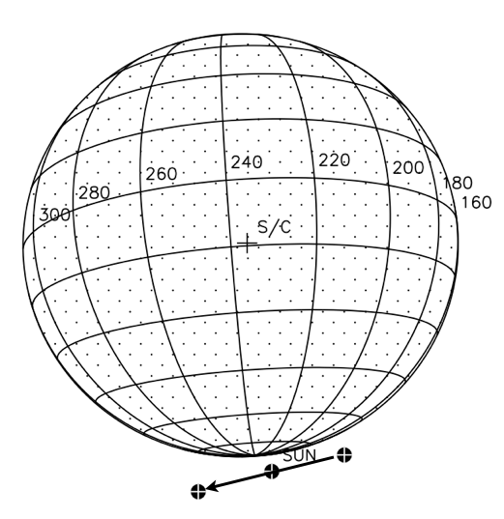
The Occultation Collection
Horizontal Cuts show Jets
2010 Solar Occultation best dataset on Properties of Jets
The higher snr of the 2010 solar occultation enabled further characterization of the supersonic jets
Mach 5 – 8
Jets are probably responsible for propelling the tiniest particles to become the E ring
Absorption profile as f(time)
The full width half max (FWHM) of jet c (Baghdad I) is ~10 km at a jet intercept altitude of 29 km (z₀)
Estimating the mach number as ~2 z₀/FWHM the gas in jet c is moving at a Mach number of 6; estimates for the other jets range from 5 to 8
2010 Solar Occultation
Notes:
8

Slide 9
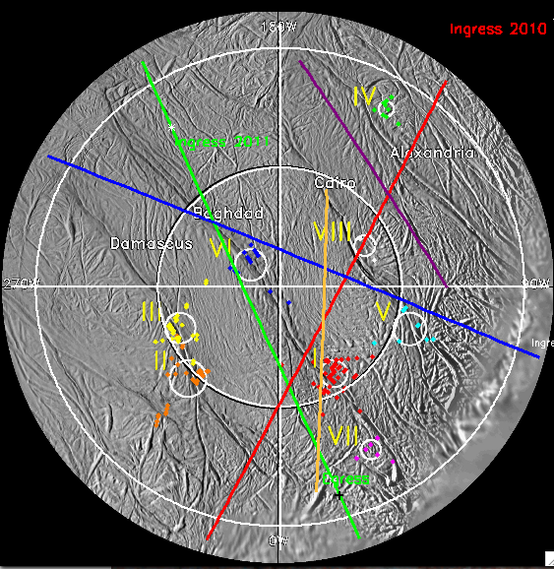
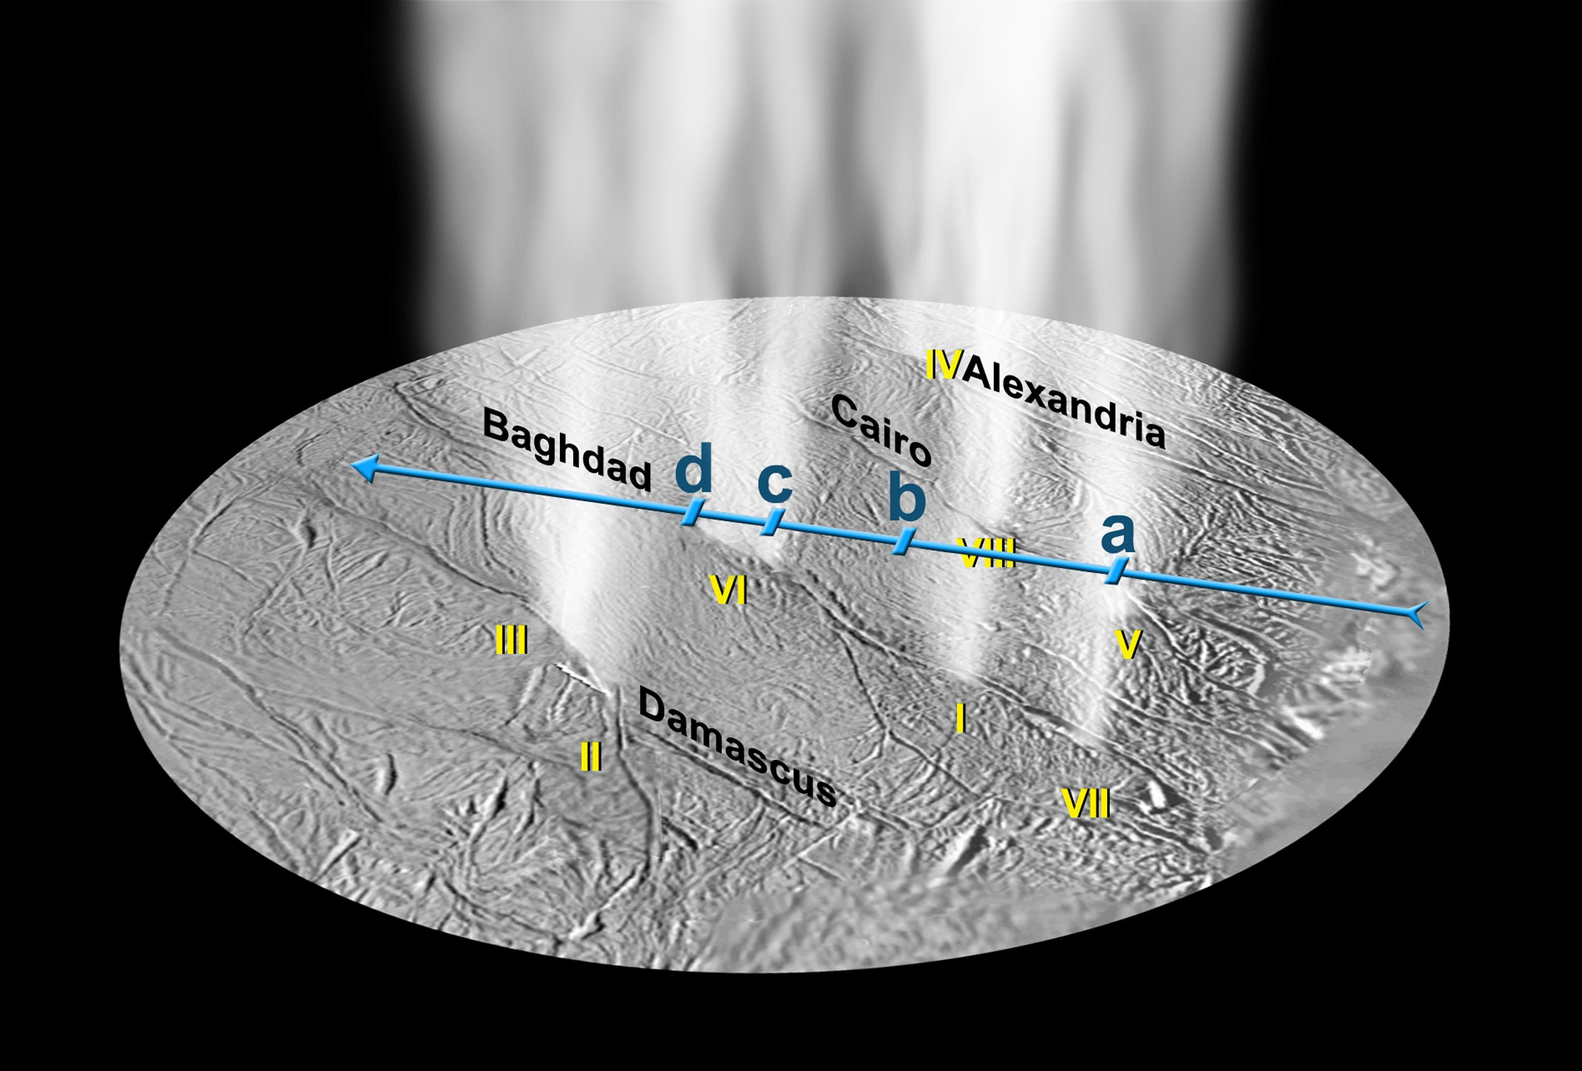
Occultation Groundtracks
*
Ingress 2005
Ingress 2005
Ingress 2010
In all occultations we look through the plume and jets to the star
- The groundtrack is the perpendicular dropped to the surface from the ray to the star
Gas comes from length of tiger stripe + jets
Egress 2007
Egress 2007
*
Ingress 2016
Impact 2016
Impact 2005
Impact 2005
*
Ingress 2007
Ingress 2007
Ingress 2016
*
Egress 2010
Egress 2010

Slide 10
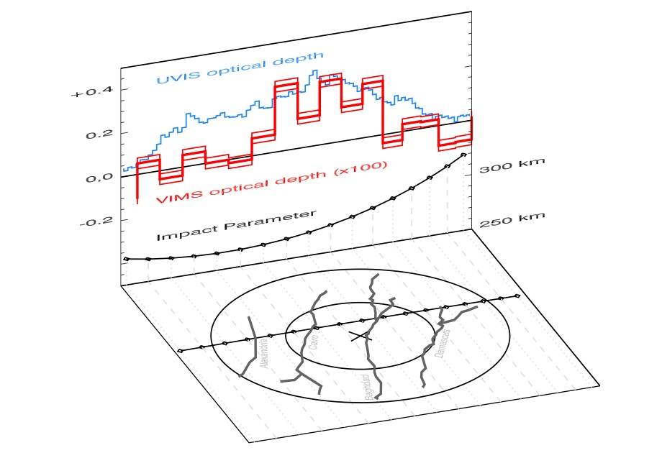
Solar Occultation Comparison Gas vs Dust
VIMS and UVIS both observed the solar occultation in 2010
Hedman (2018) compared the two to derive the dust/gas ratio
Most notably, VIMS detected little/no dust coming from Alexandria and Cairo
Dust/gas over Baghdad and Damascus is 10x dust/gas over Alexandria and Cairo
Now analyzing UVIS data to look for other differences, e.g. composition
Nothing obvious
Notes:
plume material above Baghdad and Damascus sulci has a dust-to-gas mass ratio that is roughly an order of magnitude higher than the material above Alexandria and Cairo sulci.

Slide 11
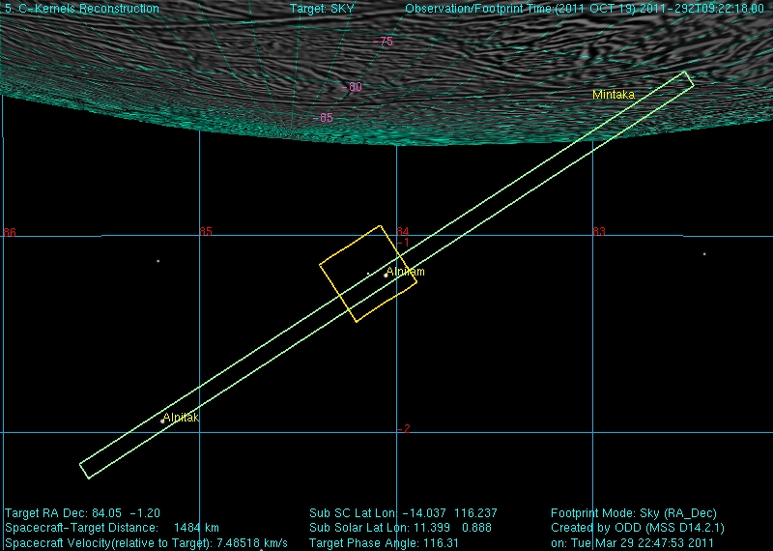
2011 Dual Occultation
Ingress
Egress
Eps Ori (Alnilam, B star)
16.5 km at closest point
HSP centered on eps Ori
Dimmer star in uv by ~2x
Column density 1.35 x 10¹⁶ cm⁻²
Zeta Ori (Alnitak, O star)
37.9 km at closest point
Column density 1.2 x 10¹⁶ cm⁻²

Slide 12
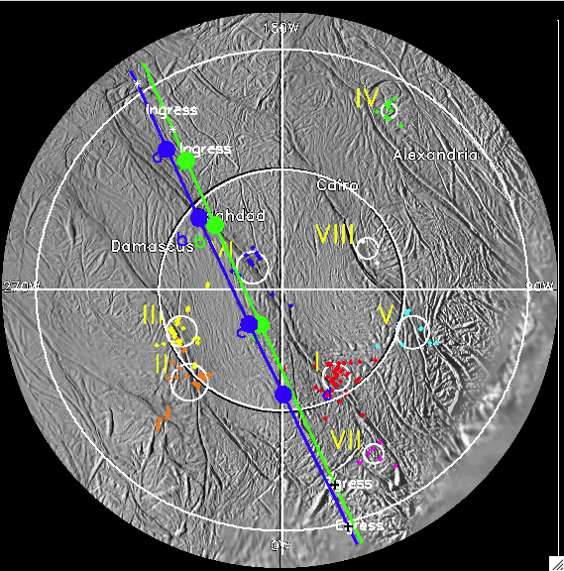
2011 Eps – Zeta Direct Comparison
c/a
a
B
c
S/C
d
FUV data summed over wavelength, as a function of time, at two altitudes
Clear signal of gas from Baghdad fissure (B)
Damascus jets (DII and DIII): “c”, and Baghdad I detected: “d”
Overall width of plume is not very different at the two altitudes (120 vs. 135 km)
Consistent with gas leaving at escape velocity on ~linear trajectory outward

Slide 13
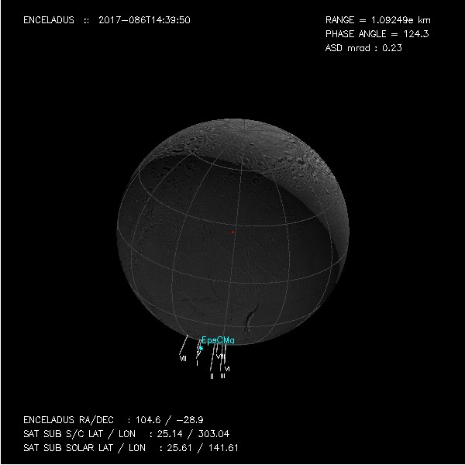
The Final Plume Occ: eps CMa Occultation 2017
Eps CMa made a horizontal cut through plume
Time of occ: 2017 27 March 14:40
Mean anomaly: ~131
South pole is tipped away from us so groundtrack only reaches 63.2 S
Occultation rayheight is higher than other horizontal cuts have been because tiger stripes are rotated away from view
Relative to limb (km)
This is altitude of star above limb; pierce point in plume is even higher
sec
Notes:
March27 of this year

Slide 14
Comparison to other Occultations
Cannot directly plot groundtrack because latitude is ~62S at closest point to pole due to south pole being rotated away from Cassini
Damascus is closest tiger stripe, roughly parallel to ground track
Intercepting plume at an altitude of ~90 km at Damascus fissure including this angular offset (17 deg) in the intercept
Higher for other tiger stripes (Alexandria is ~200 km)
267 Egress
267 Ingress

Slide 15
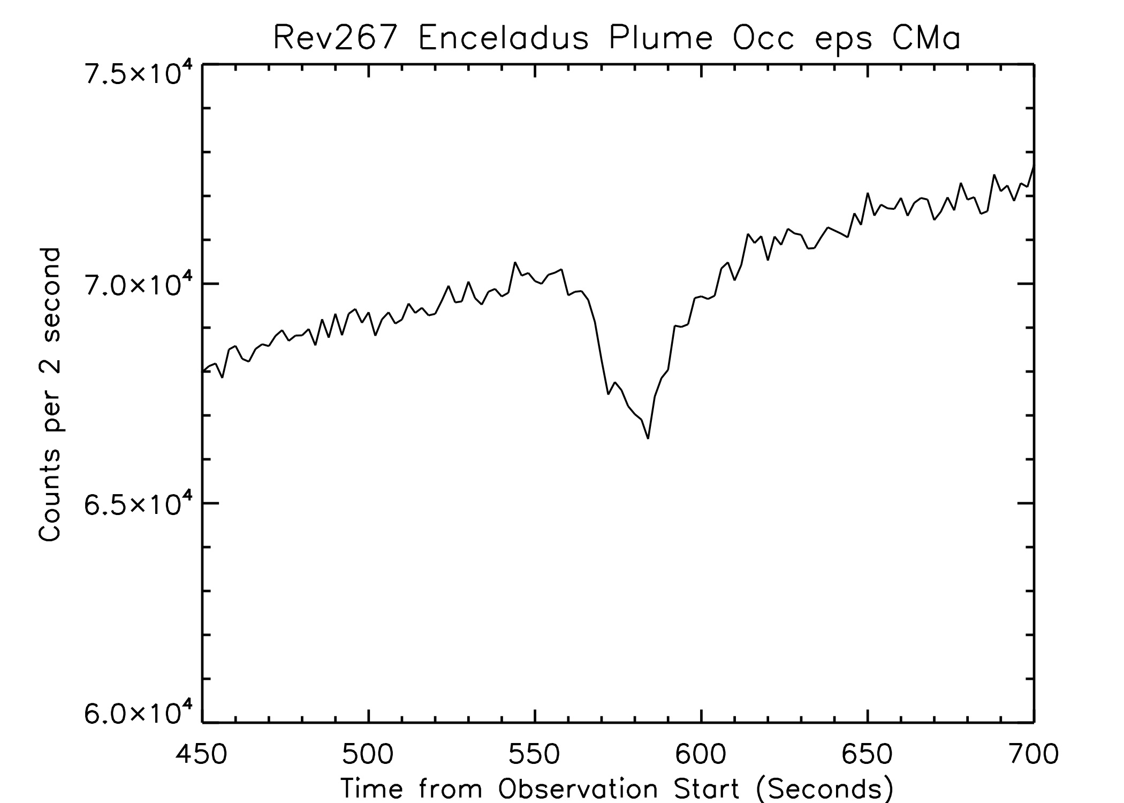
2017 Occultation Data
Clear presence of plume even at this high altitude of ray to star
Baghdad I
Damascus II, III
FUV
FUV
HSP
FUV (summed over wavelength) and HSP show plume and two jets
Dips at same time in both HSP and FUV data
Star velocity across sky = 6.75 km/sec
Plume column density from FUV best fit ~ 1 x 10¹⁶ cm⁻²
Baghdad I
Damascus II, III
Notes:
However, in spite of challenge, do see occultation

Slide 16
Jet Altitudes
Signature of jets still detectable at very high altitude (add ~30 km to rayheight for altitude of plume intersect above Baghdad fissure)
Baghdad I
Damascus II
40
Accounting for rotation of plume away from UVIS view, the ray intercept is very high
Baghdad I: 108 km above surface; mach 4
Damascus II: 91 km above surface, blended with Damascus III at 98 km altitude so cannot calculate mach #

Slide 17
The Occultation Collection (3)
Diurnal Variability - 2016
Supersonic Jets, not the bulk plume, are responsible for the diurnal variability in particulate brightness
Diurnal variability in plume brightness (particles) discovered in VIMS data (Hedman et al., 2013), with up to 3x difference between perikrone and apokrone
But UVIS had seen only ~15% water vapor variability in occultations
2016 - eps Orionis Occultation
Why? No occultations at apokrone
So, we requested another occultation, in 2016, at a mean anomaly of 208
Result: No difference in bulk column density
Bulk column density at same altitude of gamma Ori (2005) occultation at mean anomaly 117 and epsilon Ori (2016) occultation at mean anomaly 208 was the same: 1.5 x 10¹⁶ cm⁻²
Notes:
17

Slide 18
Variability in Jet Properties with Orbital Longitude? YES
Compare Baghdad I gas jet at other times
The previous estimate of column density from the 2011 zeta Orionis occultation, mean anomaly 237, at ~same altitude, was 1.6 x 10¹⁶ cm⁻²
2016 column density = 2.0 x 10¹⁶ cm⁻²
Previous estimate from the 2010 solar occultation was mach number = 6
2016 mach number = 8 – 9
Conclusion: there is more gas in this jet, going faster
This is not inconsistent with the overall plume mass flux:
The Baghdad I jet typically contributes 2% to the total plume, at this orbital longitude that has increased to 8%
The jets only contribute 3-4 % of the molecules exiting Enceladus, so even if the density and velocity increase it is still a minimal effect

Slide 19
Another interesting difference: HSP Extinction vs Rayheight Altitude
In 2016 there is a lot less gas between the tiger stripes than in other years (other orbital longitudes)

Slide 20
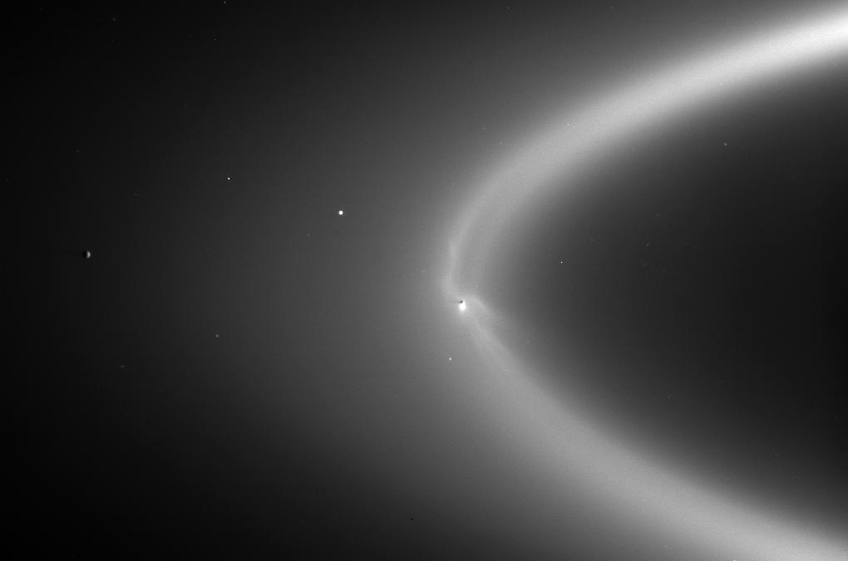
Summary
The last occultation observed by Cassini UVIS expands our timeframe of observations from 2005 to 2017
In these 12 years overall plume output has been steady to within 20%
Primarily water vapor, upper limits set for other gases; variable dust/gas mass ratio over different tiger stripes
Enhancement of gas in the plume in collimated gas jets is still detectable at heights over 100 km
Supersonic gas jets are likely responsible for the diurnal variability in brightness of the particulate component of the plume observed by ISS and VIMS
High velocity gas streams propel smallest particles out to become Saturn’s E ring
Cassini ISS image PIA08321

Slide 21
Backup Slides

Slide 22
A cautionary note… Europa Enceladus

Slide 23
Enceladus – Europa Comparisons
Data from HST ultraviolet observations can be directly compared to UVIS Enceladus data
Ultraviolet observation techniques:
Emission features
Work well for Europa because of greater electron energy at Jupiter
No consistent detection at Enceladus due to reduced electron energy at Saturn and other factors
Absorption of signal
Jupiter vs Saturn as source
Should work well if Europa has higher density plumes and given brighter signal from Jupiter
Spoiler alert: Europa’s plumes are quite different from those at Enceladus

Slide 24
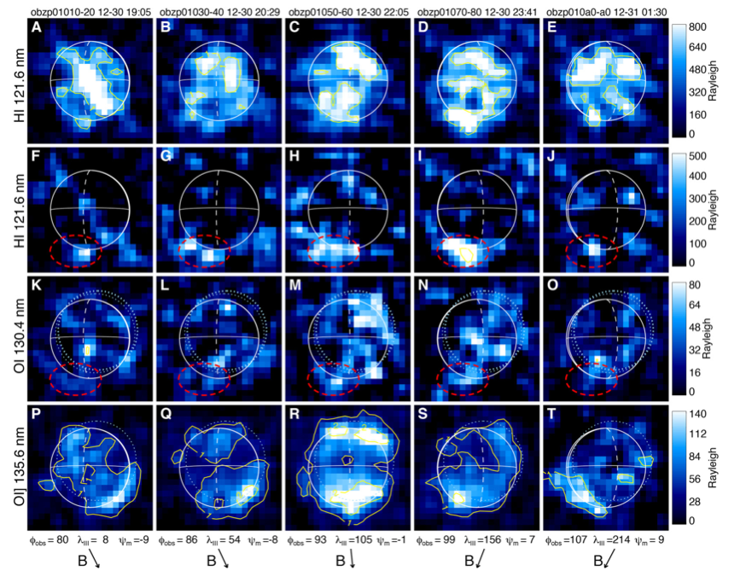
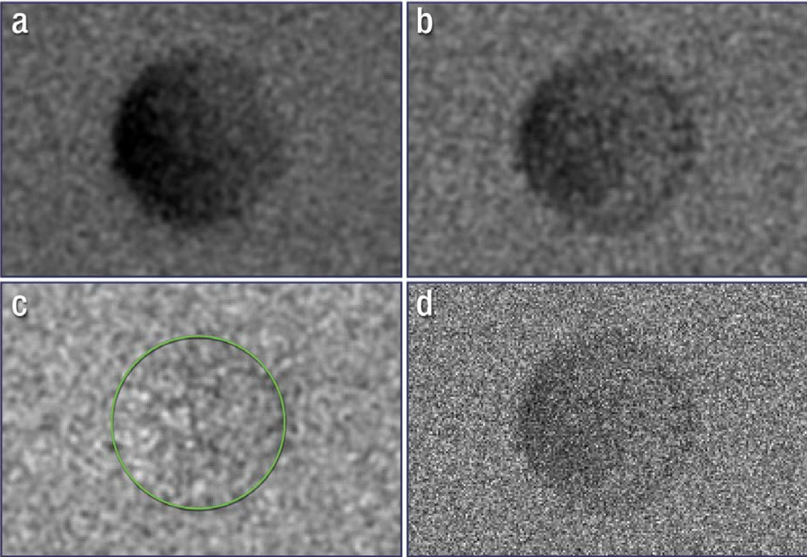
Possible Plumes from Europa
Latest results from HST and re-analysis of Galileo data make it seem more likely that there are plumes erupting from Europa
Roth et al. 2014: surplus emission at Lyman alpha and 1304 Å near south pole interpreted as water vapor eruptions similar to Enceladus
Distinct from 1304 and 1356 emission from bound O₂ atmosphere
However, of 20 HST emission observations from 2012 to 2015, only one showed enhanced emission (Rhoden et al., 2015)
Plumes are transient – not modulated diurnally like Enceladus
2014
2016
Using a different technique:
Possible plume observed at Europa‘s limb (4 of 12 transits) as Europa was observed in transit across Jupiter (Sparks et al., 2016)
Fig. 1 from Sparks et al., 2017

Slide 25
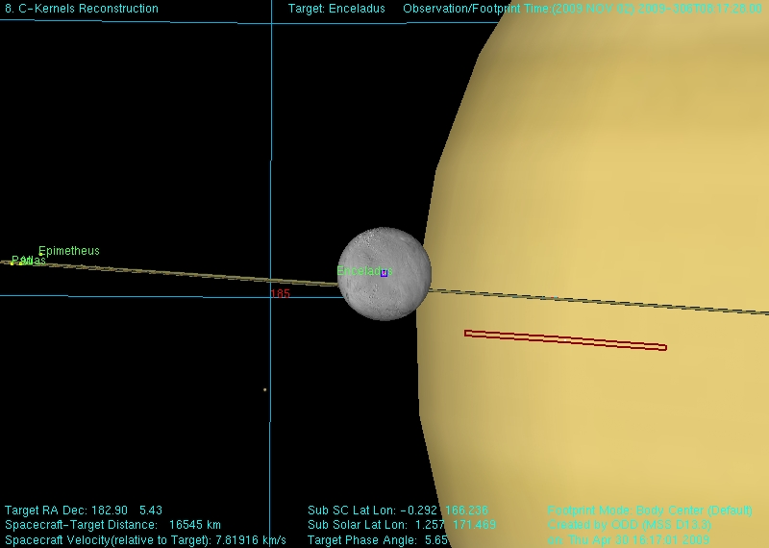
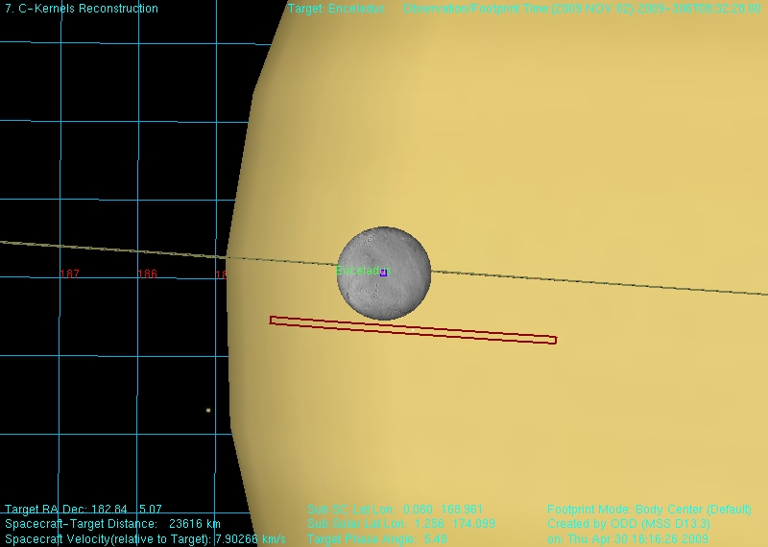
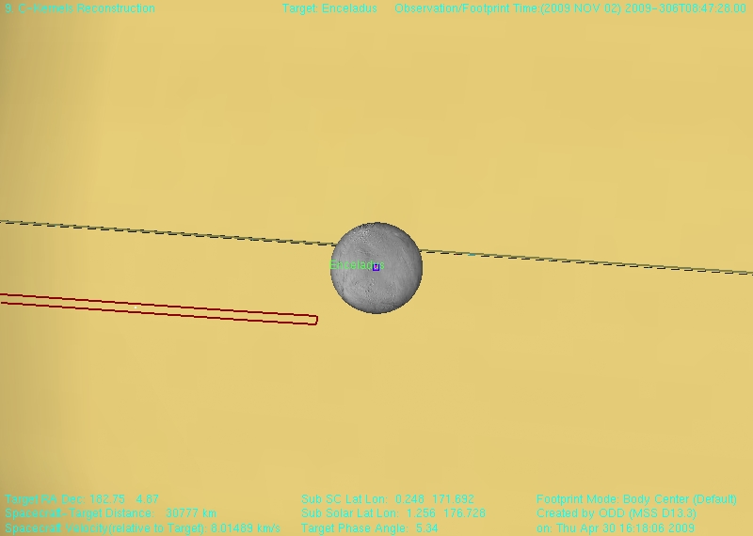
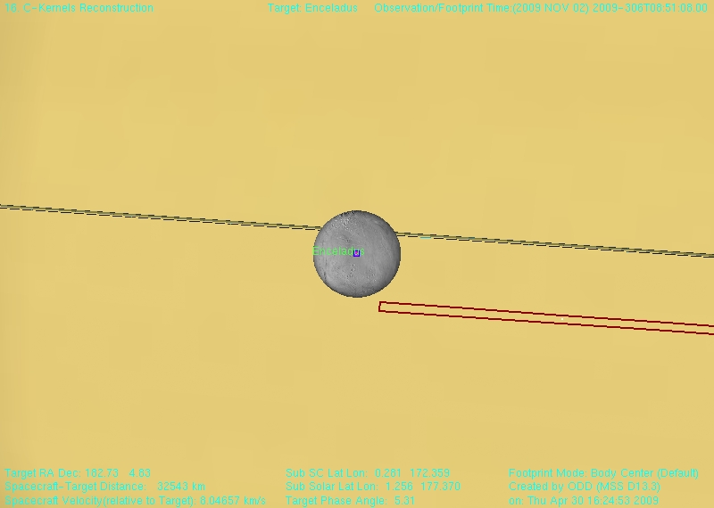
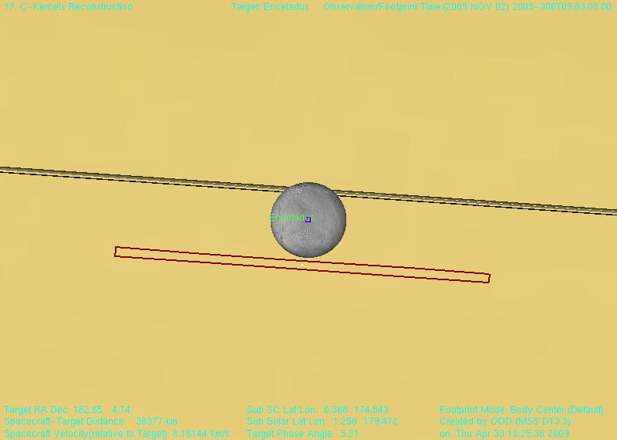
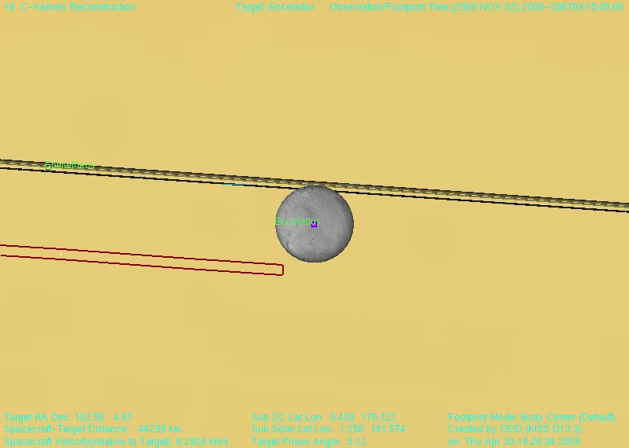
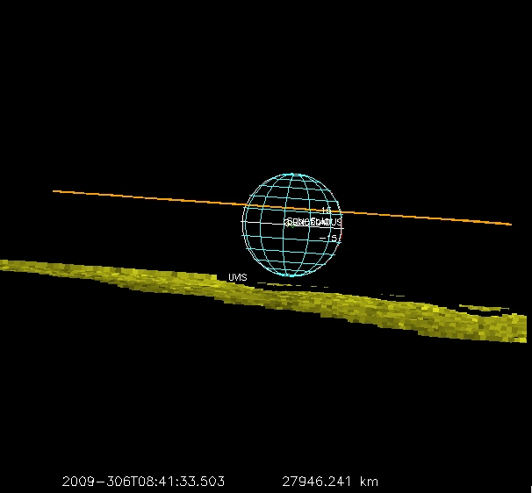
Enceladus Plume in Transit across Saturn
Compare:
Enceladus’ plume was not detected as Enceladus was observed in transit across Saturn
This was an experiment worth attempting
But, no quantitative results
Average signal (summed) = 55
Absorption in this wavelength range for column density of 1.5e16 = 7%
7% of 55 = 3.9; Sqrt(55) = 7.4
In a pixel the noise is > the signal we are looking for
Applying the Sparks et al. (2016) values for Europa plume column density would predict 26% absorption in the UVIS transit observation of Enceladus, well above the detection limit of 10%
Notes:
Each row is UVIS slit parked on Saturn (3 positions). Slit was stationary (repositioned just twice) while Enceladus moved by

Slide 26
Enceladus vs Europa Plume Characteristics
Duty cycle
Enceladus eruption is ongoing; intensity may be modulated over an orbit but it never stops
Europa eruptions are sporadic with a duty cycle of ~17% (Sparks et al., 2017) {2 of 12 observed in same place)
Column density
Typical Enceladus column density is 1.5x 10¹⁶ cm⁻²; gas leaves at escape velocity (Hansen et al., 2006)
Europa column density for 4 observations ranges between 0.7-3.3 x10¹⁷ cm⁻² (Sparks et al., 2016, 2017)
Height
The Enceladus plume has a scale length of ~80 km (Hansen et al., 2006)
Sparks et al (2016) estimate a height of >100 km. This implies a much larger eruption velocity because of Europa’s higher surface gravity.
Total eruption mass
From the transit observation the total mass in the Europa plumes visible to HST was 3.9, 6.6 and 1.4 x 10⁶ kg (Sparks et al., 2016) and 5.4 x 10⁶ kg (Sparks et al., 2017).
The total mass of Enceladus’ plume is ~3 x 10⁴ kg. The mass in the Enceladus plume is about 2 orders of magnitude less than for the plumes observed by HST at Europa.
These fundamental differences in characteristics point to differences in the energetics and mechanics of the eruption taking place at the two bodies. Presumably tidal energy is the driving force, apparently the energy is stored and released differently, possibly due to differences in the subsurface plumbing and expression of surface stresses.

Slide 27
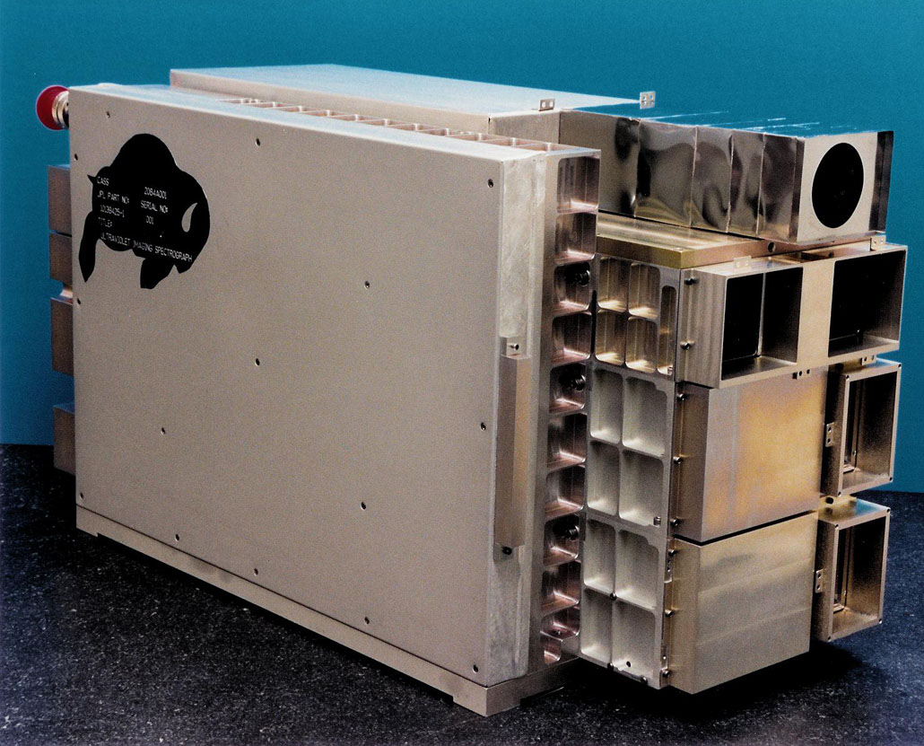
UVIS Characteristics
UVIS has 4 separate channels
For stellar occultations we use:
Far UltraViolet (FUV) spectrograph
1115 to 1915 Å
2D detector: 1024 spectral x 64 one-mrad spatial pixels
Binned to 512 spectral elements
1 - 5 sec integration time
High Speed Photometer (HSP)
2 or 8 msec time resolution
Sensitive to 1150 to 1915 Å
Hydrogen-Deuterium Absorption Cell (HDAC) not used
For the solar occultation we used:
Extreme UltraViolet (EUV) solar port
550 to 1180 Å
2D detector: 1024 spectral x 64 one-mrad spatial pixels
No spatial information using solar port because signal from sun is spread across the detector (deliberately)
Spatial rows 5 - 58 binned to two windows of 27 rows each
1 sec integration
Notes:
27

Slide 28
Estimates of Water Source Rate
This only works for complete horizontal cuts
The differences can be attributed to the presence of the jets and that the calculation was a bit too simplistic
New numbers are closer to the derivation by Yeoh et al., 2016
Given uncertainties we have recommended 200 kg/sec, now 300 kg/sec
In these 12 years overall plume output has been steady to within 20%
Year | n (cm⁻²⁾ | Uncert-ainty +/- | y (x 10⁵ cm) | v_{th} (cm / sec) | Flux: Molecules / sec | Flux: Kg/sec | Mean Anomaly
2005 | 1.5 x 10¹⁶ | 0.15 x 10¹⁶ | 120 | 45000 | 8.1 x 10²⁷ | 240 | 117
2007 | 1.4 x 10¹⁶ | 0.14 x 10¹⁶ | 110 | 45000 | 7.4 x 10²⁷ | 210 340 | 236
2010 | 0.9 x 10¹⁶ | 0.23 x 10¹⁶ | 150 | 45000 | 6 x 10²⁷ | 180 337 | 98
2011 - e | 1.35 x 10¹⁶ | 0.15 x 10¹⁶ | 120 | 45000 | 7.3 x 10²⁷ | 220 313 | 237
2011 - z | 1.2 x 10¹⁶ | 0.2 x 10¹⁶ | 135 | 45000 | 7.3 x 10²⁷ | 220
2016 | 1.5 x 10¹⁶ |  | 125 | 45000 | 8.4 x 10²⁷ | 250 | 208
2017 | 1.0 x 10¹⁶ |  | 150 | 45000 | 6.8 x 10²⁷ | 200 275 | 131
Notes:
28
28
Important message – flux has not changed much in 5 years. (Deviation is only 15%, not factors of 2)
Width (y) is at FWHM
Vlos is the line-of-sight velocity of the star across the plane of the sky
Given uncertainties our best estimate of water flux from Enceladus is 200 kg/sec

Slide 29
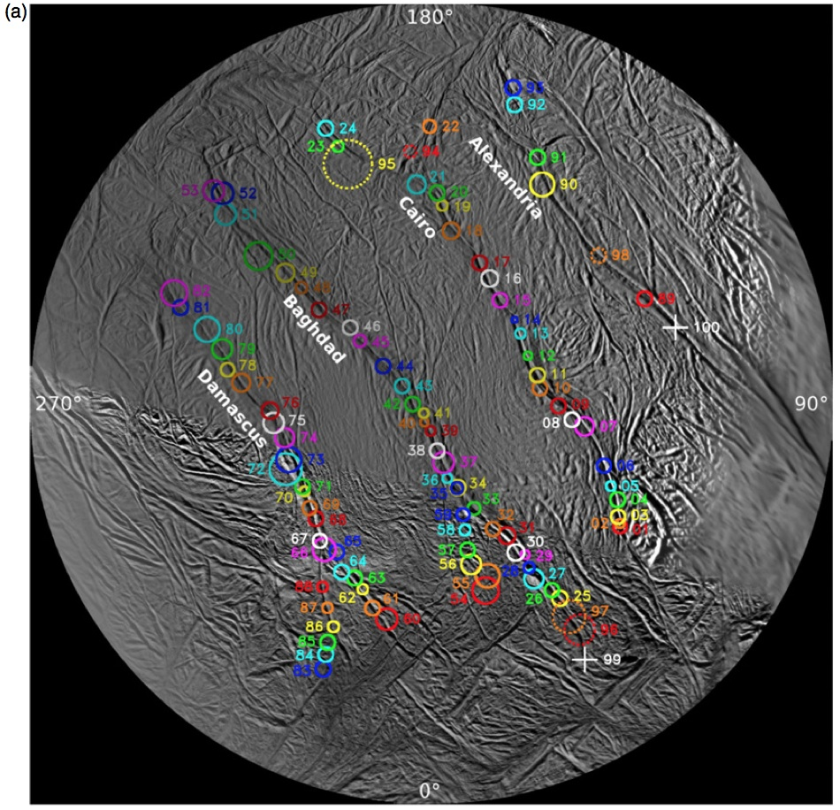
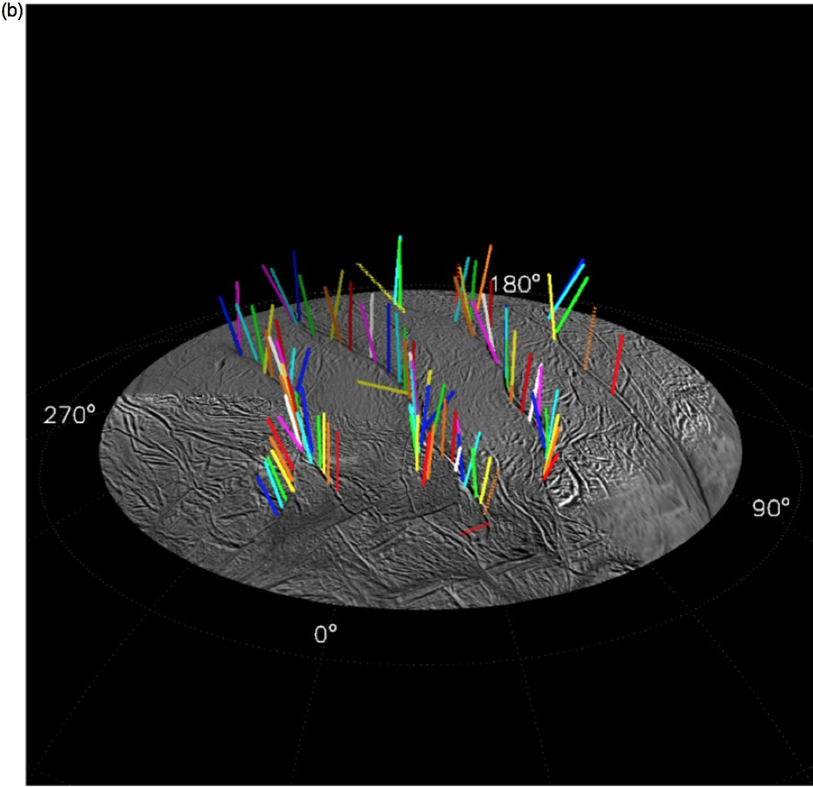
~100 Ice Particle Jets
Porco et al., 2014

Slide 30
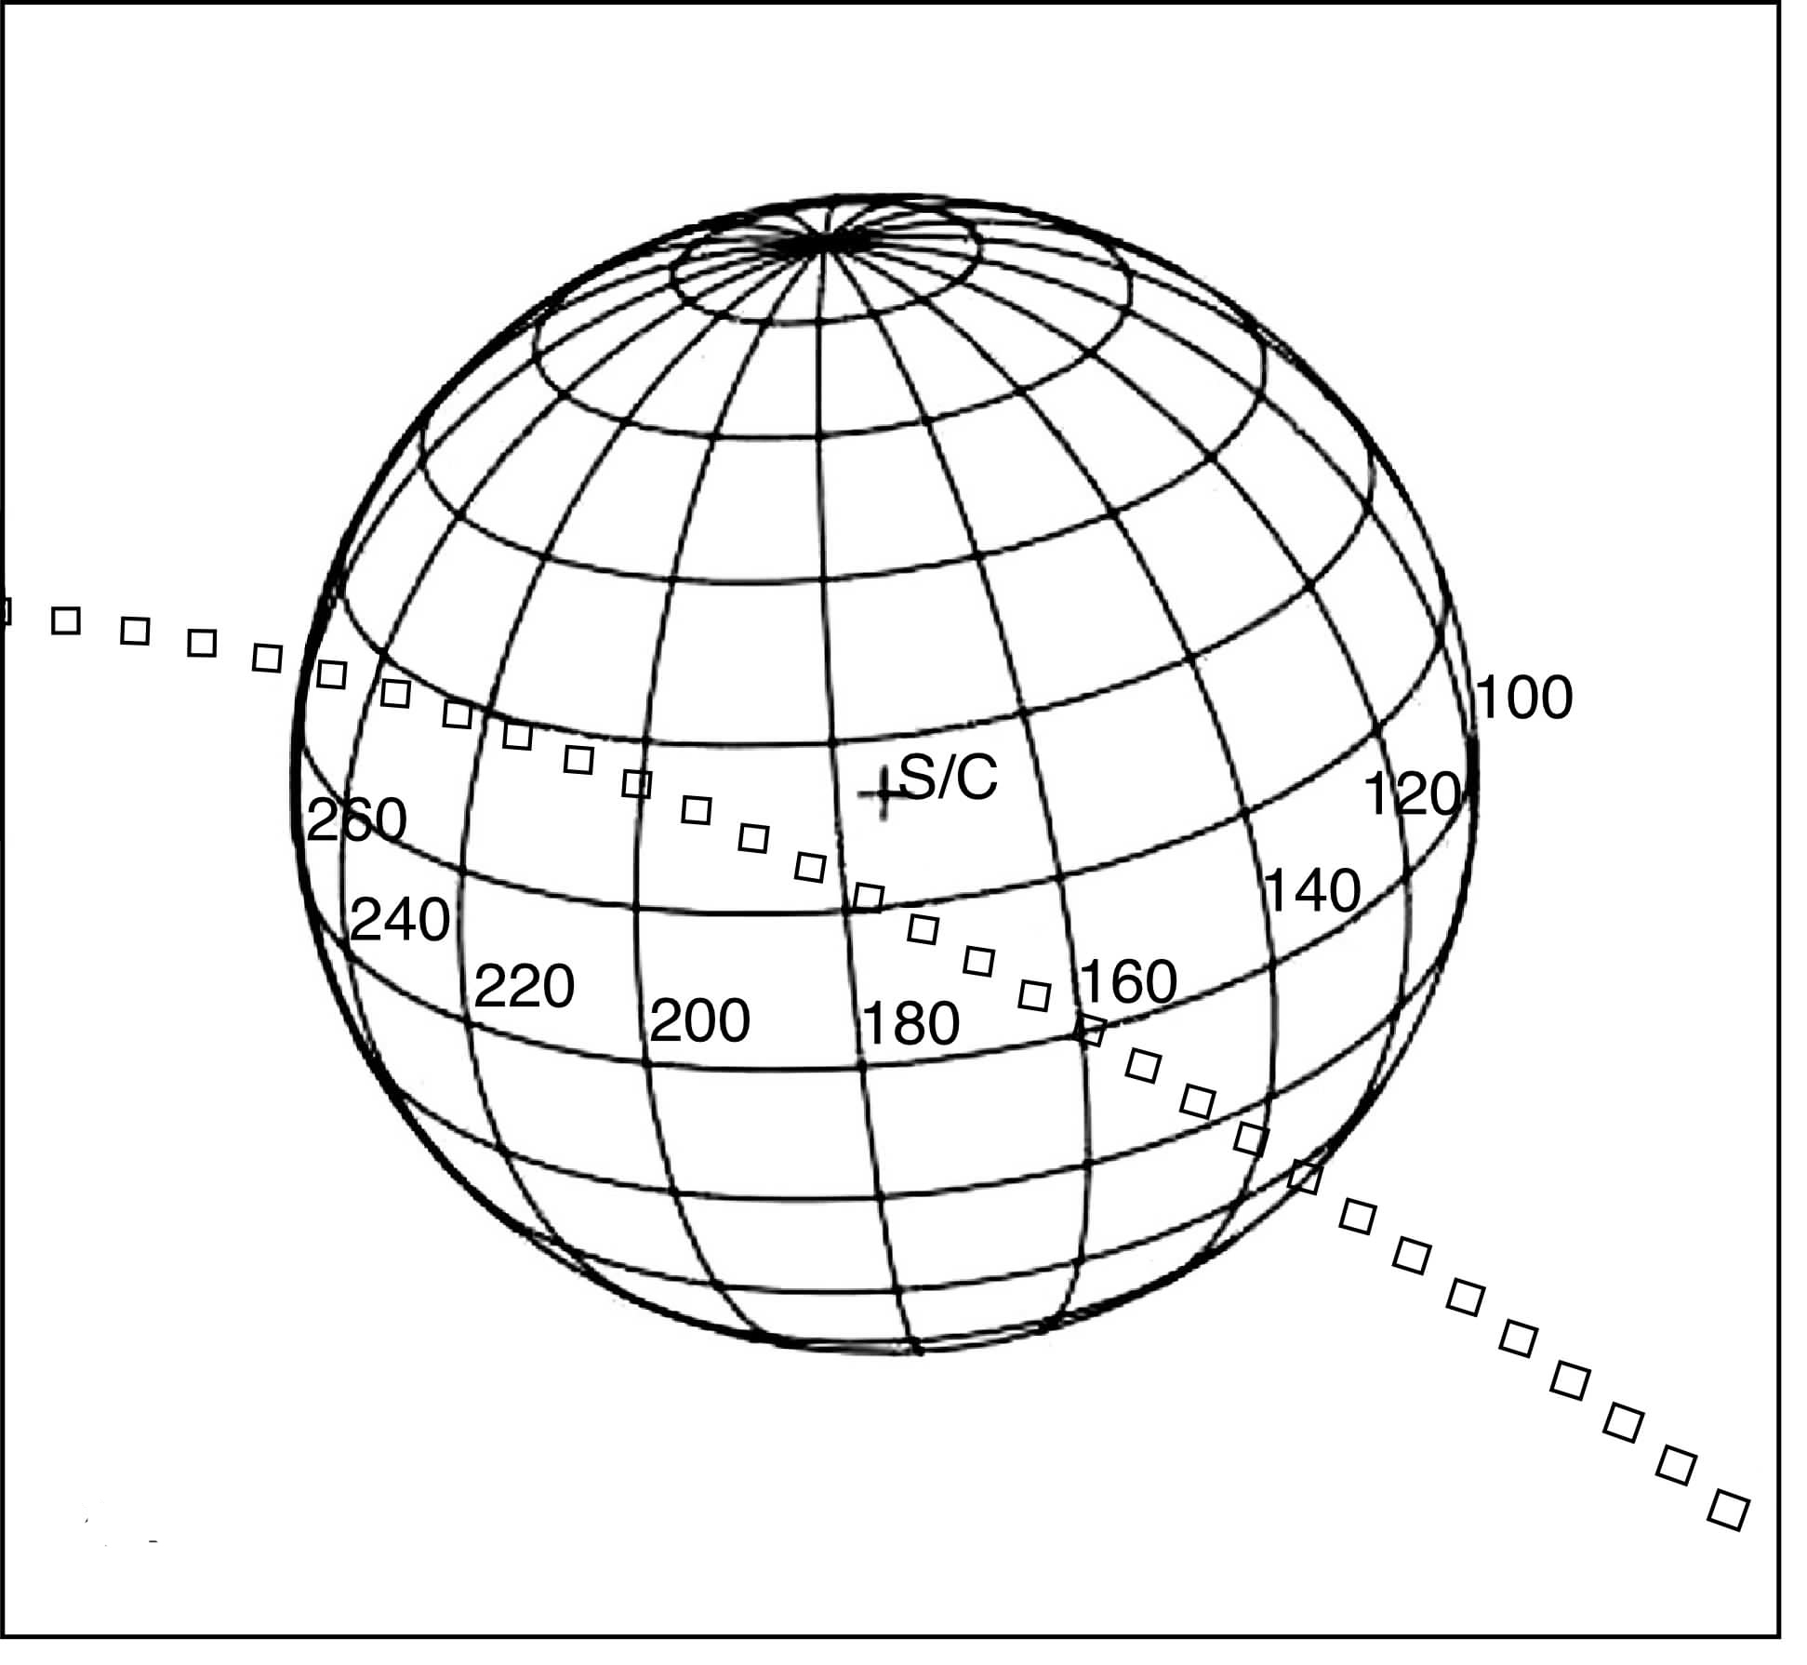
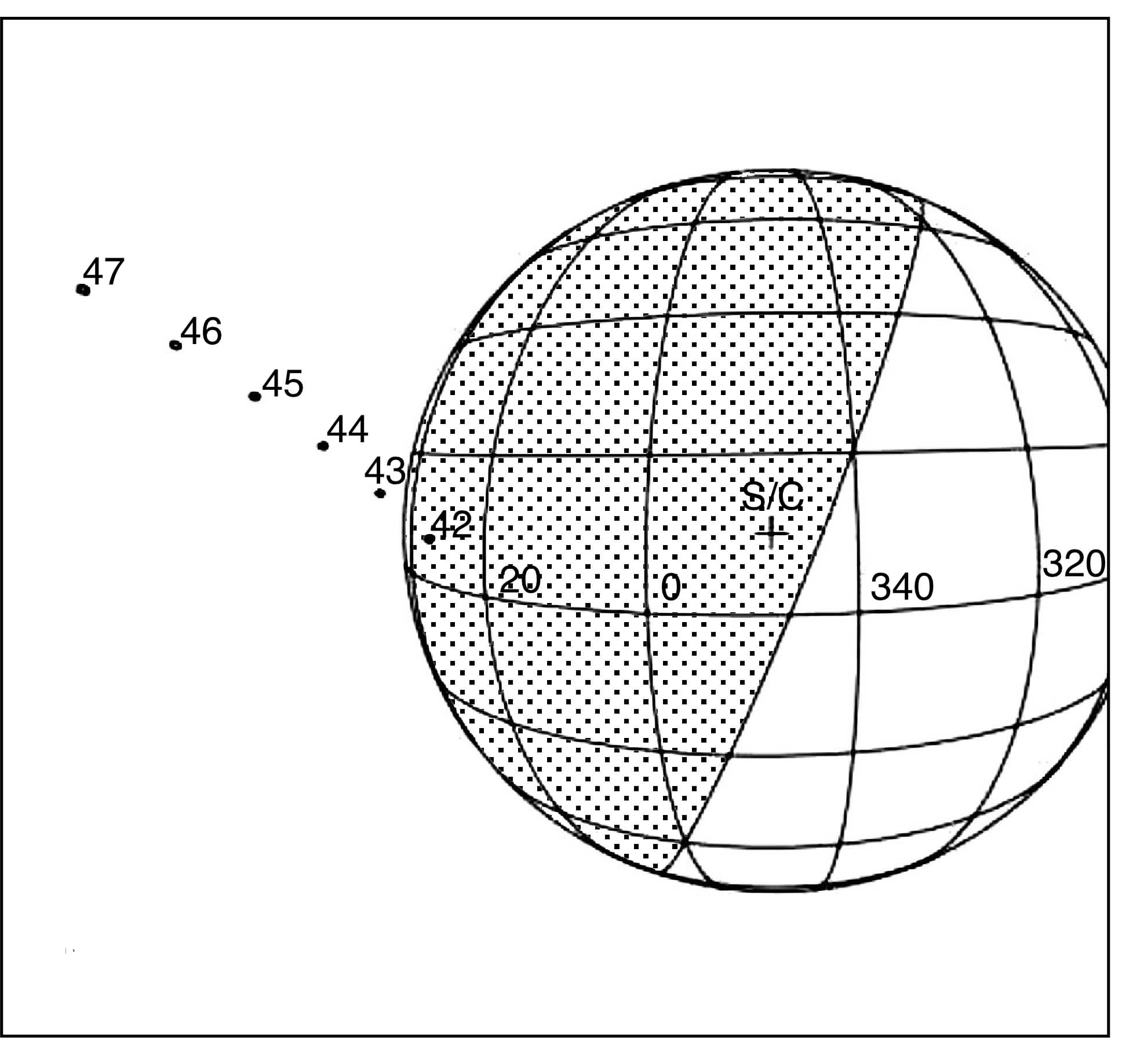
Column Density upper limits outside plume
Upper limits derived for water vapor using 2005 lambda Sco occ, 2005 gamma Ori egress, and 2016 eps Ori egress non-detections at mid-latitudes
Upper limits at 3 – 5 x 10¹⁵ cm⁻², about an order of magnitude less than the plume

Slide 31
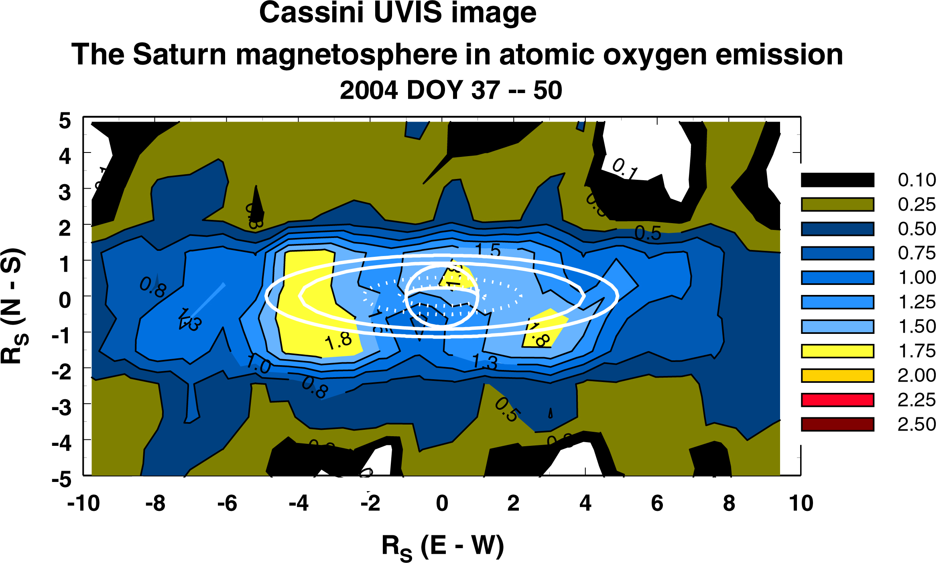
Neutral Species in Saturn’s System
The Saturnian system is filled with the products of water molecules:
H detected by Voyager in 1980, 1981
OH detected by Hubble Space Telescope in 1992
Atomic Oxygen imaged by UVIS in 2004
Water and its products are lost from the system by collisions, photo- and electron- dissociation and ionization
Estimates of required re-supply rates range from 3 x 10²⁷ to 2 x 10²⁸ water molecules/sec
Notes:
The water budget
Estimates of required re-supply rates, water molecules/sec:
2.8 x 10²⁷ 1993 Shemansky, et al.
3.75 x 10²⁷ 2002 ¹Jurac, et al.
10²⁸ 2005 Jurac and Richardson
2 x 10²⁸ 2005 Shemansky, et al.

Slide 32
UVIS image of Enceladus’ Plume
Range:
At start = 18,810 km
At end = 32,478 km
Resolution:
At start = 19 km
At end = 32 km
ICYMAP
Notes:
Same as previous plot but with different color stretch and without ra/dec grid

Slide 33
T239 Spectrum (deepest absorption)
Eps Ori position at T239
Altitude ~38 km
T239 is time of deepest absorption when ray to star pierced Baghdad I jet
Best-fit procedure gives column density = 1.9 x 10¹⁶ cm⁻²
Baghdad
Cairo

Slide 34
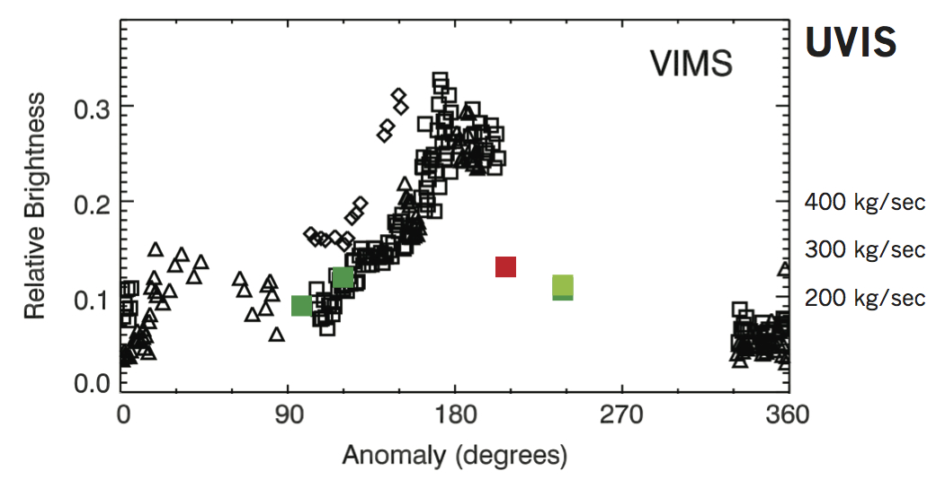
UVIS Occs compared to VIMS Results
*
With new values a true anomaly dependence seems even less likely
Rev 267 occ; Mean anomaly 131
Water flux ~275 kg/sec
* Hedman et al., 2013

Slide 35
Summary
What can we learn from two cuts through the plume at different altitudes?
Overall width of plume is not very different (120 vs. 133 km)
Consistent with gas leaving at escape velocity on ~linear trajectory
Close to surface see less gas between jets/fissures than at higher altitude (gas is collisionless, diffusion is from slightly different trajectories leaving fissure)
DIII differentiable from BI jet at 18 km, not at 40 km
Can compare column density at jets at two altitudes -> dissipation -> spreading

