Slide 1
Jets of Enceladus: Cassini's UVIS occultation observations and DSMC model of Enceladus jets
Ganna (Anya) Portyankina¹, L. W. Esposito¹, C. J. Hansen² ¹ LASP, University of Colorado, Boulder, CO, USA ² PSI, Tucson, AZ, USA

Slide 2
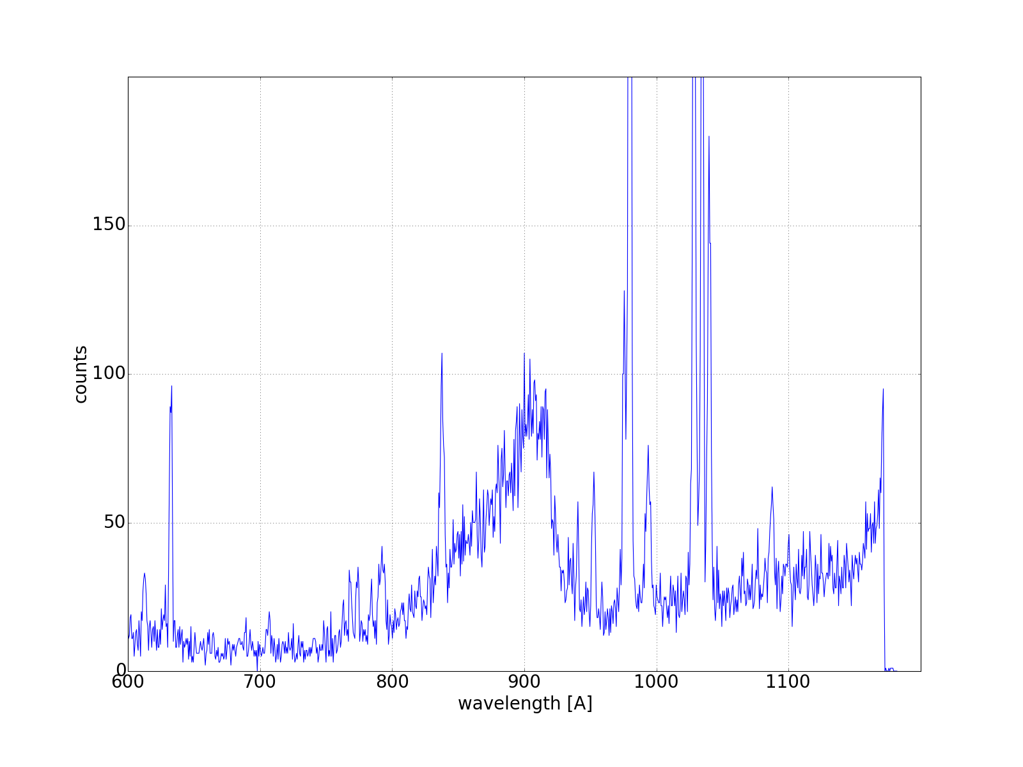
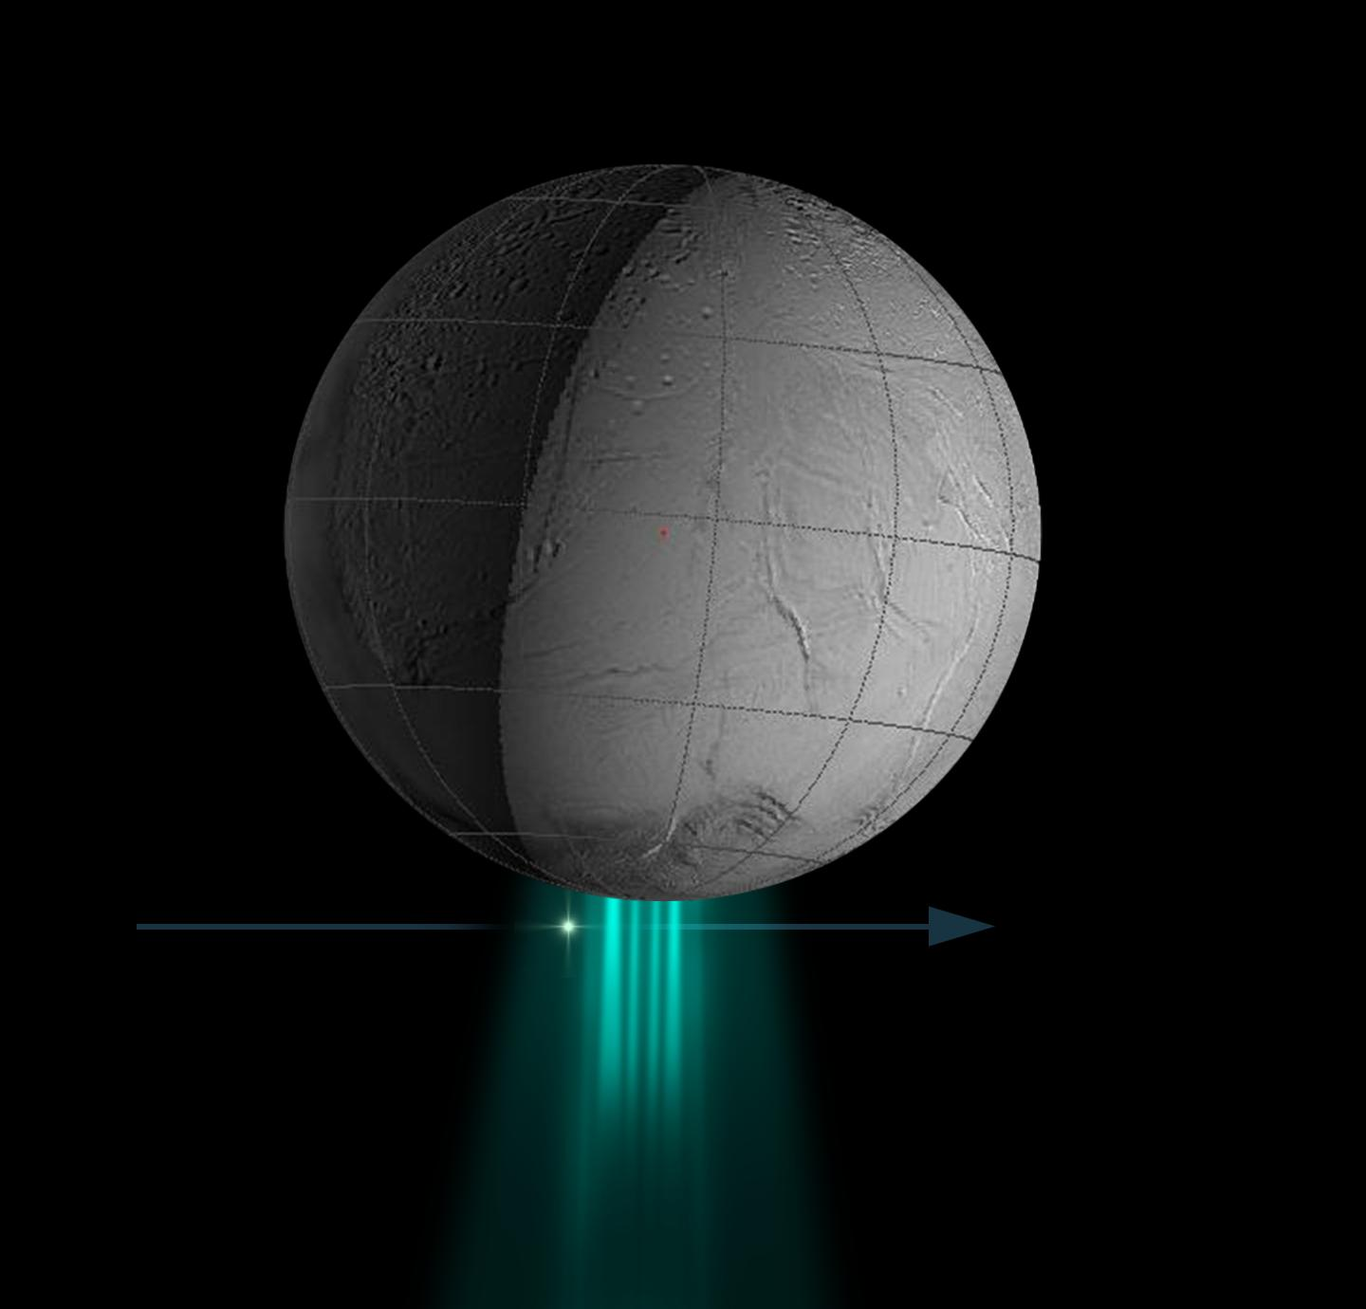
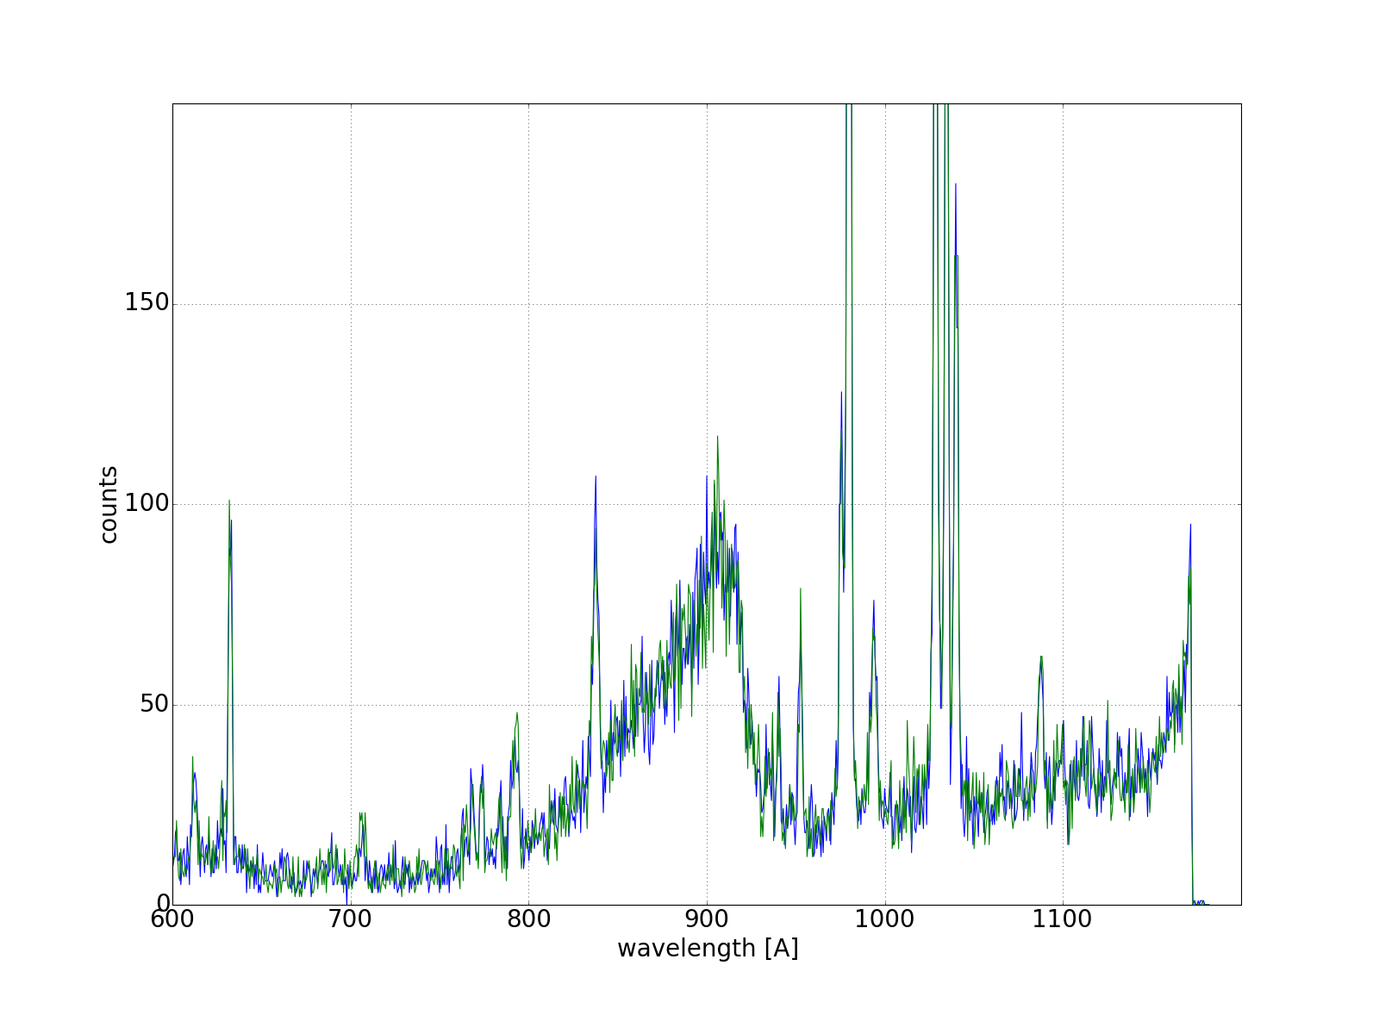
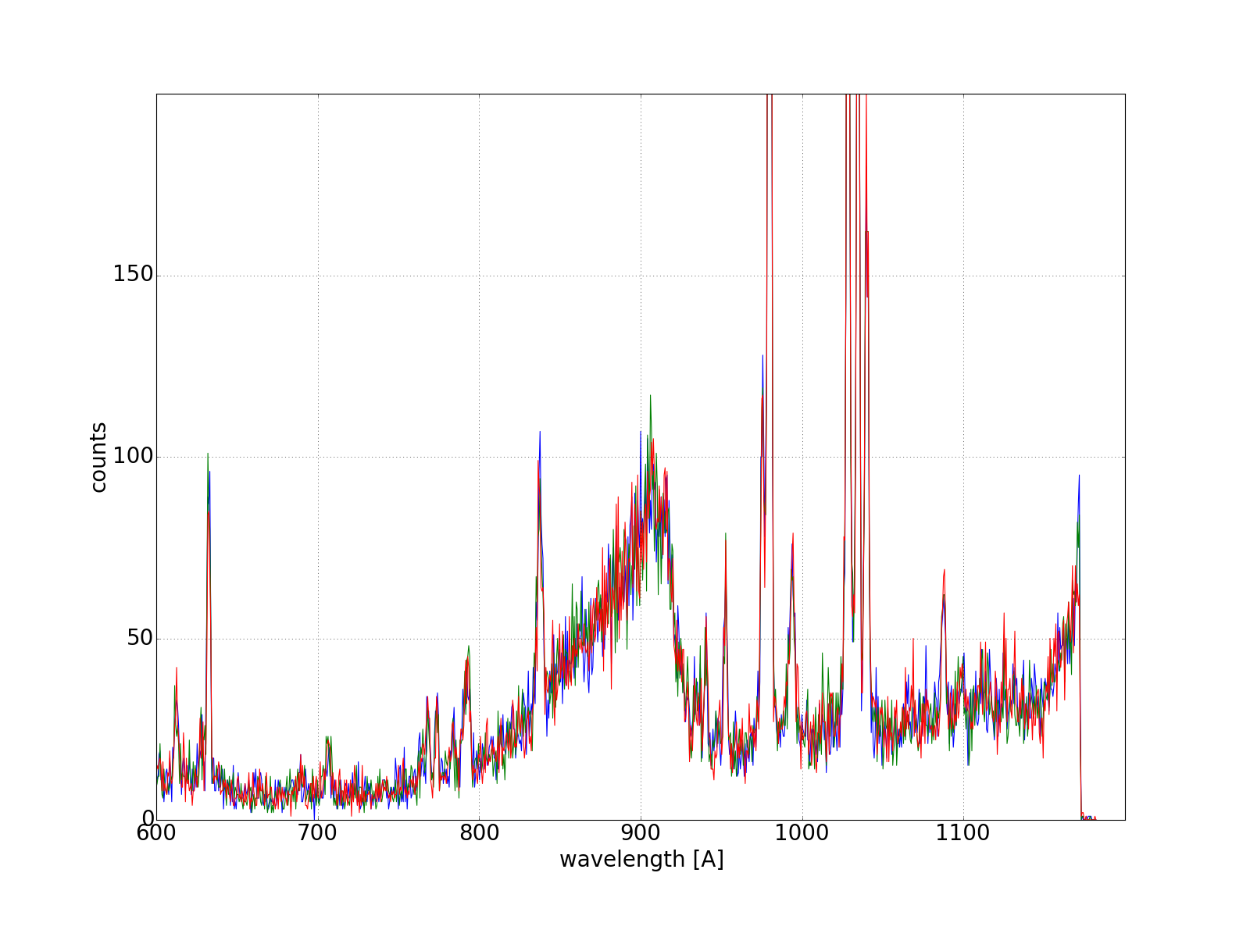
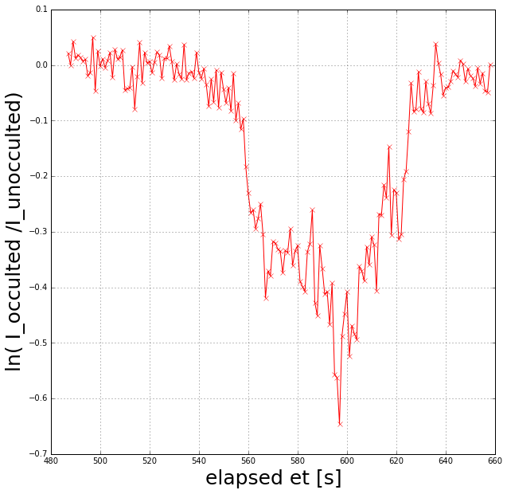
UVIS Observations of Enceladus’ Plume
UVIS occultation observation provide data about water vapor column densities along the line of sight of UVIS
Summed wavelength range 850–1000 Å as a function of time <-

Slide 3
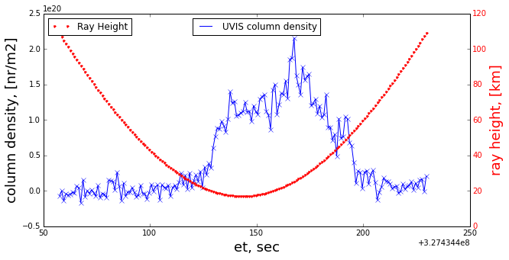
UVIS Observations of Enceladus’ Plume
This is the procedure for FUV and EUV channels.
Similar for HSP channel (minus spectra).
Geometry of the observations is the key to single jets properties.

Slide 4
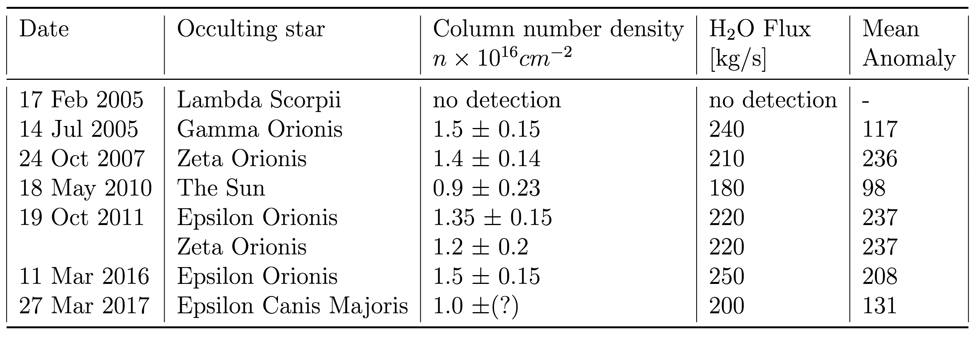
All UVIS occultation observations

Slide 5
UVIS occultation geometries
Ingress 2005
*
Egress 2007
In all occultations UVIS looks through the plume and jets.
The ground track is the perpendicular dropped to the surface from the ray to the star.
*
Impact 2005
Impact 2016
Ingress 2007
Violet => γ Ori 2005
Blue => ζ Ori 2007
Red => Sun 2010
Green => ζ (and ε) Ori 2011
Orange => ε Ori (Mar 11, 2016)
Turquoise => ε CanMaj (Mar 27, 2017)
Ingress 2016
*
Egress 2010
© C. Hansen
*

Slide 6
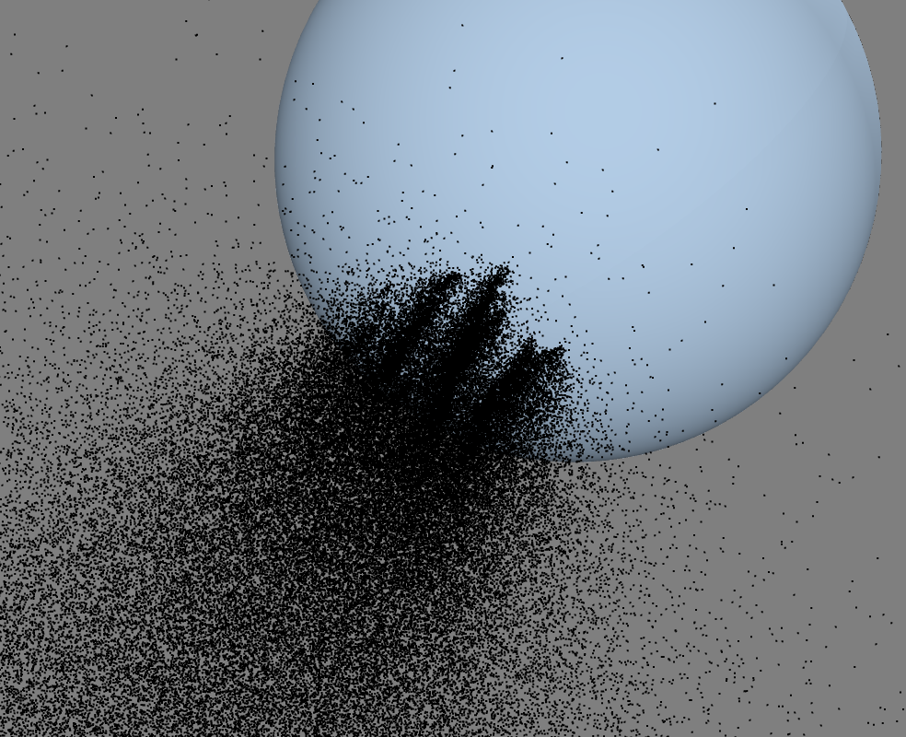
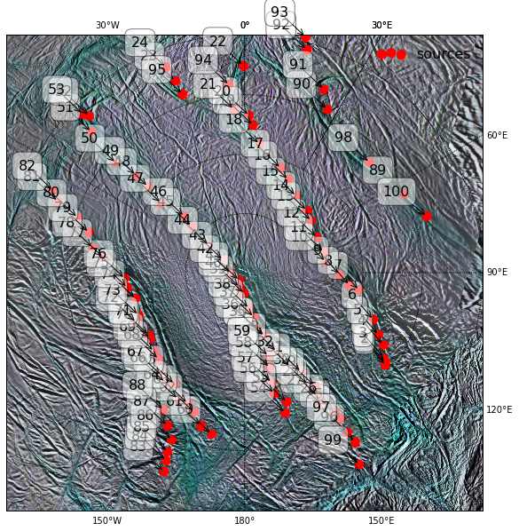
3D direct simulation Monte Carlo (DSMC) model
General properties:
High resolution (<=1km), fully 3D; Gravity of Saturn and Enceladus; Coriolis, centrifugal, and tidal forces; Collisions; Steady-state solution; Initial velocity with thermal V_{th} and vertical V_{z} components; Total flux is used to calibrate the model [Hansen et al., 2006]; Precise observational geometry with SPICE.
Source geometry: localized sources [Porco et. al. 2014]; + fitting procedure
Notes:
Each model run results in a set of coordinates and velocities of a given set of test particles.
Using geometry from SPIDE we can “cut” through each modeled jet to create a profile of exactly how it would look for UVIS during the occultation observation.

Slide 7
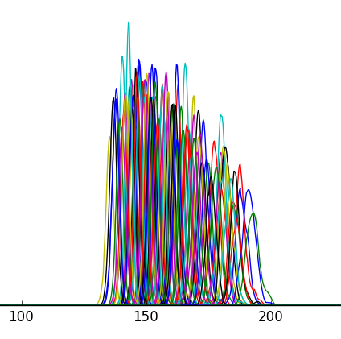
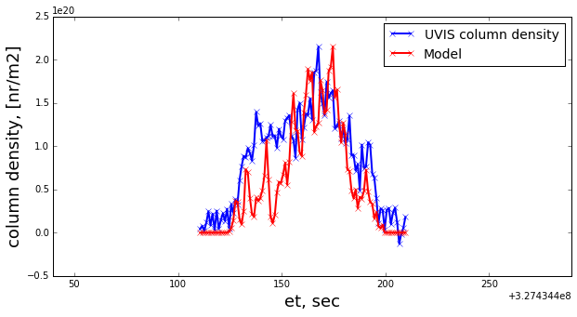
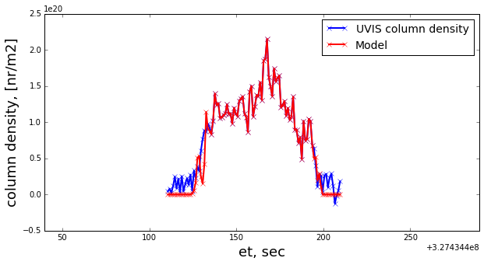
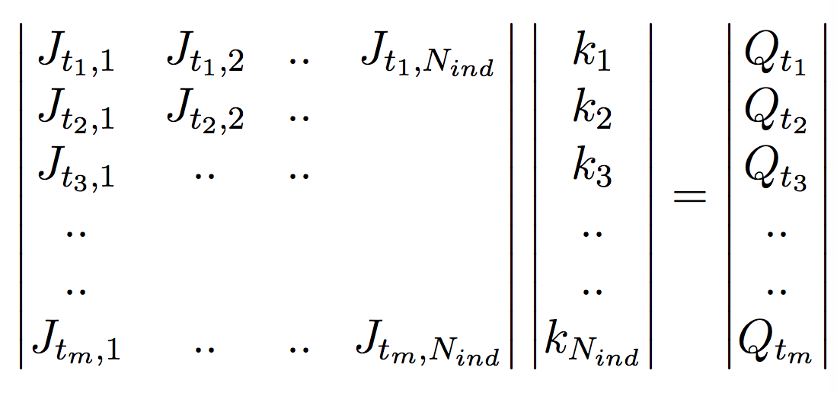
Fitting procedure
The relative strength of the jets can be modified by multiplying each of them by a coefficient k_{i}.
Gussian elimination on matrix J results in the reduced row echelon form (RREF) of J.
Result of the fitting procedure is the set of coefficients k_{i}.
?
model
fit
data
Notes:
Velocity is another free / fitting parameter, we ordinary need Vz = 1.3 to 1.8 km/s

Slide 8
FIT results

Slide 9
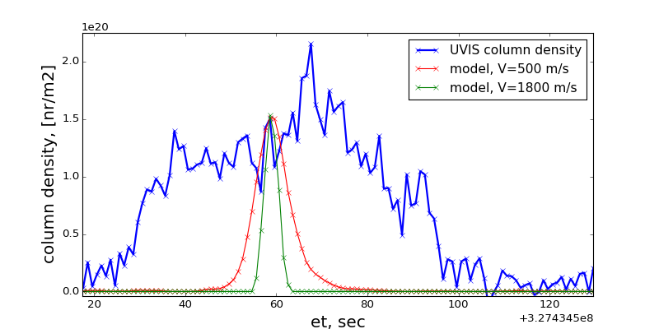
Vertical velocity
Occultation | V_{min} , km/s | RH_{min}, km | dt FUV(EUV)/HSP
ζ Ori 2007 | 1.2 | 12 | 5 s / 2 ms
Solar 2010 | 1.8 | 17 | 1s / --
𝛆 Ori 2011 | 1.3 | 17 | 2 s / 8 ms
𝛆 Ori 2016 | 1.6 | 0 (40) | 1 s / 2 ms
𝛆 CaMa 2017 | 0.8 | 60 | 2 s / 2 ms

Slide 10
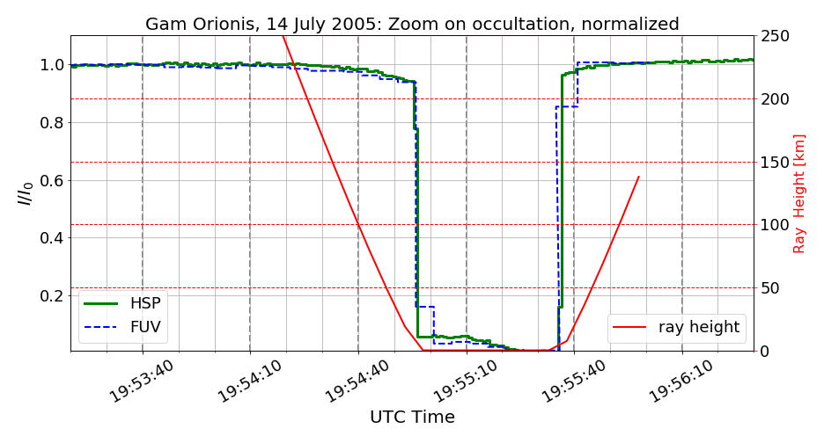
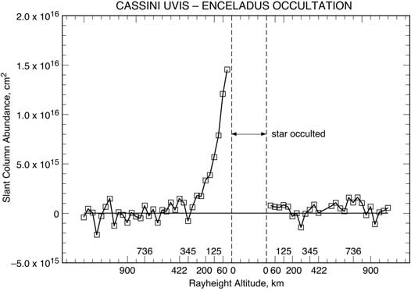
𝛄 Ori 2005
© Hansen et al., Science, 2006

Slide 11
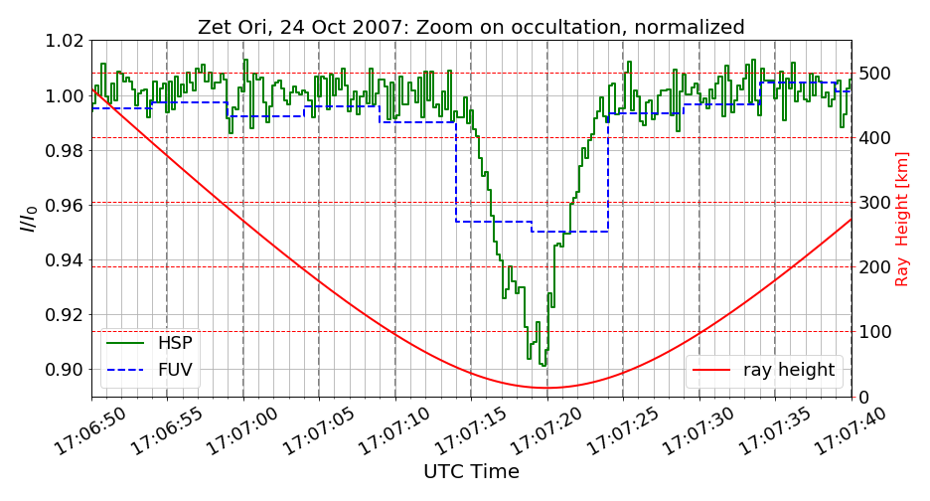
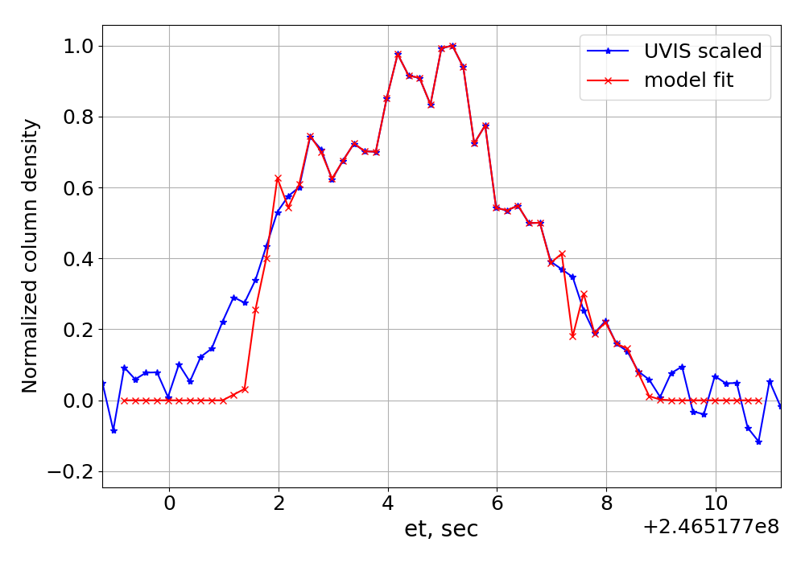
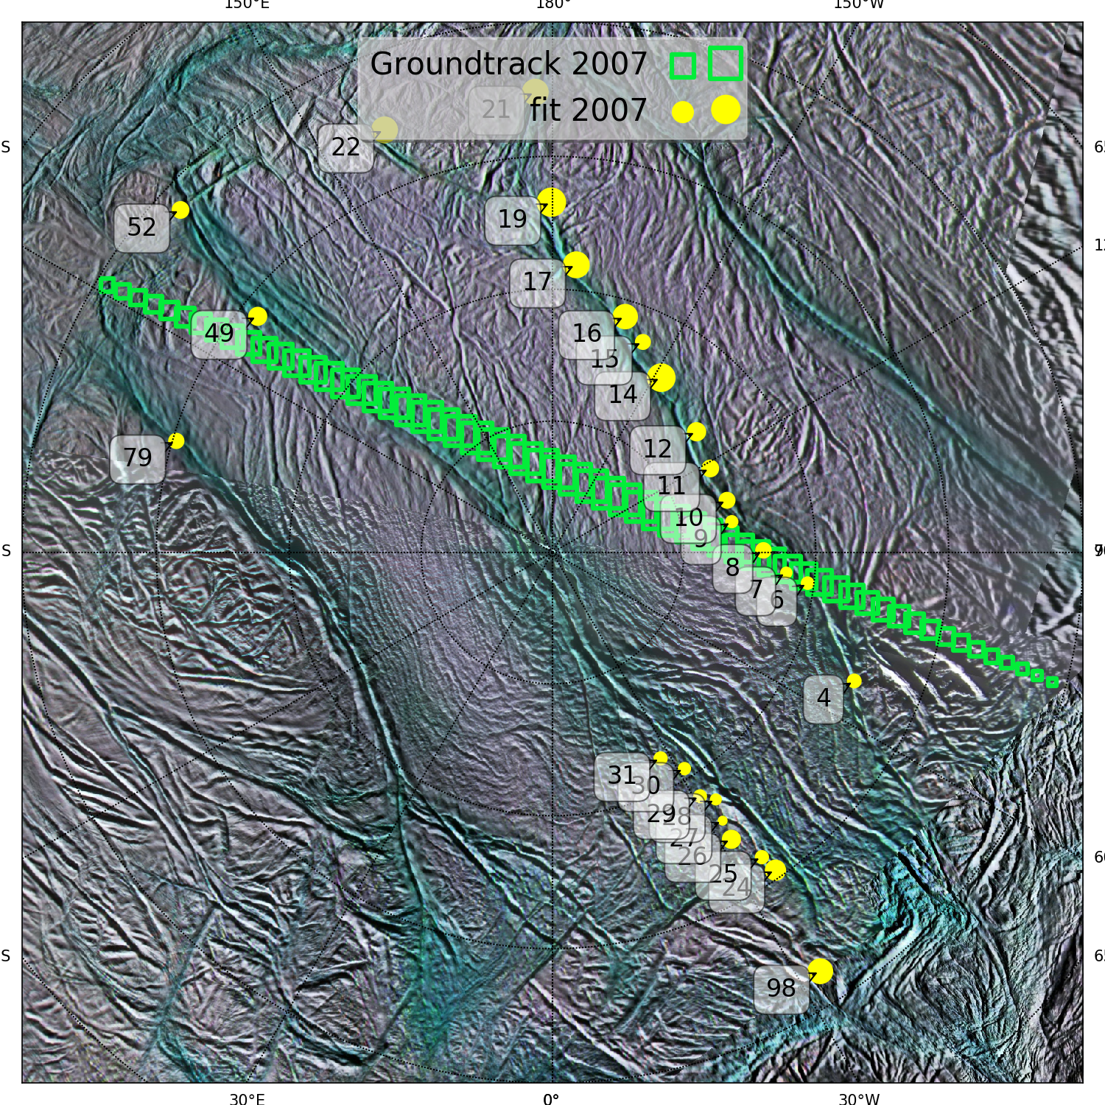
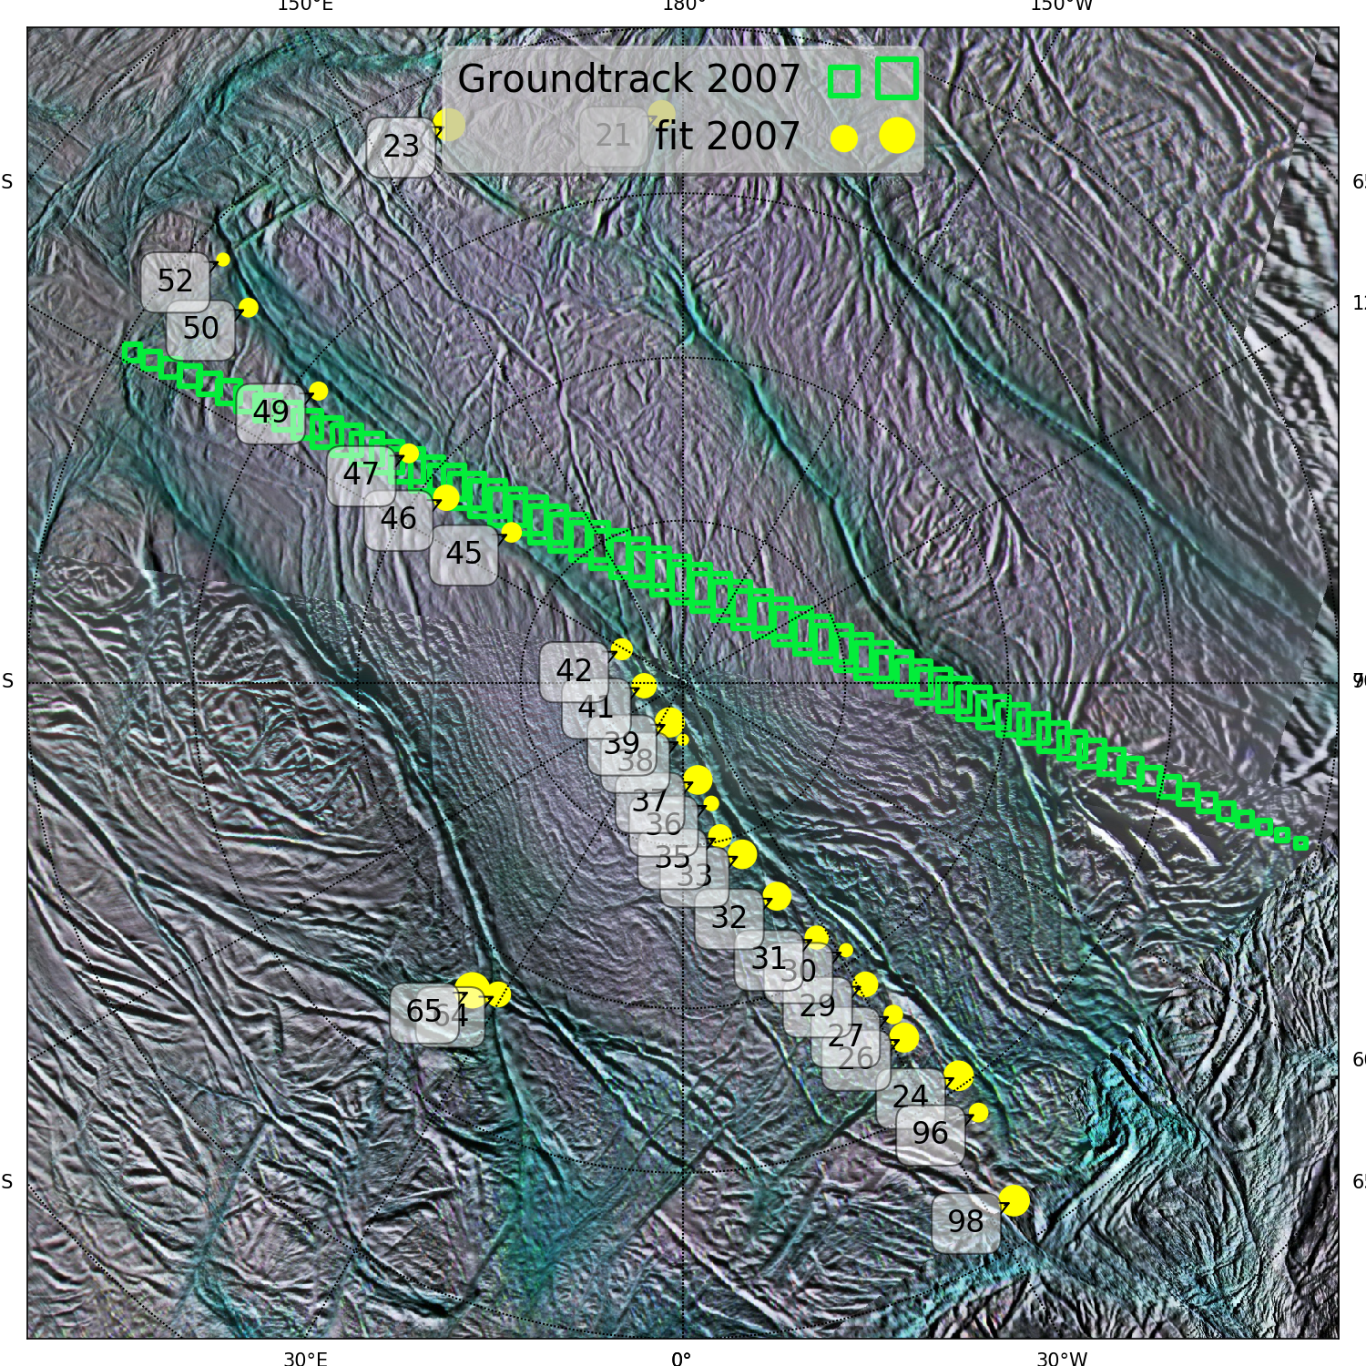
ζ Ori 2007
39 linearly independent model jets
28 jets with non-zero coefficients

Slide 12
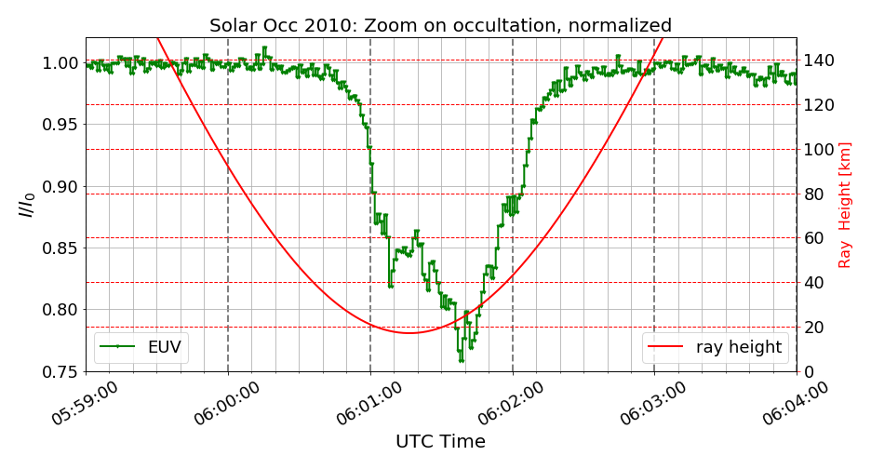
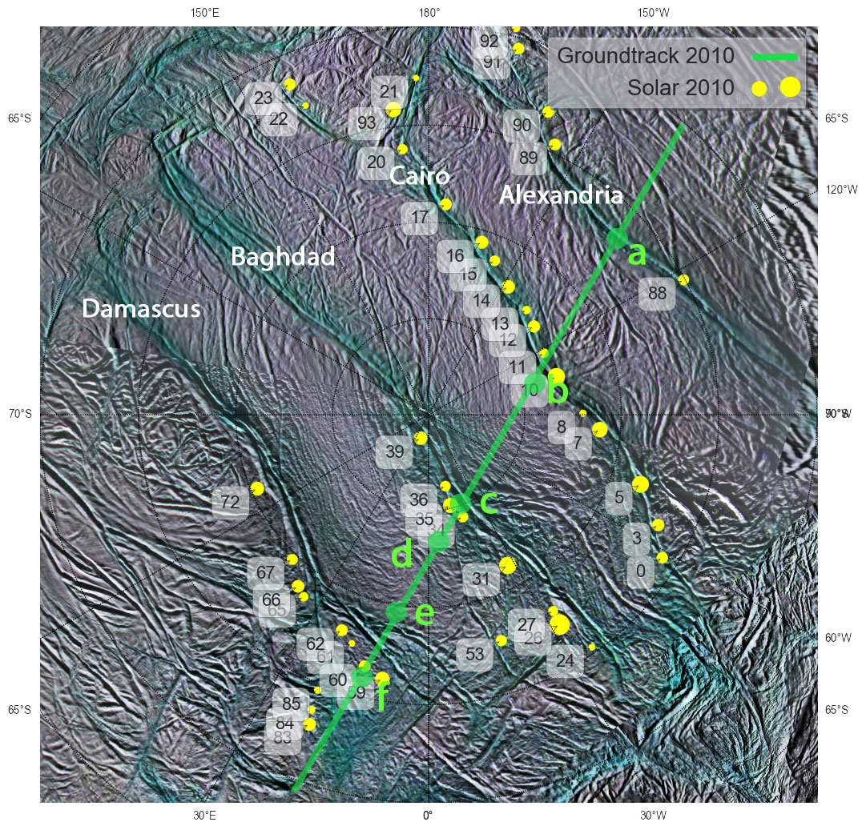
Solar occultation 2010
72 linearly independent model jets
41 jets with non-zero coefficients
Notes:
Talk about the blue curve
It is reasonable to assume that the left side of the plot (et from 130 to 180) provides more information on the single jets than the right side (from 180 to 200), because UVIS sensing through lover areas of the jets.
For every point I have full 3D information about the LOS

Slide 13
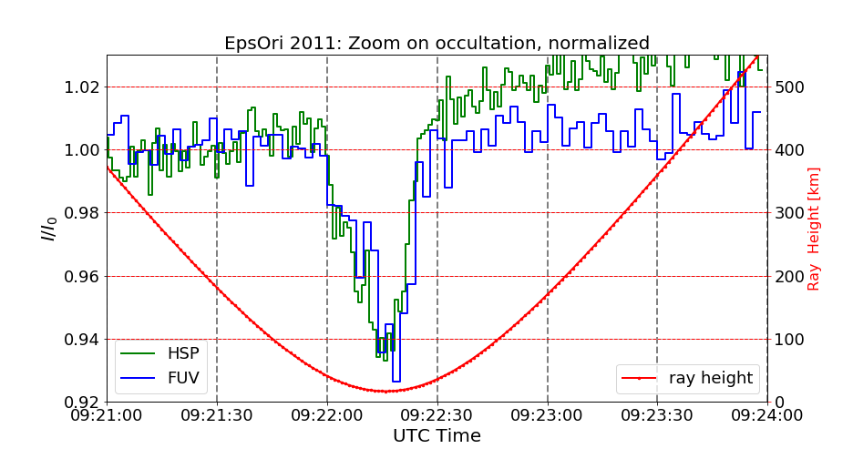
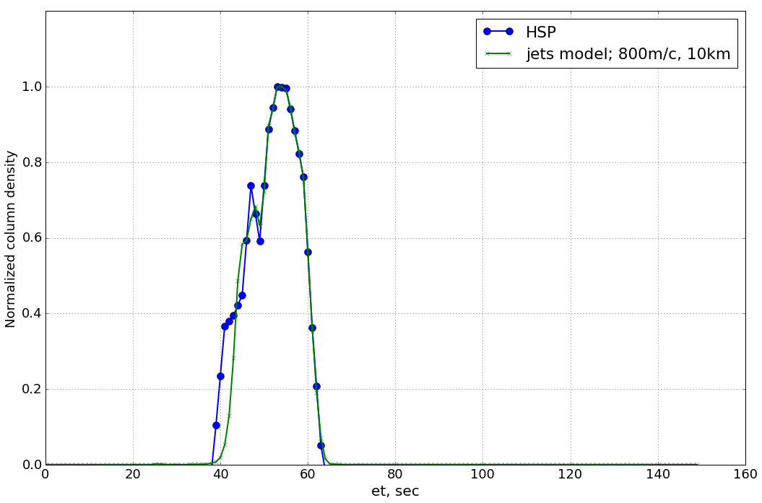
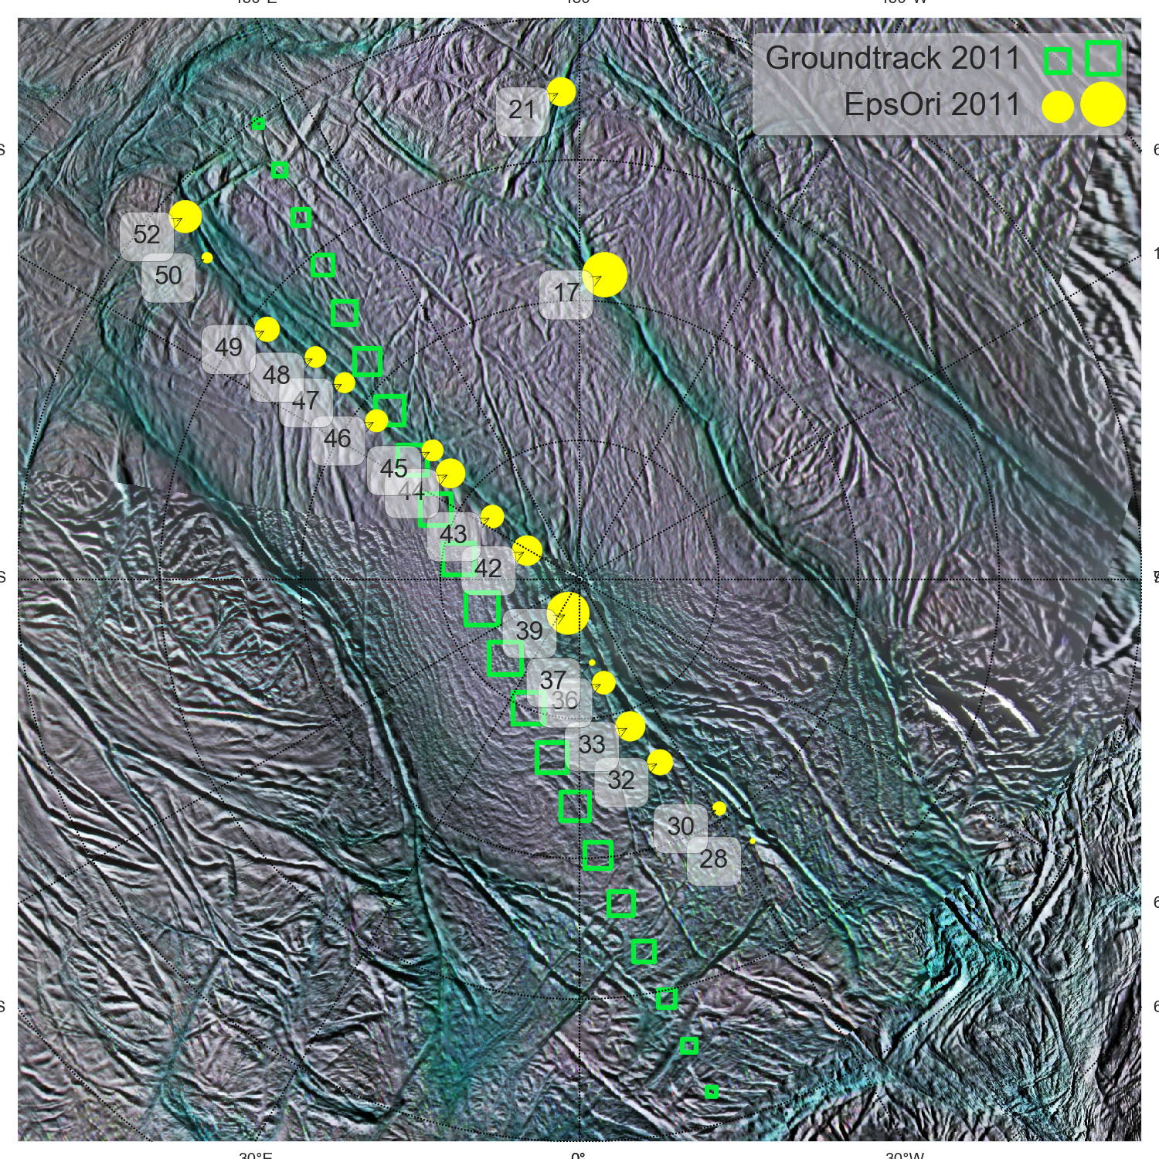
𝛆 Ori 2011
30 linearly independent model jets
17 jets with non-zero coefficients

Slide 14
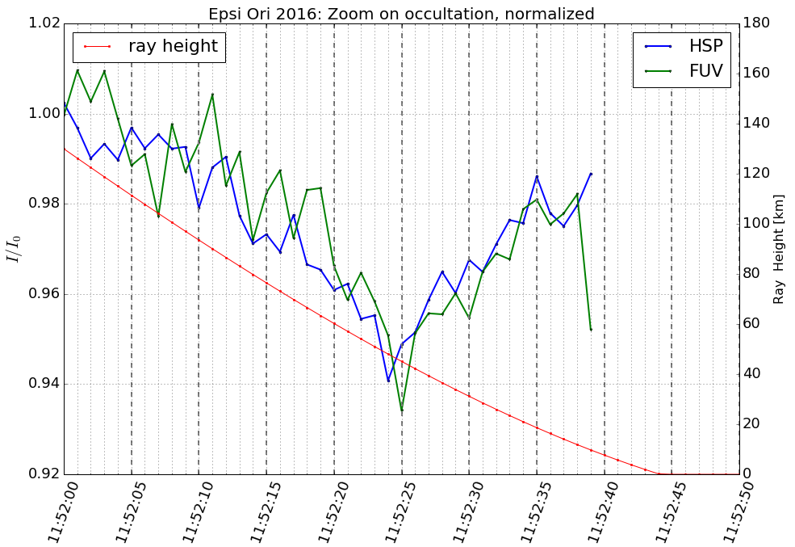
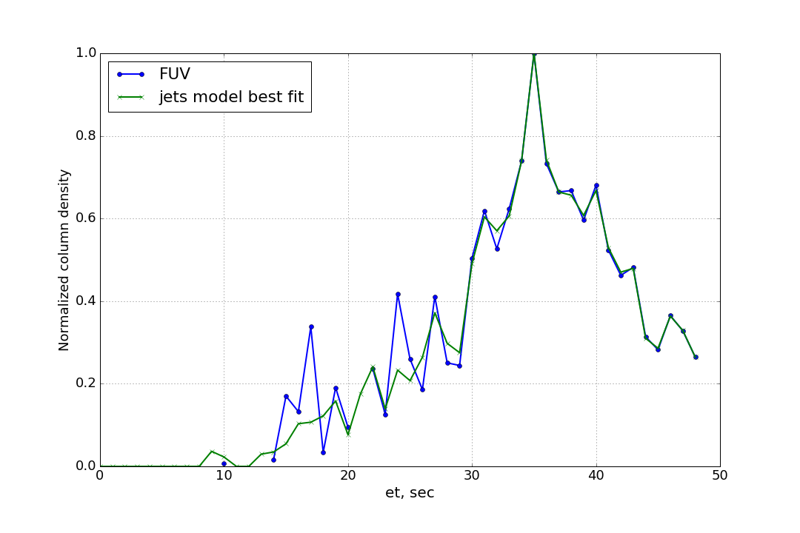
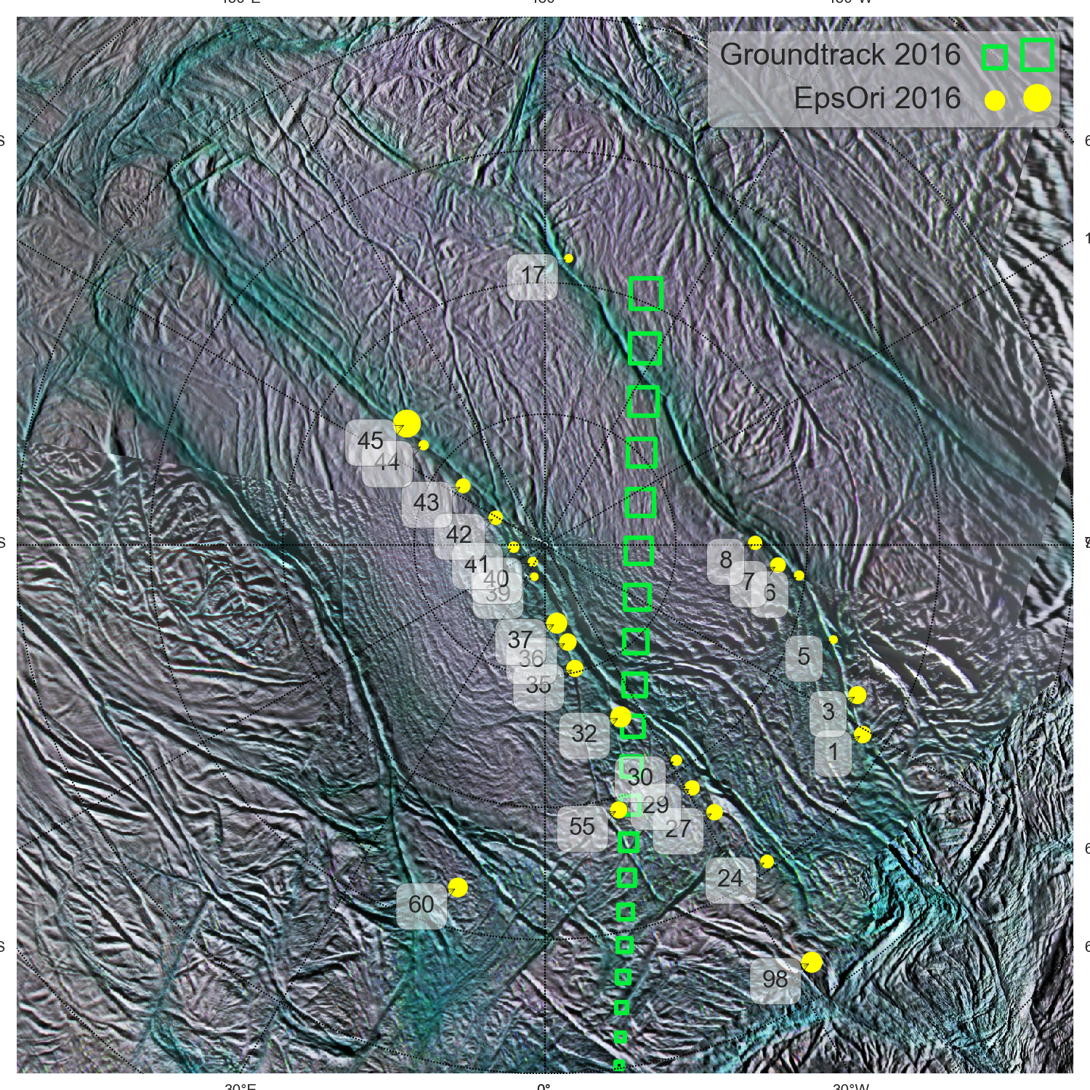
𝛆 Ori 2016
58 linearly independent model jets
28 jets with non-zero coefficients

Slide 15
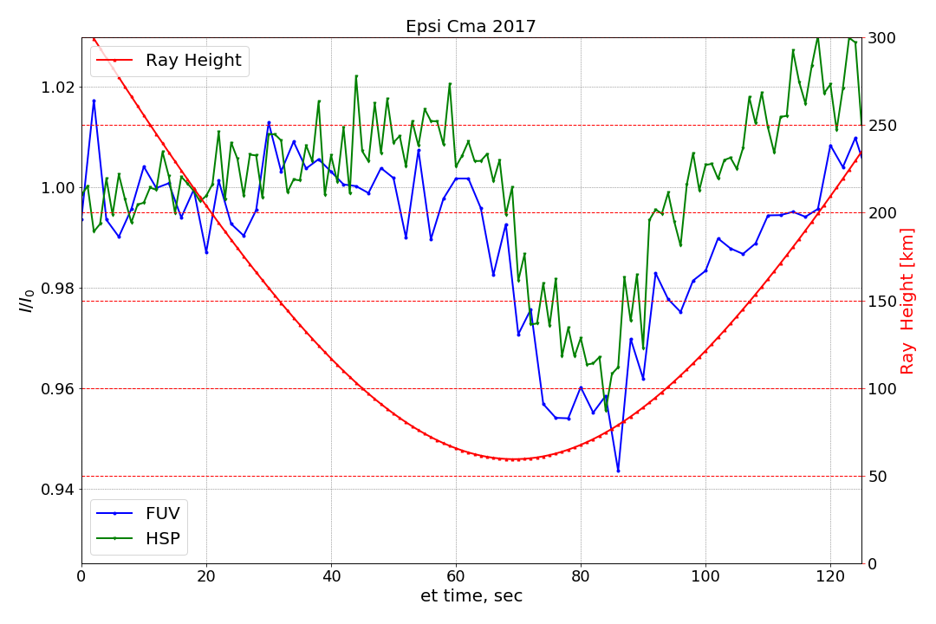
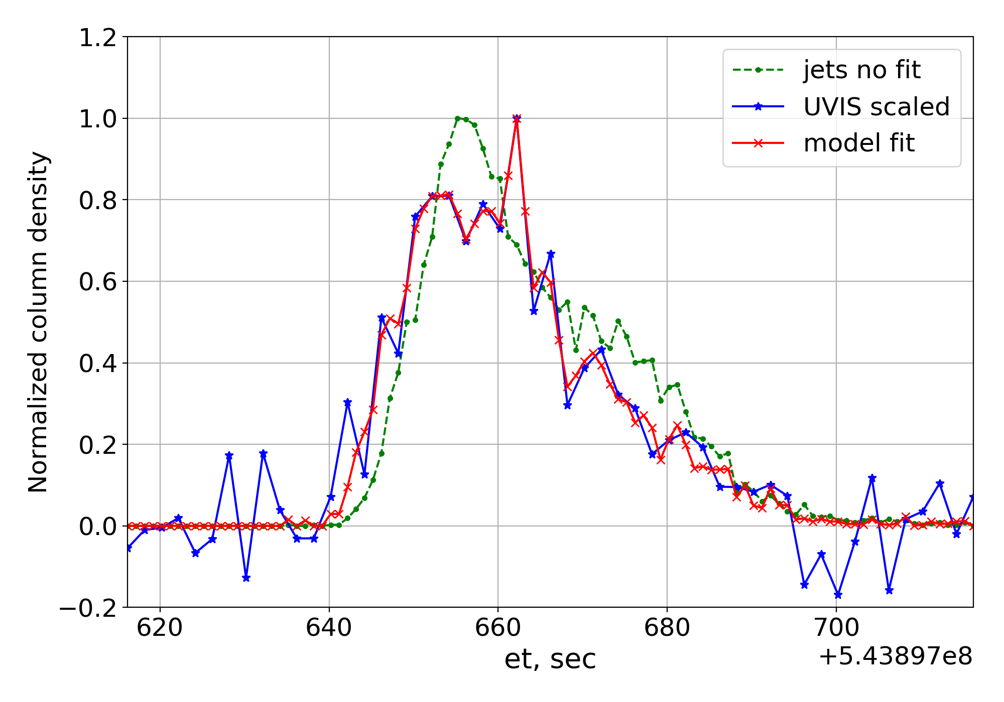
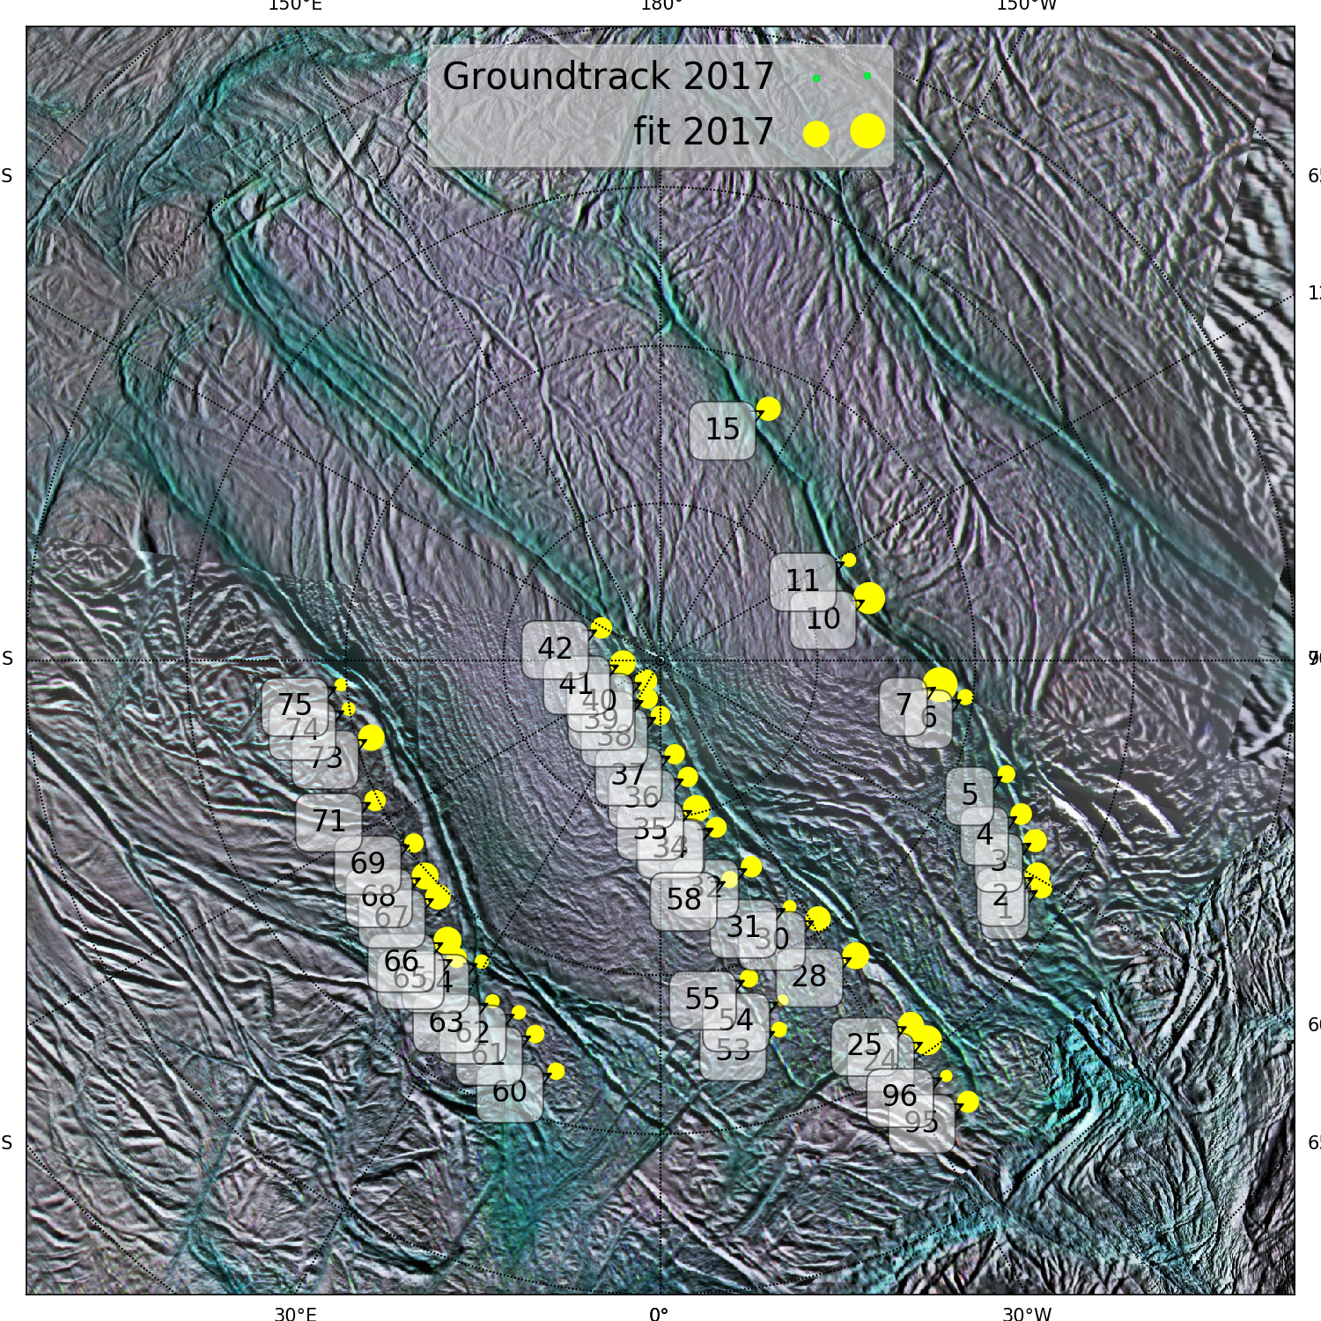
𝛆 CaMa 2017
85 linearly independent model jets
32 jets with non-zero coefficients

Slide 16
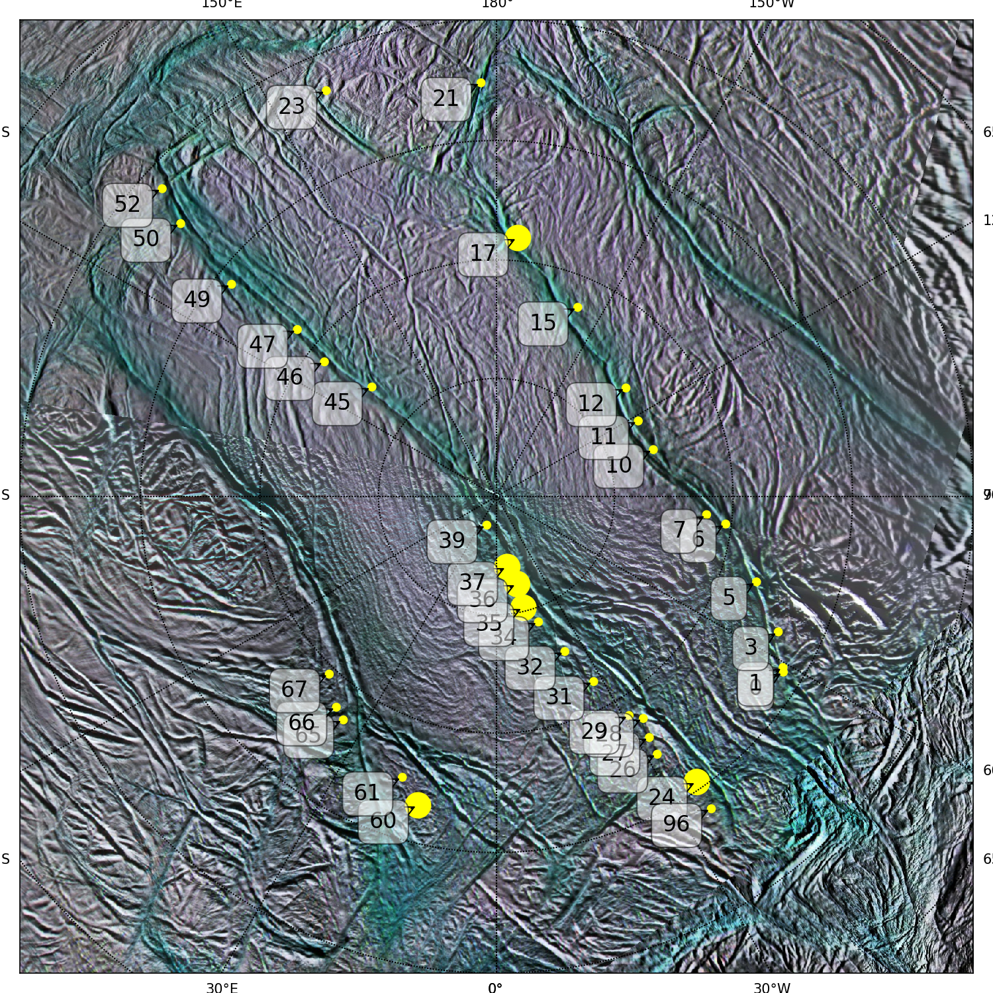
Zet. Ori. Occ. 2007
Solar Occ. 2010
Eps. Ori. Occ. 2011
Eps. Ori. Occ. 2016
Eps. Ori. Occ. 2017
Sources active through multiple years
Notes:
The list of repeated sources is not inclusive: there are might be other persistant sources, particularly in the regions not observed

Slide 17
Conclusions:
At least 41 individual jets are required to fit the highest resolution UVIS dataset (Solar occultation), while combination of a larger set of linearly-dependent jets can not be excluded.
Less jets are required to fit stellar occultation data because of their resolution and geometry.
There is a set of jets (at least 37) that repeatedly appear in the best fits, i.e. it is highly probable that they were active constantly throughout the mission.
Every occultation was special. Different number of active jets and different combination of the jets contribute to the best fits to UVIS data.
THANK YOU, CASSINI!

Slide 18
Backup slides

Slide 19
