Slide 1
Icy Satellites in the Era of Cassini
B. J. Buratti
Jet Propulsion Laboratory
Callifornia Institute of Technology
For the Icy Satellites Working Group, the Satellites Orbiter Science Team, and the Cassini Science Teams
Cassini Science Symposium
Boulder, August 15-19, 2018
©2018 California Institute of Technology. Government funding acknowledged

Slide 2
Some main questions remaining at the end of mission
Composition: What is the composition of the low albedo material on the moons? What specific
organic materials have been identified? Is ammonia or ammonia hydrate there?
2. How variable is the activity on Enceladus and what is its total heat production?
Is Enceladus the only currently active moon?
What is the relative importance of magnetospheric interactions and accretion of E-ring particles?
5. Why are the Jovian and Saturnian Systems so different? (Regular vs. Stochastic)
How extensive are the habitable zones in the system?
But we did learn a few things, as we’ll see……

Slide 3
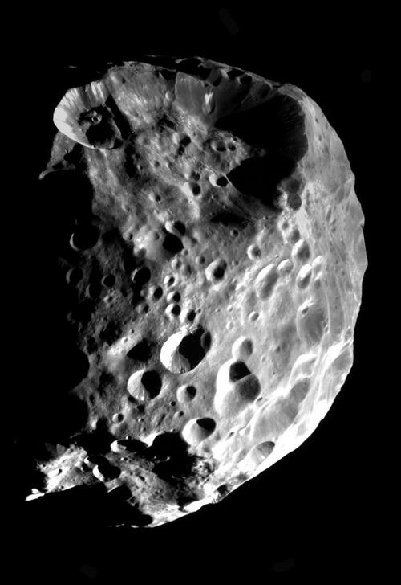
Phoebe: A captured Kuiper Belt Object
Saturn has a large family of outer irregular satellites that are believed to be captured objects that are highly collisionally evolved (Phoebe is the largest one). The Cassini mission offered a unique opportunity to observe these objects to understand the collisional evolution of the outer Solar System, in particular the transport of KBOs. Phoebe, a high density moon (1.7 gm/cc) is likely captured from the Kuiper Belt (Johnson and Lunine, 2005)
An ISS team led by T. Denk is reducing photometric measurements to derive rotation periods of Ymir: 11.93 hr; Mundilfari 6.74 h; Kari 7.70 h; Albiorix 13.32 h; Kiviuq 21.82 h. More uncertain values are: Skathi ~12 h; Bebhionn ~16 h; Thrymr ~27 h; Erriapus ~28 h.
Phoebe

Slide 4
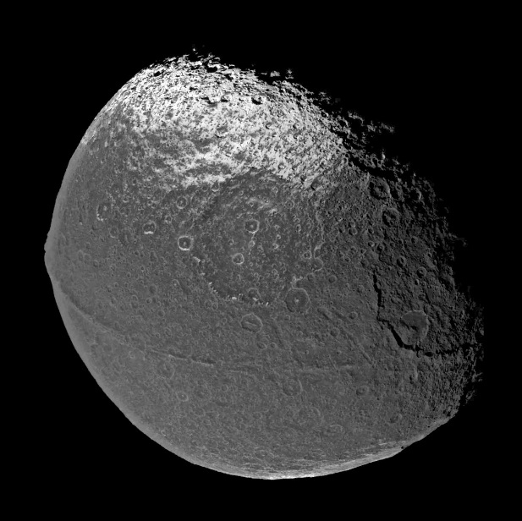
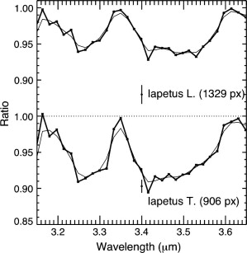
Complex Hydrocarbons on Iapetus (Cruikshank et al., 2014)
Analyzing data gathered throughout the
mission, Cruikshank et al. (2014) have
identified the spectral bands near 3.2-3.4 µm
that are characteristic of polycyclic and aromatic
hydrocarbons. These complex molecules are
thought to be some of the building blocks
of life. They have previously been detected
in the interstellar medium.
This result answers one of the prime
questions of the Cassini mission: to char-
acterize the dark material in the outer
Solar System.
But Clark et al. (2012) explain the moons’ spectra
with nano-iron + nano-hematite with sub-micron ice
Is the walnut ridge a collapsed ring?

Slide 5
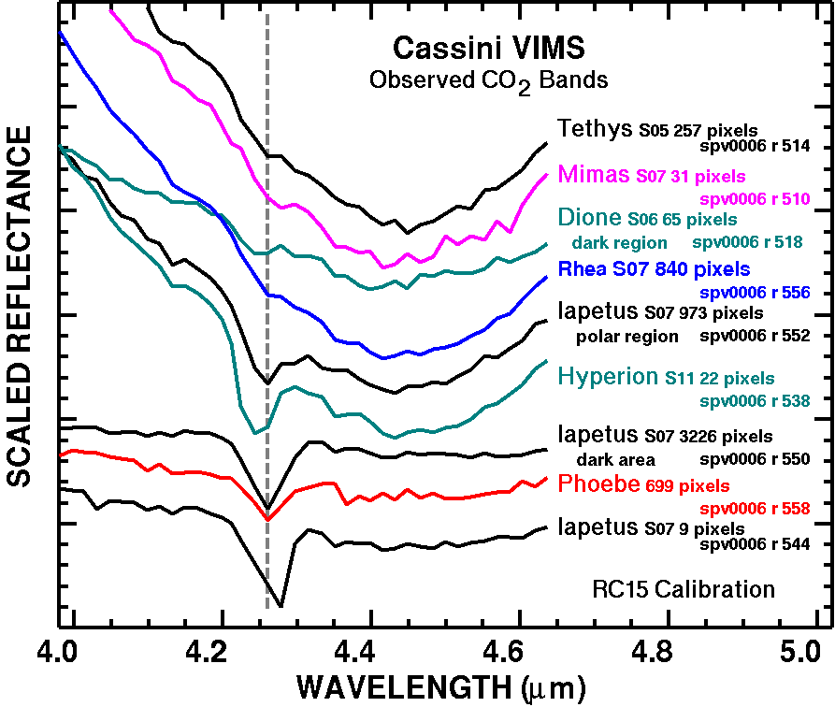
Discovery of CO₂: It’s ubiquitous
Roger Clark graph
(More CO2 in non-ice material, and more on outer than inner satellites; none found
on ring moons)

Slide 6
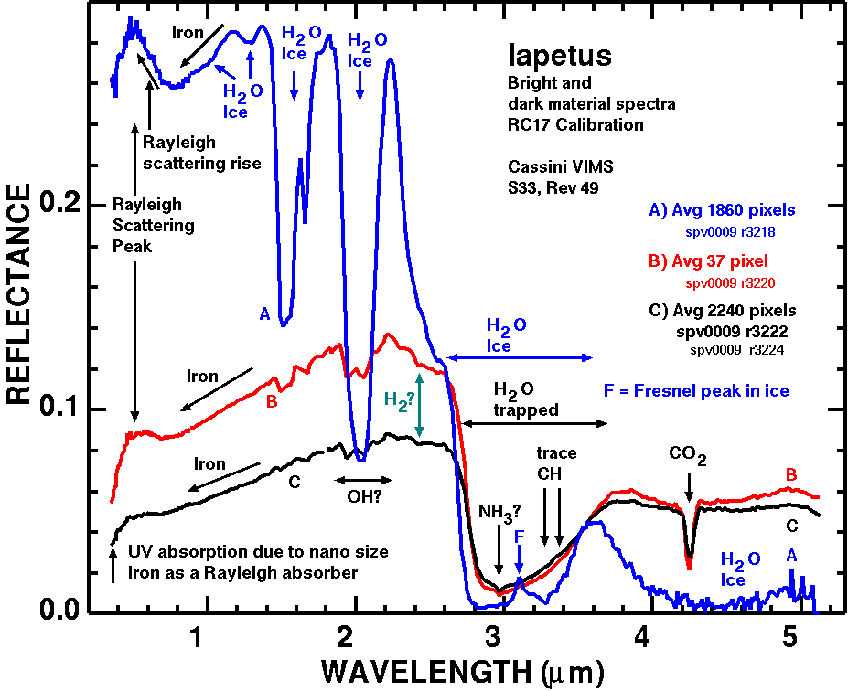
Ammonia?
Ammonia hydrate was also possibly
detected by ground-based observers
(Emery et al., 2005; Verbiscer et al., 2006).
Clark et al., Icarus, 2012
Clark et al., Icarus, 2012

Slide 7
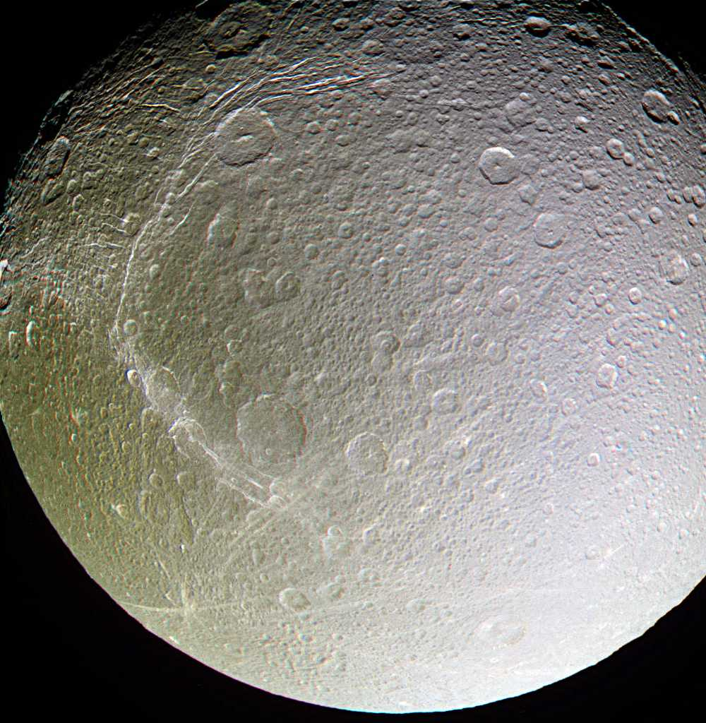
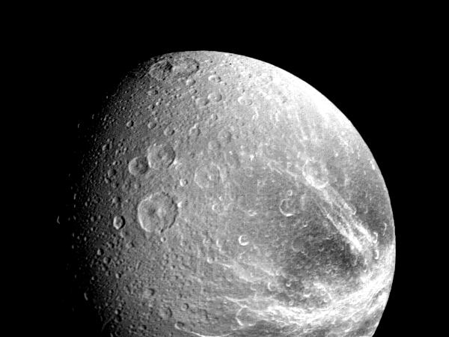
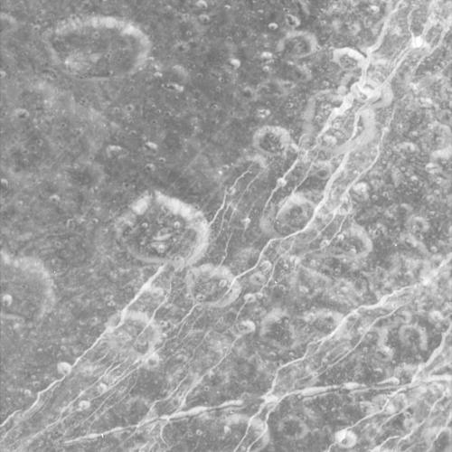
One mystery solved
Cassini
Voyager: bright “wispy streaks” on Rhea and Dione – were
they extrusions of ammonia on the surface? No! Cassini showed
they are fractures
Voyager: Rhea (left)
Dione (bottom)
Carthage fossae

Slide 8
The 101 Jets of Enceladus
Triangulation of 101 jets of
Enceladus has placed them near
hot spots previously identified by
CIRS and VIMS (Porco et al. 2014;
Nimmo et al., 2014).
Curtains of ejected ice vapor
and particles may also appear
as jets (Spitale et al. 2015)

Slide 9
The plume of Enceladus varies!
Hedman et al. (2013)
Cassini Visual Infrared Mapping Spectrometer (VIMS) observations of Enceladus
obtained when it is farthest from Saturn (apoapse, at left) are about 4 X as bright)
as when it is closest (periapse, right). This result can be explained by having the
fissures that are the source of the plumes get “squeezed” together by tidal forces
when the moon is closest to Saturn. Seasonal and long term changes still being explored

Slide 10
Seasonal changes?
Plume brightness from 2006 through 2015 showing
year-to-year changes in the amplitude of the diurnal
variations with mean anomaly, including a substantial
decrease toward the end of the mission.
From Ingersoll and Ewald (2017).

Slide 11
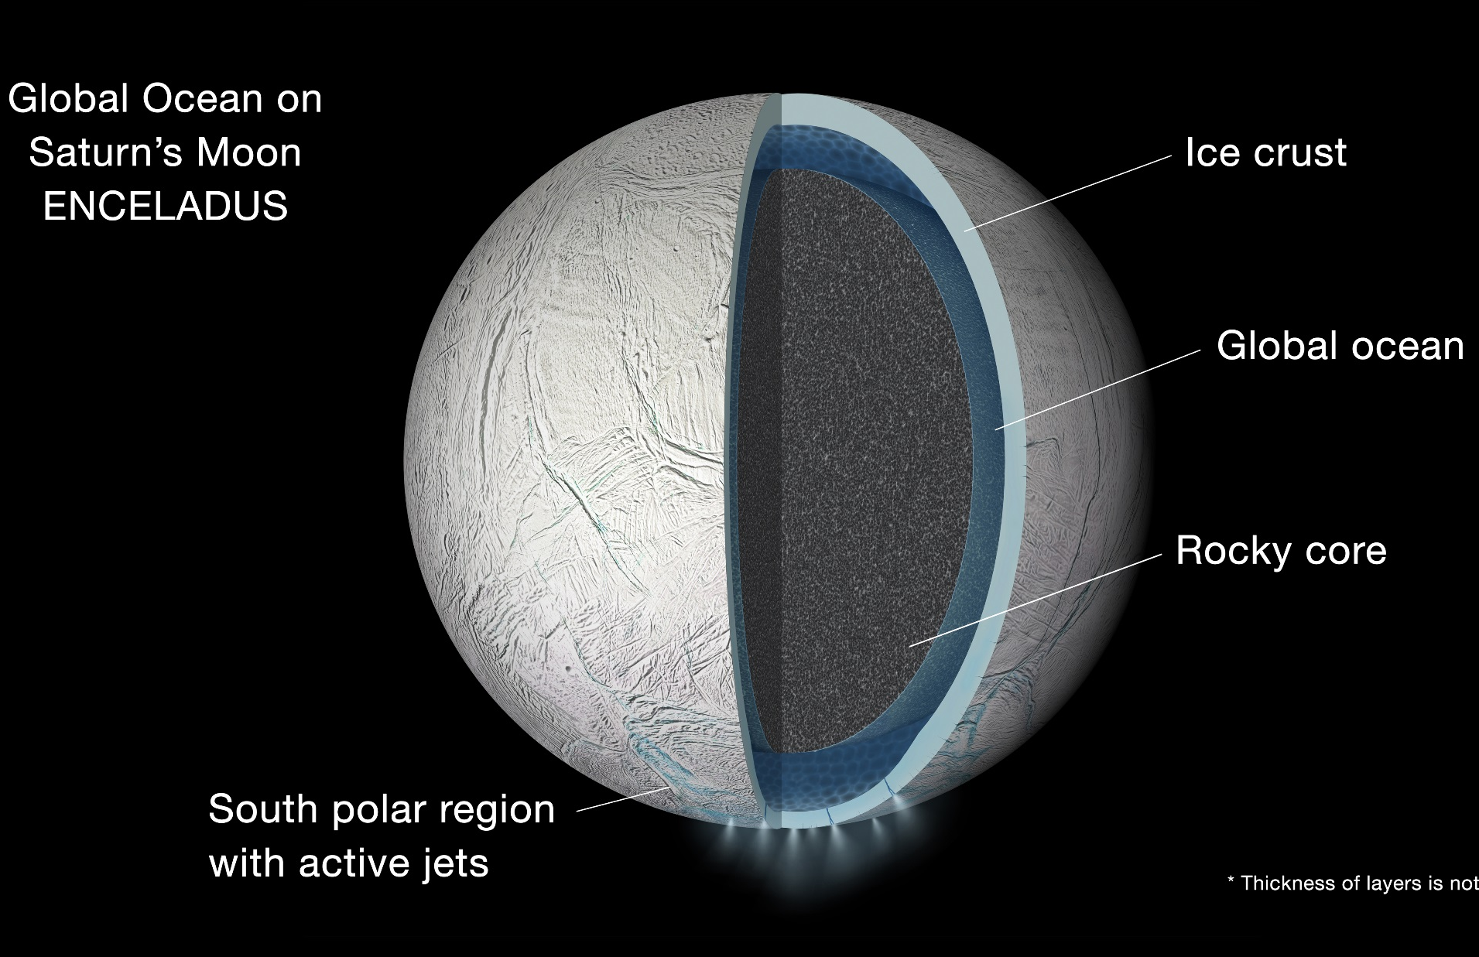
Global Ocean Inside Enceladus
Press Release - http://1.usa.gov/1NDHVlV
Explaining the magnitude of the moon’s libration requires a global ocean separating the outer ice shell from the interior. It rules out a completely frozen interior.
A global ocean may mean that tidal flexing by Saturn's gravity generates much more heat inside Enceladus than previously thought.
This discovery, together with discovery of seafloor hydrothermal activity^{2,3}, indicates that ocean could be long-lived.
*Thickness of layers is not to scale
¹"Enceladus’s measured physical libration requires a global subsurface ocean,” P.C. Thomas, et al., 2015. doi:10.1016/j.icarus.2015.08.037
²“Ongoing hydrothermal activities within Enceladus,” Hsu et al., Nature, 519, 207-210, 2015.
³“Possible evidence for a methane source in Enceladus’ ocean ,” Bouquet et al., Geophysical Research Letters, 42, 1334-1339, 2015.

Slide 12
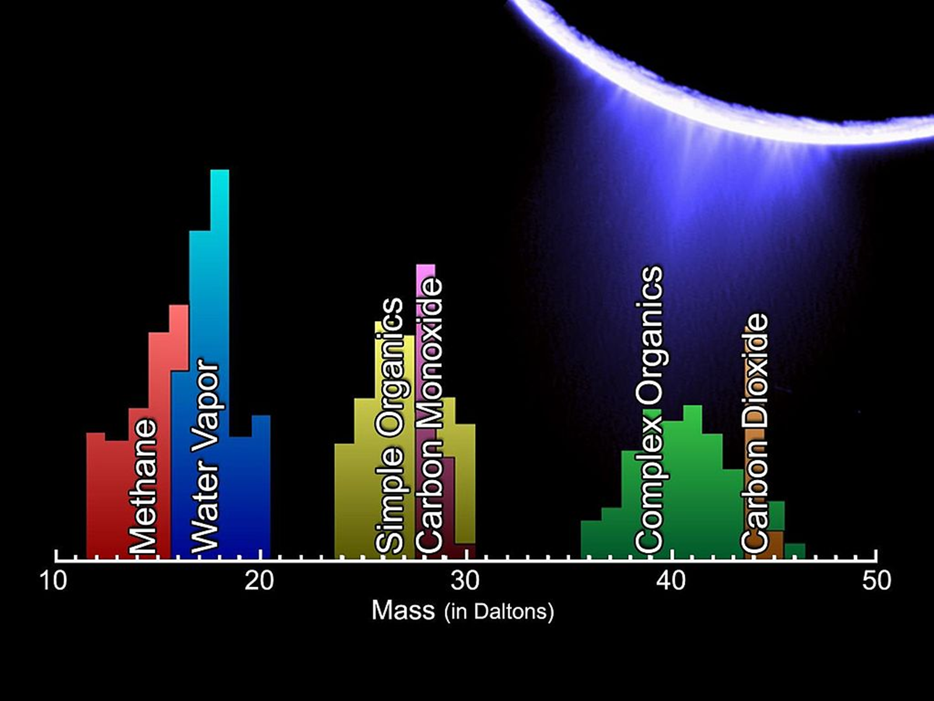
Organic material in the plume:
Another piece of evidence for a habitable
environment. Complex organics >200 AMU
(Postberg et al. (2018), Nature)
(Waite et al., 2008)

Slide 13
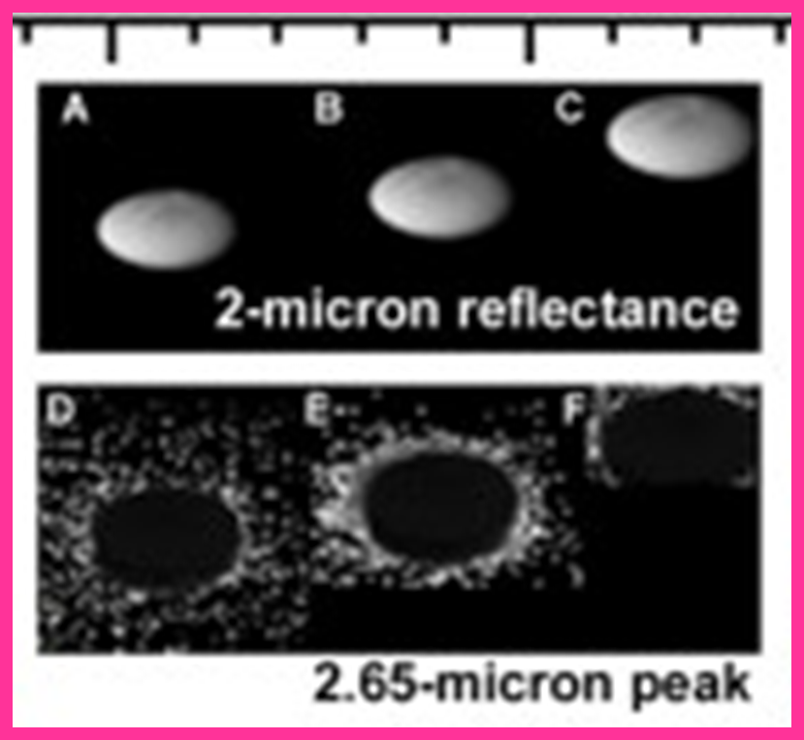
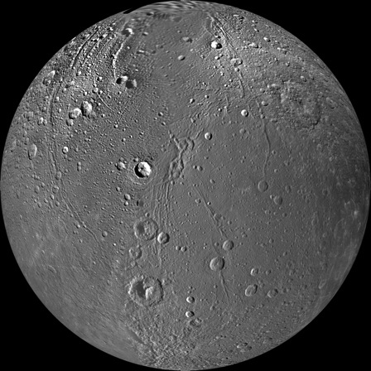
Evidence for Activity on Dione
Smooth plains on Dione (Schenk et al. 2011)
Lower crater density
Linear grooves and scarps
Rampart craters
Anomalous crater pair: Possible volcanic vent!
Clark et al., 2008
Also Fields and Particles evidence (Burch et al., 2007
Khurana et al. 2007). and evidence for an ocean
(Beuthe et al, 2017; Hemingway et al, 2016)

Slide 14
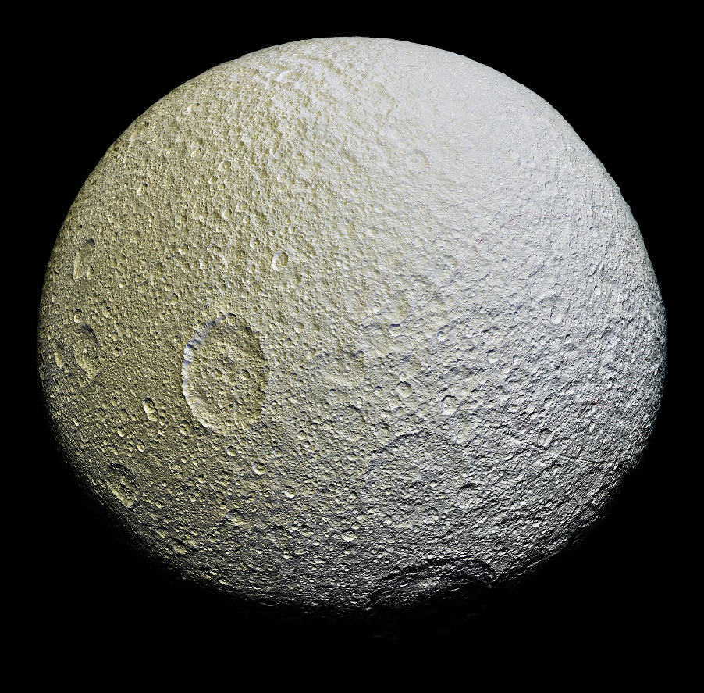
Or Tethys? (mysterious red streaks)
Schenk, 2015
Spectral differences from VIMS

Slide 15
Data taken throughout the mission found no evidence for an atmosphere or plume on Dione or Tethys
UVIS occultations of Dione and Tethys
VIMS high phase angles of Dione
Near red streak
Hansen et al., 2018
Also CIRS (Carly Howett et al., 2018) saw no heat signatures

Slide 16
Magnetospheric vs. E-ring and plume alterations
Pacmen: An example of magnetopsheric alterations (high-energy electrons). (Howett et al. 2012)
Plume fallout on Enceladus
Schenk et al. 2011; see also Hendrix et al., 2012;
Paranicas et al., 2012

Slide 17
Five Fabulous Flybys (best ever!) of ring moons during the F-ring orbits
Object | Date | Closest approach (km)
Pandora | 18 Dec 2016 | 20,000; closest by almost a factor of 3
Daphnis | 16 Jan 2017 | 17,600; closest by over an order of magnitude
Epimetheus | 30 Jan 2017 | 5900; closest by factor of 6
Pan | 7 March 2017 | 25,350; closest by a factor of 2
Atlas | 12 April 2017 | 13,170; closest by factor of 2
Additional Epimetheus:
21 Feb. 2017
Closest approach was at 10,500km at a solar phase angle of 74°
The number of observations accumulated on the small moons is at the point where real
physical characterizations can be done, including construction of geologic maps, solar phase curves
and light curves, and spatially-resolved spectroscopy

Slide 18
Example: Atlas through many eyes
VIMS
1.38 µm 1.66 µm
ISS Image
2.01 µm 3.50 µm
CIRS (thermal)
C. Howett

Slide 19
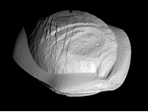
Visible and IR Spectra of Pan (VIMS): a first
IR Spectrum
Visible Spectrum
0.3
0.2
0.1
0.0
0.25
0.20
0.15
I/F
I/F
Red!
Crystalline ice band deep
0.4 0.5 0.6 0.7 0.8 0.9 1.0
1.0 2.0 3.0 4.0 5.0
Wavelength (µm)
Wavelength (µm)

Slide 20
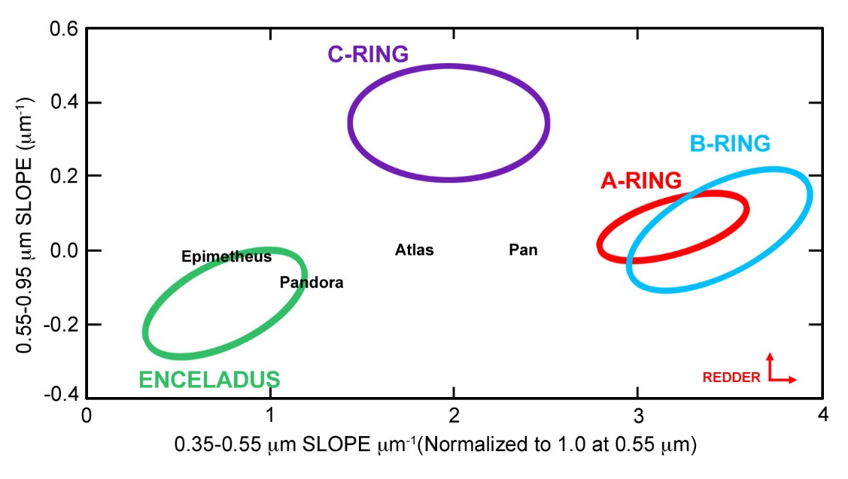
The colors of the inner moons compared to the rings
Red
(Filacchione et al. 2012; 2013; Buratti et al., 2018)

Slide 21
Are the rings and moons new (Cuk et al., 2016 Ap. J.; not in first set of questions)?
Pros
Cons
The models present plausible dynamical scenarios that work
The small mass of the rings seems to imply that they – and thus at least the inner rings - are new.
It is difficult to see how much geology could have occurred in ~1-2X108 years (possible out: impactors are planetocentric)
(Lots of disagreement on this) The ice in the rings (implying young age) could come from the E-ring to make the main ring system appear young.

Slide 22
Some main conclusions from Cassini
Even though Cassini performed compositional mapping on the main moons of Saturn, discovering organics and CO₂, many minor constituents still need to be identified, including those comprising the low-albedo material.
Habitable Ocean Worlds may be rampant (haven’t even mentioned Titan!)
Exogenous alteration processes strongly affect the surface appearance and composition; moons interact with rings and particles in the Saturnian magnetosphere
The moons have had a troubled history: Hyperion in chaotic rotation; Rhea not differentiated (large collision?) Tethys so low density (0.98 gm/cc) it could be reaccreted. Dione maybe partly differentiated, based on gravity analysis (D. Hemingway, this past PSG). And they may all be young
Completely unlike “mini Solar System” found in Jupiter system

Slide 23
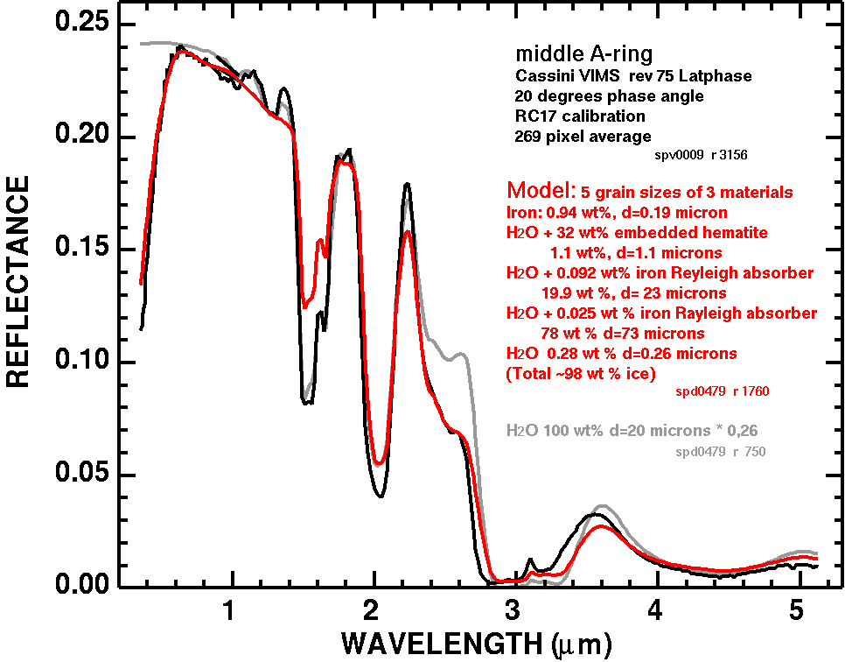
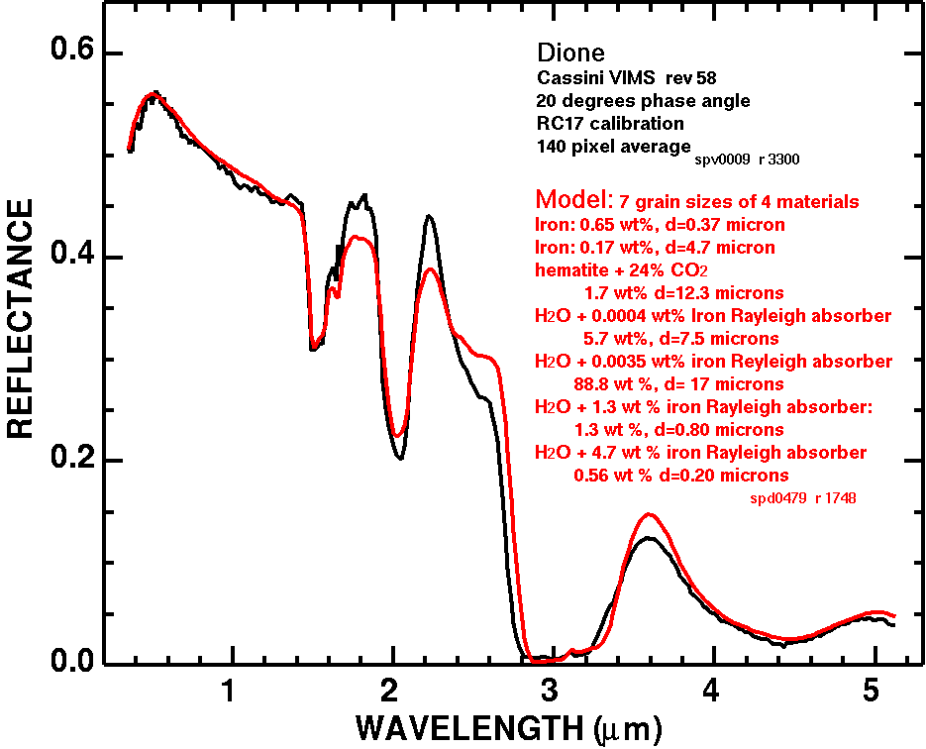
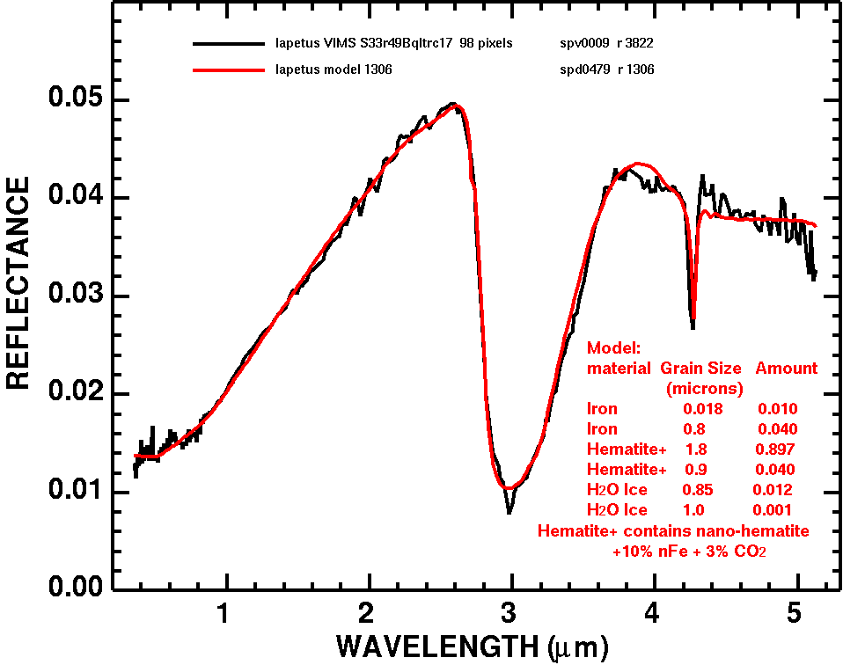
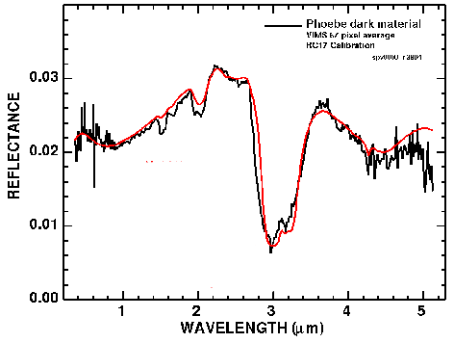
Another explanation: Nano-Iron + Nano-Hematite with sub-micron ice
Another idea is that fine-grained metallic iron dust contaminates the ice, from Phoebe to the rings. Some of the iron may be oxidized and hydrated giving the 3-micron water absorption in the dark material. The competition of sub-micron ice, iron and hematite creates the varying blue peaks and UV absorption observed throughout the system.
Rings
Dione
Phoebe
Reference:
Clark et al., Icarus, 2012
Iapetus

