Slide 1
The Big Impact of Small craters on Midsized Saturnian Satellites
Sierra Ferguson¹, Alyssa Rhoden²
^{1.} Arizona State University- School of Earth and Space Exploration, Tempe AZ, sierra.ferguson@asu.edu
^{2.}Southwest Research Institute, Boulder CO
Work presented is supported by NASA’s Cassini Data Analysis Program
Notes:
On tethys. Focus on cratering for this talk. Potentially large impact of small impacs then switcht to title. Funded by CDAP

Slide 2
Big picture Questions
When/ how did the Saturnian moons form?
What are the sources of impactors on Tethys and Dione?
Notes:
Make sure you say that the impactor flux is the means by which we figure out the "when" and is mostly based on the observed distribution of craters on a surface. Big pictures look like objectives, need to be larger
Understand the crater populations tied to saturn system dynamics
How do craters in ice look/form?
3 things that we're curious about
1. Is there evidence of a planetocentric population?
2. What might be the effect of secondary craters?
Secondaries can be more disperse

Slide 3
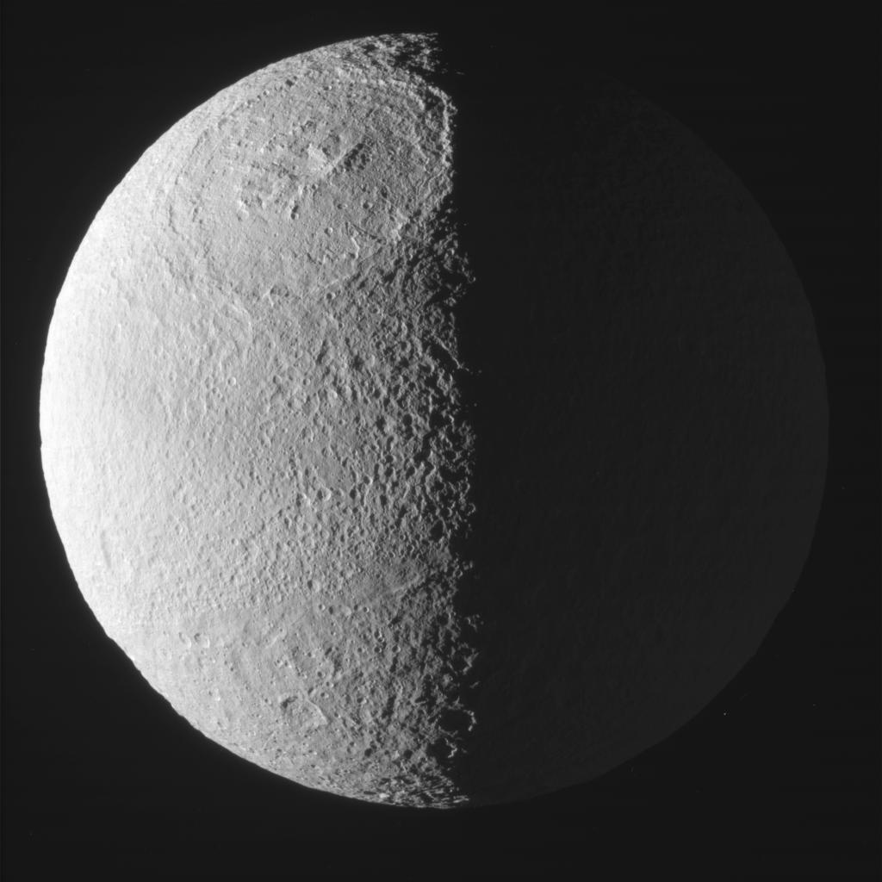
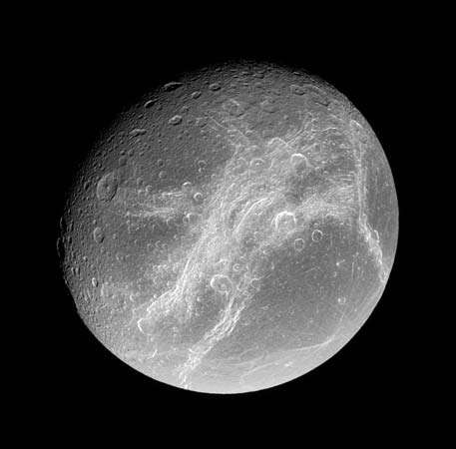
Tethys & Dione
Satellite | Radius (km) | Surface Gravity (m/s^2) | Estimated Silicate Fraction (Charnoz et al. 2011) | Notable Surface Geology
Tethys | 531 | 0.146 | ~ 6% | Odysseus impact basin (450 km diameter) & Ithaca Chasma
Dione | 561 | 0.232 | ~ 50% | Wispy Terrain
Each of these Moons also has their own pair of co-orbital moons in the L4 and L5 Lagrange points
Tethys: Calypso and Telesto
Dione: Helene and Polydeuces
Image credit: NASA/JPL/SSI
Notes:
Charnoz 6% rock given the shape. Column with co-orbital moons, introduce them

Slide 4
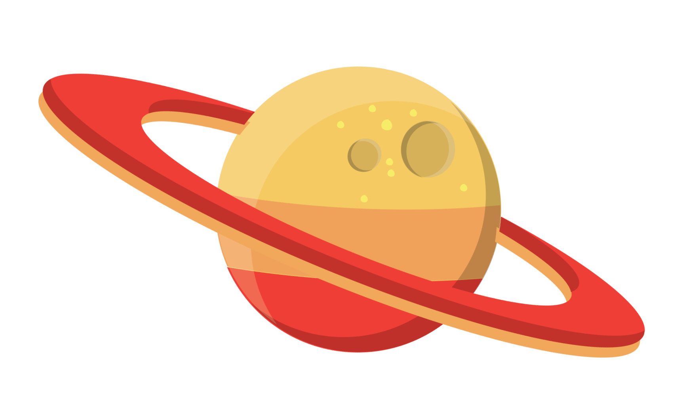
Potential Sources of impacts
Planetocentric
Heliocentric
Debris from primary impact elsewhere on satellite
Debris from impacts onto the co-orbital moons?
L5
L4
Tethys / Dione
* Orbit not to scale
Notes:
1st is planetocentric debris which is thought to Planetocentric definition: Debris that is orbiting Saturn from other things, Heliocentric impactors def.
We are still investigating the importance of debris from co-orbital moons and the influence on the crater populations

Slide 5
Objectives of this project
We map small scale features in distinct regions of Tethys and Dione to determine:
The differences in crater populations based on location on Tethys/Dione
Whether there is evidence of low velocity, oblique impacts
Whether crater sizes and morphologies differ between regions
The distribution of elongated craters that may have formed from impacts onto Tethys/Dione
These can all inform the cratering history on Tethys/Dione and can constrain impactor source populations
Notes:
Separate between heliocentric and planetocentric telling things. Change to low velocity. Secondaries = region differences as well. Can lineations be more pit chains. Point out the most amount of lineations are in the region that has the most small craters. Mention the polygonal and elliptical craters here instead

Slide 6
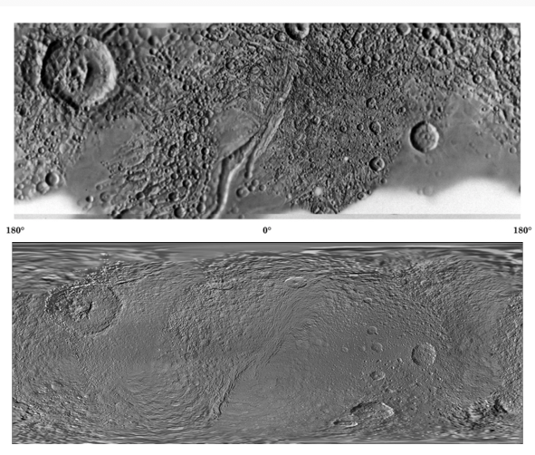
Relevance
The ages of Saturn’s Mid-sized Icy Satellites (MIM’s) are uncertain
Extrapolating the lunar chronology curve to the outer planets produces inaccurate ages
High resolution data from NASA’s Cassini mission has enabled detailed mapping of Tethys and Dione’s surfaces
We can now map craters up to 1 km in diameter
Non crater features that may be related to impacts are also able to be mapped
Crater counting and analyzing the distributions of crater types can better inform impactor models.
Comparison of the Voyager era image mosaic (top) of Tethys and the mosaic made with Cassini data (bottom)
Notes:
Small craters represent the population we’d expect to see. Pit chains, scouers? Traditionally crater counting on the Moon and Mars has been used to obtain absolute ages of planetary surfaces which works well to an extent
These worlds have samples that have been dated using radioisotope techniques
Ages on outer solar system surfaces are significantly less accurate since we do not have radiometric dates or a clear idea of the impactor flux
Traditionally, Tethys has been thought to be around 4Gyr old
Ćuk et al. 2016 hypothesized that Saturn’s midsized moons may only be 100 Myr old
Even crater counters agree that we don’t have a way to differentiate between 4Gyr and 2Gyr surfaces (OS and saturn)

Slide 7
Methods
Targeted, downloaded, and processed all raw Cassini ISS (Imaging Science Subsystems) data via the USGS PILOT software (https://pilot.wr.usgs.gov)
Completed mosaics of all potential regions using standard USGS tools
Mosaics were controlled and brought into ArcGIS for mapping
Used the CraterTools ArcGIS extension to count all identifiable craters in the mosaics
Mapped features as a crater if there was a discernable rim and the feature was circular; potential craters were mapped, these were ones that looked mostly like a crater but shadowing may have obscured
Notes:
BUMP IN CASE OF OVERTIME
Go back to report for uncertain crater words Crater tools: This tool does take into account distortions in diameter as one maps away from the equator. What qualifies as a crater and what measurements were taken? Slide showing as other types of craters (gallery of craters)

Slide 8
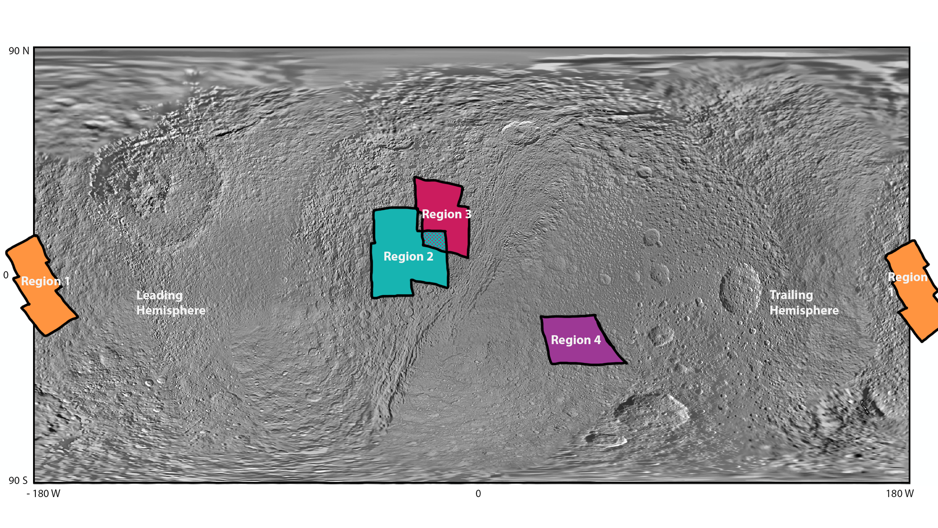
Regions mapped
Notes:
Rationale for picking regions 1-3. Wanted a spaced out sample of craters to see if there are differences in locations on Tethys. Region 4 was chosen since it is close to the antipode of Odysseus and we wanted to see if there were differences in the antipodal terrains.

Slide 9
Regions mapped
Notes:
Change colors of regions, or add outlines

Slide 10
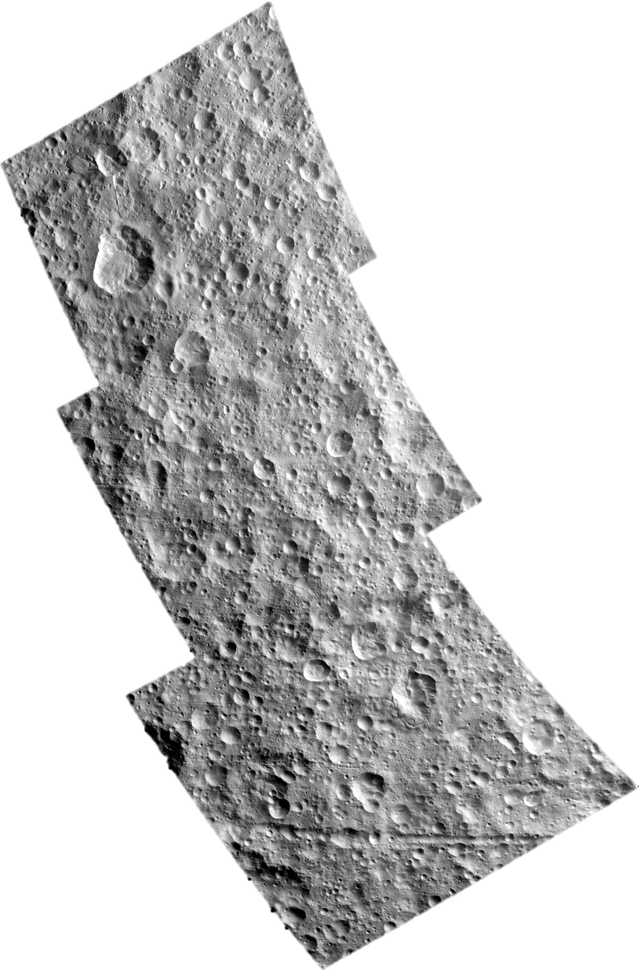
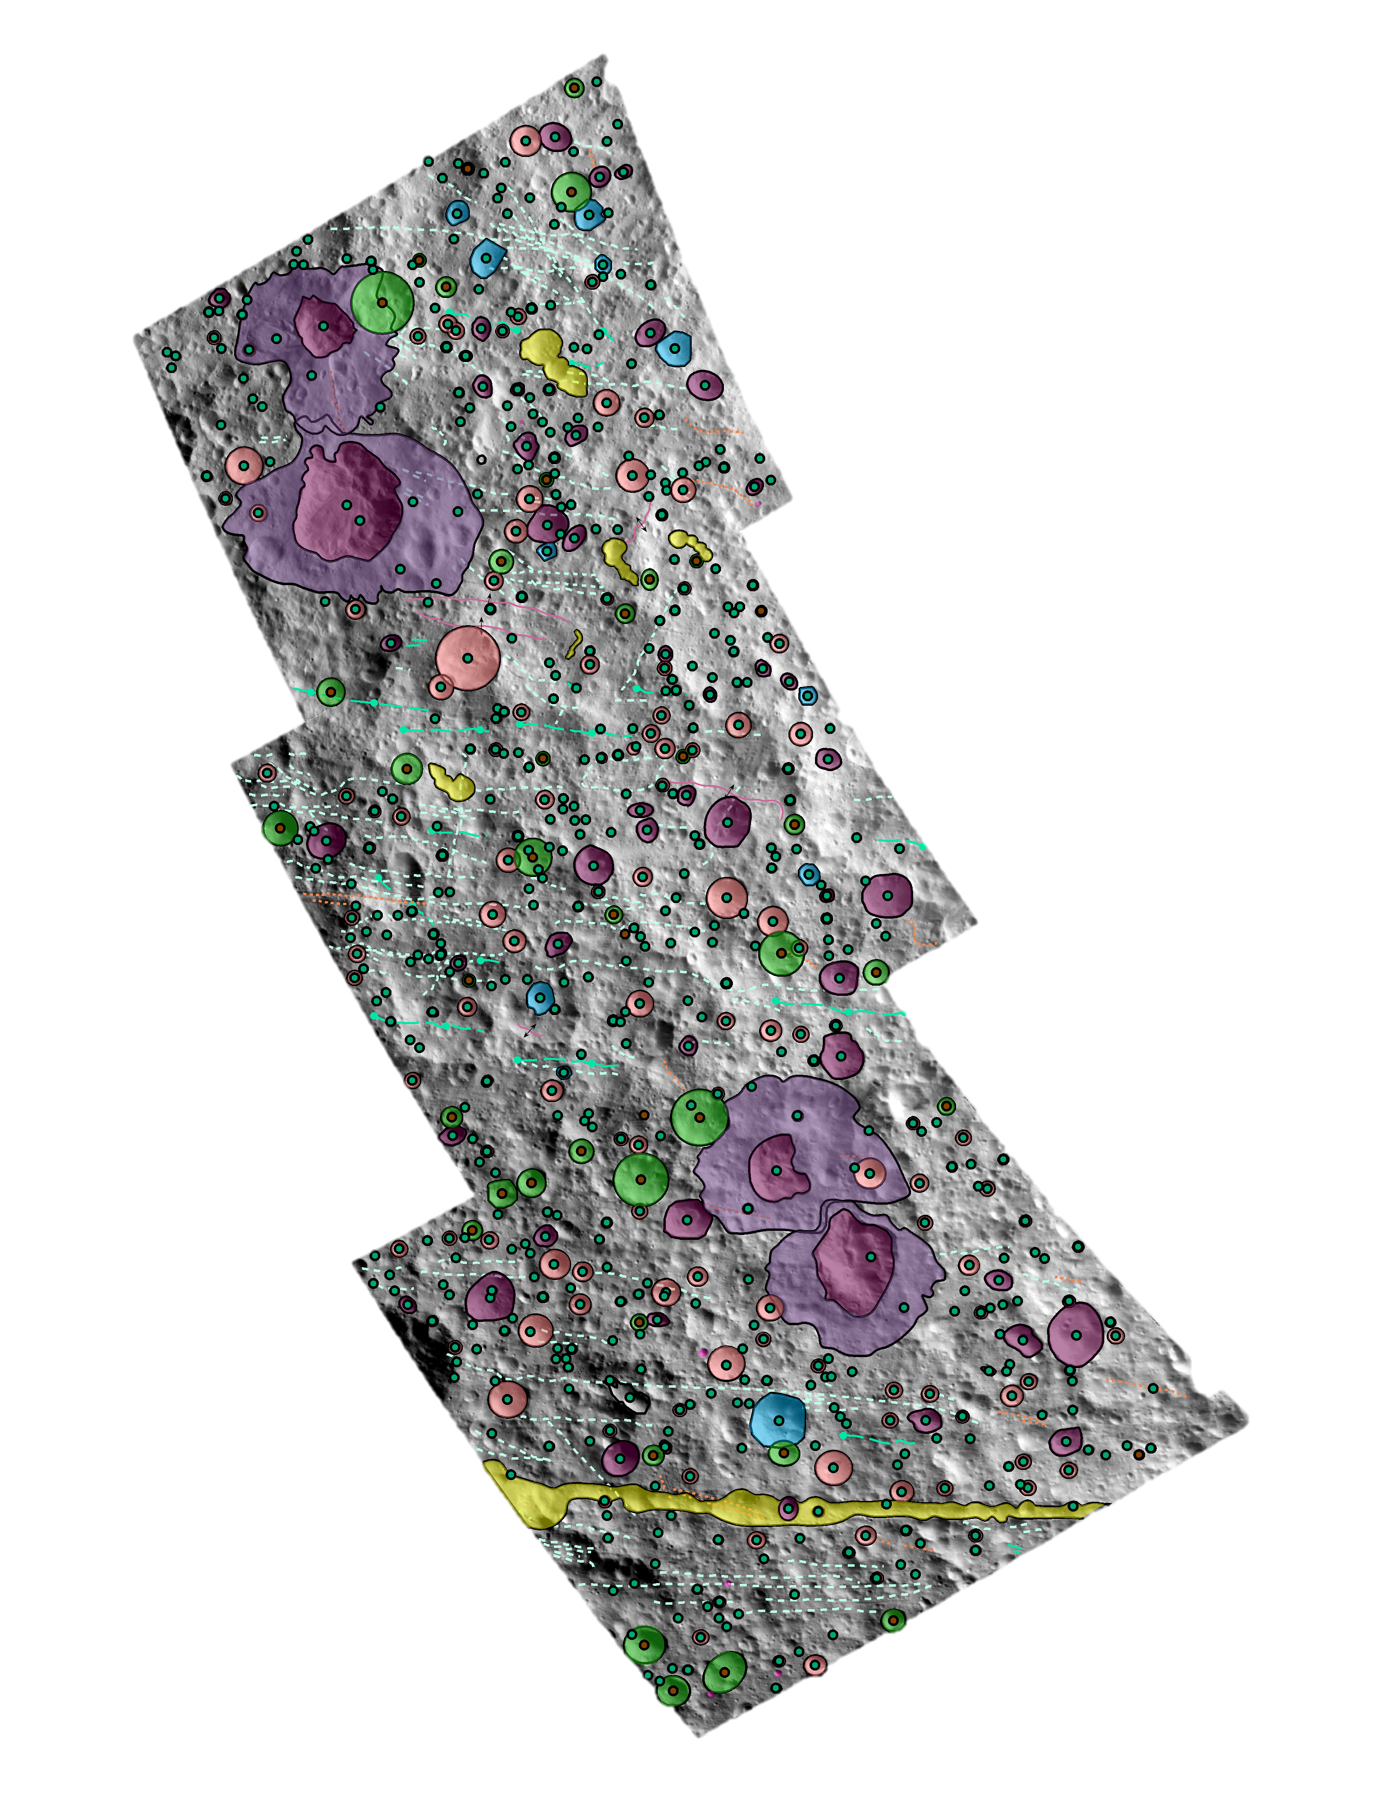
Region 1
Sun Direction
Crater type | # of craters
Elliptical | 57
Polygonal | 8
Connected | 5
All others | 521
Total | 591
Notes:
Take home point for this map: (There’s a lot going on in this region) Introduce mapping criterion: Also note the sun directioElliptical craters that have one axis longer than another and look elliptical. Polygonal craters have at least two straight rim segments that are connected. Did not break down between simple and complex, for our purposes circular was enough. Connected craters are crater chains where one portion of the rim is shared with another crater, similar to the shape of a snowman. Highest amount of mapped craters located in this region. Long connected maybe not maybe tectonic feature in the bottom left of the bottom image. Introduce the uncertain craters in that they were mapped as such because either there were shadows that covered ~50% of the crater or their rims might not have appeared as sharp to me. Where the rim wasn’t sharp it may be the case that these are just older craters that have degraded more. I did also map out lineations on the surface but don’t have time to go into detail here.

Slide 11
Regions mapped
Notes:
Change colors of regions, or add outlines

Slide 12
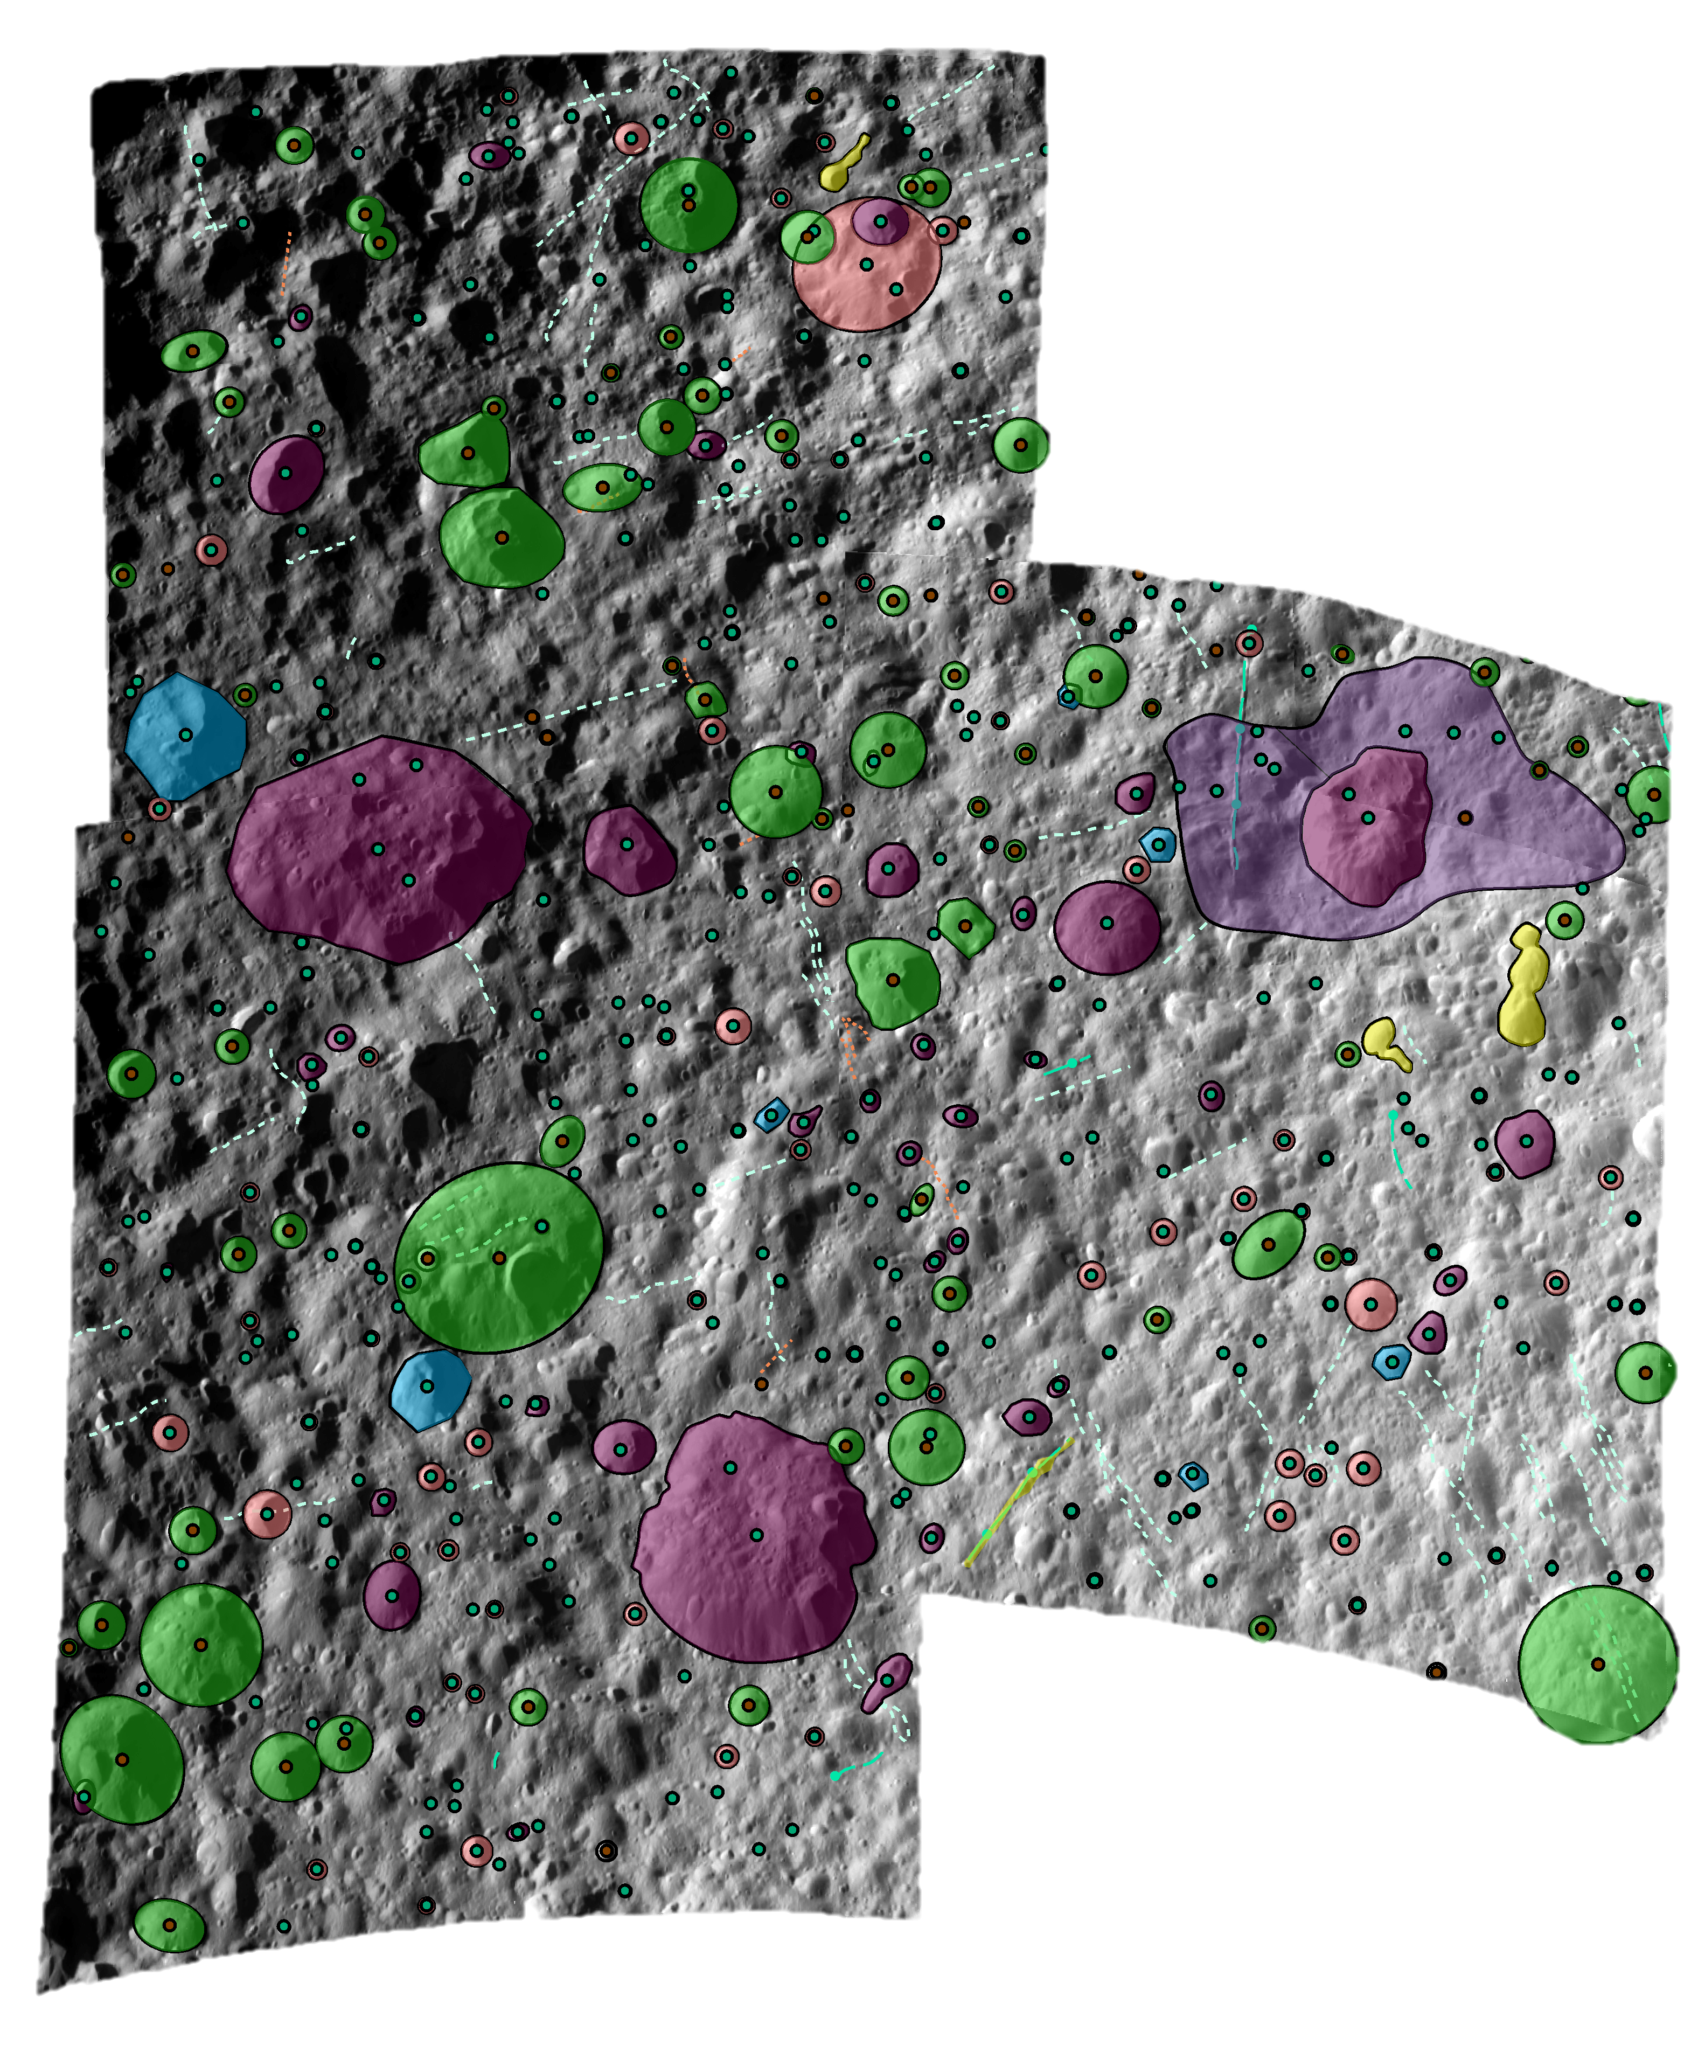
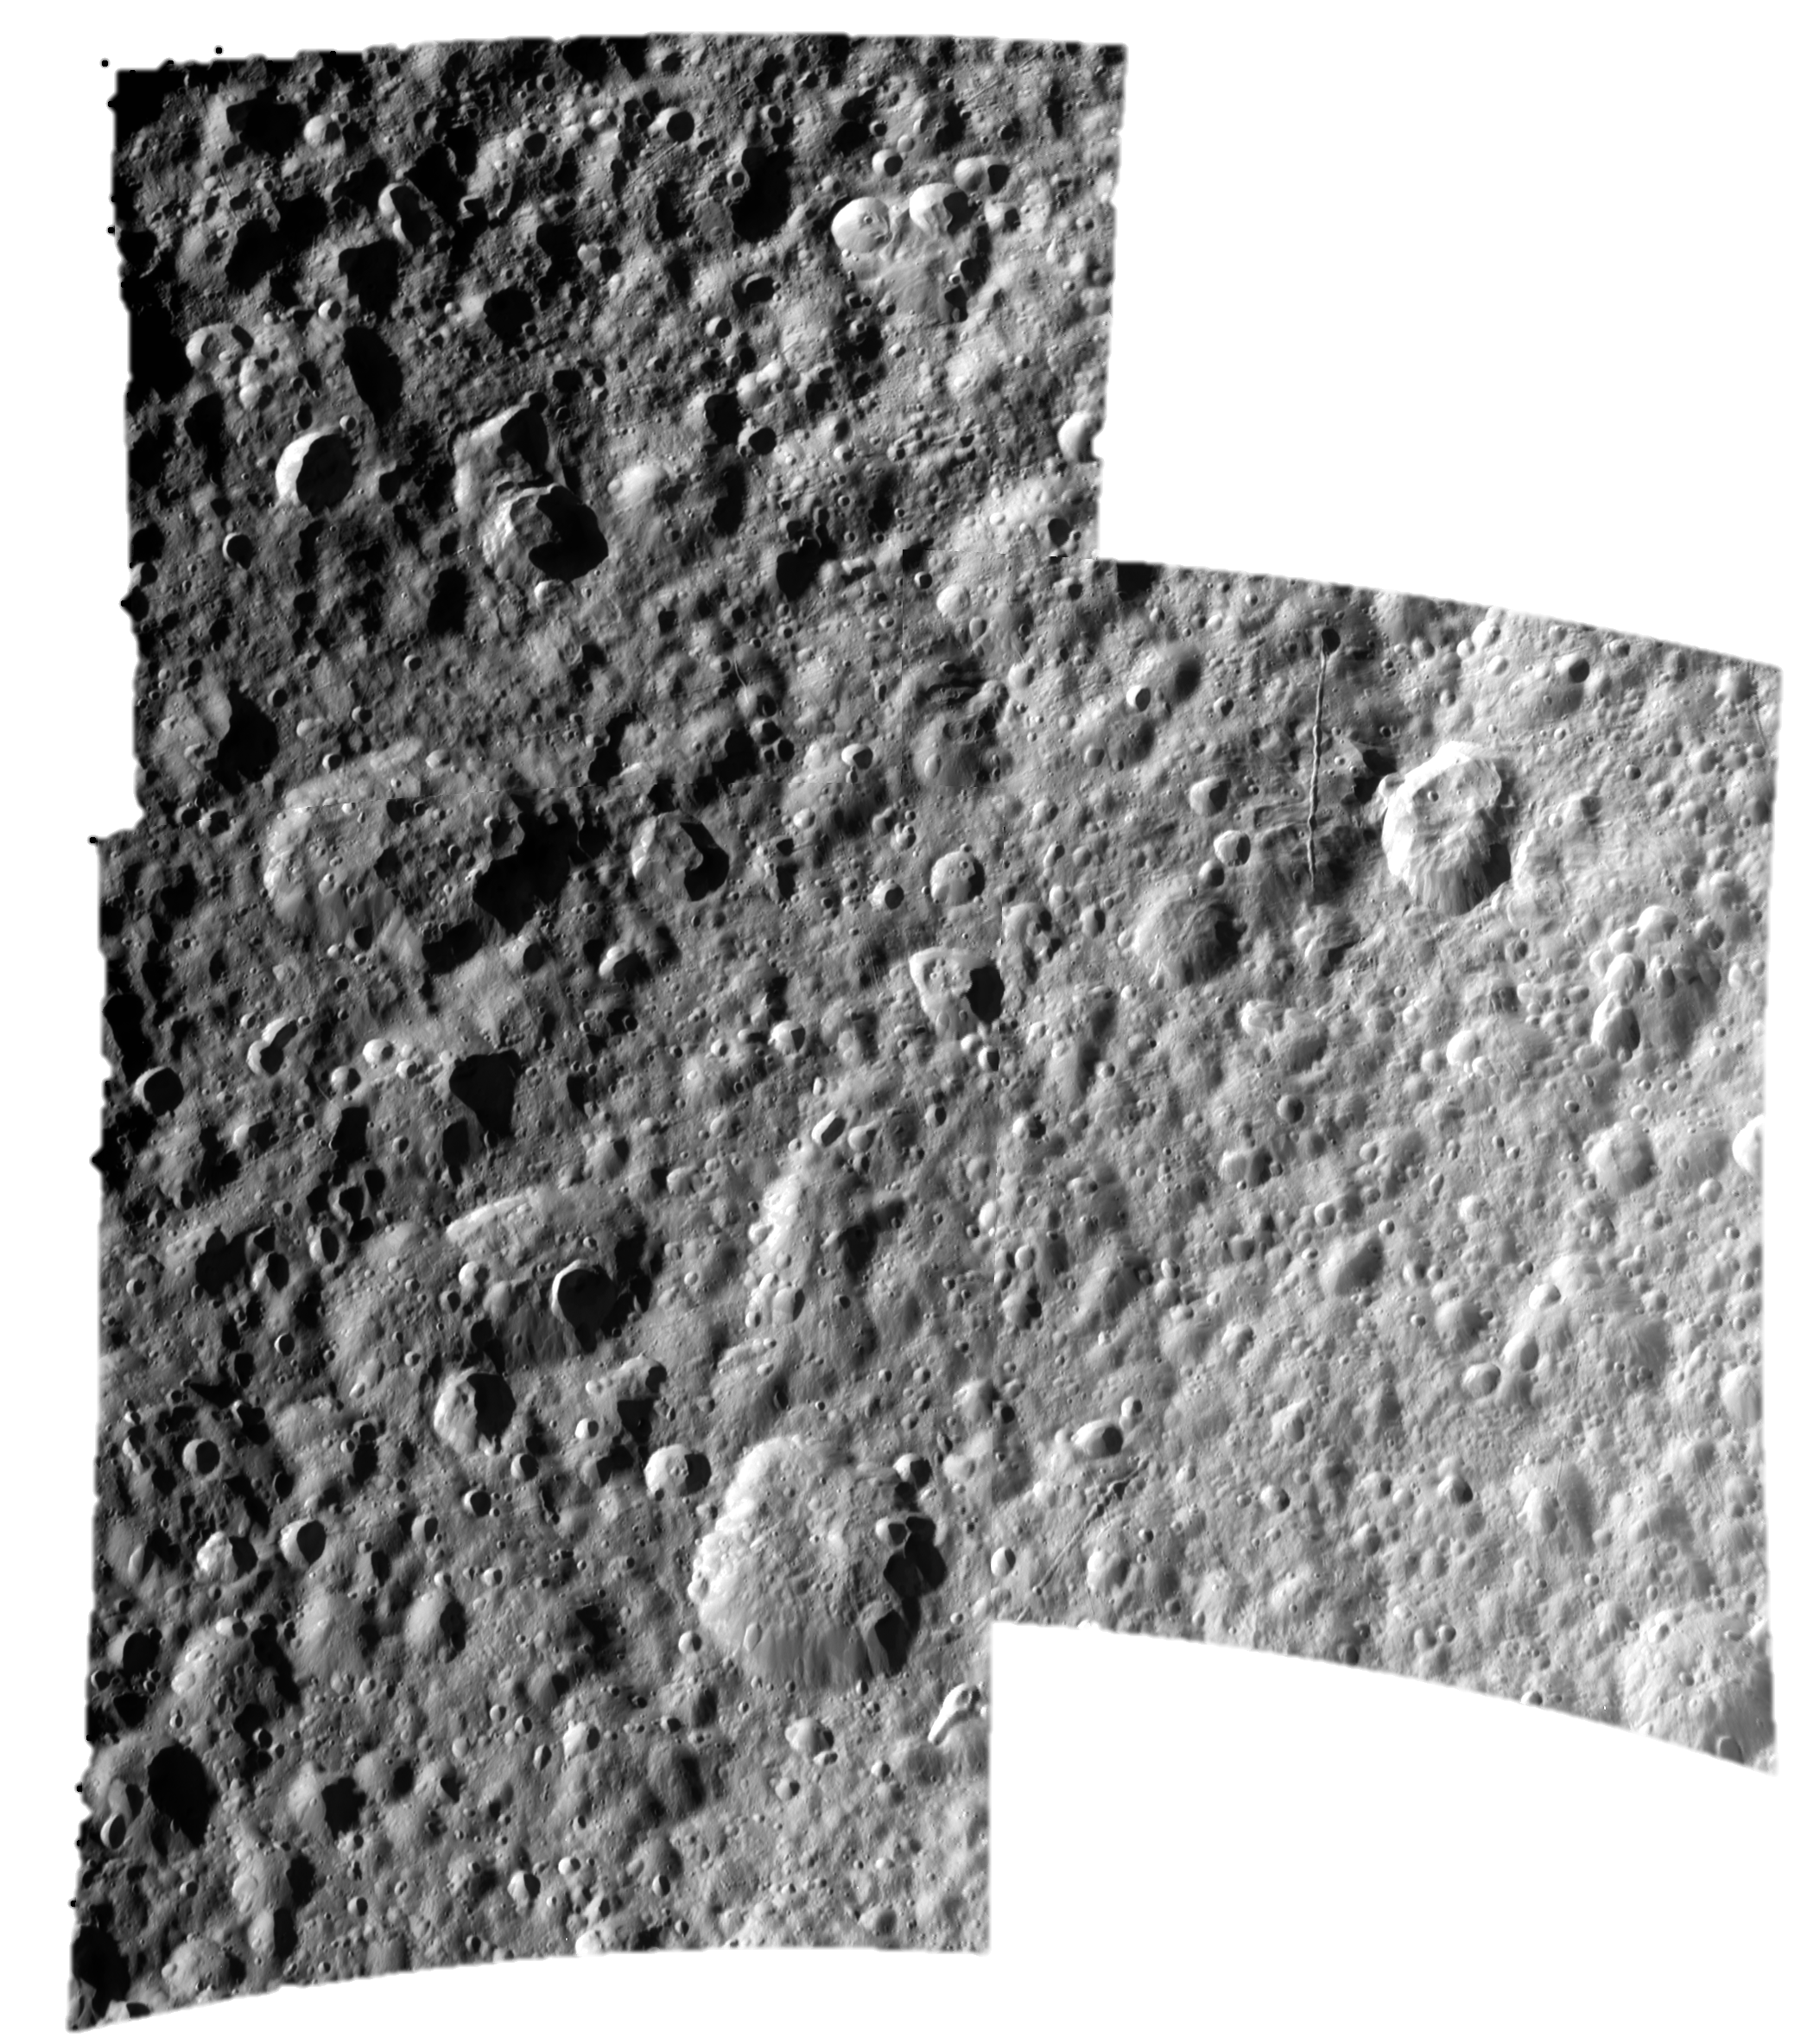
Region 2
Crater Type | # of craters
Elliptical | 50
Polygonal | 5
Connected | 2
All others | 281
Total | 338
Sun Direction
Notes:
Takeaway at the bottom of the slide: This region I had the most difficulty with mapping craters in due to the extensive shadowing on the left portion of the image

Slide 13
Regions mapped
Notes:
Change colors of regions, or add outlines

Slide 14
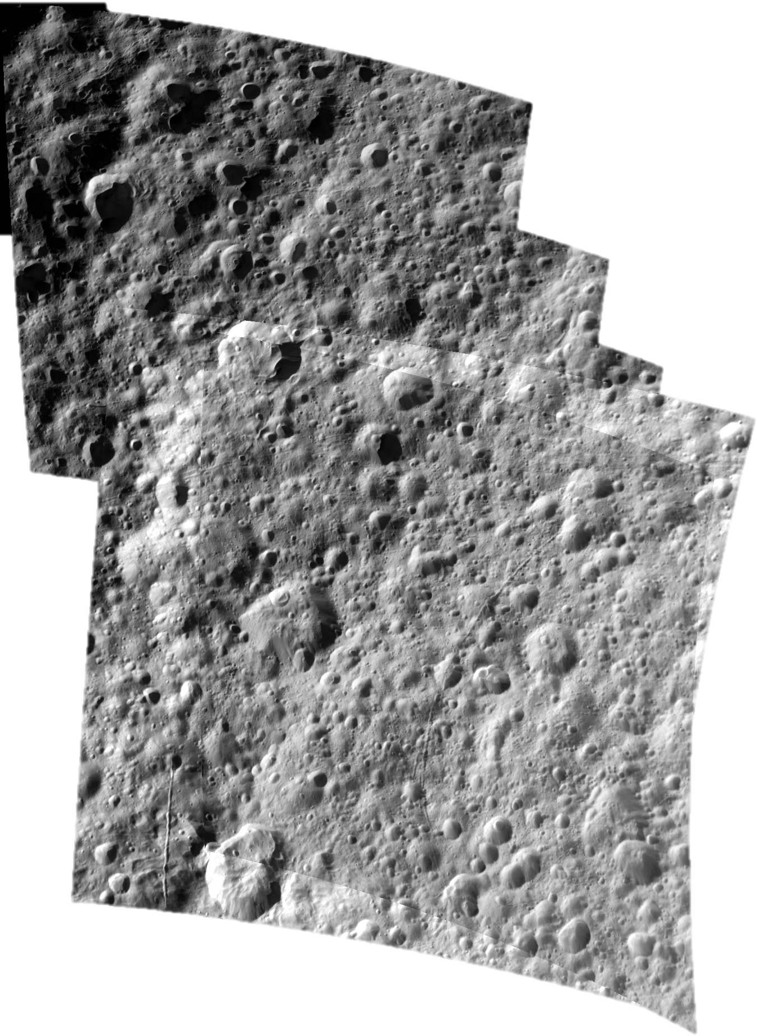
Region 3
Crater type | # of craters
Elliptical | 76
Polygonal | 10
Connected | -
All others | 196
Total | 282
Sun Direction
Notes:
Take home point: Region 3 has the most polygonal craters which is interesting given it’s proximity to Ithaca Chasma and when combined with its neighboring region of region 2 Could be an indication that the polygonal craters formed after Ithaca Chasma did since the formation of the chasma may have fractured the subsurface.

Slide 15
Regions mapped
Notes:
Change colors of regions, or add outlines

Slide 16
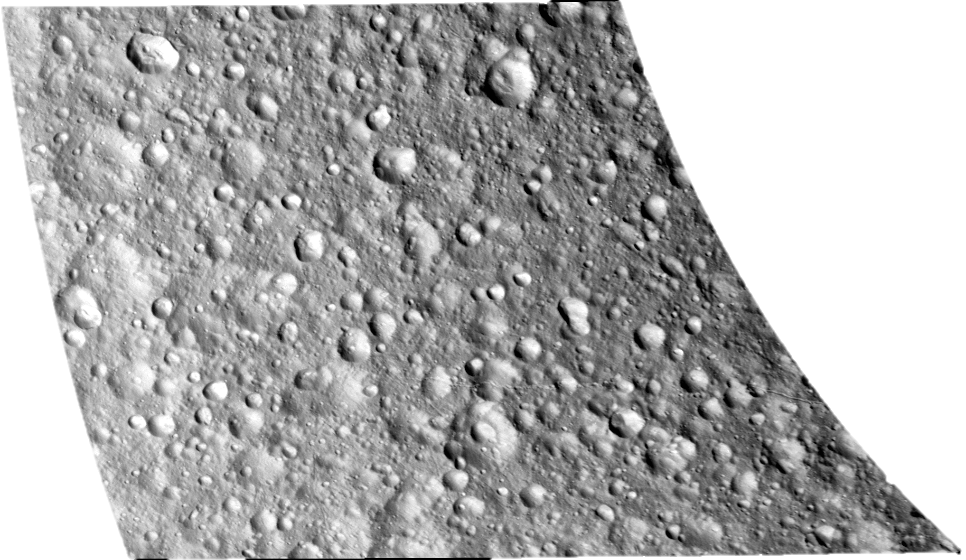
Region 4
Crater type | # of craters
Elliptical | 12
Polygonal | 2
Connected | -
All others | 177
Total | 191
Sun Direction
Notes:
Take home point: Not as much going on at this location when compared to the other three. Fewest amount of craters, even with the uncertain ones.

Slide 17
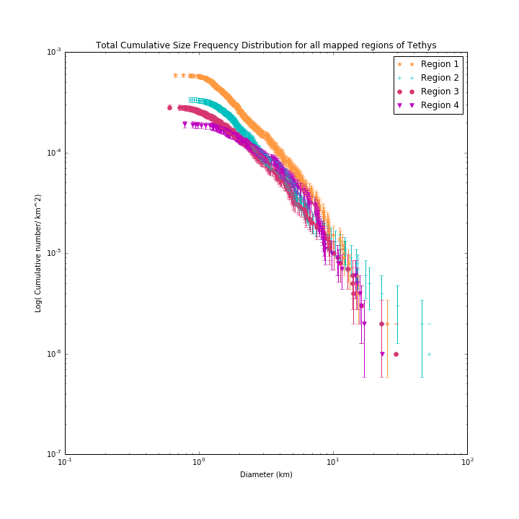
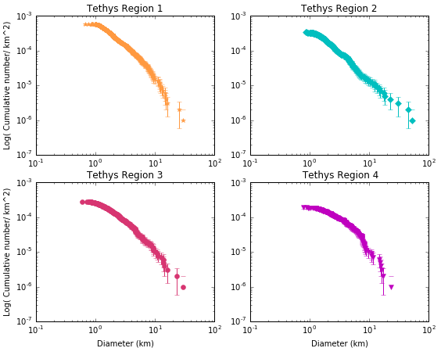
Crater Size-Frequency Distribution
Notes:
Y axis is the cumulative number of craters/area. Regions 1 and 3 similar shapes 4 is kind of similar, but has an extra sort of bump, region 2 appears to have an additional bump instead of one smooth curve.

Slide 18
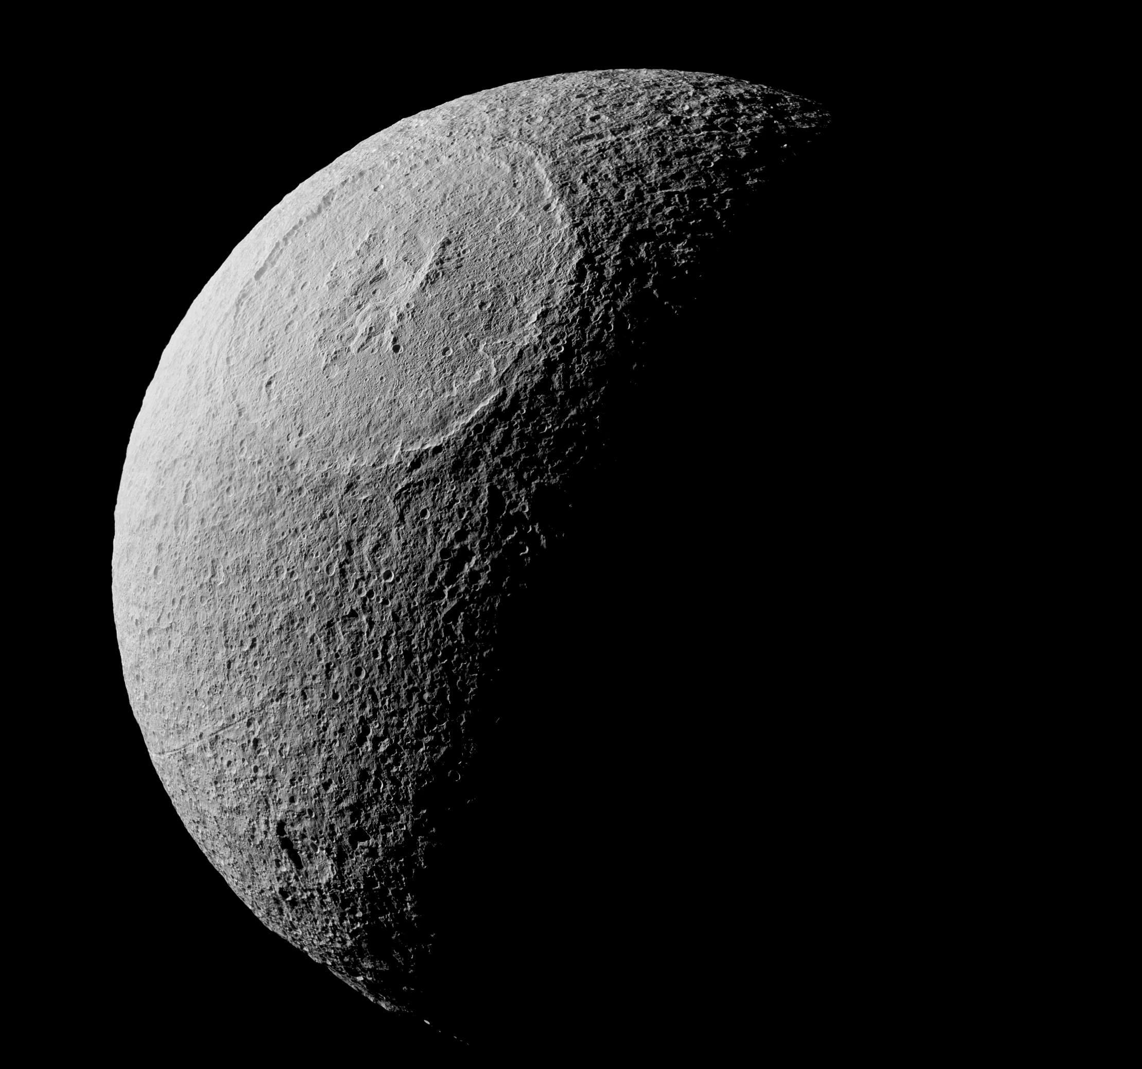
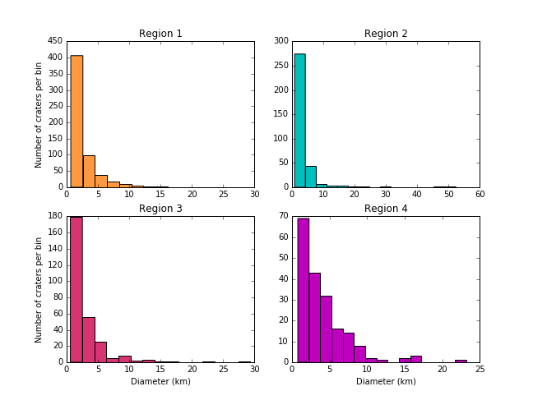
What about secondary craters?
5% Of Odysseus’ diameter
5% Of Odysseus’ diameter
5% Of Odysseus’ diameter
5% Of Odysseus’ diameter
5% Of Odysseus’ diameter
5% Of Odysseus’ diameter
5% Of Odysseus’ diameter
5% Of Odysseus’ diameter
Notes:
They could reasonably be infiltrating our counts, and on a low gravity world like Tethys it is hard to fully exclude them from any count area. So we wanted to look at the Odysseus basin. Started with the basin since the secondary crater scaling follows as 5% the original crater diameter, which for Odysseus places it at 22 km. Which is also about 99% of our mapped dataset.

Slide 19
What is the effect of secondary craters on our Distributions?
Modeled data courtesy of Beau Bierhaus
2000 fragments from the Odysseus impact were modeled to observe where they impact the surface
See LPSC 2018 Abstract 2766 for more detail on this project
Notes:
Size ranges you ask? Well that is something we’re working on since the scaling law appeared to break a bit when it was applied to basin forming impacts. We’re trying to address this now. 2000 fragments from the Odysseus impact were modeled to observe where they impact the surface. Lpsc abstract number. Conclusion on slide
Only 0.55% of the modeled fragments are predicted to impact at region 1. A
Regions 2 and 3 are predicted to experience the most secondary craters (1.9% of predicted fragments)
Region 4 shows the effect of an exclusionary zone antipodal to Odysseus. Move after the CSFD. Add data courtesy of Beau Bierhaus. Show 3D images as well.

Slide 20
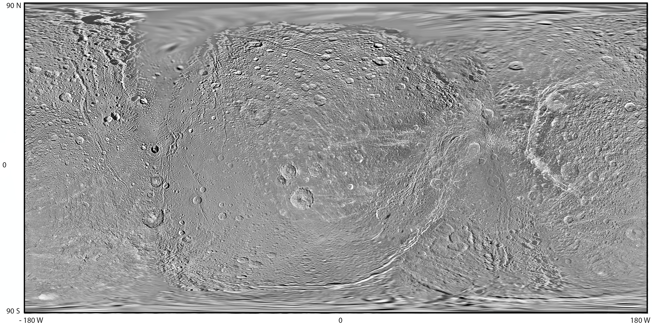
Dione Mapping
Mapping process is currently ongoing, have an initial selection of four mosaics to map on
Average image resolution is 200 m/pixel
Leading Hemisphere
Trailing Hemisphere
Notes:
The yellow location is where I am currently mapping and the areas in orange are ones that have been mosaicked and will be mapping in the future.

Slide 21
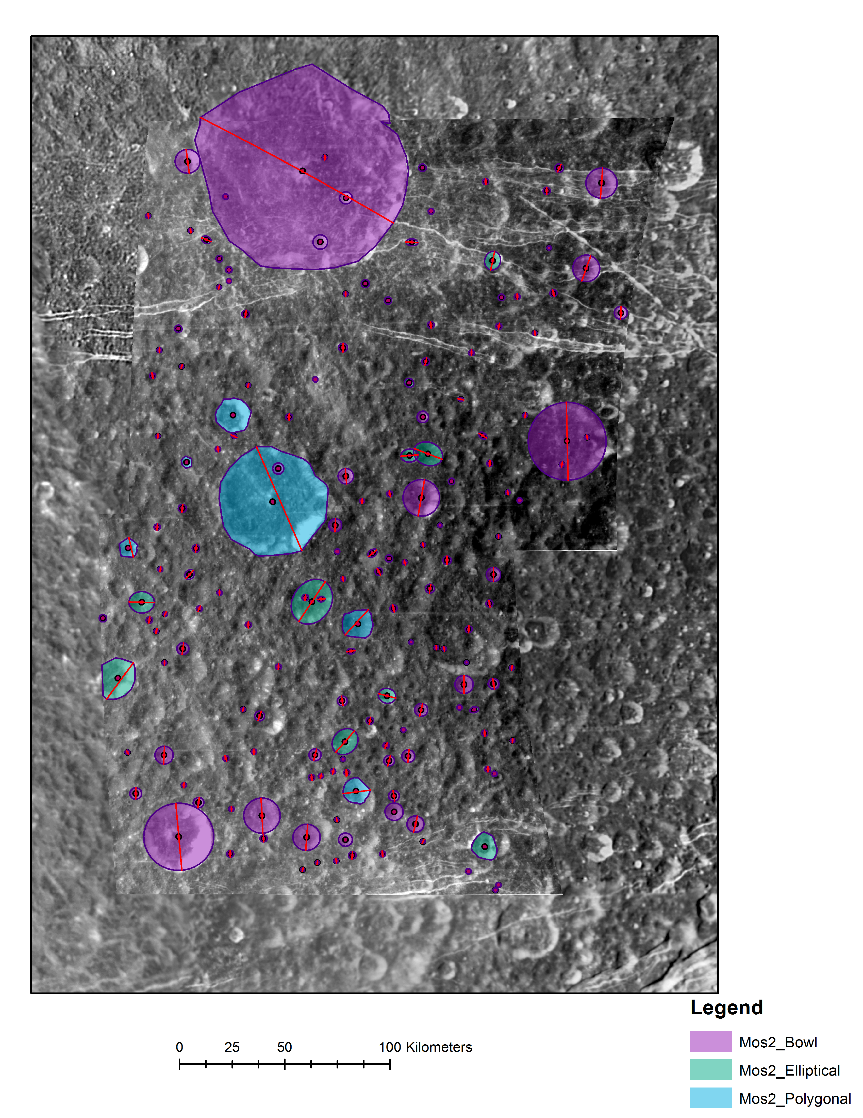
Initial Dione Map
Feature Name | # of Craters
Circular Craters | 140
Elliptical Craters | 20
Polygonal Craters | 6
Total | 166
Sun Direction
Circle
Sun Direction
Notes:
Planning on adding in the tectonics to this map for completeness of the area and to aid in the geological interpretation

Slide 22
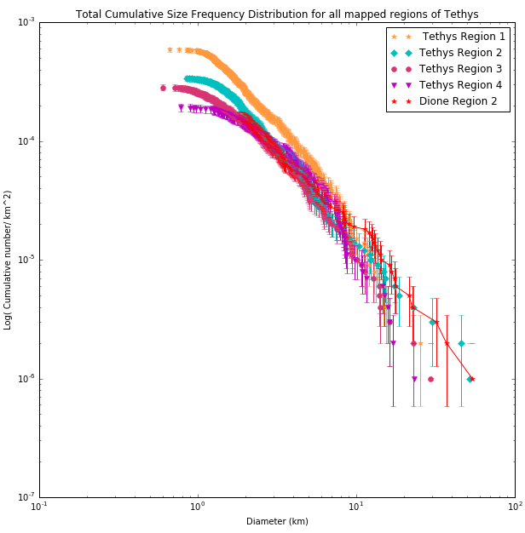
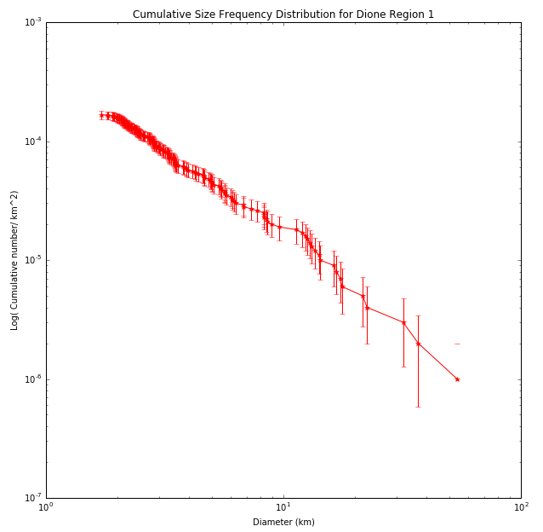
Tethys vs Dione CSFD
Notes:
Dione currently has more squiggles compared to the others at the CSFD. 71% of mapped craters in Tethys region 1 are within 1-3 km diameters. 47% of craters in the Dione region are between 2-3 km. Resolution was more prohibitive of obtaining craters less than 1.7km

Slide 23
Objectives of this project (revisited)
We map small scale features in four distinct regions of Tethys to determine:
The differences in crater populations based on location on Tethys/Dione
Whether there is evidence of low velocity, oblique impacts
Whether crater sizes and morphologies differ between regions
The distribution of elongated craters that may have formed from impacts onto Tethys
The role of planetocentric debris in the bombardment history of Tethys and Dione
There are differences on Tethys!
We see evidence for slow & oblique impacts
There are some regional differences on Tethys, too early to say for Dione
No discernable difference in elliptical crater orientation over the surface for Tethys maps
Work is still underway to determine the signature of planetocentric debris on Tethys’ crater record
Notes:
Re-visiting the objectives, what have we found?
1. There are differences! Region 1 shows the highest number of impact craters over the mapped regions and the excess of small craters is most likely not due to secondary craters from the Odysseus event. We see a sort of ”exclusion zone” near the antipode (shown by the R4 part on the CSFD).

Slide 24
Preliminary interpretations
Differences in the crater populations are seen in region 1 (Tethys) compared to the other three regions.
Appear to not be caused by secondary craters, which may indicate a period of bombardment post-Odysseus’ formation
Elliptical craters are observed, but have no discernable pattern in their orientations
Some regional differences in frequency
Highest number of polygonal craters are seen in the region closest to Ithaca Chasma
Formation of Ithaca Chasma might have fractured more of the subsurface
First mapped region of Dione appears to have more older craters in the mapped area
Due to a possible softening in the topography around the rims of the craters
Notes:
185 lineations in region 1, 86 in region 2, 87 in region 3, 48 in region 4. Merge slide 25 and 26

Slide 25
Backup Slides

Slide 26
Secondary project results
From the current view of 2000 fragments, they do not appear to be influencing our counts of region 1
Region 1 still may be older or subjected to a different impact population
Caveat being that this just looked at Odysseus and this impact alone likely produced tens of thousands of small fragments
Model showed an exclusionary zone near Odysseus’s antipode
Fragments could still land here if perturbed by 3rd body effects so we don’t realistically expect to see no fragments impact in this zone
A size comparison of modeled secondaries with our mapped dataset in overlapping areas will happen
Once we can fix the scaling laws for the basin

Slide 27
3D view of the secondary fields
Globe centered on Odysseus
Globe centered on Odysseus antipode
Notes:
Further showing the discrepancy in the antipode and non antipode of the basin. the “exclusion zone” of secondaries near the antipode of Tethys is partly real and partly not rea lpartly real: fragments that would otherwise land in this region get perturbed by 3rd body effects from Saturn, so do not deterministically land here partly not real: some fragments will land here, plus some of the fragments that initially escape Tethys but then re-impact could strike this region as well so this region should have a lower-spatial-density of secondaries, but the spatial density won’t be zero

Slide 28
Image Processing Flowchart
Notes:
Flash earlier in slides, show as part of a step I took. Not an easy process. Move to backup. Explain what a control net is. Grid of points that are overlaid on both image and then a point is clicked on. One image is held as the reference point and the second image is adjusted so that the points match, which ties the images together.

Slide 29
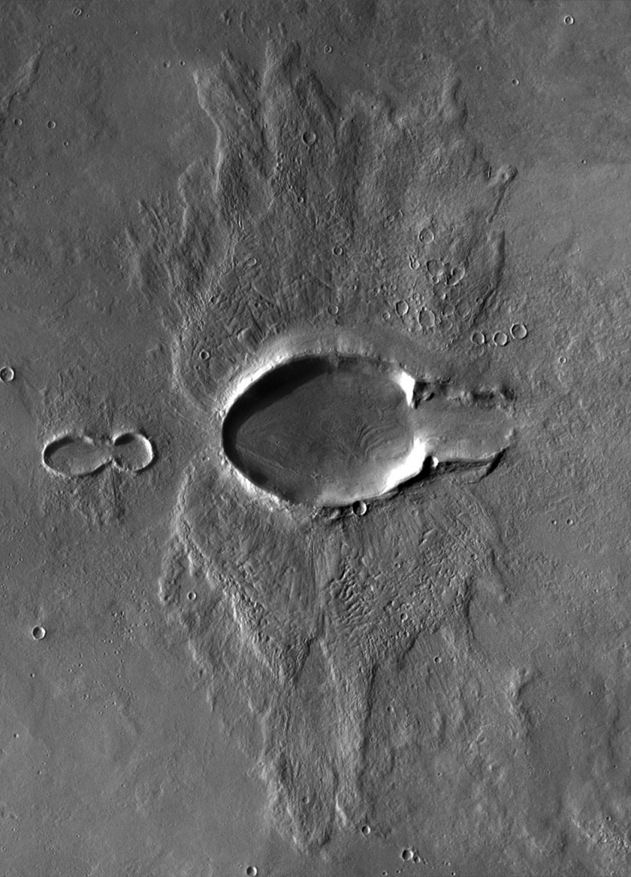
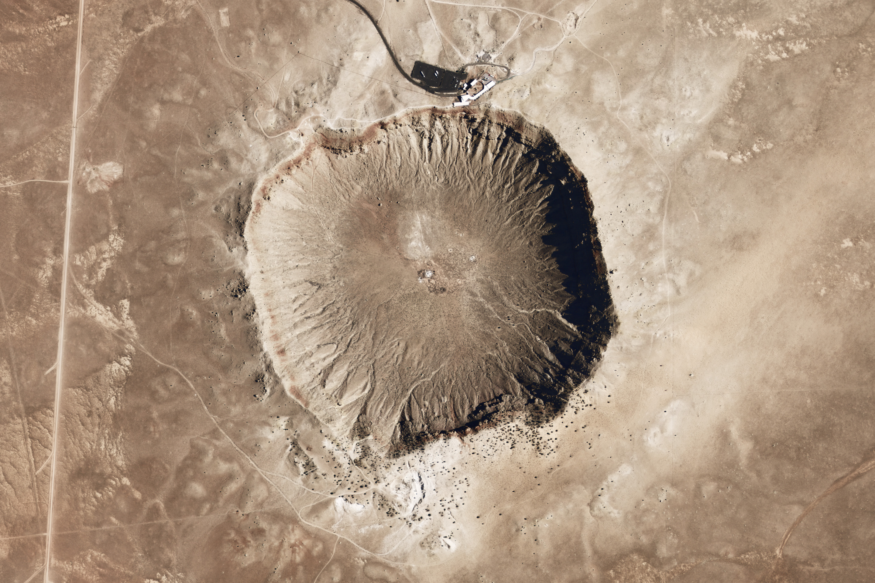
Importance of elliptical and polygonal craters
Aerial view of Meteor Crater, located outside of Winslow AZ. Image credit: NASA Earth Observatory
Elliptical craters → impact angles <~15 °
Polygonal craters → subsurface fractures
Example of an elliptical crater on Mars. Mosaic credit: Emily Lakdawalla, the Planetary Society
Notes:
Oblique=more planetocentric likely

Slide 30
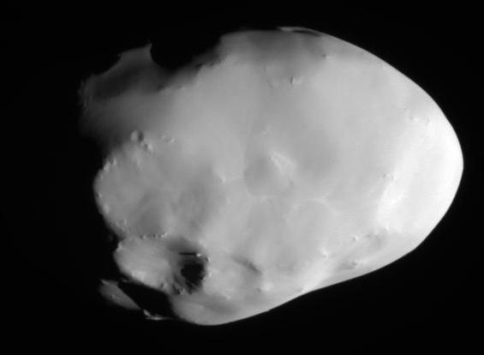
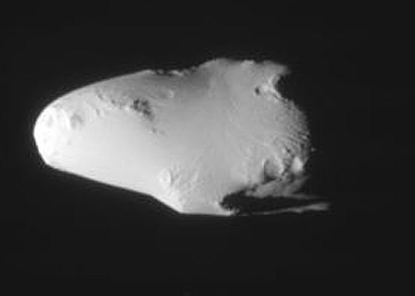
Why Tethys?
One of the moons that is expected to experience planetocentric impactors vs heliocentric impactors
Co-orbital Moons at L4 and L5, Could be contributing sources of small craters
Because of so many potential sources, Tethys is a good test moon
15 km
Telesto
Calypso
15 km
Telesto and Calypso, image credit NASA/JPL/SSI
Notes:
There are so many potential sources for these impact craters on Tethys, that it is an ideal Moon to examineSource of impactors important for more age determinations at a later date.

Slide 31
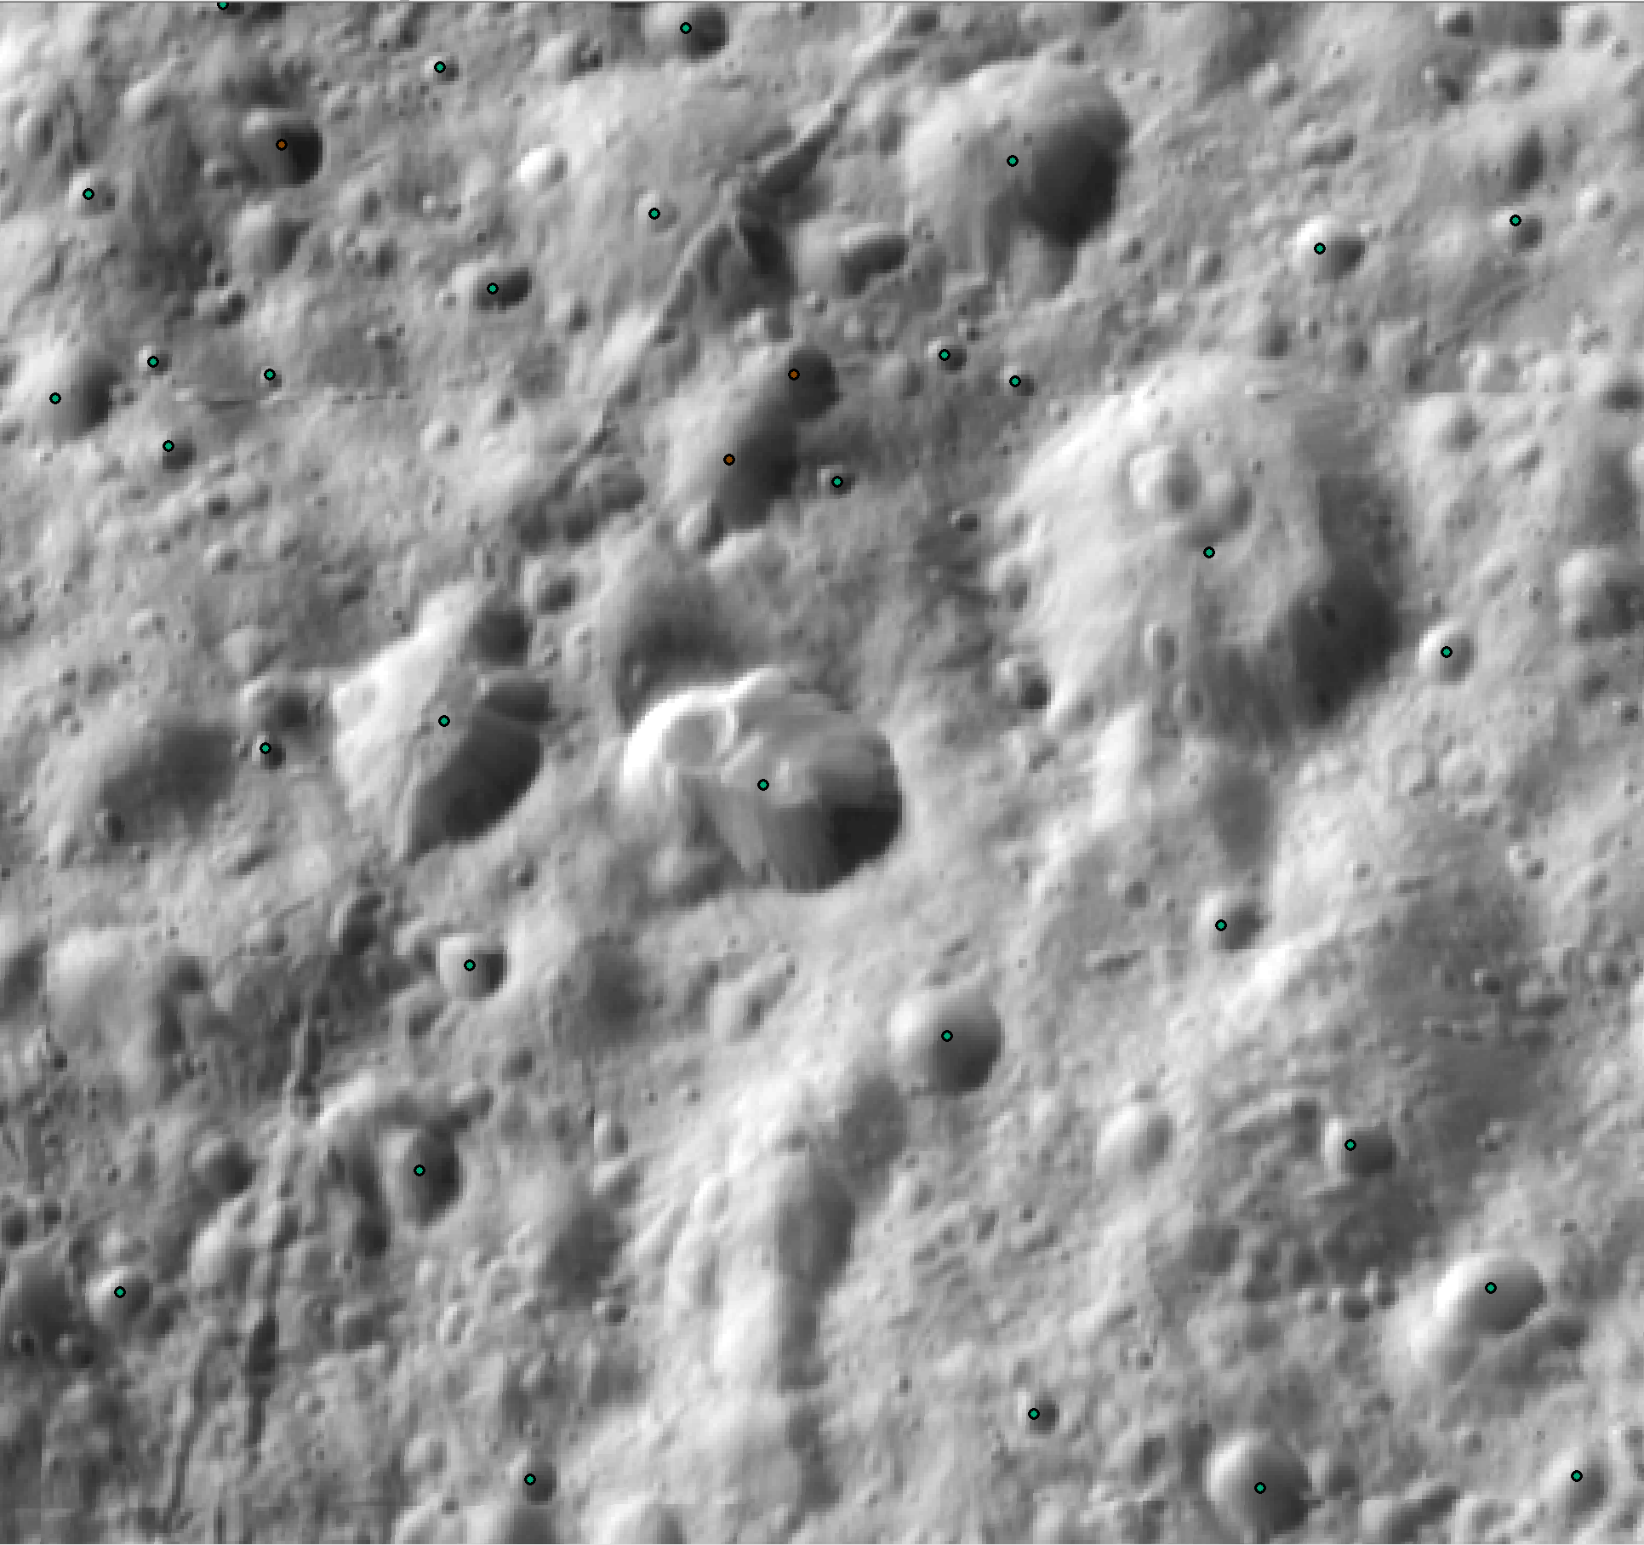
Crater Examples

Slide 32
Crater Examples

Slide 33
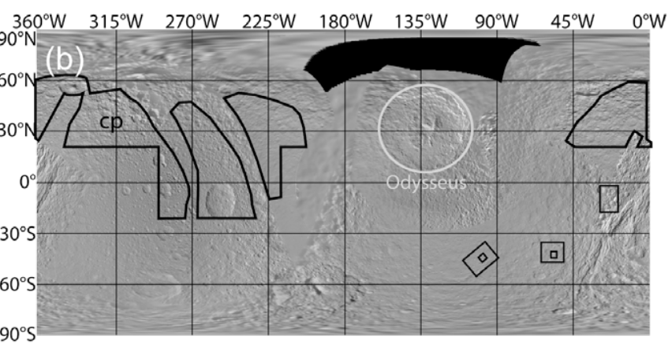
Previous Studies on Tethys (and other midsized sats)
Kirchoff and Schenk 2010 counted craters across the mid-sized satellites (excluding Enceladus)
For Tethys they determined the surface ages relative to the Odysseus basin
They placed cratered terrains at >= 4Gyr
Odysseus was dated between 1Gyr and 400Myr
Noted a lack of large craters between 30 km and 80 km relative to the other moons
Interpreted their counts to show that more planetocentric debris impacted the surfaces of Tethys, Dione, and Mimas
Locations mapped from Kirchoff and Schenk 2010.
Notes:
Odysseus counts were done based on the Tethys basemap. Craters were counted if ¼ of the rim was recognizable Give a sense of how much mapping they did. We mapped in regions that Kirchoff and Schenk did not. State this!

Slide 34
Craters could unearth some answers to
Investigate the small crater populations!
Small being ~ 1 km in diameter due to image resolution
Compare with secondary maps
Is there an overlap with predicted secondary craters and larger populations of small craters?
Polygonal and elliptical craters
Both craters provide unique insights into how they were created
Additionally a look at lineations
These can tell us about stresses and deformation that occurred on/slightly below the surface

Slide 35
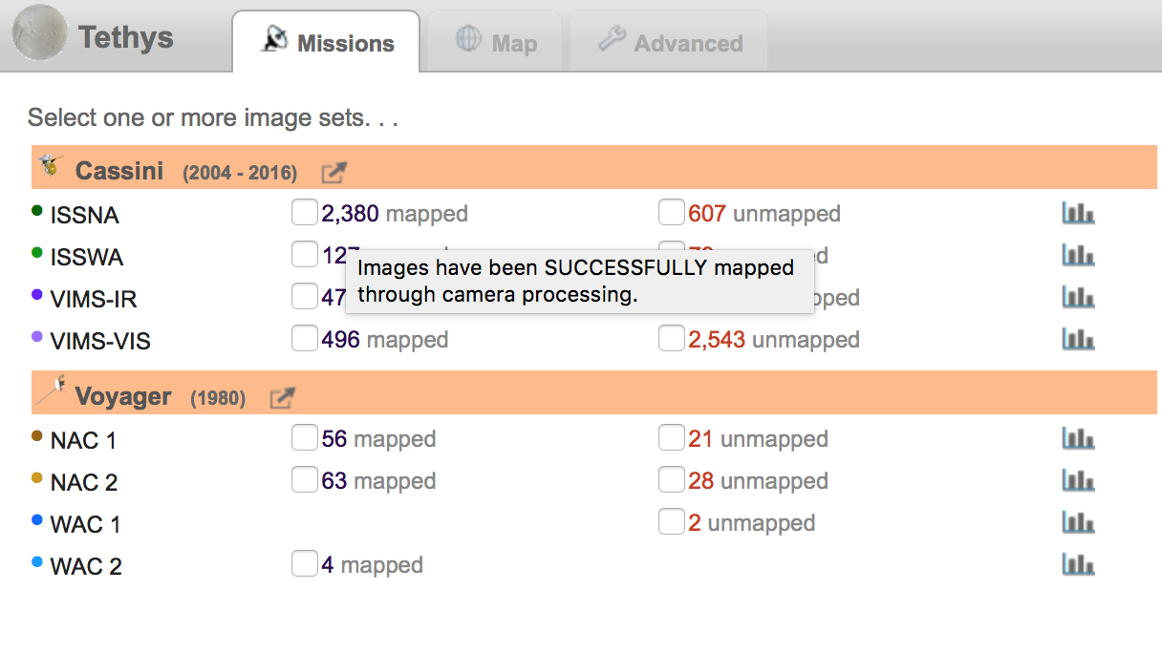
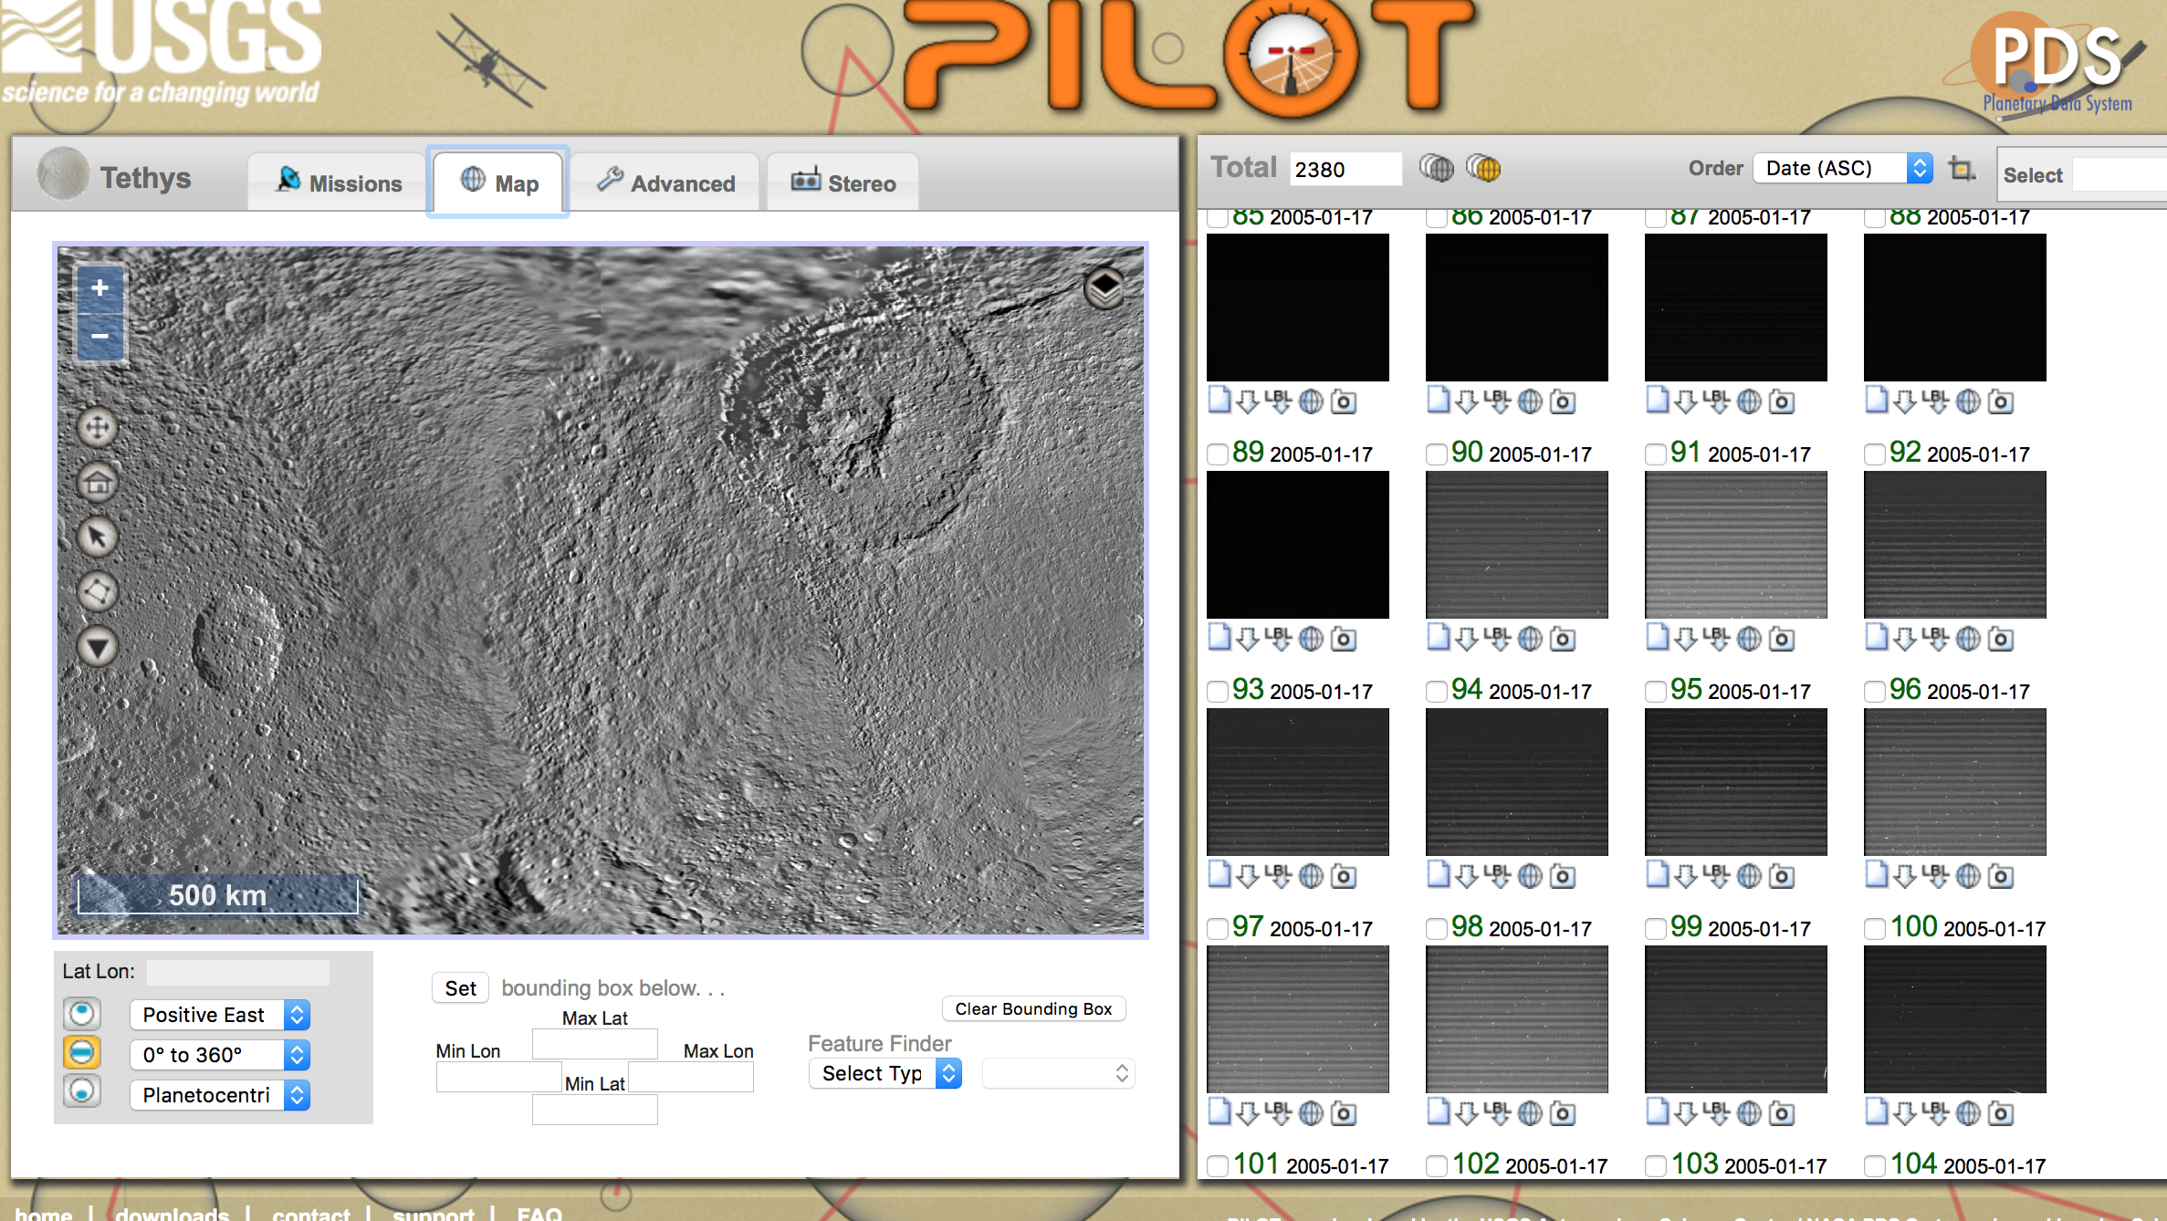
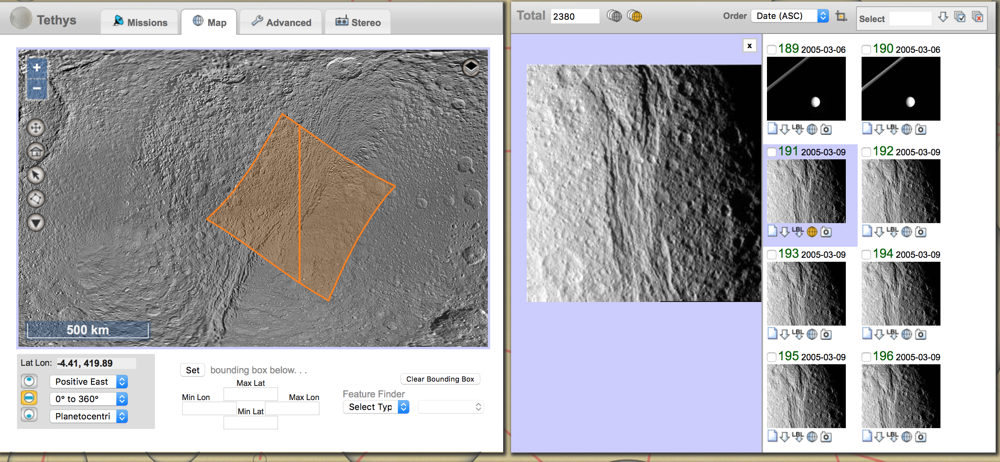
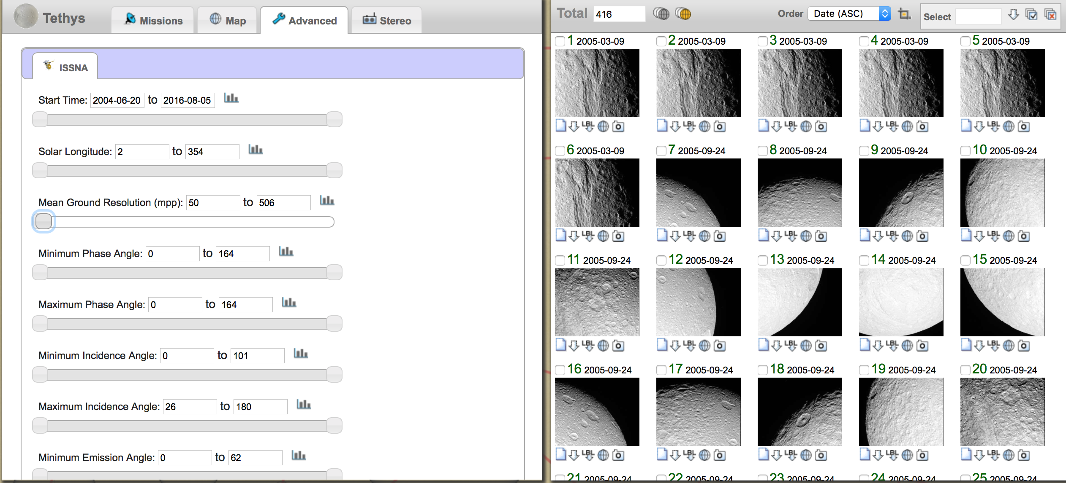
Data Acquisition
All images located using the USGS PILOT software (Planetary image locator tool)
Website: https://pilot.wr.usgs.gov

Slide 36
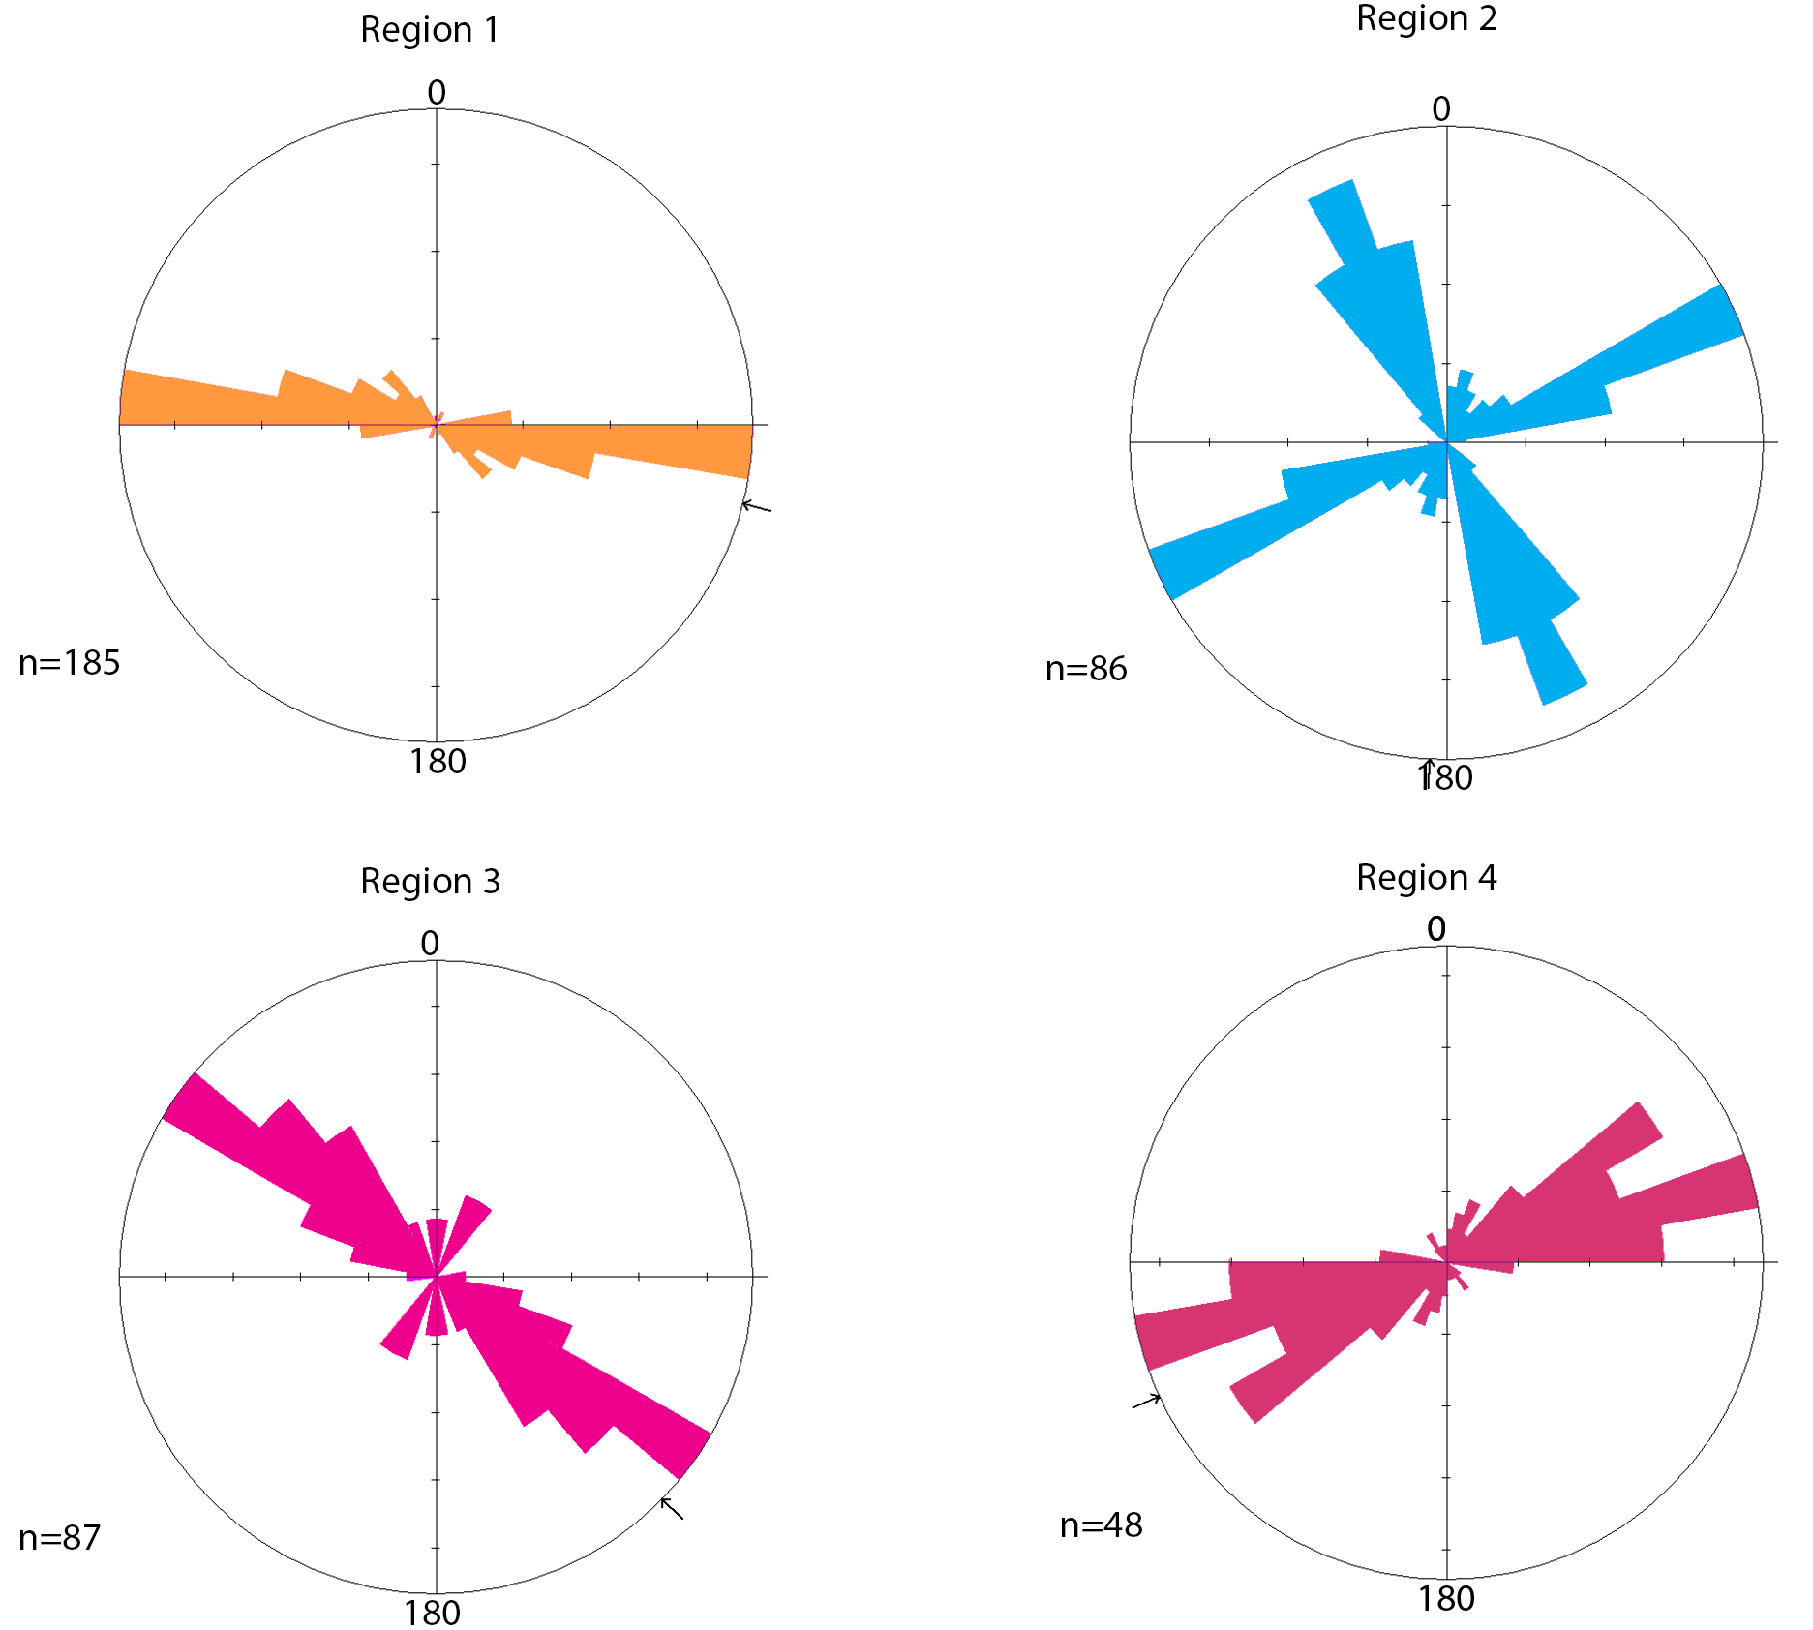
Lineation information
Ithaca Chasma
Ithaca Chasma
Notes:
Explain rose diagram better. Lengths and angles Show separated ones, we don't see a predominately isotropic stress field either. Show on Global map. Here are the histograms of the mapped lineations. Bearing is measured from 0 degrees north through 180 degrees. All histograms have equal bins. Due to the lineations having non uniform orientations, we can infer that they did not form contemperaneously. Move back into slides. Check what the edge values . 45 degres off of the lighting conditions. Kirchoff paper paper presented at COSPAR.

Slide 37
Future Work
Potential to map more regions on Tethys
1
What do the densities of small craters look like on Dione and Rhea?
2
More data points for predicted secondary crater locations
3
Could examine the secondary crater effects from other large craters on the surface
4
Notes:
Tethys and Dione also have coordbitals, Rhea does not so that can be another constraint.

Slide 38
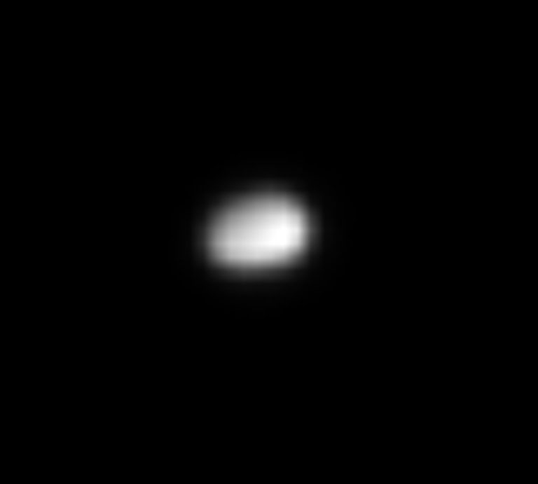
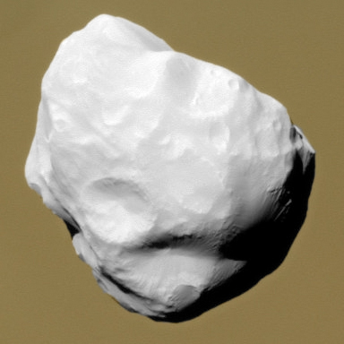
Future work
Dione is our next target for this study
More complex surface with the wispy terrain and other tectonics
Dione also has co-orbital moons (Polydeuceus and Helene)
We are working on compiling lineation maps and modeling interior structure
In addition to the tectonics, we are working on our cratering study to compare populations on Tethys and Dione
We’ll present updates for that project at the Cassini Science Symposium in August
Image credit: NASA/JPL/SSI
Notes:
P is in L5 and Helene is in L4.

Slide 39
Image information
Image | Resolution (m/pix) | Center Latitude (°) | Longitude (°)
Region 1
N1713137226_1 | 106.832 | 3.612 N | 177.752 E
N1713137436_1 | 116.185 | 6.890 S | 181.367 E
N1713137645_1 | 125.960 | 19.333 S | 186.067 E
Region 2
N1561668012_2 | 141.119 | 3.386 N | 342.299 E
N1561668355_2 | 154.882 | 14.347 N | 329.111 E
N1561668192_2 | 148.403 | 1.074 S | 327.677 E
Region 3
N1561667141_2 | 115.696 | 28.658 N | 344.346 E
N1561667296_2 | 118.816 | 23.781 N | 346.818 E
N1561667401_2 | 121.339 | 20.488 N | 348.556 E
N1561667506_2 | 124.172 | 17.113 N | 350.174 E
N1561668522_2 | 163.779 | 16.728 N | 348.829 E
Region 4
N1506219742_1 | 155.715 | 28.098 S | 41.265 E
Notes:
Make sure to be able to explain incidence and phase angle. Avg Incidence region 1: 45 degrees, region 2:avg 71 degrees, portions are higher incidence than others, region 3: AVG: 57.35 [43-68 (55.5) , 37-61 (49), 64-41 (52.5), 44-67 (55.5),48-70 (59), 52-73 (62.5), 57-78 (67.5)] region 4: 56.5

Slide 40
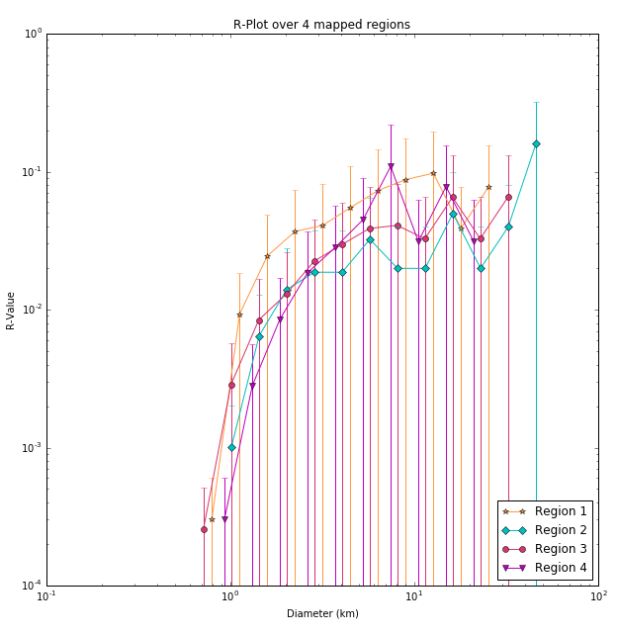
R-Plot
D_{a}= Lower diameter bin value
D_{b}= High diameter bin val (Typically √2D_{a})
N= Number of craters per bin
Notes:
Quickly conclude. Move to backup slide

Slide 41
Impact Cratering
Image credit: Lunar and Planetary Institute
Notes:
Ubiquitous process across the solar system.

Slide 42
Impact Cratering
Image credit: Lunar and Planetary Institute
Notes:
Ubiquitous process across the solar system.

Slide 43
Impact Cratering
Image credit: Lunar and Planetary Institute
Notes:
Ubiquitous process across the solar system.

Slide 44
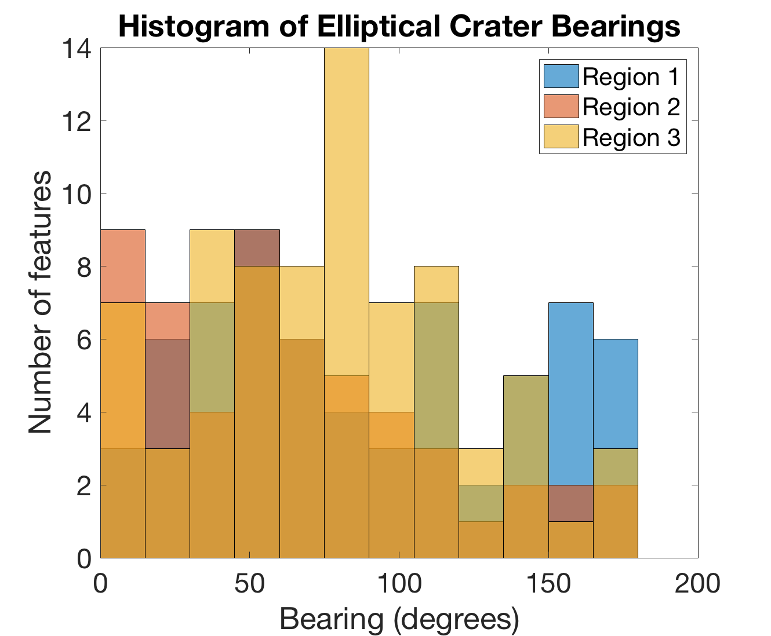
Elliptical Crater Orientations
* Region 4 still in progress of being added

Slide 45
Impact Cratering
Image credit: Lunar and Planetary Institute
Notes:
Ubiquitous process across the solar system.
Bulleted list of things that differ into ice

