Slide 1
The tide that binds: Stress and tectonics on the mid-sized icy moons of Saturn
The tide that binds: Stress and tectonics on Mimas and Enceladus (and maybe Dione)
Alyssa Rhoden, M. Neveu, T. A. Hurford, W. G. Henning, J. N. Spitale, E. M. Huff
Southwest Research Institute - Boulder

Slide 2
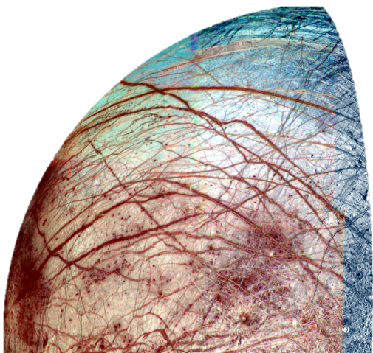
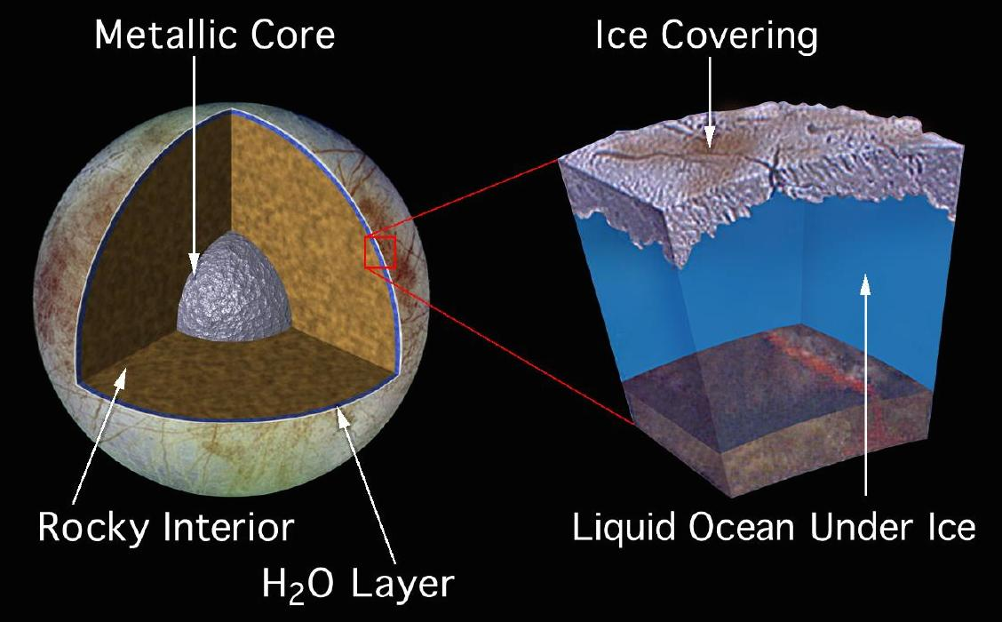
Tidal-tectonics on the original ocean moon
Eccentric orbit, e = 0.01
Global tectonic activity
Not to scale!
Subsurface liquid layer
Notes:
Europa’s eccentric orbit and subsurface ocean lead to global tidal deformation that create the rich tectonic record on its surface. Europa is pervasively fractured. The only places we don’t see fractures is where they have been wiped out by chaos formation or bands. By reproducing the fractures on Europa’s surface, we know that tidal stresses play a key role in their formation, especially cycloids, which are these arcuate features we see here. Curiously, we do not see cycloids on Enceladus.

Slide 3
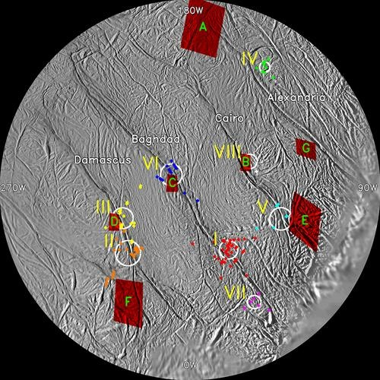
Enceladus – An active, icy world
Plumes and jets of water ice, vapor, salt-rich, and salt-poor grains
Observed plumes
(Porco et al., 2006)
Observed by Cassini for >10 yrs
E-ring implies activity for >60 yrs
Sources correlate with Tiger Stripes
Hot spots associated w/ active sources
Tides likely modulate plume activity
(e.g. Hurford et al., 2007; Nimmo et al., 2007; Hedman et al., 2013)
Source locations
(Spitale + Porco, 2007)

Slide 4
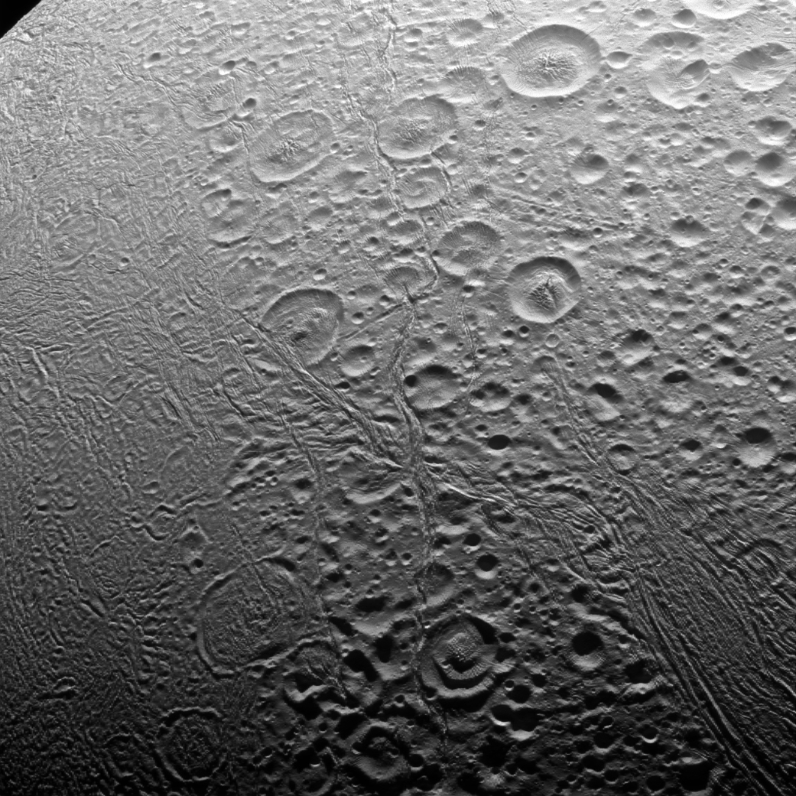
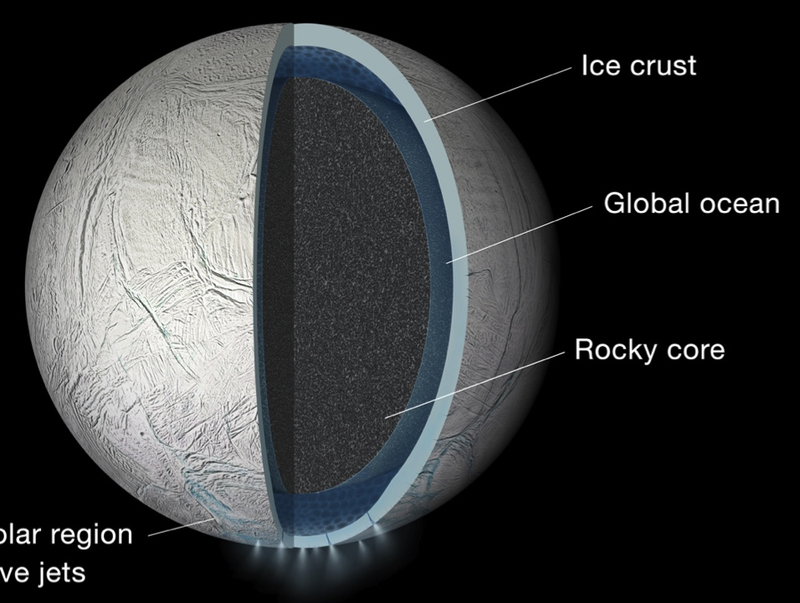
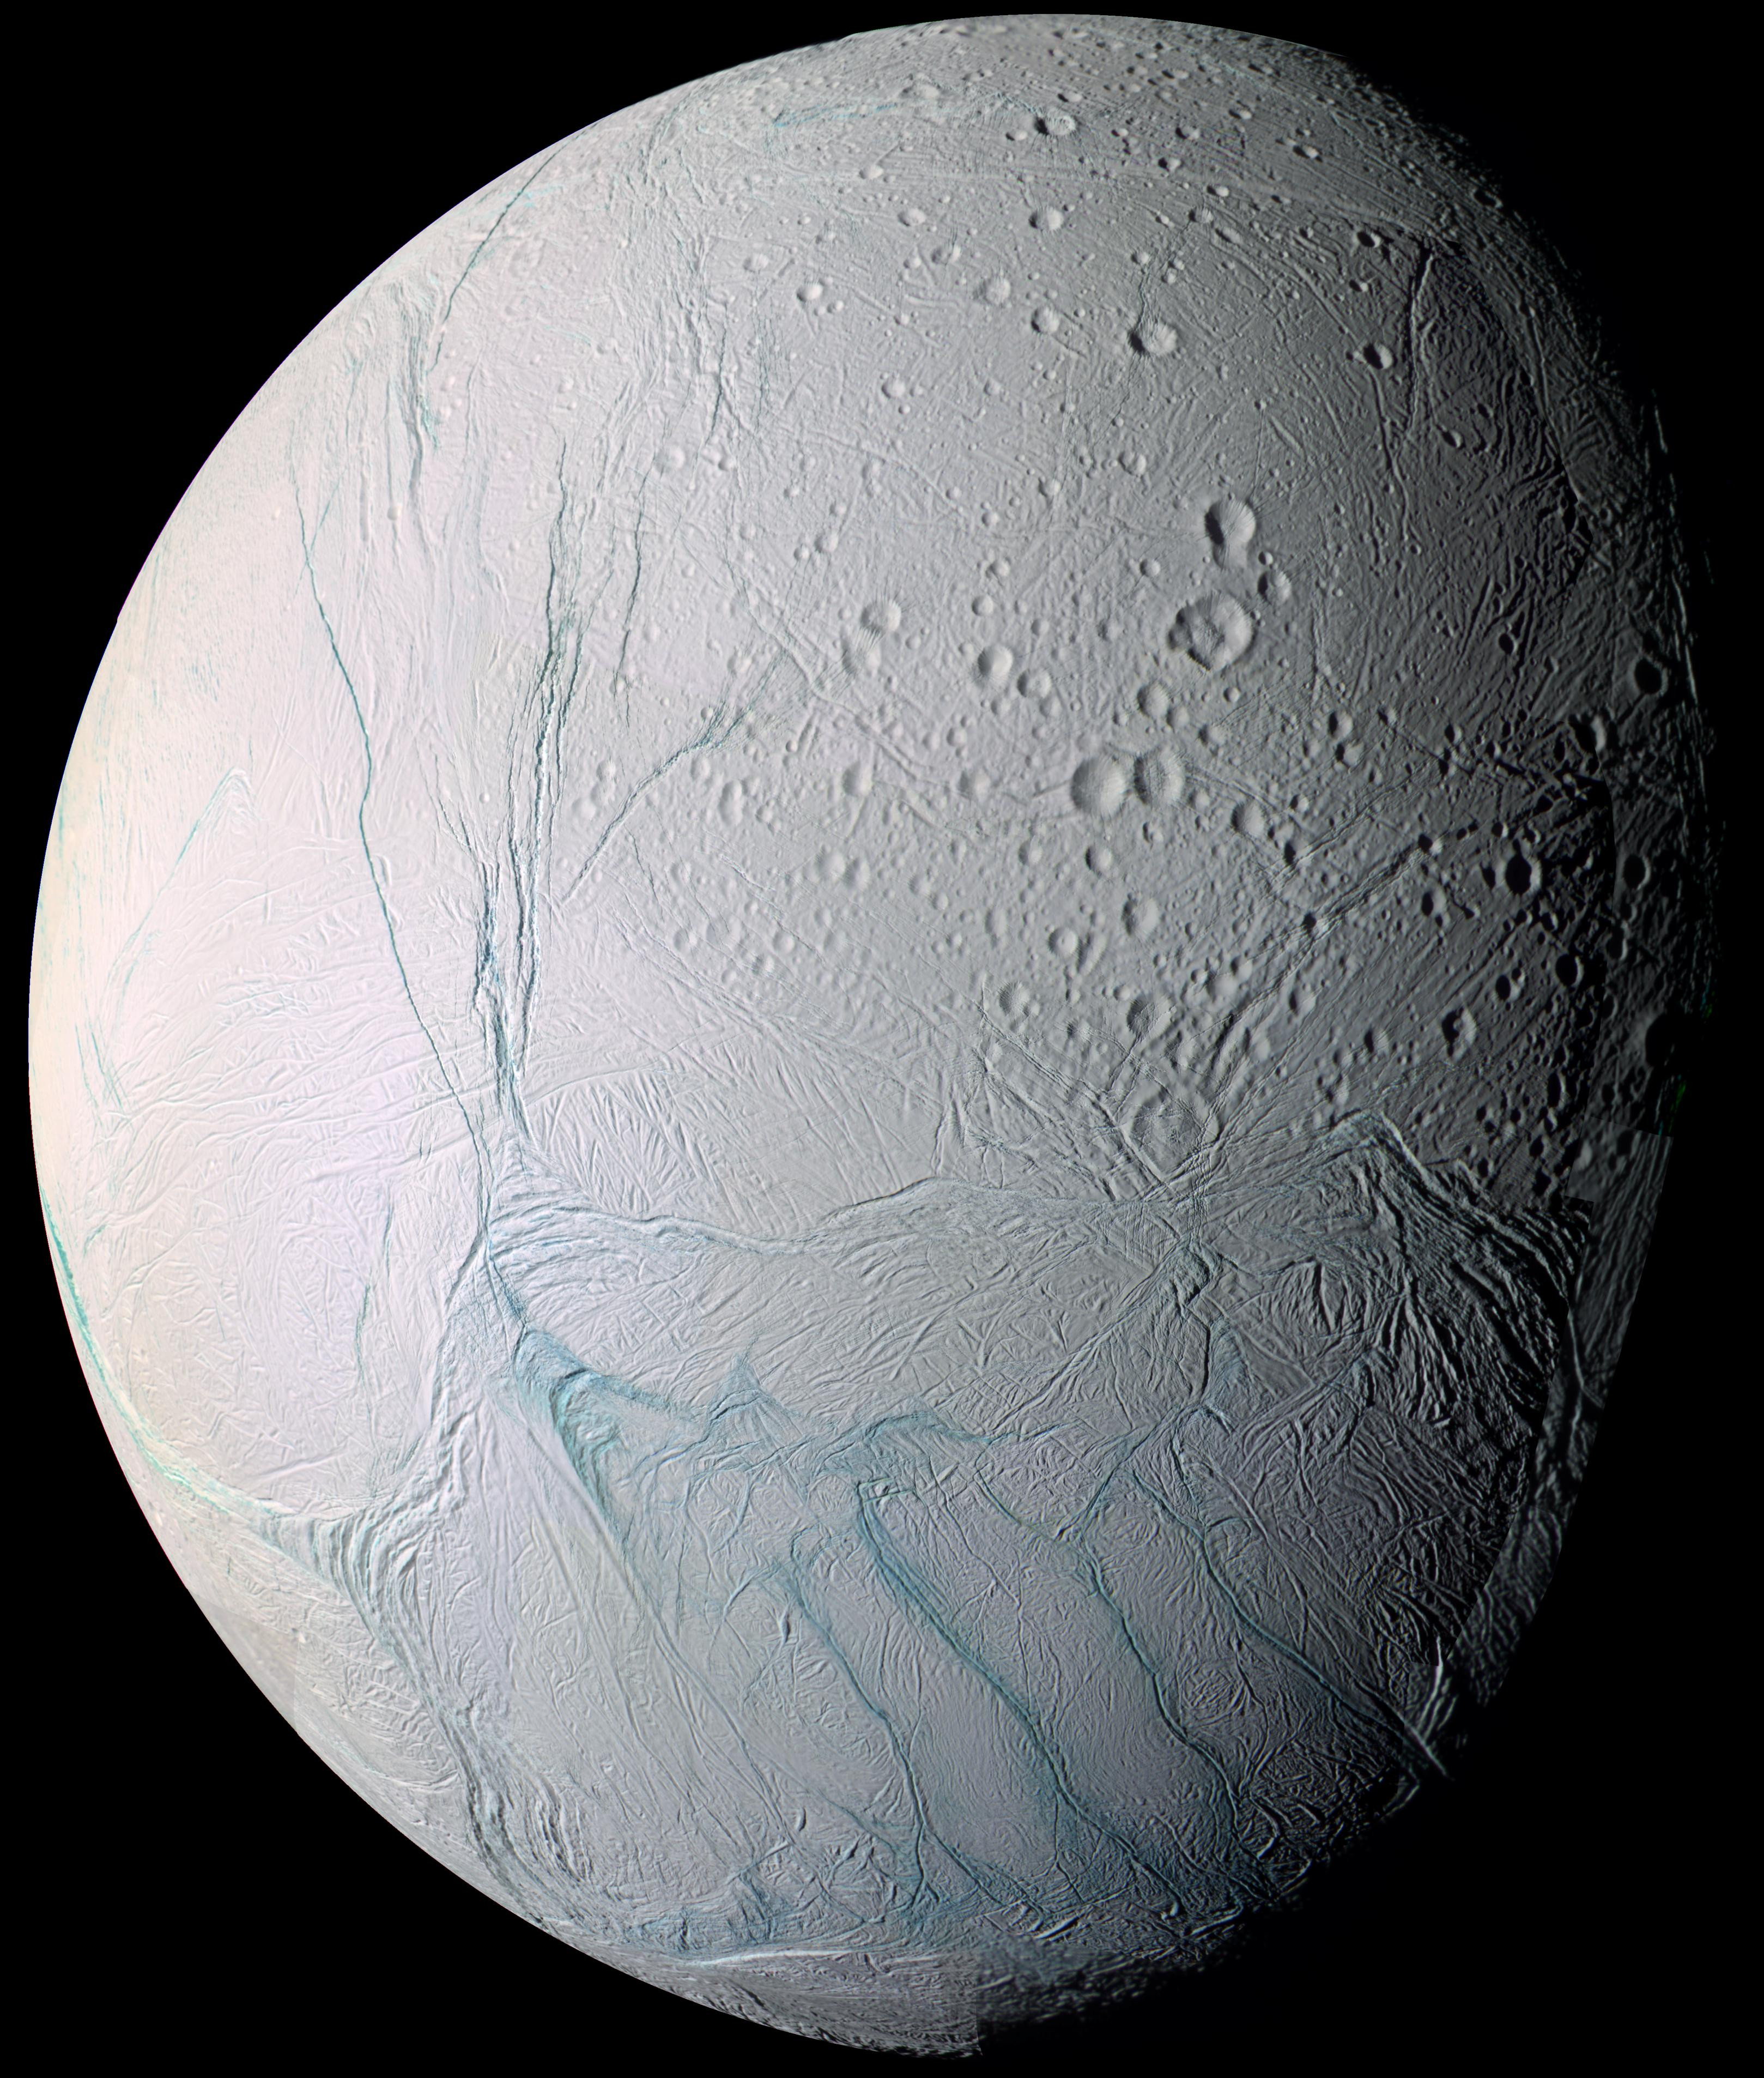
Enceladus: Global ocean but regional activity
North pole: Heavily cratered, limited tectonism
Young, heavily tectonized region at the south pole
Heavily cratered elsewhere (with some tectonism)
Ice shell is ~10 km thicker at north pole than south pole
Estimates at SP range from <1 km to >10 km
South pole: Heavily tectonized, crater free
Notes:
But where did this water come from?

Slide 5
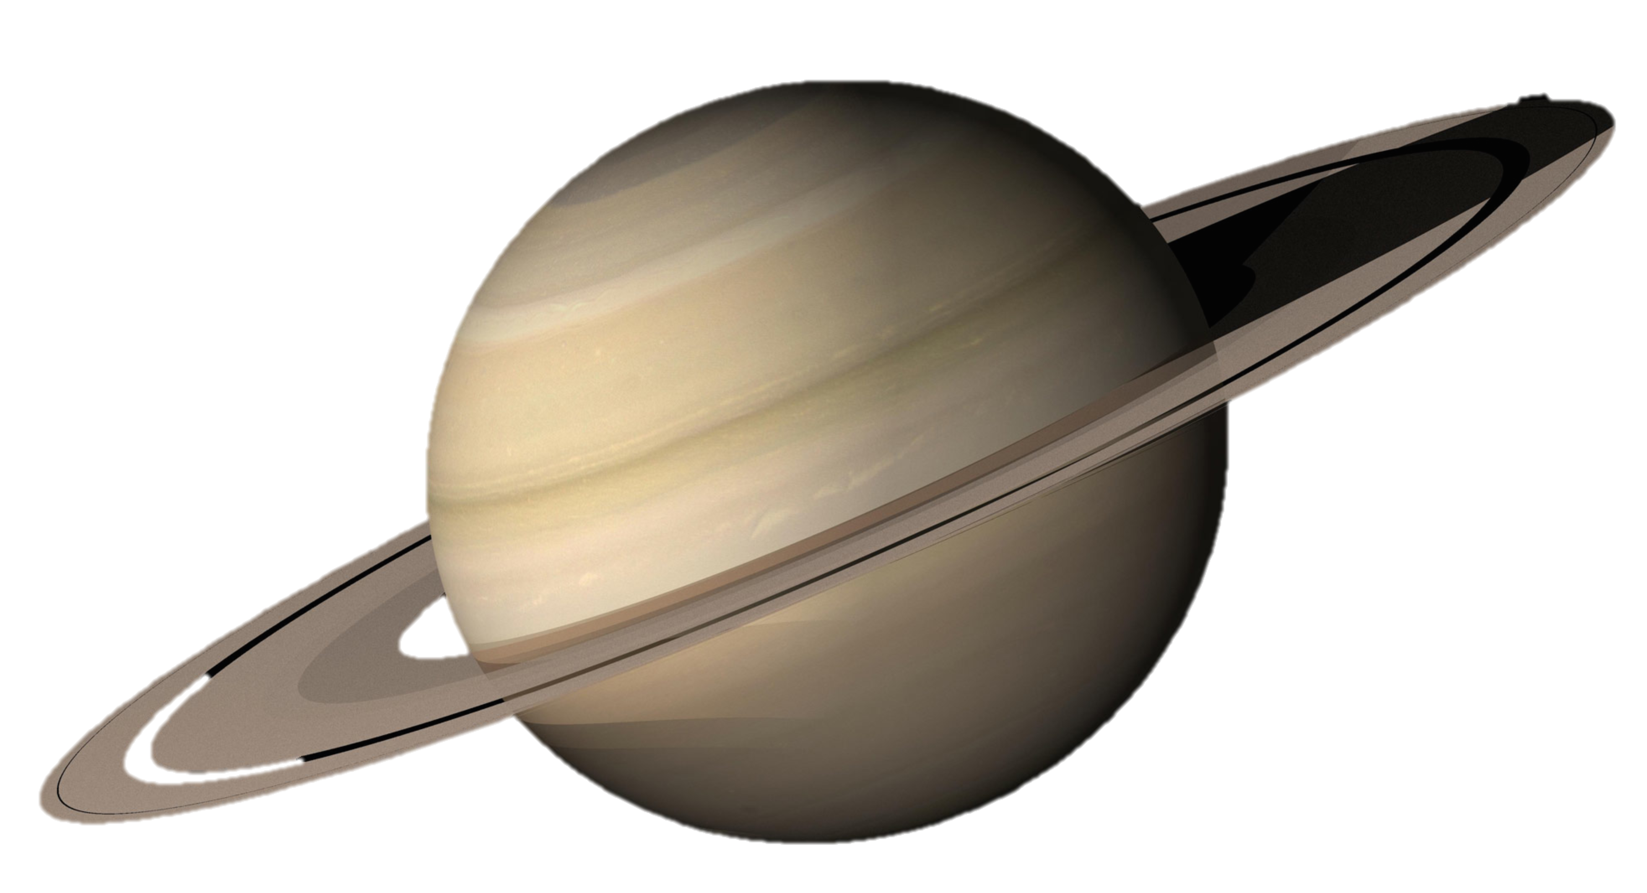
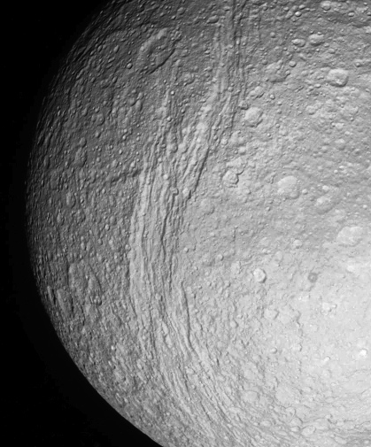
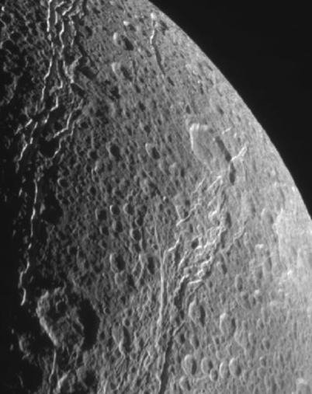
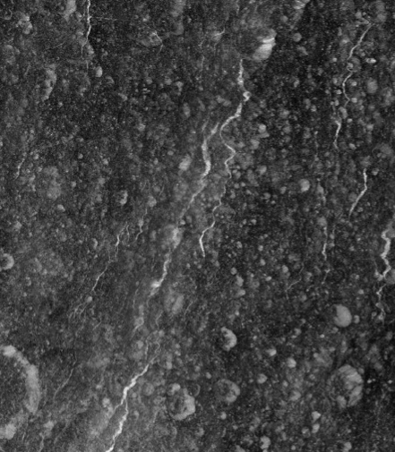
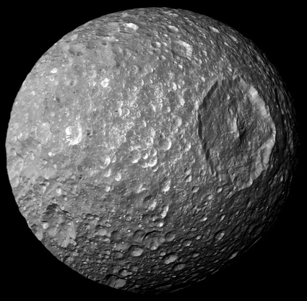
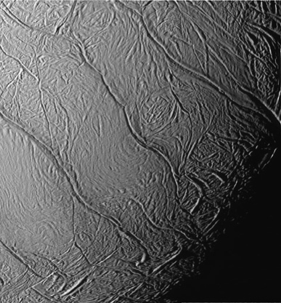
The mid-sized Saturian satellites
Tidal stresses decrease with a³, increase linearly with eccentricity
Satellite eccentricities
Mimas | Enceladus | Tethys | Dione | Rhea
0.0196 | 0.0047 | 0.0001 | 0.0022 | 0.0010
Distance from Saturn
Tethys
Dione
Rhea
Mimas
Enceladus
Ocean?
Ocean!
Ocean?
Ocean?
Ocean?
Mimas has the least tectonic activity
Notes:
We know Enceladus’ activity is related to tides, and tidal stresses increase with proximity and eccentricity.
We would expect Mimas to be the most tidally-active satellite, but actually, it’s the only moon with no tectonic activity at all.
So how could this be? Well the canonical idea is that Mimas has always been cold, so it is unresponsive to tides, and that the tectonic features on T, D, and R are unrleated to tides.
Recnt observations suggest that Mimas is differentiated and may even have an ocean
High heat flows have been reported for T, D, R that suggest past or present oceans
Models of the orbital evolution of the system suggest even higher eccentricities in the past
Model of young moons

Slide 6
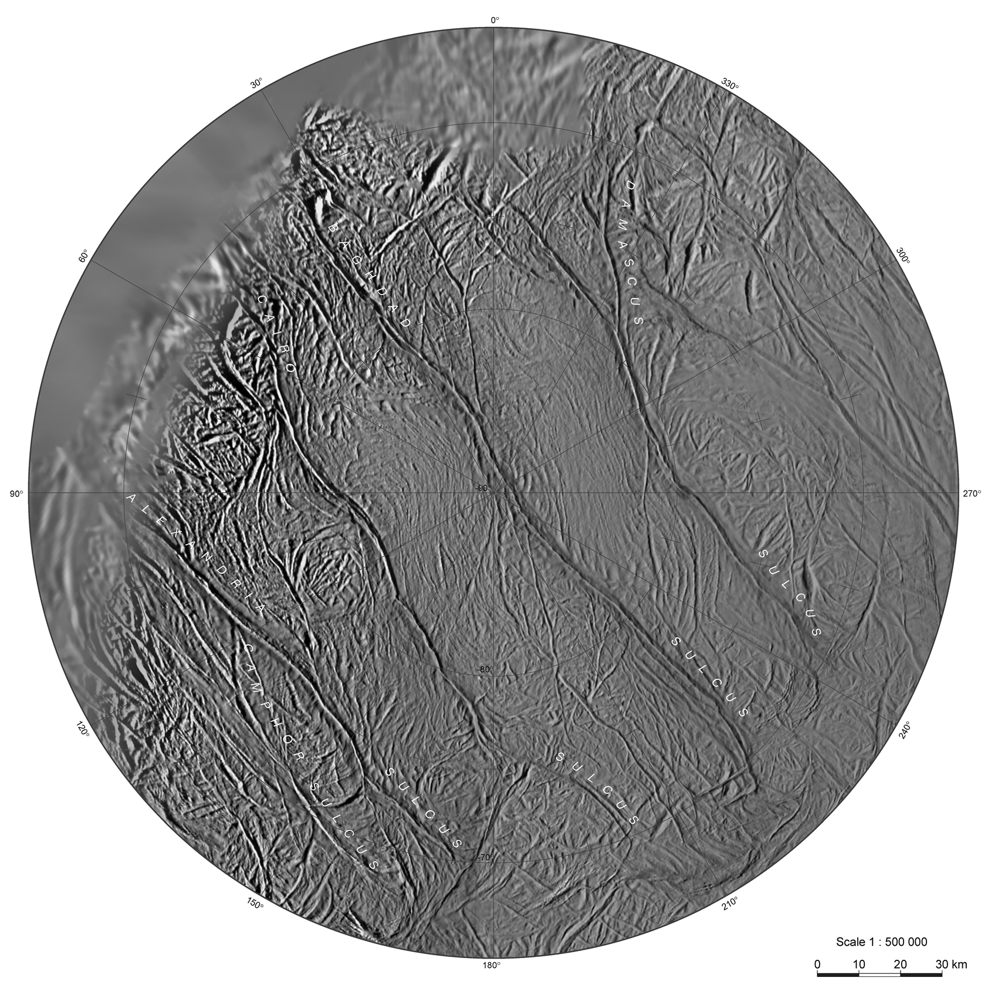
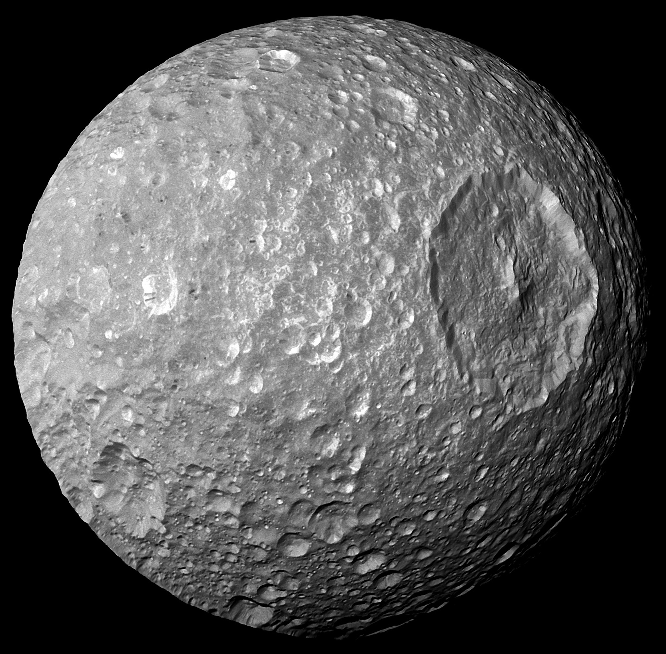
Tectonic activity linked to tides
No tectonic activity linked to tides
Enceladus’ south pole
Enceladus’ north pole
Europa
Mimas
Key question: Can we simultaneously explain activity and lack of activity?
Is an ocean-bearing Mimas compatible with the lack of fractures on its surface?
How can tidal stresses form the Tiger Stripes without fracturing the north pole?

Slide 7
We identify interior structures that produce tidal stress magnitudes and orientations that match observed fractures or the lack of fractures
Tiger Stripe Fractures (TSFs) at Enceladus’ south pole
Enceladus’ north pole and Mimas

Slide 8
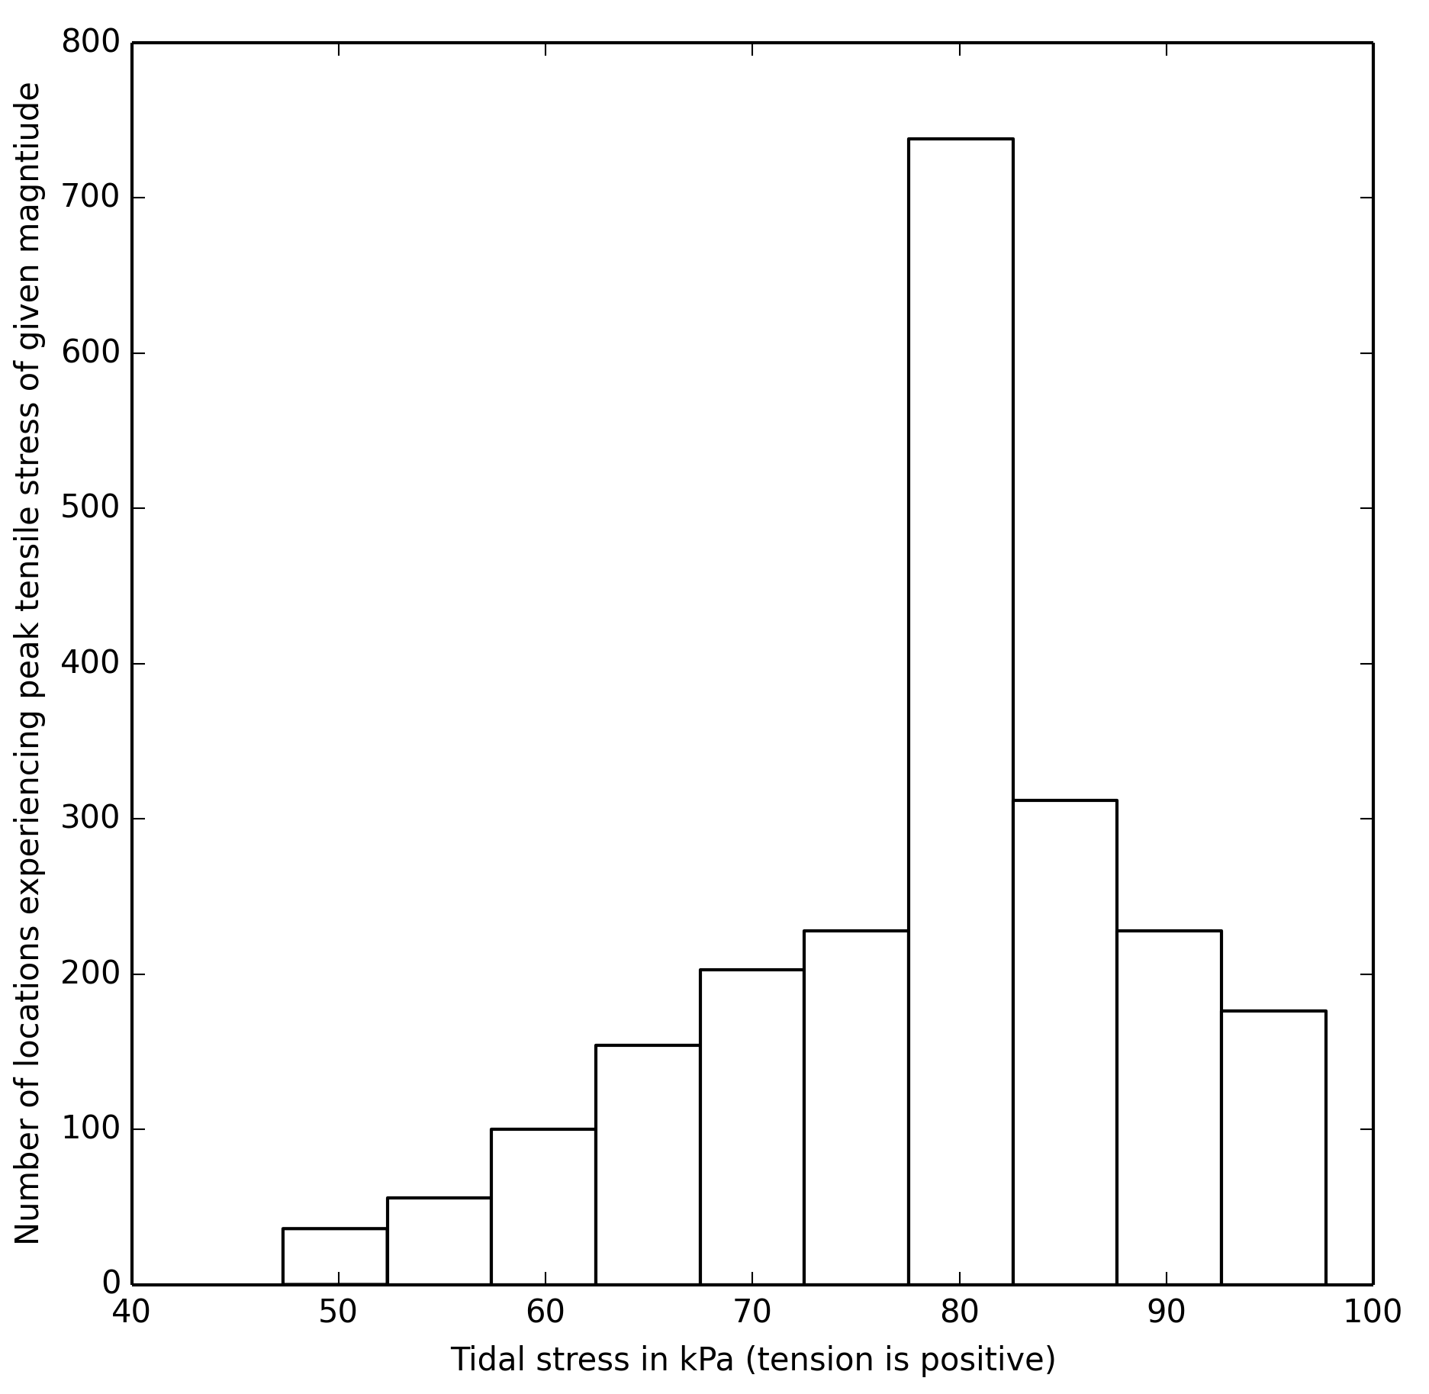
Predicting failure (of ice)
Tensile failure strength: Lab ice > 1 MPa; Sea ice 60 – 500 kPa
(e.g. Collins et al., 2009) (Dempsey et al., 1999)
Implied by fits to Europa’s fractures 50 – 90 kPa (e.g. Rhoden et al., 2010)
Global peak stress from eccentricity <100 kPa
Distribution of peak daily stress* for each location
Assumption: Failure occurs when tidal stresses > 50 kPa
Additional sources of stress, e.g. NSR and ice shell cooling should operate on
all icy, ocean worlds in eccentric orbits
*Using viscoelastic equations + “elastic” parameters from Jara-Orue + Vermeersen, 2011

Slide 9

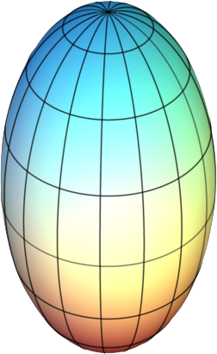
Does Mimas have an ocean?
Mimas’ librations constrain its interior
(Tajeddine et al., 2014)
Non-hydrostatic core
Global ocean
Ice shell thickness depends on viscosity
Notes:
Global ocean + high eccentricity should yield high tidal stresses – Is an ocean model consistent with the lack of activity on Mimas?

Slide 10
Can geology rule out the ocean?
How much tidal stress? Is an ocean model compatible with inactivity?
Ocean + eccentric orbit = enhanced tidal stress
?
Notes:
Global ocean + high eccentricity should yield high tidal stresses – Is an ocean model consistent with the lack of activity on Mimas?

Slide 11
Computing tidal stresses on Mimas
Equations for stress in 5-layer, viscoelastic body
(Jara-Orue + Vermeersen, 2011; Rhoden et al., 2015)
Silicate pseudo-core, 10 km
Silicate mantle, 156 km
Liquid water ocean
Ductile ice
Brittle ice, 1 km
Current ecc = 0.0197
Ecc = 0.0127 (libration proxy)
 | Low viscosity | Medium viscosity | Med/high viscosity | High viscosity
Ocean thickness | 8 km | 6 km | 4 km | 1 km
Total shell thickness | 24 km | 26 km | 28 km | 31 km
Ductile ice viscosity | 10¹² Pa*s | 10¹⁴ Pa*s | 10¹⁶ Pa*s | 10²¹ Pa*s
(Chosen to match Tajeddine et al., 2014)
Output: Principal stresses at every 5° of lat/lon at 48 time steps per orbit
Compare stresses with tensile strength of ice + stresses on active moons

Slide 12
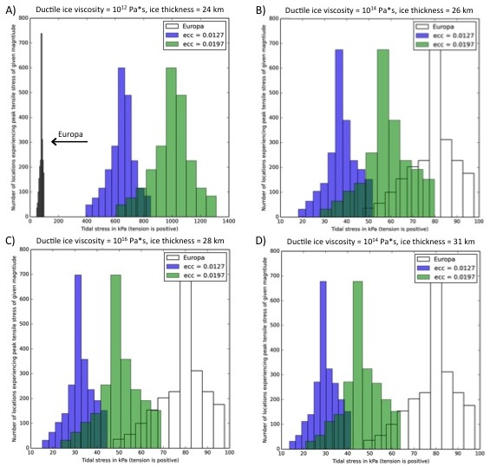
Tidal stresses on Mimas with an ocean
 | Low viscosity | Medium viscosity | Med/high viscosity | High viscosity
Ocean thickness | 8 km | 6 km | 4 km | 1 km
Total shell thickness | 24 km | 26 km | 28 km | 31 km
Ductile ice viscosity | 10¹² Pa*s | 10¹⁴ Pa*s | 10¹⁶ Pa*s | 10²¹ Pa*s
Peak stress | 1311 kPa | 80 kPa | 69 kPa | 64 kPa
Peak stress (lib proxy) | 849 kPa | 52 kPa | 45 kPa | 41 kPa
Either Mimas’ ice is stronger than Europa’s, Mimas is just barely avoiding failure (and no cooling or NSR), or Mimas has no ocean
Notes:
Also cannot have any additional stress sources like NSR or ice shell cooling.

Slide 13
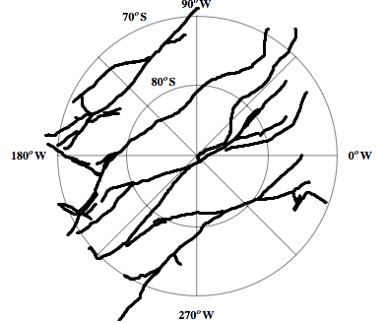
Exploring Enceladus’ hemispheric dichotomy
Goal: Identify interior structures that can form the Tiger Stripe Fractures (TSFs) in the south from tidal stress without pervasively fracturing the north
Locations of measured orientations
Applied tidal stress equations from Jara-Orue and Vermeersen (2011) for rheologically-layered bodies
Interior models:
Ice shell thickness
22 km, 12 km, 5 km, 3 km, 1 km, 500 m
Ductile ice viscosity
10¹³, 10¹⁴, 10¹⁵, 10¹⁹ Pa*s
Brittle layer thickness
10%, 20%, 30% of shell
All models include rocky core, global ocean
(Compatible with Iess et al., 2014; McKinnon 2015; Thomas et al., 2015)
Assumption: Thin shells (<10 km) apply to south pole not north pole
6391 points total, 2395 along main branches
Notes:
Measured local orientations at 6391 points. For this presentation, I’ll focus on the roughly 2400 points that lie along the most prominent four fractures.

Slide 14
One slide methodology of a 2 year project
Measured orientations along TSFs
For each interior model
Statistical analysis
Magnitude of regional peak tensile stress
Likelihood of producing observed orientations with a given failure criterion
Tidal stresses over an orbit at each TSF point
Tidal stress model
Interior structure models
Changes in predicted orientations with changes in interior
Failure assumptions
Notes:
Diurnal tidal stresses seem to modulate activity along TSFs, but did tidal stresses form the TSFs?
What other stresses might have been involved? (e.g. cooling, NSR)
What does the formation of the TSFs imply about ice failure?
Did the same stresses form the other fractures in the South Polar Terrain (SPT)?

Slide 15
Fracture orientations strongly support thick shells
Peak daily tensile stress in polar regions, by model
The north pole must be thick and cool (likely convecting) to suppress tidal stresses
The south pole can have large stresses with either:
A thin (<10 km), conducting shell in the south of any ductile shell viscosity
A thick (>10 km), warm, convecting shell
Fracture orientations STRONGLY support thick, convecting ice shells
Compatible with limited fractures at NP
Implied failure stress at Europa

Slide 16
Can we explain activity and lack of activity?
How can we explain fractures on the SP of Enceladus but not on Mimas?
  Mimas’ ice is stronger than Europa or Enceladus
  All ice shell are strong – NSR or cooling stresses break Europa/Enceladus but not Mimas
  No ocean on Mimas (also supported by circularization timescales)
How can we explain fractures at the SP of Enceladus but not the NP?
  Difference in viscosity and thickness between NP and SP
  Orientations of TSFs strongly support eccentricity-driven tidal stresses in a thick shell
  TSFs likely formed as tensile cracks due to tidal stress AT THEIR CURRENT LOCATIONS
  Any additional stress sources must affect each pole differently
    A cooler, thicker shell at the NP might accumulate cooling stresses more slowly
    NSR stresses problematic - should accumulate more in a cooler shell (less relaxation) leading to failure at the NP
This work was supported by NASA Cassini Data Analysis Program grant NNX15AL09G and NNH15ZDA001N

Slide 17
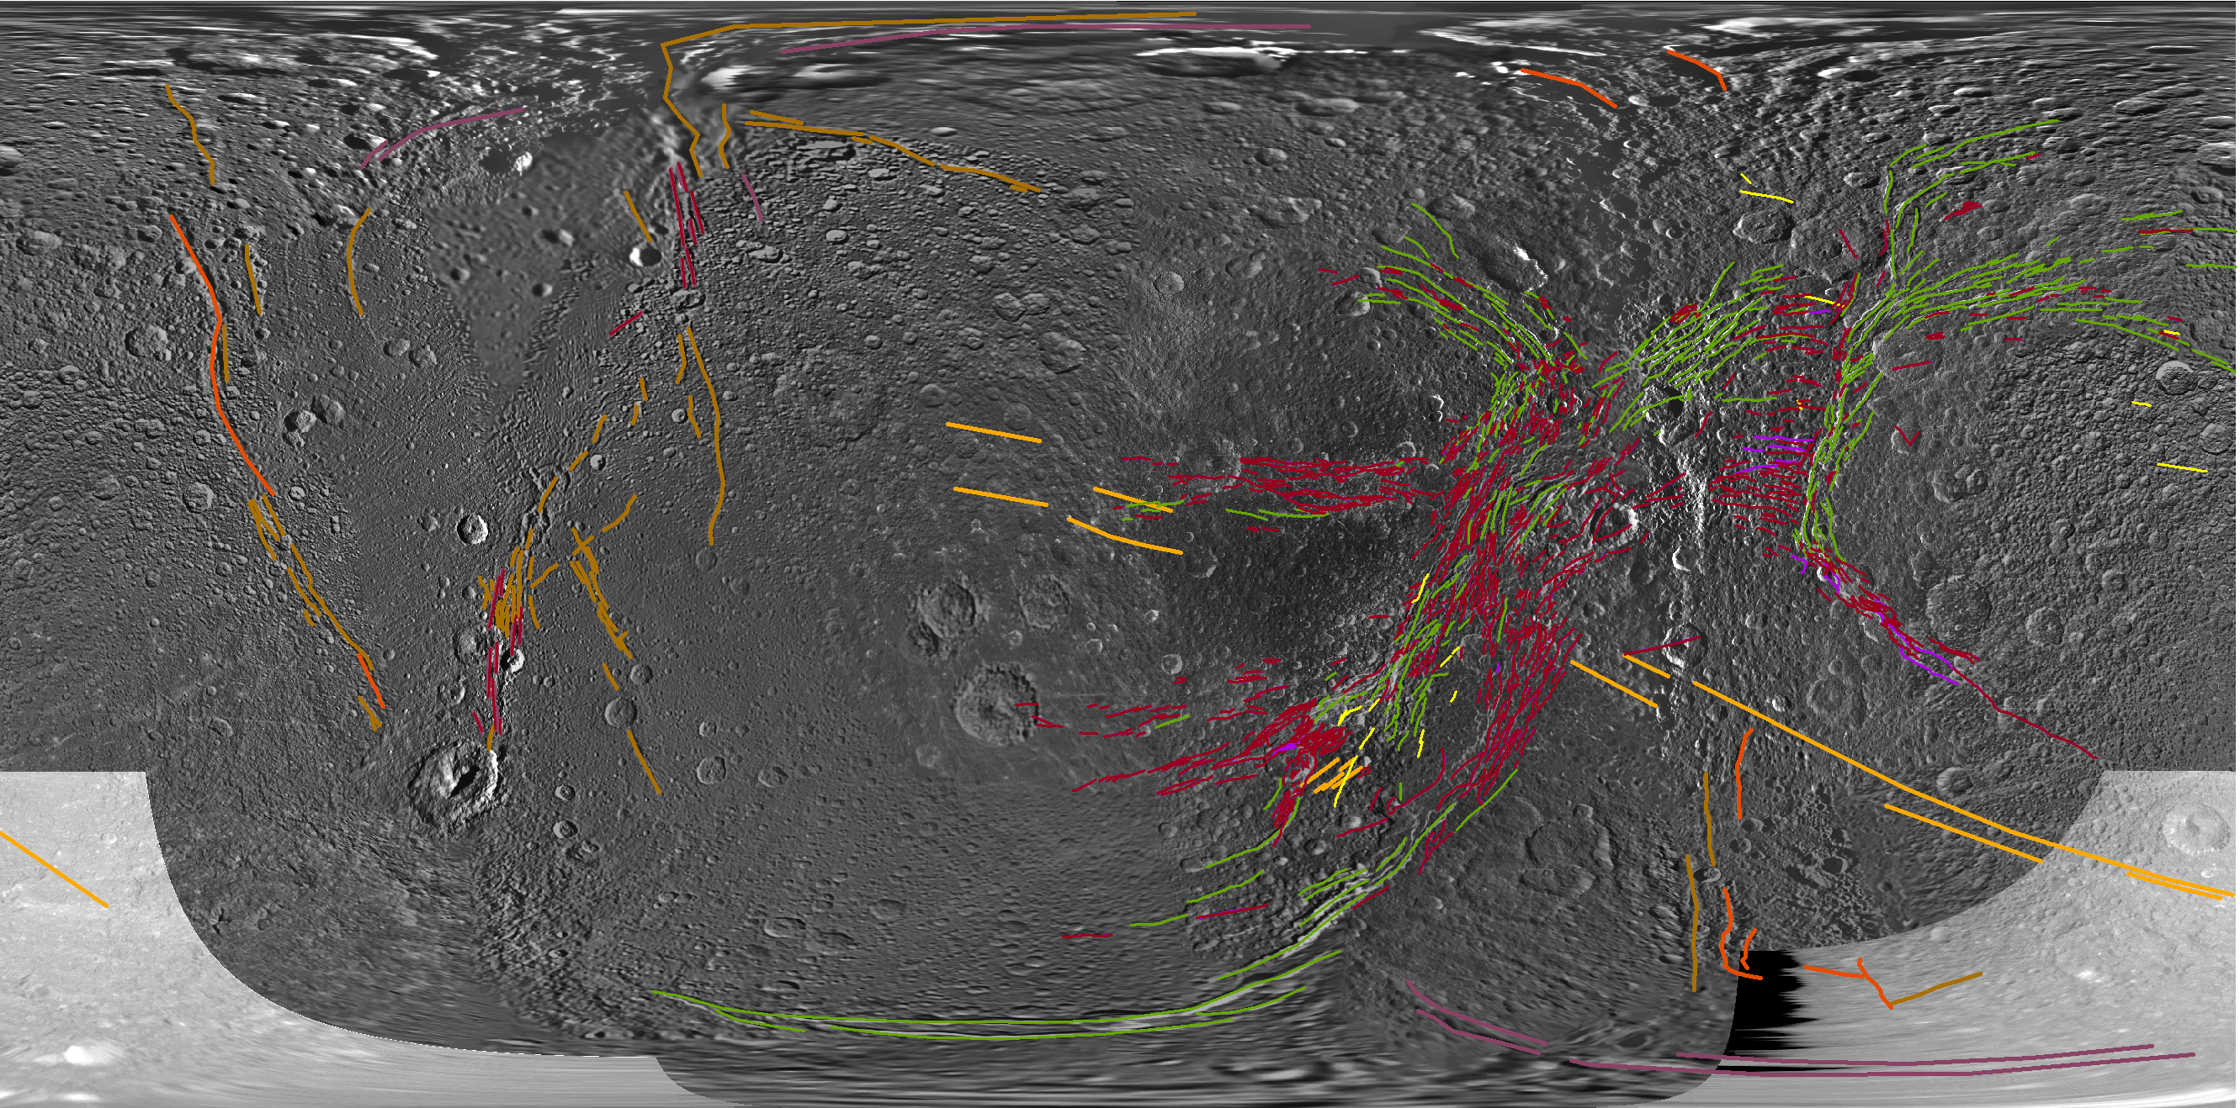
Dione?
Map courtesy of Emily Martin
Constants:
Silicate pseudo-core: 10 km
Silicate mantle: 323 km
Brittle layer viscosity: 10²¹ Pa*s
Variables:
Ductile ice visc: 10¹³, 10¹⁴, 10¹⁵ Pa*s
Brittle layer thickness: 1-2, 5, 10 km
Ocean-ice shell thicknesses: 50-178, 114-114, 178-50 km

Slide 18
At current eccentricity, Dione’s stresses are low
Peak tidal stresses are lower than the failure strength implied at Europa
If Dione’s eccentricity were even slightly higher in the past, the stresses would be comparable to Europa’s
If Dione’s fractures match a tidal stress pattern, it implies a larger past eccentricity and ocean
Cannot rule out ocean even if no tidal fractures are found
Ice shell thicknesses

Slide 19
Additional conclusions
Tidal stresses can explain the orientations of the TSFs very well
TSFs likely formed as tensile cracks due to tidal stress AT THEIR CURRENT LOCATIONS
Comparable tidal stress magnitudes are inferred for both Europa and Enceladus
  May suggest consistent low failure threshold OR
  Changes in ice shell thickness contribute to failure (implied episodic NP)
  NSR stress may not be compatible with limited fracturing in the NP (still under investigation)
Simplest explanation for Mimas’ lack of fractures is a non-hydrostatic core, NOT an ocean

