Slide 1
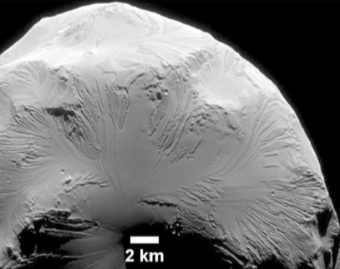
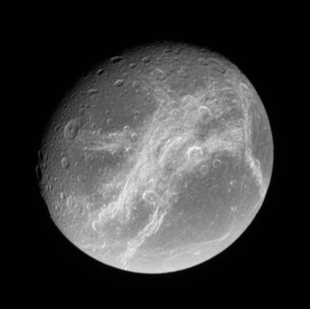
Dione and Helene
Disk-integrated observations
Emilie Royer
Amanda Hendrix
Carly Howett
Linda Spilker
August 14th, 2018 – Boulder

Slide 2
Objectives of the project
Objects formed at the same place in the solar system should have the same composition and have experienced the same weathering processes.
Therefore, differences in surface composition would suggest a different place of origin and/or differences in weathering processes altering the surface. The amount of weathering is also a possible indication of the relative ages of the two bodies.
Investigate Dione-Helene in term of origin, formation and evolution
Retrieve the photometric properties
Is Helene a captured moon?

Slide 3
Dione UVIS-ISS-VIMS-CIRS observations
8 simultaneous Dione observations in common with UVIS, ISS, VIMS and to a less extend CIRS:
2007-034 (Trailing – wispy terrains)
2008-177
2008-221
2008-242
2008-286
2008-366
2009-019
2013-178
All at phase angle <15 deg
Only one simultaneous Helene
observation on Jan 31st, 2011
at phase angle 37-67 deg

Slide 4
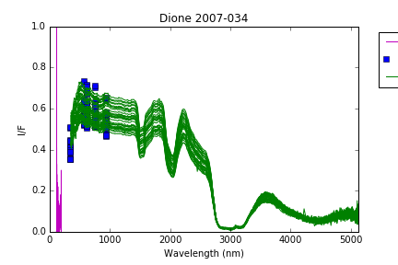
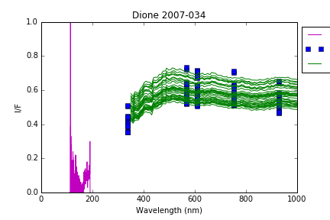
Dione UVIS-ISS-VIMS combined spectra
Satellite much darker in the FUV → water ice absorption
ISS and VIMS agreement
Gap between UVIS and ISS data
CIRS reflectance close to zero

Slide 5
Dione UVIS-ISS-VIMS combined spectra
Satellite much darker in the FUV → water ice absorption
ISS and VIMS agreement
Gap between UVIS and ISS data
CIRS reflectance close to zero

Slide 6
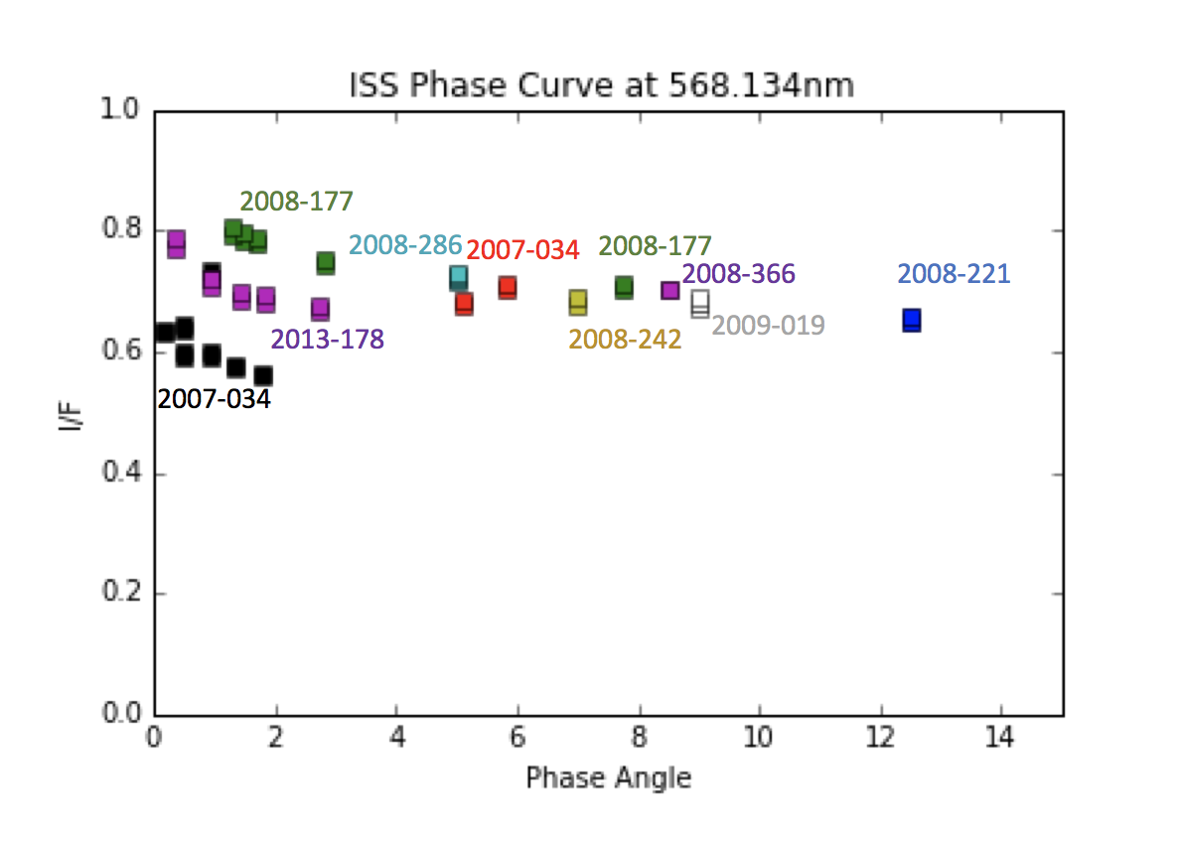
Dione phase curves (preliminary results)
180 nm
568 nm
1804 nm
2013_178
2007_034

Slide 7
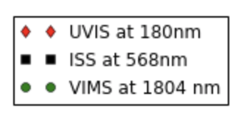
Dione phase curves (preliminary results)
180 nm
568 nm
1804 nm
2013_178
2007_034

Slide 8
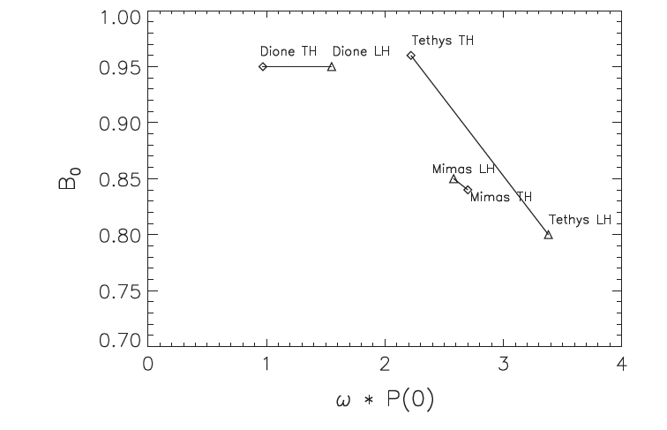
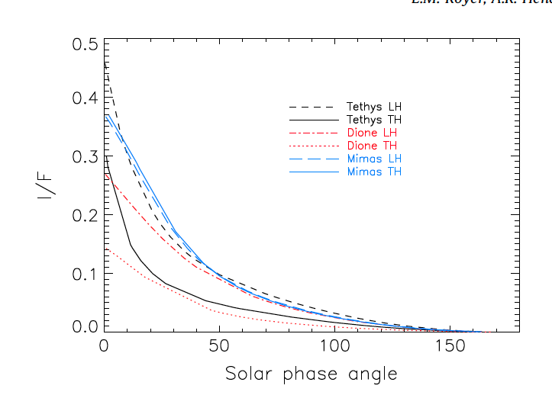
Saturn icy satellites’ phase curves as of 2014
Particle opacity
Amount of bombardment by E-ring grains
Royer and Hendrix (2014)

Slide 9
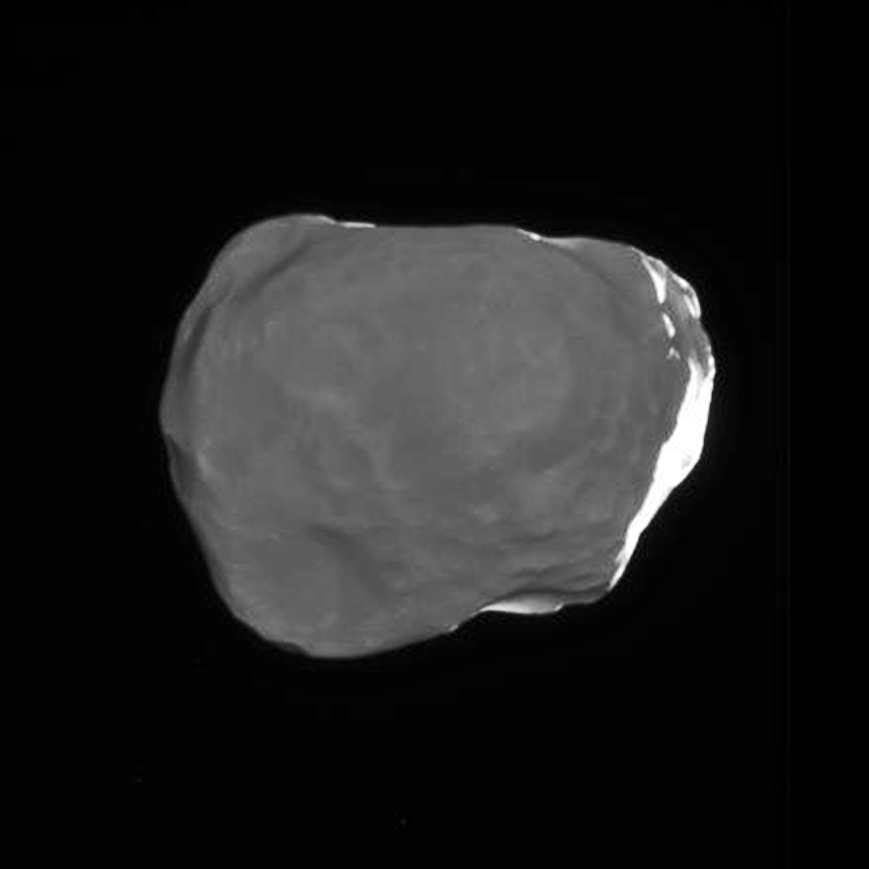
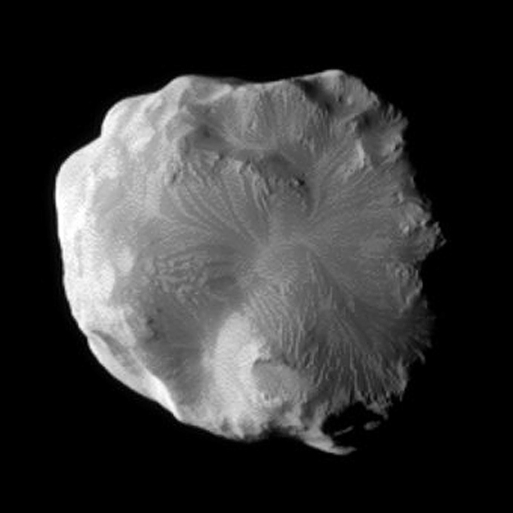
Composite spectra of Helene
Grain size analysis from UVIS and VIMS spectra
VIMS showed that Helene appears bluer and hence richer in fresh water ice than Dione (Filacchione et al., 2012)

Slide 10
Helene vs Dione UVIS spectra
Helene - day 2011_031 – leading side (118 to 150 deg longitude)
phase angle 37 to 67
Dione – day 2005_065 - trailing side (238 deg longitude)
phase angle 50.5deg
Helene - day 2011_031 - leading side (118 to 150 deg longitude)
phase angle 37 to 67
Dione - day 2006_052 - leading side (94 deg longitude)
phase angle 63.7 deg
Notes:
Variation in grain size and maybe also composition
Rotational period unknown as per JPL/Horizon

Slide 11
Helene vs Dione UVIS and ISS spectra
Dione trailing (238 deg longitude) at phase angle 50.5 deg on day 2005_065) is brighter than Helene (average of phase 37-67 deg) in VIS but darker in UV
Phase coefficient correction needed
Notes:
Need Correction of phase coefficient

Slide 12
Summary
Photometric results on Dione follow same trend for UV, VIS and IR
We can investigate better the opposition effect at multiple wavelengths with the set of 8 Dione observations
What can we say about the 0-2deg phase angle spread seen in ISS and VIMS data but not in UVIS data? CBOE?
Porosity on Dione can be better investigated
Difference in grain size between Dione leading and trailing and between Dione and Helene
Helene brighter than Dione in UV but darker than Dione in VIS? What happened in the UVIS-ISS wavelength gap? Is the change in brightness real?

