Slide 1
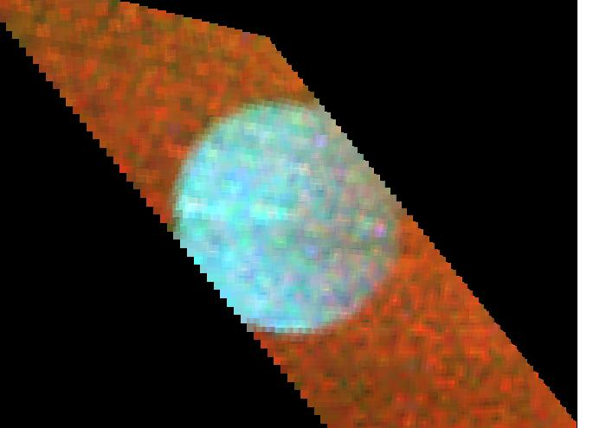
Surface Compositions of the Icy Satellites from UV Spectroscopy
Amanda Hendrix
and the UVIS Team
Cassini Science Symposium
14 August 2018
Boulder, CO
Notes:
The satellites in the Saturnian system are absorbing in the UV-visible spectral region – they’re reddish, and we want to study this spectral region to understand the surface composition and how it is being affected by environmental processing
[It’s potentially a clue to surface composition/contamination, because most of the VNIR spectrum is mainly indicative of H2O ice (plus some trace species)]

Slide 2
Thinking back to the beginning of the mission…
These were the first ever far-UV spectral observations of icy satellites … so this was really exploratory science
(There were near-UV observations of Dione, Rhea, Iapetus from HST)
What is the surface composition of the icy moons and how are they modified by their environments?
UVIS is contributing to studies of surface composition of the icy moons

Slide 3
PHOEBE
ENCELADUS
Why so dark??

Slide 4
UVIS unique contributions
Images, spectroscopy
Top-most layer (few microns)
important for studying evolution (exogenic/weathering processes)
E ring
Corotating (cold) plasma
plume fallout
FUV H₂O signature

Slide 5
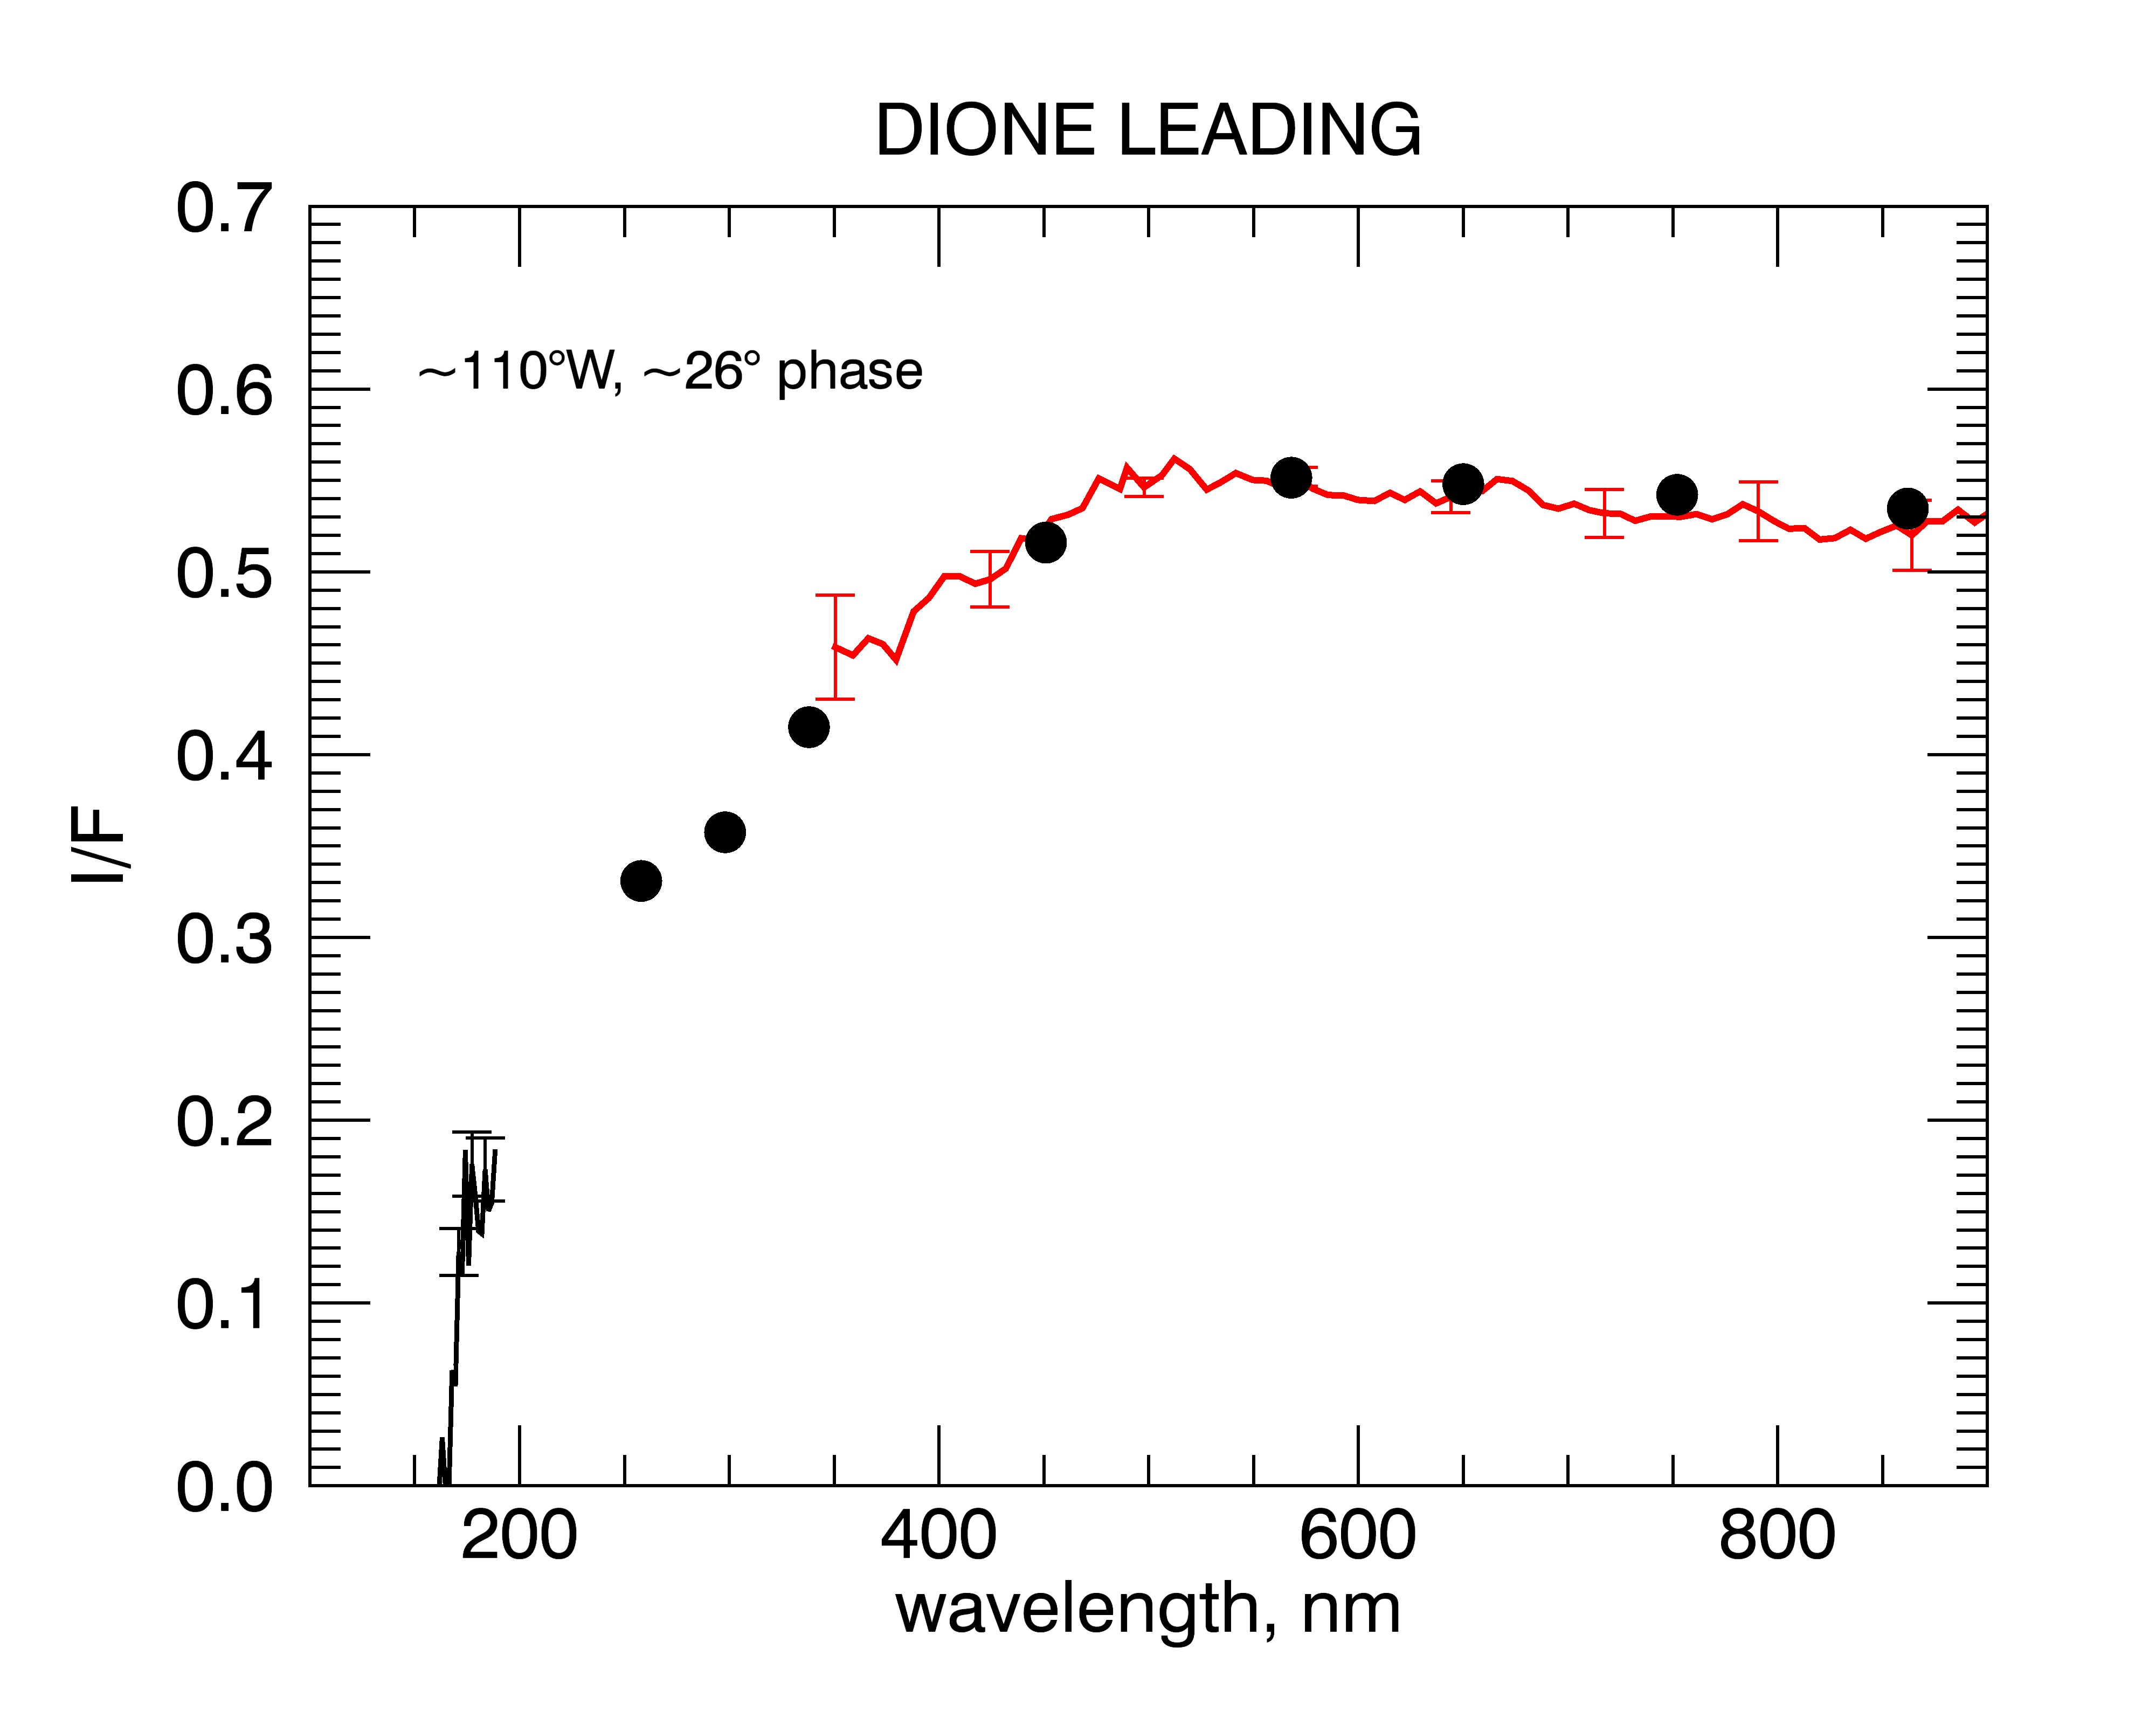
ISS
absorption
VIMS
UVIS
Notes:
Dione spectrum to demonstrate the issue.
The absorption occurs in a region where Cassini spectral coverage is not complete.

Slide 6
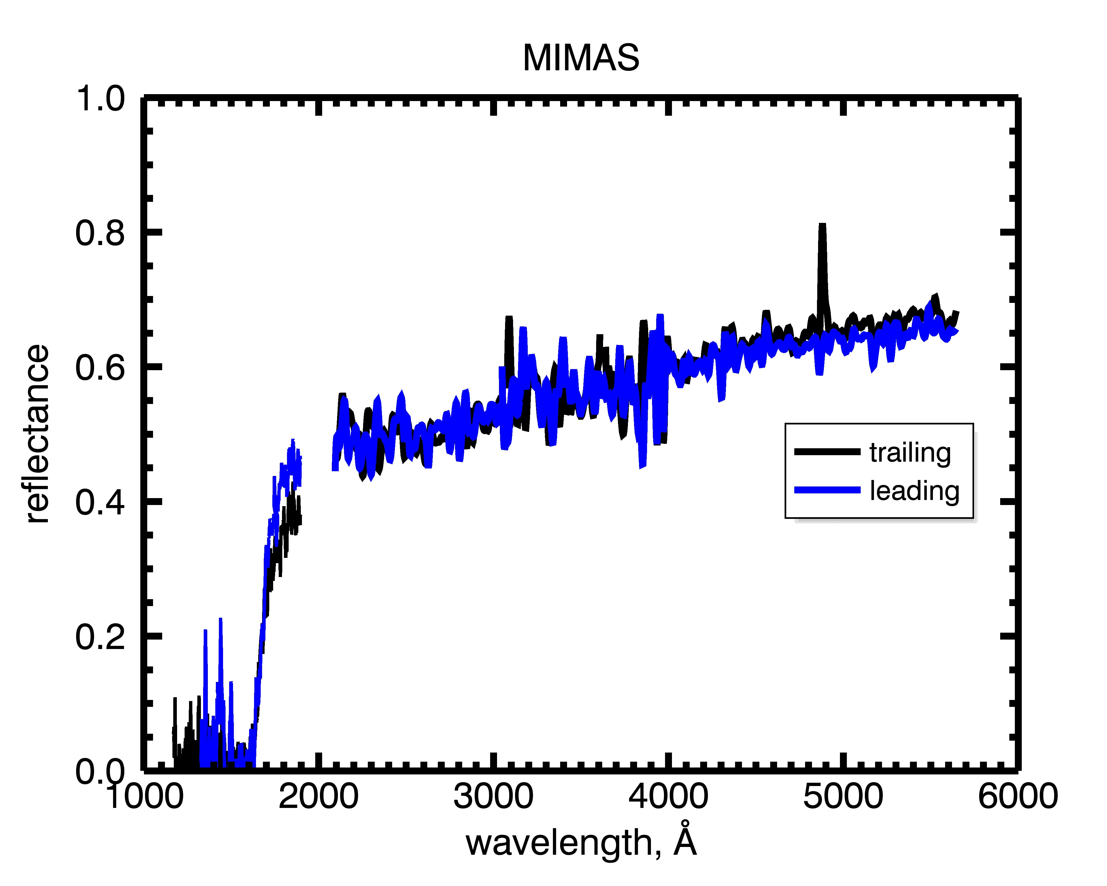
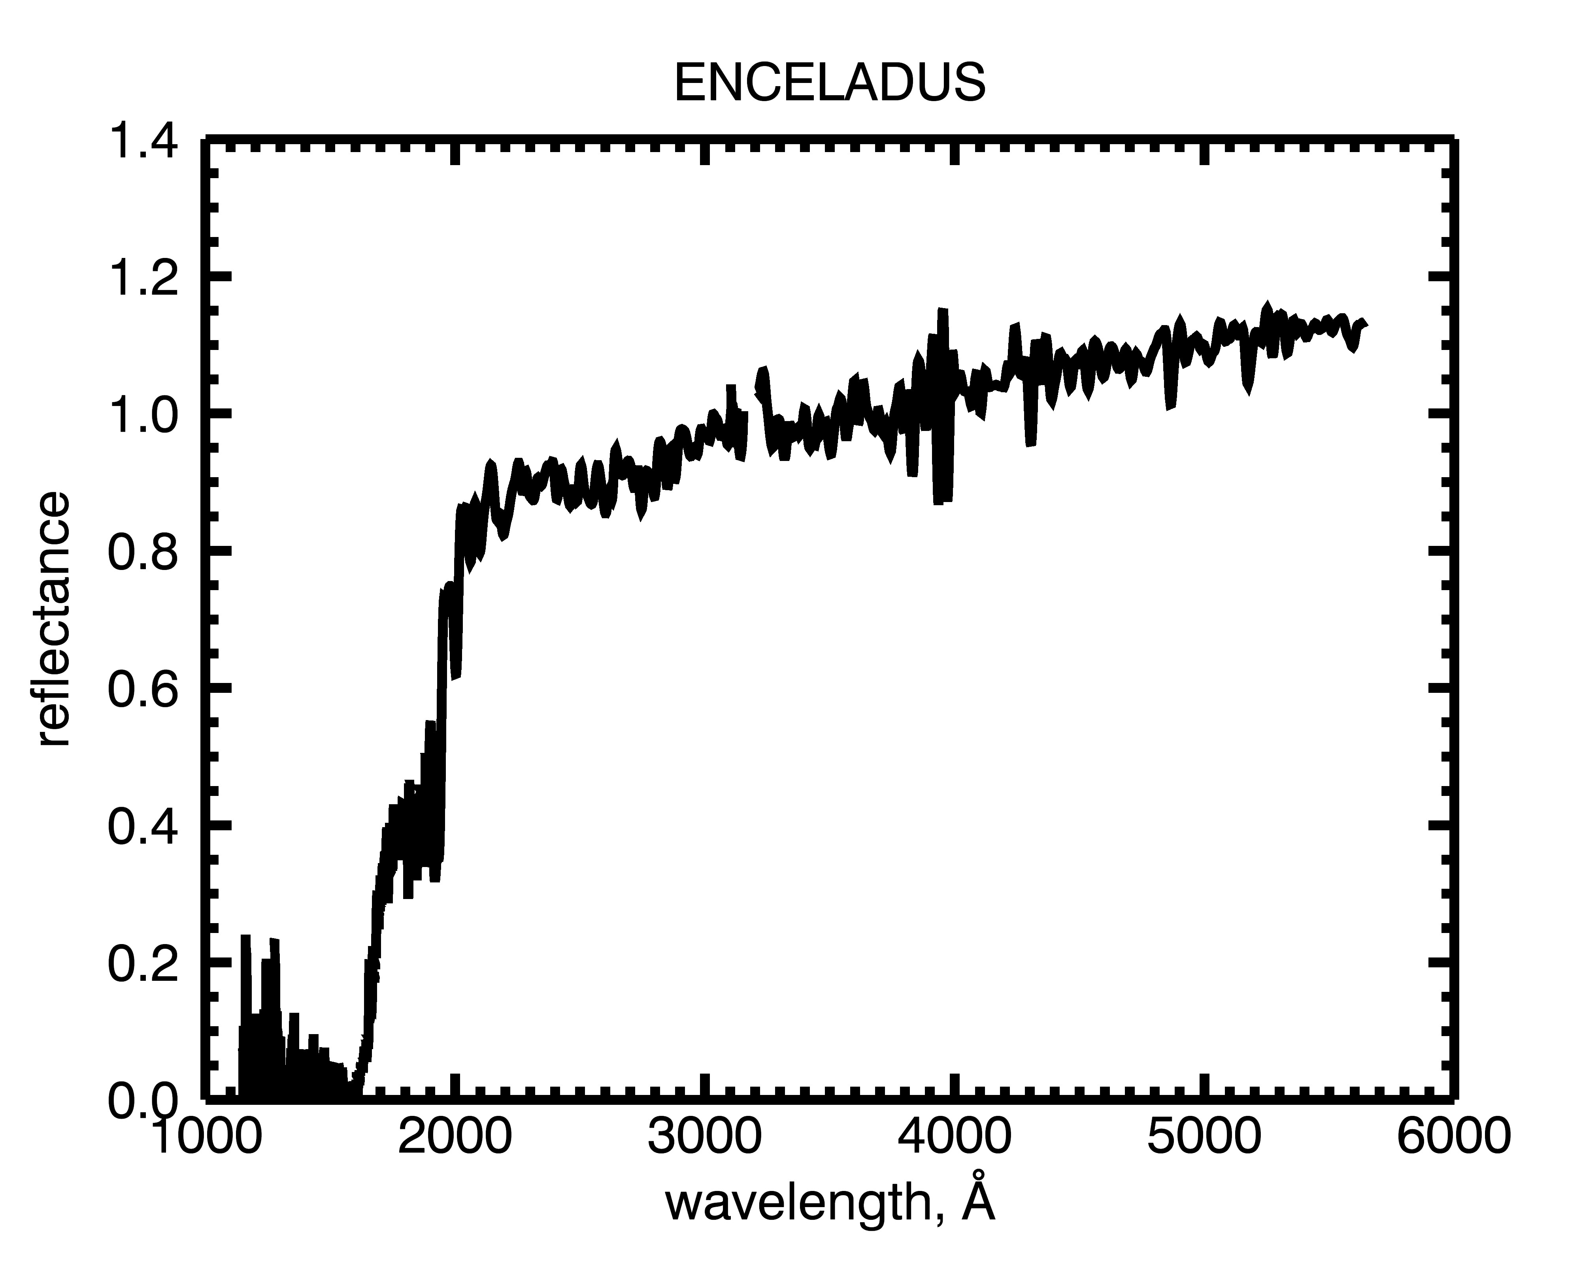
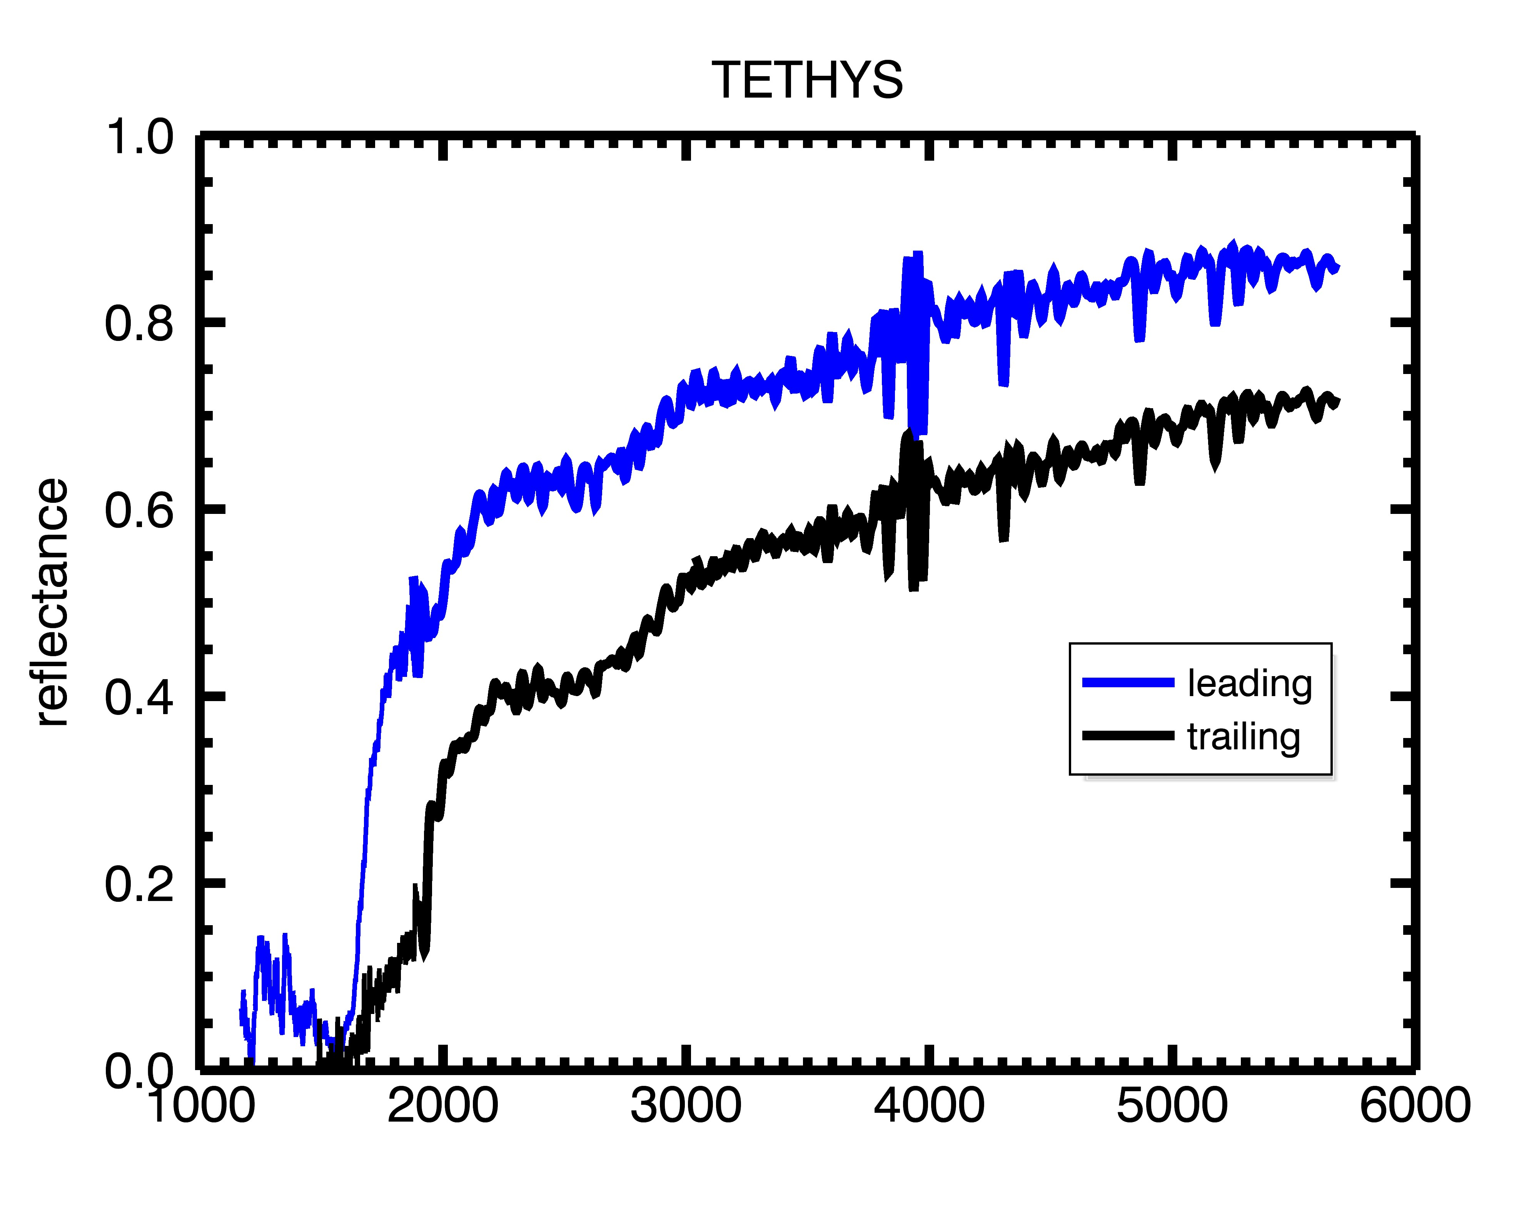
HST/STIS data
+ Cassini UVIS
Notes:
Note absorption
Also seen in Noll spectra (RH etc, id’d as O3)

Slide 7
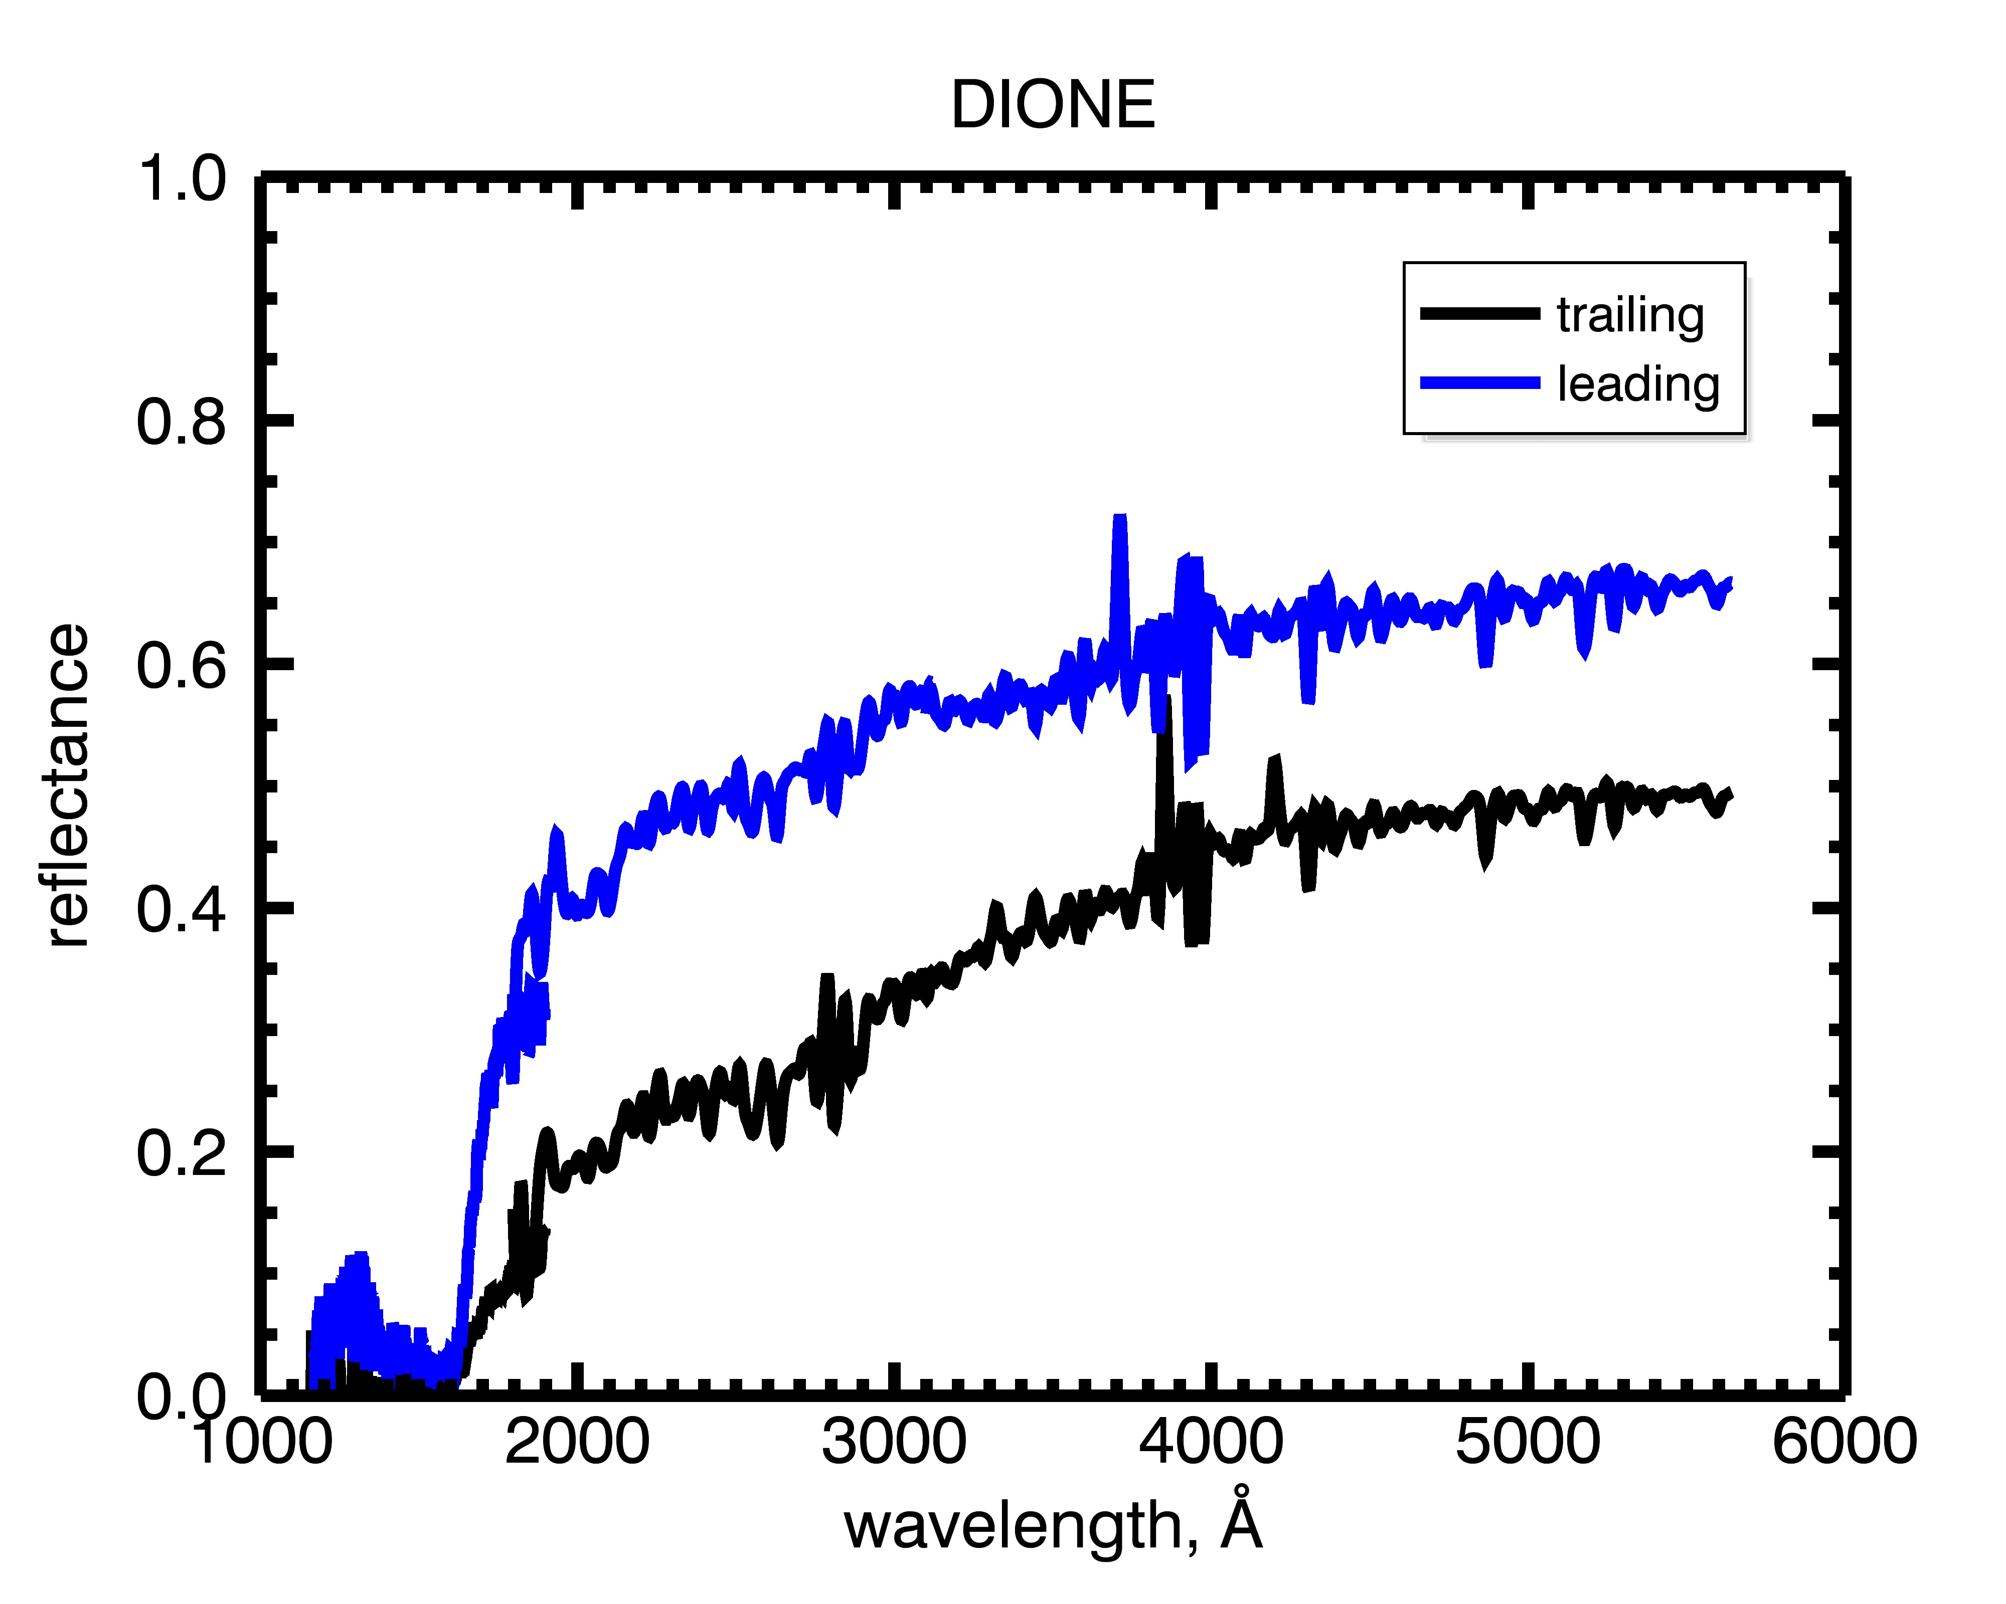
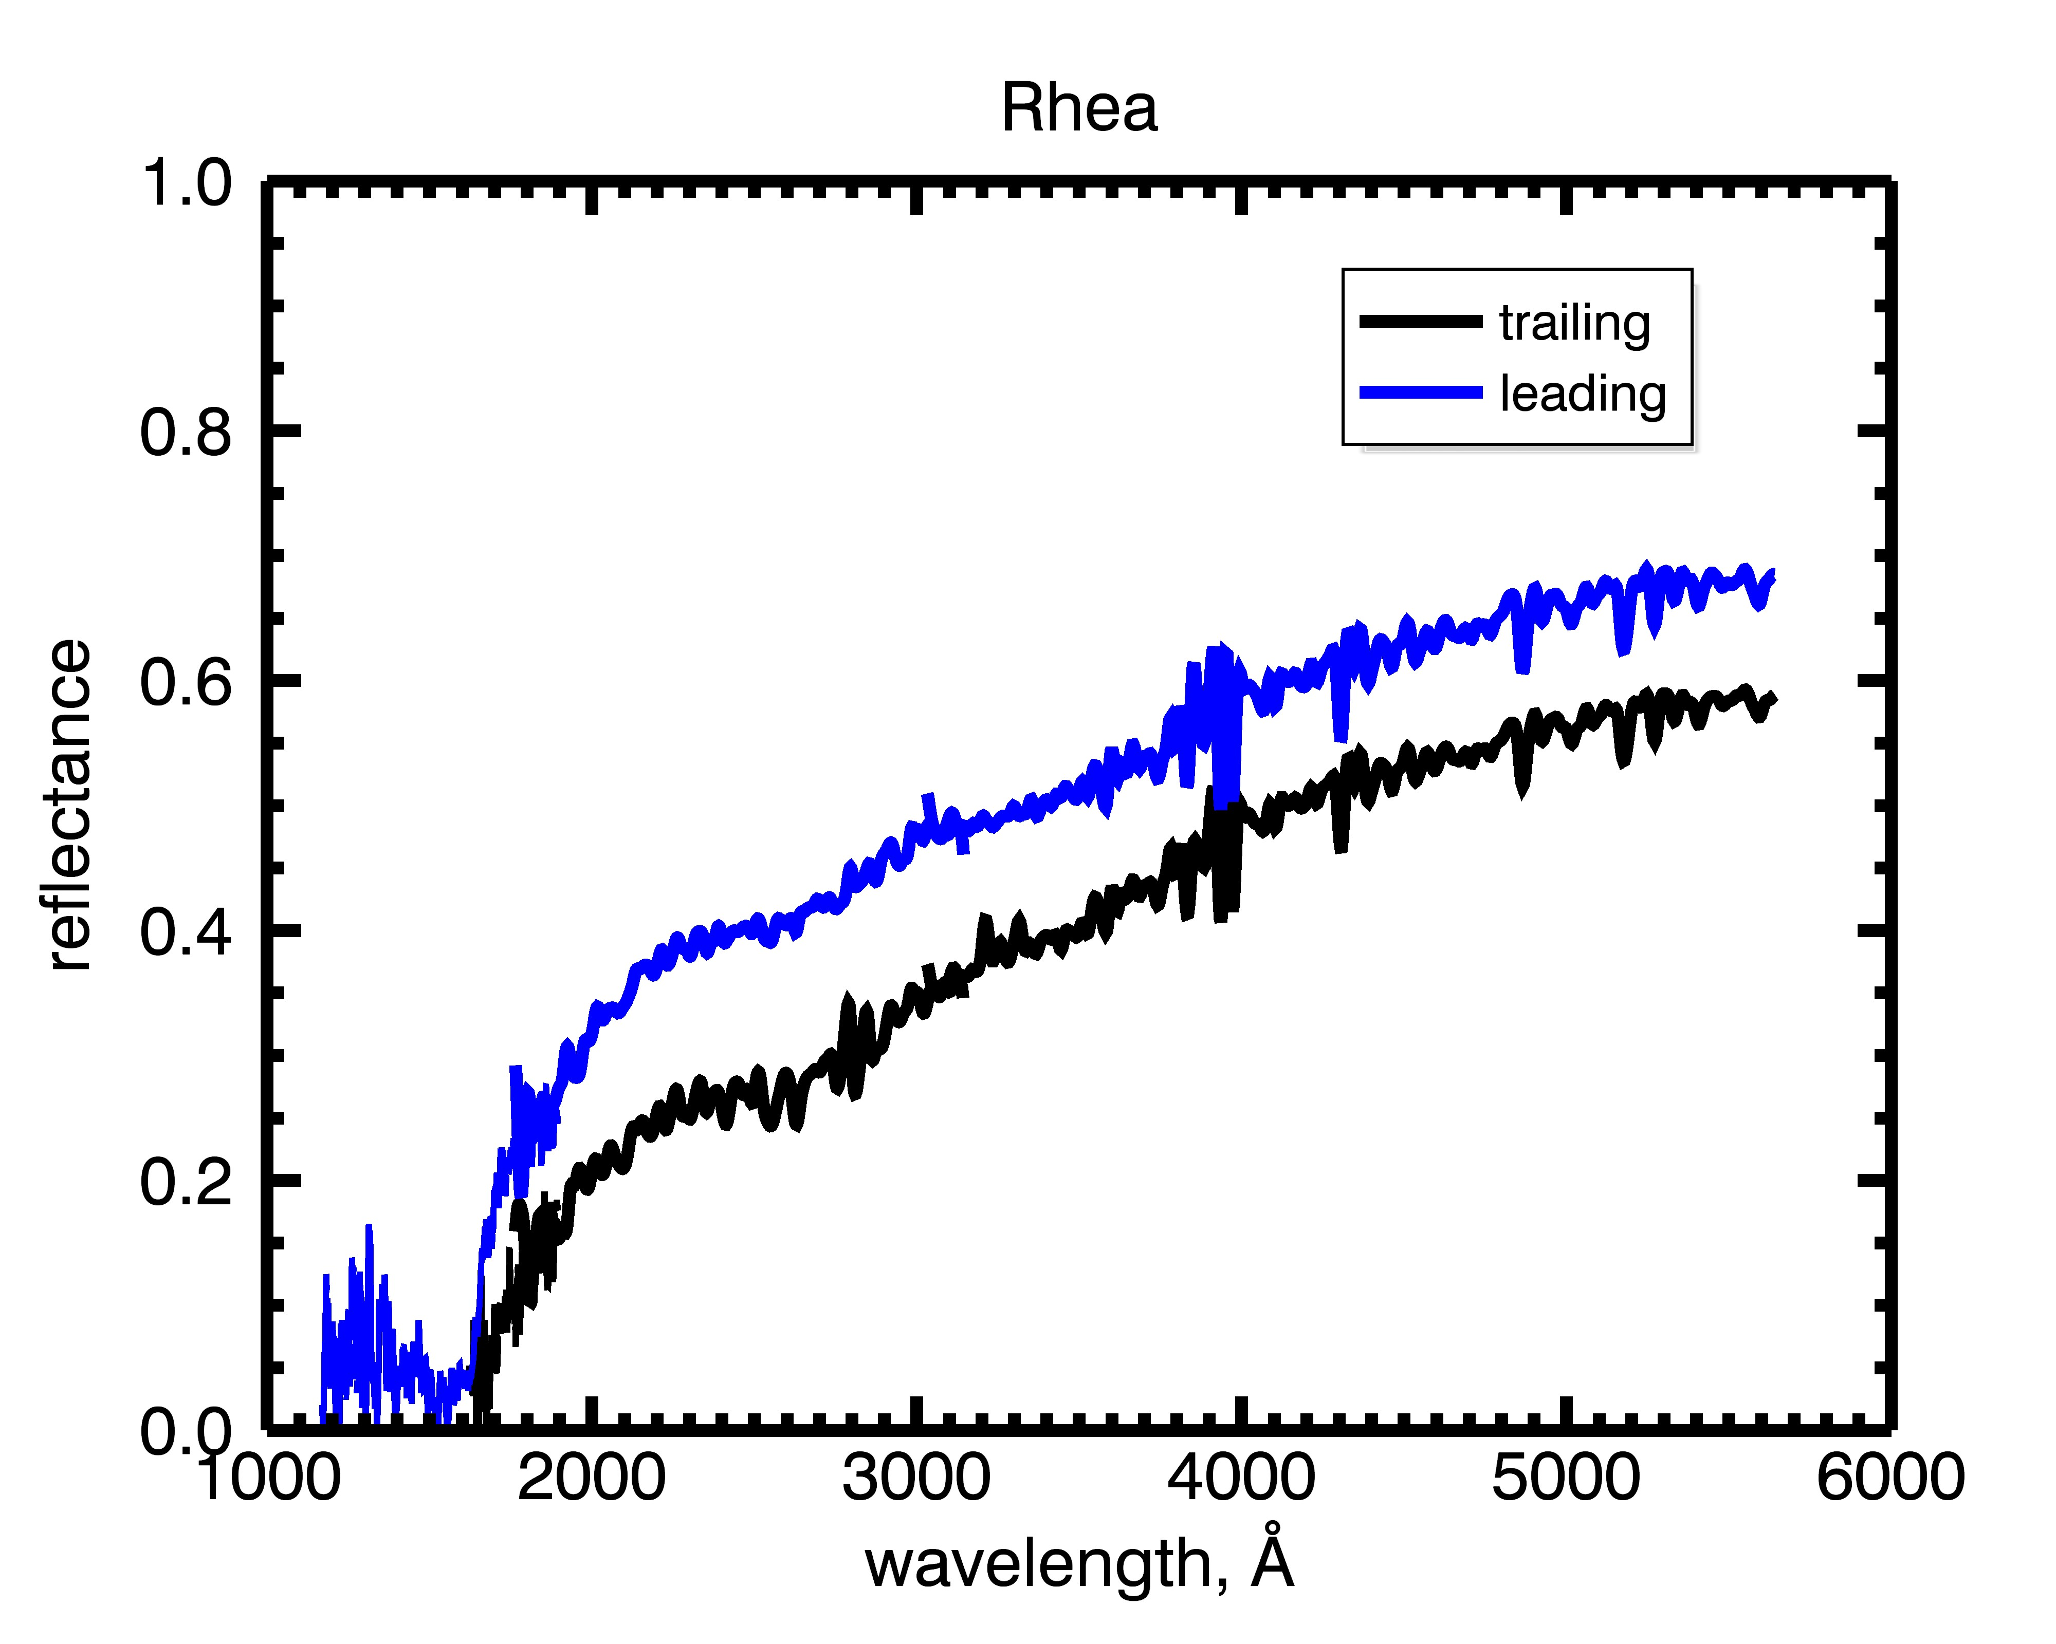
HST/STIS data
+ Cassini UVIS
Notes:
Note absorption
Also seen in Noll spectra (RH etc, id’d as O3)
They all also have some amount of reddish slope

Slide 8
Spectral Trends
Look at trends in spectral redness and trends in 260 nm absorption band depth
Compare with E ring grain flux, particle fluxes
(follows on from work by Hendrix et al., 2018, now using new HST data from STIS)

Slide 9
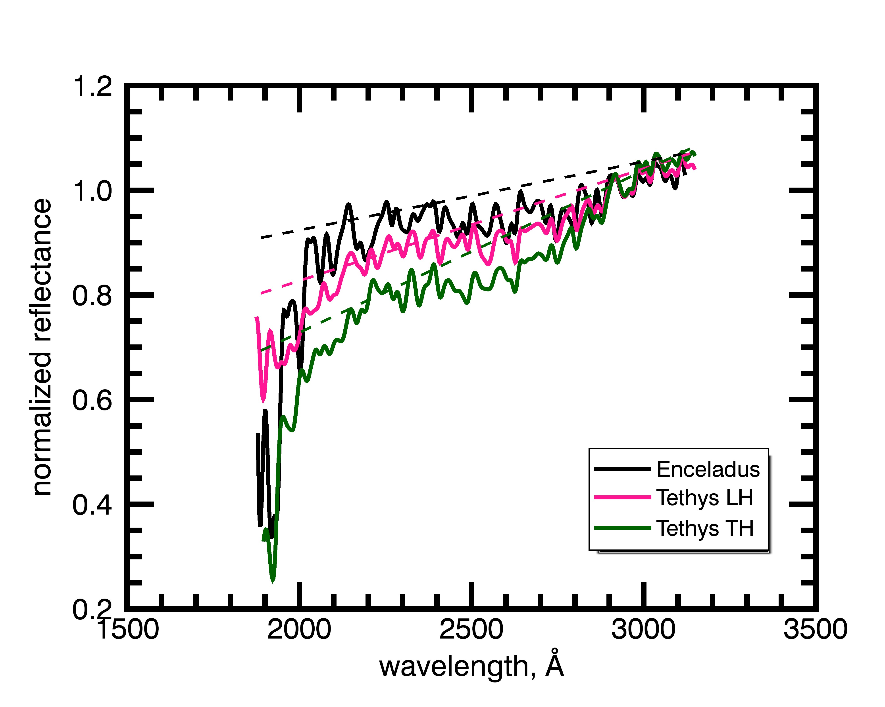

Slide 10
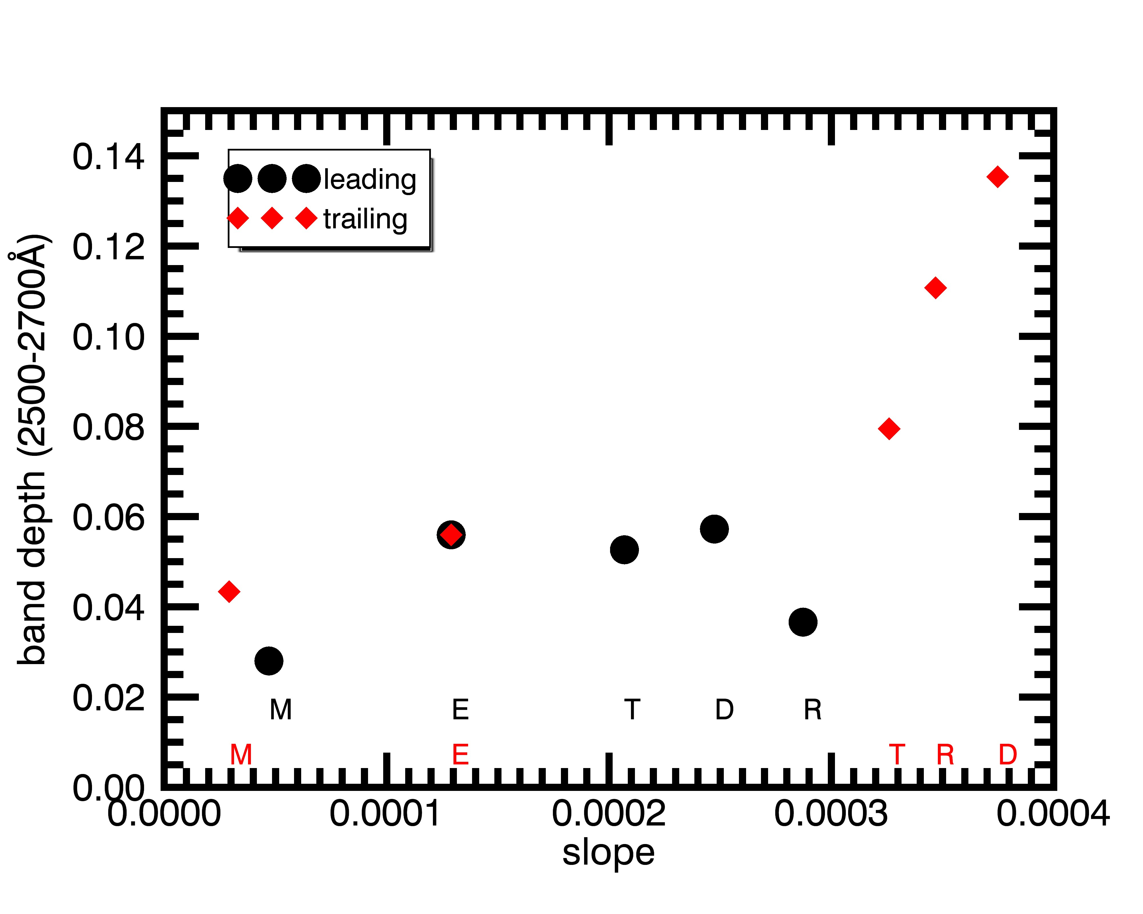
Banddepth vs. spectral slope
1
On the TH, deeper banddepths associated with redder slopes
(Less so on the LH)
Notes:
Band depths are stronger on TH compared to LH

Slide 11
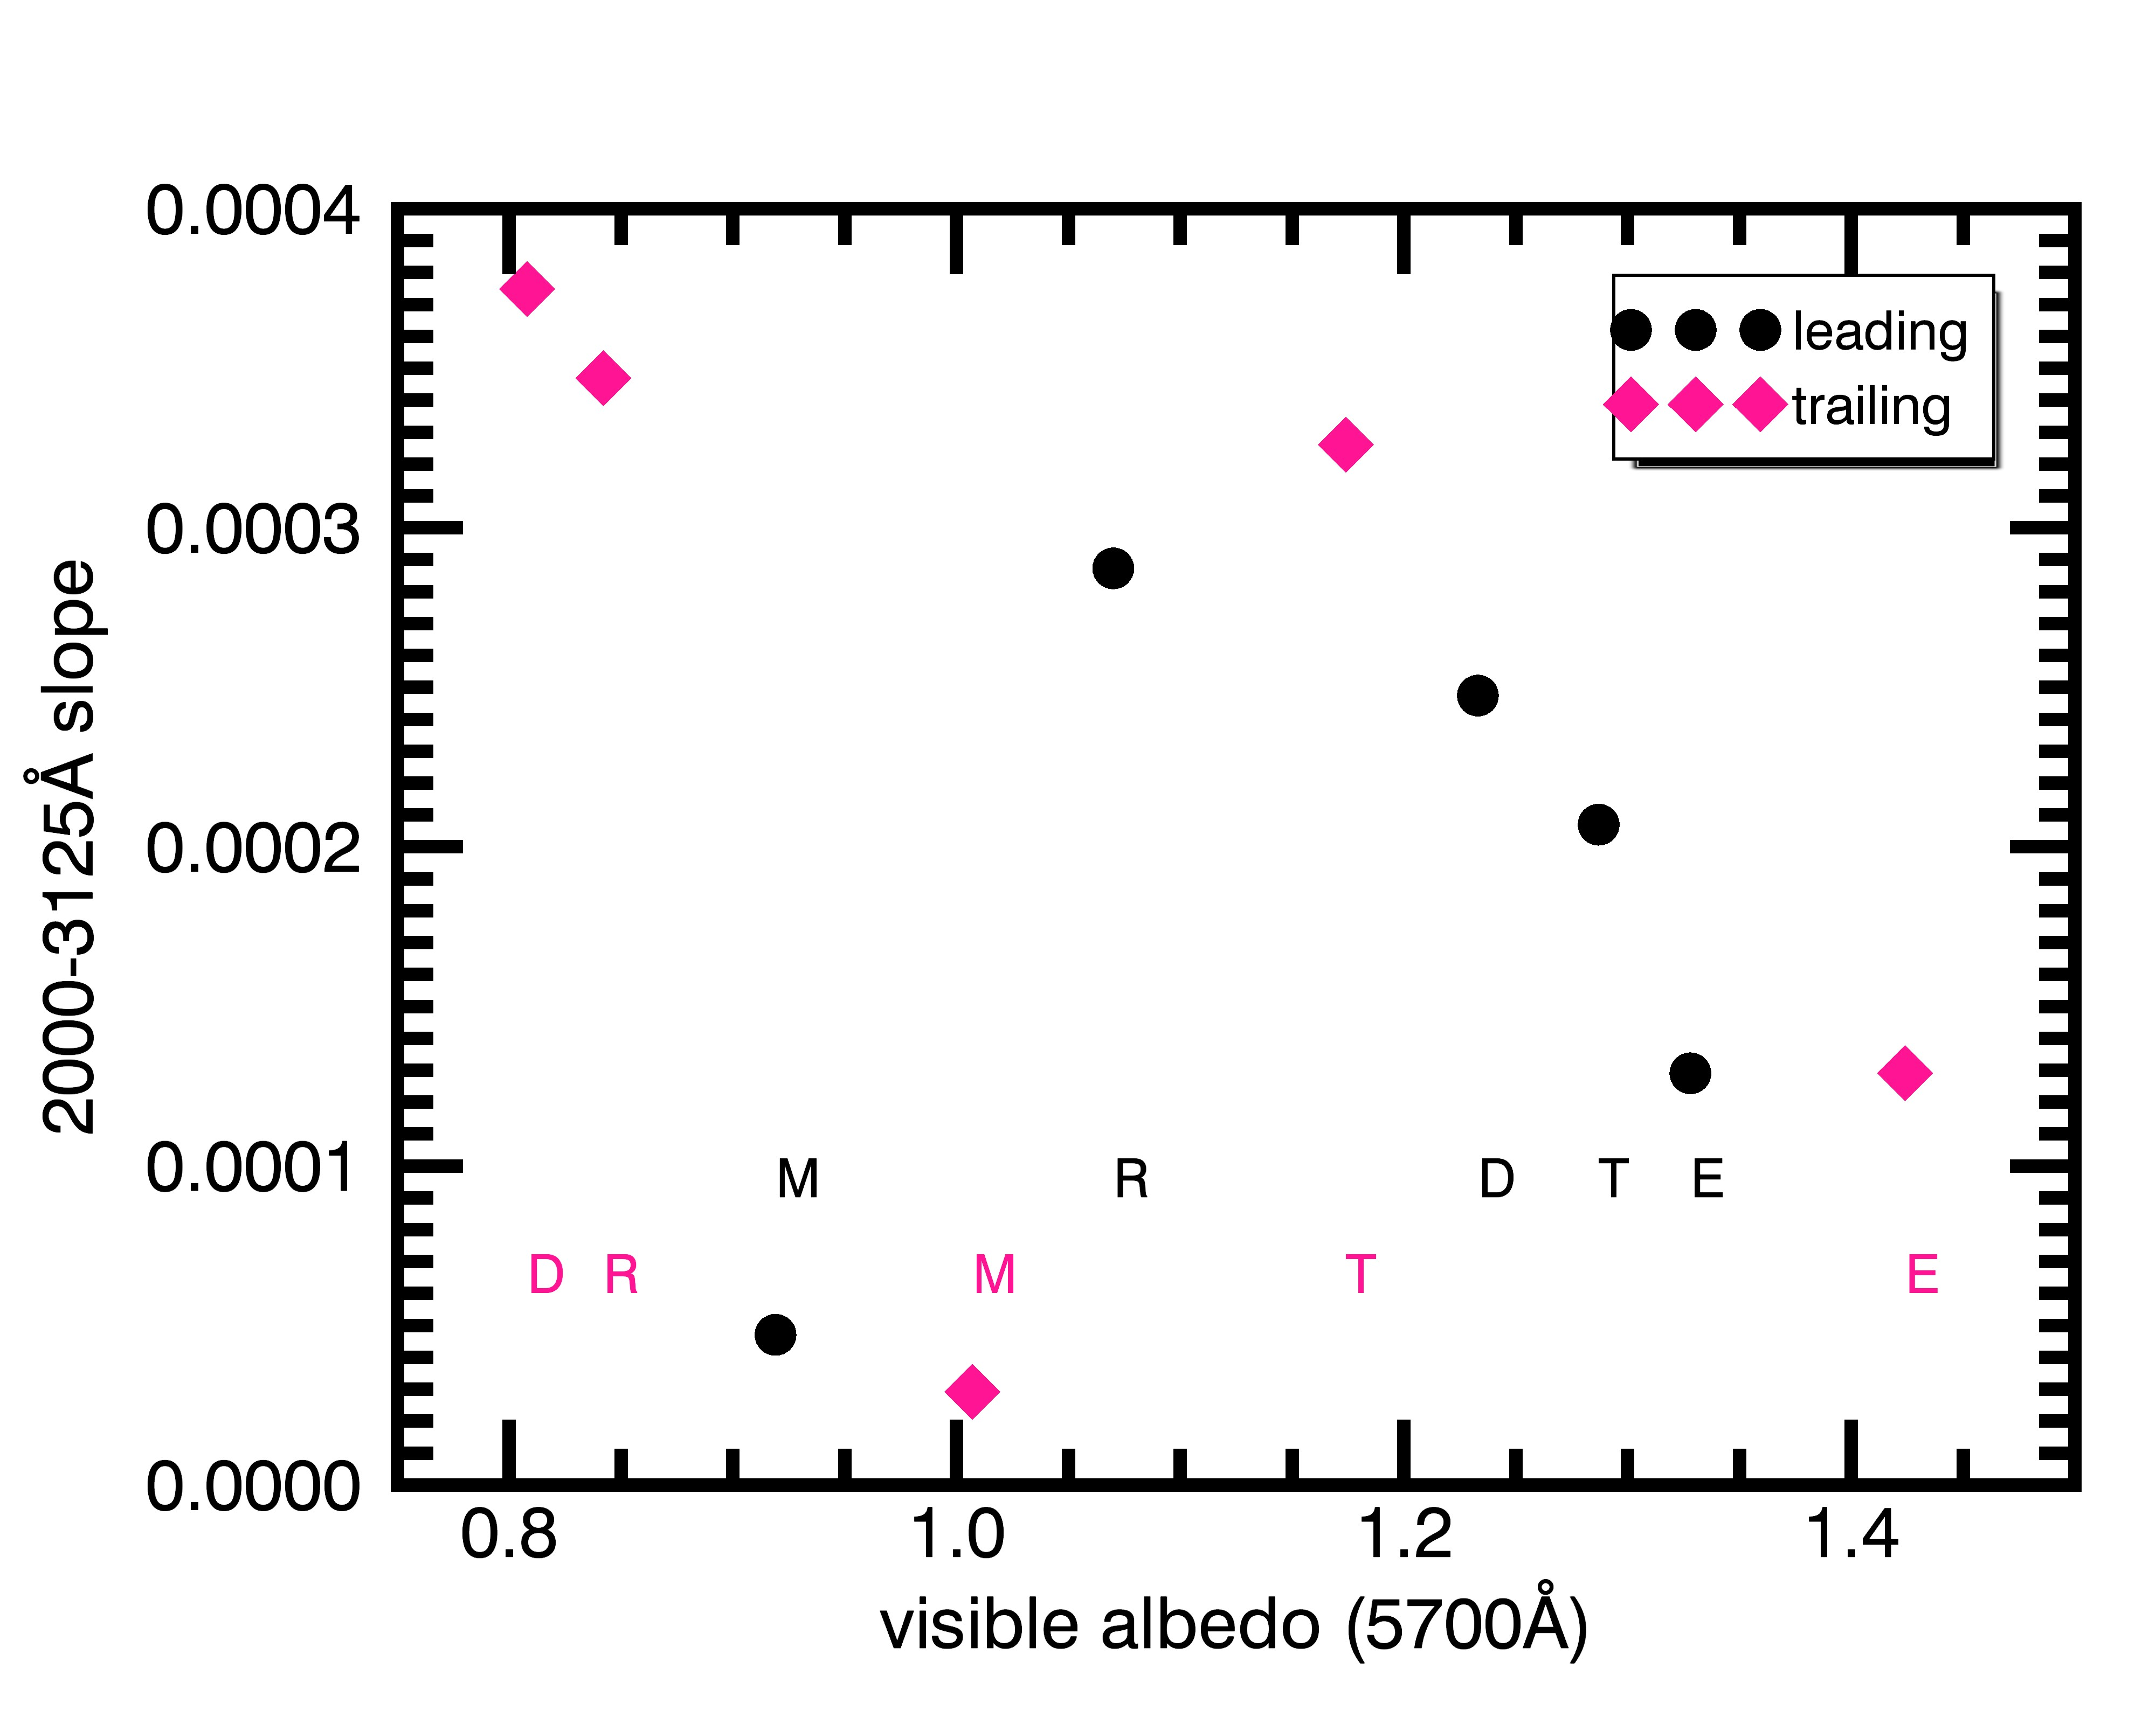
Spectral slope vs. albedo
2
Except at Mimas, lower albedos are linked with redder slopes
Notes:
Also:
LH: Band depth increases with albedo
TH: Band depths are stronger for lower albedos (except for Mimas)

Slide 12
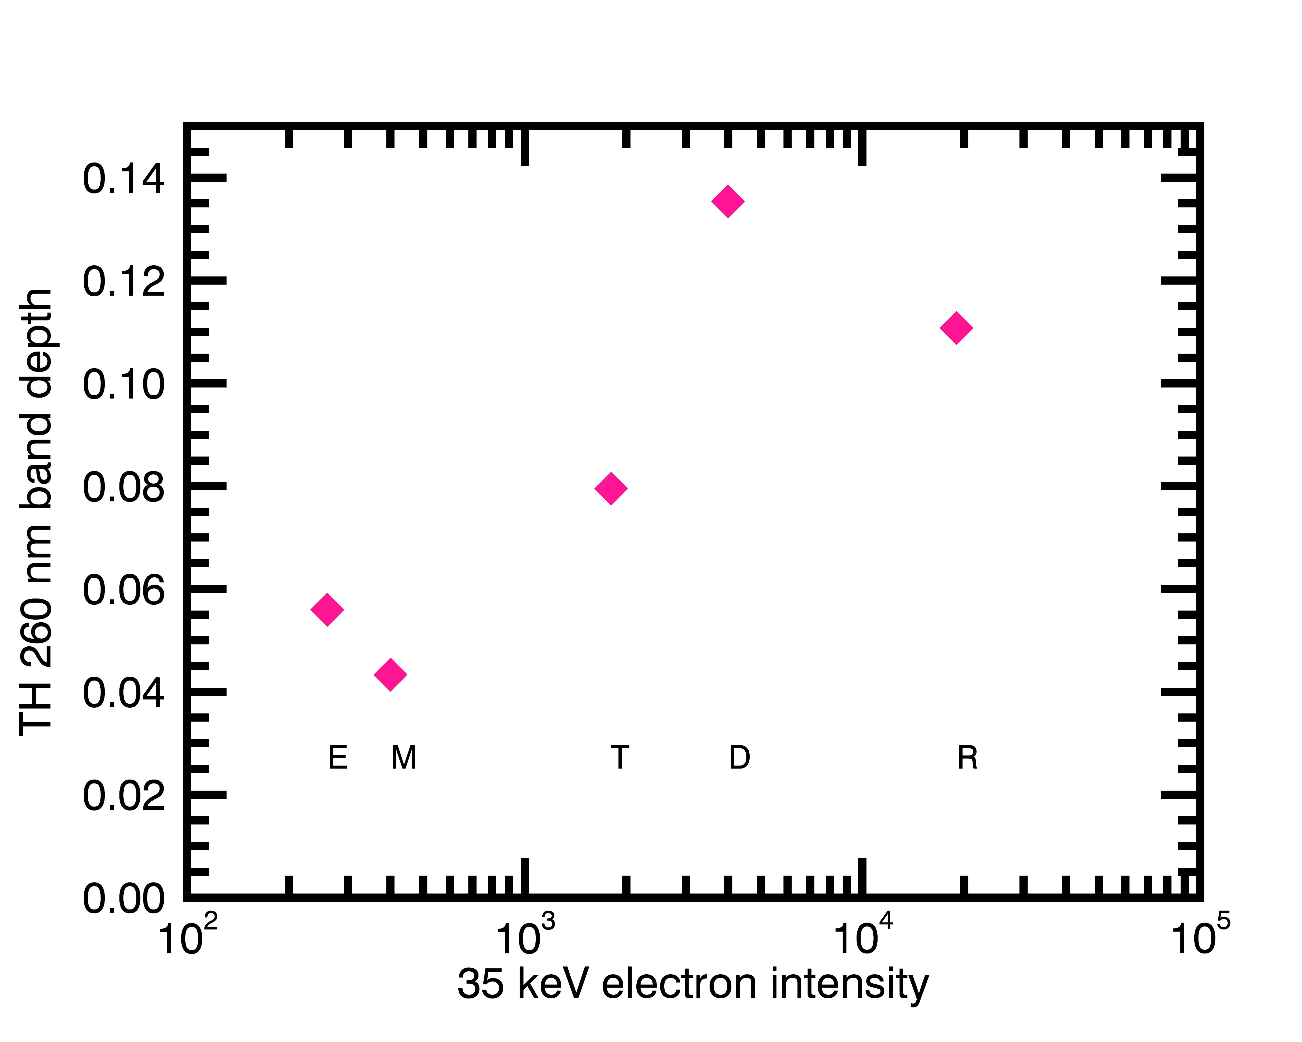
TH: Banddepth vs. ~tens of keV electrons
3
TH: the banddepth increases in strength with intensity of ~tens of keV electrons

Slide 13
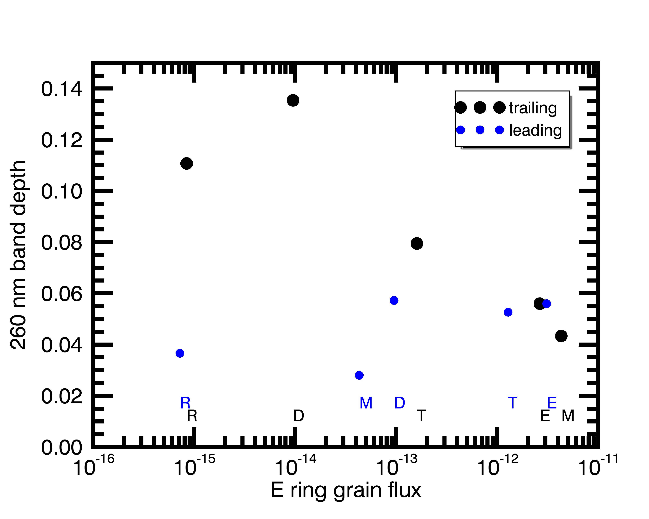
Banddepth vs. E ring grain flux
4
On the LH, 260 nm absorption band strength increases slightly with E ring grain flux.
On the TH, the abs band strength decreases with E ring grain flux.

Slide 14
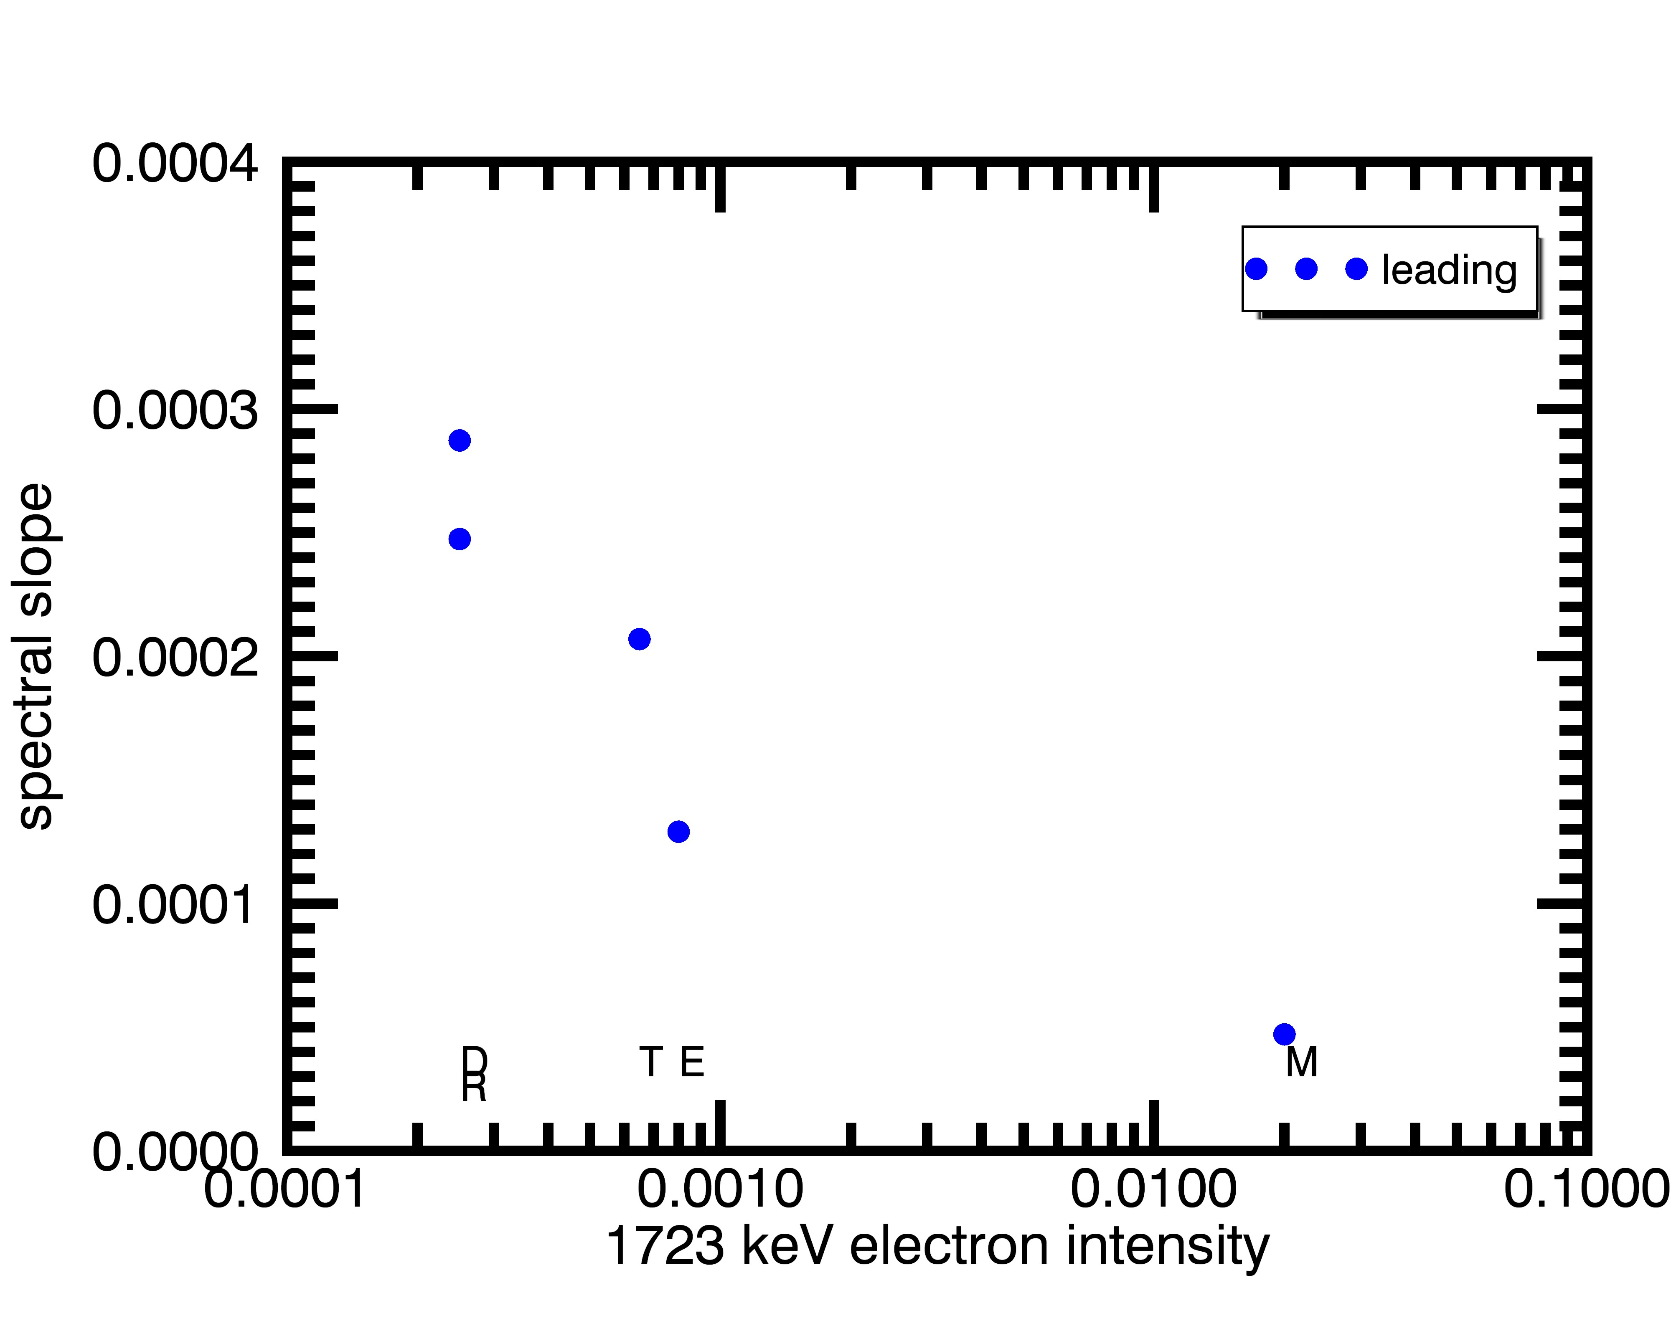
LH: MeV electrons vs. spectral slope
5
On the LH, slopes get bluer with increasing MeV electron intensity (poss. related to blue lenses)
Notes:
Because there are competing processes, it’s difficult to isolate the effects of any once process.

Slide 15
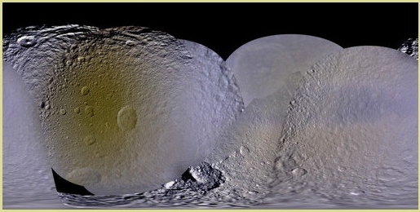
Tethys (Schenk et al., 2011)
trailing
leading
Notes:
But I think that we can largely sense the spectral effects of E ring grains by looking at the leading hemisphere of Tethys. On the LH, outside of the MeV electron lens we expect to be just E ring material. Fairly pristine – likely irradiated, but also constantly emplaced onto surface. So this is a clue to what E ring grains look like: yellowish (i.e. not pure water ice)
So this is a clue that the effects we’re seeing point to the presence of a non-water-ice species, likely some component of the E ring.

Slide 16
Some Trends
On the leading hemispheres, E ring grain bombardment and MeV electron bombardment are the primary exogenic process
MeV electrons likely contribute to bluer slopes on LH (plot 5)
260 nm absorption is related to redness (plot 1); E ring grains are yellowish/reddish (Tethys color map); E ring grains may also contribute to 260 nm bands on LH (plot 4)
On the trailing hemispheres, E ring grain bombardment and keV electron bombardment (<- may dominate effects).
The response to keV electron bombardment may be to strengthen the 260 nm absorption (plot 3) (and also darken and redden).
Notes:
The 260 nm absorption may be initially linked to E ring grains, but then strengthened by keV electron bombardment.

Slide 17
Some Possible Implications
The E ring is an important coloring agent in the Saturnian system
Already known to be an important albedo/brightening driver (Verbiscer et al., 2007)
Likely mainly a non-water ice component of the E ring grains
These signatures may be due to radiolytic processing salts and/or organics (primary non-ice species in E ring; Postberg et al., 2018)
Both get redder with radiolytic processing
Radiolysis of salts tends to produce color centers/absorptions (Hibbitts et al., 2017; Hand & Carlson, 2015) (not seen in our data)
Some organics exhibit absorptions near 260 nm
Work is ongoing to understand
Ozone? (Noll et al. 1997) Not sure about that.
Notes:
Not clear that ozone production is consistent with the trends that we observe, but we’re not ruling it out

Slide 18
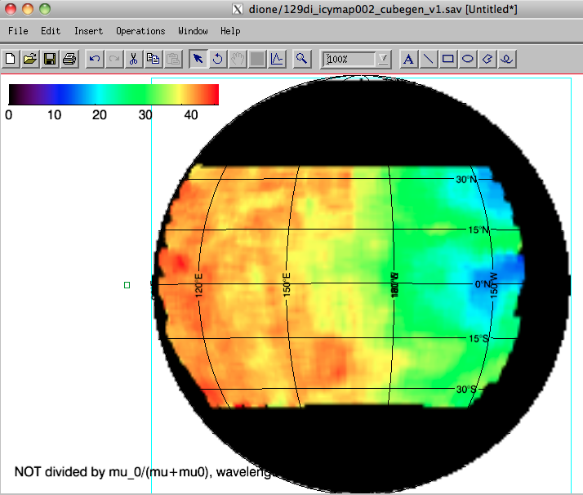
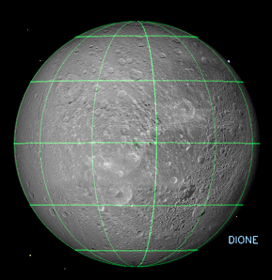
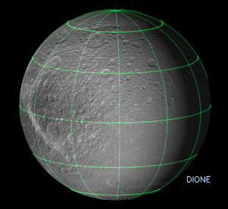
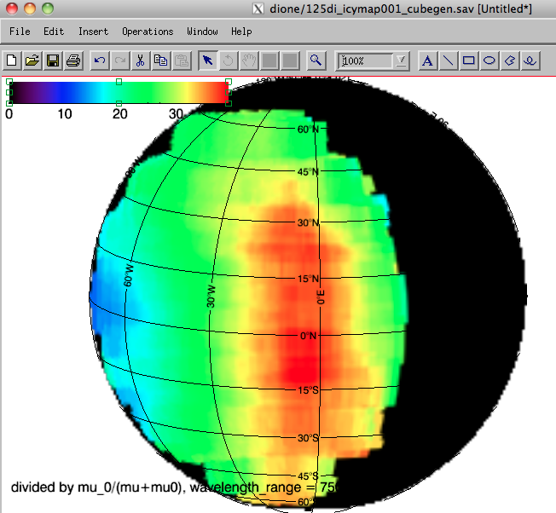
In the Next Year …
The focus will be on disk-resolved observations and the production of maps
0°W
180°W
For μ₀>0.5 only

