Slide 1
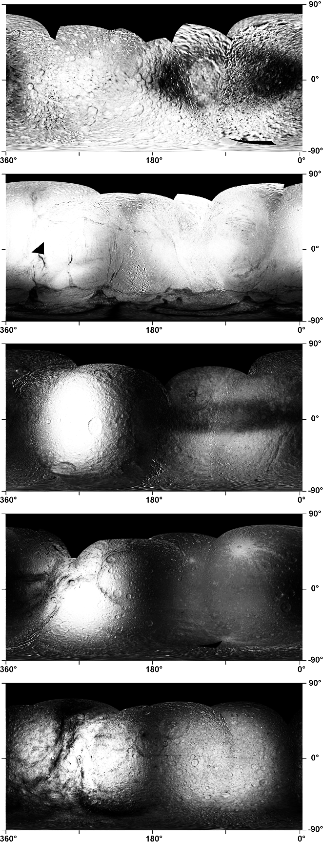
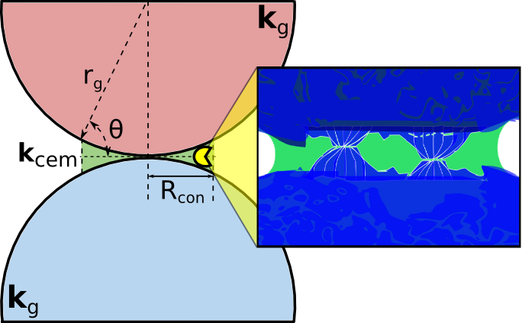
Radiation-induced sintering of icy regoliths:
Learning from PacMan
Micah J. Schaible¹, R.E. Johnson², T. Nordheim³, C. Howett⁴
¹Georgia Institute of Technology, ²University of Virginia,
³Jet Propulsion Laboratory, ⁴Southwest Research Institute
Notes:
1

Slide 2
Notes:
2

Slide 3
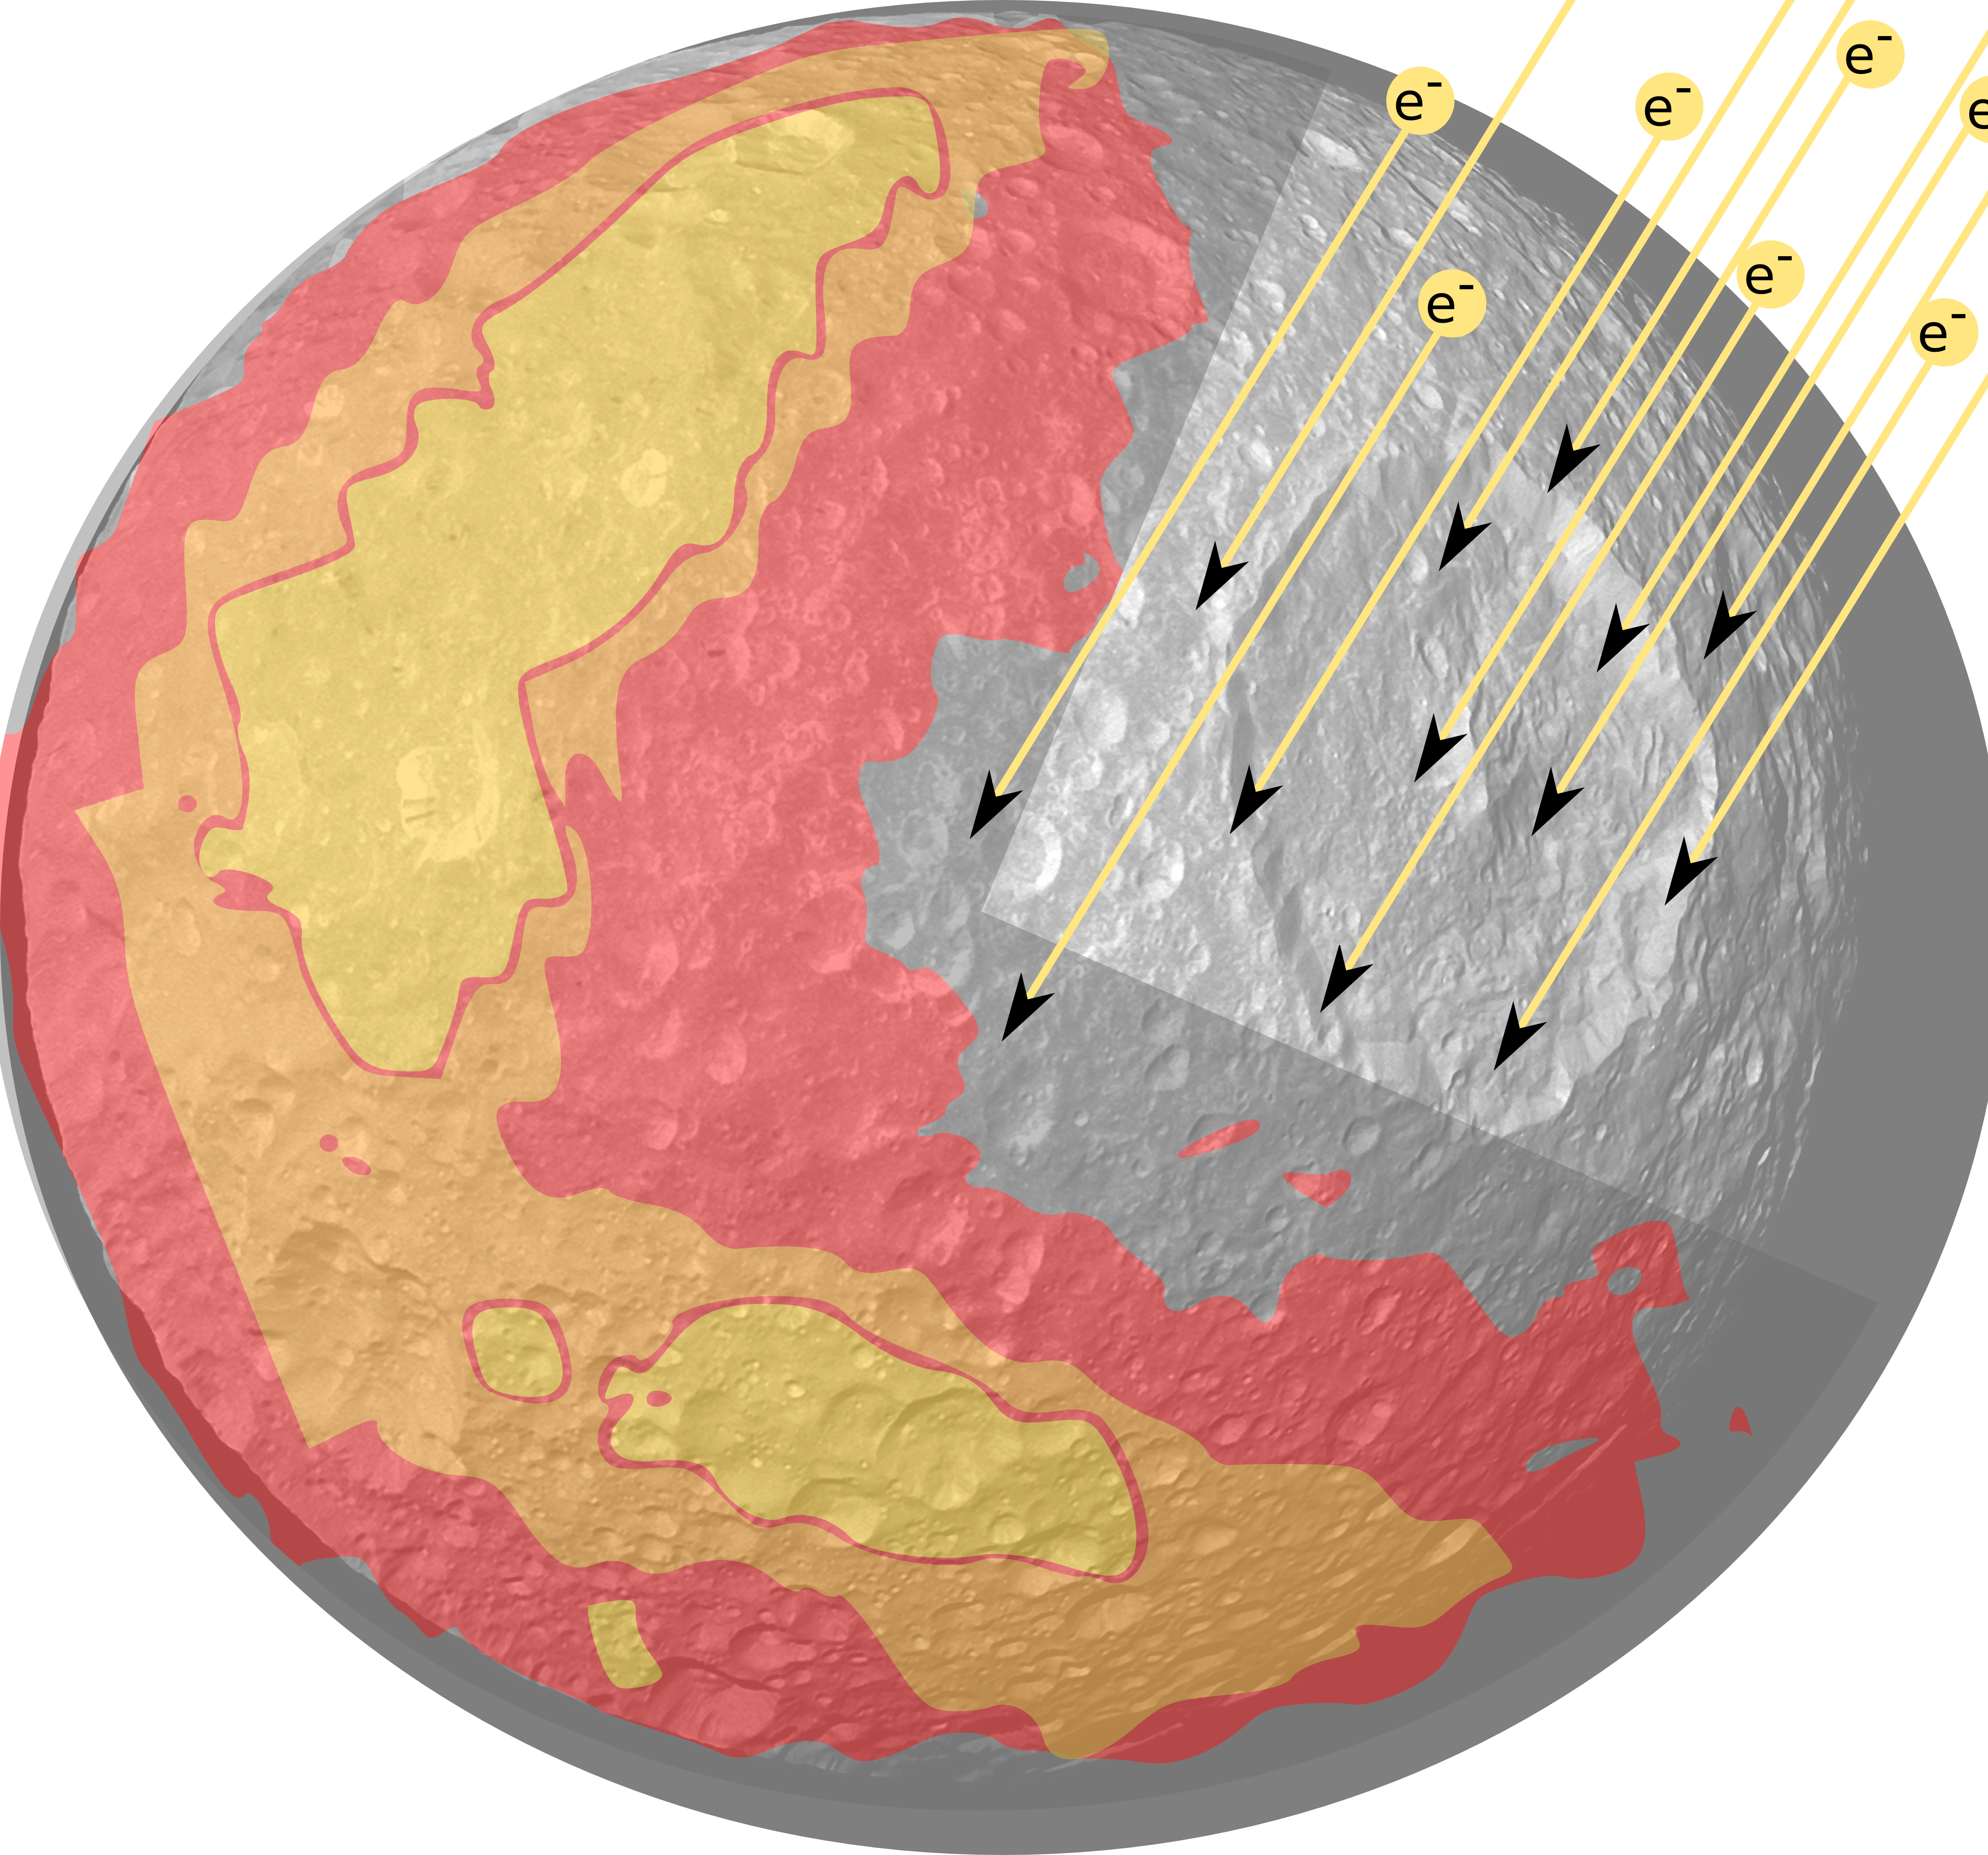
Icy moon environments
Mimas, Tethys, and Dione:
Tidally locked to Saturn
Predominantly crystalline water ice
Magnetosphere plasma
Interplanetary dust particle (IDP) and E-ring grain resurfacing
Notes:
Grain size: submicron to ~25um
Porosity: 50-95%
3

Slide 4
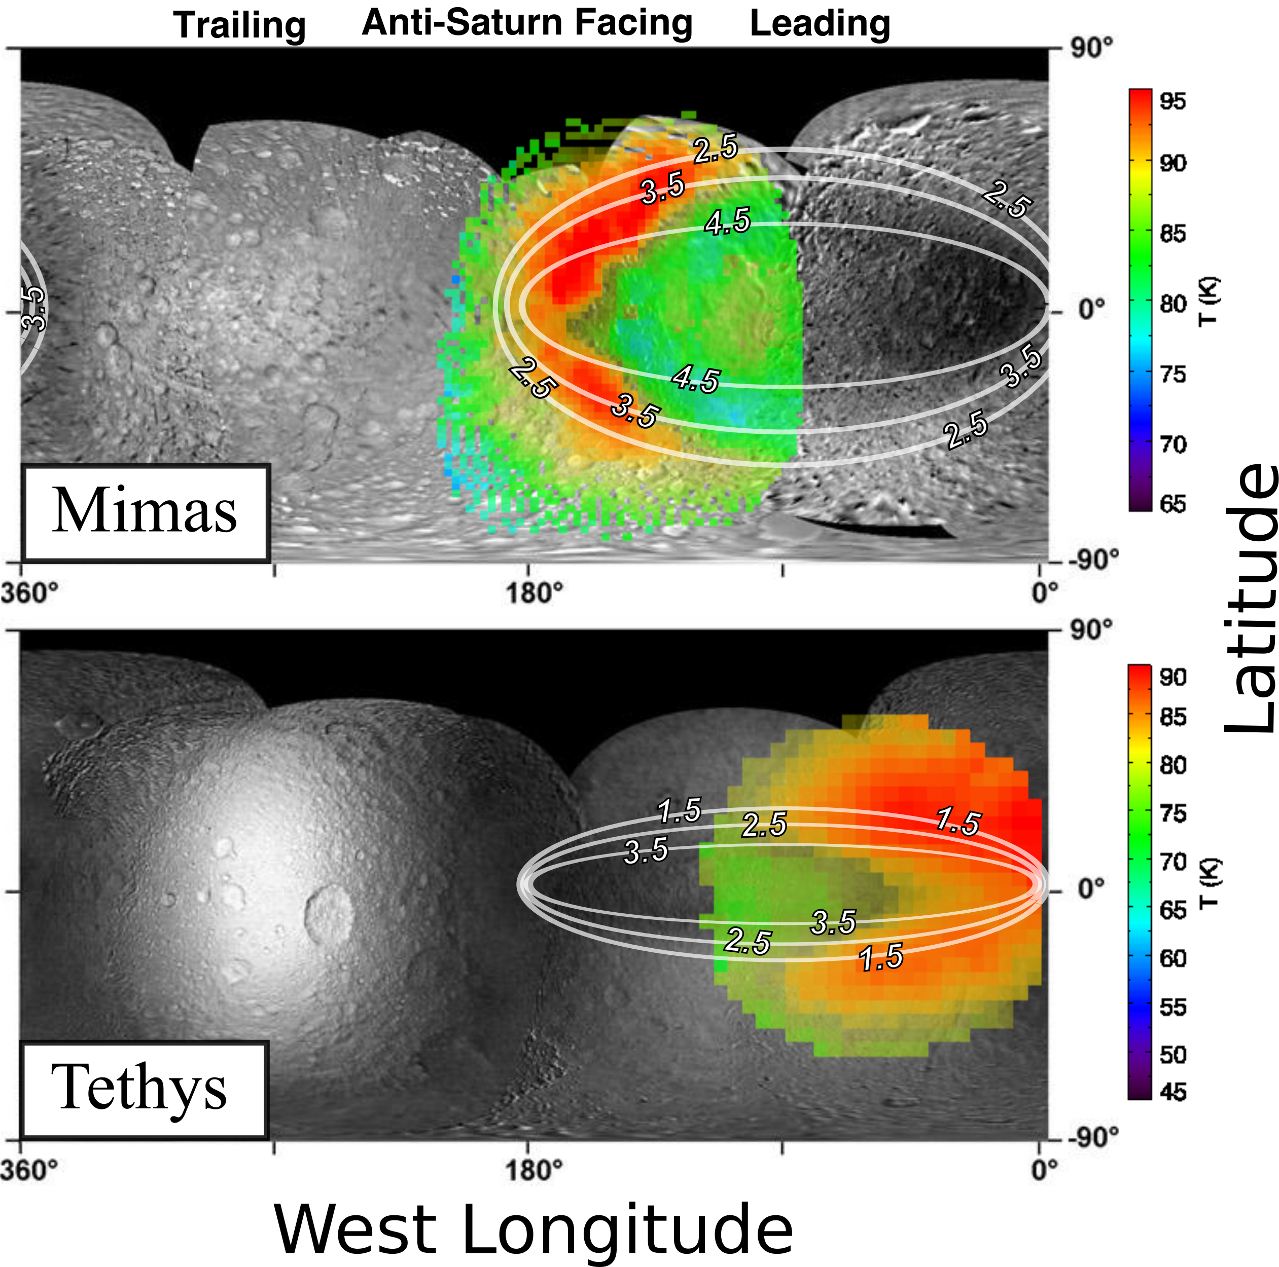
The PacMan Anomaly:
Day-time Surface Temperature Maps
Regional overlap of:
  Anamalous thermal inertia
  Optical discolorations
  High energy electron deposition contours
Schenk et al., 2012; Howett et al., 2014; Paranicas et al., 2014; Schaible et al., 2017

Slide 5
The PacMan Anomaly:
Schaible et al., 2017

Slide 6
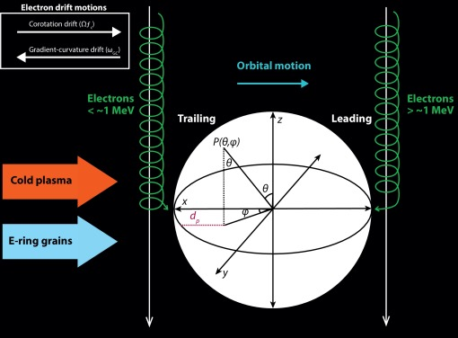
Electron environment at Mimas
Nordheim et al., 2017

Slide 7
The PacMan Anomaly:
a well defined case for space weathering
Surfaces are (roughly) regionally homogeneous: surface topology, composition, and grain impacts
Leading hemisphere radiation environment dominated by high energy (> 1 MeV) electrons
Electron interactions with water ice relatively well understood: radiation-induced diffusion, sputtering
Each step of the process can be described to 1st order using well understood modeling techniques

Slide 8
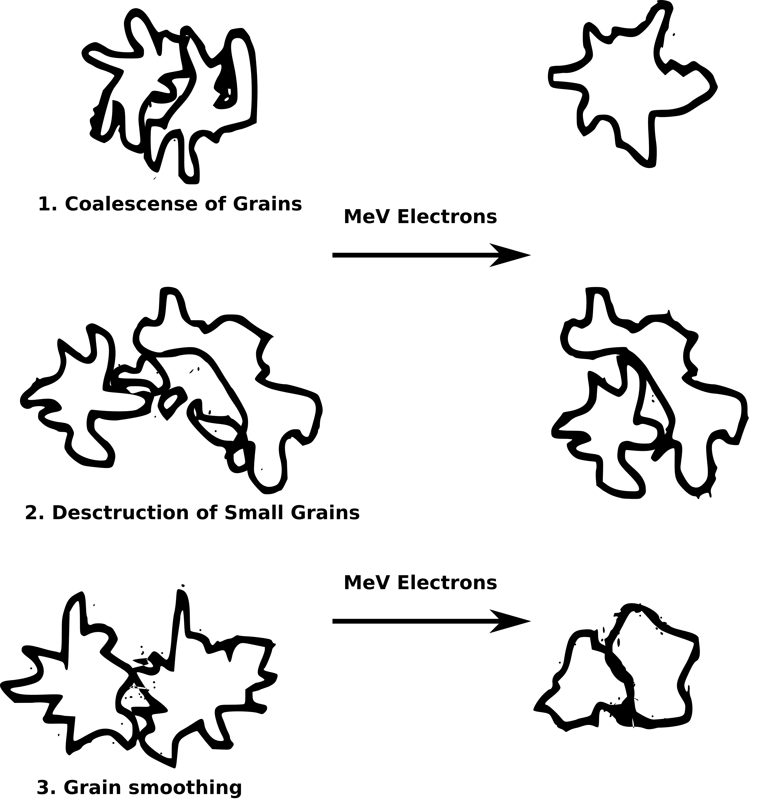
Sintering of regolith grains
~MeV electron bombardment leads to:
  Grain smoothing
  ‘Filling in’ of intergrain contact

Slide 9
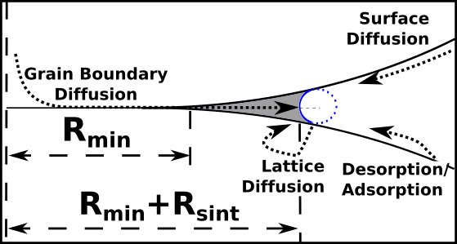
Sintering of regolith grains
Standard SA81
Schaible et al., 2017
Notes:
N = # defects created
𝑙_𝑒𝑓𝑓= Molecular diffusion length
𝜏_0 = excitation timescale
9

Slide 10
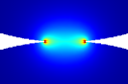
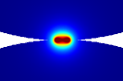
Sintering of regolith grains
Grain contact region is the 'bottle-neck' for heat flow
Sintering increases neck size
Increased the heat transport capacity of the contact
Schaible et al., 2017
Notes:
N = # defects created
𝑙_𝑒𝑓𝑓= Molecular diffusion length
𝜏_0 = excitation timescale
10

Slide 11
Radiation-Induced Sintering at the Icy Moons of Saturn
Characterize the radiation environment
  Ray tracing
  Monte Carlo
Quantify the electron induced sintering
  Molecular dynamics
  Experimental
Estimate radiation-induced sintering rates for icy regoliths under a variety of radiation conditions
Compare sintering rates with measured thermal inertia values to estimate sintering timescales,
Compare with regolith turnover timescales

Slide 12
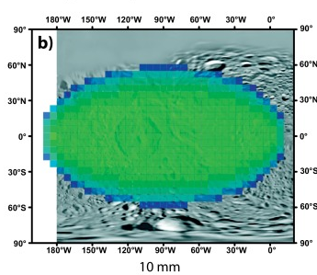
Electron environment at Mimas
Energy deposition on the leading hemisphere
Timescale in log₁₀ years
to reach 100 eV / 16 amu
→ Each molecule excited
approximately once
Nordheim et al., 2017

Slide 13
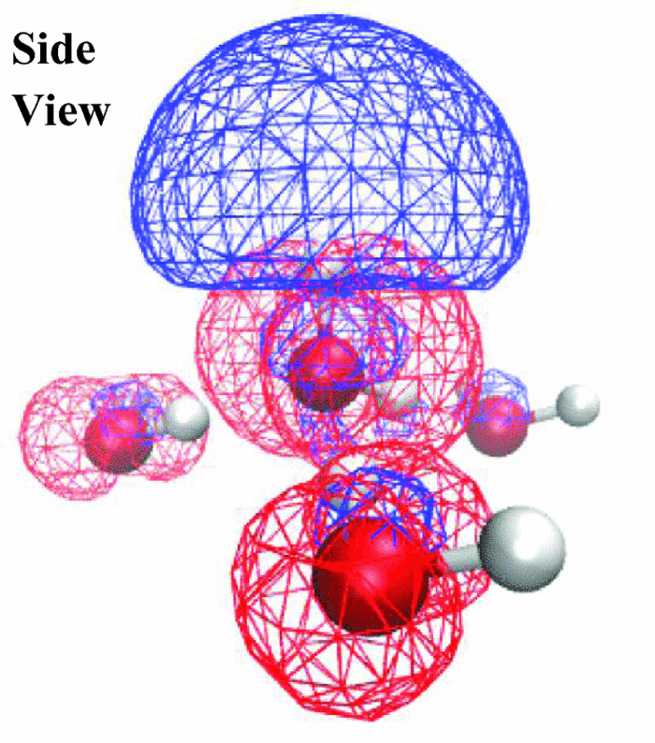
Electronic-excitation and diffusion of water molecules
Solid-state interactions reduce
molecular dissociation
Exciton delocalization leads to
dipole reversal state
Subsequent repulsion can lead
to desorption and diffusion
Could be efficient driver for
surface diffusion
DeSimone et al., 2014

Slide 14
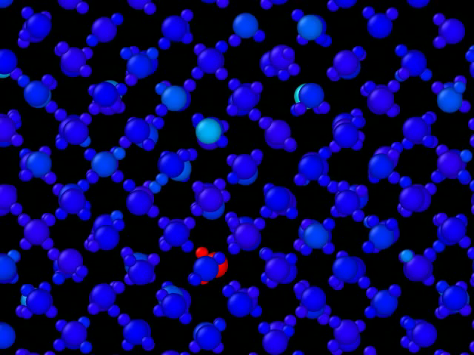
Excitation in bulk Ic ice at 80K

Slide 15
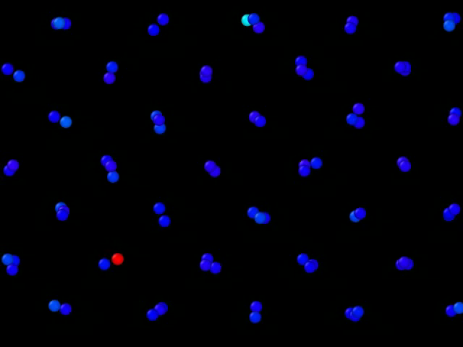
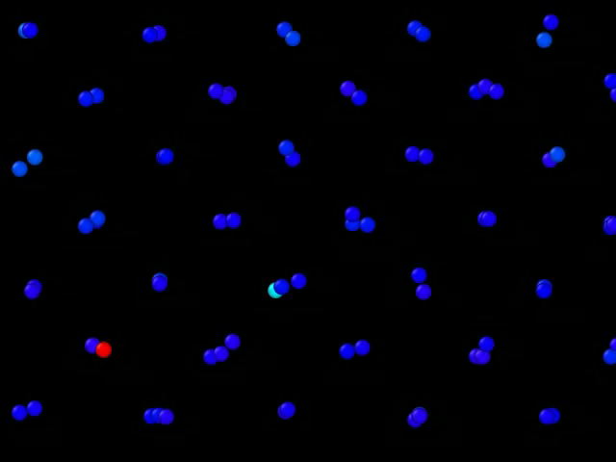
Excitation in bulk Ic ice at 80K
Front
Top

Slide 16
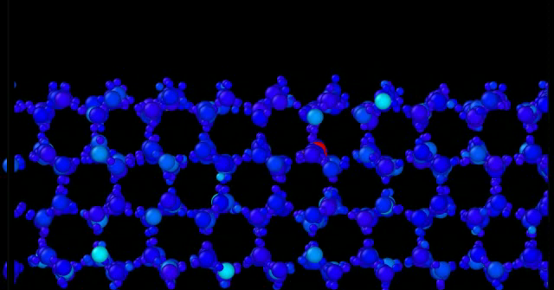
Excitation at Ih ice/vacuum interface

Slide 17
Excitation in bulk Ic ice at 80K
Average mean-squared-displacement calculated in concentric shells around the position of the primary excited molecule (PEM)
(Å²)
No strong temperature dependence
(Å)
Notes:
17

Slide 18
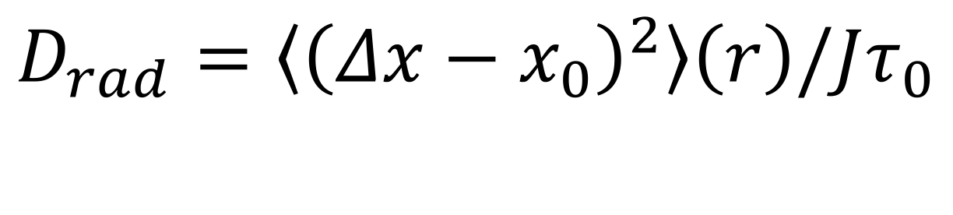
Radiation induced diffusion:
Average mean squared displacement
weighted by distance from the primary
excited molecule
$$D_{rad}=\left\langle {\left(Δx−x_{0}\right)}^{2}\right\rangle \left(r\right)/Jτ_{0}$$
τ₀ = Event Rate
Radiation-induced diffusion dominates over thermal diffusion up to ~90-100 K
Surface diffusion is the most efficient sintering pathway
Notes:
18

Slide 19
Sintering timescales (Myr)
Comparisons with resurfacing rates can constrain surface properties
Min → ’rough’ grain
Max → ‘smooth’ grain
Models suggest small ‘rough’ grains

Slide 20
Conclusions
PacMan anomalies provide a well defined case study in space weathering
Preliminary sintering models predict stable thermal anomalies
only for small or ‘rough’ regolith grains
Large uncertainties remain in
  Resurfacing timescales
  Surface grain properties
Moving Forward
A combined approach using Monte Carlo models of radiation deposition and MD simulations of mini-cascades will be used to provide improved quantitative estimates on the radiation-induced sintering rates

Slide 21
Supplementary slides

Slide 22
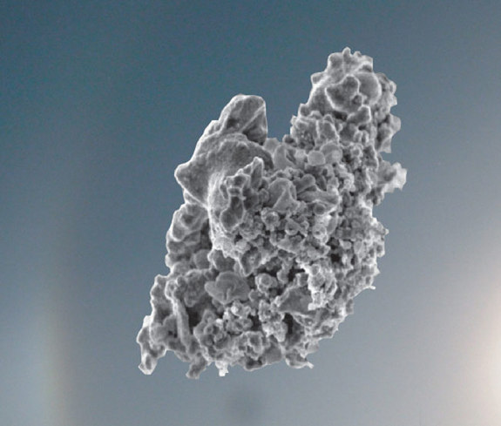
Sintering of regolith grains
Radiation-induced diffusion is more efficient for material with high defect density than well annealed ice
Notes:
Uncertainty in
Grain shape
Porosity
Size distribution
Impact resurfacing effects
22

Slide 23

Radiation induced diffusion:
N = number of displaced
molecules per mini-cascade
L_{eff} = Extent of the
mini-cascade
$$D_{rad}=NL_{eff}^{2}/Jτ_{0}$$
J = degrees of freedom for diffusion
J = 3 for bulk diffusion
J = 2 for surface diffusion
τ₀ = Event Rate
Notes:
23

Slide 24
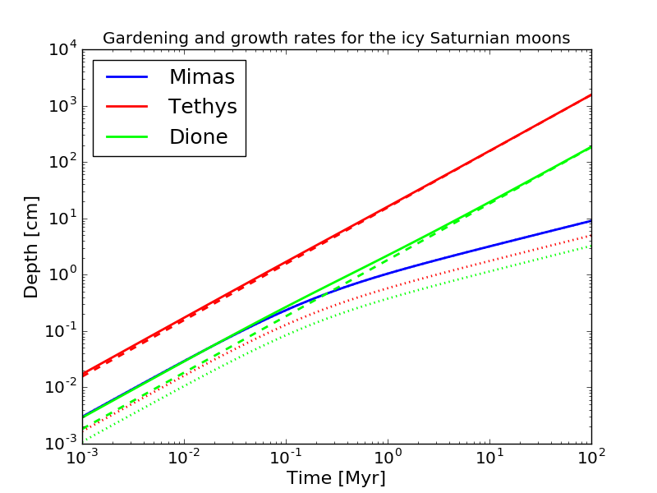
Resurfacing processes: ROUGH approximations
IDPs (dotted lines) melt and mix regolith
E-ring grains (dashed lines) ’sandblast’ and deposit fresh ice, dominates at Tethys and Dione
Mimas LH impacted only by IDPs

Slide 25
Resurfacing processes: ROUGH approximations
Ejecta rate:
sigma_IDP = fg * sigma_inf * Y
where fg is the gravitational focusing factor, sigma_inf~10-18 g/cm^2/s is the idp mass flux, and Y~10^4 is the IDP yield
The depth 'h' to which the regolith grows in time 't' is
h=σIDP*t*(1+t/t0)^(-0.55)/rho
where t0~10^5 is the mixing timescale and rho is the regolith density

Slide 26


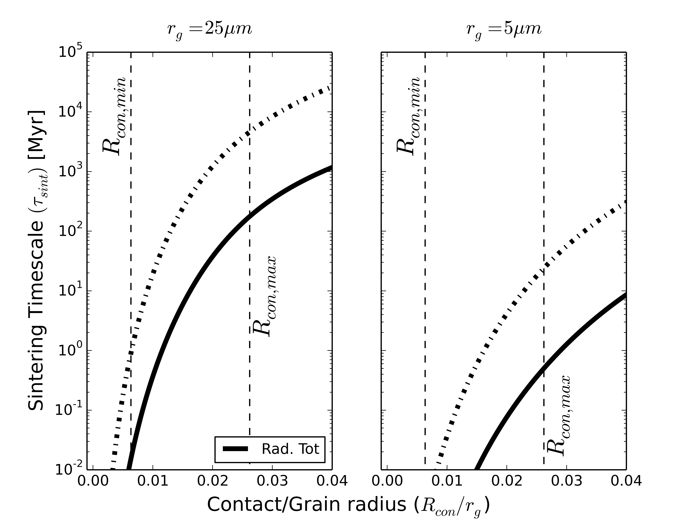
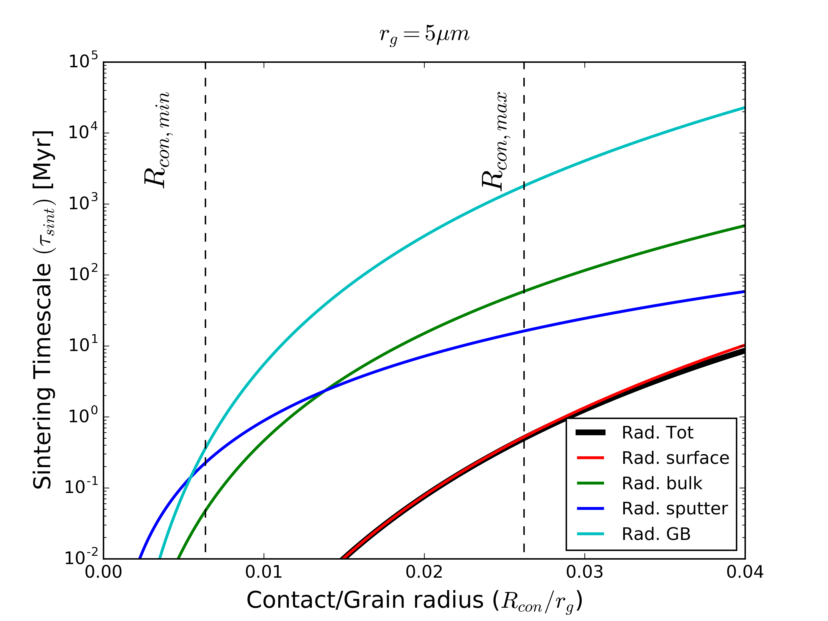
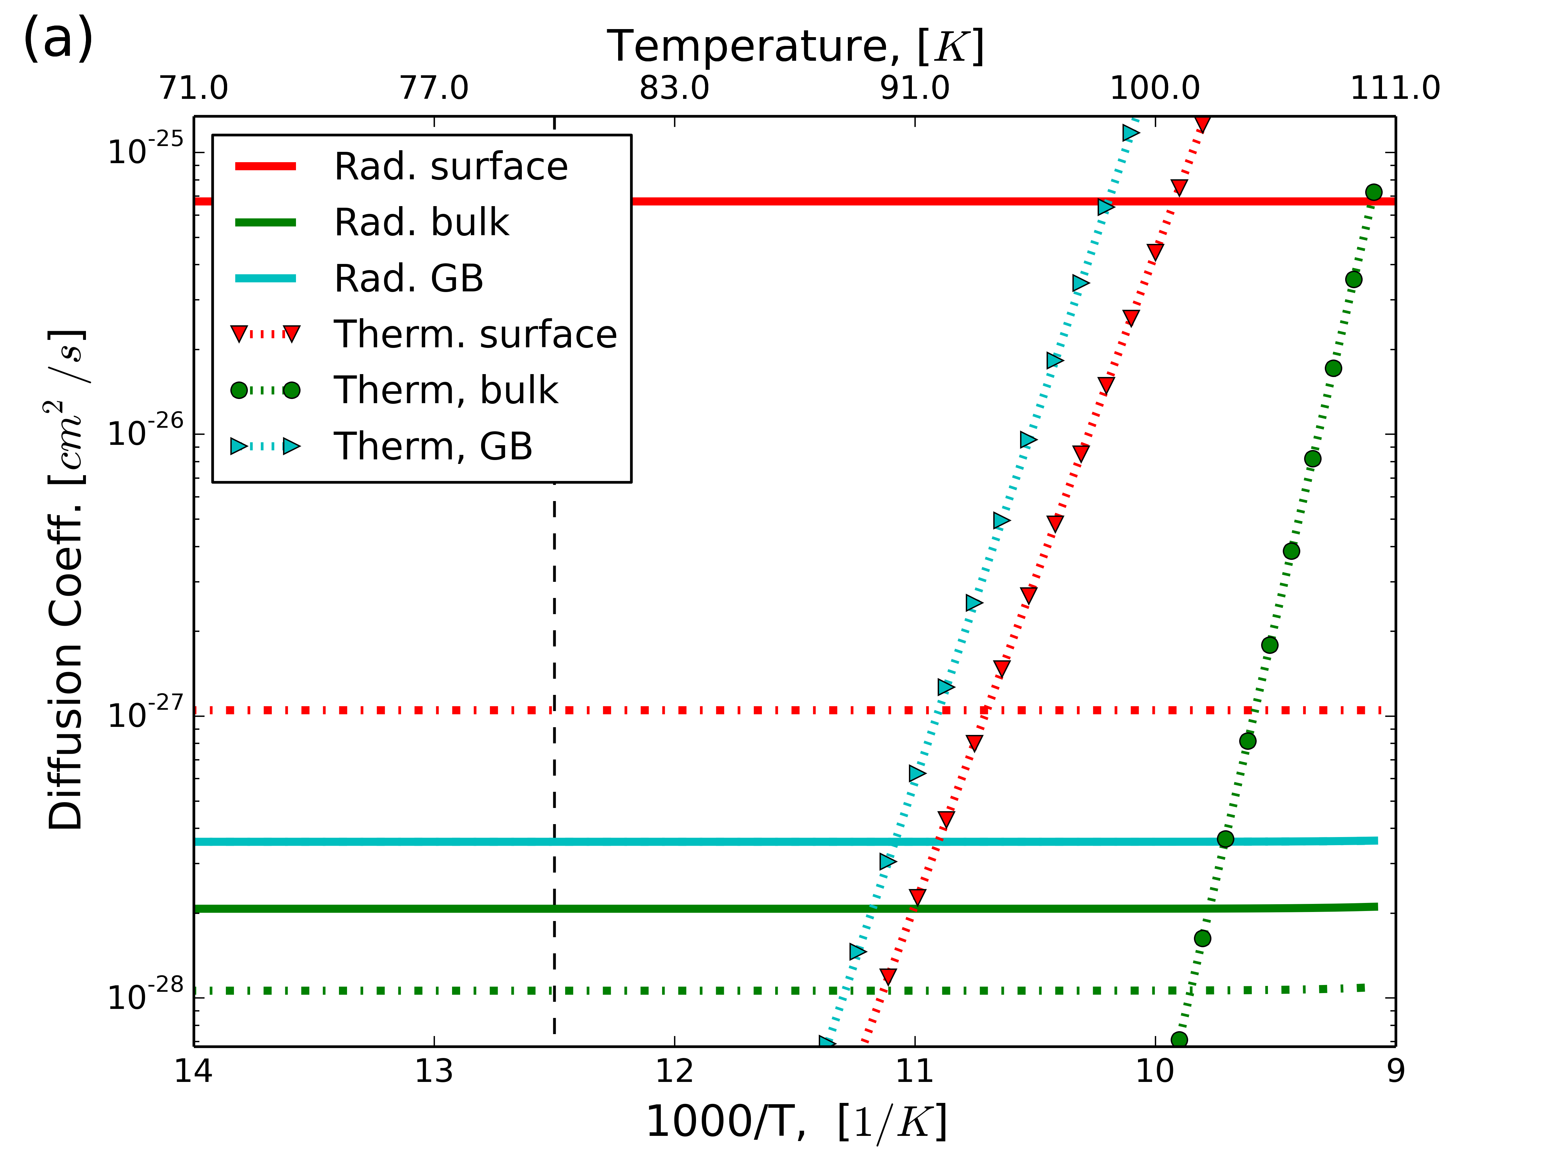
Estimates of radiation induced diffusion coefficients and spherical grain sintering
Radiation induced diffusion dominates over thermal in the relevant temperatures ranges
Solid lines = ‘rough’ grain
Dashed lines = ‘smooth’ grains
Surface diffusion dominates sintering in the size region of interest
Grain Boundary (densifying) is small, suggesting porosity changes will be small

Slide 27
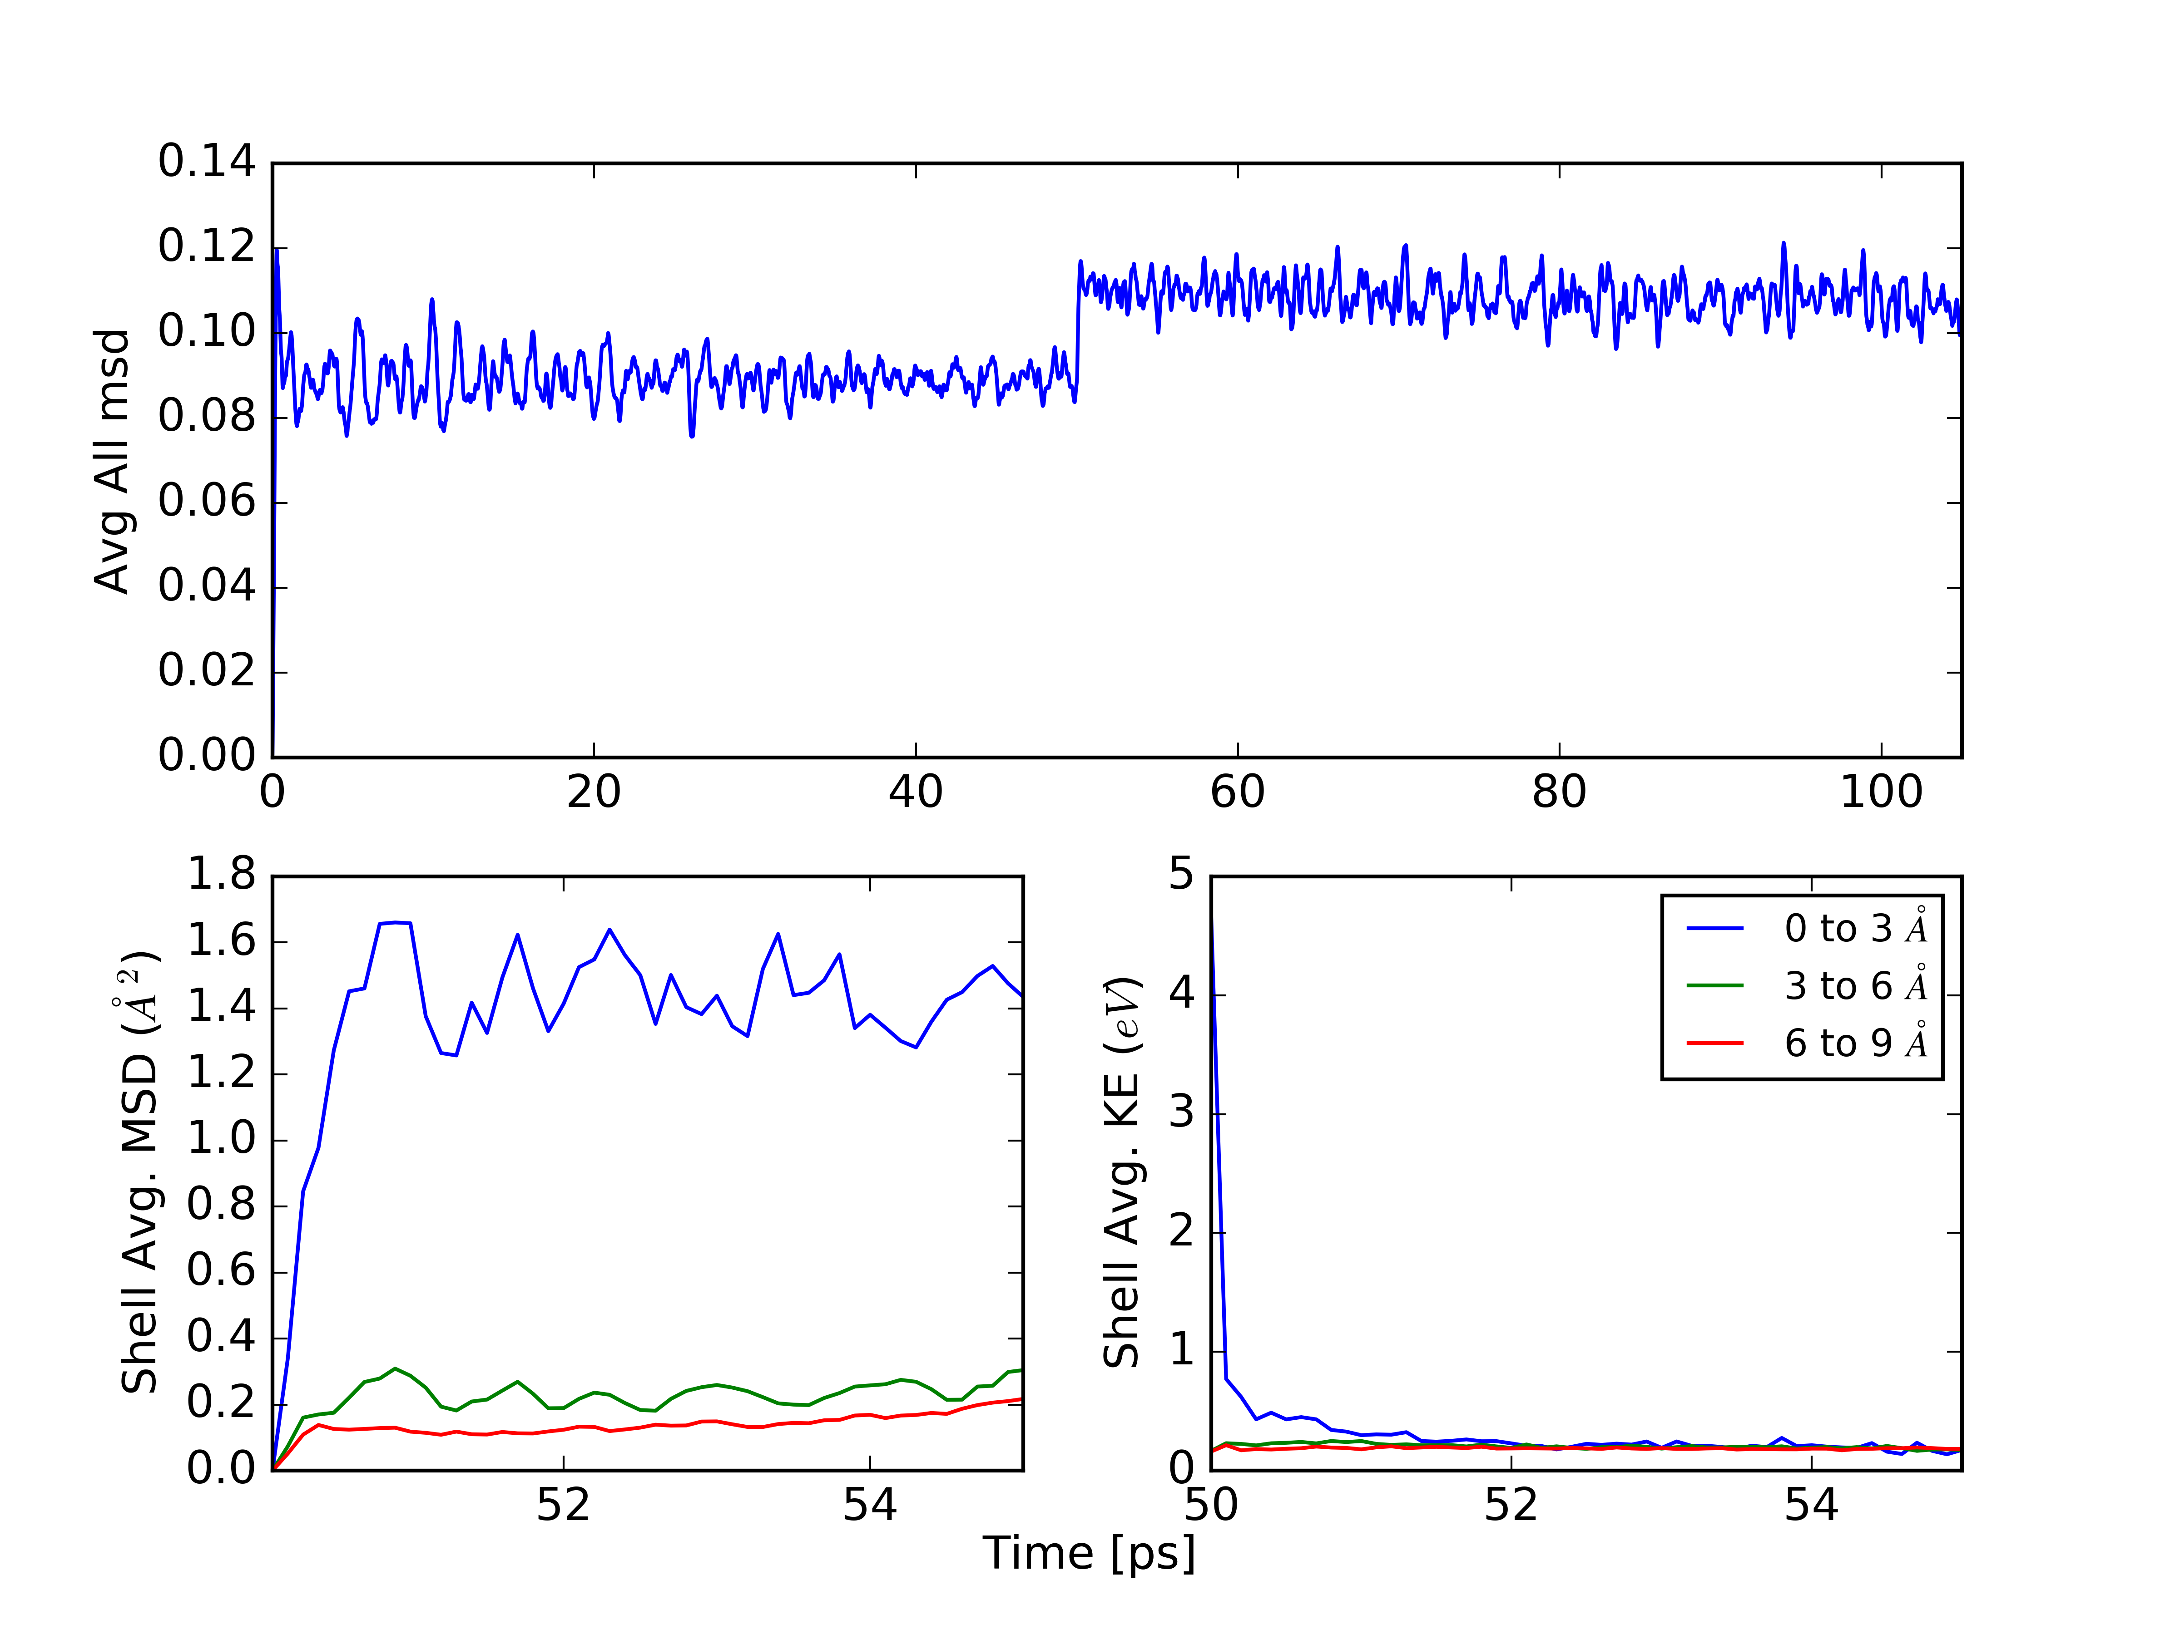
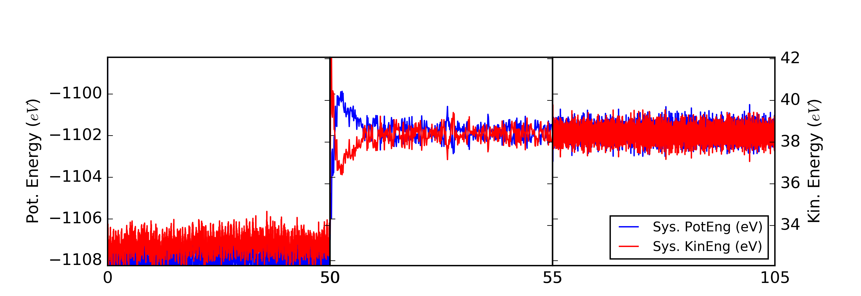
Molecular excitation event
After equilibration, give random molecule velocity corresponding to 5-10 eV energy excitation
Equipartition of kinetic and potential energies after ~5ps
Determine MSD and KE in shells
surrounding initially excited molec
Molecular displacements and
excitation energies are small only 3A
away from initial event

Slide 28
MeV electron energy deposition
Radiation induced diffusion:
Drad = N leff / (J * t0)
  N = number of molecules caused to permanently displace as a result of the electron excitation and energy dissipation events
  leff = Extent of the collision cascade or how far away from the originally excited molecule a permanent displacement can be effected
  J = degrees of freedom for diffusion
  J = 3 for bulk diffusion
  J = 2 for surface diffusion
  t0 = Event rate
Previous estimates of
  N = b * Ei / Ea where Ea is the activation energy and Ei is the energy deposited by the electron
  leff = a * N / 4 where a is the lattice spacing (diffusion hop distance)
Notes:
28

