Slide 1
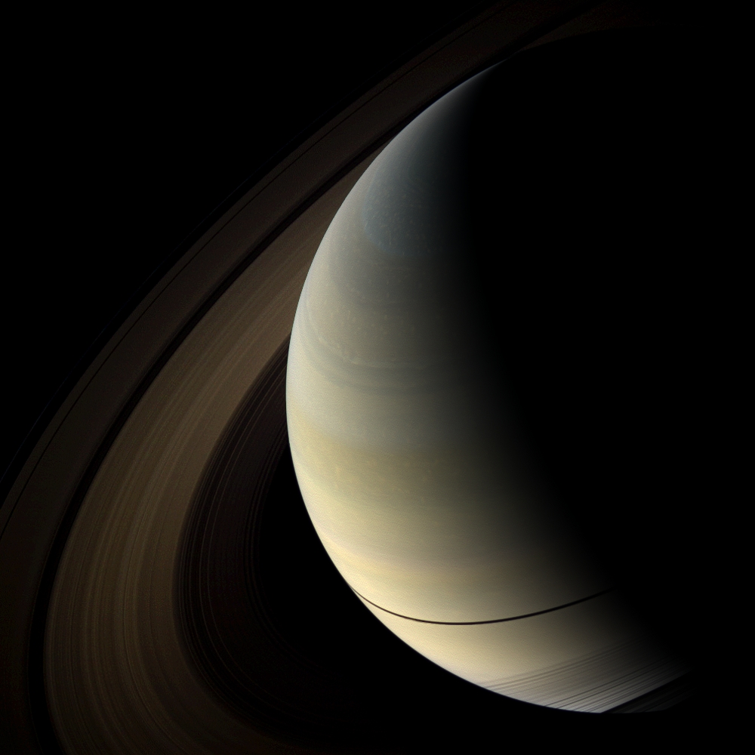
Implications for the Micrometeoroid Flux Measured by Cassini CDA for Ballistic Transport in Saturn’s Rings
Paul R. Estrada
(CSC, SETI Institute)
Richard H. Durisen
(Univ. of Indiana)
and
Jeff N. Cuzzi
(NASA ARC)

Slide 2
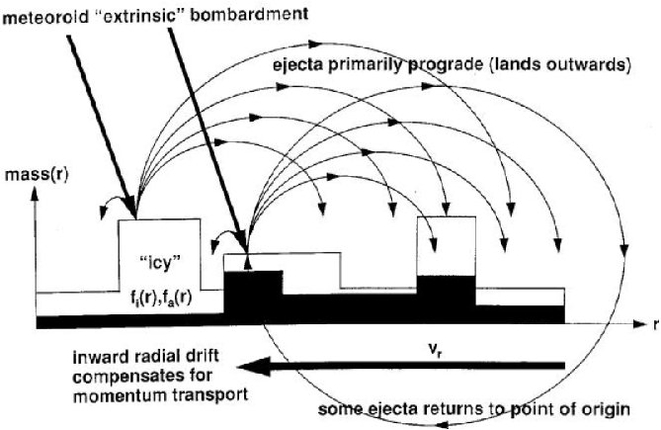
Ballistic Transport as a Process
Rings have a “huge” surface-area-to-mass ratio.
Particularly susceptible to effects of micrometeoroid bombardment.
Impacts produce large “yields” Y of particulate ejecta at v << v_{esc}.
Ejecta carry away both mass and angular momentum.
Compositional Evolution
Structural Evolution
Notes:
Nico…MB leads to several effects... - DIRECT DEPOSITION, simple, brings in mass
(likely non-icy) pollution… but this is not all, impacts then…. Yield, prograde, lands
Outwards, exchange of mass and AM in this way leads to (ii) structural evolution,
and (iii) compositional evolution which over long enough times leads to homogenization
of ring composition across the rings EVEN IN THE ABSENCE OF POLLUTION.

Slide 3
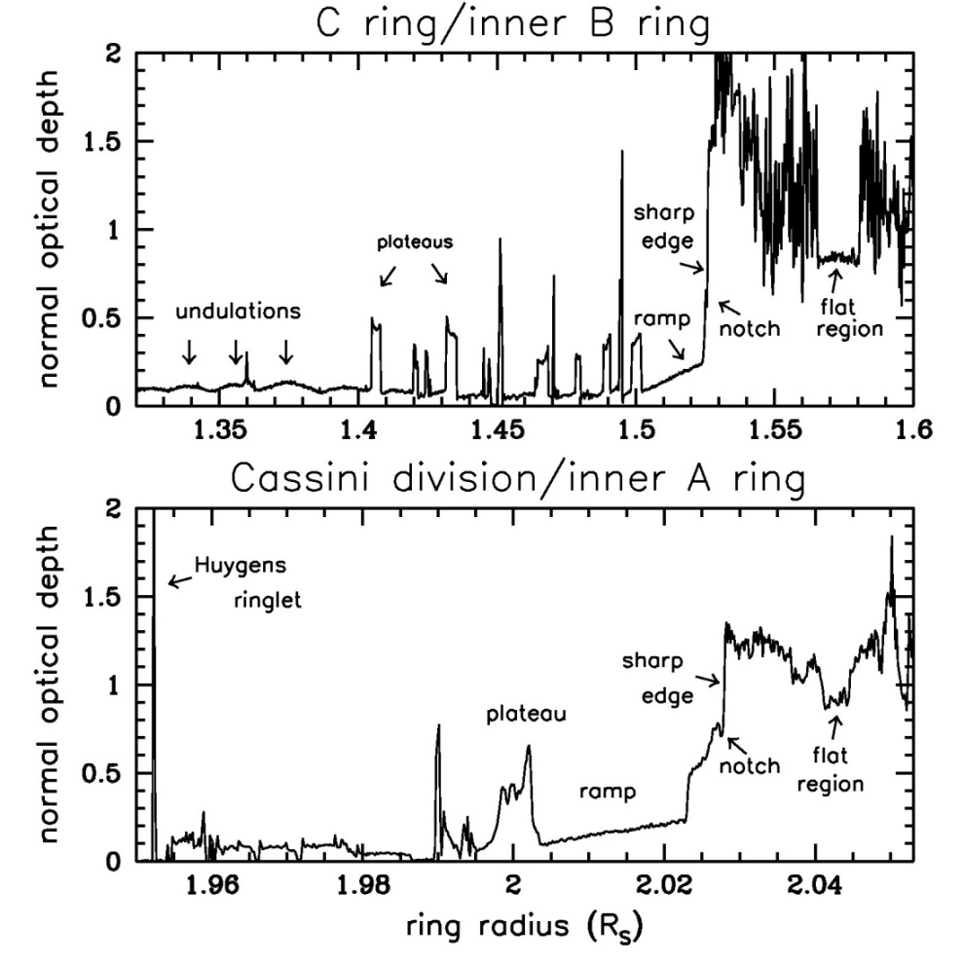
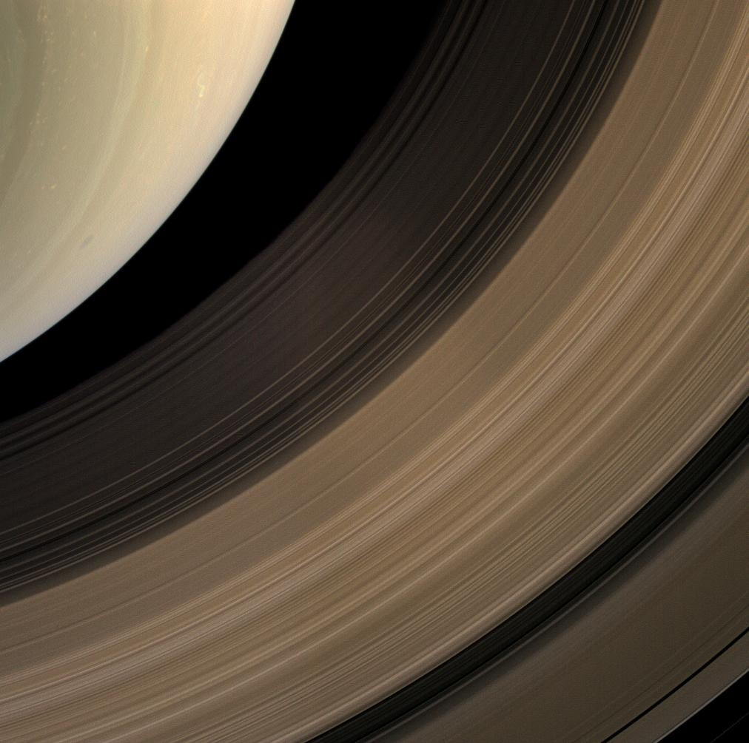
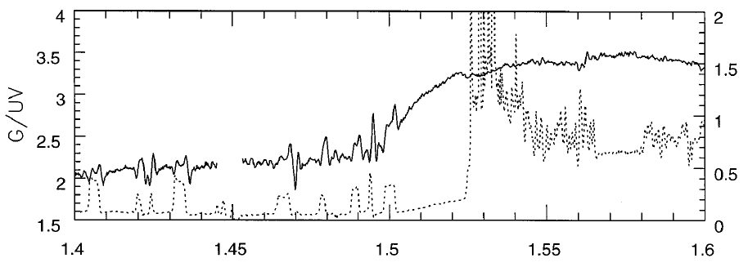
Signatures of Ballistic Transport
Maxwell gap
C
plateaus
B
undulations
Sharp inner edges
ramps
A
Notes:
We can see examples of the creation of or sculpting of ring structure in the rings – inner edges of B and A rings remarkably similar (ramp)
Compositionally, C/CD dark, A/B brighter, is this simply an optical depth effect or are there more pollutants there per unit volume which you would expect if MB is bringing in pollutants (hint it’s the latter).
Also another effect that is characteristic of BT is the gradual transition of color across sharp optical depth transitions. (If you start with a sharp compositional transition just as would be the case with just DD…)

Slide 4
Important Timescales for MB and BT
The two fundamental time units of BT are thus the direct deposition time t_{D} and the gross erosion time t_{G} and are related simply:
t_{D} = σ / σ_{im} = Y t_{G}
σ_{im} is the impact flux at the ring, and Y is the impact yield. t_{G} is the time it would take for a ringlet of σ to completely erode away if no material returned. Clearly, t_{G} << t_{D}
The impact flux
σ_{im} = 2 × σ∞ × A(τ) × F_{G}(R)
depends on the dynamics of the micrometeoroid population.
These two factors can determine ring age from (1) rate at which mass is deposited and (2) how that mass is redistributed over the rings with time
Notes:
SO naturally there are time scales associated with this process.
IF these quantities were constrained, we can say something definitive about ring age, and maybe origin.

Slide 5
Cassini Observations: The Evidence
Ring Mass: the mass of the rings has been determined to be ∼ 0.4 Mimas masses (Iess + 2017). This tells us σ.
Volume Fraction of Pollutants: Cassini radiometer data and analyses, bulk fractions, porous particles (Zhang + 2017a,b) -
C ring/CD ∼ 1 – 2 %
B ring ∼ 0.3 – 0.5 % (inner/outer); 0.1 – 0.2 % (middle)
A ring ∼ 0.2 – 0.3 %
Micrometeoroid Flux: measured from the Cassini CDA (Kempf +, in prep., Altobelli +, this meeting), tells us σ∞ and F_{G}. Flux consistent with previous values, but much more focused.
This constrains the current t_{D}, BT models + compositional observations can constrain t_{G} (and Y).
Verdict (subject to appeal): rings are young
Notes:
I present you exhibits A, B and C (not to be confused with …)

Slide 6
You telling me the rings were made when dinosaurs walked the Earth? Pffffttt…..
Current Ring Origin Scenarios:
Formed shortly after Saturn (Canup, 2010).
Tidal disruption of Comet (Dones; Charnoz + 2009)
Disruption of icy moon near Roche limit (Harris, 1984; Charnoz + 2009)
All scenarios are at or before the LHB, and thus predict ancient or primordial rings (though see talk by J. Dubinsky, this meeting)
So, can an ancient or primordial ring origin scenario be consistent with the observations?
My opinion – not likely, but let’s explore it.
Notes:
And the appeals are coming… yes, as hard as it might be to believe, this is the implication (at least the current version of the rings)
Recently Sebastien Charnoz gave a talk a the PSG and also spoke with me at length and tried to convince me it could be made consistent. I was not…
He explored an initially massive (100 Mimas mass ring) which spread under viscosity, and was subject to direct deposition of micrometeoroids (no actual BT transport
But that is fine for these scenarios) I ran some models of my own using the old flux, and the new flux…

Slide 7
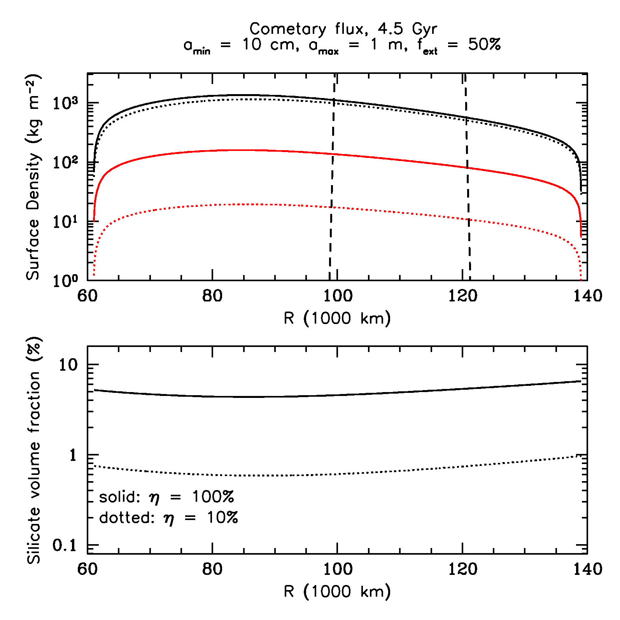
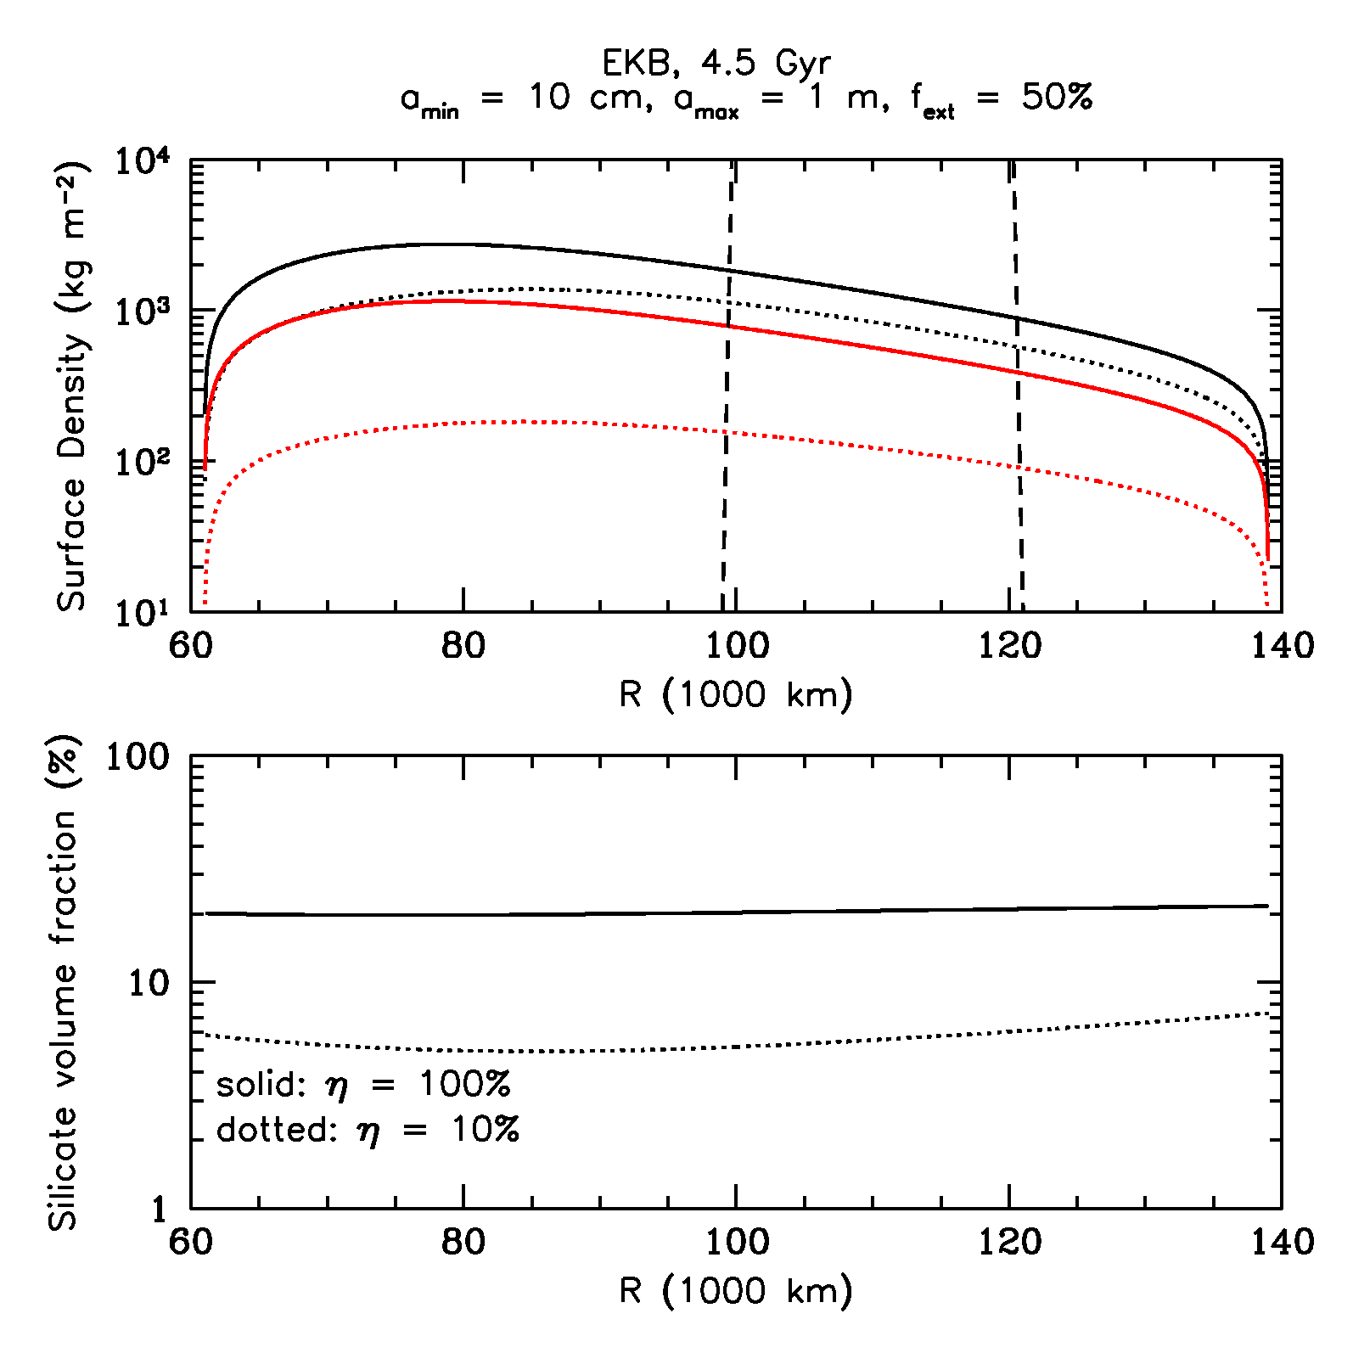
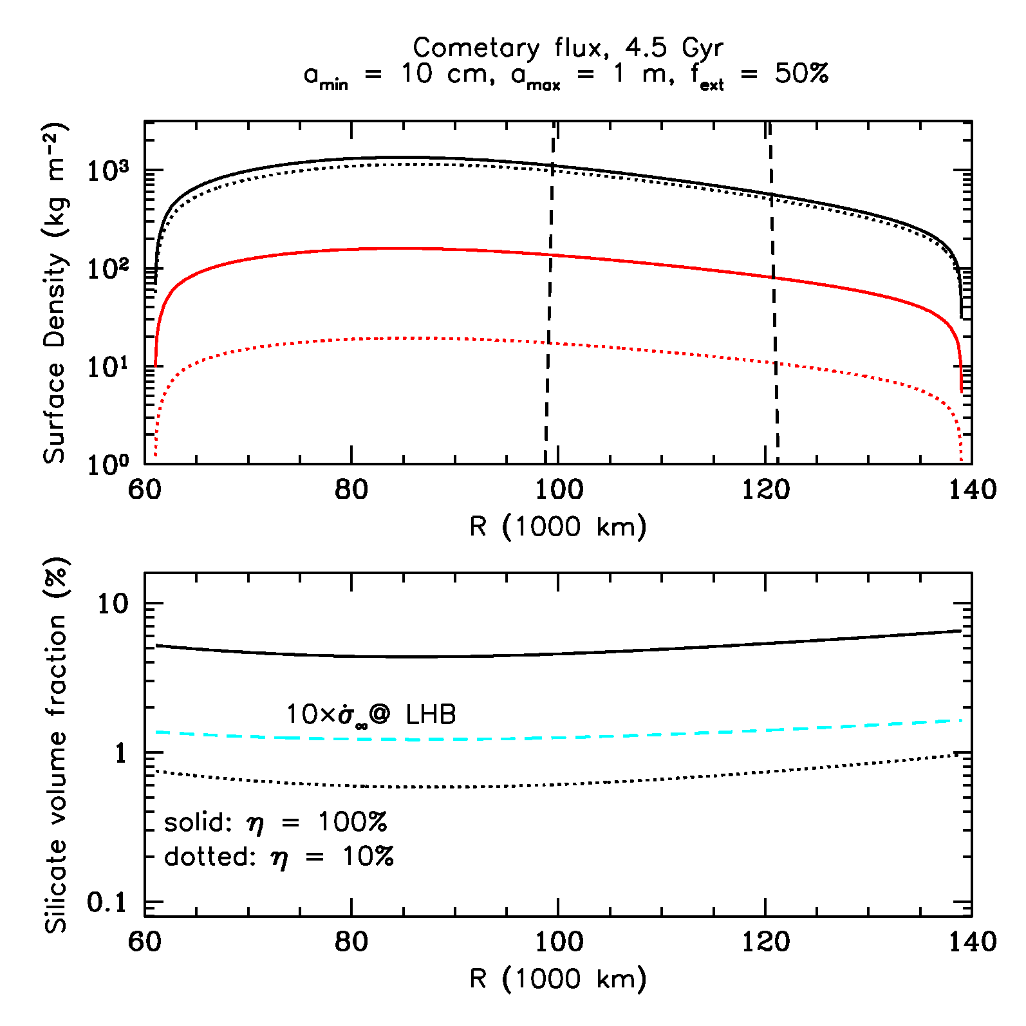
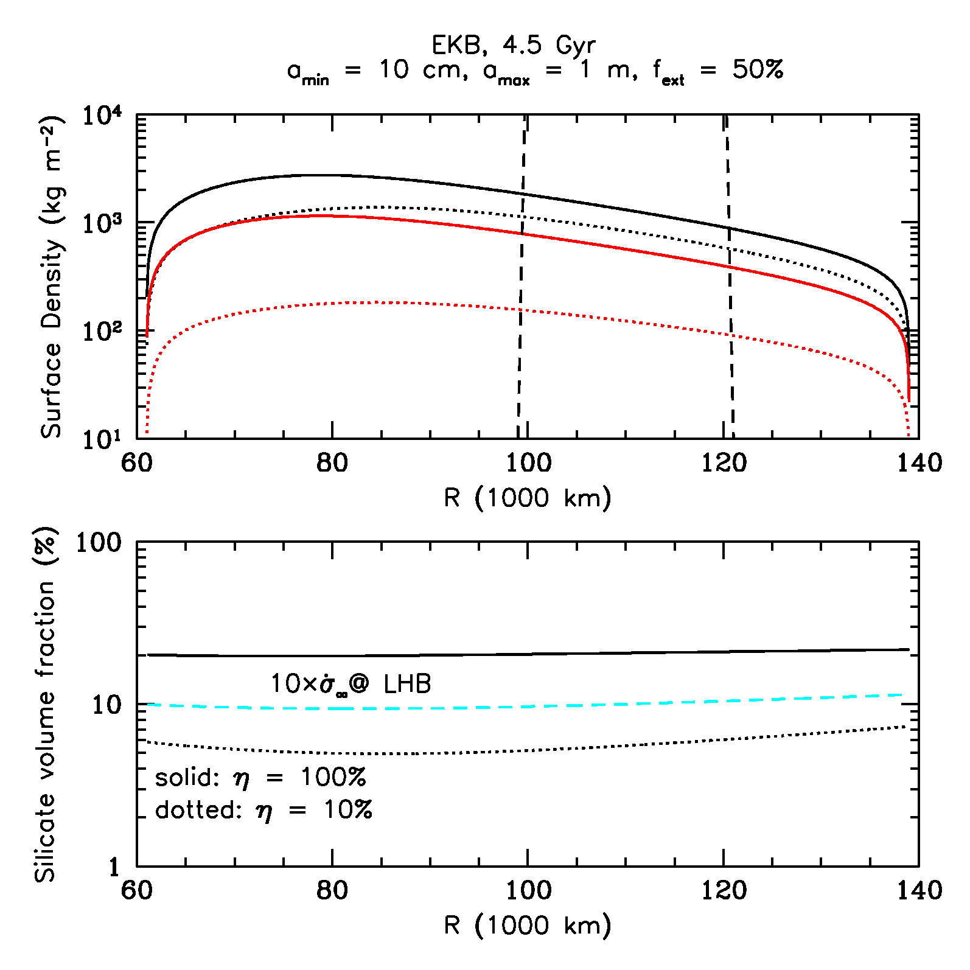
Cometary vrs. EKB Micrometeoroid Flux
After 4.5 Gyr
Notes:
Remember that this is really a measure for the B/A ring, not C ring so the volume fractions should match those.
Zahnle – 10 times at LHB. Luke?

Slide 8
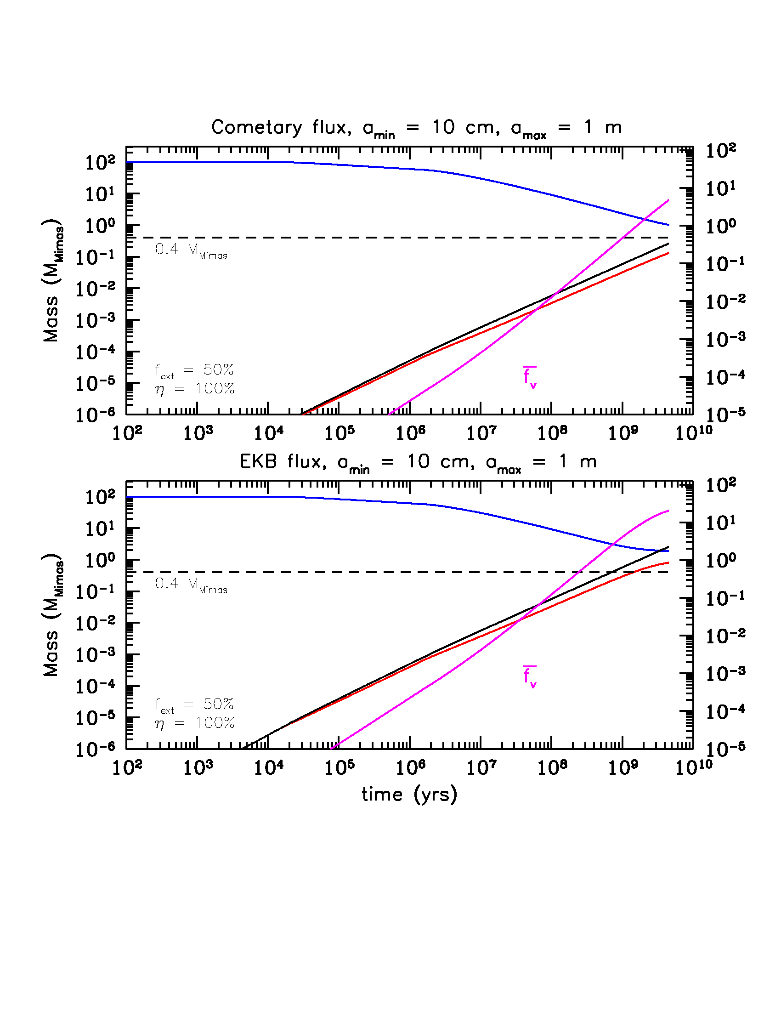
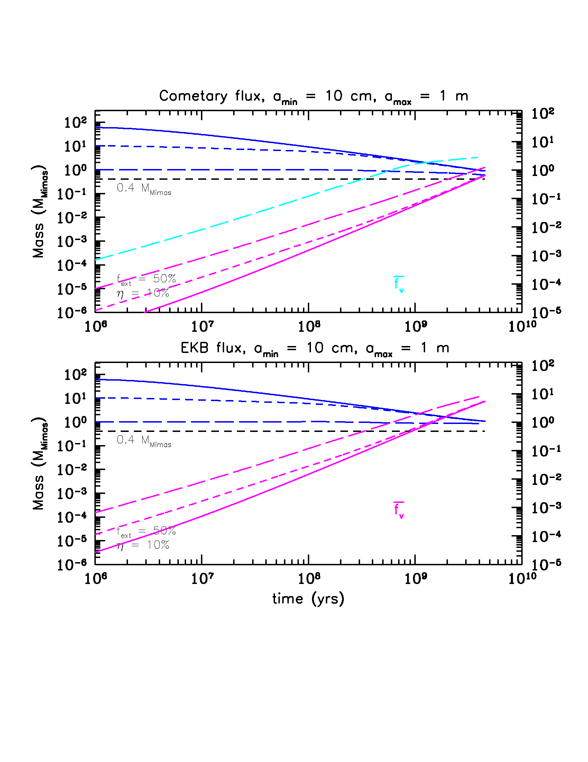
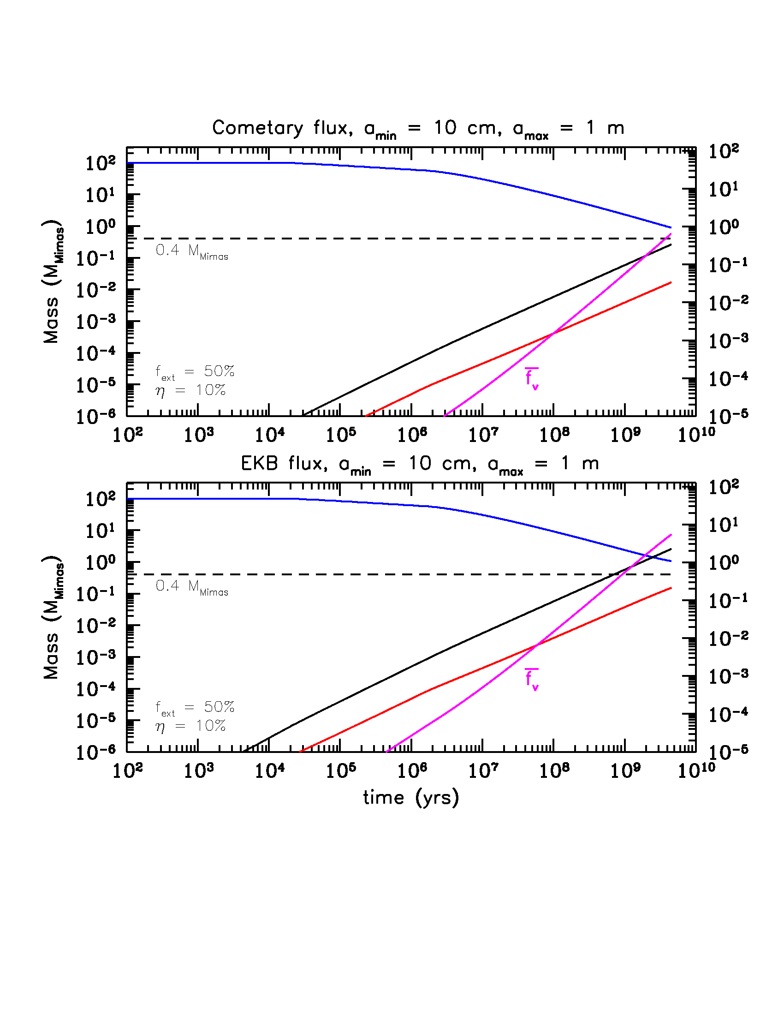
Cometary vrs. EKB Micrometeoroid Flux
The pros and cons of the old ring origin scenarios:
Pro – much more likely to occur during these epochs.
Con – can’t match the observed volume fraction, for any mass, especially if flux higher in past. Rings should be much darker.
Con – Can’t explain the C ring.
Con – disregards that compositional homogeneity would occur on much shorter time scales due to BT which is not observed.
Notes:
And this takes us back to the point I made earlier about tG << tD things happen on shorter timescales…

Slide 9
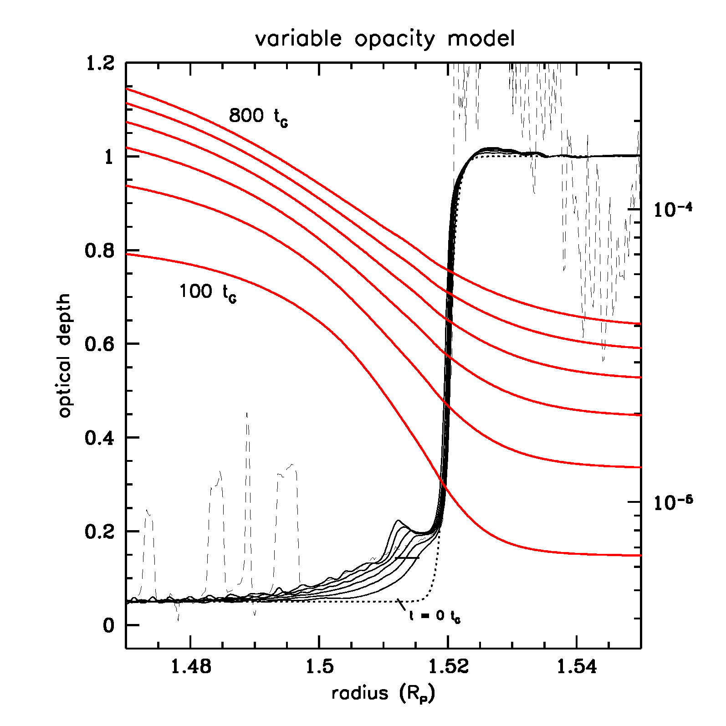
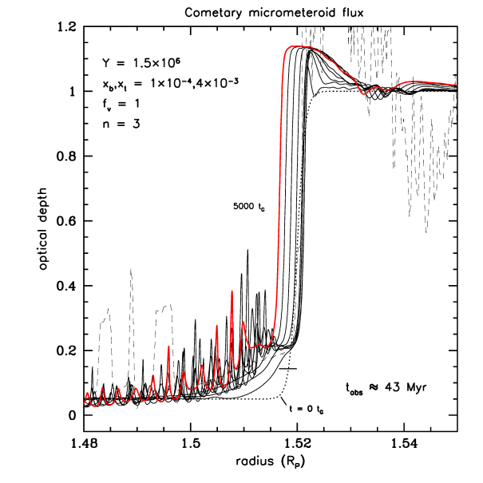
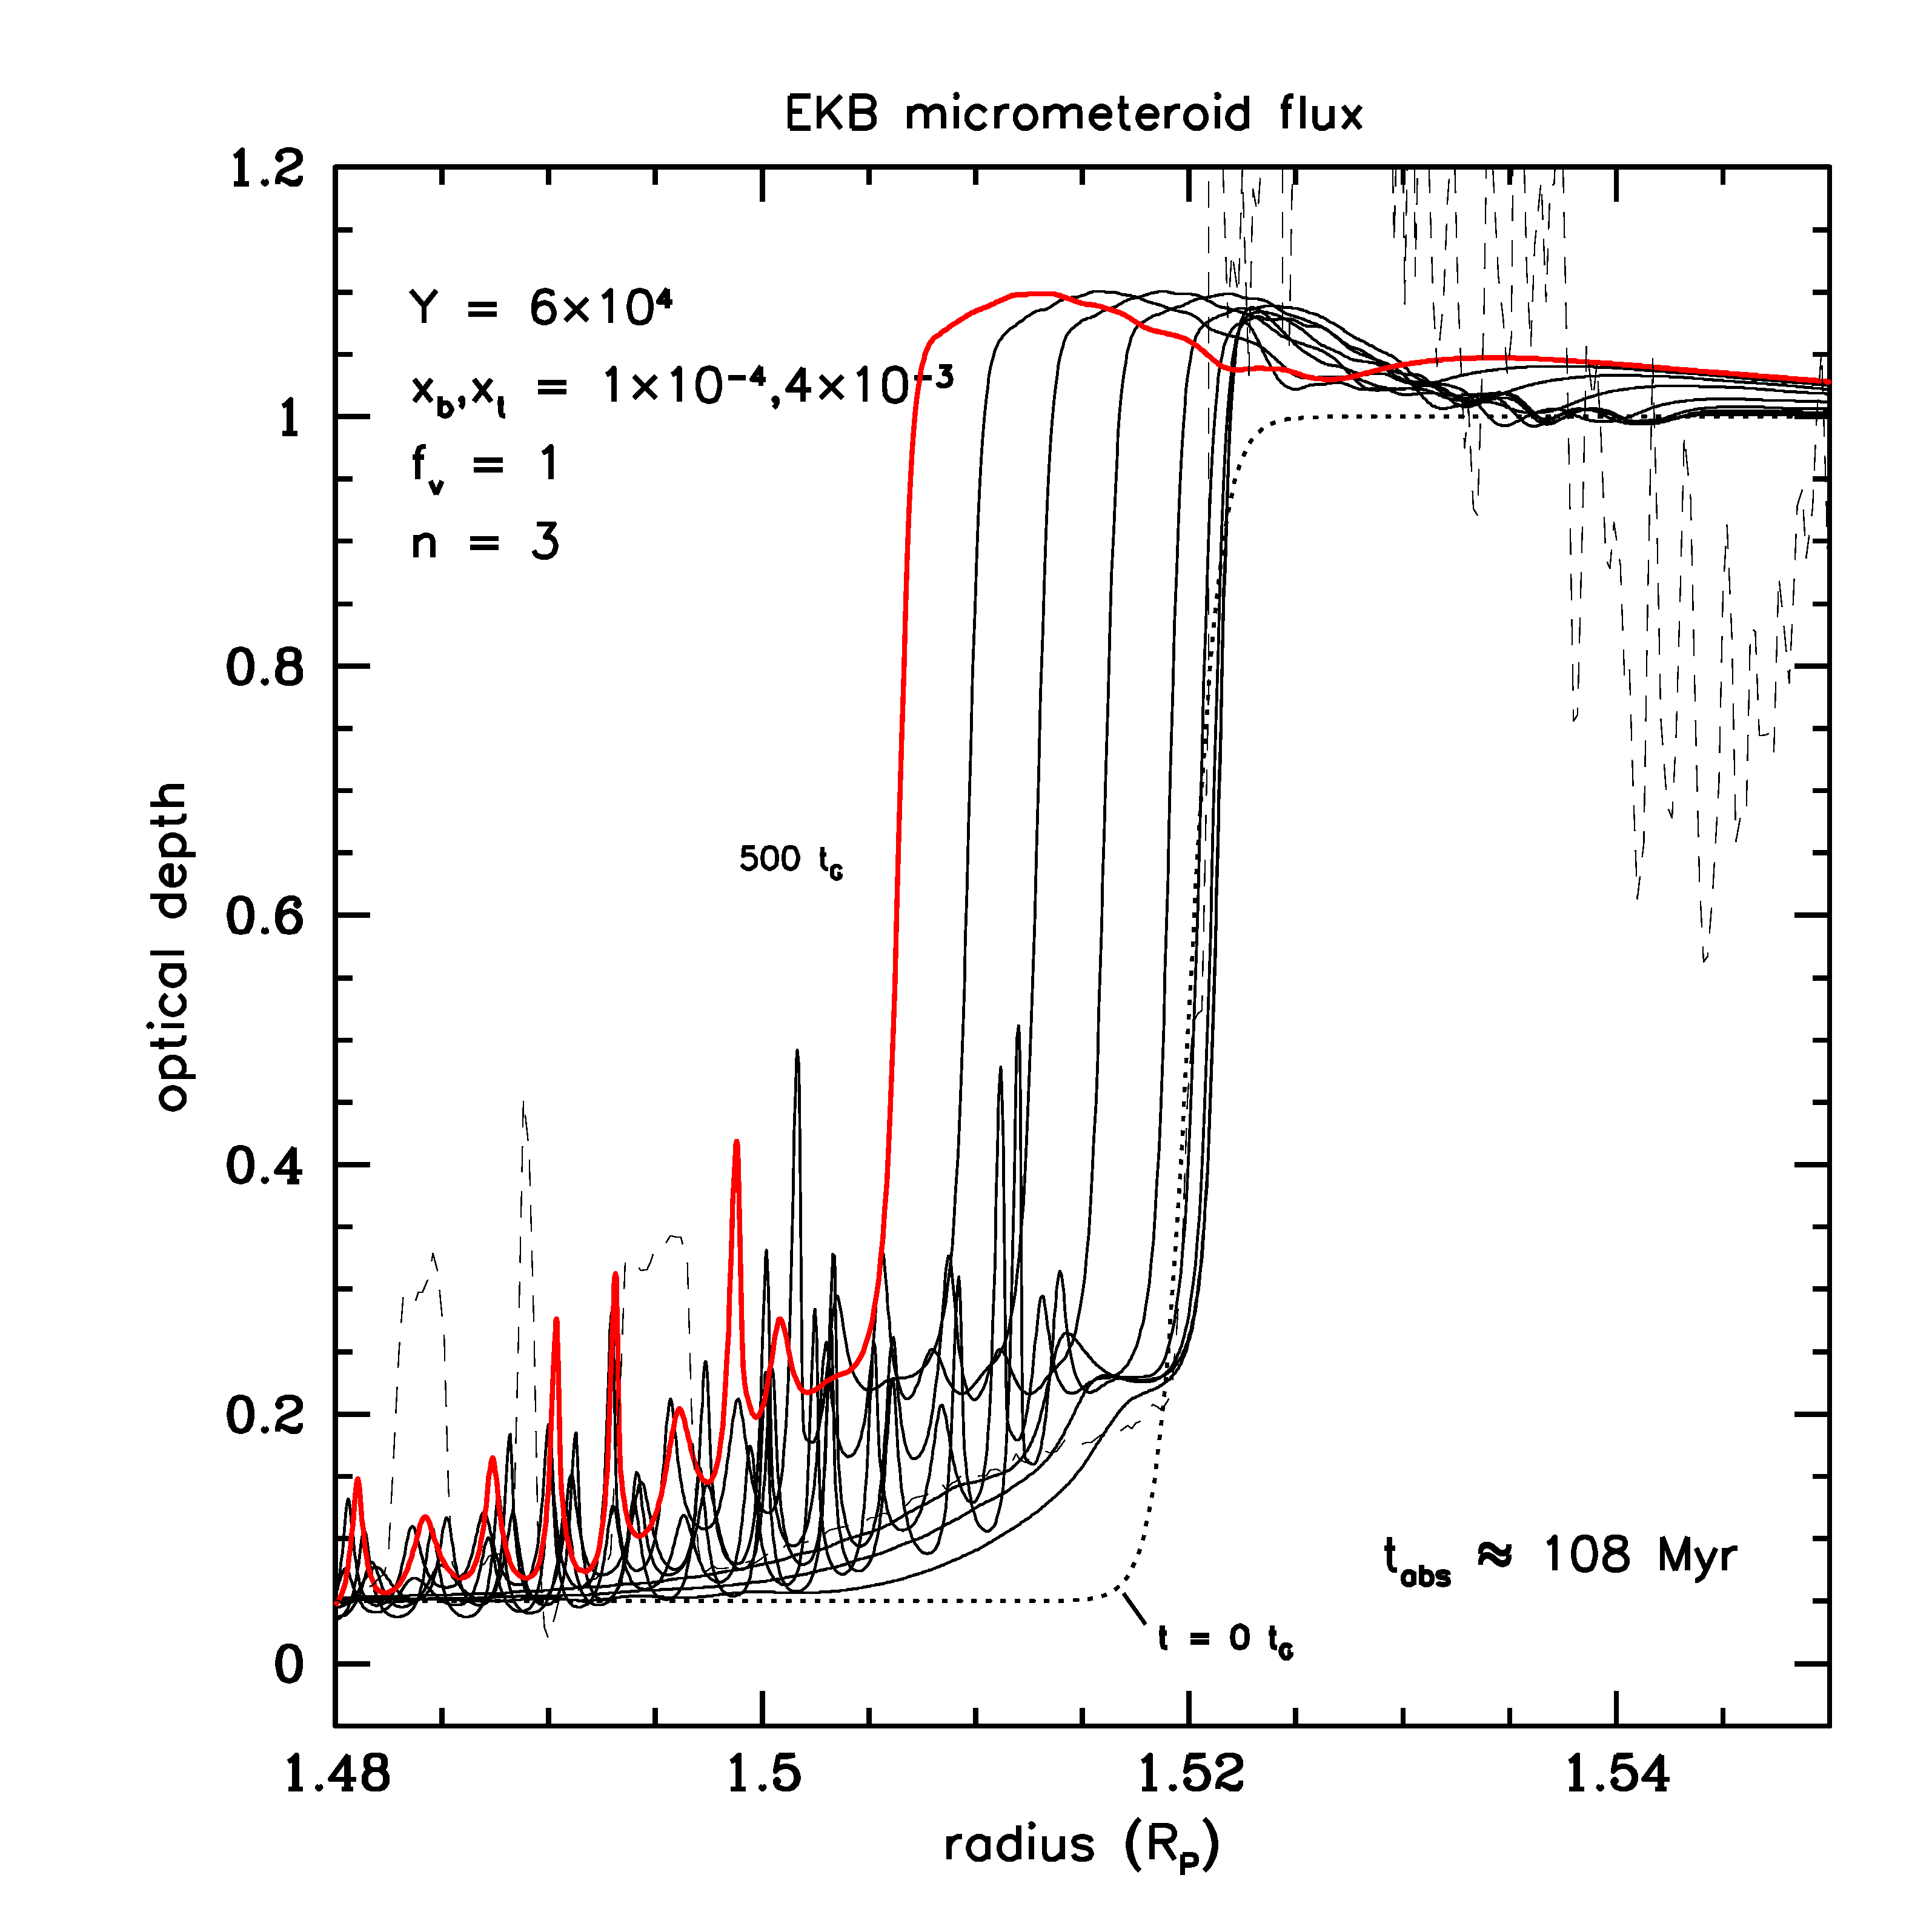
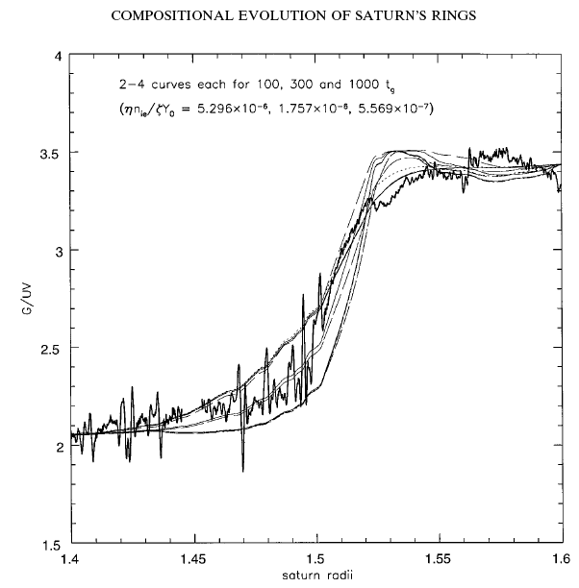
Tying Structure to Composition and Age
There are other ways to constrain the age from BT, and not just direct deposition (Recall t_{G} << t_{D}).
Shape of the color transition across the B-C ring edge
How much the inner edge drifts inwards over time
The slope of the ramp feature.
Others?
Cuzzi & Estrada 1998
Notes:
BT acts quickly to smear compositional contrasts in much shorter times than it takes to drive up the pollutants to the observed values for the retention efficiency adopted in these simulations.
So C /CD begins to become the dominant source of pollution of A/B as time goes on.

Slide 10
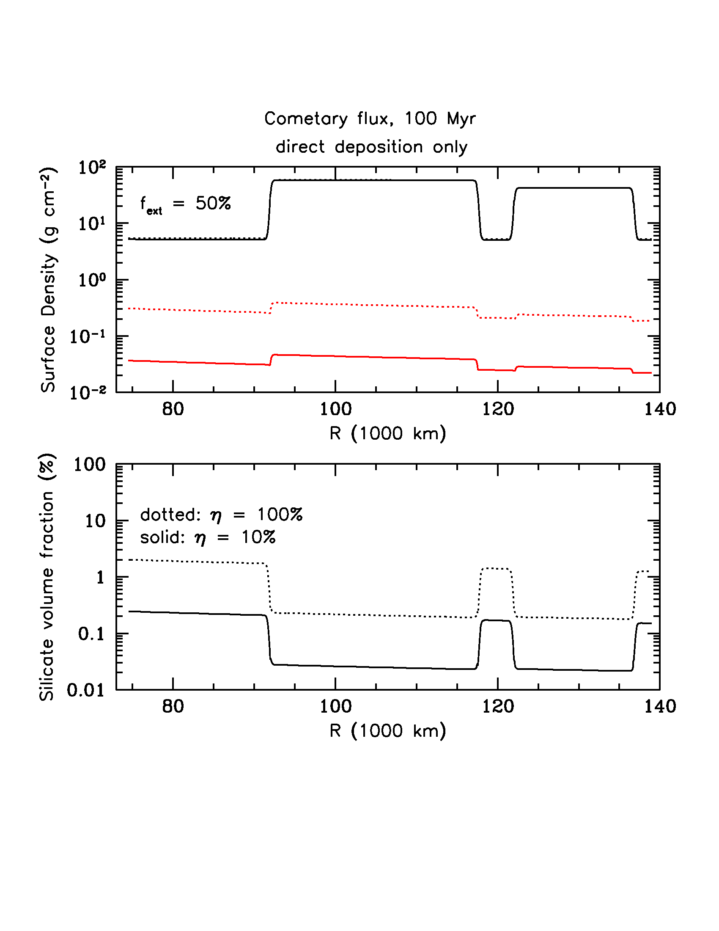
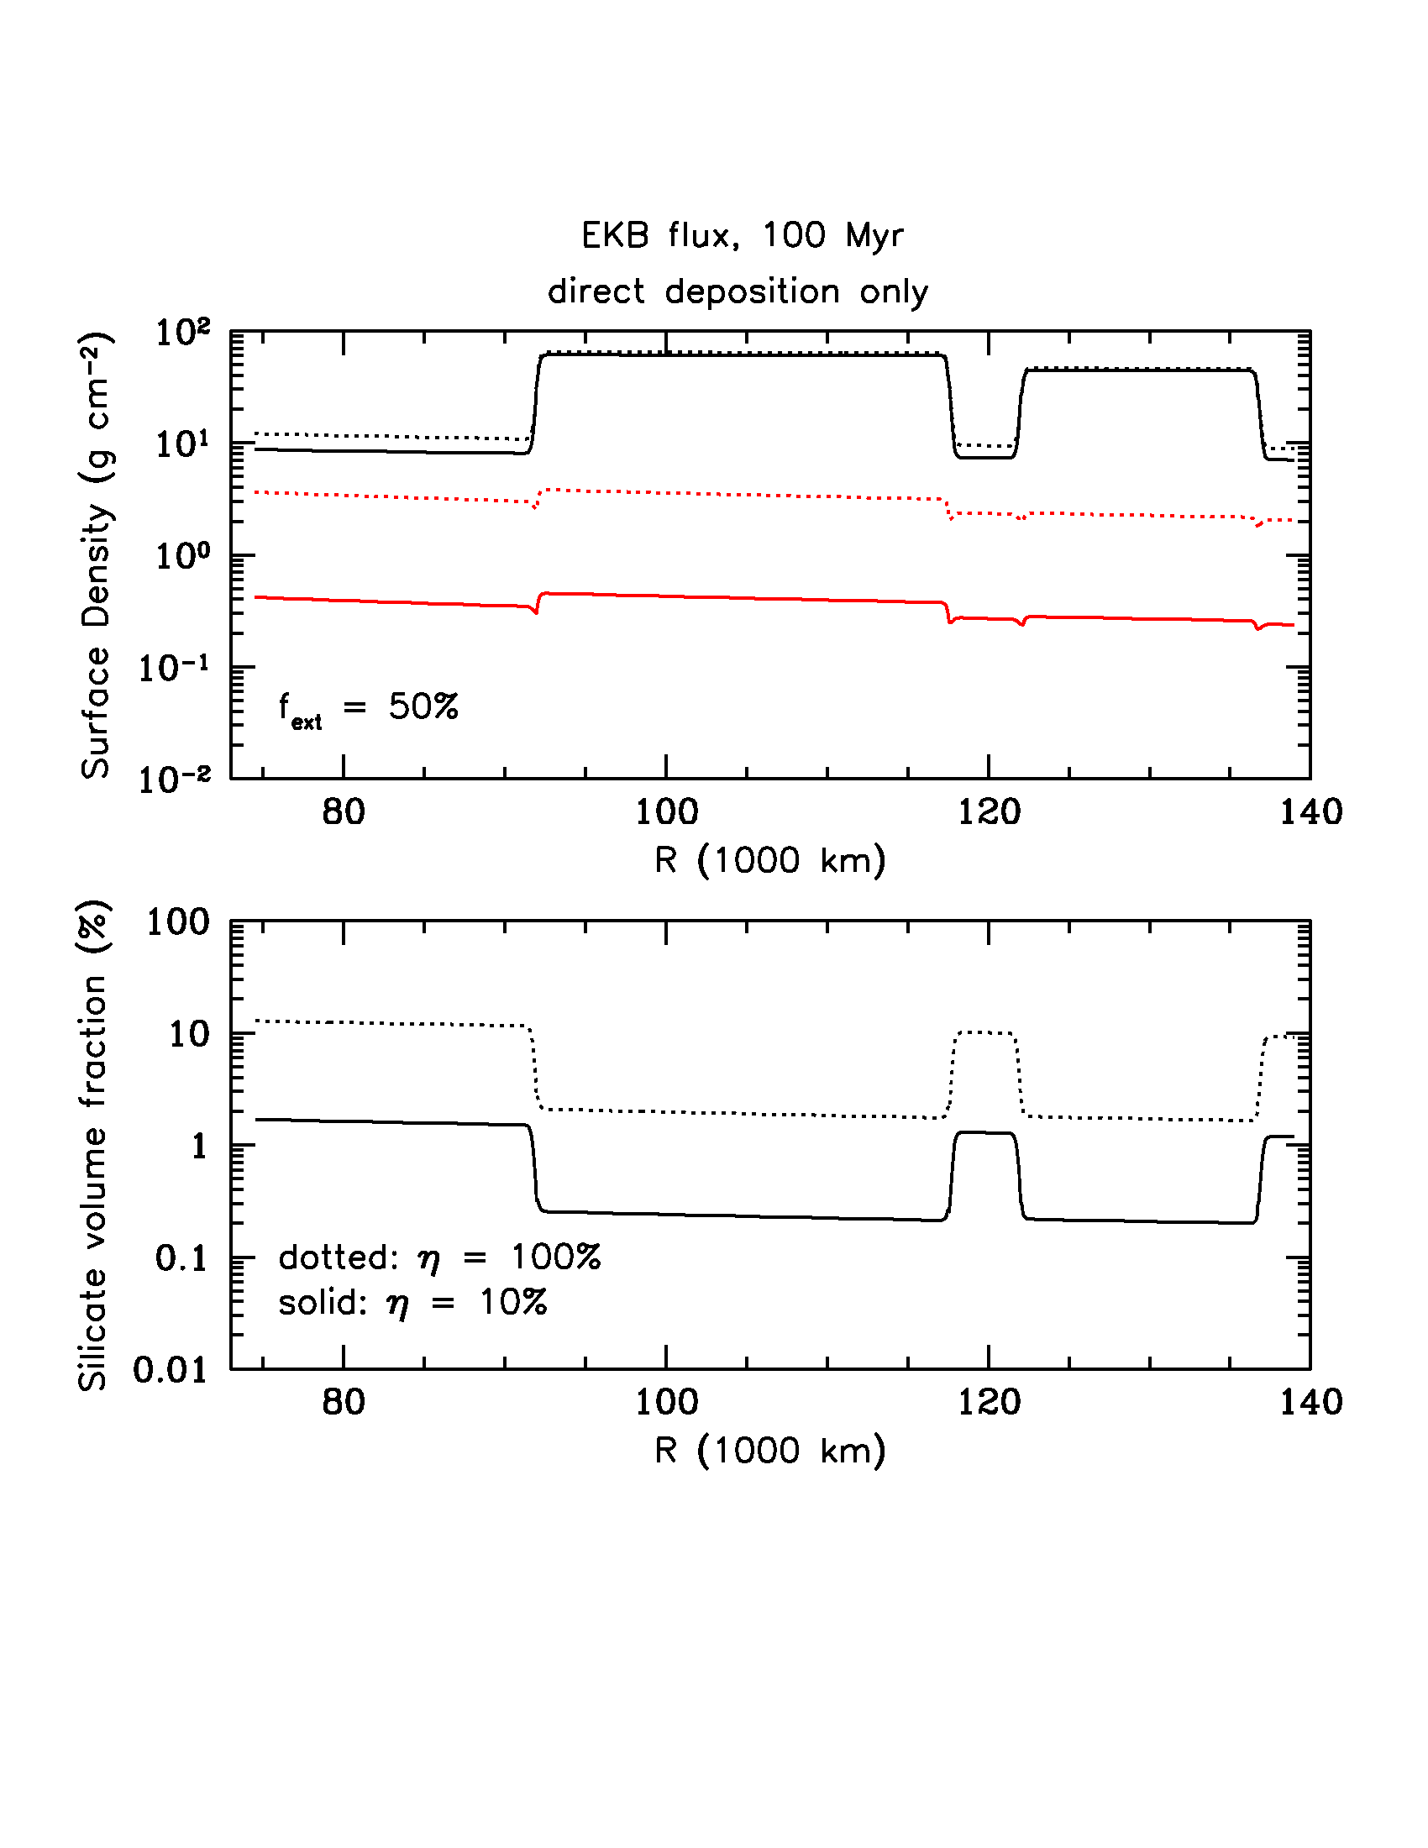
Cometary vrs. EKB Micrometeoroid Flux
Full ring model, 100 Myr
Notes:
Since we know the mass we can construct a simple model of direct deposition.

Slide 11
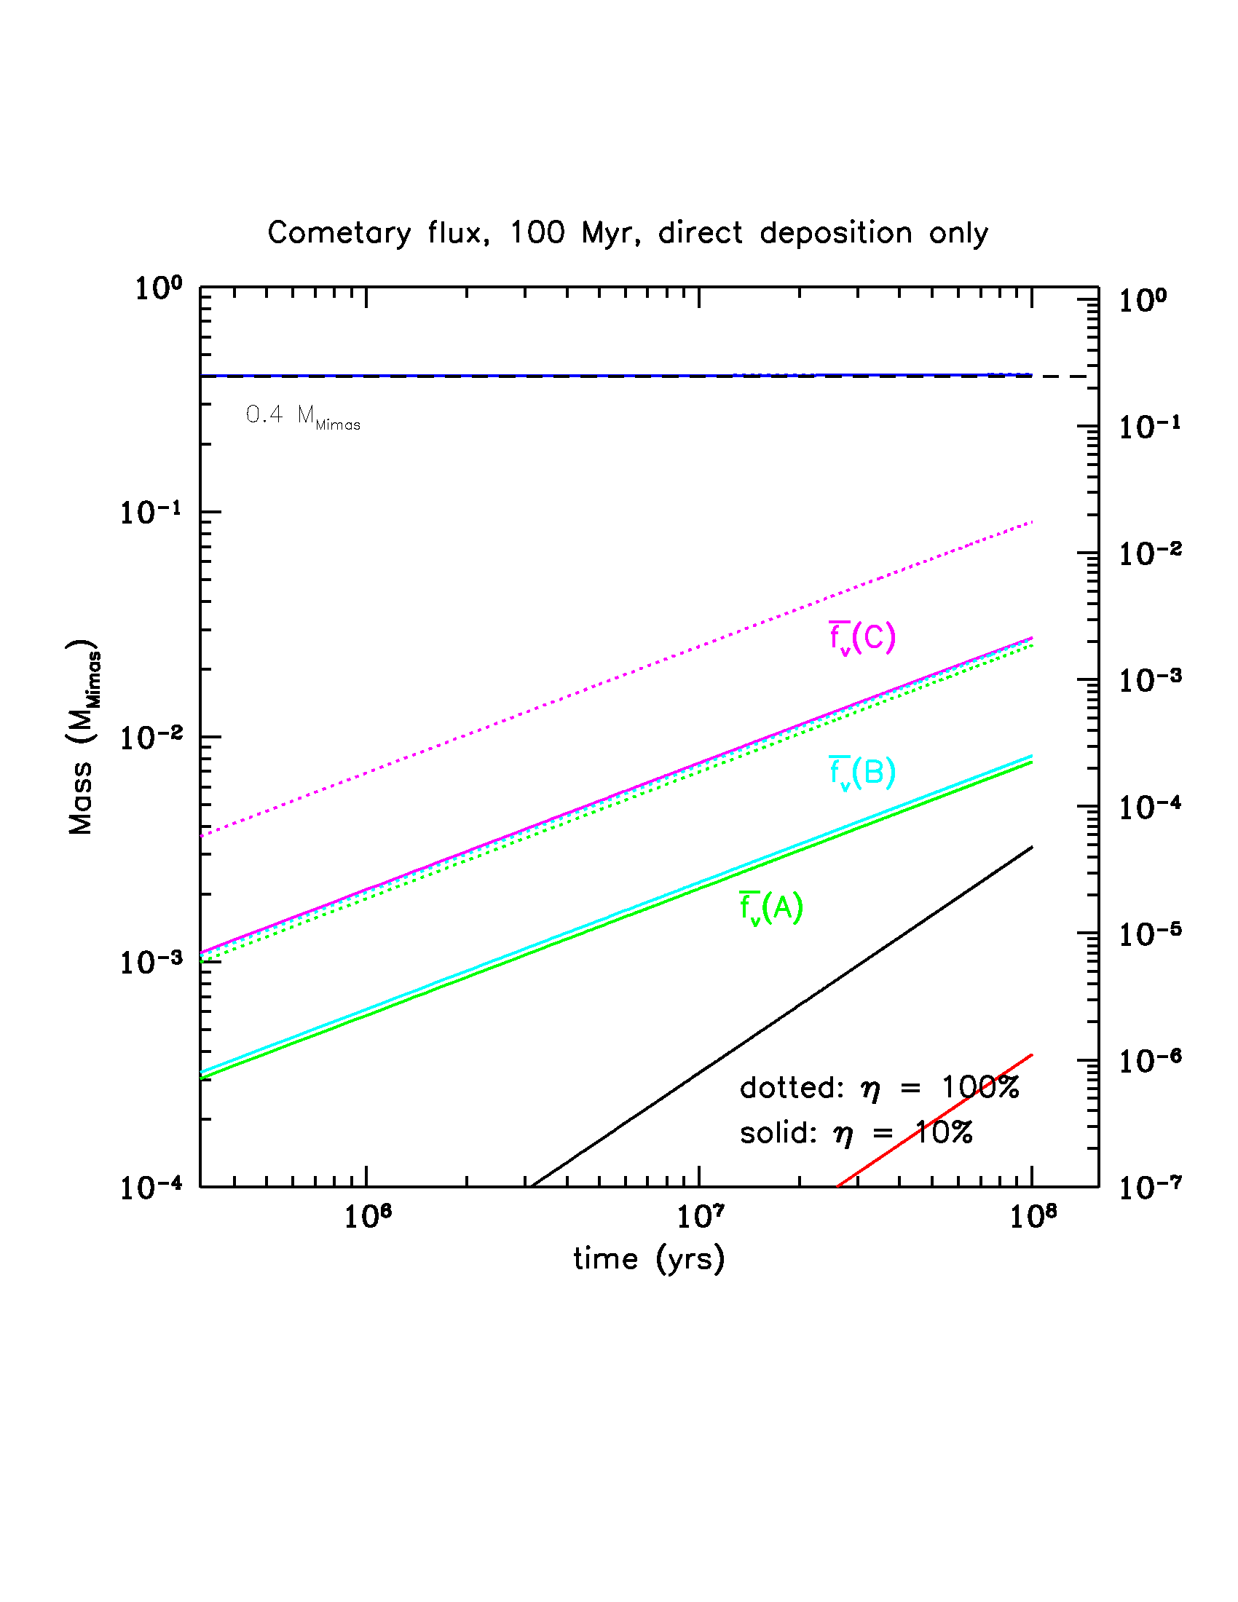
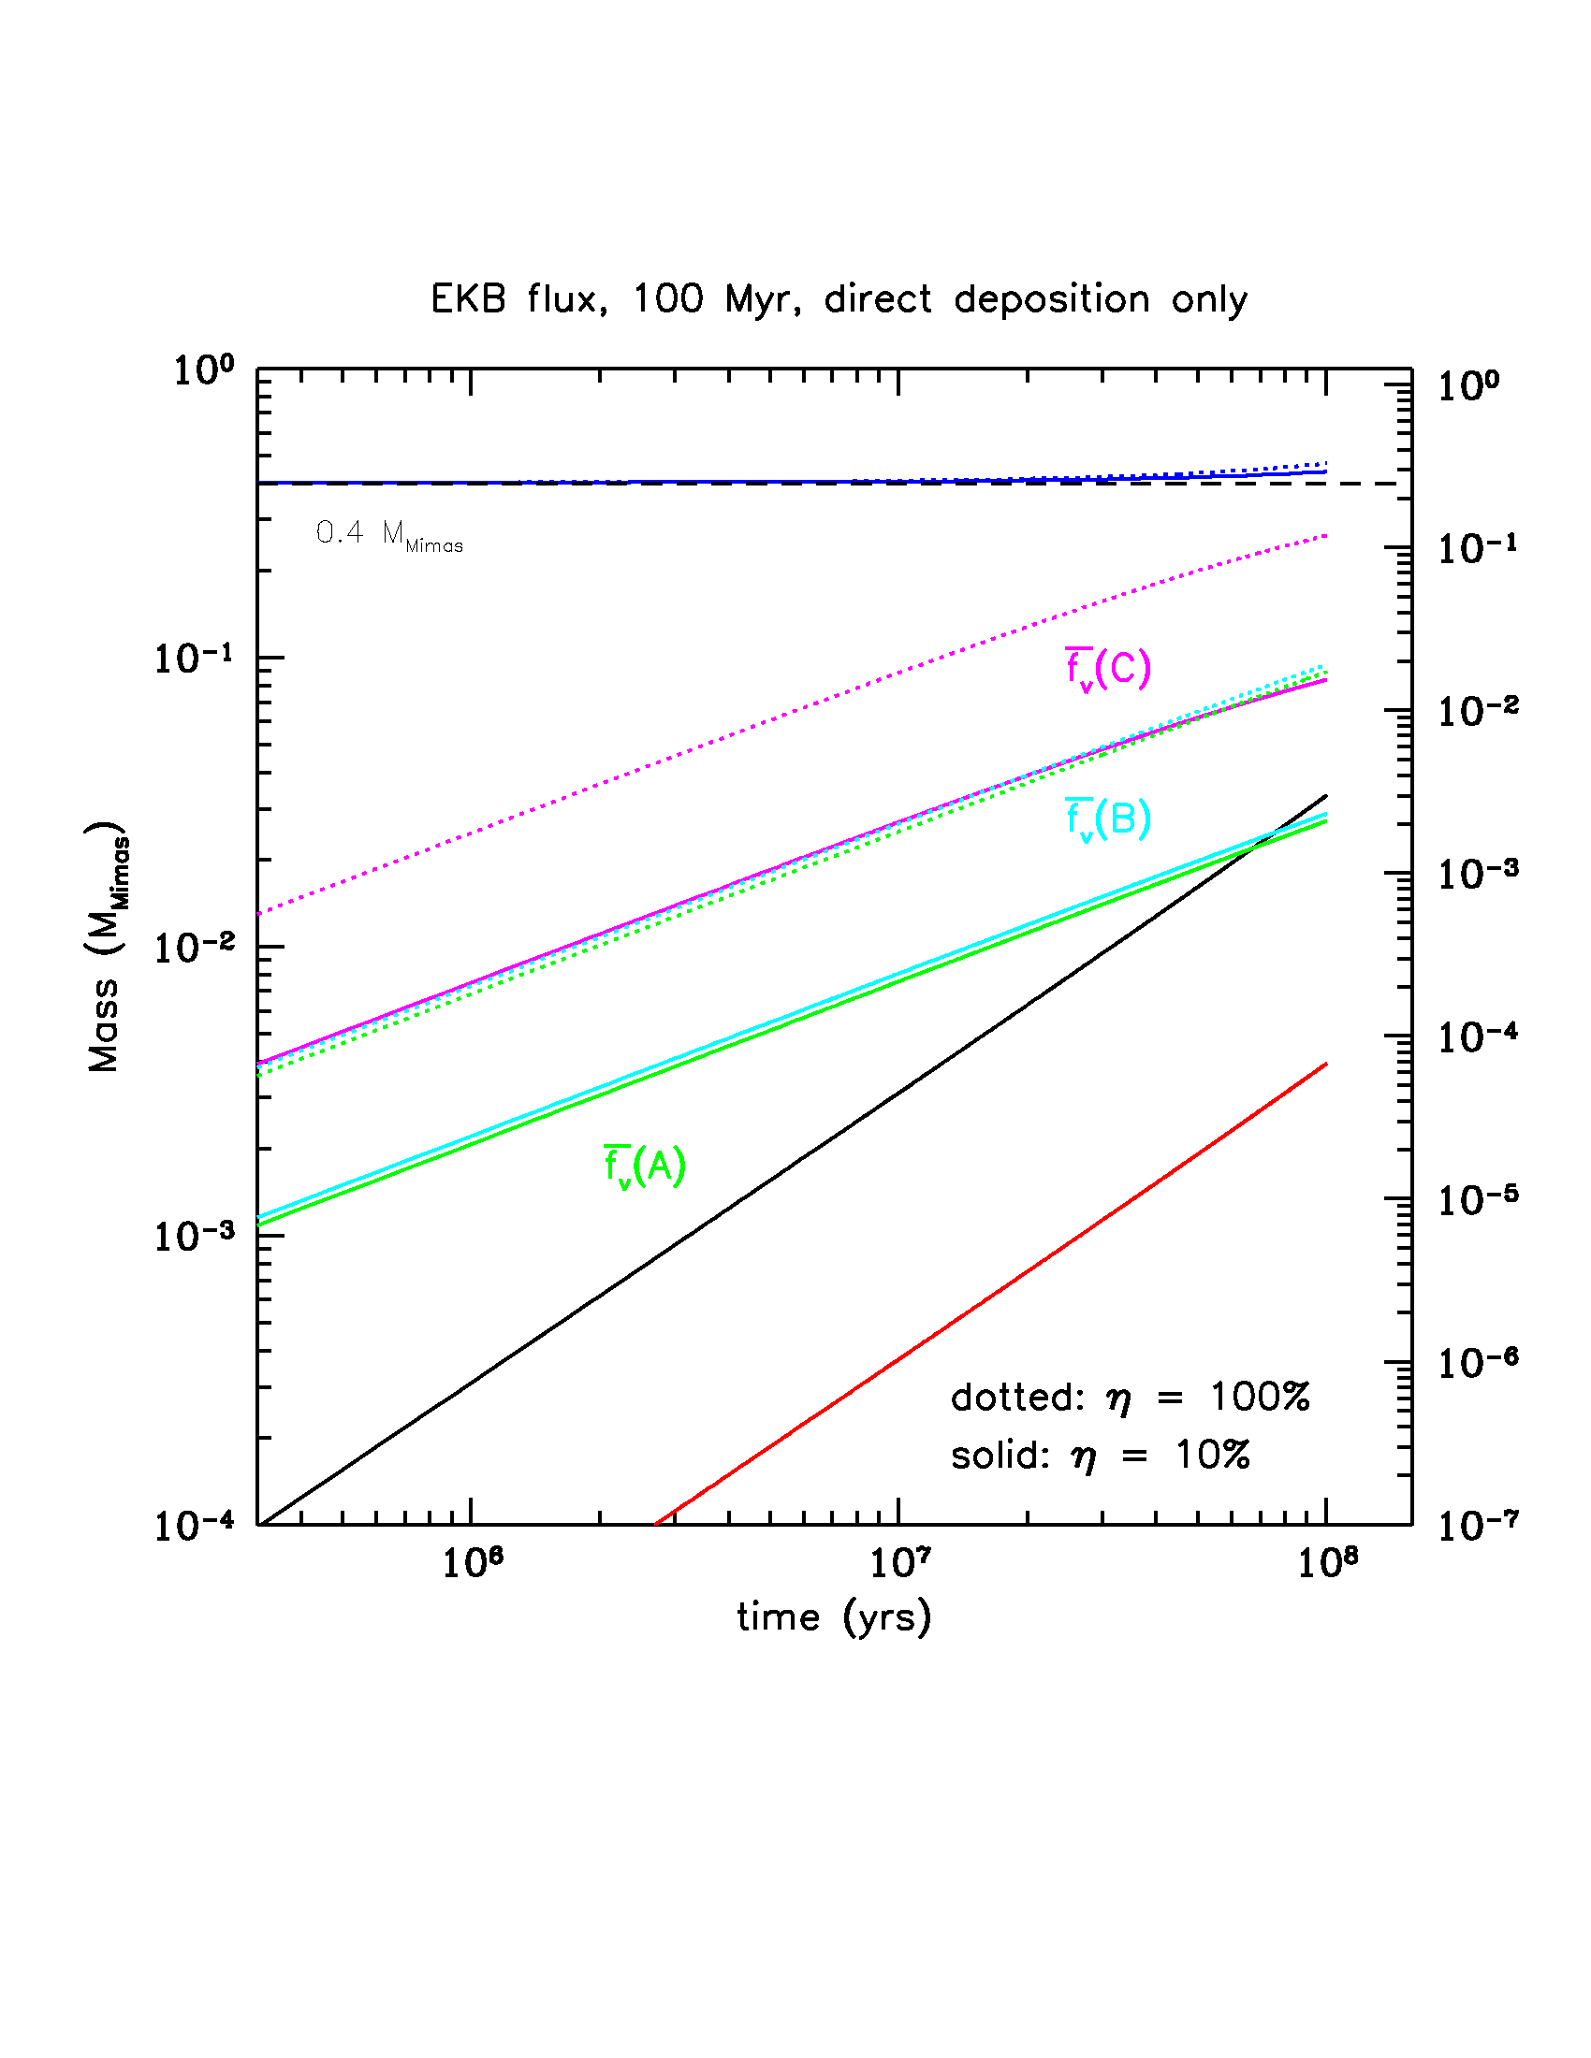
Cometary vrs. EKB Micrometeoroid Flux
Full ring model, 100 Myr
Notes:
These are simple models with no viscous evolution. We can match the volume fractions of pollutants of the rings just by DD in 10^8 timescale especially In case of new flux, or if most of the pollutants survive.
But no viscous evolution so you might think Im cheating so….

Slide 12
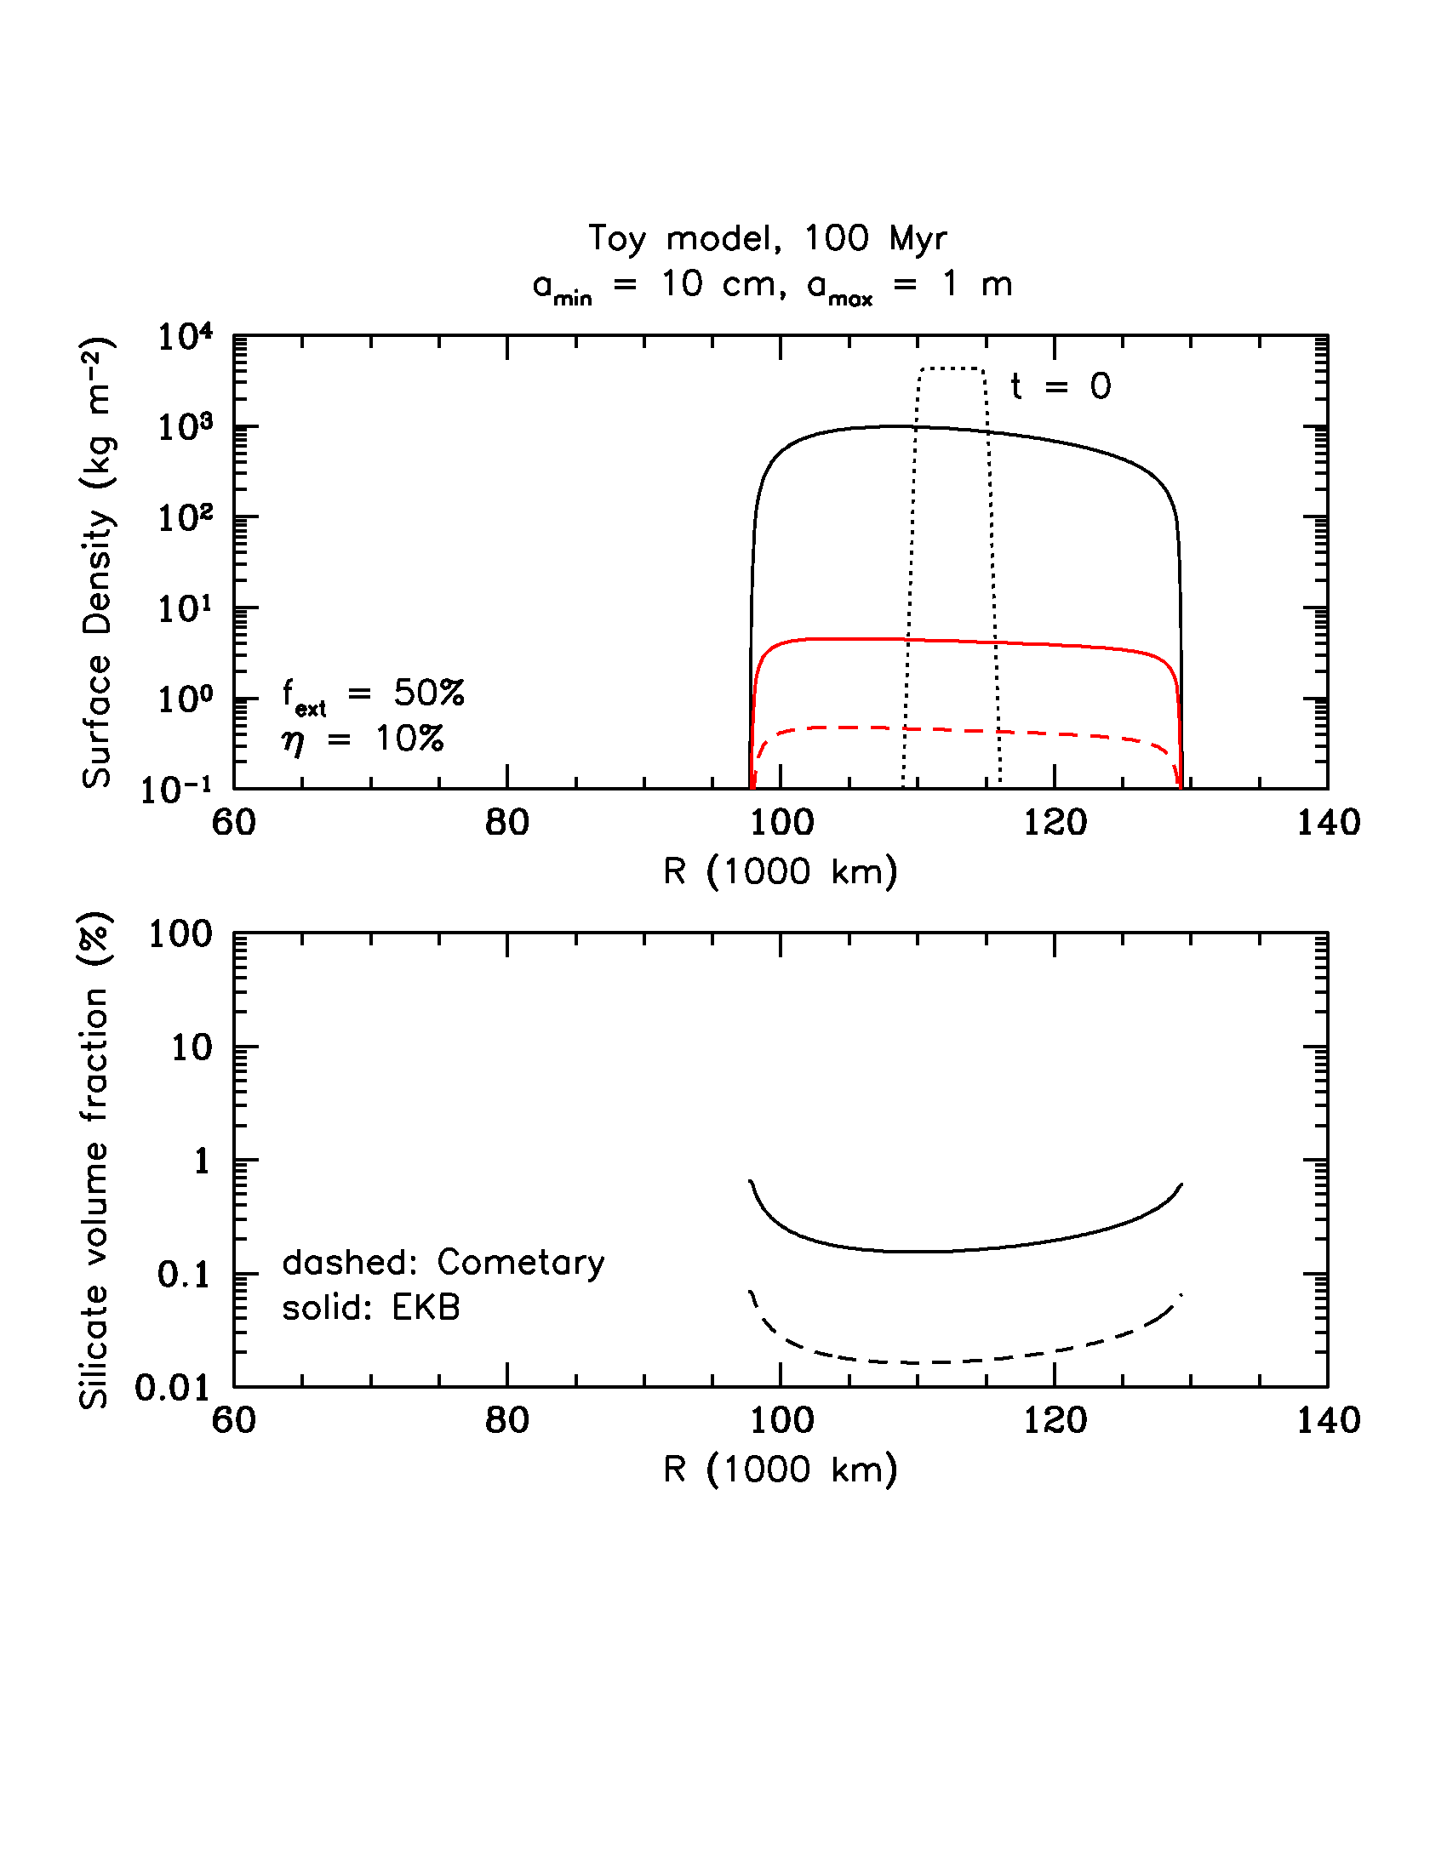
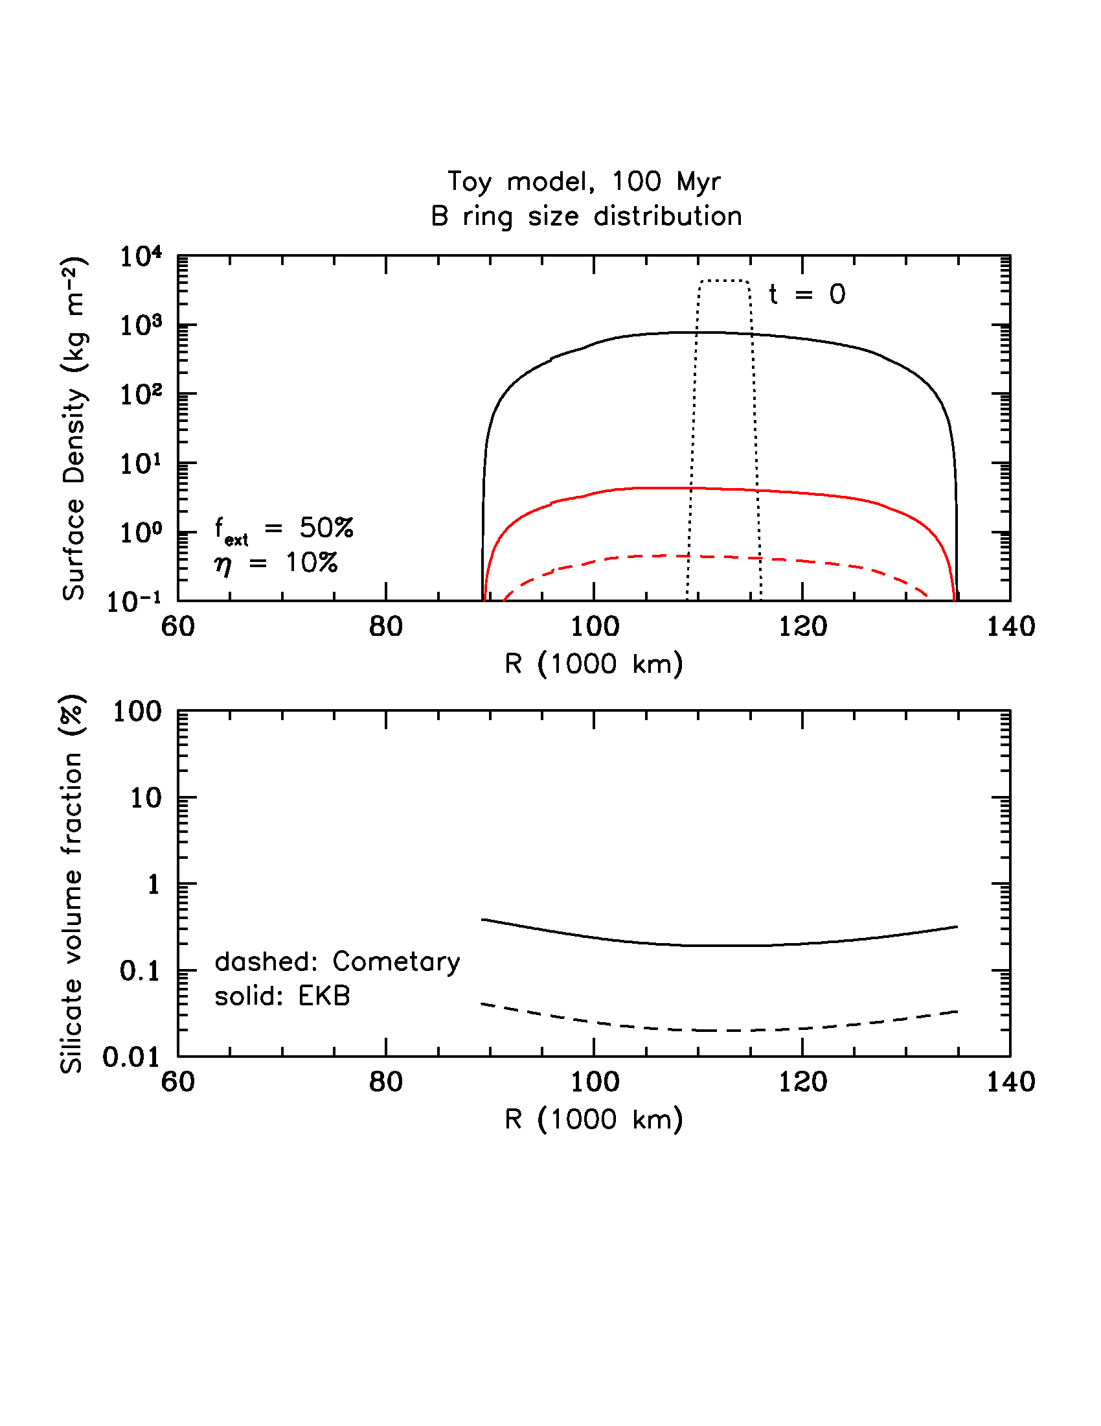
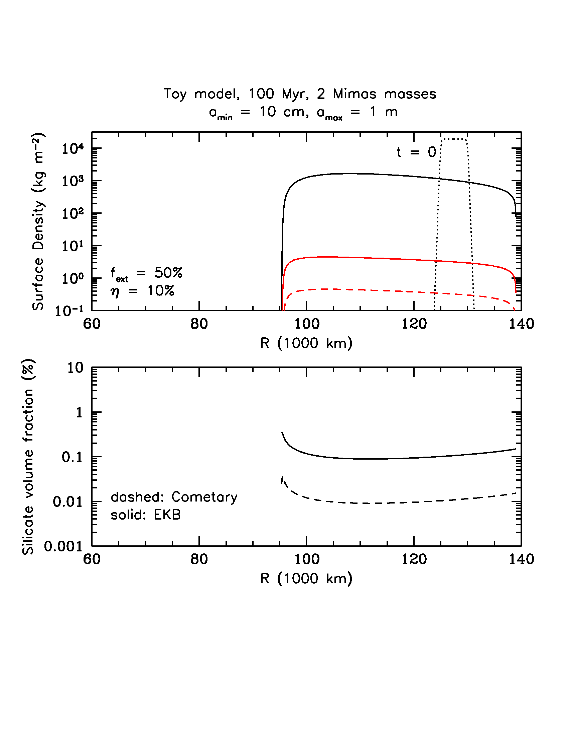
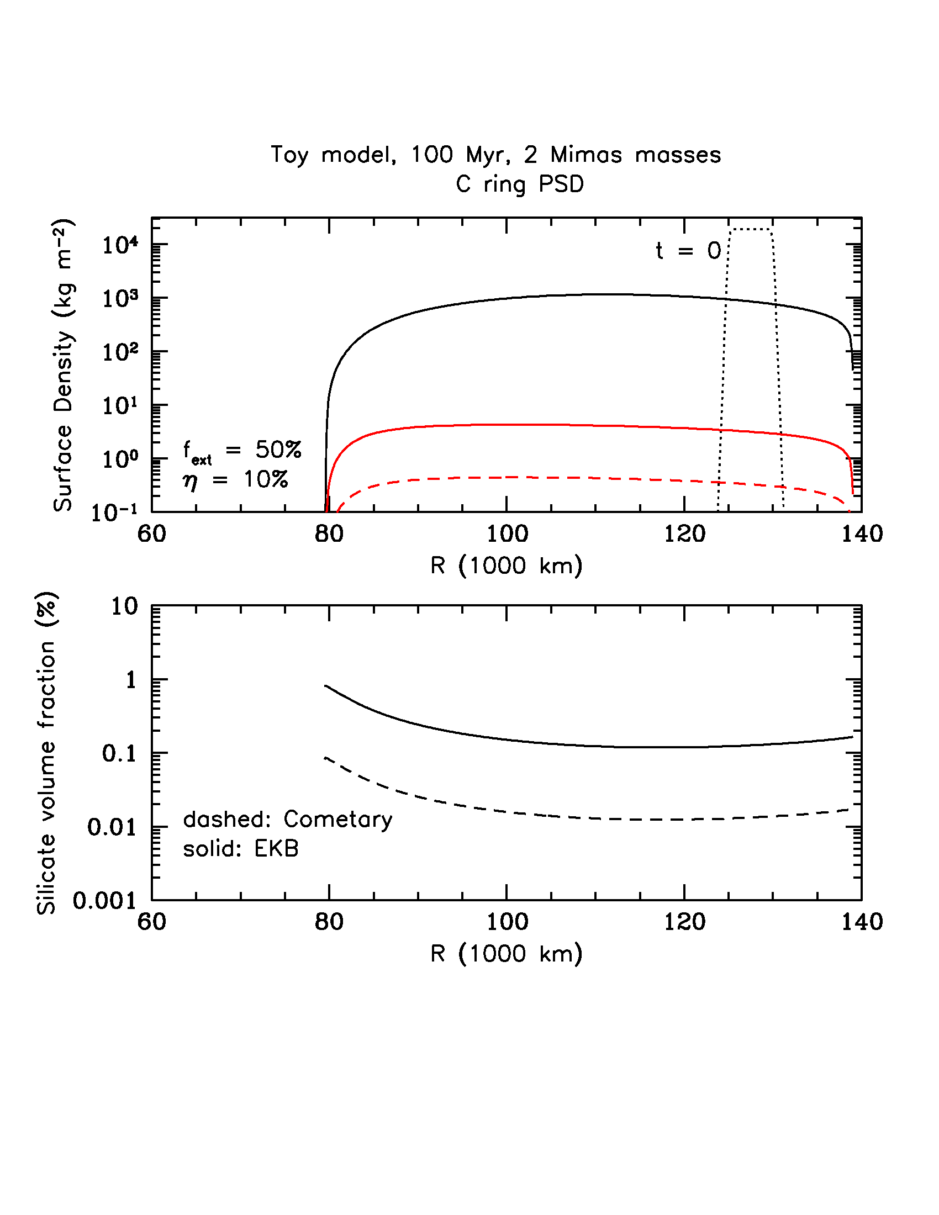
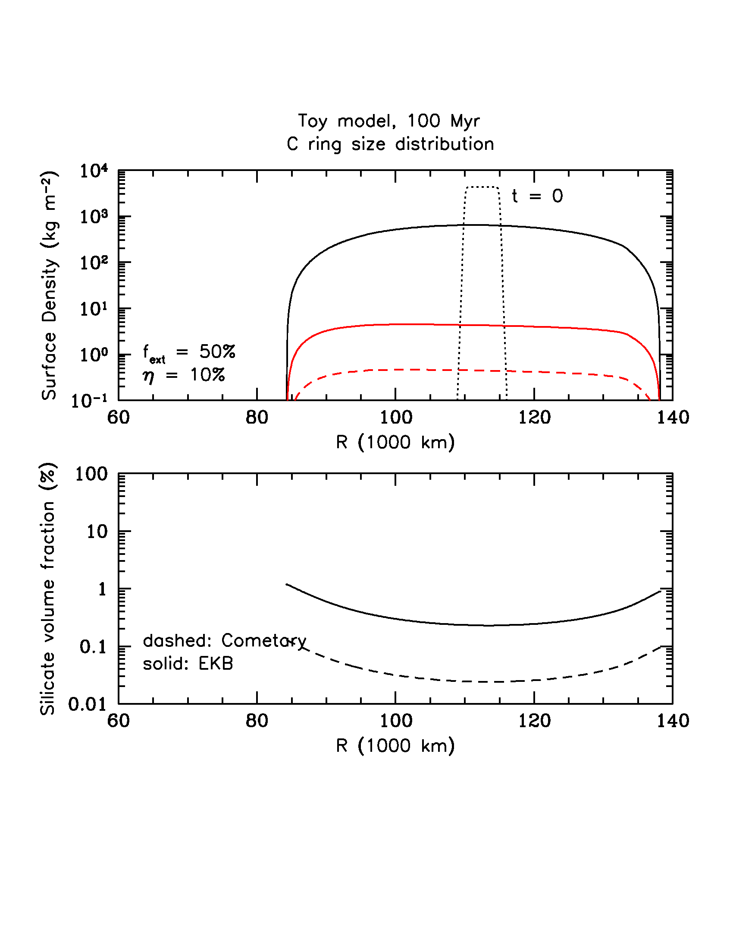
Recent Ring Spreading Models, 100 Myr, M = 0.4 Mimas
Particle size (and porosity) has an effect on how fast the annulus spreads.
Does NOT include: how particle size distributions change with both collisions and possibly micrometeoroid impact gardening. How does porosity evolve? All of these will likely affect yields and velocity and ejecta distributions.

Slide 13
A Modest Proposal for How it Might Have Gone
These models suggest possible scenario for current ring structure:
Moon (or material) that made the rings, probably not much more than ∼ 1 – 2 Mimas masses (∼ 1.5 ideal!) some ≳ 100 Myr ago.
Ring viscously spreads rapidly losing mass beyond Roche limit. Lost material eventually forms new moon(s) that tidally evolve outward.
Inner edge spreads inwards until surface density/viscosity drops sufficiently for BT to sharpen inner edge and slow spreading, probably not far from its current location.
C ring forms from material spilling over from B ring (also due to BT). AM loss may cause a C ring mass to be lost every ∼ 10⁷ years.
A Mimas mass moon forms that creates CD - Mimas 2:1 holds outer B ring in place (again when surface density drops?)
Reason to believe that C ring structure (plateaus) may be caused by BTI – but, how to explain the flat region?
Resonances from moons and planet play a role.
Requires new origin scenario – see Teodoro and Zahnle posters for more discussion!
Notes:
I agree with Sebastien Charnoz. Viscous spreading and BT are acting together. Just that it is on a more recent timescale – this seems the easiest way to reconcile the observations.

Slide 14
Conclusions
The trio of key evidence from Cassini observations, are not compatible with an ancient origin for rings.
MB population: the rings are impacted by much more material for the same exposure time than previously assumed. Probably much higher at LHB.
Volume fractions of pollutants: observed in the rings are very low – composition not homogenous, C/CD much darker than A/B. Not the case if old.
Ring mass: regardless of initial mass, spend most of their lifetime at ∼ 1 – 2 Mimas masses. A recent origin IS predictive of pollution content.
Ancient ring scenarios require initially massive ring, which cannot explain C ring, and observed fractions. Rings would homogenize EVEN IF none of the MB material survived or were all icy. Young ring models do the job just fine.
Primordial mid-sized icy moons and young rings presents a puzzle – suggests that at least some may also be young (e.g., Cuk et al., 2016).
Future of BT modeling bright – lots that can be done.
Notes:
DO UNDULATIONS BTI PRODUCED BY BT OVER LONG TIMES COMBINED WITH OTHER EFFECTS PRODUCE PLATEAUS?

Slide 15
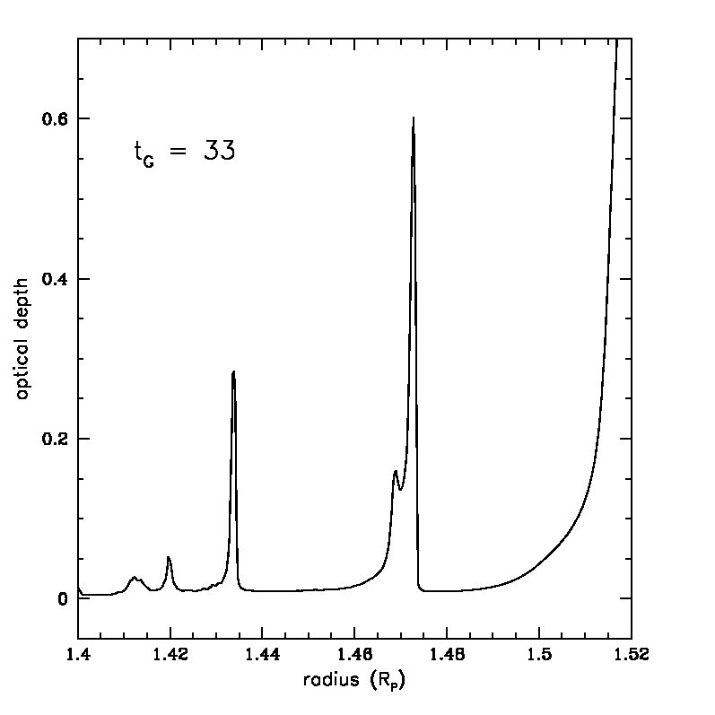

Slide 16
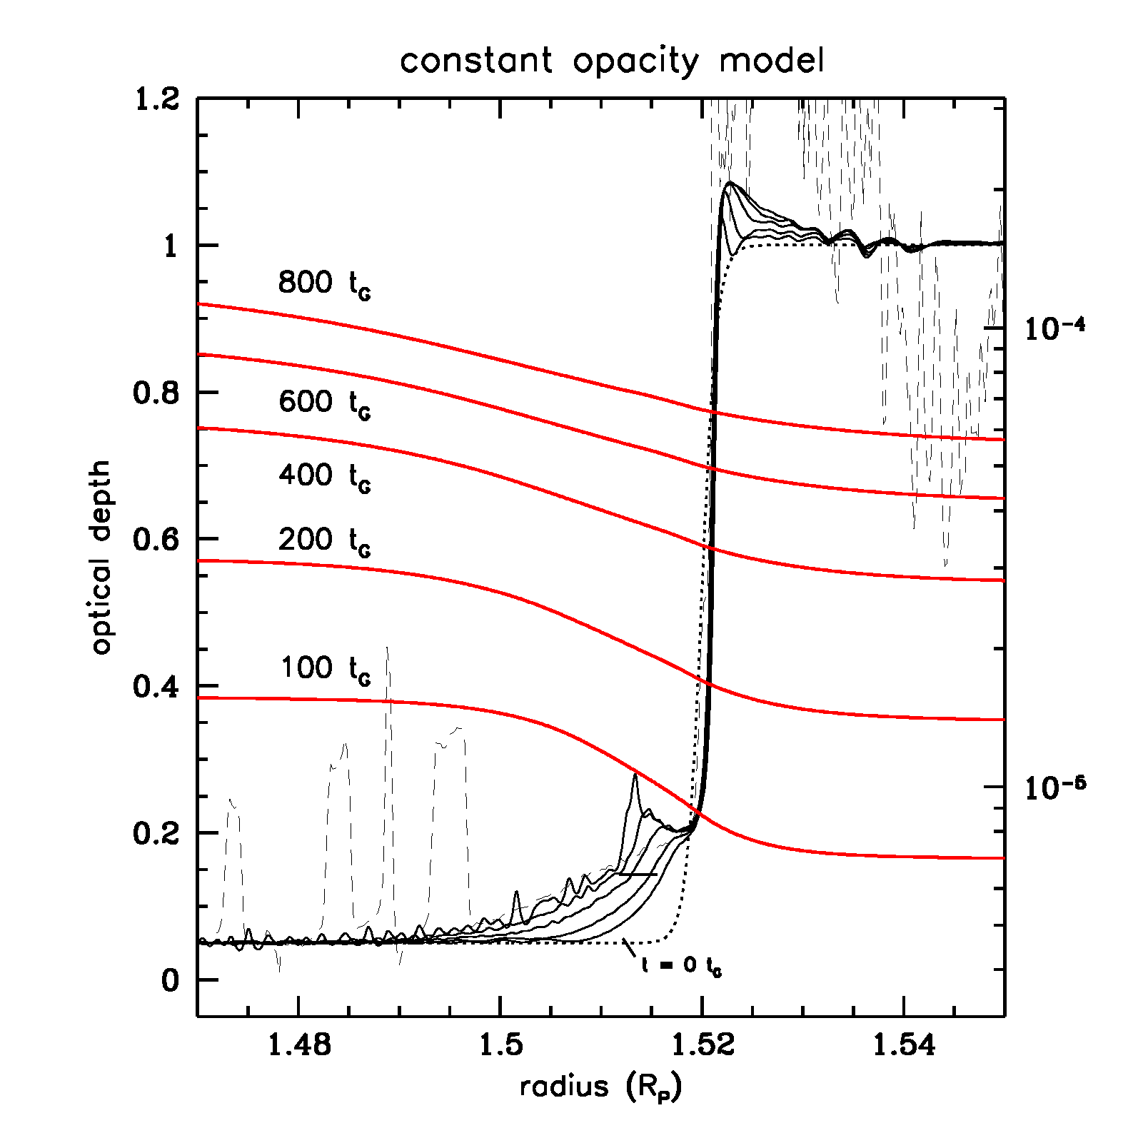
Adding Ballistic Transport
Voyager PPS imaging τ
If BT did not occur and there were only direct deposition, then we would see an abrupt change across a sharp optical depth boundary (we’d also not explain observed structural features!)
Compositional evolution creates global compositional variations; low mass density rings get polluted faster, but only initially!
Eventually as the low optical C ring darkens, it begins to darken the B ring faster as well – eventually the contrast will flatten out. This can occur quite rapidly.

Slide 18
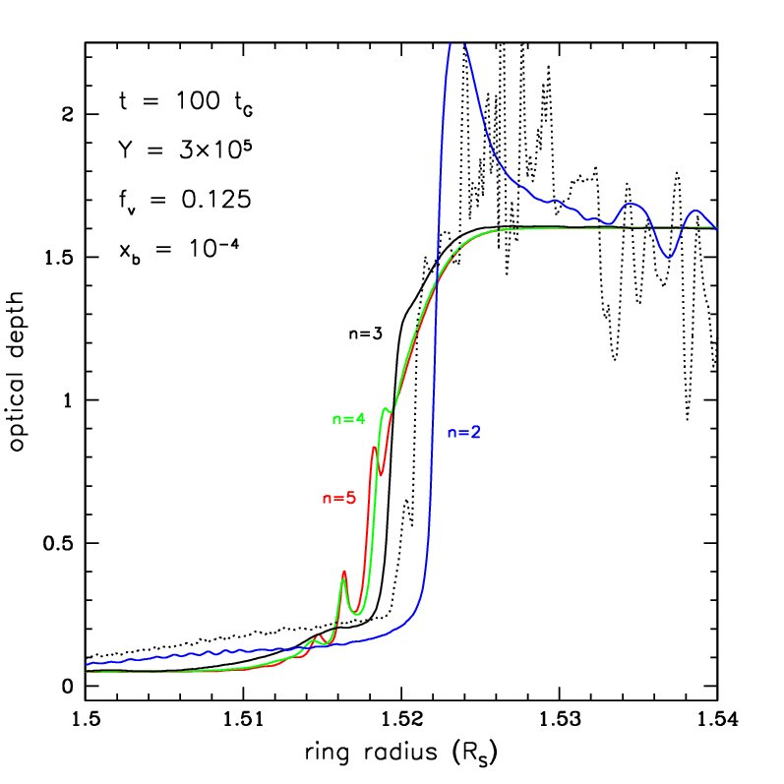
Steepness of the Ejecta Velocity Distribution
α−Arae UVIS τ
We have assumed the ejecta velocity distribution is described by a power law with index n = 3.
Higher n values lead to gradual “spilling over” of material.
steeper n concentrates more material at smallest x’s.
For higher n values, a “notch” appears.
Likely due to BTI.
Lower n leads to larger and better formed ramp.
More ejecta at intermediate and higher x’s.
No “hump”.
Strongly suggests the ejecta distribution is much more complex than what we model here.
Notes:
Led us naturally to look at different ejecta dist. And we found some very interesting behaviors…. Different n values may be important and we will return to this later… when we talk about….

Slide 19
Adding Ballistic Transport
Voyager PPS imaging τ
For a more realistic model with variable opacity, the contrast is maintained for longer times. Initial contrast is ∼ 10 after 100 t_{G}. But after ∼ 10 Myr (800 t_{G}) the contrast has already decreased to a factor of ∼ 6.
BT acts quickly to smear compositional contrasts in much shorter times than it takes to drive up the pollutants to the observed values for the retention efficiency adopted in these simulations.

Slide 20
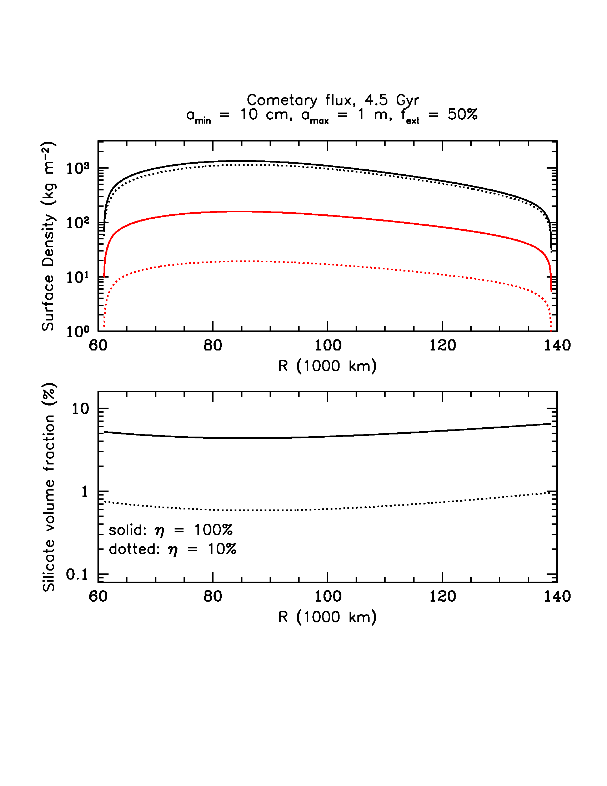
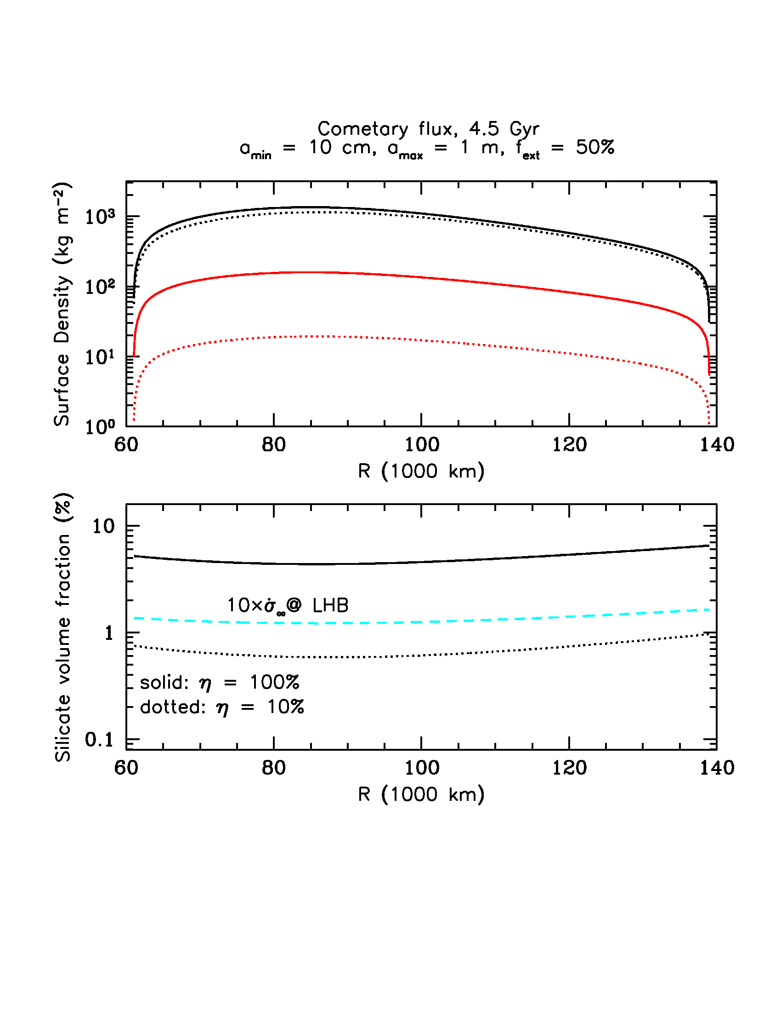
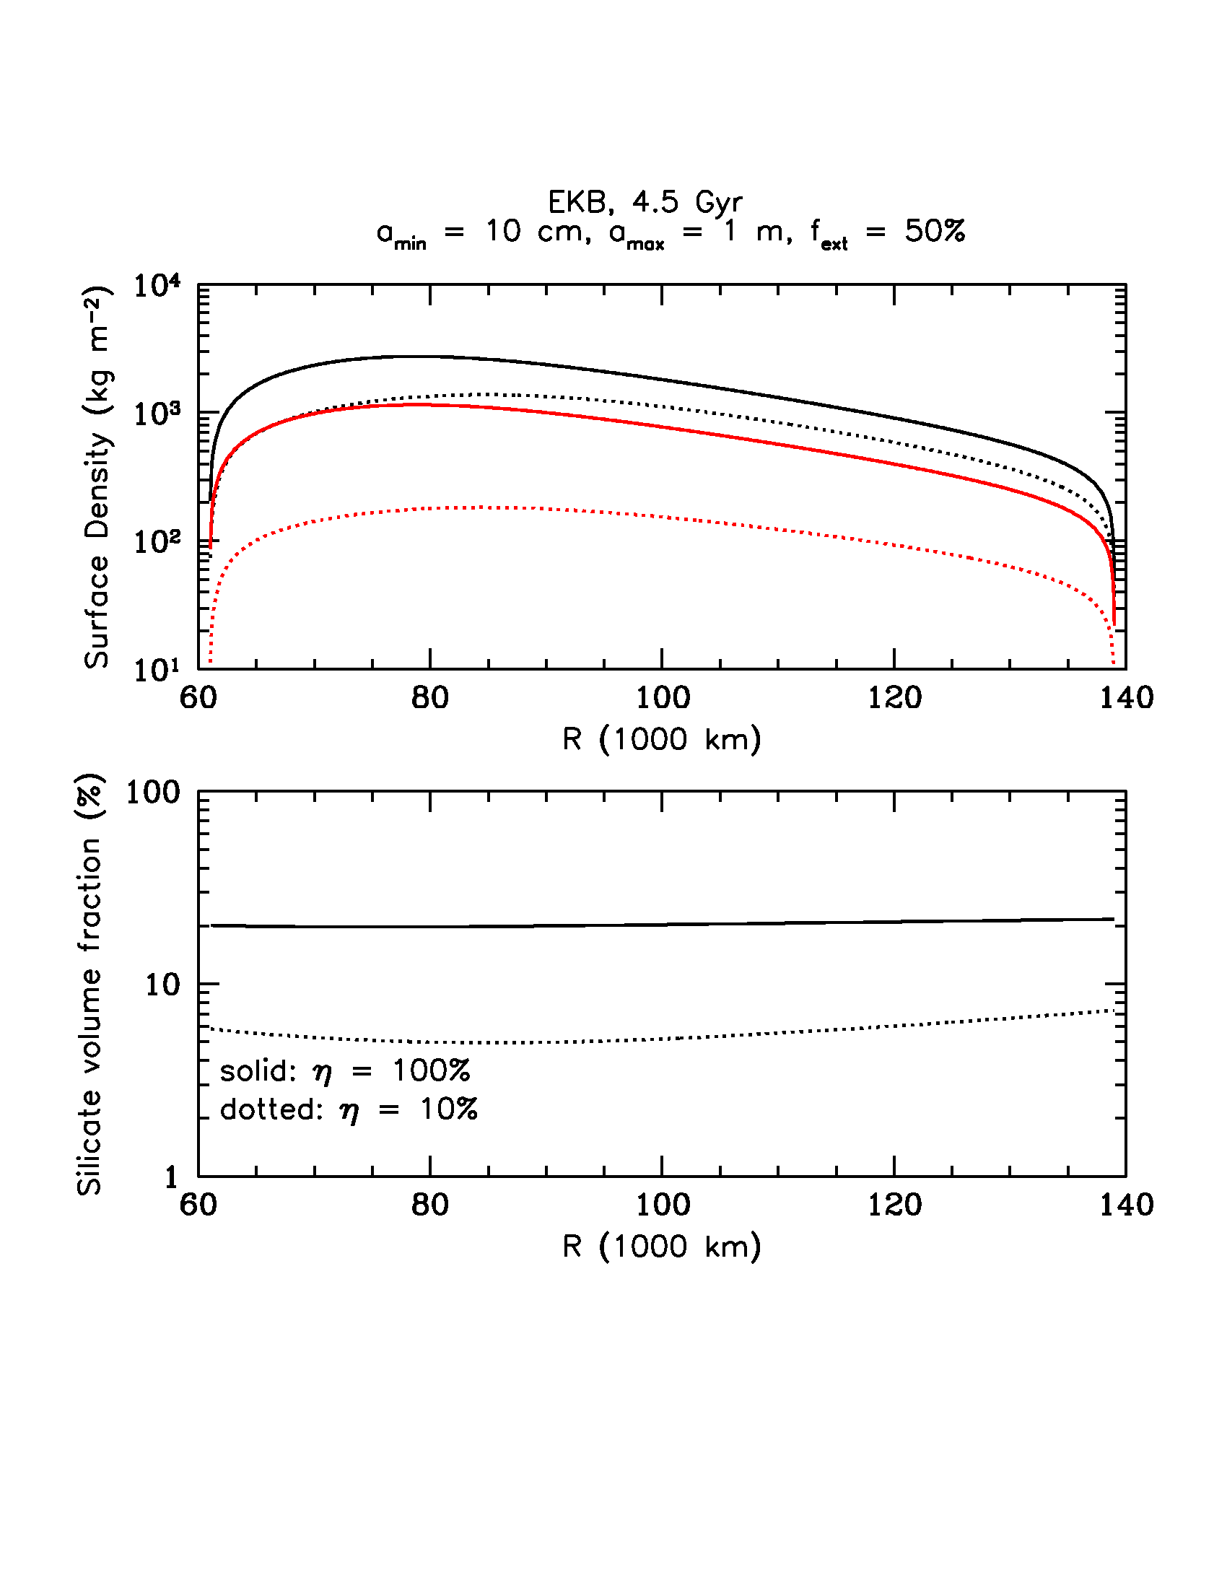
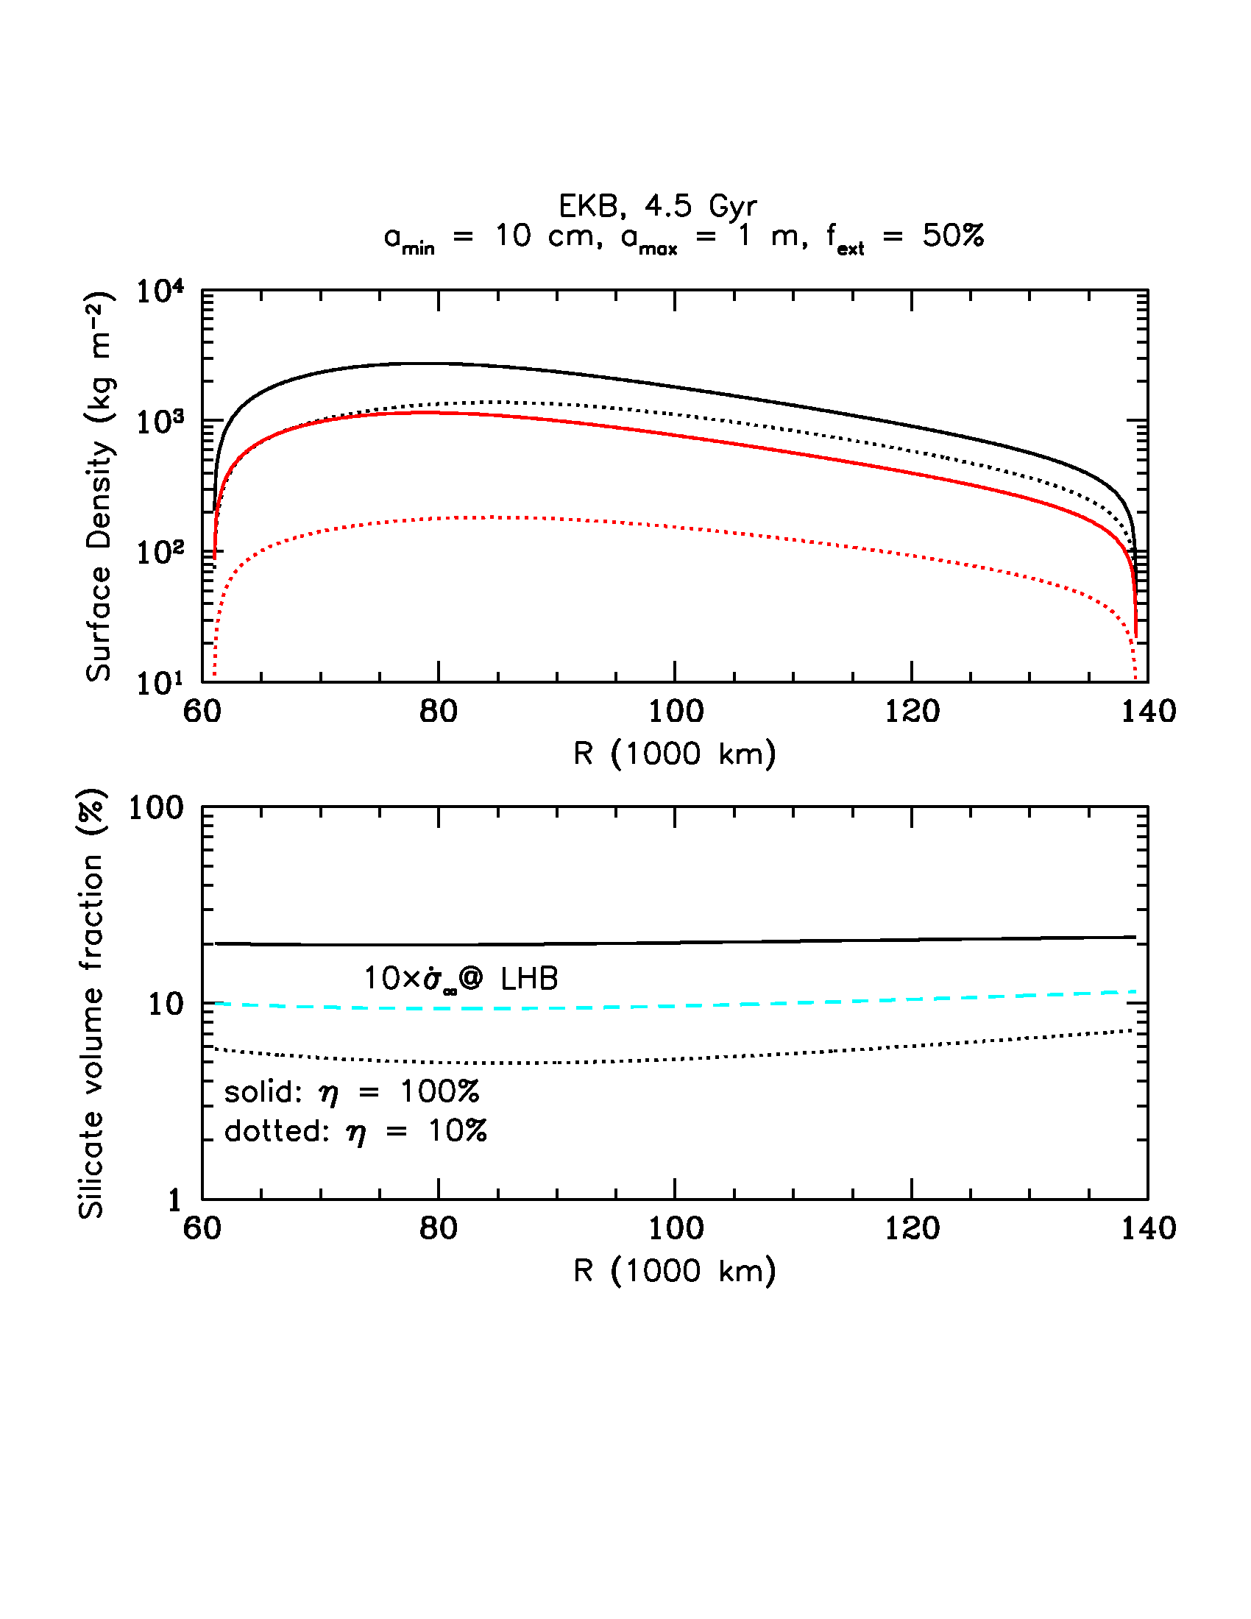
Cometary vrs. EKB Micrometeoroid Flux
After 4.5 Gyr
Notes:
Remember that this is really a measure for the B/A ring, not C ring so the volume fractions should match those.
Zahnle – 10 times at LHB. Luke?

Slide 21
Long Term Evolution of Inner B ring Edge
Voyager PPS imaging τ
EKB flux also is able to maintain a sharp inner B ring edge.
High focusing allows for much larger (and more reasonable ejecta yields).
Although ramp is not linear, it begins to exceed the observed slope in > 50 Myr (in both cases).
The structure in the ramp and C ring is not as transient as once thought.
Over 100 Myr, significant inward drift of inner edge, barring any effect to keep the edge at same place. Other effects acting on same time scale?

Slide 22
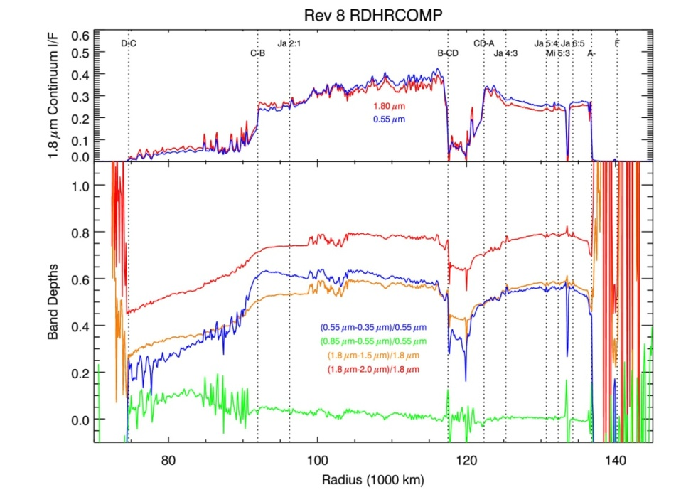
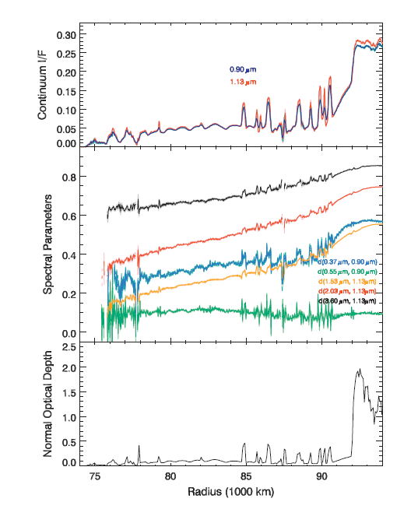
Color Variations Across Plateaus. Real?
(Nicholson et al. ,2008)
Previous results show variation across plateaus in color ratios and normalized spectral slopes, at least with VIMS, also Voyager visible.
Deeper water ice band depths suggest more icy material in the plateaus relative to the continuum.
If true – hard to reconcile with pollution.
(Hedman et al., 2013)
(Cuzzi & Estrada, 1998)

Slide 23
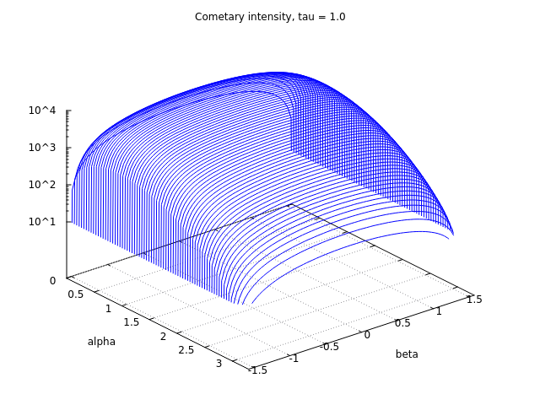
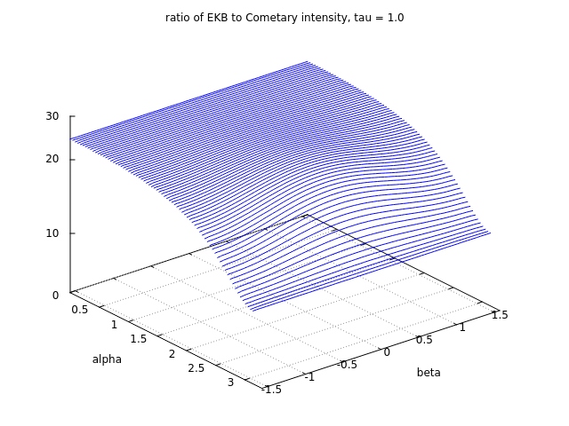
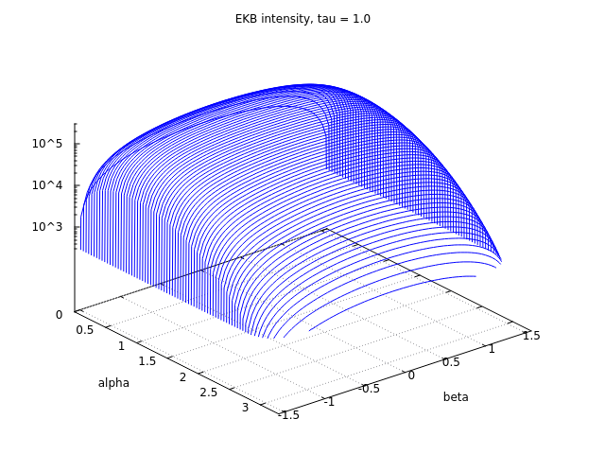
Cometary vrs. EKB Micrometeoroid Flux
Direct comparison between the EKB ejecta distribution as derived from the CDA measured flux (Kempf et al., in prep) with the cometary distribution used in previous studies (D92; CE98).
CDA Flux at infinity comparable to Cometary value, but much more gravitationally focused
Notes:
alpha and beta are the cone and clock angles of the emergent ejecta measured from the ring particle velocity vector. What does this mean? In the same time scale MORE mass is being directly deposited in the rings. This has consequences

