Slide 1
Modeling the Bombardment of Saturn’s Rings and Fit to Cassini UVIS Spectra to Estimate Their Age
14 August 2018
Josh Elliott
joshua.elliott@lasp.colorado.edu
Larry Esposito
larry.esposito@lasp.colorado.edu

Slide 2
Goals
Model ring pollution, using Markov-chain process.
  Apply filling-factor (optical depth) correction.
  Use meteoritic mass flux values presented by Kempf et.al 2017 (AGU).
Fit UVIS ring spectra, determine observed fractional pollution.
Compare Markov model ring pollution with UVIS fit.
Estimate A, B and C ring ages.

Slide 3
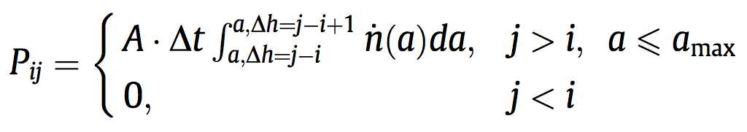
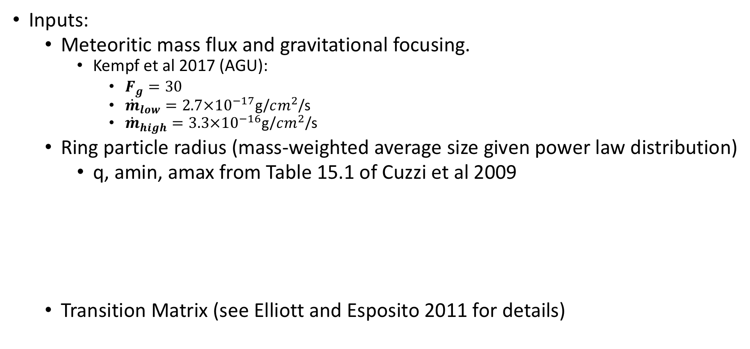
Markov Chain Regolith Growth Model (1)
Inputs:
  Meteoritic mass flux and gravitational focusing.
    Kempf et al 2017 (AGU):
      $F_{g}=30$
      ${\dot{m}}_{low}=2.7×{10}^{−17}$g/$cm^{2}$/s
      ${\dot{m}}_{high}=3.3×{10}^{−16}$g/$cm^{2}$/s
  Ring particle radius (mass-weighted average size given power law distribution)
    q, amin, amax from Table 15.1 of Cuzzi et al 2009
  Transition Matrix (see Elliott and Esposito 2011 for details)
Ring | q | amin | amax | Characteristic Size
C | 2.75 | 1cm | 1000cm | 352.2cm
B | 3.1 | 30cm | 2000cm | 852.2cm
A (outer) | 2.9 | 1cm | 2000cm | 773.1cm
Notes:
Table 15.1 of Cuzzi et al 2009 (Saturn from Cassini-Huygens) gives values for q, amax and amin. Using these values, which define a power law size distribution, we calculate the mass weighted average particle size for both the B and C rings.
Personal conversations with Jeff and Paul indicate that mass flux may be higher by an order of magnitude.

Slide 4
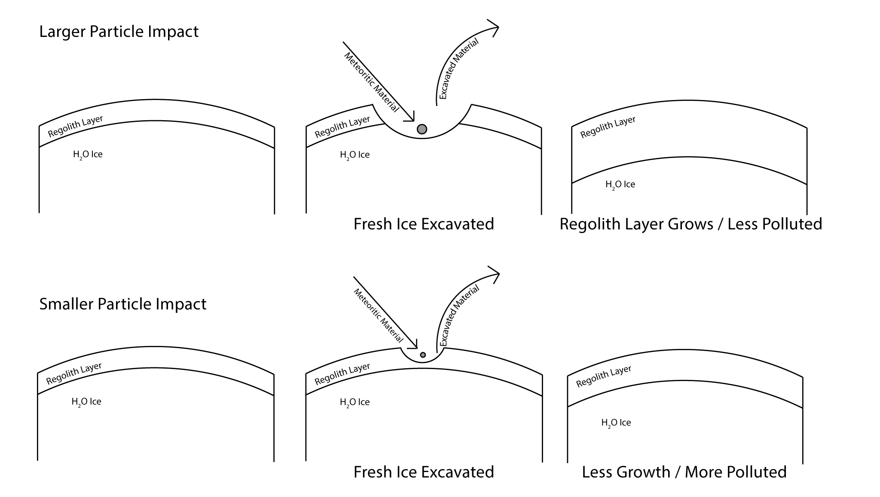
Markov Chain Regolith Growth Model (2)
No

Slide 5
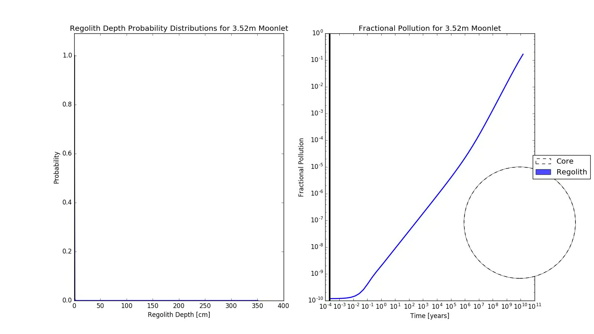
Ring Particle
Notes:
Start the video about a third of the way.

Slide 6
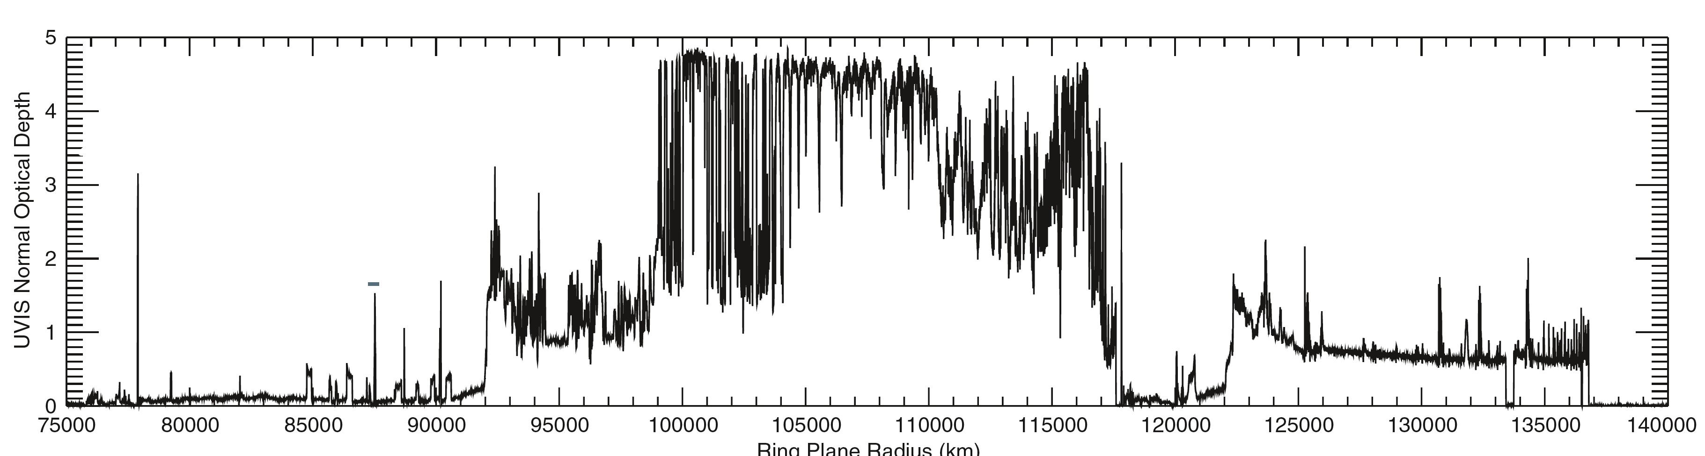
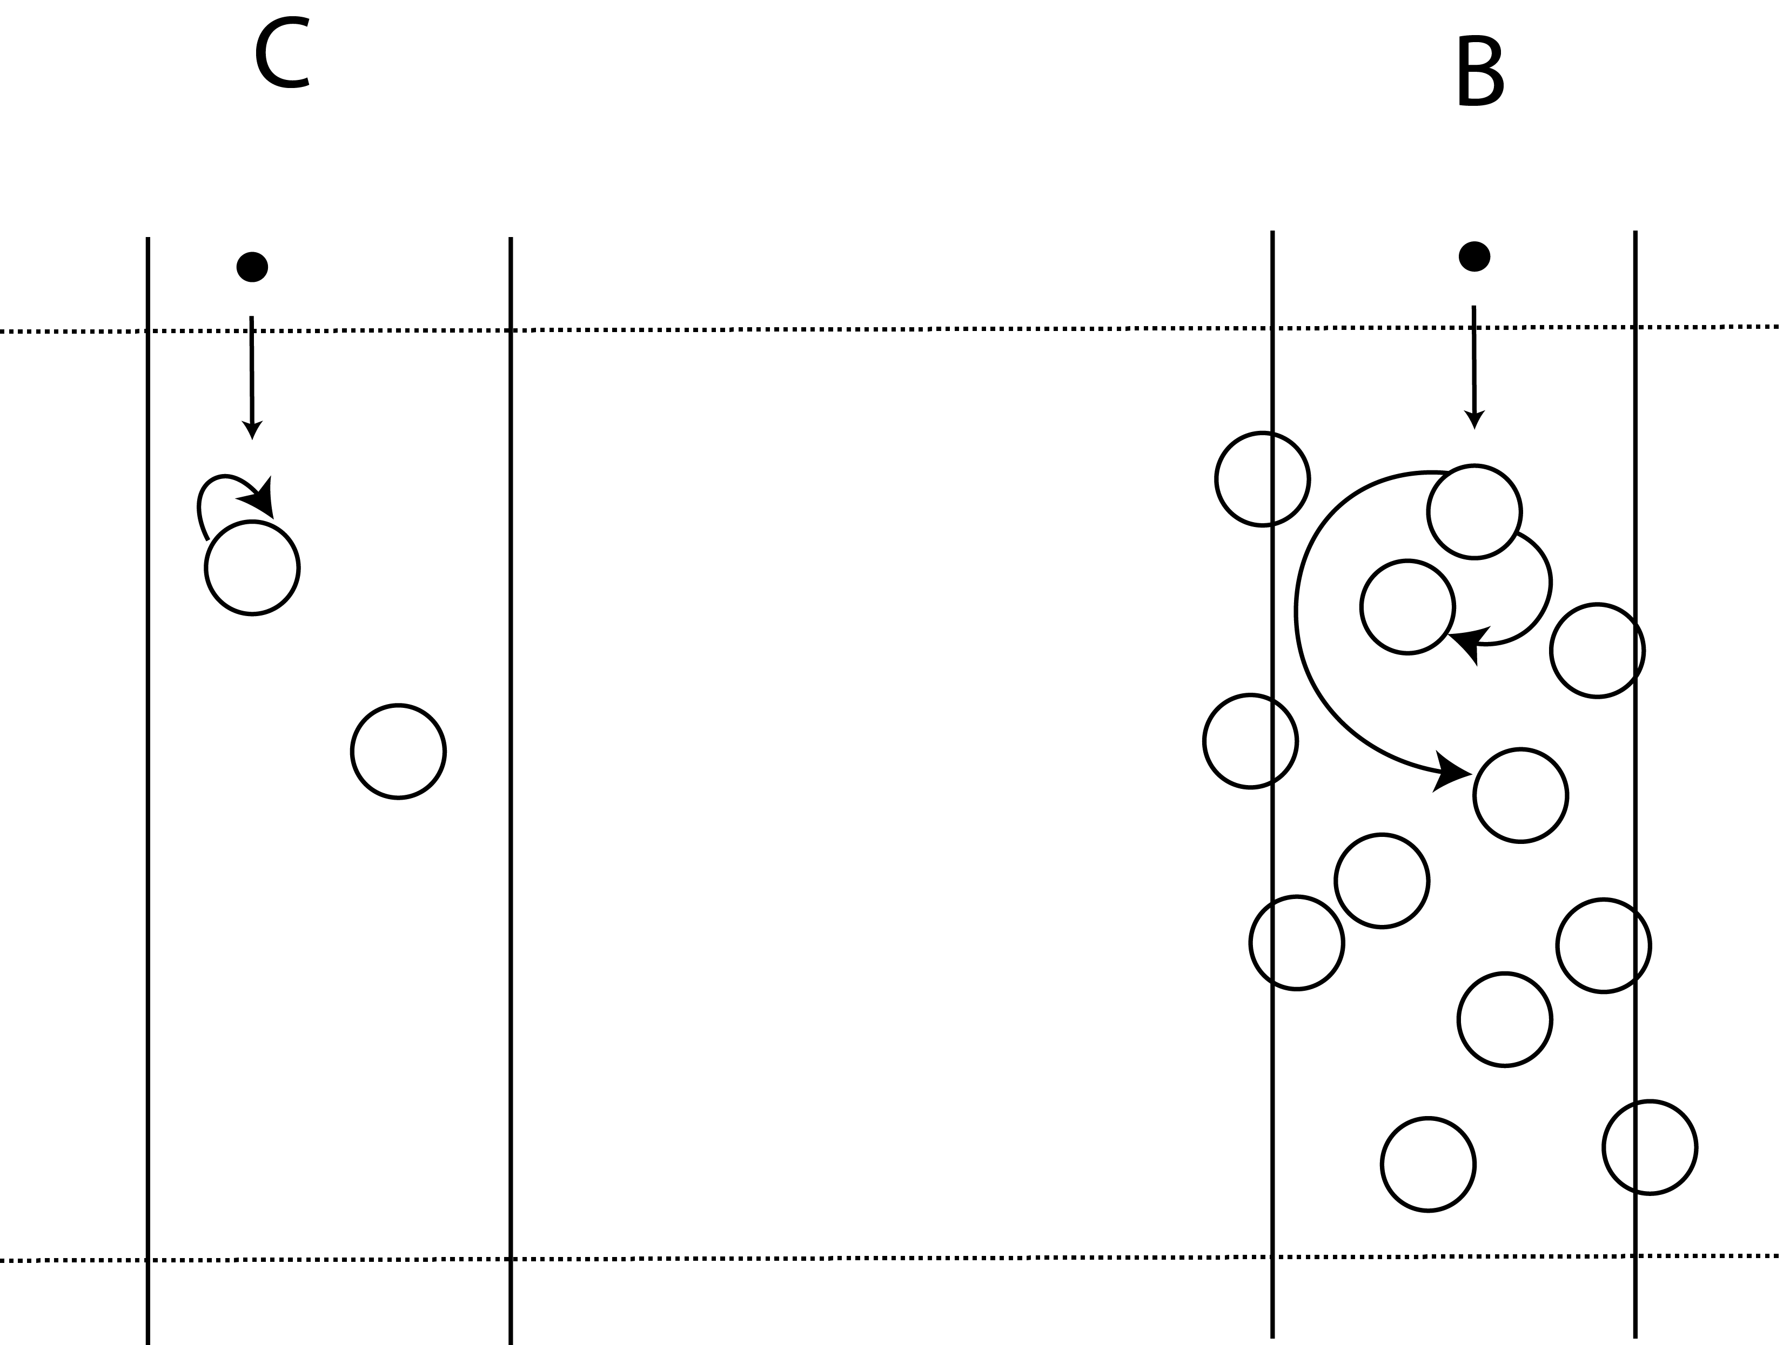
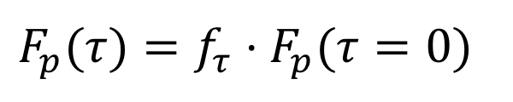
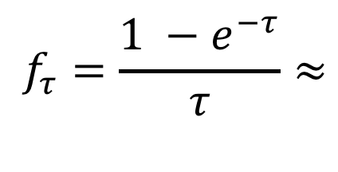
Meteoritic Flux and Ring Column Density
Colwell et al. 2009 Fig 13.1
$$f_{τ}=\frac{1 −e^{−τ}}{τ}≈$$
Probability of ejection from a particle
Number of particles who collect ejected material
$$F_{p}(τ)=f_{τ}⋅F_{p}(τ=0)$$

Slide 7
Fractional Pollution

Slide 8
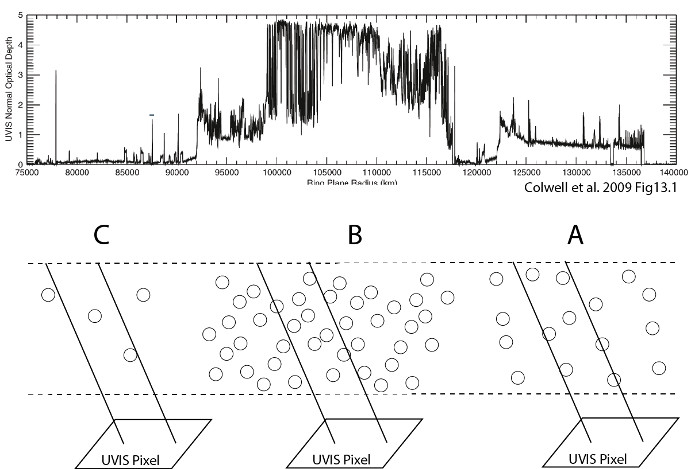
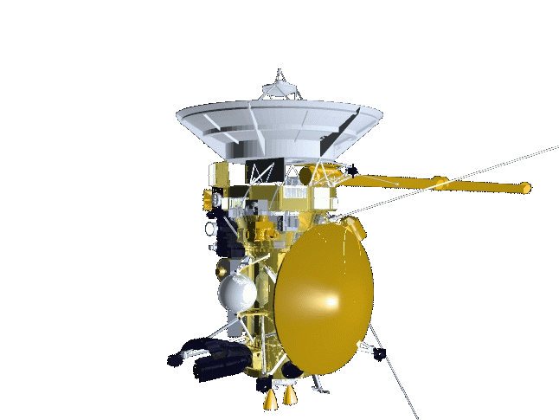
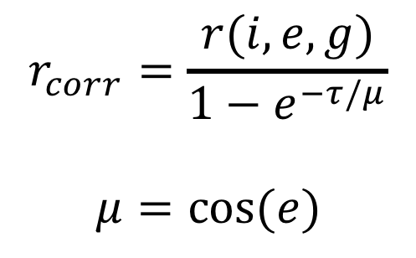
Observed Reflectance and Optical Depth
$$r_{corr}=\frac{r(i,e,g)}{1−e^{−τ/μ}}$$
$$μ=cos⁡(e)$$

Slide 9
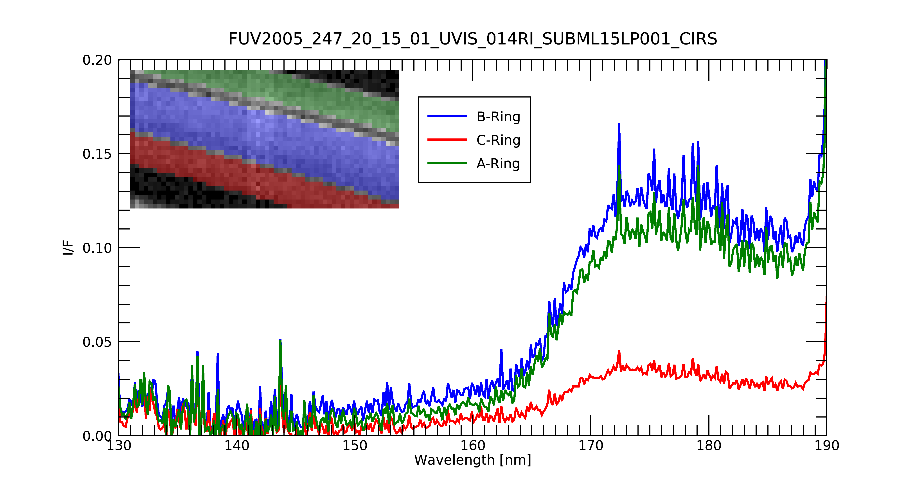
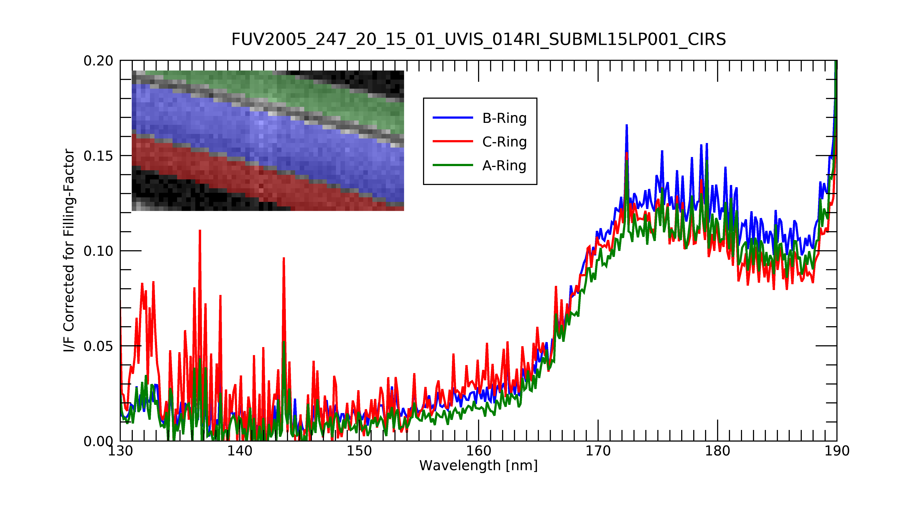
Filling-factor corrected Reflectance
UVIS measured Reflectance

Slide 10
Hapke fit
Least-squares fit to UVIS data using three free parameters, fractional-pollution, mean-slope angle and Hapke asymmetry-factor. Two pollutants are examined: Amorphous Carbon (solid) and cometary spectra from 67P (dash). C-Ring (right), B Ring (center), A Ring (left). Hapke asymmetry factor = -0.1 from fit.

Slide 11
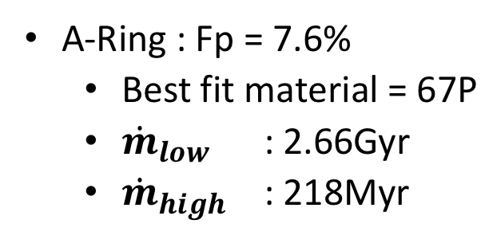
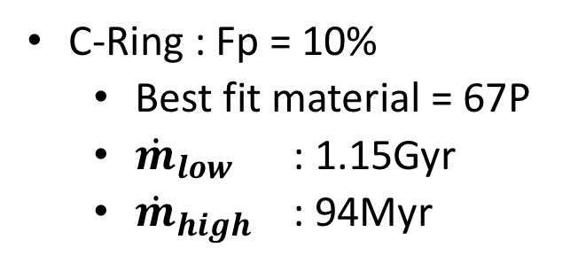
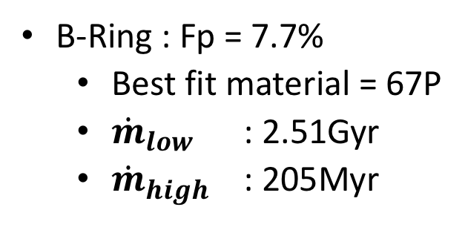
Results
C-Ring : Fp = 10%
  Best fit material = 67P
  ${\dot{m}}_{low}$ : 1.15Gyr
  ${\dot{m}}_{high}$ : 94Myr
B-Ring : Fp = 7.7%
  Best fit material = 67P
  ${\dot{m}}_{low}$ : 2.51Gyr
  ${\dot{m}}_{high}$ : 205Myr
A-Ring : Fp = 7.6%
  Best fit material = 67P
  ${\dot{m}}_{low}$ : 2.66Gyr
  ${\dot{m}}_{high}$ : 218Myr
Notes:
o : 1.147069774419277 , radius=352 , flux=CDA_low
o : 0.09385116336157694 , radius=352 , flux=CDA_high
o : 2.511651928458467 , radius=852 , flux=CDA_low
o : 0.205498794146602 , radius=852 , flux=CDA_high
o : 2.665425318129788 , radius=773 , flux=CDA_low
o : 0.2180802533015278 , radius=773 , flux=CDA_high

