Slide 1
Viscous Spreading and the Mass of Saturn’s Rings
Julien Salmon¹, Sébastien Charnoz², Aurélien Crida³, André Brahic
Cassini Science Symposium
14 August 2018
¹ Southwest Research Institute, Boulder, CO USA
² IPGP, Paris, France
³ Observatoire de la Côte d’Azur, Nice, France.

Slide 2
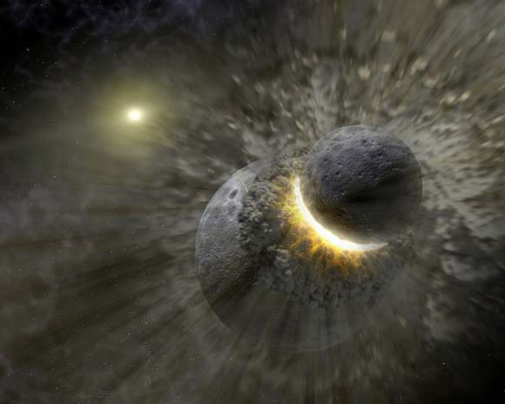
Ring formation scenarios
Remnant of Saturn's sub-nebula disk (Pollack et al. 1976).
Tidal disruption of a satellite (Harris 1984, Canup 2010)
Tidal disruption of comets (Dones 1991, Charnoz et al. 2009)
Catastrophic impact on a satellite (Pollack et al. 1973, Harris 1984, Charnoz et al. 2009)
By-product of recent moon-moon collision (Ćuk et al. 2016, Hyodo & Charnoz 2017)
Most successful ring formation scenarios imply rings as old as the Solar System
≠ observational & theoretical constraints : rings appear ~100 million years old

Slide 3
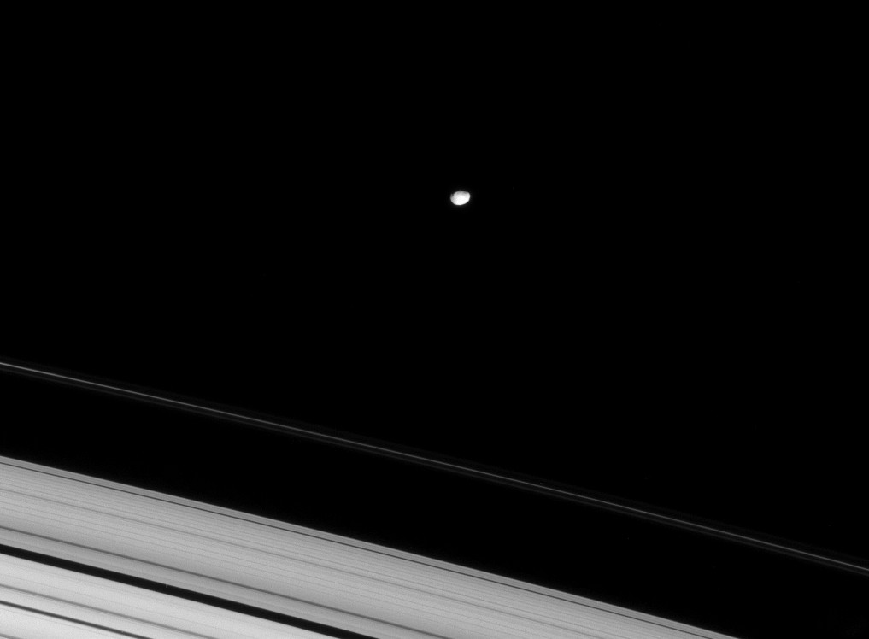
How do Saturn's rings evolve ?
viscous spreading
resonant torques from satellites
meteoritic bombardment
The study of the long-term and global evolution of the disk with these effects is essential to constrain the possible age of the rings

Slide 4
Ring particle interactions transport angular momentum
“Local” transport : random motion of particles
→ translational viscosity (Goldreich & Tremaine 1978)
2) “Non-local” transport : sound waves traveling between centers of colliding particles
→ collisional viscosity (Araki & Tremaine 1986)
3) “Gravitational” transport : scattering of ring particles due to presence of self-gravity wakes
→ gravitational viscosity (Salo 1992, 1995; Richardson 1994)

Slide 5
Measure of the disk's self-gravity
Self-gravity : formation of small particle aggregates
→ Julian-Toomre instabilities
Toomre Q parameter :
Q < 1 : gravitational instability
Salo 1995 : in rings, self-gravity wakes form when Q < 2

Slide 6
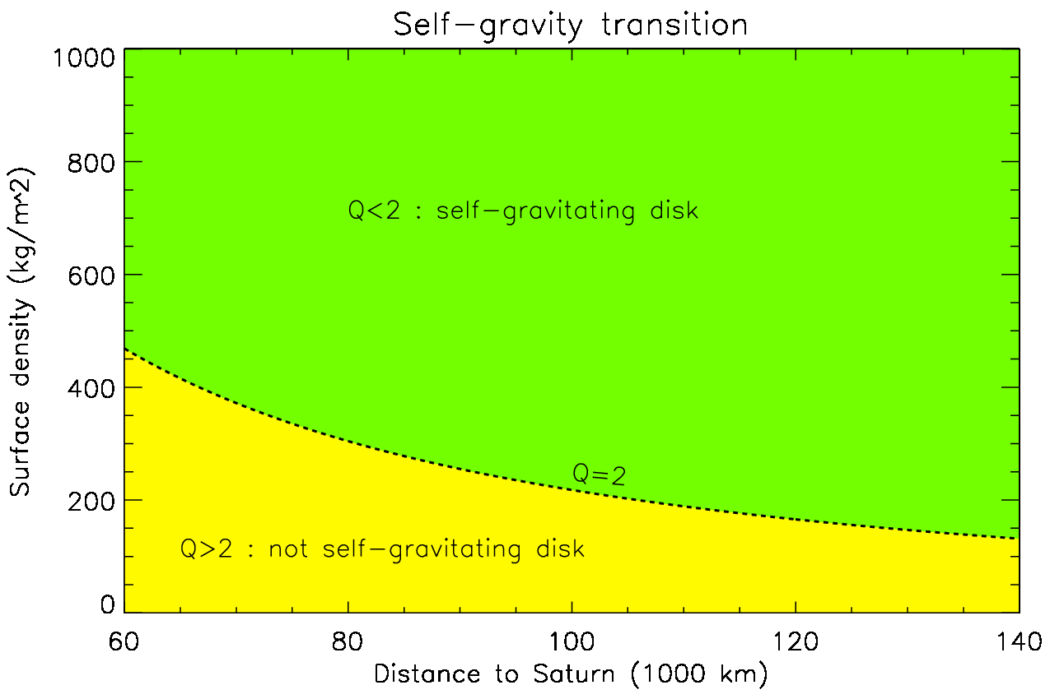
Self-gravity transitions

Slide 7
Numerical simulation of the rings viscous evolution Salmon et al. (2010)
Numerical resolution with a 2nd-order Runge-Kutta hydrocode
1D (radial) finite-elements code with staggered grid
Simpler physics
Allows long-term & large-scale simulations !
What is the viscous evolution
of an initially narrow ring
with variable viscosity
over 5 billion years
?

Slide 8
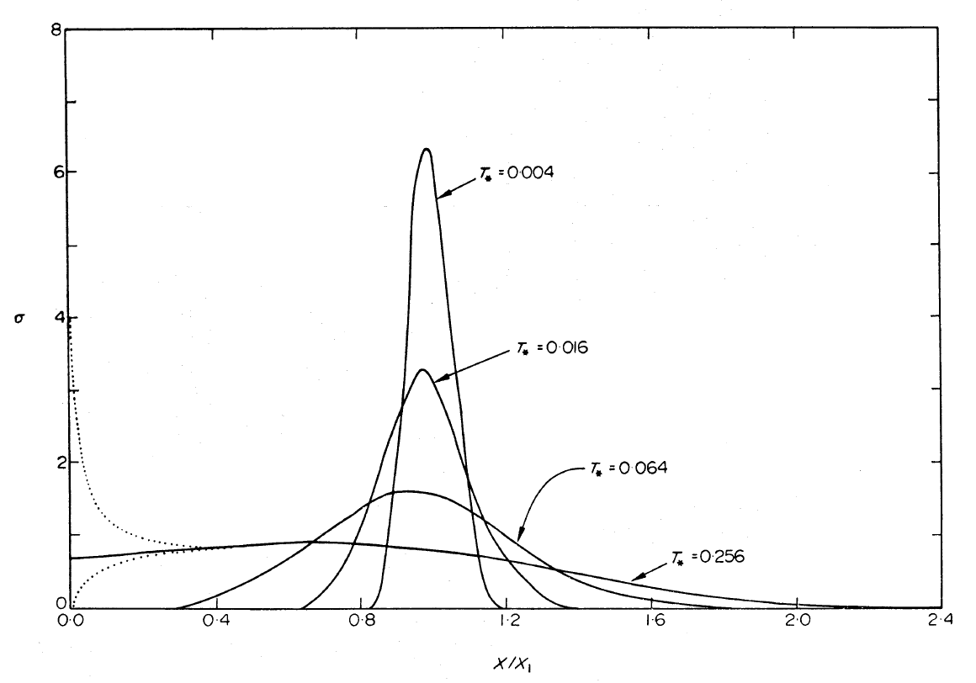
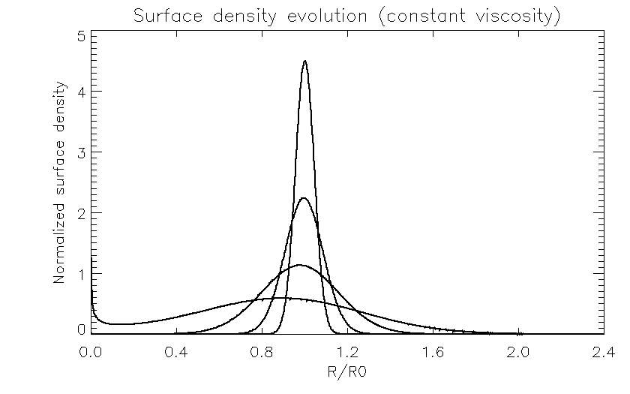
To validate the code, we reproduce the analytical solution of Lynden-Bell & Pringle (1974)
(Lynden-Bell & Pringle 1974)

Slide 9
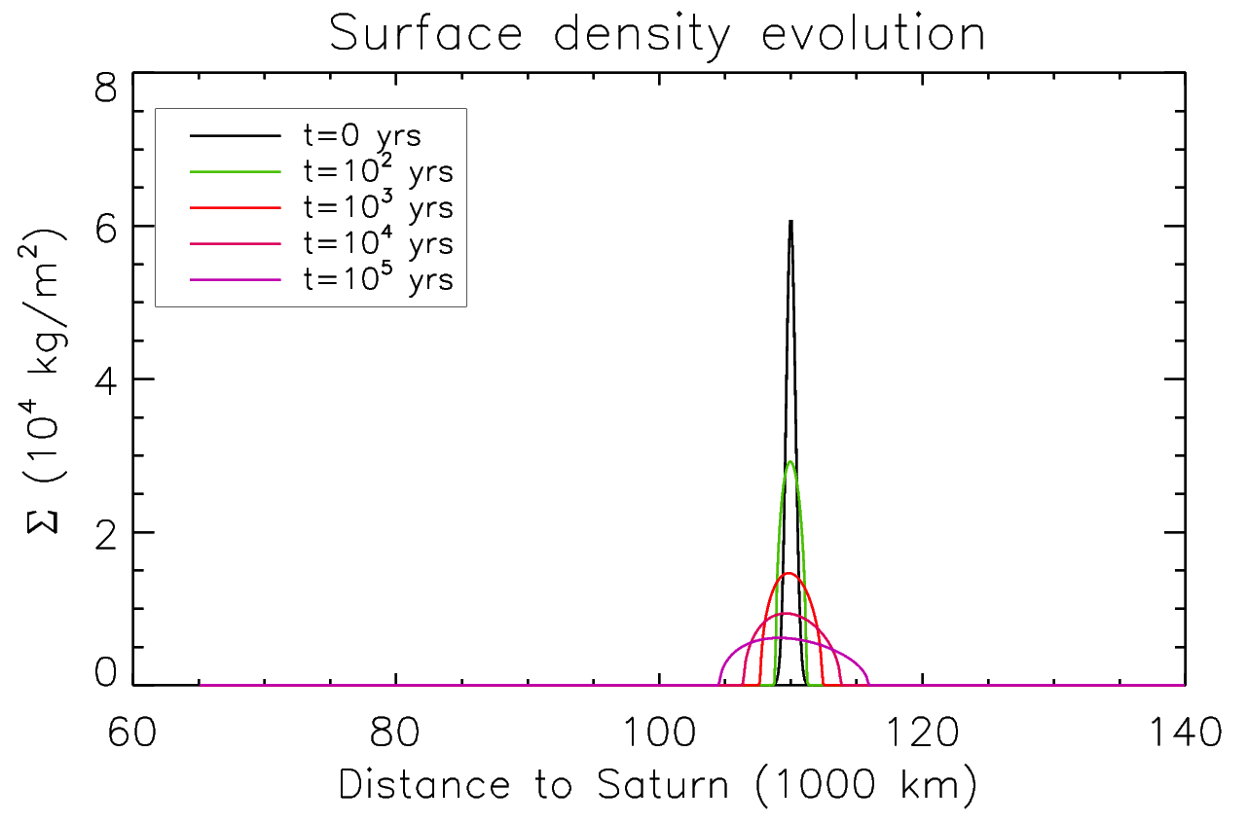
Viscous spreading with variable viscosity
material crosses the Roche limit
Constant viscosity
material falls onto the planet

Slide 10
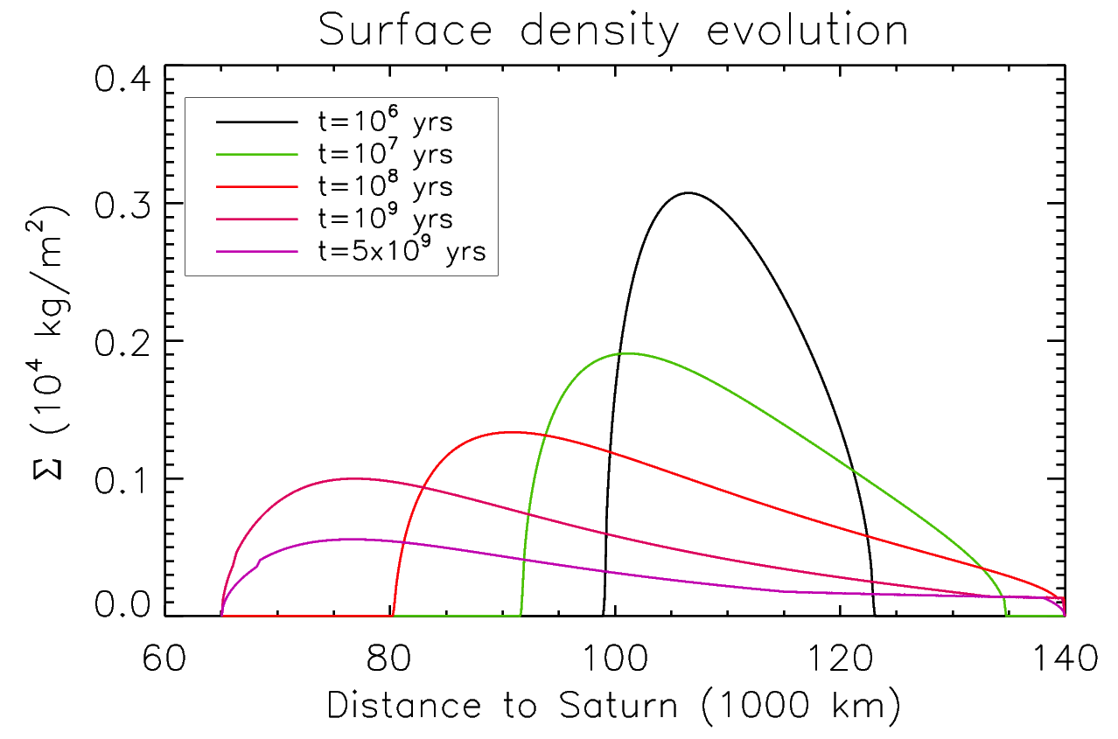
Viscous spreading over 5 billion years

Slide 11
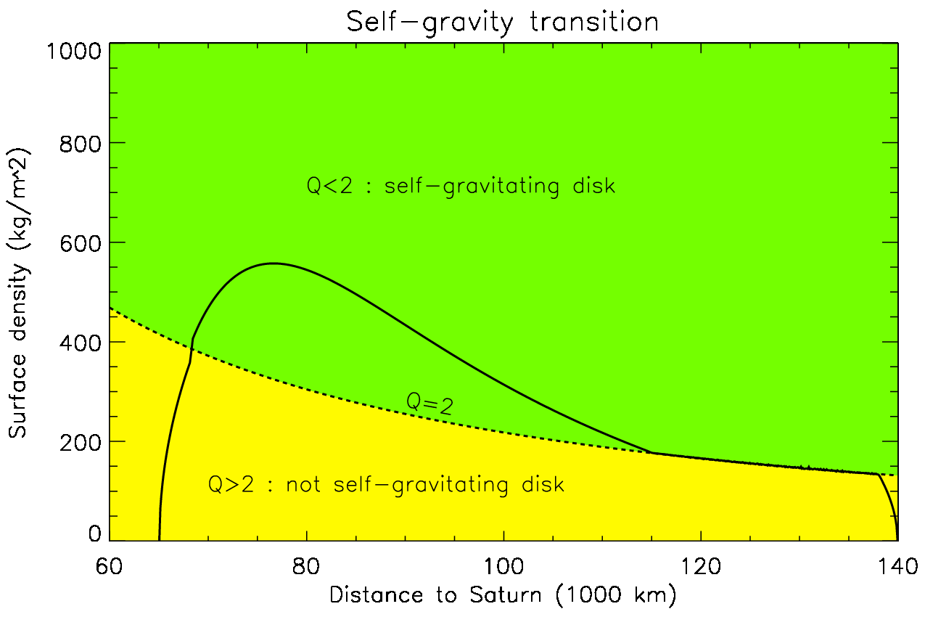
Self-gravity transitions
Surface density at t=5 Gyrs
Marginally gravitationally stable zone (Q~2)

Slide 12
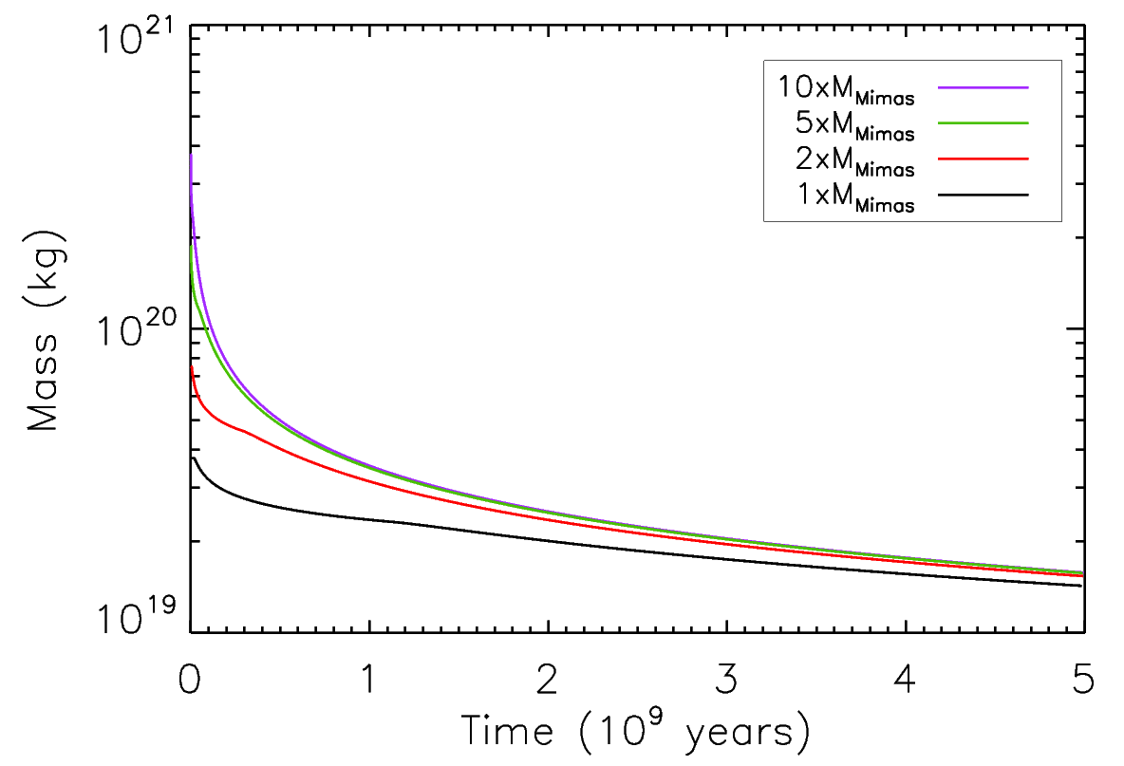
Disk mass evolution
Limiting mass ??

Slide 13
Mass of a fully non self-gravitating disk

Slide 14
Summary
Massive self-gravitating rings viscously evolve toward a marginally gravitationally stable disk (Q∼2) with a well-defined asymptotic mass
The process naturally produces a system with an inner density peak (B ring?) and less dense outer regions (A ring?)
Memory loss : viscous spreading erases initial variations in rings mass & mass distribution.

Slide 15
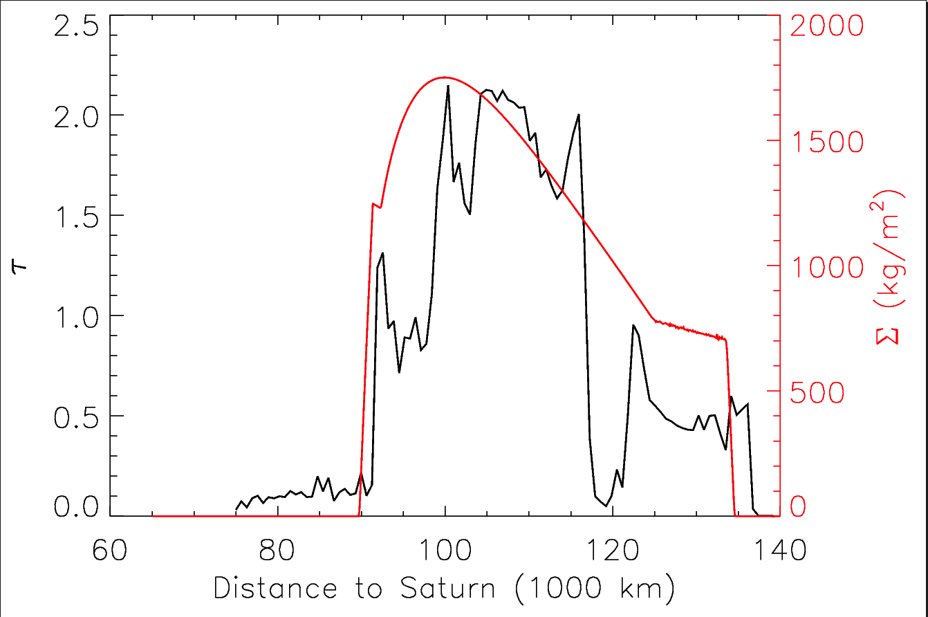
Comparison with today's rings
Surface density at $t∼{10}^{7}$ years with $r_{p}=5m$
Marginally stable zone Q~2
B ring
A ring

Slide 16
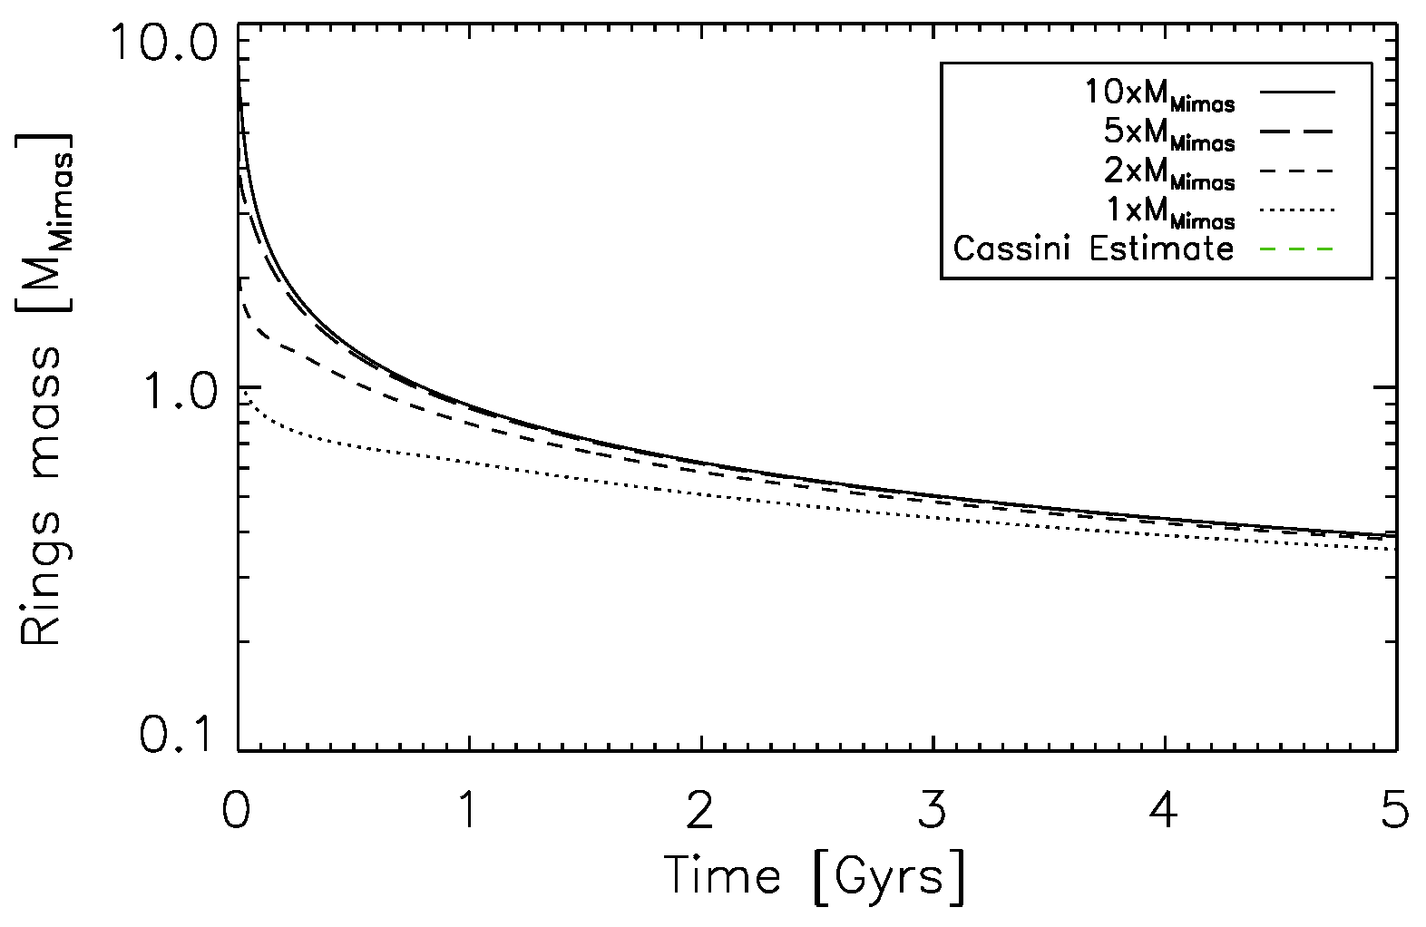
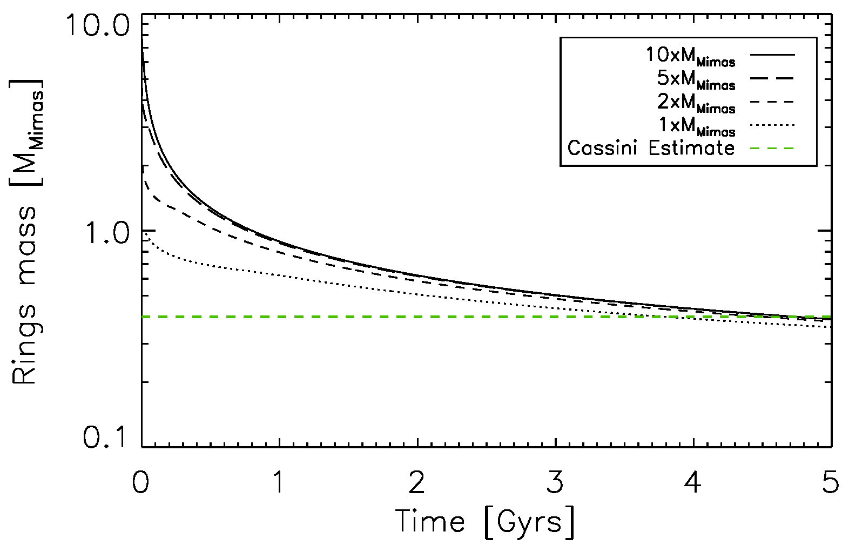
Comparison with current rings mass estimate
RSS estimate (Less et al.) :
$$M_{Rings}≈0.4 M_{Mimas}$$
Mass of current rings is characteristic of an “old” ring system

Slide 17
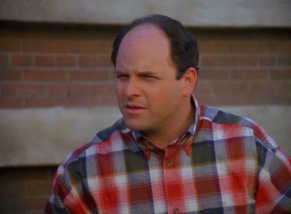
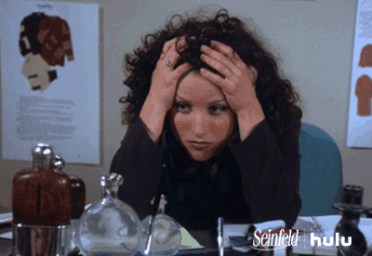
Age of the rings?
Most formation scenarios form rings >4 Gyr ago
Estimated mass of today’s rings is characteristic of a well-evolved >3Gyr-old system
Pollution models favor a ∼100Myr old system
The rings’ optical depth profile is best matched by a 10Myr-old ring

