Slide 1
Saturn Ring Results from the Cassini Composite Infrared Spectrometer
E. Deau^{1,2}, L. J. Spilker¹, R. Morishima^{1,2}, C. Ferrari³, Stuart Pilorz⁴, M. R. Showalter⁴, S. M. Brooks¹, S. G. Edgington¹
¹NASA Jet Propulsion Laboratory/California Institute of Technology, Pasadena, CA, 91109, USA,
² University of California at Los Angeles, Los Angeles, CA 90095, USA, ³Universite Paris-Diderot, USPC, Paris, FRANCE,
⁴SETI Institute, Mountain View, CA 94043, USA,

Slide 2
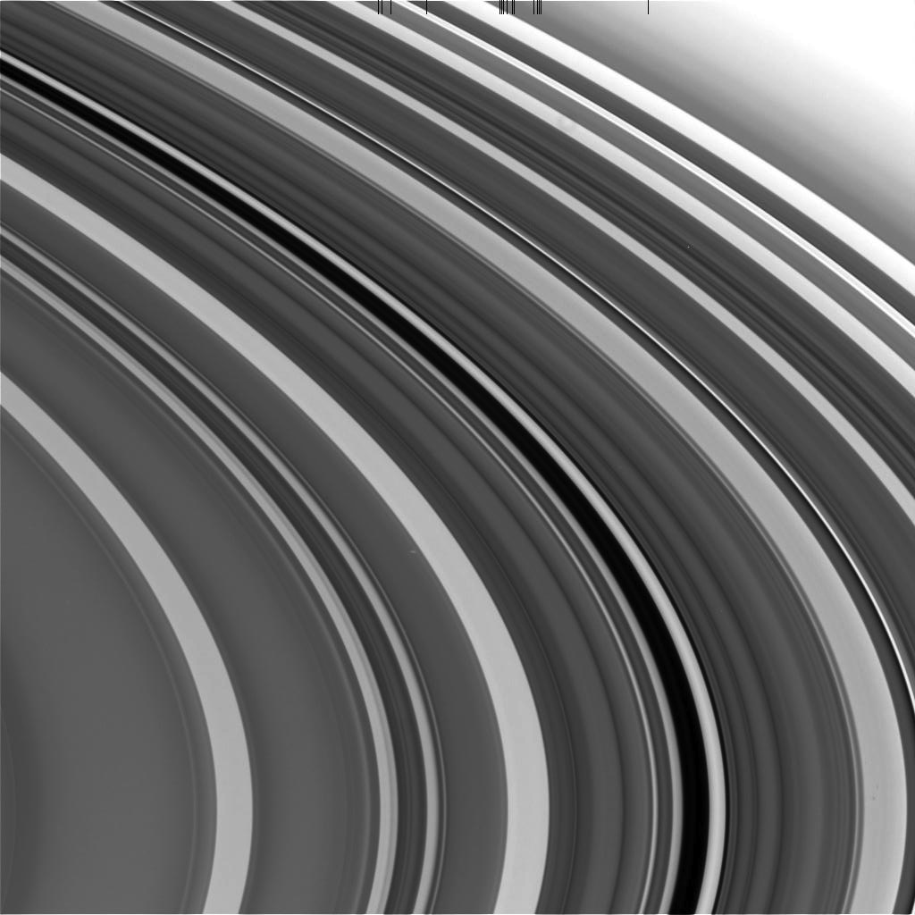
Motivation
Plateaus
Temperatures for large ring structures (dR = 3,000 km) derived earlier in mission
Diurnal eclipse, seasons, phase angle effects
Temperature-Optical depth (T- τ) correlations
Thermal behavior of small scale structures (plateaus, halos: dR < 300 km) is not well characterized
Use Grand Finale data
Very high spatial resolution
Do small scale structures thermally behave like large scale structures?
C ring Plateaus
Mimas 5:3

Slide 3
Motivation
Plateaus
Temperatures for large ring structures (dR = 3,000 km) derived earlier in mission
Diurnal eclipse, seasons, phase angle effects
Temperature-Optical depth (T- τ) correlations
Thermal behavior of small scale structures (plateaus, halos: dR < 300 km) is not well characterized
Use Ring-Grazing and Grand Finale data
Very high spatial resolution
Do small scale structures thermally behave like large scale structures?
C ring Plateaus
Mimas 5:3

Slide 4
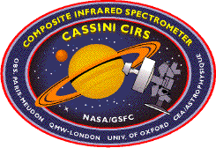
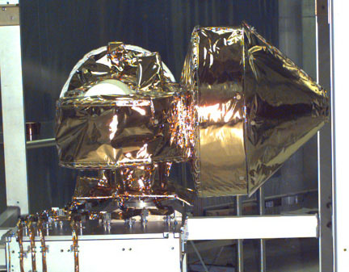
Composite Infrared Spectrometer (CIRS)
Fourier Transform
Spectrometer
Wavelength range :
FP4 : 7-9 μm
FP3: 9-17 μm
FP1:16-1000 μm
Spectral Resolution
0.5, 1, 3, 15.5 cm⁻¹
Rings: T~ 50 - 120 K ==> Max emission around ~50 microns
JPL / August 10 2009
Notes:
FP1: 3.9 mrad diameter

Slide 5
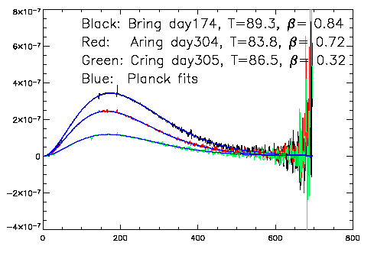
Planck Fits to CIRS Spectra
B
A
C
I_{ν}
I_{ν} = β * B_{ν}(T_{ring})
β = ε (1- e^{-τ/μ})
Wavenumber (cm⁻¹)

Slide 6
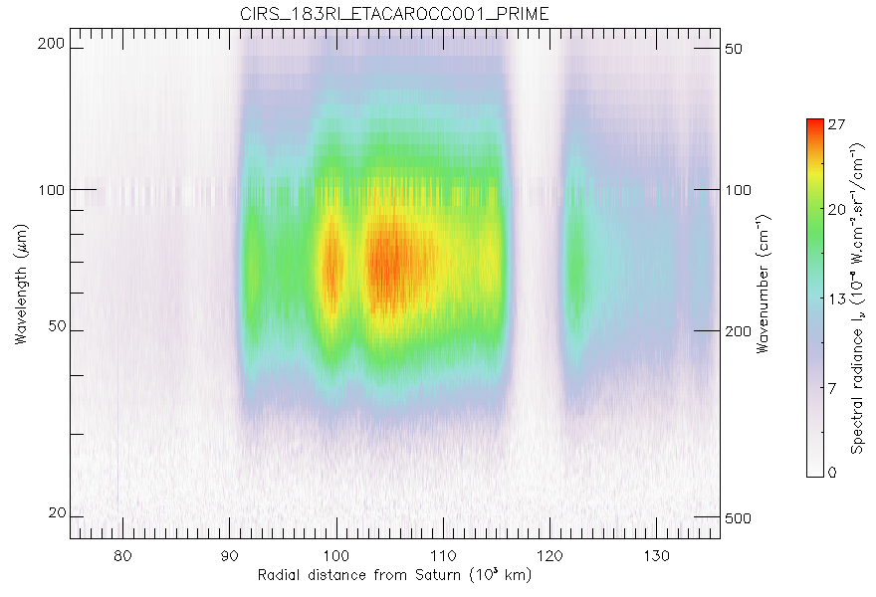
CIRS
spectrogram
a = 62º
B = 62º
B’ = 17º
R_{s/c} = 9 Rs

Slide 7
CIRS
spectrogram
a = 62º
B = 62º
B’ = 17º
R_{s/c} = 9 Rs
spectra

Slide 8
CIRS
spectrogram
a = 62º
B = 62º
B’ = 17º
R_{s/c} = 9 Rs
spectra
radial profile

Slide 9
CIRS
spectrogram
Low res Vs.
High res.
a = 62º
B = 62º
B’ = 17º
R_{s/c} = 9 Rs

Slide 10
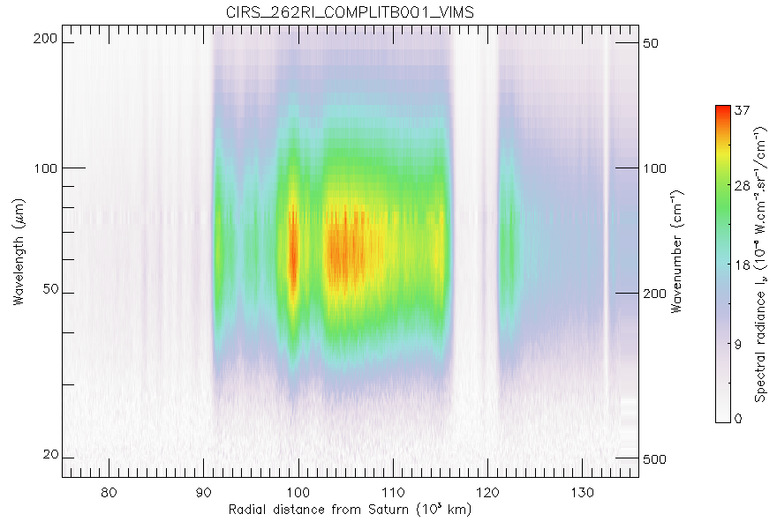
CIRS
spectrogram
Low res Vs.
High res.
a = 62º
B = 71º
B’ = 26º
R_{s/c} = 3 Rs

Slide 11
CIRS
spectrogram
Low res Vs.
High res.
a = 62º
B = 71º
B’ = 26º
R_{s/c} = 3 Rs
Encke
Gap
325 km
Plateaus
(245 km)
ER17
(250 km)

Slide 12
CIRS
spectrogram
Low res Vs.
High res.
a = 62º
B = 71º
B’ = 26º
R_{s/c} = 3 Rs
spectra
Encke
Gap
325 km
Plateaus
(245 km)
ER17
(250 km)

Slide 13
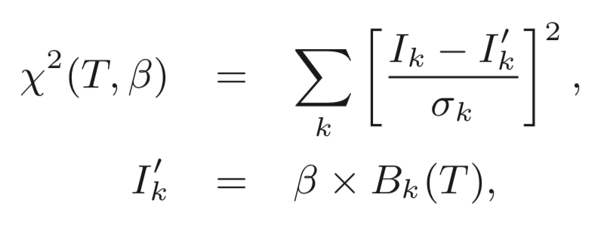
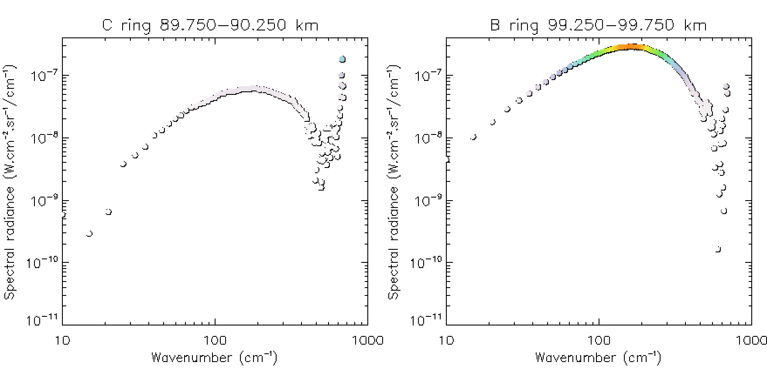
CIRS
spectrogram
Low res Vs.
High res.
Blackbody fits
Blackbody fit (50-450 cm⁻¹):
spectra
Planck function:
Output parameters:
T : Effective temperature (Kelvin)
: scaling factor
β = ε (1- e^{-τ/μ})

Slide 14
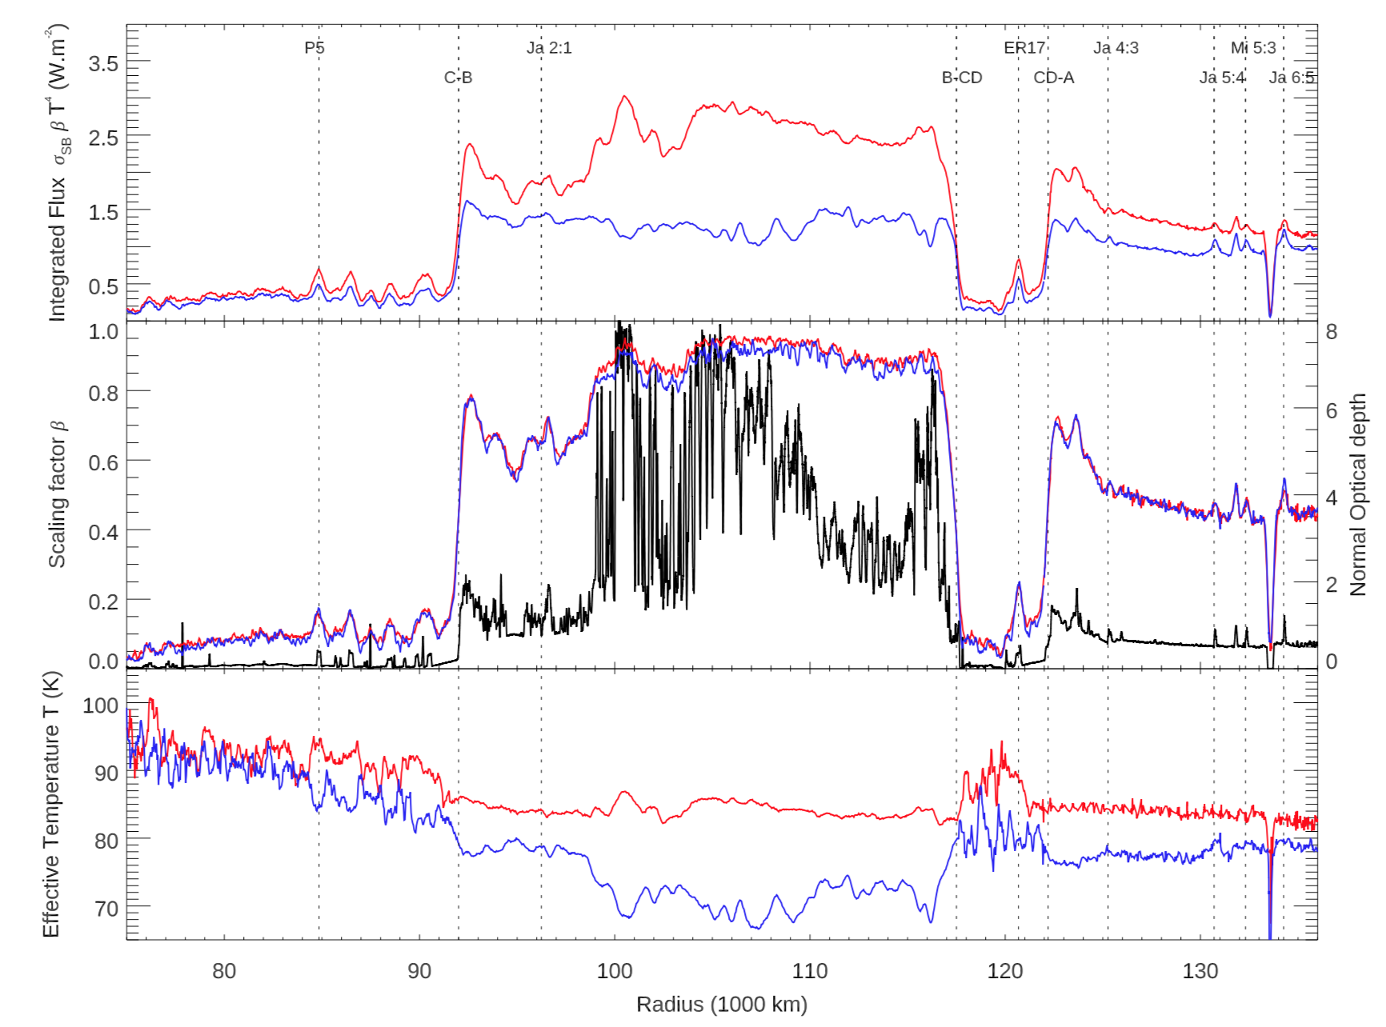
CIRS
spectrogram
Low res Vs.
High res.
Blackbody fits
Lit face
Unlit face
Tiscareno et al. Science under review

Slide 15
CIRS
spectrogram
Low res Vs.
High res.
Blackbody fits
T-τ correlations
Tiscareno et al. Science under review

Slide 16
CIRS
spectrogram
Low res Vs.
High res.
Blackbody fits
T-τ correlations
Spilker et al. 2006
Lit face
Tiscareno et al. Science under review
Notes:
We now observe the rings with much more detail, compared to the beginning of the mission. In particular on the lit side.

Slide 17
CIRS
spectrogram
Low res Vs.
High res.
Blackbody fits
T-τ correlations
Spilker et al. 2006
Lit face
Unlit face
Tiscareno et al. Science under review

Slide 18
CIRS
spectrogram
Low res Vs.
High res.
Blackbody fits
T-τ correlations
Spilker et al. 2006
Temperature T - Optical depth τ
correlations
Across ring system
(Low-τ rings Vs High-τ rings)

Slide 19
CIRS
spectrogram
Low res Vs.
High res.
Blackbody fits
T-τ correlations
Spilker et al. 2006
Temperature T - Optical depth τ
correlations
Across ring system
(Low-τ rings Vs High-τ rings)
T-τ correlation
Lit | Unlit
- | -
Low-τ rings (C & CD) are the warmest

Slide 20
CIRS
spectrogram
Low res Vs.
High res.
Blackbody fits
T-τ correlations
Spilker et al. 2006
Temperature T - Optical depth τ
correlations
Across ring system
(Low-τ rings Vs High-τ rings)
T-τ correlation
Lit | Unlit
- | -
Low-τ rings (C & CD) are the warmest
Low filling factor and low albedo
--> less shadowing and more sunlight is absorbed
Notes:
For the rings, it’s more than an optical depth effect, the major driver is albedo

Slide 21
CIRS
spectrogram
Low res Vs.
High res.
Blackbody fits
T-τ
correlations
Spilker et al. 2006
Temperature T - Optical depth τ
correlations
Across ring system
(Low-τ rings Vs High-τ rings)
Across a single ring
(Low-τ regions Vs High-τ regions)
T-τ correlation
Lit | Unlit
- | -
Low-τ rings (C & CD) are the warmest
Low filling factor and low albedo
--> less shadowing and more sunlight is absorbed

Slide 22
CIRS
spectrogram
Low res Vs.
High res.
Blackbody fits
T-τ
correlations
Spilker et al. 2006
Temperature T - Optical depth τ
correlations
Across ring system
(Low-τ rings Vs High-τ rings)
Across a single ring
(Low-τ regions Vs High-τ regions)
T-τ correlation
Lit | Unlit
- | -
T-τ correlation
Lit | Unlit
+ | -
Low-τ rings (C & CD) are the warmest
Low filling factor and low albedo
--> less shadowing and more sunlight is absorbed

Slide 23
CIRS
spectrogram
Low res Vs.
High res.
Blackbody fits
T-τ
correlations
Spilker et al. 2006
Temperature T - Optical depth τ
correlations
Across ring system
(Low-τ rings Vs High-τ rings)
Across a single ring
(Low-τ regions Vs High-τ regions)
T-τ correlation
Lit | Unlit
- | -
T-τ correlation
Lit | Unlit
+ | -
Low-τ rings (C & CD) are the warmest
Low filling factor and low albedo
--> less shadowing and more sunlight is absorbed
High-τ regions are the warmest on lit face
High-τ regions are the coldest on unlit face
Notes:
Within rings, albedo differences are minimal, whereas optical depth differences are strong

Slide 24
CIRS
spectrogram
Low res Vs.
High res.
Blackbody fits
T-τ
correlations
Spilker et al. 2006
Temperature T - Optical depth τ
correlations
Across ring system
(Low-τ rings Vs High-τ rings)
Across a single ring
(Low-τ regions Vs High-τ regions)
T-τ correlation
Lit | Unlit
- | -
T-τ correlation
Lit | Unlit
+ | -
Low-τ rings (C & CD) are the warmest
Low filling factor and low albedo
--> less shadowing and more sunlight is absorbed
High-τ regions are the warmest on lit face
High-τ regions are the coldest on unlit face
--> sunlight does not penetrate deeply into
layer

Slide 25
CIRS
spectrogram
Low res Vs.
High res.
Blackbody fits
T-τ
correlations
Spilker et al. 2006
Temperature T - Optical depth τ
correlations
Across ring system
(Low-τ rings Vs High-τ rings)
Across a single ring
(Low-τ regions Vs High-τ regions)
T-τ correlation
Lit | Unlit
- | -
T-τ correlation
Lit | Unlit
+ | -
Low-τ rings (C & CD) are the warmest
Low filling factor and low albedo
--> less shadowing and more sunlight is absorbed
High-τ regions are the warmest on lit face
High-τ regions are the coldest on unlit face
--> sunlight does not penetrate deeply into
layer
Still valid for small scale
structures ?

Slide 26
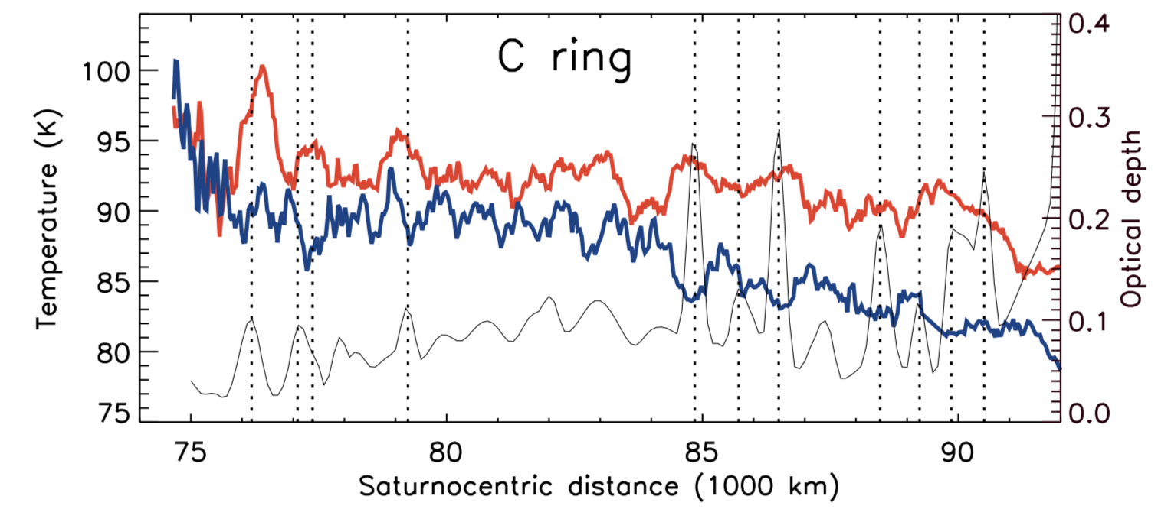
CIRS
spectrogram
Low res Vs.
High res.
Blackbody fits
T-τ
correlations
Tiscareno et al. Science under review

Slide 27
CIRS
spectrogram
Low res Vs.
High res.
Blackbody fits
T-τ
correlations
Tiscareno et al. Science under review
 | T-τ correlation
Ring | lit | unlit
C ring plateaus | + | -

Slide 28
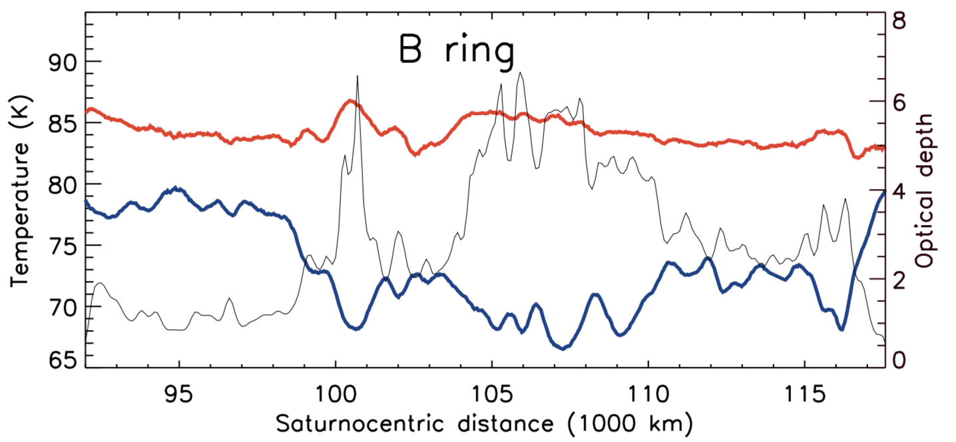
CIRS
spectrogram
Low res Vs.
High res.
Blackbody fits
T-τ
correlations
Tiscareno et al. Science under review
 | T-τ correlation
Ring | lit | unlit
C ring plateaus | + | -
B ring | + | -
B ring halo (Janus 2:1) | + | +
Notes:
Janus 2:1 96,233 km

Slide 29
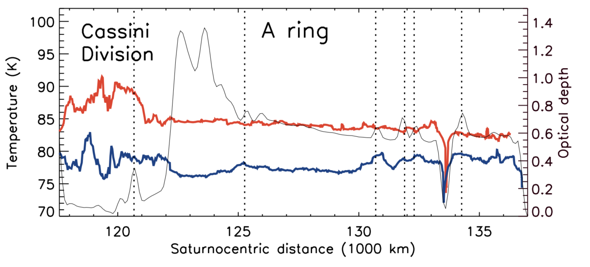
CIRS
spectrogram
Low res Vs.
High res.
Blackbody fits
T-τ
correlations
Tiscareno et al. Science under review
 | T-τ correlation
Ring | lit | unlit
C ring plateaus | + | -
B ring | + | -
B ring halo (Janus 2:1) | + | +
inner A ring | 0 | -
A ring halos (Janus 4:3/5:4/6:5 Mimas 5:3) | + | +
Notes:
In the A ring, the signal is noisy on the lit side.
On the unlit side, there is a strong correlation with optical depth. Same result is observed in the B ring halo located in the inner part of the ring.

Slide 30
CIRS
spectrogram
Low res Vs.
High res.
Blackbody fits
T-τ
correlations
C-B-A / halo
dichotomy
Tiscareno et al. Science under review
 | T-τ correlation
Ring | lit | unlit
C ring plateaus | + | -
B ring | + | -
B ring halo (Janus 2:1) | + | +
inner A ring | 0 | -
A ring halos (Janus 4:3/5:4/6:5 Mimas 5:3) | + | +
Notes:
Janus 2:1 96, 247 km

Slide 31
CIRS
spectrogram
Low res Vs.
High res.
Blackbody fits
T-τ
correlations
C-B-A / halo
dichotomy
Tiscareno et al. Science under review
 | T-τ correlation
Ring | lit | unlit
C ring plateaus | + | -
B ring | + | -
B ring halo (Janus 2:1) | + | +
inner A ring | 0 | -
A ring halos (Janus 4:3/5:4/6:5 Mimas 5:3) | + | +
A and B rings’ halos seem to not
thermally behave like large structures
(due to halo’s small and dark particles?)

Slide 32
CIRS
spectrogram
Low res Vs.
High res.
Blackbody fits
T-τ
correlations
C-B-A / halo
dichotomy
Conclusions
Grand Finale results:
CIRS spectra resolved small scale structure
Effective temperature derived from Planck fits

Slide 33
CIRS
spectrogram
Low res Vs.
High res.
Blackbody fits
T-τ
correlations
C-B-A / halo
dichotomy
Conclusions
Grand Finale results:
CIRS spectra resolved small scale structure
Effective temperature derived from Planck fits
On unlit side, halos seem to not thermally behave like large scale structures (did CIRS see small and dark particles?)
Notes:
This could be due to small and dark particles in the halo, and could be an albedo effect. Still particles still have to be resolved by CIRS. Maybe CIRS can provide a high limit to small particle’ sizes

Slide 34
CIRS
spectrogram
Low res Vs.
High res.
Blackbody fits
T-τ
correlations
C-B-A / halo
dichotomy
Conclusions
Grand Finale results:
CIRS spectra resolved small scale structure
Effective temperature derived from Planck fits
On unlit side, halos seem to not thermally behave like large scale structures (did CIRS see small and dark particles?)
Next step: comparison with Saturn Orbit Insertion (SOI)
CIRS SOI might resolve halo’s core

Slide 35
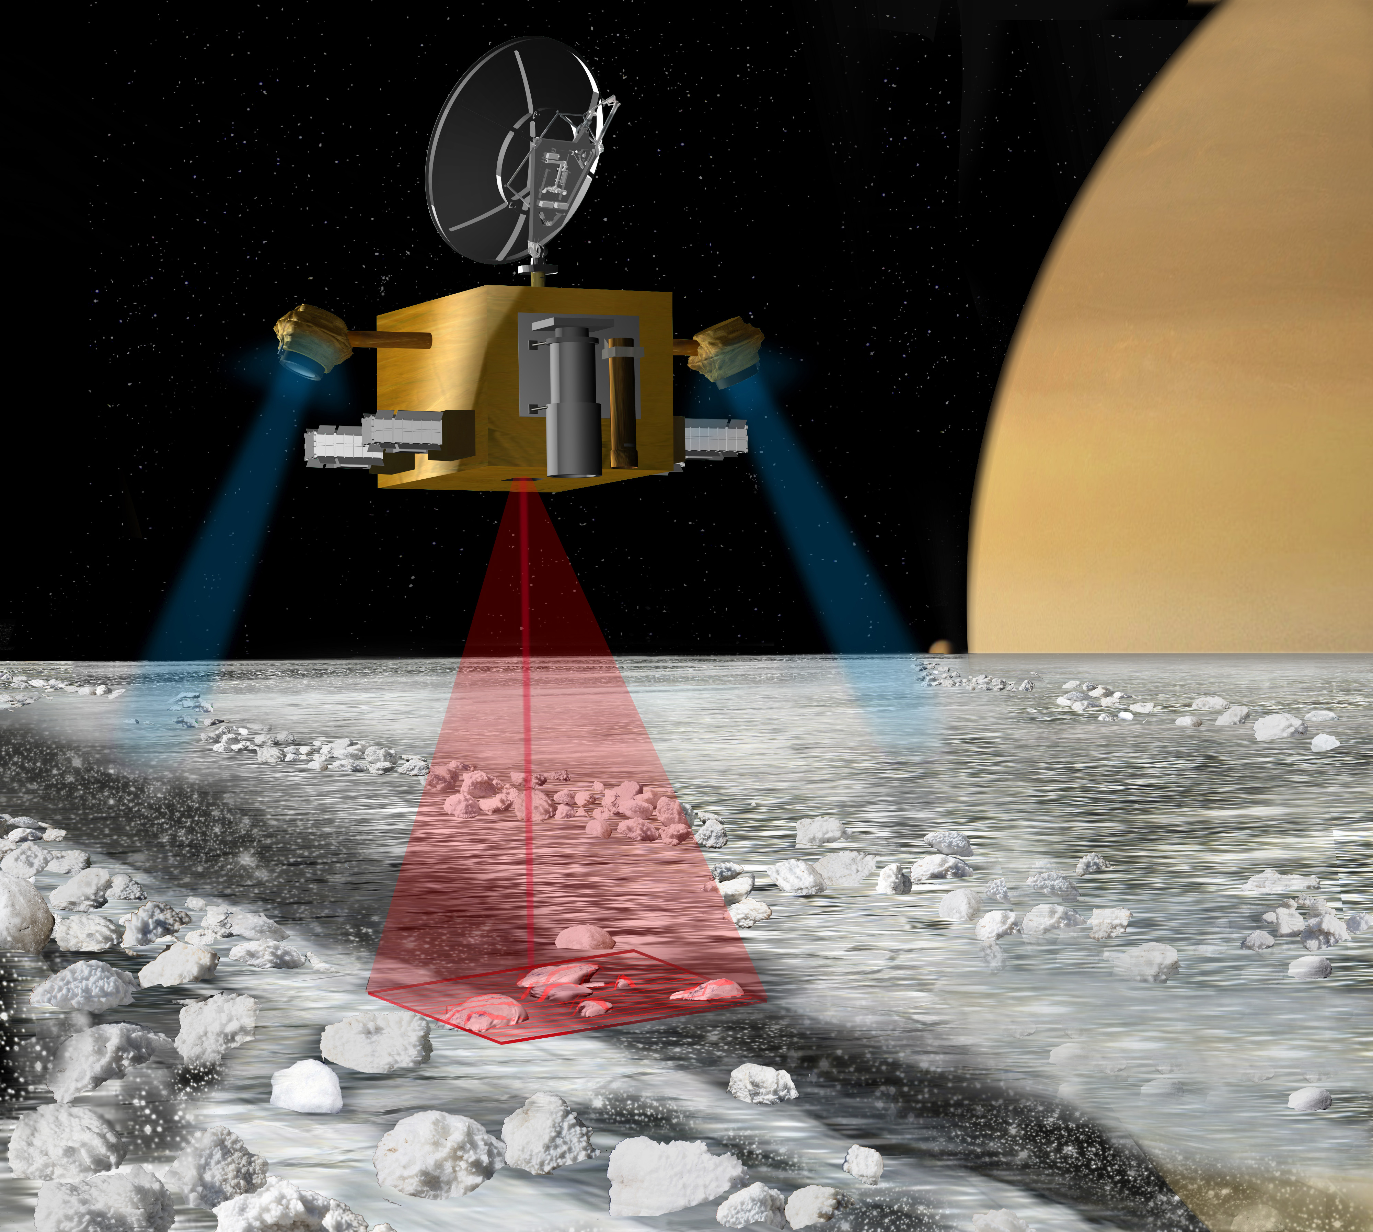
Saturn Ring
Observer
Notes:
As part of larger mission to the Saturn system, which might deliver a Titan or Enceladus orbiter, you could add this spacecraft for the rings!
Tom Spilker architected mission,
Blue beams are thrust from ion engines to hover above rings
Red beam is Lidar, send out a light bean and see what is reflected back to get 3D map of layer

Slide 36
Supplementary material

Slide 37
CIRS Temperature variations with changing solar elevation
TEMPERATURE
40 50 60 70 80 90 100 110 120
B’=-21.3º
B’=-14.6º
B’=-09.2º
B’=-02.7º
Lit rings
Unlit rings
Lit rings
Unlit rings
EQUINOX
Notes:
Temperatures range from solar elevations of 0 to 24 deg.
All data taken well outside Saturn’s shadow on the rings, between 6 am and 6 pm.
Major temperature variations in a given ring are with phase angle.

Slide 38
Questions?

Slide 39
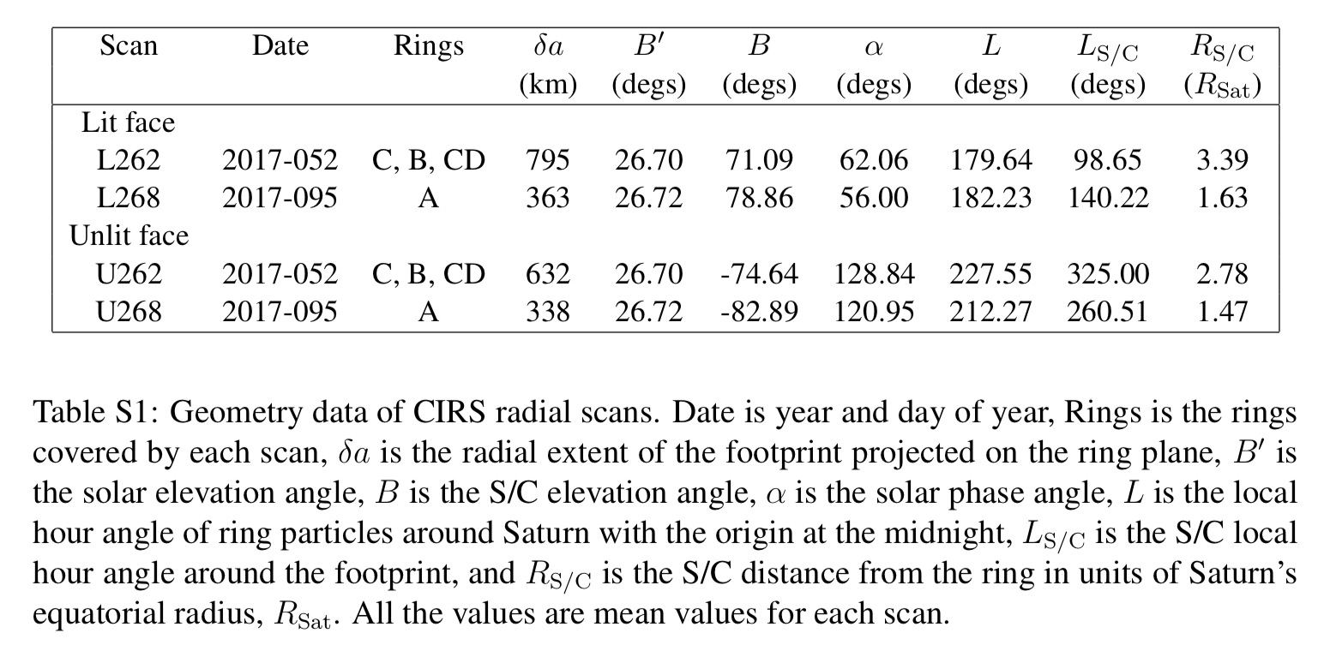

Slide 41
Outline
CIRS: Infrared emission
Spectrograms
Low resolution vs High resolution cubes
Blackbody fits
Effective temperatures
Correlation with t
Interpretation
Future work
Comparison with SOI

