Slide 1
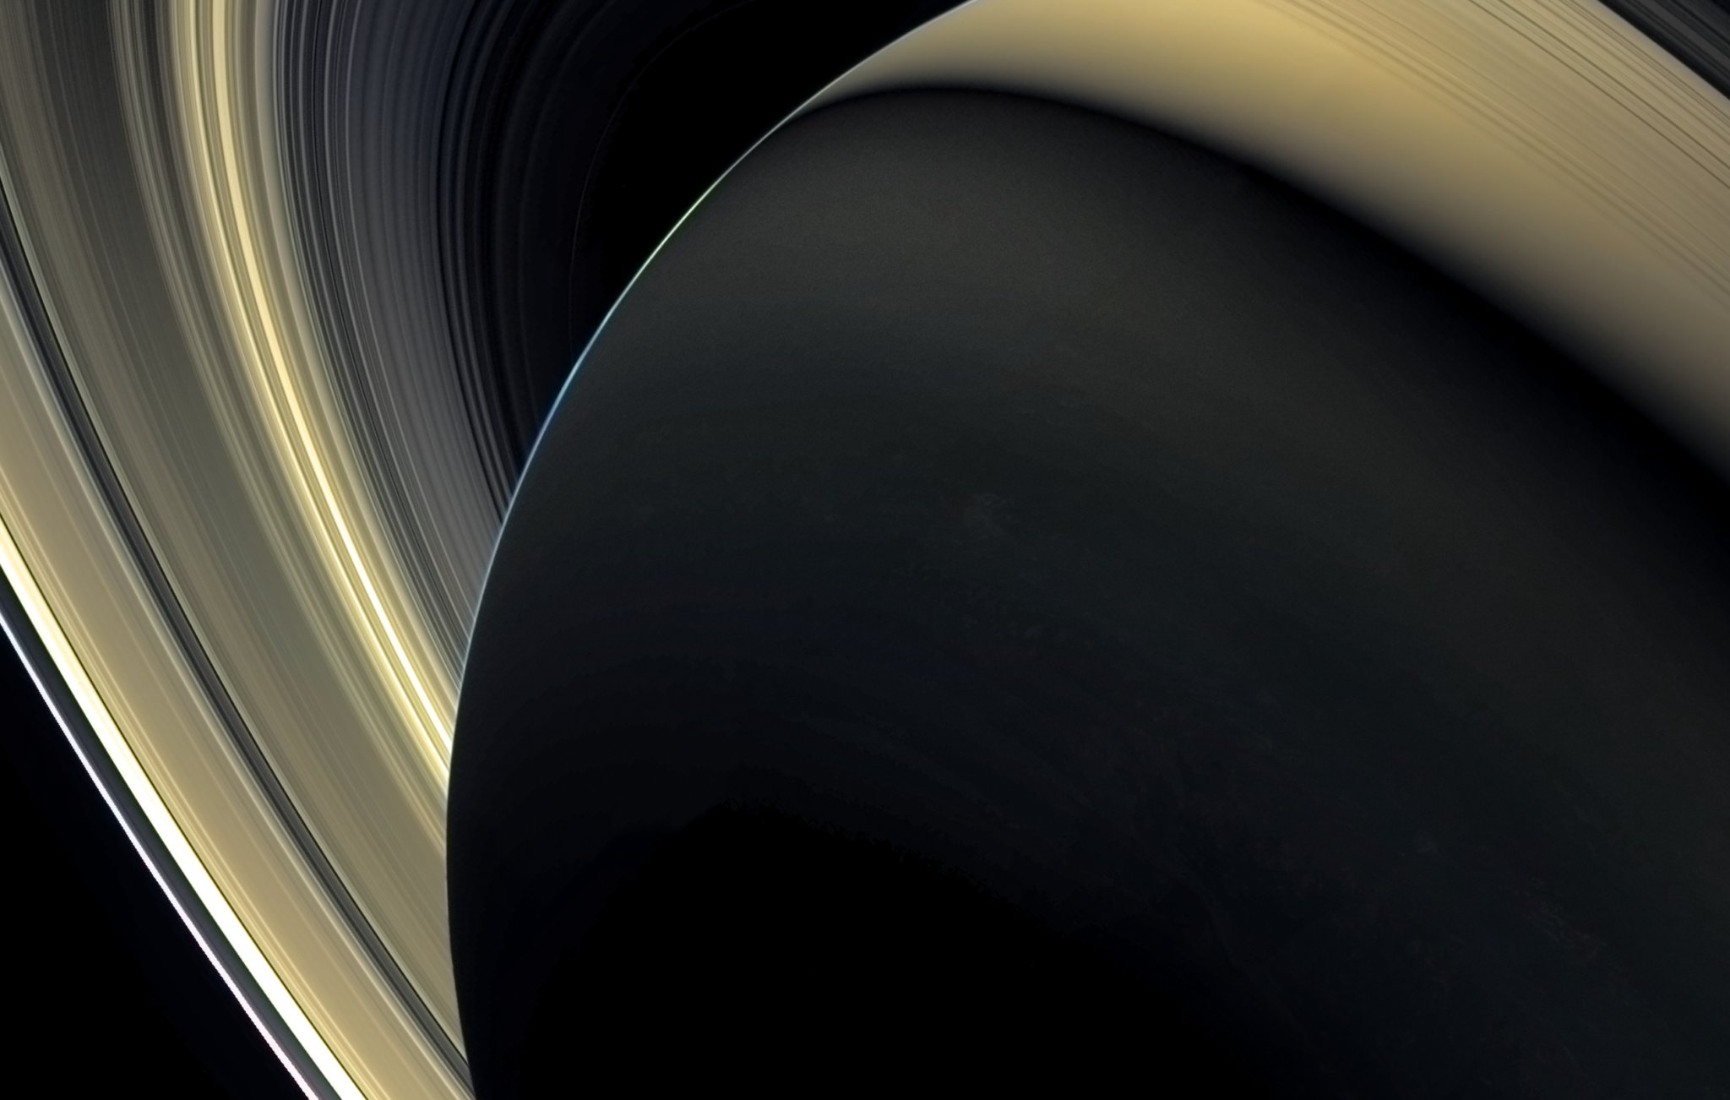
Cassini’s view of the faint D ring and Roche Division
Rob Chancia & Matt Hedman
University of Idaho
April 13, 2017 WAC mosaic constructed by Ian Regan UMSF

Slide 2
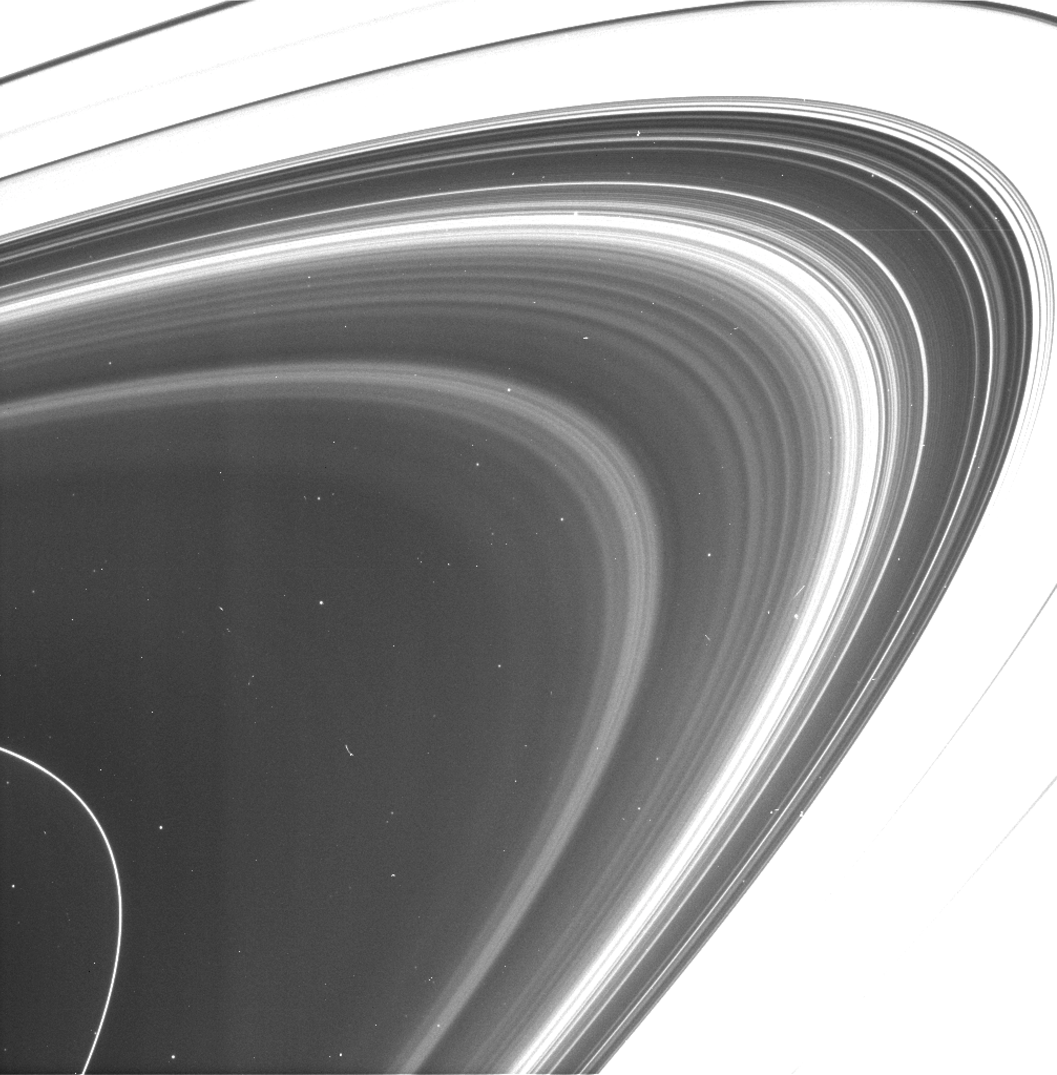
D ring
Cassini ISS
Rev 245
HPCLOSE001
N1855259044
October 2016
C ring
D73
D72
D68
Saturn
Notes:
3 main D ring ringlets named for their approximate radii:
Innermost Narrow lone ringlet D68, two broader series of dusty ringlets D72 and D73

Slide 3
D ring
Cassini ISS
Rev 245
HPCLOSE001
N1855259044
October 2016
C ring
D73
D72
D68
Saturn
Notes:
3 main D ring ringlets named for their approximate radii:
Innermost Narrow lone ringlet D68, two broader series of dusty ringlets D72 and D73

Slide 4
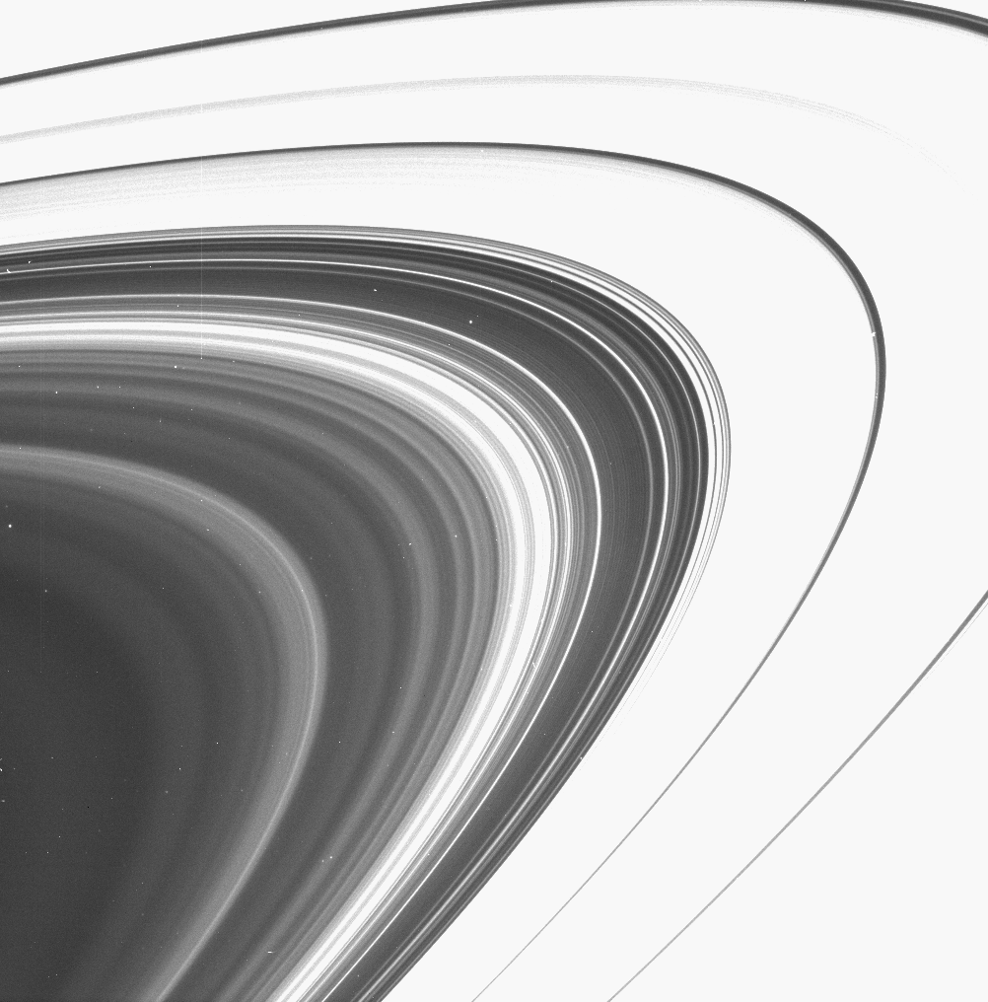
D ring
Cassini ISS
Rev 256
HPMONITOR001
N1862814220
January 2017
C ring
D73
D72
Saturn
Notes:
3 main D ring ringlets named for their approximate radii:
Innermost Narrow lone ringlet D68, two broader series of dusty ringlets D72 and D73

Slide 5
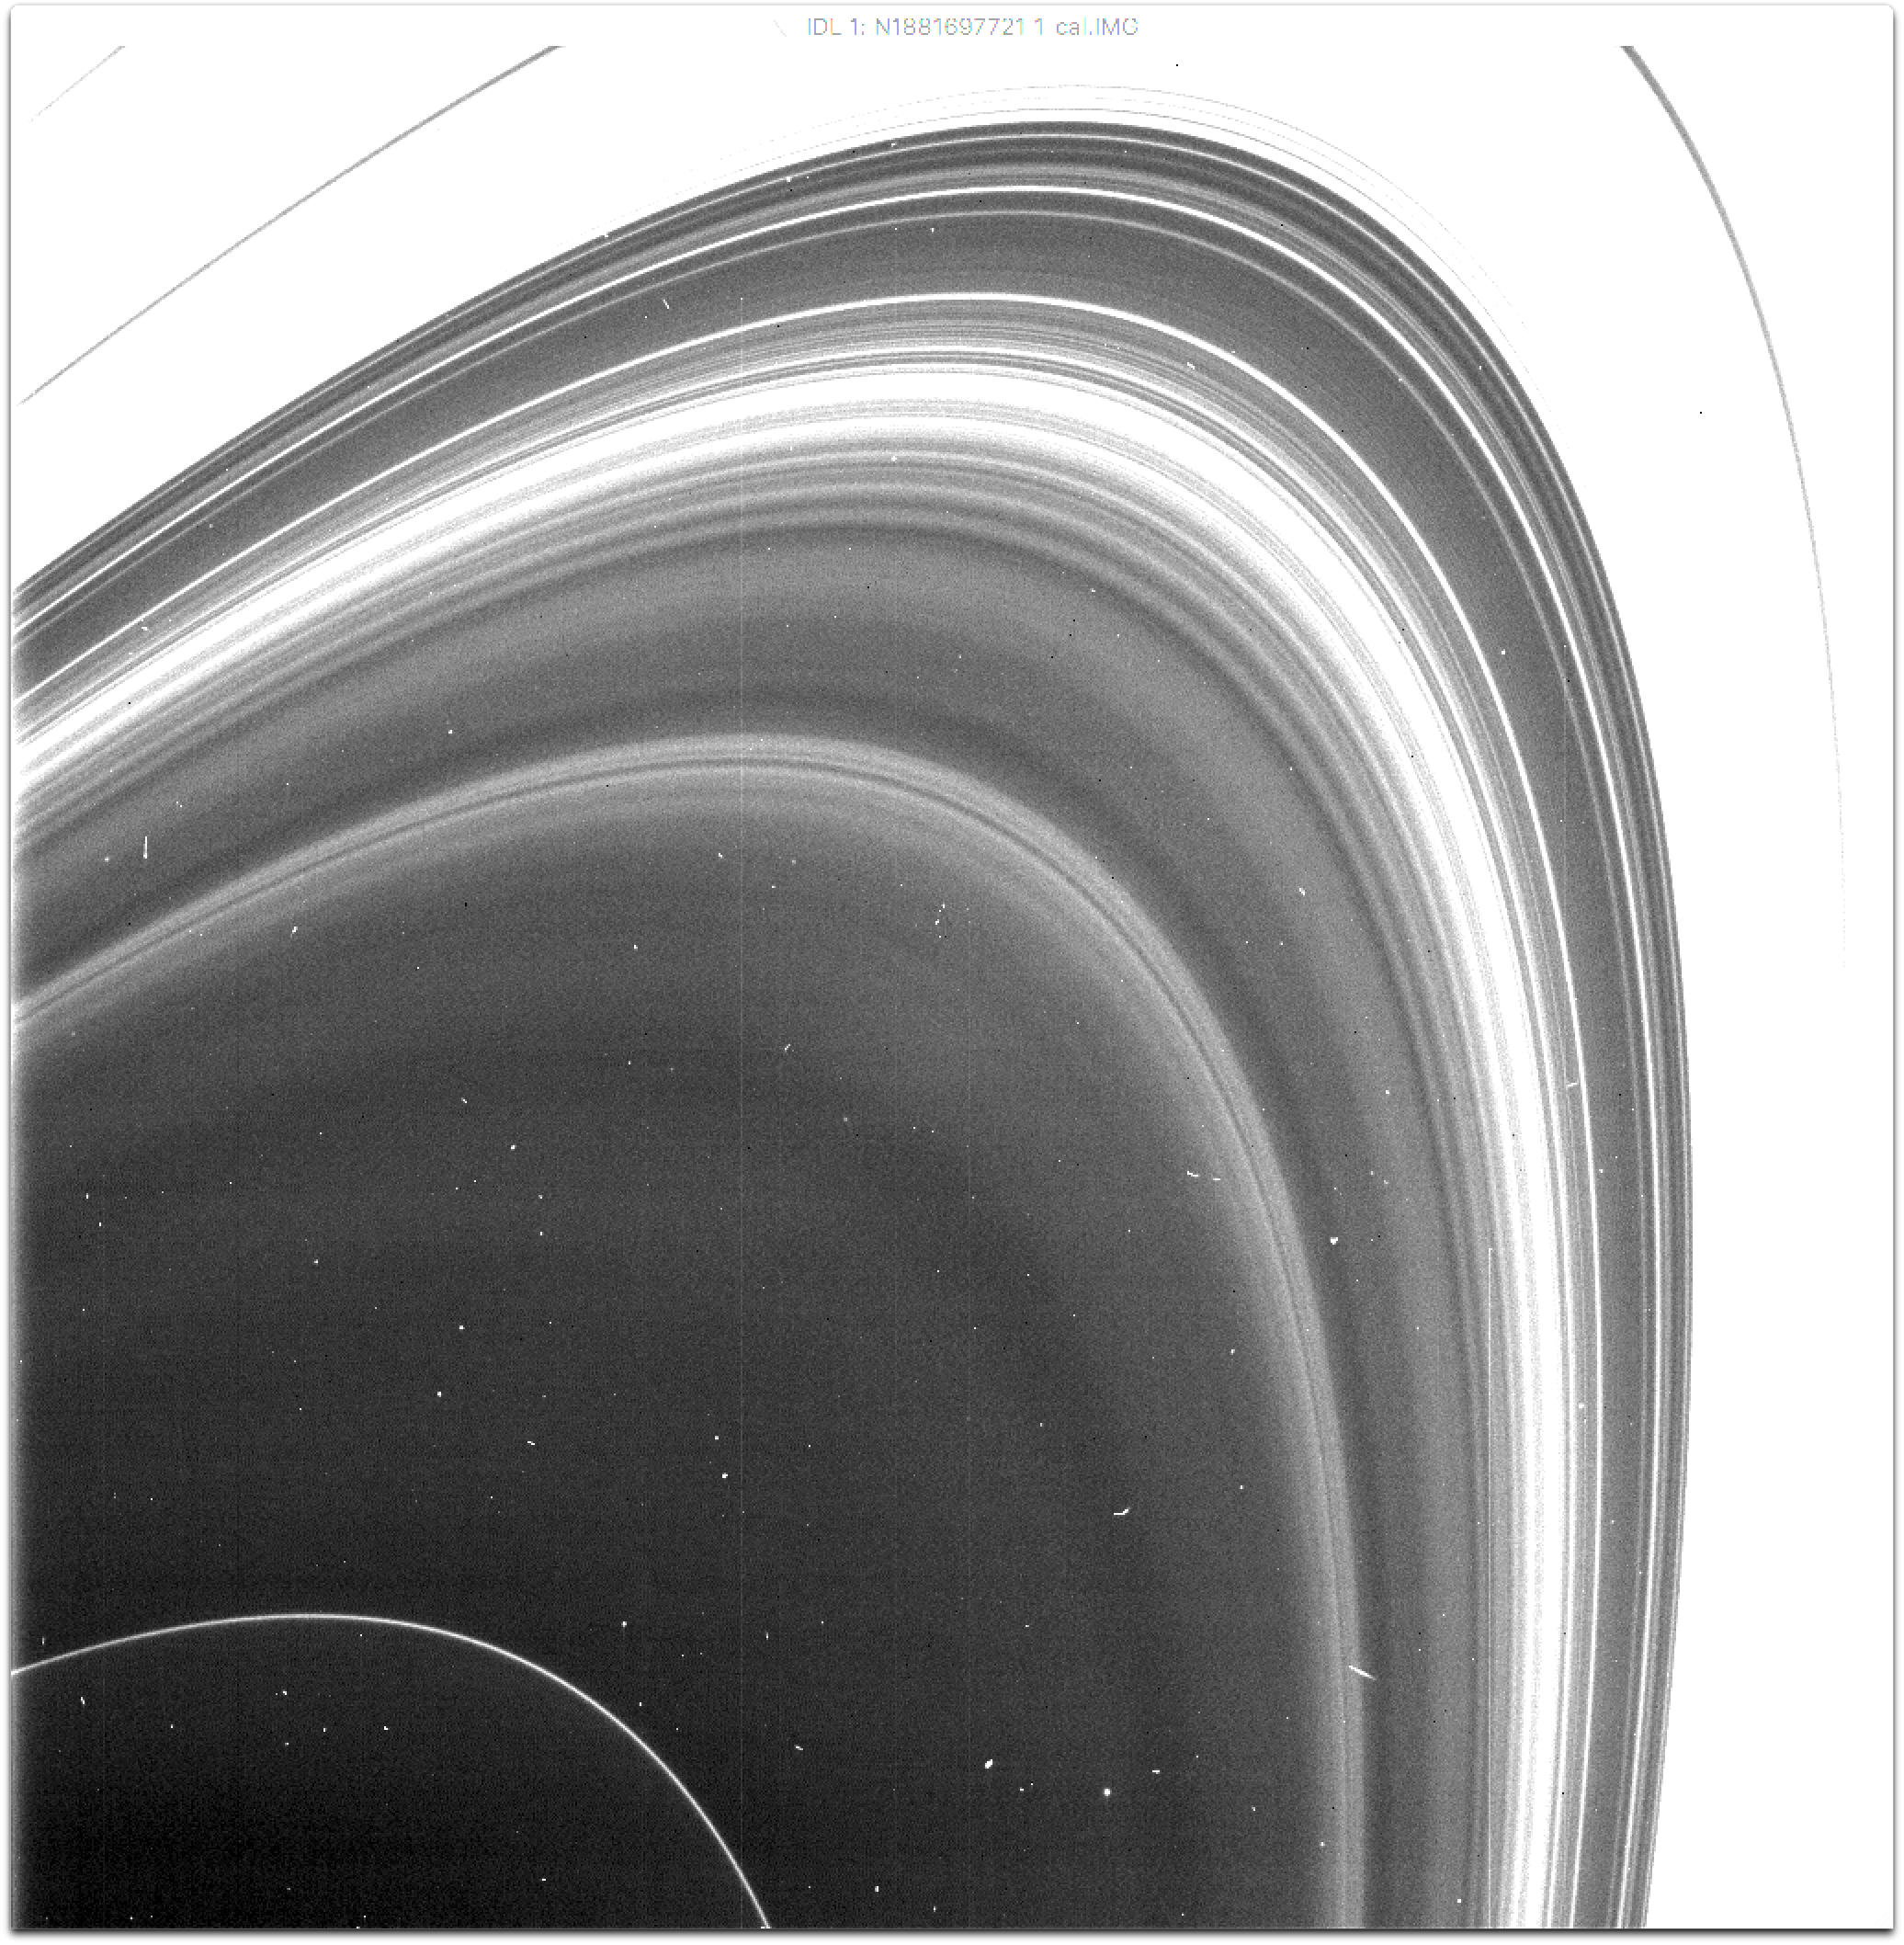
D ring
Cassini ISS
Rev 289
HPMONITOR001
N1881697721
August 2017
C ring
D73
D72
D68
Saturn

Slide 6
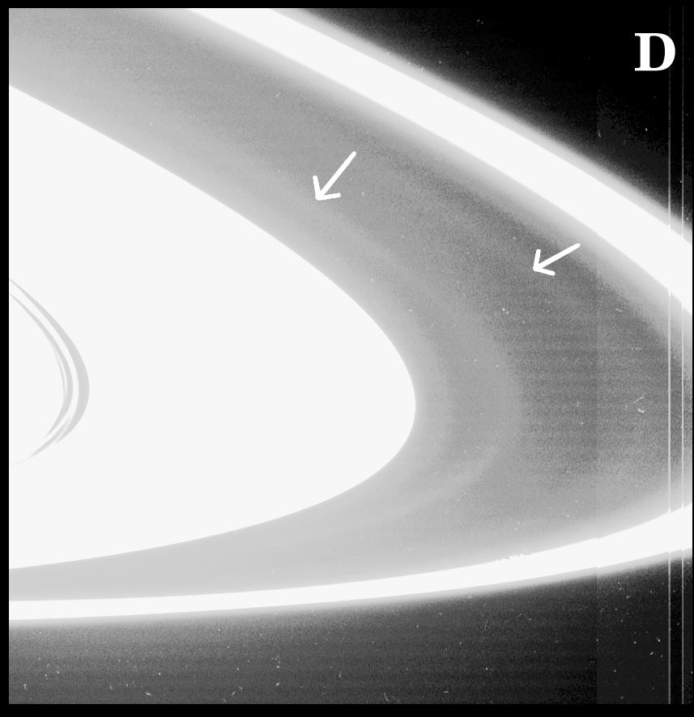
Roche Div
A ring
Roche
Division
F ring
July 2004
PIA06196
Composite of WAC images
Porco et al. 2005
Notes:
The Roche Division doesn’t get a whole lot of attention.
Literally between the A ring and Fring, and the ring moons Atlas and Prometheus it makes sense that the dust in this nearly empty gap hasn’t garnered a tremendous amount of attention.
But there are some diffuse dust populations in the Roche Division.
These two distinct dust populations were first noted early in the mission, but they generally go undetected when viewed from unideal lighting geometry.
Unlike the D ring the images of the RD don’t really get better than this until 2016.

Slide 7
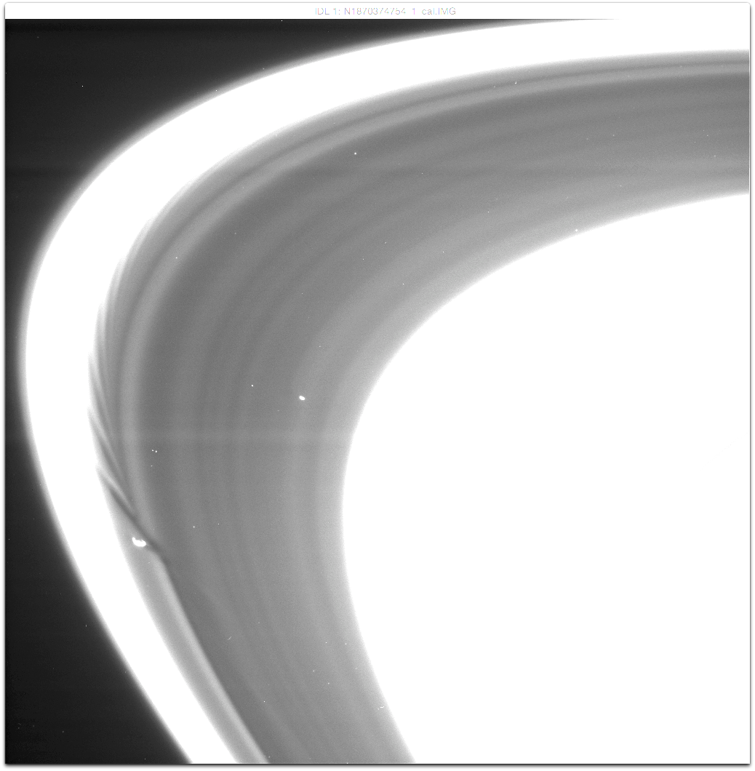
Roche Div
Roche Division
Cassini ISS
Rev 268
HPMONITOR002
N1870374754
April 2017
A ring (overexposed)
F ring
(overexposed)

Slide 8
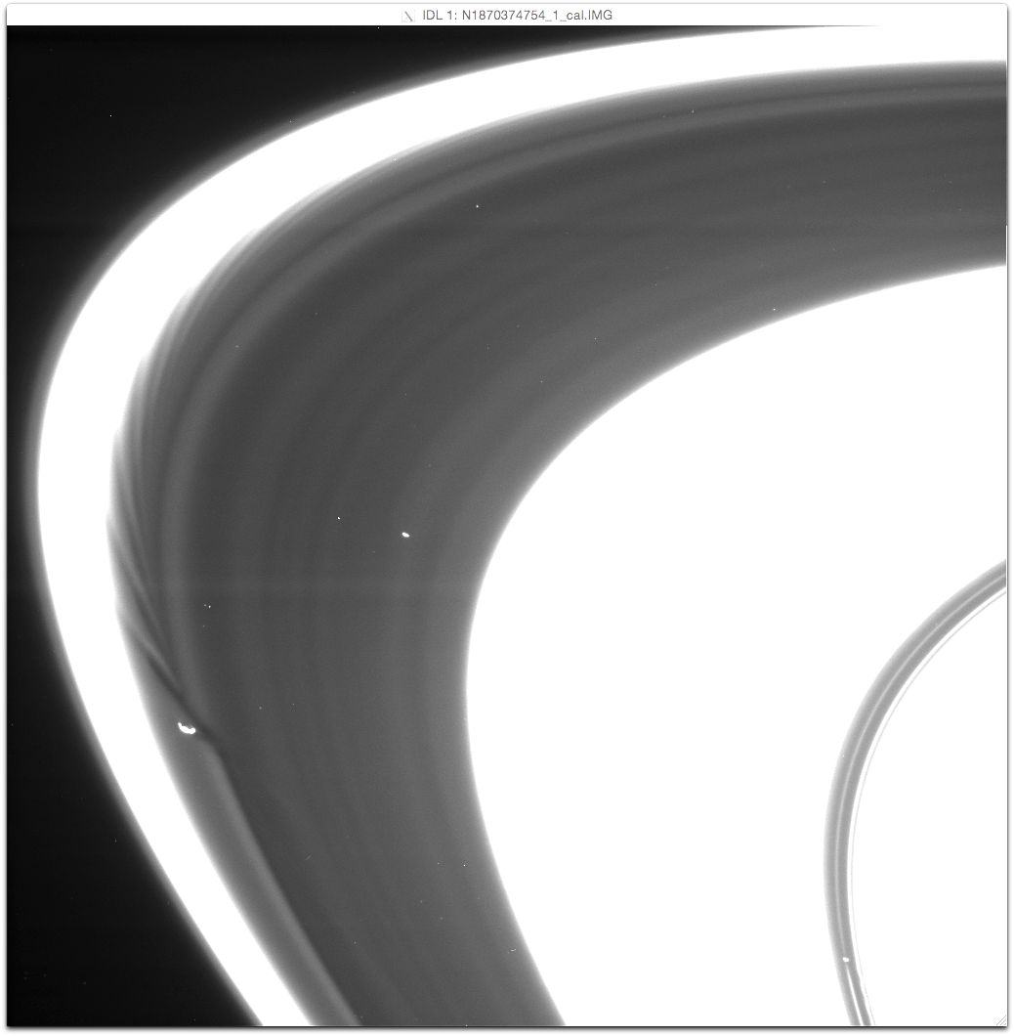
Roche Div
Roche Division
Cassini ISS
Rev 268
HPMONITOR002
N1870374754
April 2017
A ring (overexposed)
F ring
(overexposed)
Atlas
Keeler Gap
(too narrow)
home of Daphnis
Encke
Gap
Prometheus
Pan

Slide 9
Roche Div
Roche Division
Cassini ISS
Rev 268
HPMONITOR002
N1870374754
April 2017
dusty
Prometheus ringlet
A ring (overexposed)
F ring
(overexposed)
Atlas
3 dusty ringlets
Prometheus wakes
Keeler Gap
(too narrow)
home of Daphnis
Encke
Gap
Prometheus
Pan

Slide 10
Roche Div
Cassini ISS
Rev 268
HPMONITOR002
N1870374754
April 2017

Slide 11
m=2 diagonal streaks at the 2:1 Inner resonance
We see half of the 2 ‘armed’ structure in
one local orbital period.
m=-3 diagonal streaks at the 3:4 Outer resonance
We see 4/3 of the 3 ‘armed’ structure in
one local orbital period.
Uncovered by Hedman et al. 2009
Notes:
In the Hedman et al. 2009 paper periodic brightness variations were detected in the D ring, Roche Division, and G ring.
The G ring structures are the prototype for dusty ring response to a strong resonance. It’s periodic brightness variations straddling the Mimas 8:7 Inner Lindblad resonance.
The D ring and Roche Division structures had a frequency and location consistent with resonances with the rotation of Saturn. 2:1 ILR in the D ring and a 3:4 OLR in the Roche Division.

Slide 12
SKR
South
Garcìa-Melendo et al. 2011
SKR
North
Rotation rate
Ye et al. 2018
Saturn Winds Continuum
Saturn Winds Methane

Slide 13
SKR
South
Roche Division
m=-3
A ring
SKR
North
Saturn Winds Continuum
Saturn Winds Methane

Slide 14
Roche Division m=-3 structures are not present when the SKR rate sped up
SKR
South
SKR
North
Equinox
Notes:
Roche Division is well explained by the SKR, at least the inner Roche Division. Extensions out towards the Prometheus ringlet may be due to differences in particle properties. First observation where they returned was in July of 2016, and they appear in all later observations.

Slide 15

m=2 D ring structures cover all possible rates
Saturn Winds Continuum
Saturn Winds Methane
SKR
South
SKR
North
$$γ=0.4$$
Notes:
The D ring from 70-73,000 km is best explained by 3 regions: fainter inner region related to wind speeds, D72 core constant structure, outer ramp to D73 populated by SKR/mag field structures with location and strength variability.

Slide 16
D ring m=2 structures vary with the changing SKR rates
SKR
North
SKR
South
Equinox

Slide 17
m=2 D ring structures cover all possible rates
Saturn Winds Continuum
Saturn Winds Methane
SKR
South
SKR
North
$$γ=0.4$$
Notes:
The D ring from 70-73,000 km is best explained by 3 regions: fainter inner region related to wind speeds, D72 core constant structure, outer ramp to D73 populated by SKR/mag field structures with location and strength variability.

Slide 18
Conclusions:
There is strong evidence that some structures in the dusty Roche Division and D ring are driven by Electromagnetic forces related to the SKR periodicities.
Other structures in this range could be due to other magnetospheric periodicities.
The innermost D ring structures could be tracking the rotation of the equatorial jet.
D72 has closely spaced large amplitude m=2 structures that are a mystery. Could it be responding to the deep interior?
Notes:
Conclusions:
Some time variable structures in the D ring and RD match SKR variability.
Many structure are likely driven by emf.
Other structures might be tied to other phenomena associated with Saturn’s rotation.

Slide 19
Backup slides

Slide 20
Resonance Strengths:
SKR
South
Garcìa-Melendo et al. 2011
SKR related?:
Roche Division & between D72/D73
3.5 M_{Mimas}
SKR
North
Interior rotation?: D72 core
1 M_{Mimas}
Ye et al. 2018
Equatorial Jet?: Inside D72
M_{Mimas}
Saturn Winds Continuum
Saturn Winds Methane

Slide 22
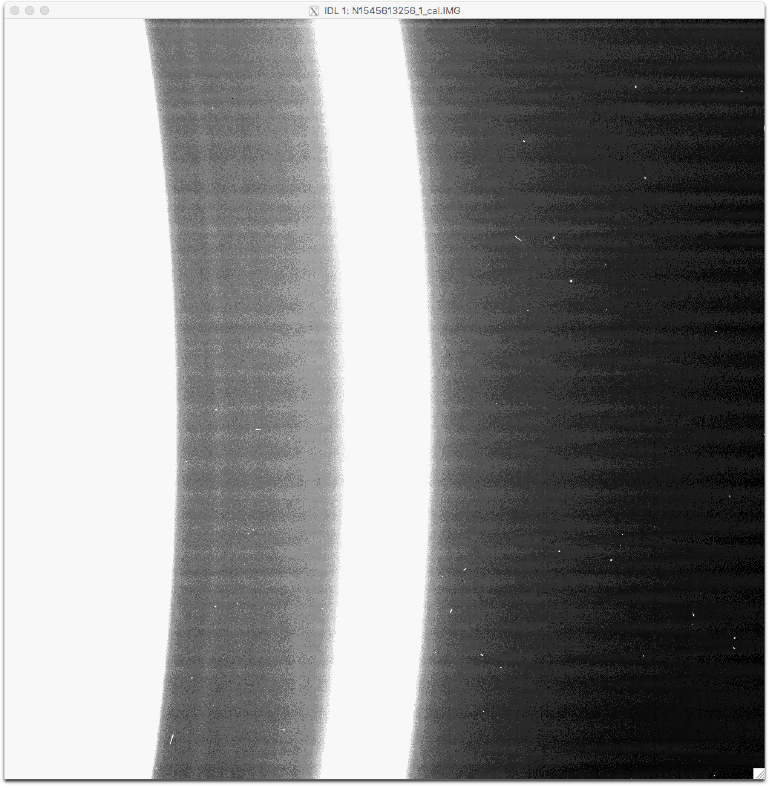
Roche Div

Slide 23
SKR
South
SKR
North
Saturn Winds Continuum
Saturn Winds Methane

Slide 24
A ring
Roche Division
SKR
South
SKR
North
Saturn Winds Continuum
Saturn Winds Methane
m=-3

Slide 25
D ring 73,000
D ring 71,500 (D72 core)
D ring 70,000
SKR
South
SKR
North
Saturn Winds Continuum
Saturn Winds Methane
m=2
m=2
m=2

Slide 26
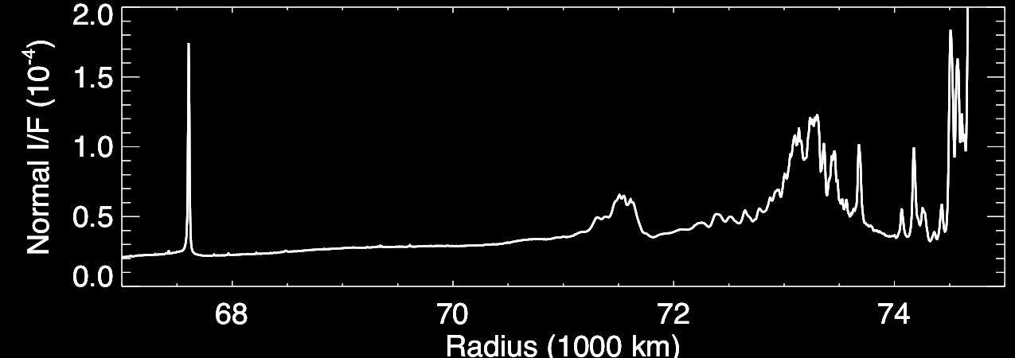
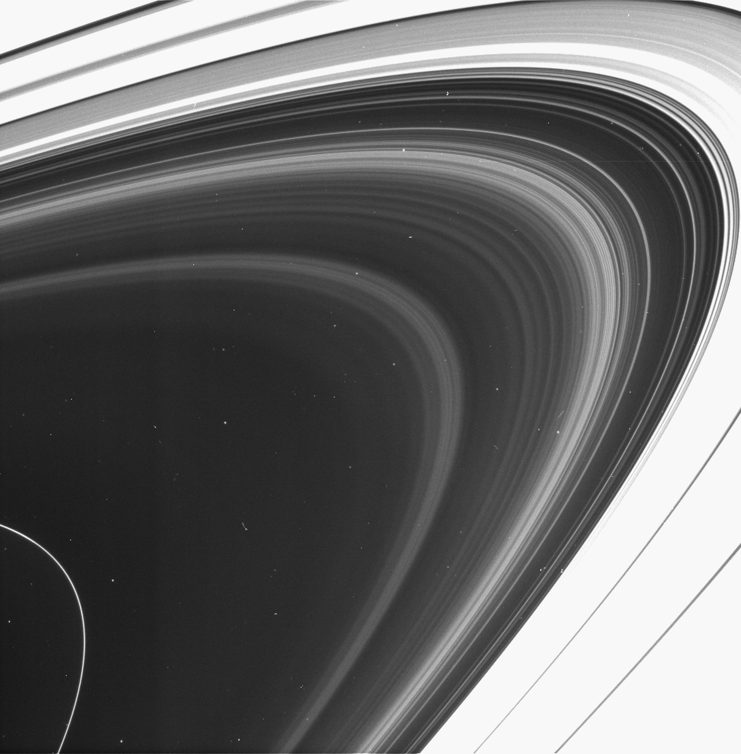
D ring
Cassini ISS
Rev 245
HPCLOSE001
N1855259044
October 2016
D73
D68
D72
C ring
C ring
D73
D72
D68
Saturn
Notes:
Closest rings to the planet
Micron size dust particles
D ring regions:
D68
D72
D73
The D ring is constantly changing
Huge shift in D72 and D68 appearance after voyager and during Cassini
The area between the ringlets is also changing

Slide 27
D ring
Cassini ISS
Rev 245
HPCLOSE001
N1855259044
October 2016
D73
D68
D72
C ring
C ring
D73
D72
D68
Saturn
Notes:
Now, here is the average radial profile of this image. I’ll be referring to these profiles throughout and we can use these to reduce the images into something quantifiable to map out the region.
The D ring is constantly evolving.

Slide 28
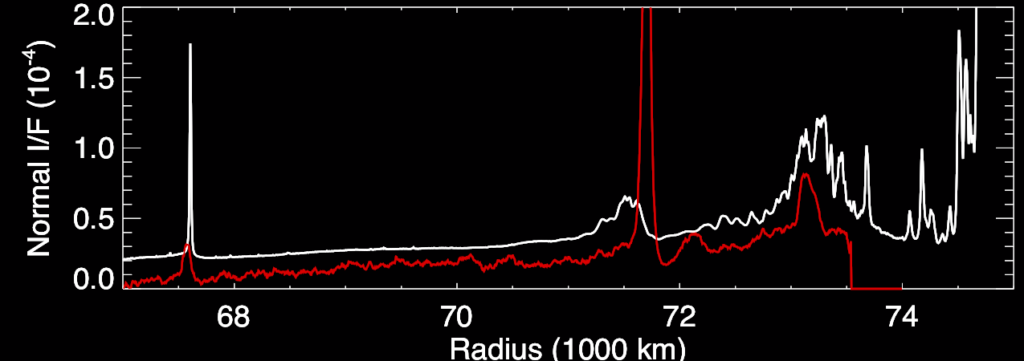
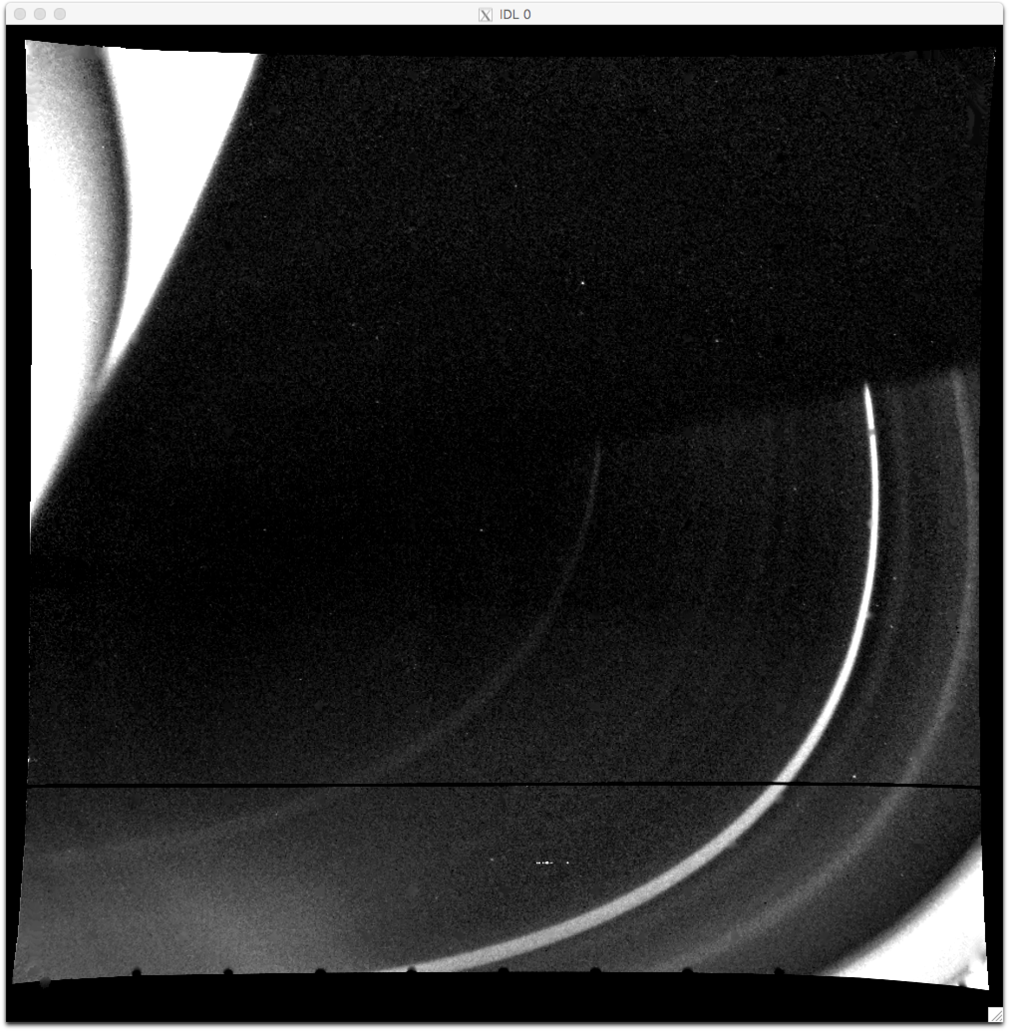
D ring
Voyager
Cassini ISS
Rev 245
HPCLOSE001
N1855259044
October 2016
D73
D68
D72
C ring
Voyager 1 ISS
C3494650
November 1980
C ring
D72
D73
D73
D68
D72
D68
Saturn
Notes:
In fact, in the Voyager days D72 was the brightest feature, and it has actually migrated inward about 200 km.
Throughout Cassini we watched the dust populations surrounding D72 go through dramatic changes I am going to talk about, but first I want to introduce the other ring region.

