Slide 1
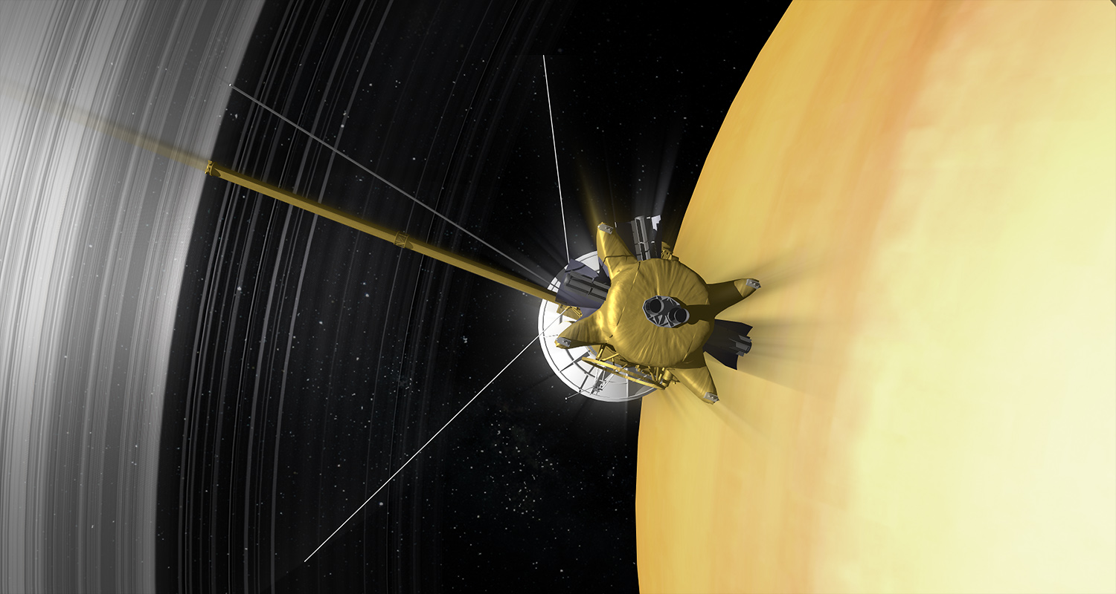
Revisit the modeling of the Saturnian ring atmosphere during the Cassini Grand Finales
Wendy Tseng¹, Bob Johnson², O.J. Tucker³, Wing Ip⁴, Mark Perry⁵ and Hunter Waite⁶
NTNU, Taiwan; 2. UVa; 3. NASA Goddard; 4. NCU, Taiwan; 5. APL; 5. SwRI
August 2018; Boulder Colorado, USA
Notes:
Good afternoon, this is Wendy Tseng from Taiwan. I have been working with Bob Johnson, OJ Tucker and Wing ip on the modeling of the ring atmosphere for a long time.
Now, with the INMS in-situ measurements during the grand fianle mission, it’s a first-ever opportunity for us to review our modeling of the ring atmosphere

Slide 2
Outline
Modeling of the ring atmosphere/ionosphere (O₂/O₂⁺, H₂/H₂⁺): SOI to Northern Solstice
Model densities vs. Cassini INMS F-ring & Proximal data
=> Sign of small grain impacts
=> More carbon material than previously thought
Transport of the ring material into Saturn’s upper atmosphere
Notes:
So first I’ll give a quick review on our previous work on the modeling of the ring atmosphere and ionosphere at SOI
Then, we compare with the new data set from the grand finale mission.
As you may have known that, there are two unexpected results such as the organic material in the main rings is more than previuos thoughts. Later, there are several INMS talks to give you more information.
Finally, I’ll talk about the transport of the ring material to Saturn’s upper atmosphere which is most people are highly interested!

Slide 3
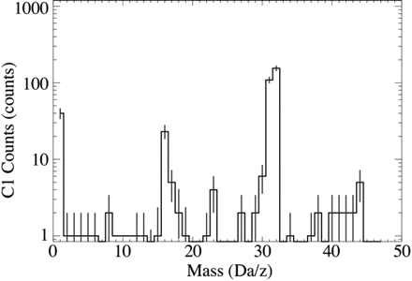
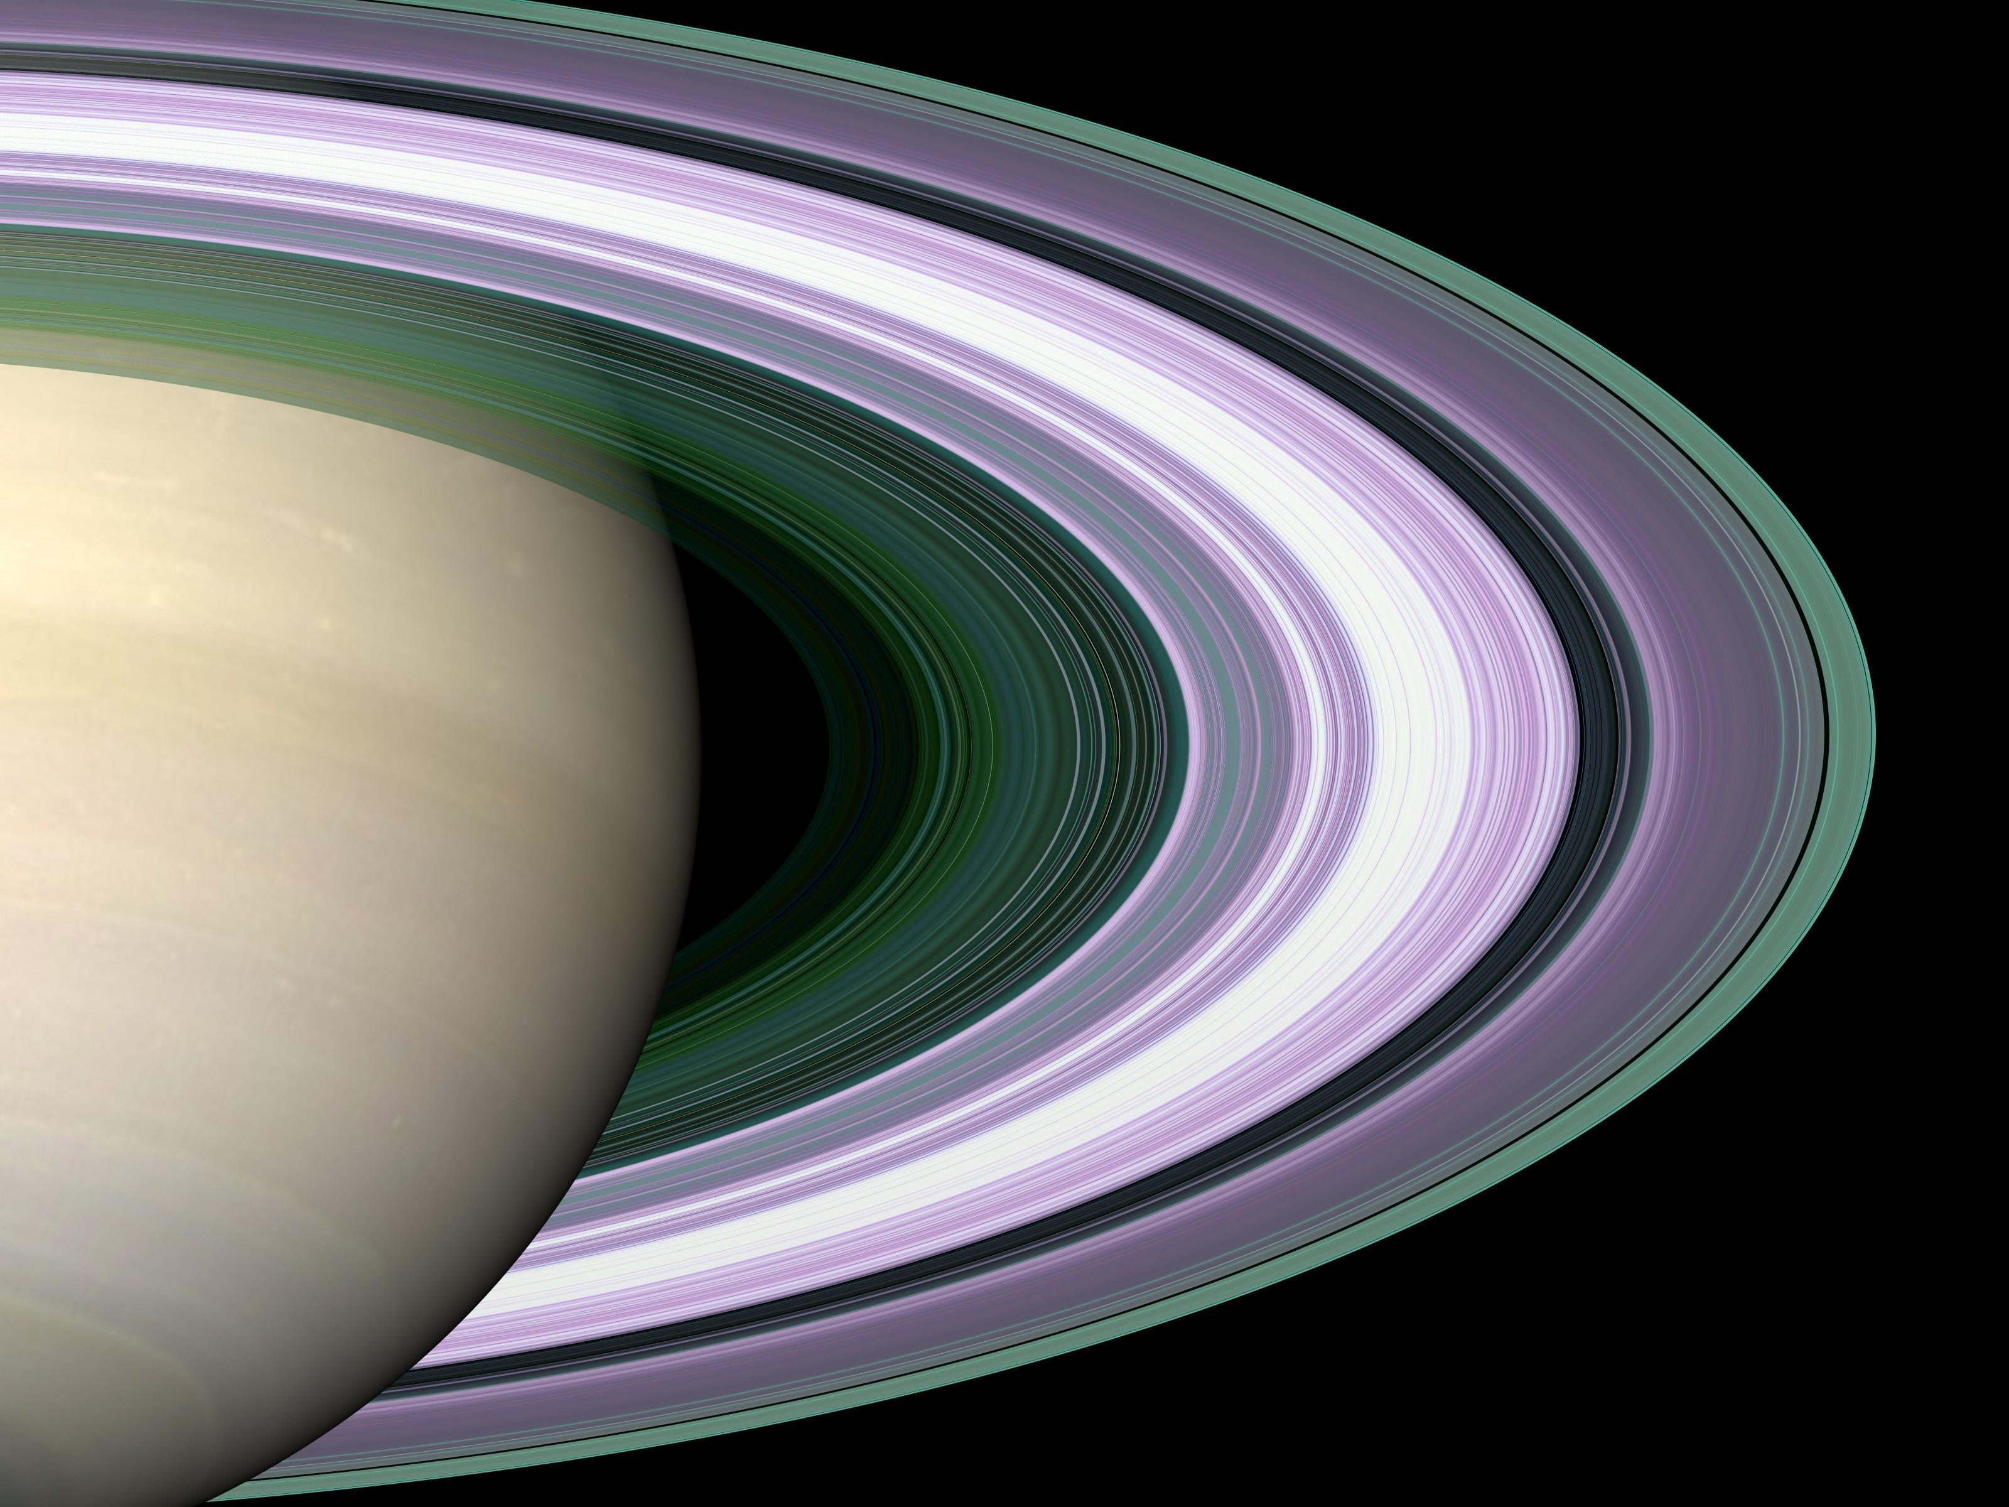
Detections of O₂⁺/O⁺ over the main rings at SOI by Cassini INMS & CAPS (Tokar et al.,2005: Waite et al., 2005; Elrod et al. 2012)
O₂⁺
O⁺
Waite et al., 2005
Notes:
At SOI, Cassini INMS and CAPS intruments have detected the O2+ and O+ over the main ring region. It is suggested that the main rings have an atmosphere of O2 which is primarily produced from photolytic decomposition of water ice. Water molecules would also be relased from the water ice, however, they would recondense on the icy grains at T~100K. This difference in the volatility leaves only O2 and H2 gas to accumulate in the atmosphere

Slide 4
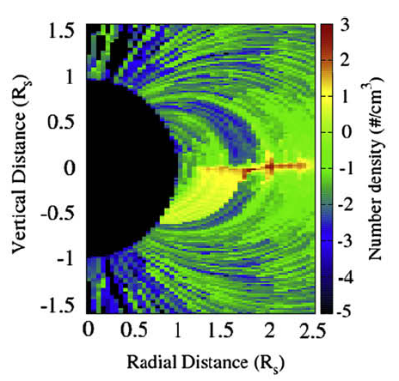
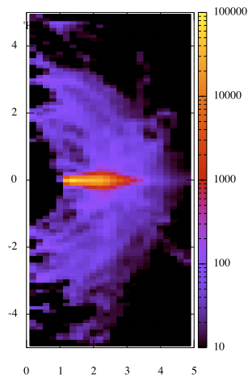
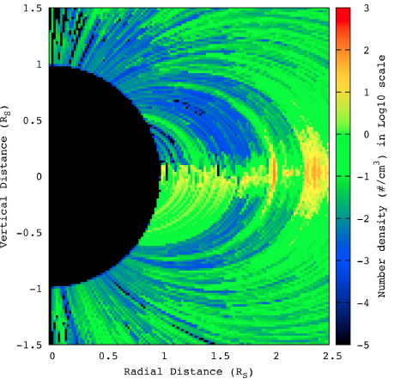
O₂/O₂⁺; H₂/H₂⁺ at SOI: Ring atmosphere/ionosphere Tseng et al., 2010; 2011
O₂⁺
H₂
B-ring
H₂ & O₂ in a ratio of 2:1
A-ring
F-ring flybys
H₂⁺
Proximal orbits
Notes:
Using with the test particle simulation to model the morphologies of the neutral O2 and H2 clouds. We emit the O2 and H2 molecules in a ratio of 2:1 from photolytic decomposition of water ice in the main ring ragion. Here we show the morphology of the ring H2 atmosphere.
In addtion, we also simulate the spatial distribution of the ring ionosphere of O2+ and H2+ by photoionization. (photoionization rate of H2 is ~ one order of magnitude smaller than the photoionization rate of O2.
Its main feature is the asymmetirc distribution above and below the ring plane because of the vertical north-shift of tha magentic equator to the ring plane.
More ions survive in the cassini division due to ring abroption. Alo there is a thin plasma dsik in the A ring region between the magnetic equator and the ring plane.

Slide 5
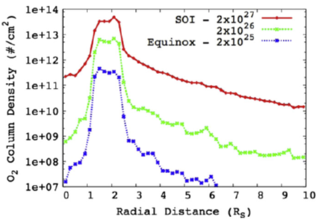
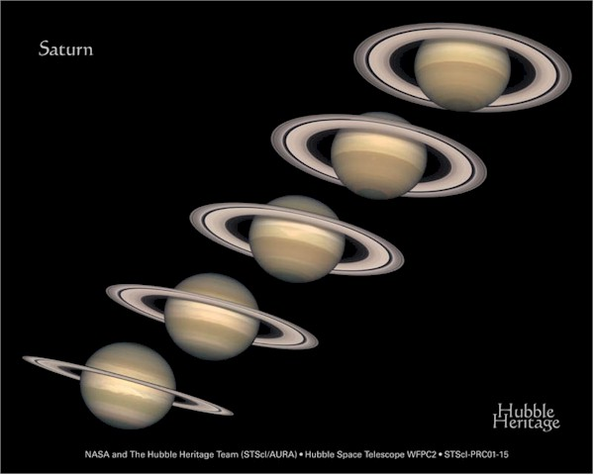
Seasonal variations of the ring atmosphere
Main Rings
Scattered component : ion-molecule collisions
Thermal component:
scale height vs. ring temperature
Scattered one: into Saturn’s atmosphere & magnetosphere
O₂ column density inside 10 Rs
Tseng et al., (2010; 2013)
Notes:
Beacsue the ring atmosphere is mainly produced from photolytic decomposition of water ice, so we predict that the ring atmosphere experience seasonal vartiations due to the orientation of the ring plane to the sun.
Here we show the O2 column density distribution in different seasons. You would see the thermal components would bound to the main ring region. A
Because we assume the eutrals would have thermal accomodation to the ring temperature. These scattered components experiencing in the ion-molecular cossions in the ring ionosphere travel into Saturn’s upper atmosphere and outer magnetosphere
nd those one who experiences ion-molecule collisions would scatter in to Saturn’s uuper atmosphere and in the outer magnetosphere.

Slide 6
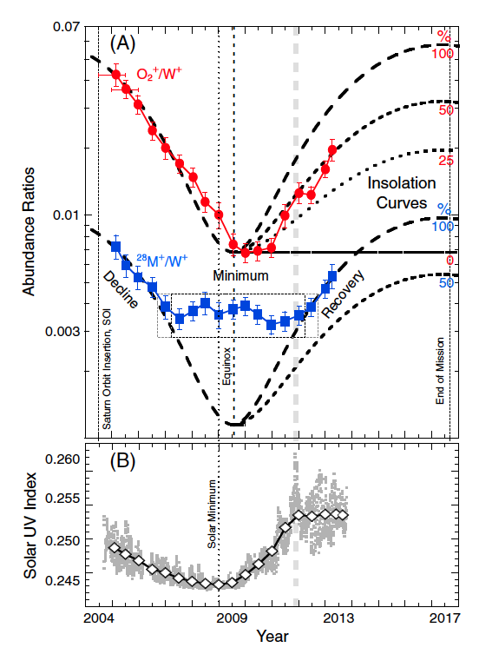
MIMI O₂⁺/W⁺
Seasonal variations in outer magnetosphere
due to ring atmosphere
(Elrod et al., 2012, 2014; Christon et al., 2013, 2014; Persoon et al., 2013;2015)
²⁸M⁺/W⁺
Christon et al., 2013
Notes:
The seasonal variations of the ring atmosphere has been confirmed by multiple instrument measurements
For thermal plasma measurements in the inner magnetosphere inside 4 Rs measure by cassini CAPS and RPWS
It is clearly showed the O2+/W+ followed the seasonal variations an d got recovery after eqinox
Surprisingly, they also found the mass 28 ions also have seasonal variations with a higher persistent level which could be from the icy astellites in the magnetosphere like Enceladus
Finally, Seasonal vairations of O2+ in the magnetosphere has been identified in the CAPS/MIMI data as well as the electron data in inner magnetosphere from RPWS
And a sharp increase of mass 28 and Carbon in a factor of 4 to 8
Here shows the MIMI/Chems data; clearly you see O2+ follwed the seasonal variation with a lagged recoverly. And aslo a rapid decay in the following years
Interestingly, they also found mass 28 alos show seasonal dependence and the longer perstent level could be from the icy satelittles like Enceladus in the magnetosphere
Mostly strikingly, the MIMI/chms

Slide 7
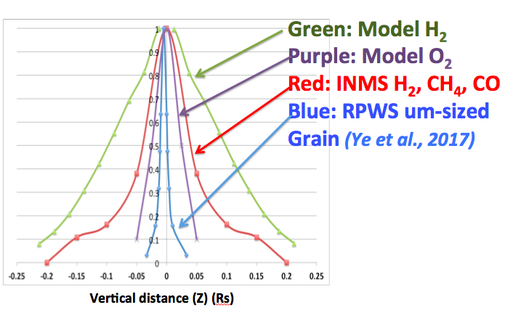
Role of nanograin?
F-ring: Data vs. Model (scale height 1/m^{0.5})
A reduced ring atmosphere at F-ring orbits ??
Quenching by the nanograins (Johnson et al., 2017)
Smaller solar activity compared to SOI
The INMS (Perry et al., 2017):
Not able to see O₂/O₂⁺
Detection-limits on heavy ions: high flyby velocity
Notes:
Thanks a lot to the cassini grand finale mission, this is the first ever opptunity to in-situ measure t the ring atmoosphere and ionosphere and ionosphere. However, there were is always unexpected things happened. There is no O2 and O2+ in the INMS data in the grand finale missions. Because of its high flyby velocity, detections limits is placed on the water-group ions. No heavier ions could travel into the detector. Neutral O2 is not seen in the data possible due to broken up inside the inms chamber. Or under detectsion limits. Aonther interesting thing is INMS have detected H2, CH4 and CO which all show similar density distribution and scale heights. However, it is not consistent with with our model. Because the nuetral thermal accomodation to the ring temperature and the scale height should showllow the 1/square mass. Like H2 and O2. Therefore we suggested the INMS reuslts are likely from the small grains impacts.
In addition, there seems a reduced ring atmosphere at the F-ring orbits there are two possible causes: one is quehcning by the nanograins in the F0ring predicted by Johnson et al., 2017. Or smaller solarSome The INMS data at the F-ring orbitsshowed no signals of neutral O2 => O2 molecules broken up inside the chamber or the O2 atmosphere is smaller than the sensibility
and O2+ ions
Another interesting thing is that all molecules detected by the INMS showed very similar distribution with roughly the same scale height. This is not consistent with our model. Because of the molecules is in thermal accomodattion with the ring temperature, so the each molecule has its own scale height follow by the one of square mass. In Johnson etal we predicted there were abundant nano-sized grain presented outside of the A-ring and F-ring. So here we also suggested that the INMS measurements here also are the results of nanograin impacts
Finally, the data in the F-ring seems to show a reduced atmosphere. So the possible causes are wither, the neutral atmosphere, similar to plsama, quenched by the anonograins. Or it’s due to smaller solar activity compared to SOI.
We also provide another compelling evidence for likely grain impact: Everything likely grain impact-induced dissociation => could not trace back to the single molecule, cluster, or particulates, grains…… due to high-velocity flybys
Now here comes the more interesting part: this plot showed the vertical distributions of all model and meausrements one over square mass
We find it very difnaficult to explain all species share the same scale heights based on our modeling conept. Sthereofree it lead us to think of another possibility. Are these neutrals due to grain evaporization inside the INMS chmaber by nanograin impacts?
Just remind you that we suded the CAPS data and RPWS electron daata between the edge of Ar-ing ad F-ring ans suggest there is a large amout of the nanograins.
The next
At the first look, the modeled H2 density is at least five times larger than the measured H2 density, it seems no sign of the ring atmosphere
However, another big puzzle puzzle in the F-ring data is the the adata showed all species of
The plot show comparisons for thescale heights information in vertical distance. Green
It led us to think of the possibility of nanograin impacts and the grain vapor vaporization in the chamner?
ADD O2 DENSITY SCALE HEIGHT (要從2D O2 density map 取出2.5 Rs的Z direction 分佈) => 我讀O2 data的Fring時; 要非常小心grid number 0.05Rs??
From comparisons with the CAPS ion data and the RPES electron data between the edeg of A-ringa dn F-ring, it is sugeested a large amount of nanograins.
So we could invetsitgate more about the possibility of grain impact signatures

Slide 8
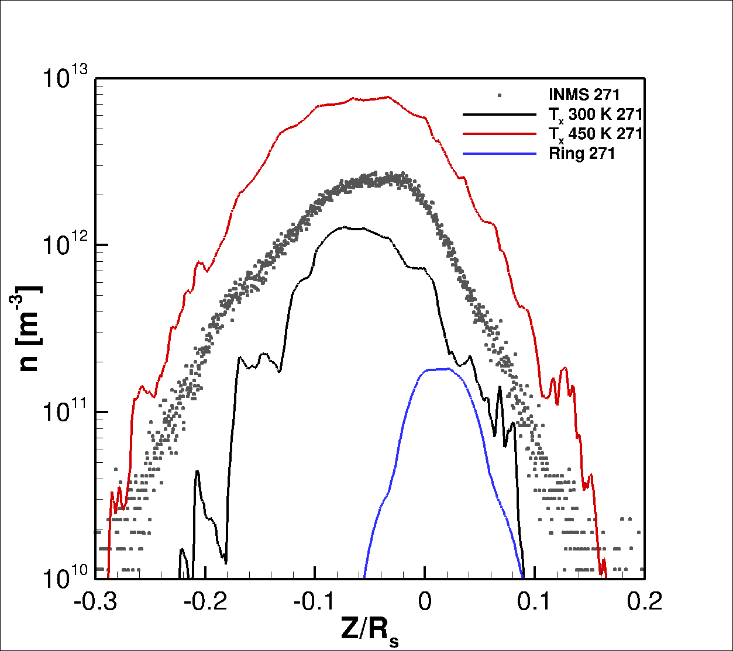
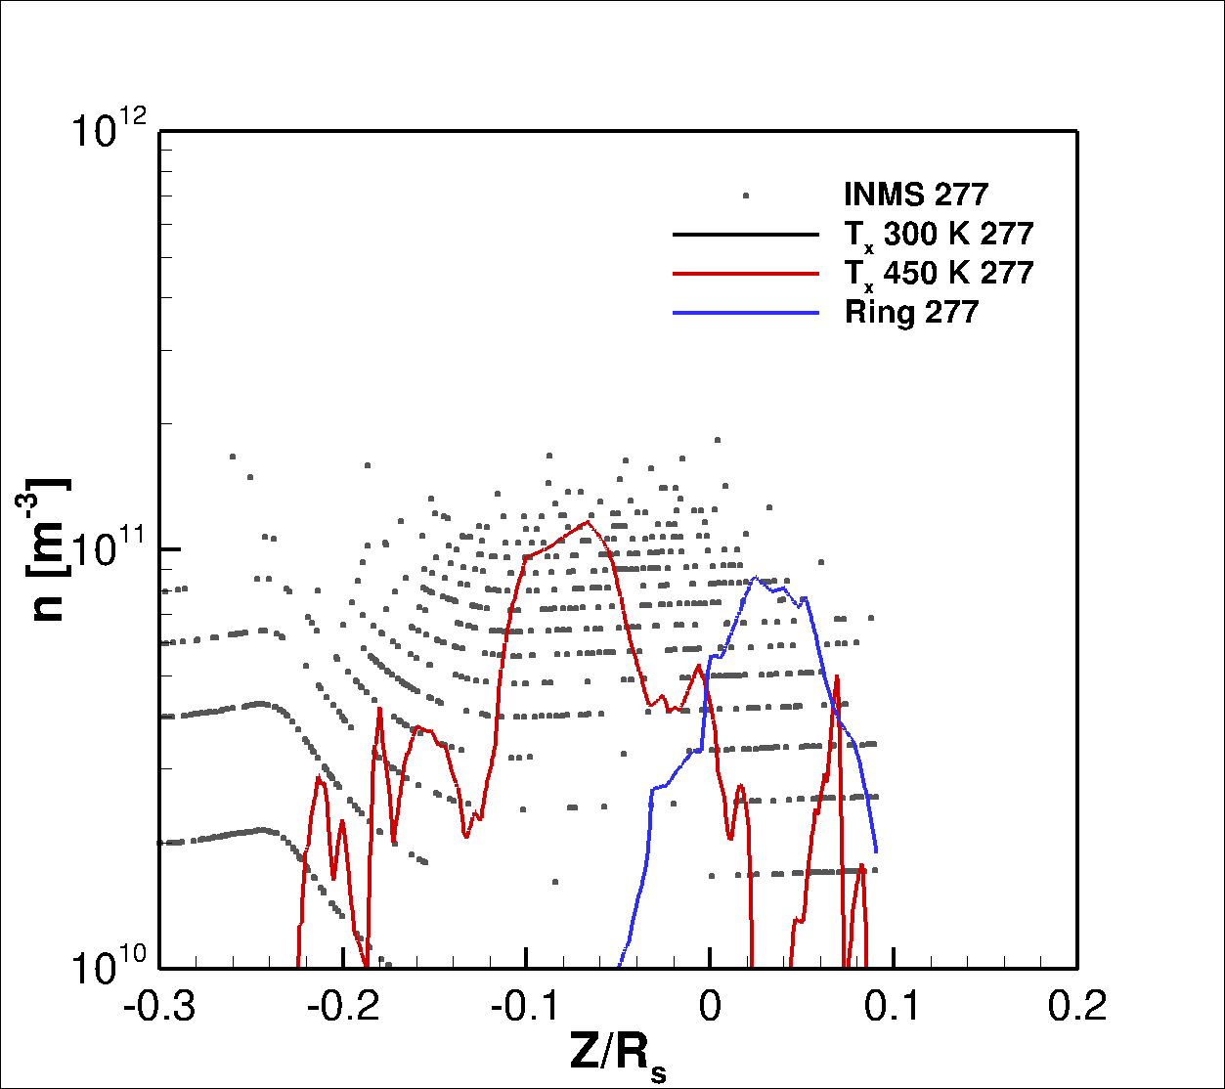
Proximal data vs. Combined model of H₂ from Saturn’s exosphere & ring atmosphere: (DSMC model: OJ Tucker et al., 2017)
C.A. 2950 km
C.A. 3890 km
Exobase
T = 450 K
INMS
Exobase
T = 450 K
Exobase
T = 300 K
INMS
Ring
Ring
High-altitude proximal data (> 4,000km)
suggests a robust H₂ ring atmosphere
Notes:
So now we’d like to see the ring atmosphere in the other end – the proximal data.
OJ tucker developed a DSMC model to simulate the Saturn’s exophere beased on the thermal properties of Exobase measured by the UVIS such as the thermal sphere T~300K It is aimed to look for any signature of the ring atmosphere in the INMS data.
For data and model comparisons, the high-altitude proximal data suttested a robust ring atmosphere

Slide 9
More carbon material in the main rings than previous thought
Cuzzi et al., 2018; Waite et al., 2017
Sources of Organic material on the rings:
Source | Mechanism | Source rate
Water ice grains | Photolysis; Radiolysis | Carbons in the ice; Enhanced CO/CO₂; O₂ suppression? Hard to produce CH₄?!
Enceladus | Plume; Torus | CO₂/H₂O: 1-2 % & CH₄/H₂O ~ <1% (Waite et al., 2017) ~25% grains: organics (Postberg et al., 2017)
IDPs | Direct Deposit | Carbons/Organics
Notes:
A big surprise is that more carbon material in the main rings than previous thoughts, sucha s Jeff’s HST specta and the INMS proximal data, So we here we invetigate some In the low-altitude flyby of INMS data In the low-Why INMS saw more CH4 > H2O; water recondensed on the ring grains at T=100K (neutral H2O sticks on the ring grains for T~ 100K
We investigate possible source if organic material on the rings. First,
It leaves the the more volatile spices accumated in the gas phase!!
The inms saw the organic material around equator
Selection-effect: chemical volatility vs. ring temperature

Slide 10
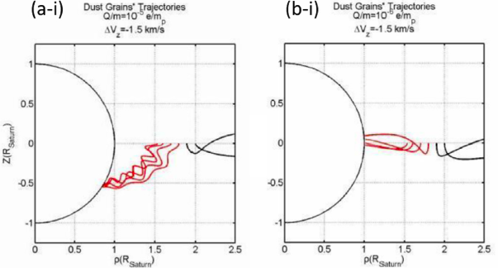
Transport of the ring material along Saturn’s equator?
Discovery of nanograins inside the D-ring by Cassini MIMI, Mitchel et al., 2017
Positively Charged particle impact (Ip et al., 2016)
Notes:
In addition to the source of organic material. Another important question would be how these ring material transport into In addition to the organic grain impacts detected by INMS, Cassini MIMI instrument also have discovered a population of 1-2 nm sized nanograins inside the D-ring around the Satrurn’s equator.
Most people believe that they are diffusive from the main rings and interested in the transport process. Wing ip provided a possible mechanism that micron-sized grain with charges normall travel along the magetic filed lines, bowever, for the charged nanograins, they could travel along the ring pane.

Slide 11
More to be explored:
A robust ring H2 atmosphere is shown in the INMS high-altitude proximal data
Constraints on the ring atmosphere:
grand finale vs. outer magnetosphere data
Interaction of neutral clouds with the ring grains (vs. removal by ion-molecule scattering)
Ice grain composition: role of organics?
Propagation of charged ring grains into Saturn’s upper atmosphere
Notes:
Outer magnetosphere data, like MIMI CHEMS, also provide an valuable constraints on the ring atmosphere

Slide 12
Backup slides

Slide 13
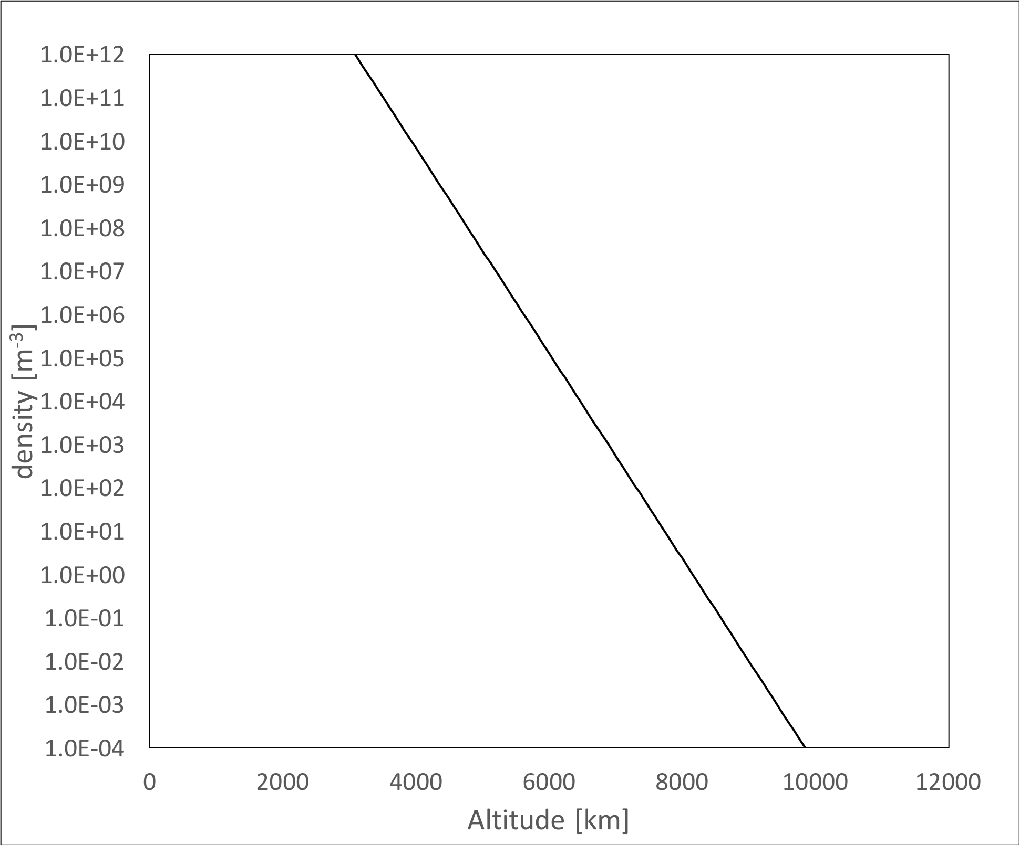
Equatorial Profile of the Extended Exosphere and Ring Atmosphere
Ring Atmo.
Tx = 370 K
Exosphere
Maybe use this as a backup slide or just to think about

Slide 14
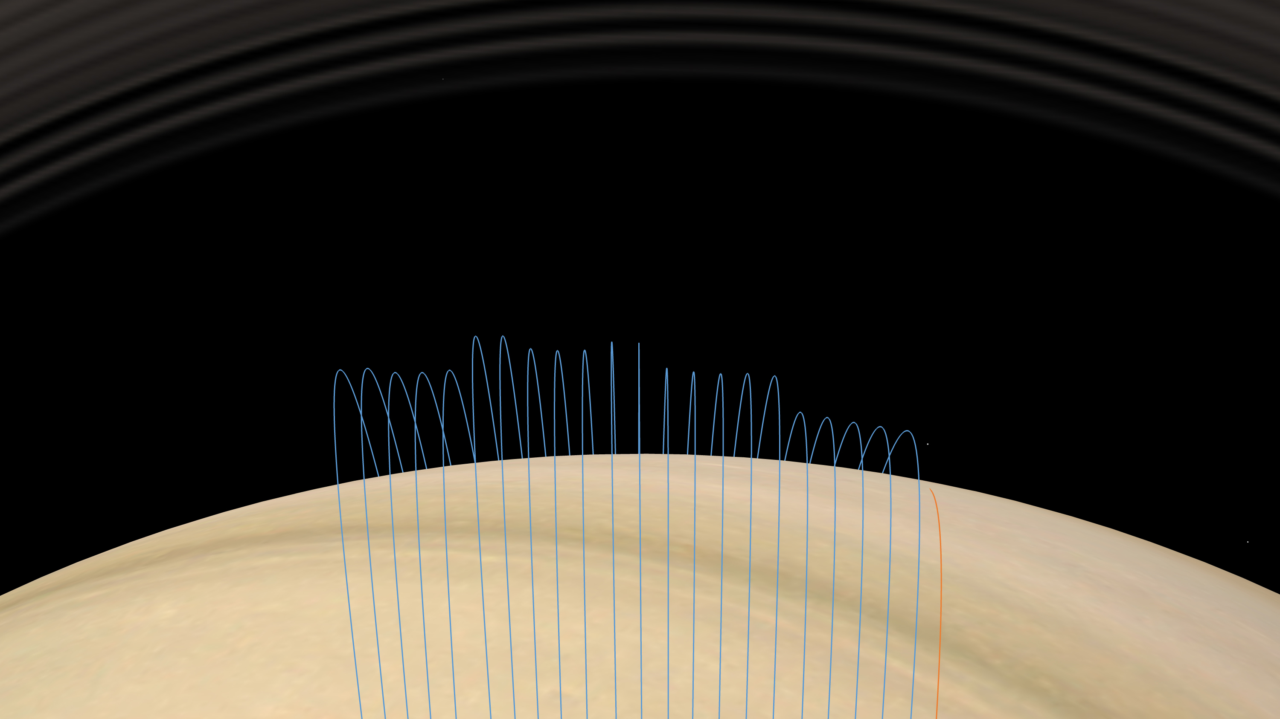
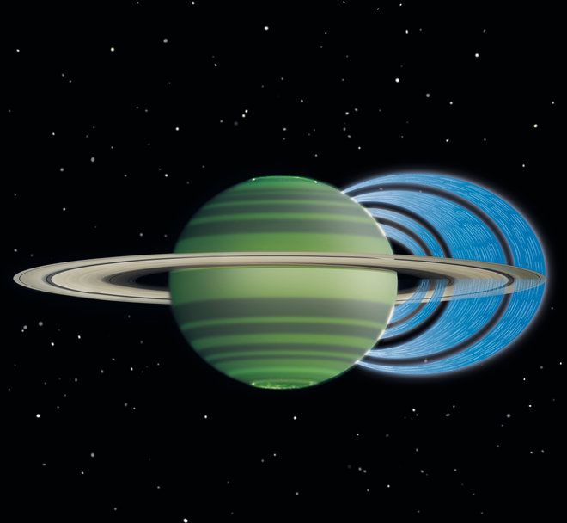
Cassini Grand Finale Orbits
Interaction Region: Saturn Atmosphere
& Ring Atmosphere & Enceladus torus
neutrals, ions, nano-grains, ring-rain & all that
Notes:
Like what I said before, the O2+ in the outer nagnetosphere
In addition, the H2O, H2O has been discovered in Saturn’s upper atmosphere. And it was suggested that oxygen-contained molecules should be an exterior source bases on a photochmeical model
And of course Enceladus water plume could be a nother major source.
H2O detection
Reduced ionospheric plasma density of Saturn. Charged particle precipitation on Saturn from the main rings. Then the infared emission of Keck
Cassini Grand finale mission data I will talk about it later.
Besides, to account for the reducedSaturn’s ionopheric plasma densit,y Long time ago, many people have thought that charged paticles (water ice grains ) could impact into saturn’s and initiate a bunch of chemical reactions.
For the first time ever, theyre were in-situ measurements in this region.
And this region showed very complex interactions. They are are the neutrals from saturn ring and encelauds torus charged particles grains…..
So, we are so excited about the Cassini Grand finale results. to see this first-ever-seen regions see which showed very interesting and complicated interactions
All material are mixed up. And the highly varable magnetoaheric environments would make the study more complicated.
All material mixed in this region: satrun atmosphere, ring atmosphere and probably Enceladus material
We have neutrals from xxx, the plasma, nano-grains, ring and all interesting stuff
Highly variabble environment, background radiation and the active magnetosphere environment

