Slide 1

Titan’s Atmosphere
…how to bake a five-layered cake
Conor A. Nixon, NASA Goddard Space FlightCenter
Cassini Science Symposium, Boulder, CO, August 15th 2018

Slide 2
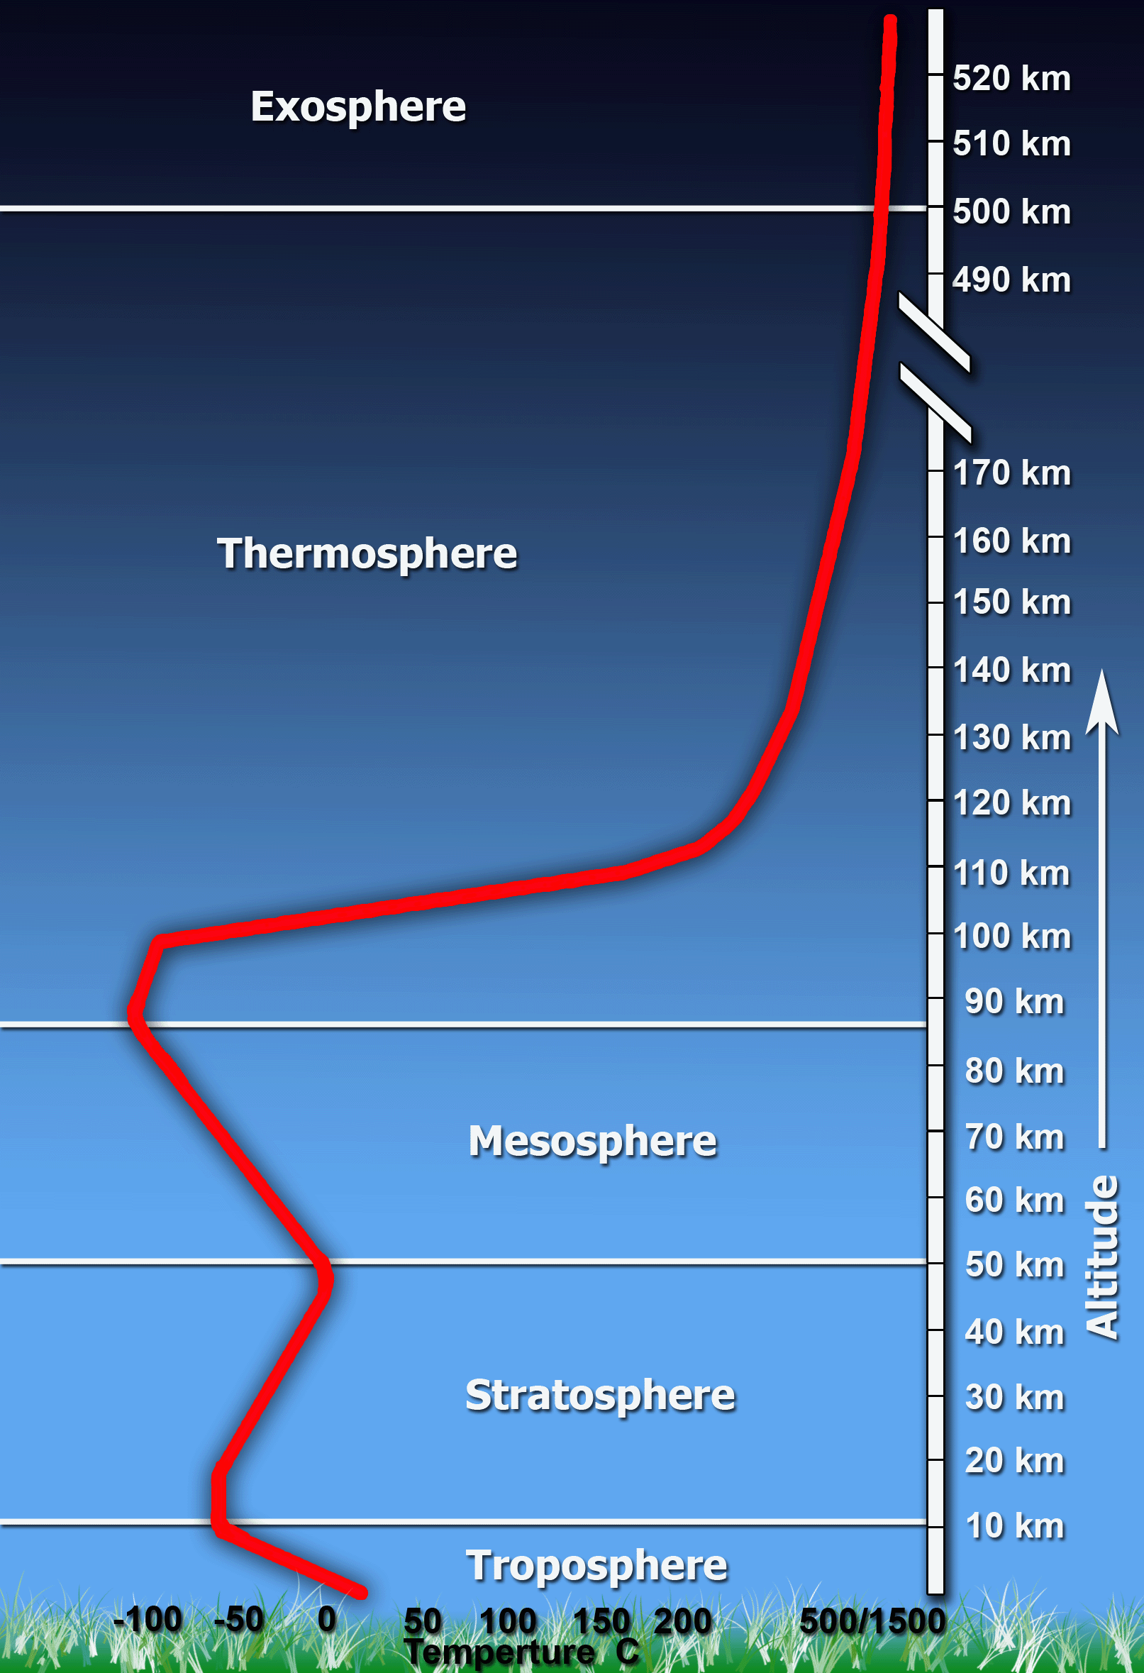
What’s with the layer cake analogy?
Atmospheric scientists had the Earth as their first example.
Earth’s atmosphere exhibits distinct layers as different physical processes become dominant.
Planetary atmospheres often show similar structure (although there are exotic exoplanet exceptions).
Titan’s atmospheric layering resembles that of he Earth, although with differences in the details.
http://www.ces.fau.edu/nasa/module-2/atmosphere/earth.php

Slide 3
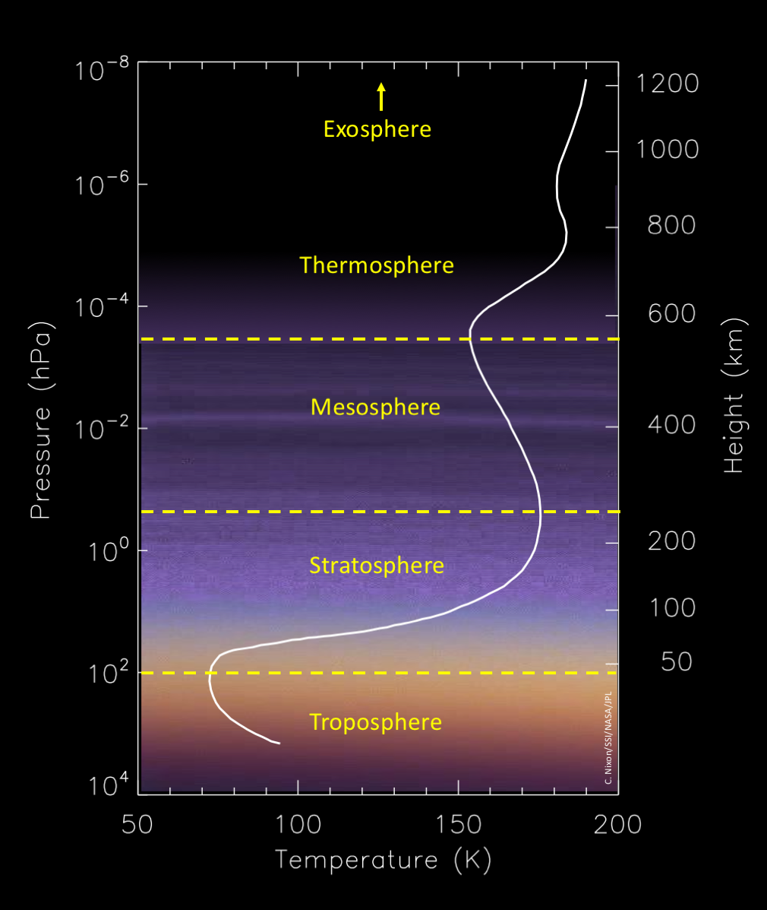
Atmospheric layers on Earth and Titan
Exosphere: unbound molecules escape to space
Thermosphere: non-LTE region of increasing temperature
Mesosphere: radiative cooling exceeds heating
Stratosphere: radiative heating leads to higher temperatures
Troposphere:
convective region due to surface heating

Slide 4
Atmospheric Similarities and Differences
Layer | Earth | Titan
Exosphere | Jeans escape, loss of helium | Jeans escape, loss of hydrogen
Thermosphere | Non-LTE temperatures Ionization region | Ions and radicals found Heavy molecule/haze formation CH₄ heating and HCN cooling
Mesosphere | Significant CO₂ cooling | Cooling by hydrcarbons, HCN and haze Mesopause predicted ~500-600 km
Stratosphere | Ozone heating Brewer-Dobson circulation | Heating by gas opacity Brewer-Dobson circulation
Troposphere | Water clouds Greenhouse warming 33℃ | Methane clouds Greenhouse warming 12℃

Slide 5
Troposphere (0-45 km)

Slide 6
Troposphere: what we knew before Cassini
Tropospheric pressure-temperature structure
Energy balance, greenhouse mechanism
Transient tropospheric clouds
Ground-based spectroscopy and (later) imaging. E.g. Brown et al. 2002 (above)
From Voyager radio occultations:
Lindal et al. 1983
Modeling by McKay et al. 1991

Slide 7
Troposphere: what we’ve learned from Cassini (I)
Lower atmosphere composition, gas profiles
Latitude variations of tropospheric temperature
Huygens GCMS, Niemann et al. 2010
Cassini RSS, Schinder et al. 2012

Slide 8
Troposphere: what we’ve learned from Cassini (II)
Spatial and temporal apparition of clouds
Cassini VIMS, Rodriguez et al. 2006
Cassini ISS, Turtle et al. 2011

Slide 9
Troposphere: what we still don’t know
What are the local variations in temperature, methane humidity over the lakes?
How repeatable are cloud patterns year-on-year?
Are the cloud droplets pure or mixed substances?

Slide 10
Stratosphere (45-350 km)

Slide 11
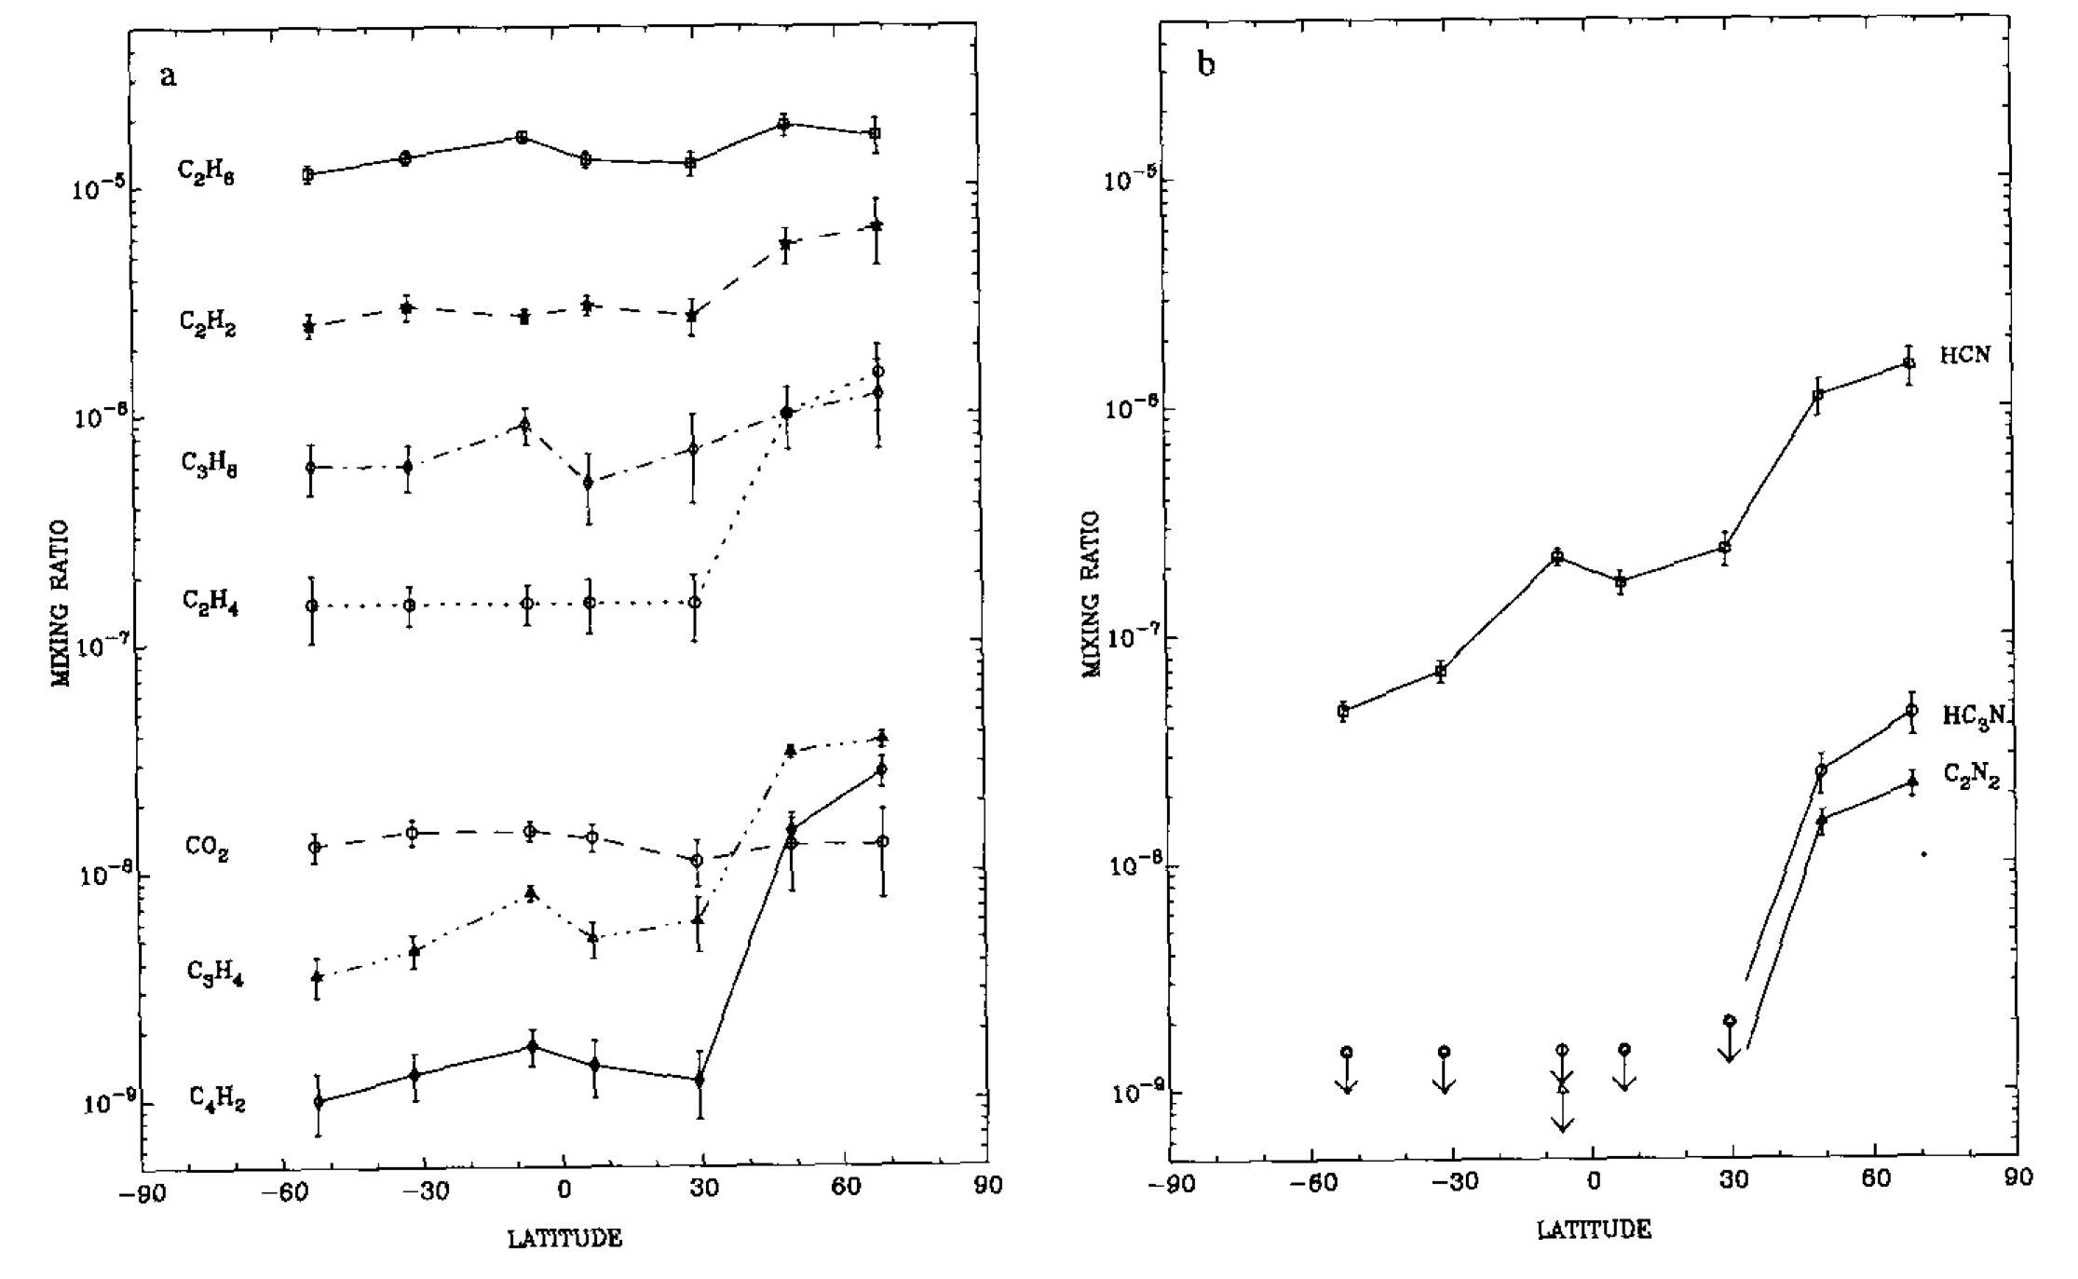
Stratosphere: what we knew before Cassini
Trace gas composition and latitude trends; D/H ratio in methane
Voyager IRIS, Coustenis et al. 1995

Slide 12
Stratosphere: what we’ve learned from Cassini (I)
2D Temperature and wind field
Cassini CIRS, Achterberg et al. 2008a

Slide 13
Stratosphere: what we’ve learned from Cassini (II)
2D trace gas abundances
Cassini CIRS, Vinatier et al. 2010

Slide 14
Stratosphere: what we’ve learned from Cassini (III)
Seasonal evolution of trace gases
Cassini CIRS, Teanby et al. 2012

Slide 15
Stratosphere: what we know from Cassini (IV)
Plus:
Haze spectral properties (DISR, VIMS, CIRS)
Haze distribution (ISS, CIRS)
Isotopic ratios in H, C, N, O (INMS, CIRS)
Noble gas abundances (INMS)
Condensed phase ice clouds (CIRS, ISS)
Global dynamics (GCM models of Cassini data)
Waves (ISS, CIRS)
…

Slide 16
Stratosphere: what we still don’t know
How is super-rotation generated and maintained?
Why is the atmospheric rotation axis tilted?
Do methane and H₂ vary with latitude?
Do haze particles seed cloud formation?

Slide 17
Mesosphere (350-600 km)

Slide 18

Mesosphere: what we knew before Cassini
Detached haze layer seen above main haze layer at ~500 km.
Voyager 1 imaging system, Smith et al. 1980

Slide 19
Mesosphere: what we’ve learned from Cassini (I)
Seasonal evolution of detached haze
2006-123 2010-092
Cassini ISS, West et al. 2011

Slide 20
Mesosphere: what we’ve learned from Cassini (II)
Coupled stratosphere-mesosphere dynamics
Cassini CIRS, Teanby et al. 2017

Slide 21
Mesosphere: what we still don’t know
What sustains, and collapses the detached haze layer?
Is there a definite and persistent mesopause?
Where is the top of the global Hadley cell?

Slide 22
Thermosphere (600-1500 km)

Slide 23
Thermosphere/ionosphere:
what we knew before Cassini
Knowledge was confined to modeling of neutral-radical reactions
Photochemical model of Voyager 1 data, Yung et al. 1984

Slide 24
Thermosphere/ionosphere:
what we’ve learned from Cassini (I)
Mesosphere-lower thermosphere neutral gas profiles
Cassini UVIS, Koskinen et al. 2011

Slide 25
Thermosphere/ionosphere:
what we’ve learned from Cassini (II)
Identification of many positive ions
Cassini INMS, Vuitton et al. 2007

Slide 26
Thermosphere/ionosphere:
what we’ve learned from Cassini (III)
Ion and neutral profiles in the upper thermosphere/ ionosphere
PAH profiles
Cassini UVIS,
Westlake et al. 2012
Cassini VIMS,
Lopes-Puertas et al. 2013

Slide 27
Thermosphere/ionosphere:
what we’ve learned from Cassini (IV)
Discovery of heavy negative ions in the upper atmosphere
Cassini CAPS, Waite et al. 2007
… and much more.

Slide 28
Thermosphere/ionosphere:
what we still don’t know
What is the structure/fractal nature of the haze particles?
Can we reconcile the INMS and CIRS H₂ abundances without a surface sink?
Is methane being permanently depleted, or in a steady state of resupply?

Slide 29
Exosphere(1500 km+)

Slide 30
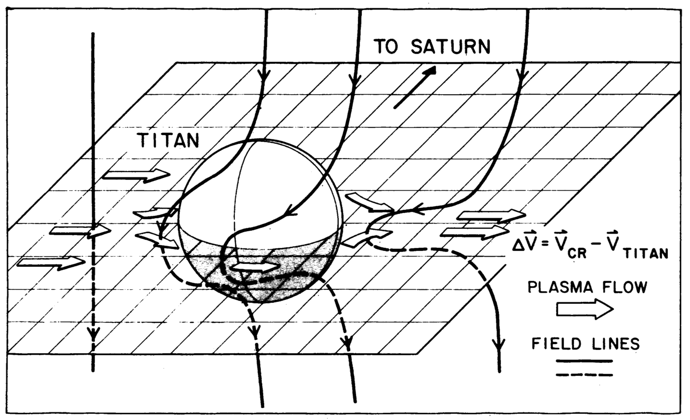
Exosphere/magnetosphere:
what we knew before Cassini
Predictive models of escape processes (e.g. Hunten)
No internal magnetic field (Voyager 1 magnetometer)
Voyager 1 magnetometer, Ness et al. 1981

Slide 31
Thermosphere/ionosphere:
what we’ve learned from Cassini (I)
Connection of external O⁺/OH flux to Titan oxygen-bearing species
Cassini INMS/CAPS data measurements; modeling, Hörst et al. 2007 (above)

Slide 32
Thermosphere/ionosphere:
what we still don’t know
Is there a Titan nitrogen torus?
Is Enceladus contributing other elements (e.g. S) to Titan’s atmosphere?

Slide 33
Putting the five layers together…

Slide 34
The layers are not really separate
Molecules produced by photochemistry mix downwards, and affect radiative balance, and hence dynamics of the lower atmosphere
Stratosphere/mesosphere global circulation redistributes molecules, affecting the vertical profiles, and causing polar saturation and clouds
The troposphere, with cold trap at 45 km, affects how much methane can diffuse upwards, mediating the ingredients for photochemistry…

Slide 35
Titan’s atmosphere is a system
Radiative processes
Chemistry
Dynamics
The radiative, chemical and dynamical processes are all inter-related and affect each other.
GCM, photochemical and radiative-equilibrium models must be careful to account for all processes, or know model limitations.

Slide 36
Summary
The layer model has its uses, allowing the key processes dominating each level to be identified and characterized.
The layer model also has inherent limitations, and can lead to artificial barriers being introduced in numerical models.
Further work on the connections between layers is needed, studying Titan as a system, and including constraints from multiple datasets instead of single instruments.
Examples:
  Coupled middle atmosphere-ionosphere GCMs.
  2D photochemical models including lateral transport.
  Addition of mixed phase condensation and microphysics.
  Longer time-domain modeling to include non–steady states.

Slide 37
‘Big Picture’ Open Questions
How far is the “Titan as early Earth” analogy accurate?
How old is Titan’s atmosphere?
Is Titan’s atmosphere episodic, or long-lasting, and is it being replenished or diminished?
How far does chemical complexity go, and is Titan brewing up the ingredients for life?

Slide 38
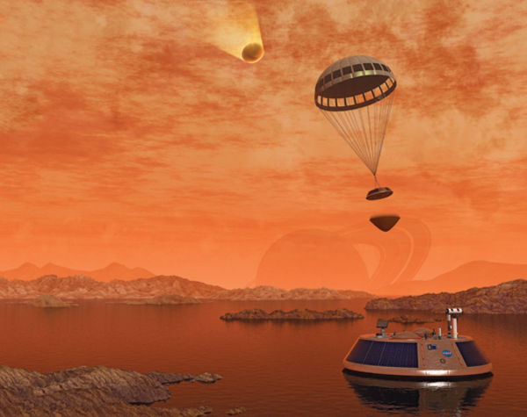

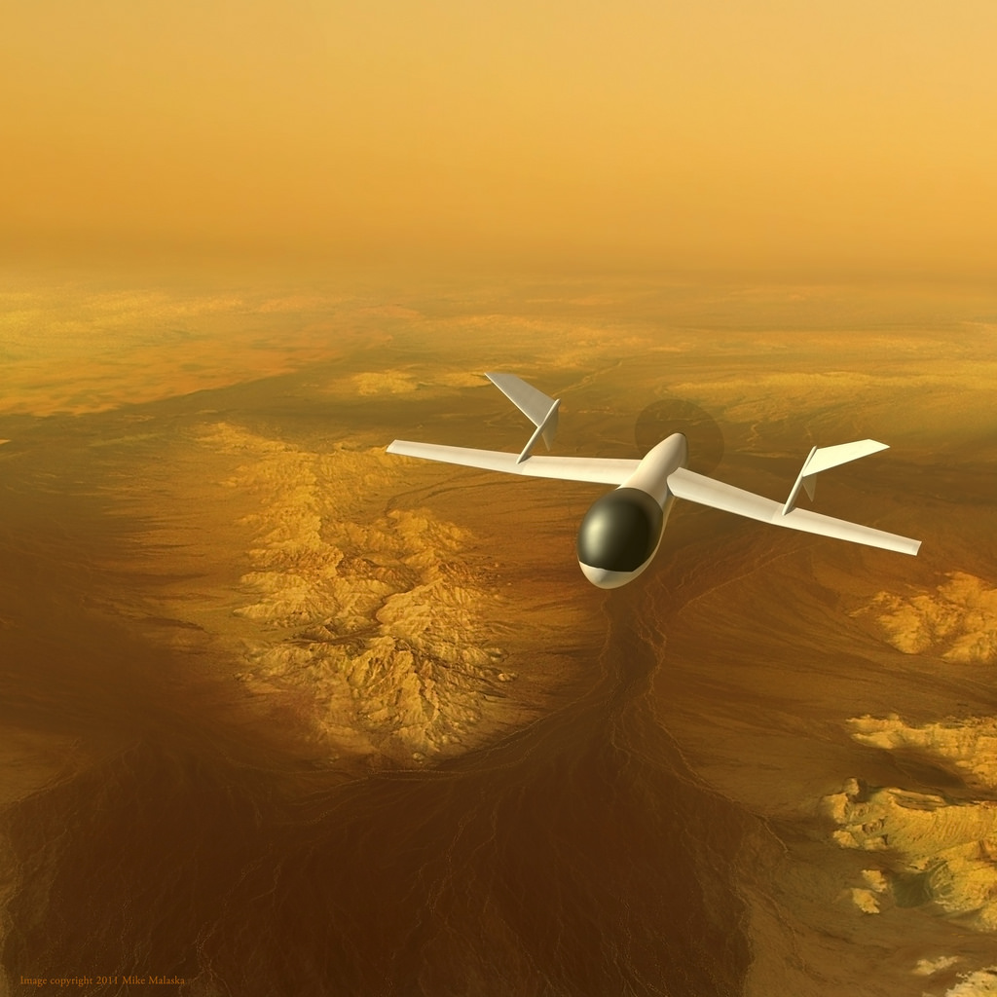
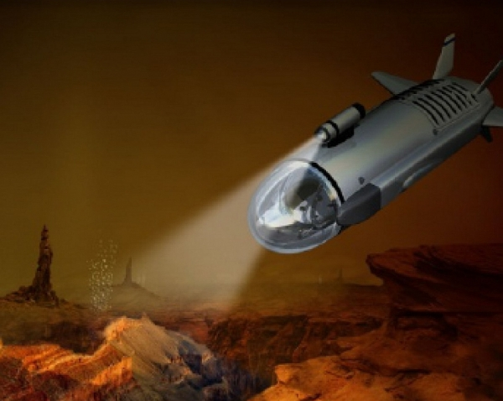
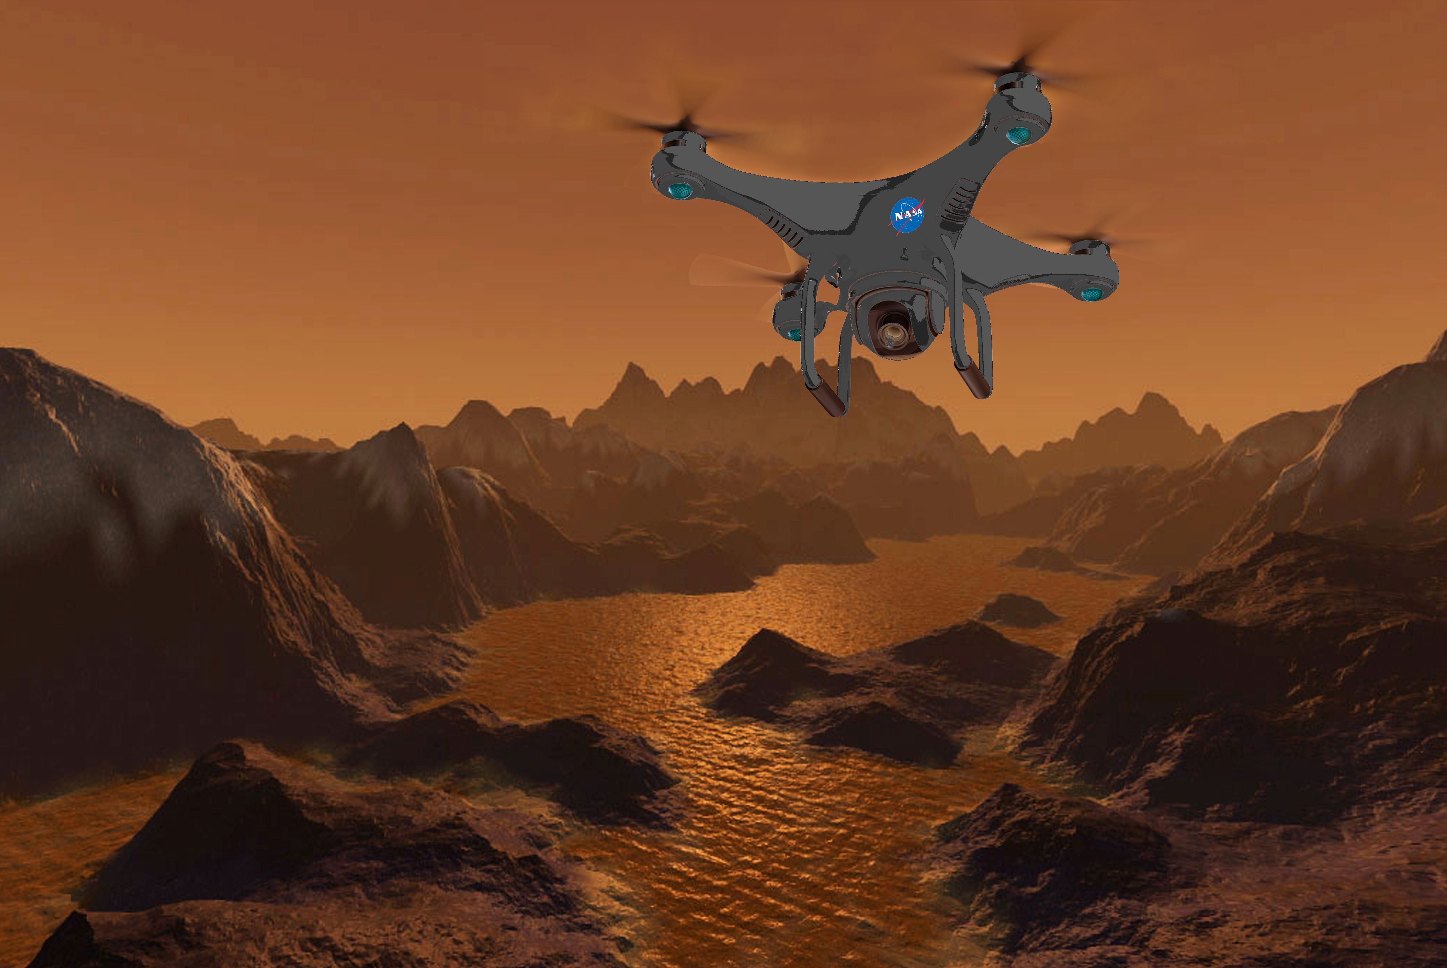
Future missions?

Slide 39

Orange Ombre Cake recipe:
http://betterwithbutter.com/orange-overload/

Slide 40
Backup slides

Slide 41
