Slide 1
frozen hydrocarbons on Titan
Jason Soderblom, Jordan Steckloff, Kendra Farnsworth, Vincent Chevrier, Alejandro Soto, Jason Barnes, Bob Brown, Alex Hayes, Stéphane Le Mouelic, Luca Maltagliati, Jason Perry, Sébastien Rodriguez, Larry Soderblom, Zibi Turtle
Cassini Science Symposium, Boulder, CO– August 15, 2018

Slide 2
Tropics

Slide 3
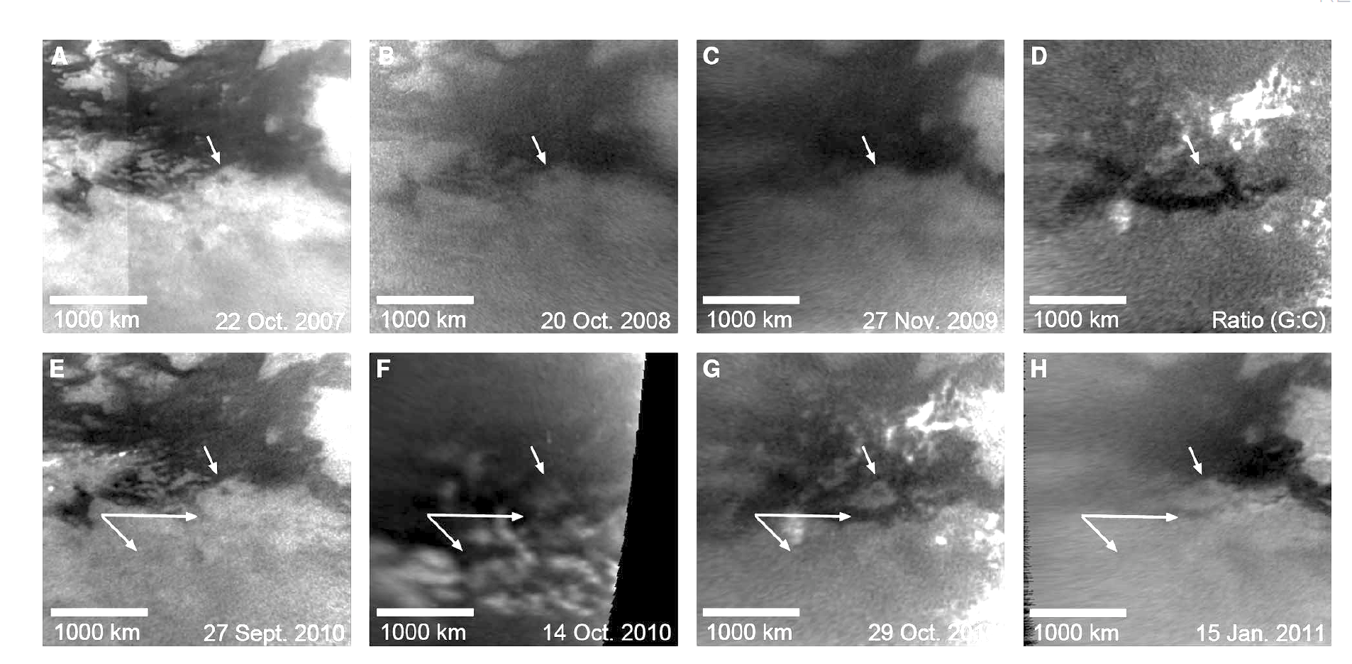
Evidence for tropical rains
Turtle et al., 2011

Slide 4
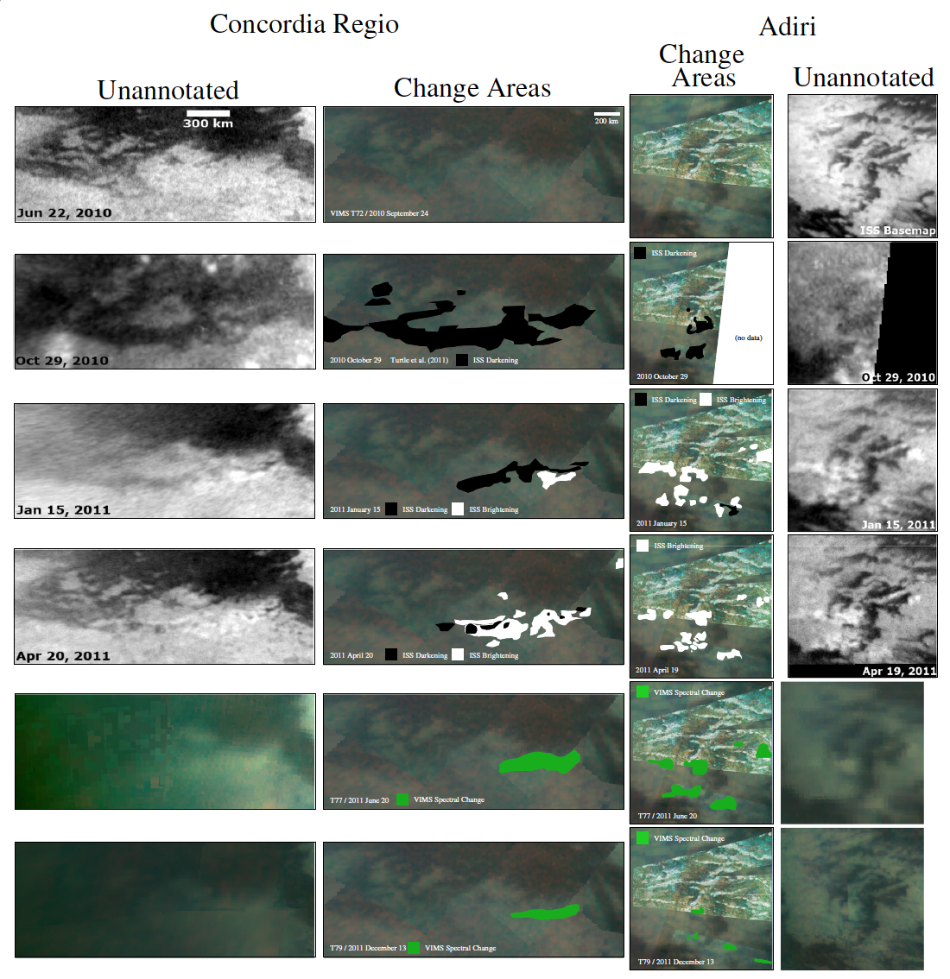
followed by brightening, that then fades
Barnes et al., 2013
500 km

Slide 5
Proposed models, Barnes et al. 2013
Brightening: dissolution, wicking upward, and subsequent re-precipitation of heavier hydrocarbons
Fading: crystals sinter into larger grains
Brightening: the rain itself freezes via evaporative cooling
Fading : sublimates away or are eroded by wind
Brightening: fine-grained materials mobilized by rain
Fading : blow away due to aeolian erosion.

Slide 6
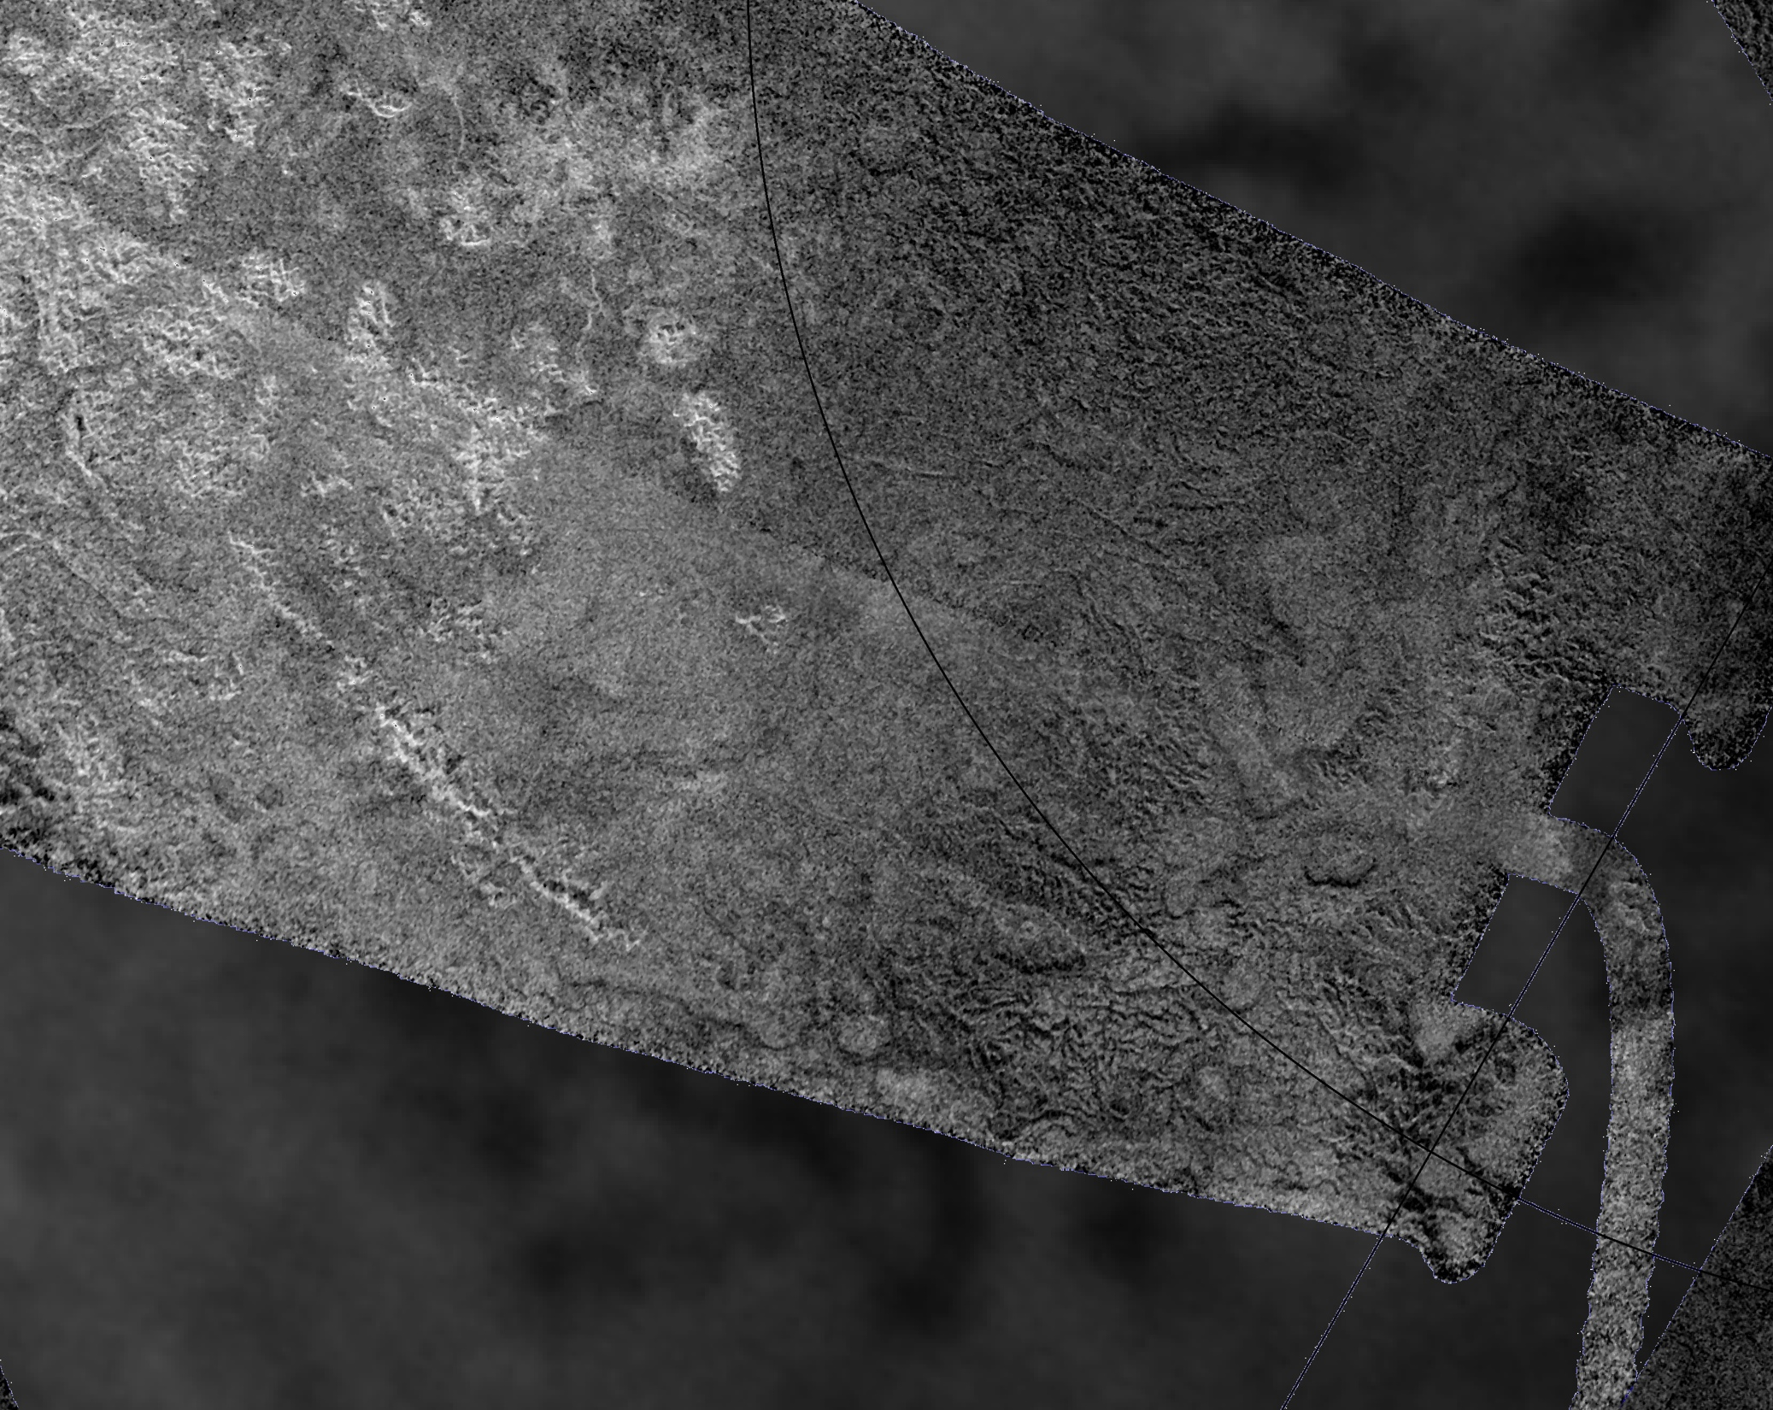
Arrakis Planitia

Slide 7
Rain inferred from ISS observations
Clouds
A large storm was observed in this area in October 2004 (Schaller et al., 2006).
Turtle et al. (2009)

Slide 8
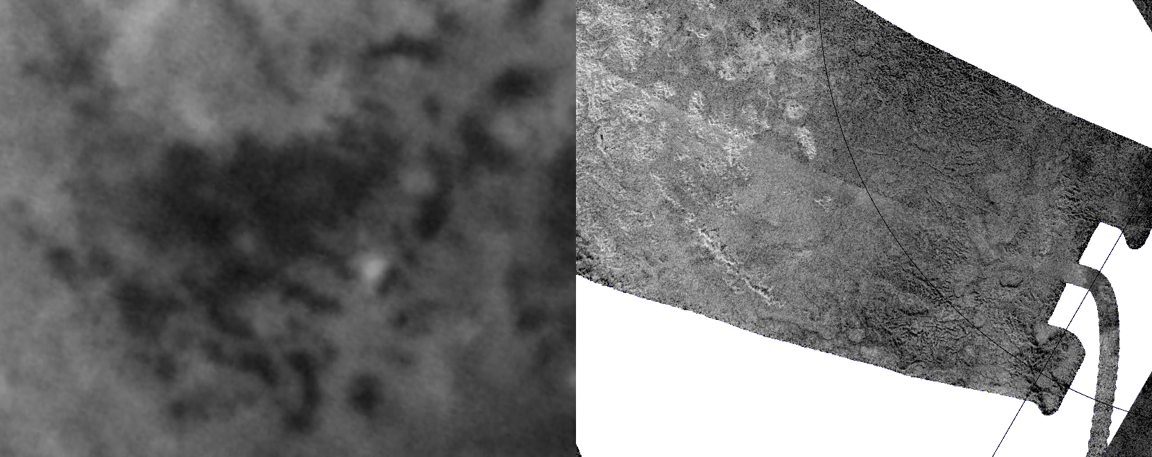
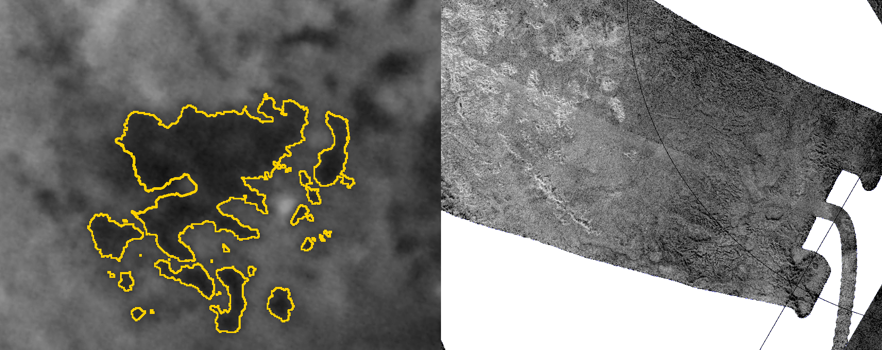
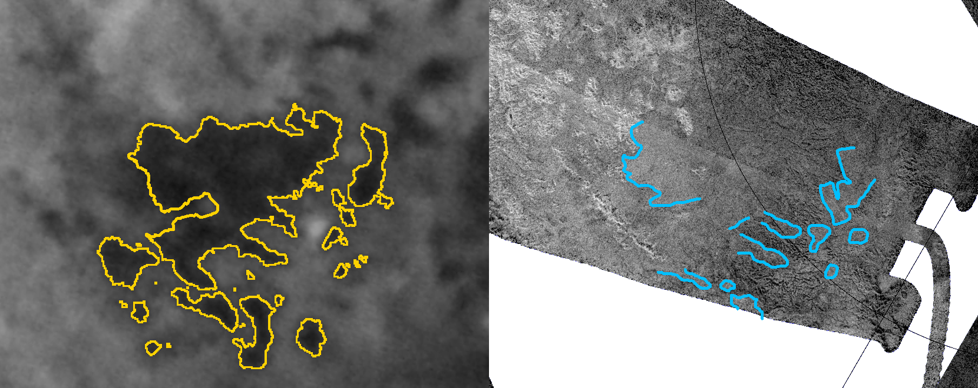
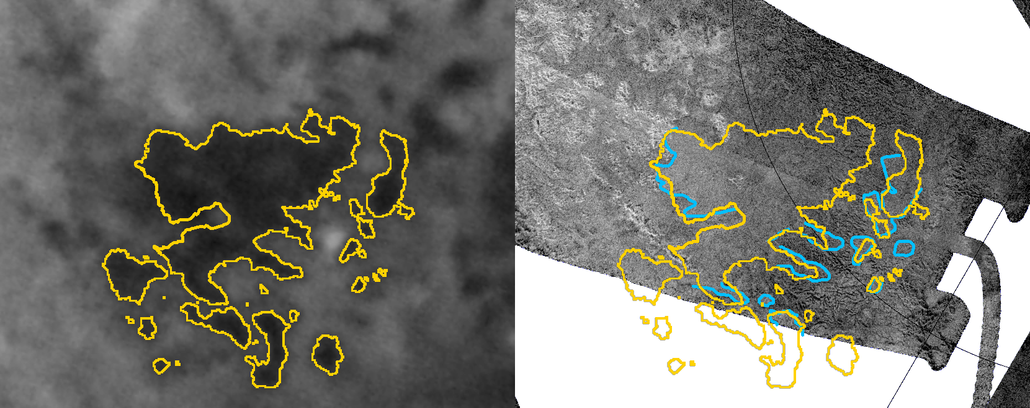
Darkening correlates with topography
Jun ‘05
Dec ‘08
Outlines indicate liquid extent
Outlines indicate apparent topography

Slide 9
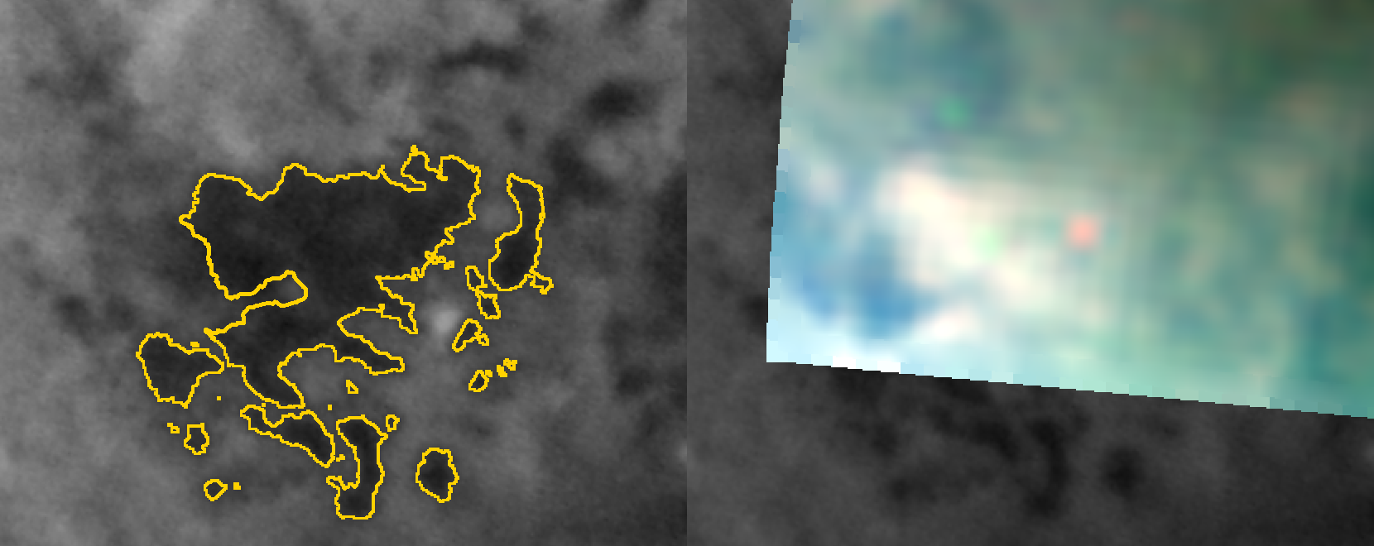
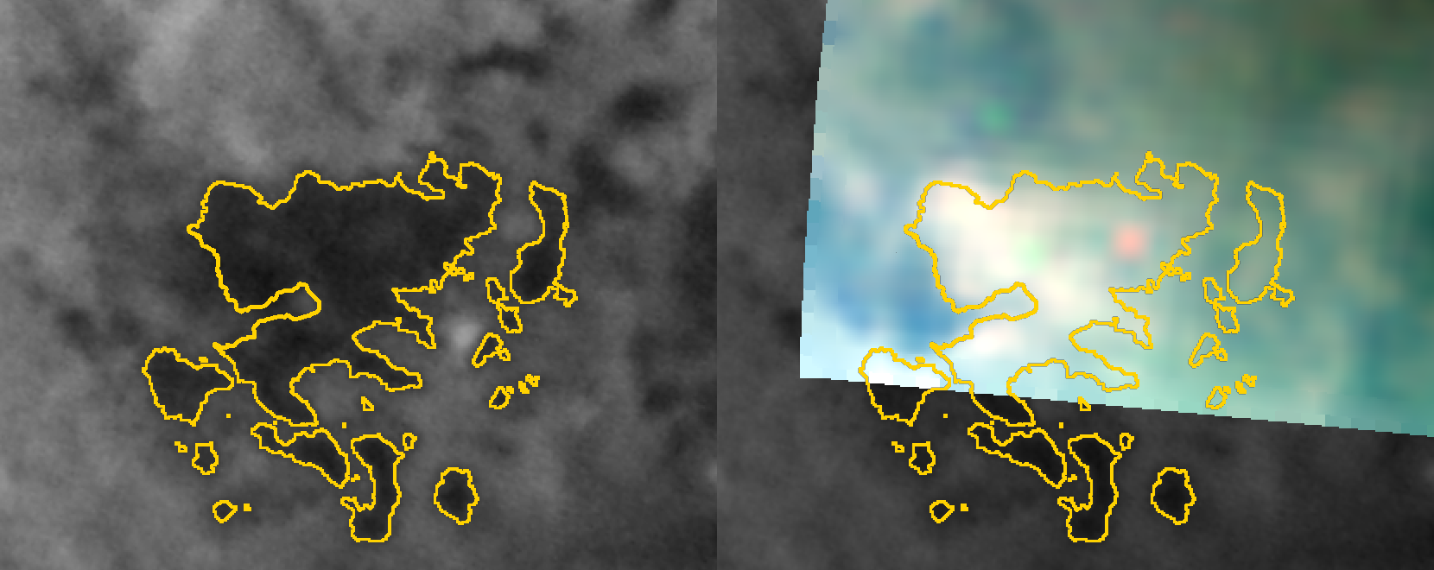
Dark areas subsequently brighten
Jun ‘05
Mar ‘09
Outlines indicate liquid extent

Slide 10
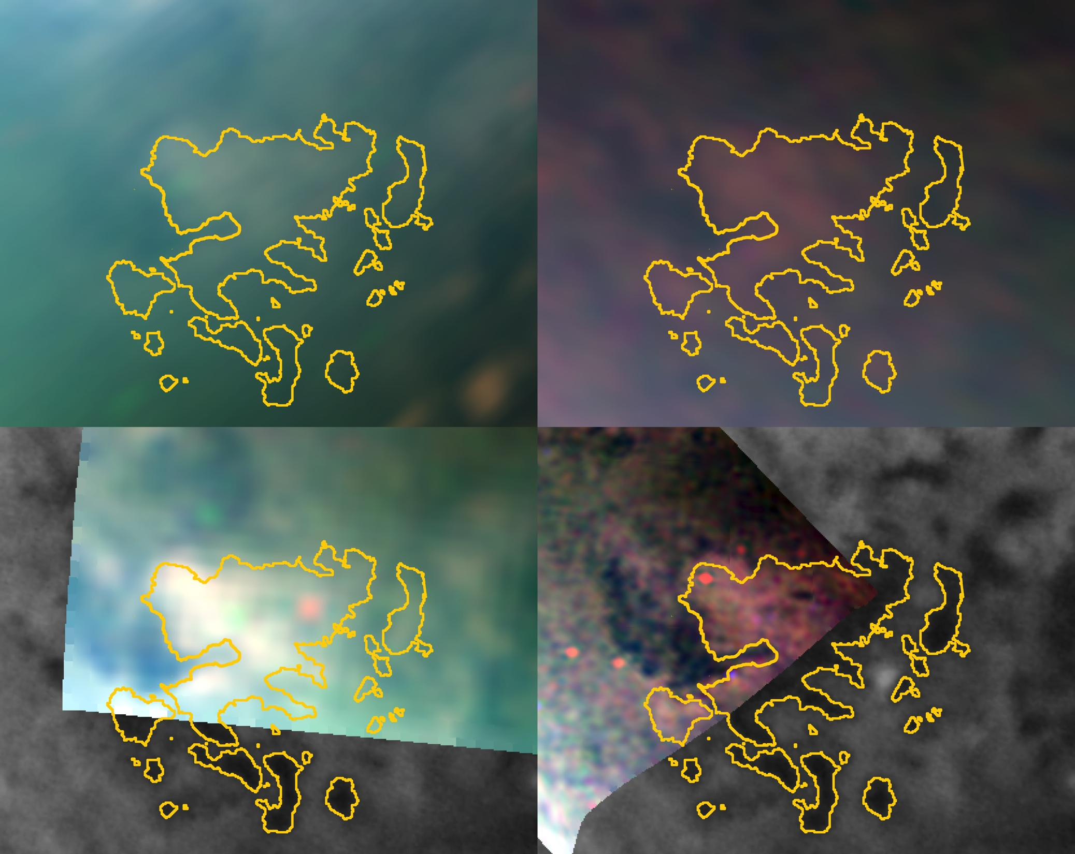
Brightening observed Jan ’07 onward
Jan ‘07
Nov ‘08
Mar ‘09
Mar ‘09
RGB =
2, 1.6, 1.3 µm

Slide 11
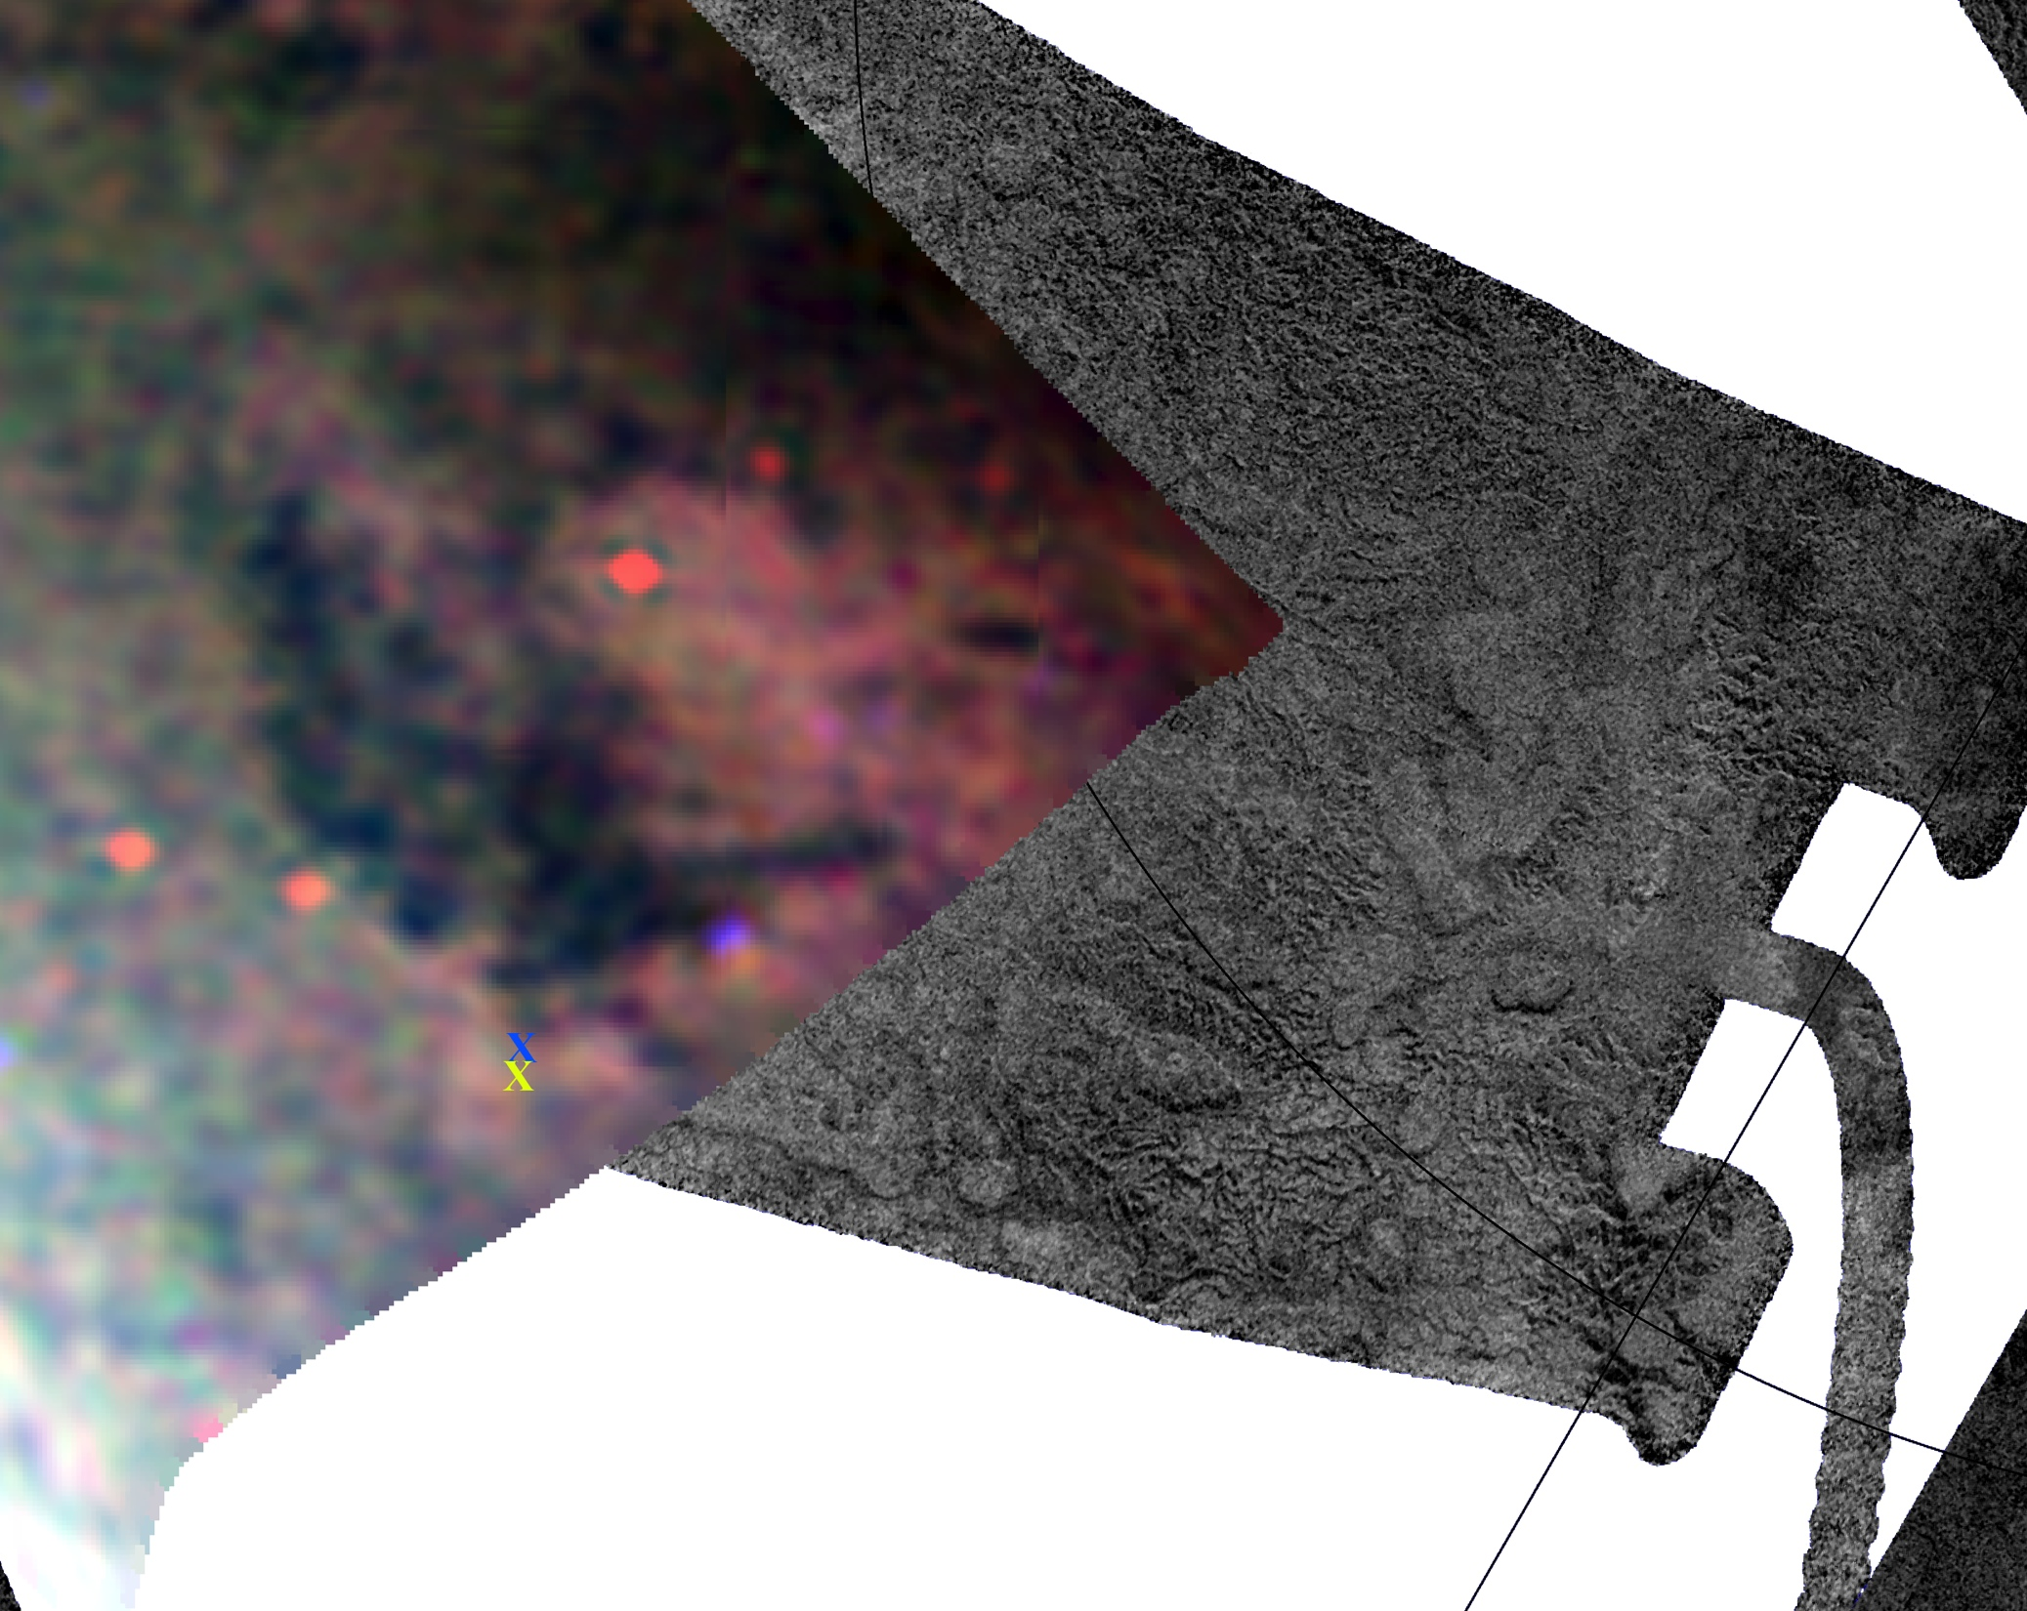
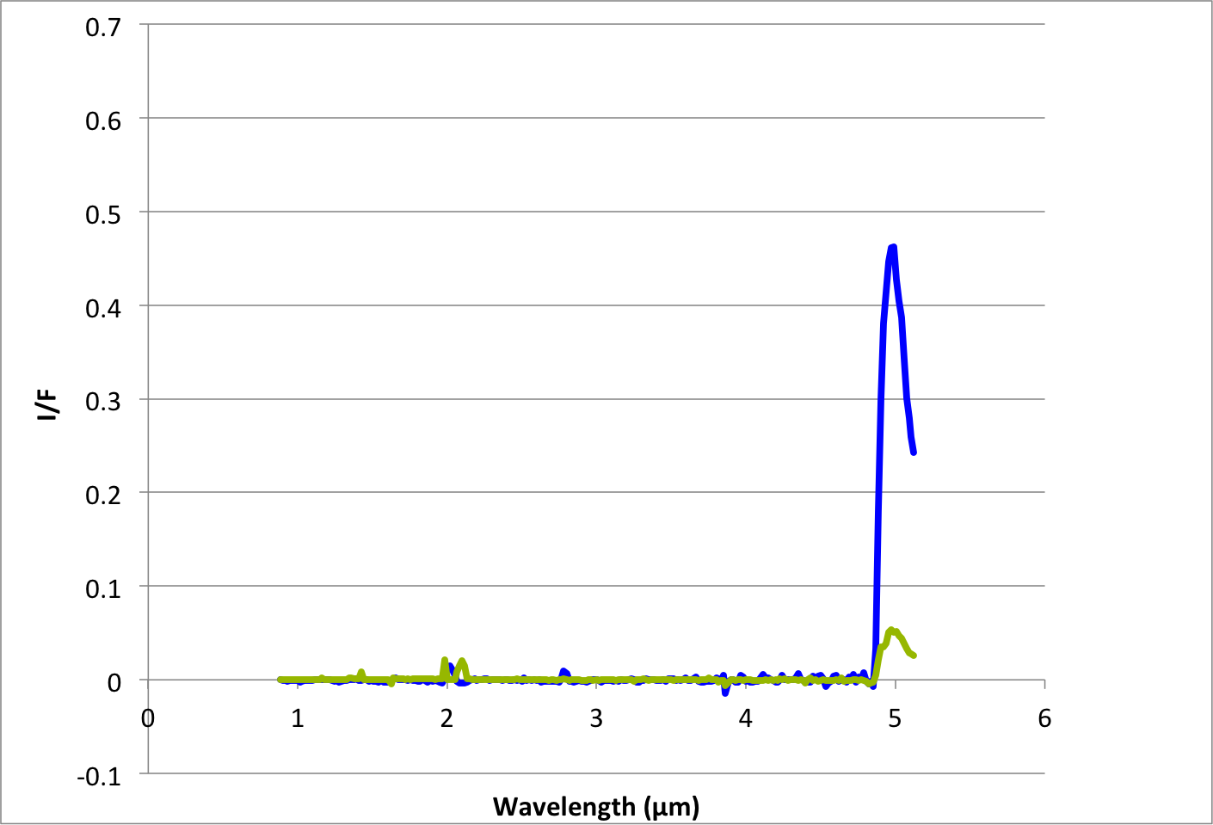
May ’07: Glints (liquid) at edge of a region

Slide 12
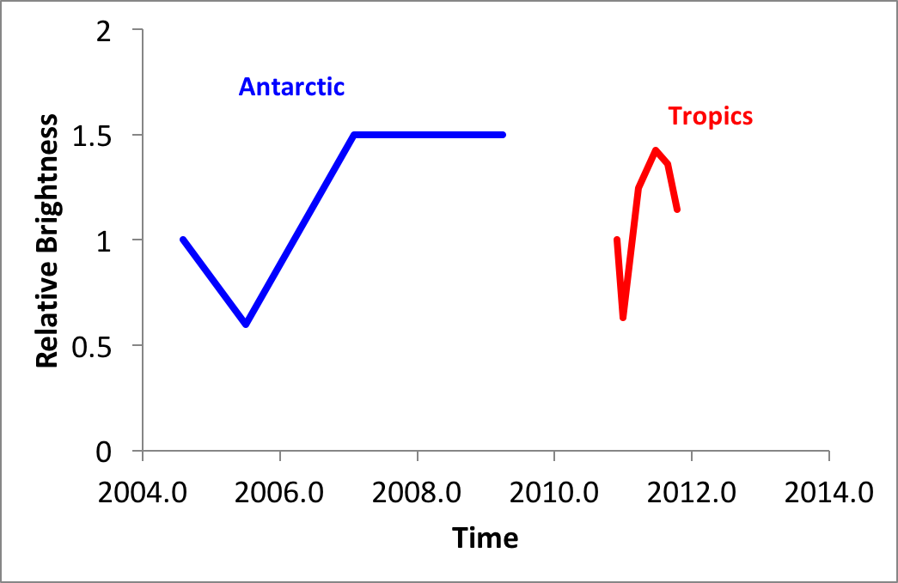
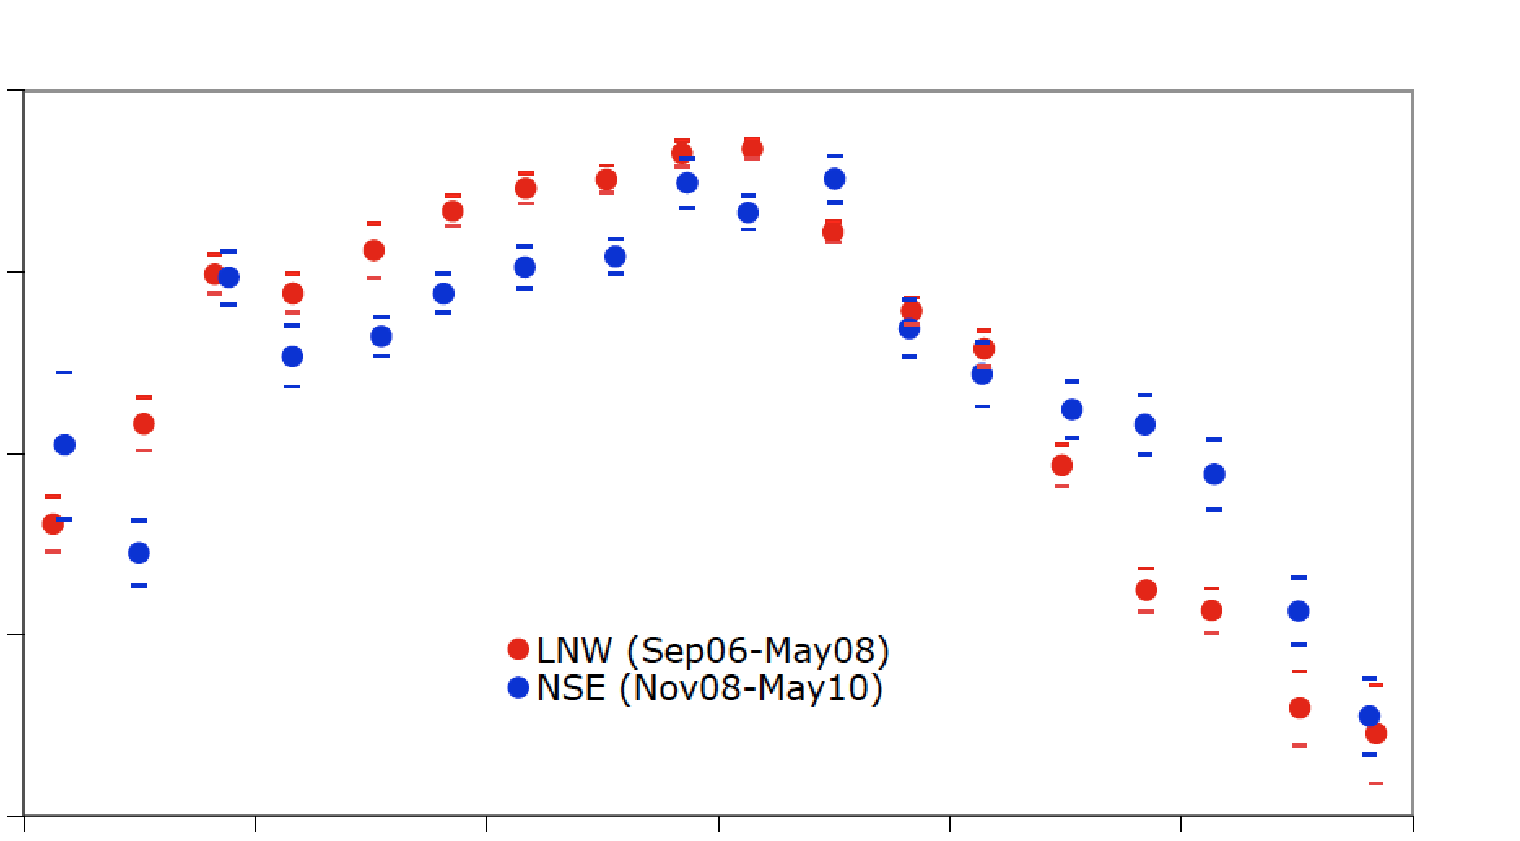
Event characteristics
Tropics
(black line)
Antarctic
(gray line)
Rain
Bright
Darkening
Rain
Bright
Bright
1.0
0.8
0.6
0.4
0.2
0.0
Pockets of liquid
U₁₀ (m/s)
180° 270° 0° 90°
L_{S}
94
93
92
91
90
GCM of Schneider et al. (2012)
Brightness Temperature (K)
Jennings et al.
(2011)
-90° -60° -30° 0° 30° 60° 90°
Latitude

Slide 13
Proposed models, Barnes et al. 2013
Brightening: dissolution, wicking upward, and subsequent re-precipitation of heavier hydrocarbons
Darkening: crystals sinter together over time
Brightening: the rain itself freezes via evaporative cooling
Darkening: sublimates away or are eroded by wind
Brightening: fine-grained materials mobilized by the presence of liquid
Darkening: blow away due to aeolian erosion.

Slide 14
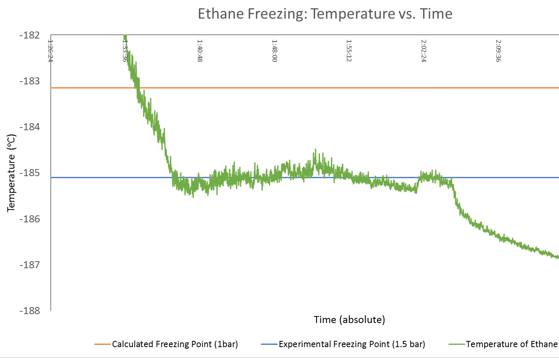
Freezing C₂H₆ in a 1.5 bar N₂ atm
Liquid State
88 ± 3K (Farnsworth et al., 2016)
Frozen State
Roger Clark’s Lab (Clark et al., 2010):
Ethane melted at 94–97K
Became slush when cooled back to 90–91K
Notes:
hysteresis in the freezing point

Slide 15
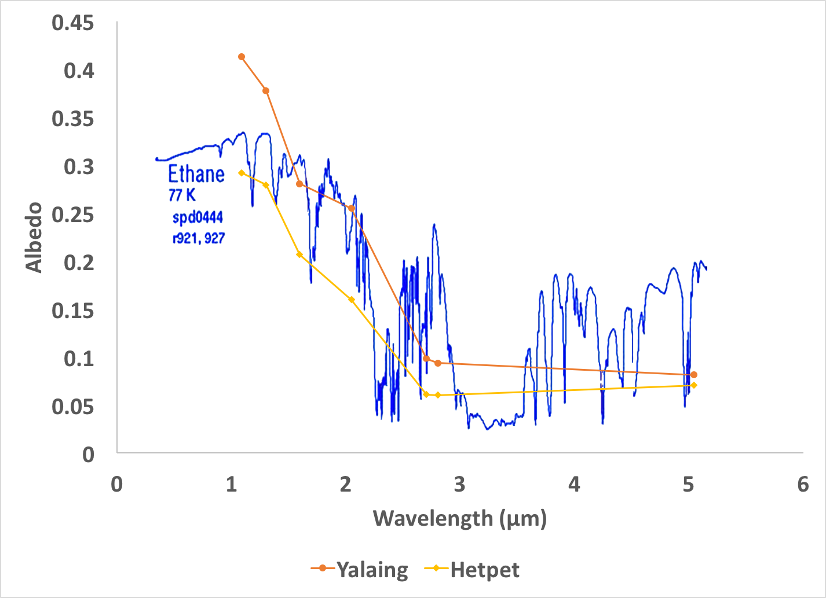
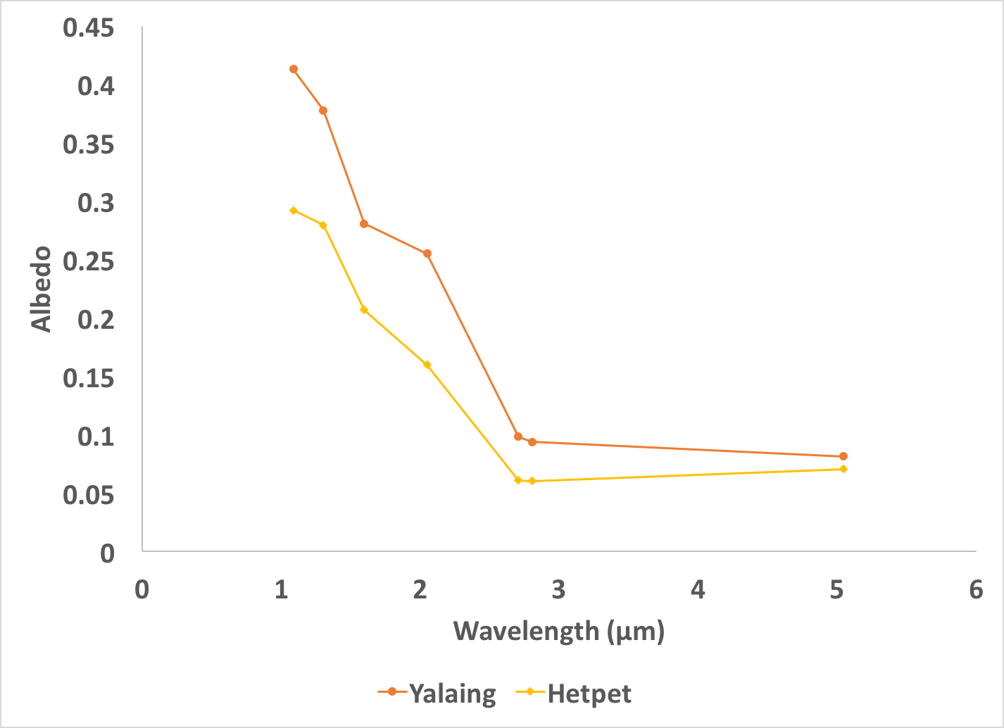
Spectral analysis
Yalaing
(Clark et al. 2009)
Hetpet
RT model (Hirtzig et al., 2013; Cornet et al., 2017)
500 km

Slide 16
Summary
Twice, Cassini observed rapid surface darkening on Titan
Associated with cloud activity
Darkening conforms to topography
Suggests pooled rain
Following both events, the surface subsequently brightened
Tropics: fast; warmer; low winds
Polar: slower; cooler; moderate winds
Suggests a temperature-dependent process
No obvious absorption features
Radiative transfer modeling just now where we can examine the broad spectral shape of the bright material
Working hypothesis: A CH₄-C₂H₆-N₂ rain pooled on the surface; CH₄ evaporated & the N₂ exsolved; C₂H₆ froze
Extensive laboratory and modeling work to test this hypothesis

