Slide 1








Pond Hockey on Titan?
How to Stratify Titan’s Vernal Ponds and form Ethane Ice Deposits
Jordan Steckloff
Jason Soderblom
Vincent Chevrier
Kendra Farnsworth
Alejandro Soto
Jennifer Hanley
Will Grundy
Jessica Groven
Logan Pearce

Slide 2
Methane readily evaporates on Titan, removing heat and concentrating other liquid constituents; we want to explore how this affects vernal ponds on Titan
methane
ethane
nitrogen
Methane/nitrogen evaporate
Notes:
rename from question to what happens to hydrocarbons sitting on titan

Slide 3
At Titan temperatures, CH₄-C₂H₆-N₂ mixtures are highly non-ideal (molecules interact)

Slide 4
At Titan temperatures, CH₄-C₂H₆-N₂ mixtures are highly non-ideal (molecules interact)

Slide 5
London Dispersion Forces hold methane molecules together in liquid phase
-
-
-
-
-
-
-
-
-
-
-
-
-
-
-
-
-
-
-
-
-
-
-
-
-
-
-
-
-
-
-
-
-
-
-
-

Slide 6
London Dispersion Forces hold methane molecules together in liquid phase
-
-
-
-
-
-
-
-
-
-
-
-
-
-
-
-
-
-
-
-
-
-
-
-
-
-
-
-
-
-
-
-
-
-
-
-

Slide 7
London Dispersion Forces hold methane molecules together in liquid phase
_
+
-
-
-
-
-
-
-
-
-
-
-
-
_
-
-
-
+
-
-
-
-
-
-
-
-
-
_
+
-
-
-
-
-
-
-
-
-
-
-
-

Slide 8
London Dispersion Forces hold methane molecules together in liquid phase
_
_
+
+
-
+
-
-
_
-
-
-
-
-
_
-
-
-
-
-
-
+
-
-
-
-
-
-
-
-
-
_
-
+
-
-
-
_
-
-
-
-
-
-
+
-
-
-

Slide 9
London Dispersion Forces hold methane molecules together in liquid phase
_
_
+
+
-
+
-
-
-
-
-
_
-
-
-
-
-
_
-
-
+
-
-
-
-
-
-
-
-
-
-
_
-
_
-
-
-
+
-
-
-
-
-
-
+
-
-
-

Slide 10
Nitrogen molecules can bond to methane molecules with London Dispersion Forces

Slide 11
Nitrogen molecules can bond to methane molecules with London Dispersion Forces
-
-
-
-
-
-
-
-
-
-
-
-
-
-
-
-
-
-
-
-
-
-
-
-
-
-
-
-
-
-
-
-
-
-
-
-
-
-
-
-
-
-
-
-
-
-
-
-

Slide 12
Nitrogen molecules can bond to methane molecules with London Dispersion Forces
-
-
-
-
-
-
-
-
-
-
-
-
_
+
-
-
-
-
-
-
-
-
-
-
-
-
_
-
-
-
+
-
-
-
-
-
-
-
-
-
_
+
-
-
-
-
-
-
-
-
-
-
-
-

Slide 13
Nitrogen molecules can bond to methane molecules with London Dispersion Forces
-
-
-
-
_
-
-
-
-
+
+
-
-
_
_
-
-
-
-
-
_
-
-
-
+
-
_
-
-
+
-
-
_
-
-
-
-
-
+
-
-
-
-
-
-
-
_
-
+
-
-
-
_
+
-
-
-
-
-
-
+
-
-
-

Slide 14
Ethane molecules form stronger dipoles, interrupting nitrogen dissolution into CH₄-C₂H₆ mixture

Slide 15
Ethane molecules form stronger dipoles, interrupting nitrogen dissolution into CH₄-C₂H₆ mixture
-
-
-
-
-
-
-
-
-
-
-
-
-
-
-
-
-
-
-
-
-
-
-
-
-
-
-
-
-
-
-
-
-
-
-
-
-
-
-
-
-
-
-
-
-
-
-
-
-
-
-
-

Slide 16
Ethane molecules form stronger dipoles, interrupting nitrogen dissolution into CH₄-C₂H₆ mixture
-
-
-
-
-
-
-
-
-
-
-
-
_
+
+
_
-
-
-
-
-
-
-
-
-
-
-
_
-
-
+
-
-
-
-
-
-
-
-
-
-
-
-
-
-
-
_
+
-
-
-
-
-
-
-
-
-
-
-
-
-
-
-
-
-
-

Slide 17
Ethane molecules form stronger dipoles, interrupting nitrogen dissolution into CH₄-C₂H₆ mixture
-
-
-
-
-
-
-
-
+
-
-
-
-
-
-
_
+
_
_
-
-
+
-
-
-
-
+
-
_
-
-
-
_
-
-
+
-
-
_
-
-
-
-
-
_
-
-
-
-
-
-
-
-
+
-
-
-
-
_
-
-
-
-
-
-
-
-
-
+
+
-
-
-
-

Slide 18
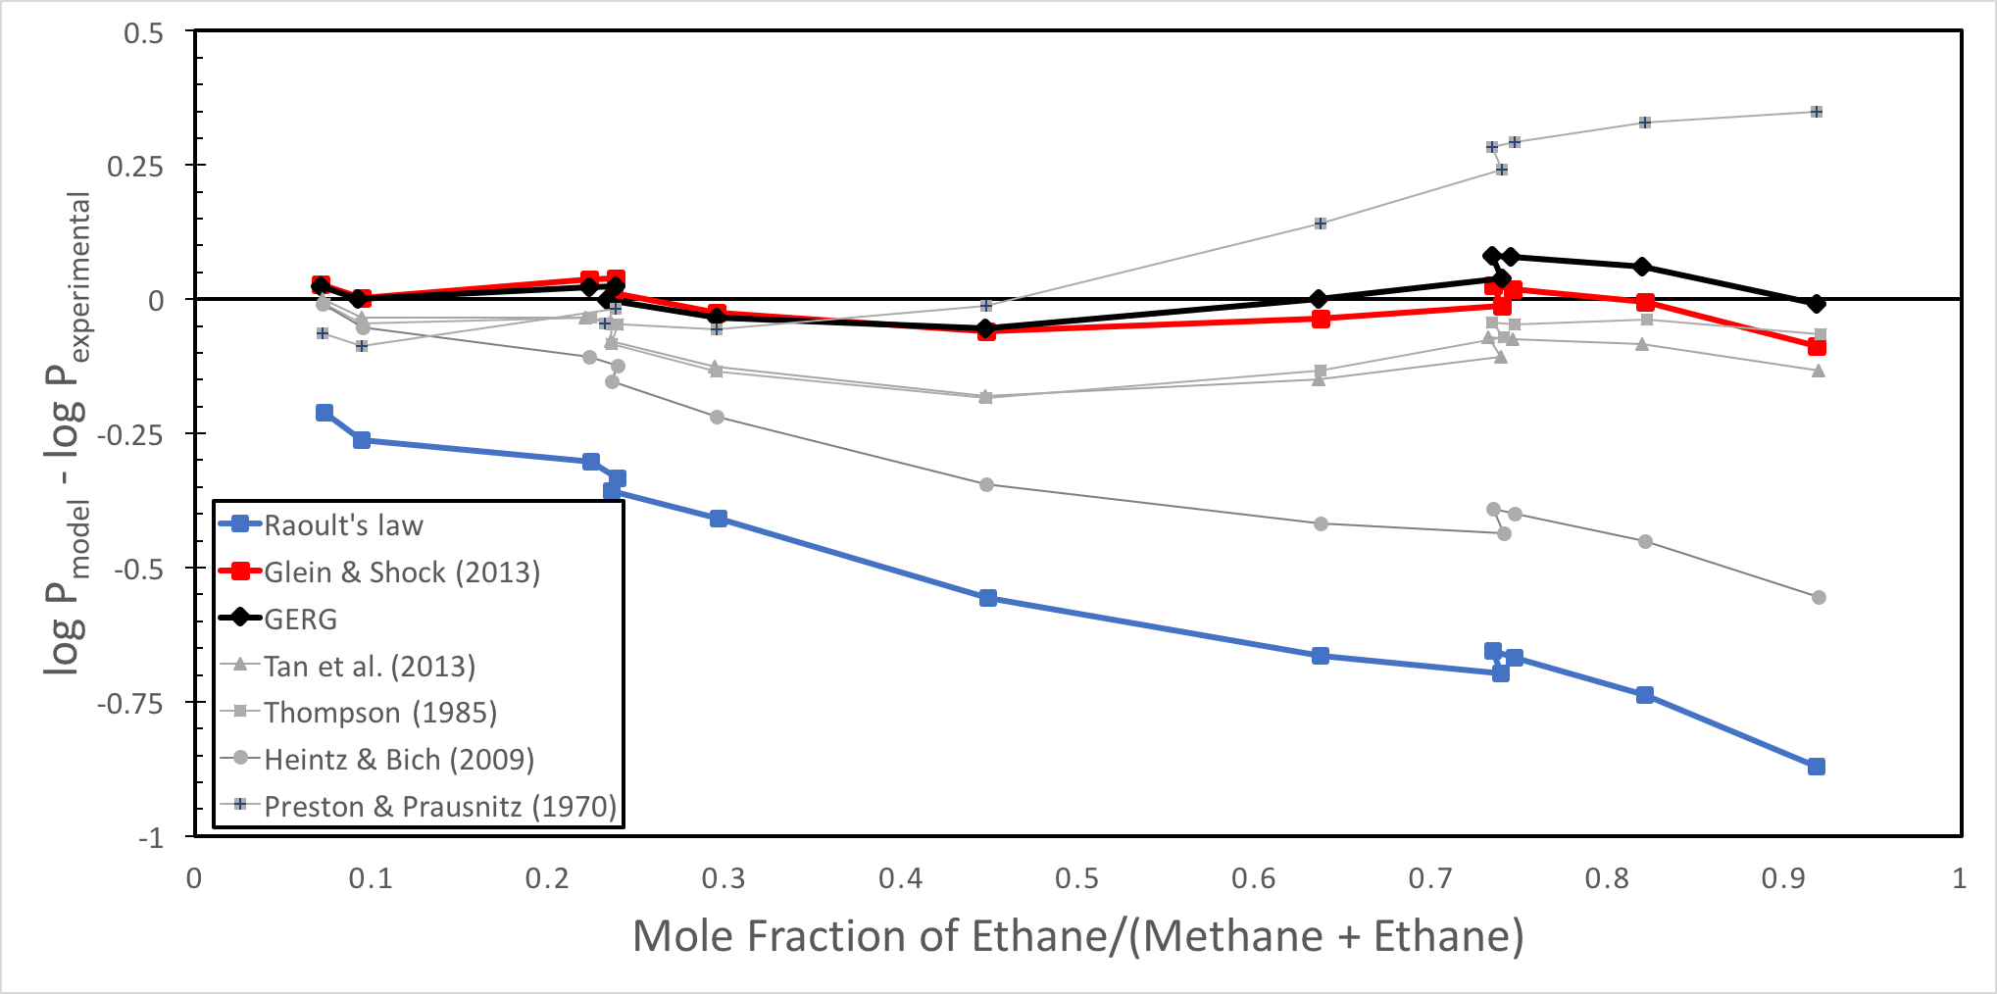
We model CH₄-C₂H₆-N₂ using the GERG-2008 equation of state, which models these non-ideal interactions
log P_{model} – log P_{experimental}
Methane mole fraction (x_{methane}/(x_{methane} + x_{ethane}))
Replotted from Glein & Shock (2013)

Slide 19
At typical Titan temperatures, liquid density decreases with increasing methane content

Slide 20
Mixture density increases as methane evaporates → surface layer sinks and mixes into pond

Slide 21
At cooler temperatures, N₂ solubility in methane-rich mixtures is highly temperature dependent

Slide 22
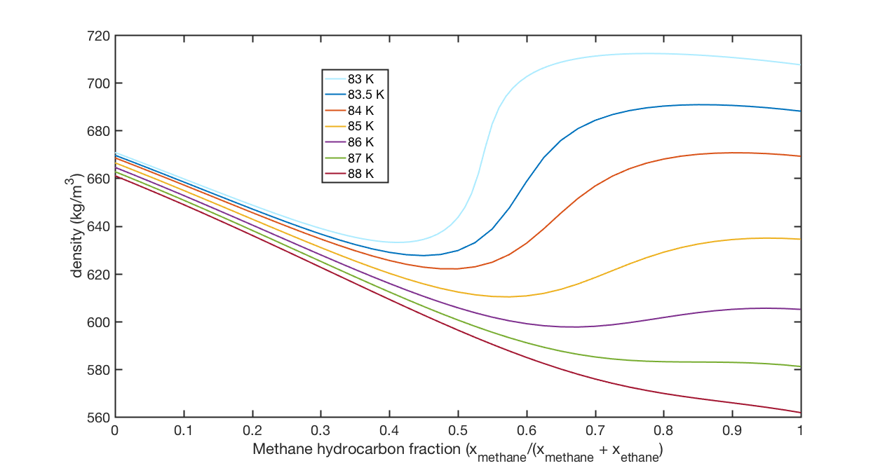
At cooler temperatures, density of a CH₄-C₂H₆-N₂ mixture deviates from monotonic behavior

Slide 23
At 86 K, methane evaporation will reduce the density of the surface layer; leading to pond stratification
Local density maximum

Slide 24
At 86 K, methane evaporation will reduce the density of the surface layer; leading to pond stratification
Local density minimum

Slide 25
Further methane loss will increase surface layer’s density…

Slide 26
Further methane loss will increase surface layer’s density… eventually mixing the pond

Slide 27
Stratification repeats until the local minimum composition is reached → no further stratification.

Slide 28
Once bulk composition matches local minimum, further methane evaporation will keep pond well-mixed

Slide 29
Below 84 K, the methane-rich density becomes so dense that overturn shuts down

Slide 30
Below 84 K, the methane-rich density becomes so dense that overturn shuts down

Slide 31
Below 84 K, the methane-rich density becomes so dense that overturn shuts down

Slide 32
Methane evaporation causes compositional changes that can causes temperature-dependent stratification
84 - 86 K
Polymictic→holomictic
Above 86 K
holomictic
Below 84 K
meromictic
Notes:
rename from question to what happens to hydrocarbons sitting on titan

Slide 33
We observe this stratification behavior experimentally between 84 and 87 K
1:1 methane:ethane, saturated with 1.5 bar nitrogen at 85K

Slide 34
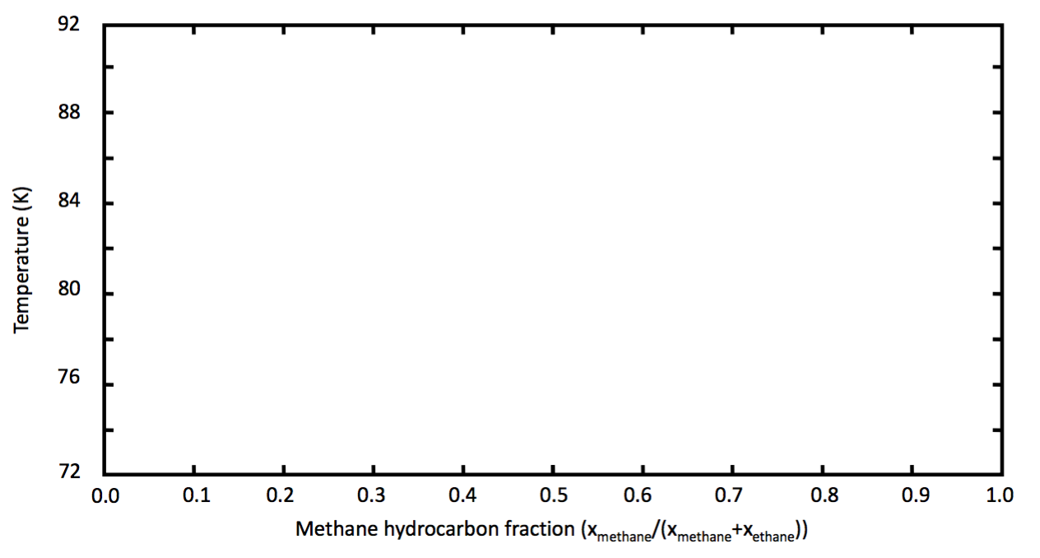
If temperature and composition changes take mixture across the liquidus curve, ice will form
?

Slide 35
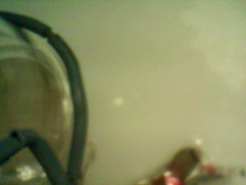

We are using U. Arkansas’ Titan test chamber to find the liquidus curve of a CH₄-C₂H₆-N₂ mixture on Titan
Liquid C₂H₆
Solid C₂H₆

Slide 36
We are currently mapping the CH₄-C₂H₆-N₂ solidus & liquidus curves under Titan’s conditions
Omar et al. (1962)
Inferred from Hanley et al. (2016)

Slide 37
Can an evaporatively cooled CH₄-C₂H₆-N₂ pond on Titan cross the liquidus curve?
methane
ethane
nitrogen

Slide 38
At 90 K, only a (nearly) pure C₂H₆-N₂ mixture freezes

Slide 39
Density-driven mixing will cause ethane to precipitate out of the entire pond bulk if it becomes enriched enough
Likely region of ethane ice formation

Slide 40
At 86 K, a mixture crosses the liquidus curve
Notes:
FIX TO REFLECT ACCURATE TEMPERATURES

Slide 41
At 86 K, pond would overturn prior to forming ice → ice would form throughout pond bulk when holomictic
Probable region of ethane ice formation

Slide 42
At 85 K, liquidus curve is likely around a methane fraction of ~0.4
Notes:
FIX TO REFLECT ACCURATE TEMPERATURES

Slide 43
At 85 K, surface layer would likely precipitate ice prior to mixing, preserving stratification
Probable region of ethane ice formation

Slide 44
At 85 K, surface layer would likely precipitate ice prior to mixing, preserving stratification
Probable region of ethane ice formation

Slide 45
Stratification and overturn determines whether ice forms only at a pond’s surface or throughout its bulk

Slide 46
Eventually, all the remaining methane and nitrogen evaporates, leaving a smooth ice deposit
Evaporative cooling
Possible stratification
Ethane ice precipitation
Ice revealed

Slide 47
From above, the surface would rapidly brighten due to ice’s sudden exposure
Pond Hockey on Titan!!!

Slide 48
Conclusions
Ethane-rich mixture is buoyant on a methane-rich mixture below 86 K
  Episodic (polymictic) stratification below 86 K
  Permanent (meromictic) stratification below 84 K
Ethane Ice formation likely possible below 90 K
  Ice forms throughout pond volume between 86-90 K
  Form only at pond’s surface below 86 K
  Consistent with Cassini observations of seasonal lakes
    Eyasi Lacus, Whitmore Lacus, Kati Thanda, Racetrack Lacus

Slide 49
Titan’s N₂ concentration depends sensitively on the amount of CH₄ and C₂H₆ in the liquid

Slide 50
At overturn, pond may become supersaturated with N₂, causing rapid exsolution of nitrogen, and rapid cooling
Epilimnion composition at overturn
Hypolimnion composition at overturn

Slide 51
What we still don’t know…

Slide 52
What we still don’t know…
The liquidus-solidus curves for methane-ethane-nitrogen mixtures under Titan conditions
Whether evaporative cooling can overcome sensible heat flow on Titan (still toy model)

Slide 55
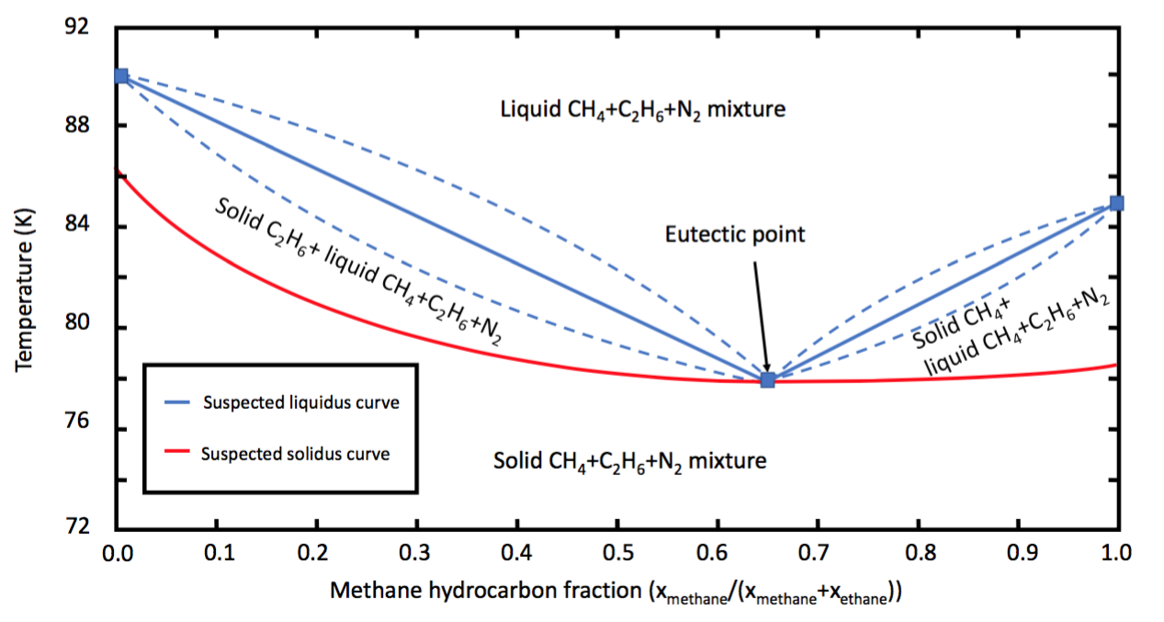
At 90 K, only a pure (or nearly pure) ethane-nitrogen binary mixture will freeze

Slide 56
0.28 methane fraction is probably across the liquidus curve

Slide 57
0.28 methane fraction is probably across the liquidus curve

Slide 59

Ethane ice formed at surface of petri dish at 86 K
Solid C₂H₆ layer
N₂ bubbles

Slide 60
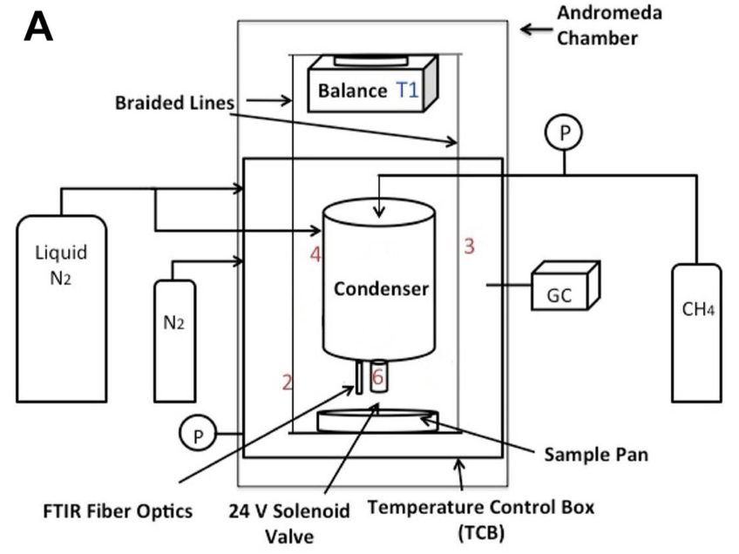
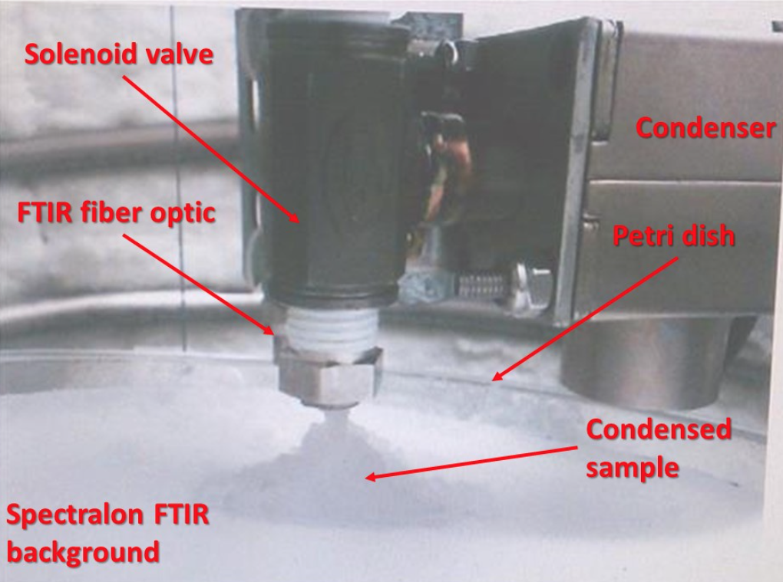
We used the Titan Simulation Chamber to verify ethane ice formation conditions experimentally

Slide 63
Conclusions
Dissolved nitrogen significantly depresses methane’s evaporation rate on Titan

Slide 64
Backup Slides

Slide 65
Methane readily evaporates on Titan, cooling the liquid and concentrating other liquid constituents
methane
ethane
nitrogen
Methane/nitrogen evaporate
Evaporatively cools
Enriched in ethane
Notes:
rename from question to what happens to hydrocarbons sitting on titan

Slide 66
Further methane loss will increase surface layer’s density…
Probable region of ethane ice formation

Slide 67
Further methane loss will increase surface layer’s density… eventually mixing the pond
Probable region of ethane ice formation

Slide 68
Stratification repeats until the local minimum composition is reached → no further stratification.
Probable region of ethane ice formation

Slide 69
Further methane evaporation will keep pond well mixed; entire volume of pond may cross liquidus curve
Probable region of ethane ice formation

Slide 71
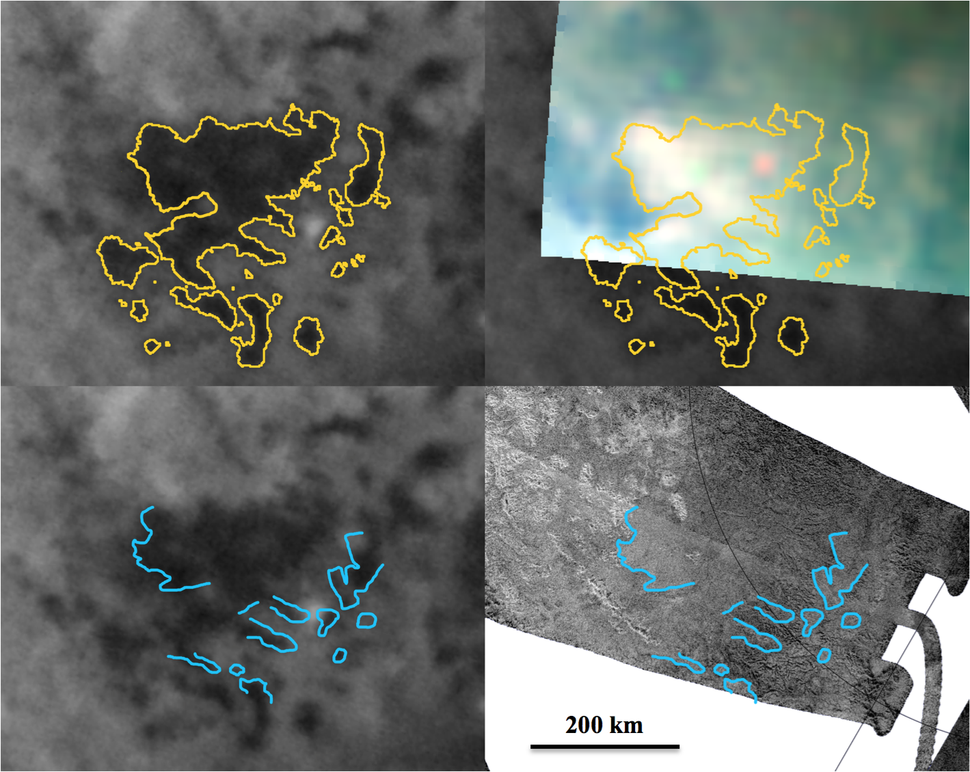
The surface of Titan darkened and then brightened following the October 2004 southern storm
2005 ISS
2007 VIMS
200 km
(Soderblom et al. 2014)

Slide 72
Correlation with topographic boundaries suggests these are pools of hydrocarbons
SAR Topographic boundaries
2005 ISS
200 km
(Soderblom et al. 2014)

Slide 73
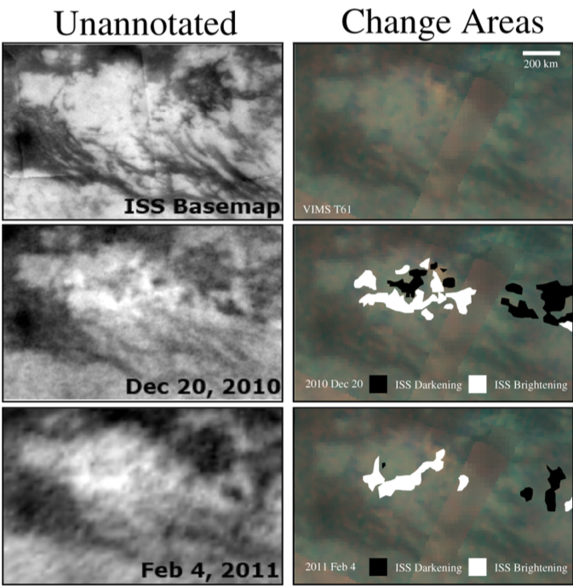
Similar behavior observed in the tropics, but on much faster timescales
Barnes et al. (2013)

Slide 74
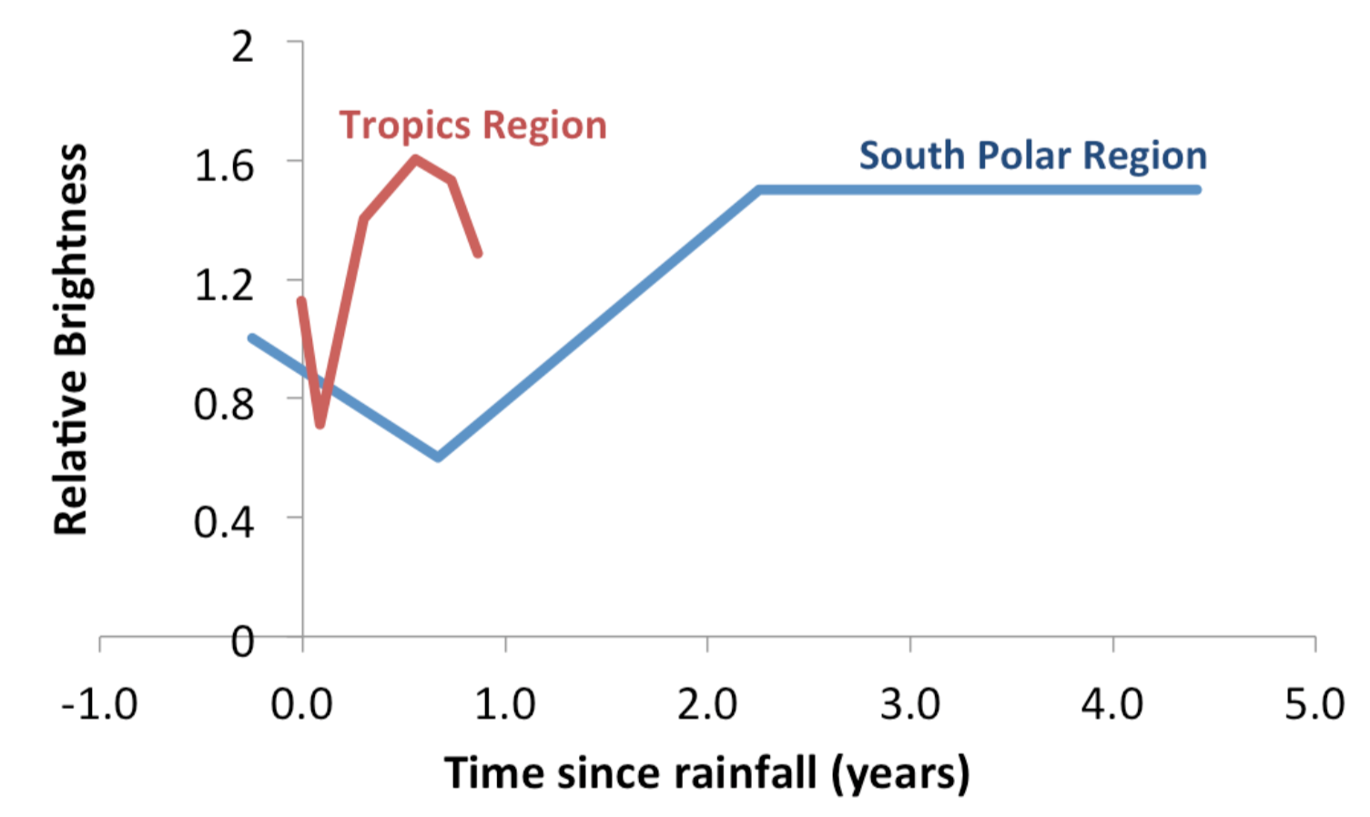
Latitudinal variation in timescales suggest a thermo- dynamic process is likely causing these albedo changes

Slide 75
At 85 K, surface layer must reach methane fraction of 0.28 to overturn (mix)

Slide 76
We model CH₄-C₂H₆-N₂ using the GERG-2008 equation of state, which models these non-ideal interactions
Replotted from Glein & Shock (2013)

Slide 77
We would observe a dark pond that rapidly brightens, then return to initial state as ice sublimates/melts

