Slide 1
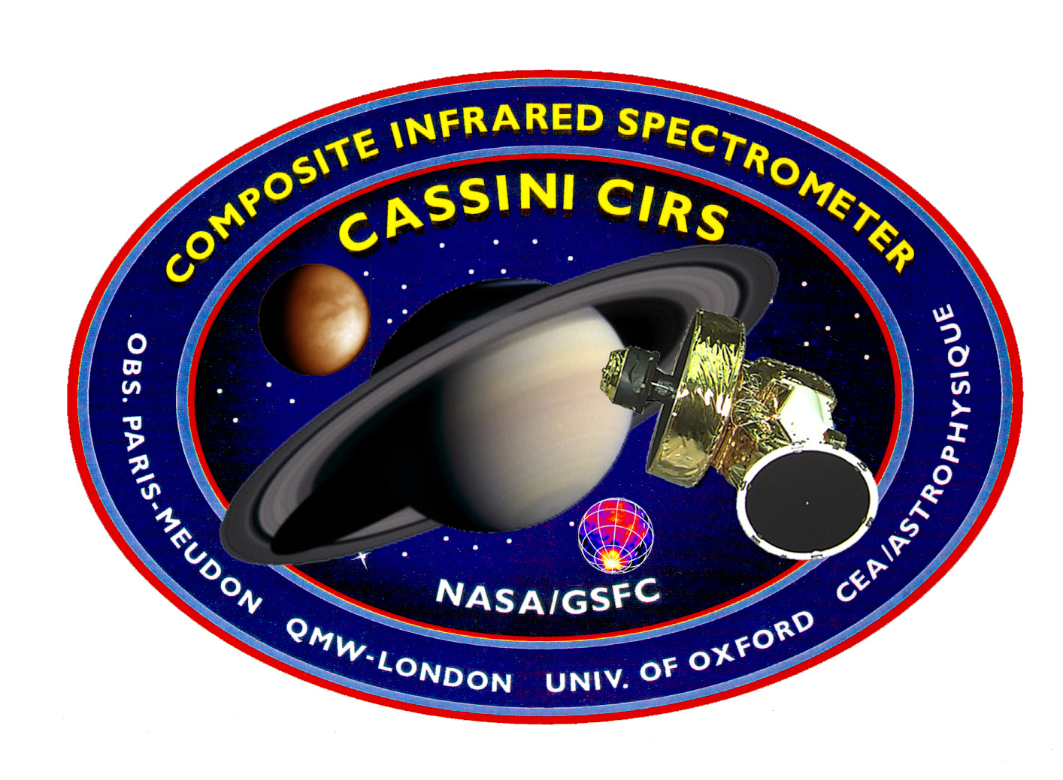
Titan Surface Temperatures
Through the Cassini Mission
D. E. Jennings, V. Cottini, C. A. Nixon, A. Coustenis and T. Tokano Cassini Science Symposium
University of Colorado, Boulder 15 August 2018

Slide 2
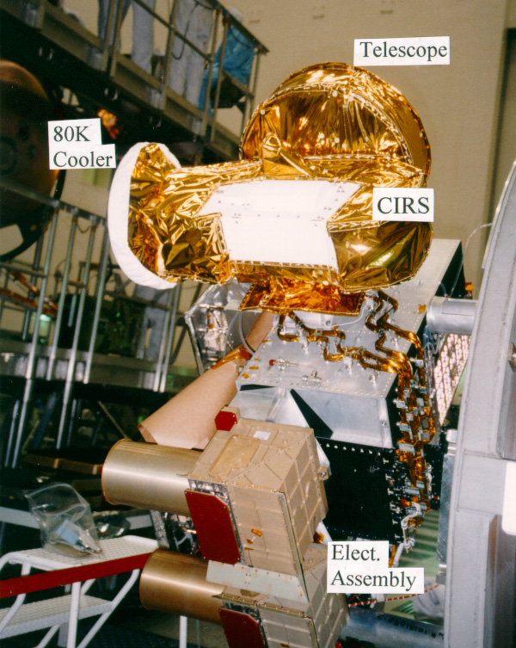
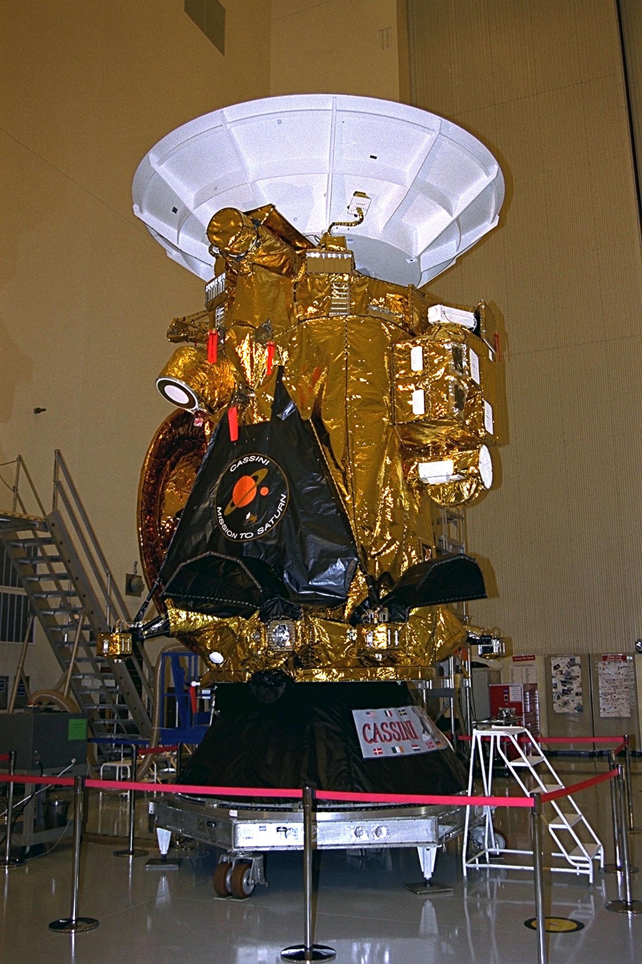
CIRS on Cassini
CIRS

Slide 3
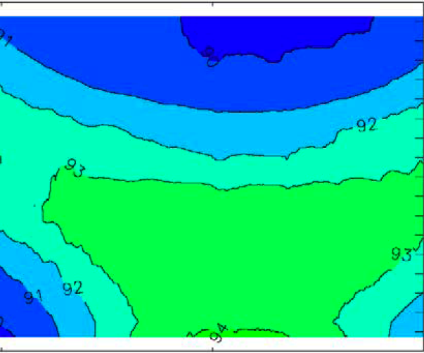
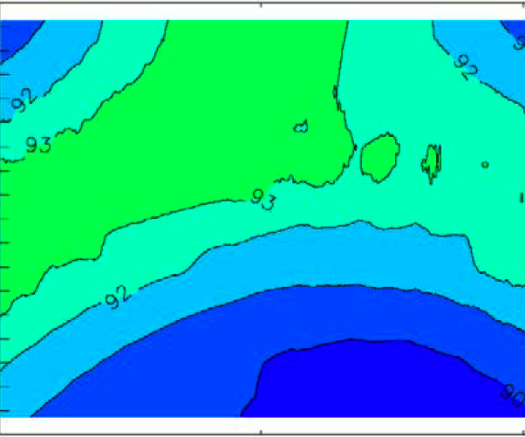
Cassini has covered almost all
of Northern Winter and Spring
Arrival
EOM
Map from Tokano 2005

Slide 4
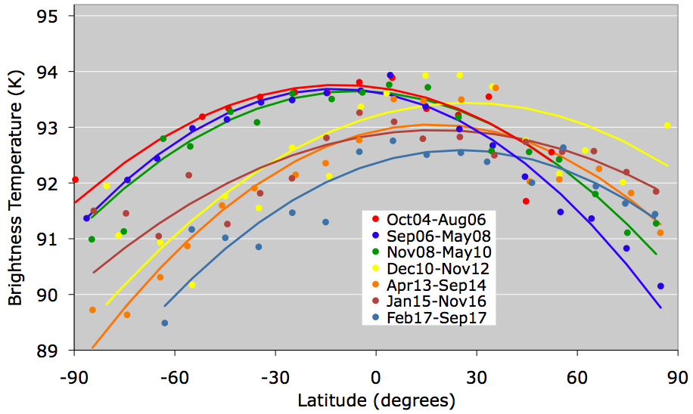
Titan Surface Brightness Temperatures
Seasonal Shift Northward

Slide 5
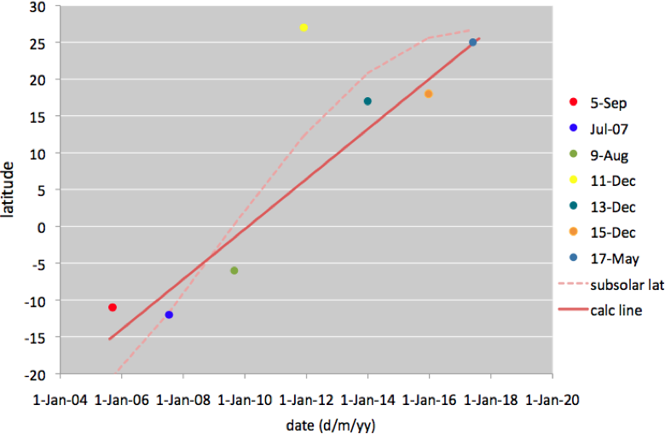
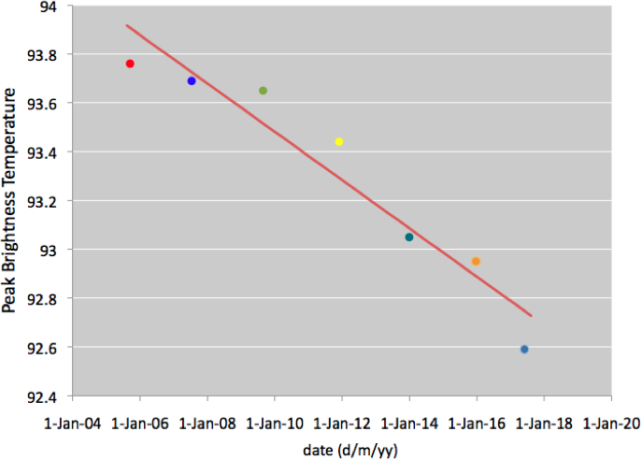
Shifts of Temperature Over the Mission
Peak moved north
Temperature decreased

Slide 6
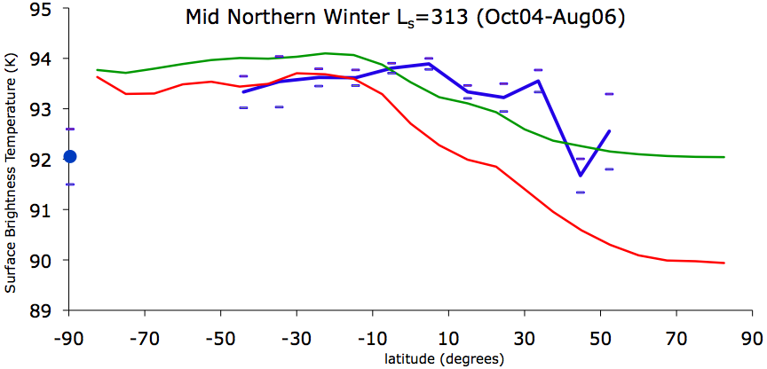
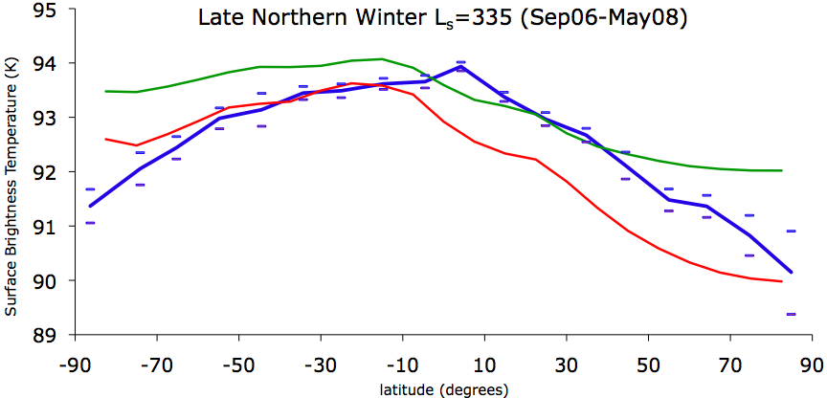
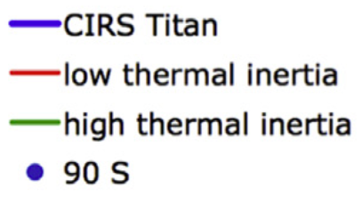
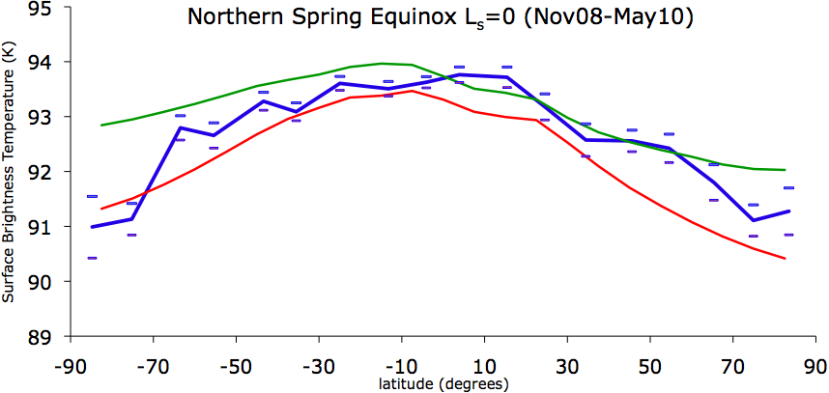
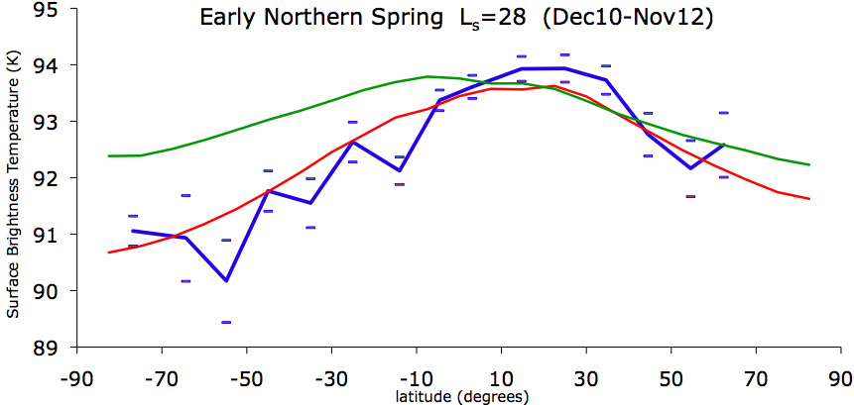
Comparison with GCM
from Tokano (2005)

Slide 7
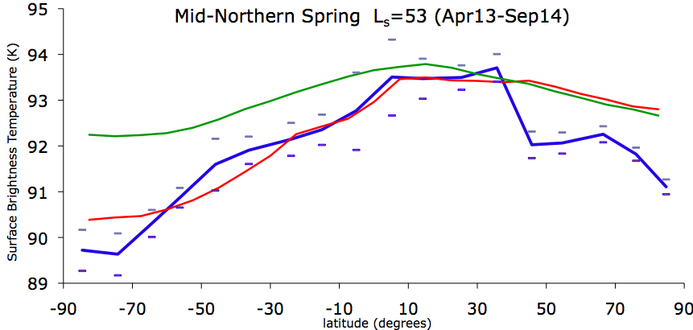
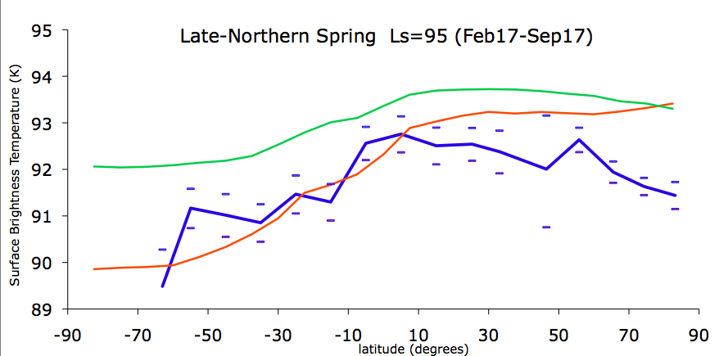
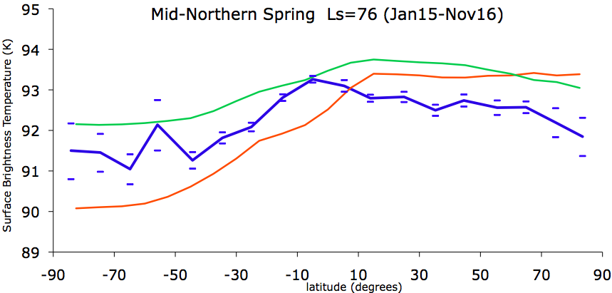
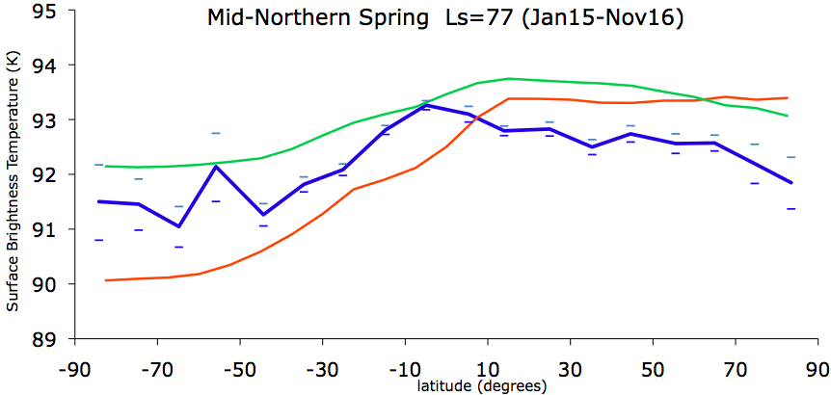
Comparison with GCM
from Tokano (2005)

Slide 8
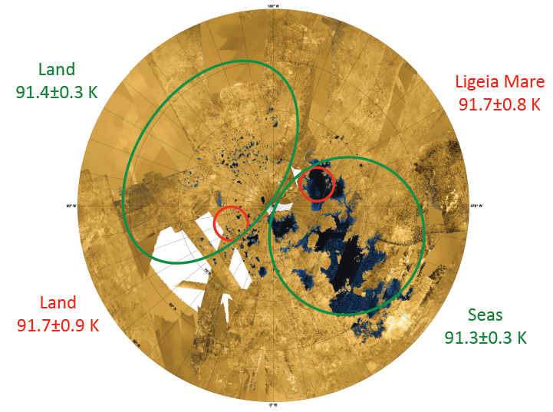
Temperatures at Latitude of Seas

Slide 9
Seasonal Changes
In Zonal Temperature Distribution
Temperatures at poles changed by ~2 K over mission.
Peak temperature decreased from 93.8 to 92.6K over mission.
Latitude of peak temperature moved from
approximately 12 S to 25 N over mission.
Seasonal lag ~0.7 year (0.35 Titan month).
Agrees with Voyager results from one Titan year earlier.
Temperatures generally follow Tokano model (2005).
Depressed temperatures in north by ~ 1 K in 2013-17.
Also seen by 2.2 cm radiometry (Le Gall et al. 2015).

Slide 10
Temperatures in north
may be moderated by liquids
Northern high-latitudes have not warmed as much as predicted, lagging model by ~1 K.
Temperatures in north may be suppressed by evaporative
cooling of the seas (Tokano & Lorenz 2015).
Differences between land and sea temperatures are not
detected, so < 1 K.
Therefore, land may also be cooled evaporatively;
i.e., land in north may be wet (Lora 2015).

