Slide 1




Reinterpretation of Huygens-GCMS data in Titan’s atmosphere
Thomas Gautier¹, J. Serigano², S. Hörst² & M. Trainer³
¹LATMOS / CNRS, France
² JHU, Baltimore, USA
³ NASA GSFC, Greenbelt, USA

Slide 2
GCMS Measurements
Mass Spectrometer of Huygens
Determine the content in volatile of the lower atmosphere and surface
Measurement from 146km altitude down to surface (579 MS)
MS response (cps)
m/z
Few species above detection threshold at high alt.
CH₄ mixing ratio in lower atmosphere (1.4 to 5%)
Niemann et al., Nature (2005)
Niemann et al. JGR (2010)
Notes:
Direct sampling of the atmosphere through leak to the MS ionization chamber
~2.5 hours descent on January 14th 2005

Slide 3
Measurements: surface
Significant increase of methane after impact
Source of methane at the surface
Species condensed near the surface
(C₂N₂, C₆H₆..)
No identification of most of the minor species
No vertical profile of (not so) minor species C₂H₆, HCN etc.
Niemann et al., Nature (2005)
Niemann et al. JGR (2010)

Slide 4
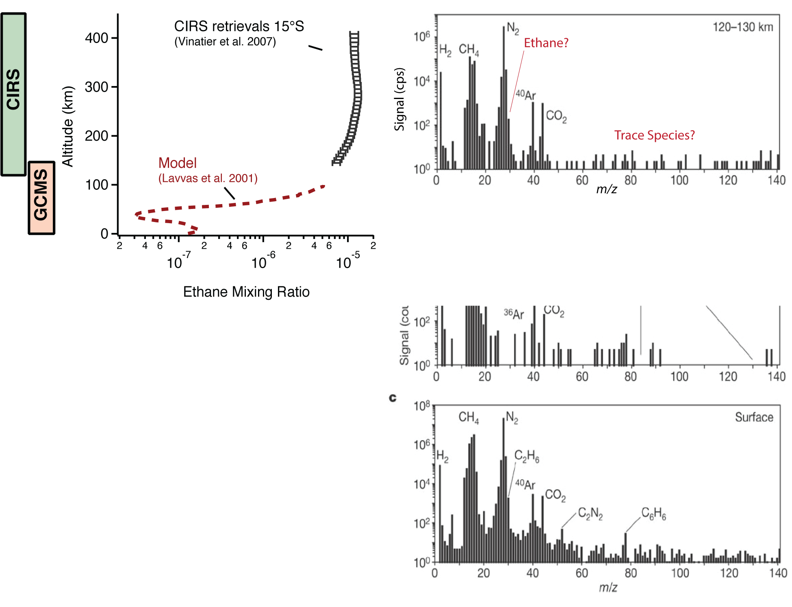
Why care?
Only measurement in Titan low atmosphere for trace compounds
Attributed species so far:
~40% of the peaks
~98% of the total ion count
60% of the trace organic content in the data has not been identified
Identification complicated by fragmentation pattern
Ethane vertical profile in Titan’s atmosphere, actual measurements only go down to ~135km

Slide 5
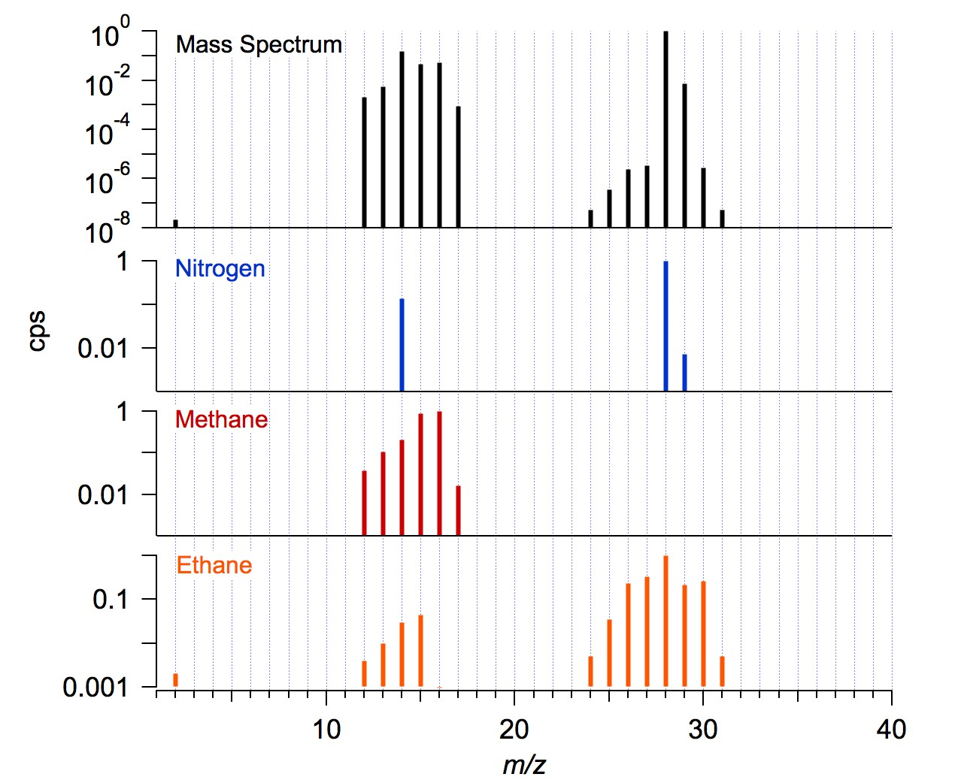
Fragmentation patterns (Electron Ionization)

Slide 6
How to get some science done?
Measured MS
General Idea
Decompose GCMS spectra as a sum of fragmentation pattern of the molecules in the atmosphere weighted by their abundance
m/z | 22 | 23 | 24 | 25 | 26 | 27 | 28 | 29 | 30
cps | 0 | 0 | 412 | 610 | 752 | 900 | 1294 | 1204 | 940
Database
m/z | 22 | 23 | 24 | 25 | 26 | 27 | 28 | 29 | 30
Species 1 | 0 | 0 | 25 | 50 | 100 | 0 | 0 | 0 | 0
Species 2 | 0 | 0 | 16 | 30 | 36 | 100 | 42 | 72 | 20
Species 3 | 0 | 0 | 20 | 20 | 10 | 20 | 100 | 70 | 80
k₁
k₂
K₃
n
Minimize n equations with k unknowns
MATHEMATICAL solution based on a set of solutions that fits the observation
Multiple linear fitting decomposition
$Cps\left(n\right)=k1∗spec1(n)$+ $k2∗$ $spec$₂($n$)+ $k3∗$ $spec 3$($n$)

Slide 7
Method validation
Species | Simulated Abundance
CH4 | ?
C2H6 | ?
C2H4 | ?
C2H2 | ?
C3H8 | ?
C3H6 | ?
C4H10 | ?
C4H8 | ?
C4H8 | ?
C4H8 | ?
C4H6 | ?
C5H12 | ?
CO2 | ?
CO | ?
C4H10 | ?
C5H12 | ?
C6H14 | ?
C7H8 | ?
C6H6 | ?
C8H10 | ?
C5H10 | ?
C6H12 | ?
C5H12 | ?
Xe | ?
Kr | ?
Ar | ?
N2 | ?
H2 | ?
C4H2 | ?
CH3CCH | ?
C5H8 | ?
C7H10 | ?
C7H14 | ?
HCN | ?
HC3N | ?
CH3CN | ?
C3H5N | ?
Pick a random number of species among 37 at random abundances and generate a simulated mass spectrum

Slide 8
Method validation
Species | Simulated Abundance | Retrieved Abundance | Error (ppm)
CH4 | 20.000 | 20.000 | -0.02
C2H6 | 1.200 | 1.199 | -0.55
C2H4 | 0.900 | 0.900 | 0.17
C2H2 | 1.000 | 1.000 | 0.10
C3H8 | 0.000 | 0.001 | 0.54
C3H6 | 0.000 | 0.001 | 0.94
C4H10 | - | - | -
C4H8 | 0.252 | 0.256 | 4.33
C4H8 | 0.220 | 0.214 | -6.03
C4H8 | - | - | -
C4H6 | 0.038 | 0.038 | 0.05
C5H12 | - | - | -
CO2 | - | - | -
CO | 0.000 | 0.001 | 1.01
C4H10 | 0.243 | 0.245 | 2.34
C5H12 | - | - | -
C6H14 | 0.283 | 0.280 | -2.68
C7H8 | - | - | -
C6H6 | 0.001 | 0.000 | -1.06
C8H10 | - | - | -
C5H10 | - | - | 0.10
C6H12 | - | - | -
C5H12 | - | - | -
Xe | - | - | -
Kr | - | - | -
Ar | 2.000 | 2.000 | -
N2 | 980.000 | 980.000 | -0.36
H2 | - | - | -
C4H2 | - | - | -
CH3CCH | 0.182 | 0.182 | -0.19
C5H8 | - | - | -
C7H10 | - | - | -
C7H14 | - | - | -
HCN | - | - | -
HC3N | 0.282 | 0.282 | 0.24
CH3CN | 0.000 | 0.001 | 0.54
C3H5N | 0.156 | 0.155 | -0.05
Decomposition of the simulated MS of an unknown number of species at unknown abundances.

Slide 9
Method validation
Species | Simulated Abundance | Retrieved Abundance | Error (ppm)
CH4 | 20.000 | 20.000 | -0.02
C2H6 | 1.200 | 1.199 | -0.55
C2H4 | 0.900 | 0.900 | 0.17
C2H2 | 1.000 | 1.000 | 0.10
C3H8 | 0.000 | 0.001 | 0.54
C3H6 | 0.000 | 0.001 | 0.94
C4H10 | - | - | -
C4H8 | 0.252 | 0.256 | 4.33
C4H8 | 0.220 | 0.214 | -6.03
C4H8 | - | - | -
C4H6 | 0.038 | 0.038 | 0.05
C5H12 | - | - | -
CO2 | - | - | -
CO | 0.000 | 0.001 | 1.01
C4H10 | 0.243 | 0.245 | 2.34
C5H12 | - | - | -
C6H14 | 0.283 | 0.280 | -2.68
C7H8 | - | - | -
C6H6 | 0.001 | 0.000 | -1.06
C8H10 | - | - | -
C5H10 | - | - | 0.10
C6H12 | - | - | -
C5H12 | - | - | -
Xe | - | - | -
Kr | - | - | -
Ar | 2.000 | 2.000 | -
N2 | 980.000 | 980.000 | -0.36
H2 | - | - | -
C4H2 | - | - | -
CH3CCH | 0.182 | 0.182 | -0.19
C5H8 | - | - | -
C7H10 | - | - | -
C7H14 | - | - | -
HCN | - | - | -
HC3N | 0.282 | 0.282 | 0.24
CH3CN | 0.000 | 0.001 | 0.54
C3H5N | 0.156 | 0.155 | -0.05
Decomposition of the simulated MS of an unknown number of species at unknown abundances.
IT WORKS !
… on a SIMULATED MS …

Slide 10
Actual Huygens data
Noise
Isotope effects
Instrument effects (cross-talk etc.)
Fragmentation pattern of the molecules IS NOT the one from databases
Screw up the decomposition
MS response (cps)
m/z
Niemann et al. JGR (2010)

Slide 11
Actual Huygens data
Noise
Isotope effects
Instrument effects (cross-talk etc.)
Fragmentation pattern of the molecules IS NOT the one from databases
Screw up the decomposition
MS response (cps)
m/z
Niemann et al. JGR (2010)
Use calibration data from the actual flight (or spare) instrument => not available for GCMS…

Slide 12
Actual Huygens data
Noise
Isotope effects
Instrument effects (cross-talk etc.)
Fragmentation pattern of the molecules IS NOT the one from databases
Screw up the decomposition
MS response (cps)
m/z
Use calibration data from the actual flight (or spare) instrument => not available for GCMS…
Use Monte-Carlo method (a.k.a. brute force)
  Decompose the MS hundreds of thousands times with a slightly different fragmentation pattern database each time.
  species probability density function

Slide 13
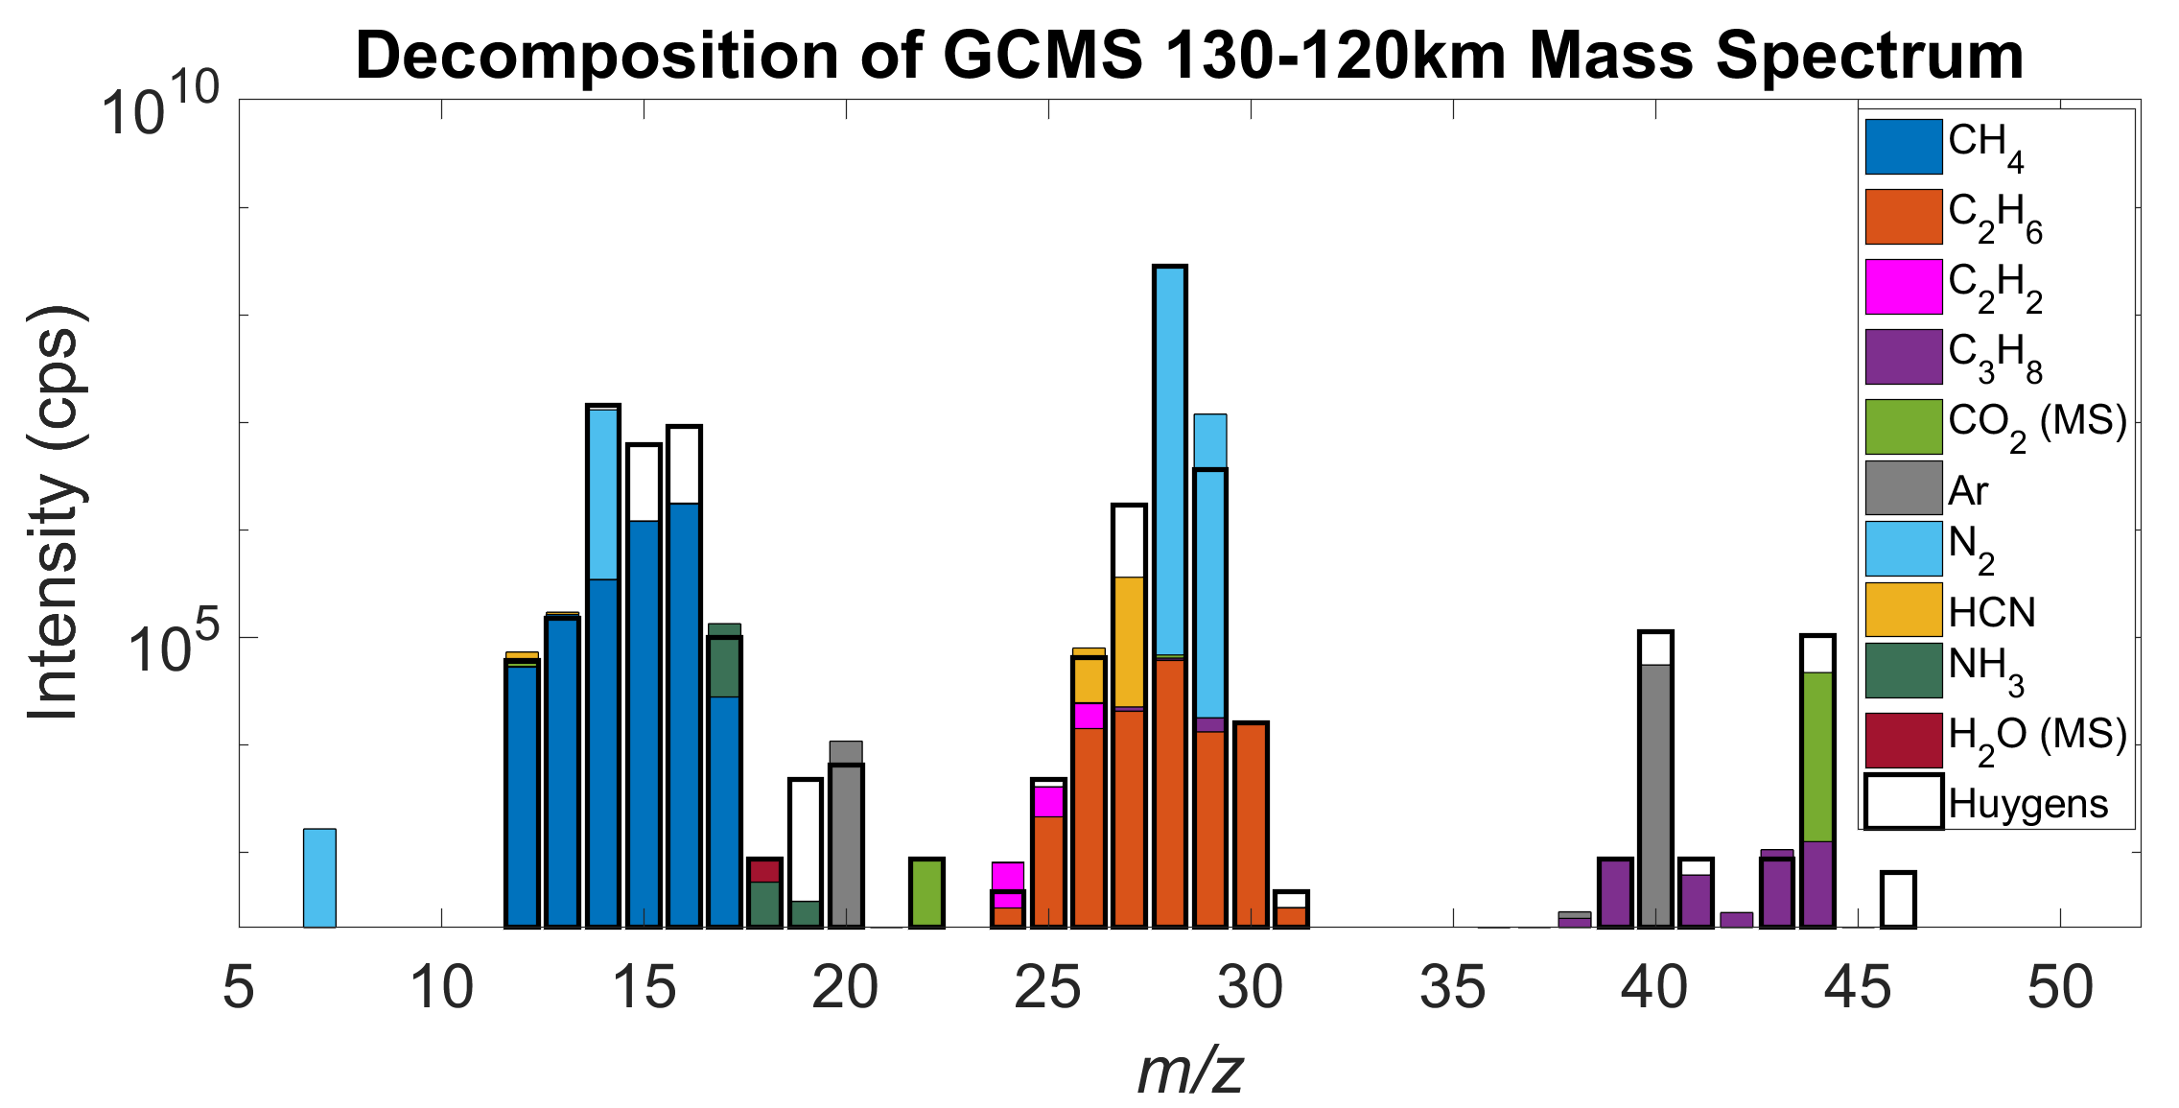
Actual Huygens data
Doubled the number of identified species @ 130 km altitude
MS response (cps)
m/z
Niemann et al. JGR (2010)
Decomposition of flight data (stack of the MS acquired between 130 and 120 km atl above Titan)

Slide 14
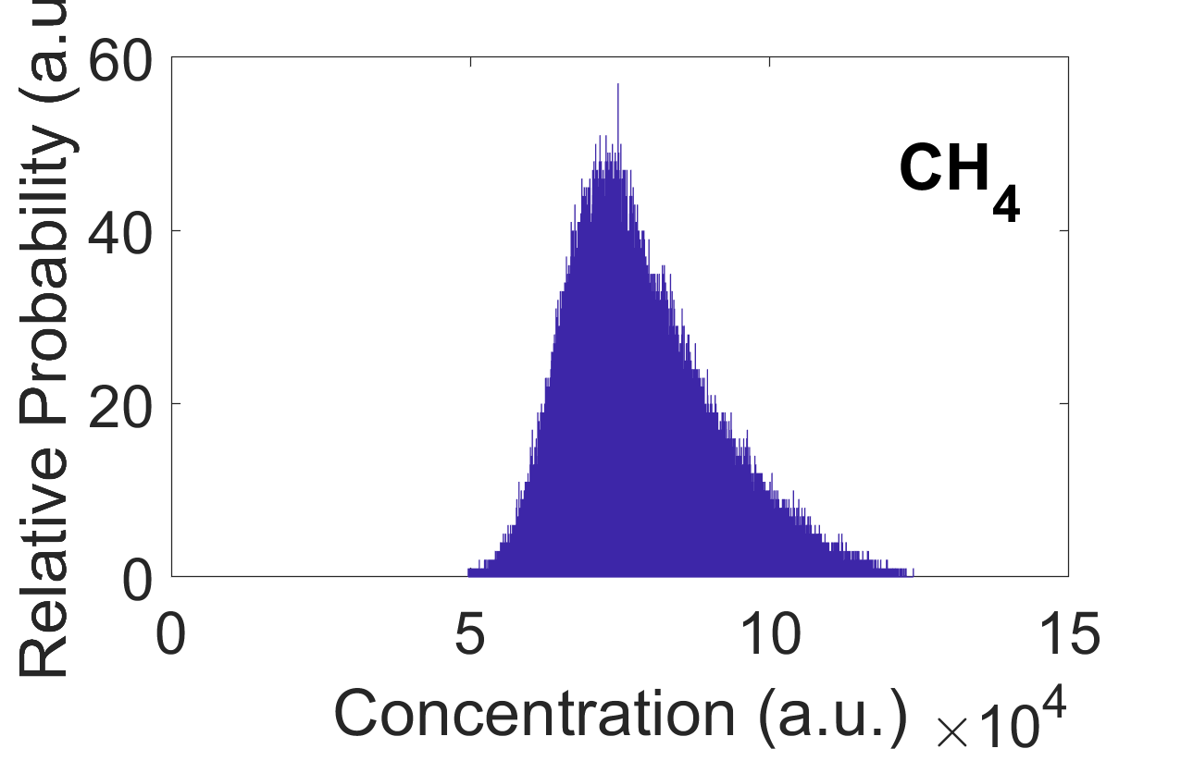
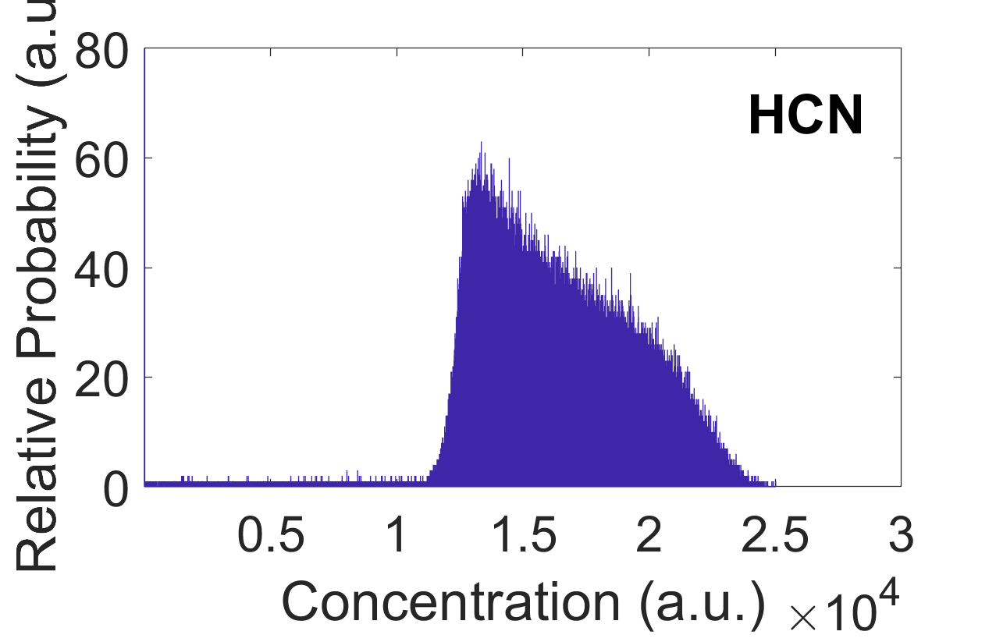
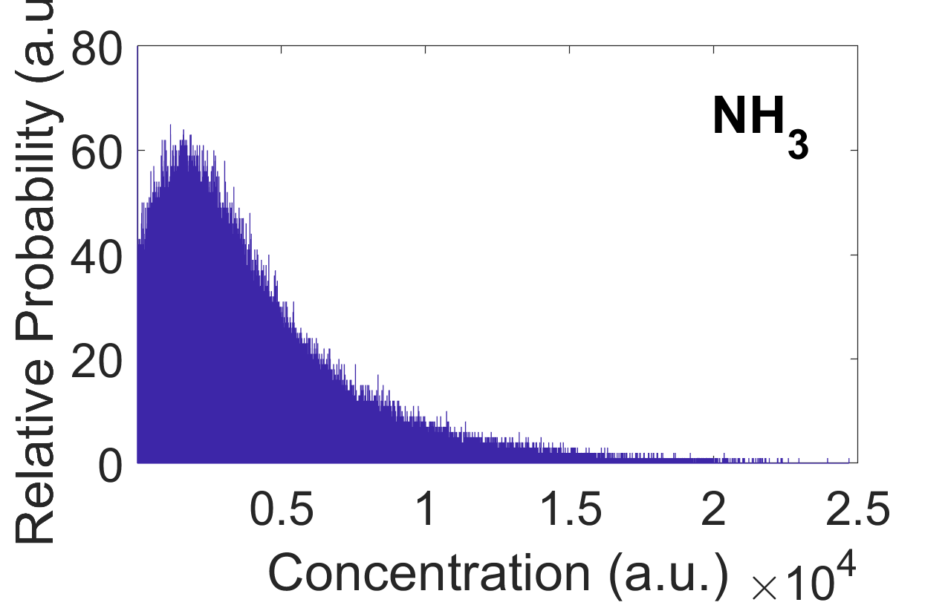
Actual Huygens data
Doubled the number of identified species @ 130 km altitude
Decomposition of flight data (stack of the MS acquired between 130 and 120 km above Titan)

Slide 15
To come / Objectives
Ethane mole fraction in Titan’s lower atmosphere
  proper quantitative calibration
Identify / Quantify trace organics
  Need calibration data as good as possible
Vertical profiles above Huygens landing site
  this talk x 579 Mass Spectra

Slide 16
Sequential | Inversion | Multiple linear fitting
Boundary conditions Reduced database Low S/N needed | Time efficient All species are treated as equal Possible to treat part of the spectra independently | Boundary conditions All species are treated as equal Possible to treat part of the spectra independently
Fragmentation pattern sensitivity (+++) Database sensitivity +++ Overpower high molecular weight species | Sensitive to Noise Fragmentation pattern sensitivity (++) Potentially unstable solution | Fragmentation pattern sensitivity (+) More Time consuming
COSAC (Philae)
INMS (Cassini)
This work – GCMS (Huygens)

Slide 17
Sequential decomposition
Boundary conditions
Reduced database
Noise substraction
Very sensitive to species in database
Overpower high molecular weight species

Slide 18
Maxtrix inversion based decomposition
MS = Observed spectrum
m/z | 20 | 21 | 22 | 23 | 24 | 25 | 26 | 27 | 28 | 29 | 30
cps | 100 | 0 | 0 | 0 | 412 | 610 | 752 | 900 | 1294 | 1204 | 940
Time efficient
All species are treated as equal
Possible to treat part of the spectra independently
DB= Database
m/z | 20 | 21 | 22 | 23 | 24 | 25 | 26 | 27 | 28 | 29 | 30
Species 1 | 25 | 0 | 0 | 0 | 25 | 50 | 100 | 0 | 0 | 0 | 0
Species 2 | 0 | 0 | 0 | 0 | 16 | 30 | 36 | 100 | 42 | 72 | 20
Species 3 | 0 | 0 | 0 | 0 | 20 | 20 | 10 | 20 | 100 | 70 | 80
Sensitive to Noise
Sensitive to accurate fragmentation pattern
Potentially unstable solution
 | Raw | Relative Abundances
Species 1 | 4 | 0.4
Species 2 | 7 | 0.7
Species 3 | 10 | 1
Inv(MS)*DB

Slide 19
