Slide 1
Seasonal Variations of Titan’s Stratospheric Temperatures and Winds from Cassini/CIRS
R. K. Achterberg, P. J. Gierasch, C. A. Nixon, F. M. Flasar
Cassini Science Symposium
15 Aug 2018

Slide 2
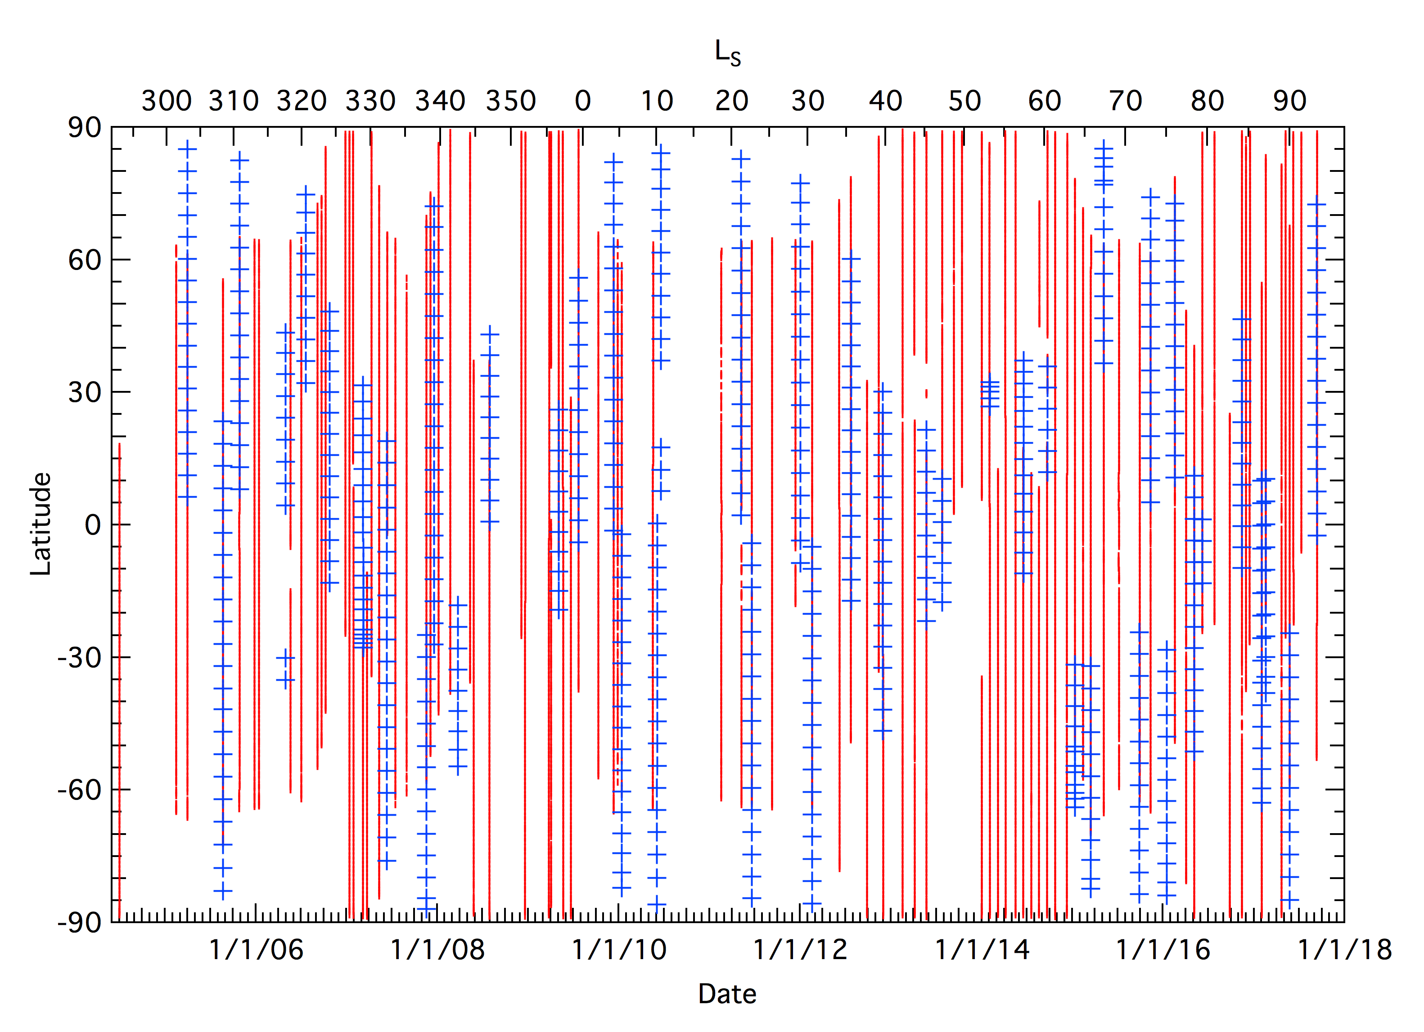
Final Coverage of CIRS Temperatures Mapping Observations: 138 nadir maps on 97 flybys 43 limb maps Covering L_{S} = 293 (mid northern winter) to L_{S} = 93 (northern summer solstice)
Red = nadir maps, blue = limb maps

Slide 3
CIRS Nadir Temperature Maps
Slowly scan array across visible hemisphere of Titan
~2° spatial resolution in FP3/4
3 cm⁻¹ spectral resolution
Allows temperature retrievals between about 0.2 – 8 mbar, with best information at 1 mbar, from ν₄ band of CH₄

Slide 4
Time variation of northern temperatures
In mid-stratosphere, slow warming through late winter and early spring. Warming slows/stops at ~L_{S}=70 ˚.
Warming interrupted by cooling in late winter near pole. Weakening of subsidence from meridional circulation?
In upper stratosphere, cooling observed during winter and heating during spring.

Slide 5
Time variation of southern temperatures
Very weak meridional gradient in southern hemisphere during southern winter.
Rapid cooling of polar latitudes during mid-winter (L_{S}=20˚-50˚)
Temperatures in upper stratosphere begin warming around L_{S}=60˚-70˚, likely from subsidence in winter polar branch of the meridional circulation.

Slide 6
Time variation of near-equatorial temperatures
At 1 mbar, low northern latitudes show slight warming during late winter, switching to cooling during northern mid-spring
Equator and low southern latitudes show slight cooling starting near equinox
Bezard et al. (2018) raditive-dynamical model shows that temperature variations near the equator are can be explained by reduction in insolation as Titan moves away from the sun plus seasonal changes in vertical winds.
Bezard et al. (2018)

Slide 7
Stratospheric Temperature Cross-sections (Nadir Maps)
Strong cooling of southern hemisphere between 2009 (S fall equinox) and 2014 (S. mid autumn)
Vertical T profiles are nearly isothermal in south polar middle stratosphere in 2013-2014 (L_{S} 40˚-60˚), with strong meridional temperature gradients at 70˚S
In 2016-2017 (L_{S} 60˚-80˚), south polar upper stratosphere warms, and mid-stratosphere meridional temperature gradient weakens and shifts northward.

Slide 8
Stratospheric Winds (from Nadir Maps)
Zonal mean winds calculated using gradient wind approximation, assuming U = 0 at 20 mbar.
Northern hemisphere jet weakened after equinox, while new jet formed in southern hemisphere near ~70˚S in mid-autumn (L_{S} ~ 45˚), shifted northward to ~45˚S by late 2016 (L_{S} ~ 80˚)

Slide 9
Limb Temperature Maps
CIRS FP4 (1 x 10 array) perpendicular to limb every 5° latitude at two altitudes
Vertical resolution of ~35 km
15.5 cm⁻¹ spectral resolution
Allows T retrievals from ~0.005 – 5 mbar at a single longitude, using ν₄ band of CH₄

Slide 10
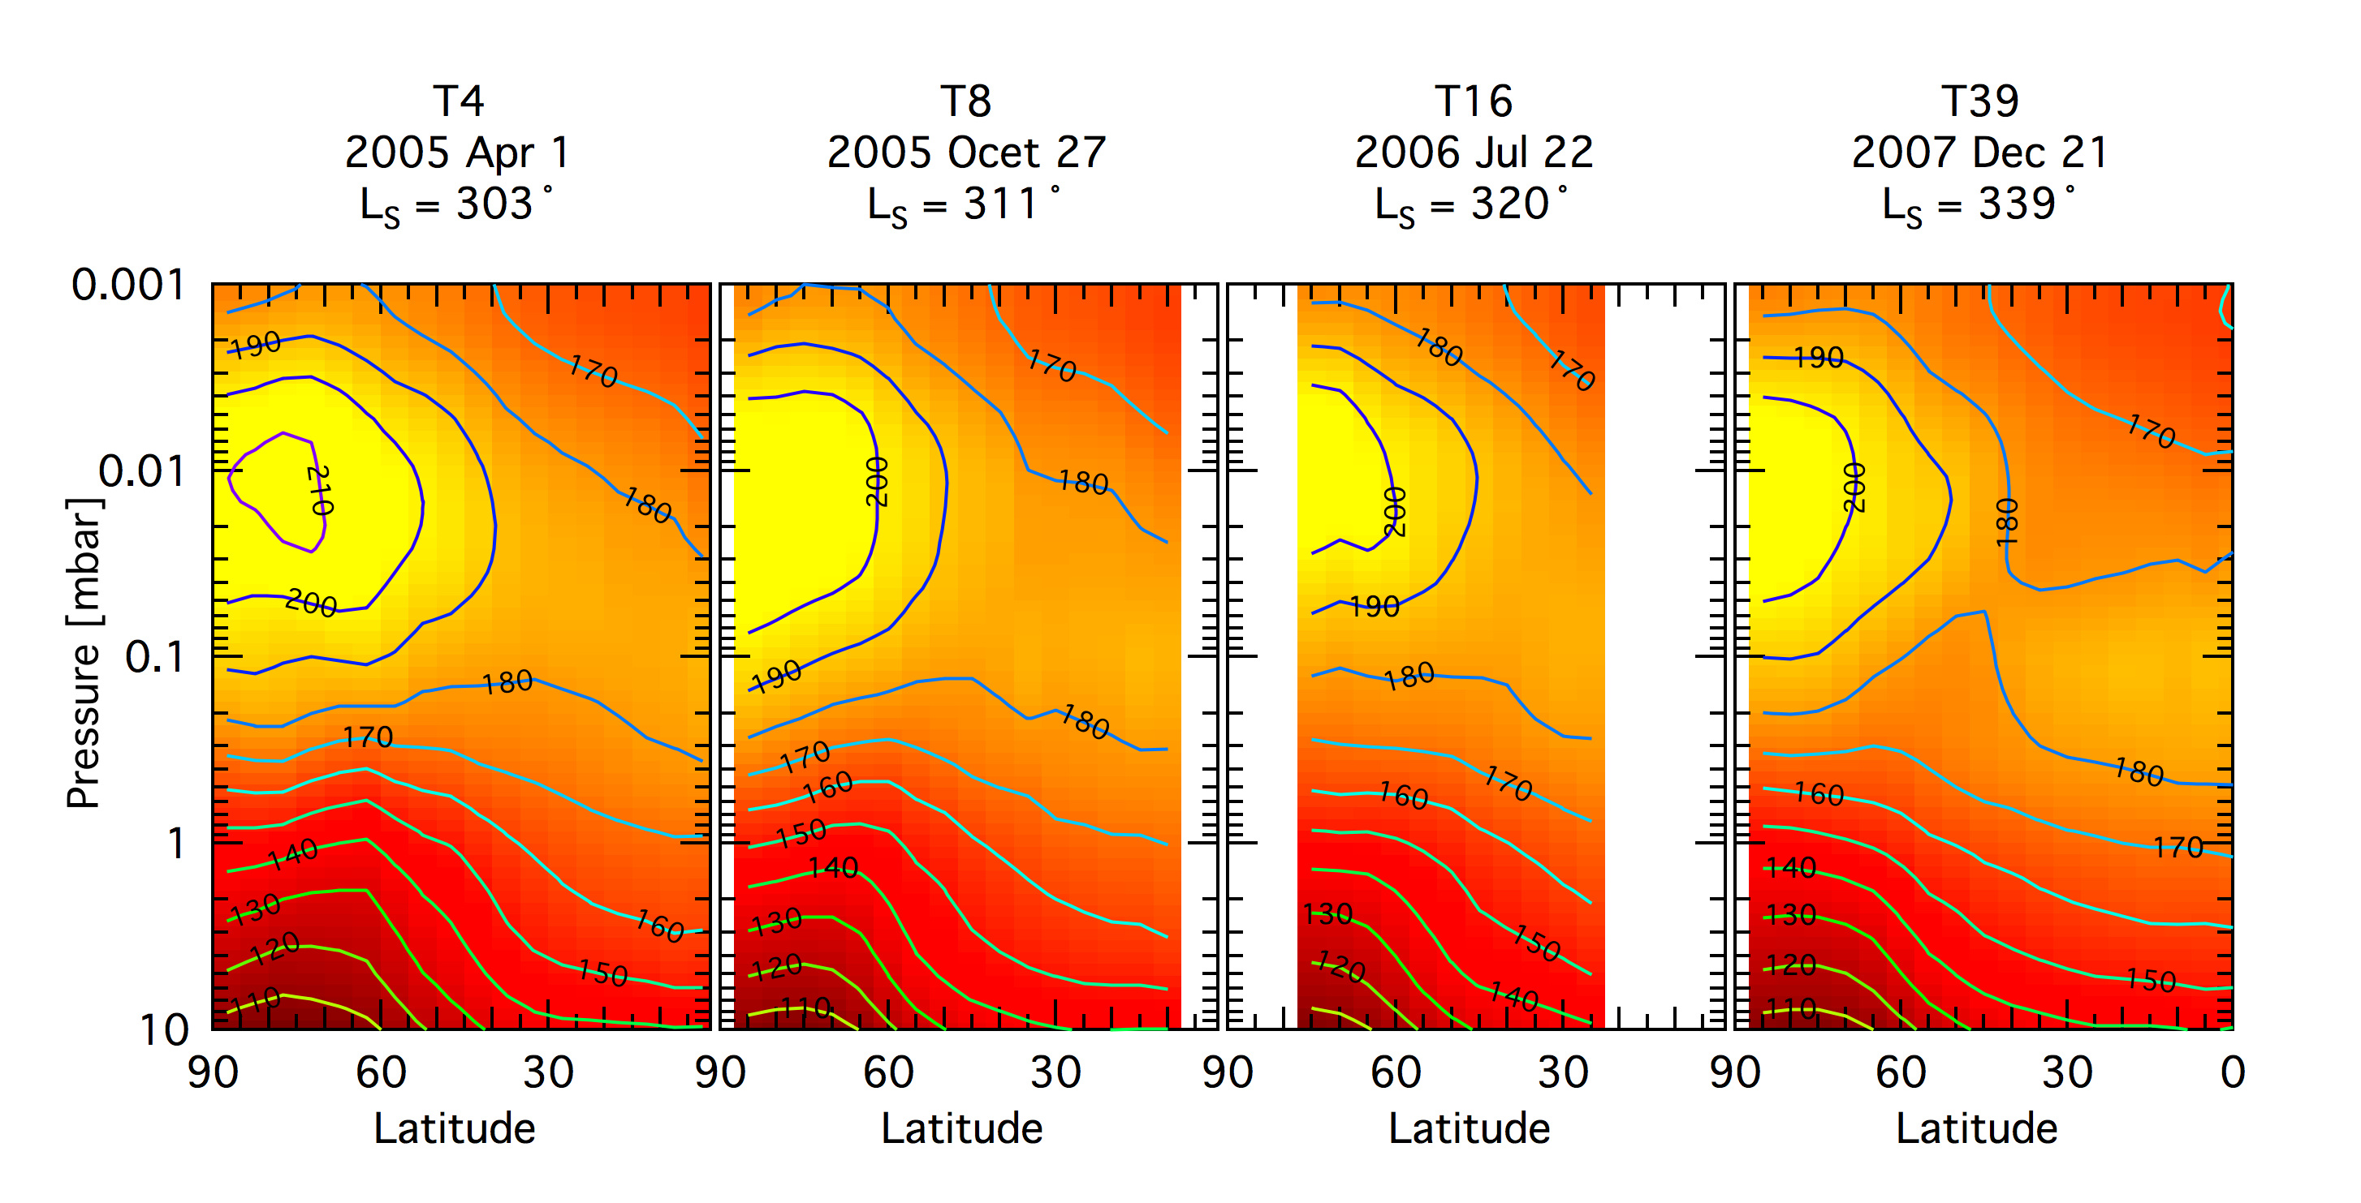
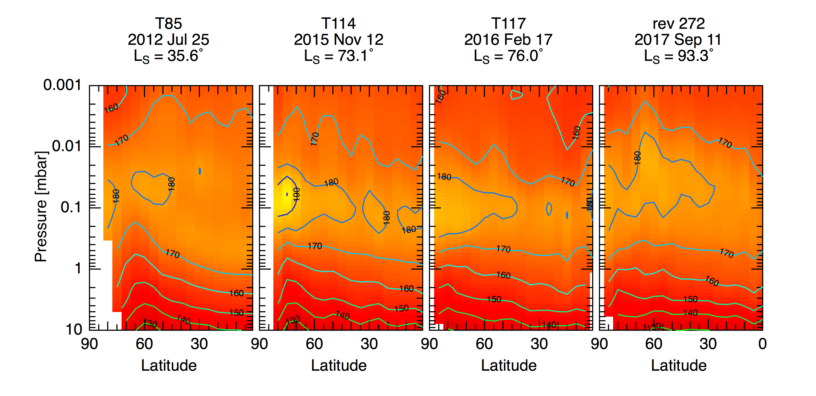
Warm (200K) elevated north polar stratopause present during winter disappears soon after equinox. In the middle stratosphere, gradual warming of polar and mid-latitudes, as seen in nadir maps.
N hemisphere limb maps

Slide 11
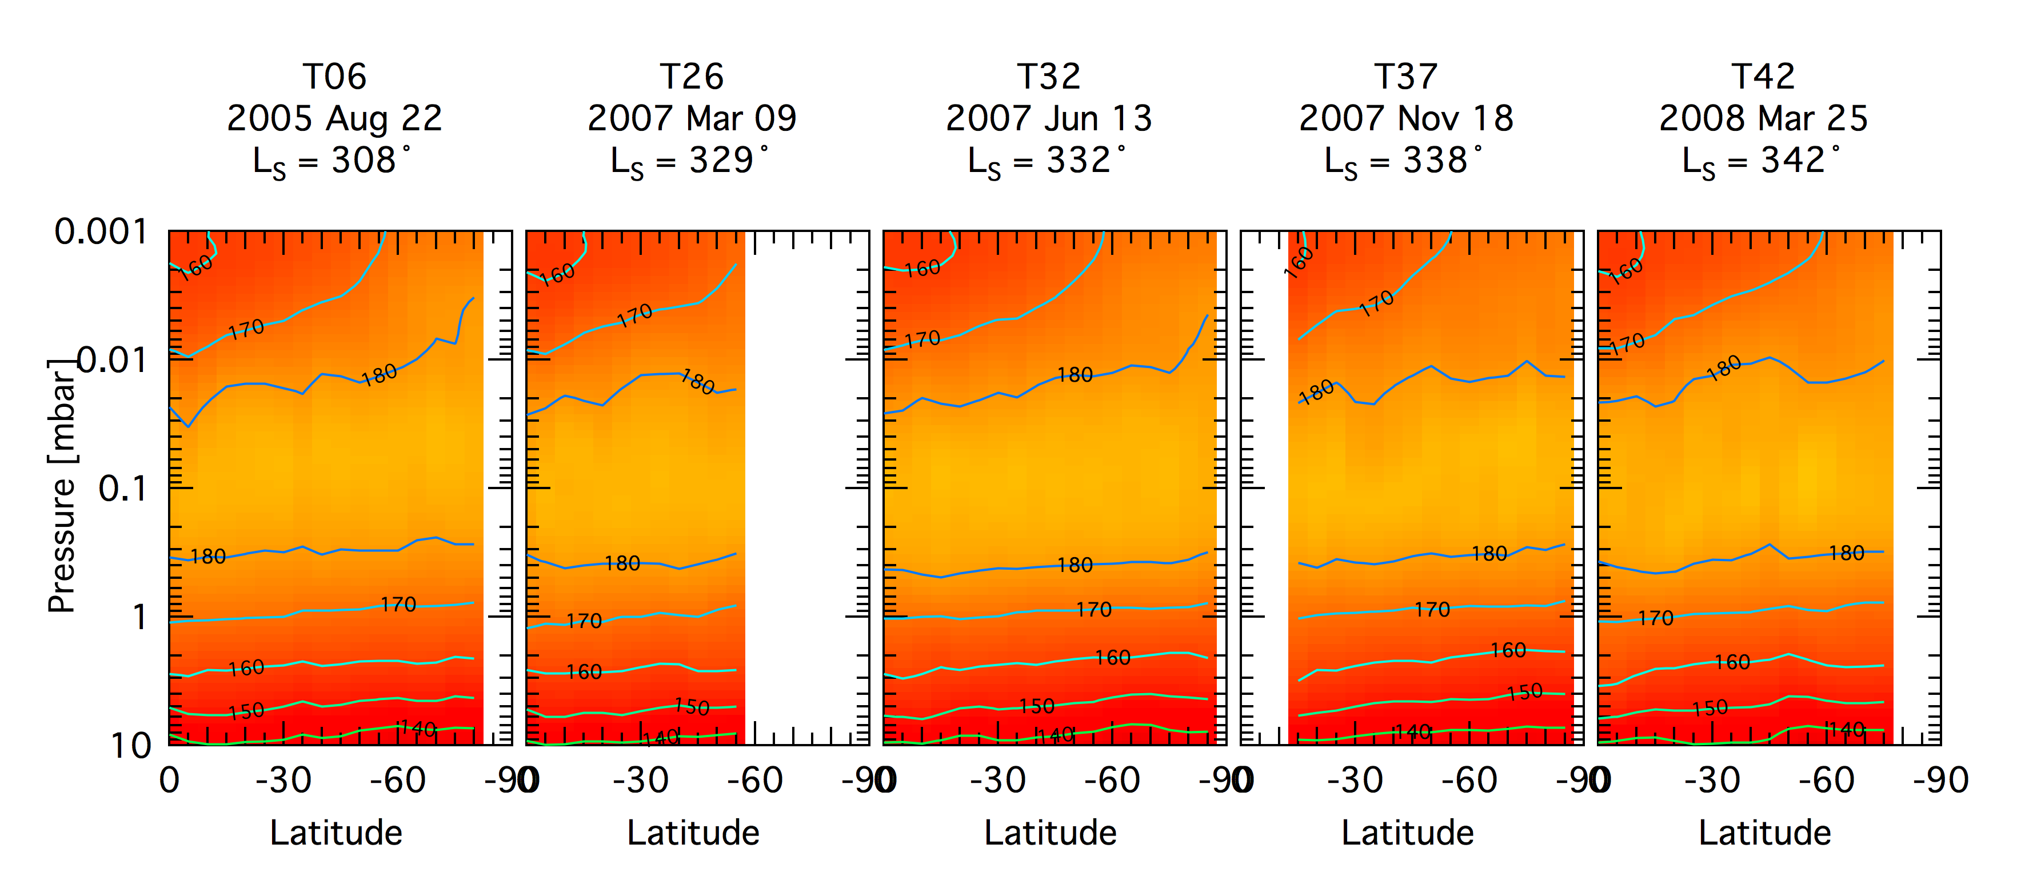
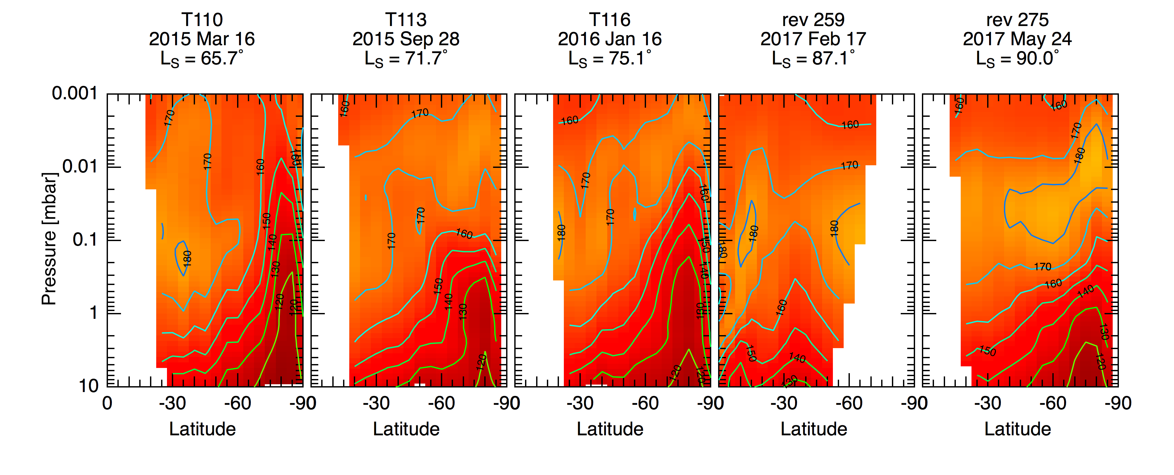
Elevated stratopause appears after equinox. Considerable variability in polar temperatures at p < 0.1 mbar; warm polar stratopause appears after equinox, disappears during mid-autumn, then reappears.
S hemisphere limb maps

Slide 12
Summary
South polar (<70˚S) temperatures cooled rapidly during mid-autumn (L_{S} 30˚-60˚), reaching minimum ~120K. Upper stratospheric temperatures at S pole have been increasing over last year or two.
South polar jet formed at ~70˚S in mid-autumn (LS ~ 45˚), and later moved equatorward.
Equatorial latitudes have been cooling since equinox, from reduced solar heating as Saturn approaches apoapsis.
Elevated warm winter polar stratopause appears to be forming, but limb observations show considerable variability from flyby to flyby.

