Slide 1
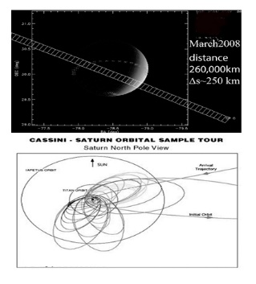
Cassini UVIS Observations of Titan Airglow
JOSEPH AJELLO
EMILIE
ROYER
LASP CASSINI TEAM
MIKE STEVENS
SCOTT EVANS
CHARLES MALONE
JC GERARD
THOMAS CRAVENS
Cassini Symposium : August 2018
Notes:
4-Solar System Objects: Earth, Titan, Triton, Pluto
126 flybys x 10000 scans per 4’=775 observations or about 70
Cassini UVIS: 2-channels, slit= 2mR x 60 mR(0.1 x 3 . 4 deg) 64 x 1024 pixels = 5A /pixel
100,00km fill FOV full Titan Diameter night/day x H

Slide 2
Outline
MAIN Point: Two main sources of N₂ airglow:
1) solar XUV main source of dayglow 900-1200 km in ionosphere.
2) magnetosphere particle precipitation source of UV/visible night glow (600-1400 km).

Slide 3
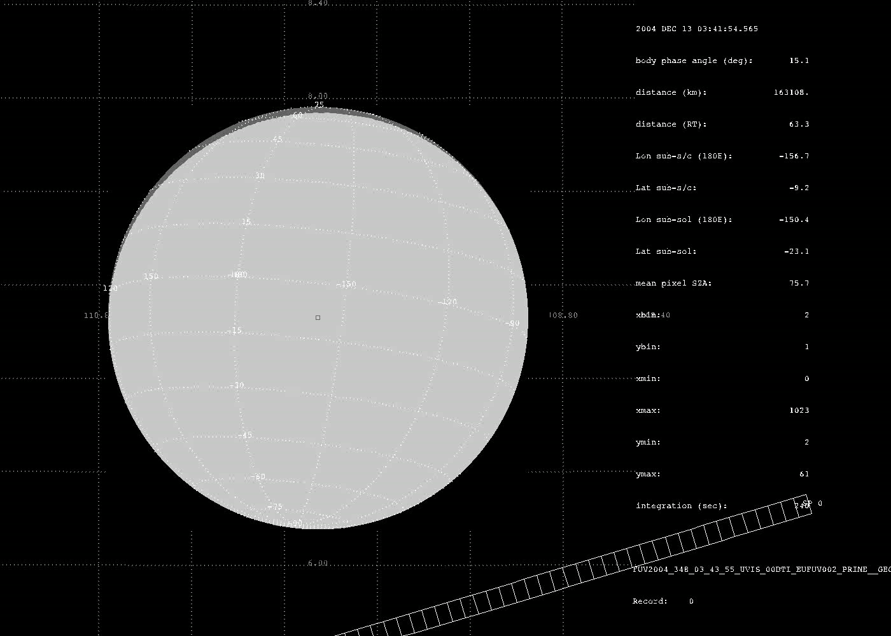
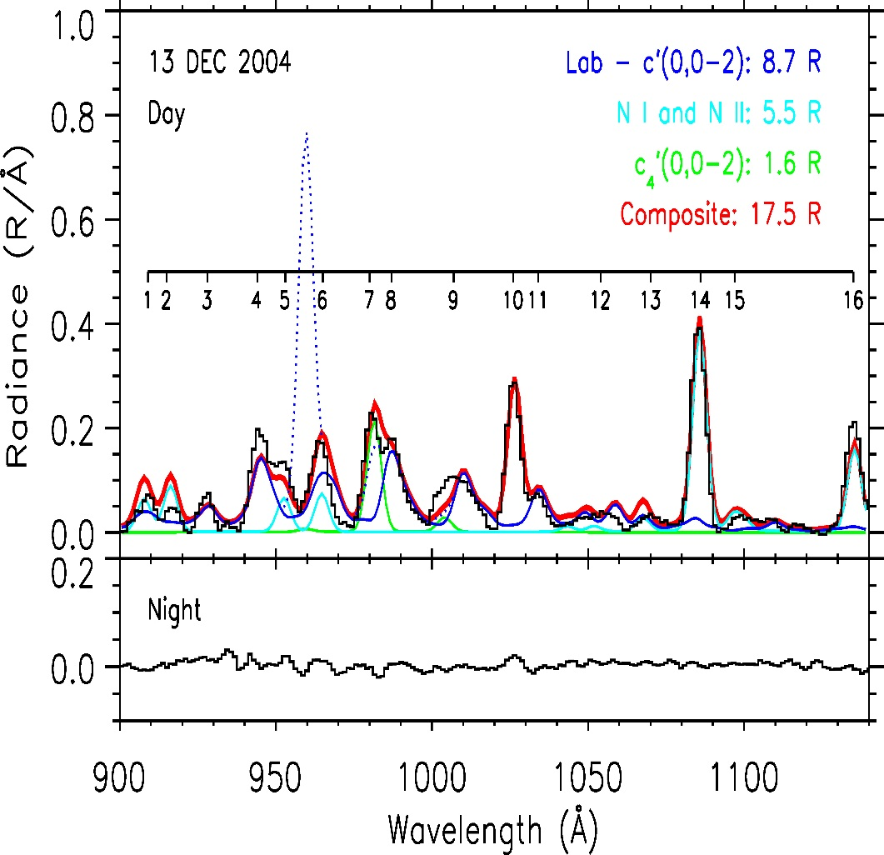
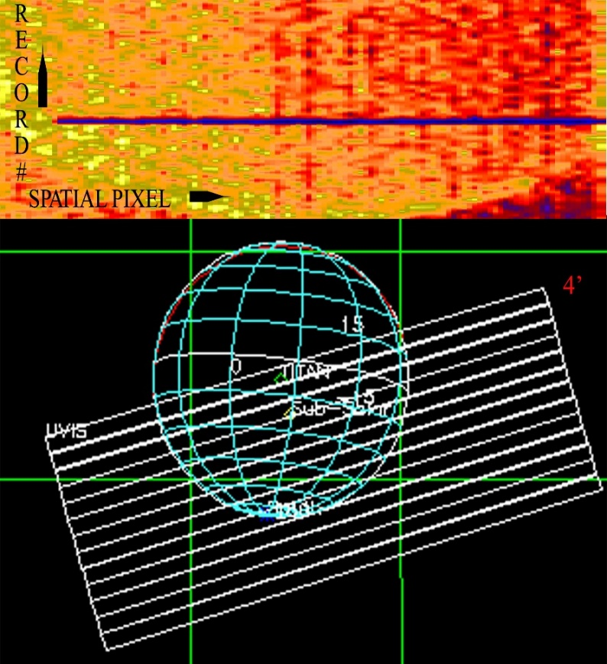
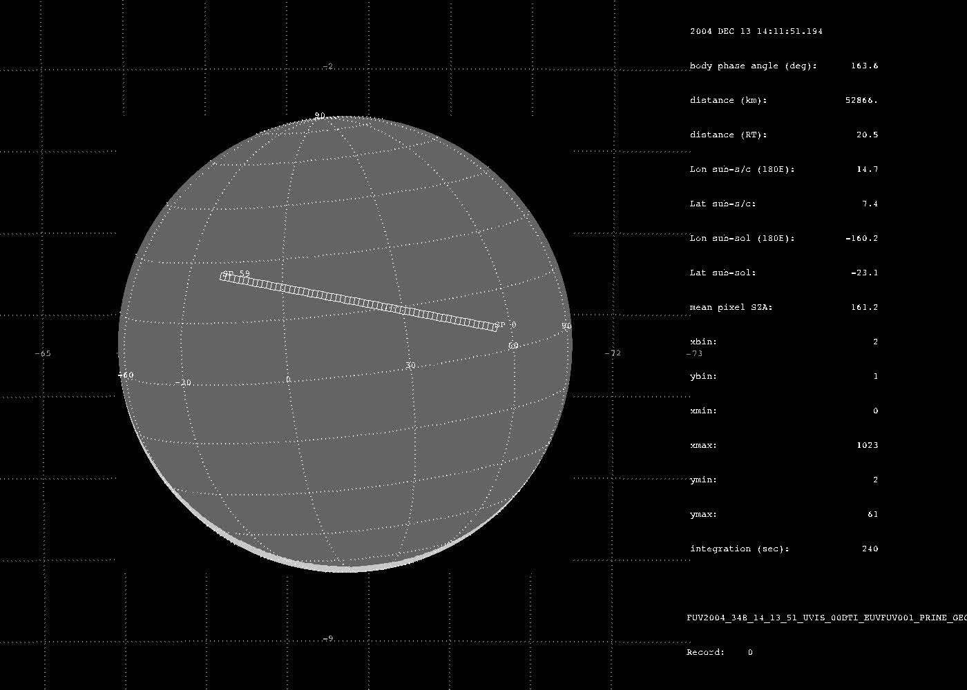
First Cassini UVIS 2004 4-hr @10⁵ km 58-4’ Observation Titan Airglow & 2007 analysis e + N₂ Lab Spectrum.
Notes:
16 dayglow features vs 1 voyager
N2 + H Ly-B =RV bands EUV
Not c’(0,0)=thick
4-hr obs- no model tll Lab
14 N-atoms per photon

Slide 4
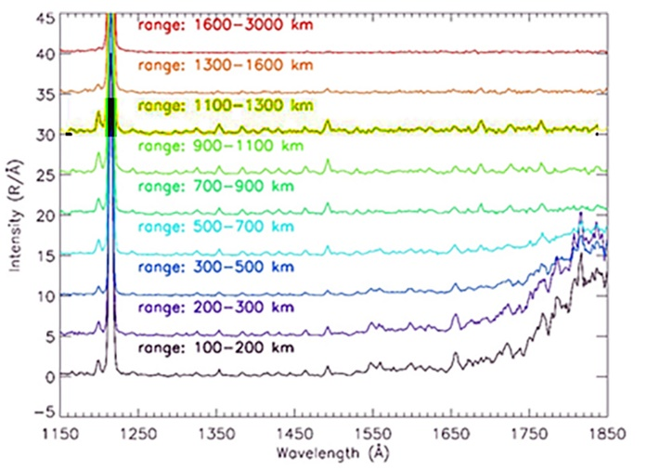
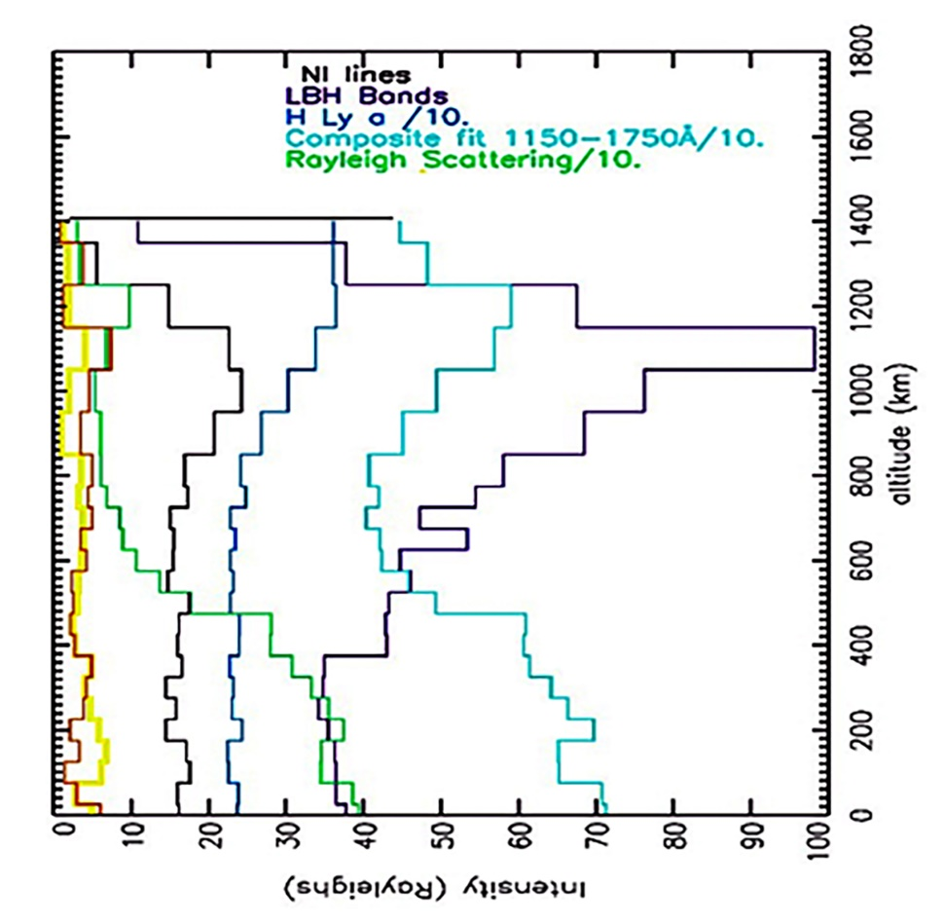
Limb Profile behavior of FUV Photelectron-Excited Dayglow
FUV Limb Spectra in 4-atmosphere Layers.
Ionosphere from LBH Bands, exosphere from H Lyα, ΕΝΑ, Particles from Rayl Scatt.
Ionosphere
Tholin Haze
Notes:
FUV =red haze (700km)+ ionosphere (1000 km)+ENA (exosphere=1400km)=escape at 1 eV of N-atoms –orbit @ ionized
14 fast atoms + PDI (1eV)= chemistry of nitriles+ tholins
Study S/N at 100 km=stare

Slide 5
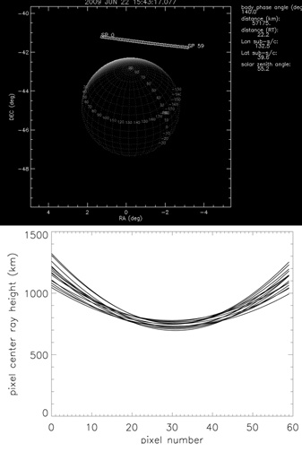
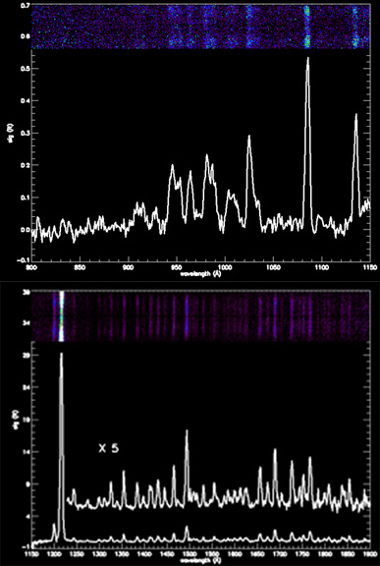
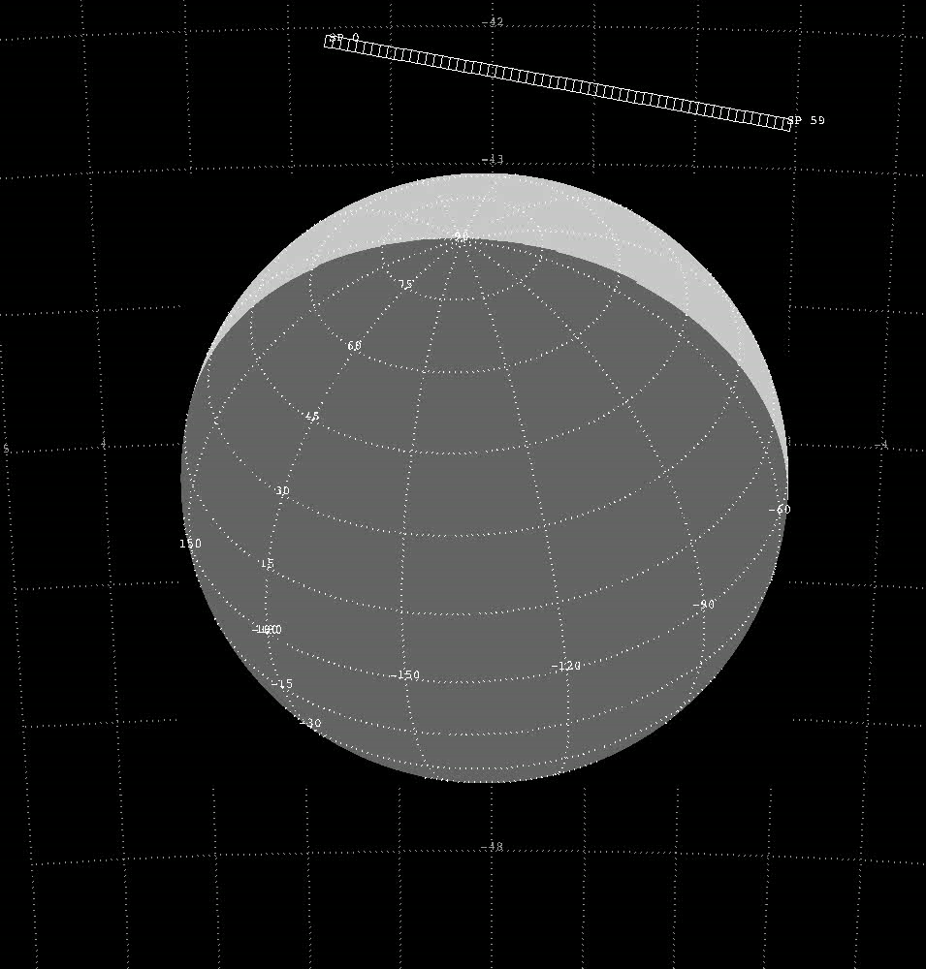
Best (S/N) Titan Dayglow UVIS Limb Spectrum; T57 22June 2009: ‘800 km MRH STARE (Reposition)’ Stevens et al., 2011
One hour UV image 15 – 4 minute records at 60k km ~100 km res.
EUV
Modeling vectors are:
(A) EUV: 16 R+FUV:43R +fast N.
B) UV glow 8 x 10⁷ Watts vs 10⁹ Watts Solar.
C) N₂ Dissociation of Atmosphere (20% loss of
N₂ (1 x 10²⁷ s⁻¹).
FUV
Notes:
800 km
Bright source of UV in solar system

Slide 6
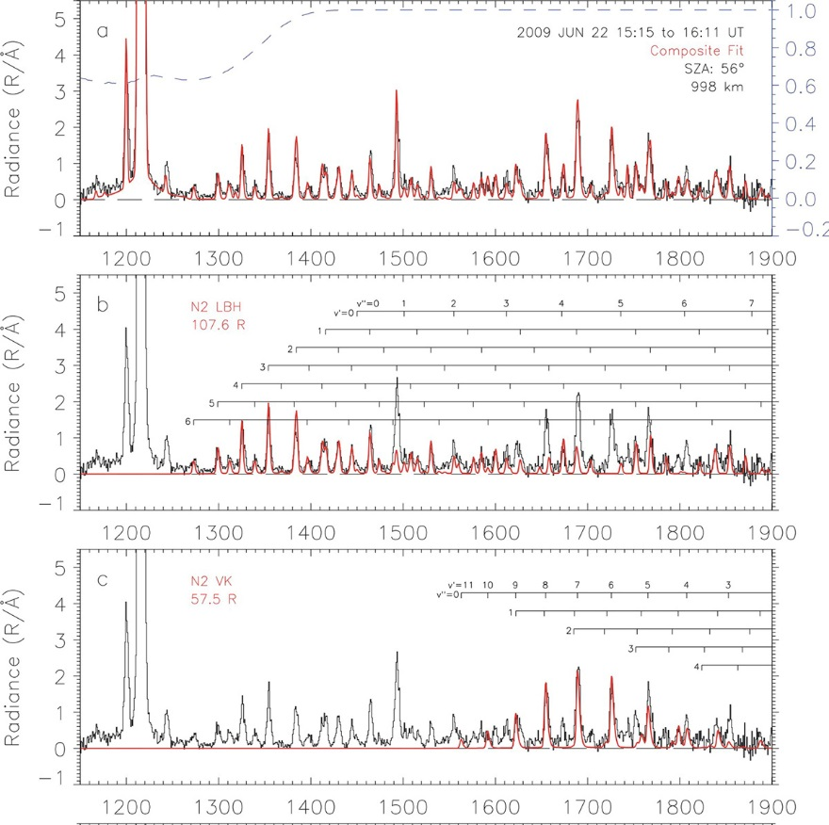
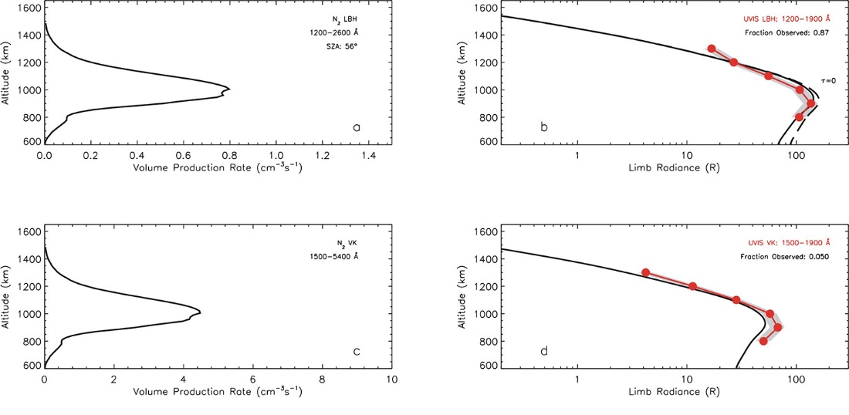
‘STARE’ OBSERVATION vs FUV model VPR (“AURIC”)
Orbit T57: 22 Jun 2009
V(z)=g(z) x ω − forward model
g_{j} (z) = F (ε) x n(z) x σ(ε).
Airglow Modeling Results
MLR – backward model.
Notes:
800 kmStare=discovery VK bands
Enable MLR and VPR

Slide 7
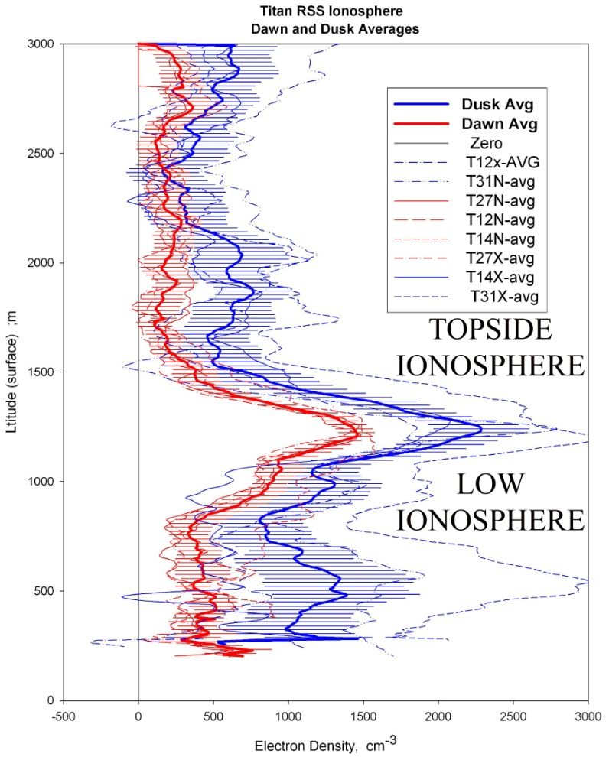
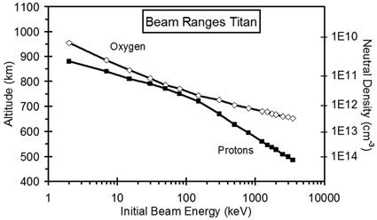
TITAN PROTON, O⁺ PLASMA (0.1 keV-4 MeV) & SOLAR XUV GENERATES 2-level IONOSPHERE (300-1500 KM) – Radio Occultation shows region Nightglow
Solar XUV Excitation –Strong Top Ionosphere-every orbit,
-Magnetospheric Nightglow: ~lower layer =High energy p & O⁺ Plasma (Cravens ., 2008).
Notes:
Kliore found topside ionosphere by solar XUV
Ion precipitation 27-4 MeV p, O⁺ from MiMi(ion-neutral=lower ionosphere

Slide 8
Airglow Image on Earth Separating p⁺ and e—Aurora on N₂ &
Similar Titan’s uv night ionosphere
IMAGE spacecraft FUV p⁺ (Doppler shifted H Ly-α) & e⁻ aurora (N₂ LBH) & Titan’s induced magnetosphere of MeV p⁺ and O⁺ => N₂ LBH.
Notes:
Two nighttime emission layers like earth aurora
O⁺ & p cross field lines

Slide 9
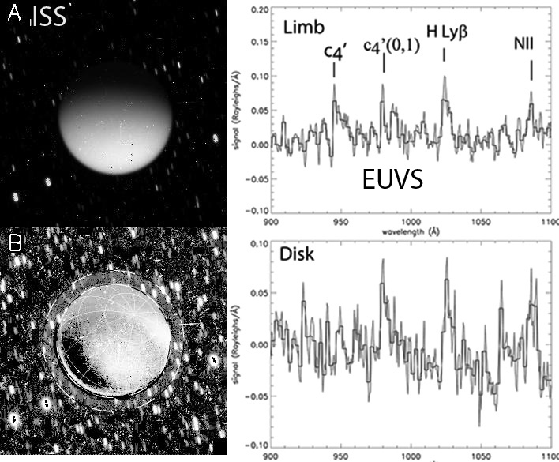
Titan EUV and ISS airglow During May2009 titan-saturn solar Eclipse
1) In Eclipse p and O⁺ excite EUV and visible,
2) a)10 minute ISS image.
b)Saturn-shine subtracted = 300-1000 km visible-N2 glows,
3) UVIS 2.6 hour CY bands at 645x10³ km,
Notes:
-UV –visible emission on dark and visible below 800 km
-Free of solar XUV

Slide 10
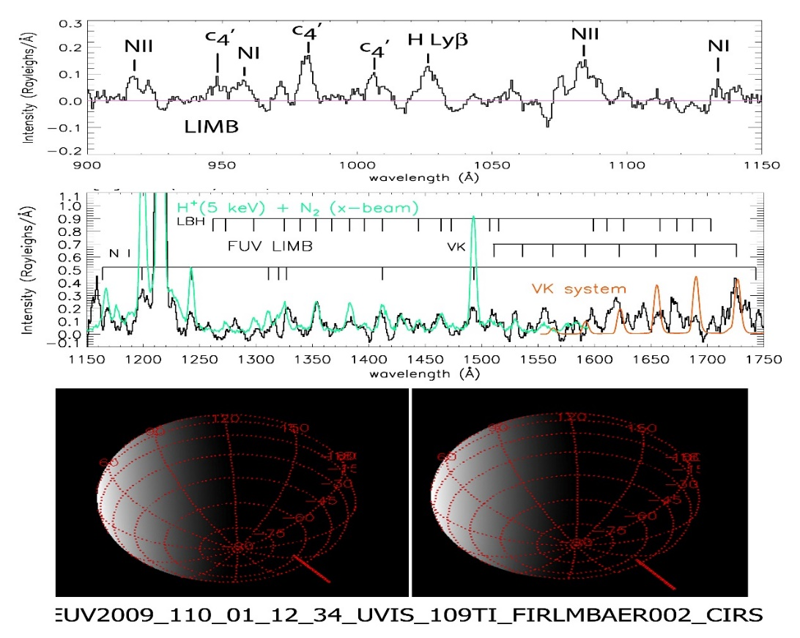
The Close-Cassini EUVS darkside Limb plasma impact spectrum Close -Approach
Date= May 7, 2009
SZA= 124 deg
C/A = 16,000km
Surface to 1000 km.
Compare to lab spectrum and dayglow (10%).
Notes:
first nightglow-closer thatn eclipse 16,000km vs 600,00 km

Slide 11
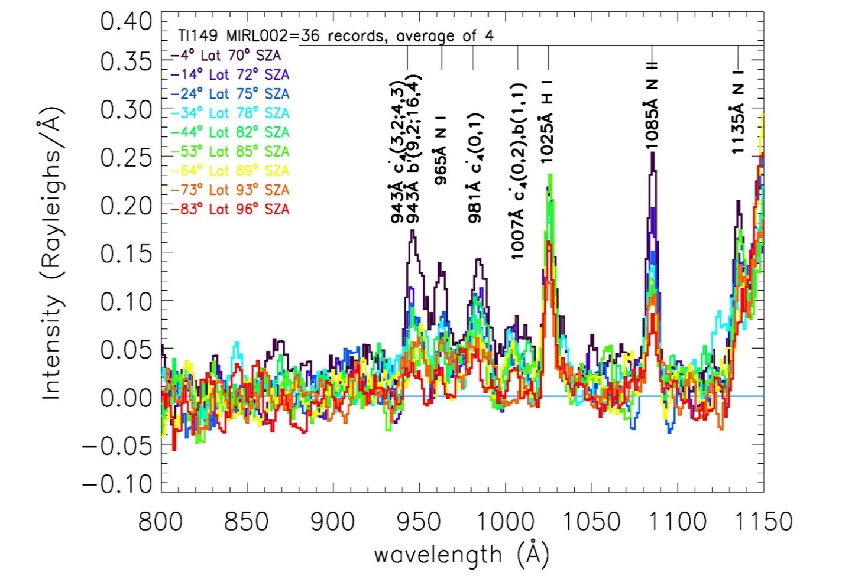
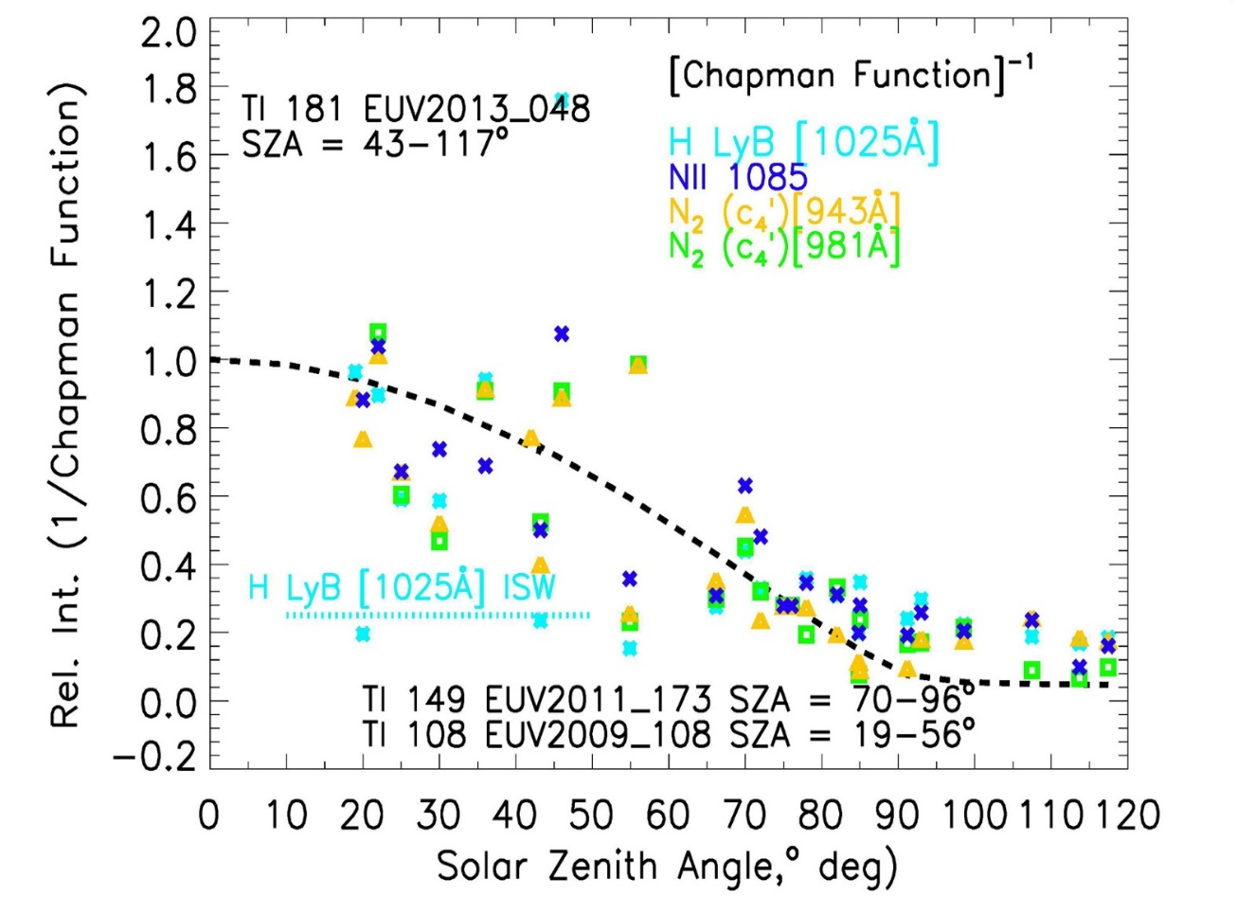
Titan Dayglow EUV Intensities on Saturn Orbit 181 vary SZA (COS sza)from 14-120 deg Chapman Layer
Strongest contribution to dayglow from solar XUV; Nightglow 10% of dayglow.
Notes:
Dayglow and night glow from 14-150 deg
Chapman layer function fits intensity variation

Slide 12
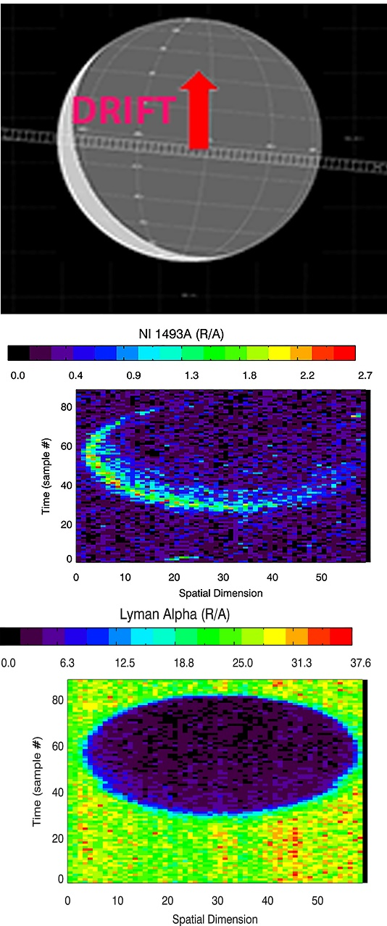
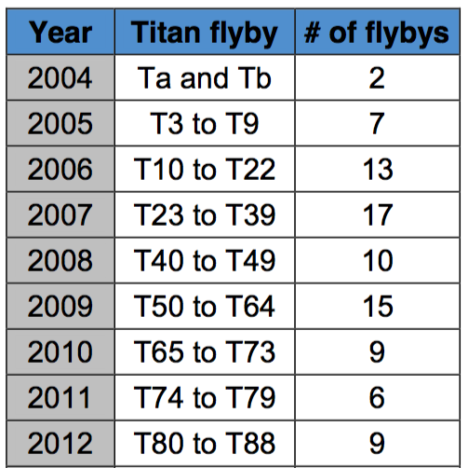
FUV 2009 DOY141
93 -4’ Observations
In 14-UV N₂ emissions
THE TITAN LIBRARY
Total number of Titan observations 9499 = 775 Data-Cubes –consecutive observations e.g. 149.3 nm & H Ly-a.
Notes:
Titan Library content enable choice of best UV images

Slide 13
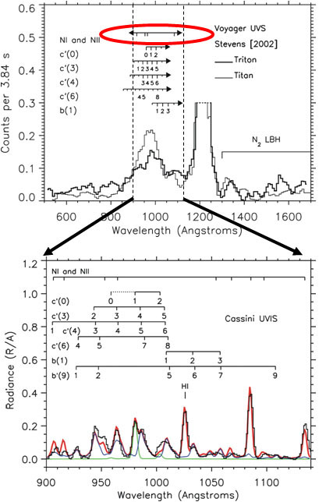
Uvis (5Å fwhm) results FOR 13 –YEARS OF OBSERVING TITAN – vs v1 (30 Å fwhm)
Dayglow emissions are factor of ten brighter than the nightglow and excited by solar photoelectrons. Energy from PEs in day-from Magnetosphere ions p, O⁺) in night.
UV day-night signature of N₂ and N-dissociation products ( =>14 fast-N-atoms/photon) =source of the lower atmospheric haze, surface composition, ionosphere and exosphere escape and N - ENA.
100 Titan UVIS observations with UV airglow analyzed to date over solar cycle (13 year mission) , total of ~5000 pairs of EUV/FUV; A total of 9499 observations (775 by Data-Cubes) solar cycle available in PDS.

