Slide 1
Highlights and open questions on Titan’s atmospheric chemistry
Véronique Vuitton
Institut de Planétologie et d’Astrophysique de Grenoble
Univ. Grenoble Alpes
C.A. Nixon et al. « Titan’s cold case files - Outstanding questions after Cassini-Huygens » Planet. Space. Sci. 155, 50-72 (2018)
V. Vuitton, R.V. Yelle, S.J. Klippenstein, S.M. Hörst, P. Lavvas « Simulating the density of organic species in the atmosphere of Titan with a coupled ion-neutral photochemical model » accepted in Icarus
Cassini Science Symposium - August 12-17, 2018 - University of Colorado, Boulder

Slide 2
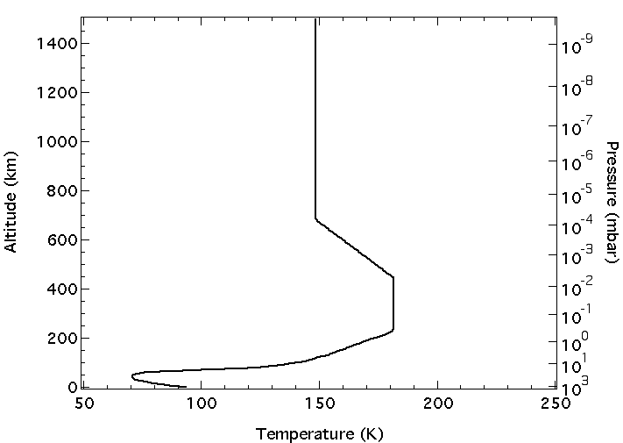
H₂
N₂
CH₄
EUV
e_{s}⁻
(keV)
FUV
N_{x}⁺
CH_{x}⁺
O⁺
(MeV)
C_{x}H_{y}N_{z}⁺
C_{x}H_{y}N_{z}⁻
H⁺ (MeV)
N
CH_{x}
C_{x}H_{y}N_{z}
NUV
organic haze
cosmic rays
(TeV)
C_{x}H_{y}N_{z}⁺
clouds
Notes:
Cassini Solstice Mission: 2010-2017

Slide 3
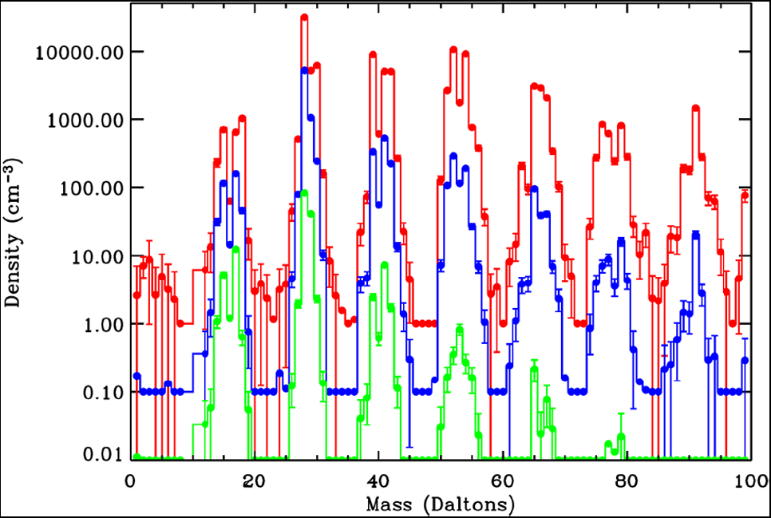
Detection of numerous positive ions
Cravens et al., GRL (2006)
1027-1200 km (× 100)
1200-1400 km (× 10)
1400-1600 km (× 1)
Concentration at the ppm level
Unit mass resolution m/z 28: N₂⁺, C₂H₄⁺, HCNH⁺, CO⁺
Necessity of numerical models to interpret the data
Notes:
Measured mass spectra for three altitude intervals are shown – average density versus Mass (in Daltons). Red: 1027 km–1200 km, multiplied by a factor of 100. Blue: 1200 km–1400 km, multiplied by a factor of 10. Green: 1400 km–1600 km, multiplied by a factor of 1. 1s statistical error bars are shown.

Slide 4
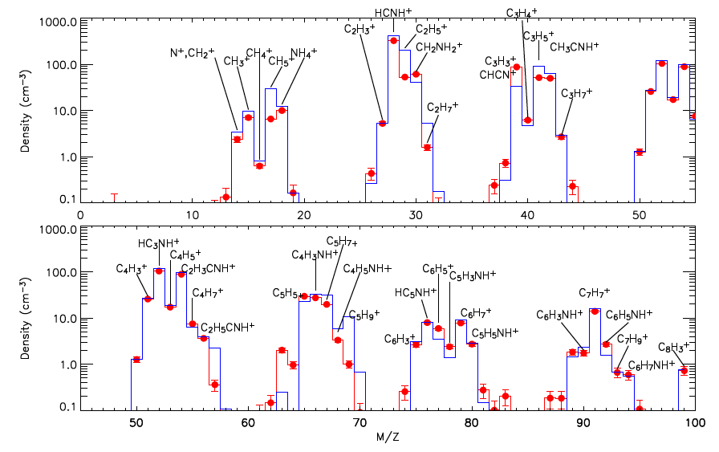
Identification of ions and main reactions
Vuitton et al., ApJ (2006), Icarus (2007)
CH₄
N₂
INMS at ∼1100 km Photochemical model
EUV
EUV
CH₄
CH_{x}⁺
N_{x}⁺
C_{x}H_{y}
C_{x}H_{y}
C_{x}H_{y}N
C_{x}H_{y}H⁺
C_{x}H_{y}NH⁺
e_{T}
e_{T}
C_{x}H_{y} + C_{x’}H_{y’}
C_{x}H_{y}N + C_{x’}H_{y’}
Indirect but most sensitive way to detect neutral species:
C₆H₆, NH₃, CH₂NH, C₂H₃CN, C₂H₅CN …
Source of neutral species:
C₆H₆, NH₃, HNC …

Slide 5
Total electron/ion densities
Sagnieres et al., JGR (2015); Vigren et al., Icarus (2013,2015), ApJ (2016)
Vuitton et al., accepted in Icarus
Why is there a factor of 2-3 disagreement between the observed and modeled positive ion (and electron) densities on the dayside?

Slide 6
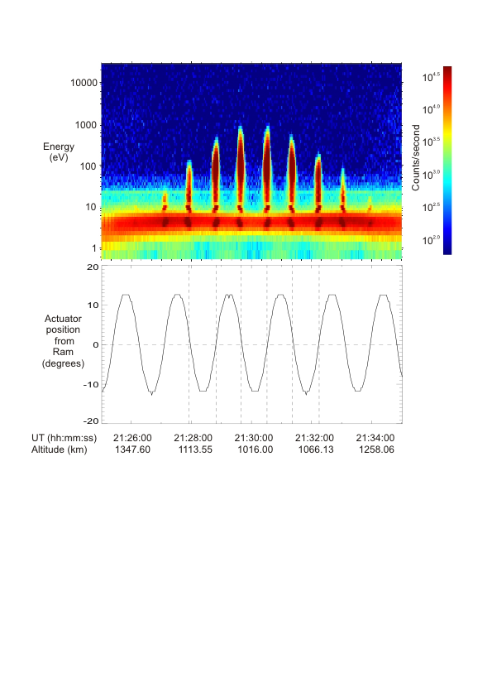
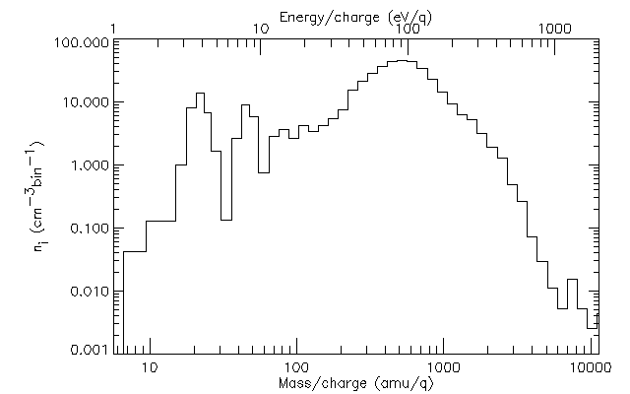
Identification of anions and main processes
Vuitton et al. PSS (2009)
Dominant production processes:
dissociative electron attachment
e_{s}⁻ + CH₄ → H⁻ + CH₃
proton transfer
H⁻ + HCN → CN⁻ + H₂
CN⁻
(26)
C₃N⁻/C₄H⁻
(50/49)
Why is the total integrated density /100 of observations?
Are we missing a source of light ions?
Is the efficiency of the CAPS MCPs under-estimated?
C₅N⁻
(74)

Slide 7
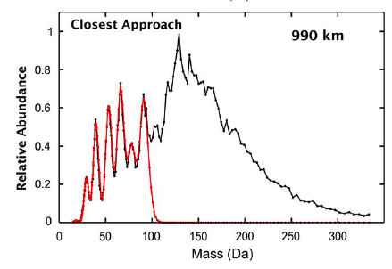
Macromolecules in the thermosphere
Coates et al., GRL (2007); Crary et al., PSS (2009)
Positive and negative ions extending up to m/z = 10³ and 10⁴ u, respectively
resolution too low to interpret the data
chemical models not suitable for m/z > 100
What is the chemical nature of the macromolecules?
Are they nitrogen rich and resemble HCN polymers?
Do they contain polyaromatic and/or heterocyclic subunits?

Slide 8
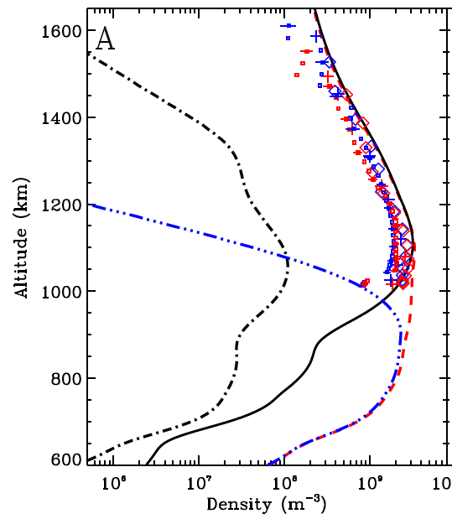
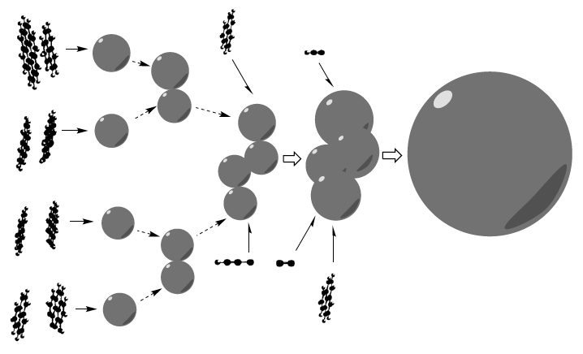
Formation of aerosols
Lavvas et al. ApJ (2011), PNAS (2013)
electrons
low mass anions
high mass anions
What are the processes responsible for the growth of aerosols?
What are the relative contributions of ion-neutral vs. radical reaction pathways?
cations
Notes:
at ∼1100 km, most of the macromolecules (m/z > 100) become negatively charged
negatively charged macromolecules attract positive ions, causing a rapid increase in particle size: at 1000 km, macromolecules have an average size of 500 u
1000 - 650 km
benzene + radicals → PACs
PACs coagulate → aerosols
PACs deposition onto aerosols
spherical particles of ∼1 nm
650 - 500 km
particles aggregate
slow sedimentation velocity
rapid growth over a narrow altitude region
particles of 160 nm with D_{f} = 2
< 500 km
interaction between radicals and aggregates
aggregates smoothed toward a more spherical shape

Slide 9
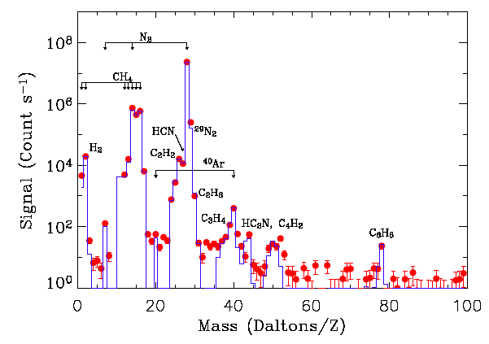
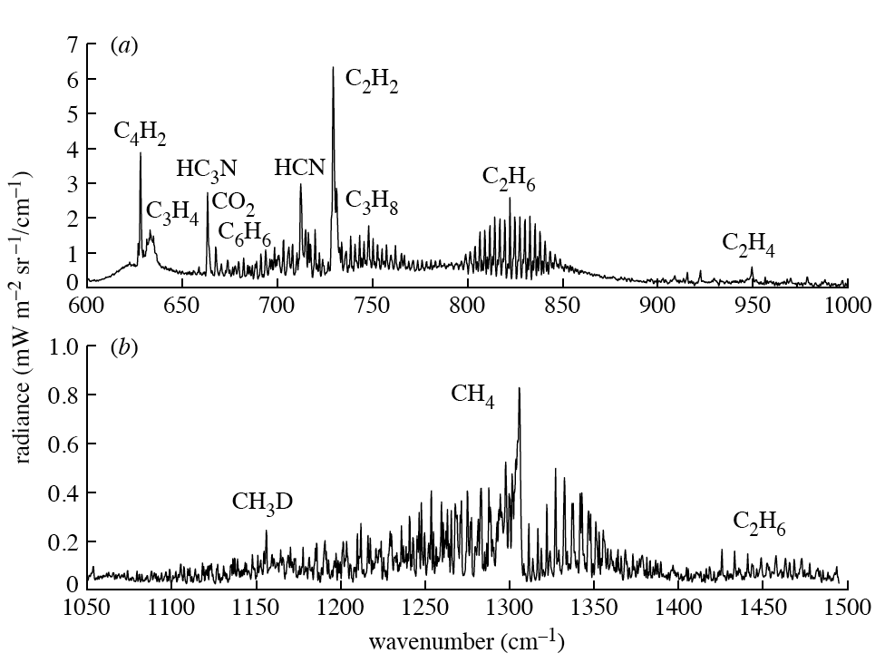
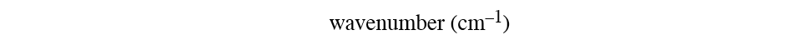
Neutral hydrocarbons & nitriles
Waite et al., Science (2005); Bézard, Phil Trans R Soc (2009)
Detection of one new neutral species: C₃H₆
Complete vertical profiles for several species:
C₂H₂, C₂H₄, C₄H₂, C₆H₆, HCN, HC₃N

Slide 10
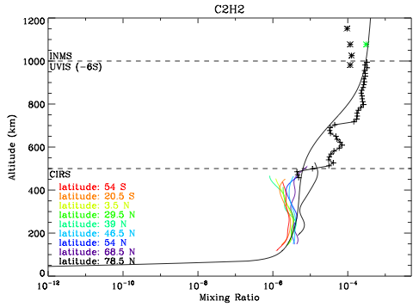
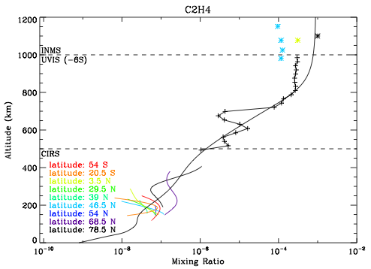
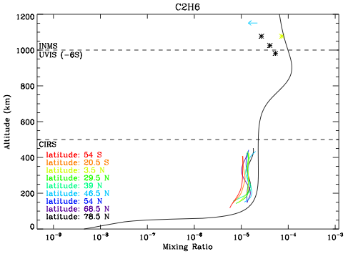
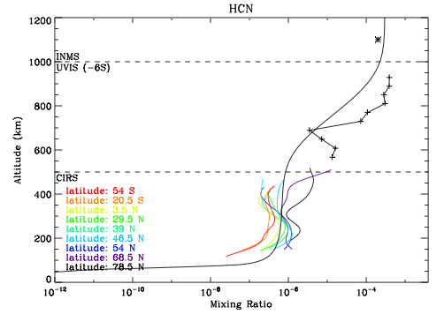
Comparison with observations
Vuitton et al., accepted in Icarus

Slide 11
Heterogeneous chemistry?
Vuitton et al., accepted in Icarus
Detection of new neutral species by Herschel and ALMA:
HNC, C₂H₃CN, C₂H₅CN
Mixed success for the models
  How do neutral (and ion) species interact with the photochemical haze and various condensates in the lower atmosphere?

Slide 12
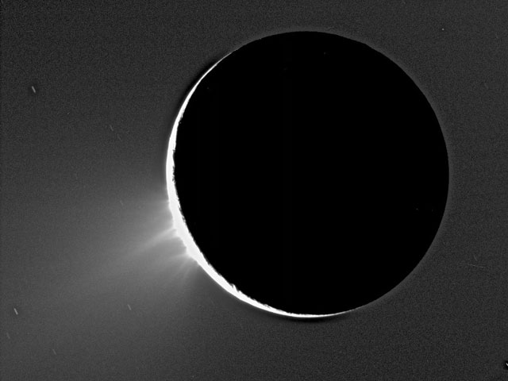
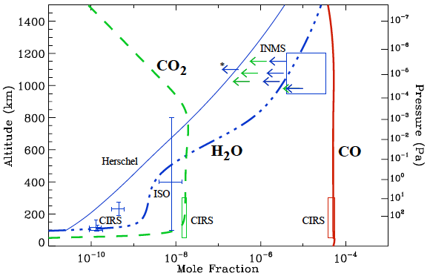
What about oxygen-bearing species?
Hörst et al. JGR (2008)
1-D steady state models cannot reproduce all 3 species detected in the atmosphere
What is the nature, intensity and time variability of the source(s) of oxygen in the atmosphere?
Can biological precursors such as amino acids and nucleotide bases or other chemical species with some prebiotic potential be synthesized in the atmosphere?
O^{+*} + N₂ → O(³P) + N₂⁺
Notes:
76
HC₅NH⁺/ C₂H₅NO₂H⁺
90
CH₃C₅NH⁺/ C₃H₇NO₂H⁺

Slide 13
Conclusions
Overall, models do a good job at reproducing observed ion and neutral densities suggesting a proper understanding of the atmospheric chemistry
Amongst the newly discovered species, the chemistry of C₃H₆, HNC and C₂H₃CN is well understood but C₂H₅CN remains a challenge
The emphasis is now on spatial and temporal variations, which requires (i) analysis of the entire observational datasets (INMS, UVIS), (ii) development of multi-dimensional models
Detection of more ¹⁵N and ¹⁸O bearing species would provide some constrains on the origin and evolution of Titan’s nitrogen and oxygen inventory
Laboratory simulation experiments are the only way to comprehend the formation processes and the composition of complex organic matter
A very high resolution mass spectrometer will be the instrument of choice for any future mission to Titan

