Slide 1

The legacy of Cassini RPWS: Radio and plasma waves at Saturn
W. S. Kurth¹, D. A. Gurnett¹, T. F. Averkamp¹, R. Bostrom², P. Canu³, B. Cecconi⁴, N. Cornilleau-Wehrlin³, W. M. Farrell⁵, G. Fischer⁶, P. Galopeau⁷, G. Gustafsson², L. Hadid², G. B. Hospodarsky¹, L. Lamy⁴, A. Lecacheux⁴, P. Louarn⁸, R. J. MacDowall⁵,
J. D. Menietti¹, R. Modolo⁷, M. Morooka², A. Pedersen⁹, A. M. Persoon¹, A. Sulaiman¹, J.-E. Wahlund², S. Ye¹, P. Zarka⁴
University of Iowa, Iowa City, IA, USA
(2) IRF-U, Uppsala, Sweden
(3) Plasma Physics Laboratory, Ecole Polytechnique, Paris, France
(4) Observatoire de Paris, Meudon, France
(5) GSFC, Greenbelt, MD, USA
(6) Austrian Academy of Sciences, Graz, Austria
(7) LATMOS/IPSL, UVSQ, University Paris CNRS, Guyancourt, France
(8) IRAP, Toulouse, France
(9) University of Oslo, Oslo, Norway
Cassini Science Symposium
16 August 2018

Slide 2
Outline
Dual, variable periodicity of SKR
Magnetospheric interaction with Enceladus
SKR source and relation to aurora
In situ ionospheric observations
Dust in the magnetosphere
Frequency and duration of thunderstorms, GWS
Plasma density in the magnetosphere
Coupling between Saturn and the rings
Titan’s ionosphere, interaction with magnetosphere, solar wind

Slide 3
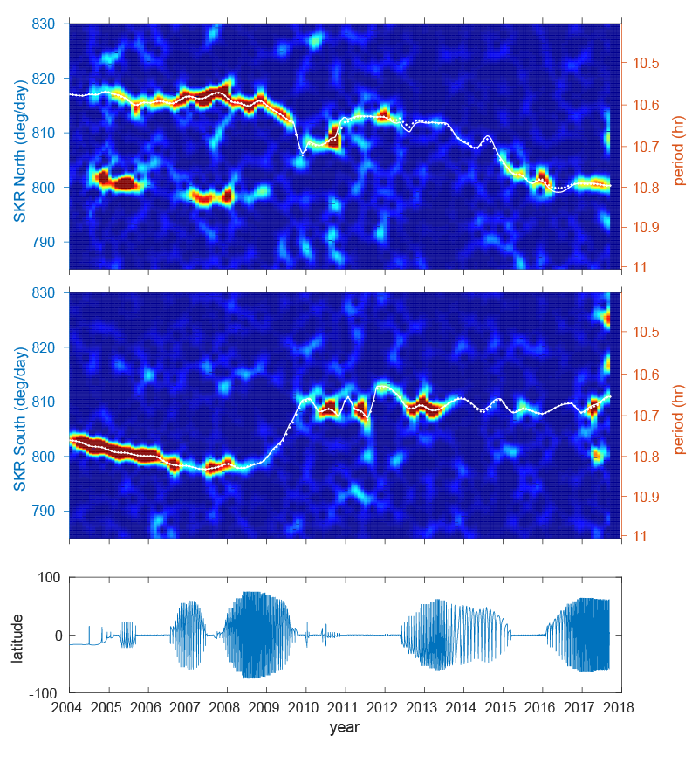
The complexities of the near-rotational modulations of Saturn Kilometric Radiation
Saturn emits Saturn kilometric radiation (SKR) that is modulated at close to the rotation period but which varies by up to one percent on a time scale of years.
Cassini radio observations revealed the appearance of a second component, also with a variable period.
The two periods originate in opposite hemispheres, eventually switching in a complex way after Saturn’s equinox.
The north-south asymmetry has potentially important implications on how angular momentum is transferred from the interior to the magnetosphere.
Narrowband radio emissions and auroral hiss have also exhibited similar periodicities.
Zarka et al., Nature, 2007; Kurth et al., JGR, 2008; Gurnett et al., GRL, 2009; Ye et al., JGR, 2010; Lamy, PRE7, 2011; Fischer et al., Icarus, 2015; Ye et al., GRL, 2018.
Notes:
Primary Reference:
D. A. Gurnett, A. Lecacheux, W. S. Kurth, A. M. Persoon, J. B. Groene, L. Lamy, P. Zarka, and J. F. Carbary, Geophys. Res. Lett., 36, L16102, doi:10.1029/2009GL039621, 2009.
Related References:
W. S. Kurth, T. F. Averkamp, D. A. Gurnett, J. B. Groene, and A. Lecacheux, An Update to a Saturn Longitude System Based on Kilometric Radio Emissions, J. Geophys. Res., 113, A05222, doi:10.1029/2007JA012861, 2008.

Slide 4
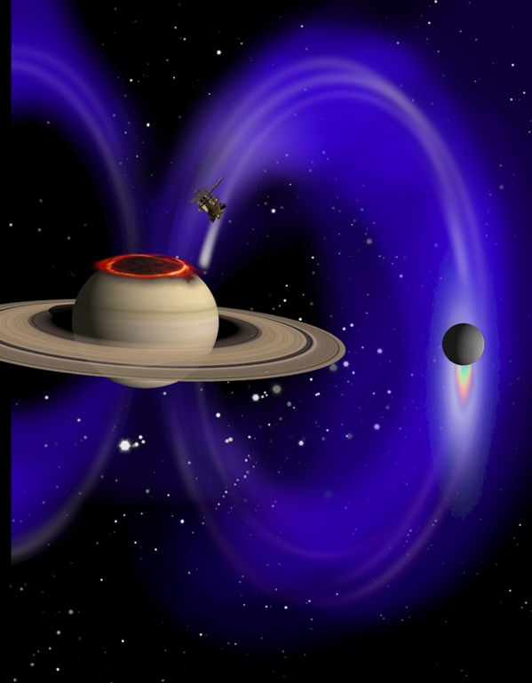
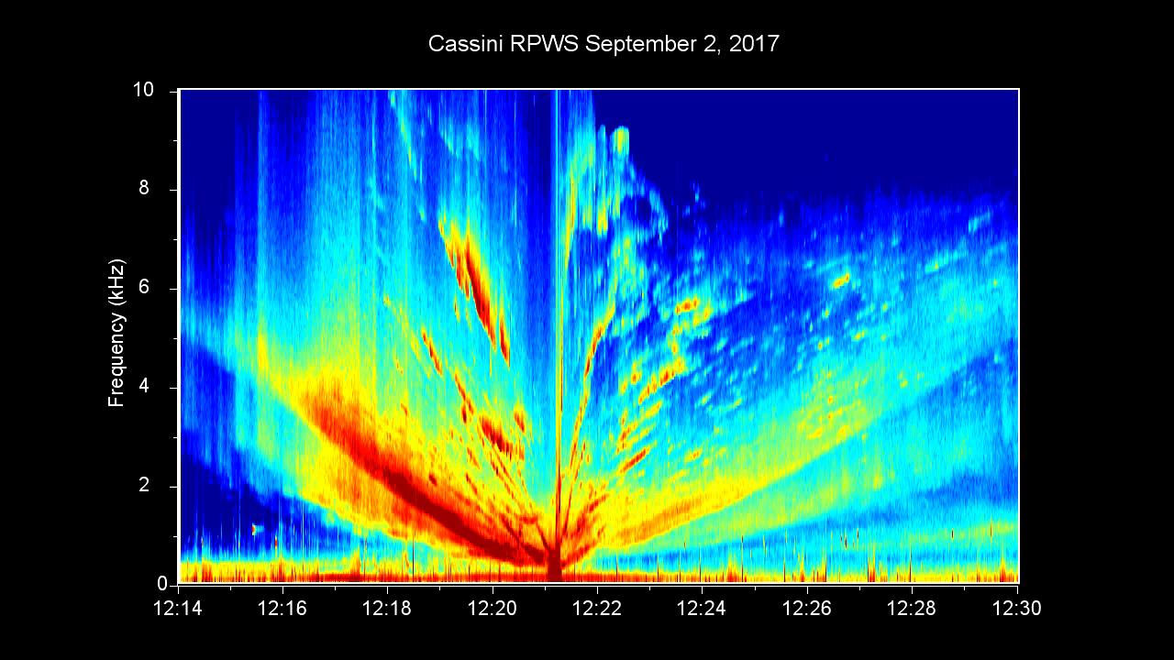
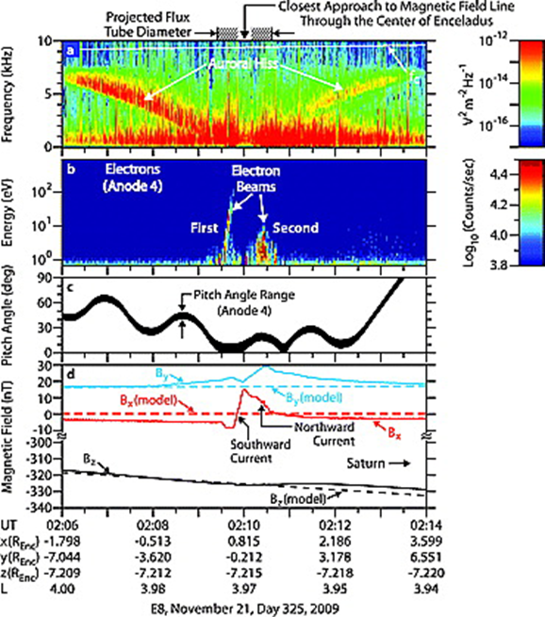
VLF Saucer – Enceladus Interaction
On orbit 291 Cassini observed a feature known as a VLF saucer on the field line connecting Cassini with Enceladus but very close to Saturn.
The observation adds confidence that the Enceladus interaction extends far along the Enceladus field line, resulting in a footprint aurora found by Pryor et al. (Nature, 2011;. Sulaiman et al., GRL, 2018; poster this afternoon.
Gurnett et al., GRL (2011) showed auroral hiss associated with electron beams originating near Enceladus.

Slide 5
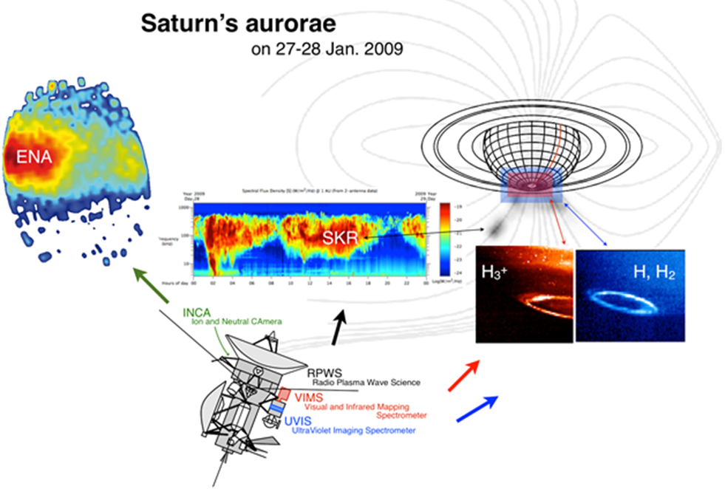
In situ characterization of the SKR source region
Cassini found Saturn Kilometric Radiation (SKR) to be remarkably similar to radio emissions from Earth's magnetosphere (AKR or auroral kilometric radiation).
In late 2008, Cassini's instruments made in situ measurements of an SKR source region and confirmed the cyclotron maser instability produces the radio emission. Additional source crossings occurred during the Grand Finale.
The same instability is found above Earth's polar regions, leading to the generation of AKR. The mechanism is thought to generate many astrophysical radio emissions.
Mutel et al., GRL, 2010; Lamy et al., GRL, 2010; Schippers et al., JGR, 2011; Menietti et al., JGR, 2011; Lamy et al., JGR, 2011; Kurth et al., PRE7, 2011; Lamy et al., Science, 2018.
SKR is also associated with UV and IR auroral emissions and correlated with injections as observed by MIMI/INCA.
Hence, SKR is often used as a proxy for magnetospheric dynamics such as solar wind compressions and magnetotail reconnection.

Slide 6
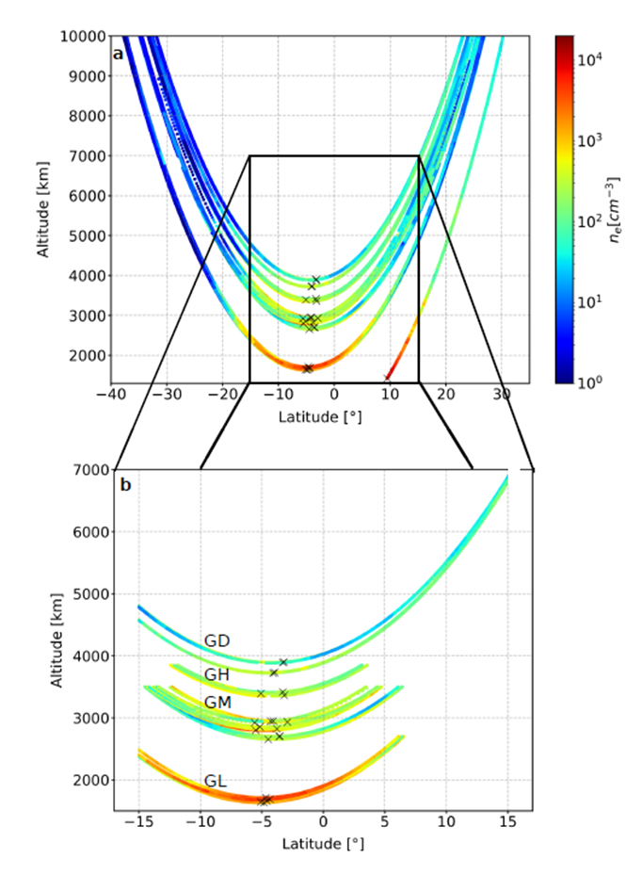
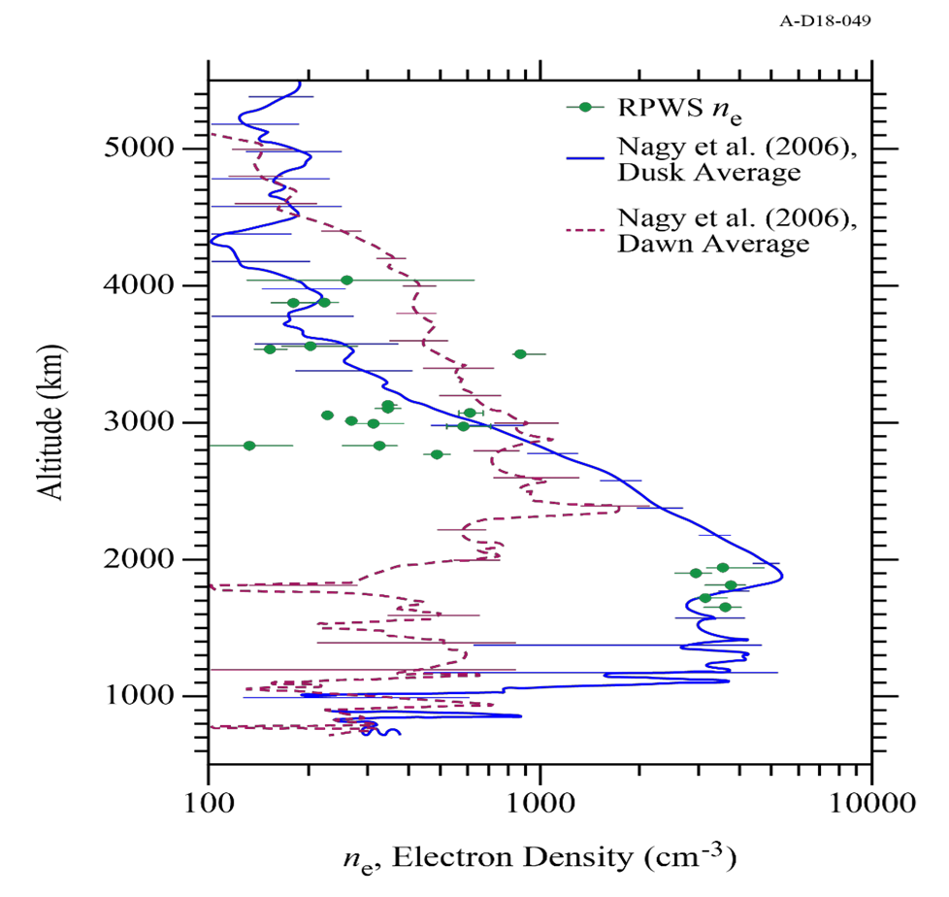
In situ observations of Saturn’s ionosphere
Persoon et al., GRL, 2018
Wahlund et al., Science, 2018; Hadid et al., GRL, 2018
RPWS Langmuir probe and identification of f_{pe} and f_{UH} frequencies provide independent and consistent electron density profiles
Evidence for substantial variation both in position and time
Southern ionospheric densities depleted due to ring shadowing
Increase in Te at lowest altitudes
Large positive ion densities suggest small grains (nm or smaller) carry significant negative charge – consistent with CDA and MIMI detection of tiny grains.

Slide 7
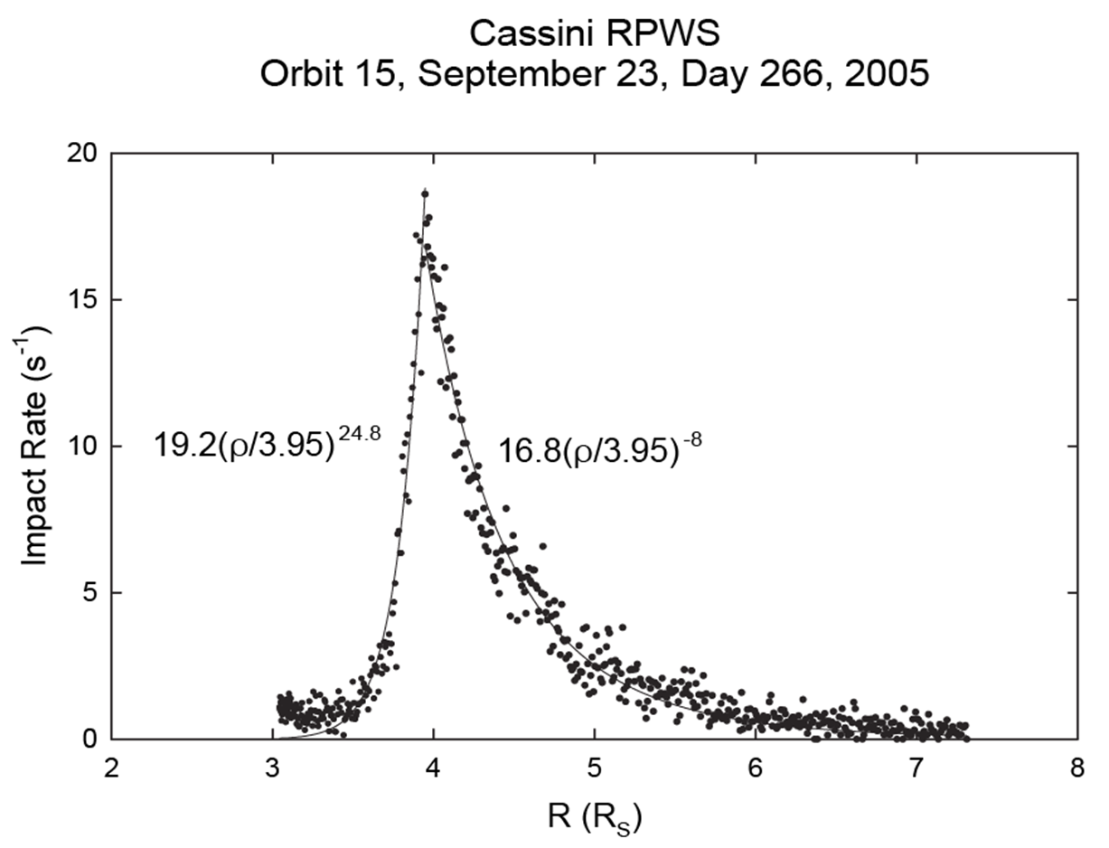
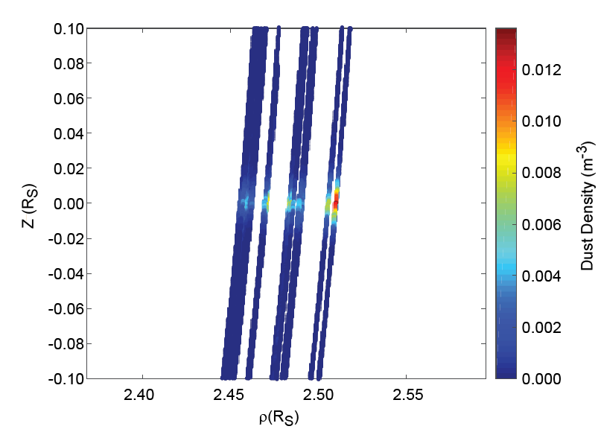
Saturn system dust observations
Dust near
Enceladus
J/E Ring
E Ring
Ye et al., JGR, 2018
Kurth et al., PSS, 2006.
Ye et al., Icarus, 2016
RPWS measured micron-size dust throughout the Saturnian system; does not depend on pointing, but is not calibrated for accurate mass determination or impact speed.
Carried out survey-like measurements of the distribution of dust in the E ring and close to Enceladus, the region near the main ring system such as the Janus and Epimethius ring, and the D ring.
Found few micron-size particles between the D ring and Saturn.
D Ring
Ye et al., poster this afternoon.
Ye et al., GRL, 2018

Slide 8
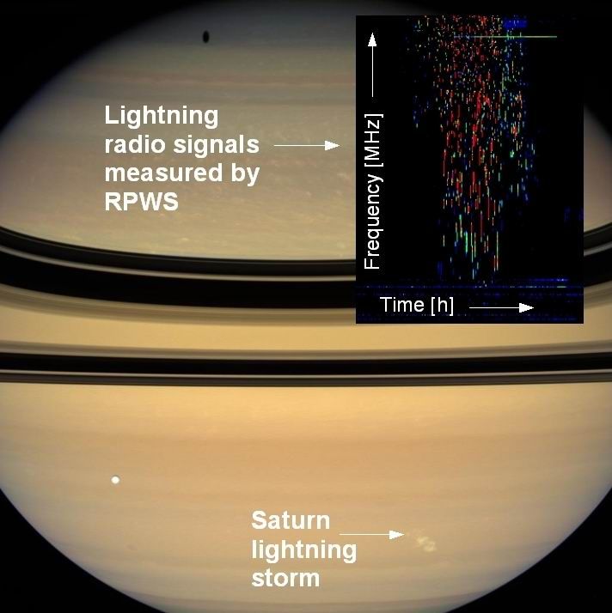
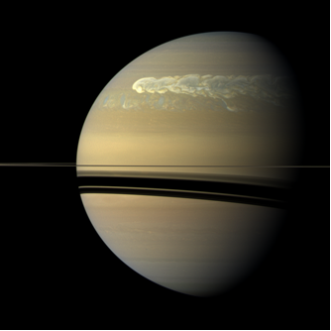
Lightning at Saturn
Bursty radio emissions from lightning discharges were first observed by the Voyagers, but they could not be attributed to storm cloud features in Saturn’s atmosphere. Cassini RPWS detected similar emissions and these were correlated with the appearance of convective storms.
Around Saturn equinox, when the night side of Saturn was not illuminated by ring shine, Cassini provided us the first simultaneousl detection of optical flashes and radio emissions from lightning.
Saturn’s lightning storms can last for several months, but there are also long intervals of time with no activity.
In December 2010 the RPWS instrument detected the first indication of a lightning storm that developed into the most gigantic thunderstorm ever observed by a spacecraft, commonly called a Great White Spot. The first lightning was detected on December 5 and within just one week the flash rate had reached a value of 10 flashes per second. The flashes finally disappeared in late August 2011.
Fischer et al., Icarus, 2007; Fischer et al., Nature, 2011.

Slide 9
Plasma density models for Saturn’s inner magnetosphere
Model Electron Densities
Electron density measurements have been obtained by the Cassini RPWS instrument from passes through Saturn's inner magnetosphere.
The electron densities are derived from measurements of the upper hybrid resonance frequency over a range of latitudes and L values from 2.4 to 10.
The model uses an analytical solution of the field-aligned force equation, including the ambipolar electric field, to determine the equatorial ion densities and scale heights as a function of L.
Models of water group ion, hydrogen ion, and electron densities are derived.
Persoon et al., JGR, 2009; and poster this afternoon
Persoon et al., poster

Slide 10
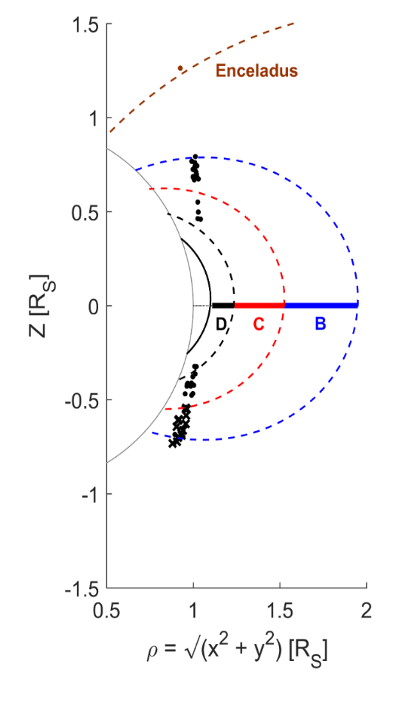
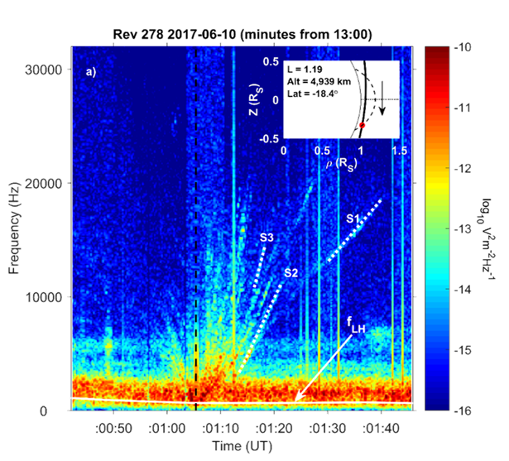
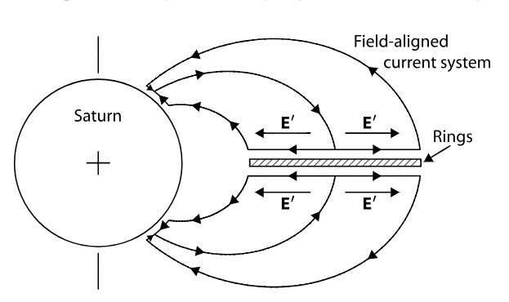
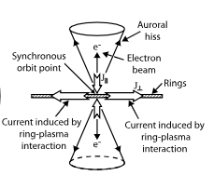
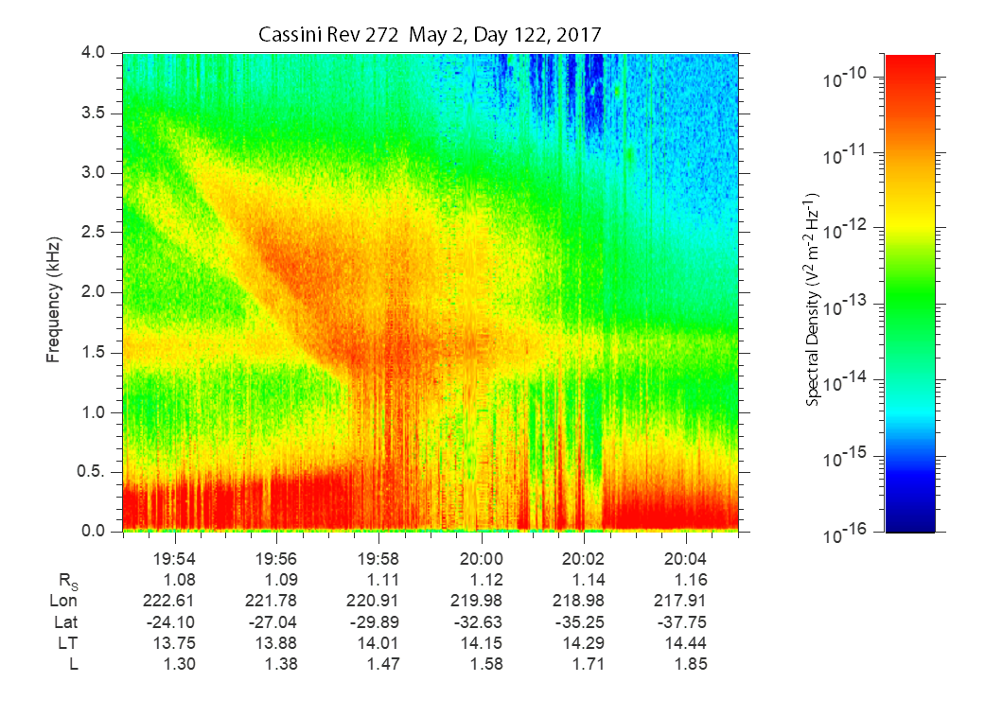
Auroral hiss: Evidence of Saturn – Ring Coupling
Xin et al., JGR, 2006; Farrell et al., later this morning
Auroral hiss is commonly observed on field lines intersecting the rings both during SOI and the Grand Finale orbits
The hiss is driven by electron beams, suggesting currents on these field lines
Hence, the auroral hiss provides evidence of strong connections between Saturn and its ring system.
Suliaman et al., GRL, 2018; and poster, this afternoon.

Slide 11
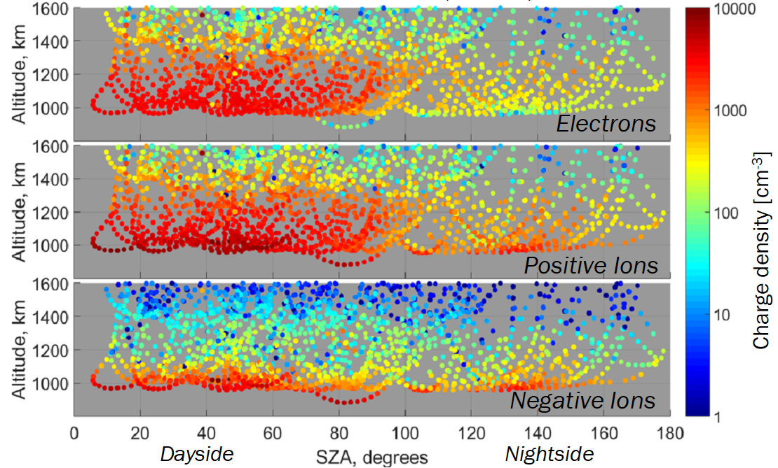
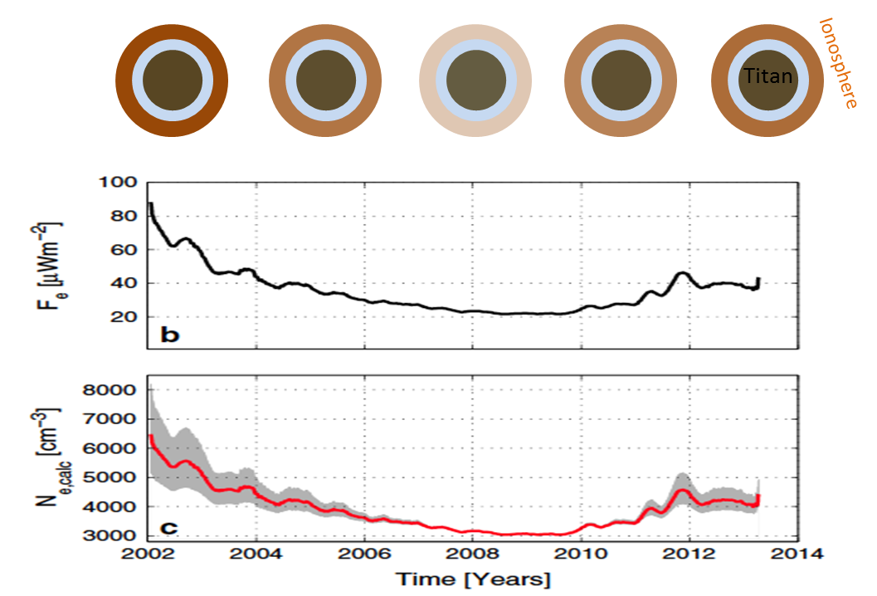
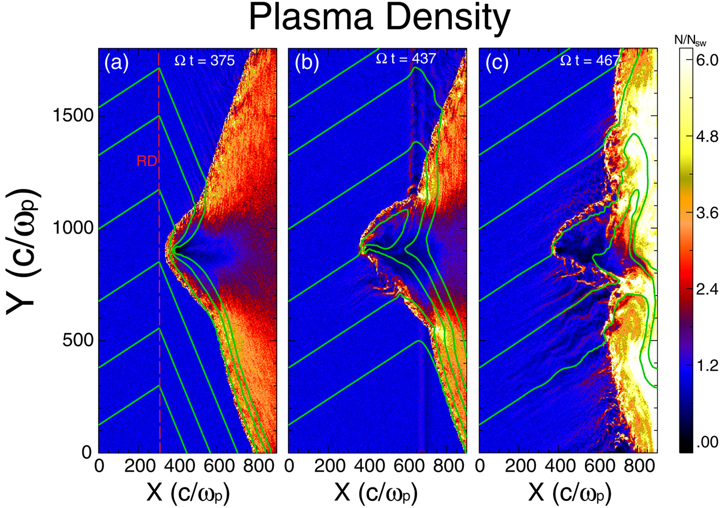
In situ Measurements of Titan’s Ionosphere
Edberg et al., JGR, 2013
Shebanits et al., PSS, 2013
In situ observations of Titan’s ionosphere including electrons and both positive and negative ions
Solar cycle variations in the ionospheric density dominated by solar EUV
Interaction of Titan with the supersonic solar wind leading to a deformed bow shock encompassing both Titan and Saturn.
Omidi et al., JGR, 2017.

Slide 12
Other RPWS Science
Occurrence, periodicity, and source of narrowband (nb) radio emissions
Z mode emissions as a source for nb emissions and as an important mechanism for accelerating radiation belt electrons.
Electron cyclotron harmonic emissions, particularly within injection events
Auroral hiss occurrence, periodicity, and as indicator of a plasmapause-like density gradient near the auroral current system and open-closed field line boundary.

Slide 13
Summary
Dual, variable periodicity of SKR
Magnetospheric interaction with Enceladus
SKR source and relation to aurora
In situ ionospheric observations
Dust in the magnetosphere
Frequency and duration of thunderstorms, GWS
Plasma density in the magnetosphere
Coupling between Saturn and the rings
Titan’s ionosphere, interaction with magnetosphere, solar wind

