Slide 1
Global Maps of Energetic Ions at Saturn and their Relation to the Magnetic Field
J.F. Carbary¹, D.G. Mitchell¹, P. Kollmann¹,
E. Roussos², N. Krupp², & D.C. Hamilton³
¹ Johns Hopkins University Applied Physics Laboratory, Laurel, MD, USA
² Max-Planck-Institute für Sonnensystemforschung, Göttingen, Germany ³ University of Maryland Department of Physics, College Park, MD, USA.
Presented at the Cassini Science Symposium, Boulder, CO
13-17 August 2018

Slide 2
Some Particulars of these Global Maps
• Dataset is entire Cassini Mission from SOI (July 2004) to Final Orbit (September 2017).
• Use of MIMI/CHEMS PHA fluxes, extending down to a few keV with species resolution (H⁺, W⁺, etc.).
(only discuss H⁺ here)
• Correction for seasonal warping of the magnetodisk.
• Mapping in cylindrical and spherical coordinates.
• Separation into dayside (X>0) and nightside (X<0) maps.
• Construction of analytical models of these fluxes, based on fits to lognormal distributions (in range).
• Use of Achilleos (2010) force-balance model.

Slide 3
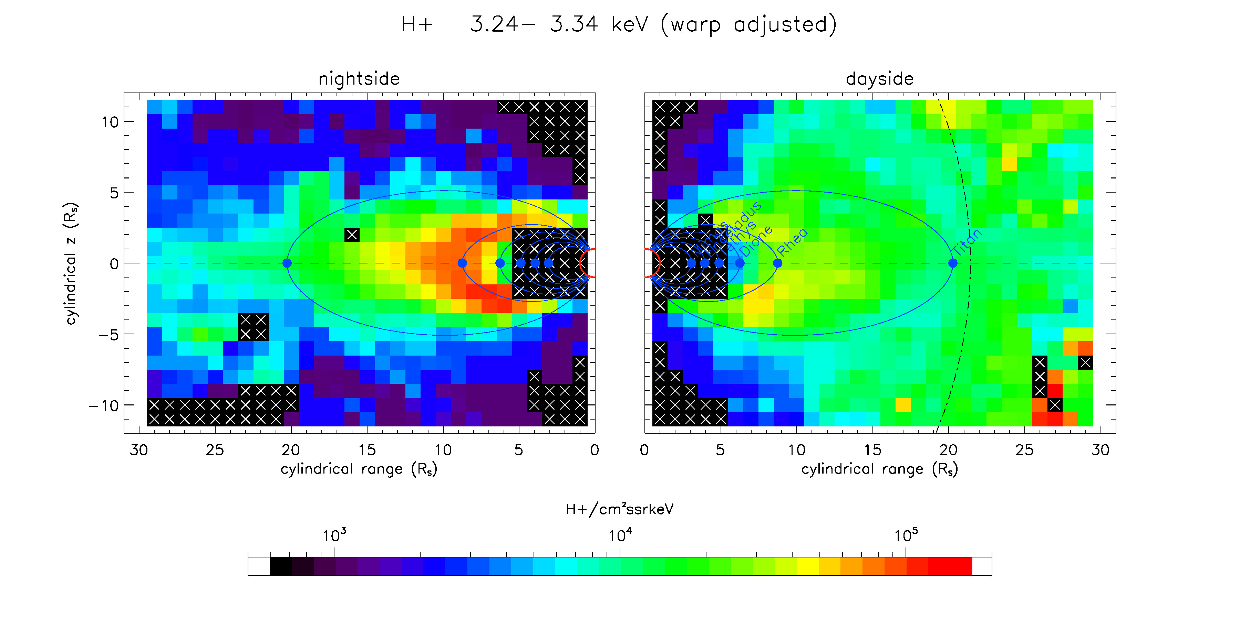
Cylindrical Coordinates

Slide 4
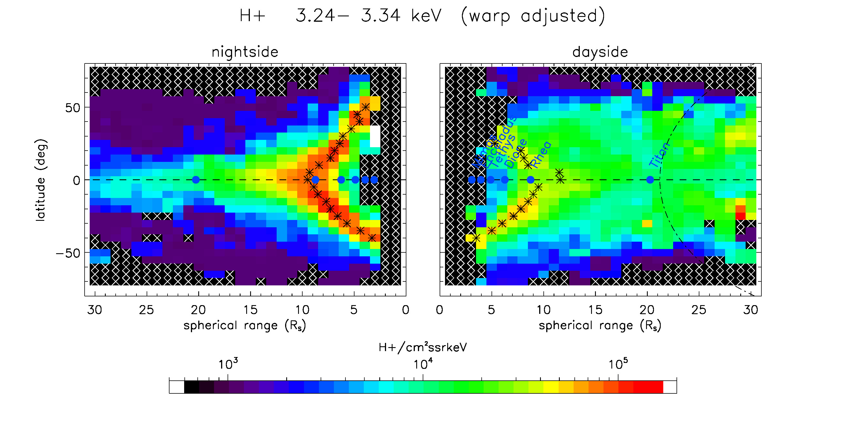
Spherical Coordinates

Slide 5
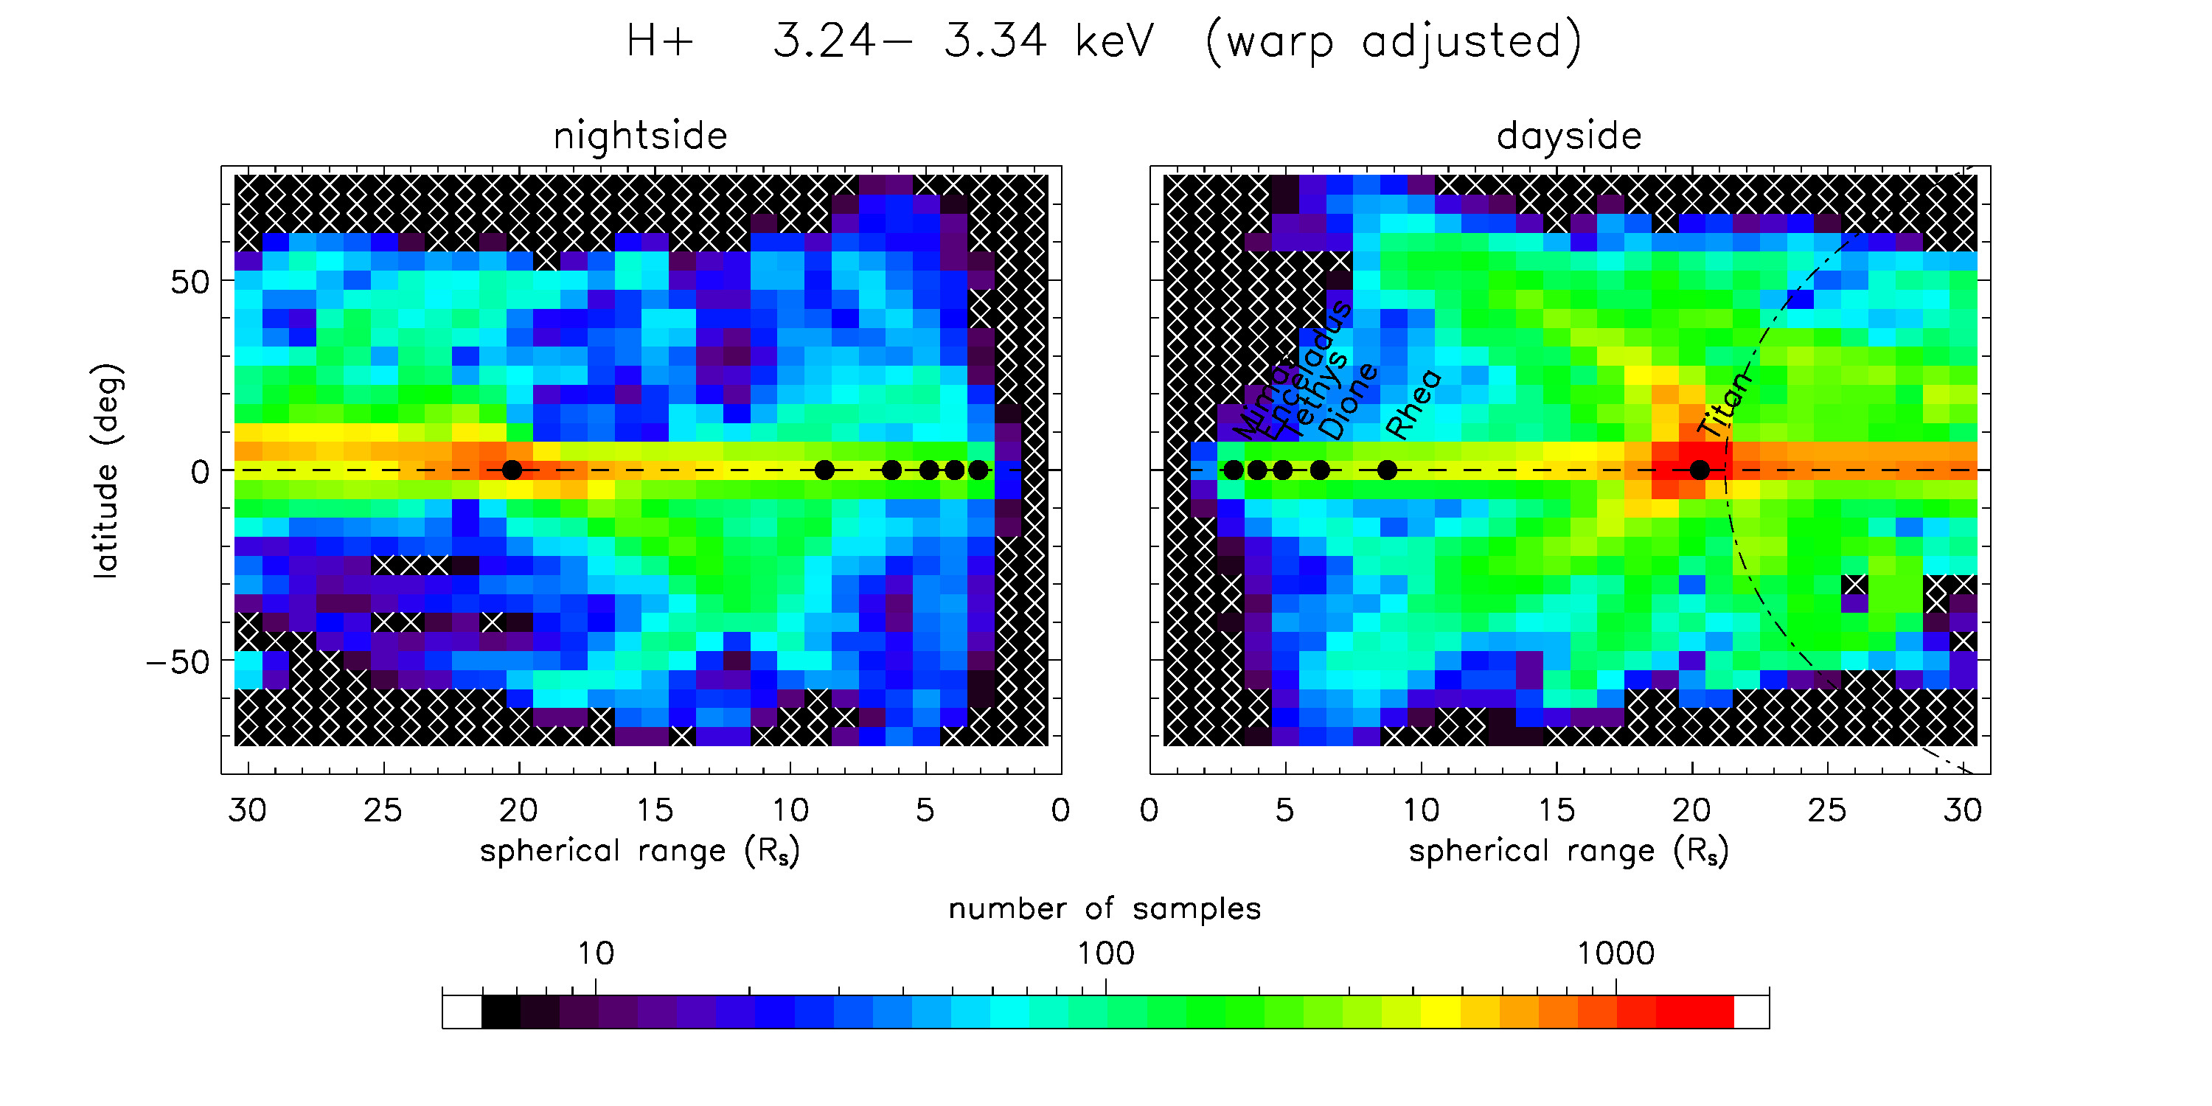
Sample Numbers in Spherical Coordinates

Slide 6
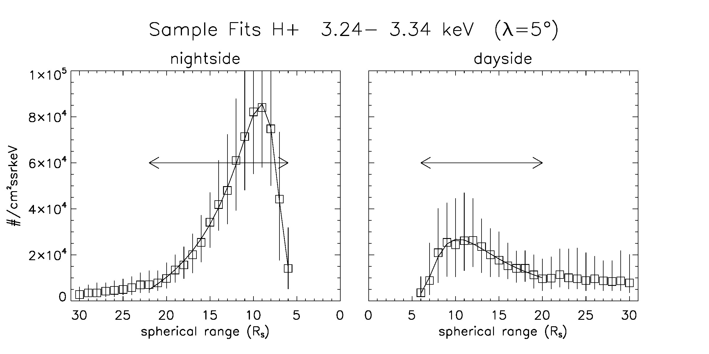
Sample Distributions and Lognormal Fits in Range
${F\left(r\right)}/r=A_{0}exp\left({−z}^{2}\right)+A_{3}+A_{4}log\left(r\right)$ where $z={\left(\log{r−A_{1}}\right)}/{A_{2}}$
Arrows indicate fitting intervals. F(r) is forced to zero at origin.

Slide 7
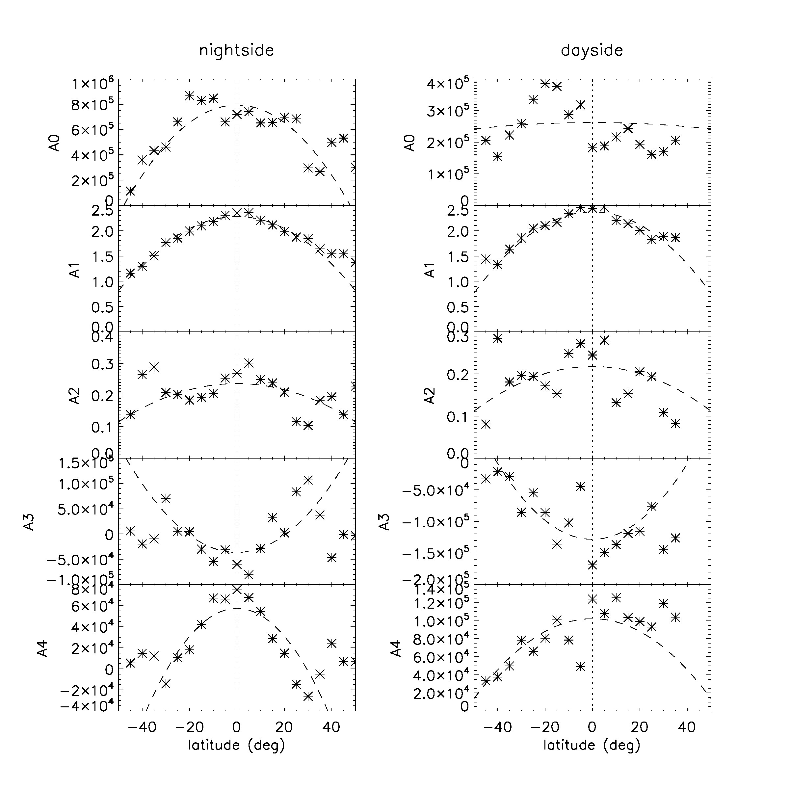
Fitting the Lognormals
One least-square lognormal fit is performed for each latitude bin. The five coefficients A₀, A₁, A₂, A₃, A₄ are then plotted as functions of latitude, as shown here. One set of fits is performed for the dayside, and one for the nightside. Then each of the coefficient curves is themselves subject to another fit, of the form:
$$A_{i}=C_{0i}+C_{1i}λ^{2}$$
where λ is latitude. This function is forced to be symmetric in latitude. The dashed lines in each frame indicate these fits in latitude.

Slide 8
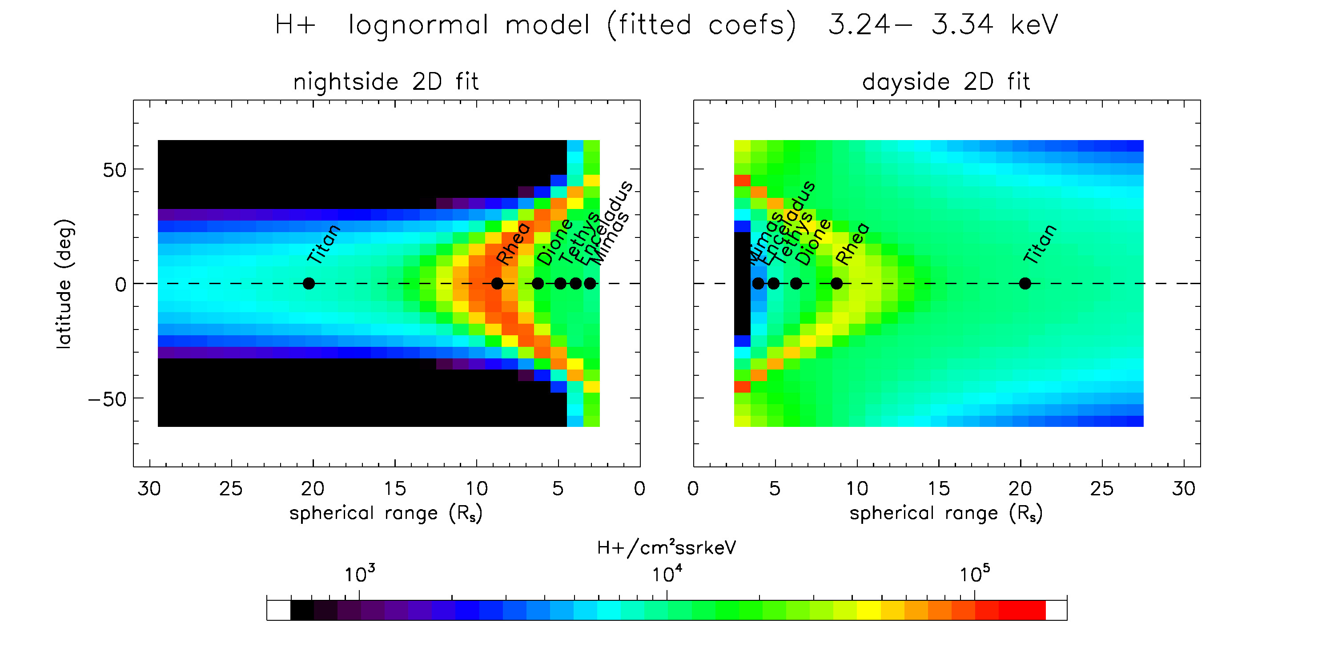
The Model for H⁺ in Spherical Coordinates

Slide 9
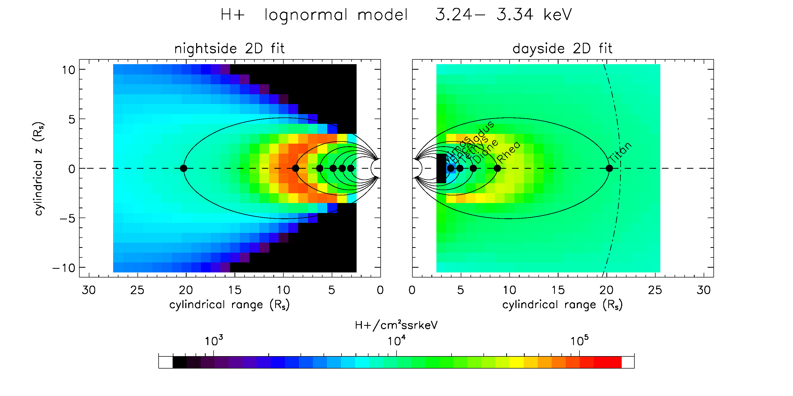
The Model in Cylindrical Coordinates (the Net Result)

Slide 10
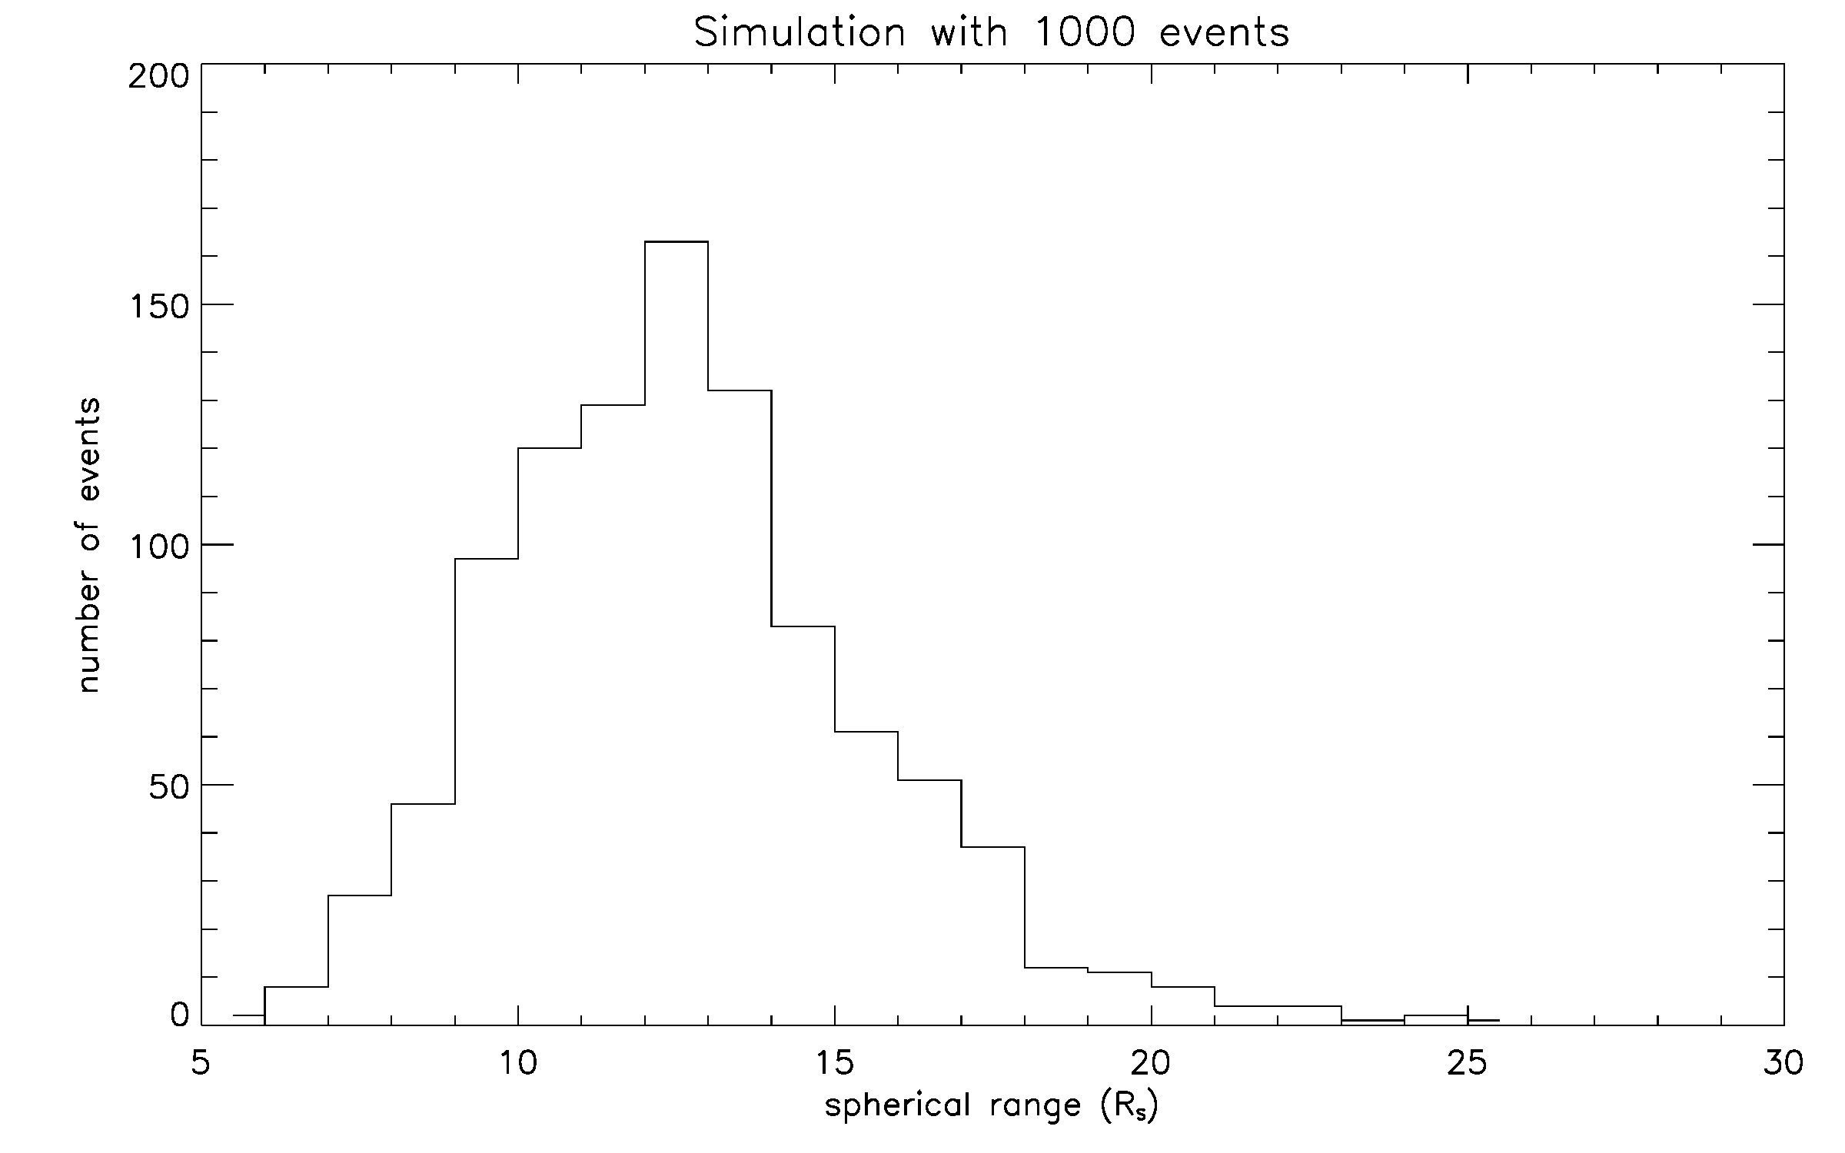
Conclusions
• Flux bifurcation at ~10 R_{S} along magnetic field lines, on the dayside and nightside (a plasma-pause boundary?).
• Fluxes generally greater on the nightside than the dayside, a result of particle injections from the magnetotail or a noon-midnight electric field.
• The magnetodisk thickness is greater on the dayside than nightside (implies compression by the solar wind).
• Use of lognormal distribution in range has implications for the (radial) distribution of injections (see last slide at right).

Slide 11
