Slide 1
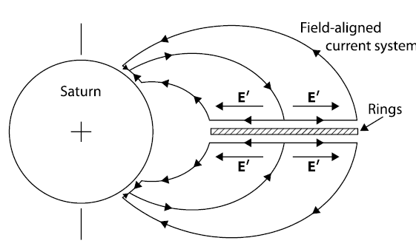
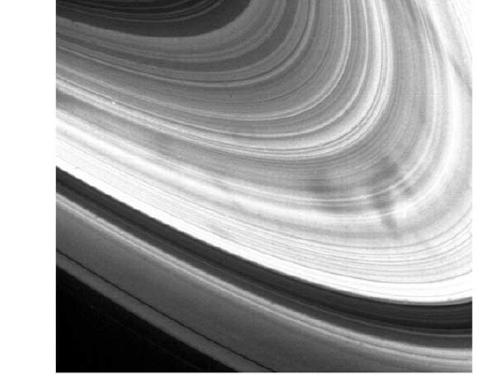
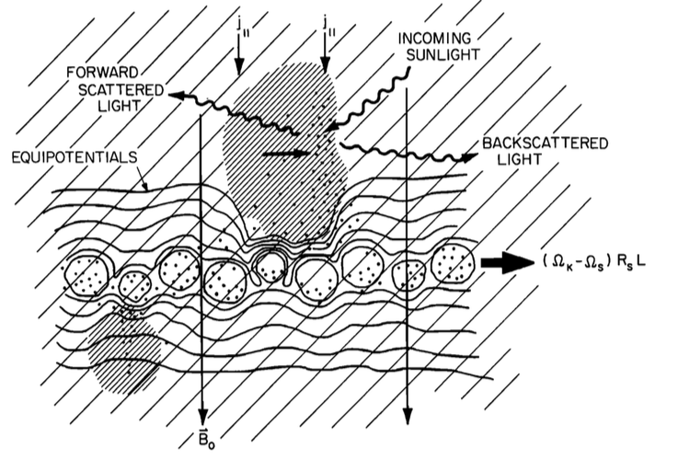
Evidence for a (Solid) Ring-Driven Current System
W. M. Farrell¹, D. A. Gurnett², W. S. Kurth², A. M. Persoon², A. Sulaiman², G. B. Hospodarsky², J. D. Menietti², L. Z. Hadid³, J.-E. Wahlund³, M. Morooka³, R. J. MacDowall¹
1. NASA/Goddard SFC, Grenbelt MD, 2. University of Iowa, Iowa City, IA, 3. Swedish Institute of Space Physics, Uppsala, Sweden
Notes:
Title, RPWS team, mention solid ring to differentiate from ring current

Slide 2
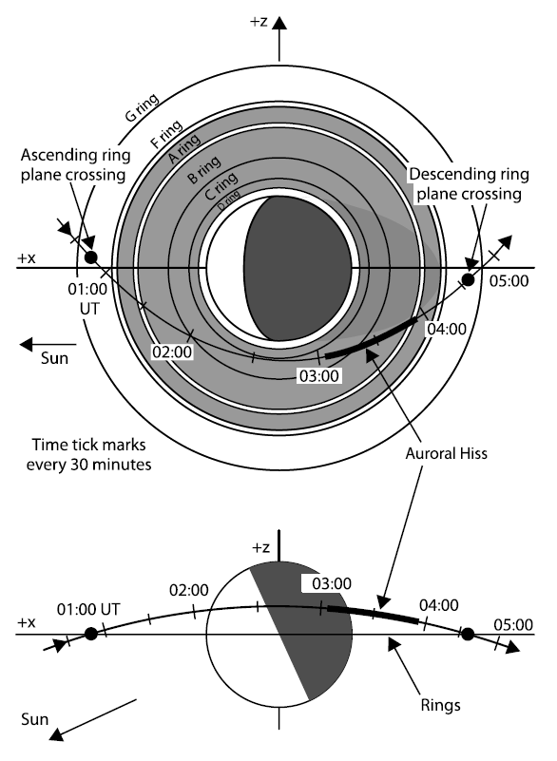
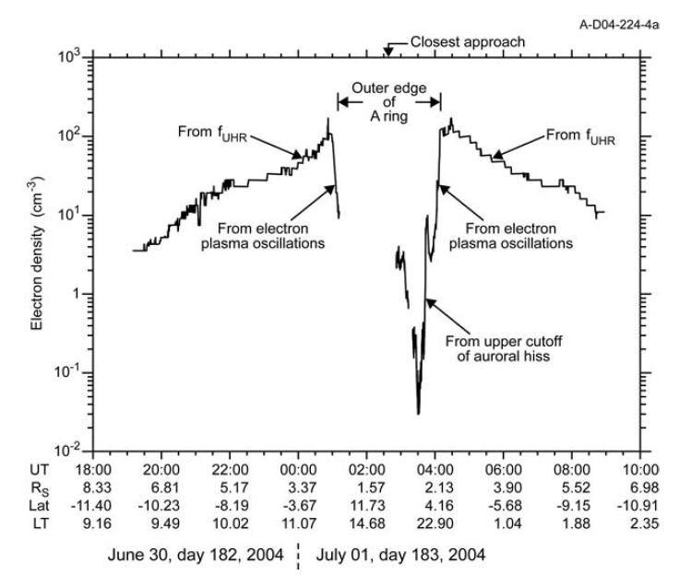
Cassini SOI
July 1 2004
Ring tilt: ~-26º
120 cm⁻³
Thrusters
To within 20000 km of cloud tops
Over unlit surface
0.04 cm⁻³
Gurnett et al, 2005
Ne from f_{pe}, & f_{UH}, consistent with LP
From Xin et al., 2006
-Steep density drop across A-B ring
Ring-Plasma Cavity in center of B-ring
Notes:
Really the story starts back over 14 years ago dueing Cassini’s orbit insetion into the Saturn system. During this time Cassin passed right over the rings….
And the radio and plasma wave system was detecting plasma waves like the upper hybrid frequency and plasma frequency, that allowed a derivation of the electron plasma density…
As describe dby Gurnett in 2005, what was found that over the rings there is a very deep ring-plasma cavity right over the B-ring…with densities at 0.04/cc….on the other edge of the A ring we find dnesities near 120/cc from the combination of the enceladus torus and the seasonal ring ionosphere and there is a near a factor fo 10^4 drop in density across the A ring into the central B ring.
Cassini did an orbit insertion burn at the apex of its CA, which was at ~1.3 Rs. However, after this burn, we go a nice set of ovservatiosn that are revealong. For the sceience paper, Ann Persoon and Don Gurnett translated the UH and fpe into ne measurements…and that plot is on the right. And it is stunning! What is observed is a large plasma torus up to 100/cc that appears to aburptly dies at the rings….dropping in dnesity by almost 4 orders of magnitude. As we show, in the center of the B ring, densities are near 0.04/cc. So this is one impressive steep cliff….with plasma adjacent to the rings in the form of a 2-component torus (will address) and then absorption by the ‘solid’ rings. Rings behave like a solid wall. Going to be a theme….

Slide 3
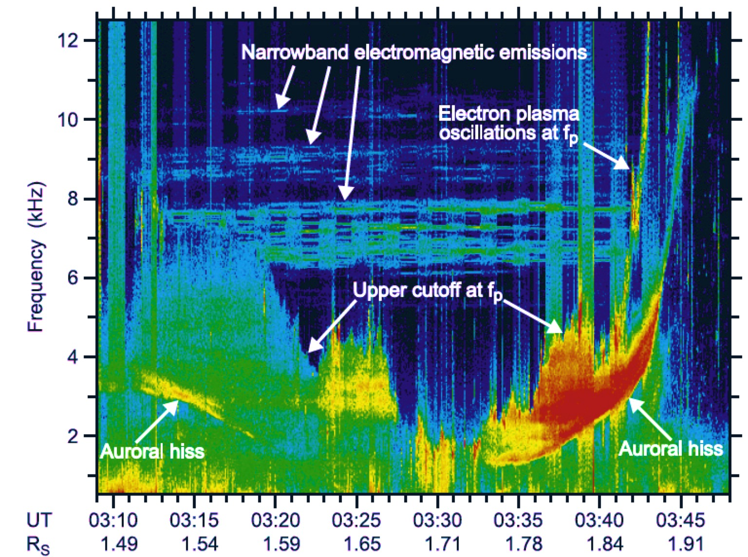
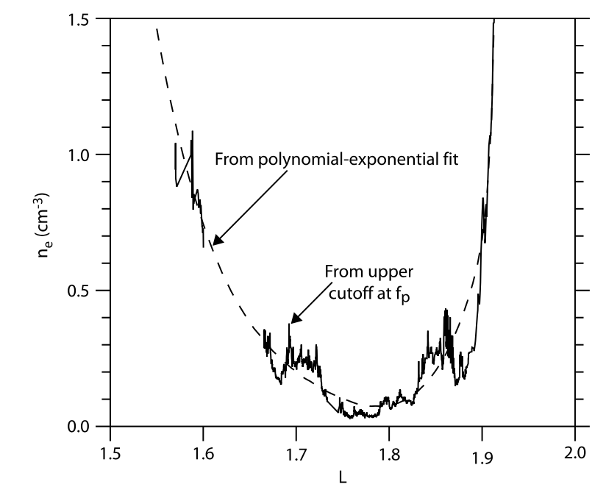
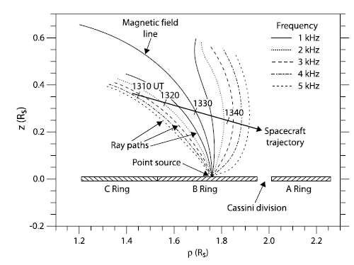
Plasma Cavity & Electron Beam near Synchronous Position (1.76 Rs) [Xin et al, 2006]
SOI Ring
Over-Flight
‘Look-and-feel’ of an Auroral Plasma Cavity
<--- 1/cc
<--- 0.1/cc
Density Min: 1.76 Rs at ~0.04/cc
Observe ‘Auroral’ Hiss emission
3) Parallel propagating electron beam near 1.76 R_{s} is source of auroral hiss
4) Cavity suggests parallel E-field
Very near the synchronous position!
<--- 0.01/cc
B-ring
Notes:
In the center of the B-ring Gurnett et al and Xin et al 2006 reported the presence of this deep plasma cavity by examining the high freuqency edge of the whistler mode emission - a cerenkov-type emission normally found in auroral regions called auroral hiss. However, this hiss is found right overtop the B ring. Auroral hiss is ussaly associated with electron beams of moderate energy, like many 10’s to 10 keV….
In fact, this entire regions was very reminiscent of ‘auroral plasma cavities’ that you fiind associated with discrete aurora arcs at Earth…a location where there are intense Brikland-like field-aligned currents.
Moving into the center part of the B-ring, we encounter a very low dnesity plasa…at 0.04/cc. Xin et al reported that in the center of this plasma cavity, we remote sense the presence of an electron beam, this through its auroral hiss whister mode emission. Im fact the whister mode emsision has its upper cutoff at the local plamsa freq and thus ‘lights up’ a density value.
Xin et al placed this observation into a larger context…

Slide 4
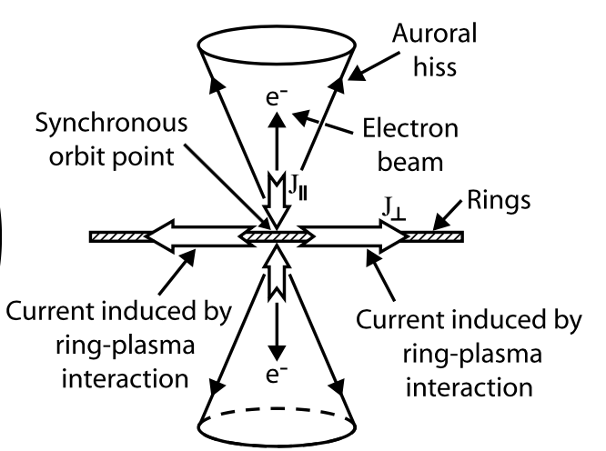
Rings as an Electrical Generator
From Xin et al, 2006 (adapted herein)
Ring-Plasma Cavity
Electron beam
J,
J,
Solid Ring
Current System
Rings as an electrical
current generator
J,
J,
Get electrostatic drag and retarding MHD force:
ρ_{m} dΔv/dt = J x B
Notes:
Here is the idea: that the current system is drivne by a drag force betwene the keplarian moving ring material and the cor-rotating plasma material…..and currents would form to counter that drag. For example, for material beyond the syn point, the rings ar emoving slower than co-rotation, creating a drag on the plasma out of the page, and you thus needed a j x B force into the page to create MHD foce balance. For material inside the syn poitn, the ring material is moving faster than the corotating palsma, creating a ‘push’ into the page…and this has to be coutnered in an MHD sense by a J x B foce out of the page…at the sychronous point, your woild have a field alighned curret – the electron beam- ….which revealed itself as the auroral hiis signal in the center of the ring plasma cavity. You woild also get parallel currents along the outer edge of the rings, near L-2.27, and currents along the inner edge…which turns out to be the D-ring which we examined during the proximal orbit sequence….
So the question:
Implication for electron beam: In essece, the beam is part of a larger current system driven by the rings…as describe by Xin et al, charge particles (even large chunck) in plasma equilibrium with the ring are not corotating but moving on Keplarian velocities, and this difference drives cross-ring currents, in different directions relative to the sync radial location. And we have evidence besisde the beam for this current…fore xample, it closes along the outer edge of the A-ring which in fact we know is electriclally active…so you can start to see elements of this currnt system via the Cassini overflight.
Rings as more solid structures

Slide 5
Rings as an Electrical Generator
From Xin et al, 2006 (adapted herein)
Ring-Plasma Cavity
Electron beam
J,
J,
Solid Ring
Current System
Rings as an electrical
current generator
J,
J,
Is there any other evidence proving the existence of Xin et al Solid Ring Current System?
Notes:
So the question: [read vg].
Implication for electron beam: In essece, the beam is part of a larger current system driven by the rings…as describe by Xin et al, charge particles (even large chunck) in plasma equilibrium with the ring are not corotating but moving on Keplarian velocities, and this difference drives cross-ring currents, in different directions relative to the sync radial location. And we have evidence besisde the beam for this current…fore xample, it closes along the outer edge of the A-ring which in fact we know is electriclally active…so you can start to see elements of this currnt system via the Cassini overflight.
Rings as more solid structures

Slide 6
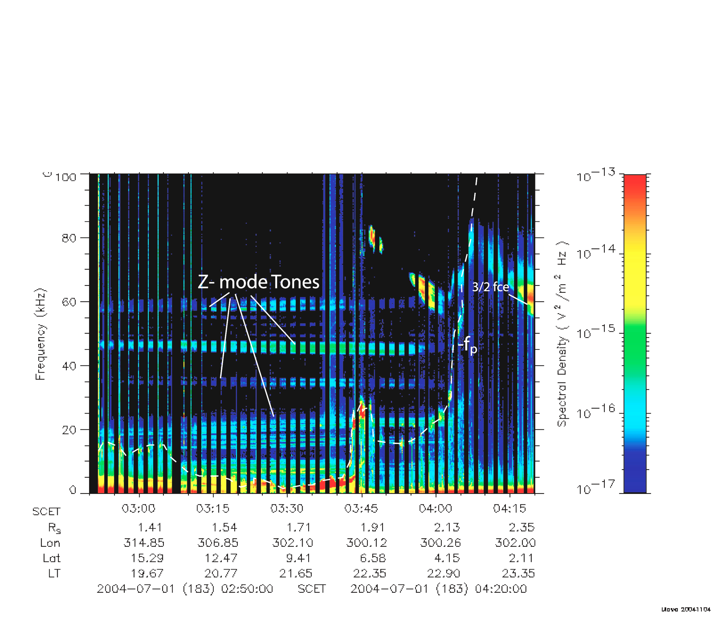
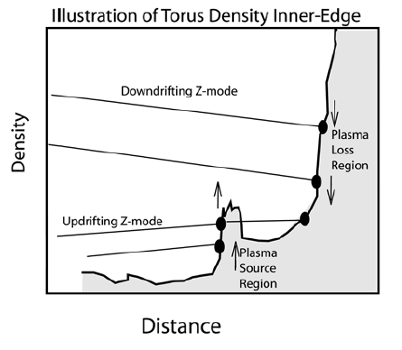
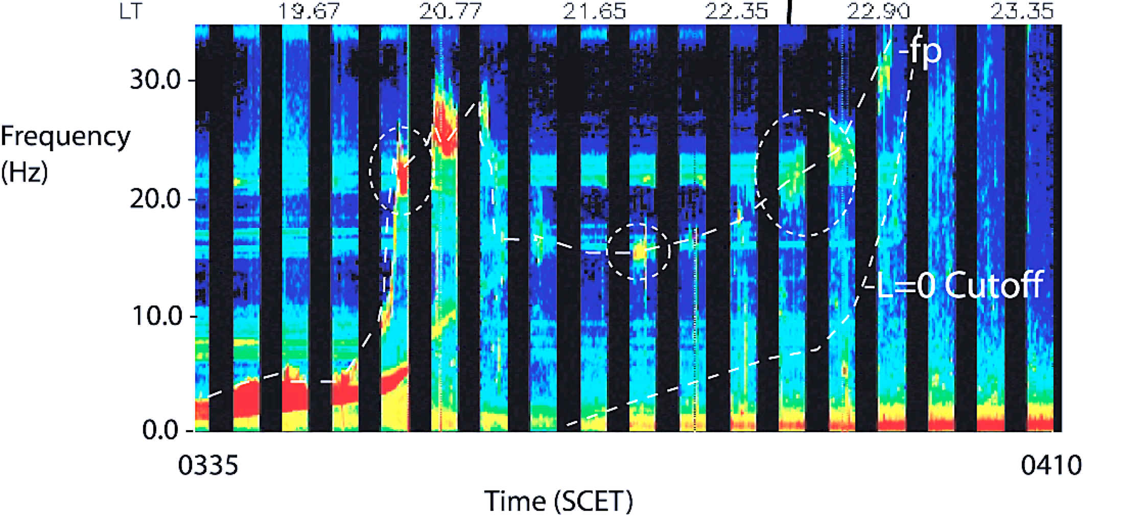
Outer Edge of A-ring (L ~ 2.1-2.3)
SOI Ring Over-Flight
<---100/cc
Steep drop in
electron density
-Edge formed via
A-ring absorption of
Ring-ionosphere and Enceladus torus plasma
-Z-mode tones
<---10/cc
<--- 1/cc
[Farrell et al., 2008]
Notes:
Lets first start at the outer edge of the solid ring current system at the edge of the A-ring. Ine thing we noticed was that very steep drop in plasma density…as I mentioned nearly 10_4 drop in density from L-2.27 to L = 1.76…in about 0.5 Rs….you can see that here…I show RPWS wideband data with freq plotted along the y axis and time along the x axis…the local electron plasma freq show up indicating the dsteep drop in dnesity over the A-ring…you can see the plasma line…allows us to derive the local plasma density….cassini division and then the fpe over the auroral hiss over the B ring.
But another thing that stand out are thse z-mode tones and they have a source at these hot spots located along the wall of the plasma cavity. This is telling us that these field lines along the outer edge of the plasma cavity definded by the main solid ring is electrically active….in fact, in high resolution you can see ‘hot spots’ where the z-mode emissions originate…the hot spots are intensifation in local electron plasma frequency emissions that are associated with an electron current and plasma wave instabilty.
During SOI, Between 2.2 and 2.5 Rs, Cassini RPWS detected that four order of mangitude plasma density drop….like a cliff. This occurred at the outer edge of the A-ring and we wrote a number of papers addressing both the precipitous drop but also the z-mode emissions from ‘hot spots’ idnetified by intensifications in the local plasma frequnecy. I show on the left a spectrogram and box out the location of this precipipis density droput along the other A ring/inner edge of the Enceladus plasma torus. This spectrogram is our reference spectrogram…In essence, to torus plasma (which consists of two compoents, will get to that) is being absorbed by the ring. Since the z-modes is emitted from this inner torus edge, we noted the drifts as being indicative of a change in density in the active region, and frm thse drifts calcuate a density loss rate along the boundary…this loss rate matched a simpler calcultion ncely matched the torus plasma flux rate into the ring surface.
Mass unloading….transfer enceladus torus ion and electron plasma to the outer A-ring, thereby reducung the mass carried by field lines….charge moving corotationall now moving at keplarian speeds….this effective speed up should crate a current along the outer edge of the A-ring. We called it ‘mass unloading’…
Did not have a single snapshot, but could remote sense the active region’s densitiy via z-mode tones.

Slide 7
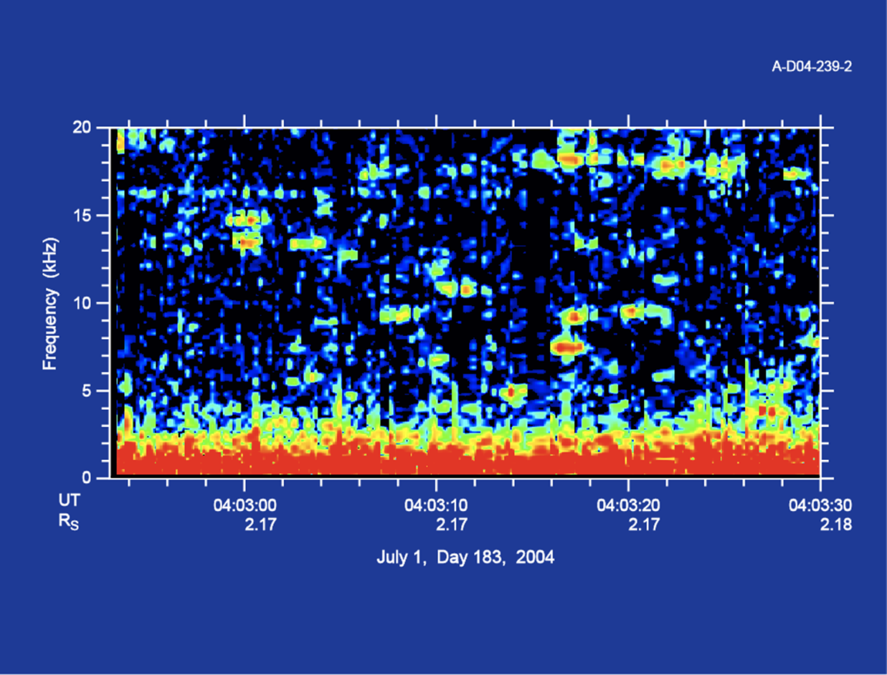
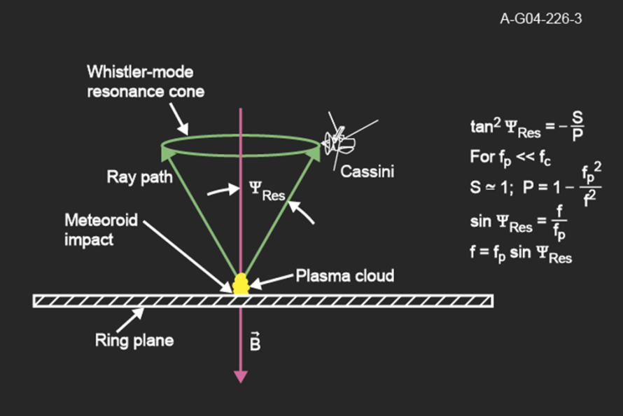
Outer Edge of A-ring (L ~ 2.1-2.3)
-Bursts of electrostatic whistler mode emission (auroral hiss like)
-Whistler-mode bursts
are evidence for Impulsive parallel-propagating electron beams
-Too frequent to be impacts from IDPs…and not seen elsewhere
SOI Ring Over-Flight
<---100/cc
<---10/cc
<--- 1/cc
Notes:
Another piece of evidence is the presence of these whistelr mode bursts….actually in the same mode as the auroral hiss…which would be indicative of field aligned elecrtron beams – bursty in nature – fowing along the outer adge of the A-ring, along where the density dropps and where there are the z-mode hot spots…..
A strange observation at the outer edge of the A-ring was of thes whistelr mode bursts, that were interpreted by Don Gurnett to be from dust impacts onto the A ring….however, these are limited to the outer edge of the A ring….not seen elsewhere. Suggests that larger ‘rogue’ dust, possible from outer E ring, is falling onto the denser rings. A ring-ring interaction. Too many events to be IDPs….another possible interprtation is that it represents a bursty electron beam being generated at the outer edge of the A ring, as part of the ring plasma current system.

Slide 8
Activity on outer edge of A-ring
L ~2.1-2.3
Ring-Plasma Cavity
Strong Cold Plasma
Density Gradient
J,
J,
- Z-mode source location hot spots
- Bursty WM emissions
Indicative of anisotropic, impulsive electron beams
Indicative of current flow along the outer edge of the rings
J,
J,
Solid Ring
Current System
Rings as an electrical
current generator
Notes:
So we now have this picture for the outher edge of the main rings where there may be bursty field aligned electrns beams that give rise to active’ hot spots of plasma wave activity and the burtsy auroral hiss – indicative of parallel propagating burst electron beams
Implication for electron beam: In essece, the beam is part of a larger current system driven by the rings…as describe by Xin et al, charge particles (even large chunck) in plasma equilibrium with the ring are not corotating but moving on Keplarian velocities, and this difference drives cross-ring currents, in different directions relative to the sync radial location. And we have evidence besisde the beam for this current…fore xample, it closes along the outer edge of the A-ring which in fact we know is electriclally active…so you can start to see elements of this currnt system via the Cassini overflight.
Rings as more solid structures

Slide 9
Near the Middle of the B-ring
Ring-Plasma Cavity
L ~1.76
J,
J,
J,
J,
Solid Ring
Current System
Rings as an electrical
current generator
Notes:
Ok…so now lets shift to the center of the B-ring…
Implication for electron beam: In essece, the beam is part of a larger current system driven by the rings…as describe by Xin et al, charge particles (even large chunck) in plasma equilibrium with the ring are not corotating but moving on Keplarian velocities, and this difference drives cross-ring currents, in different directions relative to the sync radial location. And we have evidence besisde the beam for this current…fore xample, it closes along the outer edge of the A-ring which in fact we know is electriclally active…so you can start to see elements of this currnt system via the Cassini overflight.
Rings as more solid structures

Slide 10
Near the Middle of the B-ring
Ring-Plasma Cavity
L ~1.76
-‘Auroral hiss’ emission
-Deep Plasma Cavity
-Electron beams
Looks like an auroral plasma cavity
J,
J,
J,
J,
Solid Ring
Current System
Rings as an electrical
current generator
Notes:
We already discussed that at this location near the sync point, we have that deep ring plasma cavity, auroral hiss, and electron beams….we talked about this…but the only other thing Ill say about this
Implication for electron beam: In essece, the beam is part of a larger current system driven by the rings…as describe by Xin et al, charge particles (even large chunck) in plasma equilibrium with the ring are not corotating but moving on Keplarian velocities, and this difference drives cross-ring currents, in different directions relative to the sync radial location. And we have evidence besisde the beam for this current…fore xample, it closes along the outer edge of the A-ring which in fact we know is electriclally active…so you can start to see elements of this currnt system via the Cassini overflight.
Rings as more solid structures

Slide 11
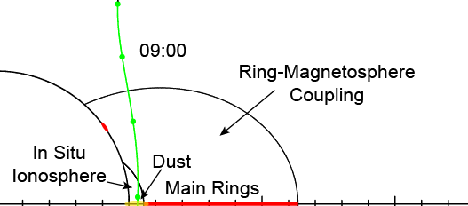
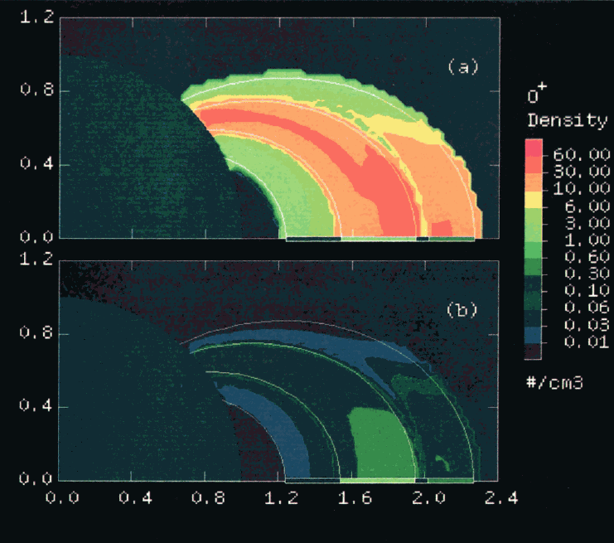
Cassini Era
Evacuated, near-empty plasma on ring-connecting field lines
Cassini flew over rings and passed by on ring connected magnetic field lines
Cassini Trajectory
0.1-1/cm³
R
0.04/cm³
B
A
Voyager Era
Wilson and Waite, 1989
Impact ionization O+, W+ plasma with density > 30/cm³
Voyager did not fly over rings
> 30/cm³
Impactors might not be as vigorous in ring erosion & impact plasma creation as envisioned
Notes:
During the priximal orbits we detected a droput in the electroin density at low altitudes over field lines conncted to the main rings…this as evident in the abrupt decrease in the HF edge of the local whislter mode…and this suggests that the RPC extends to low altidues….so we have this picutre of the RPC with a deep vacuum over the main B-ring and even low dnesiies at low altiude along these field liens…
However, just to note, this view is diametially opposite tio that follwing the Voayer encounter…now remember Voyager did not pass over the ring,s but model of the expect impact ionized plasma on the reings suggested densities along the field oines connecte dot the densie B ring region of over 30 /cc….but instead Cassini measured depleted plasma over the rings at near a factor of 10000 below modeled values….
So maybe impactors on the rings are not as vigorous in generating plasma as originally thought…

Slide 12
Inner Edge of the Solid Ring Current System: The D-ring?
Very complex region:
Evidence for drag and parallel currents
Ring-Plasma Cavity
Solid Ring
Current System
Rings as an electrical
current generator
Notes:
Ok..so now , lets go to the inner edge of the rings where again we expectthe formation of field aligned currents….whre the Sold ring current system closed…
This diagram has been a good map so far, but one issue this diagram may not exactly repesent properly is the location of current closure along the inner edge…in fact, we are finding evidence that closure is occuring along the inner edge of the D-ring, where the ring and ionosphere have drag on each other….
----
Implication for electron beam: In essece, the beam is part of a larger current system driven by the rings…as describe by Xin et al, charge particles (even large chunck) in plasma equilibrium with the ring are not corotating but moving on Keplarian velocities, and this difference drives cross-ring currents, in different directions relative to the sync radial location. And we have evidence besisde the beam for this current…fore xample, it closes along the outer edge of the A-ring which in fact we know is electriclally active…so you can start to see elements of this currnt system via the Cassini overflight.
Rings as more solid structures

Slide 13
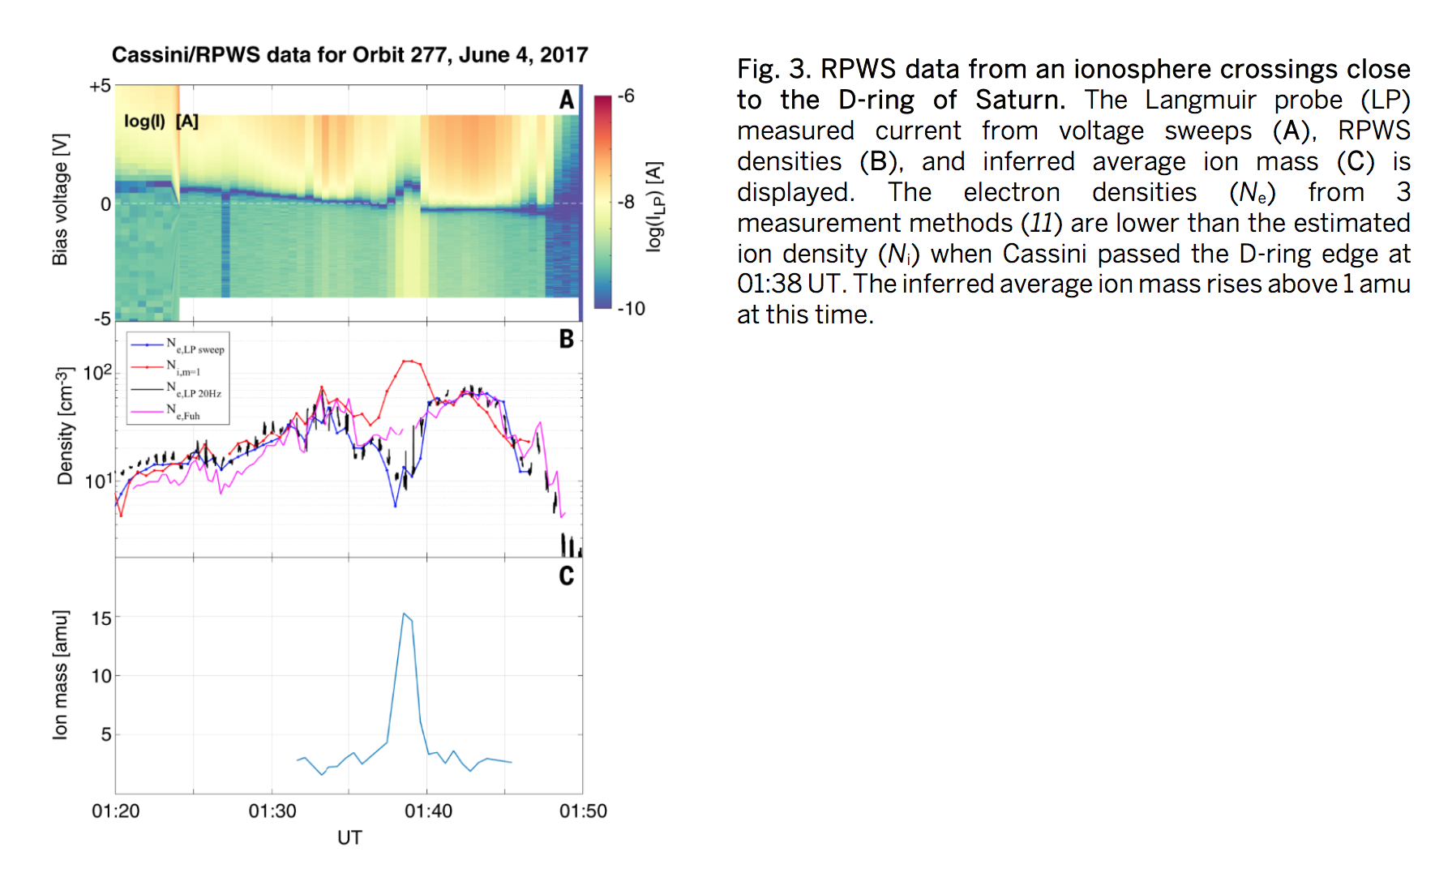
D-ring Langmuir Probe Observations [Wahlund et al., 2018]
-en_{e} + en_{i} + n_{d}q_{d} = 0
n_{d}q_{d}v_{d} = n_{i}ev_{i}
Get electrostatic drag force:
ρ_{m} dΔv/dt = J x B
Part of the In situ evidence for the
Xin et al current system
Notes:
As an example of that drag, I show the Langmuir probe data from the grand finale orbits that crossed slozer to the D-ring,,,…and during orbit 277 RPWS detected micron sized dust impact and the LP system detected a droput in the electrin density relative to the ion density….indicating the presnece of small dust grains that have charged negative. Now the velcities are different between the ions an dust, and we thus epect a
We note that the dust is not moving co-rotationally and we this expect the development of a quasi-radial E-field and current to create a restoring force on the dragging system.
So while in Xin et al they did not formally define the neature of the plasma-particle drag force…they suggested some ideas, we are possibly sensing during these 4 D-ring passes exectly how athe particles and palsma may exert such a drag….with the grains pulling the electrons out of the co-rotting plasma to form grain sheaths that disrupts ion flow since some portion of the ions have occupy the sheath….this then is the ‘drag’ and a J x B force forms to push back on the drag….
But the dust grain sheath will treap ions and remove them from the flow.

Slide 14
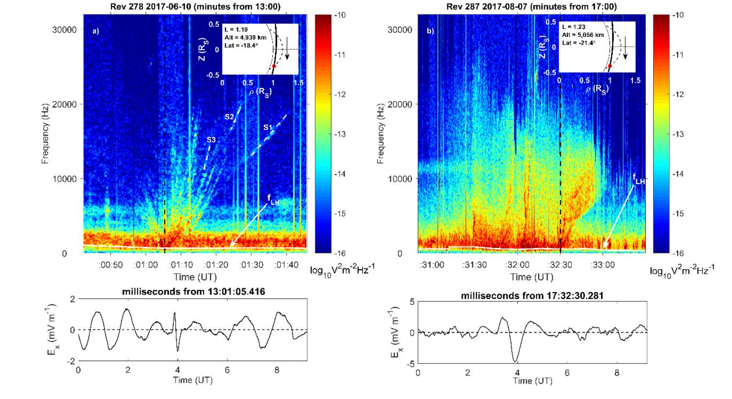
‘Saucers’ in the field lines connecting to the D-ring (L ~ 1.2) [Sulaiman et al., 2018]
Upward electron beams
Downward currents
L = 1.19
L =1.23
Notes:
Field aligned currets also were sensed by in the form of these VLF suacer emissions – a cerenkov whistler mode wave like auroral hiss, only the funnel feateru is not filled in due to the limited extent of the emissions source. In this case, its inferred that the source is below the spacecaft and with upward moving elecrtrons indicative of downward currents
Of course there are field aligned current also,,,,and Ali suiliman had reported on detecing auroral hiss from field lines connected to the D-ring…..

Slide 15
Solid Ring Current System:
New Context for Spokes dynamics
Notes:
One other piece of circumstantial evidence is actually found in the Voyager era….the spokes….and we may have new context to the spokes dynamic if we place the spokes in thisE-field and curtrent environment os the solid ring currnt system. Imagine there is some impulse event that released small submicron dust grains – these could esily get accelerated by the radiali E field of the SRCS to transport the grains inward planetward of the sync point and outward beyond the sync point.

Slide 16


Self-Induced Spoke Transport
[Goertz and Morfill 1983]
Impact raises a dense dusty plasma cloud
Get gradient in pickup, creating azimuthal E_{φ}
Create radial V_{r} = E_{φ} x B_{z} for the plasma cloud
The Eφ transport process is itself transient and self-induced (i.e., originates with the impact event)
Notes:
Let’s first review the spokes dynamics from Goertz and Morfill….go down list….

Slide 17
Xin et al 2006 Solid Ring Current System and Spokes
E
E
If there is already a radial E present via the Solid Ring Current System, might not need the more complex, transient, self-induced Eφ x B system
Spokes are aligned radially, and move radially…if they consist of small grain, they would move under the influence of the environmental Eρ already in place
Some triggering event lifts and charges the dust, but they move under Eρ
Submicron dust is a ‘poor man’s E-field detector’
Notes:
However, if there is already an environmentally-created radially directed E-field, this can drive dust grains without having to involke the transient E-phi and more complex drift mechanism. What is more is small dust, acting as a poor man’s E-field sensor will move under the inflence of the E, while the plasm will get picked up and move in the phi driection…so it suggests the radial fingers are indeed small particualtes.

Slide 18
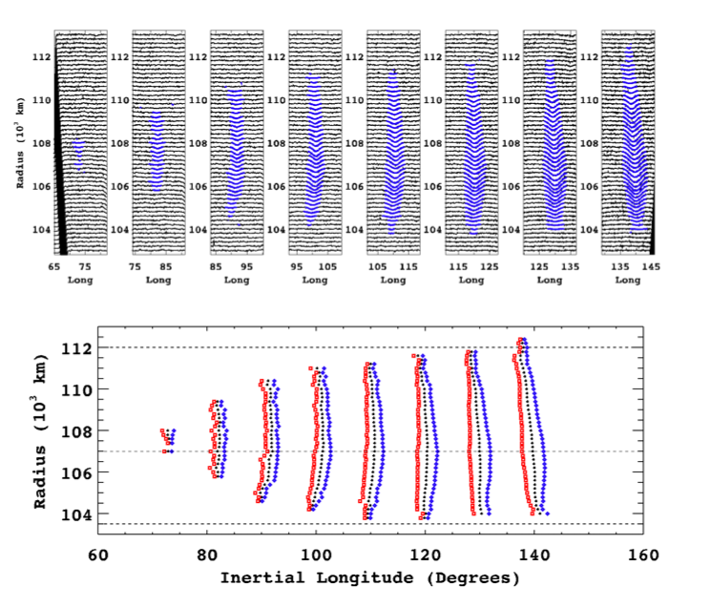
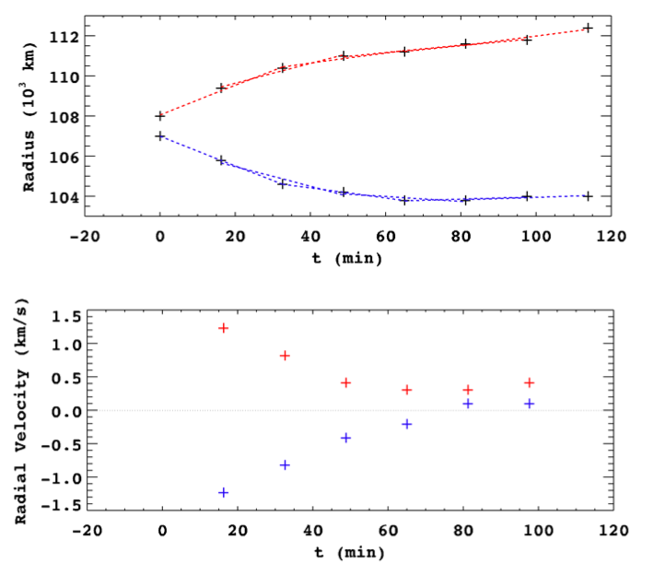
Mitchell et al. 2013: The behavior of spokes in Saturn’s B-ring
Aug 2008 – 8 consecutive images
E
E
Far easier to believe that there is an existing radial E-field from the Solid Ring Current System than an impact self-induced Eφ process
Charged submicron grains move radially under
F = q(E + vB), with E >> vB
with E being that from the SRCS
Spokes might be a visual manifestation of E
Notes:
As an example I show the mitchell et al results of spoke evolution with the spoke material moving both inward and outward with time….driven by the E-field respectively. Small grains would be expected to move =under the inflence of this E. This would also tell is the grains are positive. Spokes might be a visual manifestation of the driving E-field environment,

Slide 19
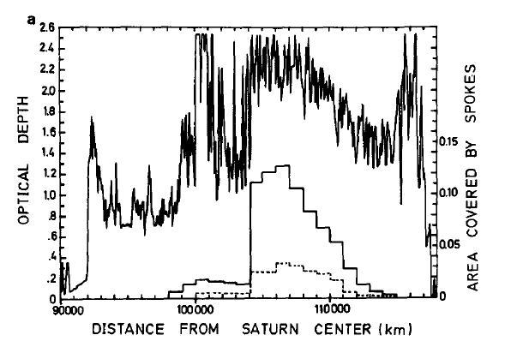
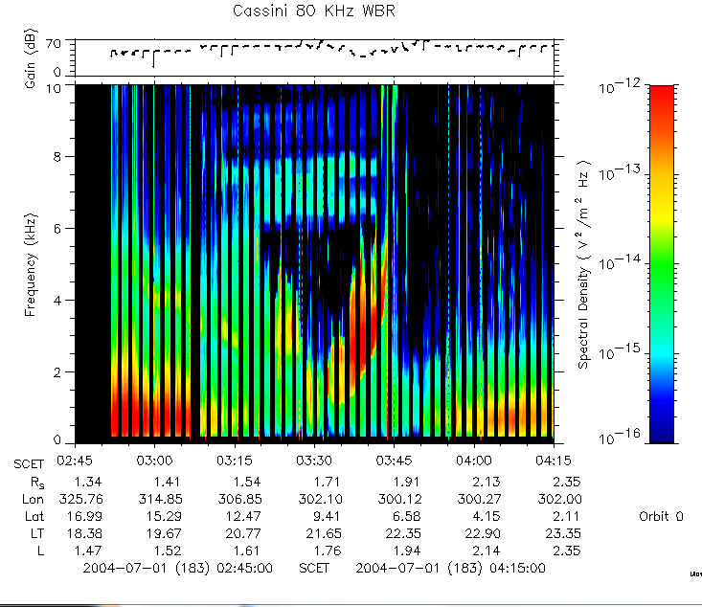
Spokes locations co-aligned
w/ the ring plasma
evacuation (cavity) region
Grun et
al, 1992
V2 observations
--------------------Spokes – Morning ansa
--------------------Spokes-Evening ansa
Cassini
Division
|----
-- >
0.5/cm³- >
<-fp
- fpe
RPWS
WB
SOI pass
Ring Plasma
Cavity
The Spokes, The Ring Plasma Cavity and the SRCS are likely interconnected
-0.04/cm³
Notes:
One other thing…the spokes appear to be co-loacred with the ring plasma cavity…suggesitng that the cavity, current system and spokes are all interrelated…the spokes may be the visual manifestation of the E-field and Xin current system
As an example, the spoke occurrence location appear to align themselves where the centerla B-ring plasma cavity exists, where ambipolar processes might be the greatest. Aslo, as the ring tilt angle places the ring in sunlight, we expect the palsma cavity to disapper due to phot-electron emission and the formation of the ionospehre…and the spokes are reported to also disapper at large tile angles…so as the cavity ‘fills in, the spokes go way.
So there is ciricumstantial evidenc that the two might be conencted….so whether you think the spokes are from mm, lightning, or ambipolar rpocess asso with the plasm cavity, the proximal orbits will provide the plasma context to idnetifiy the spoke forming processes.
Get better alignment here

Slide 20
Solid Ring Current System Features
Active Location at: | Activity Manifested as: | Indicative of:
L = 2.2 Field Line | -Z mode hot spots -Cerenkov WM bursts | -Field aligned electron beams -Parallel E field -Parallel currents
Ring Plane | Spoke Motion | Radially directed E field across ring face
L = 1.78 Field Line | -Auroral Hiss at rings -Ring Plasma Cavity | -Field aligned electron beam -Cross-ring potential drop -Parallel E-field -Parallel current
L < 1.2 D-ring | -Electron absorption by dust -Cerenkov ‘Saucer’ emissions | -Evidence of ‘drag’ -Parallel currents
Notes:
So this table defines some of the sold ring current system features….

Slide 21
Conclusions
In addressing the evidence for the Xin et al Solid Ring Current System, we also present a review of some of the Cassini RPWS observations at the rings.
Bookends: Observations at the very beginning (SOI) and end of Cassini mission (Grand Finale) very relevant to study
  Cassini mag connected to the rings
Body of evidence supports this SRCS model
  Possible additional evidence in the spokes observations
However, the D-ring/Ionosphere connection looks very complex, and we are still figuring it all out – in the context of the other key observations provided by MAG/MIMI/INMS
  There is a complex dusty plasma present and particulate-plasma drag is complex
  Dusty-plasma effects found in both the D-ring and at very low altitude
Notes:
Go down list….

Slide 23
Backup

Slide 24
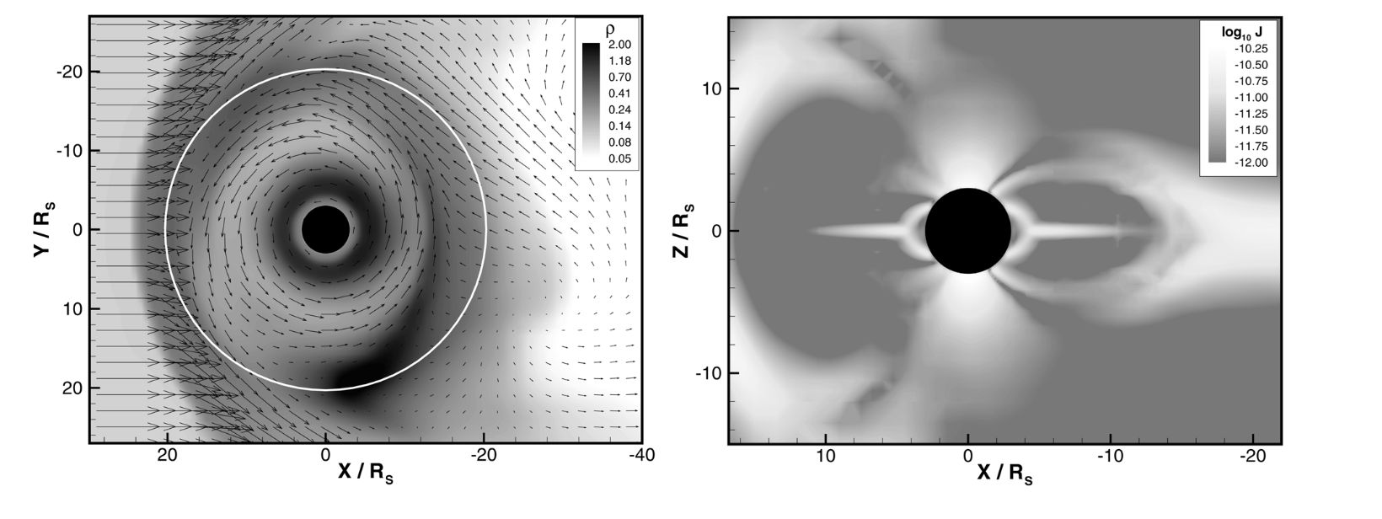
Solid Ring-Plasma ‘Drag’ Not completely unexpected [Gombosi et al , 2000]

Slide 26
Ring-Plasma Slow Down Not completely unexpected [Gombosi et al , 2000]

Slide 27
From Xin et al, 2006 (adapted herein)
Ring-Plasma Cavity
Electron beam
Solid Ring
Current System
Rings as an electrical
current generator
Effective ‘drag’ force from:
-Ring neutral-plasma collisions
-Pickup of ring exo-ions
-Charging of dust by co-rotating plasma
Notes:
Here is the idea: that the current system is drivne by a drag force betwene the keplarian moving ring material and the cor-rotating plasma material…..and currents would form to counter that drag. For example, for material beyond the syn point, the rings ar emoving slower than co-rotation, creating a drag on the plasma out of the page, and you thus needed a j x B force into the page to create MHD foce balance. For material inside the syn poitn, the ring material is moving faster than the corotating palsma, creating a ‘push’ into the page…and this has to be coutnered in an MHD sense by a J x B foce out of the page…at the sychronous point, your woild have a field alighned curret – the electron beam- ….which revealed itself as the auroral hiis signal in the center of the ring plasma cavity. You woild also get parallel currents along the outer edge of the rings, near L-2.27, and currents along the inner edge…which turns out to be the D-ring which we examined during the proximal orbit sequence….
So the question:
Implication for electron beam: In essece, the beam is part of a larger current system driven by the rings…as describe by Xin et al, charge particles (even large chunck) in plasma equilibrium with the ring are not corotating but moving on Keplarian velocities, and this difference drives cross-ring currents, in different directions relative to the sync radial location. And we have evidence besisde the beam for this current…fore xample, it closes along the outer edge of the A-ring which in fact we know is electriclally active…so you can start to see elements of this currnt system via the Cassini overflight.
Rings as more solid structures

Slide 28
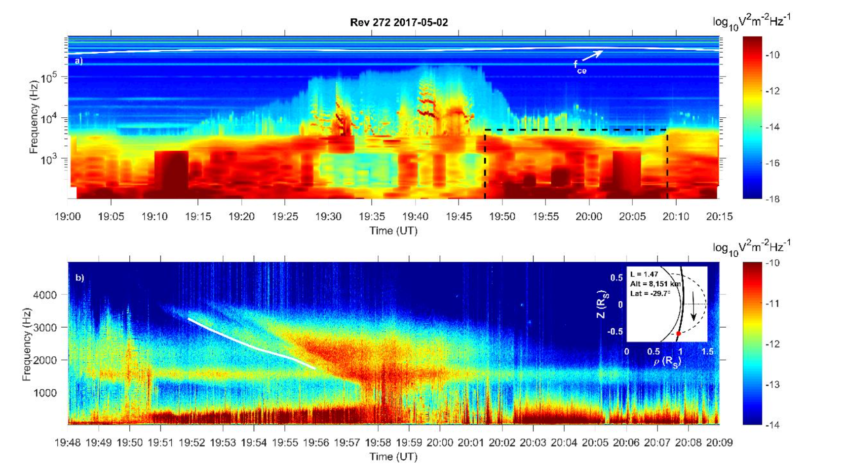
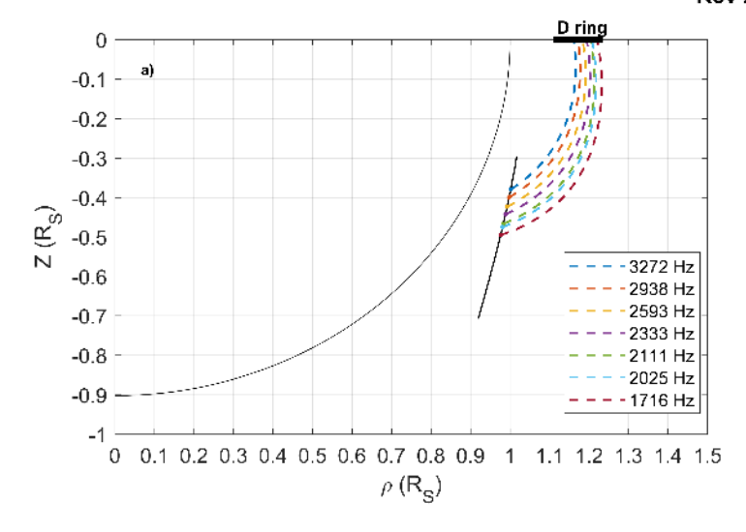
Auroral Hiss from the D-ring (L ~ 1.47) [Sulaiman et al., 2018]
‘Auroral hiss’ indicative of field aligned electron beams
A Cerenkov disturbance of the beam in the cold plasma
Notes:
Of course there are field aligned current also,,,,and Ali suiliman had reported on detecing auroral hiss from field lines connected to the D-ring…..

Slide 29
SRCS Key Features
Active field lines near L = 2.2, with evidence for field aligned currents and E||
Radially directed E and J – outward pointing E_{ρ} & J_{ρ} beyond sync point, inward pointing inside sync point
Deep Ring-Plasma Cavity, auroral hiss, electron beams, field aligned currents, and E||near sync point – has ‘look and feel’ of an auroral plasma cavity
Active field lines along inner edge of D-ring: Very complex where viscous drag between co-rotating ionospheric plasma and D-ring grains also forms field-aligned currents

Slide 30
