Slide 1
A Large Seasonal Variation of Energetic C⁺ and CO⁺ Abundances in Saturn’s Magnetosphere Probably Resulting from Changing Ring Illumination
D.C. Hamilton¹, S.P. Christon², D.G. Mitchell³, R. Morishima⁴, and R. Hodyss⁵
¹University of Maryland
²Focused Analysis and Research
³Johns Hopkins Applied Physics Laboratory
⁴UCLA/JPL
⁵JPL
Cassini Science Seminar
August 13-17, 2018
Boulder, Colorado

Slide 2
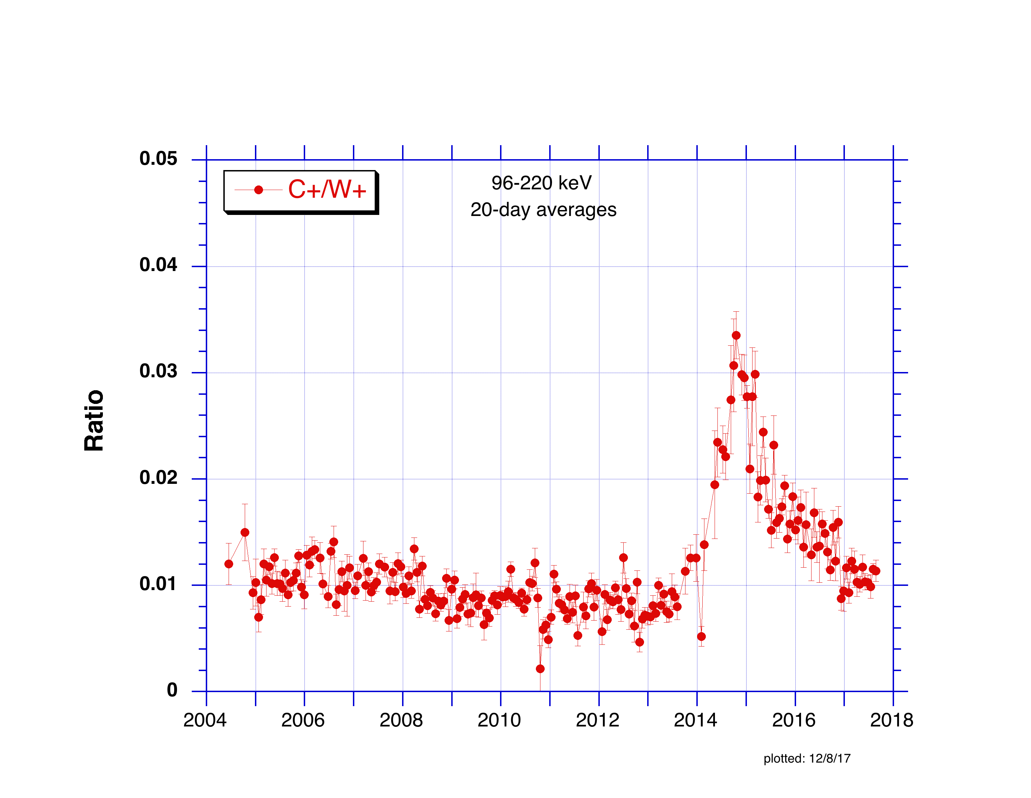
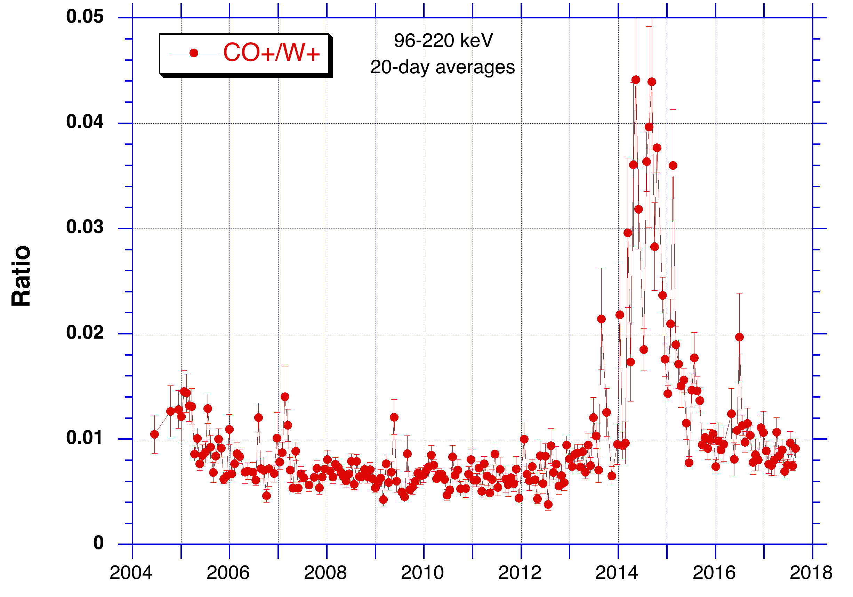
Cassini/MIMI/CHEMS
The Big Picture (2004-2017 end of mission)
Abundance ratios of C+/W+ and CO+/W+ are shown from July 2004 to Sept 2017.
Most remarkable are the large increases in C+ and CO+ relative to the water ion group in 2014 and 2015.
The relative increase in C+ is a factor of ~4 and that of CO+ is a factor of ~8.
A gradual ~30% decrease in the C+/W+ ratio from 2004 to 2013 is also apparent.

Slide 3
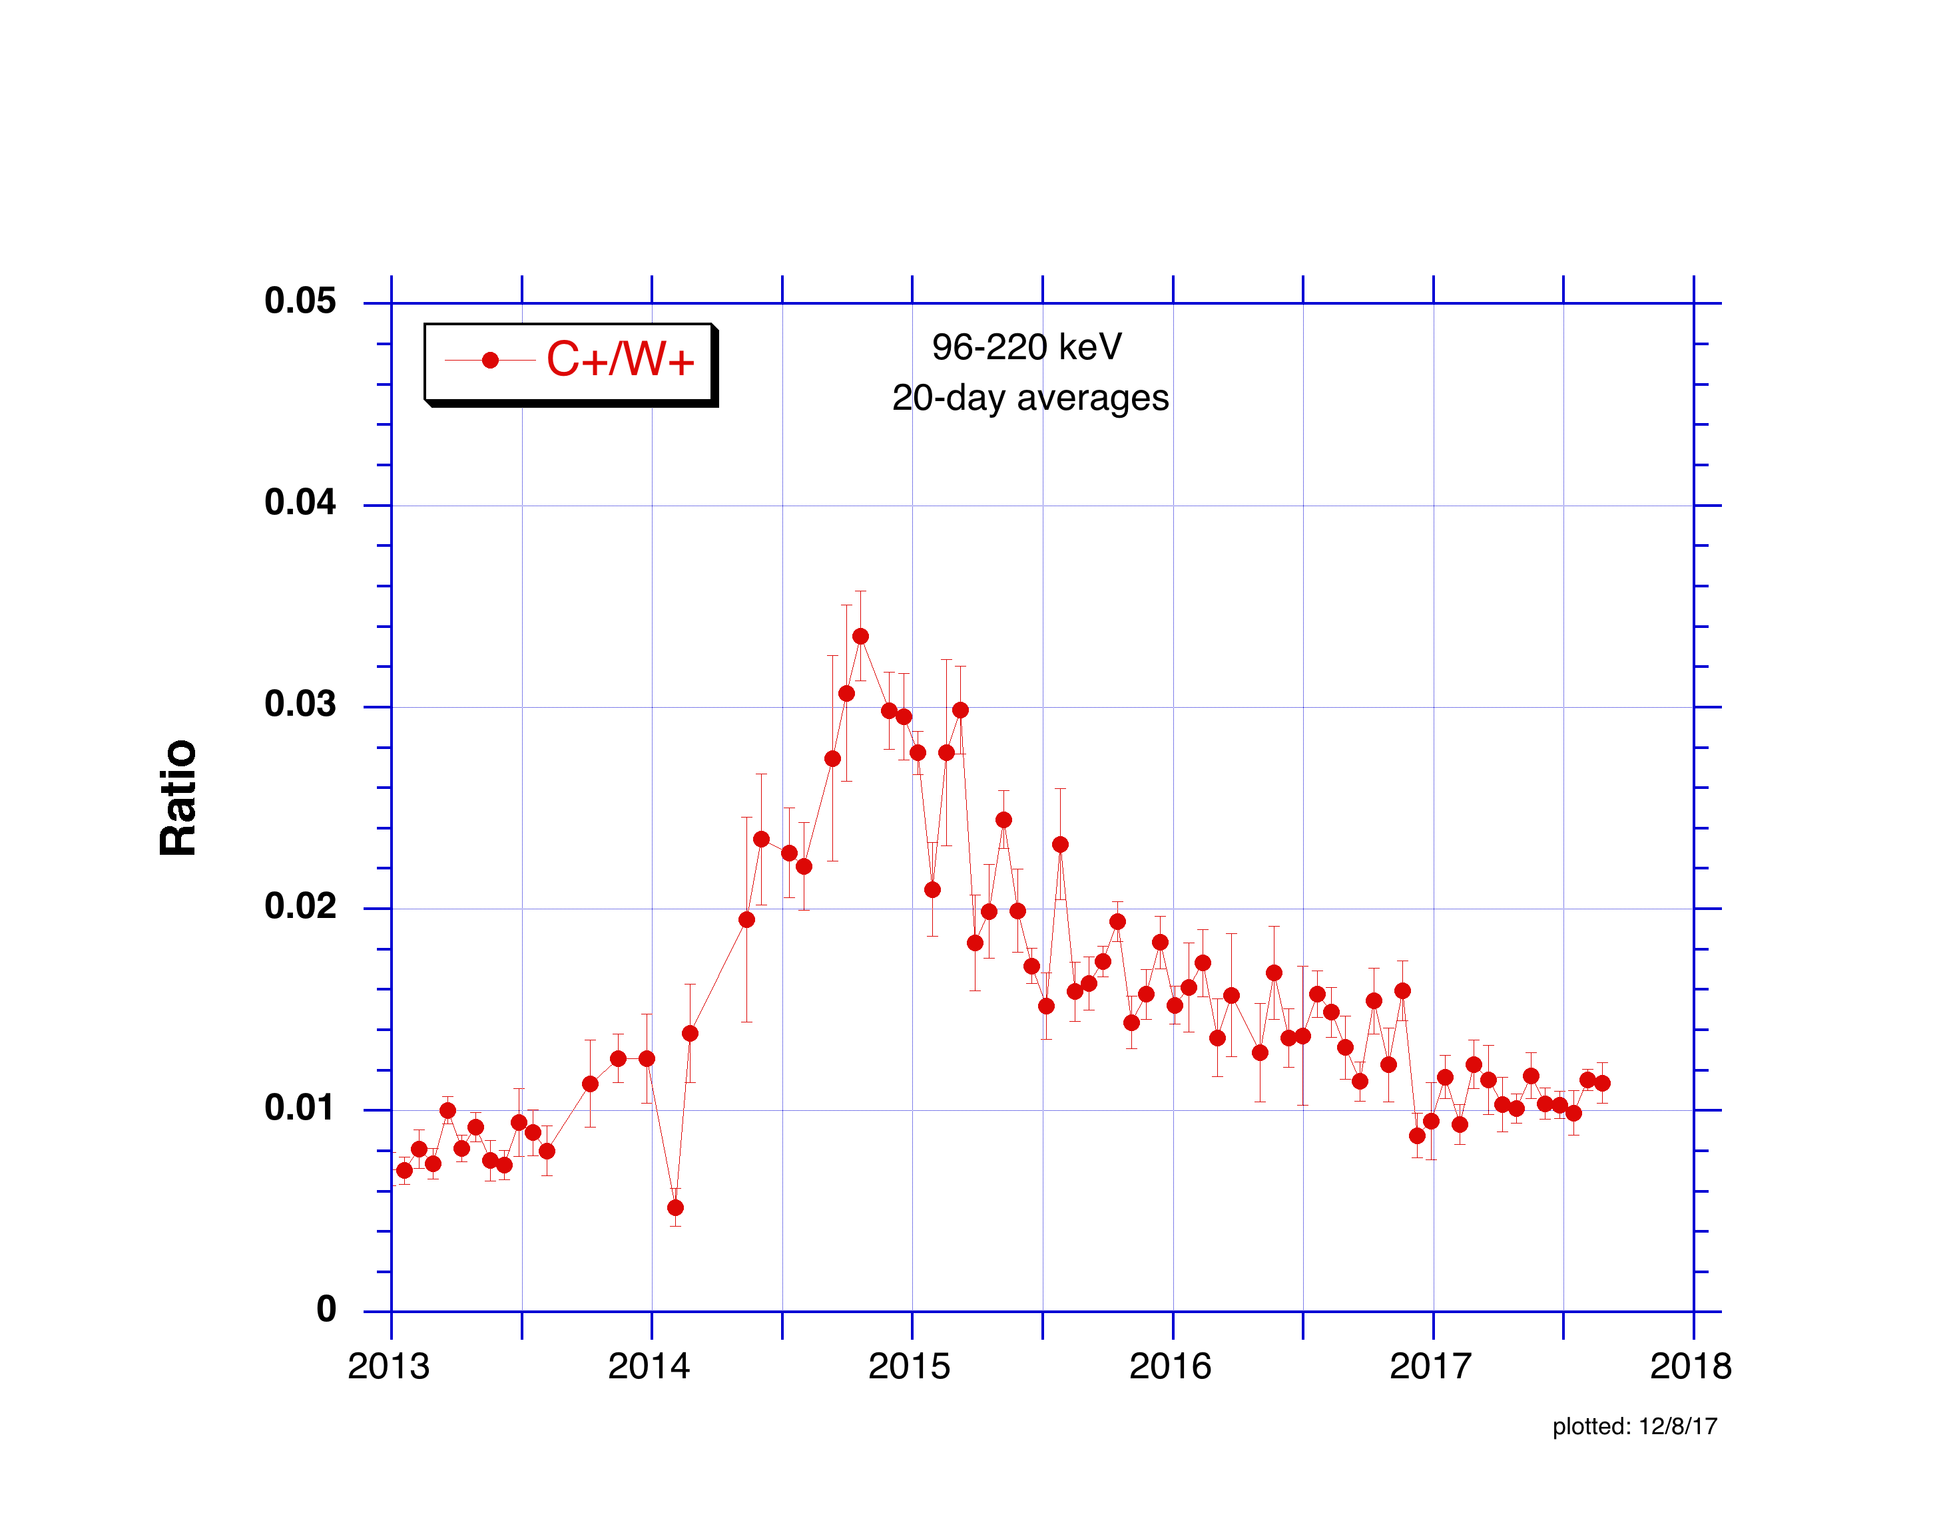
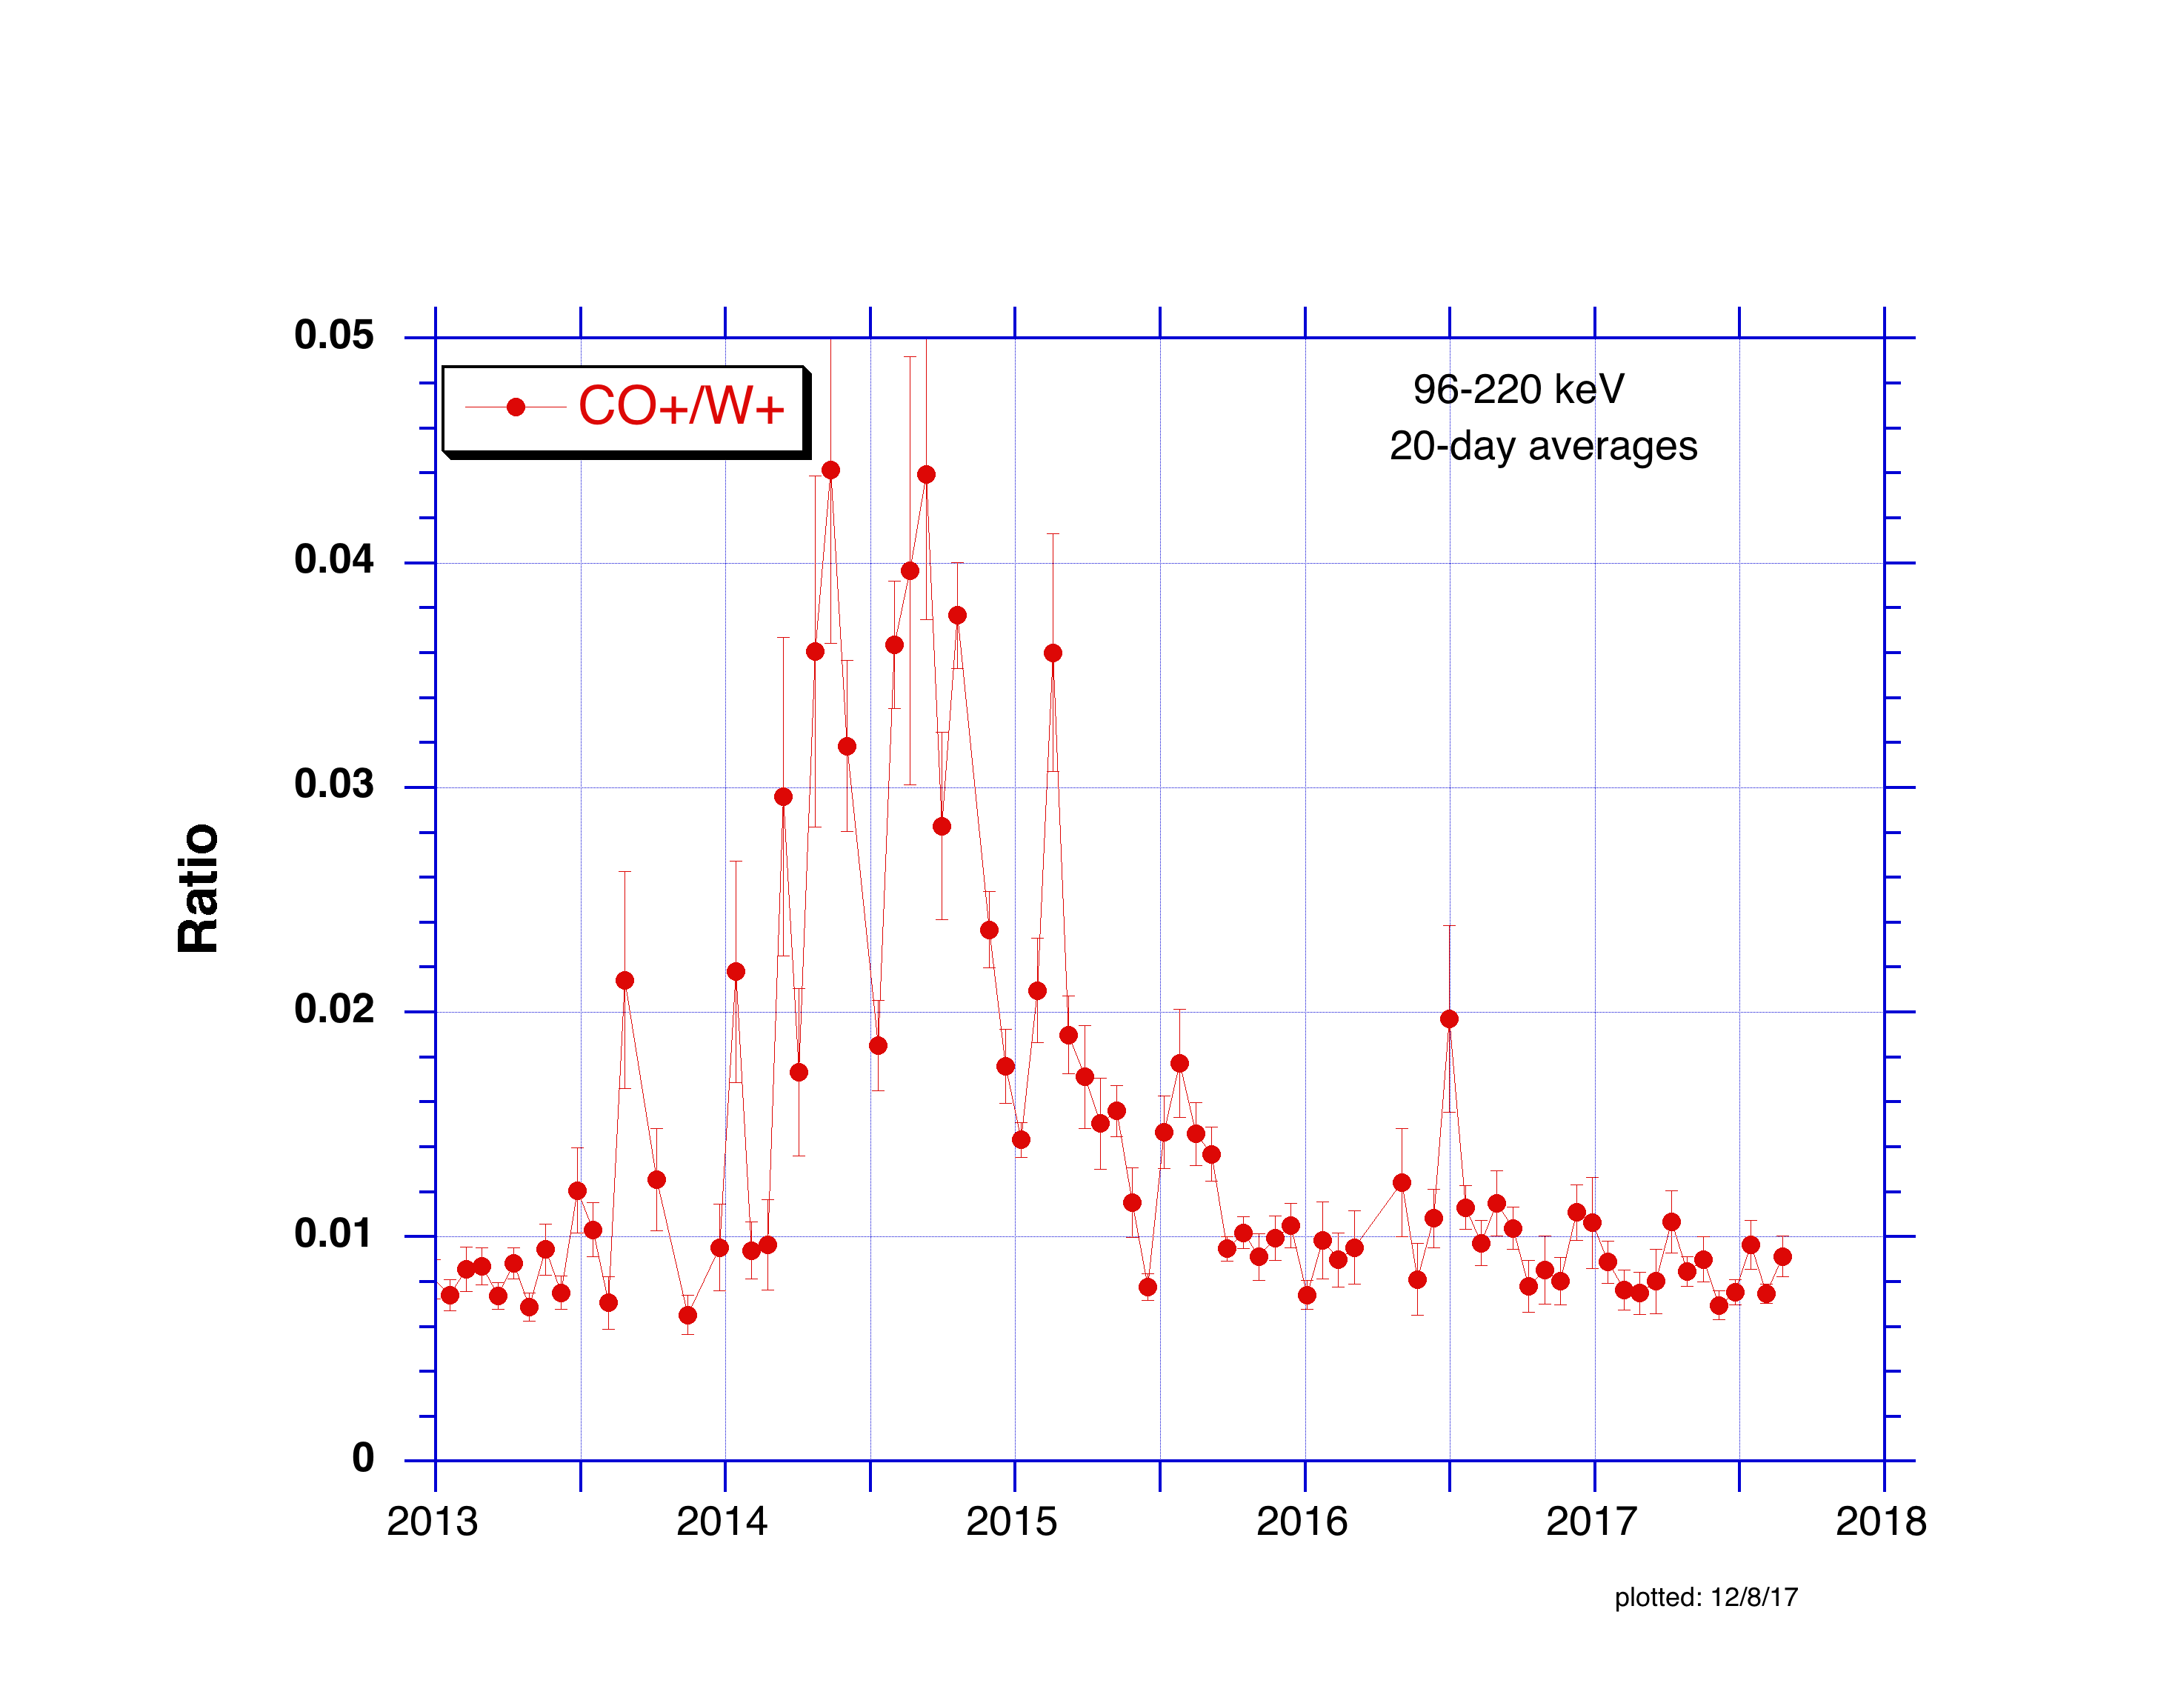
Cassini/MIMI/CHEMS
Jan 2013 – Sept 2017
The CO+ increase began in March 2014, about 3 months earlier than that of C+.
The CO+ enhancement is essentially over by Sept. 2015, lasting about 1.5 years.
The C+ enhancement lasted longer with an exponential like decay and did not return to pre-enhancement levels as of Sept 2017.

Slide 4
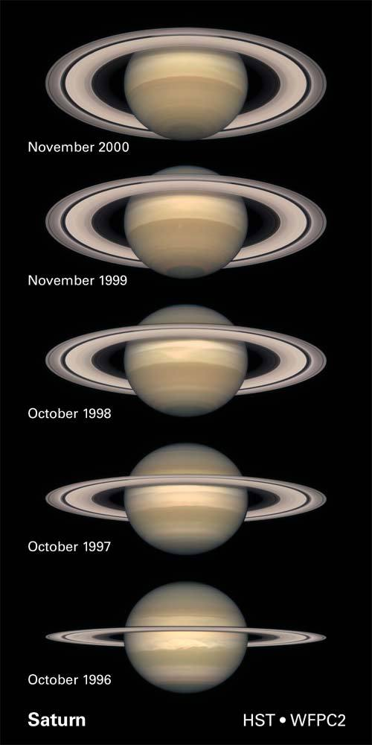
When Cassini arrived at Saturn in 2004, Saturn’s rotation axis was tilted away from the sun, and the south side of the rings were illuminated.
Minimum ring illumination occurred in August 2009 at equinox.
Since 2009 Saturn’s rotation axis has increasingly tilted toward the sun, illuminating the north side of the rings.

Slide 5
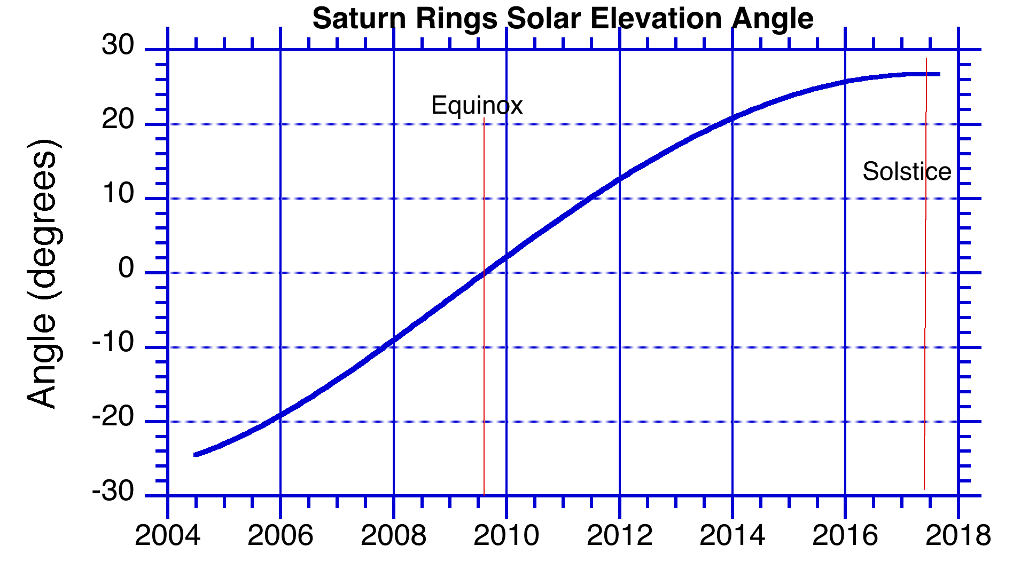
Blue: South face
Red: North face
80K
Morishima et al (Icarus 279, 2-19, 2016) used CIRS data to determine the seasonal change in ring temperature from 2005 to mid-2013 (solar elevation angles from -24°to +21°).
Hodyss et al (Icarus 194, 836-842, 2008) experimentally explored the sublimation of a
CO₂:H₂O ice mixture as it is warmed from 60 K.
They found preferential sublimation of segregated CO₂ as the ice was warmed above 80 K.
The north face of the rings exceeded 80K at when the solar elevation angle passed 20°, near the beginning of 2014.
(Data after mid-2013 from Morishima, private comm.)

Slide 6
Hypothesis
CO₂ from Enceladus (or elsewhere) builds up on the ring ice in the years around equinox when the rings are cold.
Since the Aug. 10, 2009 equinox, the north side of the rings has been warming, exceeding 80 K near the beginning of 2014.
Over some period of time (months) CO₂ and its products (CO⁺ and C⁺) build up in the magnetosphere with the CO⁺ and C⁺ being accelerated to suprathermal energies by the usual magnetospheric processes. The enhancement became obvious in CO⁺ around March of 2014 with the C⁺ enhancement beginning a couple months later.
The excess ring CO₂ is gradually exhausted, and the magnetospheric CO⁺ and C⁺ abundances begin to decline. The CO⁺ decrease is faster because it has a shorter lifetime than C⁺.
The C⁺/W⁺ ratio was low early in the mission because the excess CO₂ on the south side of the rings (accumulated around the previous equinox in Nov. 1995) had already mostly disappeared before Cassini arrived at Saturn in 2004, but the C⁺ continued to decline somewhat (~30%) over the next few years.

Slide 7
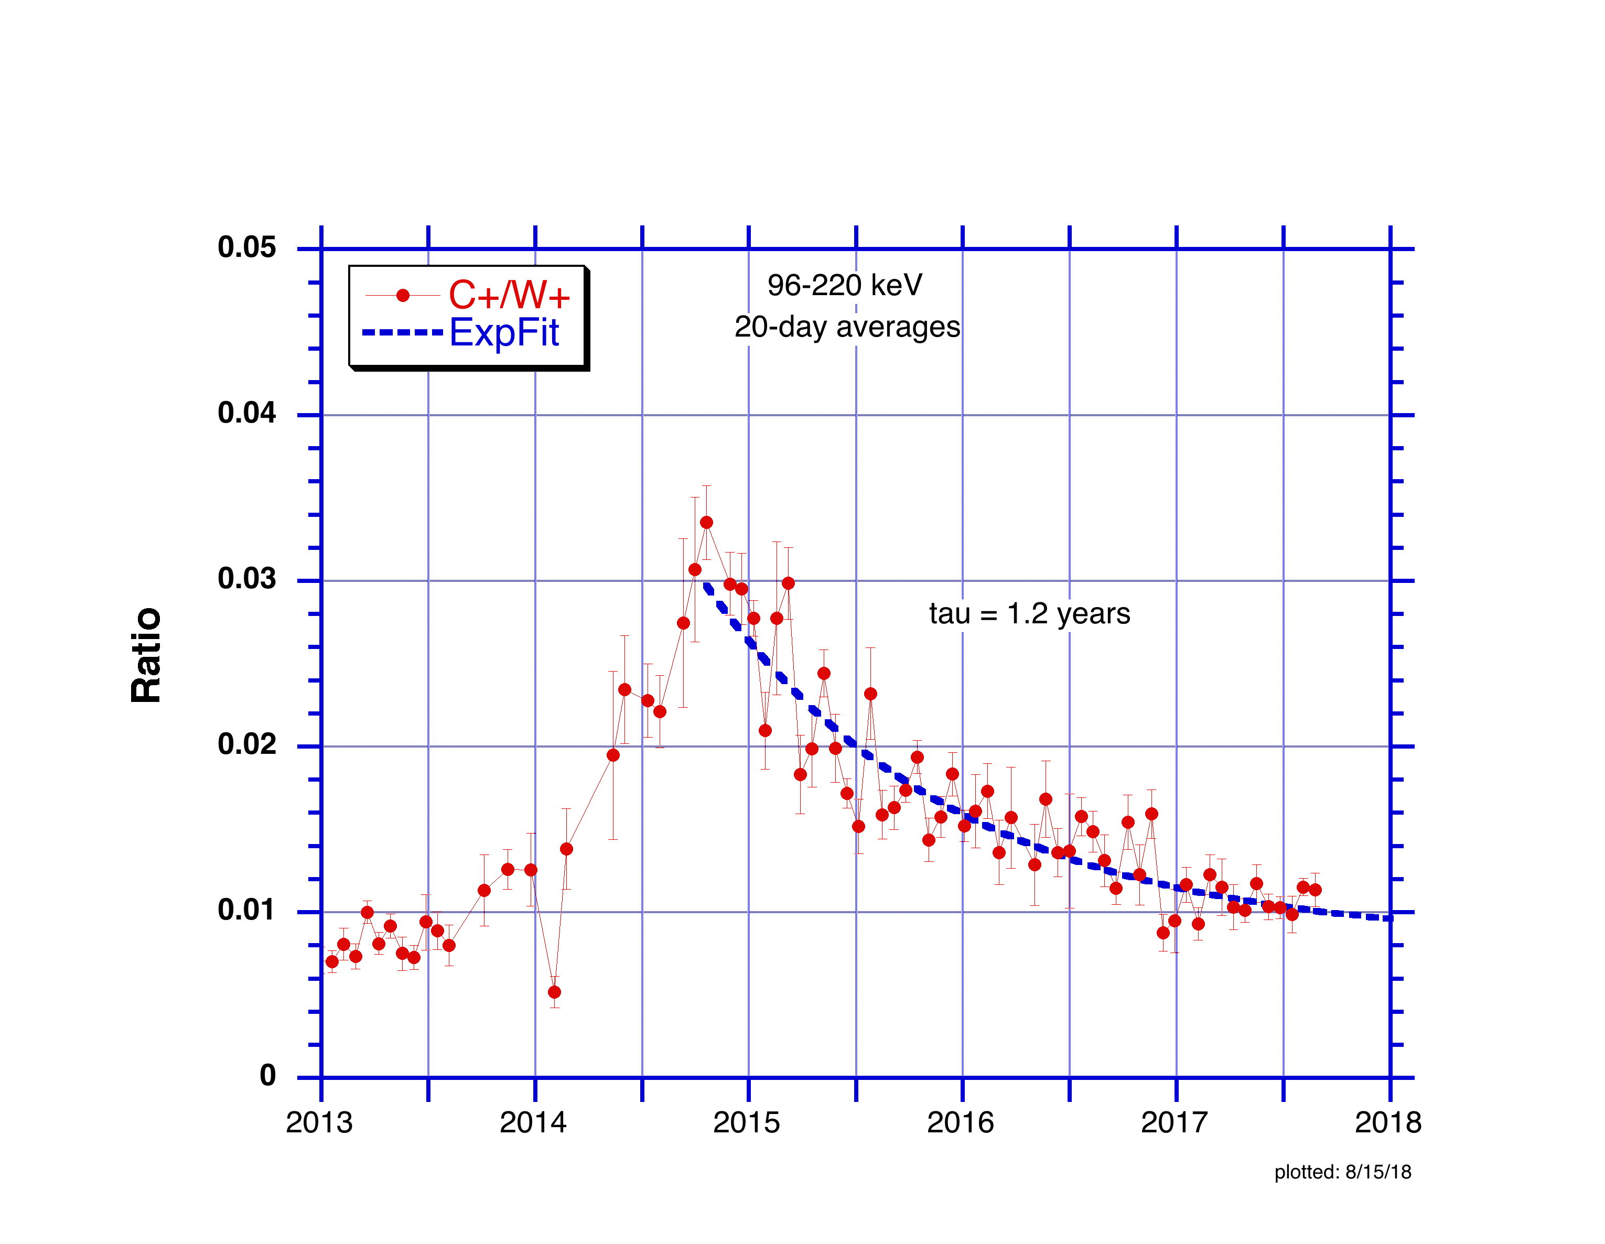

Slide 8
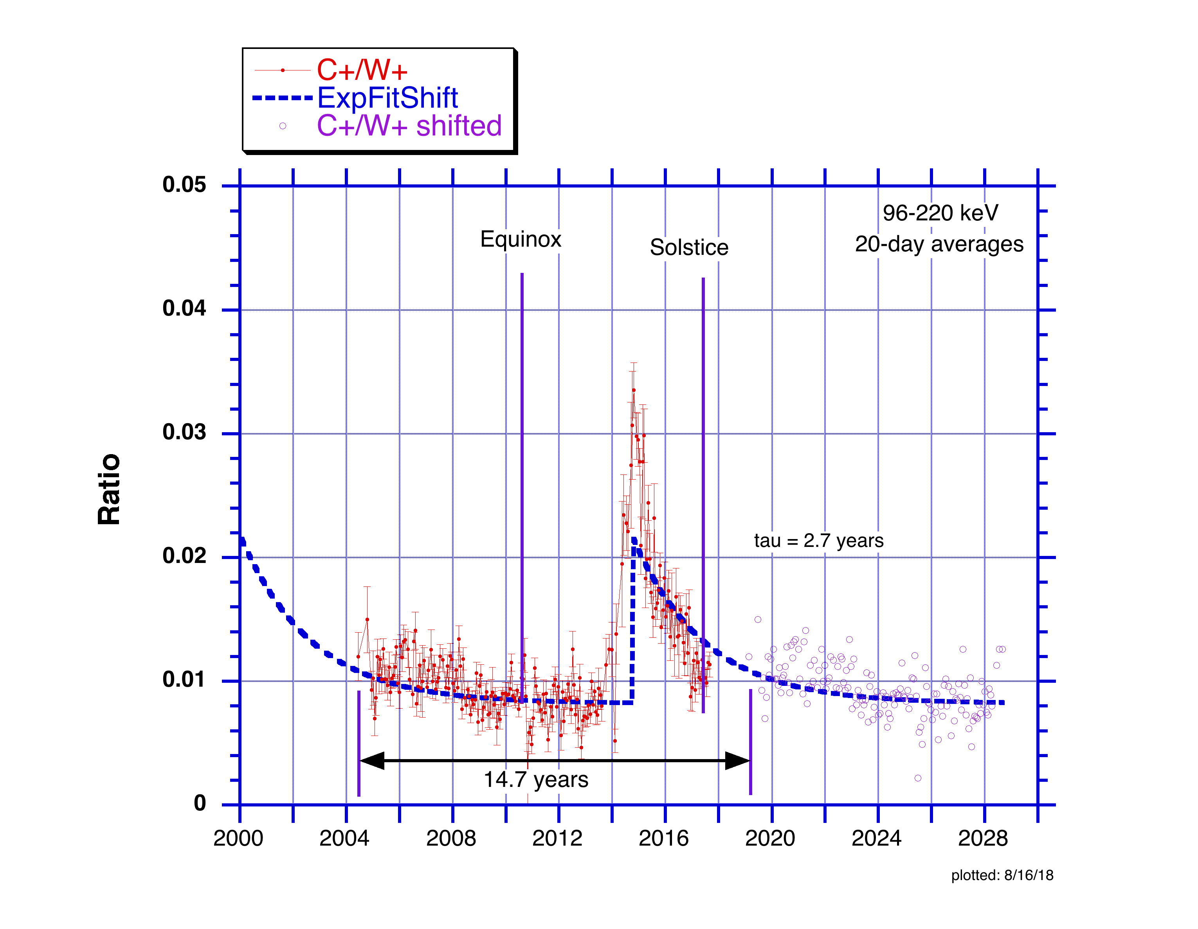

Slide 9
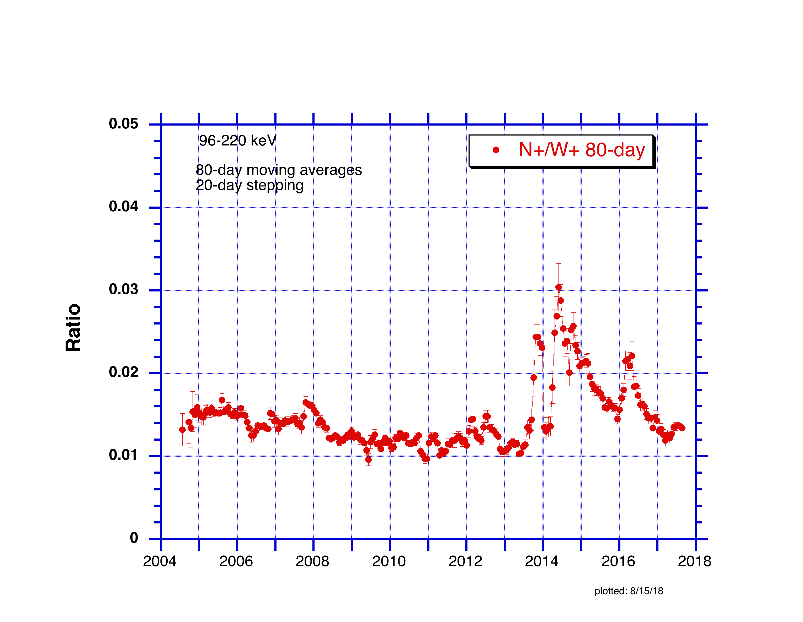
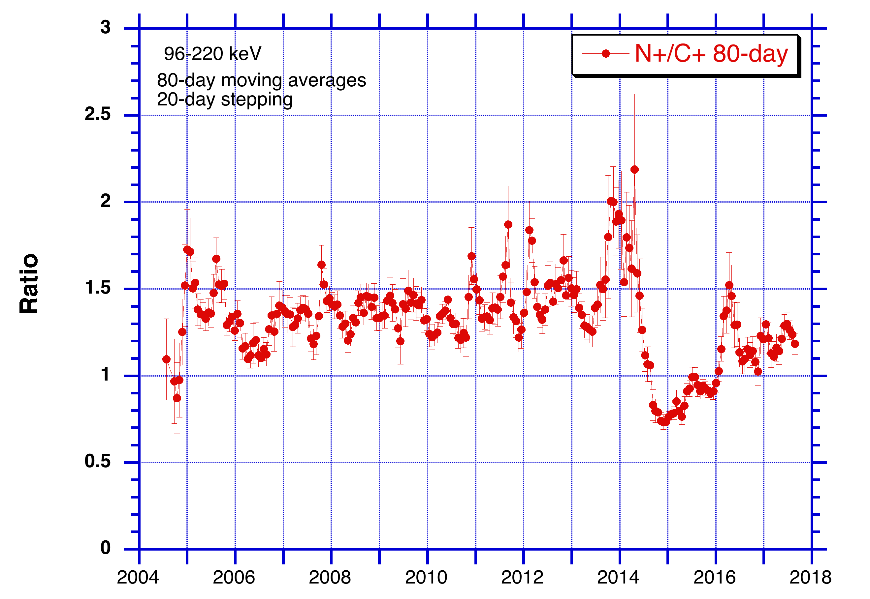

Slide 10
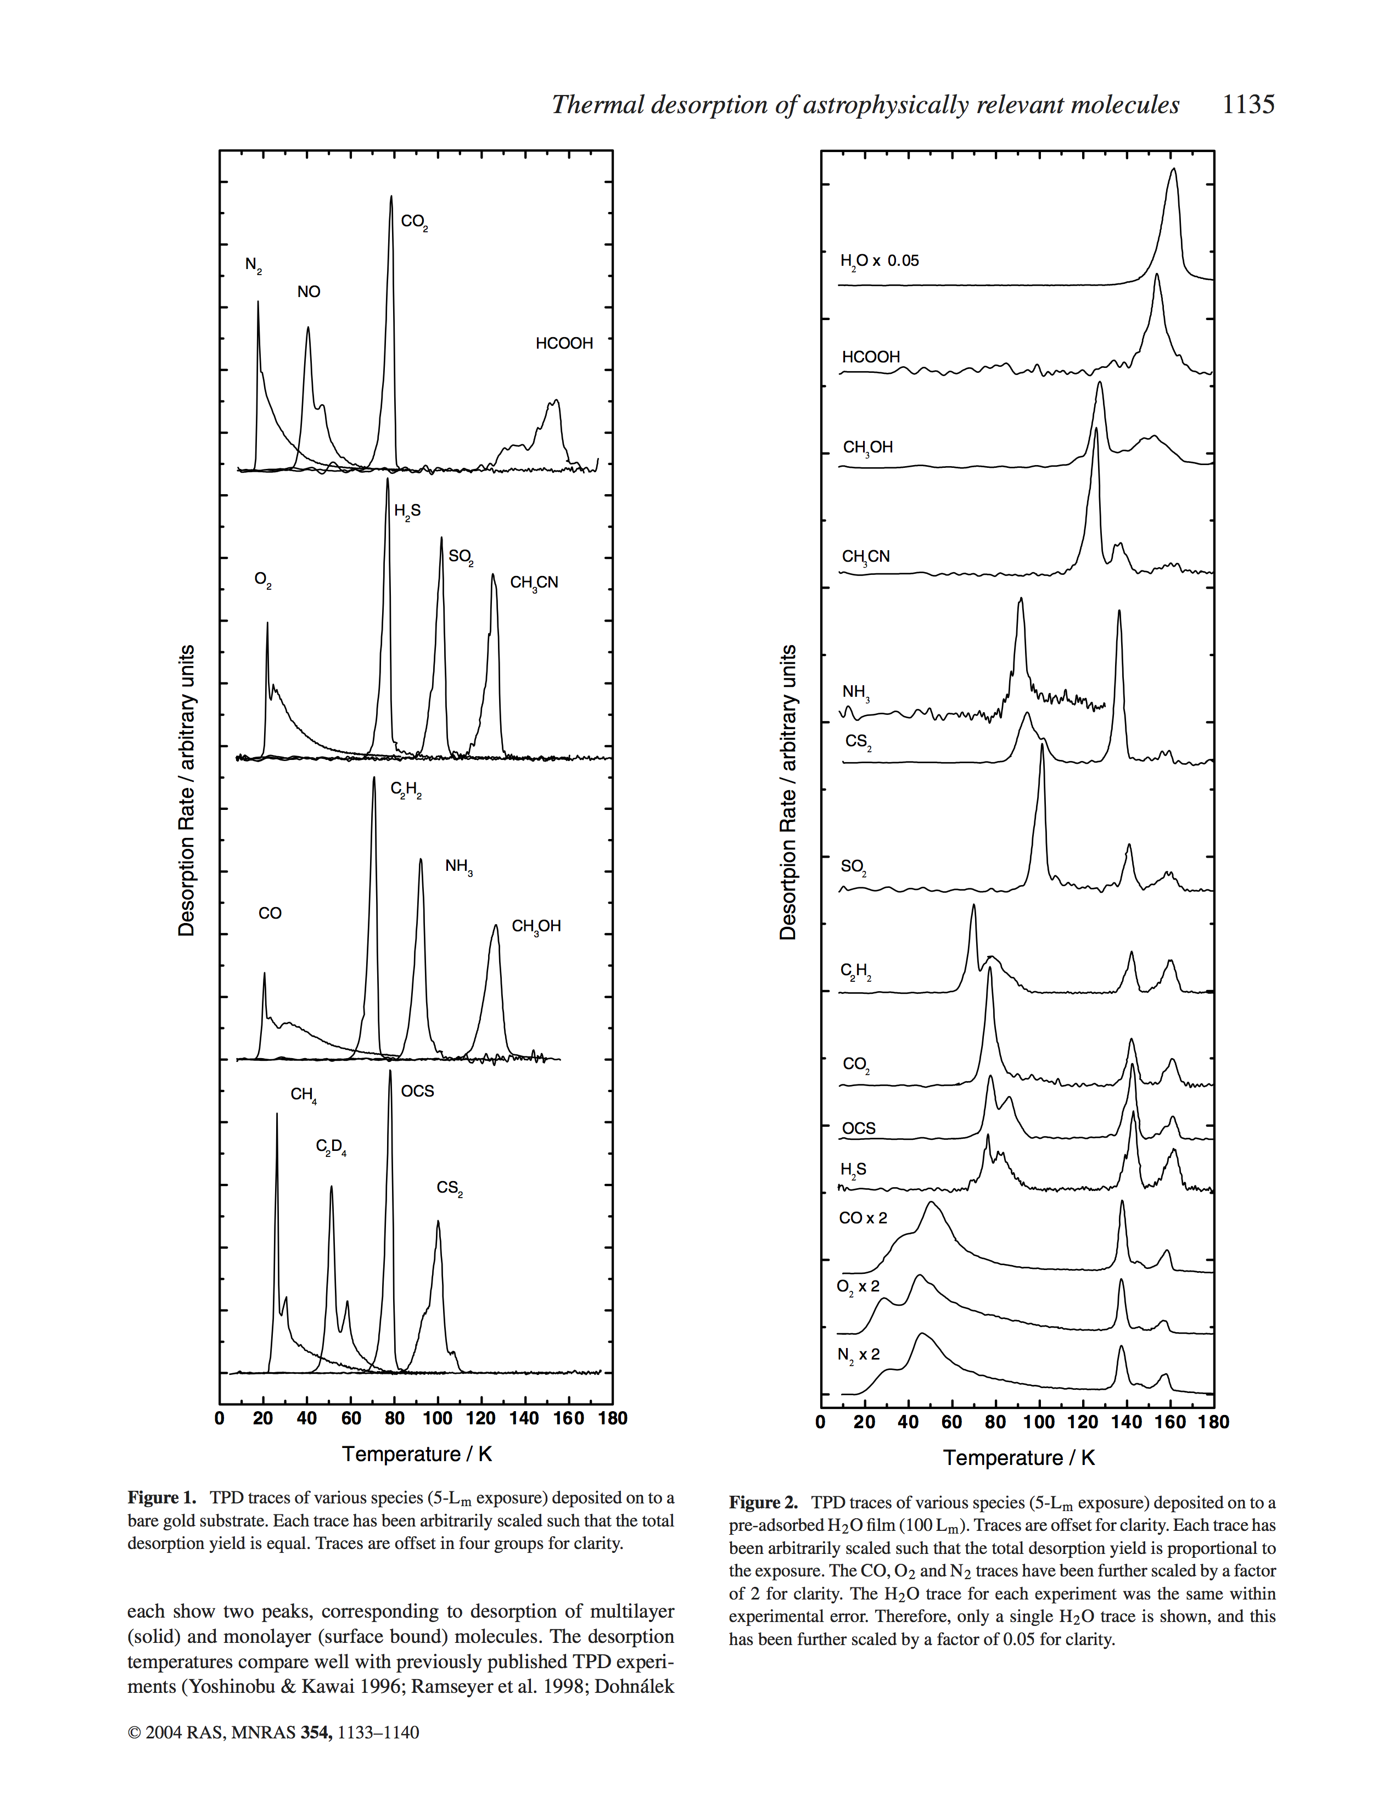
Collins et al, 2004
“Thermal desorption of astrophysically
relevant molecules”
NH₃
CO₂
N₂

Slide 11
Extras

Slide 12
