Slide 1
Constraints on Saturn’s Deep Interior from Seismic Inversions
Ethan Dederick & Jason Jackiewicz
New Mexico State University
Cassini Symposium
August 16th, 2018

Slide 2
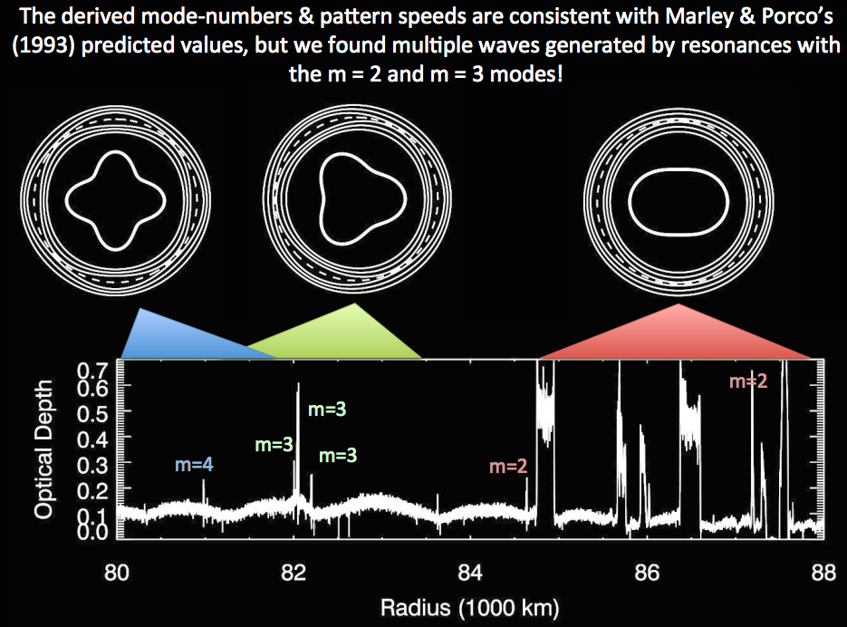
Where the gaps occur and what they look like tell us what modes currently exist within Saturn.
Nicholson & Hedman: Kronoseismology II

Slide 3
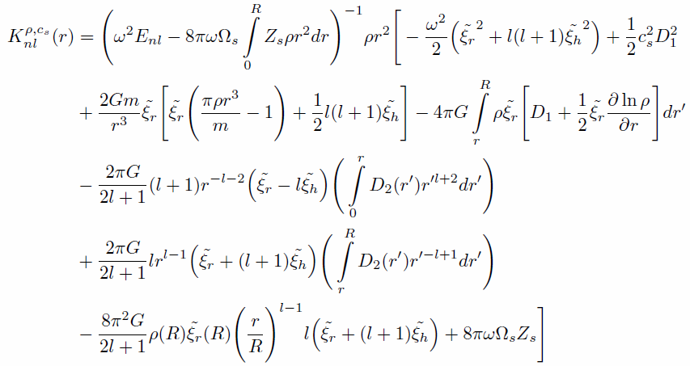
The Inverse Problem

Slide 4
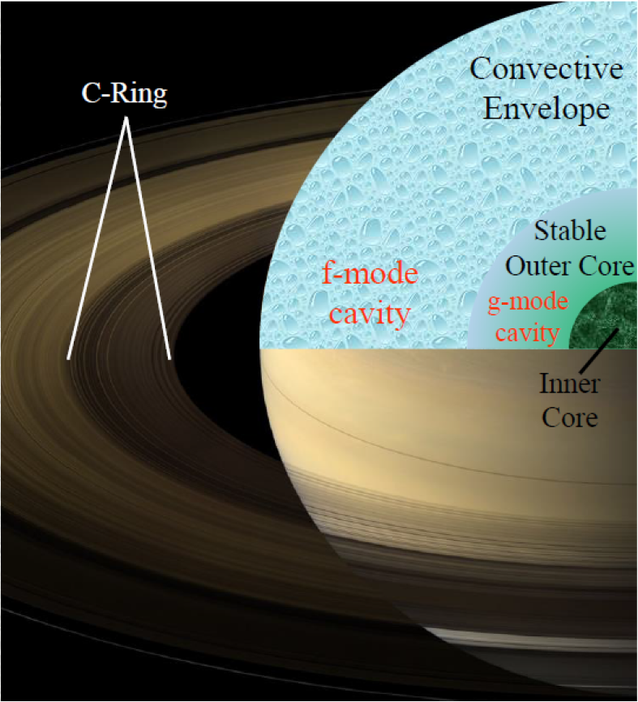
1) Create Saturn Models
Fuller 2014

Slide 5
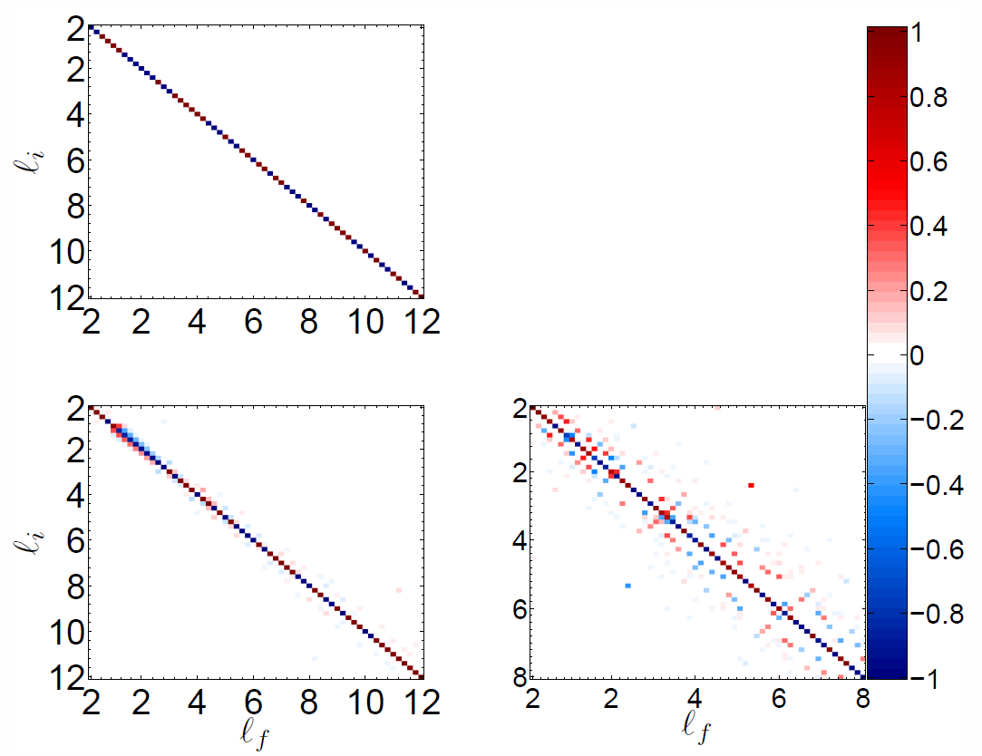
2) Calculate Mode Frequencies and Eigenfunctions
Ω_{s} = 100,000 hrs
Ω_{s} = 30 hrs
Ω_{s} = 10.57 hrs

Slide 6
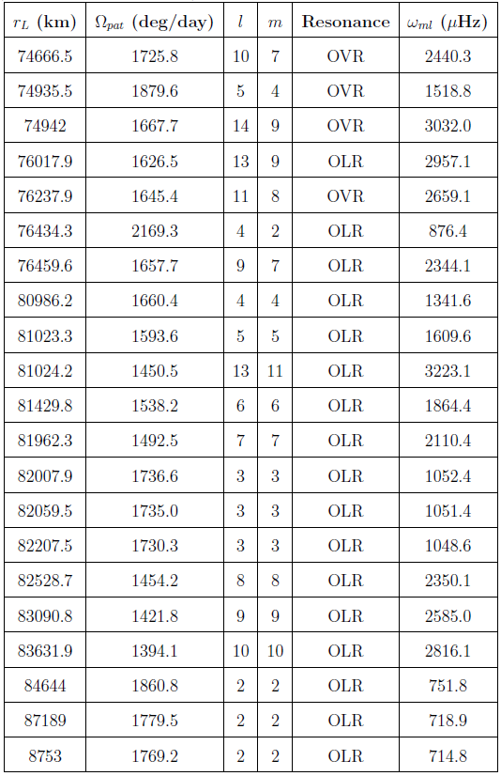
Which model is closest to Saturn?
Run a Monte Carlo for parameter space of convergent models
Minimize Chi-Square for frequencies
D = 4.4837
r_{in} = 0.0971
r_{out} = 0.4138

Slide 7
3) Calculate Kernels
l = 10, m = 7 f-mode
Notes:
But how do we interpret exactly where these kernels probe the interior? We create a target function and averaging kernel.

Slide 8
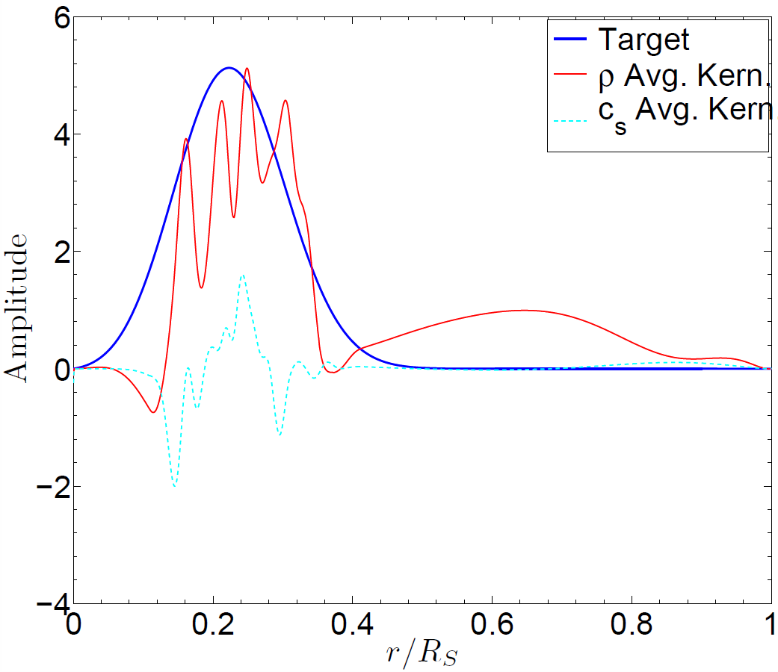
4) Perform the inversion

Slide 9
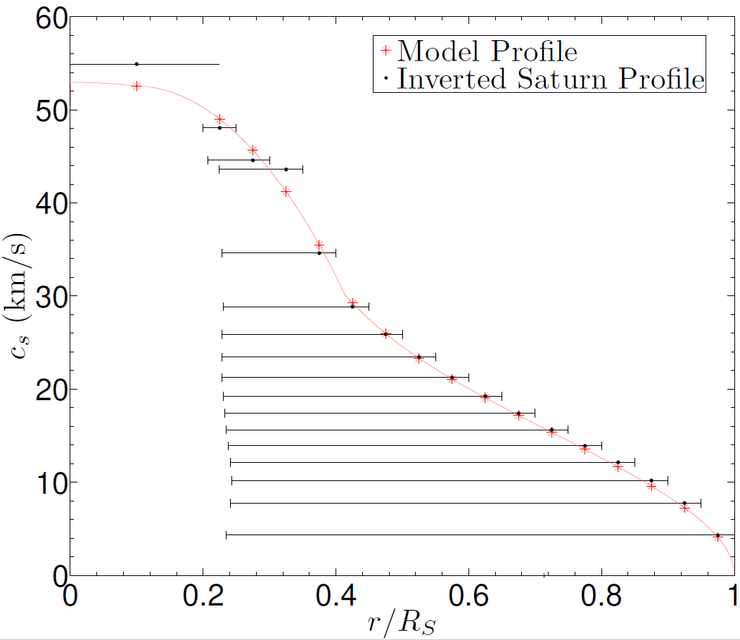
5) Results

Slide 10
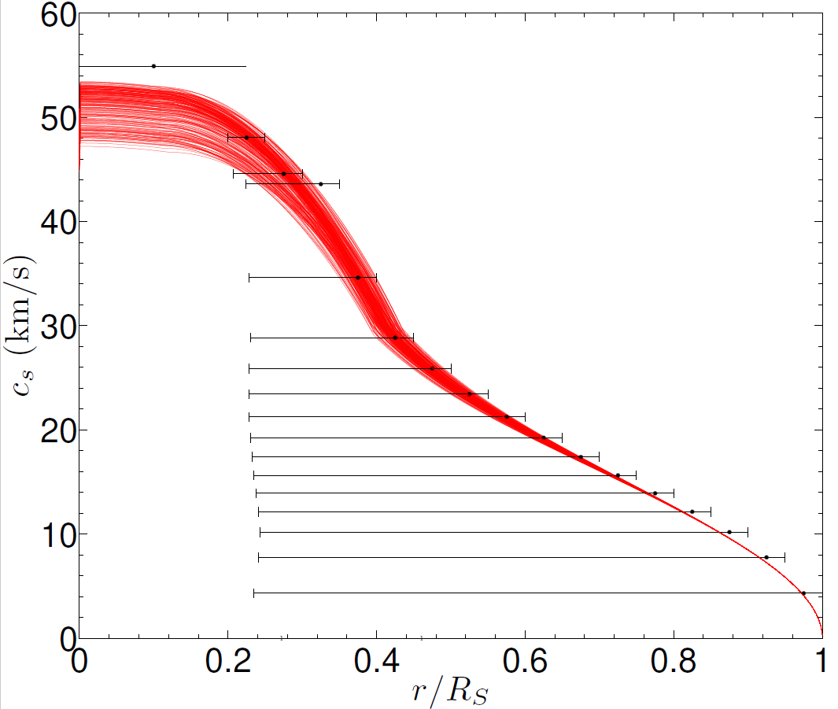
New Saturn Constraints

Slide 11
Bonus Slides!

Slide 12
Kernel Comparison

Slide 13
Linearity Test

Slide 14
Recovery Test

Slide 15
Inversions with Differential Rotation

