Slide 1
Saturn's deep atmosphere revealed
by the Cassini Grand Finale gravity measurements
Eli Galanti
Weizmann Institute of Science
With: Yohai Kaspi, Yamila Miguel, Tristan Guillot, Daniele Durante, Paolo Racioppa, and Luciano Iess
Cassini symposium - Boulder, CO - August 2018

Slide 2
The cloud-level winds in Saturn
The winds are predominantly symmetric (red), but a a-symmetric flow also exists (green).
Wind depends on Saturn rotation rate, which is not well known (gray area).
(Garcia-Melendo et al., 2011)
The question: how deep are the winds?

Slide 3
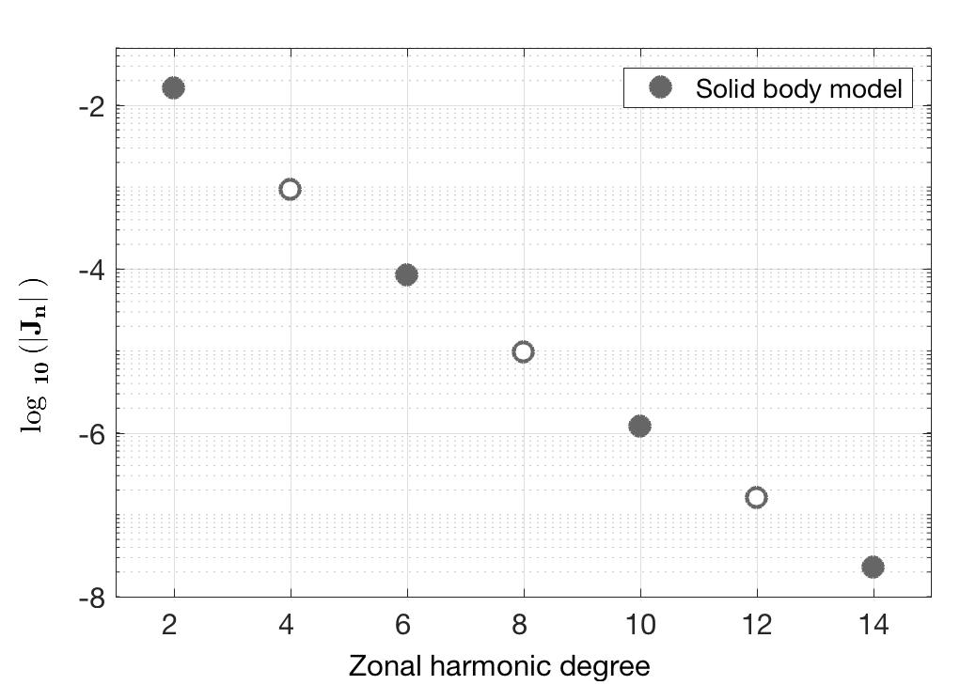
The Cassini gravity measurements
Prediction with a typical interior model that assumes uniform rotation.

Slide 4
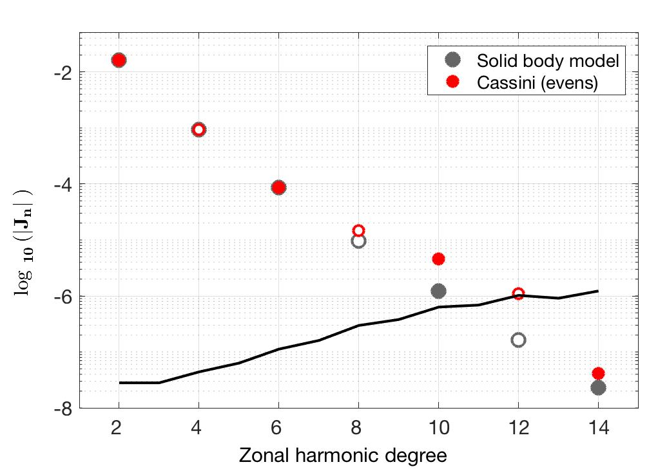
The Cassini gravity measurements
The Cassini measurements of the even harmonics.
3σ uncertainty
Measured harmonics are different than those expected from uniform rotation
Indication for strong differential rotation (deep winds!)

Slide 5
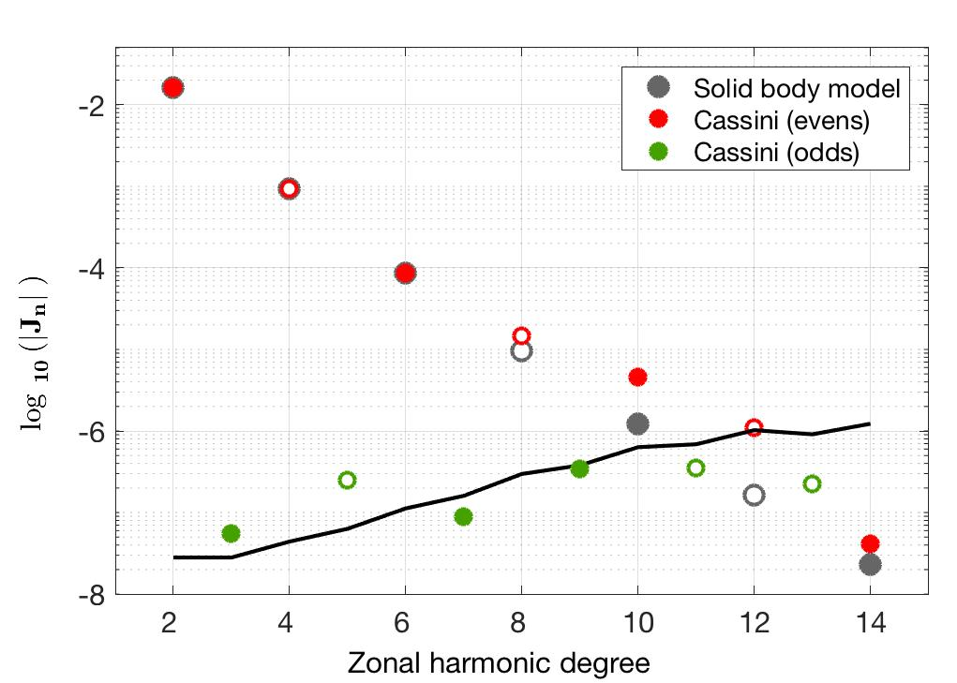
The Cassini gravity measurements
Together with the measurements of the odd harmonics
3σ uncertainty
Odd harmonics are close to uncertainty limit

Slide 6
First, need to estimate:
The contribution of Rigid-Body to gravity field
Use a wide range of interior models with uniform rotation rate

Slide 7
A simple model for estimating the dynamical gravity signature
Use observed winds and assume simple decay model to get flow field
Use thermal wind balance model to get density anomalies and thus gravity signal
Thermal wind balance

Slide 8
Prediction of wind-induced gravity harmonics
Effect of wind depth

Slide 9
Prediction of wind-induced gravity harmonics
Add the measurements (with respect to rigid-body solutions)
Can partially explain the even harmonics
But not the odd harmonics

Slide 10
A different flow below the cloud level?
Cloud-level wind might not represent the interior flow everywhere.
Observations of the winds (Garcia-Melendo et al., 2011) has uncertainties of up to ±20 m/s, and also indicate change of flow with depth.
“Some differences at the mid latitude jet peaks may be a combination of real changes and measurement uncertainties.” (Garcia-Melendo et al., 2011)

Slide 11
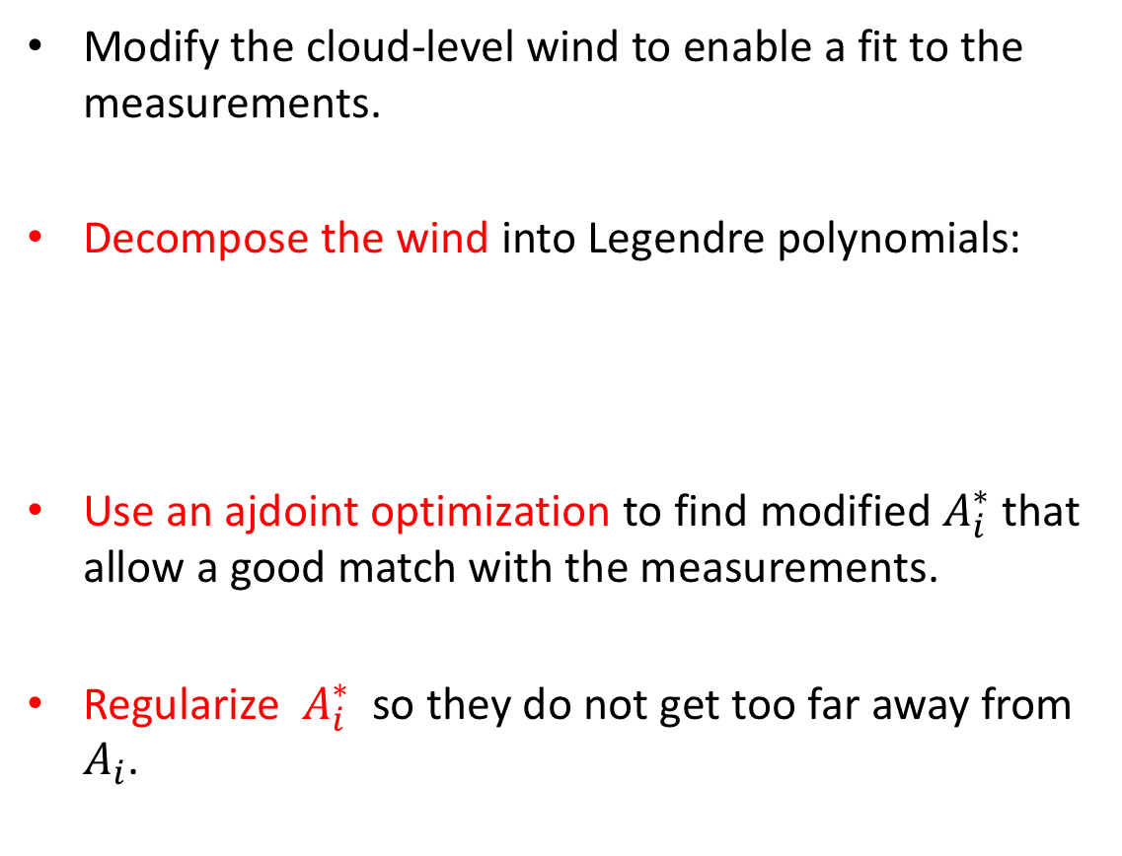
A possible Resolution
Modify the cloud-level wind to enable a fit to the measurements.
Decompose the wind into Legendre polynomials:
Use an ajdoint optimization to find modified $A_{i}^{∗}$ that allow a good match with the measurements.
Regularize $A_{i}^{∗}$ so they do not get too far away from $A_{i}$.

Slide 12
First, the gravity resulting from the cloud-level winds

Slide 13
First, the gravity resulting from the cloud-level winds
Solution reached with depth of winds – 11,000 km

Slide 14
Next, solving for all gravity harmonics with modified wind
Optimal solution reached with wind depth of 8,700 km

Slide 15
The flow below the cloud level
Solution requires minors modifications of the wind,
aside from a region around 25-35º North and South

Slide 16
The flow below the cloud level
Solution requires minors modifications of the wind,
aside from a region around 25-35º North and South

Slide 17
Conclusion
Cassini gravity measurements indicate to substantial differential flows. Odd harmonics are small.
Measurements can be partially explained with observed cloud-level winds projected to depth of ~11,000 km.
Need to consider a flow that is modified from the cloud-level observations.
A moderately modified wind, extended to depth of ~8,700 km, can explain all measured gravity harmonics.
This depth is consistent with MHD considerations.
Galanti et al, GRL Cassini special issue, accepted.

