Slide 1
Saturn and Jupiter: Cassini Explores the Gas Giants Top ten hits from a flagship mission Selections based on a combination of (1) AO and Traceability Matrix (2) Scientific significance (3) Coolness
Andrew Ingersoll
California Institute of Technology
Saturn Science Symposium
Boulder, Colorado, August 13-17, 2018

Slide 2
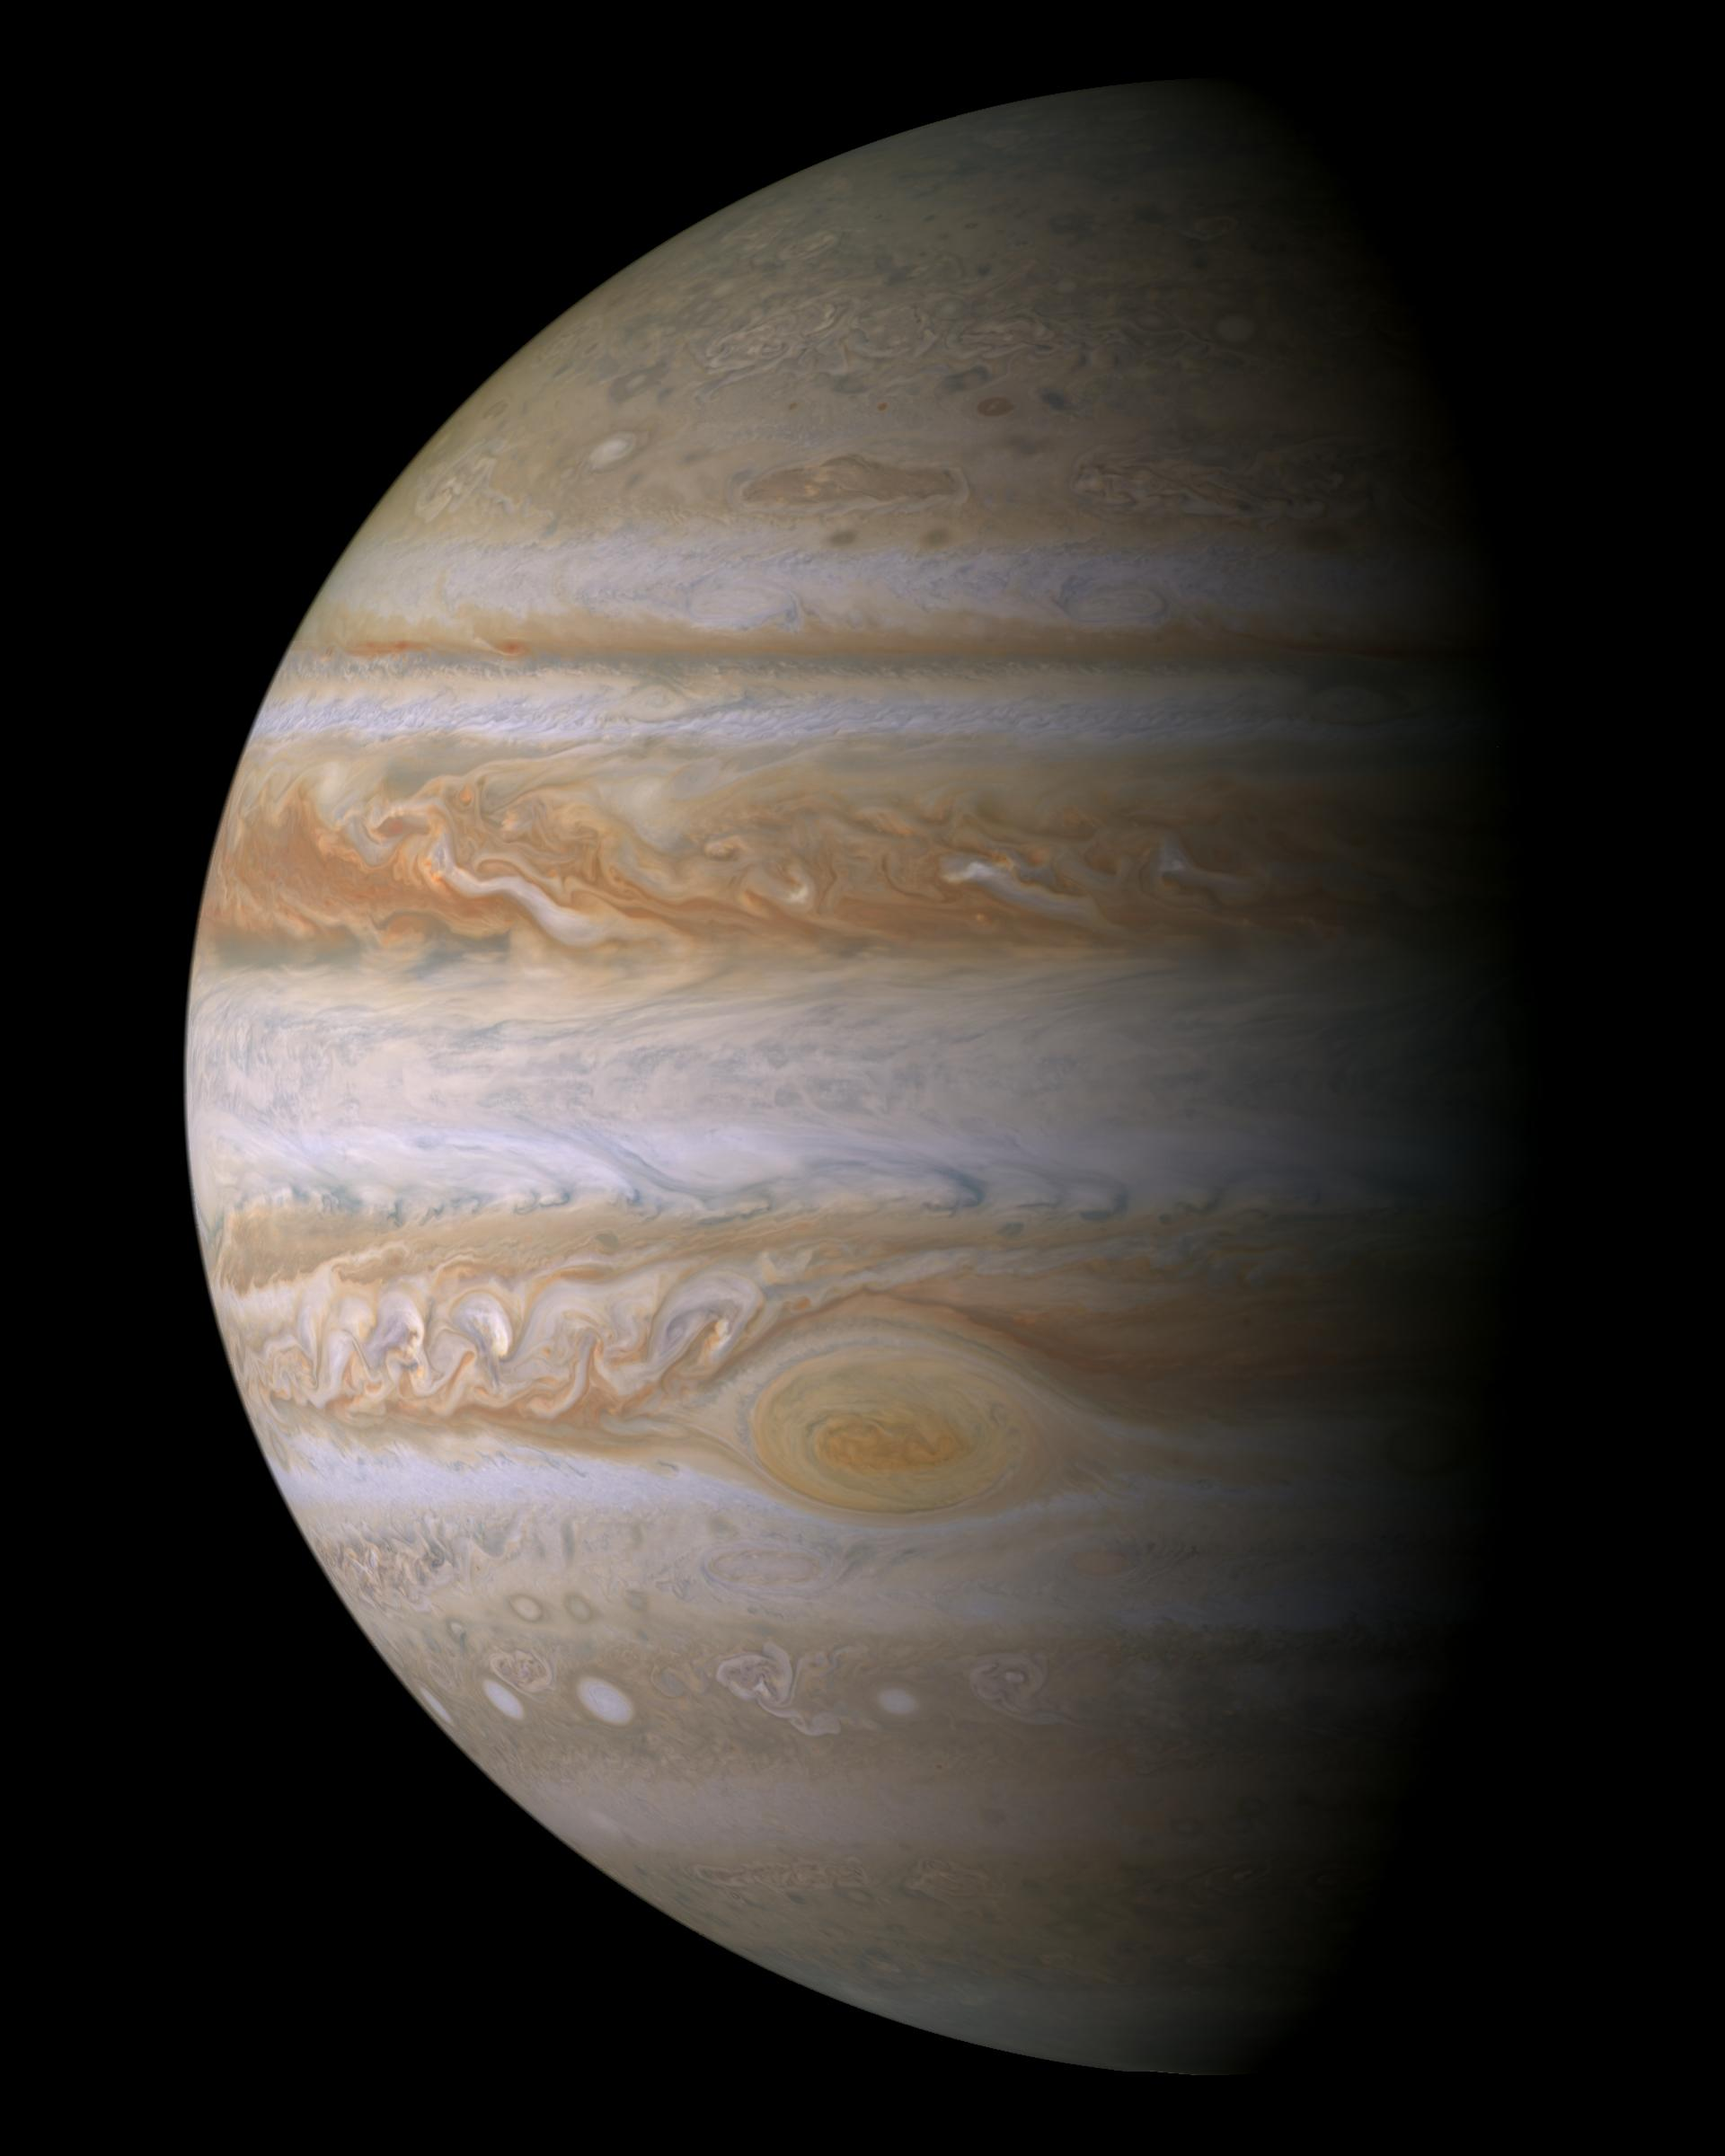
10. Jupiter clouds
one chromophore
Carlson et al. (2016)
Sromovsky et a. (2017)
PIA04866 VIMS

Slide 3
10. Jupiter movies
Cylindrical and
polar mosaics
PIA03452
PIA03453
PAI03454
ISS

Slide 4
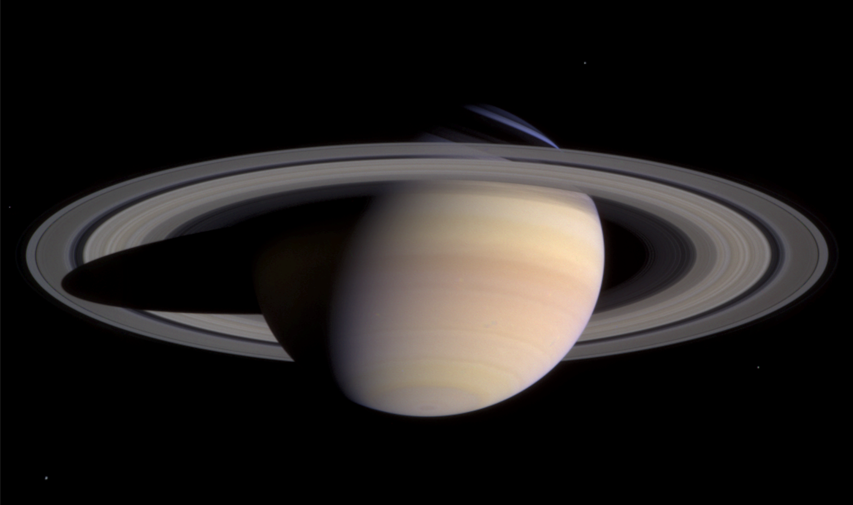
9. Clouds, chemistry, seasonal change
PIA05389 approaching Saturn 2004 ISS

Slide 5
Giant storm
2010-2011
9. Seasonal change
Saturn emitted power
Li, L et al. (2015) CIRS

Slide 6
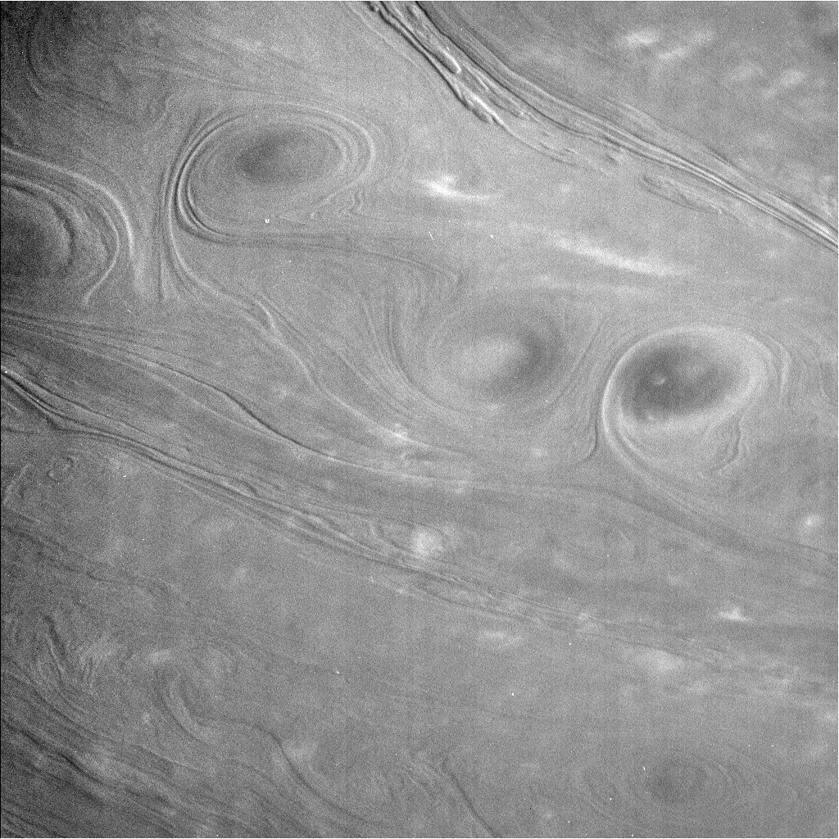
8. Left: Proximal orbit
image, scale bar 1000 km.
Right: scale bar 20,000 km
Ingersoll and Ewald (2018) ISS

Slide 7
7. Saturn lightning
Dyudina et al. (2007)
RPWS and ISS

Slide 8
7. Lightning in daylight in the
great storm of 2010-2011. PIA14921 ISS

Slide 9
6. Upper atmosphere Saturn
Thermospheric temperature
Koskinen et al. (2017) UVIS

Slide 10
6. Upper atmosphere
Saturn temperatures and winds.
15-year oscillation
Fouchet et al. (2010) CIRS

Slide 11
5. Saturn hexagon and polar
cyclone PIA14946. False color.
Red = reflecting surface hidden
by methane gas. Blue = no
methane to reflecting surface.
ISS and VIMS

Slide 12
4. Elemental abundances relative
to solar. Saturn and Jupiter.
Excerpted from Fletcher et al. (2009)
CIRS (Saturn), Galileo Probe (Jupiter)

Slide 13
4. Saturn composition and chemistry
Fletcher et al. (2009) P < 0.5 bar; CIRS

Slide 14
4. Saturn chemistry and composition
Fletcher et al. (2011), P > 1.3 bar VIMS

Slide 15
3. Zonal winds and eddy
momentum flux. Saturn.
Del Genio and Barbara
(2012) ISS

Slide 16
<u’v’> [ m² s⁻² ]
<u>
3. Zonal winds and eddy
momentum flux. Jupiter.
Salyk et al. (2006) ISS

Slide 17
2. Saturn rotation
Hedman & Nicholson (2013) ISS

Slide 18
Saturn’s 30-year storm.
Formed on 5 December 2010
in a westward jet. Copious
lightning (> 10 s-1 )
PIA12826 ISS, RPWS

Slide 19
Storm as a wave source
that heats the stratosphere
Fletcher et al. (2013) CIRS

Slide 20
Storm bringing high-entropy
air up from below – temperature
and low para-H2
Achterberg et al. (2012) CIRS

Slide 21
After Cassini: The next steps
Observe Saturn seasonal variations from Earth
Develop a giant planet cloud-resolving model
Develop a fully coupled weather-layer/interior model
Use ring seismology and gravity to constrain interior models
Develop the case for a Saturn probe
Join forces to advocate another flagship mission

Slide 22
After Cassini: The next steps
Observe Saturn seasonal variations from Earth
Develop a giant planet cloud-resolving model
Develop a fully coupled weather-layer/interior model
Use ring seismology and gravity to constrain interior models
Develop the case for a Saturn probe
Join forces to advocate another flagship mission
The End
If you are leaving for the airport at
noon tomorrow, I will accept a ride

