Slide 1
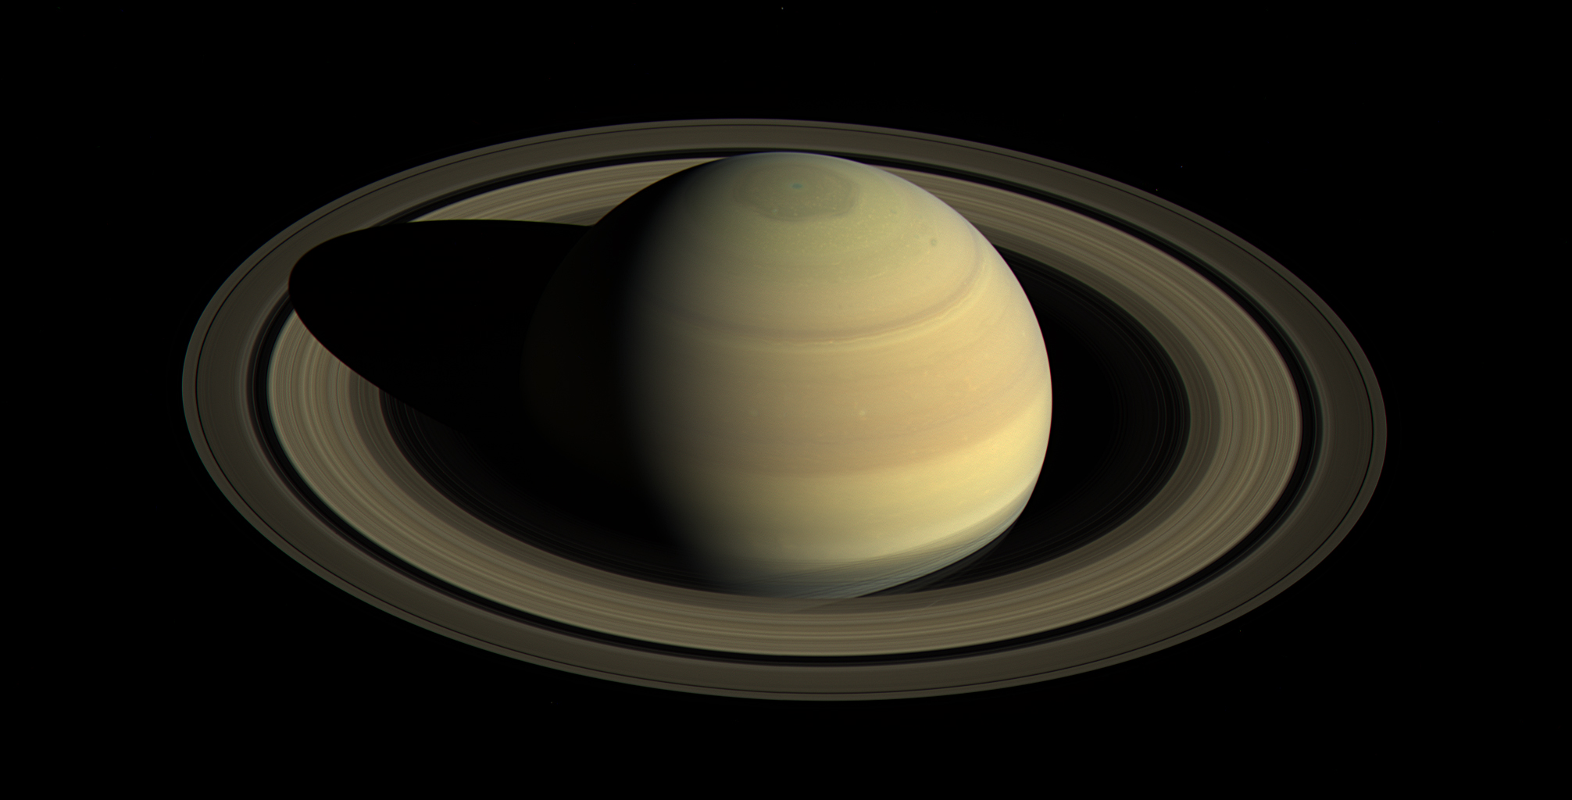
Saturn's stratospheric dynamics and chemistry revealed by CIRS limb observations
Sandrine Guerlet – LMD
Thierry Fouchet – Observatoire de Paris
Cassini Symposium, Boulder, July 2018

Slide 2
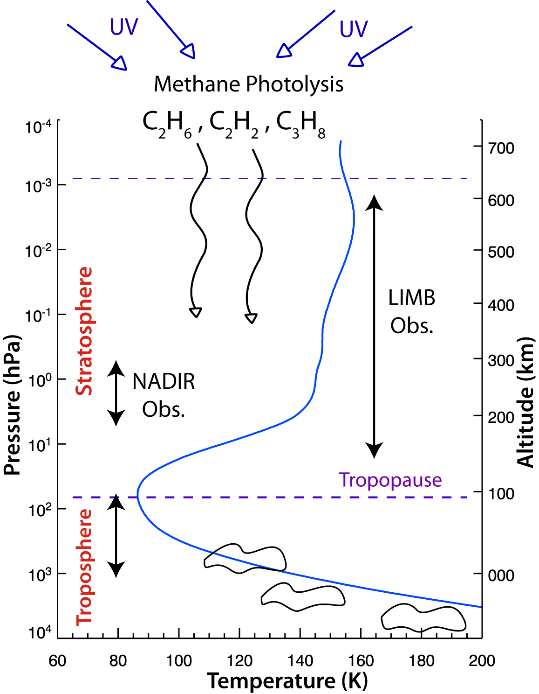
Saturn’s atmospheric structure
CH₄ (~0.45 %) stratosphere
Hydrocarbon photochemistry (C₂H₆, C₂H₂, C₃H₈,…)
Important seasonal effects
Saturn’s axial tilt ~28°, ring shadowing
Radiative timescales < Saturn’s year in the whole stratosphere
Photochemical lifetimes < Saturn’s year in the upper stratosphere
Goal : map stratospheric temperature and composition insights into dynamical and chemical processes.

Slide 3
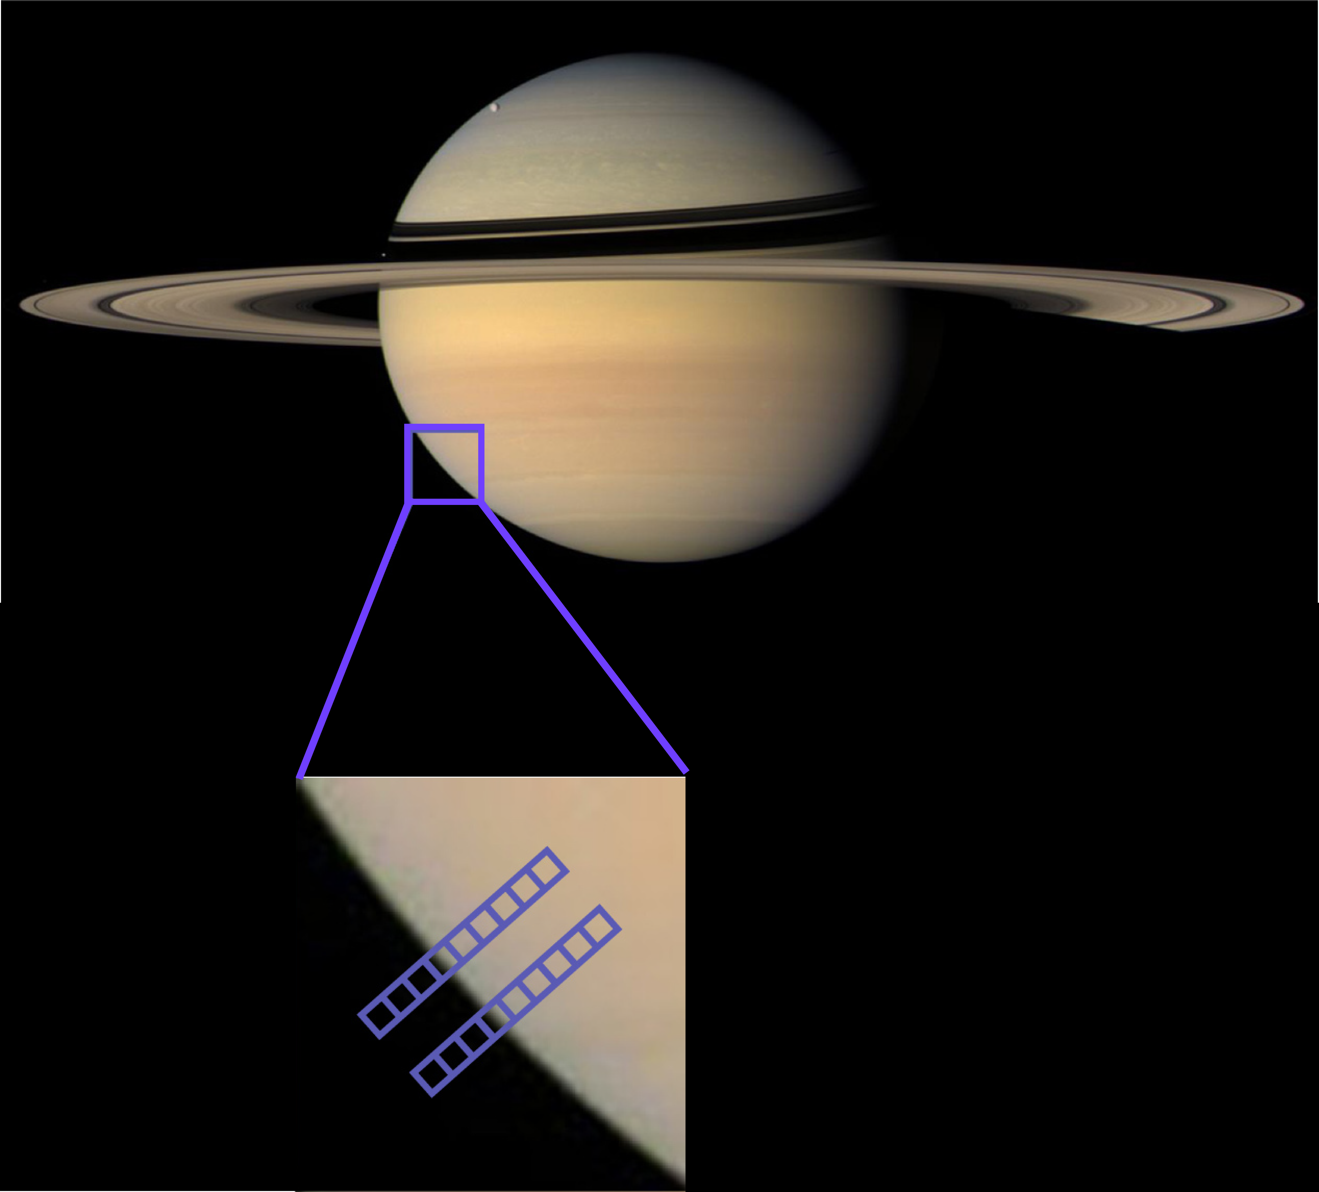
CIRS instrument
Composite InfraRed Spectrometer
(7 – 17 µm ; 600 – 1300 cm⁻¹)
Nadir or limb-viewing geometry.
Limb : higher sensitivity to trace species (C₄H₂, C₆H₆…) ; higher vertical coverage and resolution.
Focal planes FP3 and FP4 = arrays of 10 detectors

Slide 4
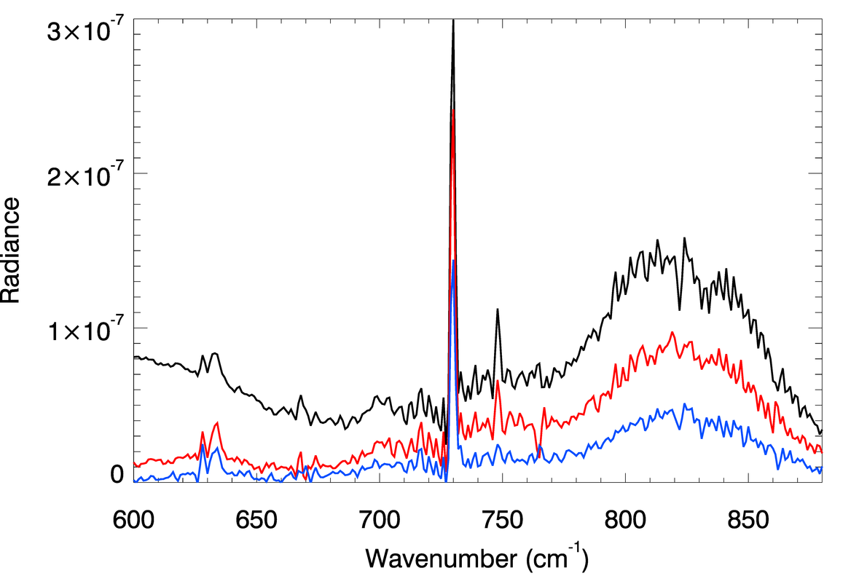
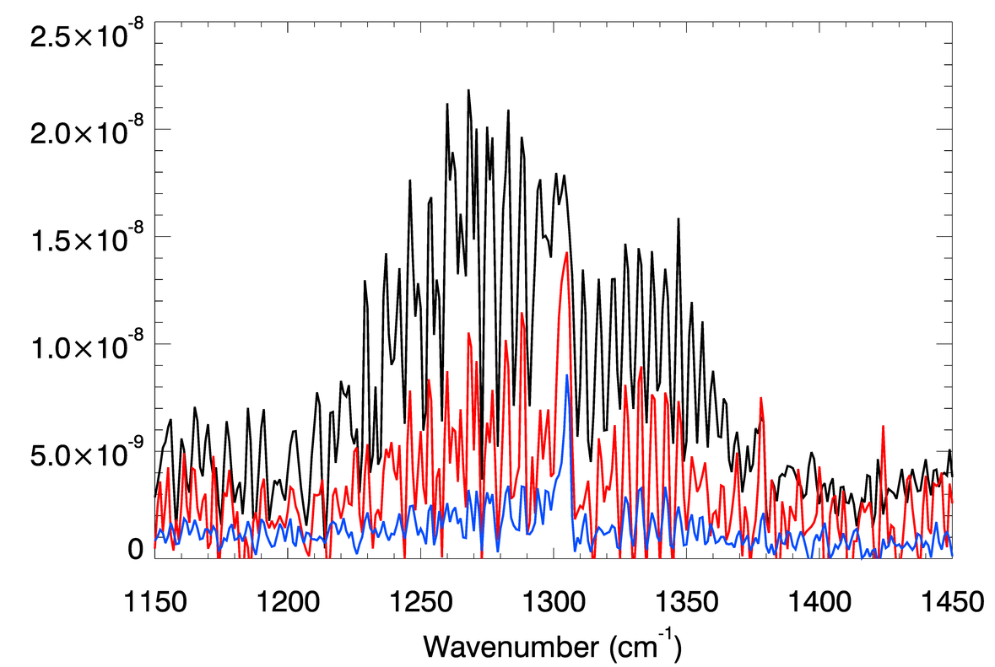
Example of spectra and analysis
Radiative transfer code coupled to a bayesian retrieval algorithm.
1. CH₄ and H₂- H₂, H₂- He CIA temperature profiles (20 – 0.01 mbar).
2. Other hydrocarbon signatures abundance profiles (5 – 0.01 mbar).
Temperature and abundance maps with unprecedented vertical coverage, at different seasons.
C₂H₂
CH₄
z=240km
z=305km
z=370km
C₂H₆
C₆H₆
C₃H₈
CO₂
Cassini/CIRS spectra at 80°S in 2007, at 3 tangent altitudes

Slide 5
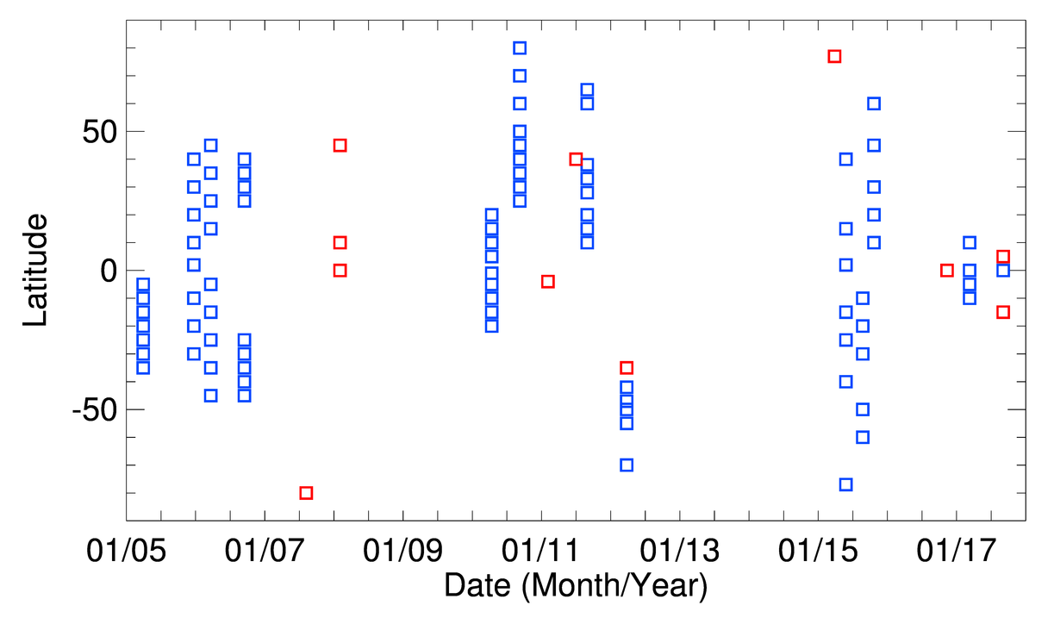
Limb data coverage over the Cassini mission
Winter
Summer
Summer
Automn
Winter

Slide 6
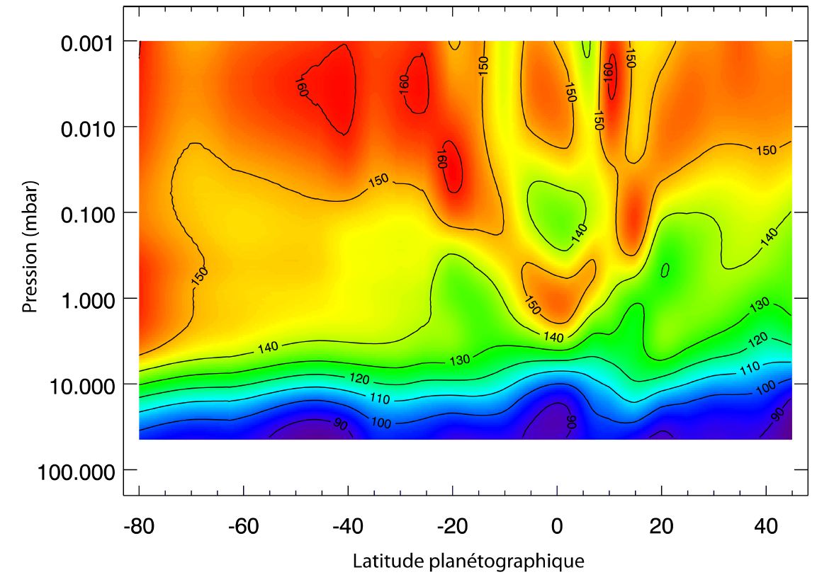
Temperature map from 2005/2006 limb data
Température en 2005/2006
Discovery of an equatorial oscillation

Slide 7
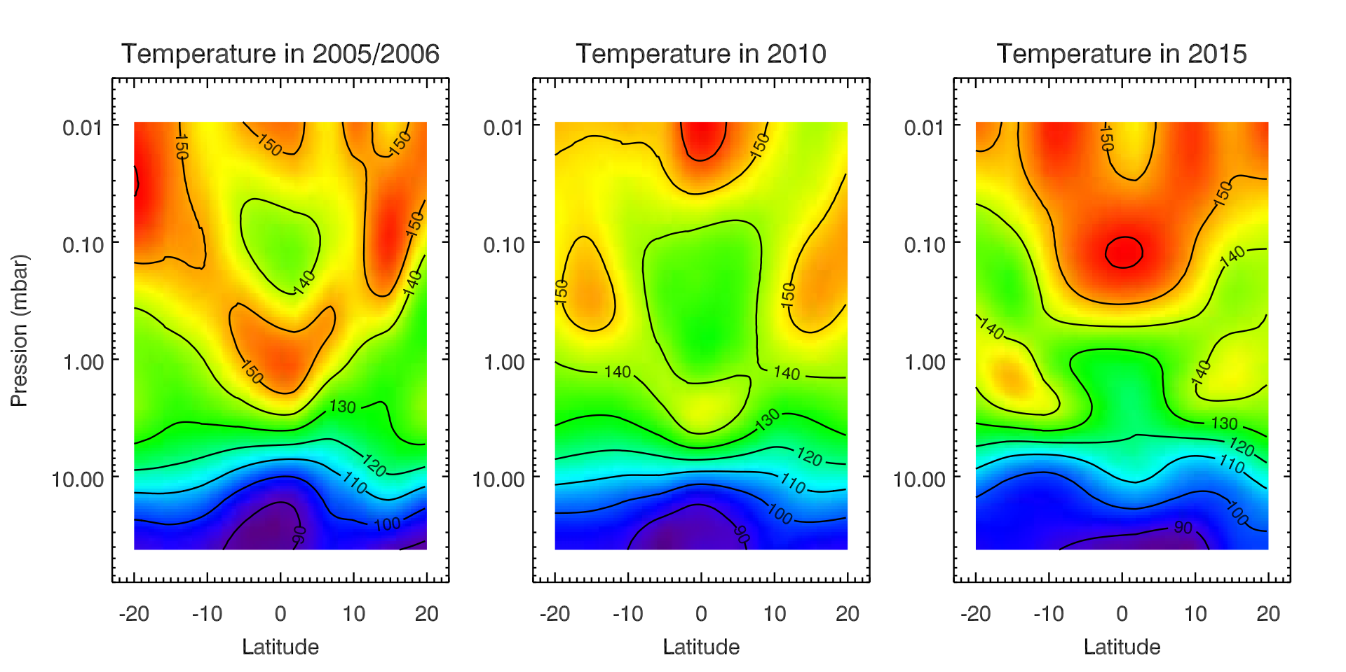
Evolution of Saturn's oscillation from CIRS limb spectra: 2005, 2010, 2015
Extreme temperature changes of up to 25K
Downward propagation of the warm and cold anomalies

Slide 8
Thermal wind and temporal change
Thermal wind equation: relates dT/dθ to du/dz.
Strong shear of the zonal wind, from 50 to 80 m/s/H.
Relative, not absolute values (depend on boundary condition, here 0m/s).
Downward propagation of the westward and eastward jets

Slide 9
Analoguous phenomenon in Earth and Jupiter's stratospheres
Quasi-Biennal Oscillation on Earth:
Downward propagations of easterlies and westerlies
Quasi-periodic, 26 months mean
Mechanism: interactions between upward-propagating waves and mean zonal flow. Waves deposit energy and momentum below the jet maximum ;
the jets move downward.
Quasi-Quadriennal oscillation in Jupiter discovered in 1990
Nice example of comparative planetology

Slide 10
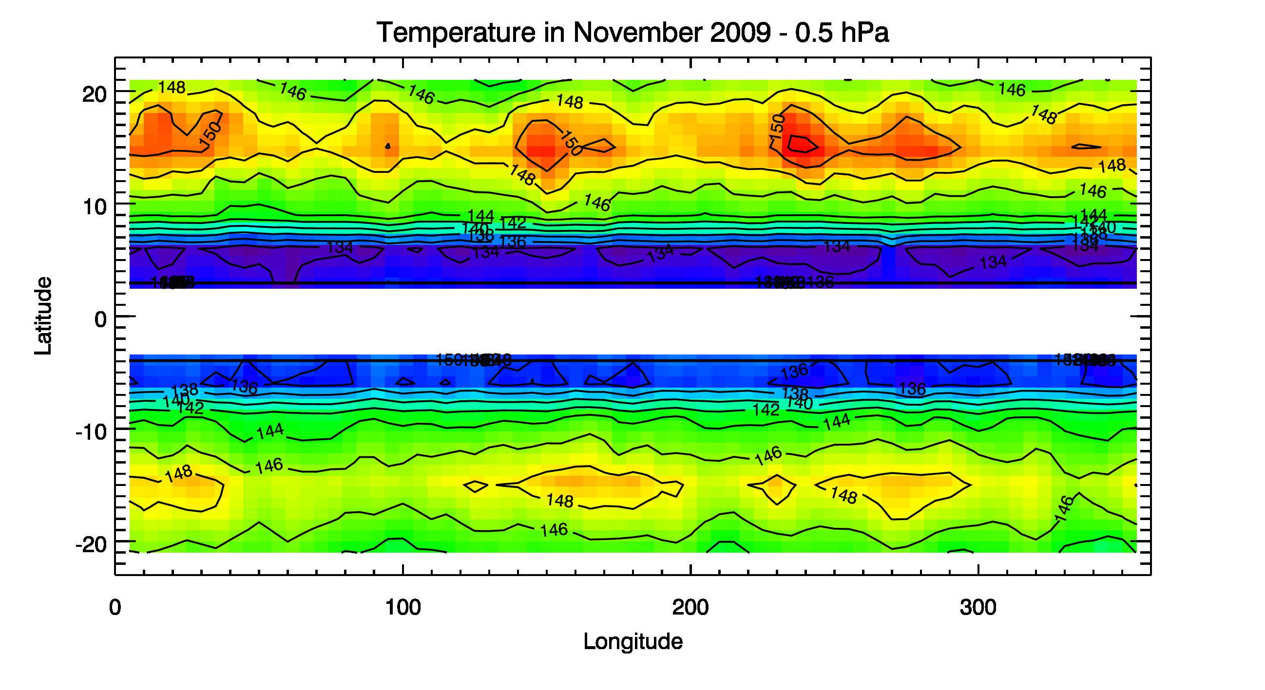
A Rossby wave ?
Mode 3 signature at 15°N and 15°S symmetric wrt equator + hint for westward motion characteristic of a Rossby wave.

Slide 11
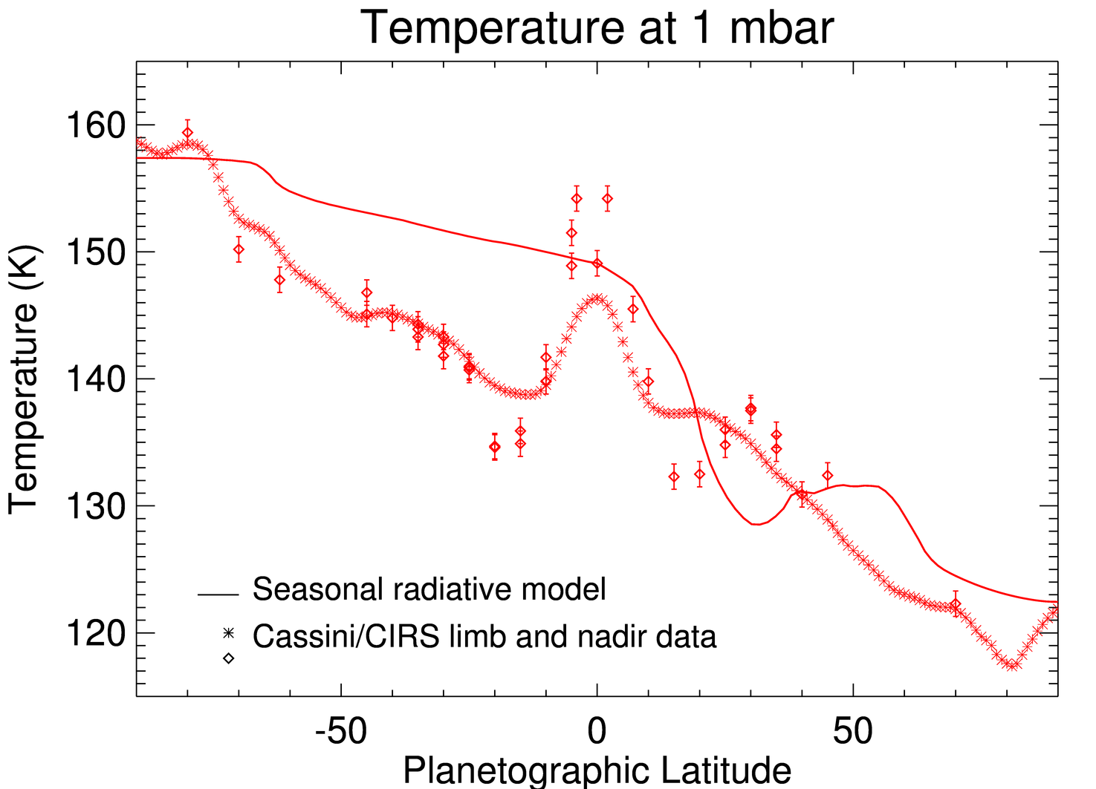
Thermal structure in 2005
Summer
Ring’s shadows
Winter
Radiative equilibrium (Guerlet 2014)
Nadir (Fletcher 2007)
Limb (Guerlet 2009)
Three years after the 2002 solstice.
Pole-to-pole temperature gradient of ~40K .

Slide 12
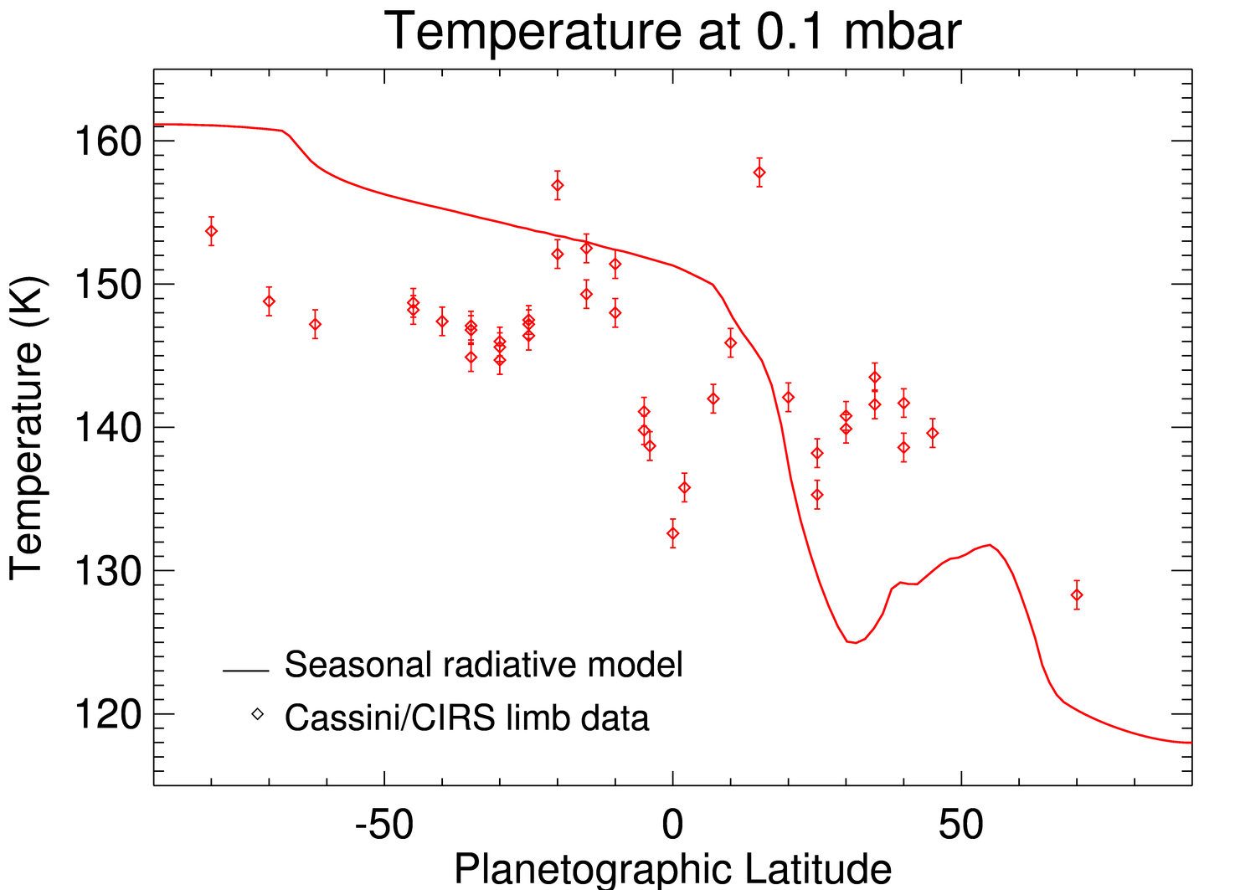
Thermal structure in 2005
Summer
Ring’s shadows
Winter
Expected cooling under the ring’s shadow not seen ; summer latitudes colder than expected : upwelling in summer, subsidence in winter ?

Slide 13
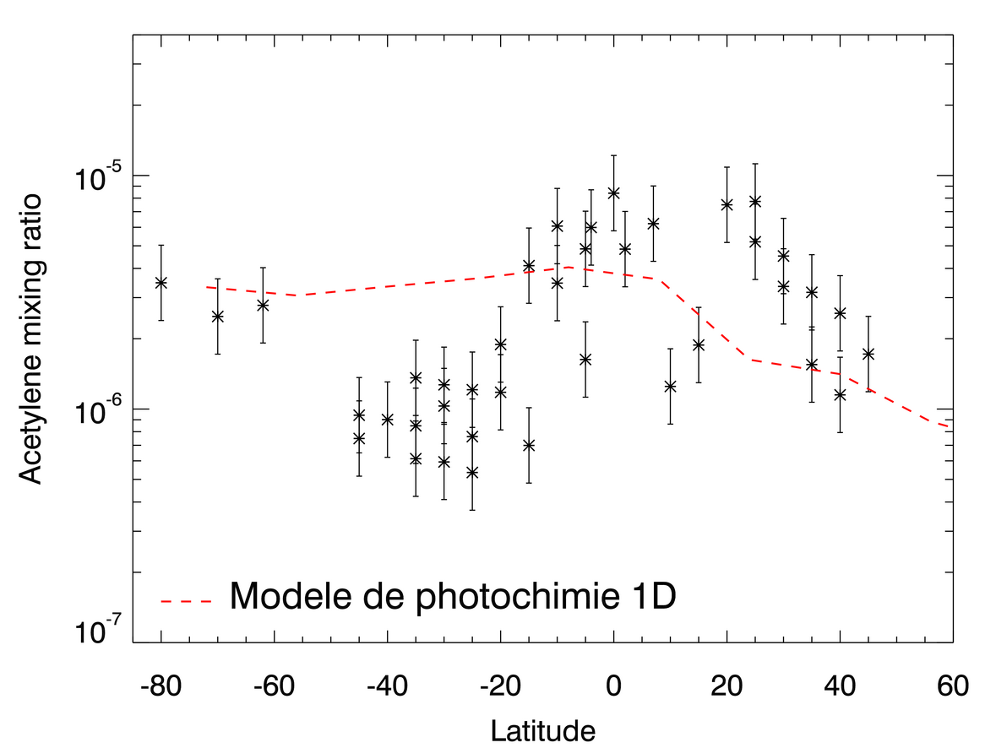
Acetylene (C₂H₂) distribution in 2005
P=0,01 mbar
Summer
Winter
1D Photochemical model
In upper stratosphere : photochemical lifetime < one season.
At odds with seasonal photochemical model (Moses et al.)

Slide 14
Acetylene (C₂H₂) distribution in 2005
P=0,01 mbar
Summer
Winter
1D Photochemical model
Hints for the transport of trace species by seasonal circulation (consistent with temperature map).

Slide 15
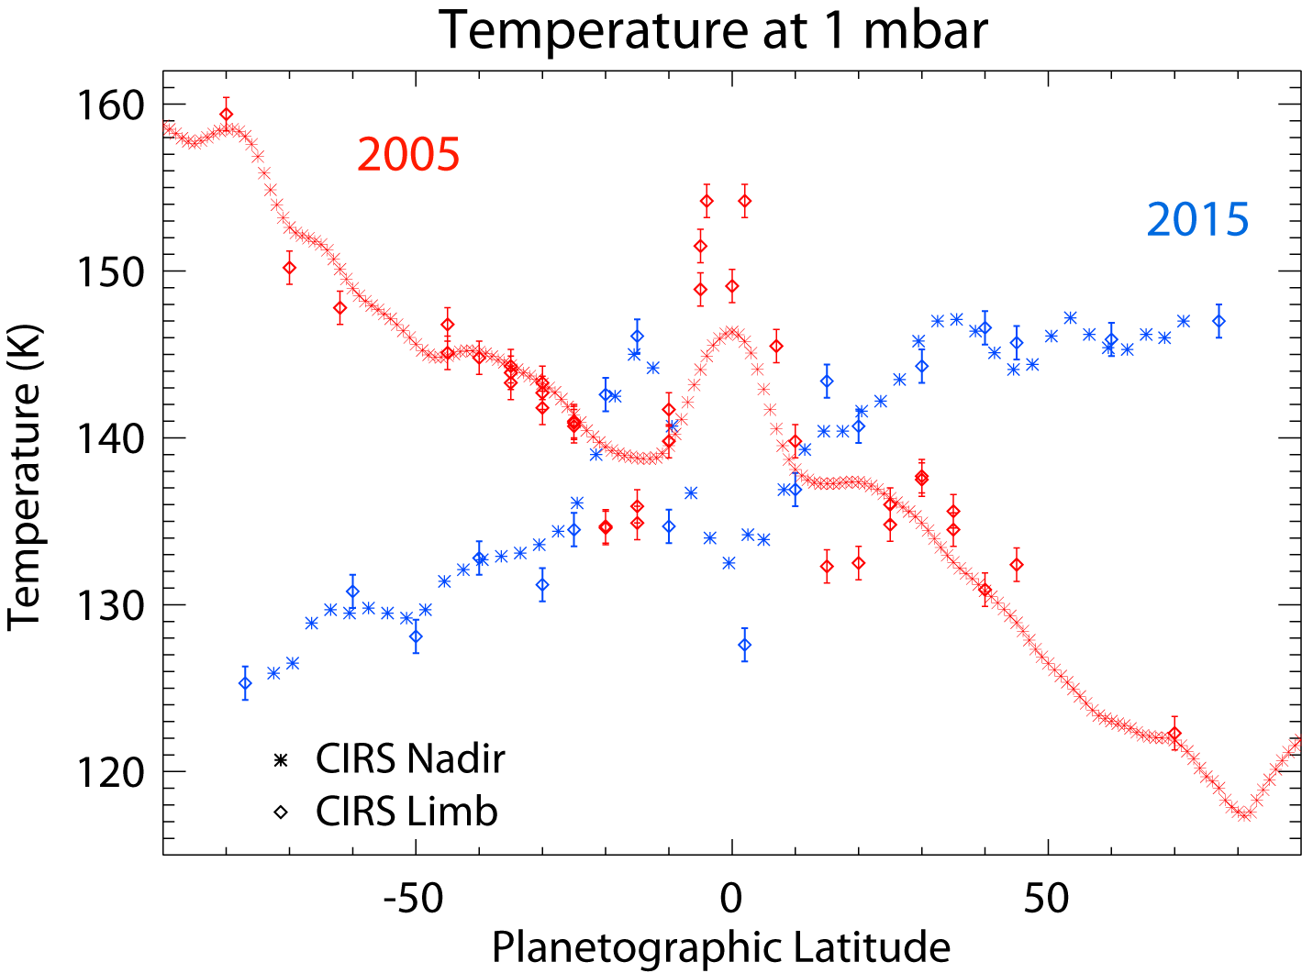
Seasonal variations : 2005 → 2015
Southern hemisphere has cooled by ~20K (summer → autumn), northern hemisphere is warming (winter → spring).

Slide 16
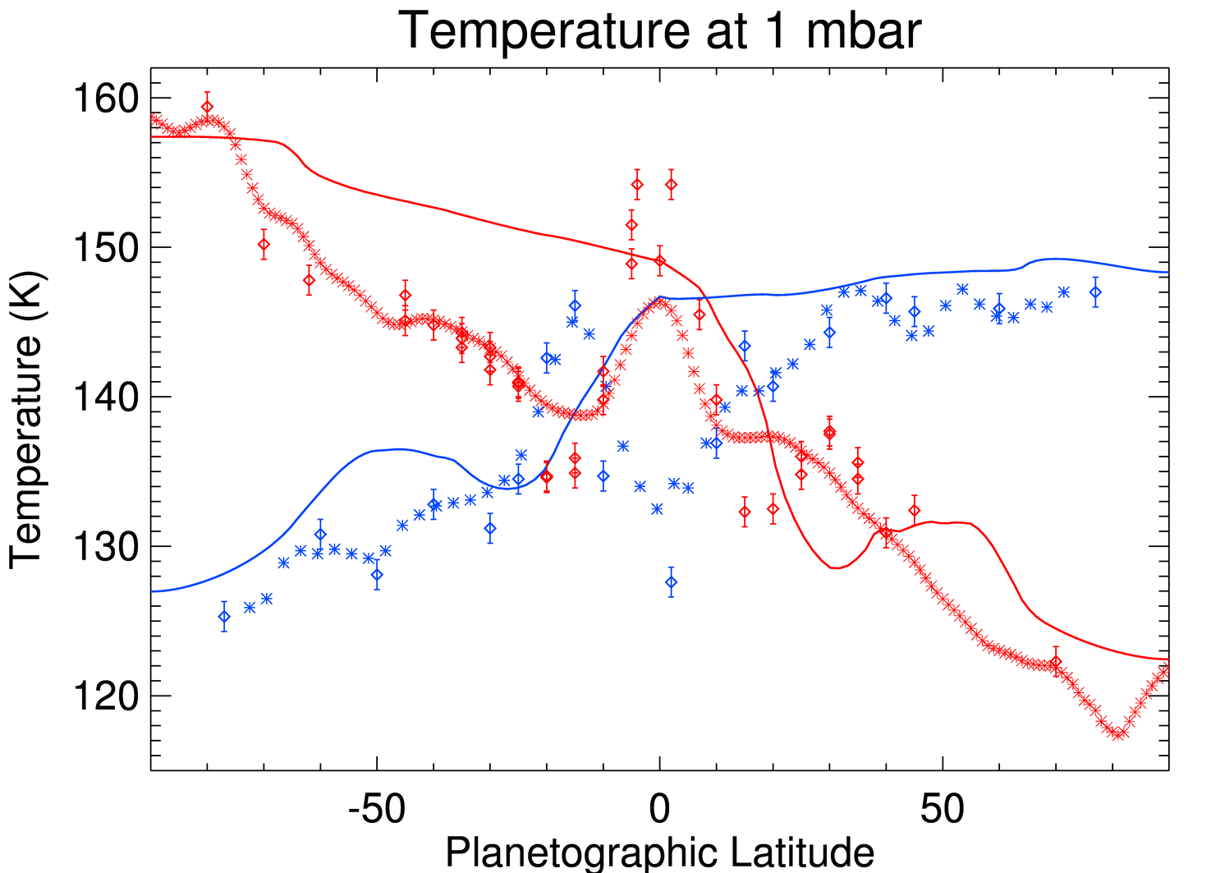
Seasonal variations : 2005 → 2015
Summer
spring
autumn
winter
Radiative equilibrium model
Observations
2005 2015
In 2015 : temperature in northern hemisphere ~in agreement with model.

Slide 17
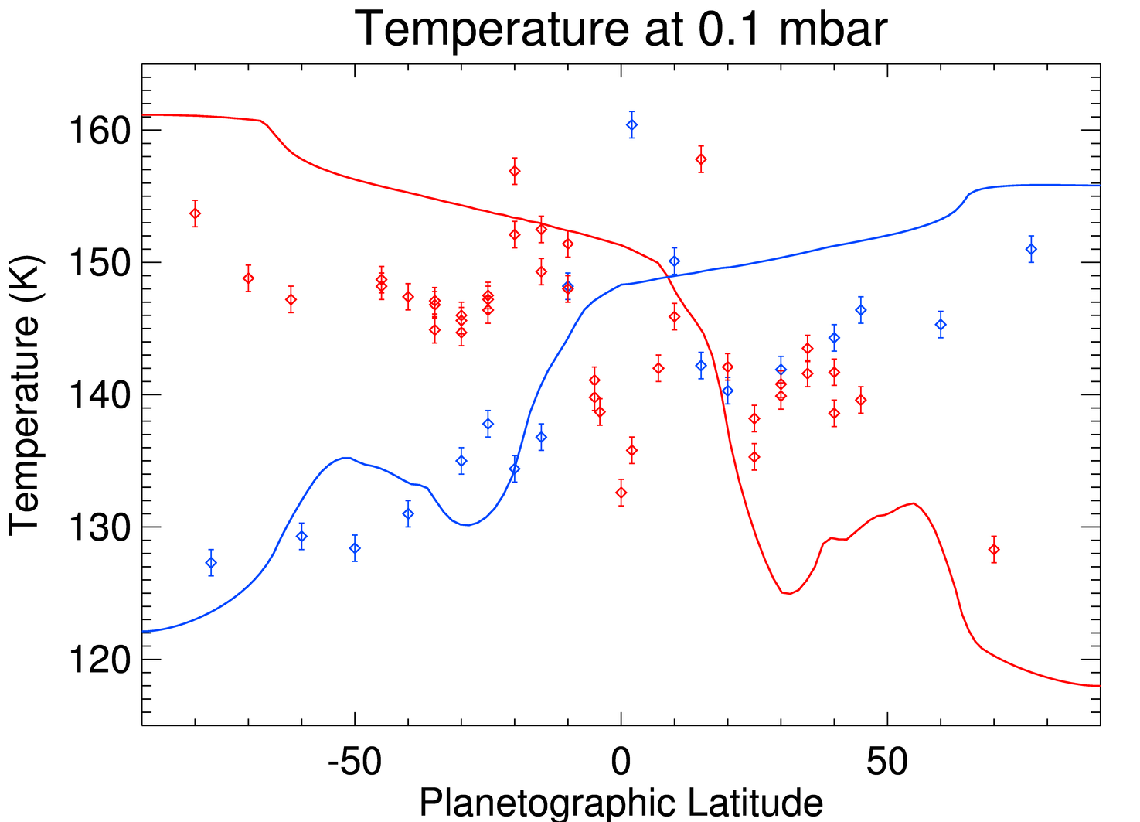
Seasonal variations : 2005 → 2015
Summer
spring
autumn
Radiative equilibrium model
Observations
2005 2015
winter
Northern mid-latitudes: strong disagreement with radiative equilibrium profiles: circulation already reversed?

Slide 18
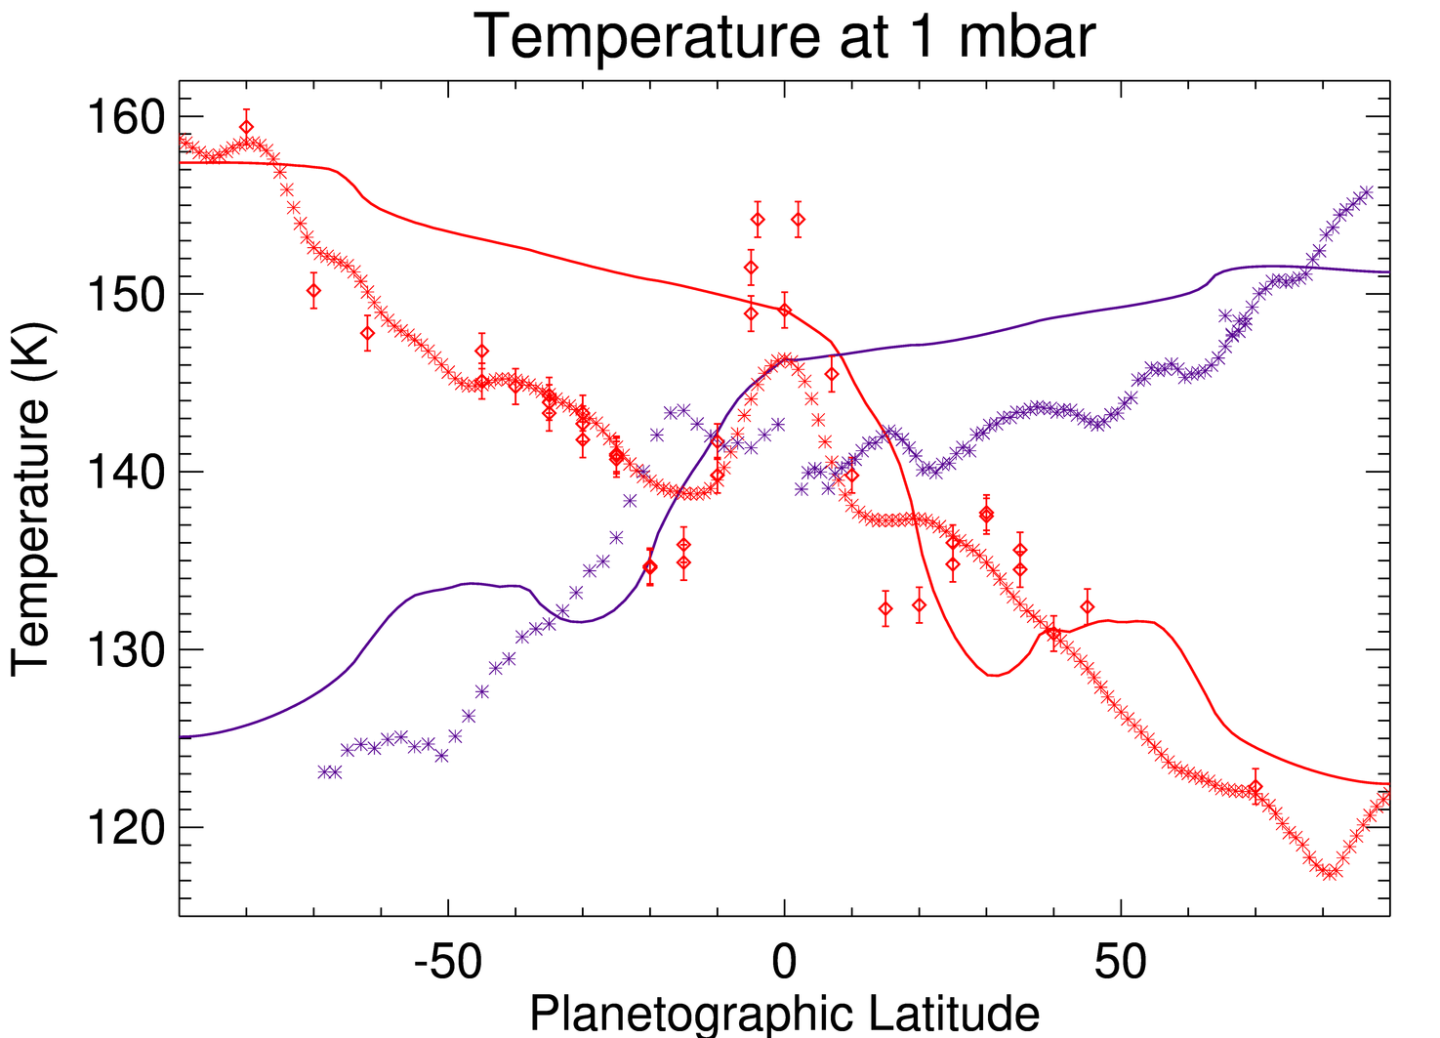
Seasonal variations : 2005 → 2017
Summer
summer
Winter
winter
Radiative equilibrium model
Observations
2005 2017
In 2017 : ~symmetric with respect to 2005. Northern mid-latitudes have cooled down between 2015 and 2017 ! Hint for reversal of circulation !

Slide 19
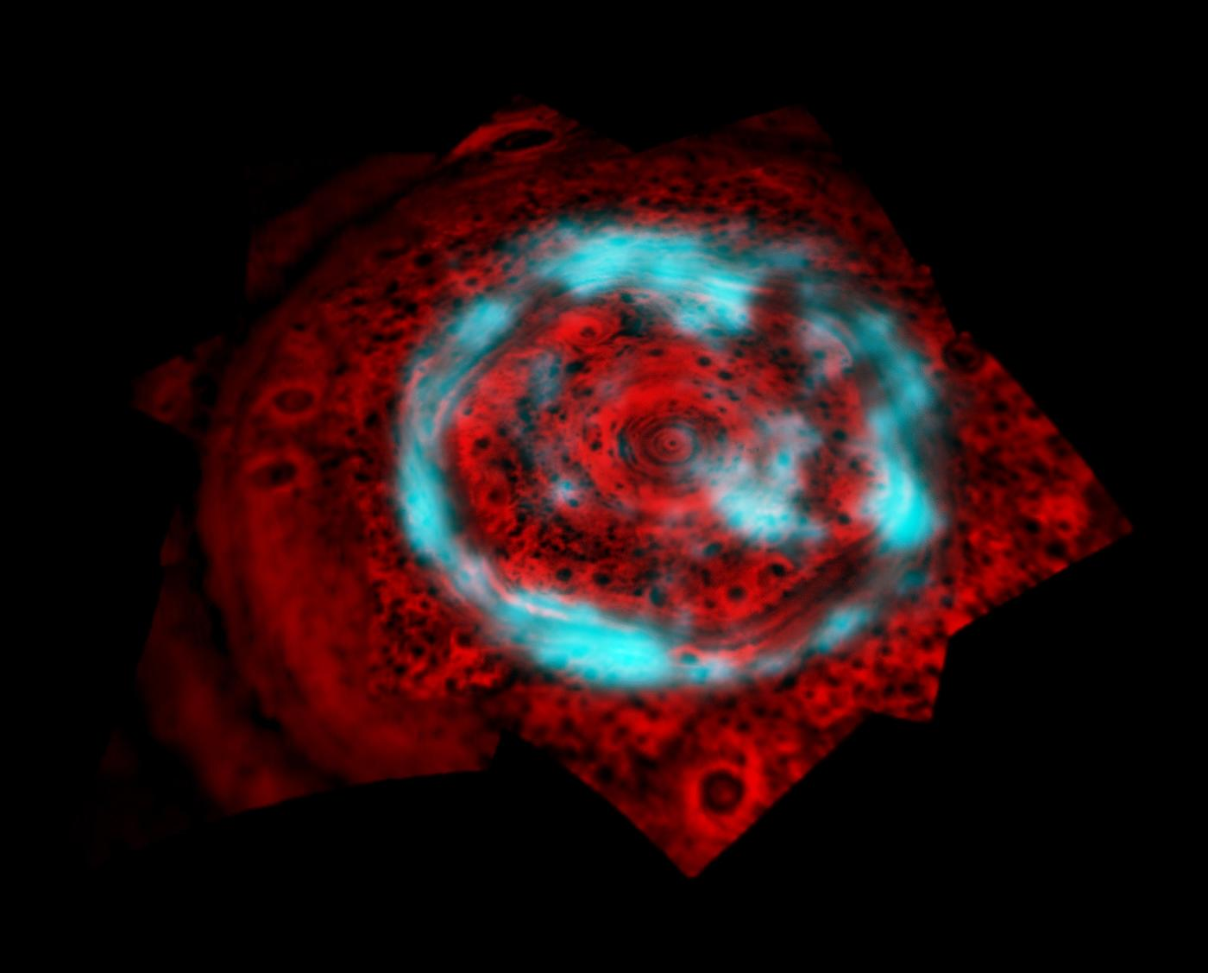
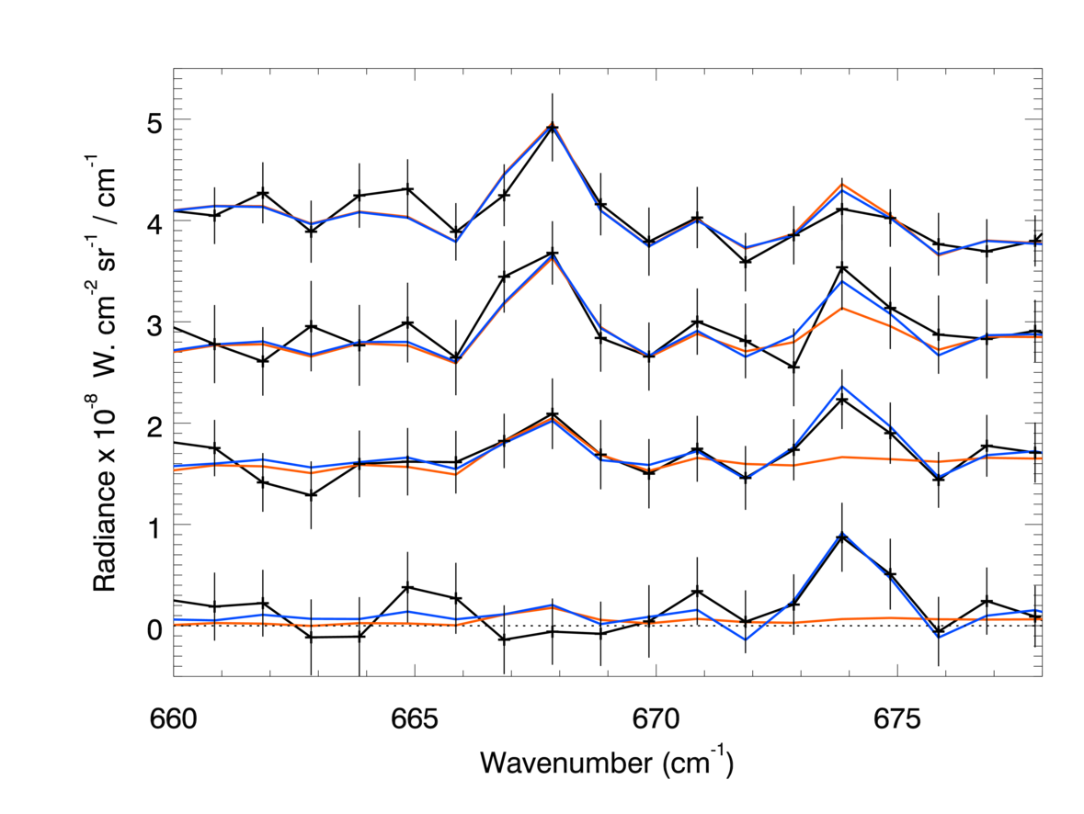
Polar regions : hints for a much more complex chemistry
Detection of benzene (C₆H₆) in Saturn’s upper stratosphere
CO₂
C₆H₆
P=3.5 hPa
P=0.6 hPa
P=0.1 hPa
P=0.02 hPa
Cannot be explained with neutral photochemistry : ion chemistry model needed.
CIRS spectra at 77°N, 4 altitudes

Slide 20
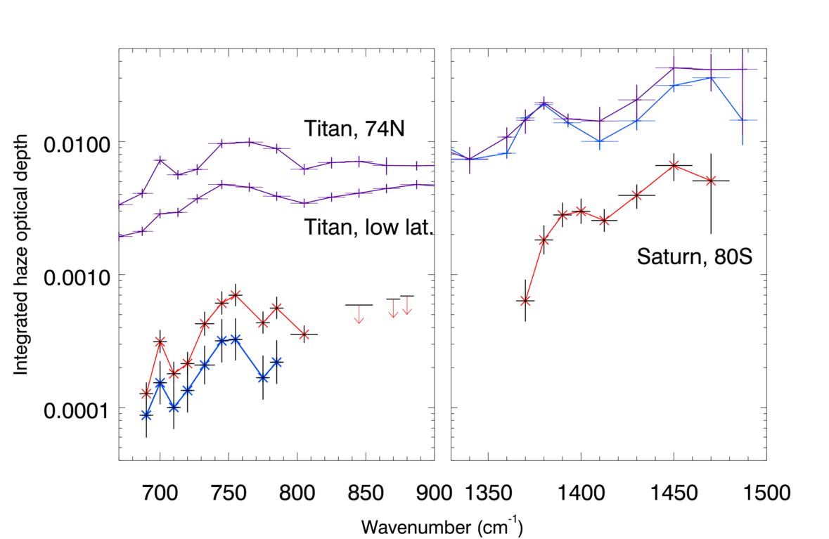
Aerosol opacities
Saturn, 80S
Saturn 80S
Saturn 77N
Similar signatures in Titan's stratosphere (Vinatier et al., 2012), attributed to vibration modes of aromatic and aliphatic hydrocarbons.
Aerosol mass loading of ~ 10⁻⁵ g/cm²
In Jupiter’s polar stratosphere: ~ 10⁻⁴ g/cm² (Zhang et al., 2013)
consistent with relative auroral energy.

Slide 21
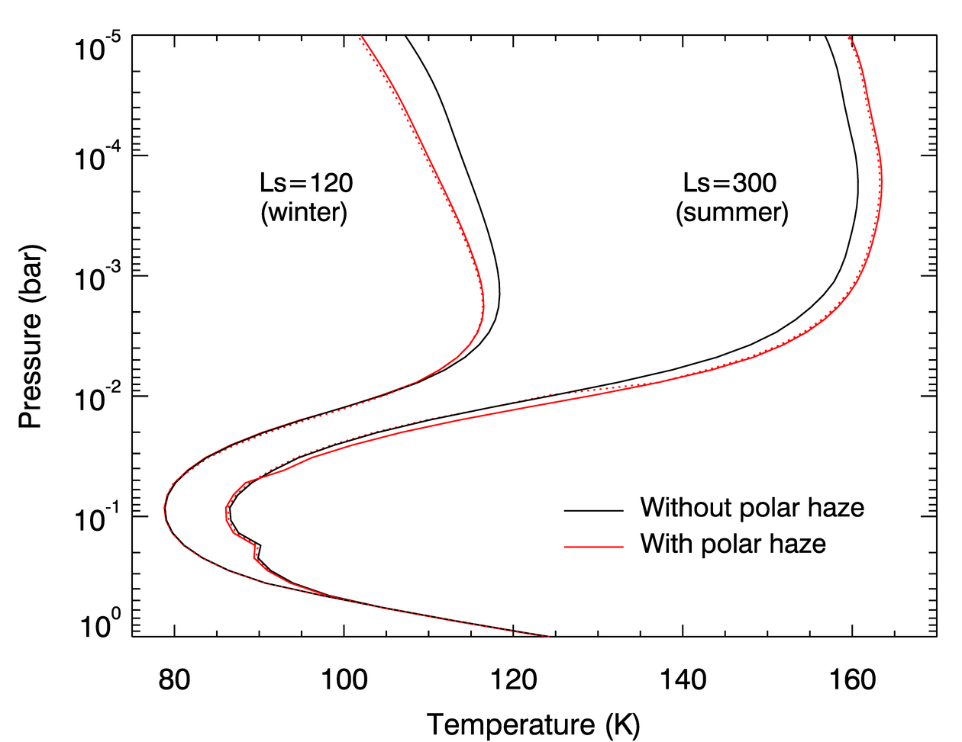
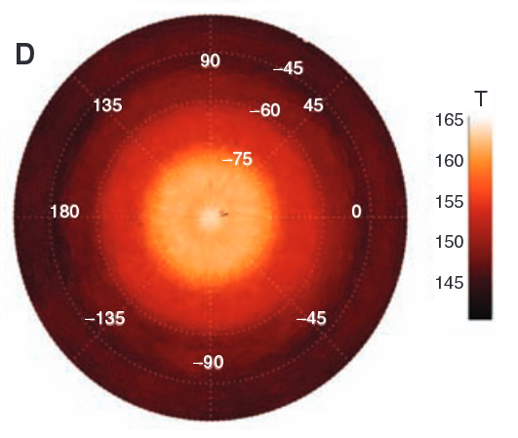
Radiative impact of polar aerosols
Cooling effect in winter (-5K), warming effect in summer (+6K).
Could partly explained the « warm polar hood » observed at 1 mbar (temperature « step » of +8K located at 75S in 2006).
80S
Temperature at 1 mbar over the summer pole, Fletcher et al., 2008
Temperature profiles from a radiative-convective equilibrium model.

Slide 22
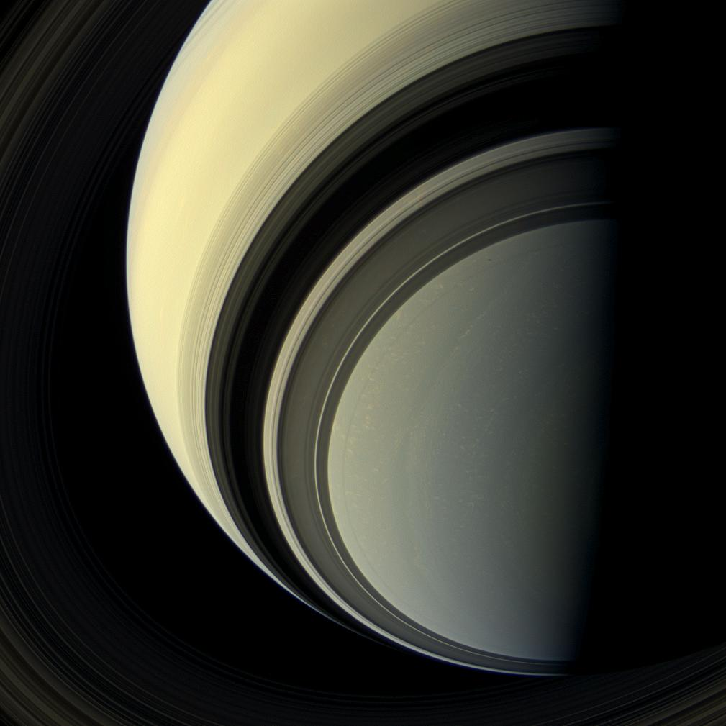
Summary
Cassini/CIRS observations thermal structure and composition.
Main results :
Study of the equatorial oscillation and its evolution ;
Hints for seasonal circulation in the middle and upper stratosphere ;
Ion chemistry in auroral regions (production of benzene and complex aerosols).
Still many dataset to analyse and results to interpret !
Ongoing development of a General Circulation Model...

Slide 23
References
Fouchet et al., Nature, 2008.
Guerlet et al., Icarus, 2009.
Guerlet et al., Icarus, 2010.
Guerlet et al., GRL, 2011.
Guerlet et al., Icarus, 2014.
Sylvestre et al., Icarus, 2015
Guerlet et al., A&A, 2015.
Guerlet et al., JGR, 2018.

