Slide 1
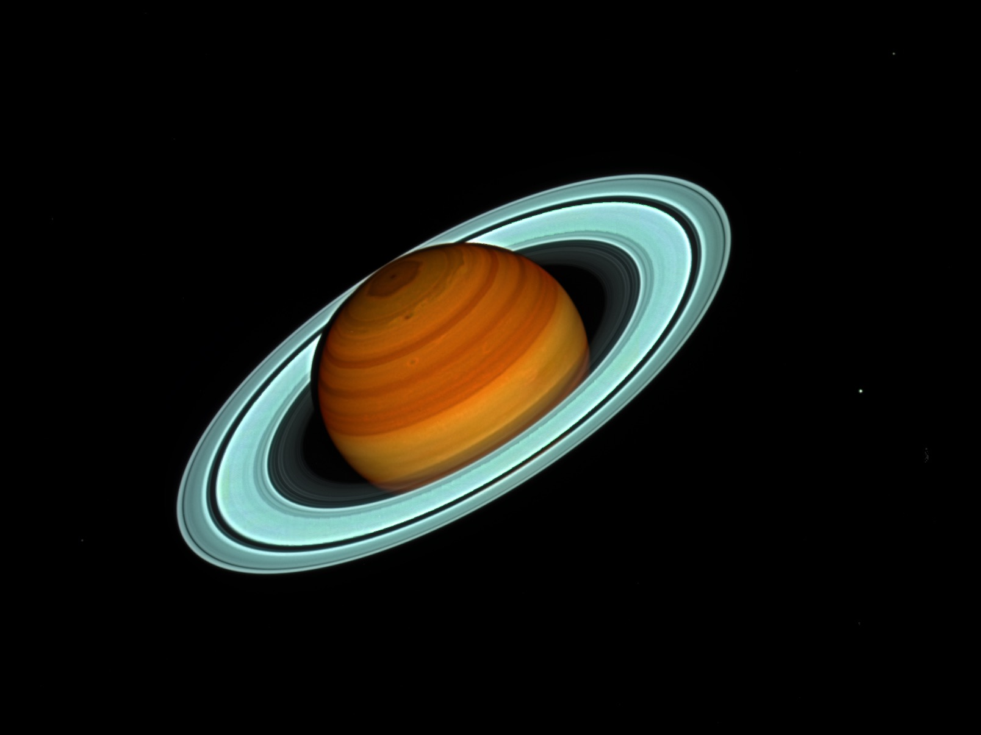
POTENTIAL VORTICITY OF SATURN’S POLAR REGIONS
Arrate Antuñano¹, T. del Río-Gaztelurrutia², A. Sánchez-Lavega², P.L. Read³, and L.N. Fletcher¹
¹ Department of Physics & Astronomy, University of Leicester, University Road, Leicester LE1 7RH, UK.
² Departamento de Física Aplicada I, Escuela de Ingeniería de Bilbao, Universidad del País Vasco, Bilbao, Spain.
³ Clarendon Laboratory, University of Oxford, Parks Road, Oxford, OX1 3PU, UK.

Slide 2
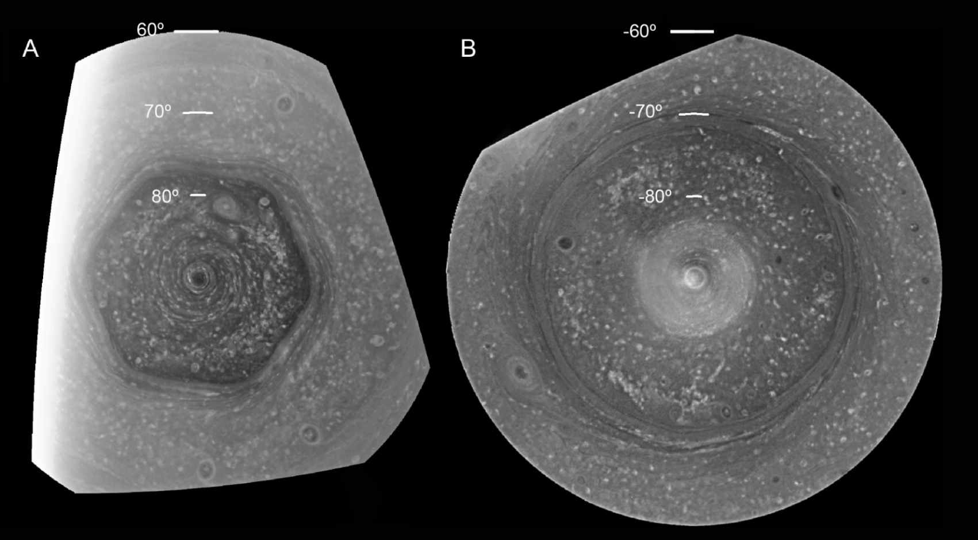
Introduction Goal & Dataset Potential Vorticity Results Conclusions
Cloud Morphology
Northern spring, 14 June 2013
Southern late summer, 3 December 2008
Antuñano et al. 2015

Slide 3
Introduction Goal & Dataset Potential Vorticity Results Conclusions
Cloud Morphology
Northern spring, 14 June 2013
Southern late summer, 3 December 2008
Antuñano et al. 2015

Slide 4
Introduction Goal & Dataset Potential Vorticity Results Conclusions
Cloud Morphology
Northern spring, 14 June 2013
Southern late summer, 3 December 2008
Antuñano et al. 2015

Slide 5
Introduction Goal & Dataset Potential Vorticity Results Conclusions
Cloud Morphology
Northern spring, 14 June 2013
Southern late summer, 3 December 2008
Antuñano et al. 2015

Slide 6
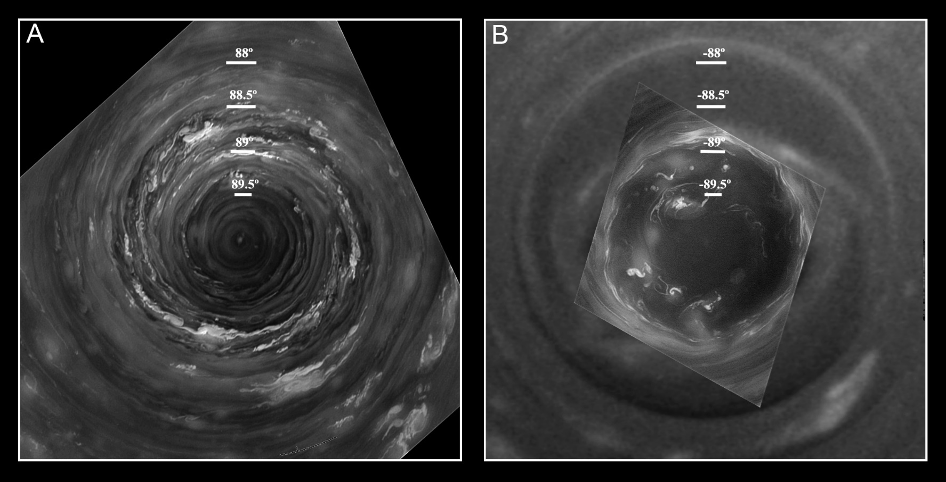
Introduction Goal & Dataset Potential Vorticity Results Conclusions
Cloud Morphology
Northern spring, 14 June 2013
Southern late summer, 3 December 2008
NORTH
SOUTH
Antuñano et al. 2015

Slide 7
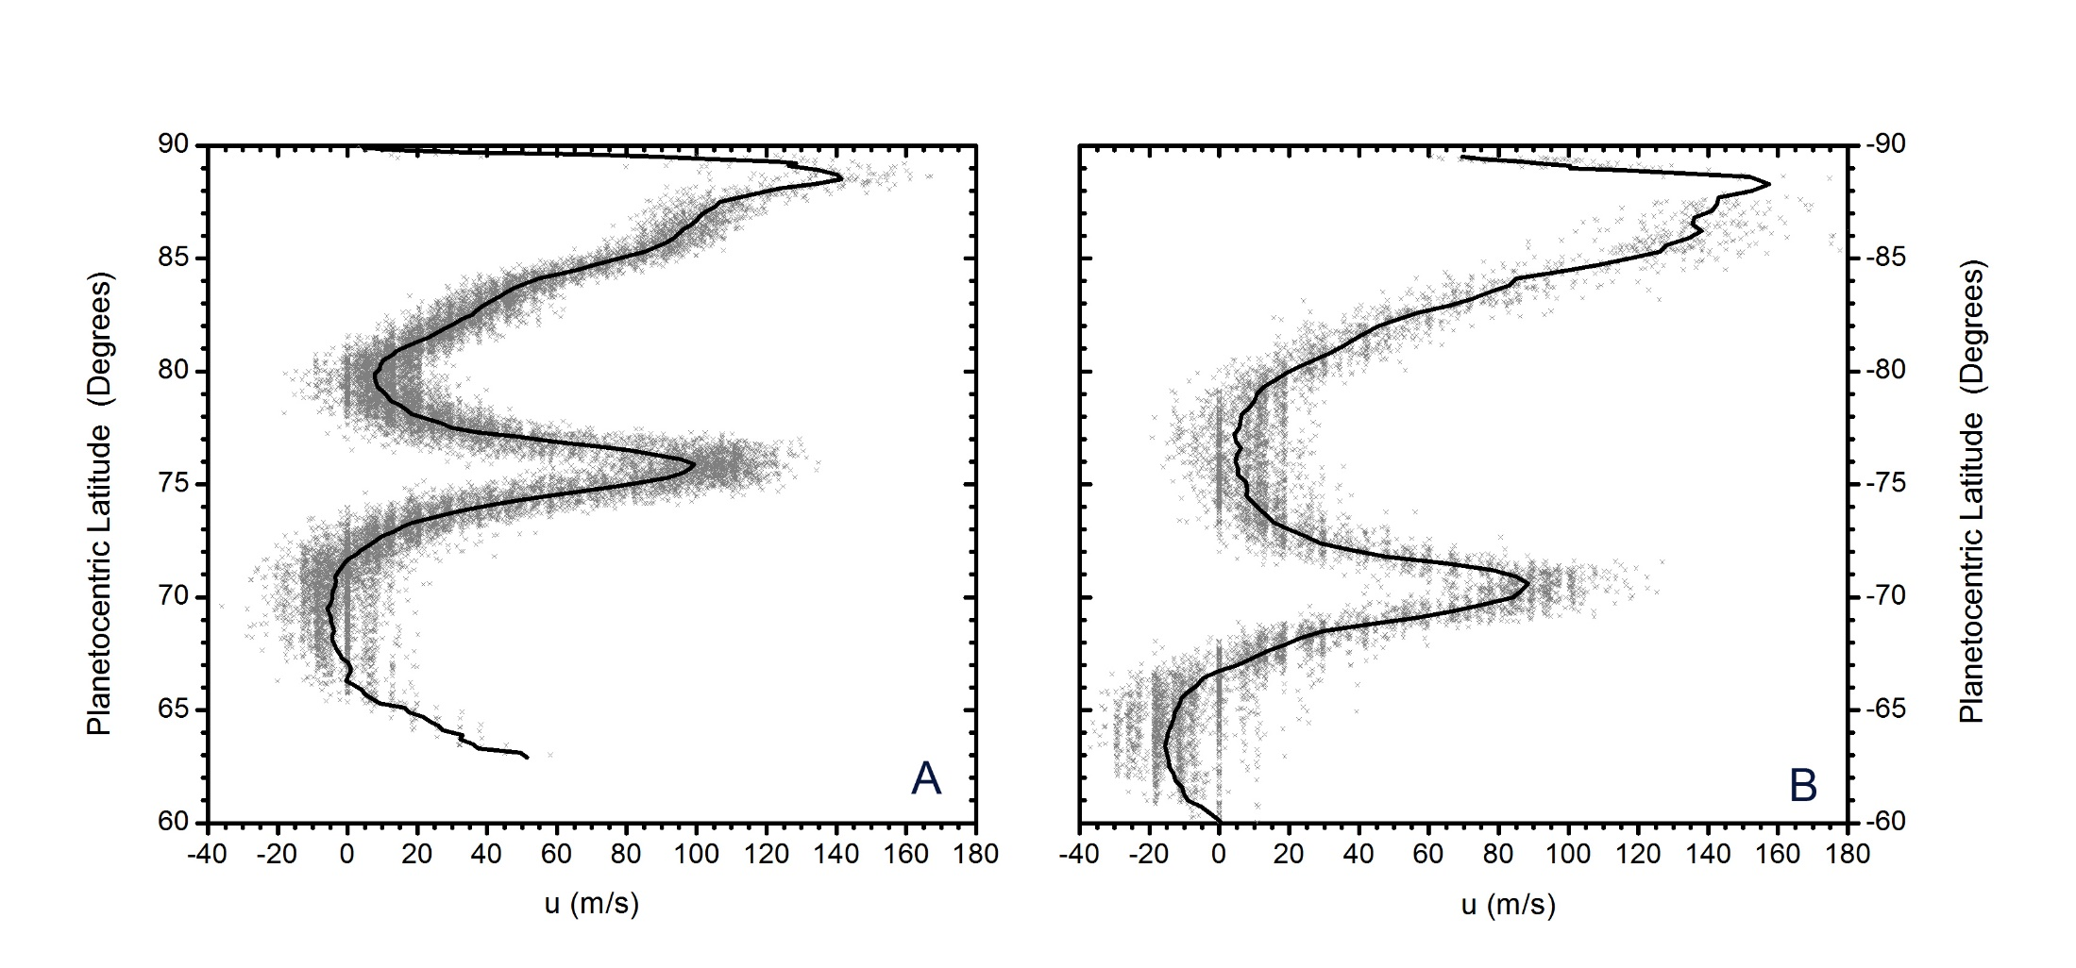
Introduction Goal & Dataset Potential Vorticity Results Conclusions
Zonal Wind Profile
Unchanged zonal wind profile in the last ~ 40 years
Hexagon
Antuñano et al. 2015

Slide 8
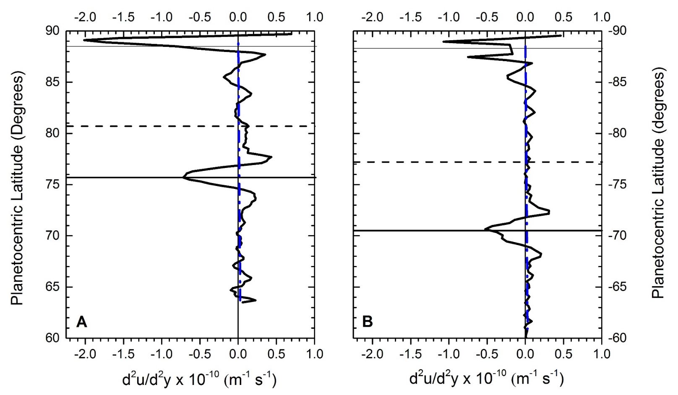
Introduction Goal & Dataset Potential Vorticity Results Conclusions
Vorticity Gradients (d²u/d²y)
Rayleigh-Kuo instability for barotropic conditions is satisfied at the flanks.
Antuñano et al. 2015

Slide 9
Introduction Goal & Dataset Potential Vorticity Results Conclusions
Vorticity Gradients (d²u/d²y)
Rayleigh-Kuo instability for barotropic conditions is satisfied at the flanks.
Antuñano et al. 2015

Slide 10
Introduction Goal & Dataset Potential Vorticity Results Conclusions
Seasonal variations on the temperature field
TROPOSPHERE
Fletcher et al. 2018 (Accepted in Nature Communications)
STRATOSPHERE

Slide 11
Introduction Goal & Dataset Potential Vorticity Results Conclusions
High resolution wind measurements:
June 2013 (early northern summer) (Antuñano et al., 2015)
December 2008 (late northern winter) (García-Melendo et al., 2011) & (Antuñano et al., 2015)
October 2006 (southern summer) (Sánchez-Lavega et al., 2006)

Slide 12
Introduction Goal & Dataset Potential Vorticity Results Conclusions
High resolution wind measurements:
June 2013 (early northern summer) (Antuñano et al., 2015)
December 2008 (late northern winter) (García-Melendo et al., 2011) & (Antuñano et al., 2015)
October 2006 (southern summer) (Sánchez-Lavega et al., 2006)
Zonally averaged temperature profiles:
Interpolated temperature measurements over the whole Cassini mission.
Focal plane 1 (10-600 cm⁻¹), sensing the 80-800 mbar range
focal plane 4 (1100-1400 cm⁻¹), sensing the 0.5-5.0 mbar range.
Maximum spatial resolution ~ 2° latitude.

Slide 13
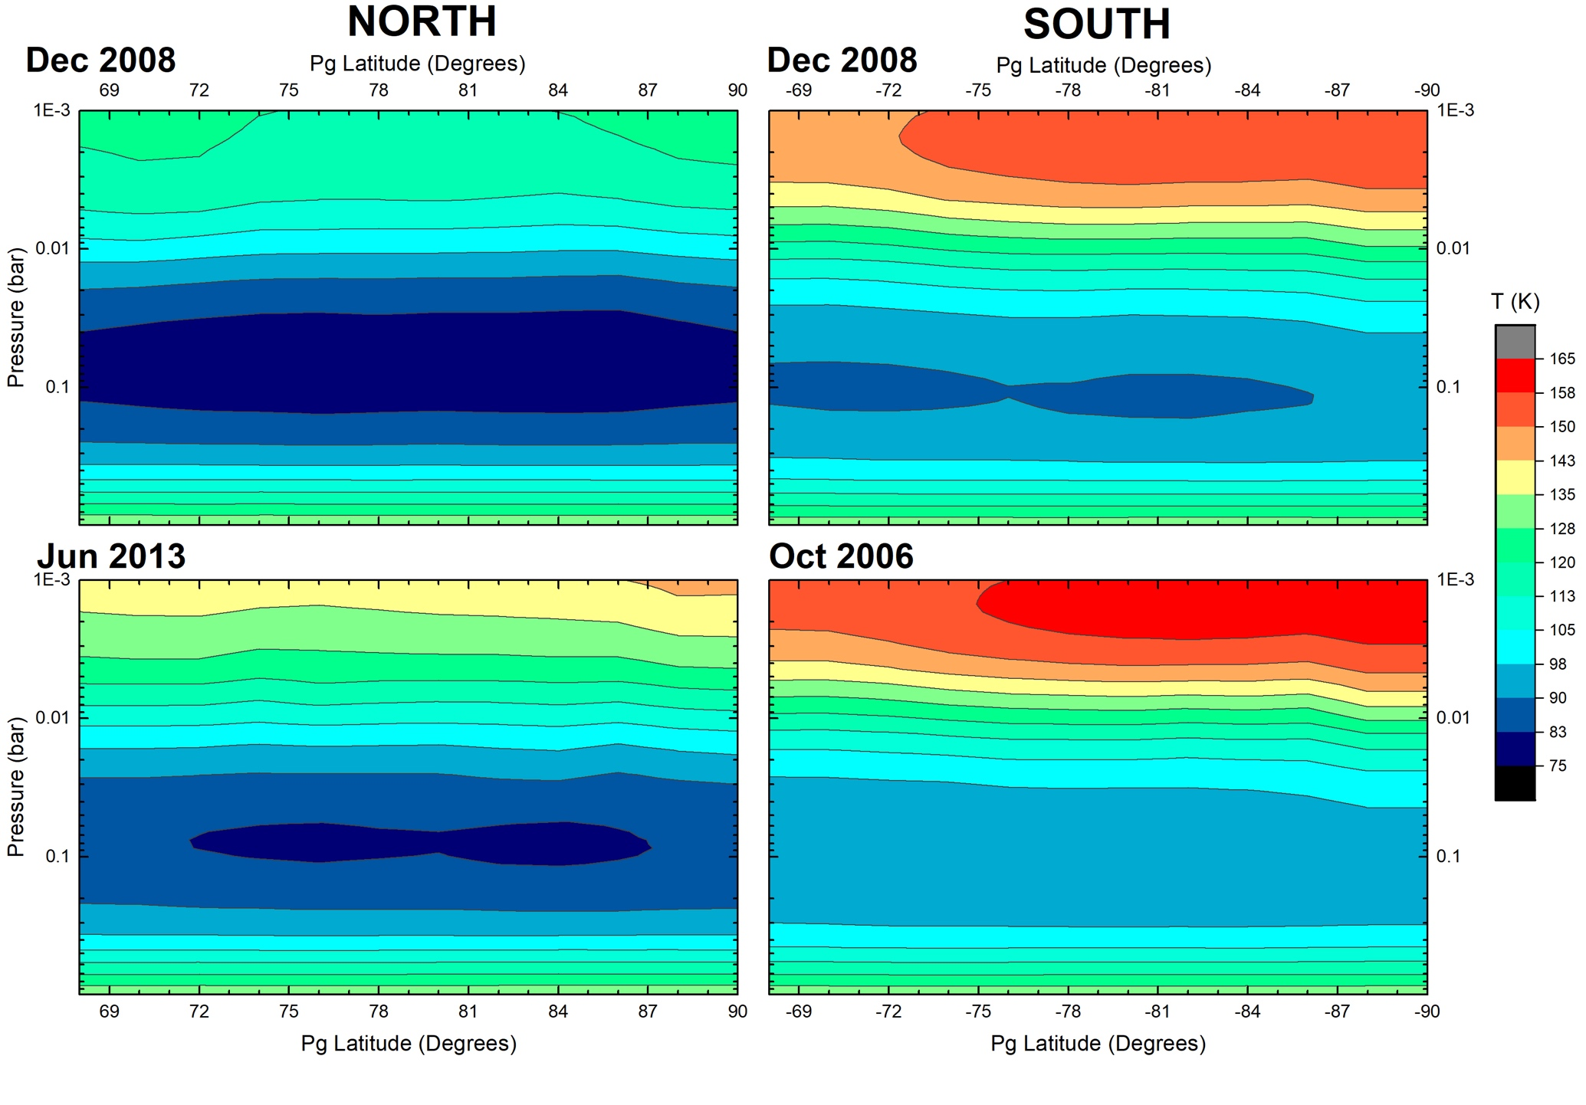
Introduction Goal & Dataset Potential Vorticity Results Conclusions

Slide 14
$$q_{g}=\left(f+ξ_{g}\right)−f \frac{∂}{∂P} \left(\frac{P}{\left.s(P\right)} \frac{T´}{<T>}\right)$$
Introduction Goal & Dataset Potential Vorticity Results Conclusions
$$\frac{∂u}{∂ln(P)}= \frac{R^{∗}}{f}{ \left(\frac{∂T}{∂y}\right)}_{P}$$
Thermal Wind
~ Barotropic behaviour at the troposphere.
More baroclinic at the stratosphere.
Westward jets less negative with altitude.
Eastward jets become slower with height.
No significant temporal changes
NORTH
Dec 2008
Jun 2013
SOUTH
Oct 2006
Dec 2008

Slide 15
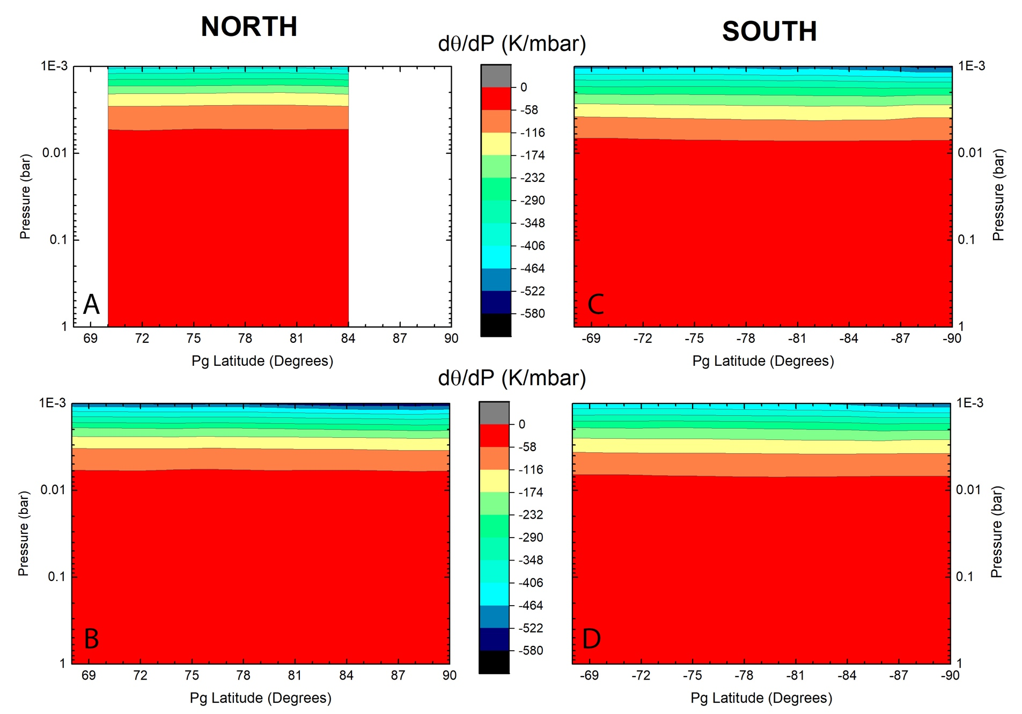
$$q_{g}=\left(f+ξ_{g}\right)−f \frac{∂}{∂P} \left(\frac{P}{\left.s(P\right)} \frac{T´}{<T>}\right)$$
Introduction Goal & Dataset Potential Vorticity Results Conclusions
d$θ$/dP
Statically stable atmosphere (d$θ$/dP < 0)
More stable at the stratosphere.
Stratified atmosphere.
No significant temporal changes
Dec 2008
Oct 2006
Jun 2013
Dec 2008
Dec 2008

Slide 16
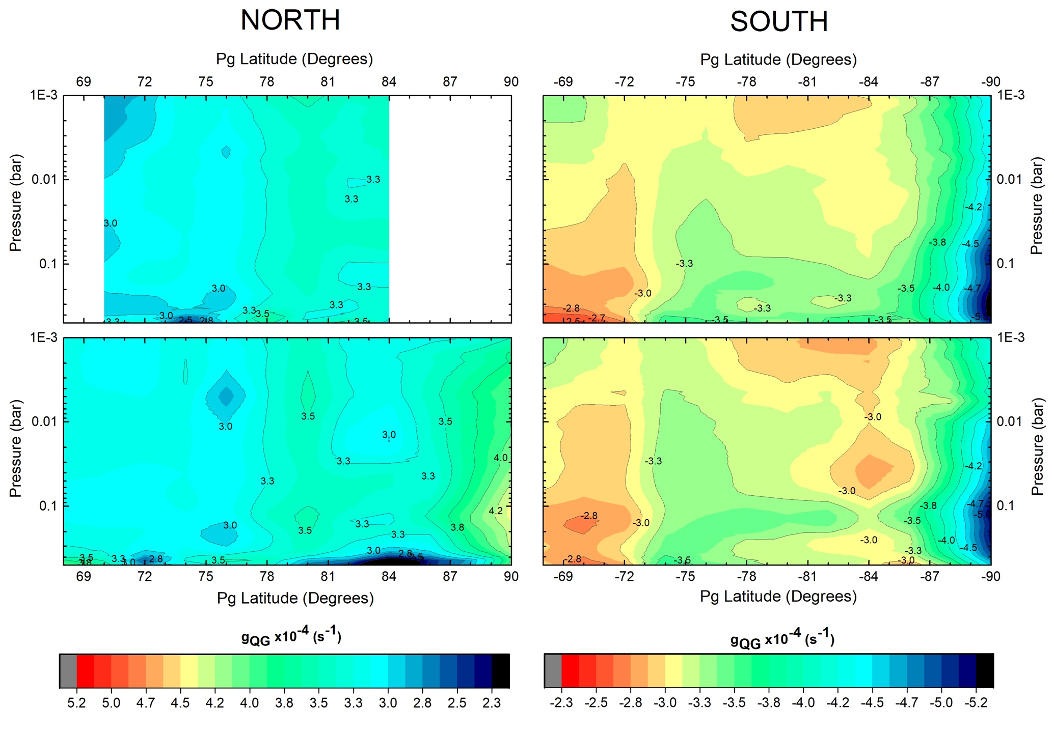
Introduction Goal & Dataset Potential Vorticity Results Conclusions
$$q_{g}=\left(f+ξ_{g}\right)−f \frac{∂}{∂P} \left(\frac{P}{\left.s(P\right)} \frac{T´}{<T>}\right)$$
Quasi-Geostrophic Potential Vorticity
Dominance of Coriolis.
Step like behavior.
Maximum vorticity ~ 100-200 mbar.
Standard deviation:
~ 0.5 x 10⁻⁴ s⁻¹ to
~ 0.06 x 10⁻⁴ s⁻¹
Dec 2008
Dec 2008
Jun 2013
Oct 2006

Slide 17
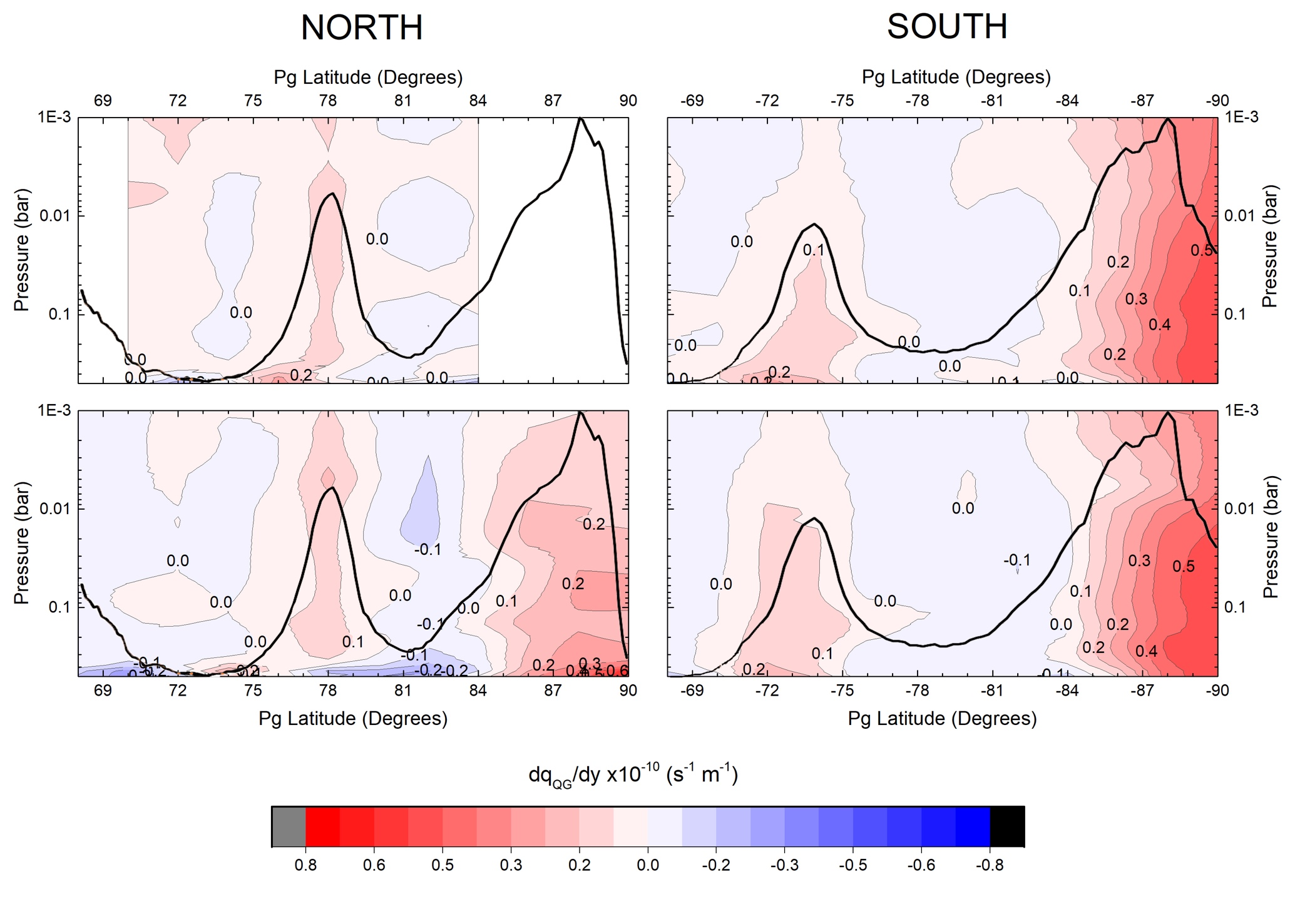
Introduction Goal & Dataset Potential Vorticity Results Conclusions
Meridional gradients of Quasi-Geostrophic Potential Vorticity: dQ/dY
Charney-Stern Criterion for dynamical instability to grow:
$\frac{dq}{dy}$ changes sign.
Dynamical instability could grow mainly at:
Hexagon flanks.
Flanks of jet at 73.9° S.
Southern flank of polar jets.
Dec 2008
Dec 2008
Jun 2013
Oct 2006

Slide 18
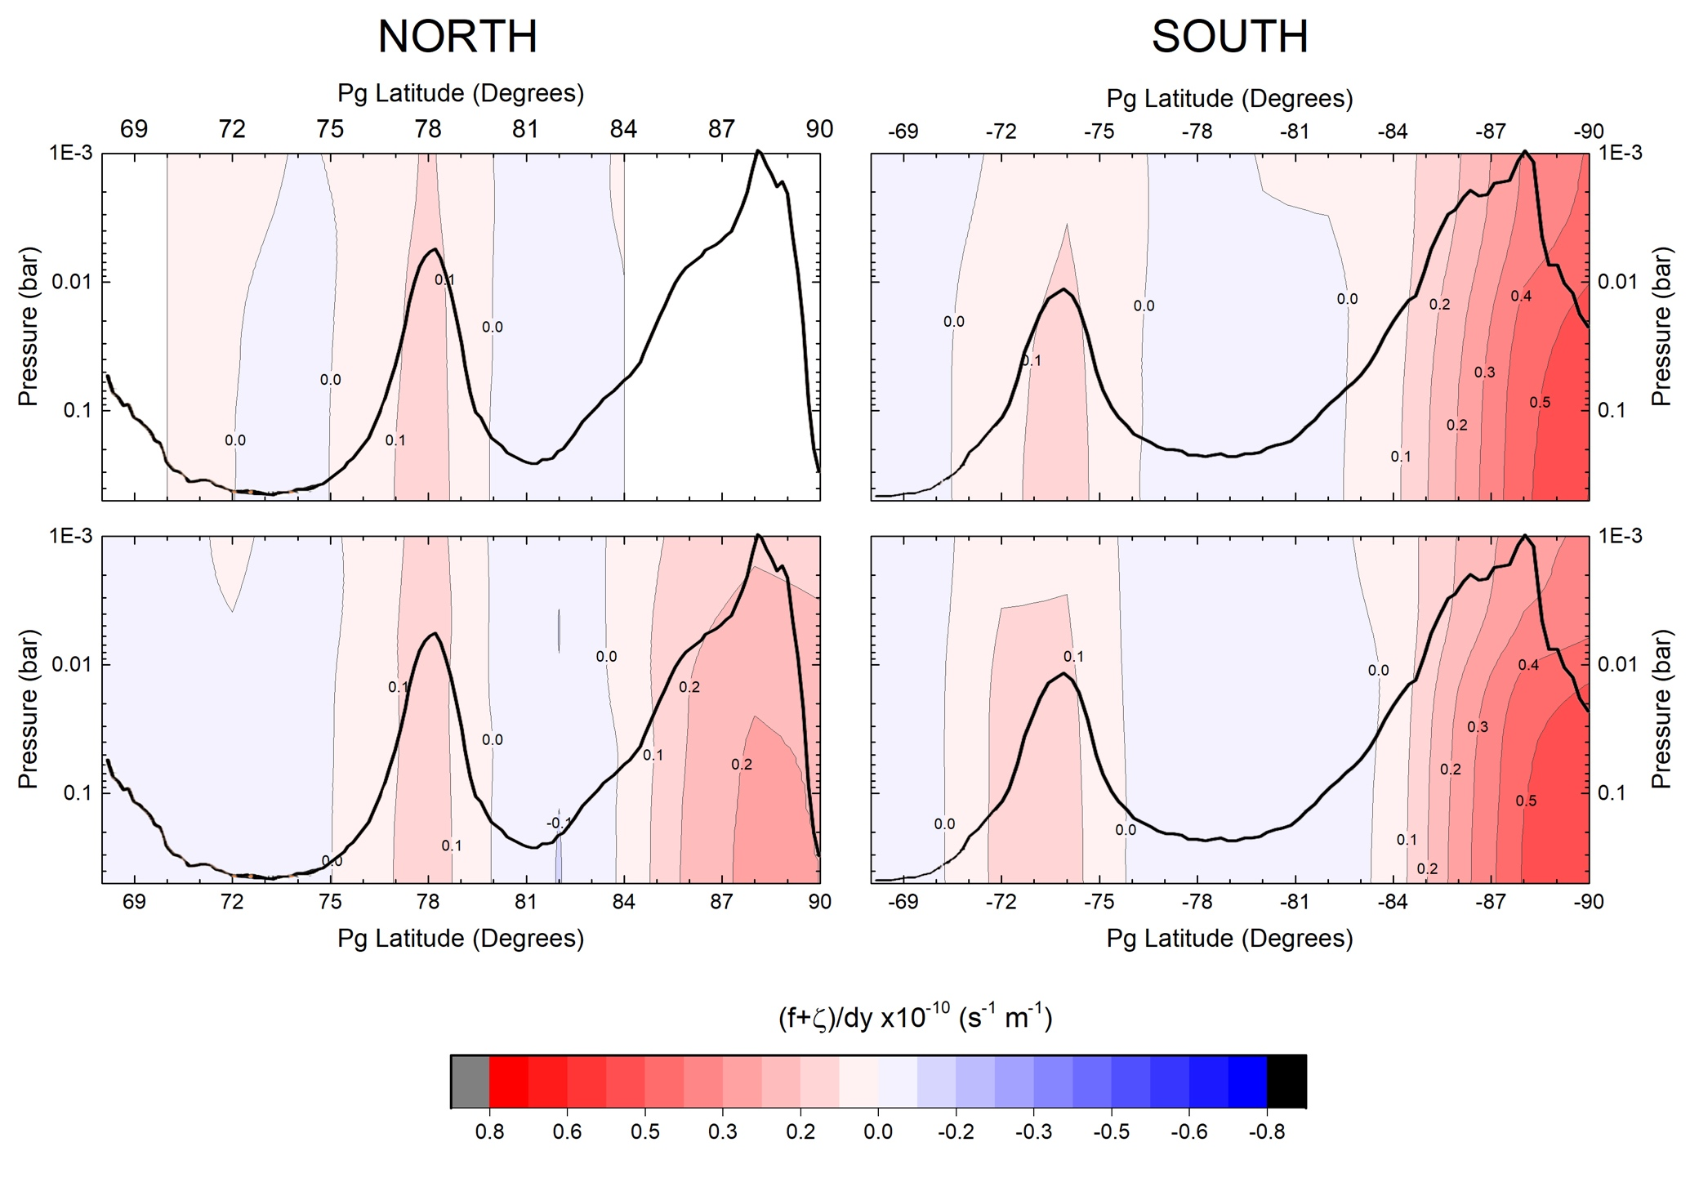
Introduction Goal & Dataset Potential Vorticity Results Conclusions
Meridional gradients of Absolute Vorticity d$\left(f+ξ_{g}\right)/dy$
Barotropic term accounts for the main tendencies of the meridional gradients!
Small contribution of the variations in the stratification of the atmosphere.
Dec 2008
Dec 2008
Jun 2013
Oct 2006

Slide 19
Introduction Goal & Dataset Potential Vorticity Results Conclusions
We have computed QGPV maps up to both poles between the upper troposphere (500 mbar) and upper stratosphere (1 mbar).
Similar behaviour at both polar regions
Step like behaviour Maximum QGPV at the upper troposphere.
Dominance of the Coriolis parameter.
We have analysed the stability of the jets at Saturn’s polar regions by computing Meridional gradients of QPV.
Dynamical instability could overall develop on the flanks of both the Hexagon jet and the eastward jet at 73.9° S on the southern flanks of both polar jets.
Barotropic term is responsible for the locations where dynamical instabilities could develop.
We have analysed the seasonal variability of Saturn’s polar dynamics between Dec 2008 and June 2013 (north) and Oct 2006 and Dec 2008 (south).
We do not detect any significant variability over an interval of nearly 7 Earth years or ~0.25 of a Saturnian year.

Slide 21
Introduction Goal & Dataset Potential Vorticity Results Conclusions
Quasi-geostrophic potential vorticity:
$$q_{g}=\left(f+ξ_{g}\right)−f \frac{∂}{∂P} \left(\frac{P}{\left.s(P\right)} \frac{T´}{<T>}\right)$$

Slide 22
Introduction Goal & Dataset Potential Vorticity Results Conclusions
Quasi-geostrophic potential vorticity:
$$q_{g}=\left(f+ξ_{g}\right)−f \frac{∂}{∂P} \left(\frac{P}{\left.s(P\right)} \frac{T´}{<T>}\right)$$
Absolute vorticity
Stretching term

Slide 23
Introduction Goal & Dataset Potential Vorticity Results Conclusions
Quasi-geostrophic potential vorticity:
$T´=T−<T>$
$$q_{g}=\left(f+ξ_{g}\right)−f \frac{∂}{∂P} \left(\frac{P}{\left.s(P\right)} \frac{T´}{<T>}\right)$$
Absolute vorticity
Stretching term

Slide 24
Introduction Goal & Dataset Potential Vorticity Results Conclusions
Quasi-geostrophic potential vorticity:
Static stability:
$T´=T−<T>$
$$q_{g}=\left(f+ξ_{g}\right)−f \frac{∂}{∂P} \left(\frac{P}{\left.s(P\right)} \frac{T´}{<T>}\right)$$
Absolute vorticity
Stretching term
$$s(P)=−\frac{C_{P}^{0}}{<C_{p}>} \frac{∂<\ln{θ}>}{∂\ln{P}}$$

Slide 25
Introduction Goal & Dataset Potential Vorticity Results Conclusions
Quasi-geostrophic potential vorticity:
Static stability:
$T´=T−<T>$
$$q_{g}=\left(f+ξ_{g}\right)−f \frac{∂}{∂P} \left(\frac{P}{\left.s(P\right)} \frac{T´}{<T>}\right)$$
Absolute vorticity
Stretching term
specific heat capacity at 1 bar level
$$s(P)=−\frac{C_{P}^{0}}{<C_{p}>} \frac{∂<\ln{θ}>}{∂\ln{P}}$$

Slide 26
Introduction Goal & Dataset Potential Vorticity Results Conclusions
Quasi-geostrophic potential vorticity:
Static stability:
Potential Temperature:
$T´=T−<T>$
$$q_{g}=\left(f+ξ_{g}\right)−f \frac{∂}{∂P} \left(\frac{P}{\left.s(P\right)} \frac{T´}{<T>}\right)$$
Absolute vorticity
Stretching term
specific heat capacity at 1 bar level
$$s(P)=−\frac{C_{P}^{0}}{<C_{p}>} \frac{∂<\ln{θ}>}{∂\ln{P}}$$
$θ=τ {\left(\frac{P}{P_{0}}\right)}^{{−κ}^{0}}$

Slide 27
Introduction Goal & Dataset Potential Vorticity Results Conclusions
Quasi-geostrophic potential vorticity:
Static stability:
Potential Temperature:
$T´=T−<T>$
$$q_{g}=\left(f+ξ_{g}\right)−f \frac{∂}{∂P} \left(\frac{P}{\left.s(P\right)} \frac{T´}{<T>}\right)$$
Absolute vorticity
Stretching term
specific heat capacity at 1 bar level
$$s(P)=−\frac{C_{P}^{0}}{<C_{p}>} \frac{∂<\ln{θ}>}{∂\ln{P}}$$
$${C_{p}}/{R^{∗} \sim A+B T+C T^{2}+D T^{3}}$$
$θ=τ {\left(\frac{P}{P_{0}}\right)}^{{−κ}^{0}}$
$$C_{p}\left(T\right) \frac{δT}{T}= C_{p}^{0} \frac{δτ}{τ}$$
$$κ^{0}= {R^{∗}}/{C_{p}^{0}}$$

Slide 28
Introduction Goal & Dataset Potential Vorticity Results Conclusions
Analyse the potential vorticity of Saturn’s polar regions up to the pole:
Conserves in adiabatic and frictionless flow.
A good dynamical tracer.
Analyse the stability of the jets present at the Polar Regions above cloud tops.
Understand the seasonal variability on the polar atmospheric dynamics.

Slide 29
$$q_{g}=\left(f+ξ_{g}\right)−f \frac{∂}{∂P} \left(\frac{P}{\left.s(P\right)} \frac{T´}{<T>}\right)$$
Introduction Goal & Dataset Potential Vorticity Results Conclusions
$$ξ\left(λ,φ\right)= − \frac{1}{R\left(φ\right)} \frac{∂u}{∂φ}+ \frac{u}{R\left(φ\right)} tanφ$$
Relative Vorticity
NORTH
No significant seasonal changes
f/10 everywhere, except at the poles, where f ~ $ξ$
Dec 2008
Jun 2013
SOUTH
Oct 2006
Dec 2008

Slide 30
Introduction Goal & Dataset Potential Vorticity Results Conclusions
Seasonal variations on the temperature field
5 mbar
Fletcher et al. 2018 (Accepted in Nature Communications)

