Slide 1
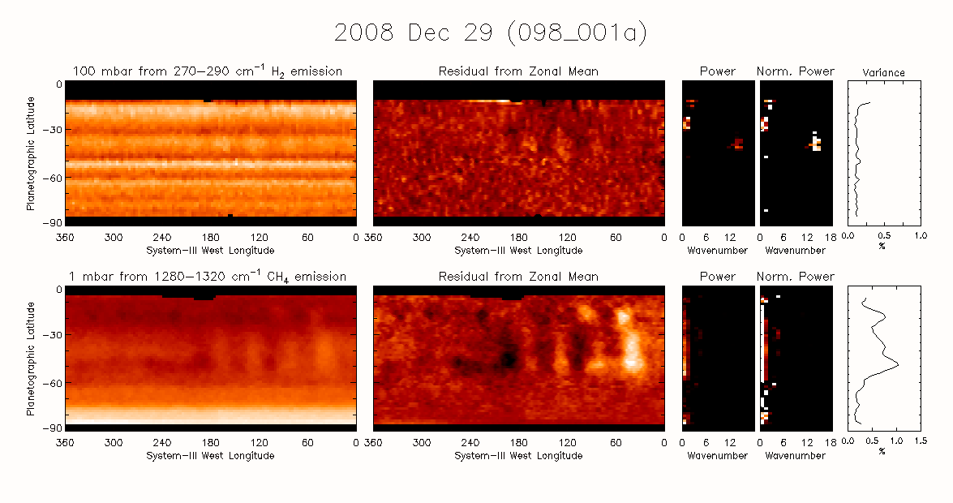
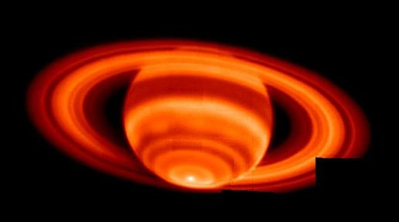
A Survey of Slowly Moving Thermal Waves in Saturn from Cassini CIRS and Ground-Based Thermal Observations from 2003 to 2017
Glenn S Orton¹, Leigh N Fletcher², James Sinclair¹, F Michael Flasar³, Richard K. Achterberg⁴, Padma Yanamandra-Fisher⁶
¹Jet Propulsion Laboratory, California institute of Technology, ²University of Leicester,
³NASA Goddard Space Flight Center. ⁴University of Maryland. ⁵Space Science Institute

Slide 2
Objectives
Use CIRS FIRMAP sequences from 2004 to 2017 to characterize temperature waves in Saturn’s troposphere and stratosphere
  Rudimentary taxonomy of waves & wave properties using brightness-temperature proxies for tropospheric and stratospheric kinetic temperatures
  First part of a study continuing with real retrievals and analysis
  No discussion of the 2010-2011 springtime storm (“beacon”)
Use strategic ground-based thermal-infrared observations
  verify CIRS observations
  extend the time frame of the CIRS study

Slide 3
61 Individual FIRMAPS
Southern Hemisphere (21)
Northern Hemisphere (40)
00A_001 2004 Oct 30
006_005A 2005 Apr 8
006_005B 2005 Apr 9
012_008 2005 Aug 3
012_009 2005 Jul 30
049_020 2007 Sep 1
076_A001 2008 Jul 16
076_B001 2008 Jul 17
097_002 2008 Dec 19
098_001 2008 Dec 29
101_002 2009 Jan 26
108_001 2009 Apr 6
139_002 2010 Oct 18
171_001 2012 Sep 1
197_002 2013 Sep 14
199_003 2013 Dec 5
203_001 2014 Dec 4
213_002 2015 Mar 18
227_001 2015 Dec 3
242_001 2016 Sep 14
284_001 2017 Jul 20
004_004 2005 Mar 10
008_007 2005 May 22
017_010 2005 Oct 30
018_011 2005 Nov 25
022_014A 2006 Mar 22
022_014B 2006 Mar 23
027_015 2006 Aug 1
040_018 2007 Mar 2
055_030 2008 Jan 1
060_A027 2008 Mar 5
060_B027 2008 Mar 5
068_A024 2008 May 20
068_B024 2008 May 21
075_A002 2008 Jul 10
076_B002 2008 Jul 11
076_C002 2008 Jul 12
095_001 2008 Nov 28
099_001 2009 Jan 1
101_001 2009 Jan 20
110_001 2009 May 16
114_001 2009 Jul 1
120_001F 2009 Nov 4
152_001 2011 Aug 22
160_001 2012 Jan 27
170_101 2012 Aug 16
209_001 2014 Oct 18
215_001a 2015 May 13-14
215_001b 2015 May 13-14
220_001 2015 Jun 13
222_001 2015 Oct 3
227_001 2015 Dec 3
230_001 2016 Jan 26
233_001 2016 Mar 13
235_001 2016 Apr 30
236_002 2016 Jun 9
239_001 2016 Aug 11
243_001 2016 Sep 20
257_001 2017 Jan 19
270_001 2017 Apr 17
290_001 2017 Aug 25

Slide 4
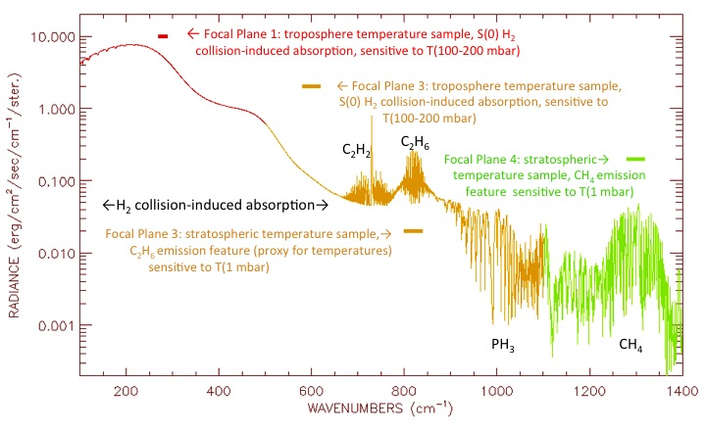
Initial Reconnaissance by Brightness-Temperature Proxy
mbar)
S(1)
mbar)

Slide 5
Sensitivity to tropospheric
temperatures via H₂ collision-
induced emission
Sensitivity to stratospheric temperatures via C₂H₆ and CH₄ band emissions.
⬆ ⬆ ⬆
COMICS/VISIR
COMICS/VISIR
⬆ ⬆ ⬆

Slide 6
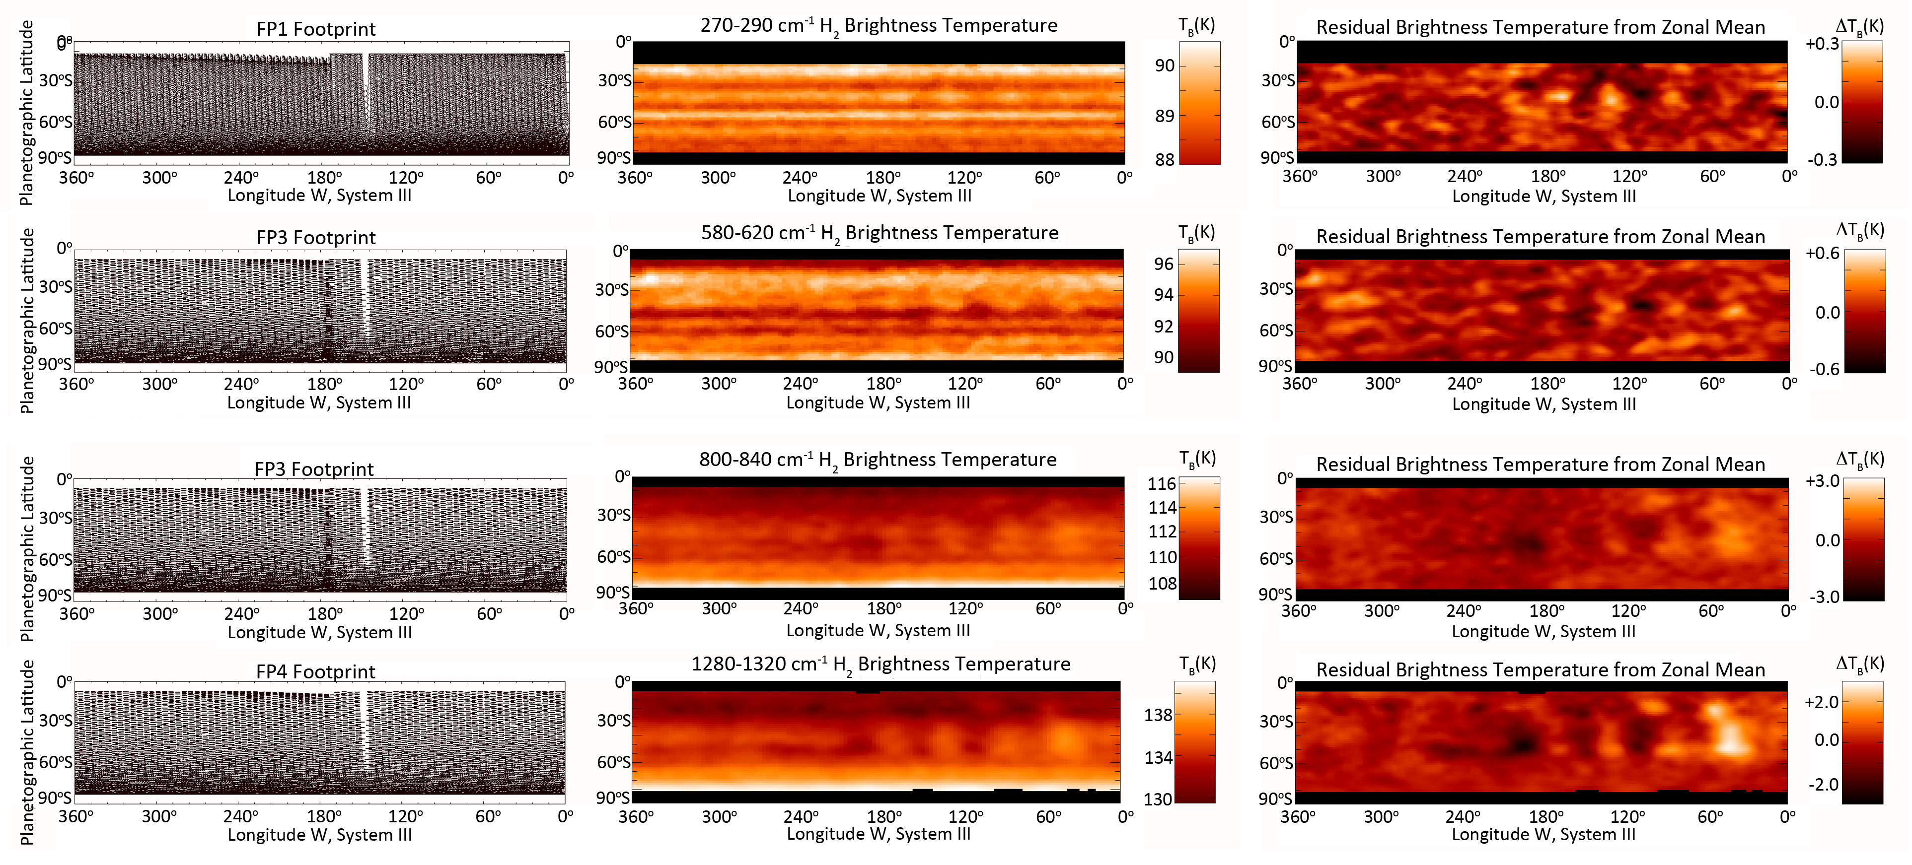
Creation of of “proxy maps”
• Scan ~90º of latitude in N or S hemisphere, over ~10-hour rotation, covering close to 360º of longitude
• Map the radiance in each spectral interval with Nyquist sampling over adjacent fields of view
• Convert to brightness temperature
• Determine the zonal mean brightness temperature
• Subtract this from the map to reveal residual brightness temperatures, ΔT_{B}, that are sensitive to waves
• Determine variance at each latitude as well as power spectrum from Lomb-Scargle periodogram analysis
Upper troposphere, ~100-mbar temperatures from 270-290 cm⁻¹ brightness temperatures
x10
Stratosphere, ~1-mbar temperatures from 270-290 cm⁻¹ brightness temperatures

Slide 7
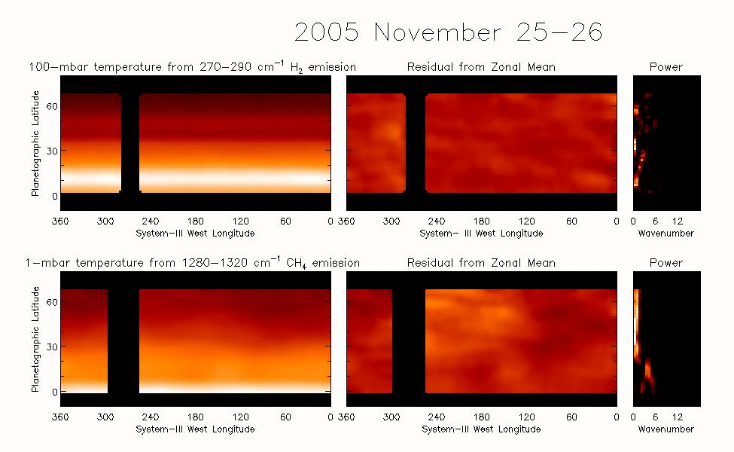
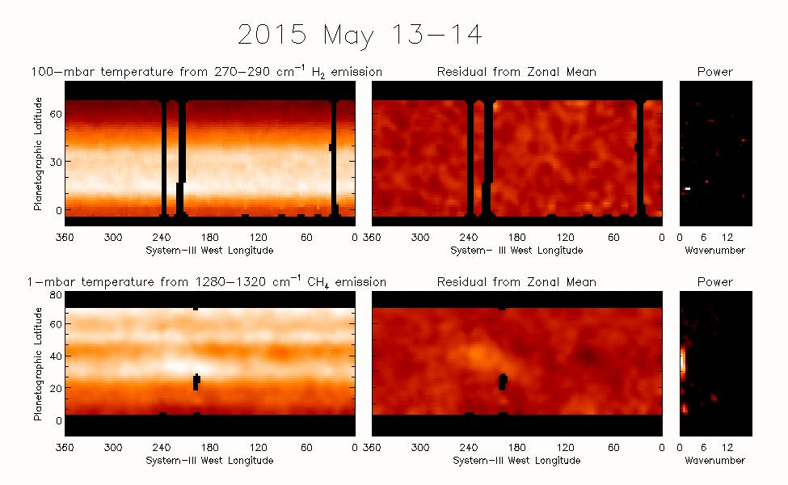
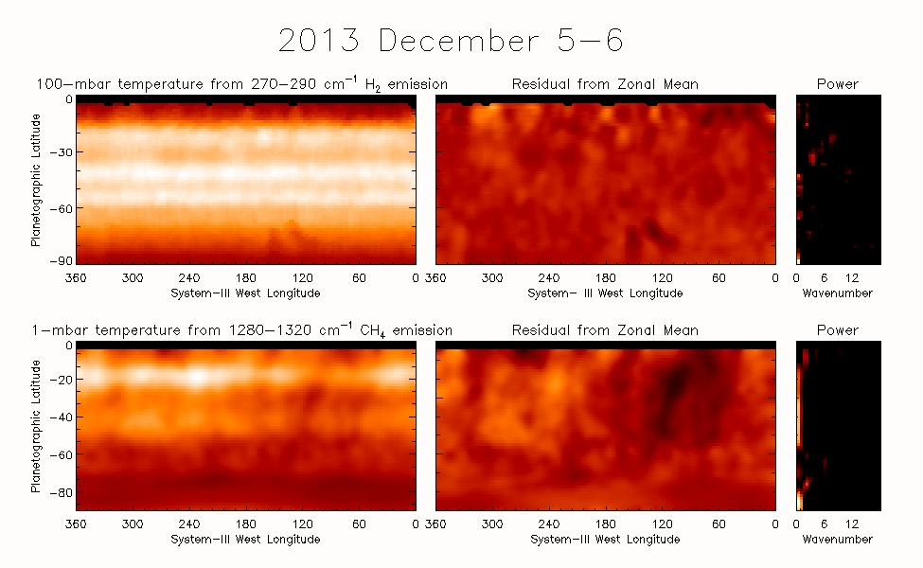
BASIC WAVE TAXONOMY
1. Wavenumber 1-2 oscillations
Easiest to see in the absence of other wave structures (e.g. northern hemisphere in winter),
but they are fairly common, in fact rather ubiquitous
Prominent in stratosphere, not so much in troposphere.
Wavenumber-2 oscillations dominated Voyager IRIS observations (Achterberg & Flasar 1996)
Most often seen imposed on other wave structures, so hard to follow evolution in time.

Slide 8
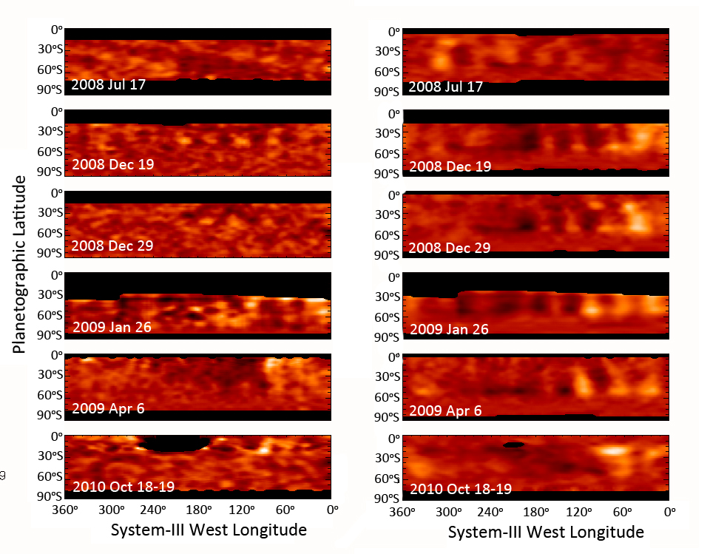
BASIC WAVE TAXONOMY
2. Prominent high-wavenumber oscillations in the southern hemisphere, which extend from 15°S to 35°S
Most prominent wave structure of all waves surveyed Troposphere Stratosphere
Evolution can be tracked.

Slide 9
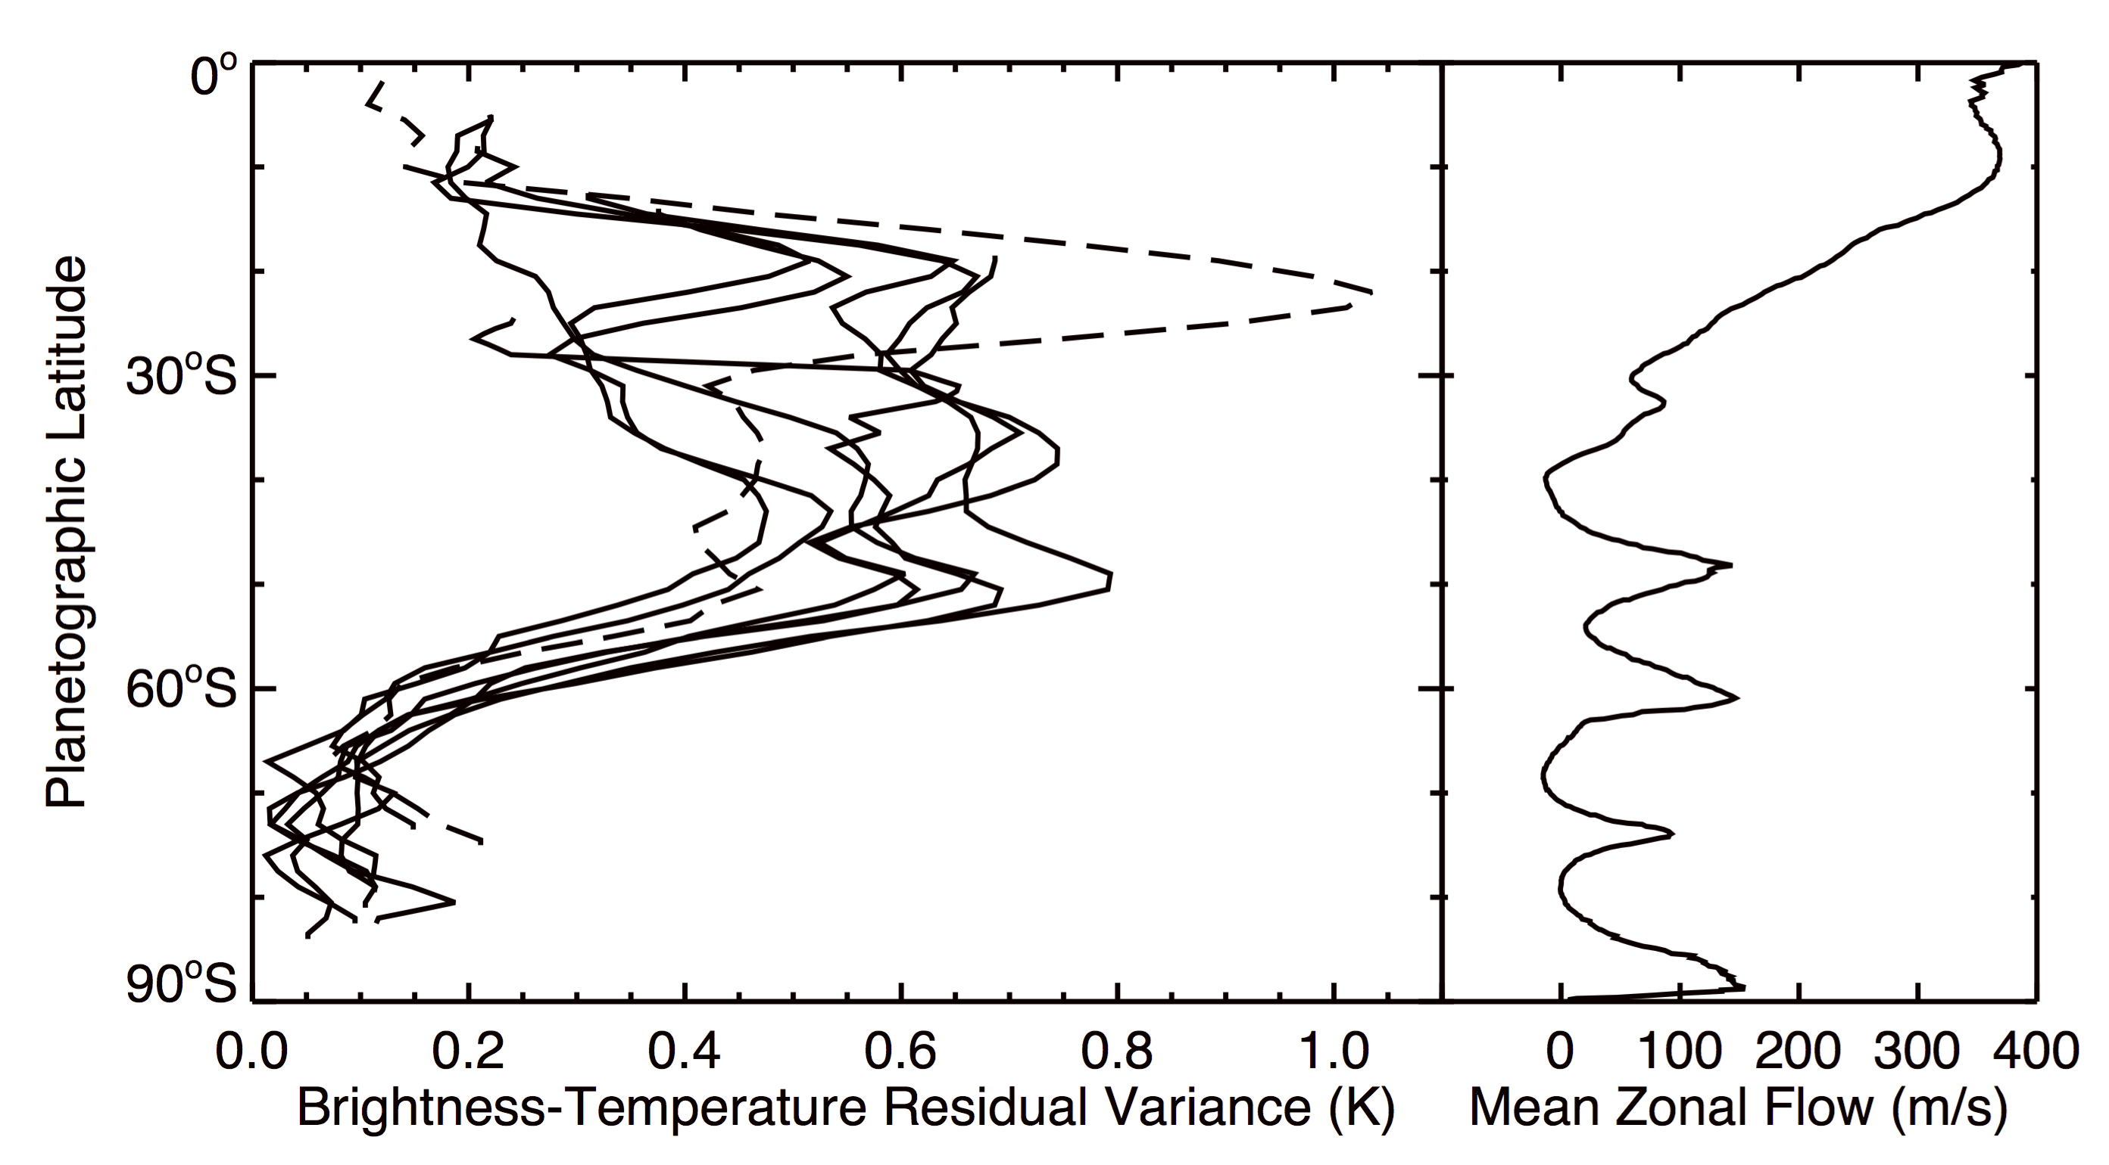
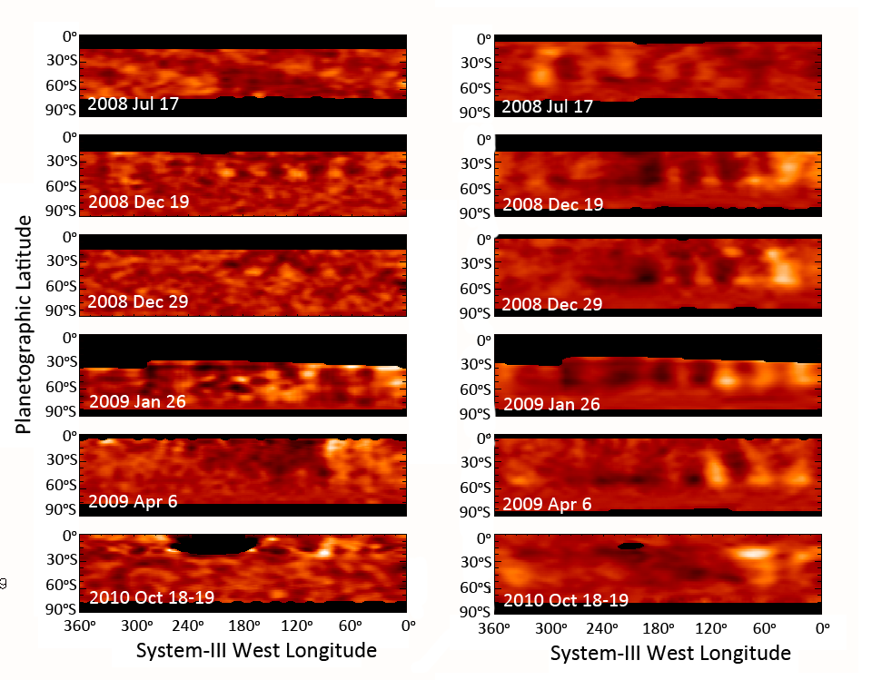
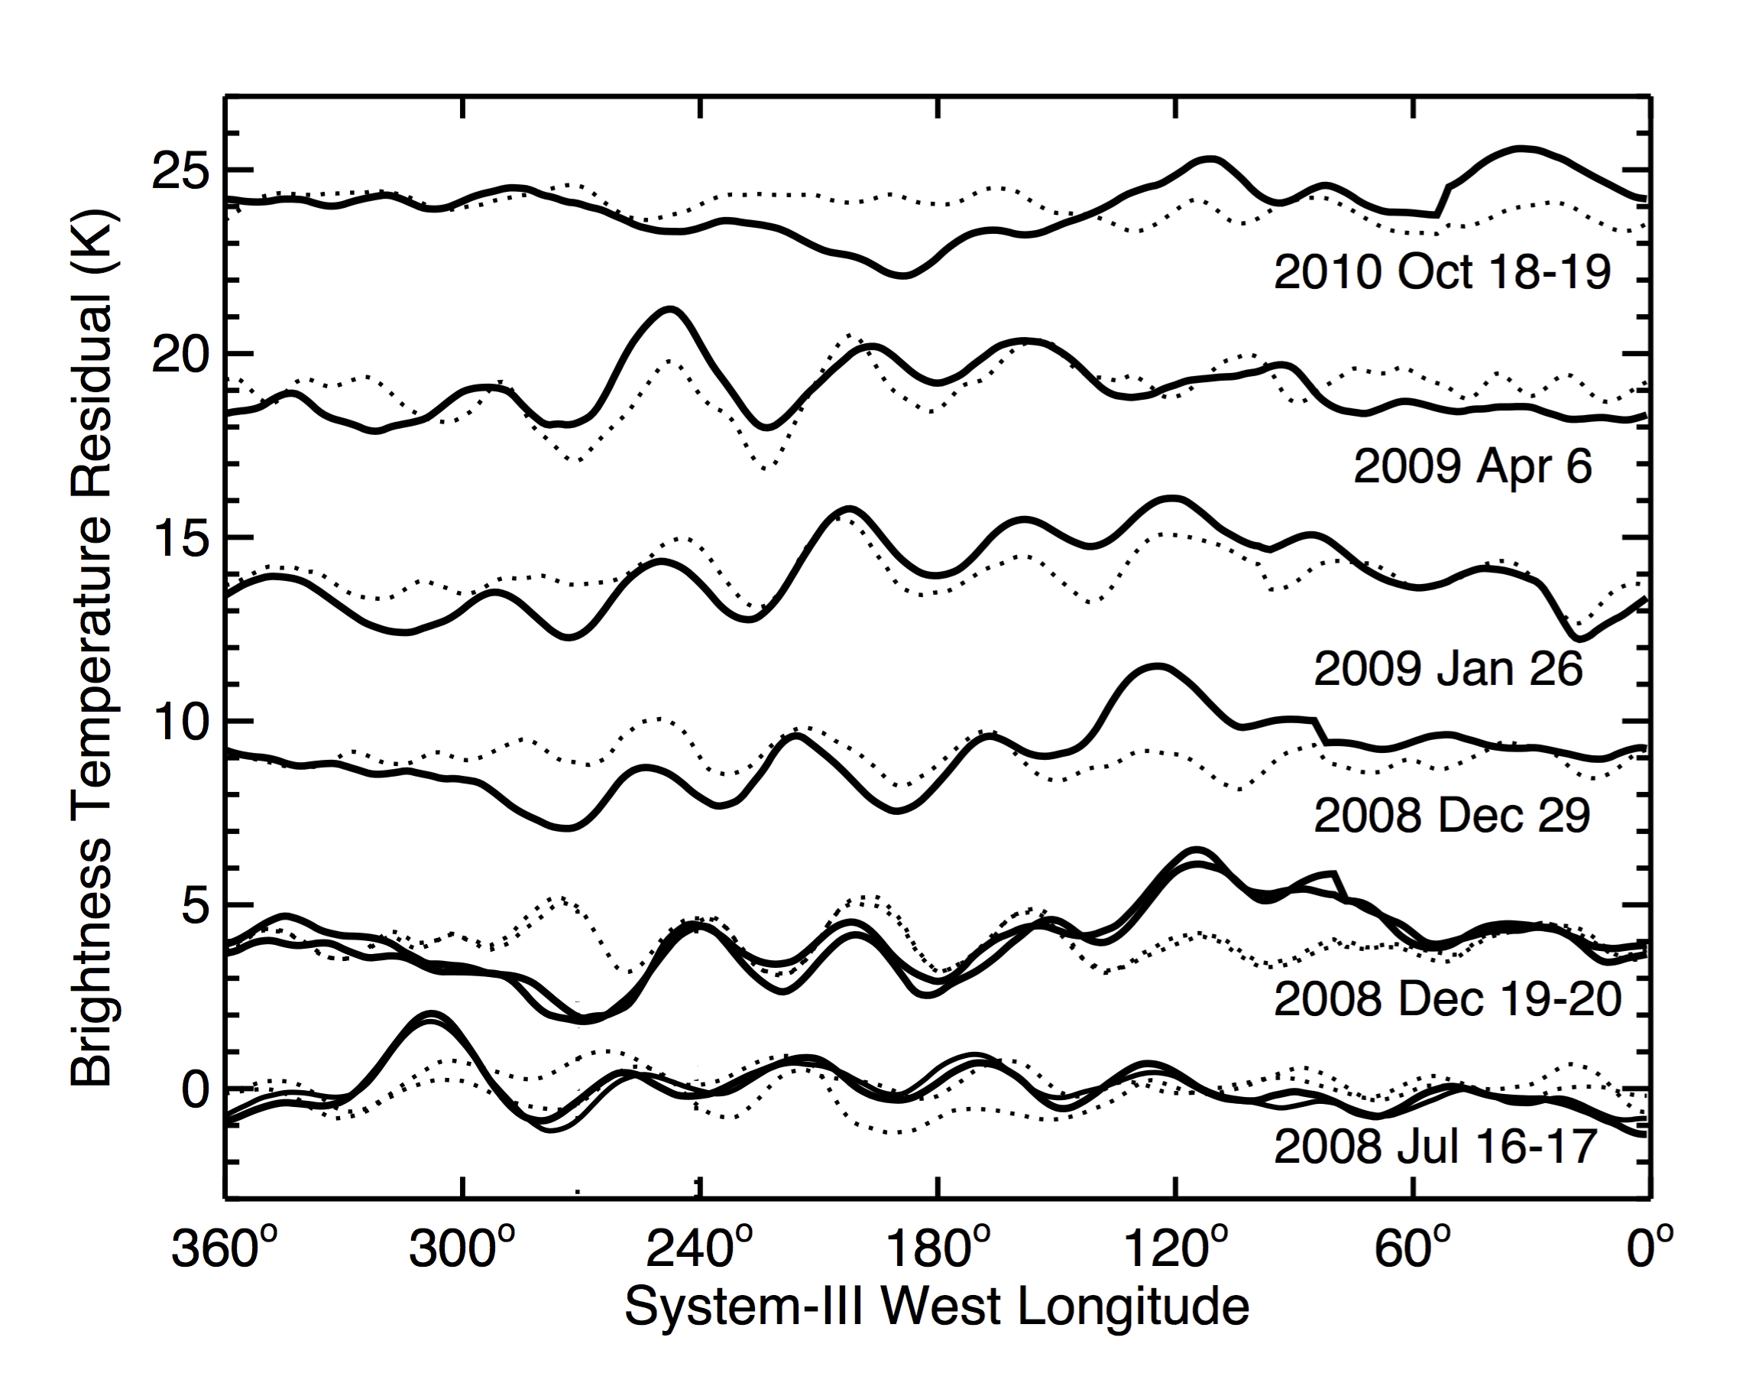
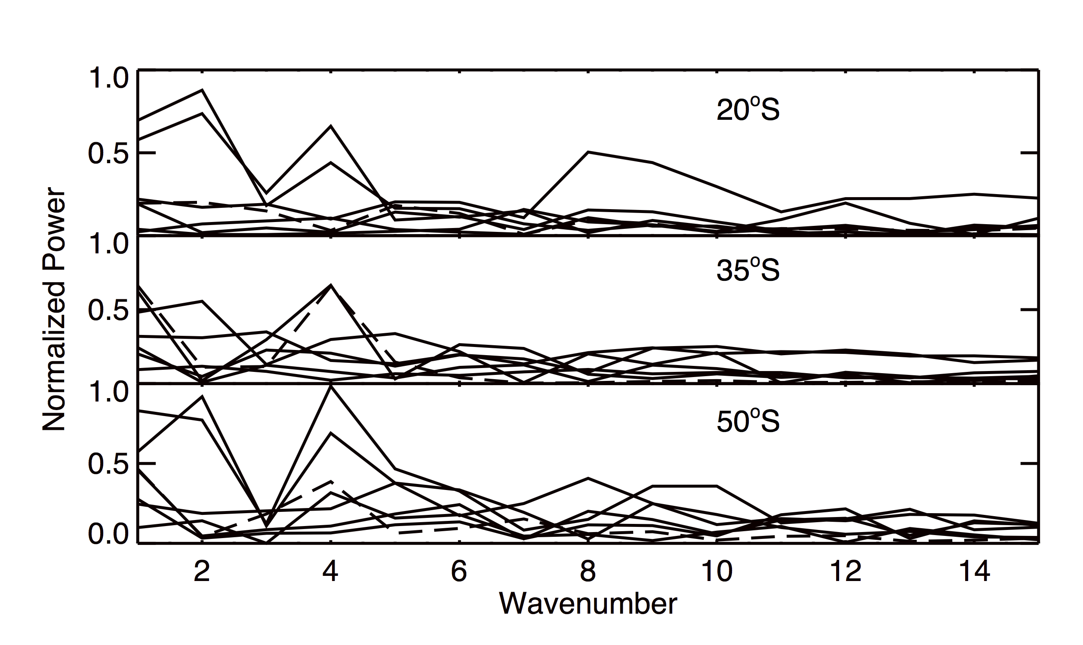
Southern Mid-Latitude Wave Properties
Heavy lines – 580-620 cm⁻¹ tropospheric residuals
270-290 cm⁻¹
Dotted lines – 1280-1320 cm⁻¹ stratospheric residuals
Both are consistent with -0.5º / day motion (using SKR period)

Slide 10
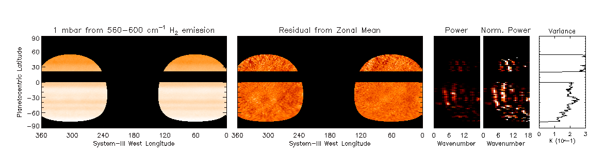
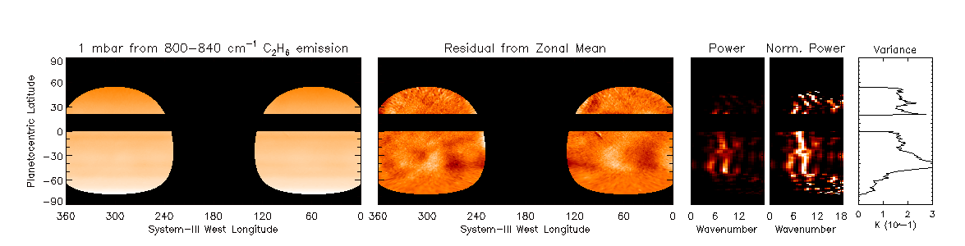
Verified by ground-based observations.
2008 May (VLT: VISIR)
H₂: 17.6-17.8 μm
C₂H₆: 12.2-12.5 μm
Notes:
All pre-storm observations

Slide 11
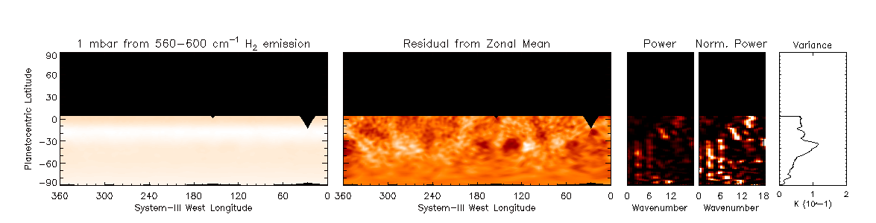
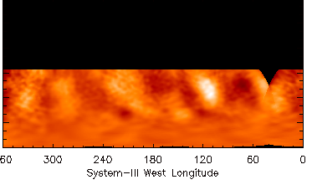
With an extension of the same phenomenon back in time.
2008 May (VLT: VISIR)
2003 Dec (IRTF: MIRSI)
H₂: 17.6-17.8 μm
H₂: 17.6-17.8 μm
C₂H₆: 12.2-12.5 μm
C₂H₆: 12.2-12.5 μm
Notes:
All pre-storm observations

Slide 12
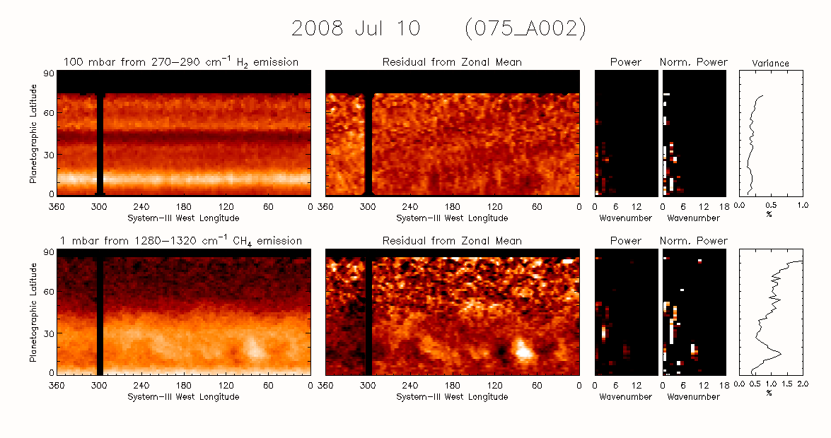
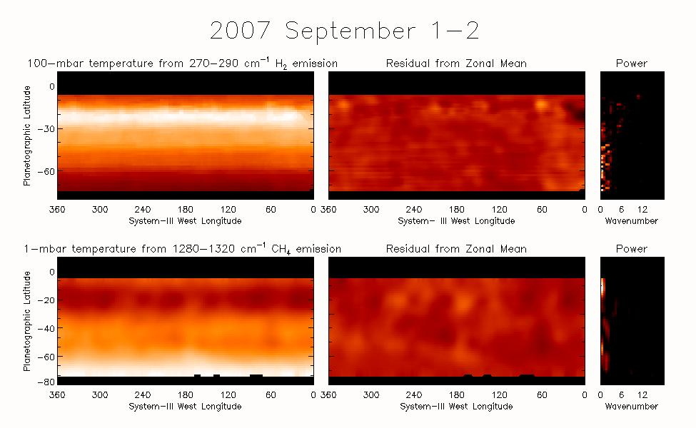
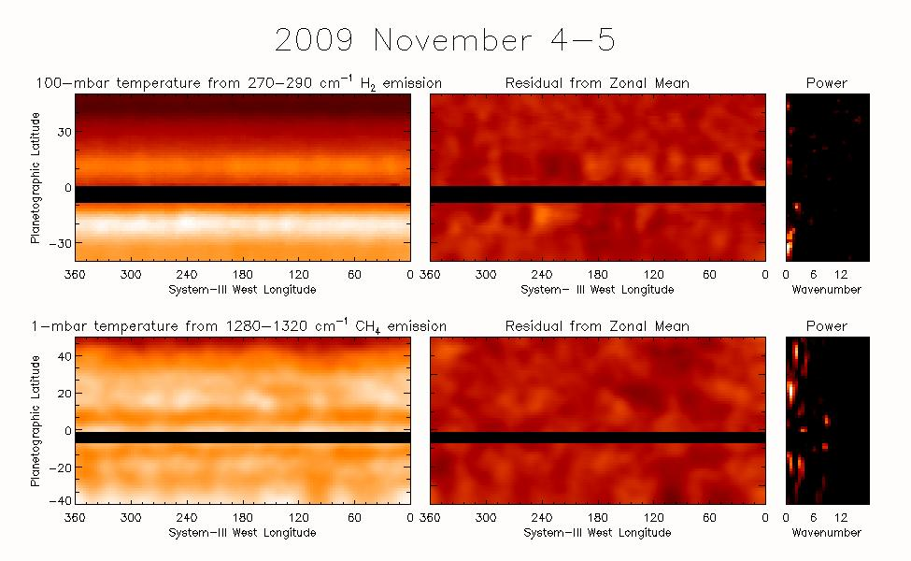
BASIC WAVE TAXONOMY
3a. Low-latitude waves

Slide 13
BASIC WAVE TAXONOMY
3a. Low-latitude waves
Also identified by Guerlet et al. (2018) and classified as a hemispherically symmetric Rossby wave with n=1 and s=3.
T(150 mbar)
T(0.5 mbar)
Other waves by Li et al. (2006, 2013)

Slide 14
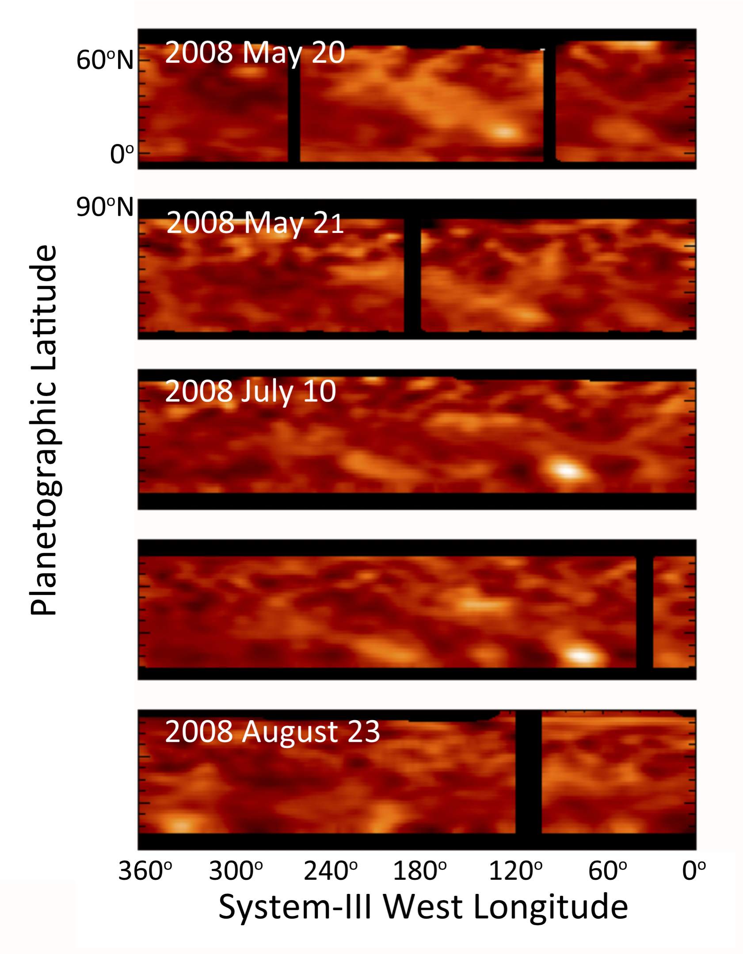
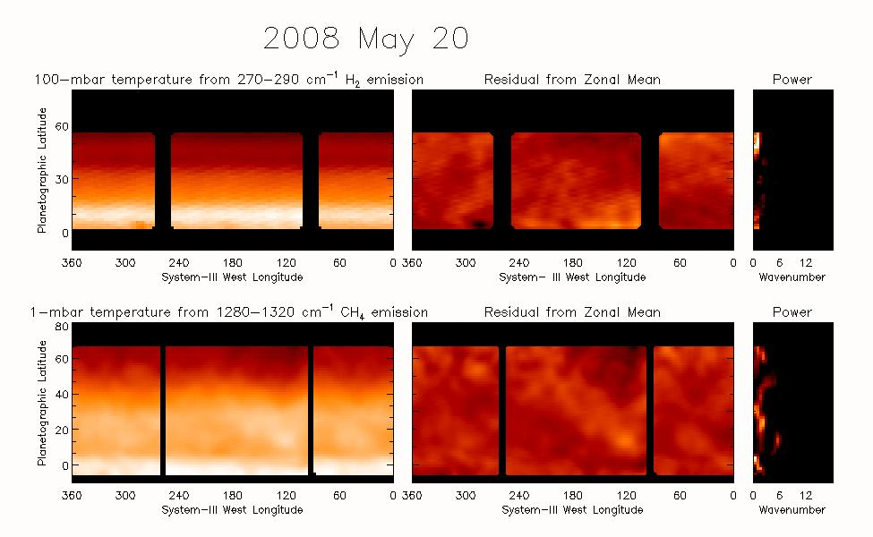
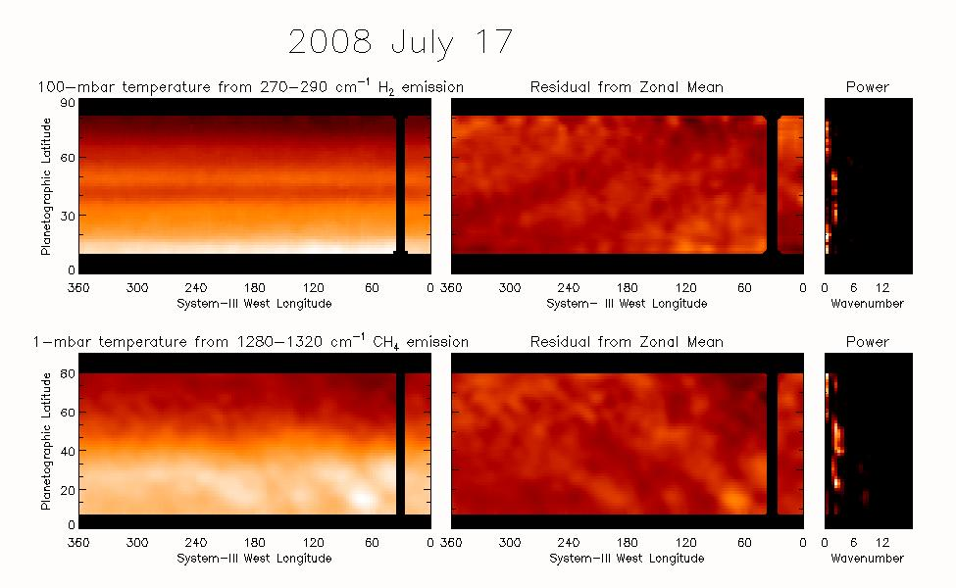
BASIC WAVE TAXONOMY
3b. Some low-latitude waves have northwest extensions
90ºN
60ºN
30ºN
0º
90ºN
60ºN
30ºN
0º
90ºN
60ºN
30ºN
0º
90ºN
60ºN
30ºN
0º
2008 July 17
90ºN
60ºN
30ºN

Slide 15
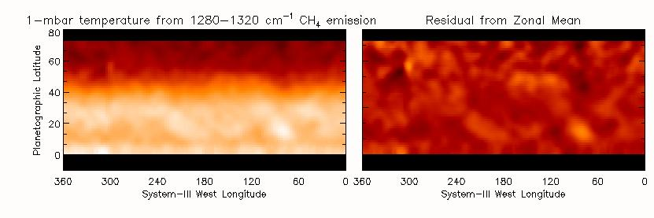
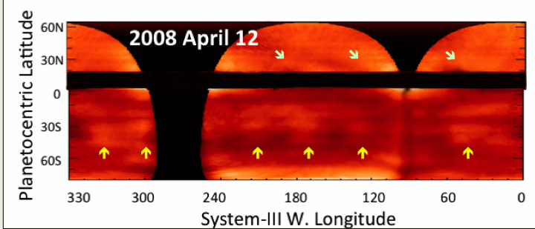
2008 July 11
Northern hemisphere thermal waves in early- to mid-2008 look like artifacts of the mapping, but their presence is verified by ground-based observations.
Cylindrical-map composite of 12.2-μm C₂H₆ emission, detected by VISIR. It shows prominent stratospheric waves in the southern hemisphere (yellow arrows). The map also confirms the presence of diagonal-like waves across the northern hemisphere (light green arrows) that are detected in CIRS data. Note that latitudes blocked by the rings are blacked out.

Slide 16
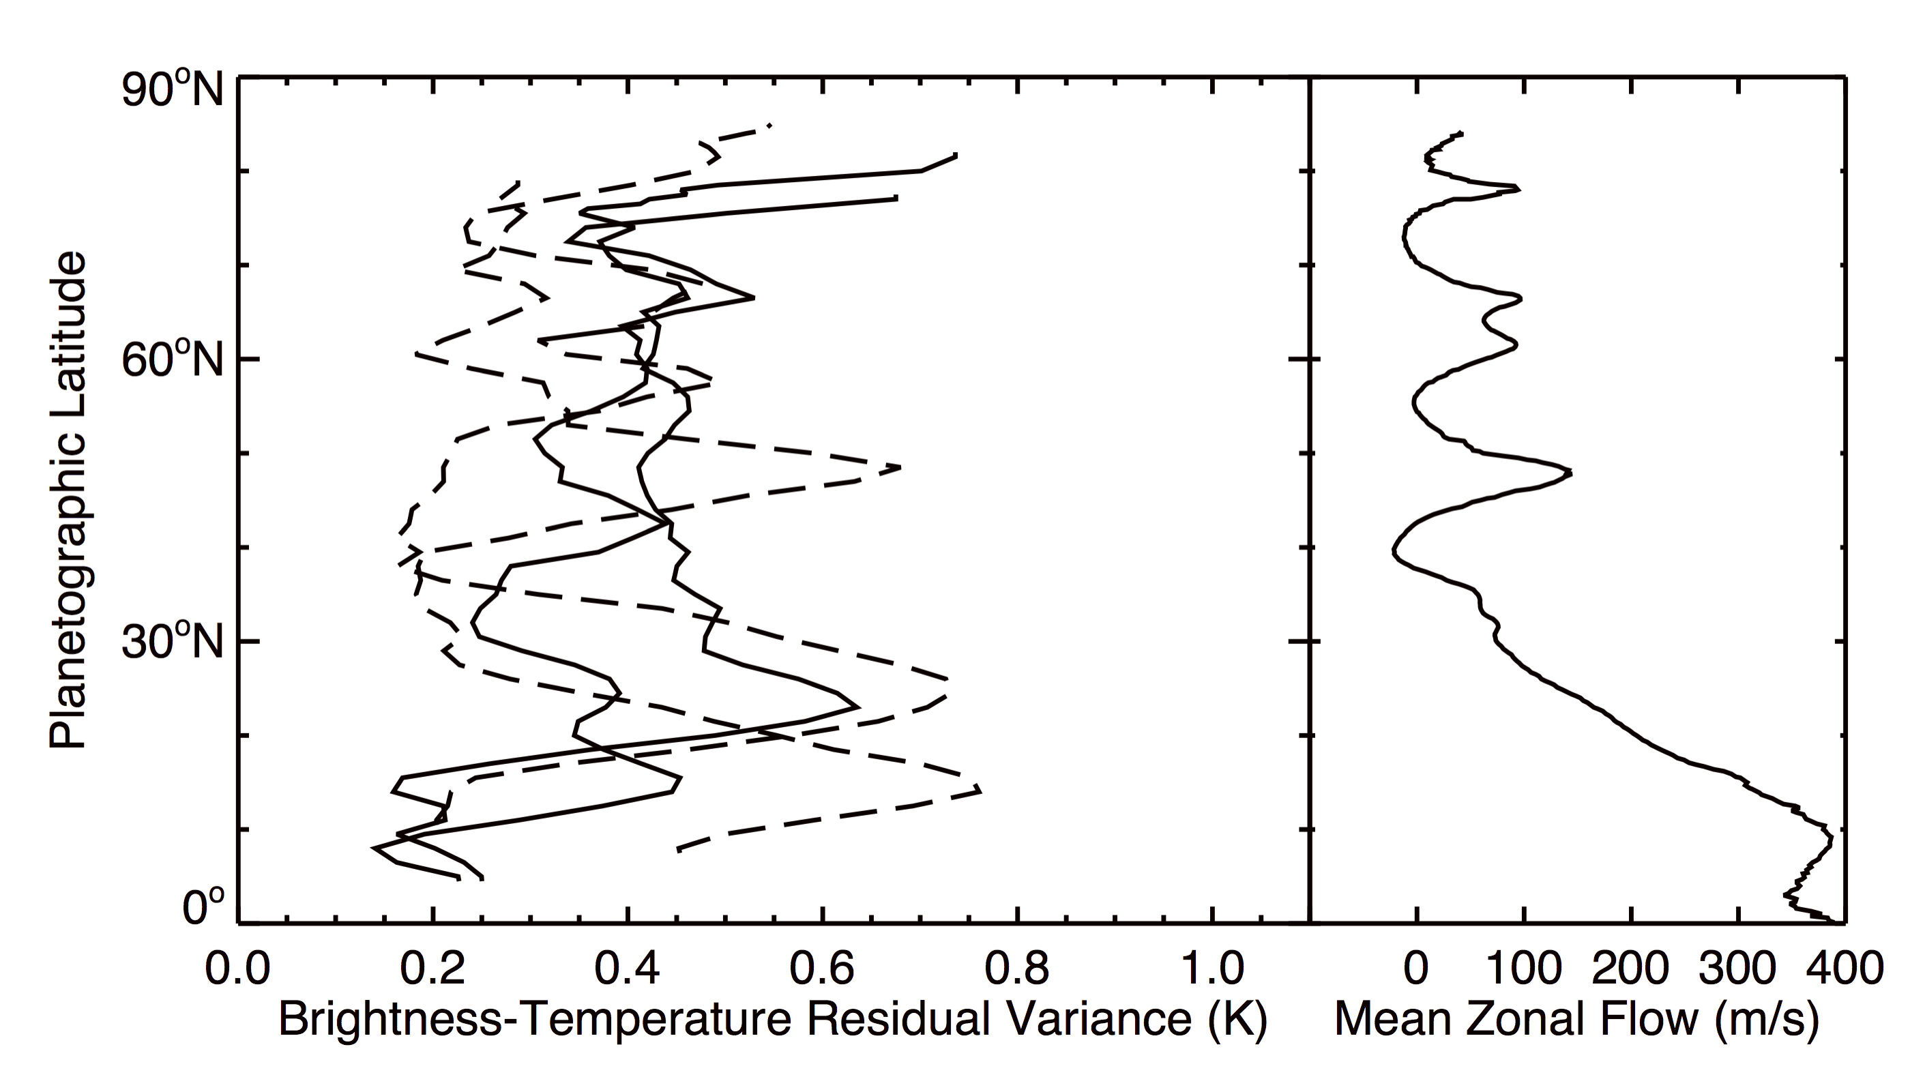
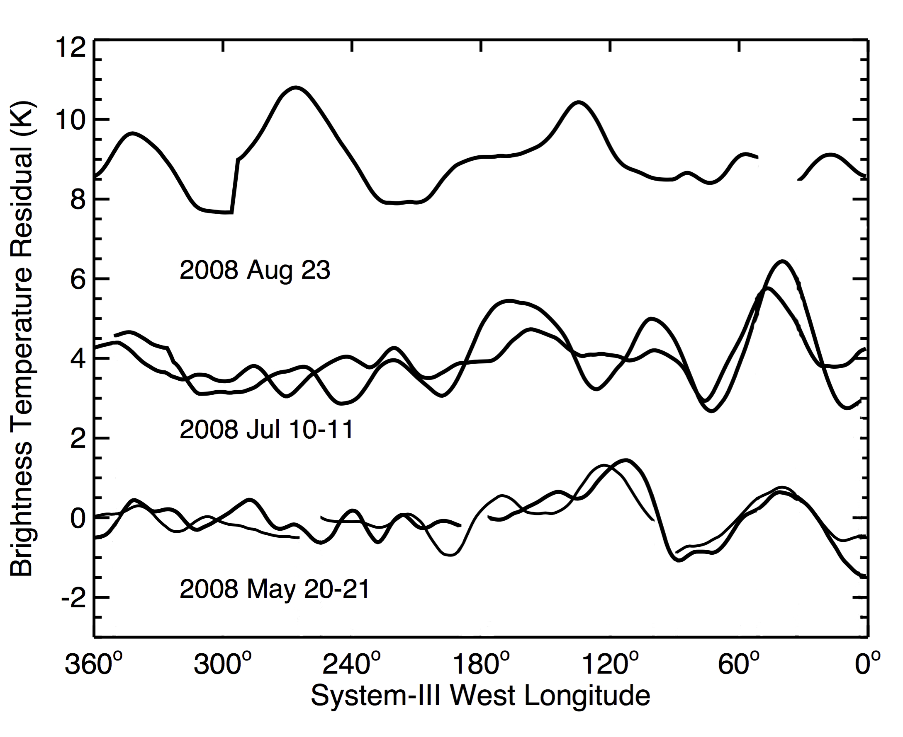
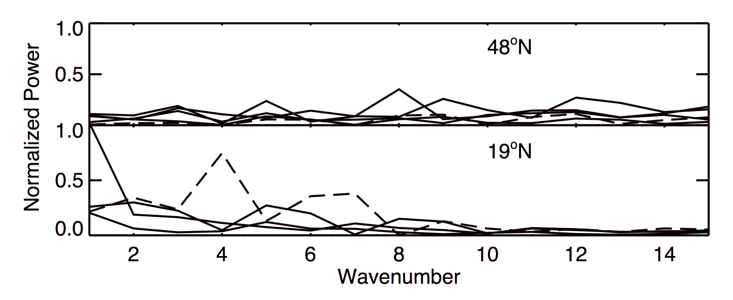
Properties of northwest-extending waves
2008 July 17
Sequence is consistent with -0.6º / day motion (using SKR period)

Slide 17
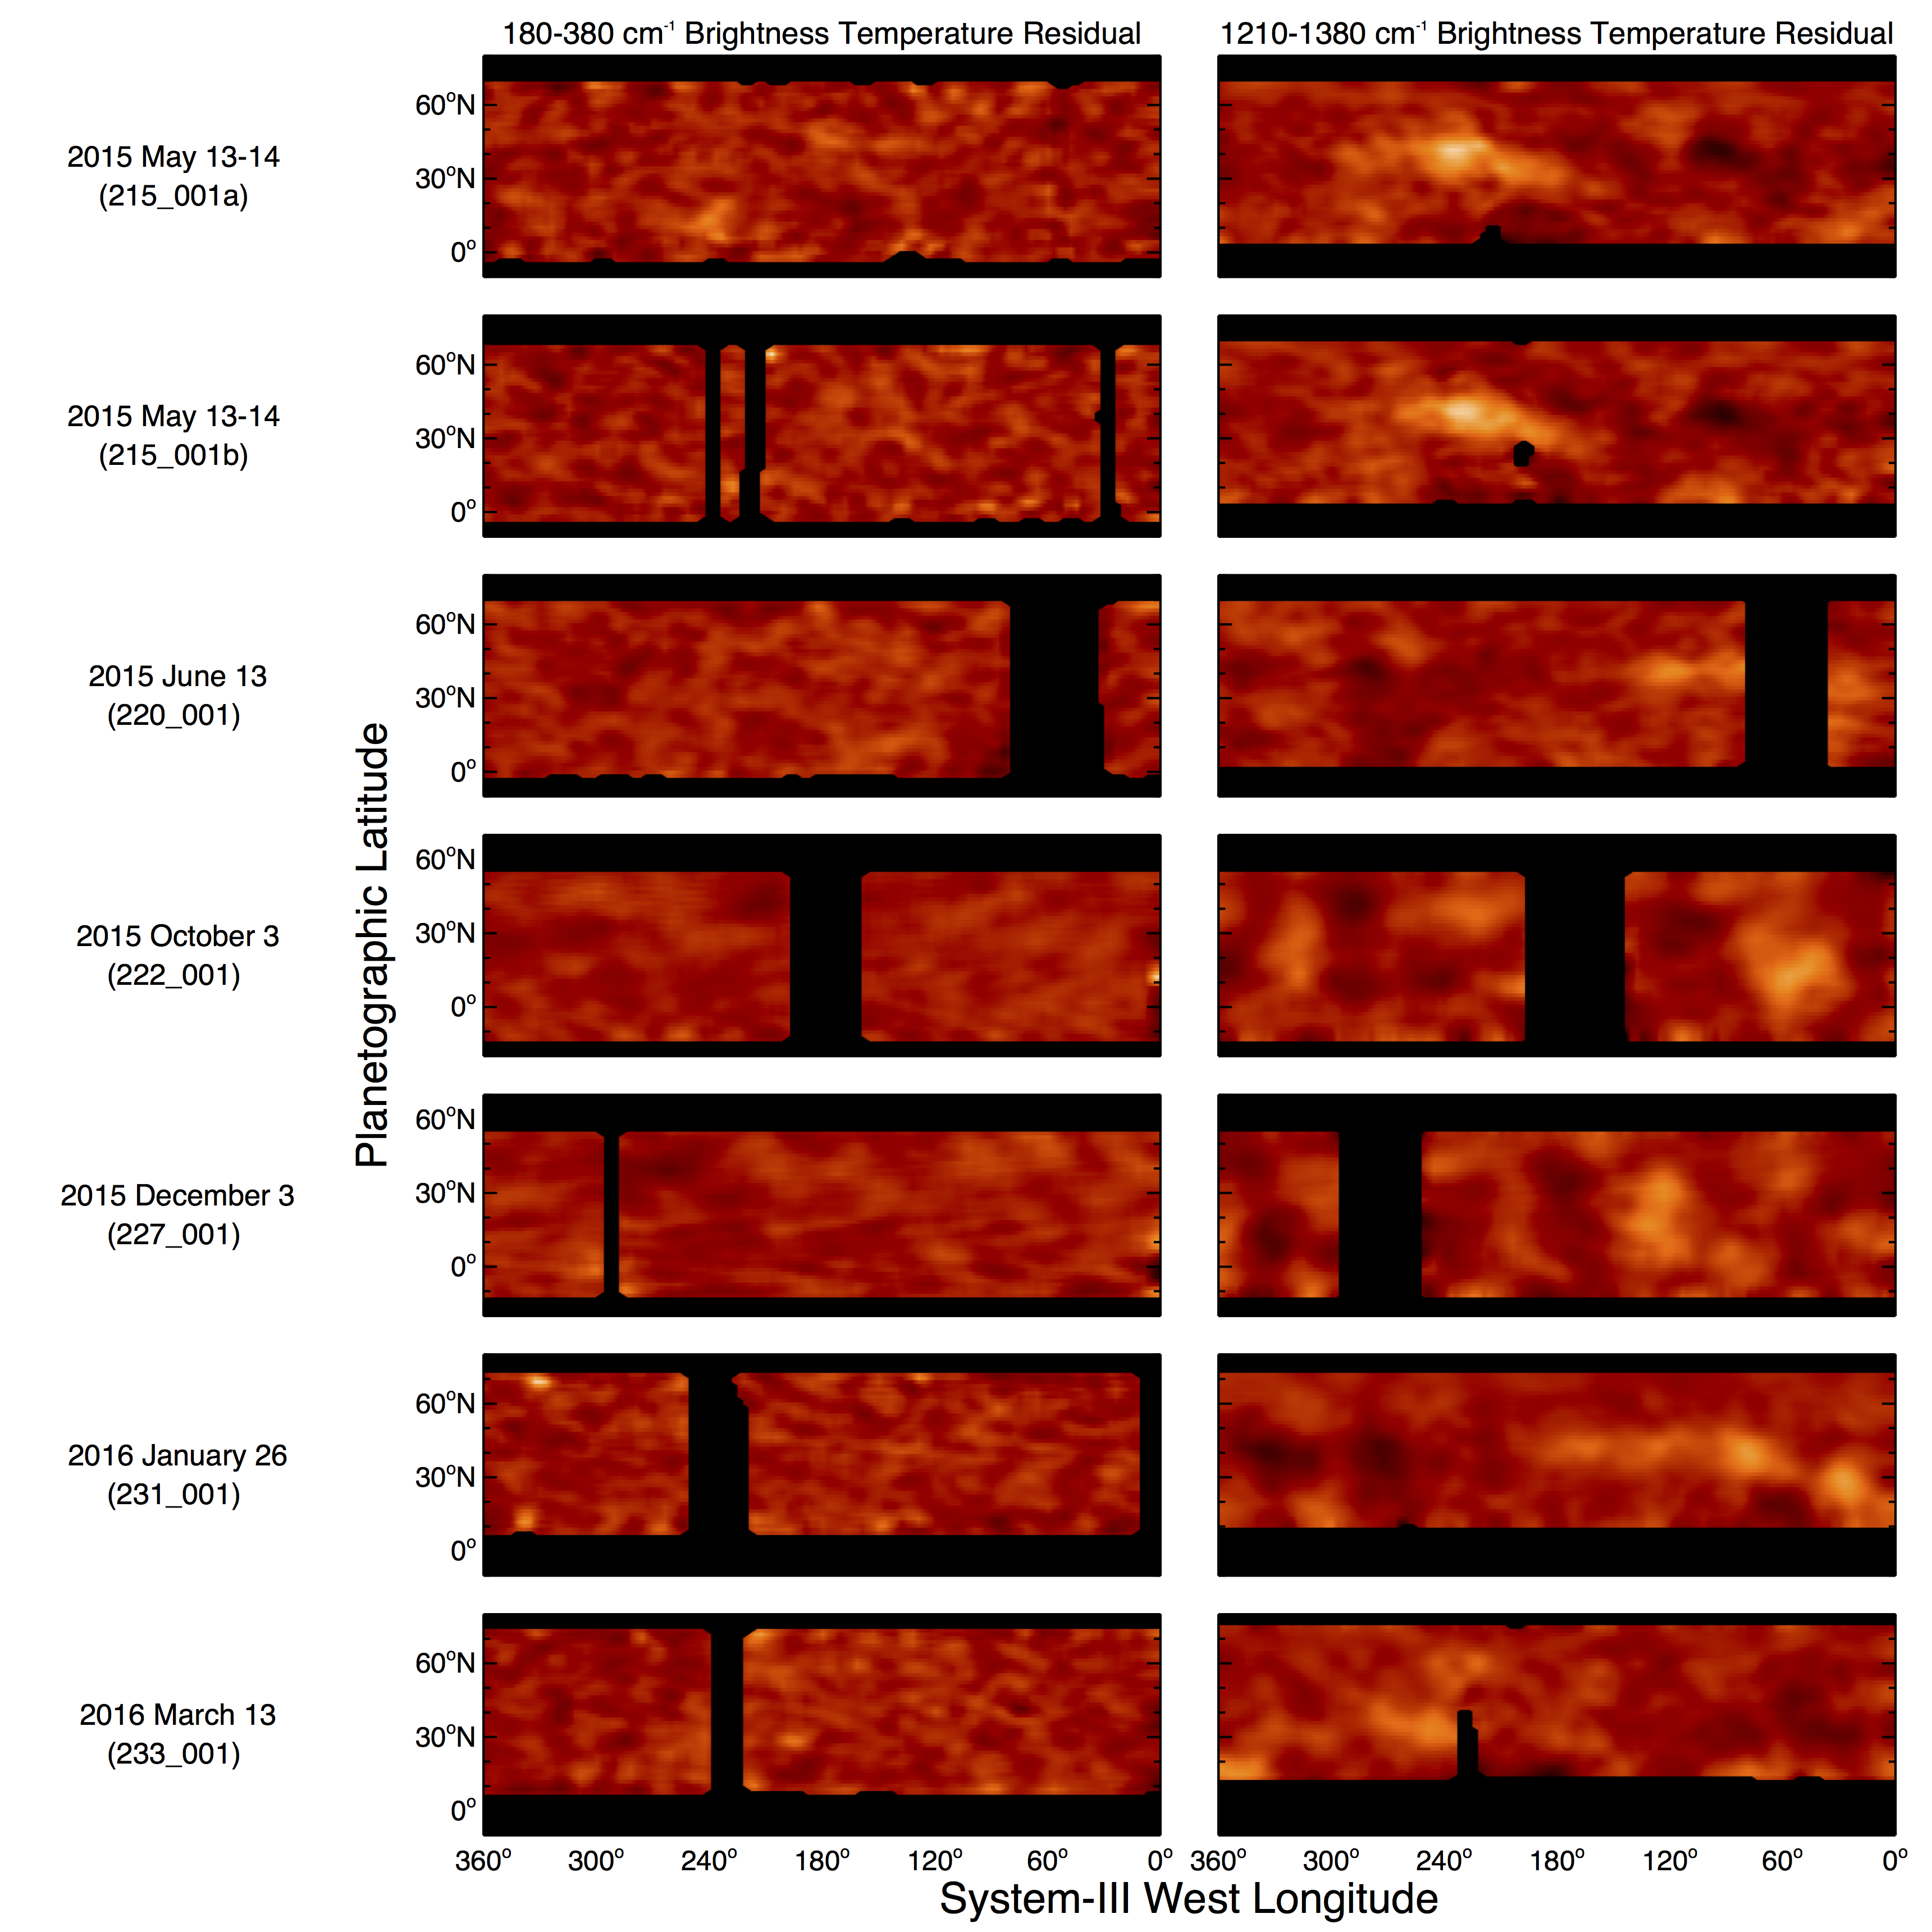
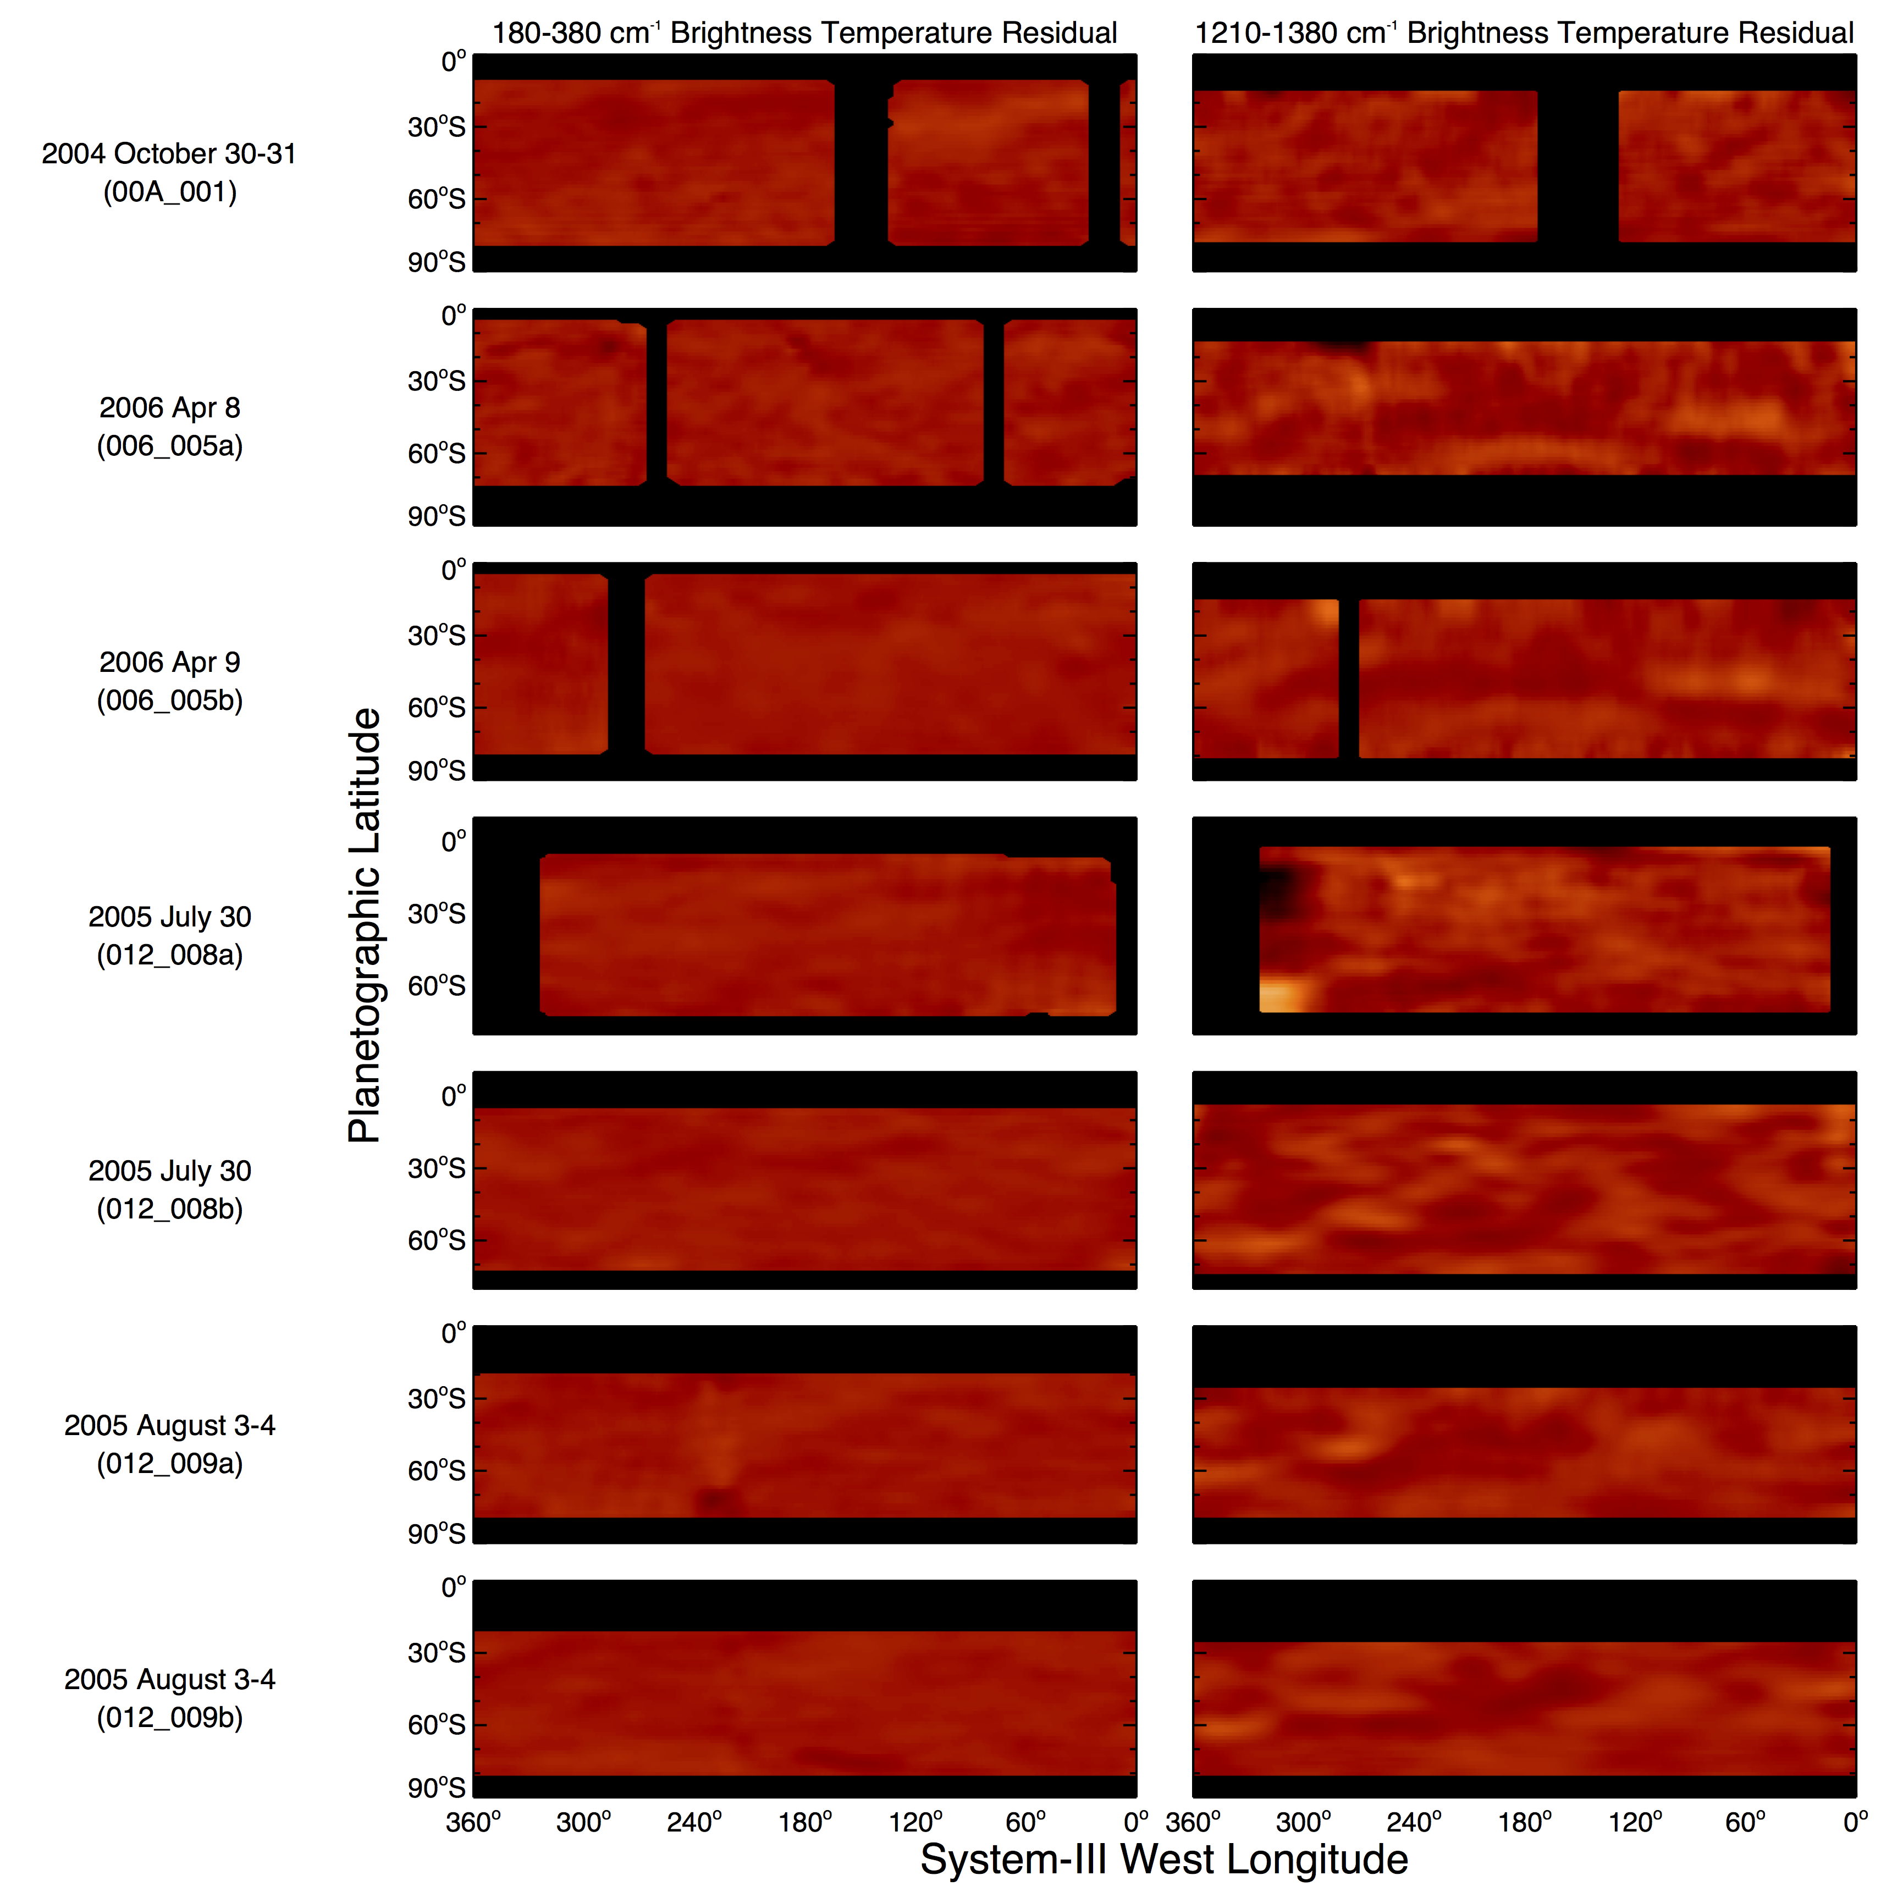
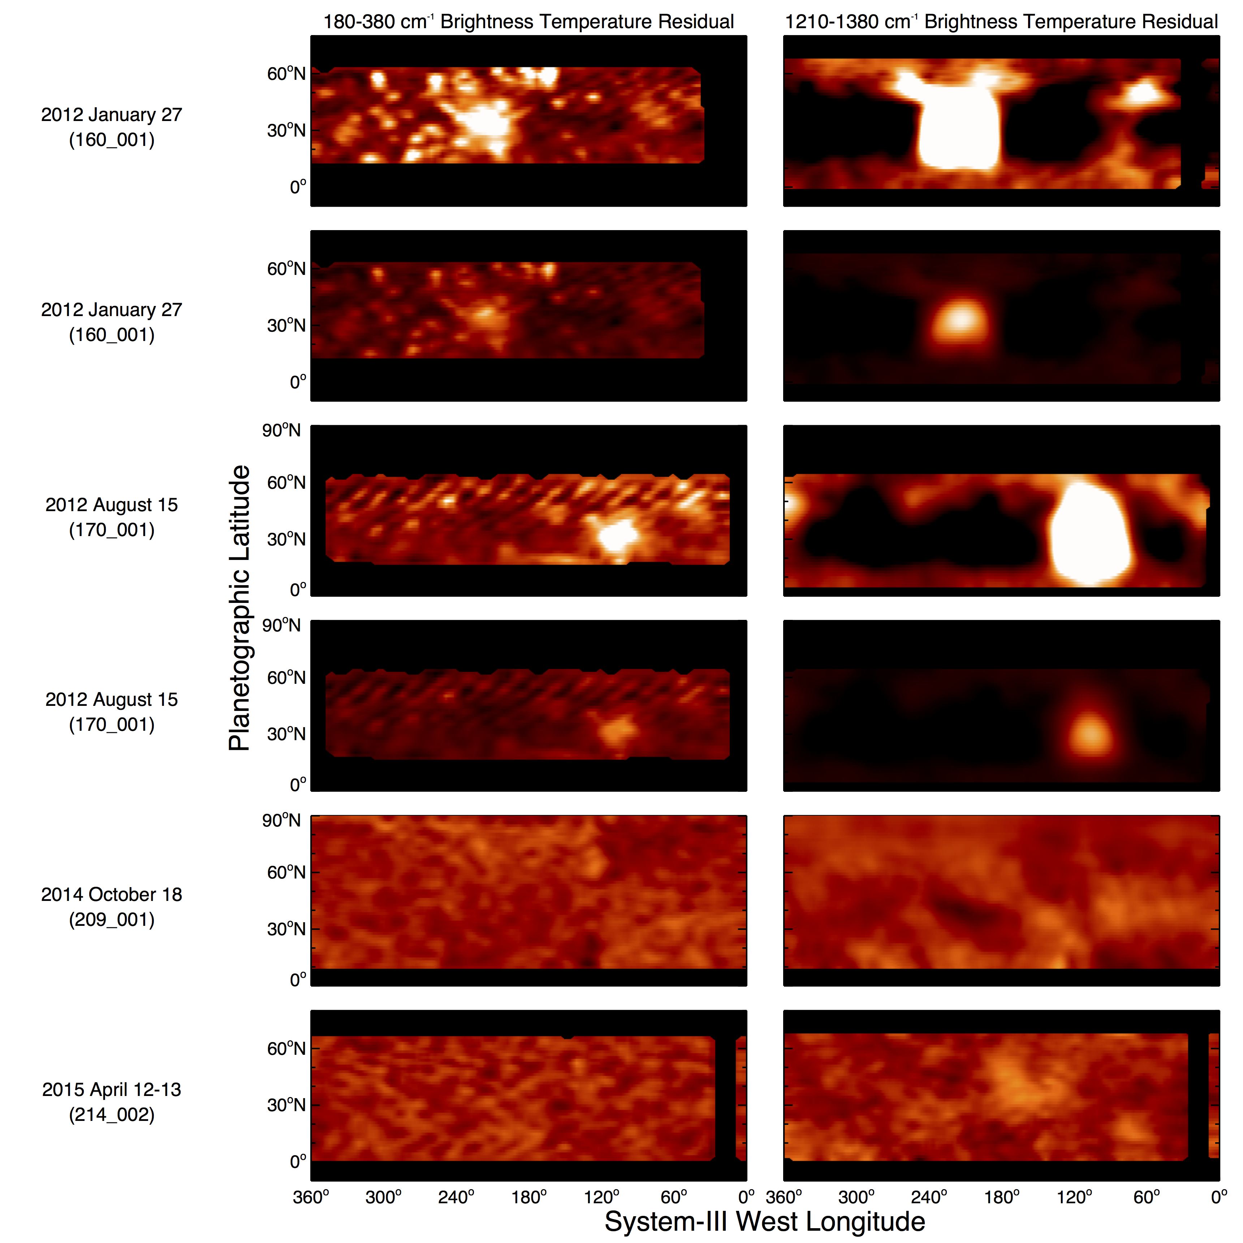
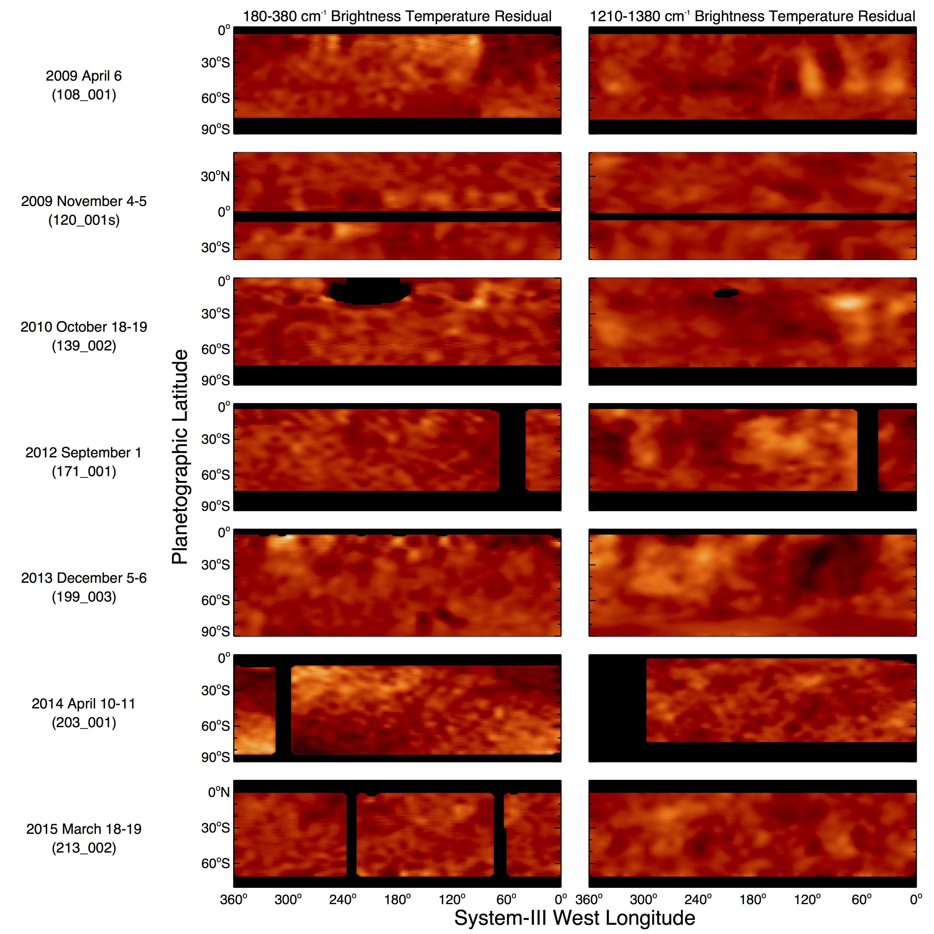
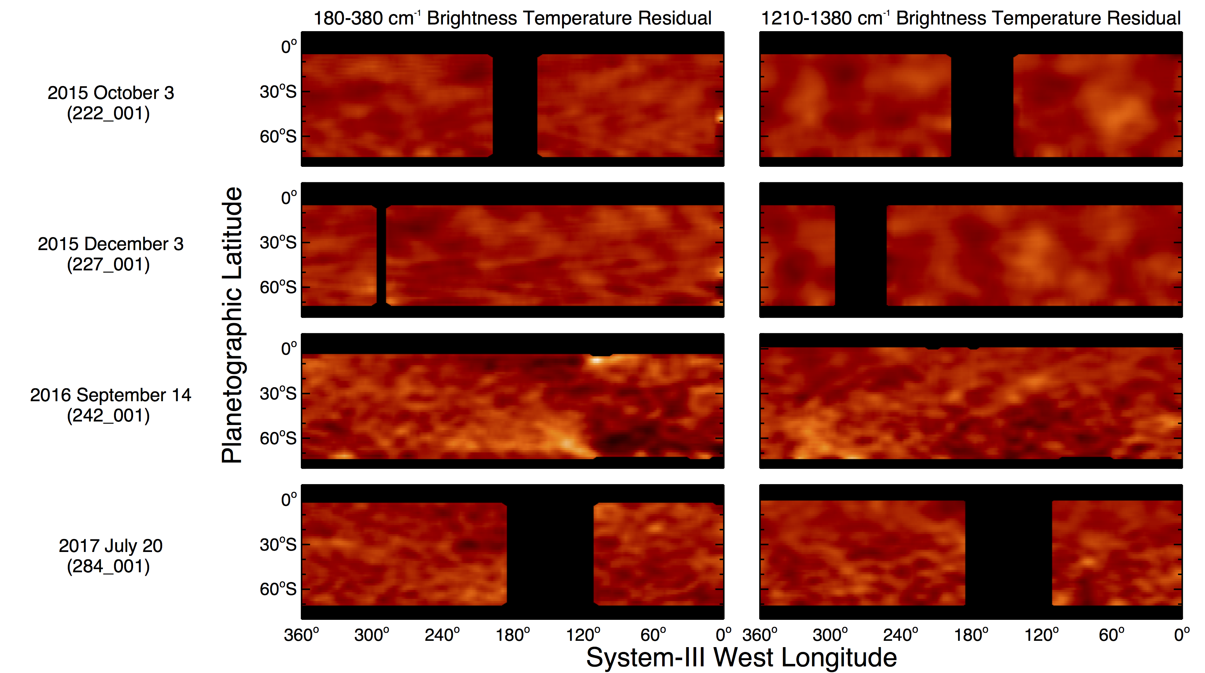
BASIC WAVE TAXONOMY
4. Many stratospheric mid-latitude wavenumber >2 oscillations in both hemispheres.
Xx]

Slide 18
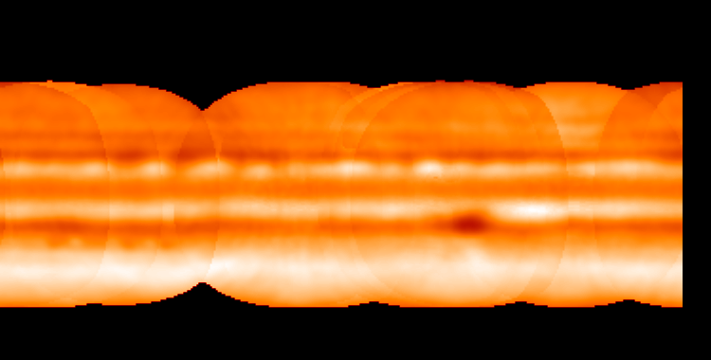
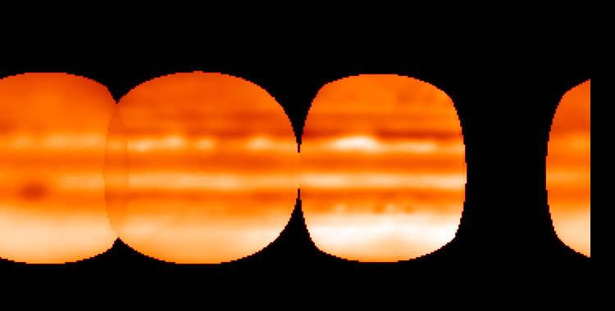
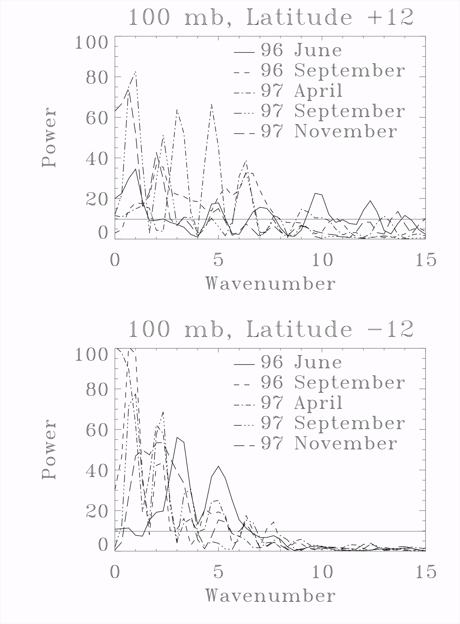
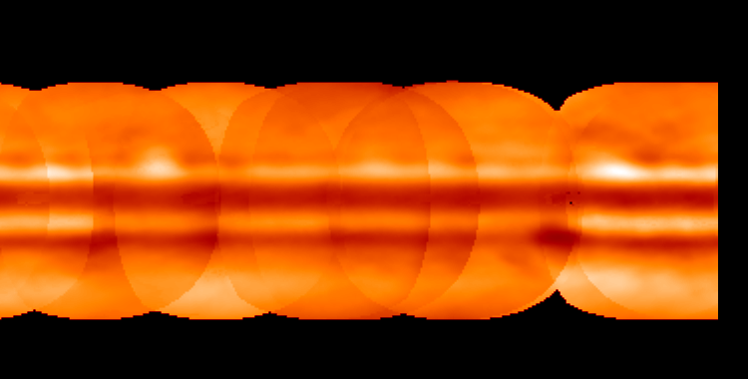
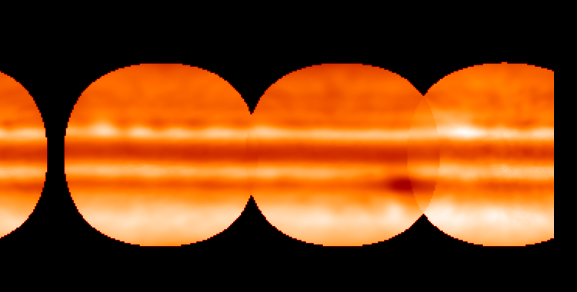
Comparison with Jupiter’s upper-tropospheric waves: T(100 mbar) ref. B. Fisher, G. Orton, J. Liu, T. Schneider, M. Ressler, W. Hoffman. 2016. Icarus. 280, 268-277
The organization of Jupiter's upper tropospheric temperature structure and its evolution: 1996-1997.
・Largely confined to NEB and SEB
・ Always present
・ Cover all 360º of longitude
・ Characterized by a broad power spectrum
・ Stratospheric waves have independent behavior
1996 June
1996 September
1997 September
1997 November

Slide 19
What we know so far
• At least four general types of zonal temperature waves in Saturn:
-Wavenumber-1 and -2 oscillations in both hemispheres, which are often broad in latitude
and nearly ubiquitous
-Prominent wavenumber-4 to -12 oscillations in the southern hemisphere
-Low-latitude waves, some of which are prominent and extend far to the northwest
-Wavenumber > 2 mid-latitude stratospheric waves in both hemispheres
• Prominent waves
- Phase speed is -0.5º to -0.6º of longitude per day relative to the SKR period
- Lifetime of a few months (north) to two years (south)
- Power spectra and latitude extent are different from each other
• Saturn’s thermal waves are different from Jupiter’s, which have a broad power distribution,
extend over 360° in longitude, are confined to the NEB and SEB and are virtually always
present in the troposphere. Stratospheric waves behave very independently.

Slide 20
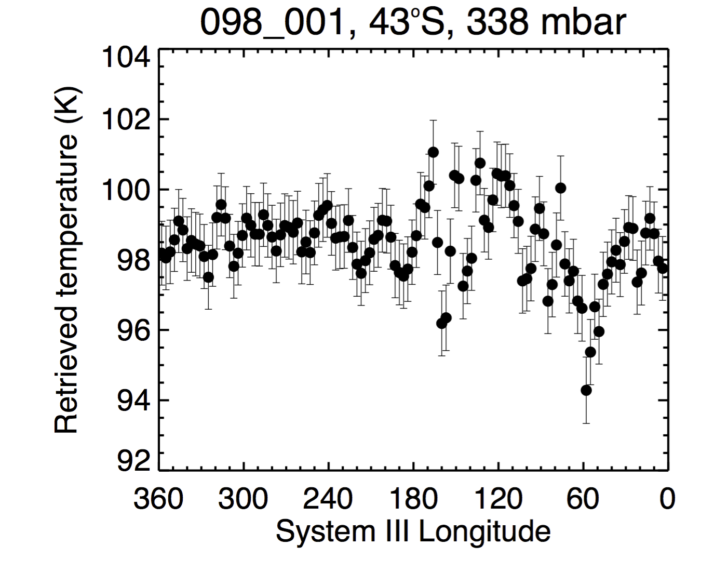
What’s next?
Undertake full temperature retrievals:
  we’re just beginning this with the prominent waves

Slide 21
What’s next:
Identify / model the origin of the waves
Wavenumber-2 thermal oscillations: similar to waves identified by Achterberg and Flasar (1996) in Voyager IRIS maps
-confined in latitude by meridional variations of zonal-mean winds
-confined vertically by variations of static stability in Saturn’s atmosphere
-meridional structure suggests excitation by barotropic instability of the zonal mean flow at mid-latitudes
-low phase velocities a consequence of the gradient in potential vorticity vanishing where the zonal winds are small.
Guerlet et al. (2018) identification of near-equatorial waves as a hemispherically symmetric Rossby wave.
GCM producing 10-mbar thermal waves
(Spiga, EGU 2015)
Cross-check visible cloud structure to determine whether some of the small-scale oscillations are not simply periodic chains of vortices.

Slide 22
What’s next?
Keep observing for northern equivalent of the prominent waves in the southern hemisphere.
  If purely a function of season, northern equivalent of prominent southern-hemisphere waves in 2003 & 2008 waves should appear in 2018 & 2023
  If they don’t then we have another fundamental difference between Saturn’s northern and southern hemispheres.

Slide 23
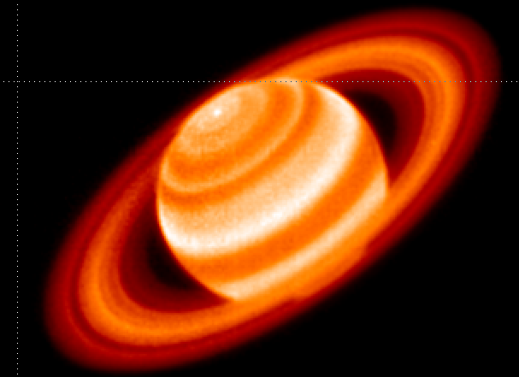
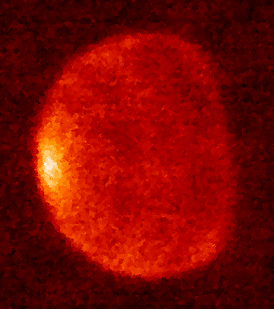
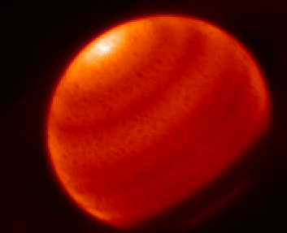
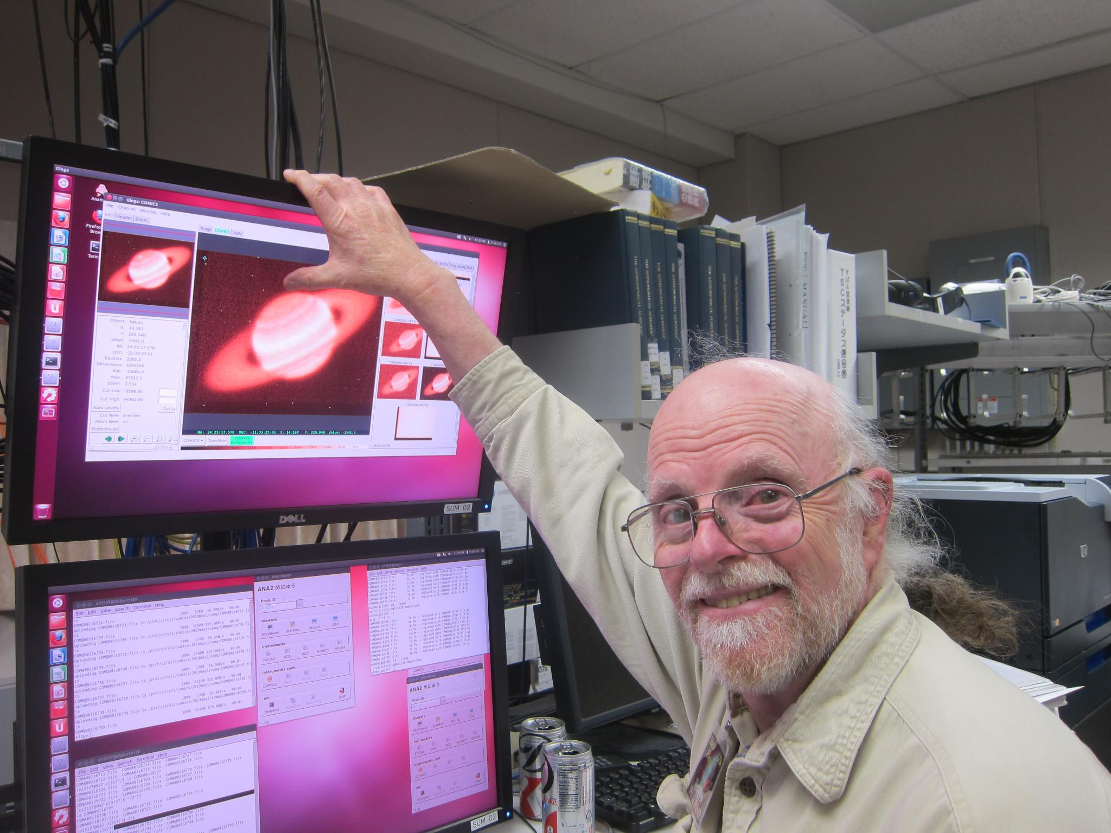
We’ll be working on this with all deliberate speed
2017 May 18 7.8 μm
2017 May 17 12.5 μm
2017 May 17 17.80 μm
Observing run on Subaru using COMICS:
Sinclair, Orton, Momary: 2018 August 19-20

Slide 24
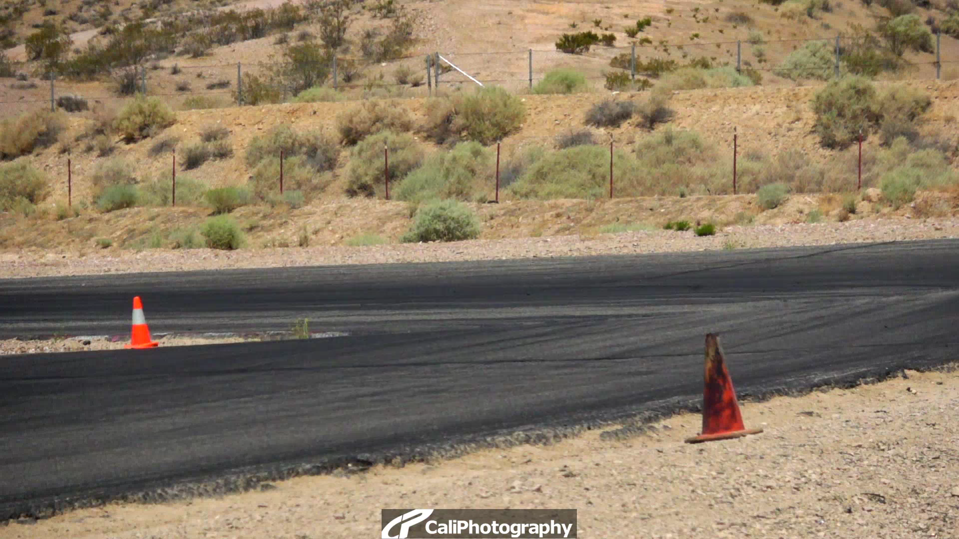
We’ll be working on this with all deliberate speed
Questions?

Slide 25
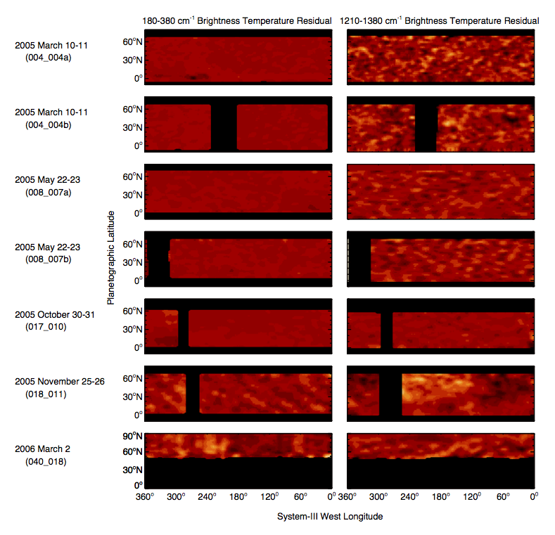
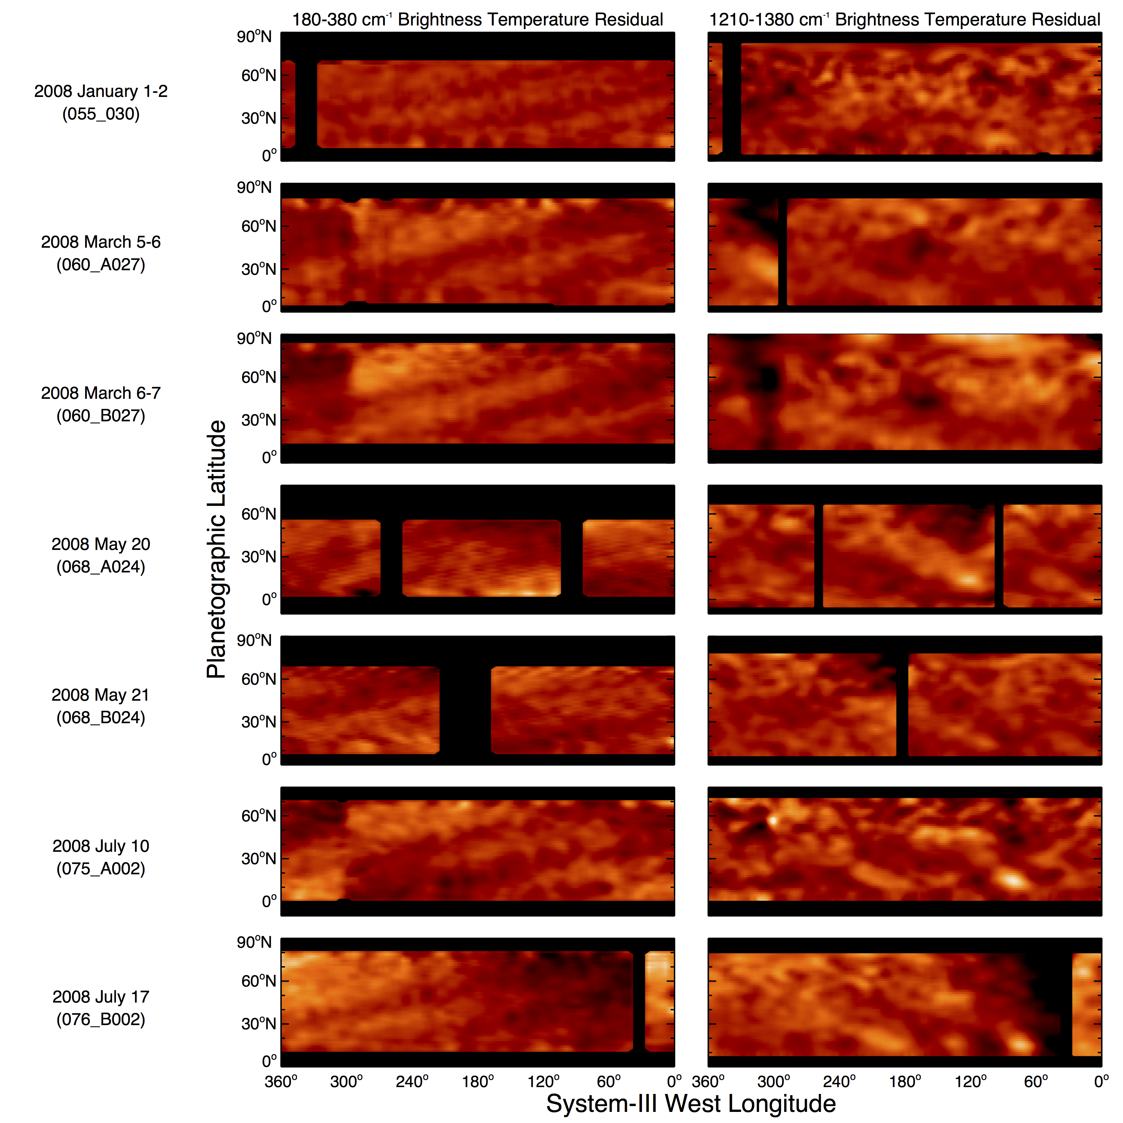
Backup visuals

Slide 26
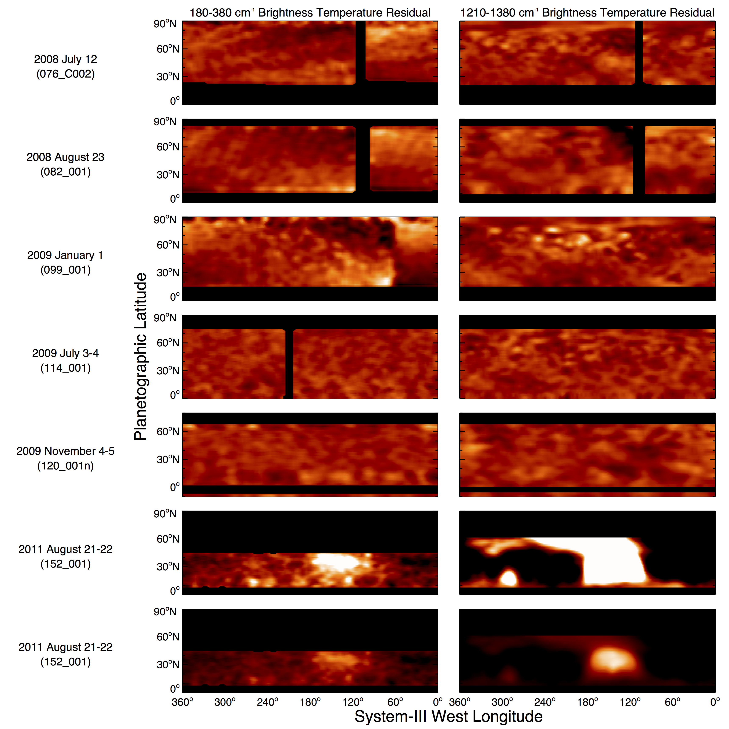

Slide 27
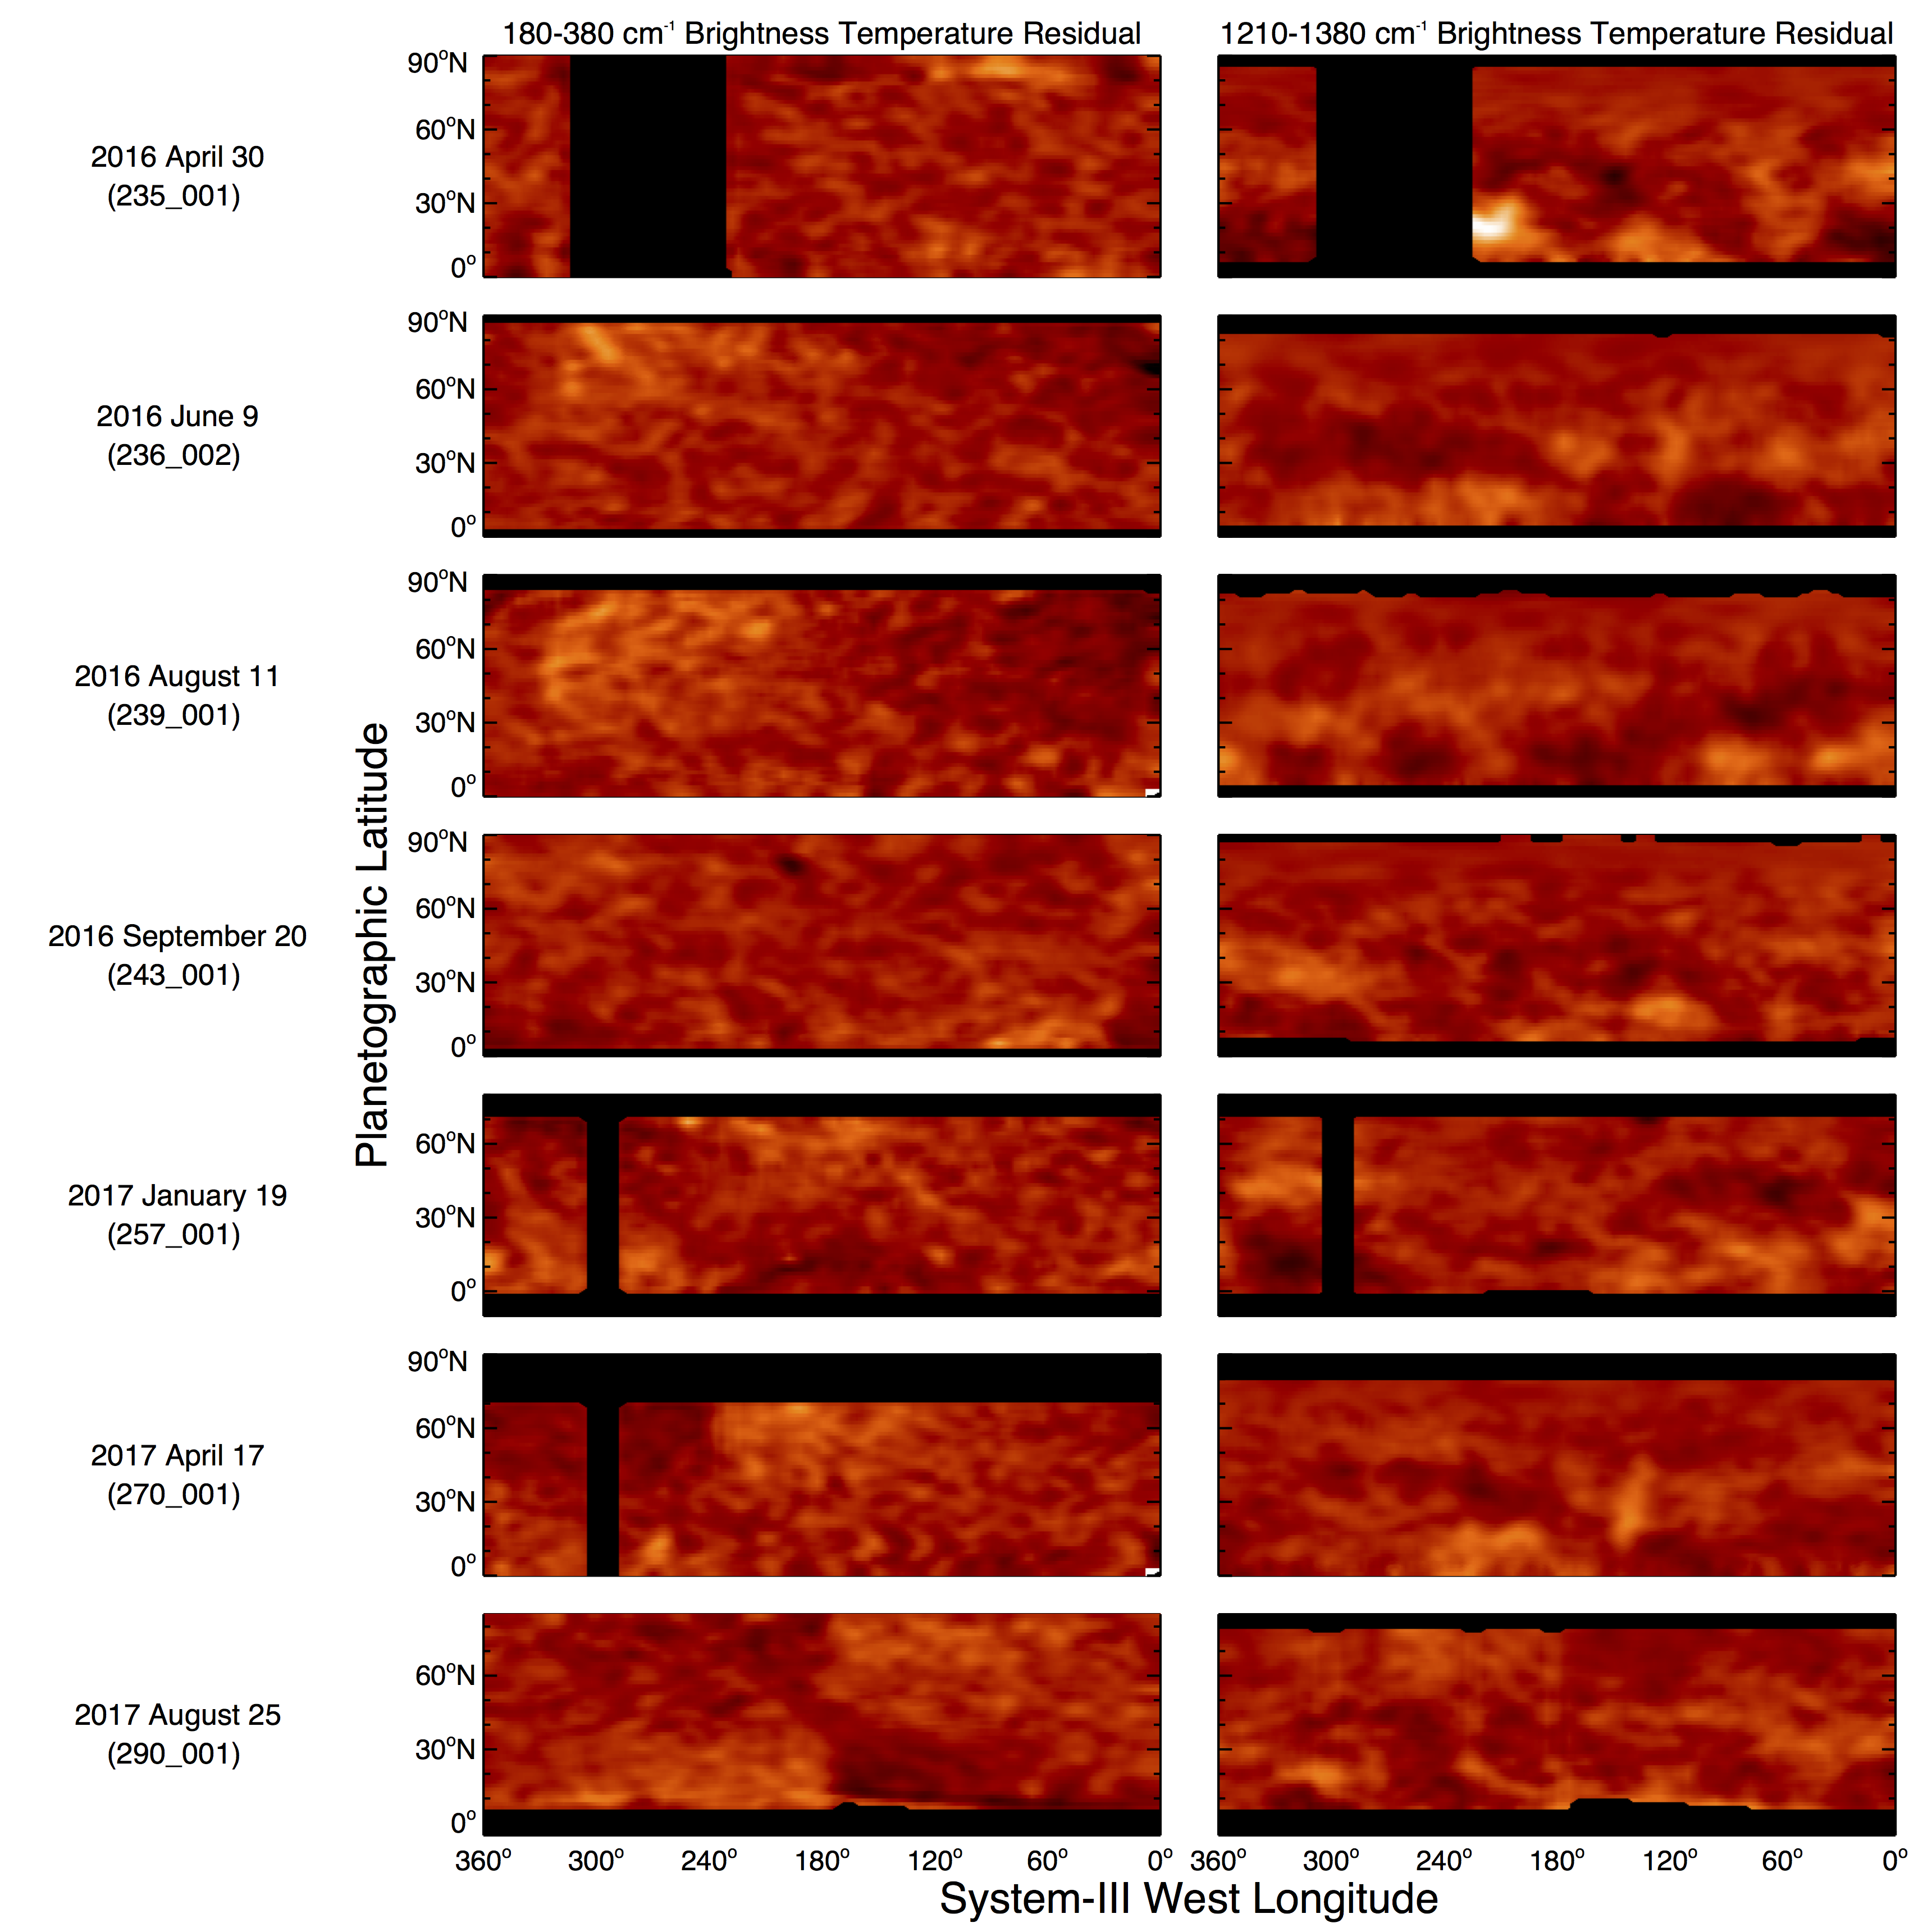

Slide 28
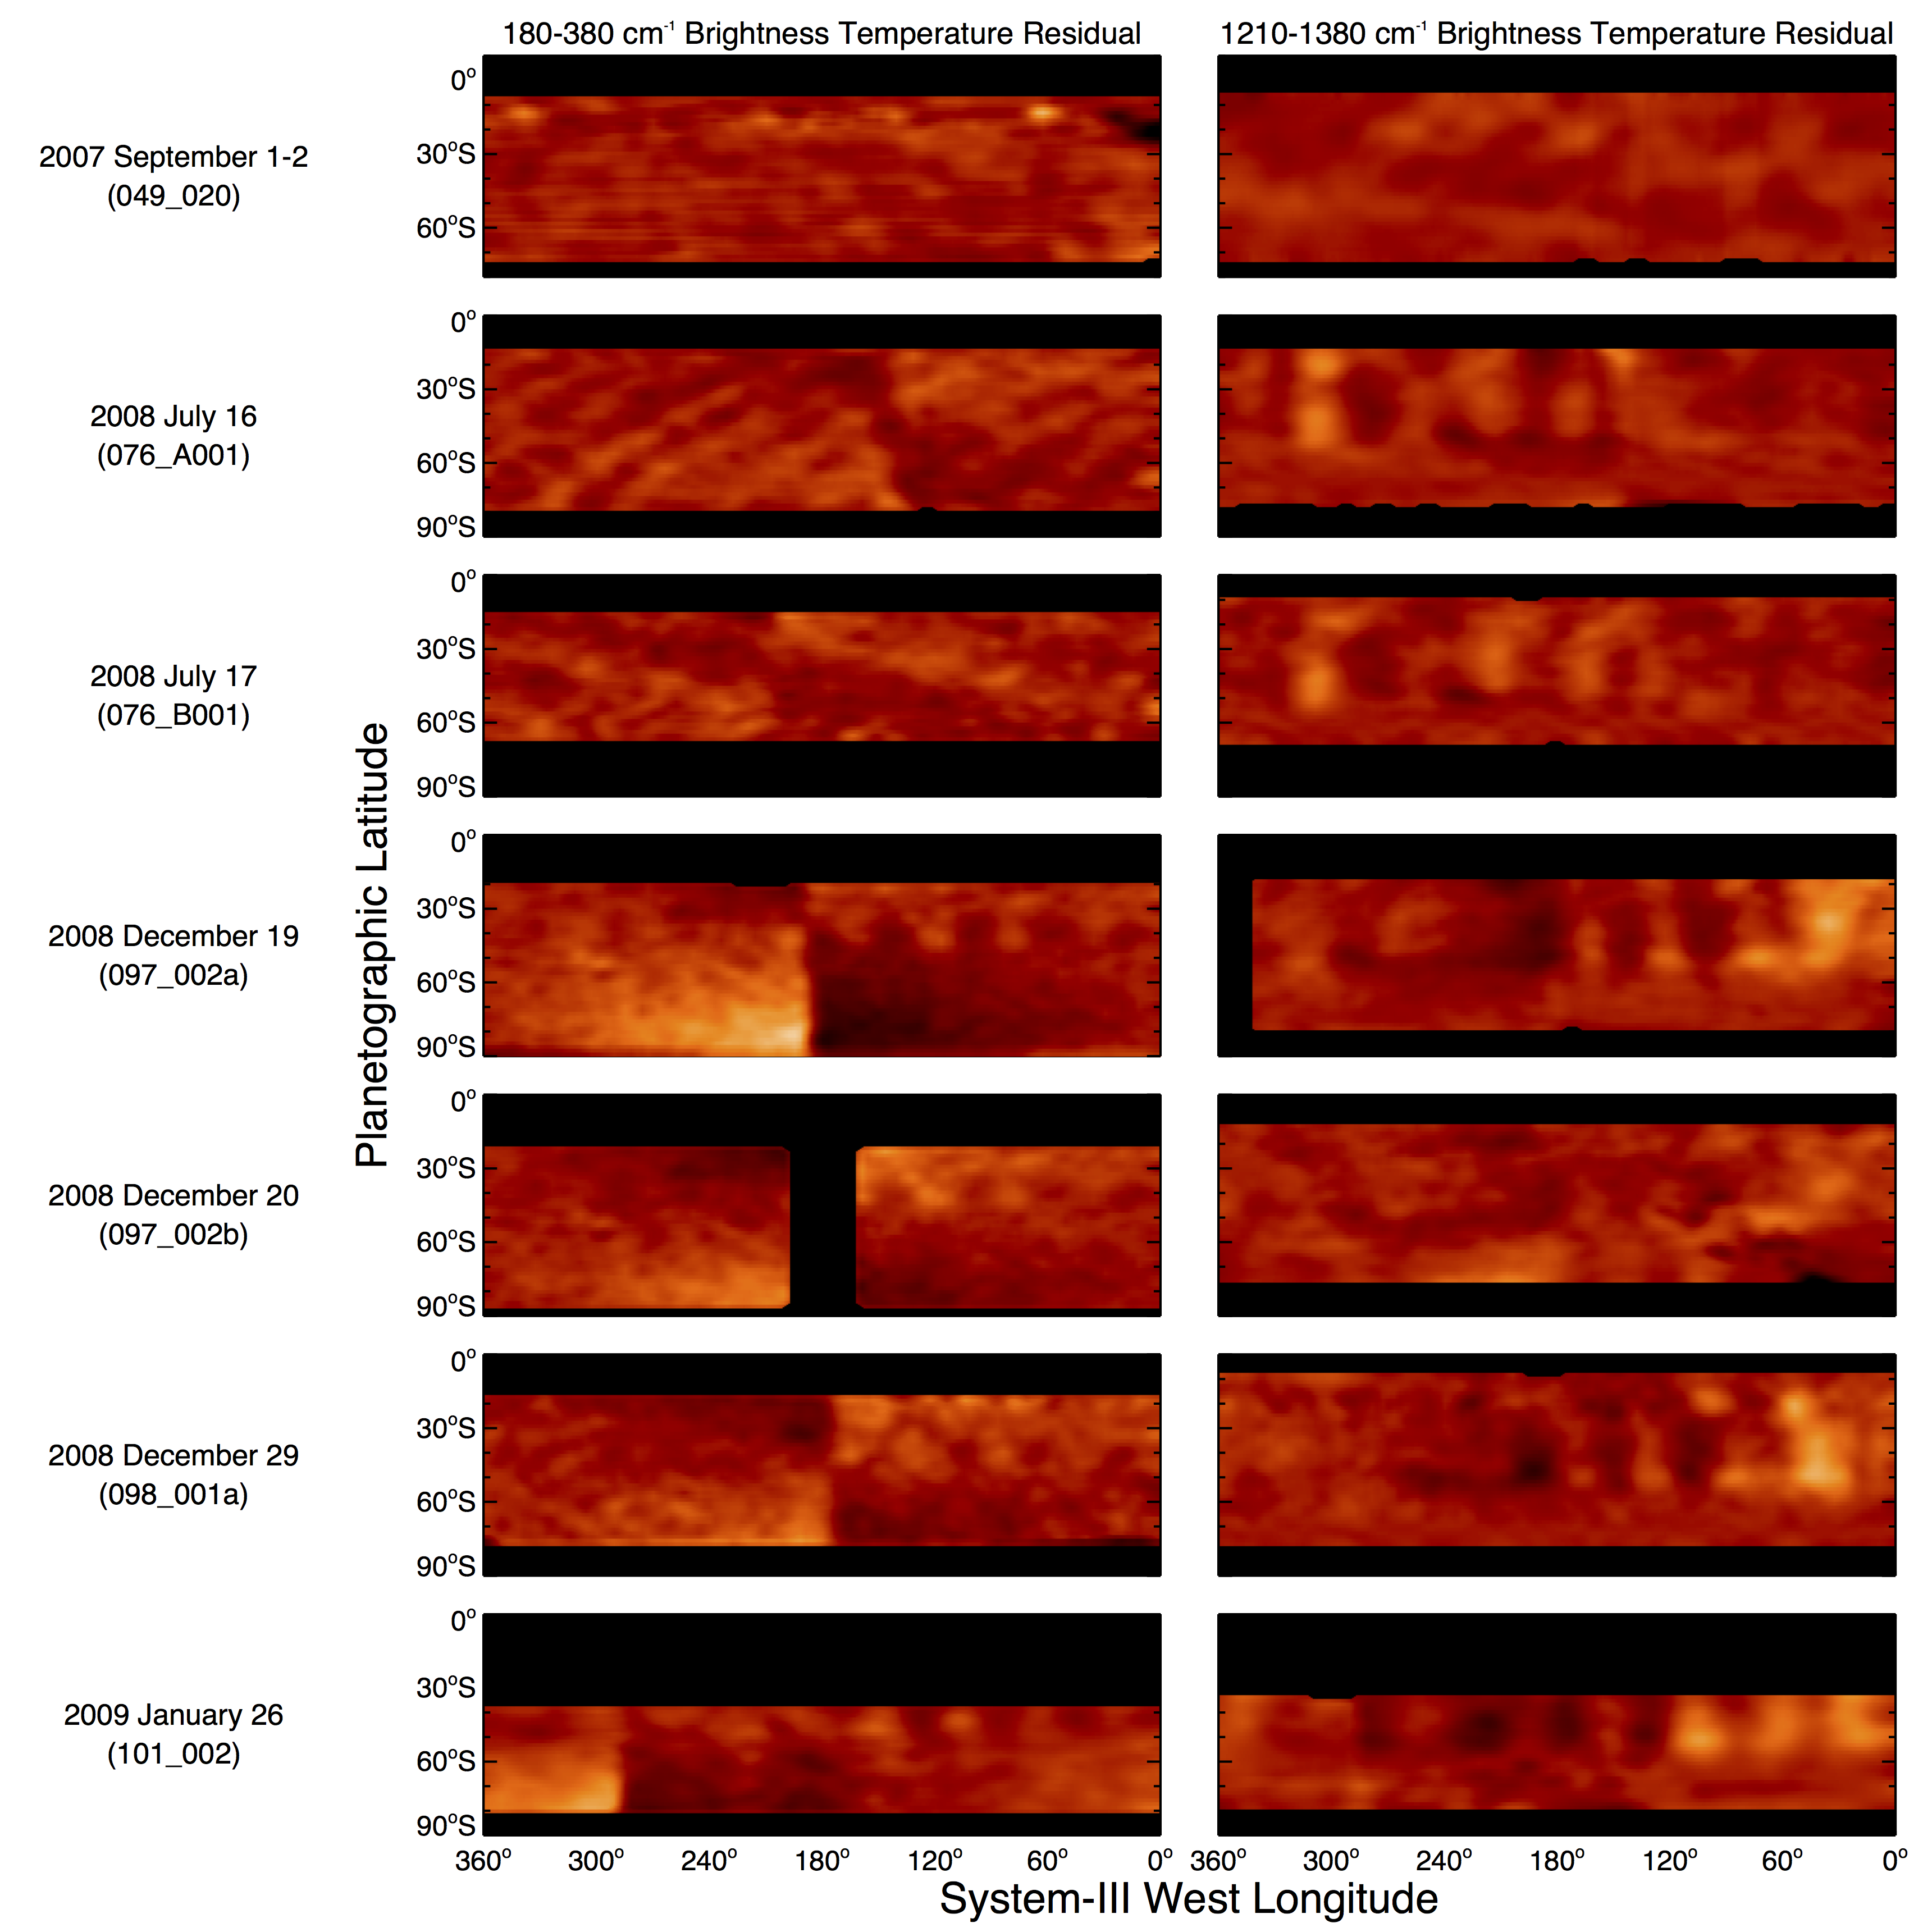

Slide 30
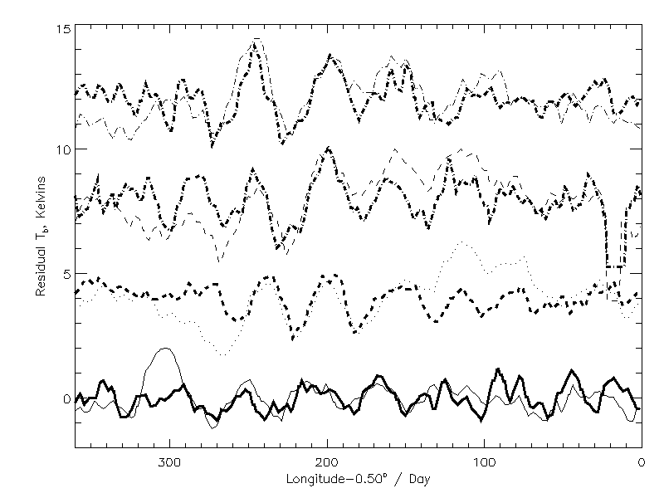
Wave phase speed at 40°S, consistent with -0.5°/ day offset
2009 Apr 6
2009 Jan 26
2008 Dec 19
2008 Jul 16
Heavy lines – 580-620 cm⁻¹ tropospheric residuals
270-290 cm⁻¹
Light lines – 1280-1320 cm⁻¹ stratospheric residuals

Slide 31
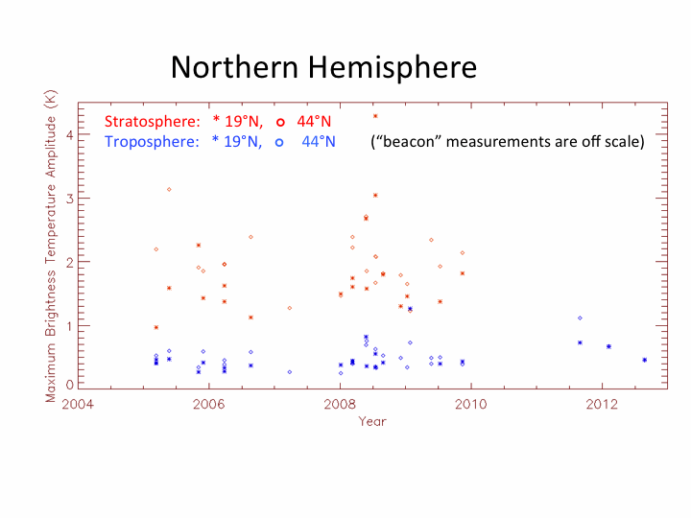



(N.B. beacon temperatures are off scale)
Pronounced time variability
of the most prominent waves
in the northern and southern
hemispheres.
Prominent northern waves appeared over several months
Prominent southern waves appeared for over two years.
For the southern hemisphere,
prominent waves are also seen
in 2003-2004 from the
ground-based record, much
stronger than in earlier years.
Note: beacon temperature
displacements are off scale

Slide 32


BASIC WAVE TAXONOMY
4. Stratospheric mid-latitude wavenumber >2 oscillations in both hemispheres

Slide 33


