Slide 1
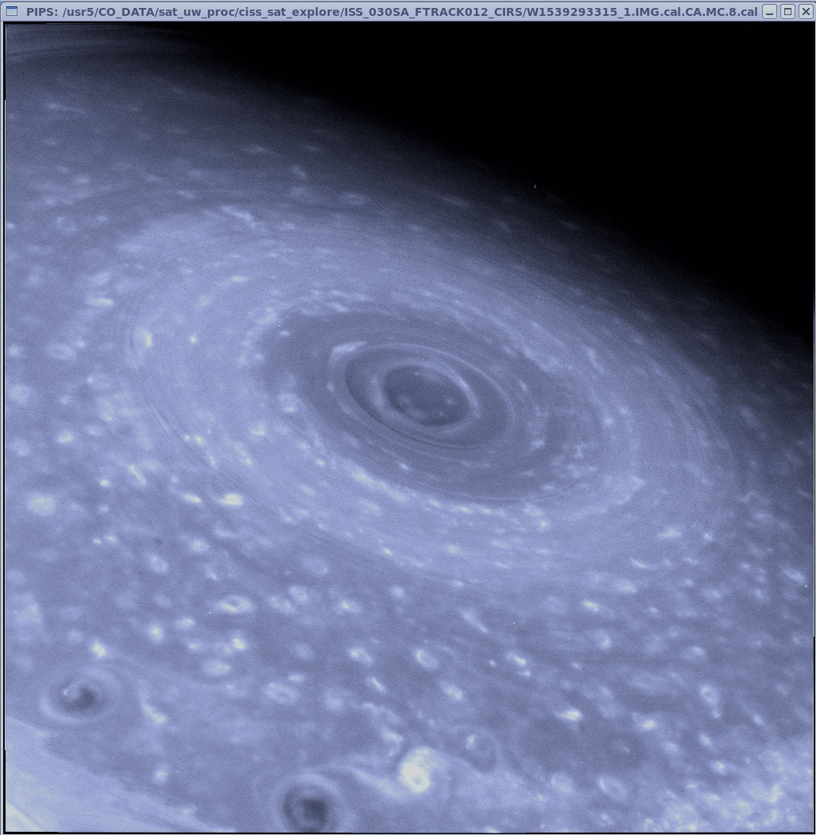
S35: Saturn’s South Polar Cloud Structure Inferred from 2006 Cassini VIMS Spectra
L. A. Sromovsky, K. H. Baines, P. M. Fry
University of Wisconsin – Madison
17 August 2018
Cassini Science Symposium, Boulder, CO
12-17 August 2018
Notes:
Good morning. This image of Saturn’s south polar region was taken by Cassini’s Imaging Science Subsystem in 2006 using the deeply penetrating 752-nm filter. It contains a fascinating variety of cloud features, including at the center of this image what resembles the eye of a hurricane, with a double eye-wall, casting shadows that imply a vertical relief ranging up to 100 km or more, according to a geometric analysis by Dyudina et al. (2009). What I want to discuss today is what can be learned about the vertical structure and composition of the aerosols in this region from a radiation transfer analysis of VIMS spectral observations, which provide powerful constraints not available from ISS imaging. But first, I need to provide some background information.

Slide 2
S35: Saturn’s South Polar Cloud Structure Inferred from 2006 Cassini VIMS Spectra
L. A. Sromovsky, K. H. Baines, P. M. Fry
University of Wisconsin – Madison
17 August 2018
Cassini Science Symposium, Boulder, CO
12-17 August 2018
Notes:
Good morning. This image of Saturn’s south polar region was taken by Cassini’s Imaging Science Subsystem in 2006 using the deeply penetrating 752-nm filter. It contains a fascinating variety of cloud features, including at the center of this image what resembles the eye of a hurricane, with a double eye-wall, casting shadows that imply a vertical relief ranging up to 100 km or more, according to a geometric analysis by Dyudina et al. (2009). What I want to discuss today is what can be learned about the vertical structure and composition of the aerosols in this region from a radiation transfer analysis of VIMS spectral observations, which provide powerful constraints not available from ISS imaging. But first, I need to provide some background information.

Slide 3
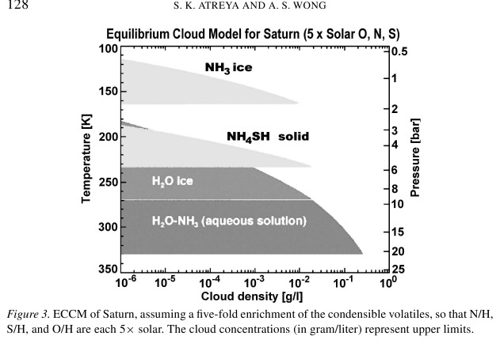
ECCM models by Atreya and Wong (2005) predict an NH₃ ice cloud as the upper layer of Saturn’s condensation clouds.
Near IR spectra should easily detect NH₃ ice clouds because of ammonia’s strong absorption feature near 3 microns.
Notes:
Equilibrium Cloud Condensation Models by Atryea and Wong in a 2005 Space Science Reviews article predict an ammonia ice a cloud as the upper layer of Saturn’s condensation clouds.
Near IR spectra should easily detect this ammonia ice cloud layer because of ammonia’s strong absorption feature near 3 microns.

Slide 4
But this absorption feature is almost never seen because of a thick overlying haze of unknown composition (perhaps diphosphine).
P₂H₄?
ECCM models by Atreya and Wong (2005) predict an NH₃ ice cloud as the upper layer of Saturn’s condensation clouds.
Near IR spectra should easily detect NH₃ ice clouds because of ammonia’s strong absorption feature near 3 microns.
Notes:
But this absorption feature is almost never seen because of a thick overlying haze of unknown composition (perhaps diphosphine). Its optical depth at 2 microns is significant, ranging from 3-6 in most regions of Saturn. But there are some situtations where violent convection can move the material from the deeper layers up to the visible cloud deck, then revealing the signature of ammonia.

Slide 5
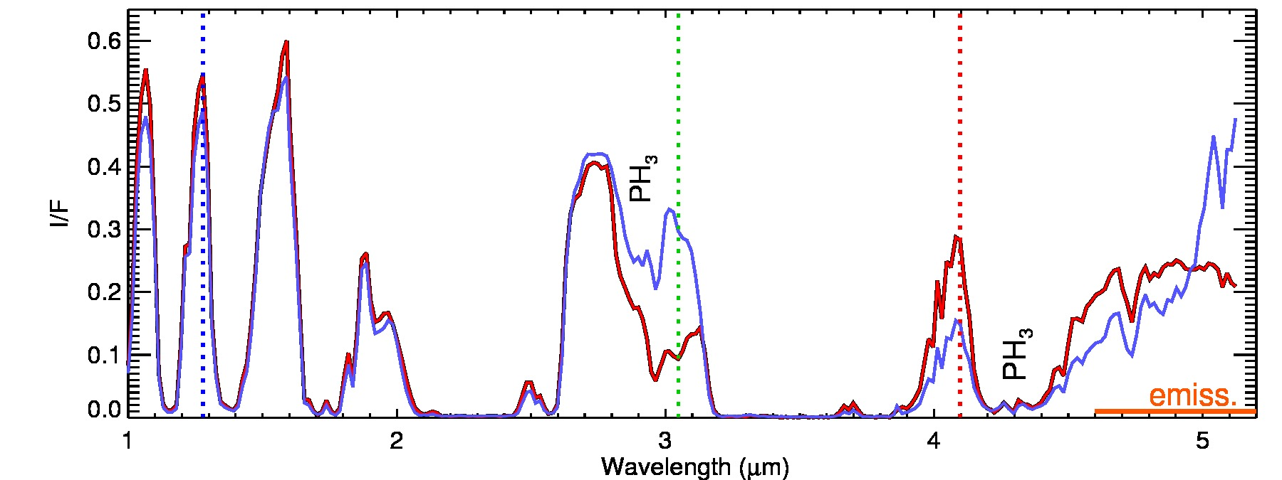
The most dramatic example: The Great Storm of 2010-2011
NH₃ ice is made visible by strong convection that penetrates the overlying layer.
The storm head is very bright at continuum wavelengths,
very dark at 3.05 microns,
giving NH₃ ice a distinctive near IR color.
Cassini VIMS spectra
Background spectrum
Storm head
Notes:
The most dramatic example is provided by the Great Storm of 2010-2011. A VIMS spectrum of the storm head at an active stage is here shown in red [X], with a background cloud spectrum shown in blue [X]. Images at 3 key wavelengths are shown at the top, with locations of the spectral samples indicated by colored circles. At this point the storm was producing copius amounts of lightning and rapid vertical convection penetrating the overlying haze.[x] It was bright at a wide range of continuum wavelengths, indicating the presence of large particles. {X] But it was very dark at 3.05 microns, revealing the key signature of ammonia ice. [X] The color composite with 3.05 microns as the green component yeilds a distinctive near-IR magenta color. [x] In this case NH₃ ice is made visible by strong convection that penetrates the overlying layer.

Slide 6
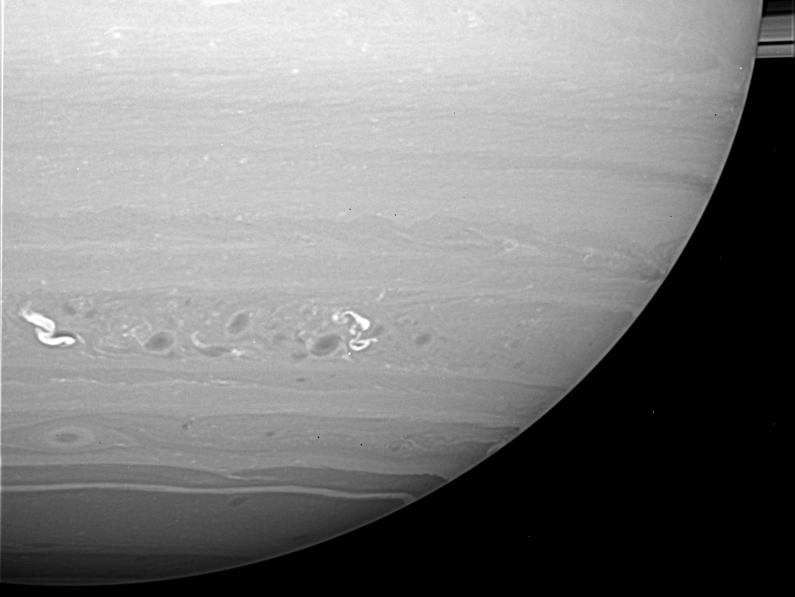
A second example of NH₃ detection: Storm Alley thunderstorms
Dyudina et al. (2007) showed that there was a strong spatial and nearly perfect temporal correlation between bright cloud features at 35ºS and lightning activity, an indicator of strong convection.
Notes:
A second example of ammonia ice detection is provided by the Storm Alley thunderstorms.
[X] Dyudina et al. (2007) showed that there was a strong spatial and nearly perfect temporal correlation between bright cloud features at 35ºS and lightning activity, an indicator of strong convection.

Slide 7
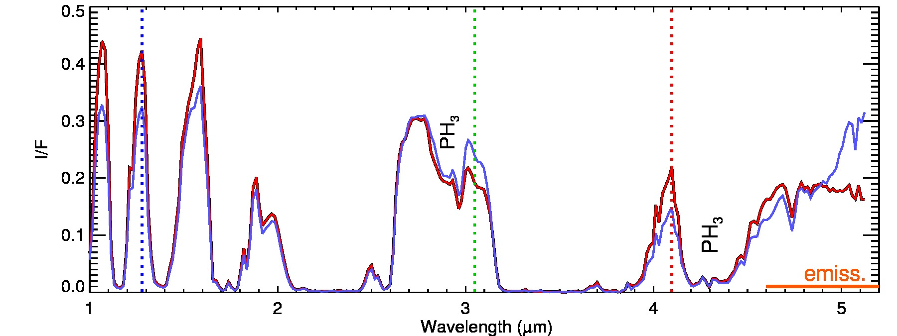
VIMS observations of Storm Alley thunderstorms
NH₃ ice is made visible by strong convection that penetrates the overlying layer.
Storms are bright at continuum wavelengths,
dark at 3.05 microns,
and show the same near-IR color of NH₃ ice.
Notes:
These VIMS images of the Storm Alley region use the same format and wavelengths as used for the Great Storm.
[X] These storm clouds are also bright at the same pair of continuum wavelengths.
[X] They also appear darker than background clouds at 3.05 microns.
[X]The result is the same near-IR ammonia ice color signature as for the Great Storm.
[X] Again, ammonia ice is made visible by strong convection that penetrates the overlying haze layer.
Next we turn to the south polar region.

Slide 8
75∘S
Saturn’s South Polar Region in October 2006
89∘S
86∘S
VIMS
ISS 752 nm
Small discrete cloud features are seen from 75 S almost to the pole.
No lightning detected that would indicate strong convection.
Surprisingly, ammonia ice signatures are present anyway.
Notes:
[X] In the south polar region there are numerous small bright cloud features from about 75º S almost to the south pole, as well as a ring of bright clouds at 86º S, and decreasing reflectivity toward the pole, with an especially low reflectivity within 1 degree of the pole.
[X] No lightning has been detected to indicate the presence of strong convection. [X] Yet, in the following we will show that the small cloud features do have ammonia ice signatures. First we will look at VIMS observations from the region outlined by the black square, and second the inner region outlined by the white square.

Slide 9
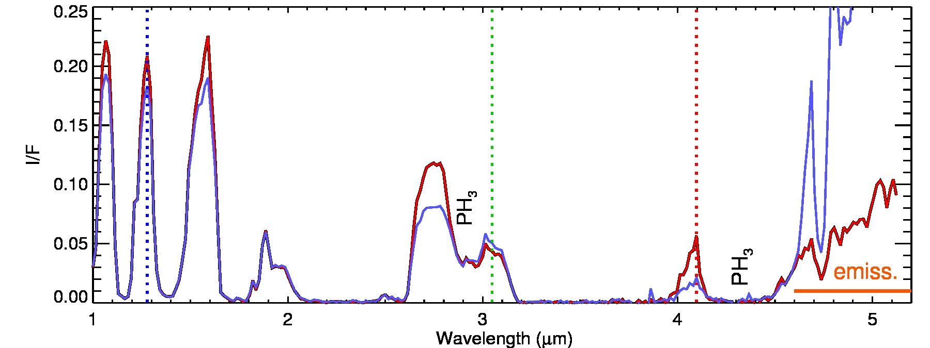
VIMS 2006 observations of the south polar region
Bright at continuum wavelengths
Dark at 3.05 microns
Distinctive near-IR color
Notes:
These spectra and images of the outer south polar region again use the previous format.
[X] The rsample bright cloud circled in red is bright at continuum wavelengths,
[X] dark at 3.05 microns.
[X] and also has the characteristic magenta near-IR color signature.

Slide 10
All discrete bright clouds poleward of 75º S have NH₃ ice signatures
Bright cloud that is not made of NH₃ ice
Bright clouds that exhibit NH₃ ice signatures
Notes:
Here we focus on VIMS observations from 75º S to the south pole, inside a region bounded by a bright cloud band without an NH₃ signature.
The left VIMS composite is the outer region and the right color composite is the inner region.
Red circles identify some of the bright clouds that exhibit ammonia ice signatures.
It turns out that all discrete bright clouds inside 75\deg S have ammonia ice signatures.

Slide 11
We interpret the VIMS measurements of these spectral features using a 4-layer model of polar cloud structure.
stratospheric haze, n=1.4
P₂H₄?, n=1.82
NH₃ ice
NH₄SH
Notes:
We interpret the VIMS spectra of these features using a 4-layer model of polar cloud structure.
[X] At the top is a stratospheric haze of very low optical depth.
[X] Next is a layer of relatively non-absorbing haze, perhaps made of diphosphine.
[X] A layer on ammonia ice.
[X] and finally a deep thermal-blocking layer assumed to be ammonium hydrogen sulfide
The middle layers are treated as sheet clouds with adjustable pressures, optical depths, and particle sizes.
The bottom layer is treated as a 20 optical depth per bar layer extending upward from 4 bars to an adjustable top pressure.

Slide 12
Model fits to VIMS spectra
Relative to the background cloud structure, the NH3 signature structure
(1) provides significant blocking of thermal radiation (in the region beyond 4.7 microns).
(2) is brighter at continuum wavelengths
(3) is darker at 3.05 microns.
Notes:
Here is an example fit to the spectrum of an NH3-signature cloud from the outer polar region. The VIMS background region (from location 4) is shown in green in the upper plot, with the model spectrum displayed as black dots. The VIMS observed spectrum of the NH3-signature cloud is shown in dull red in the lower panel, with the model spectrum also shown as black dots. The background observed spectrum is shown underneath in green for reference.
[X] Relative to the background cloud structure, the NH3 signature structure
[X] (1) provides significant blocking of thermal radiation (in the region beyond 4.8 microns).
[X} (2) is brighter at continuum wavelengths
[X} (3) is darker at 3.05 microns.

Slide 13
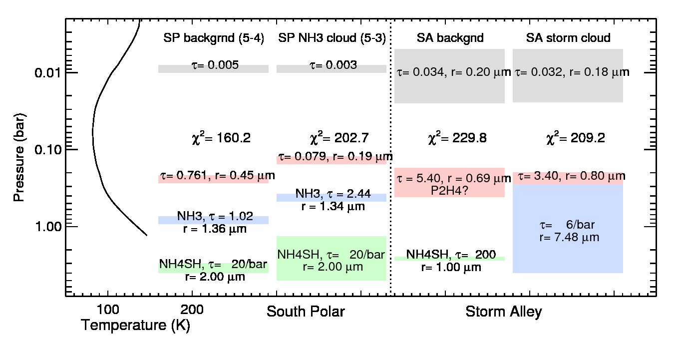
Model of NH₃-signature cloud at 77º S compared to model of background cloud:
Relative to the background cloud, the NH₃ ice signature structure has:
The same stratospheric haze opacity
A pink layer with half the particle size and 1/9 the optical depth.
An NH₃ layer of more than 2 x the optical depth and is 400 mbar higher in altitude.
An NH₄SH layer that reaches 1.5 bar higher in altitude.
Notes:
This slide shows the model vertical structures corresponding to the model spectra shown in the previous slide. [X] Relative to the background cloud, [X] the ammonia-signature structure shows about the same stratospheric haze opacity, but other layers are different. [X] The pink layer has about half the particle size and 1/9 the optical depth. [X] The NH3 layer has twice the optical depth and is elevated 400 mb in altitude. [X] And the NH4SH layer reaches 1.5 bars higher in altiude.

Slide 14
Model clouds at 77º S compared to Storm Alley clouds:
Upper layers in Storm Alley have roughly an order of magnitude more optical depth.
Notes:
Compared to the south polar clouds, the Storm Alley clouds have much greater optical depths, with ten times the stratospheric optical depth,
And 7-35 times the diphosphine optical depth. The storm alley thunderstorms have to penentrate into the diphosphine layer to produce any evidence of ammonia absorption. The south polar clouds don’t need violent convection because the overlying diphosphine layer is so optically thin that the ammonia absorption can be seen relatively easily.

Slide 15
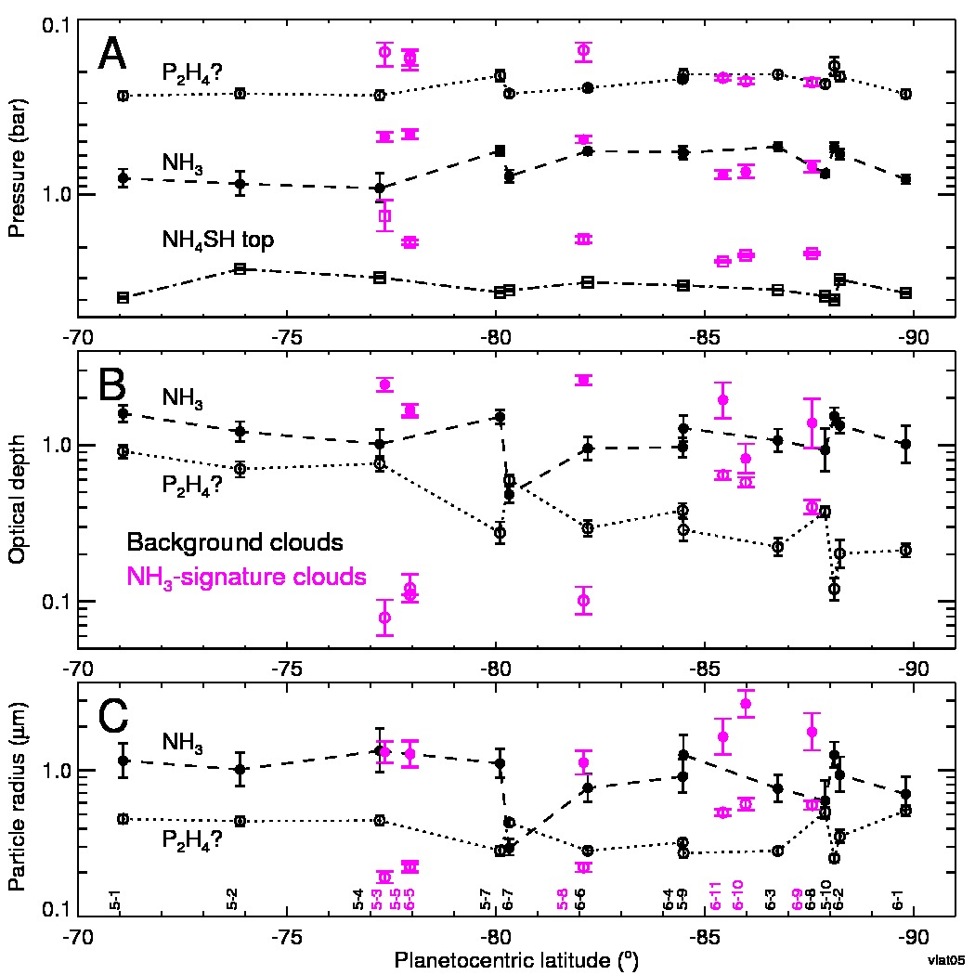
NH₃-signature cloud models (magenta) compared to background models (black) over a wide range of polar latitudes:
All have elevated deep cloud tops.
There is a split near latitude 83 deg S:
Furthest from pole, the diphosphine and NH3 layers are elevated, and the diphosphine optical depth is significantly reduced, while it is increased for the NH3 layer.
Closer to the pole, these layers are not elevated and only the ammonia layer optical depth is signifcantly increased, while both layers show increased particle size.
Notes:
These plots summarize model fit parameters as a function of latitude for background clouds (black) and ammonia-signature clouds (magenta). At the top are pressures of the diphosphine layer (near 300 mb), the ammonia layer (500 mb to 1 bar), and the top of the NH4SH layer (2-4 bars). In the next panel (B) are the optical depths of the ammonia layer (filled circles) and diphosphine layer (open circles). At the bottom are estimated particle sizes for the ammonia and diphosphine layers. Note that the south pole is at the far right in these plots.
Some general trends are worth noting in the characteristics of the NH3-signature clouds compared to the background clouds.
[X] All have significantly elevated deep cloud tops, suggesting that the features are induced by some vertical convection in the water layer.
[X] There is a split in other parameters near lattitude 83 degrees South.
[X] Furtheset from the pole, the diphosphine and ammonia layers are elevated, and the diphosphine optical depth is significantly reduced, while it is incrdeased for the ammonia layer.
[X] Closer to the pole, these layers are not elevated, and only the ammonia layer optical depth is significantly increasee, while both layers show increased particle size.

Slide 16
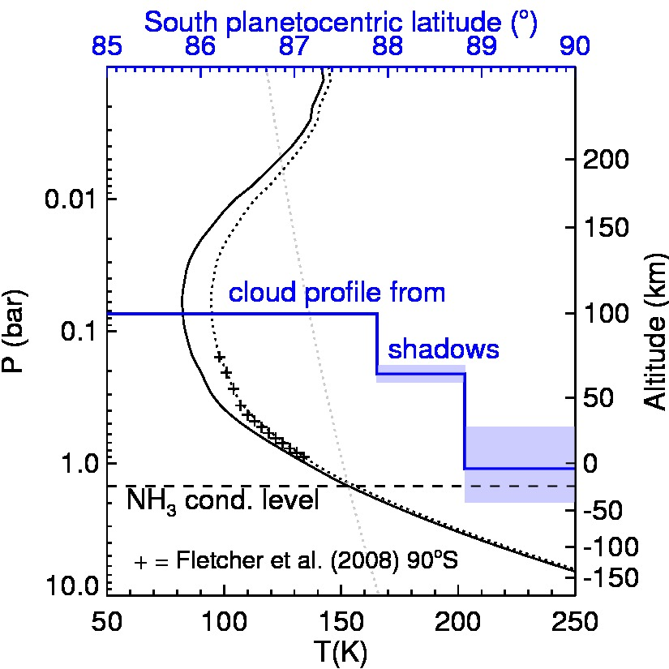
What about the eyewall cloud structure?
Dyudina et al. (2009) showed that dark crescent features beginning at 1 and 2 degrees from the pole were shadows, based on their orientation with respect to the direction of incomling sunlight.
They estimated relative heights of inner (70 km) and outer (30 km) eyewalls based on lengths of shadows that were cast.
They suggested that the eyewall clouds were formed by convection over two scale heights, with clouds rising past the tropopause.
However …
Notes:
What about the eyewall cloud structure, you might ask?
[X] Dyudina et al. (2009) showed that dark crescent features beginning at 1 and 2 degrees from the pole were shadows, based on their orientation with respect to the direction of incomling sunlight (indicated by the white arrows).
[X]They estimated the relative height from shadow length, finding that the inner wall averaged 70+/-30 km and the outer wall averaged about 30 km.
[X] They suggested that the eyewall clouds were formed by convection over two scale heights, rising slightly above the tropopause.
[X] However, this interpretation is not consistent with VIMS constraints…

Slide 17
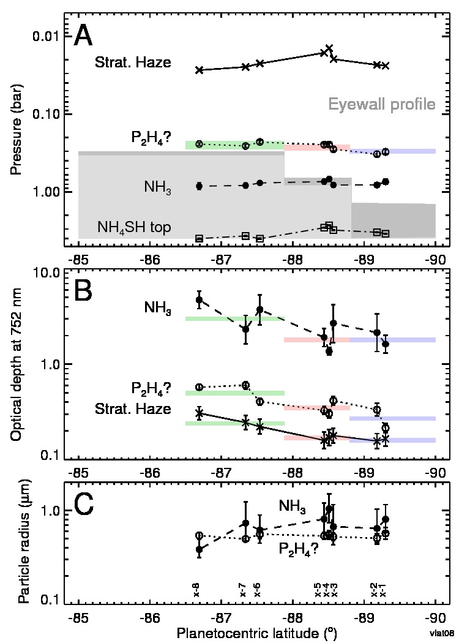
ISS 752 nm
VIMS
VIMS spectra between 86 deg S and 90 deg S, at locations shown in the above VIMS image, yielded cloud models shown in the plots at the right.
In panel A, all the cloud layers appear at nearly the same pressures throughout the region. They do not show the stair-step eye wall structure inferred from shadow geometry.
Except for the deep layer, optical depths are small and decrease slightly towards the pole, suggesting downward motions and evaporation rather than deep convection reaching up to the tropopause.
Notes:
VIMS spectra between 86 deg S and 90 deg S at locations shown in the above VIMS image, yielded cloud models shown in the plots at the right.
[X] In panel A, all the cloud layers appear at nearly the same pressures all the way across this inner region. They do not show the stairstep eyewall structure (shown in gray) that was inferred from shadow geometry.
[X] Except for the deep layer, optical depths are small and decrease slightly towards the pole, suggesting downward motions and evaporation rather than deep convection reaching up to the tropopause.

Slide 18
P₂H₄ layer
NH₃ layer
Outer shadow
Inner shadow
88º S
89º S
90º S
Possible shadow explanation: step increases in optical depth of the diphosphine layer away from the pole create shadows on deeper (possibly ammonia) layer.
Notes:
The most plausible shadow explanation that is consistent with radiation transfer modeling is that the shadows are created by optical depth step changes in the putative diphosphine layer. A step change at 89 deg S produces the inner shadow, and a step increase at 88 deg S produces the outer shadow.
Each step increase away from the pole creates a shadow on the lower layers, probably mainly on the ammonia layer. A more complete discussion of the pros and cons of this model, and the implication that it should produce anti-shadows as well as shadows, will be presented at the DPS meeting in October.

Slide 19
Conclusions:
Over most of Saturn, the 3-micron absorption feature of ammonia ice is hidden from external observations by an overlying layer typically near the 200 mbar level, with 3-6 or more optical depths of particles with an unknown composition, which may be P₂H₄.
In the Great Storm of 2010-11 and in Storm Alley, NH₃ ice was made visible by strong convection of NH₃ particles that penetrated above or significantly into this overlying layer.
In the south polar region, a significant thinning of the overlying putative diphosphine layer, to just a fraction of one optical depth, allows the detection of ammonia ice signatures without the need for strong convection.
Enhanced south polar ammonia ice signatures associated with small bright features appear to be related to a possible convective pulse at the 3-bar level in the NH₄SH cloud, although there is no evident mass transport from this level to much higher levels.
The prior interpretation of cloud shadows as deep convective eyewalls is inconsistent with radiative transfer models that instead suggest that shadows are created by small step decreases in optical depth of the putative diphosphine layer at 88º S and 89º S.

Slide 20
Conclusions:
Over most of Saturn, the 3-micron absorption feature of ammonia ice is hidden from external observations by an overlying layer typically near the 200 mbar level, with 3-6 or more optical depths of particles with an unknown composition, which may be P₂H₄.
In the Great Storm of 2010-11 and in Storm Alley, NH₃ ice was made visible by strong convection of NH₃ particles that penetrated above or significantly into this overlying layer.
In the south polar region, a significant thinning of the overlying putative diphosphine layer, to just a fraction of one optical depth, allows the detection of ammonia ice signatures without the need for strong convection.
Enhanced south polar ammonia ice signatures associated with small bright features appear to be related to a possible convective pulse at the 3-bar level in the NH₄SH cloud, although there is no evident mass transport from this level to much higher levels.
The prior interpretation of cloud shadows as deep convective eyewalls is inconsistent with radiative transfer models that instead suggest that shadows are created by small step decreases in optical depth of the putative diphosphine layer at 88º S and 89º S.

Slide 22
Example model fits to VIMS south polar spectra:
Example model fits to VIMS Storm Alley:

