Slide 1
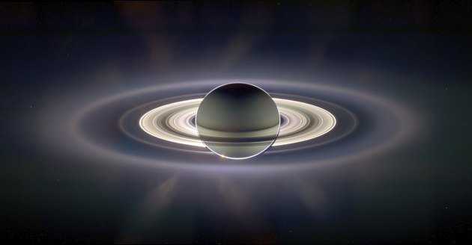
Monitoring Saturn's Upper Atmosphere Density Variations Using
Helium 584 Å Airglow and Determining the He Mixing Ratio
Christopher D. Parkinson,
Tommi Koskinen, and Larry Esposito
Final Cassini Science Symposium
August 17, 2018

Slide 2
Principal Parameters
The principal parameters involved in determining the He 584 Å albedo are:
f_{He}, the helium volume mixing ratio well below the homopause,
the eddy diffusion coefficient at the homopause, K_{h},
the solar He 584 Å flux and line shape, and
the atmospheric temperature profile, T(z).
Parkinson et al. (1998) used a reference model atmosphere where f_{He} = 0.033 ± 0.025 from the Voyager IRIS measurements (Conrath et al., 1984), but also explored other values. For their reference conditions they chose K_{h} = 10⁶ - 10⁹ cm² s⁻¹.

Slide 3
Previous Results
The first Saturnian He 584 Å dayglow emission observation was from Voyager 1 (Broadfoot et al., 1981) with a disk-averaged value of 3.1 ± 0.4 R. Voyager 2 reported a disk-averaged value of 4.2 ± 0.5 R (Sandel et al., 1982)
Parkinson et al. (1998) found that K_{h} “is likely to be greater than 10⁸ cm²s⁻¹” for reference model atmospheres.
Need for a more detailed analysis using new measurements (i.e. Cassini UVIS)
Issues and Uncertainties (Parkinson et al., 1998)
Problems with Voyager calibration? Were there unknown uncertainties in the airglow measurement due to calibration?
integrated He 584Å solar line flux
planetary mixing ratio of He in the deep atmosphere
Notes:
Was Voyager callibrated correctly?
If there’s an uncertainty in the solar photons flux. Actually measured on earth.
What is the mixing ratio of He in the deep atmosphere. It is uncertain.

Slide 4
Equation of Radiative Transfer

Slide 5
Parameters/terms defined

Slide 6
Feautrier Technique

Slide 7
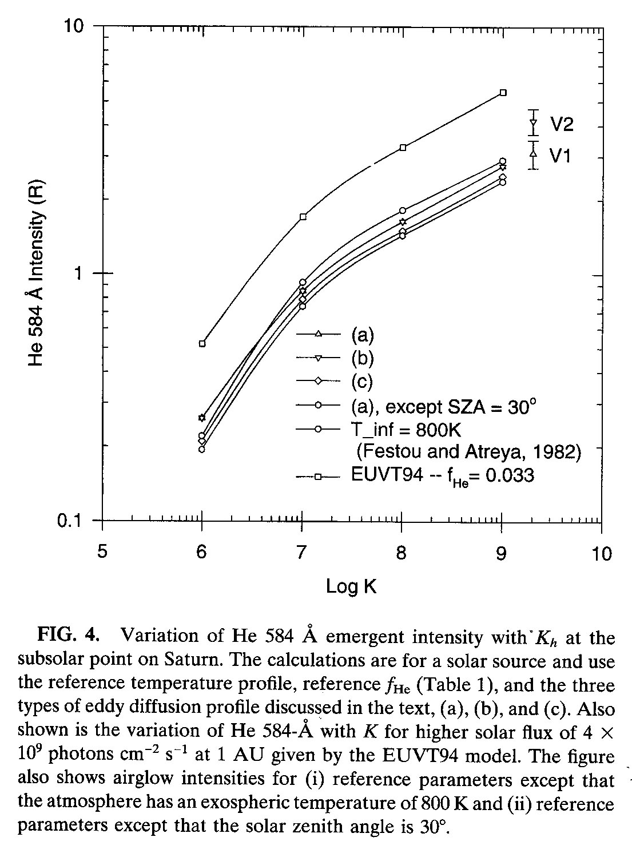
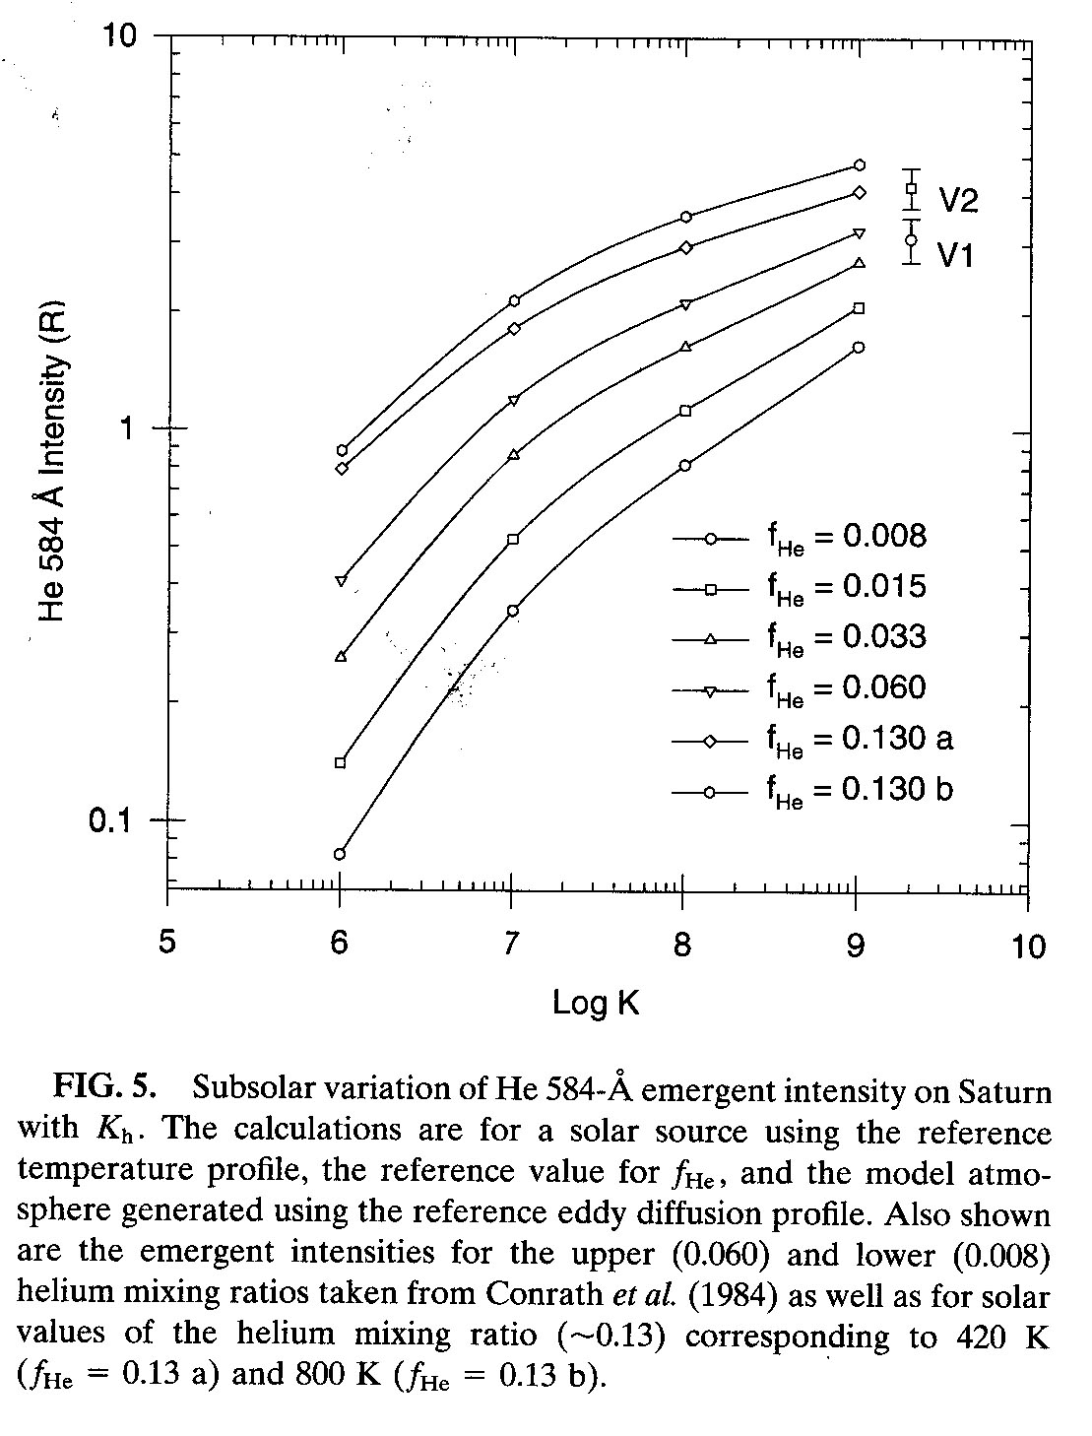
Summary of Parkinson et al. (1998) (Feautrier technique RT model)

Slide 8
New Direction
These reference model atmospheres are superseded by those determined by Koskinen et al. (2015) giving precise stellar occultation values for the mixing ratios of He, atomic H, H₂, and CH₄.
Also evaluated are hitherto unprecedented accurate temperature and eddy mixing profiles, T(z) and K_{z}.
Koskinen et al. (2018) predict f_{He} = 0.11 +/- 0.02; vary our model atmosphere using new T(z) and K_{z} over this range for input to RT model.
Apply resonance scattering model to the He 584 Å problem using the Feautrier technique to solve the equation of radiative transfer assuming partial frequency redistribution (Gladstone, 1982; Parkinson et al., 1998; Parkinson et al., 2006; 2016)

Slide 9
So…what about the Cassini epoch?
He 584 Å line is definitely present with a sunlit disk averaged brightness of 0.6 +/- 0.1 R obtained (peak ~500 counts with 5-sigma detection) observed Oct 2004 case
no Koskinen et al. (2015) occultation data sets for comparison

Slide 10
Same observation, broken into sequential segments with smaller integration times:
Clearly there is evidence for short term variation!

Slide 11
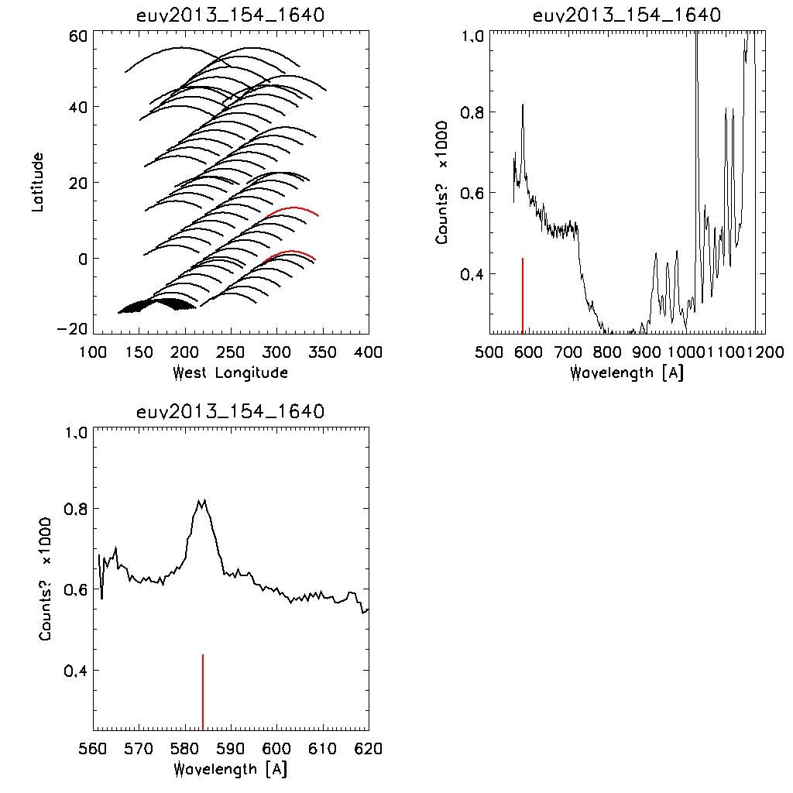
Other Cassini Observations
(Compare with ST31 December 2008)
(Compare with ST42 October 2014)
Weak signal
with very few
counts
Peak ~2000 counts,
Integrated line
Brightness ~1.8 R

Slide 12
Choose stellar occultation cases corresponding to:
ST31 Dec 2008 (long. 17.9ºN)
ST42 Oct 2014 (long. 5.85ºS)
Case 1 corresponds closely to solar minimum
Case 2 corresponds closely to solar maximum
Obtain solar flux values obtained from TIMED/SEE solar EUV experiment

Slide 13
Run the RT code for both cases f_{He} = 0.11 :
ST31 Dec 2008 (long. 17.9ºN)
ST42 Oct 2014 (long. 5.85ºS)

Slide 14
Variation of He 584 A emergent intensity with K_{h} for Voyager 1 and 2, Cassini 2004, 2008, 2014
2014
2008
2004

Slide 15
Interpretation: Solar flux
NASA Solar Cycle 24 Sunspot Number Prediction

Slide 16
Summary, Final Plunge, and what is next…
It would appear that the Cassini epoch He 584 Å brightness for this sample set is lower than during the Voyager epoch with the corresponding effects consistent with and illustrated by both observations and modeling
Clear evidence for short term variation
2004/2008 brightness “anomalies” are not fully explained by solar flux and need to examine this more closely
may be due to geometry (latitude/longitude), observation corresponding to lower/higher K_{z} profile at this particular moment, ring shadowing, and/or temperature profile
Using stellar occulation atmospheres combined with powerful RT code provide precise method for monitoring upper atmospheric density variations using the He 584 Å airglow
Methodology also provides method to obtain/constrain He mixing ratio in the deep atmosphere; ST42 model atmosphere and EUV2013_153_1640 observation case closely match in He 584 Å brightness for He mixing ratio of 0.11.
More analysis required for 0.11 +/- 0.02.
Look at observational data sets closest to UVIS Final Plunge

