Slide 1
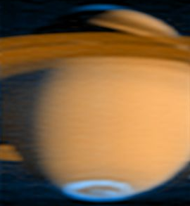
Cassini UV reflection spectra of Saturn: Acetylene and Haze
Robert West, Juliette Hu, Tommi Koskinen, Wayne Pryor, and Scott Edgington

Slide 2
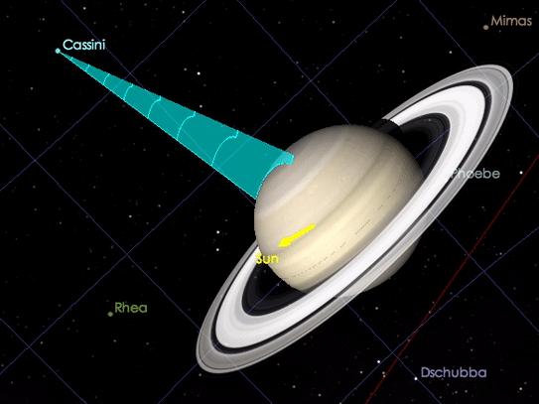
Observations
UVIS FUV Data Cubes: 60 pixels X N time steps X 1024 Spectral Elements
For this initial study we selected long-integration sequences – riders on CIRS COMPSIT observations
  20 minutes/integration
  Mostly fixed pointing
  Variety of latitudes, phase, emission, incidence angles and time coverage
Notes:
Certain datasets are more accessible to analysis.
We want dayside observations (because we're examining scattering and I/F). We want minimal ring interference because we're focusing on Saturn's body, rather than its rings. Wide latitude range to understand the distribution latitudinally. Multiple phase angles so we haven't accidentally excluded any factors linked to phase angle in analysis.
This GIF depicts how we used Cosmographia to find these observations. Cosmographia allows you to load in .json files and kernels specifying the attitude and geometry so that you can see the observation actually taking place. So, from a list of 127 observations, spanning the entirety of Cassini's arrival to present time, we checked for observations that matched -->
this criteria. We isolated 12 observations spanning from 2009 to 2017 with latitude from northern to southern hemisphere but excluding -30 to 10 degrees planetographic. Unfortunately, latitudes in that region generally had some ring interference, so we decided to focus on observations that didn't intersect the rings. An interesting goal for future research would be to look at those datasets by filtering out ring pixels.

Slide 3
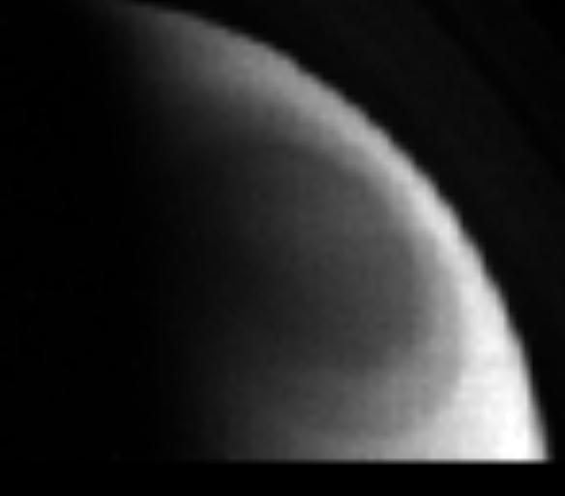
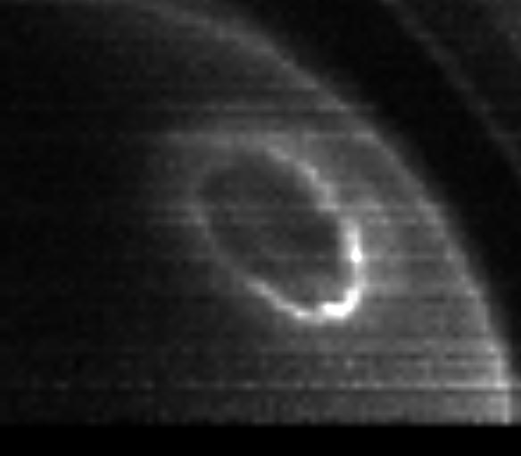
Data Cube Example: Saturn’s North Polar Region
171.2-191.0 nm
Ly-α

Slide 4
Analyses of IUE Data from 1978 - 1980
Figure from Chen et al., 1991JGR Planets
Most apparent are spectral features from C₂H_{2.}
These data carry no information on latitudinal gradients.
UVIS

Slide 5
Mesurements and Model Results from HST in 1994
Prangé et al., Icarus 180 (2006) 379–392.
Note the large variations at the minimum around 1700 Angstroms

Slide 6
Potential Constituent Absorption Cross Sections
Prangé et al., Icarus 180 (2006) 379–392.

Slide 7
Optical depth to the 10-mbar level
From the photochemical model that Julie Moses ran to match the 2005 southern mid-latitude occultation.
The solid line includes CH₄, C₂H₆, C₂H₂, C₂H₄ and C₆H₆.
The dashed line shows the optical depth excluding C₂H₄ and C₆H₆.
Signatures of C₂H₄ and C₆H₆ are buried in larger opacity from C₂H₂

Slide 8
Constraints on Retrievals I. UVIS FUV Stellar Occultations
Vertical Profiles from UVIS FUV occultations (Koskinen et al., Geophys. Res. Lett., 43, 7895–7901, 2016)
Many more occultations awaiting analysis
Nadir observations probe deeper levels and are more extensive in latitude and time be have very poor vertical resolution

Slide 9
Constraints on Retrievals, II. Infrared at 2.1 mbar
From Sinclair et al., Icarus 225 (2013) 257–271. (Cassini-CIRS)
Red circles indicate 2005 results, blue crosses indicate 2009 results and green triangles indicate 2010 results

Slide 10
Sample Data (+ symbols) and Model (Acetylene Only)

Slide 11
Sample Data (+ symbols) and Model (Acetylene Only)

Slide 12
Sample Data (+ symbols) and Model (Acetylene Only)

Slide 13
Summary So Far, Illustrated by Just a Few Spectra
Wait, there’s more to come!
Low and mid-latitude spectra are consistent with acetylene as the only absorber over a limited spectral range (180-188 nm) while wavelengths 160-180 nm show evidence for some other (haze or H₂O) absorber.
Haze absorption in the range 180-190 nm ramps up strongly poleward of -65 degrees, consistent with ISS and CIRS data
The case for and against H₂O in the region 0.1 – 20 mbar.
  Pro: H₂O opacity may have the ‘right’ wavelength dependence to help with the model fit in the region 160-180 nm (opacity steeply increasing toward 160 nm).
  Con: H₂O opacity was not needed to fit the UVIS stellar occultation profiles and is not part of CIRS stratospheric retrievals

Slide 14
Goals for This Study – Beyond Results from IUE and HST and UVIS Analysis of Few Data
UVIS data are now in the realm of ‘Big Data’ and demand a ‘big data’ approach
Our current effort is to develop the methodology to tackle the entire UVIS Saturn spectral image data set.
Our ‘small’ initial set consists of ~18,000 Saturn spectra selected for high S/N (implies long integration times) and selecting the spectral range 160 – 190 nm (reflected sunlight)

Slide 15
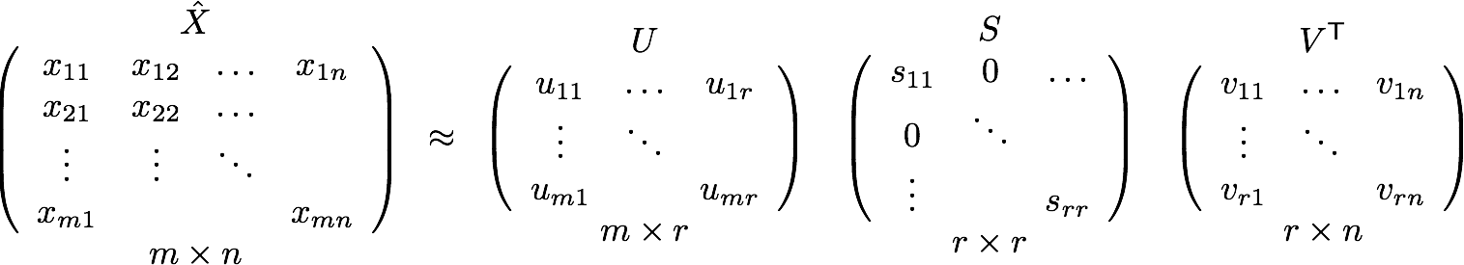
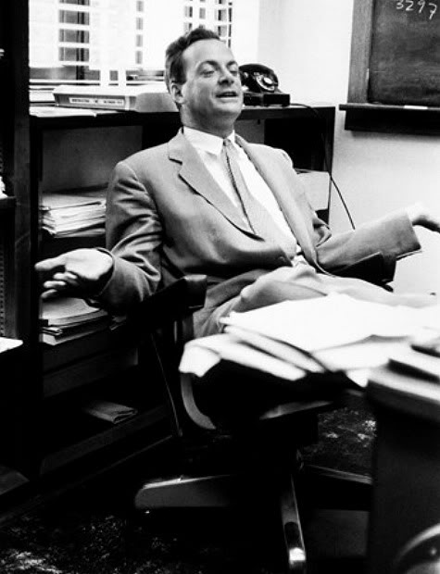

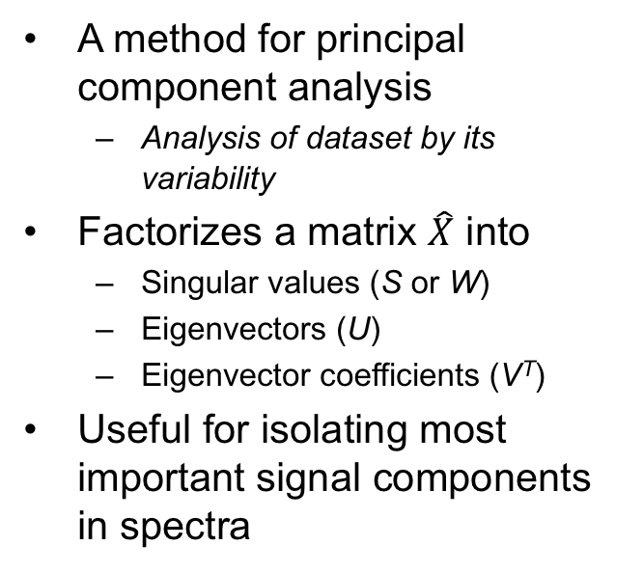
Singular value decomposition (SVD)
Application
A method for principal component analysis
  Analysis of dataset by its variability
Factorizes a matrix $\hat{X}$ into
  Singular values (S or W)
  Eigenvectors (U)
  Eigenvector coefficients (V^{T})
Useful for isolating most important signal components in spectra
Original image with 400 row vectors.
With 50 eigenvectors from matrix U.
Notes:
Used to reduce noise. SVD can be applied to principal component analysis which is a way of looking at data through its variability. That's what we'd like to see, since we're considering the changing behavior of acetylene through time and latitude!
For example, look at this image of Richard Feynman. 400 vectors
it can be factorized into three matrices,

Slide 16
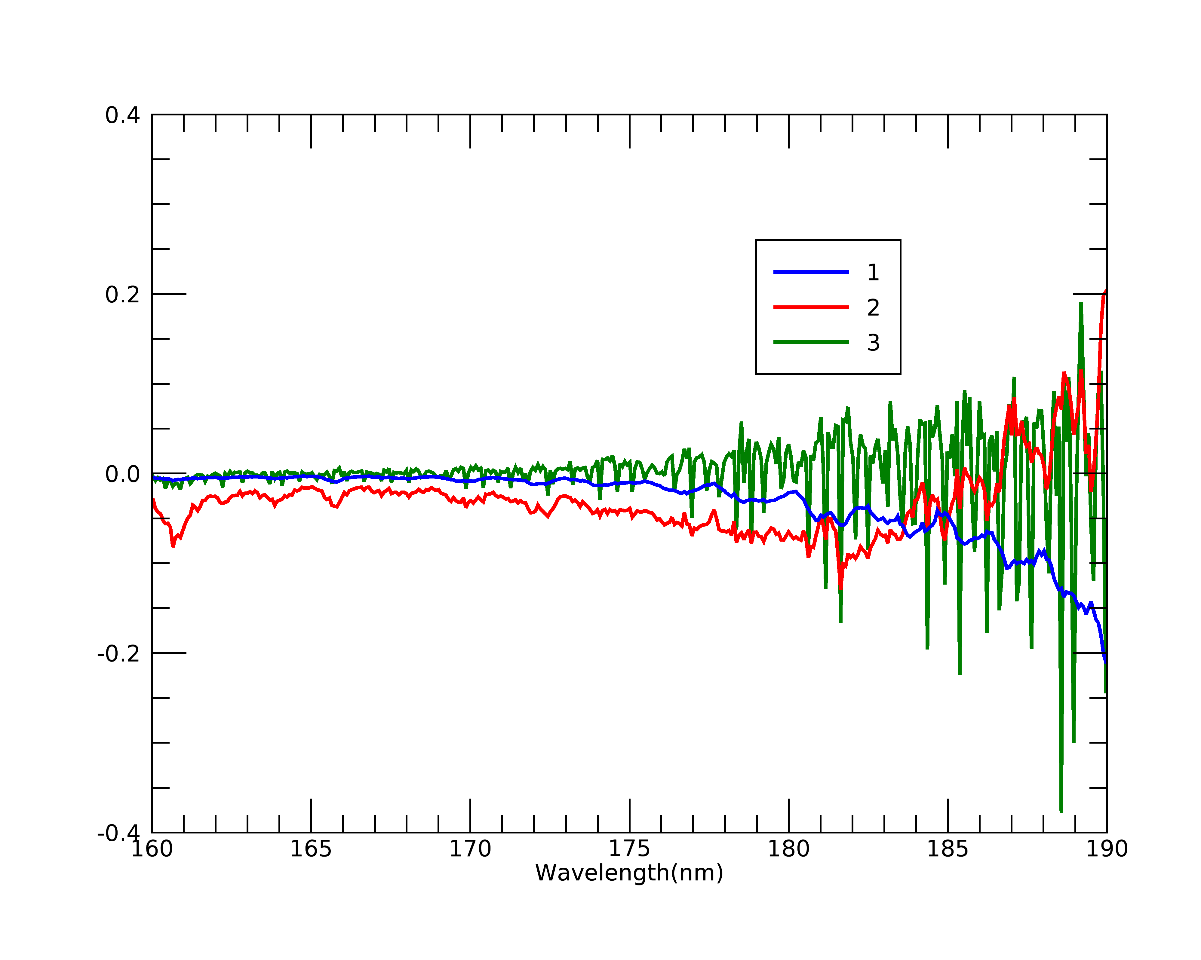
Eigenvectors from Our Initial Study~18,000 Spectra
Running SVD on large calibrated data array
Can reconstruct input array satisfactorily with only 3 eigenvectors (the rest is noise)
  First eigenvector represents average spectrum
  Second eigenvector is mostly acetylene spectral variation.
  Third eigenvector is mostly instrumental variation.

Slide 17
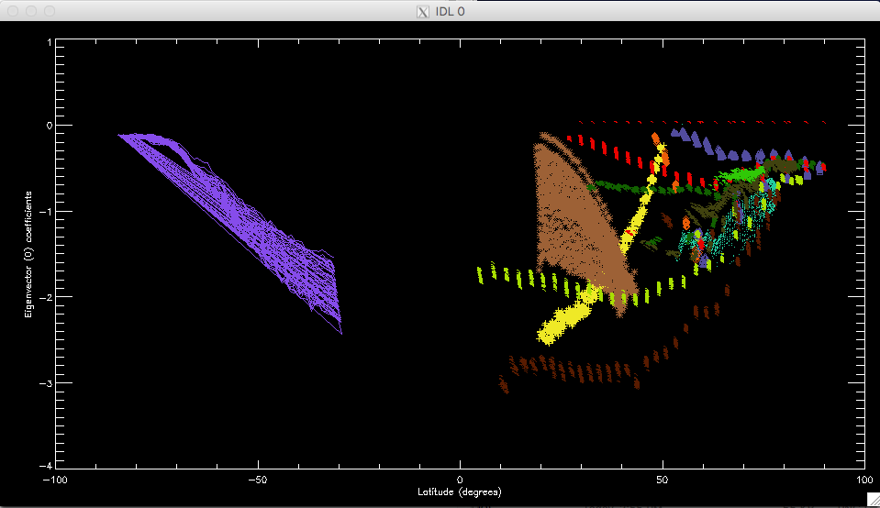
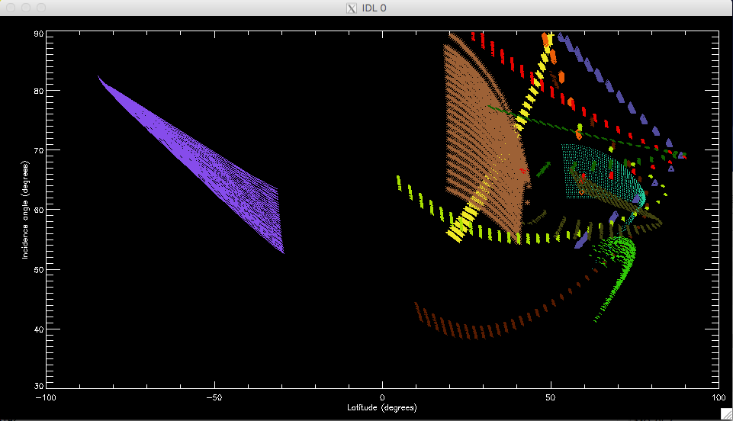
Comparison of 1st eigenvector coefficients and incidence angle vs. latitude
Correlations are not apparent with other scattering-geometry parameters or with eigenvector 2.
Eigenvector 1 Versus Latitude
Observations denoted by color
Incidence Angle Versus Latitude
Notes:
There is a strong correlation in these plots pointing to a strong influence of the coefficient on emission angle. This is probably telling us that the acetylene mixing ratio is increasing as the pressure increases because as the emission angle increases the measurements sense lower pressure levels (= higher altitudes).

Slide 18
For the Future
We anticipate that analyses of these data will advance the state of the art for acetylene, haze, and possibly H₂O in Saturn’s stratosphere thanks to:
  Extensive latitude and time coverage
  Tie-in with UVIS stellar occultations and CIRS analyses
  Phase angle coverage to reveal forward-scattering properties of the high-altitude aerosols (important for particle physical properties assessment)
  Seasonal and latitudinal variations and photochemistry/haze relation, including ring shadow effects and ‘ring rain’

